Slide 1
Modern Applied Mathematics in Bioelectromagnetism – Part I
IBB:
Prof. Dr. rer. nat. Carsten Wolters (Coordinator and main responsibility)
Prof. Dr. rer. nat. Joachim Gross (one lecture in SS)
Radiology:
Dr. rer. nat. Jochen Bauer (one lecture in WS and one lecture in SS)
Epilepsy Center Münster-Osnabrück:
PD. Dr. med. Christoph Kellinghaus (one lecture in WS)
Dr. med. Gabriel Möddel (one lecture in SS)
Lecture, Oct.8, 2024
Notes:
Tensor weiter erlaeutern
Zeitableitung
Programmlaenge, 1Mill.
WM-Rendering->5000 nodes
1:10 raus und anfangs erwaehnen

Slide 3
Outline
General planning for this lecture (language? required knowledge? Participants-email-list! target group!)
Literature for this lecture
Introduction to the lecture

Slide 4
Target group
The course will be offered over two semesters (winter semester 2024/25 and summer semester 2025). The following applications are available: - MSc Mathematics, PO 2020, Specialization "Scientific Computing", Type I - MSc Mathematics, PO 2020, broadening (area of applied mathematics) - BSc Mathematics, PO 2020, broadening (specialization in modeling and analytical methods) - BSC Mathematics, PO 2020, advanced supplement Modeling and Numerical Methods In these cases, the lecture parts of both semesters (4 SWS in total) and the exercise parts of both semesters (2 SWS in total) must be completed, the exercises for both exercise parts must be passed and an oral exam on everything must be taken. The following other possible uses exist: - MSc Mathematics, PO 2020, specialization "Scientific Computing", type II. In this case, the lecture parts of both semesters (4 SWS in total) have to be passed and a reduced course work (from the possibilities of the examination regulations) has to be done, whose form and extent will be announced by Prof. Dr. Carsten Wolters at the beginning of the course. The QISPOS registrations will not take place until the summer semester 2025, when the respective supplementary parts to the lecture and the exercises are also offered.

Slide 5
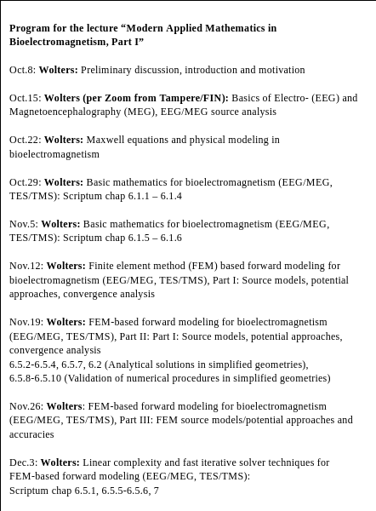
Lecture planning for Part I

Slide 6
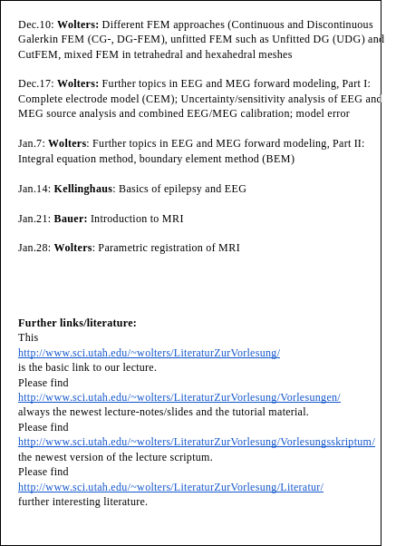
Lecture planning for Part I

Slide 7
Outline
General planning for this lecture (language? required knowledge? Participants-email-list!)
Literature for this lecture
Introduction to the lecture

Slide 8
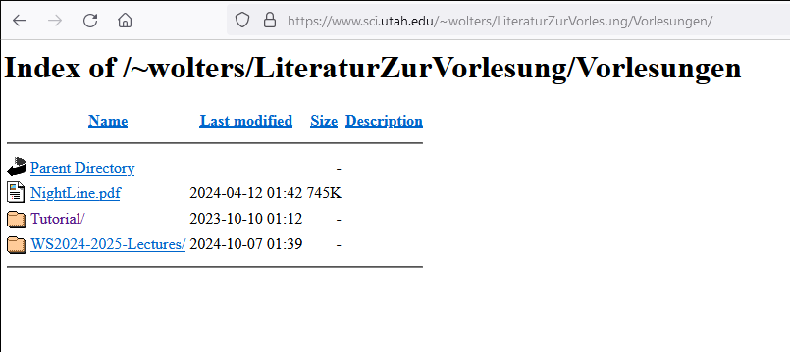
Literature for this lecture
Lecture webside: http://www.sci.utah.edu/~wolters/LiteraturZurVorlesung/
Notes:
PEBBLES: Parallel and Element Based grey Box Linear Equation Solver

Slide 9
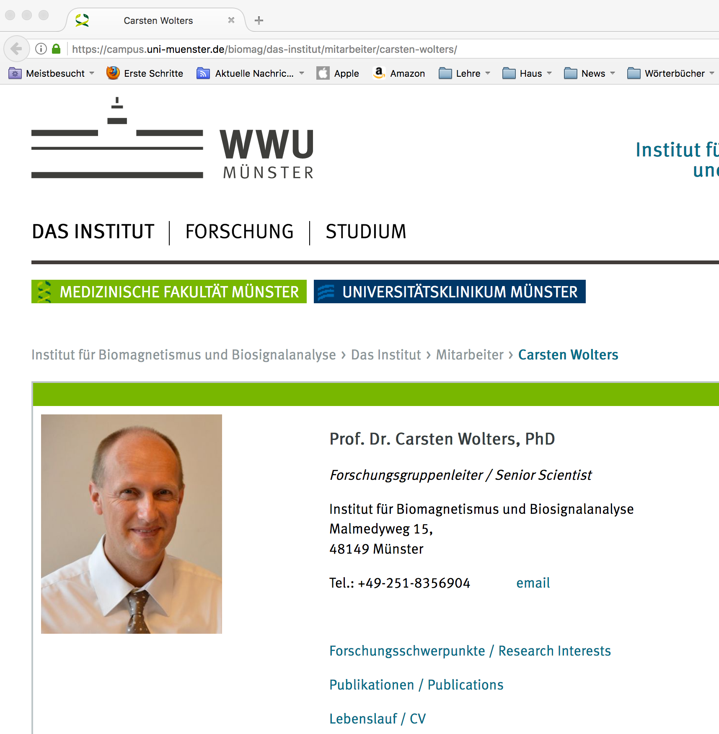
Link for literature to own work:
Links to all PhD, Master and Bachelor theses and to lecture scriptum
All own publications
Notes:
PEBBLES: Parallel and Element Based grey Box Linear Equation Solver

Slide 10
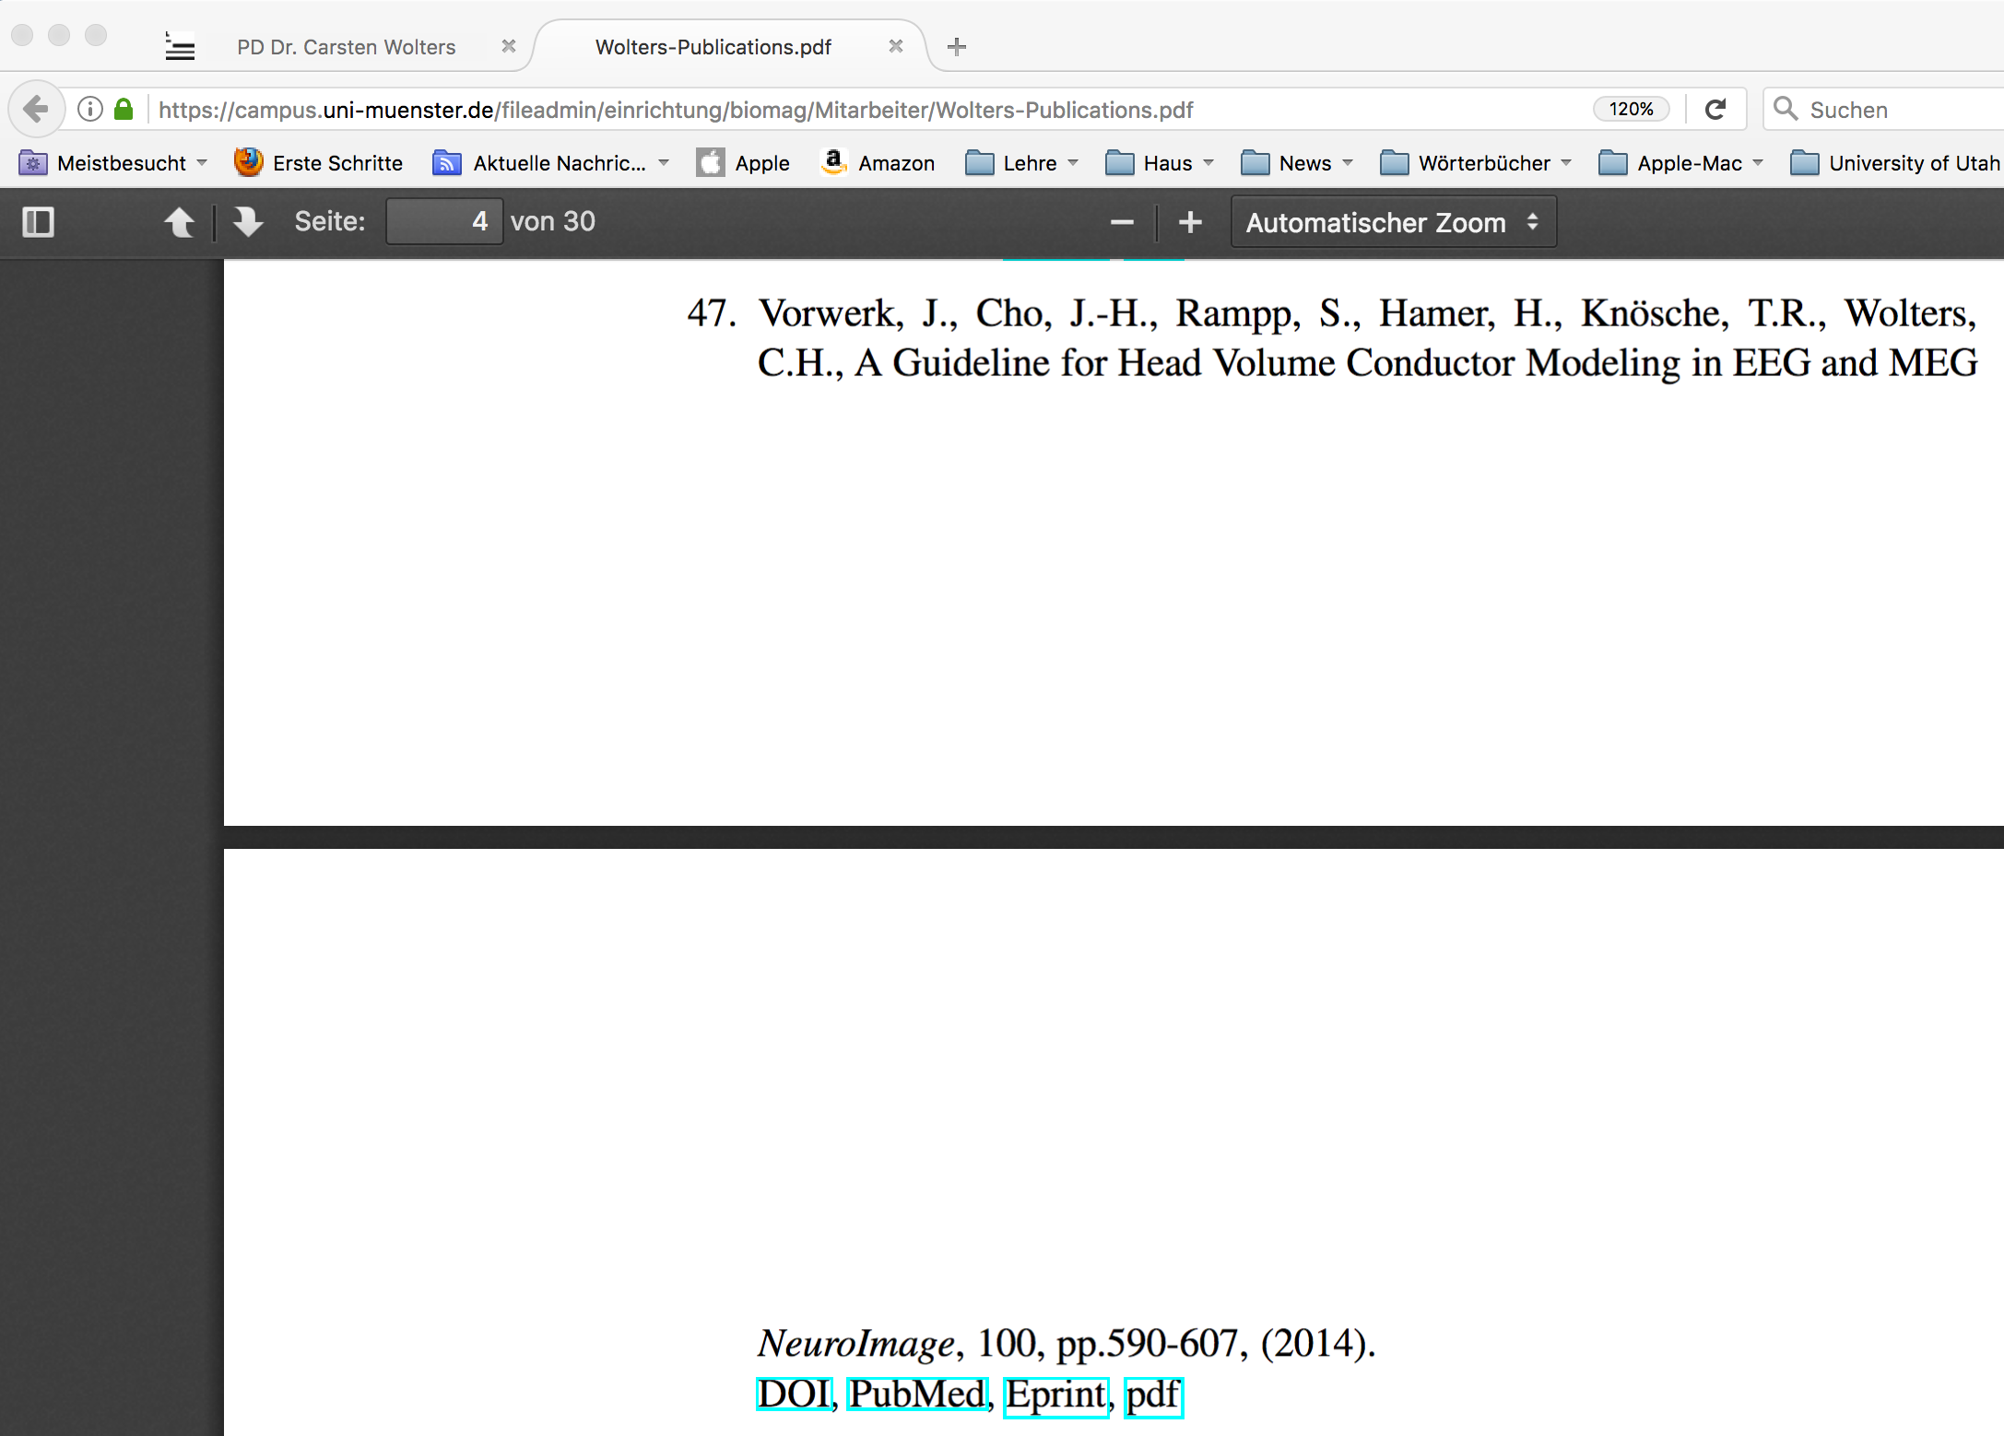
[Vorwerk, Cho, Rampp, Hamer, Knösche & Wolters, NeuroImage, 2014]
Link for literature to own work:
Notes:
10

Slide 11
Outline
General planning for this lecture (language? required knowledge? Participants-email-list!)
Literature for this lecture
Introduction to the lecture

Slide 12
Introduction to the lecture: Part I
Main steps for brain stimulation: Setup of head model, targeting, optimization of stimulation
Part I will focus on head modeling and EEG/MEG neuroimaging (non-invasive targeting):
Short history of important bioelectromagnetism- or neuroimaging-methods
Evoked responses and non-invasive source analysis

Slide 13
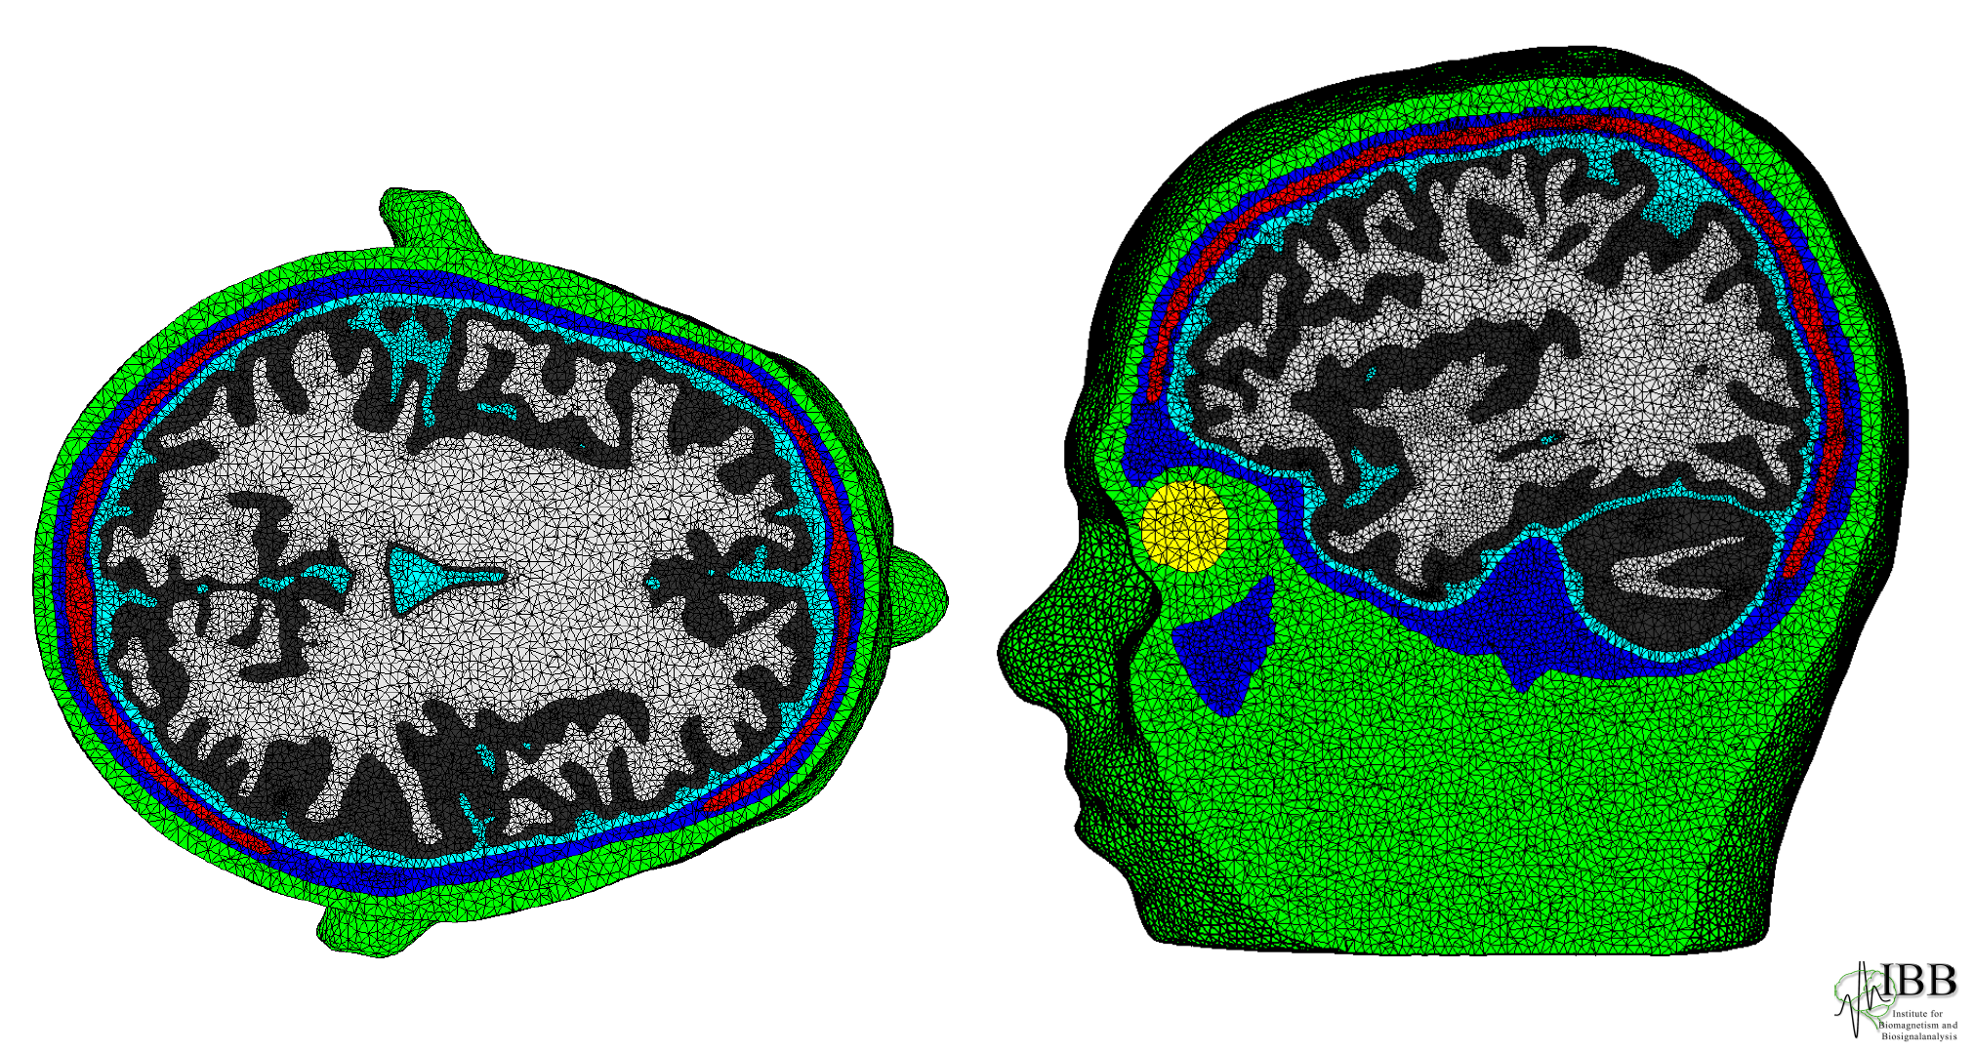
Setup of head model
[Vorwerk, Cho, Rampp, Hamer, Knösche & Wolters, NeuroImage, 2014]
Notes:
13

Slide 14
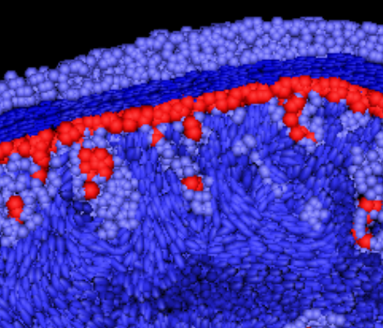
[Vorwerk, Cho, Rampp, Hamer, Knösche & Wolters, NeuroImage, 2014]
[Wolters, Anwander, Tricoche, Weinstein, Koch & MacLeod, NeuroImage, 2006]
Setup of head model
Notes:
14

Slide 15
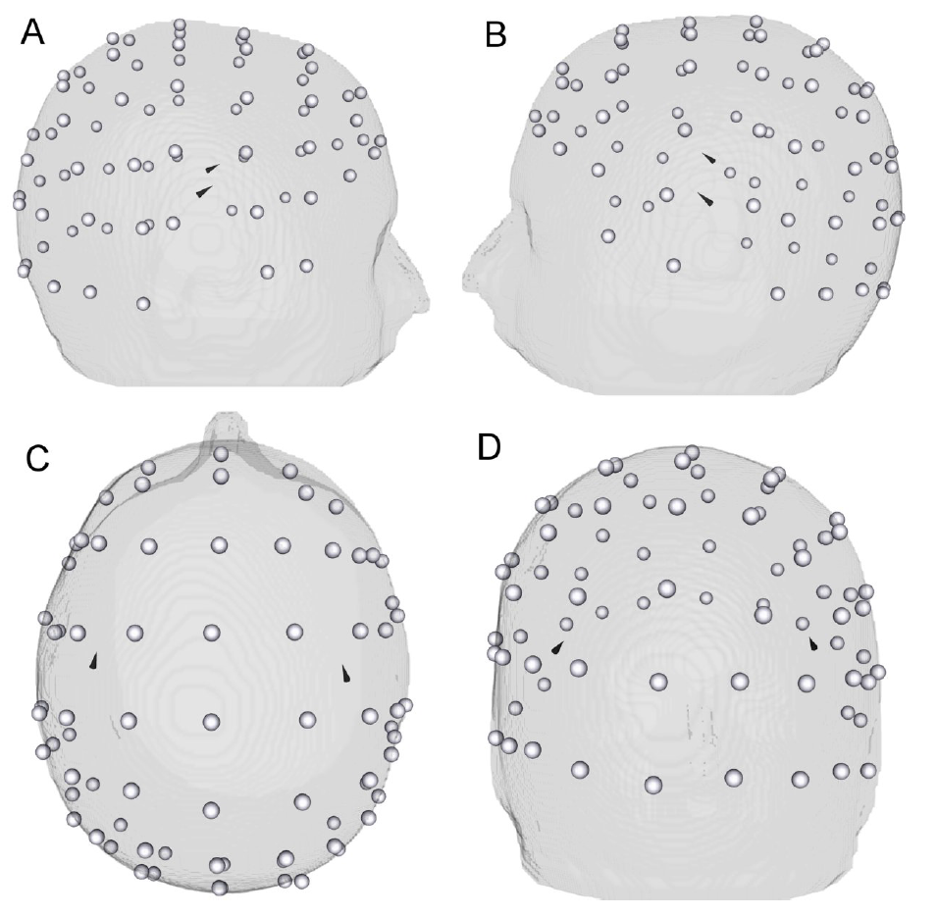
[Wagner, Burger & Wolters, SIAM J. Appl. Math., 2016]
[Schmidt, Wagner, Burger, van Rienen & Wolters, J. Neur. Eng., 2015]
[Wagner, PhD thesis in Mathematics, WWU Münster, 2015]
Targeting
[Wagner, Burger & Wolters, SIAM J. Appl. Math., 2016]
[Schmidt, Wagner, Burger, van Rienen & Wolters, J. Neur. Eng., 2015]
Notes:
Segmented MRI (upper row), T1 MRI (middle row) and the source space points (blue points) shown on T1 (lower row) MRI.
Sagittal (left column), coronal (middle column) and axial (right column) slices.
Please note that the slices selected in the lower row are different from the top two rows in order to better visualize the source space points.
The color codes for the 7CA tissues are scalp (green), skull compacta (brown), skull spongiosa (beige), dura mater (dark turquoise), CSF (light turquoise), gray matter (burgundy) and white matter (red).

Slide 16
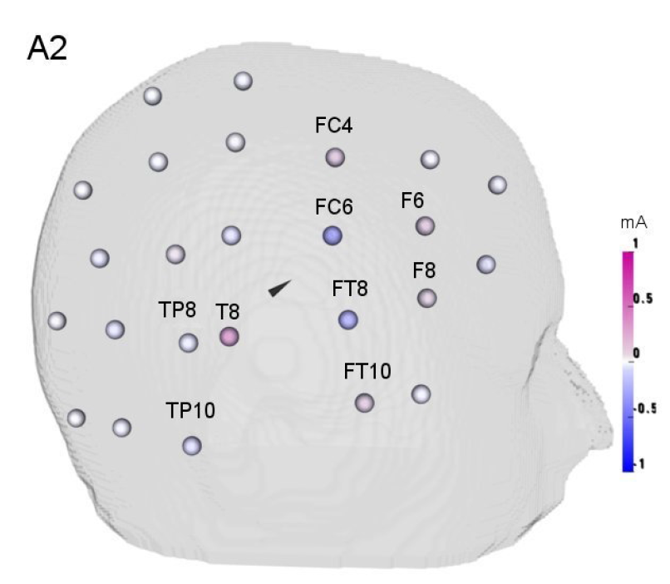
[Wagner, Burger & Wolters, SIAM J. Appl. Math., 2016]
[Schmidt, Wagner, Burger, van Rienen & Wolters, J. Neur. Eng., 2015]
[Wagner, PhD thesis in Mathematics, WWU Münster, 2015]
Optimization of stimulation
[Wagner, Burger & Wolters, SIAM J. Appl. Math., 2016]
[Schmidt, Wagner, Burger, van Rienen & Wolters, J. Neur. Eng., 2015]
Notes:
Segmented MRI (upper row), T1 MRI (middle row) and the source space points (blue points) shown on T1 (lower row) MRI.
Sagittal (left column), coronal (middle column) and axial (right column) slices.
Please note that the slices selected in the lower row are different from the top two rows in order to better visualize the source space points.
The color codes for the 7CA tissues are scalp (green), skull compacta (brown), skull spongiosa (beige), dura mater (dark turquoise), CSF (light turquoise), gray matter (burgundy) and white matter (red).

Slide 17
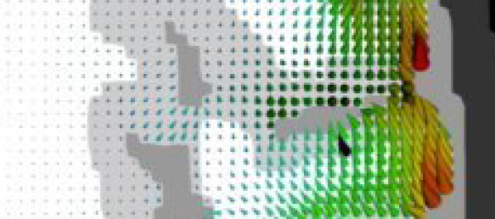
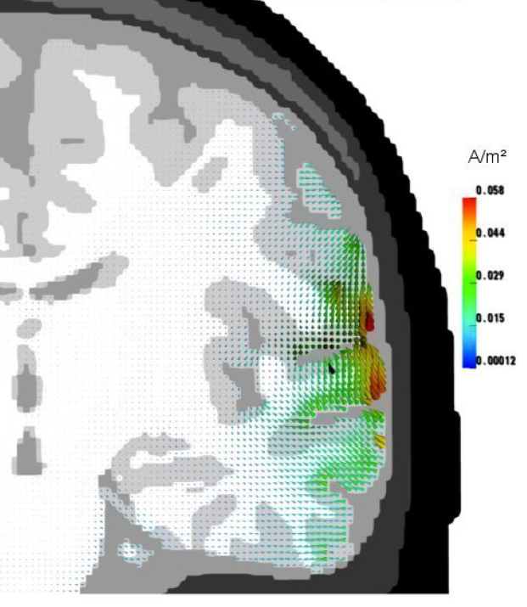
[Wagner, Burger & Wolters, SIAM J. Appl. Math., 2016]
[Schmidt, Wagner, Burger, van Rienen & Wolters, J. Neur. Eng., 2015]
[Wagner, PhD thesis in Mathematics, WWU Münster, 2015]
Optimization of stimulation
[Wagner, Burger & Wolters, SIAM J. Appl. Math., 2016]
[Schmidt, Wagner, Burger, van Rienen & Wolters, J. Neur. Eng., 2015]
Notes:
Segmented MRI (upper row), T1 MRI (middle row) and the source space points (blue points) shown on T1 (lower row) MRI.
Sagittal (left column), coronal (middle column) and axial (right column) slices.
Please note that the slices selected in the lower row are different from the top two rows in order to better visualize the source space points.
The color codes for the 7CA tissues are scalp (green), skull compacta (brown), skull spongiosa (beige), dura mater (dark turquoise), CSF (light turquoise), gray matter (burgundy) and white matter (red).

Slide 18
Introduction to the lecture: Part I
Main steps for brain stimulation: Setup of head model, targeting, optimization of stimulation
Part I will focus on head modeling and non-invasive targeting:
Short history of important bioelectromagnetism- or neuroimaging-methods
Evoked responses and non-invasive source analysis

Slide 19
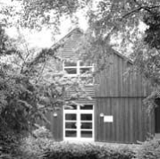
Institute for Biomagnetism and Biosignalanalysis (IBB)
Bioelectromagnetism-research:
Electroencephalography (EEG)
Magnetoencephalography (MEG)
Magnetic Resonance Imaging (MRI)
Transcranial Electric Stimulation (TES)
Transcranial Magnetic Stimulation (TMS)
Notes:
Cohen et al. measured first MEG in 1968: alpha-activity is about 10^7 times weaker than the earth magnetic field

Slide 20
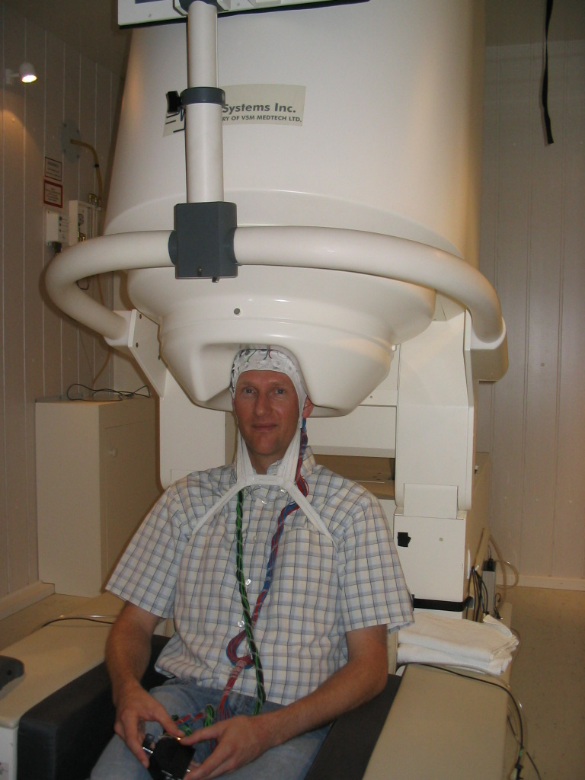
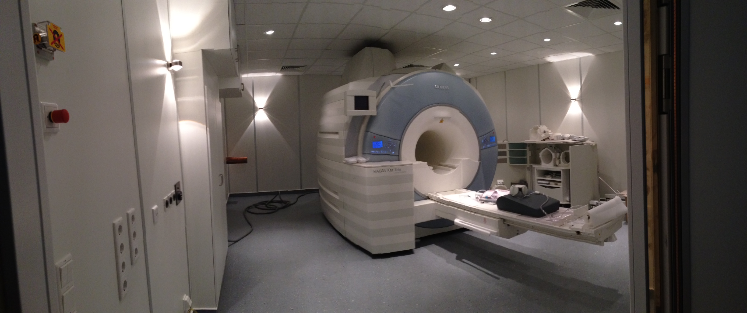
Measurement and analysis of EEG/MEG and MRI data
3Tesla Research-MRI
304 channel MEG
128 channel EEG

Slide 21
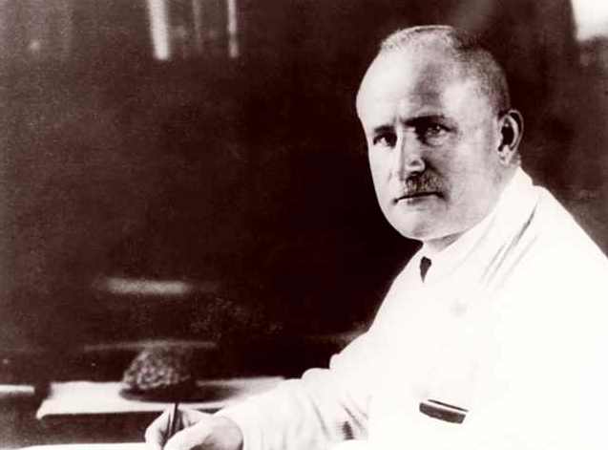
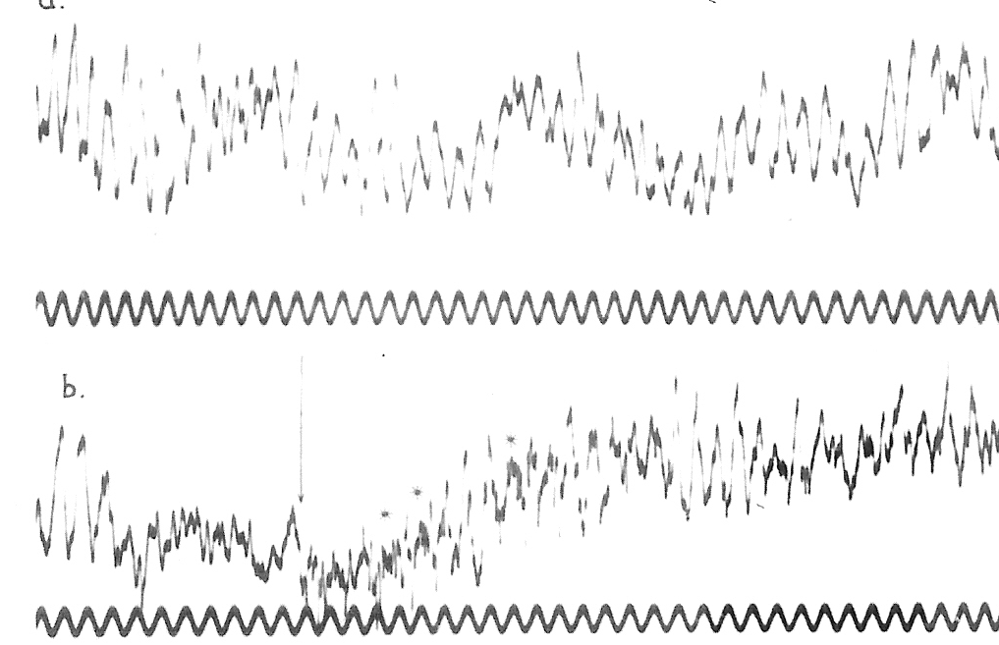
Short history of electroencephalography (EEG)
Hans Berger
1873-1941
Neurologist and psychiatrist
3 times nominated for Nobel-price
1924: First EEG in Jena

Slide 22
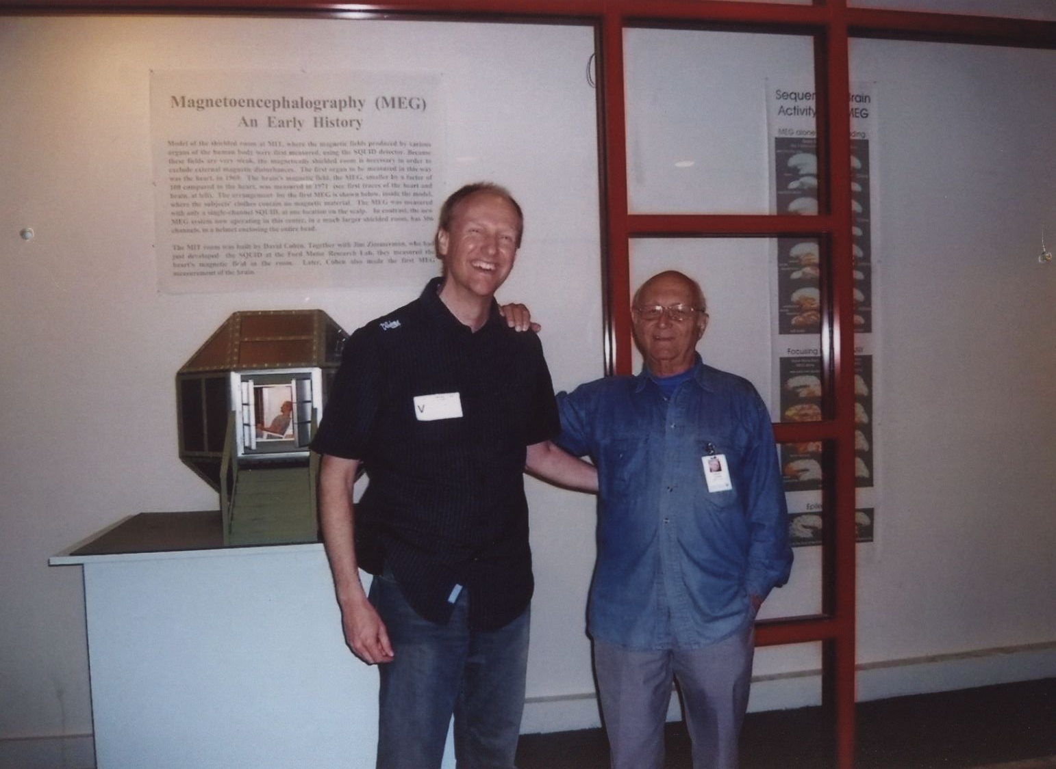
Short history of magnetoencephalography (MEG)
David Cohen (Physiker)
2010 in Boston/USA
Notes:
Cohen et al. measured first MEG in 1968: alpha-activity is about 10^7 times weaker than the earth magnetic field

Slide 23
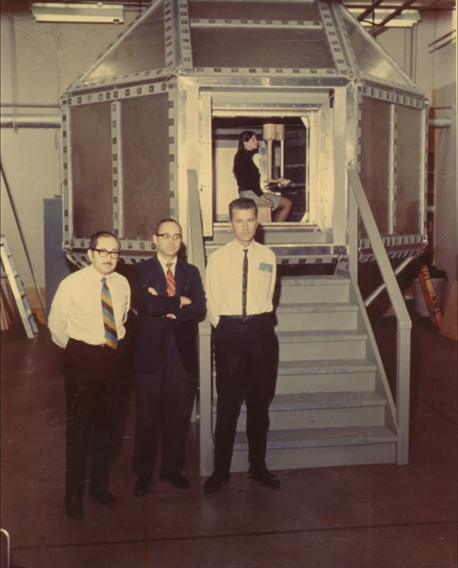
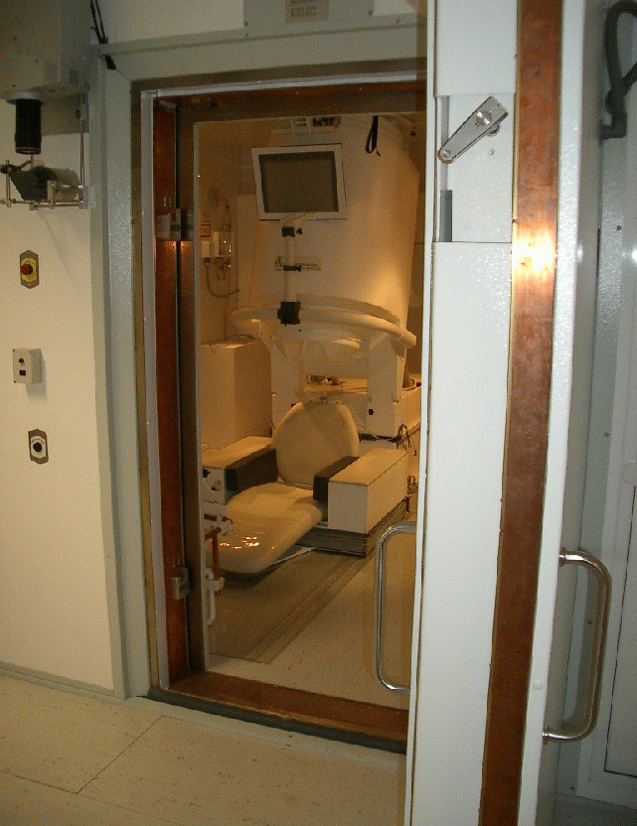
Short history of magnetoencephalography (MEG)
David Cohen (Physicist)
1968: Measured the first MEG at MIT in Boston/USA
Notes:
From left to right: Edgar Edelsack, David Cohen and James Zimmermann

Slide 24
Short history of magnetoencephalography (MEG)
David Cohen (Physicist)
1968: Measured the first MEG at MIT in Boston/USA
Notes:
From left to right: Edgar Edelsack, David Cohen and James Zimmermann

Slide 25
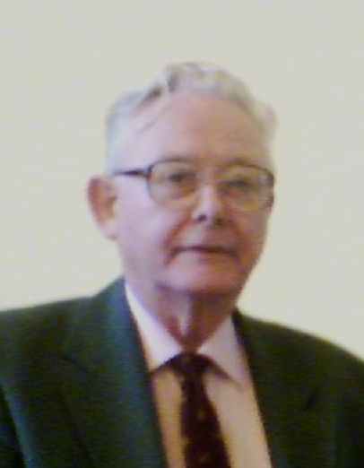
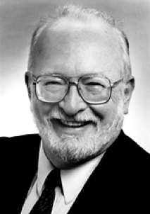
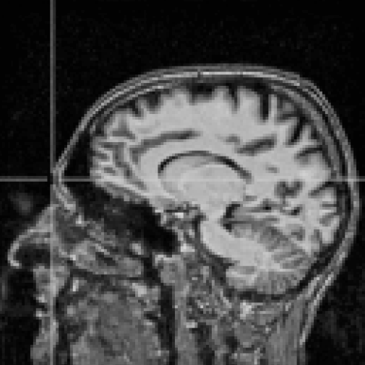
Short history of magnetic resonance imaging (MRI)
Peter Mansfield (Physicist), Paul Lauterbur (Chemist)
1971: developed MRI as imaging modality
Nobel-price of physiology/medicine (2003) for MRI work
Notes:
Grundlagen des Bildkontrastes:
Unterschiedliche Relaxationszeiten verschiedener Gewebearten
Unterschiedlicher Gehalt an Wasserstoff-Atomen in verschiedenen Geweben (Haut, Schädel)
Zwei grundlegende Ideen:
Einführung von Gradientenfeldern in das konventionelle NMR-Experiment, um NMR-Signale bestimmten räumlichen Bereichen zuzuordnen (Ortskodierung)
Durch gefilterte Rückprojektion ein Abbild des Untersuchungsobjekts errechnen

Slide 26
Introduction to the lecture: Part I
Main steps for brain stimulation: Setup of head model, targeting, optimization of stimulation
Part I will focus on head modeling and non-invasive targeting:
Short history of important bioelectromagnetism- or neuroimaging-methods
Evoked responses and non-invasive source analysis

Slide 27
The concept of evoked potentials and fields using the example of somatosensory evoked potentials (SEP) and fields (SEF)

Slide 28
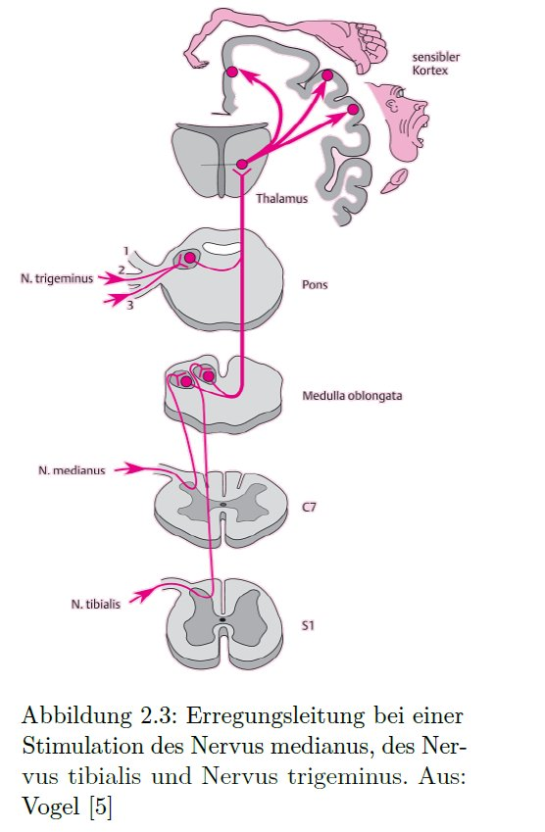
[Grottke, Bachelor thesis in Physics, WWU Münster, 2015]
Somatosensory evoked potentials (SEP) and fields (SEF)

Slide 29
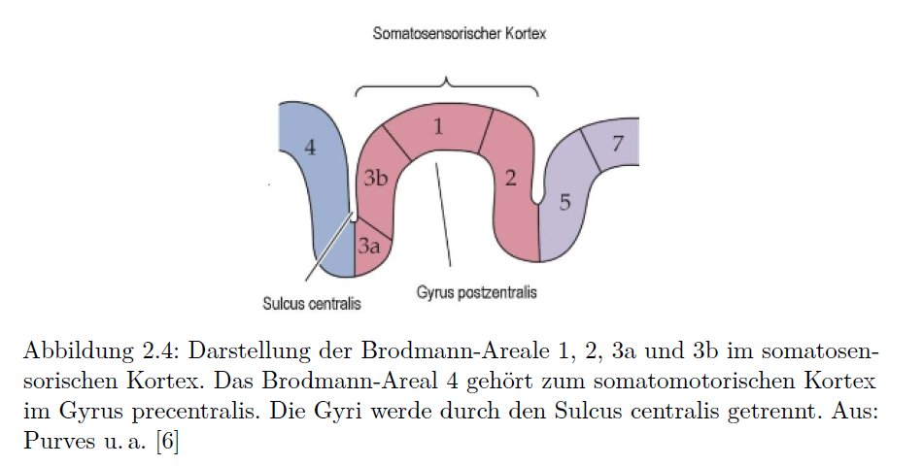
[Grottke, Bachelor thesis in Physics, WWU Münster, 2015]
Somatosensory evoked potentials (SEP) and fields (SEF)

Slide 30
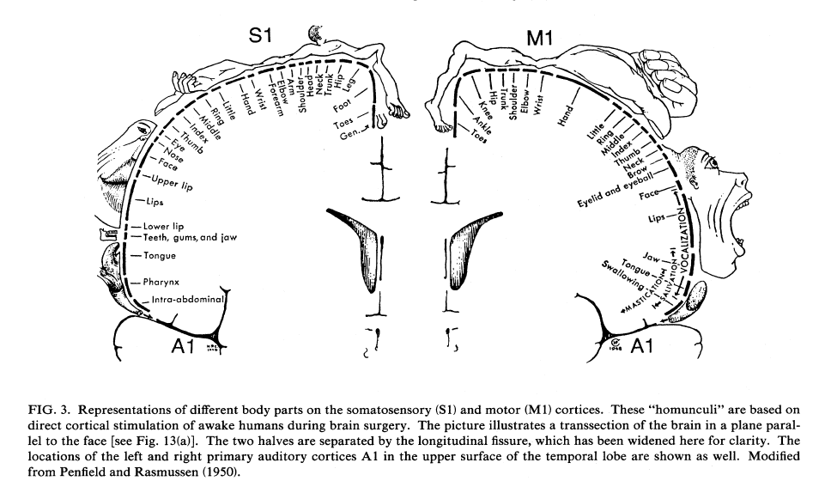
S1 and M1 homunculi

Slide 31
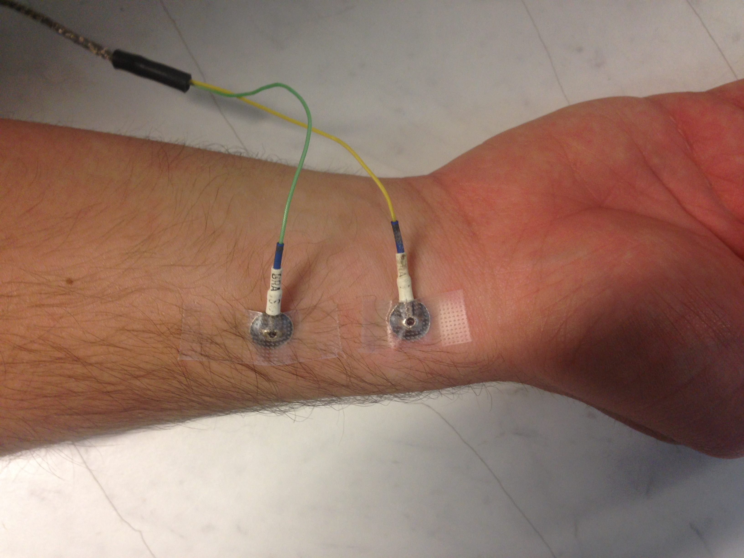
Somatosensory evoked potentials (SEP) and fields (SEF)
[Piastra, PhD thesis, 2019]
Electric stimulation of the medianus nerve
Combined MEG/EEG
Notes:
31

Slide 32
Somatosensory evoked potentials (SEP) and fields (SEF)
[Piastra, PhD thesis, 2019]
MEG sensor MLP33: Field strength over time
EEG electrode CP3: Potential difference to reference electrode at Cz over time
Notes:
32

Slide 33
Somatosensory evoked potentials (SEP) and fields (SEF)
[Piastra, PhD thesis, 2019]
MEG sensor MLP33: Field strength over time
EEG electrode CP3: Potential difference to reference electrode at Cz over time
SEF
SEP
Notes:
33

Slide 34
Somatosensory evoked potentials (SEP) and fields (SEF)
[Piastra, PhD thesis, 2019]
SEF at sensor MLP33: Field strength over time
SEP electrode CP3: Potential difference to reference electrode at Cz over time
SEF and SEP butterfly plots over all sensors
Notes:
34

Slide 35
Somatosensory evoked potentials (SEP) and fields (SEF)
[Piastra, PhD thesis, 2019]
SEF and SEP butterfly plots over all sensors
SEF topography at 20 ms post-stimulus:
N20m component
SEP topography at 20 ms post-stimulus:
P20/N20 component
Notes:
35

Slide 36
The concept of evoked potentials and fields using the example of auditory evoked potentials (AEP) and fields (AEF)

Slide 37
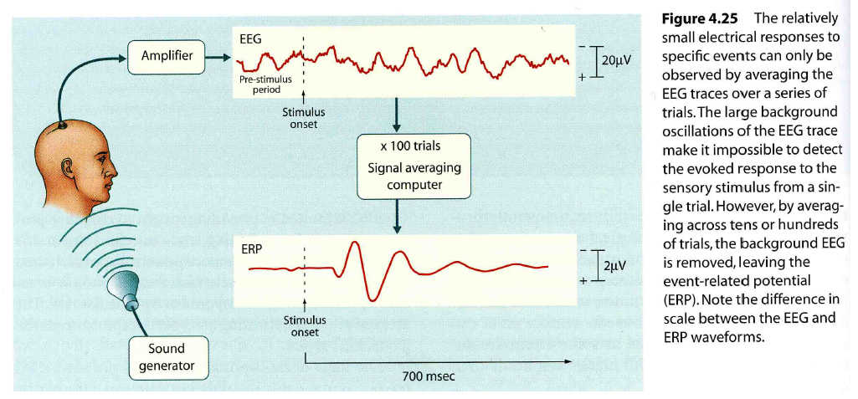
[Gazzaniga, Ivry & Mangun, Cognitive Neuroscience, 2nd ed., W.W.Norton & Company, 2002]
Evoked responses

Slide 38
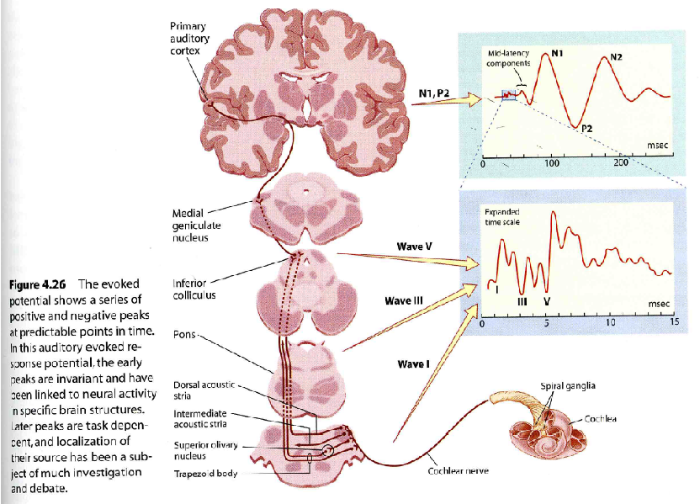
[Gazzaniga, Ivry & Mangun, Cognitive Neuroscience, 2nd ed., W.W.Norton & Company, 2002]
Auditory evoked potential (AEP)
Only contralateral path is shown.

Slide 39
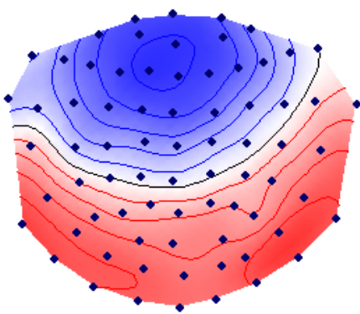
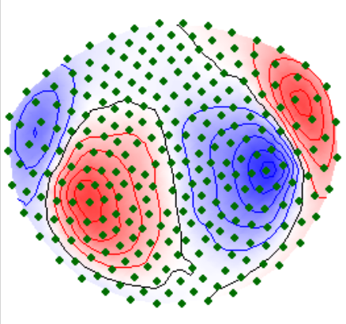
[Okamoto, Stracke, Wolters, Schmael & Pantev, J Neurosci, 2007]
N100 component of AEP/AEF
AEP-N1 component
AEF-N1 component

Slide 40
Reconstruction of neuronal networks using
EEG and MEG source analysis
Model for the sources
The forward problem
The inverse problem

Slide 41
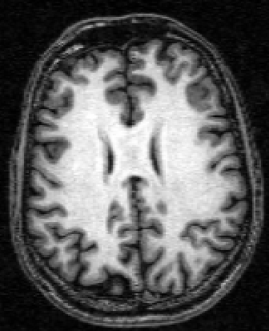
Gray and White Matter
Gray matter
(GM)
White matter (WM)
T1 weighted Magnetic Resonance
Image (T1-MRI)
Notes:
Cortex:
=====
The neo- or isocortex, i.e., 90% of the cerebral cortex, has a 6 layered structure.
Source model:
=========
1.000.000 activated pyramidal dendrites -> 1.000.000x5x10^{-5} nAm=50nAm
Density of pyramidal cells in the cortex=1.000.000/30mm^2=33.333 pyramidal cells/mm^2

Slide 42
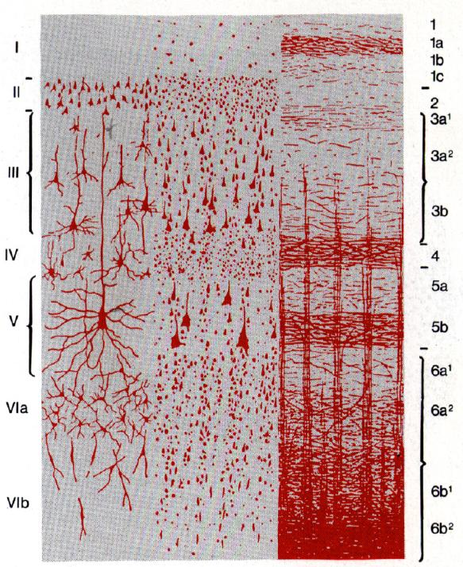
The source model
Microscopic current flow (~5×10⁻⁵ nAm)
cortex
+
source
-
synapse
sink
-
+
-
cell body
Equivalent Current Dipole (Primary current) (~50 nAm)
parameters:
position : x₀
moment : M
Size of Macroscopic Neural Activity
~30 mm² = 5.5×5.5 mm²
Notes:
1.000.000 activated pyramidal dendrites -> 1.000.000x5x10^{-5} nAm=50nAm
Density of pyramidal cells in the cortex=1.000.000/30mm^2=33.333 pyramidal cells/mm^2
1mm^2 activated tissue produces magnetic field of 0.1pT=0.1*10^{-12}T (Okada in turtle brain)

Slide 43
Reconstruction of neuronal networks using
EEG and MEG source analysis
Model for the sources
The forward problem
The inverse problem

Slide 44
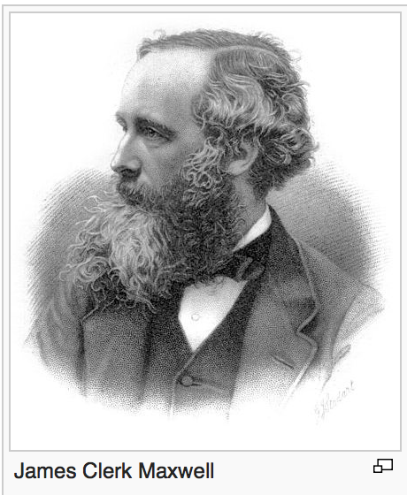
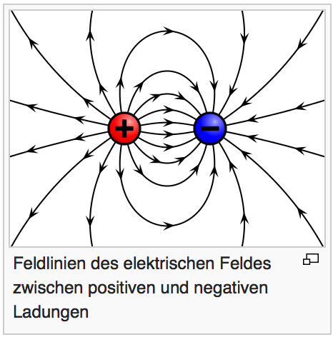
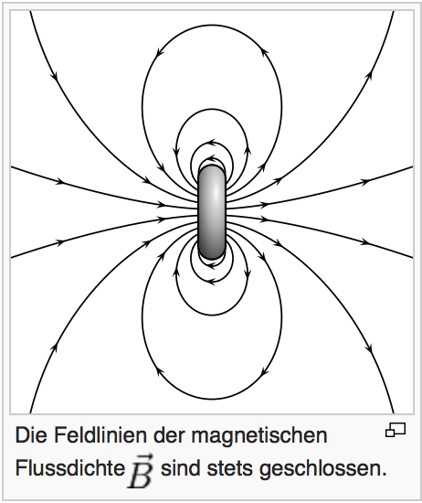
Maxwell equations
Notes:
D: elektrische Flussdichte
E: elektrische Feldstärke
H: magnetische Feldstärke
B: magnetische Flussdichte
Verlauf der elektrischen Feldstärke zeigt die Richtung der vom Feld ausgeübten Kraft an und Feldliniendichte stellt die Feldstärke dar.
Beim magnetischen Feld wirkt die Kraft senkrecht zur Richtung der magnetischen Flussdichte.
In Quellenfeldern zeichnen sich die Feldlinien durch einen Anfang und ein Ende aus (oder verschwinden im Unendlichen).
In Wirbelfeldern sind die Feldlinien geschlossene Kurven.
Induktionsgesetz von Faraday

Slide 45
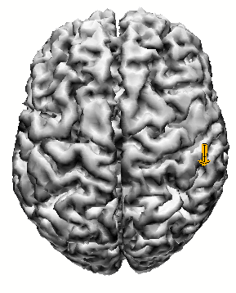
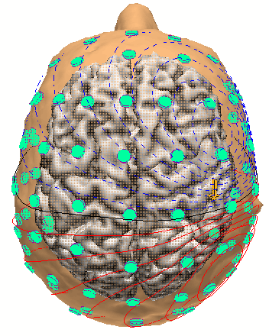
EEG forward problem
[Wolters & de Munck, Scholarpedia, 2007]
[de Munck, Wolters & Clerc, In: Handbook of neural activity measurement, 2012]
Place a dipole
Compute the EEG
Simulate
quasistatic
Maxwell equations
Notes:
42 year old female suffering from medically intractable complex partial seizures of mesial-temporal origin
Seizures had duration of up to 10 minutes and a frequency of twice to 5 times a month
Measurements:
=========
A short-term barbiturate (Schlafmittel), known to provoke epileptiform activity
-> 60-channel EEG montage with reference at the ear contralateral to the epileptic focus
Source reconstruction:
==============
Single dipole fit at signal peak
->Localization of the secondary activations, propagating along the temporal cortical surface
->Primary activity in the hippocampus and the amygdala (cannot be measured outside)
Therapy:
======
Selective amygdalohippocampectomy
-> Patient free of seizures

Slide 46
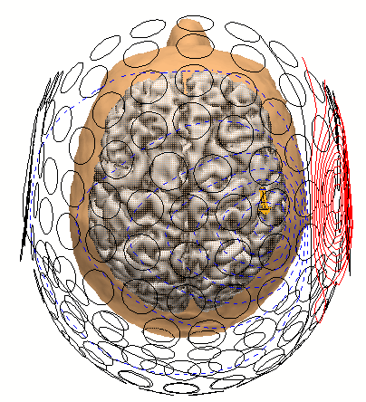
MEG forward problem
[Wolters & de Munck, Scholarpedia, 2007]
[de Munck, Wolters & Clerc, In: Handbook of neural activity measurement, 2012]
Place a dipole
Compute the MEG
Simulate
quasistatic
Maxwell equations

Slide 47
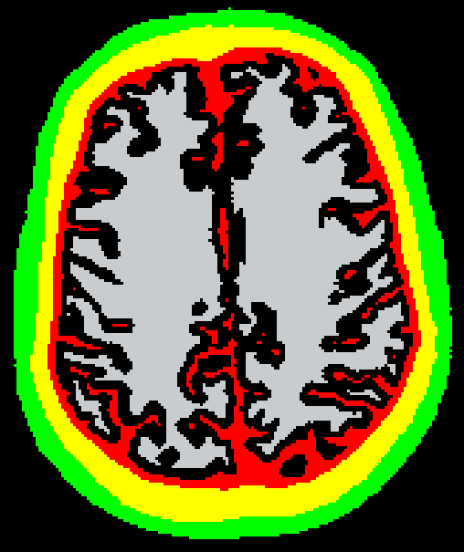
Multi-compartment volume conductor model
[Wolters & de Munck, Scholarpedia, 2007]
[de Munck, Wolters & Clerc, In: Handbook of neural activity measurement, 2012]
Skin | 0.33 S/m
Skull | anisotropic/ 3-layer
CSF | 1.79 S/m
Gray matter | 0.33 S/m
White matter | anisotropic

Slide 48
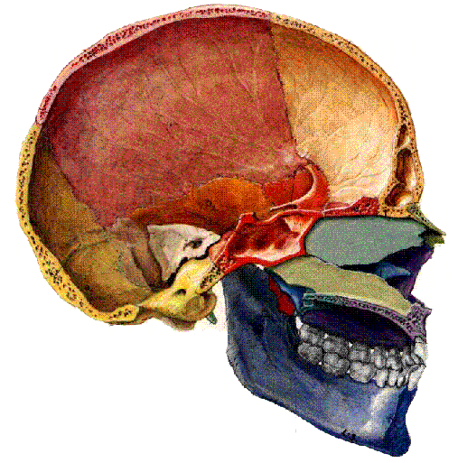
Three-layered human skull

Slide 49
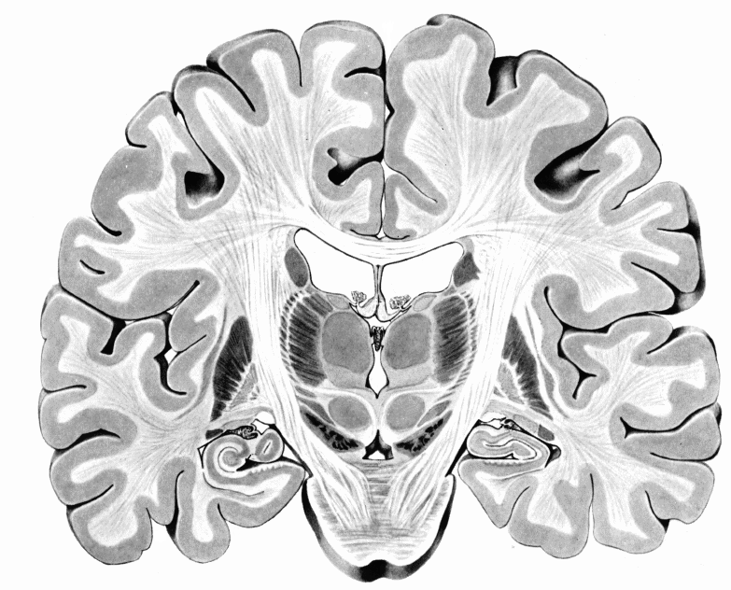
Anisotropy of white matter (WM)
Transversally: 1
Longitudinally: 9

Slide 50
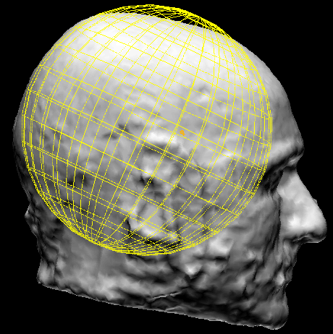
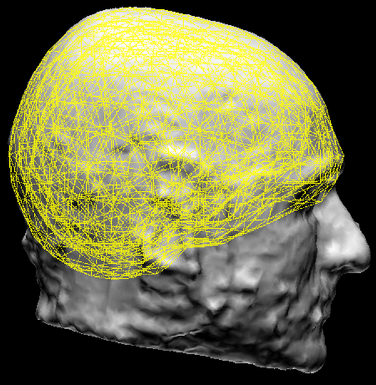
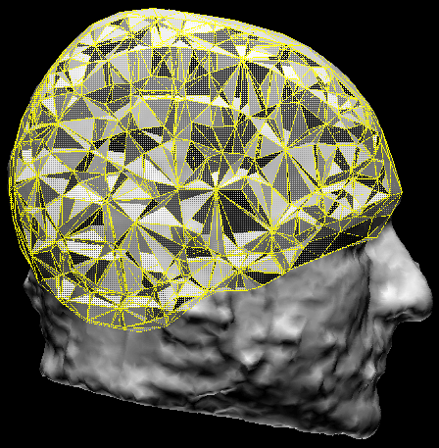
Volume conductor modeling
Spherical shells
Boundary element
Finite Element (FE)
 | Geometry | Conductivity
Skin | unreal. | unreal.
Skull | unreal. | unreal.
CSF | unreal. | unreal.
GM | unreal. | unreal.
WM | unreal. | unreal.
 | Geometry | Conductivity
Skin | realistic | realistic
Skull | realistic | unreal.
CSF | unrealistic (1 isotropic value)
GM
WM
 | Geometry | Conductivity
Skin | realistic | realistic
Skull | realistic | realistic
CSF | realistic | realistic
GM | realistic | realistic
WM | realistic | realistic

Slide 51
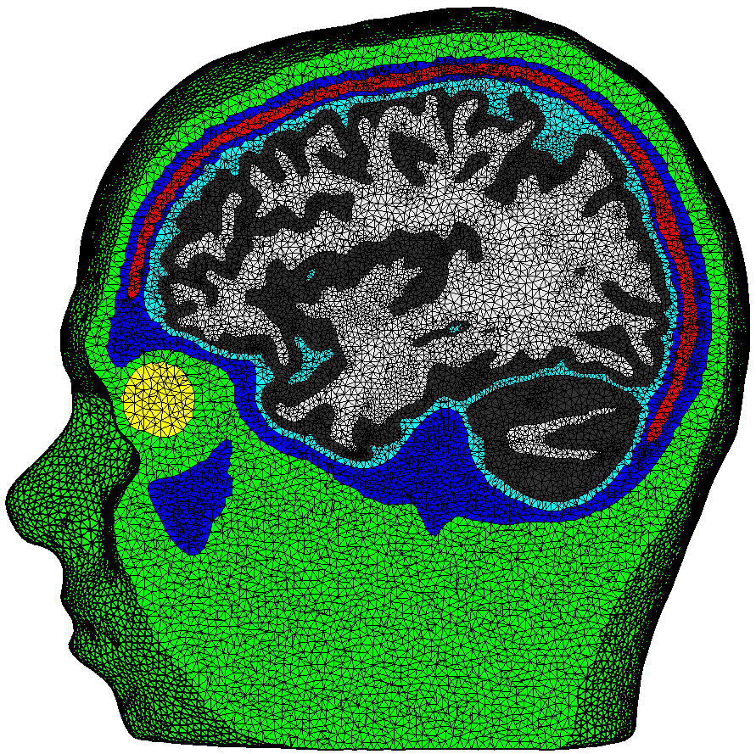
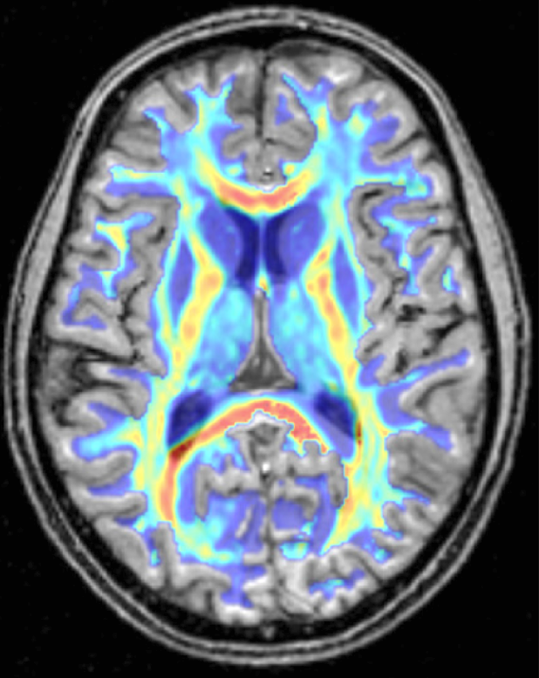
Realistically shaped multi-compartment anisotropic head volume conductor modeling for accurate simulation in EEG/MEG and tCS/TMS
[Wolters, Anwander, Tricoche, Weinstein, Koch & MacLeod, NeuroImage, 2006]
[Vorwerk, Cho, Rampp, Hamer, Knösche & Wolters, NeuroImage, 2014]
[Wagner, Rampersad, Aydin, Vorwerk, Oostendorp, Neuling, Herrmann, Stegeman & Wolters, J. Neur. Eng., 2014]
Notes:
51

Slide 52
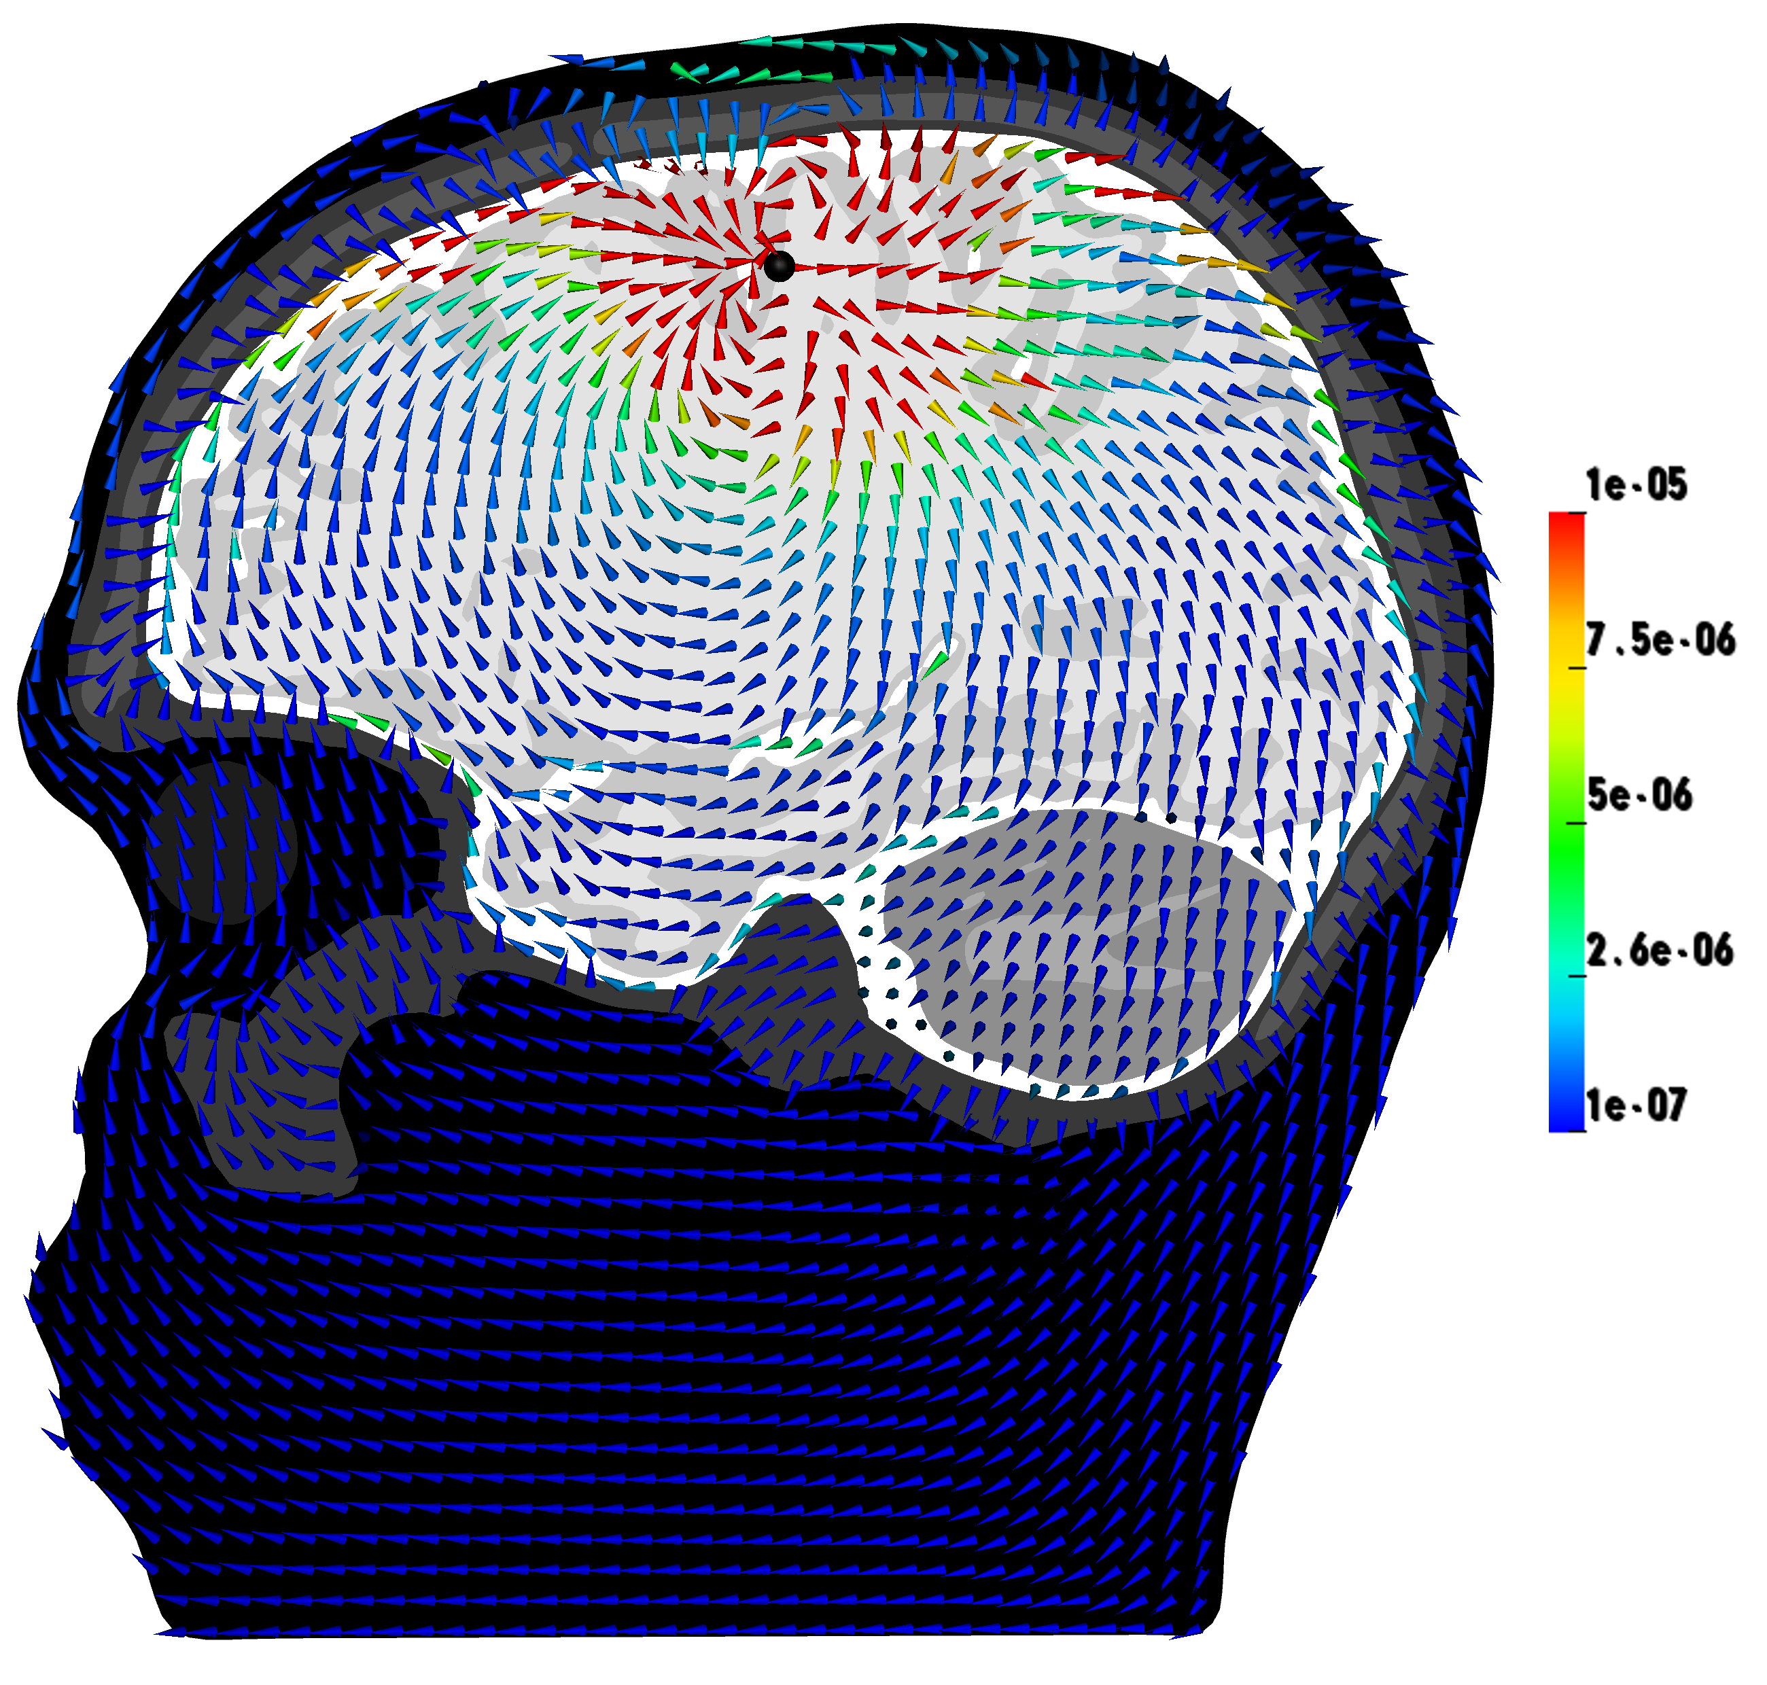
The forward problem in EEG/MEG
[Wolters & de Munck, Scholarpedia, 2007]
[de Munck, Wolters & Clerc, In: Handbook of neural activity measurement, 2012]
Simulate
potential distribution
or current
Notes:
52

Slide 53
Reconstruction of neuronal networks using
EEG and MEG source analysis
Model for the sources
The forward problem
The inverse problem

Slide 54
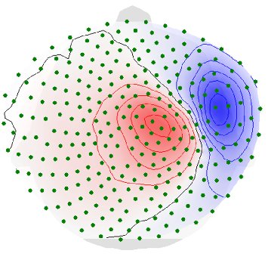
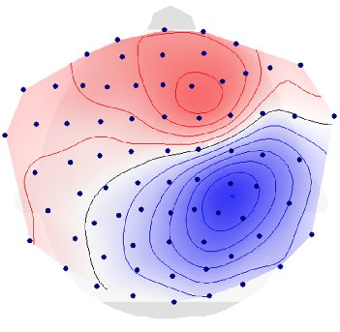
[Antonakakis, Schrader, Wollbrink, Oostenveld, Rampp, Haueisen & Wolters, HBM, 2019]
Source analysis: The inverse Problem
SEF-P20
Reconstruct
source
SEP-P20

Slide 55
[Antonakakis, Schrader, Wollbrink, Oostenveld, Rampp, Haueisen & Wolters, HBM, 2019]
Source analysis: The inverse Problem
SEF-P20
Reconstruct
source
SEP-P20

Slide 56
Thank you for your attention!
Notes:
56

