Slide 1
Sensitivity of EEG and MEG to tissue conductivities and individual skull conductivity calibration
Carsten Wolters
Lecture, Jan.7, 2025
Notes:
Tensor weiter erlaeutern
Zeitableitung
Programmlaenge, 1Mill.
WM-Rendering->5000 nodes
1:10 raus und anfangs erwaehnen

Slide 2
Structure of the lecture
EEG and MEG sensitivity analysis
A global EEG sensitivity study
Individual calibration of skull conductivity for combined EEG/MEG

Slide 3
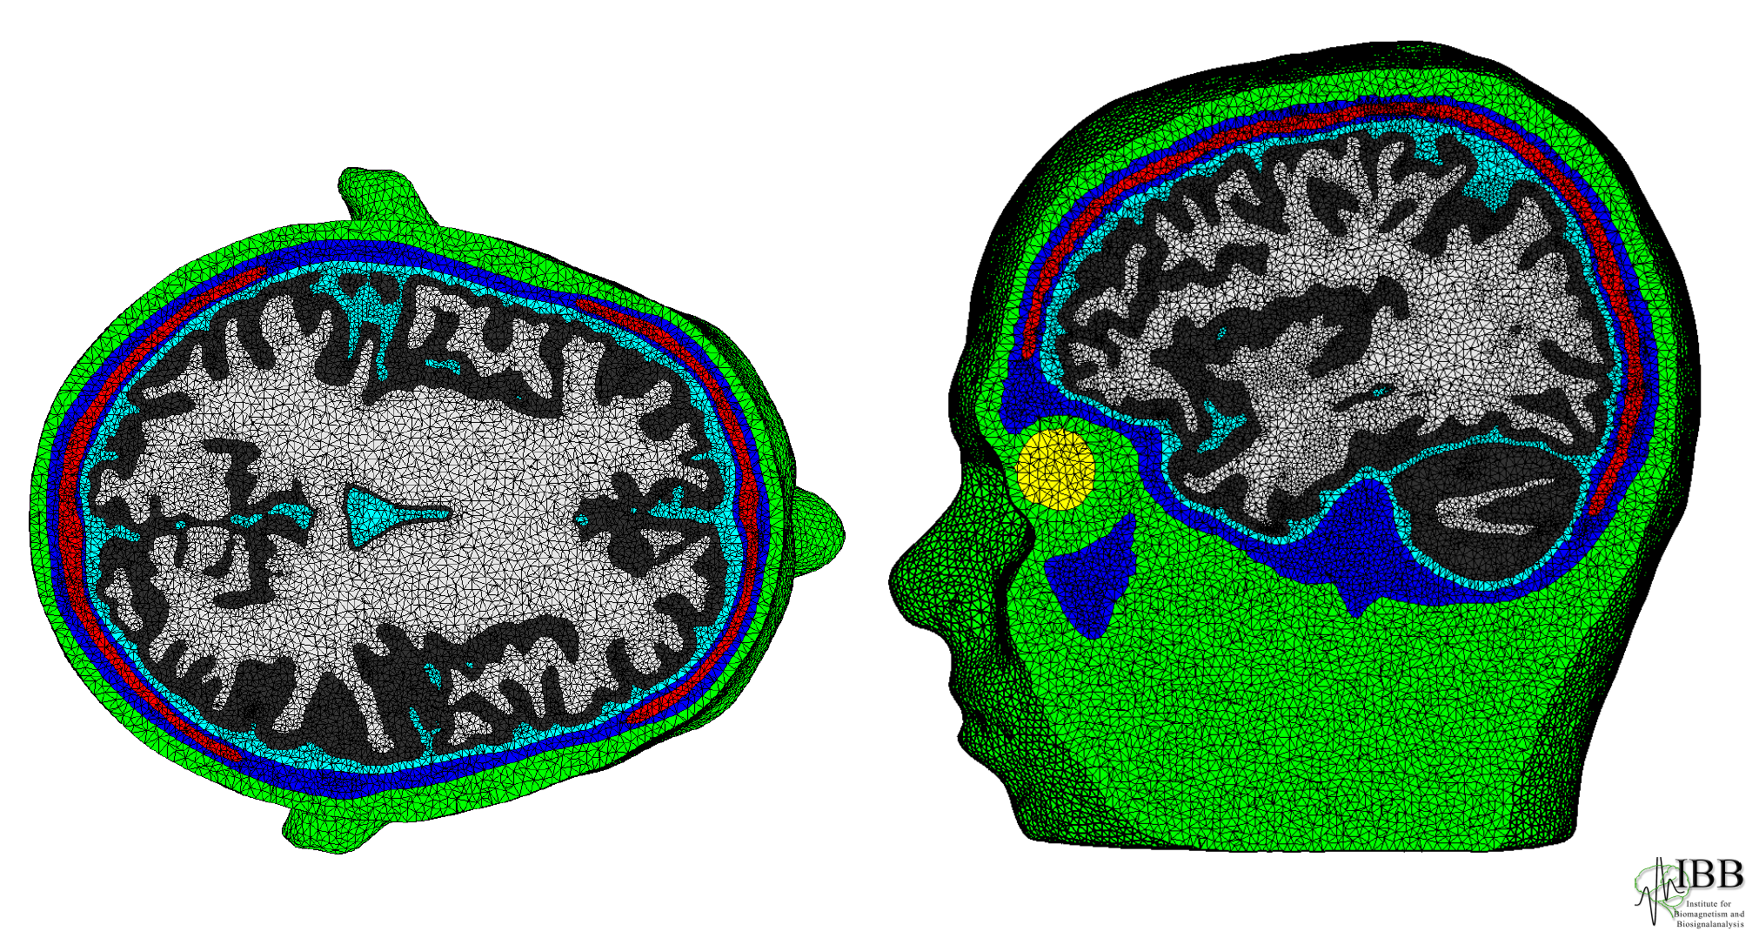
[Wolters, Anwander, Tricoche, Weinstein, Koch & MacLeod, NeuroImage, 2006]
[Vorwerk, Cho, Rampp, Hamer, Knösche & Wolters, NeuroImage, 2014]
Head volume conductor modeling using FEM

Slide 4
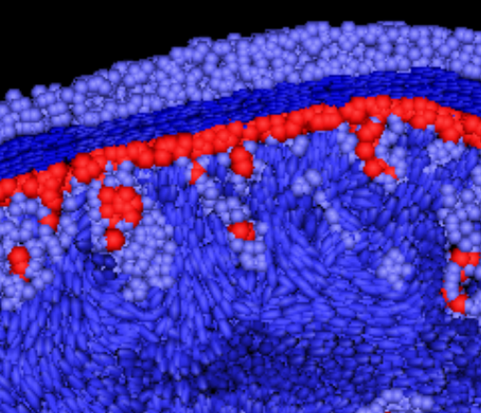
[Wolters, Anwander, Tricoche, Weinstein, Koch & MacLeod, NeuroImage, 2006]
[Vorwerk, Cho, Rampp, Hamer, Knösche & Wolters, NeuroImage, 2014]
Head volume conductor modeling using FEM

Slide 5
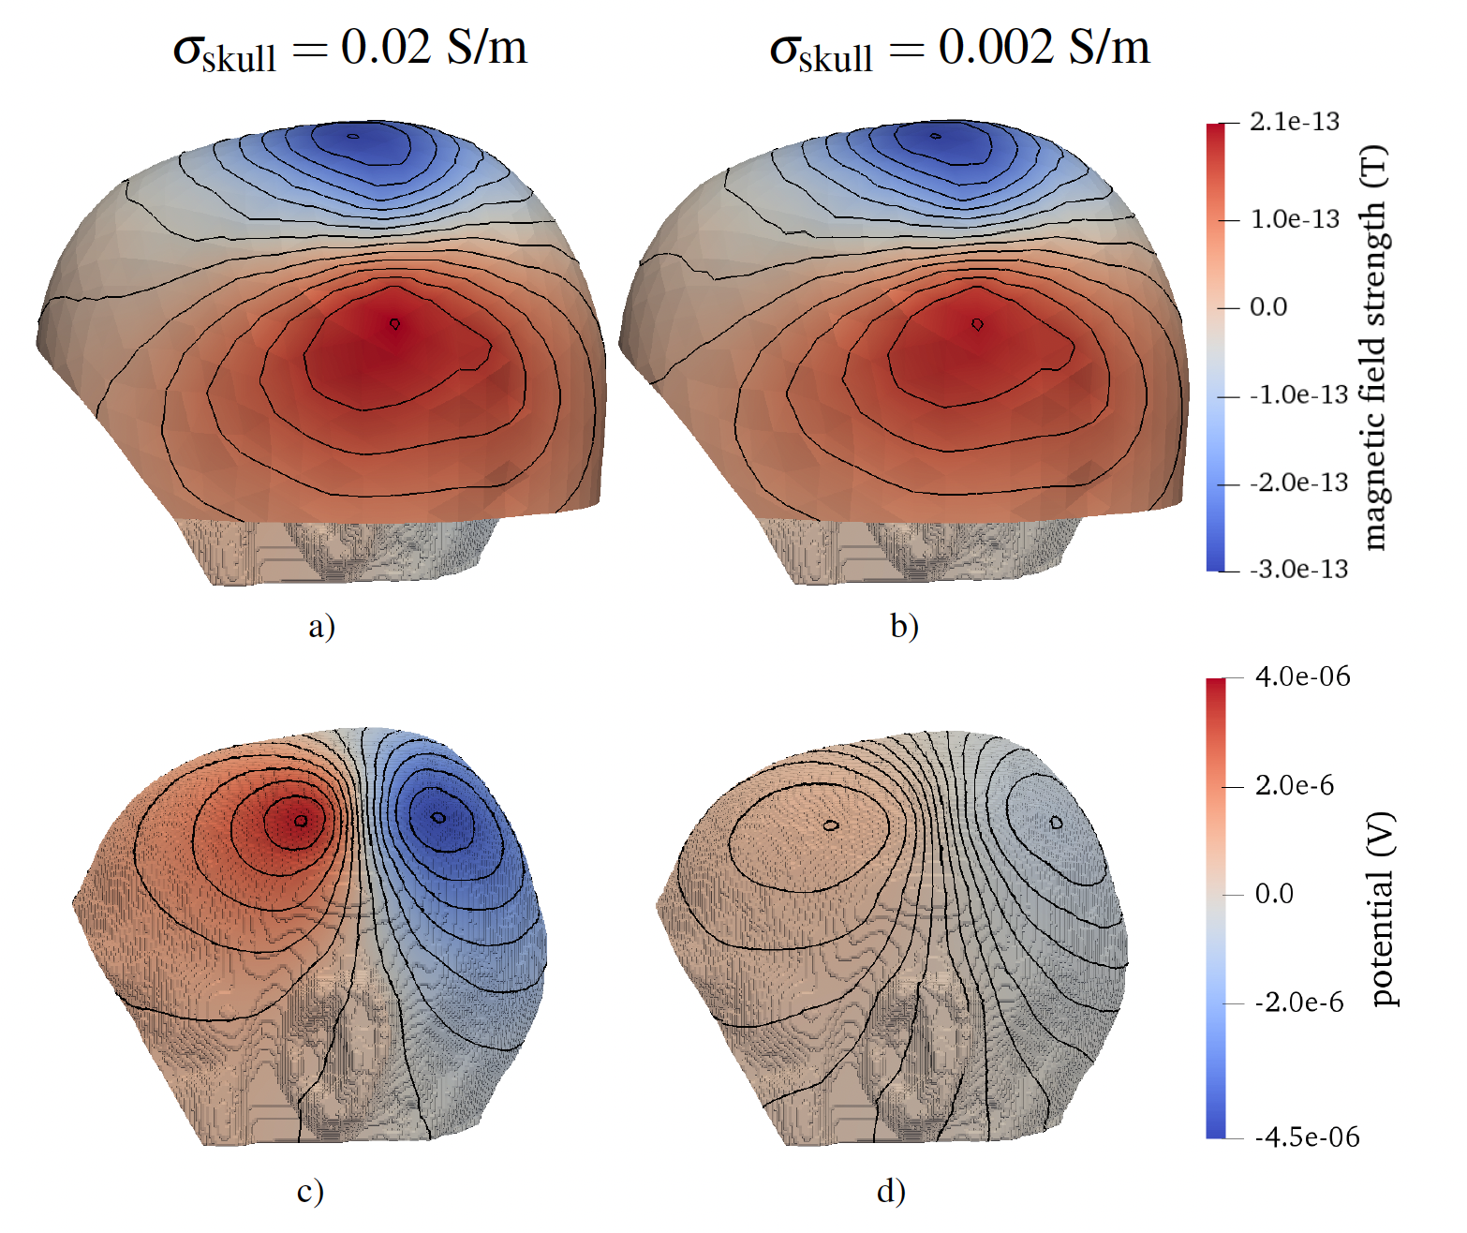
Influence of skull conductivity on EEG and MEG forward simulation
[Schrader, PhD thesis, 2022]
[Vorwerk, Aydin, Wolters & Butson, Front Neurosci, 2019]

Slide 6
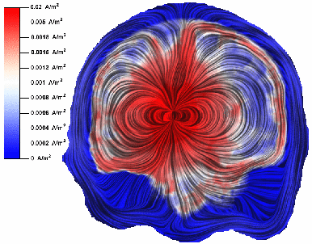
Influence of (extreme 1:10) white mater anisotropic conductivity on volume currents
[Wolters, Anwander, Tricoche, Weinstein, Koch & MacLeod, NeuroImage, 2006]
[Wolters & de Munck, Scholarpedia, 2007]

Slide 7
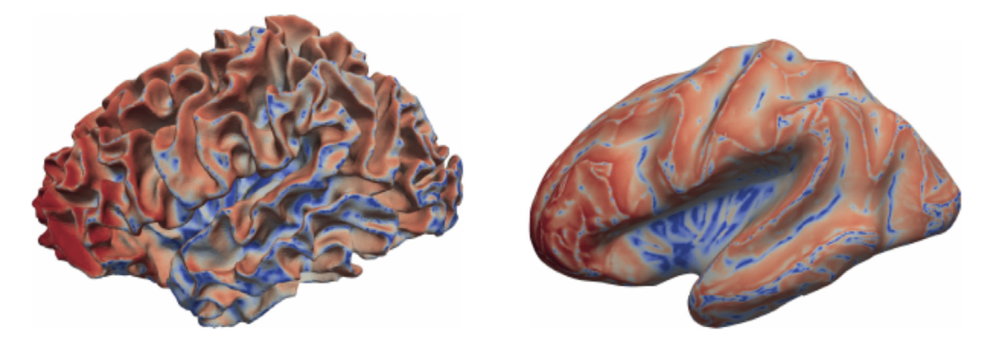
Sensitivity profiles and complementarity: EEG (blue) and MEG (red)
[Piastra, Nüßing, Vorwerk, Clerc, Engwer & Wolters, Human Brain Mapping, 2021]

Slide 8
Structure of the lecture
EEG and MEG sensitivity analysis
A global EEG sensitivity study
Individual calibration of skull conductivity for combined EEG/MEG

Slide 9
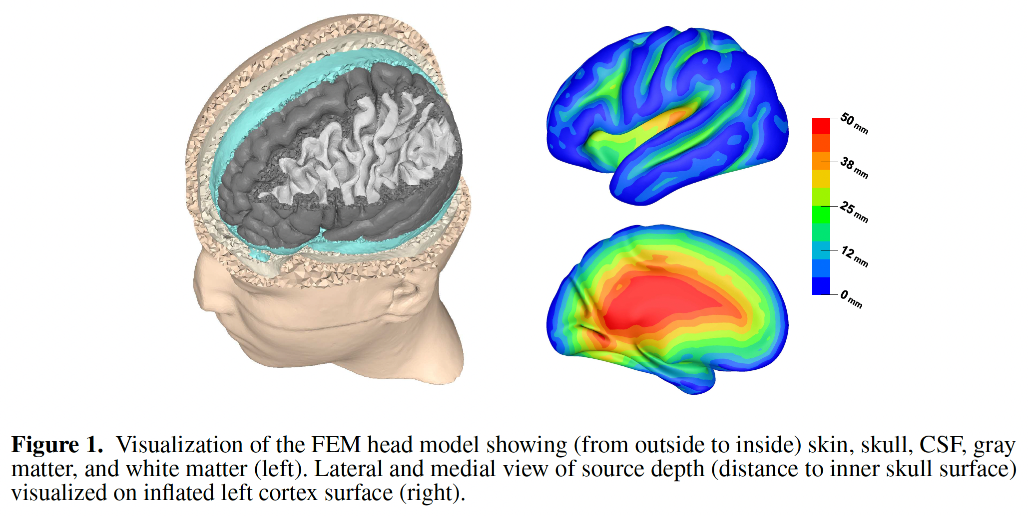
[Vorwerk, Wolters, Baumgarten, Front in Human Neurosci, 2024]
The head model
#Nodes: ~3.5 Mill.; #Tetrahedra-Elements: ~21 Mill.
Notes:
Biot-Savart: B(r)=

Slide 10
[Vorwerk, Wolters, Baumgarten, Front in Human Neurosci, 2024]
The head model
#Nodes source space for reference sources: ~35K (nodes of cortical triangle mesh)
#Nodes source space for inverse reconstructions (to avoid inverse crime): ~70K (barycenters of elements of cortical triangle mesh)
Notes:
Biot-Savart: B(r)=

Slide 11
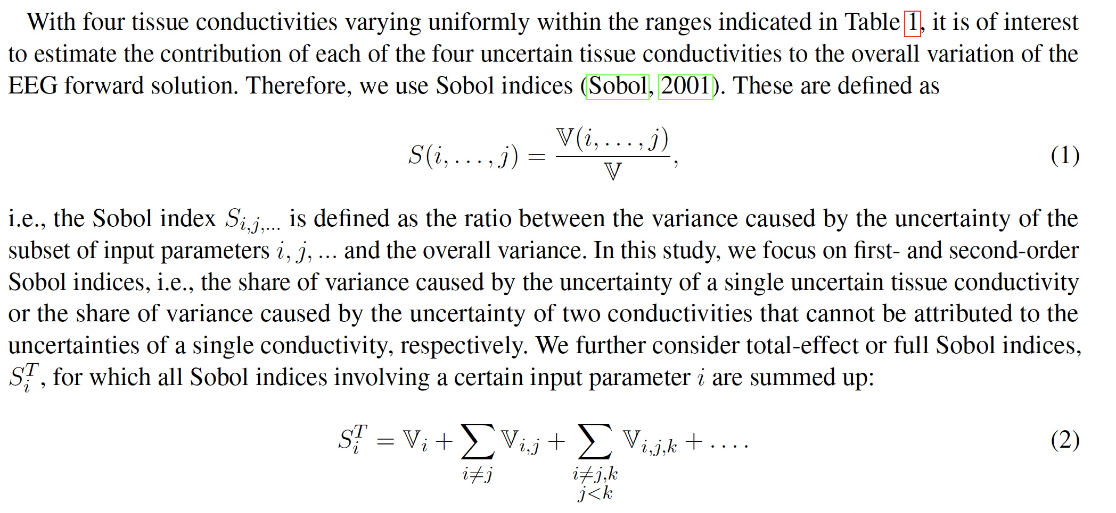
[Vorwerk, Wolters, Baumgarten, Front in Human Neurosci, 2024]
Sensitivity analysis
Notes:
Biot-Savart: B(r)=

Slide 12
[Vorwerk, Wolters, Baumgarten, Front in Human Neurosci, 2024]
Sensitivity analysis
Notes:
Biot-Savart: B(r)=

Slide 13
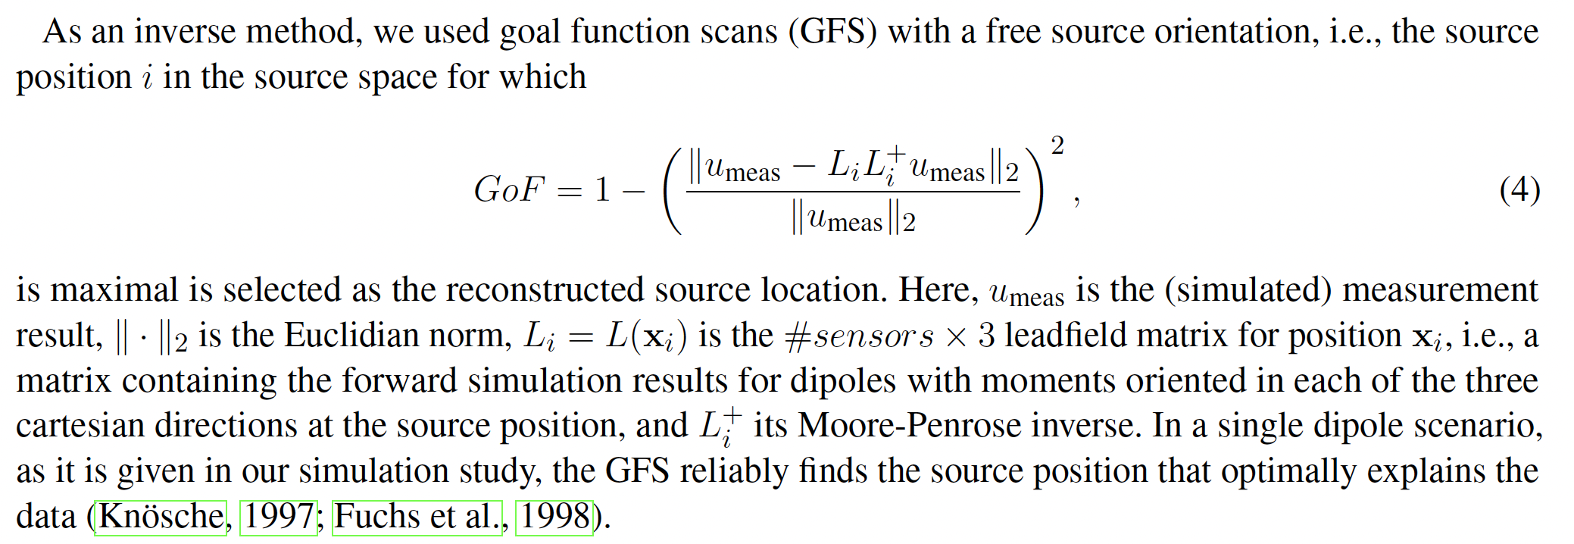
[Vorwerk, Wolters, Baumgarten, Front in Human Neurosci, 2024]
Sensitivity analysis
Notes:
Biot-Savart: B(r)=

Slide 14
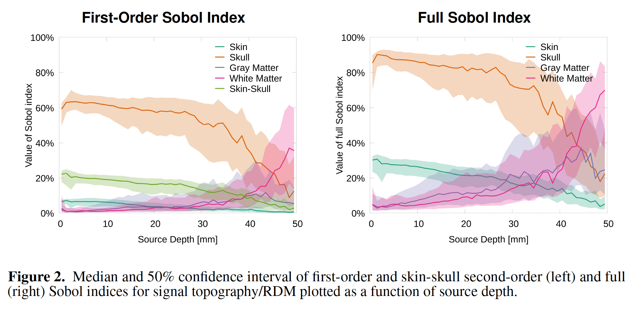
[Vorwerk, Wolters, Baumgarten, Front in Human Neurosci, 2024]
Sensitivity of EEG forward problem
Notes:
Biot-Savart: B(r)=

Slide 15
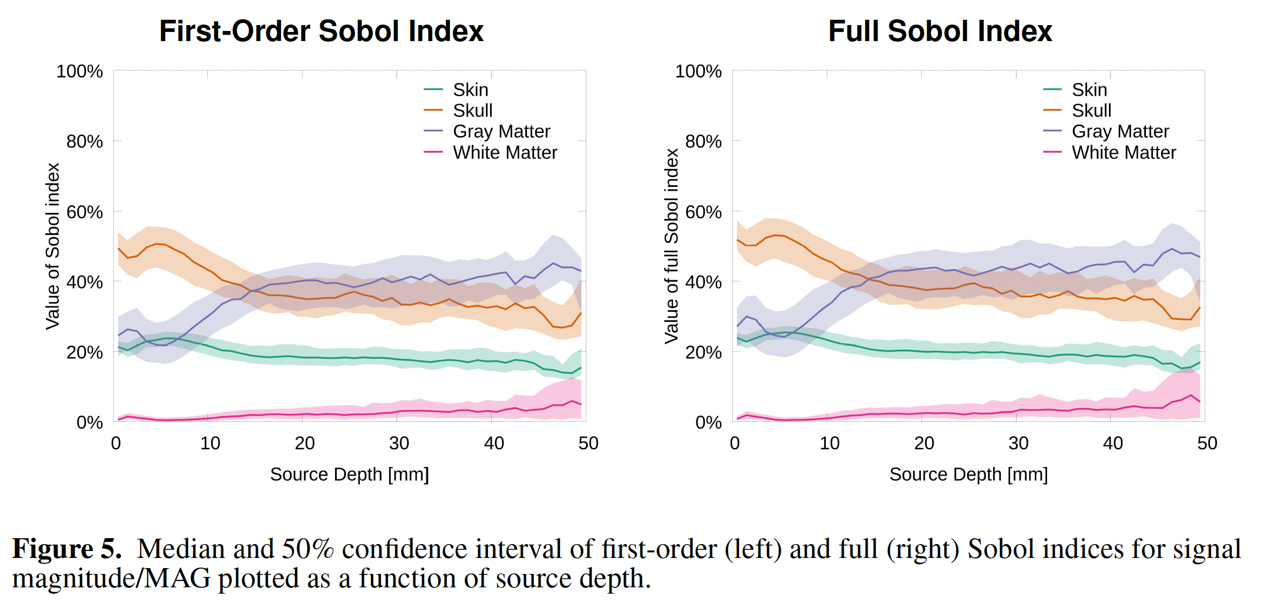
[Vorwerk, Wolters, Baumgarten, Front in Human Neurosci, 2024]
Sensitivity of EEG forward problem
Notes:
Biot-Savart: B(r)=

Slide 16
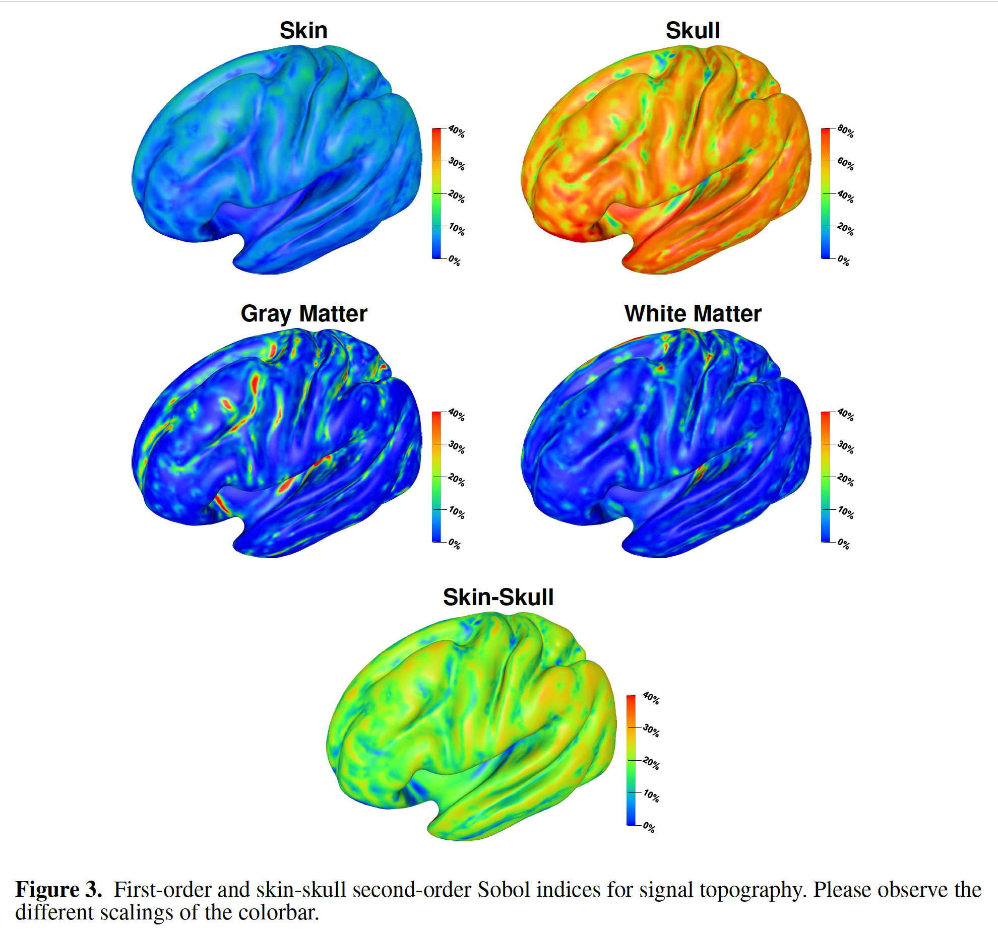
[Vorwerk, Wolters, Baumgarten, Front in Human Neurosci, 2024]
Sensitivity of EEG forward problem
Notes:
Biot-Savart: B(r)=

Slide 17
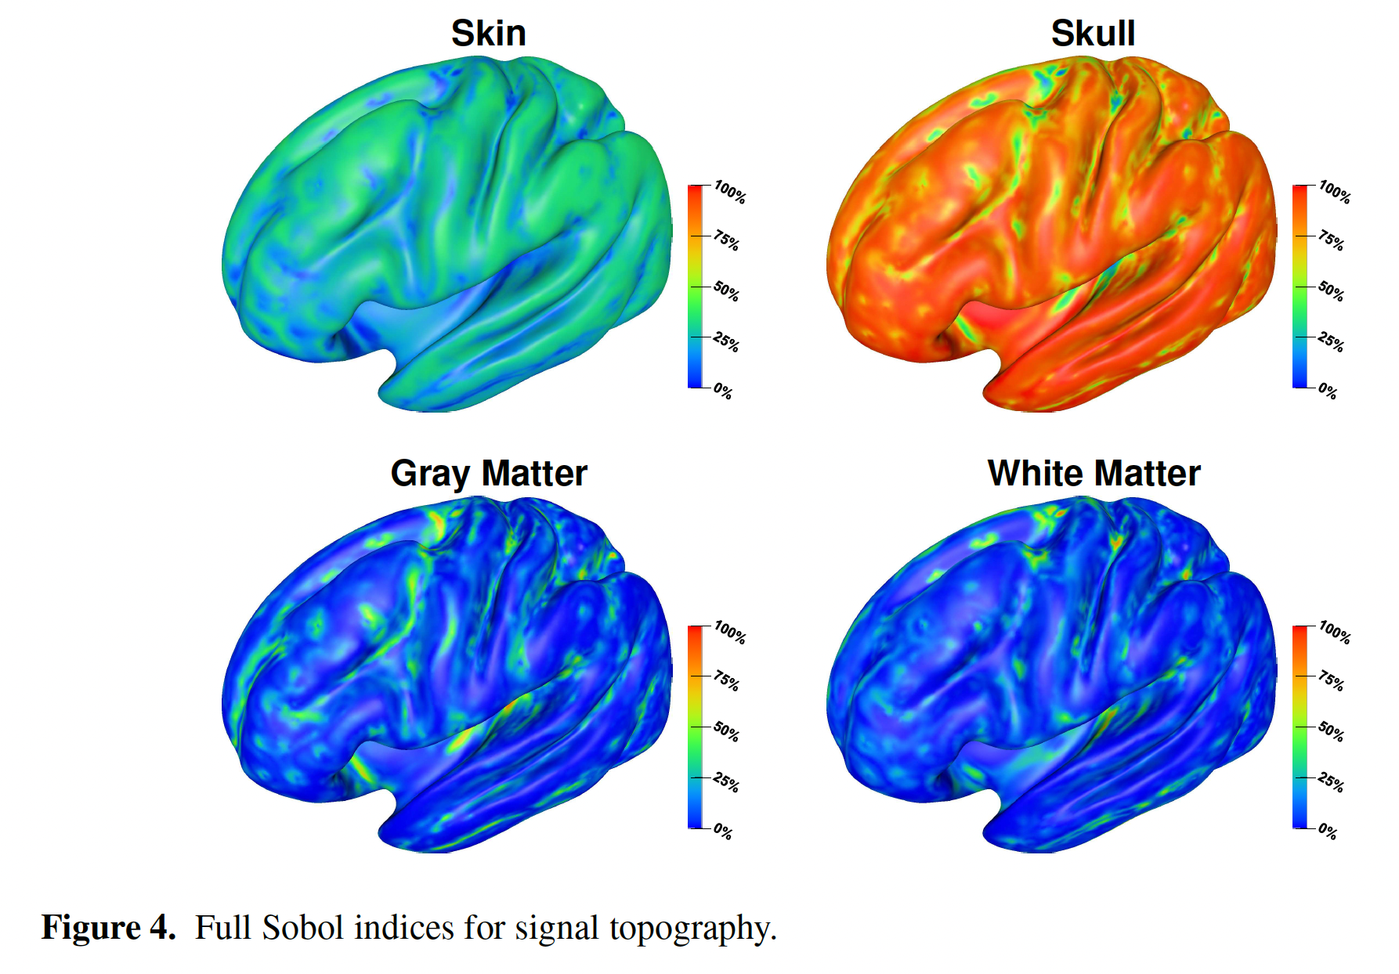
[Vorwerk, Wolters, Baumgarten, Front in Human Neurosci, 2024]
Sensitivity of EEG forward problem
Notes:
Biot-Savart: B(r)=

Slide 18
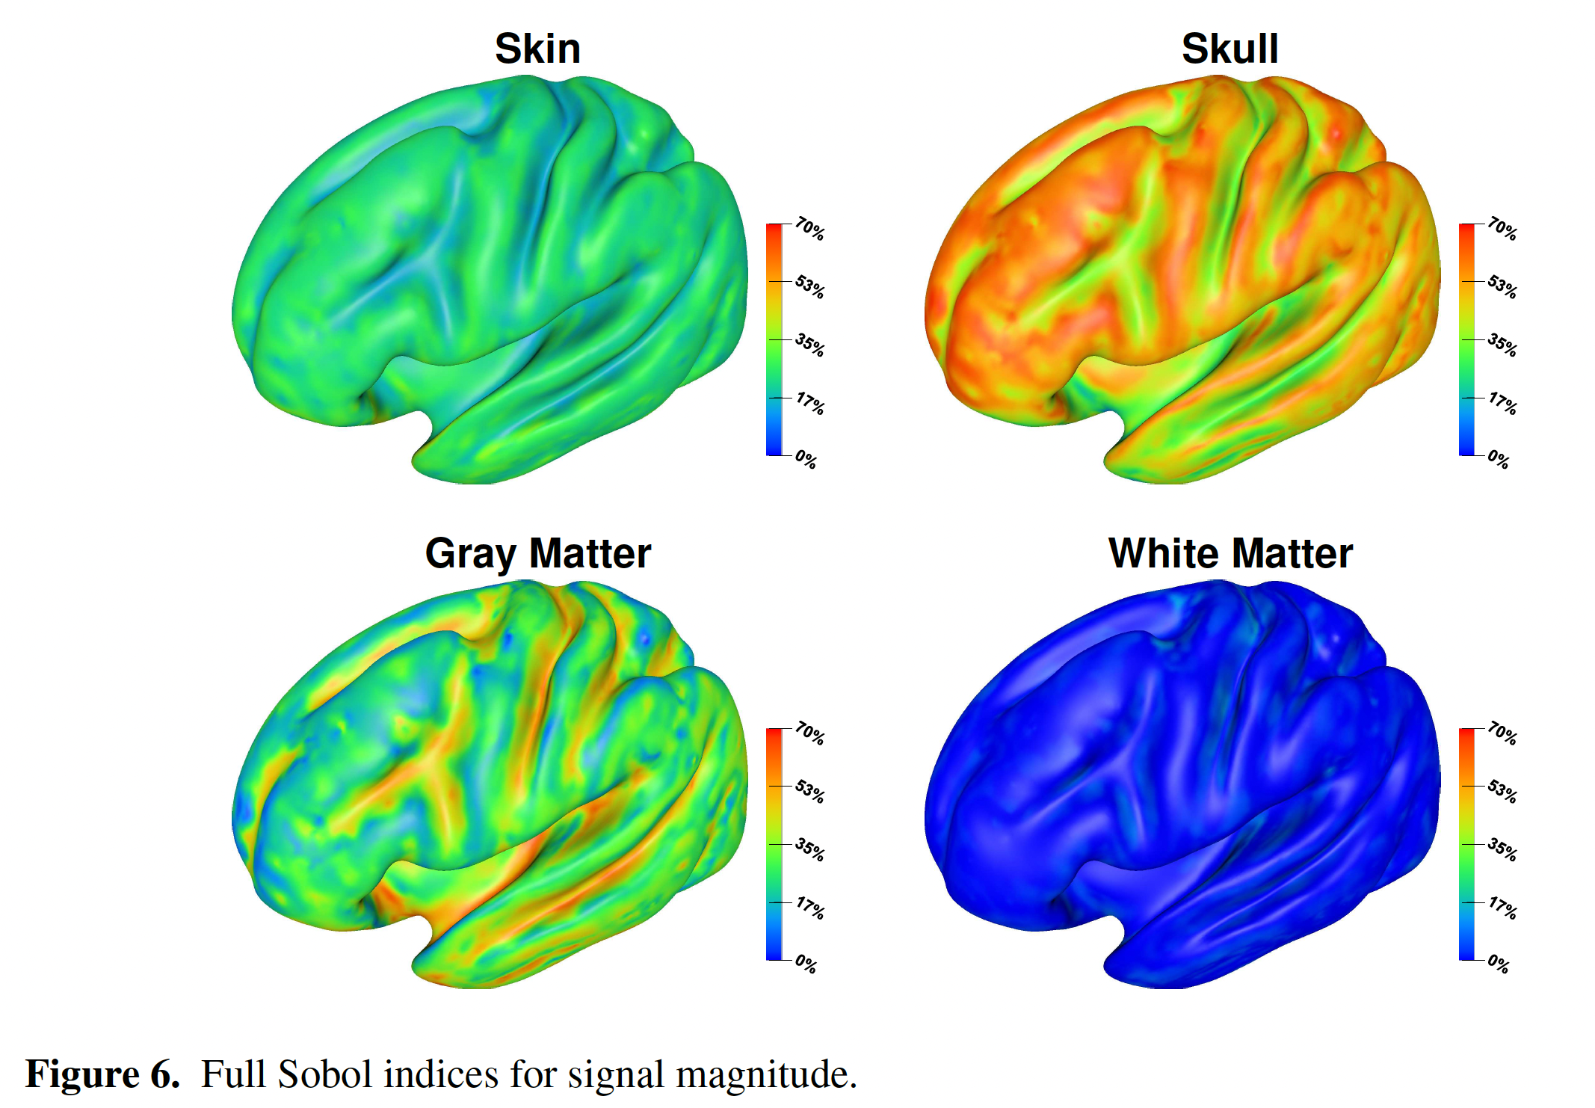
[Vorwerk, Wolters, Baumgarten, Front in Human Neurosci, 2024]
Sensitivity of EEG forward problem
Notes:
Biot-Savart: B(r)=

Slide 19
[Vorwerk, Wolters, Baumgarten, Front in Human Neurosci, 2024]
Sensitivity of EEG inverse problem
Notes:
Biot-Savart: B(r)=

Slide 20
[Vorwerk, Wolters, Baumgarten, Front in Human Neurosci, 2024]
Sensitivity of EEG inverse problem
and
Notes:
Biot-Savart: B(r)=

Slide 21
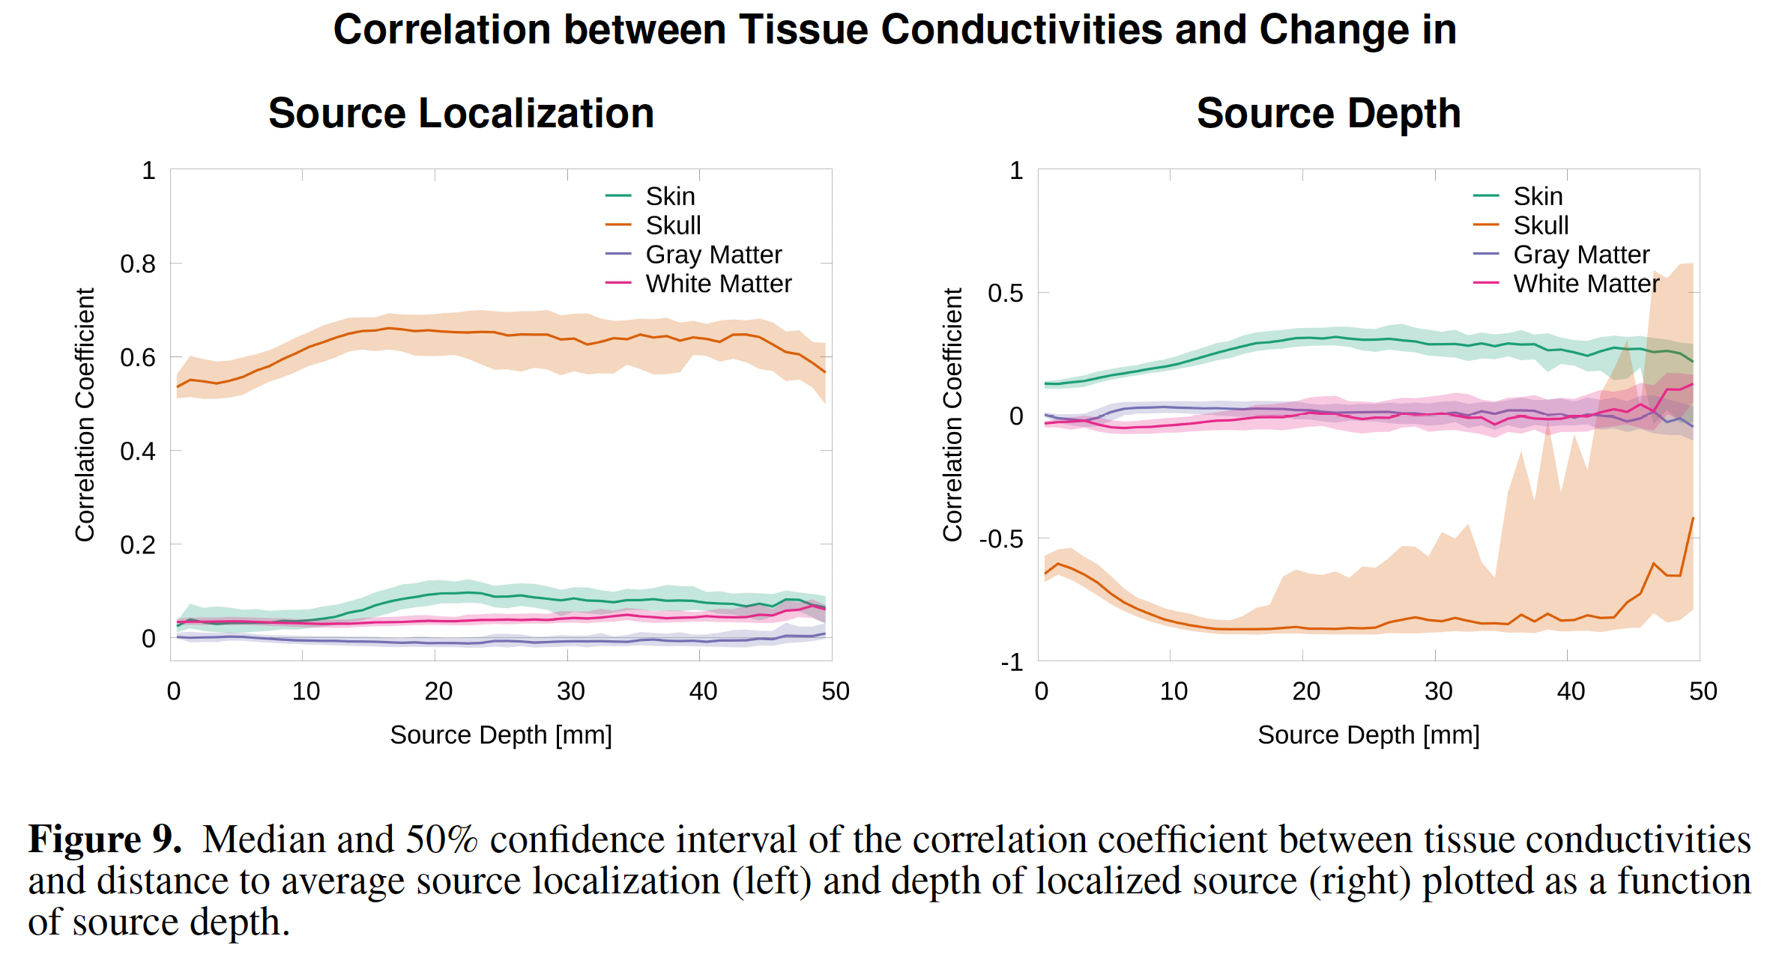
[Vorwerk, Wolters, Baumgarten, Front in Human Neurosci, 2024]
Sensitivity of EEG inverse problem
change
change
Notes:
Biot-Savart: B(r)=

Slide 22
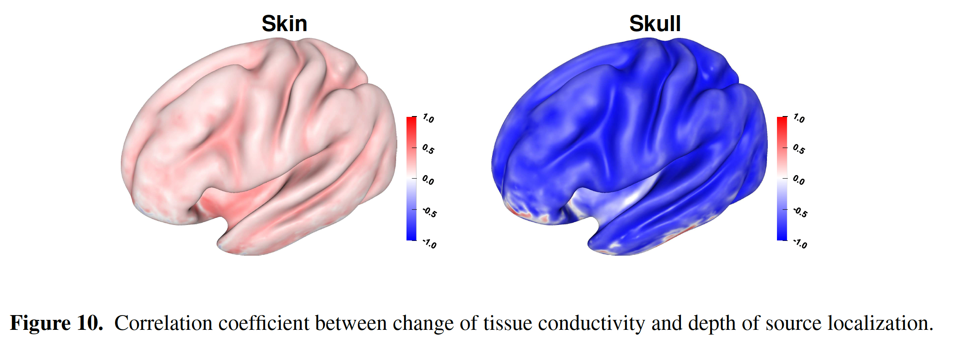
[Vorwerk, Wolters, Baumgarten, Front in Human Neurosci, 2024]
Sensitivity of EEG inverse problem
Notes:
Biot-Savart: B(r)=

Slide 23
[Vorwerk, Wolters, Baumgarten, Front in Human Neurosci, 2024]
Discussion: Sensitivity of EEG to uncertain head tissue conductivities
Notes:
Biot-Savart: B(r)=

Slide 24
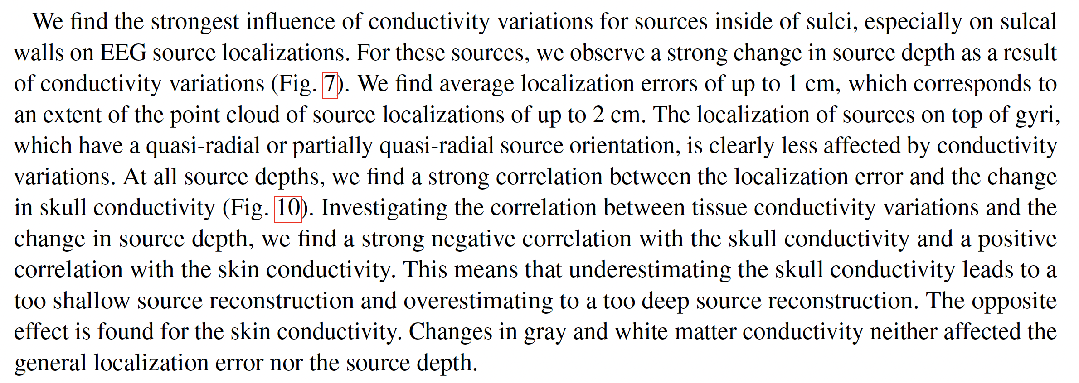
[Vorwerk, Wolters, Baumgarten, Front in Human Neurosci, 2024]
Discussion: Sensitivity of EEG to uncertain head tissue conductivities
Notes:
Biot-Savart: B(r)=

Slide 25
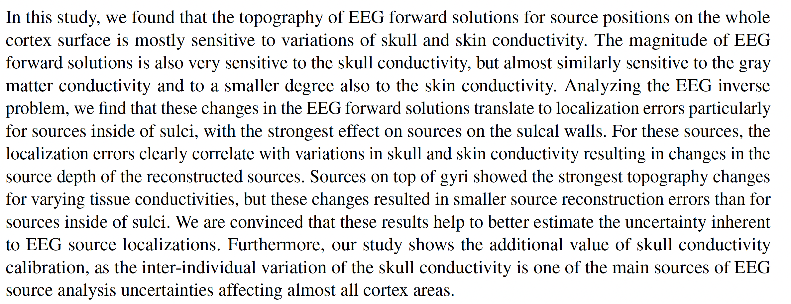
[Vorwerk, Wolters, Baumgarten, Front in Human Neurosci, 2024]
Conclusion: Sensitivity of EEG to uncertain head tissue conductivities
Notes:
Biot-Savart: B(r)=

Slide 26
Structure of the lecture
EEG and MEG sensitivity analysis
A global EEG sensitivity study
Individual calibration of skull conductivity for combined EEG/MEG

Slide 27
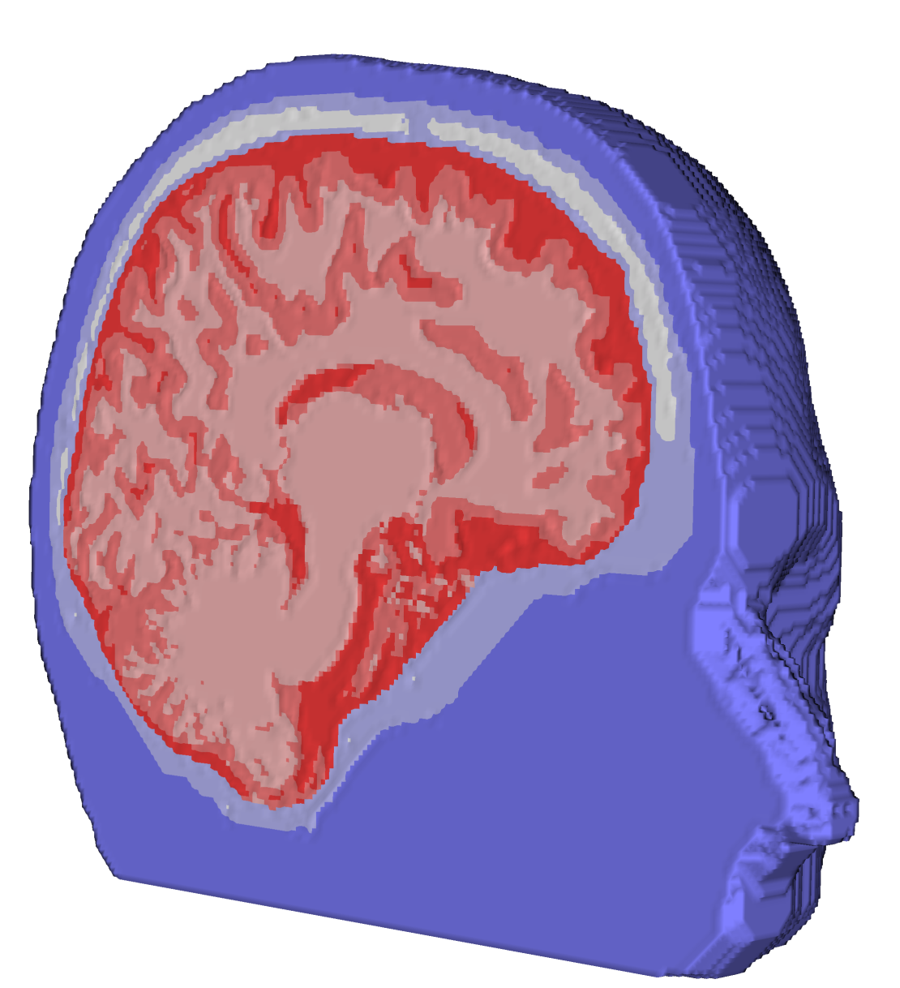
Head volume conductor modeling
[Aydin, Vorwerk, Küpper, Heers, Kugel,Galka, Hamid, Wellmer, Kellinghaus, Rampp & Wolters, PLOS ONE, 2014]
[Antonakakis, Schrader, Aydin, Khan, Gross, Zervakis, Rampp & Wolters, NeuroImage, 2020]
[Schrader, Antonakakis, Rampp, Engwer & Wolters, Phys Med Biol, 2020]
MRI measurement
Anisotropic
head model
Segmentation
T1, T2, DTI (27 min)

Slide 28
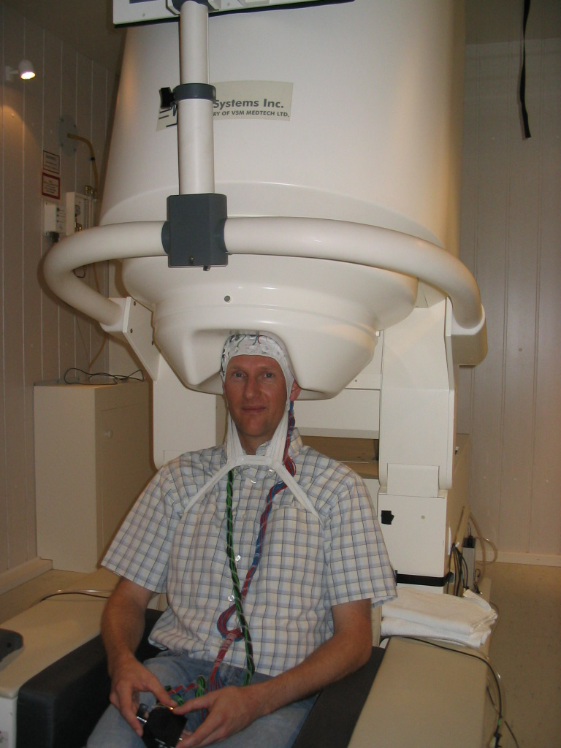
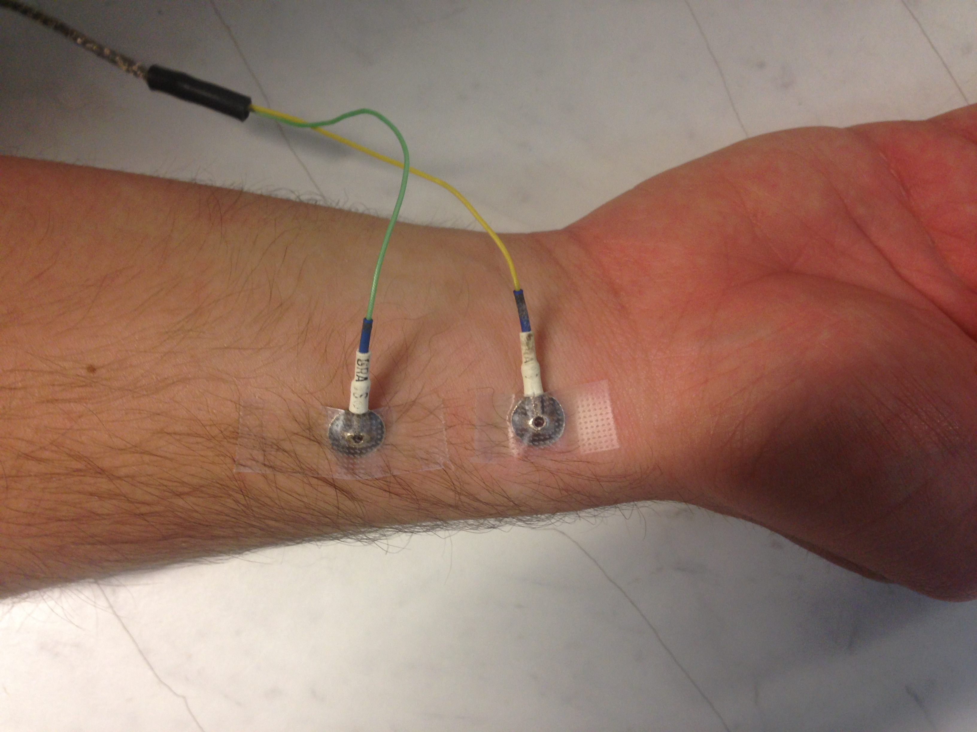
Skull-conductivity calibration: Somatosensory evoked potentials (SEP) and fields (SEF)
[Wolters, Antonakakis, Khan, Piastra, Vorwerk, In: Groppa & Meuth, Springer-Verlag, 2021]
Combined EEG/MEG
Electric stimulation of the medianus nerve

Slide 29
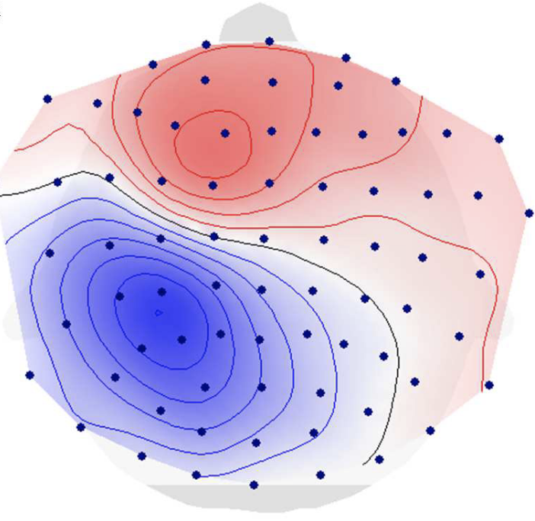
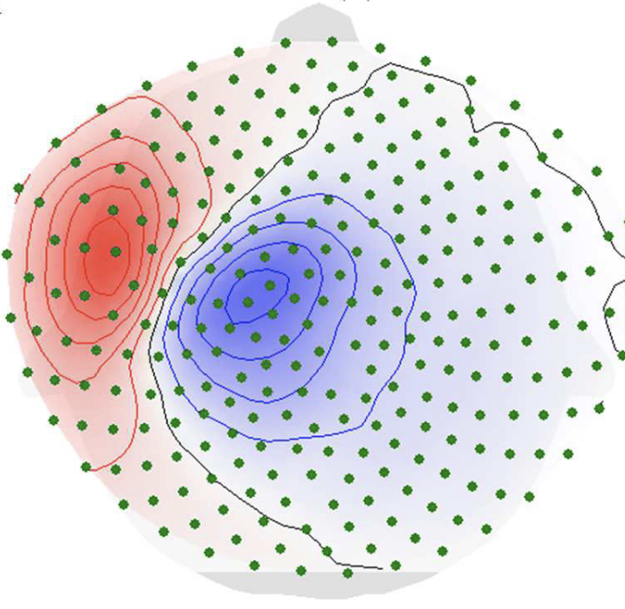
Skull-conductivity calibration: Somatosensory evoked potentials (SEP) and fields (SEF)
[Antonakakis, Schrader, Aydin, Khan, Gross, Zervakis, Rampp & Wolters, NeuroImage, 2020]
[Schrader, Antonakakis, Rampp, Engwer & Wolters, Phys Med Biol, 2020]
[Huang et al., 2007; Dassios et al., 2007; Baysal & Haueisen, 2004; Fuchs et al., 1998]
SEP P20/N20
SEF M20

Slide 30
Skull-conductivity calibration: Individual calibration curves in a group study (20 subjects)
[Antonakakis, Schrader, Aydin, Khan, Gross, Zervakis, Rampp & Wolters, NeuroImage, 2020]

Slide 31
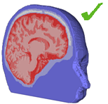
Head volume conductor modeling
[Aydin, Vorwerk, Küpper, Heers, Kugel,Galka, Hamid, Wellmer, Kellinghaus, Rampp & Wolters, PLOS ONE, 2014]
[Antonakakis, Schrader, Aydin, Khan, Gross, Zervakis, Rampp & Wolters, NeuroImage, 2020]
[Schrader, Antonakakis, Rampp, Engwer & Wolters, Phys Med Biol, 2020]
Anisotropic
head model
Calibration for skull conductivity
MRI measurement
Segmentation
T1, T2, DTI (27 min)
Medianus-nerve stimulation (7 min)
Skull conductivity
High interindividual variability
EEG very sensitive
MEG nearly not influenced

Slide 32
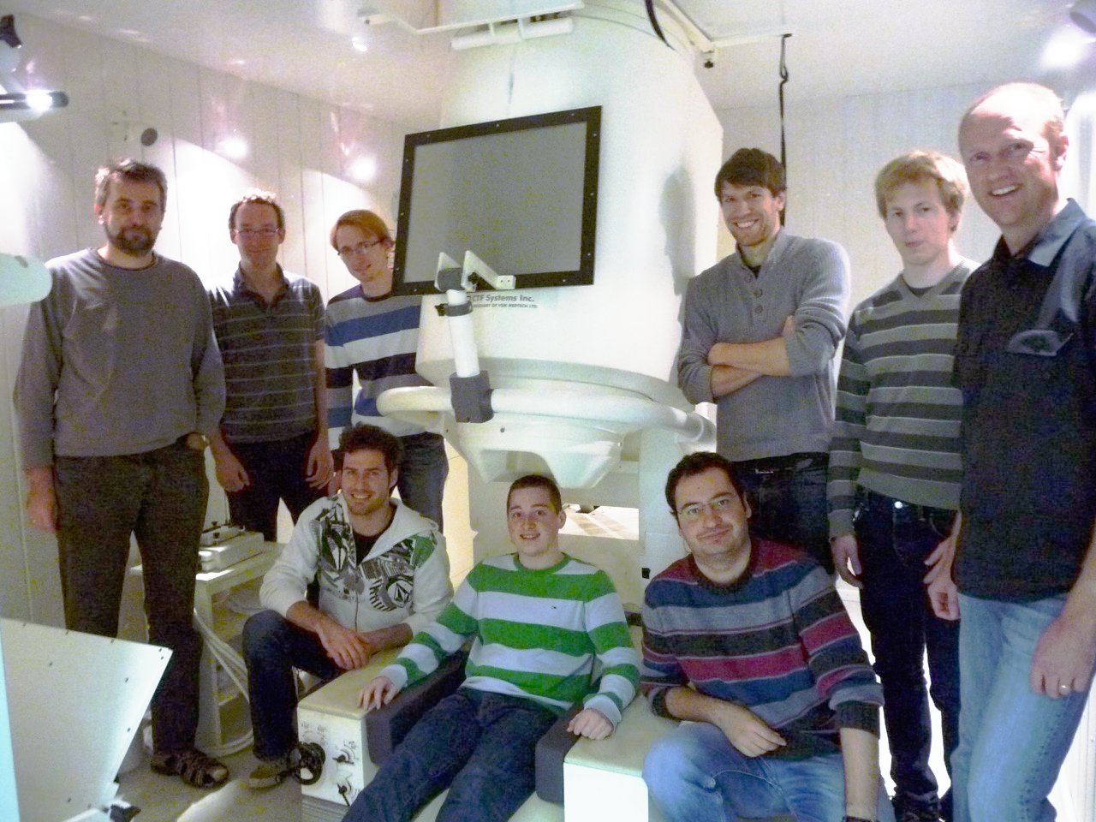
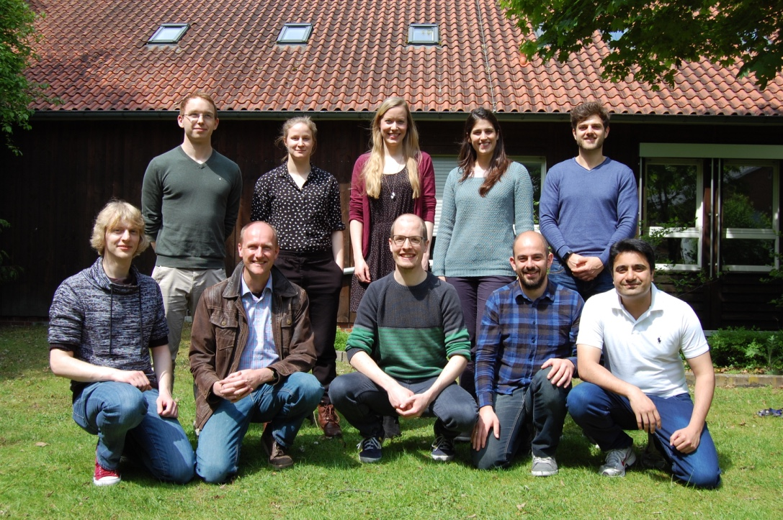
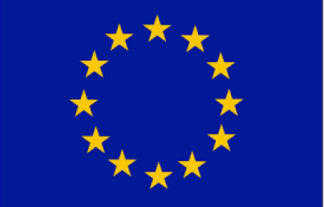
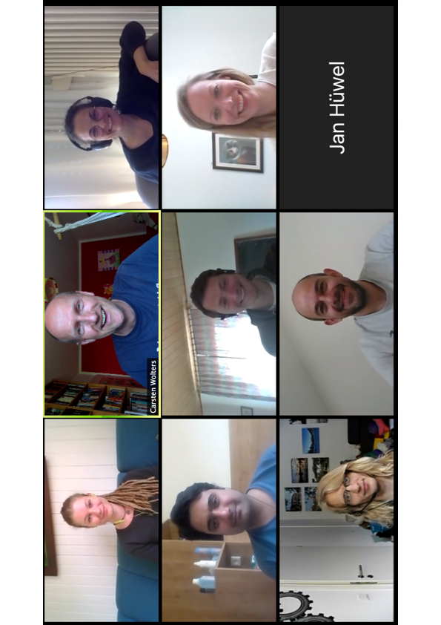
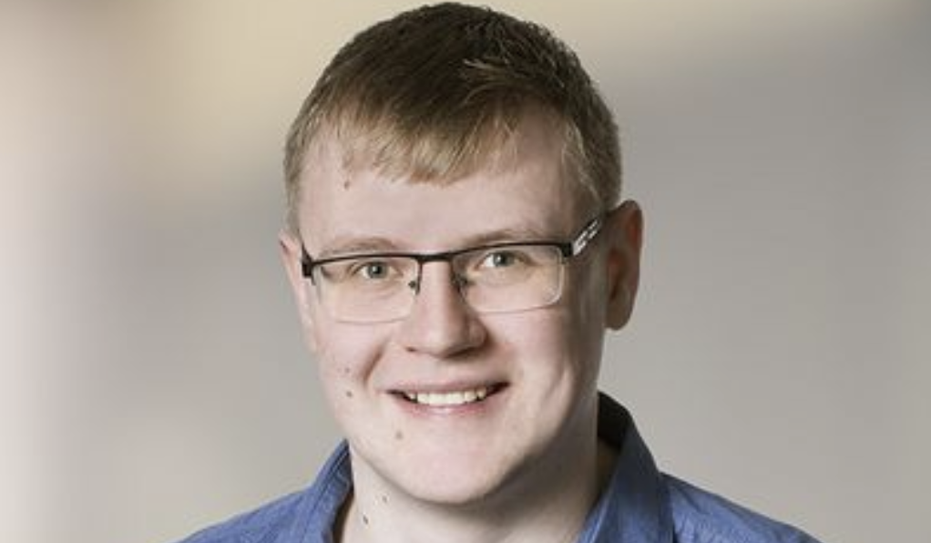
Thank you for your attention!
SIM-NEURO work-group at IBB
Notes:
32
32

