Slide 1
Existence and uniqueness for the EEG forward problem
Carsten H. Wolters
Institut für Biomagnetismus und Biosignalanalyse, Westf. Wilhelms-Universität Münster, Germany
Lecture, Oct 29, 2024

Slide 2
[Wolters, Lecture scriptum]

Slide 3
Structure of the lecture
Existence and uniqueness of the forward problem solution (Chapters 6.1.1-6.1.5 from lecture scriptum)
6.1.1: Basics
6.1.2: The subtraction approach to get rid of the singularity on the right-hand-side (derivation of the equation for the correction potential)
6.1.3: Types of partial differential equations
6.1.4: Sobolev spaces
6.1.5: A variational formulation
6.1.6: Variational formulation, existence and uniqueness of the solution for the correction potential

Slide 4
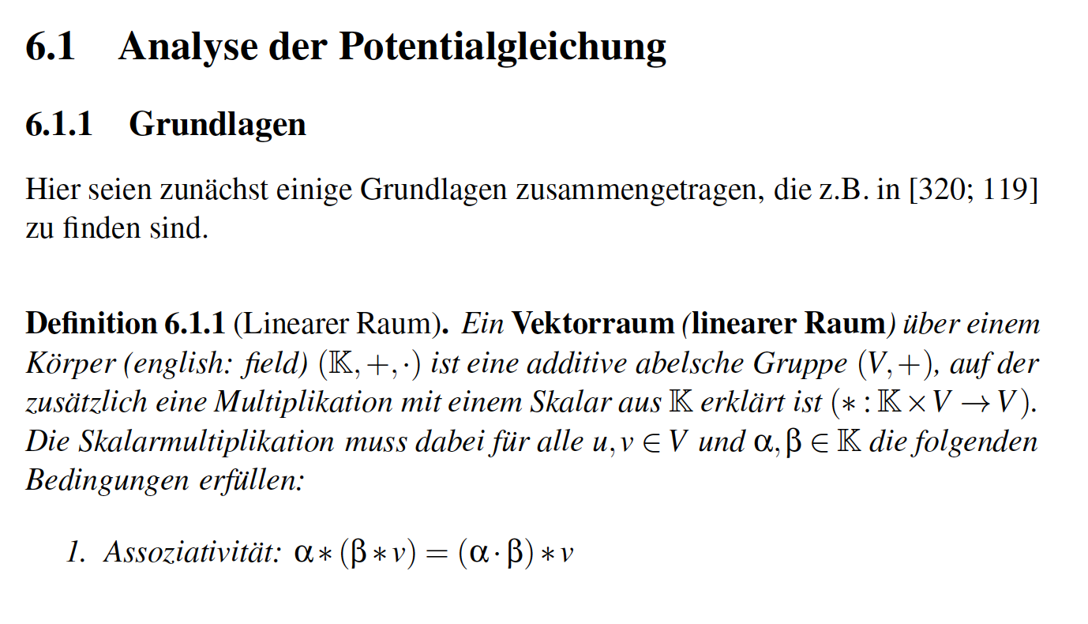
[Wolters, Lecture scriptum]

Slide 5
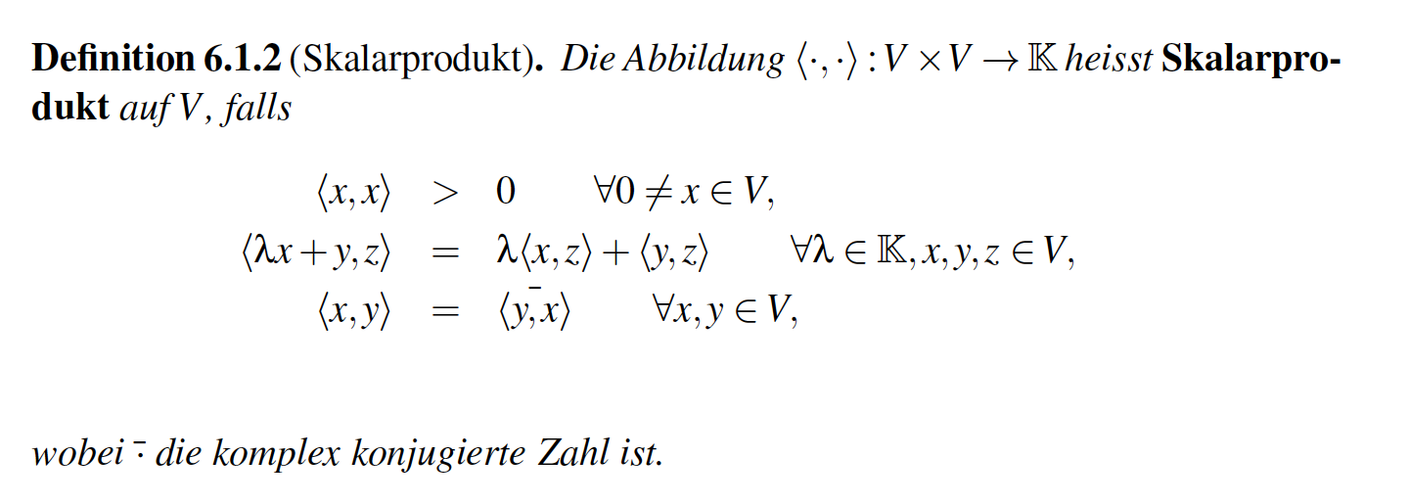
[Wolters, Lecture scriptum]

Slide 6
[Wolters, Lecture scriptum]

Slide 7
[Wolters, Lecture scriptum]

Slide 8
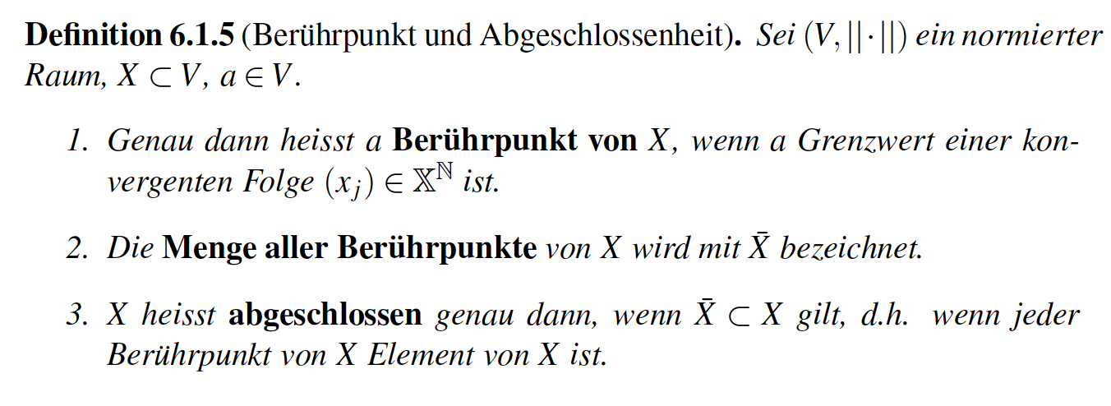
[Wolters, Lecture scriptum]

Slide 9
[Wolters, Lecture scriptum]

Slide 10
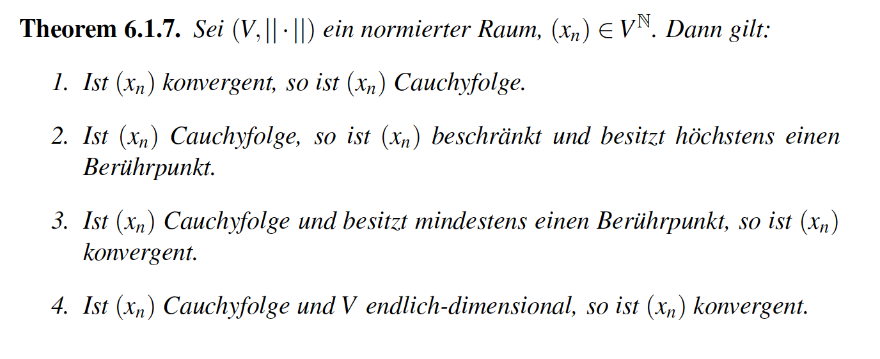
[Wolters, Lecture scriptum]

Slide 11
[Wolters, Lecture scriptum]

Slide 12
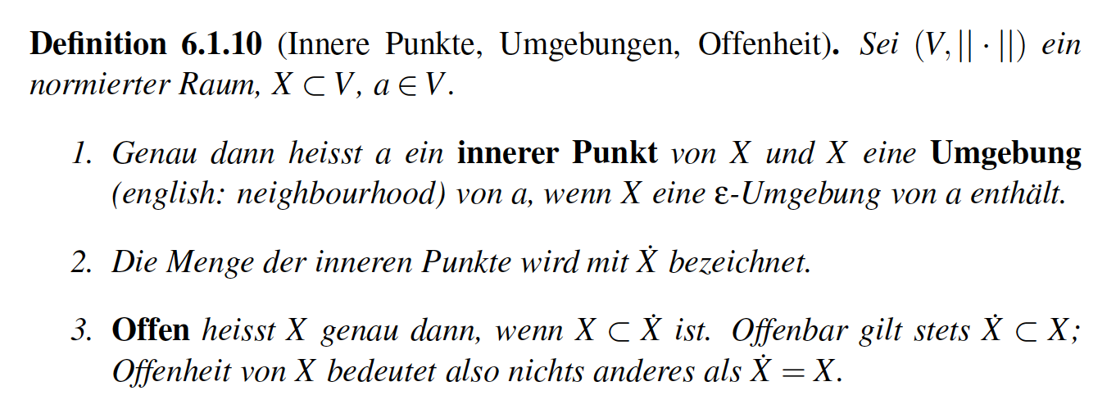
[Wolters, Lecture scriptum]

Slide 13
[Wolters, Lecture scriptum]

Slide 14
[Wolters, Lecture scriptum]

Slide 15
[Wolters, Lecture scriptum]
Notes:
Vervollständigung = completion

Slide 16
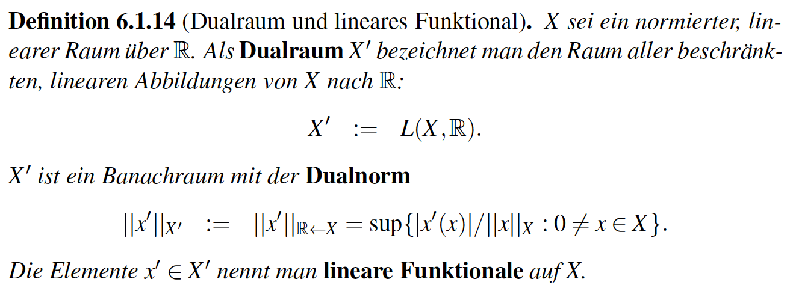
[Wolters, Lecture scriptum]

Slide 17
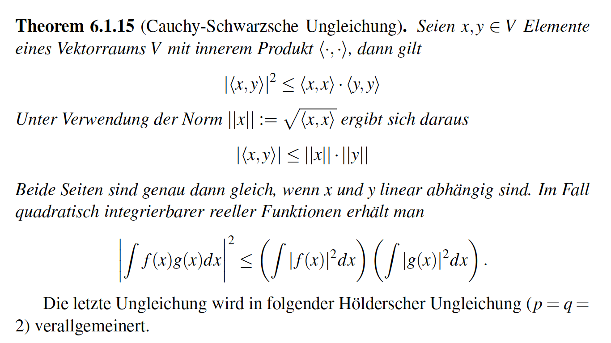
[Wolters, Lecture scriptum]

Slide 18
[Wolters, Lecture scriptum]
Notes:
Massraum = measure space

Slide 19
Structure of the lecture
Existence and uniqueness of the forward problem solution (Chapters 6.1.1-6.1.5 from lecture scriptum)
6.1.1: Basics
6.1.2: The subtraction approach to get rid of the singularity on the right-hand-side (derivation of the equation for the correction potential)
6.1.3: Types of partial differential equations
6.1.4: Sobolev spaces
6.1.5: A variational formulation
6.1.6: Variational formulation, existence and uniqueness of the solution for the correction potential

Slide 20
[Wolters, Lecture scriptum]

Slide 21
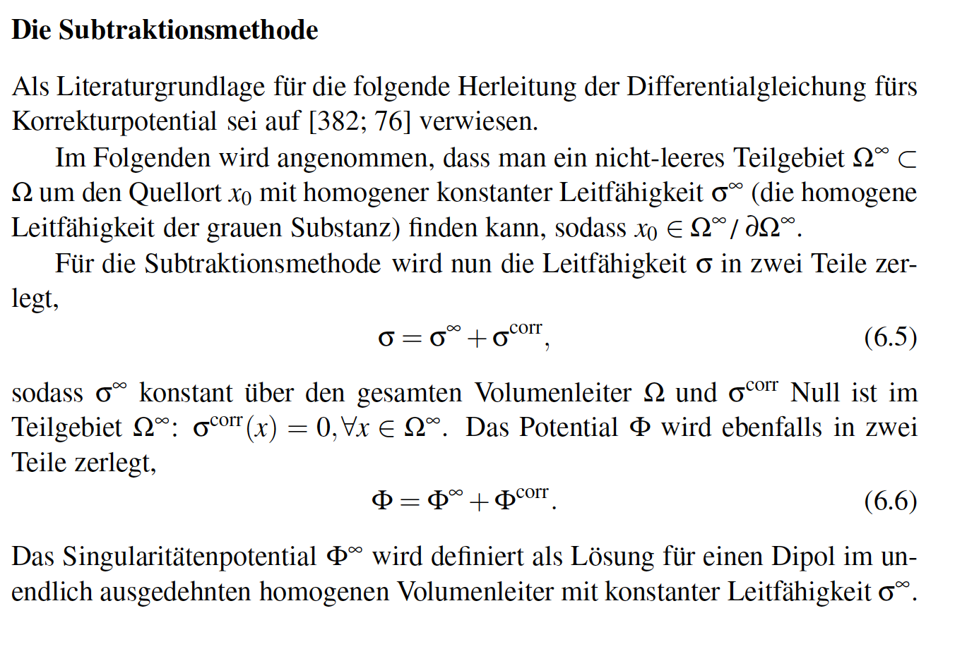
[Wolters, Lecture scriptum]

Slide 22
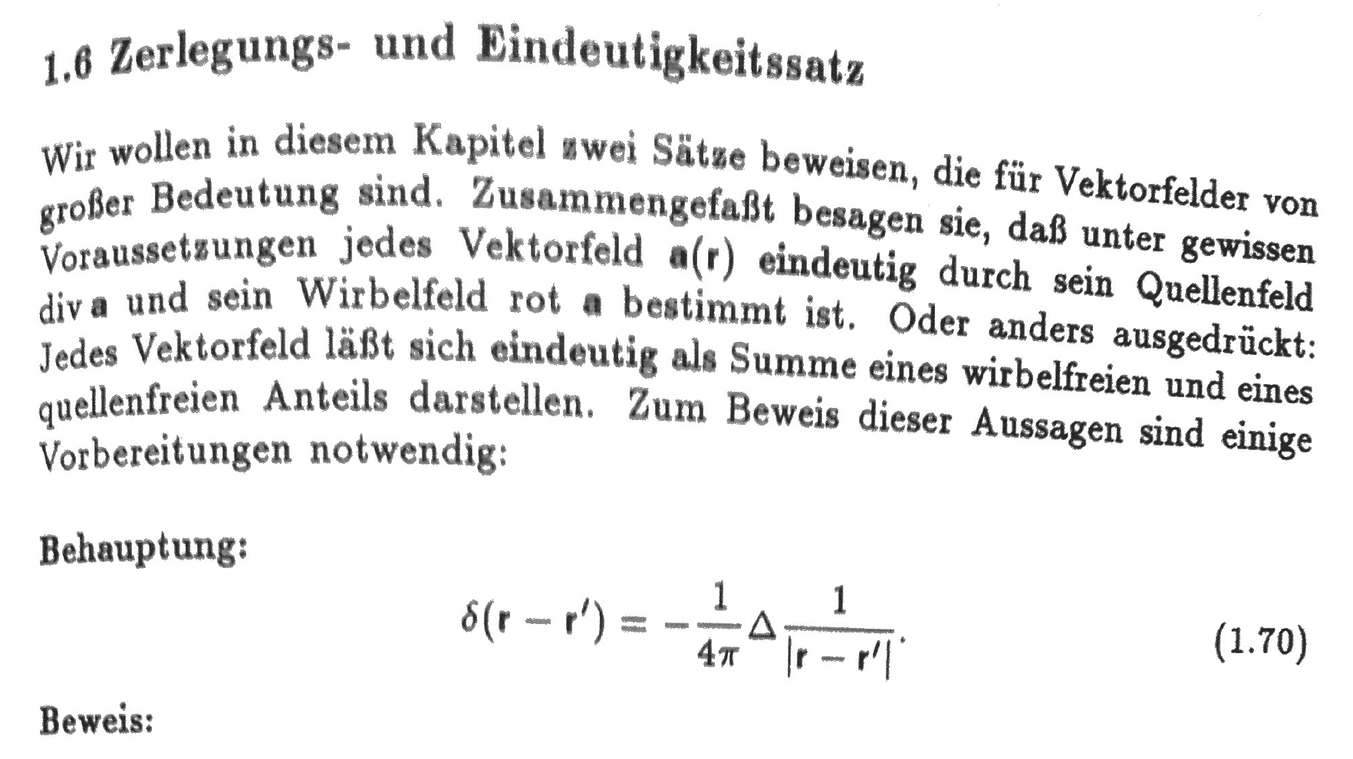
[Nolting, Elektodynamik, Verlag Zimmermann-Neufang, Ulmen, 1992]
Hilfssätze aus Nolting-Buch
Proof can be found in the file ProofOfStatement1.70.pdf on our webside
Notes:
Tensor weiter erlaeutern
Zeitableitung
Programmlaenge, 1Mill.
WM-Rendering->5000 nodes
1:10 raus und anfangs erwaehnen

Slide 23
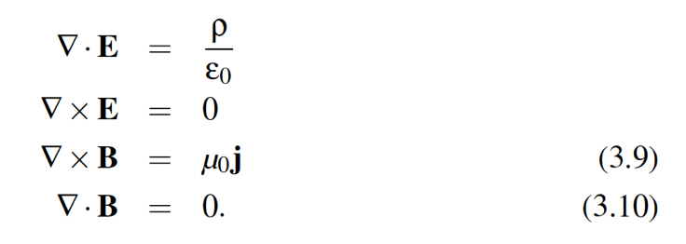
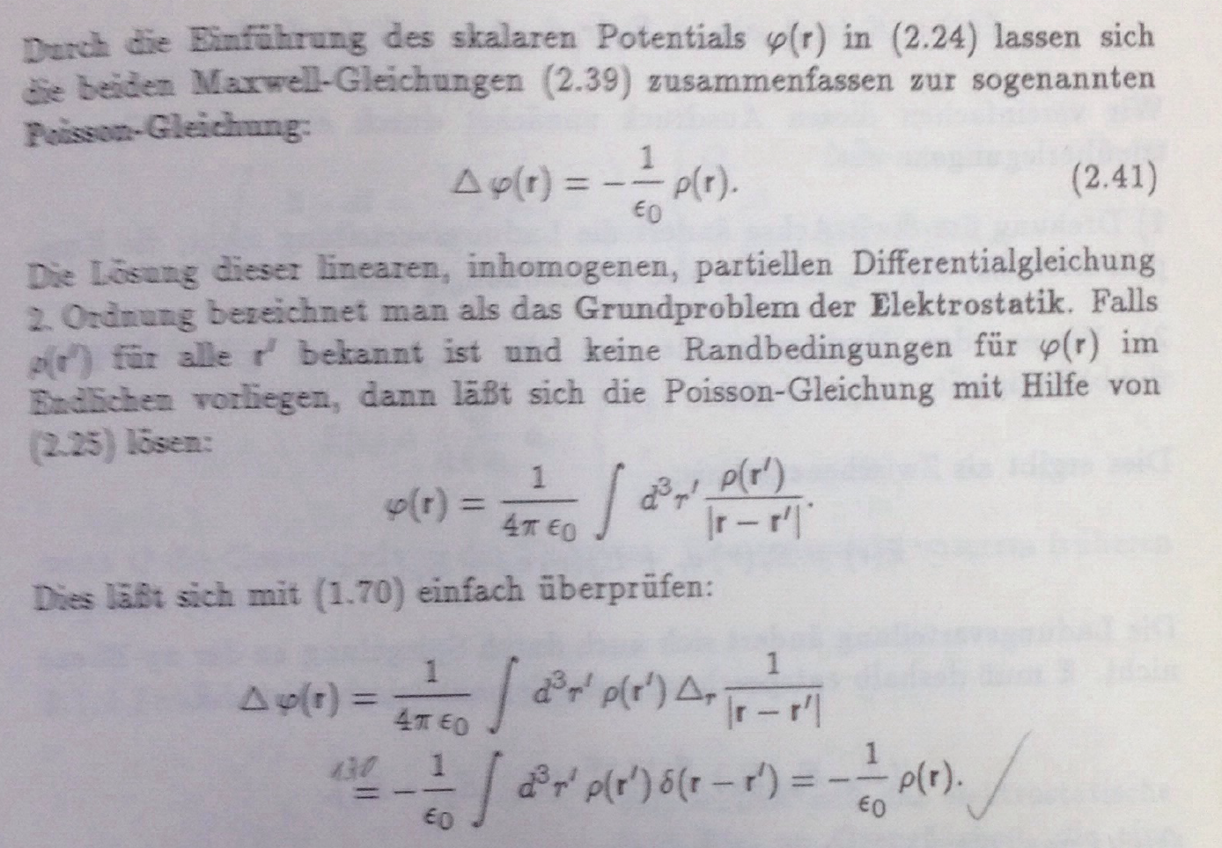
[Nolting, Seite 61, Elektodynamik, Verlag Zimmermann-Neufang, Ulmen, 1992]
Bei uns im Skriptum:
Die beiden Gleichungen
für E in
Hilfssätze aus Nolting-Buch

Slide 24
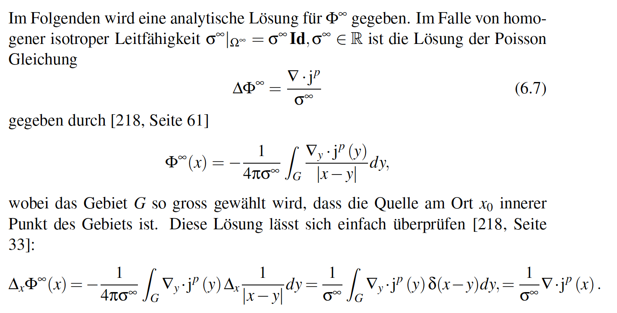
[Wolters, Lecture scriptum]

Slide 25
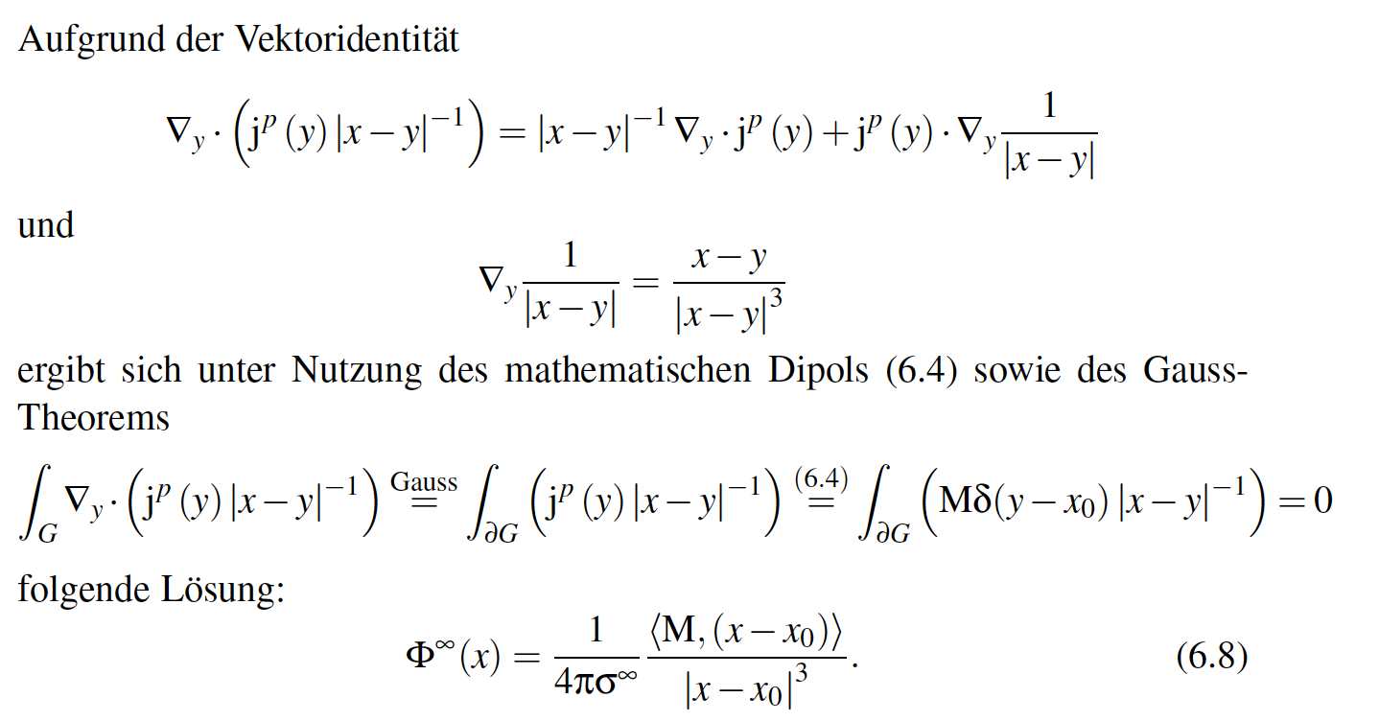
[Wolters, Lecture scriptum]

Slide 26
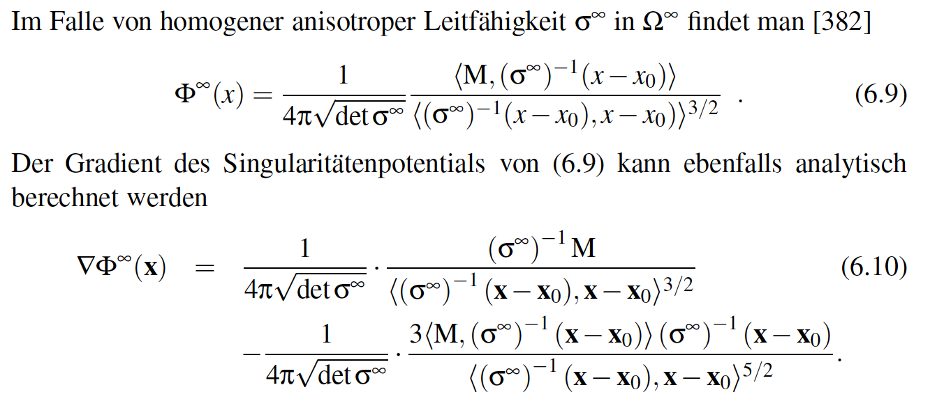
[Wolters, Lecture scriptum]

Slide 27
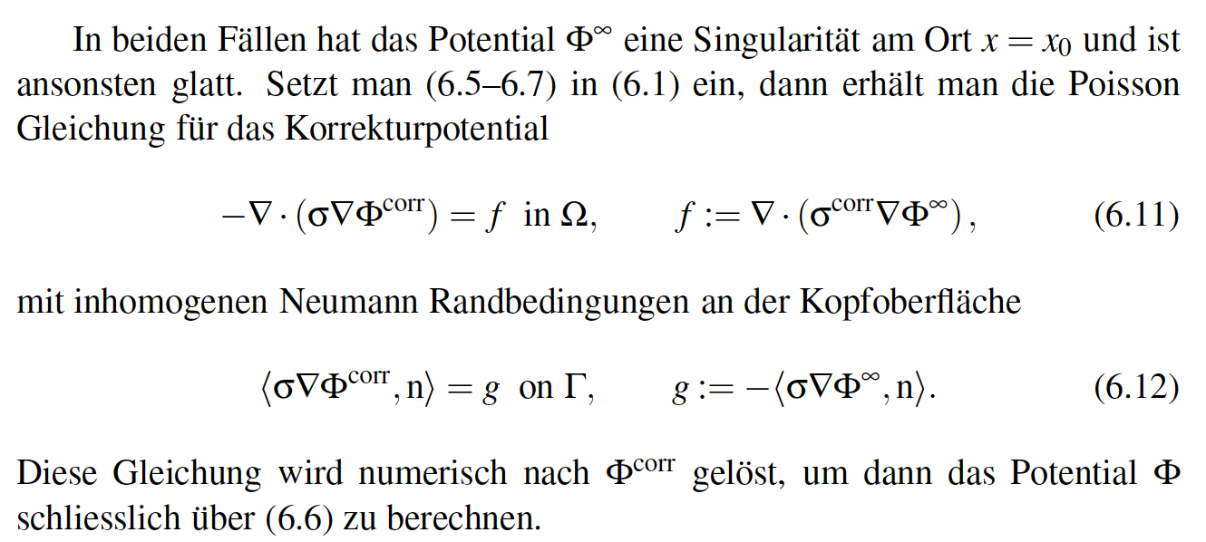
[Wolters, Lecture scriptum]

Slide 28
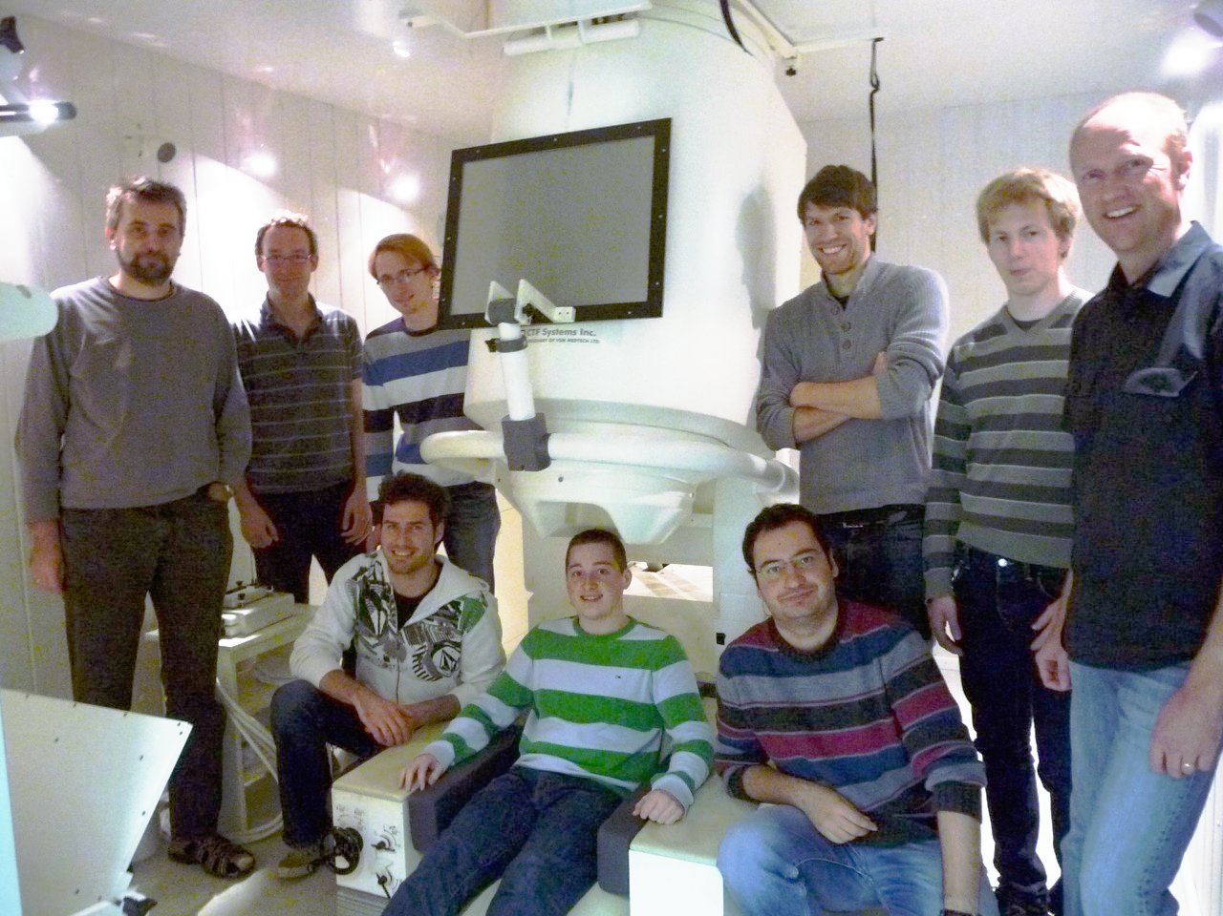
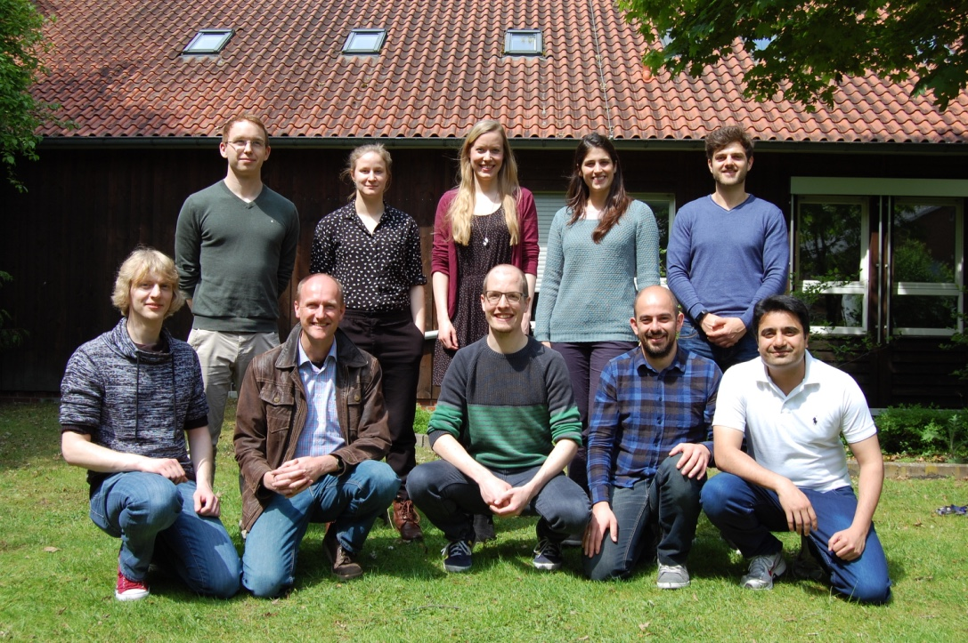
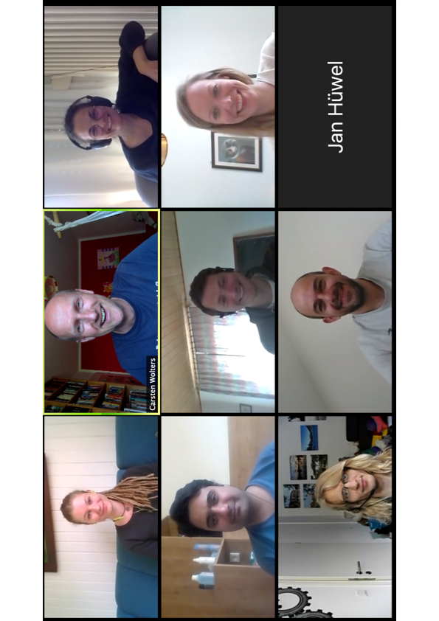
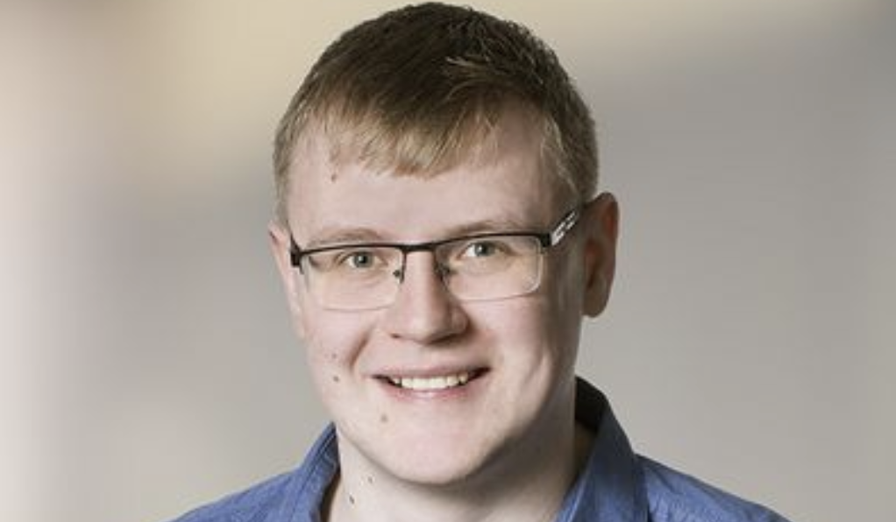
Thank you for your attention!
SIM-NEURO work-group at IBB
Notes:
28
28

