Slide 1
Linear complexity of finite element method based forward modeling in bioelectromagnetism
Carsten Wolters
Institut für Biomagnetismus und Biosignalanalyse, Westf. Wilhelms-Universität Münster, Germany
Lecture on Nov.26, 2024
Notes:
Tensor weiter erlaeutern
Zeitableitung
Programmlaenge, 1Mill.
WM-Rendering->5000 nodes
1:10 raus und anfangs erwaehnen

Slide 2
Structure of the lecture
Linear complexity for FEM forward modeling: Transfer matrices
Fast FE solver methods

Slide 3
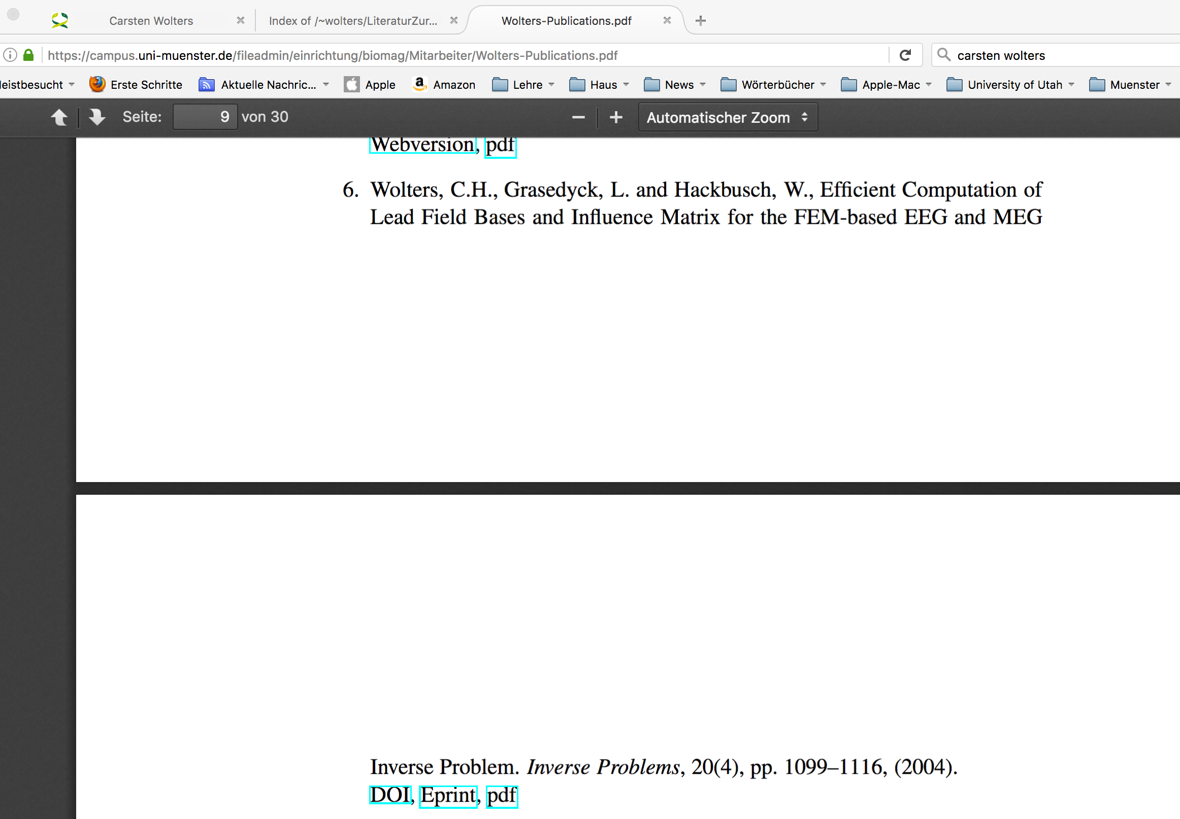
Link to own work for transfer matrices:
[Wolters, Grasedyck & Hackbusch, Inverse Problems, 2004]
Notes:
PEBBLES: Parallel and Element Based grey Box Linear Equation Solver

Slide 4
EEG transfer matrix
[Weinstein, Zhukov & Johnson, Annals Biomed. Eng.,2000]
[Wolters, Grasedyck & Hackbusch, Inverse Problems, 2004]
Notes:
D: electric displacement
rho: electric free charge density
E: electric field
B: magnetic induction
mu: magnetic permeability (vacuum)
j: electric current density
Phi: electric scalar potential
Psi: magnetic flux
A: magnetic vector potential
divA=0: Coulomb’s gauge
conductor loop

Slide 5
MEG transfer matrix
[Wolters, Grasedyck & Hackbusch, Inverse Problems, 2004]
Notes:
D: electric displacement
rho: electric free charge density
E: electric field
B: magnetic induction
mu: magnetic permeability (vacuum)
j: electric current density
Phi: electric scalar potential
Psi: magnetic flux
A: magnetic vector potential
divA=0: Coulomb’s gauge
conductor loop

Slide 6
MEG transfer matrix
[Wolters, Grasedyck & Hackbusch, Inverse Problems, 2004]
Notes:
D: electric displacement
rho: electric free charge density
E: electric field
B: magnetic induction
mu: magnetic permeability (vacuum)
j: electric current density
Phi: electric scalar potential
Psi: magnetic flux
A: magnetic vector potential
divA=0: Coulomb’s gauge
conductor loop

Slide 7
MEG transfer matrix
[Wolters, Grasedyck & Hackbusch, Inverse Problems, 2004]
Notes:
D: electric displacement
rho: electric free charge density
E: electric field
B: magnetic induction
mu: magnetic permeability (vacuum)
j: electric current density
Phi: electric scalar potential
Psi: magnetic flux
A: magnetic vector potential
divA=0: Coulomb’s gauge
conductor loop

Slide 8
Computing the transfer matrices
[Wolters, Grasedyck & Hackbusch, Inverse Problems, 2004]
Notes:
der Tensor muss erklärt werden!!

Slide 9
Outline
Linear complexity for FEM forward modeling: Transfer matrices
Fast FE solver methods

Slide 10
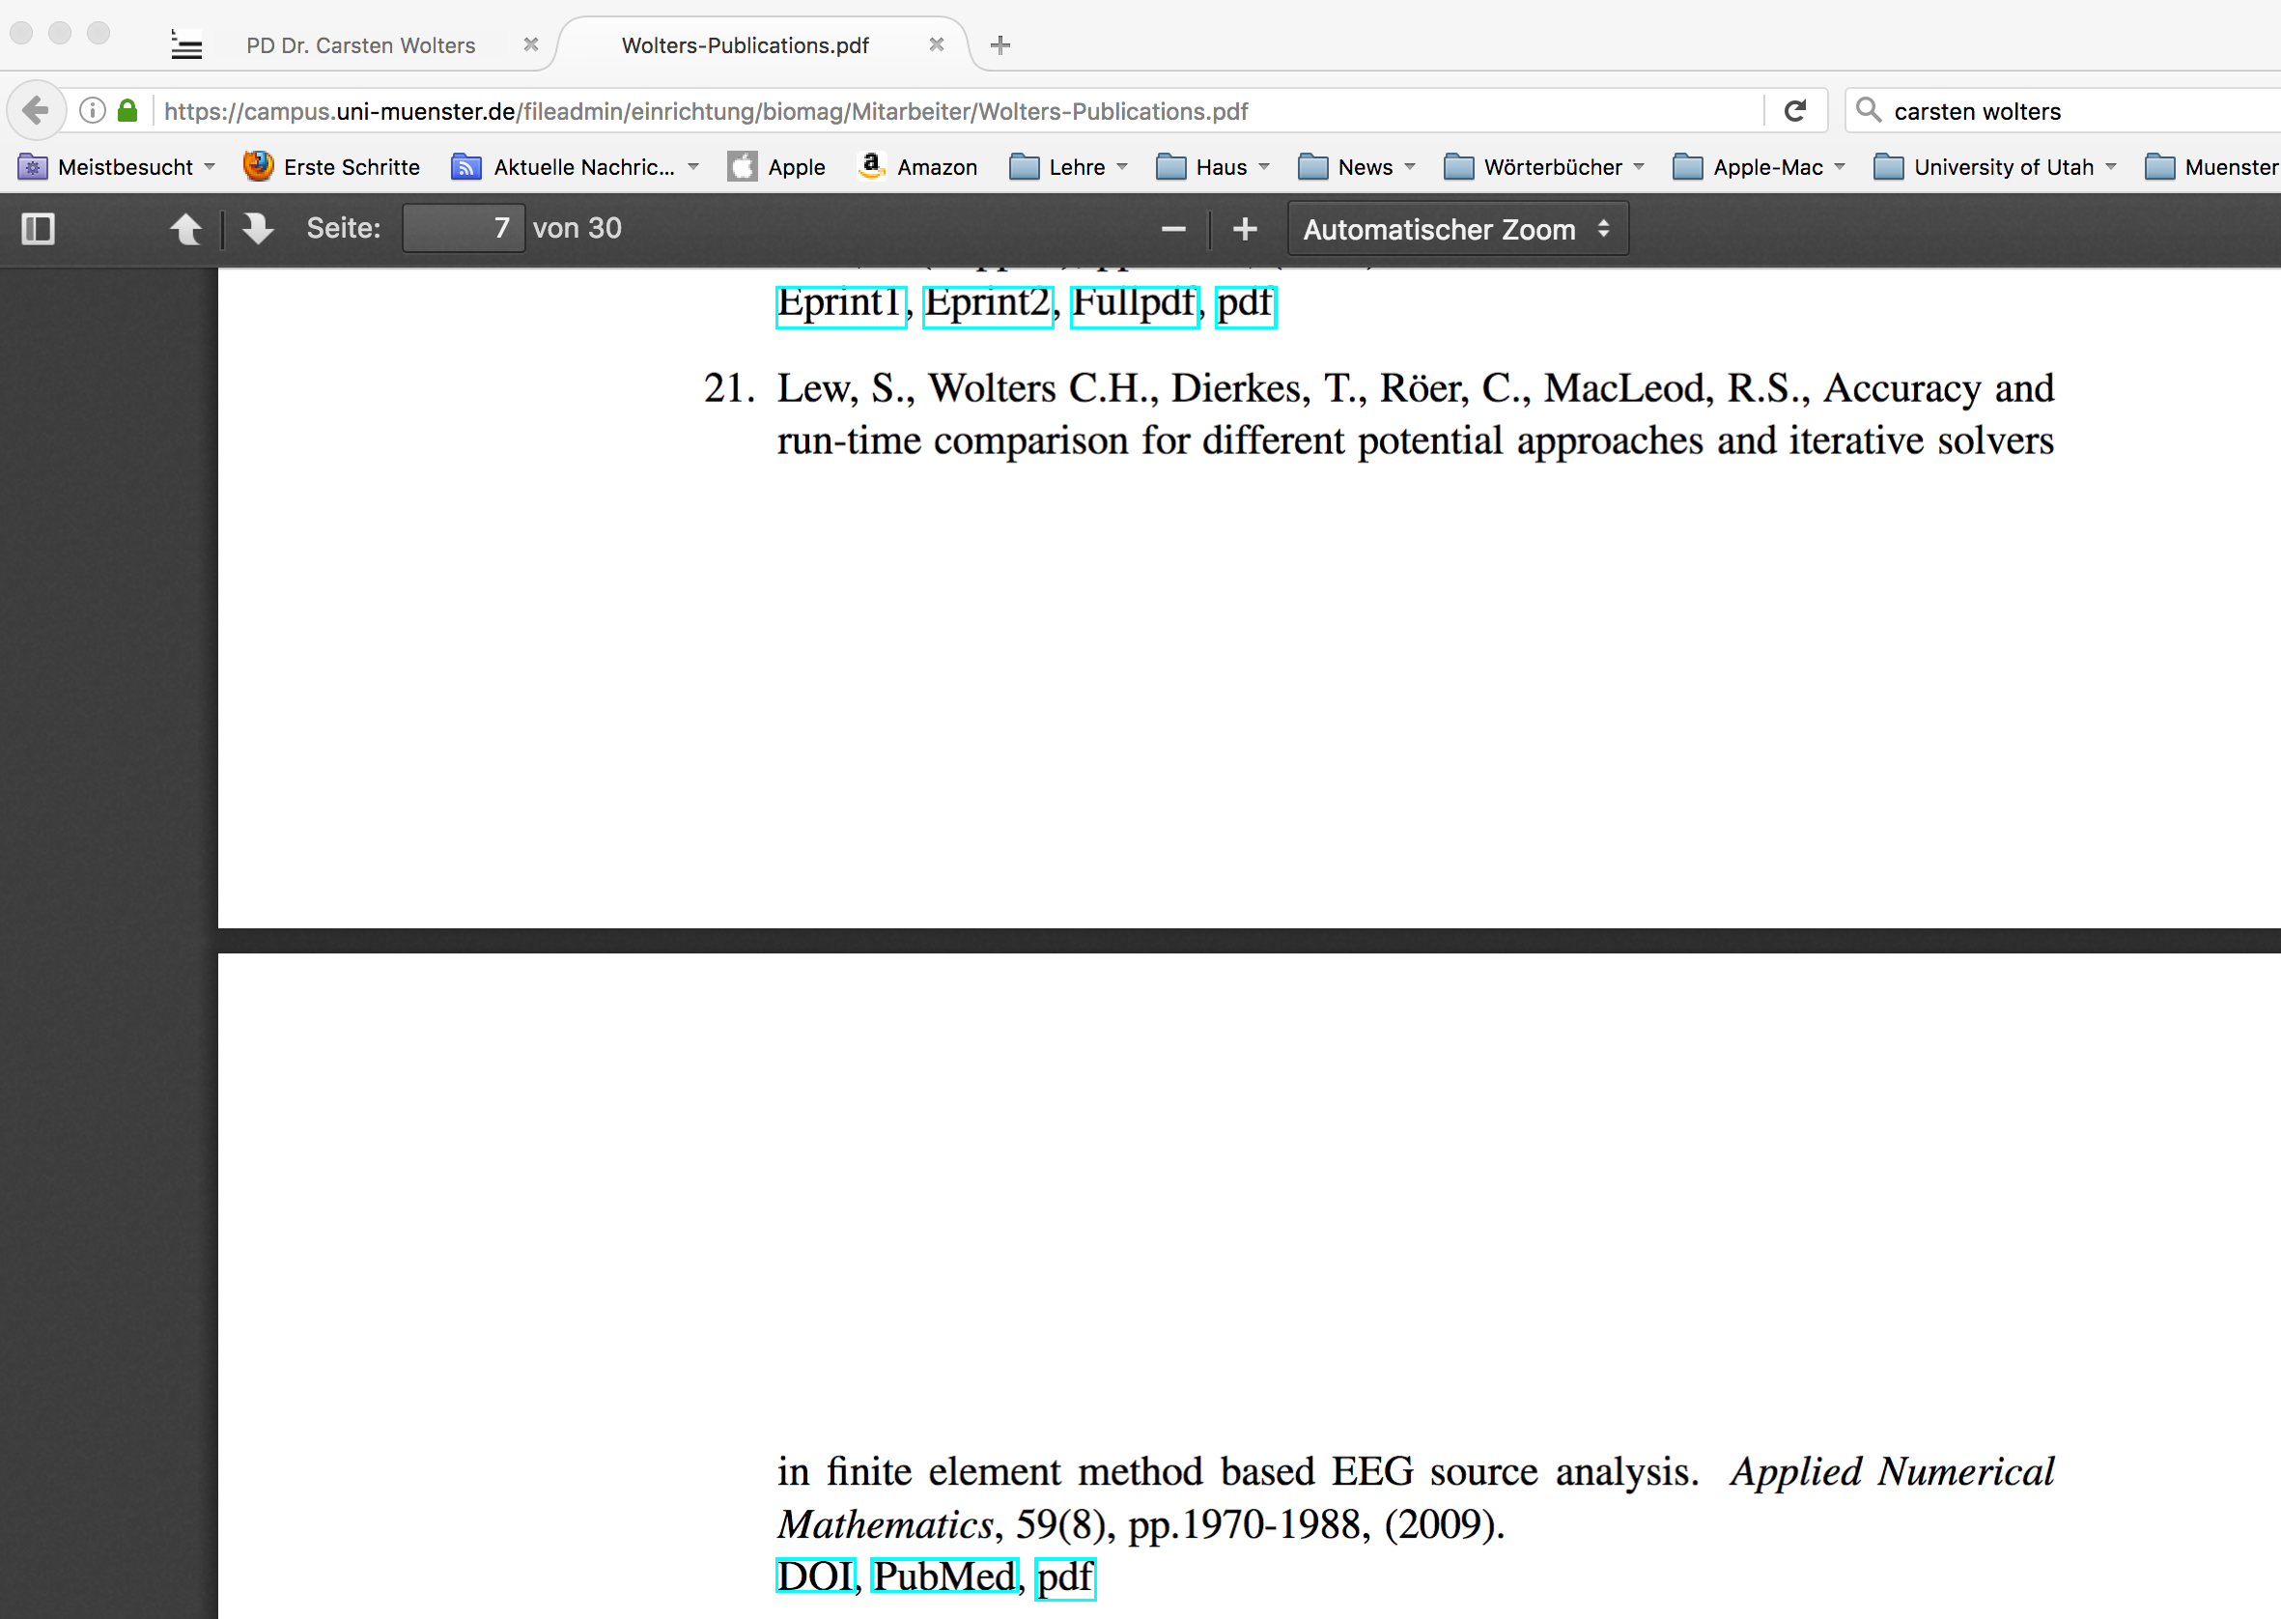
[Wolters, Vorlesungsskriptum, Chapter 7.2]
[Wolters, Kuhn, Anwander & Reitzinger, Comp. Vis. Sci.., 2002]
[Lew, Wolters, Dierkes, Roer & MacLeod, Appl.Num.Math., 2009]
Link to this work:
Notes:
PEBBLES: Parallel and Element Based grey Box Linear Equation Solver

Slide 11
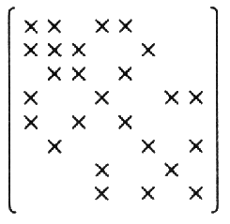
FEM solver aspects
[Wolters, Vorlesungsskriptum, Chapter 7.2]
[Wolters, Kuhn, Anwander & Reitzinger, Comp. Vis. Sci.., 2002]
[Lew, Wolters, Dierkes, Roer & MacLeod, Appl.Num.Math., 2009]
Notes:
D: electric displacement
rho: electric free charge density
E: electric field
B: magnetic induction
mu: magnetic permeability (vacuum)
j: electric current density
Phi: electric scalar potential
Psi: magnetic flux
A: magnetic vector potential
divA=0: Coulomb’s gauge
conductor loop

Slide 12
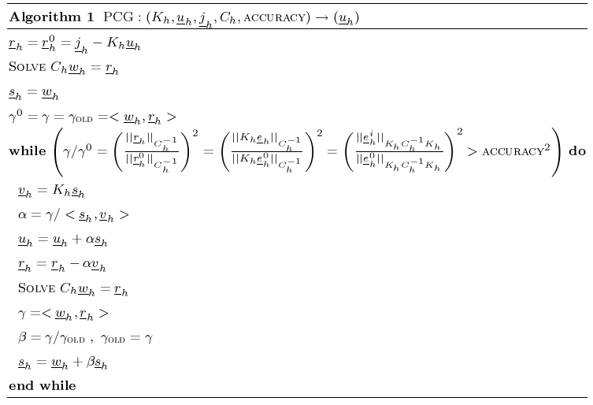
[Hackbusch, Springer, 1994]
Preconditioned Conjugate Gradient Method
PCG accuracy

Slide 13
Iterative solver for FE-equation system
[Wolters, Vorlesungsskriptum, Chapter 7.2]
[Wolters, Kuhn, Anwander & Reitzinger, Comp. Vis. Sci.., 2002]
[Lew, Wolters, Dierkes, Roer & MacLeod, Appl.Num.Math., 2009]
FE discretization, meshsize:
with condition number
Example:
Notes:
der Tensor muss erklärt werden!!

Slide 14
Link to this work:
[Wolters, Reitzinger, Basermann, Burkhardt, Hartmann, Kruggel & Anwander, Proceedings of BIOMAG Helsinki, 2000]
Notes:
PEBBLES: Parallel and Element Based grey Box Linear Equation Solver

Slide 15
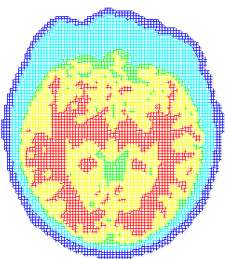
Iterative solver for FE-equation system
[Wolters, Reitzinger, Basermann, Burkhardt, Hartmann, Kruggel & Anwander, Proceedings of BIOMAG Helsinki, 2000]
Notes:
der Tensor muss erklärt werden!!

Slide 16
Iterative solver for FE-equation system
[Wolters, Reitzinger, Basermann, Burkhardt, Hartmann, Kruggel & Anwander, Proceedings of BIOMAG Helsinki, 2000]
FE discretization, meshsize:
with condition number
Convergence of the CG solver:
Example:
Strategy: Preconditioning!
Notes:
c wird asymptotische Konvergenzrate genannt, denn
lim_{i->infty}(c^i\frac{2}{1+c^{2i}})^(1/i)=c
Formel wird mit Hilfe der Chebyshev-Polynome bewiesen und ist nur eine obere Schranke, denn es wird ja \sigma_M=[a,b] gewaehlt, obwohl womoeglich \sigma_M=[a,a´]\cup[b´,b] moeglich waere.

Slide 17
[Wolters, Vorlesungsskriptum, Chapter 7.2]
[Wolters, Kuhn, Anwander & Reitzinger, Comp. Vis. Sci.., 2002]
[Lew, Wolters, Dierkes, Roer & MacLeod, Appl.Num.Math., 2009]
Jacobi preconditioning

Slide 18
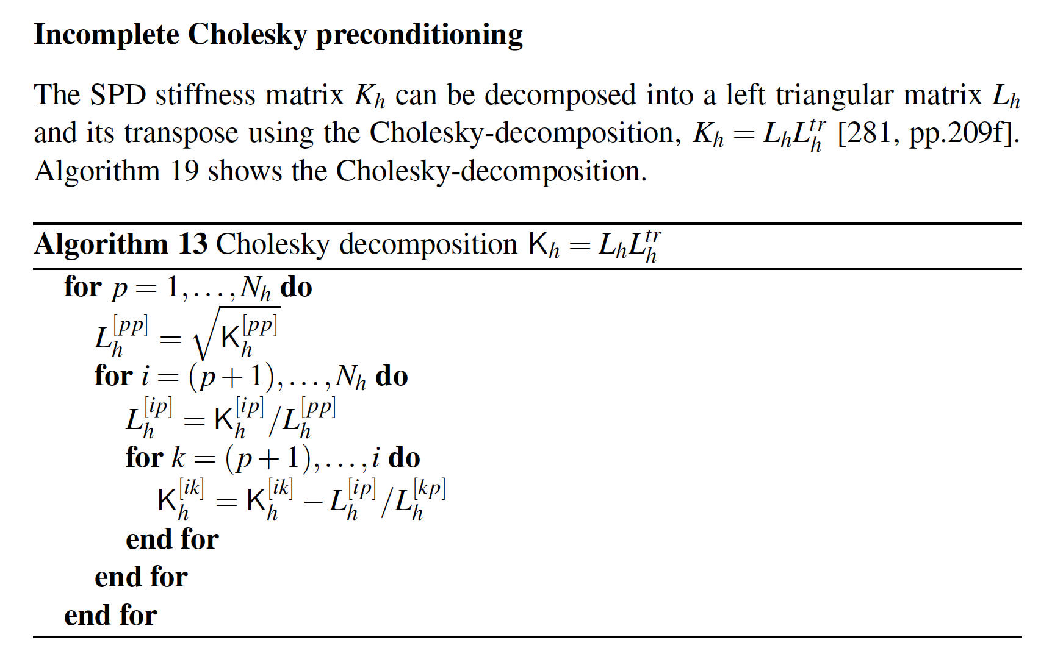
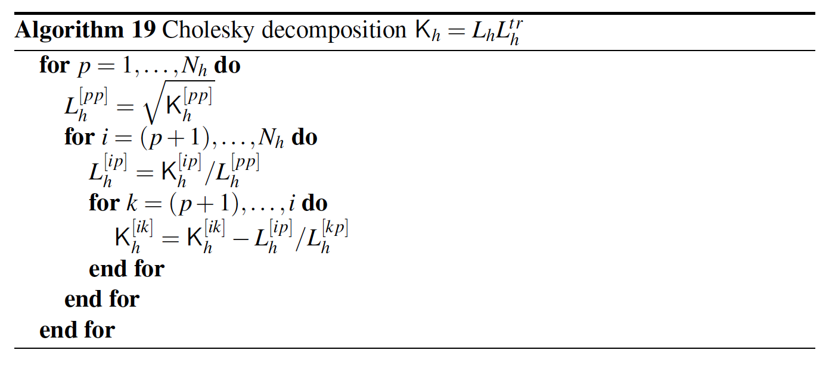
[Wolters, Vorlesungsskriptum, Chapter 7.2]
[Wolters, Kuhn, Anwander & Reitzinger, Comp. Vis. Sci.., 2002]
[Lew, Wolters, Dierkes, Roer & MacLeod, Appl.Num.Math., 2009]
Incomplete Cholesky preconditioning

Slide 19
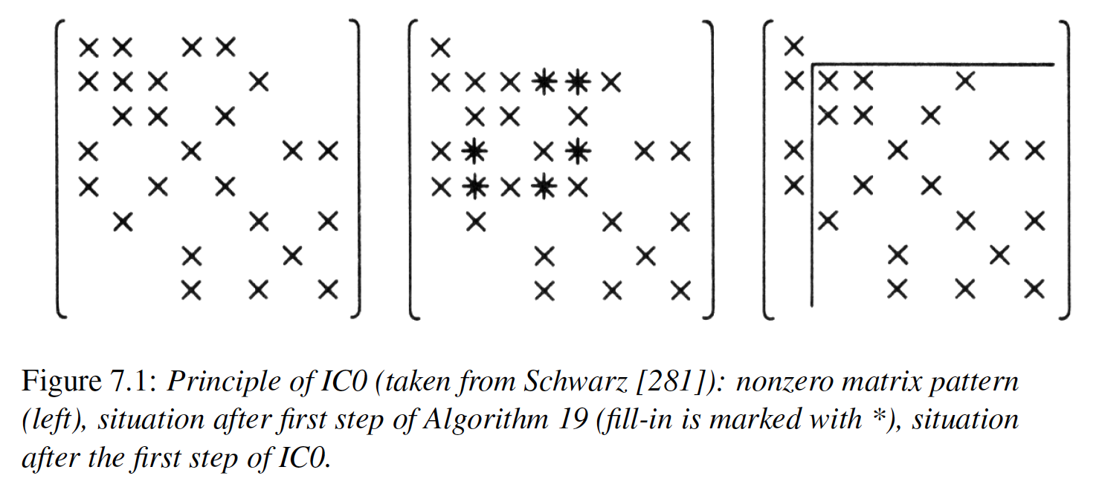
[Wolters, Vorlesungsskriptum, Chapter 7.2]
[Wolters, Kuhn, Anwander & Reitzinger, Comp. Vis. Sci.., 2002]
[Lew, Wolters, Dierkes, Roer & MacLeod, Appl.Num.Math., 2009]
Incomplete Cholesky preconditioning

Slide 20
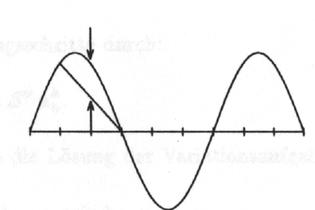
MultiGrid (MG) preconditioning
[Hackbusch, Springer, 1994]
[Wolters, Vorlesungsskriptum, Chapter 7.2]
[Wolters, Kuhn, Anwander & Reitzinger, Comp. Vis. Sci.., 2002]
[Lew, Wolters, Dierkes, Roer & MacLeod, Appl.Num.Math., 2009]
Principle of MG
Smoother for high-frequency error components is effective

Slide 21
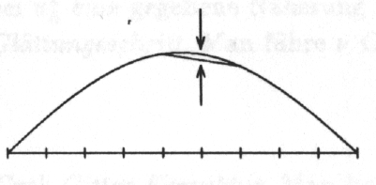
MultiGrid (MG) preconditioning
[Hackbusch, Springer, 1994]
[Wolters, Vorlesungsskriptum, Chapter 7.2]
[Wolters, Kuhn, Anwander & Reitzinger, Comp. Vis. Sci.., 2002]
[Lew, Wolters, Dierkes, Roer & MacLeod, Appl.Num.Math., 2009]
Principle of MG
Smoother for low-frequency error components not effective

Slide 22
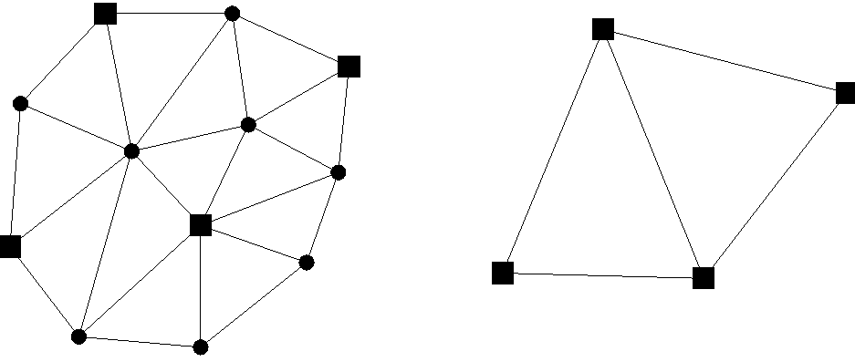
MultiGrid (MG) preconditioning
[Hackbusch, Springer, 1994]
[Wolters, Vorlesungsskriptum, Chapter 7.2]
[Wolters, Kuhn, Anwander & Reitzinger, Comp. Vis. Sci.., 2002]
[Lew, Wolters, Dierkes, Roer & MacLeod, Appl.Num.Math., 2009]
Principle of the MG
Smoother for high-frequency error components
Coarse grid correction for low-frequency error components

Slide 23
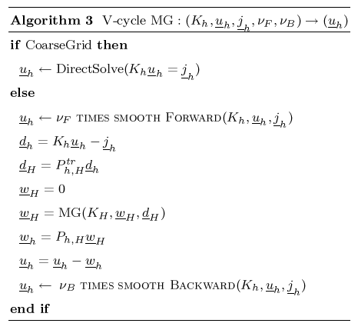
[Hackbusch, Springer, 1994]
[Wolters, Vorlesungsskriptum, Chapter 7.2]
[Wolters, Kuhn, Anwander & Reitzinger, Comp. Vis. Sci.., 2002]
[Lew, Wolters, Dierkes, Roer & MacLeod, Appl.Num.Math., 2009]
MultiGrid (MG) preconditioning

Slide 24
Geometric Multigrid
[Hackbusch, Springer, 1994]
[Wolters, Vorlesungsskriptum, Chapter 7.2]
[Wolters, Kuhn, Anwander & Reitzinger, Comp. Vis. Sci.., 2002]
[Lew, Wolters, Dierkes, Roer & MacLeod, Appl.Num.Math., 2009]
Complexity:
O(N)
Convergence rate:
h-independent
high
Geometric MG (GMG)
Problem-specific smoother for high-frequency error components
Coarse grid correction for low-frequency error components
Problems in our application
Choice of the smoother is difficult (Inhomogeneities/Anisotropies)
Generation of the coarse grids difficult
Strategy: Algebraic MG (AMG)!

Slide 25
Algebraic Multigrid
[Ruge and Stüben, SIAM, 1986; Stüben, GMD, Tech.Report, 1999]
[Wolters, Vorlesungsskriptum, Chapter 7.2]
[Wolters, Kuhn, Anwander & Reitzinger, Comp. Vis. Sci.., 2002]
[Lew, Wolters, Dierkes, Roer & MacLeod, Appl.Num.Math., 2009]
Principle of the AMG:
Smoother is given (Gauss-Seidel)
Coarse grids and interpolation matrices are constructed from the entries of K
Diagonal entries <-> nodes
Nondiagonal entries <-> edges
Only one high resolution FE mesh!
Problems:
AMG-interpolation non-optimal:
Some few error components are not well reduced, i.e., some few eigenvalues of the AMG iteration matrix are close to 1
Strategy: AMG-CG!

Slide 26
[Hackbusch, Springer, 1994]
[Wolters, Vorlesungsskriptum, Chapter 7.2]
[Wolters, Kuhn, Anwander & Reitzinger, Comp. Vis. Sci.., 2002]
[Lew, Wolters, Dierkes, Roer & MacLeod, Appl.Num.Math., 2009]
Preconditioned Conjugate Gradient Method
PCG accuracy

Slide 27
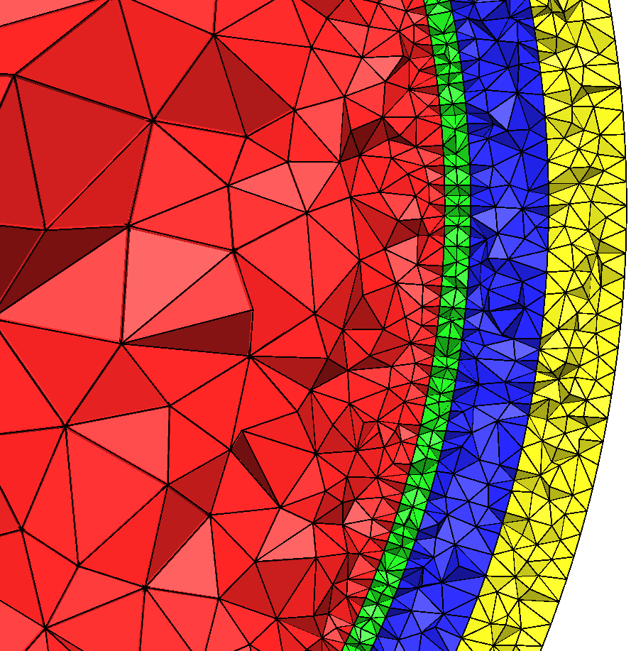
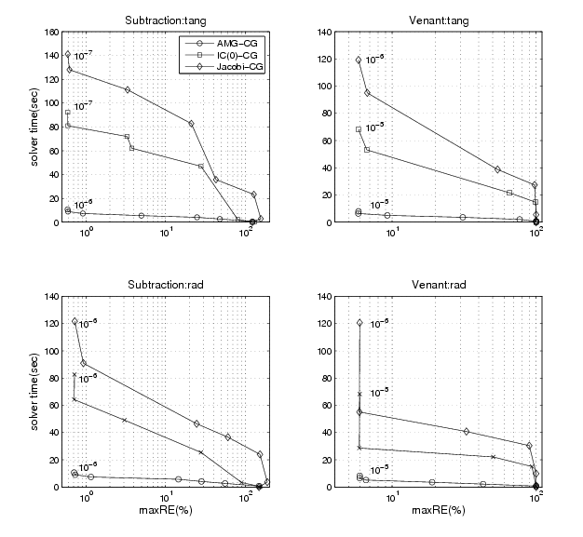
Solver: “Maximal relative error over all eccentricities” versus “solution time”
[Lew, Wolters, Dierkes, Roer & MacLeod, Appl.Num.Math., 2009]
Nodes: 360,056
Elements: 2,165,281
Notes:
highlighted

Slide 28
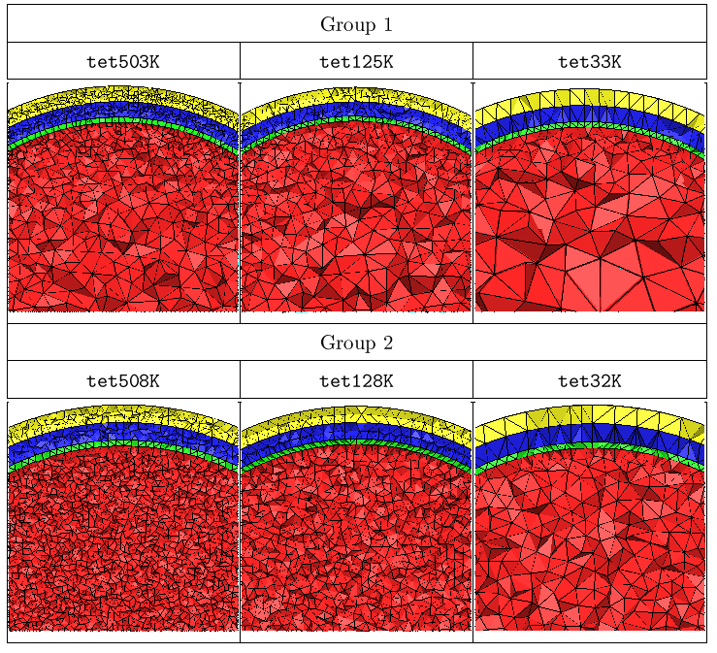
[Lew, Wolters, Dierkes, Roer & MacLeod, Appl.Num.Math., 2009]
FE models tuned for subtraction (group 1) and for the direct potential methods (group 2)

Slide 29
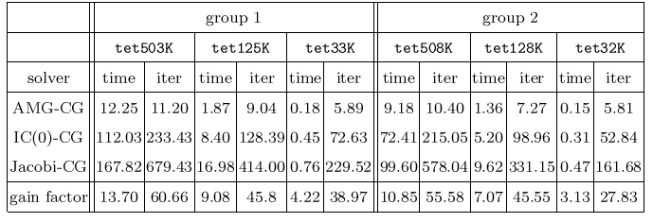
[Lew, Wolters, Dierkes, Roer & MacLeod, Appl.Num.Math., 2009]
Comparison of different preconditioners

Slide 30
Link to this work:
[Wolters, Grasedyck, Anwander & Hackbusch, Biomag, 2004]
Notes:
PEBBLES: Parallel and Element Based grey Box Linear Equation Solver

Slide 31
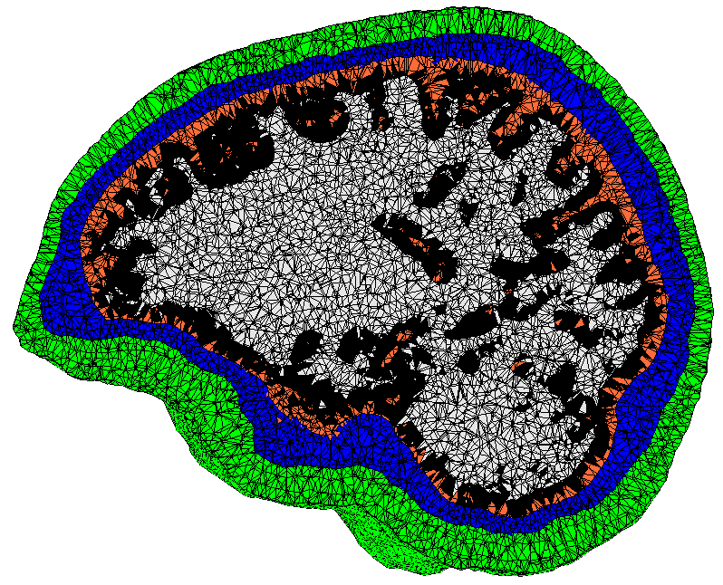
Efficiency of the fast FE transfer matrix approaches
[Wolters, Grasedyck, Anwander & Hackbusch, Biomag, 2004]
Head model: Tetrahedral FE, 147,287 nodes, 892,119 elements
Notes:
der Tensor muss erklärt werden!!

Slide 32
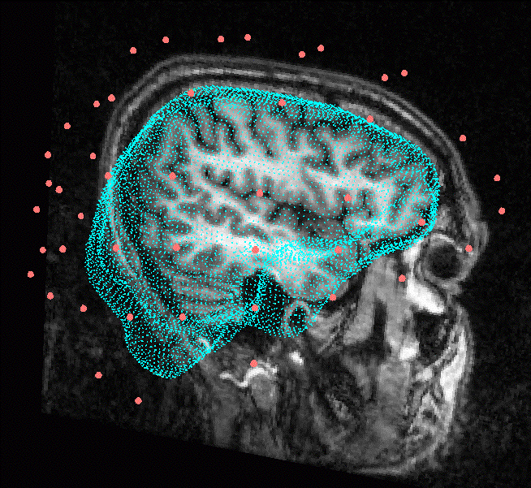
[Wolters, Grasedyck, Anwander & Hackbusch, Biomag, 2004]
Efficiency of the fast FE transfer matrix approaches
Head model: Tetrahedral FE, 147,287 nodes, 892,119 elements
Influence space: brain surface mesh, 2mm resolution, 9555 nodes
Notes:
der Tensor muss erklärt werden!!

Slide 33
[Wolters, Grasedyck, Anwander & Hackbusch, Biomag, 2004]
Efficiency of the fast FE transfer matrix approaches
Head model: Tetrahedral FE, 147,287 nodes, 892,119 elements
Influence space: brain surface mesh, 2mm resolution, 9555 nodes
Number of FE forward solutions:
EEG, 71 electrodes: 9555 * 3 = 28665
MEG, 147 channels: 9555 * 2 = 19110 (tangential constraint)
FE approach and dipole model: Venant
Notes:
der Tensor muss erklärt werden!!

Slide 34
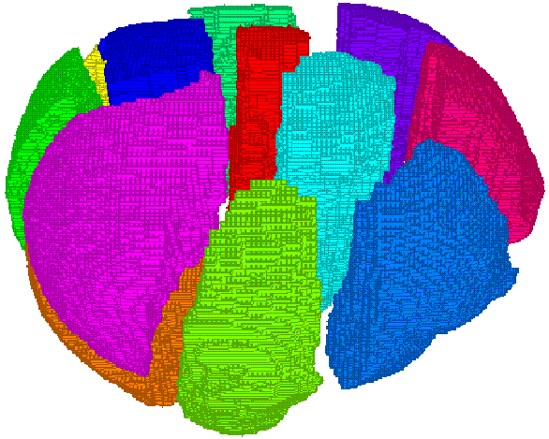
Parallel AMG-CG on distributed memory computers
[Wolters, Kuhn, Anwander & Reitzinger, Comp.Vis.Sci, 2002]
``Element-wise’’ partitioning into subdomains
Parallel MultiRHS-AMG-CG: Communication is only necessary for:
Smoother (ω-Jacobi within interface nodes, Gauss-Seidel between blocks and for inner nodes)
distribution of coarse grid solution
inner products within PCG method
Notes:
Irregular k way partitioning scheme for irregular graphs

Slide 35
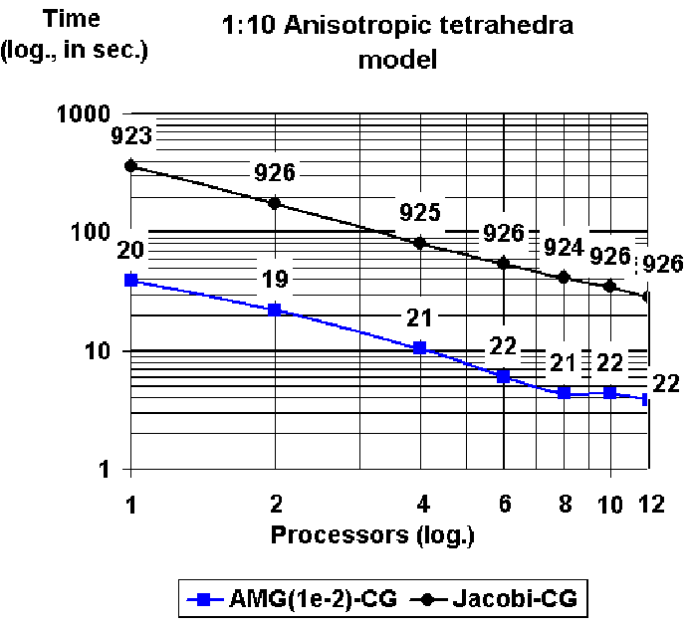
Results for parallel solver methods
[Wolters, Kuhn, Anwander & Reitzinger, Comp.Vis.Sci, 2002]
SGI Origin2000, each processor 195MHz, MIPS 10000
Distribution of memory
About a linear speedup for moderate processor number
Jacobi-CG on 1 proc <-> AMG-CG on 8 procs: Speedup factor of about 80 (10 MG, 8 parallel.)
Anisotropy and inhomogeneity does not change performance results
Stable preconditioning for moderate processor numbers
Solver time comparison: Unknowns:147.287

Slide 36
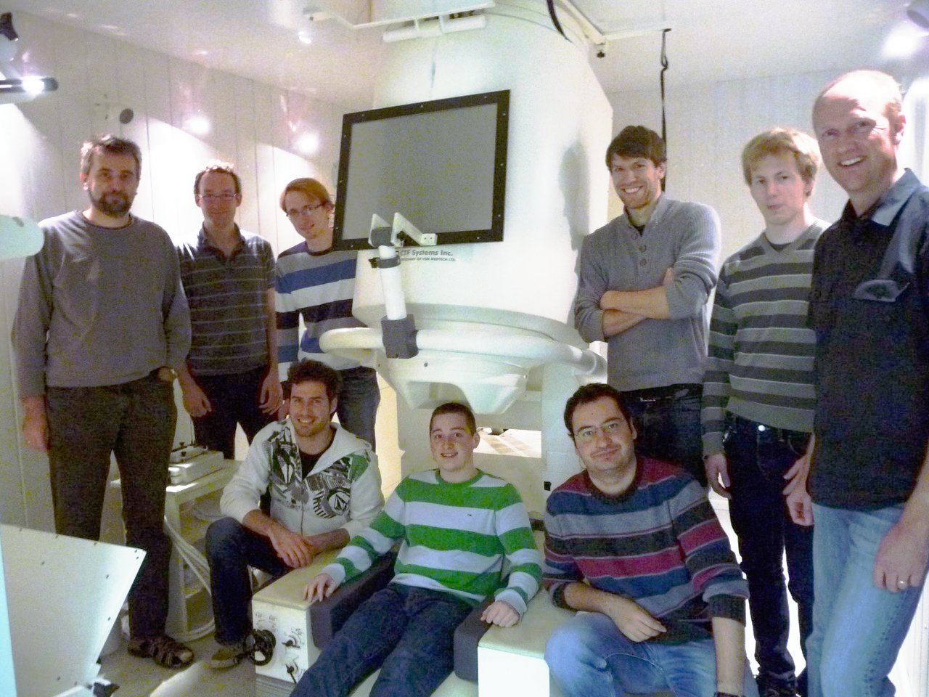
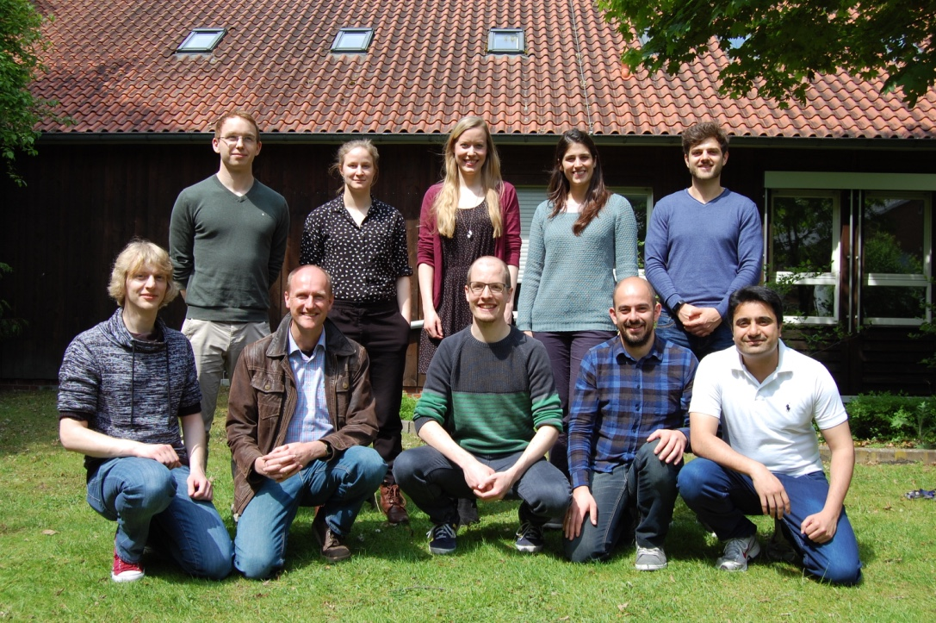
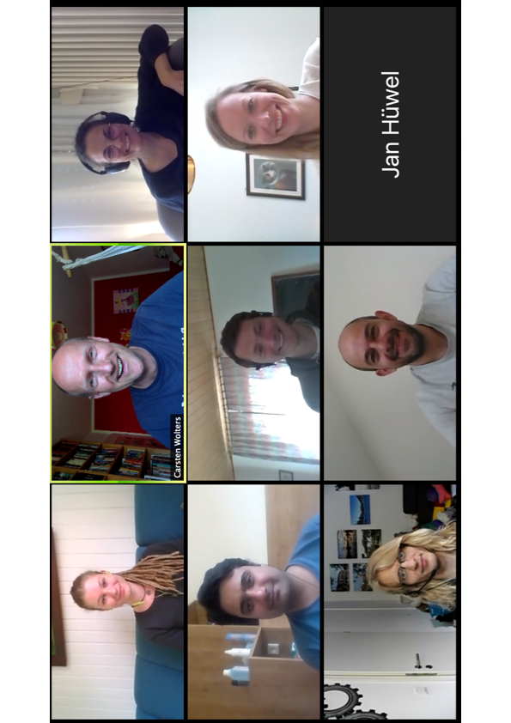
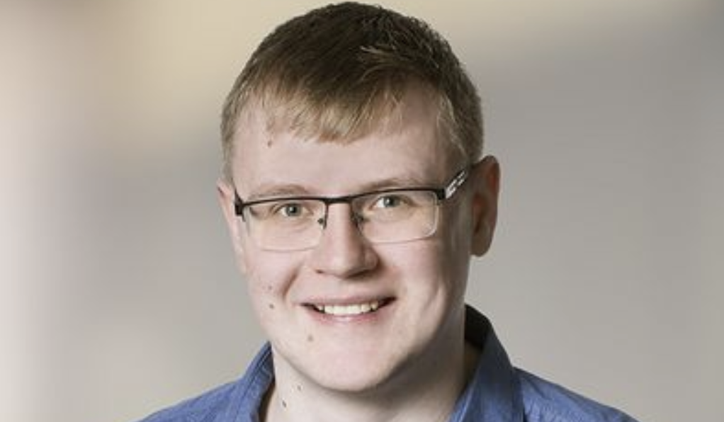
Thank you for your attention!
SIM-NEURO work-group at IBB
Notes:
36
36

