Slide 1
The finite element method and convergence theory for the EEG forward problem solution
Carsten H. Wolters
Institut für Biomagnetismus und Biosignalanalyse, Westf. Wilhelms-Universität Münster, Germany
Lectures on Nov.19+26, 2024

Slide 2
Saint Venant source modeling approach
Notes:
PEBBLES: Parallel and Element Based grey Box Linear Equation Solver

Slide 3
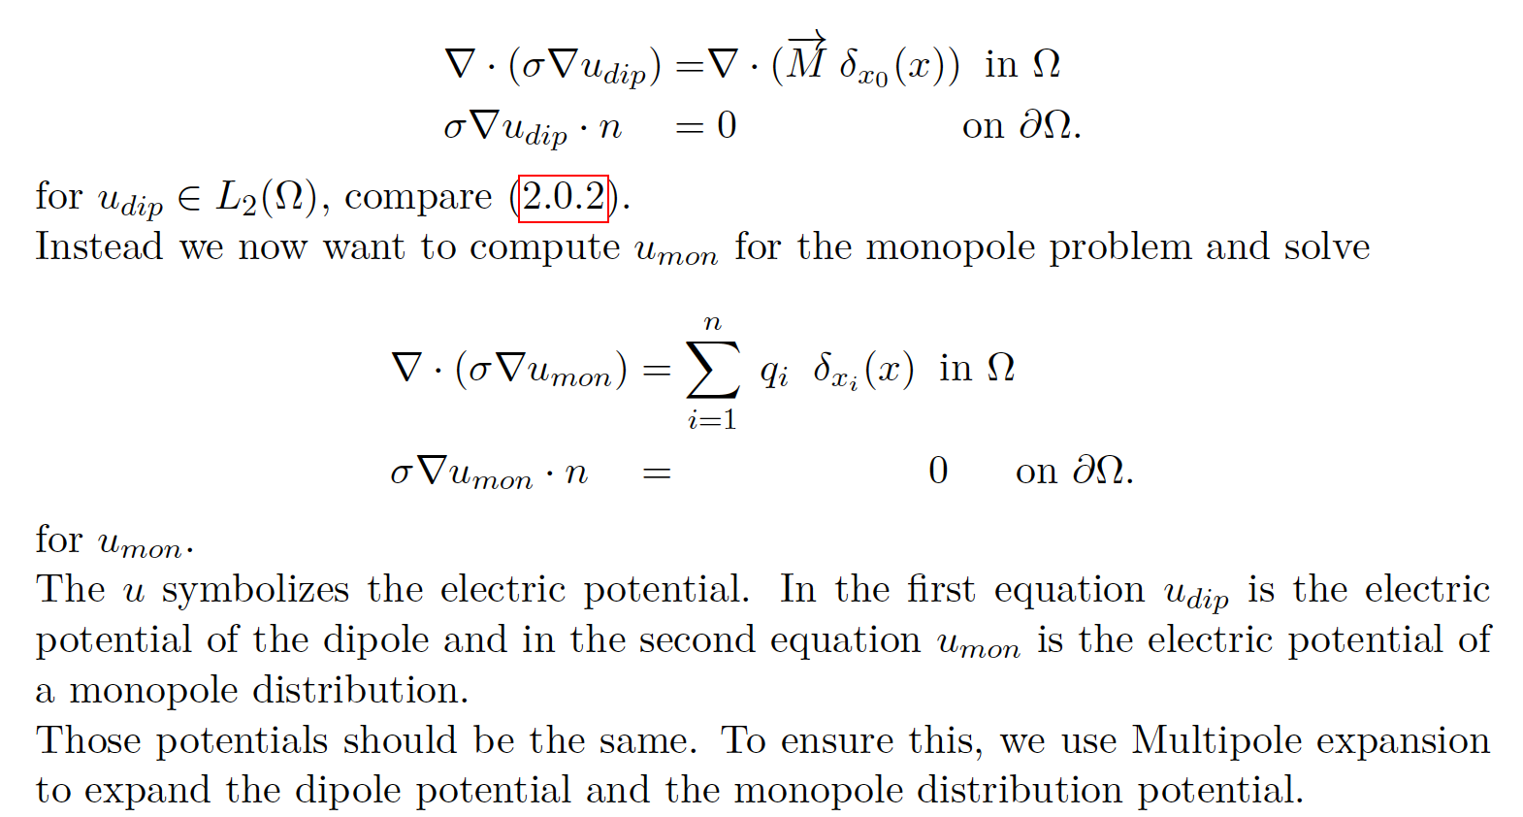
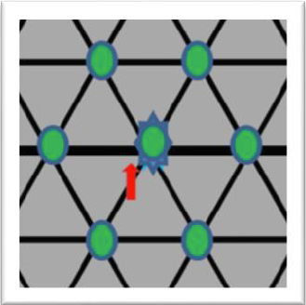
The Venant source model
[Vorwerk, Hanrath, Wolters & Grasedyck, NeuroImage, 2019]
[Hanrath, Dissertation in Maths, RWTH Aachen, 2019]
[Wolters, Lecture scriptum]
$$∆x_{i}=x_{i}−x_{0}$$
Notes:
PEBBLES: Parallel and Element Based grey Box Linear Equation Solver

Slide 4
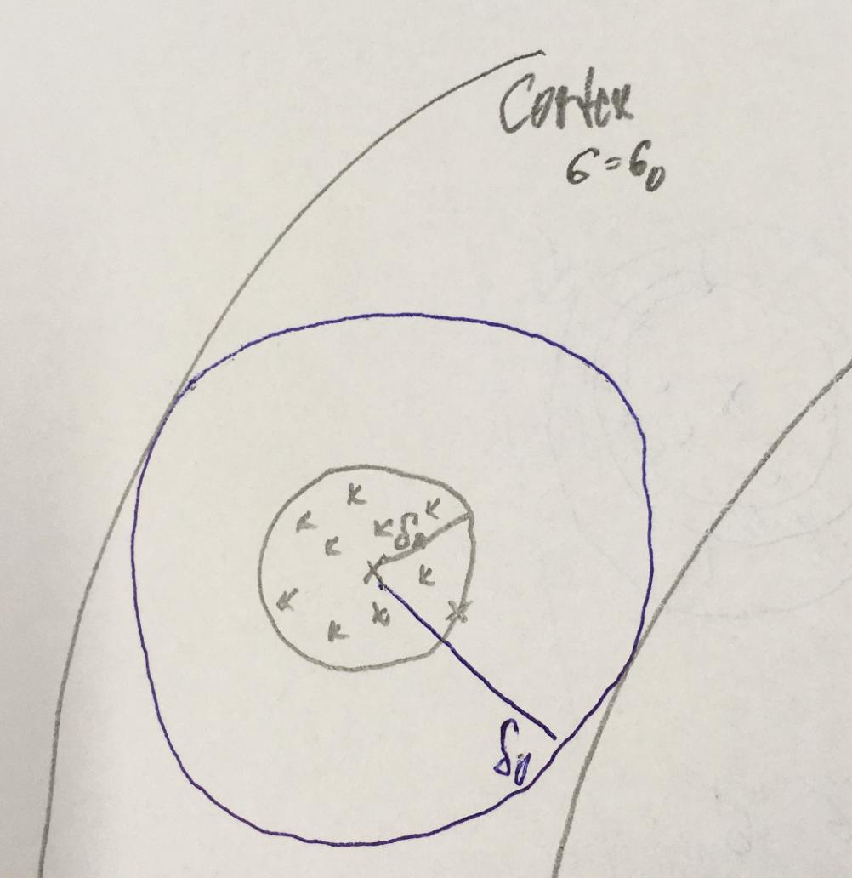
The Venant source model
[Hanrath, Dissertation in Maths, RWTH Aachen, 2019]
Notes:
PEBBLES: Parallel and Element Based grey Box Linear Equation Solver

Slide 5
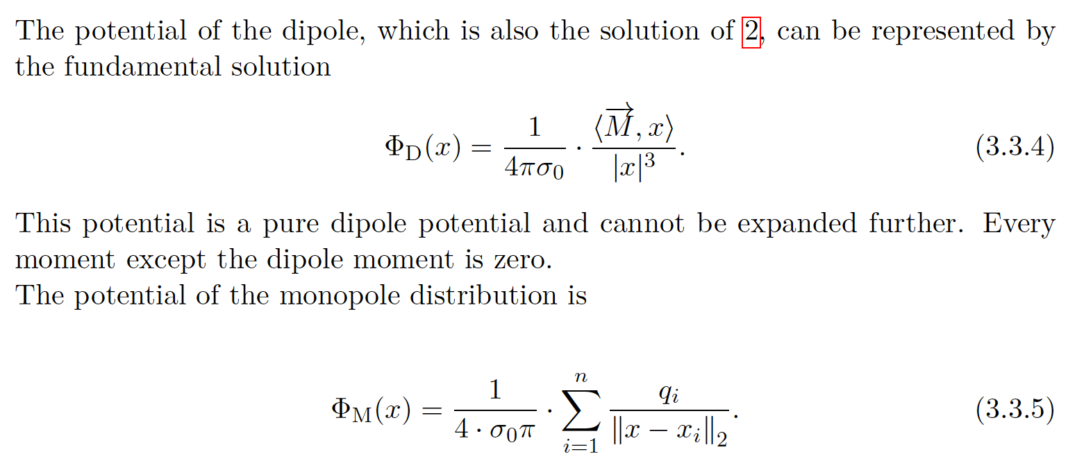
The Venant source model
[Hanrath, Dissertation in Maths, RWTH Aachen, 2019]

Slide 6
The Venant source model
[Hanrath, Dissertation in Maths, RWTH Aachen, 2019]
-1

Slide 7
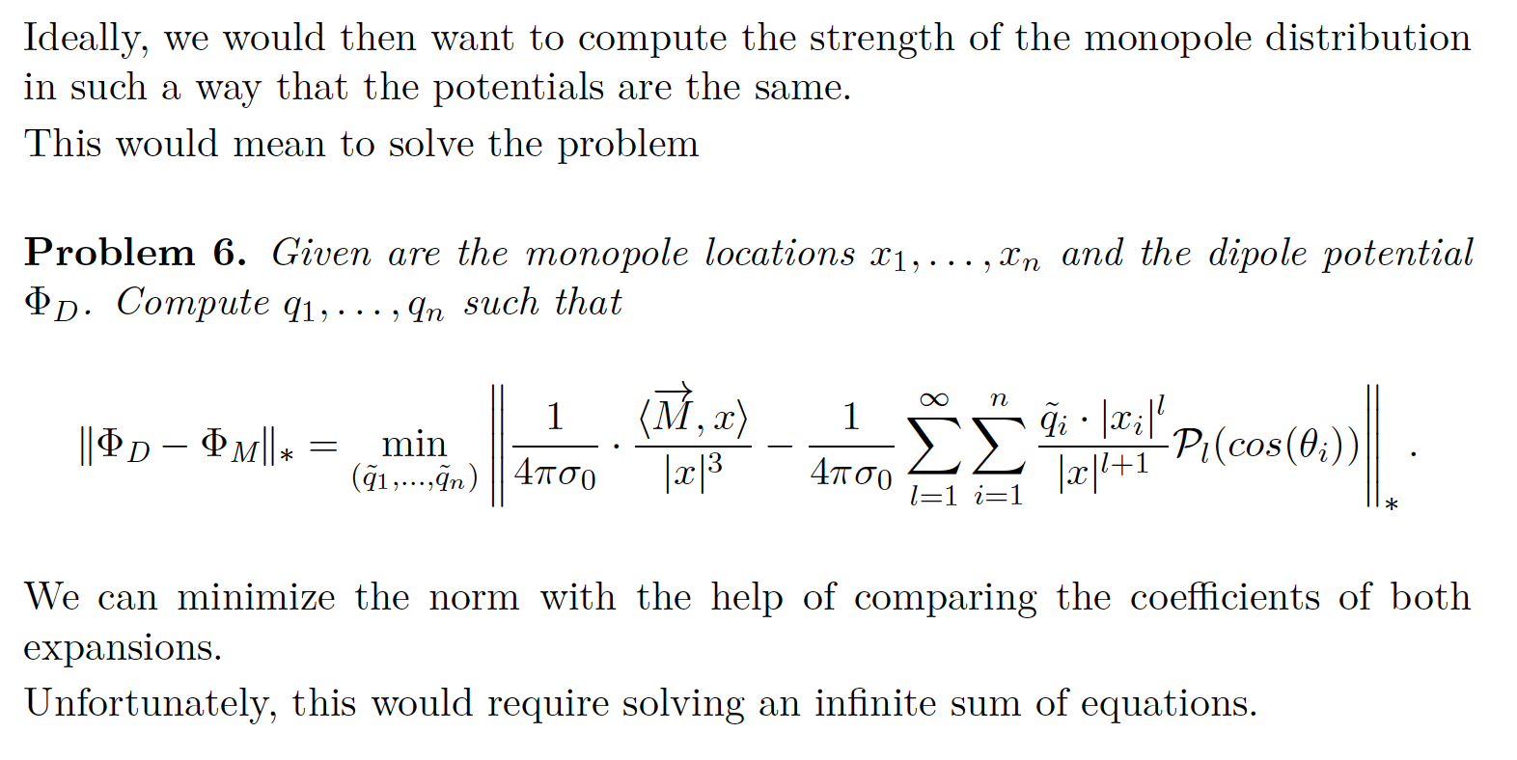
The Venant source model
[Hanrath, Dissertation in Maths, RWTH Aachen, 2019]
-1

Slide 8
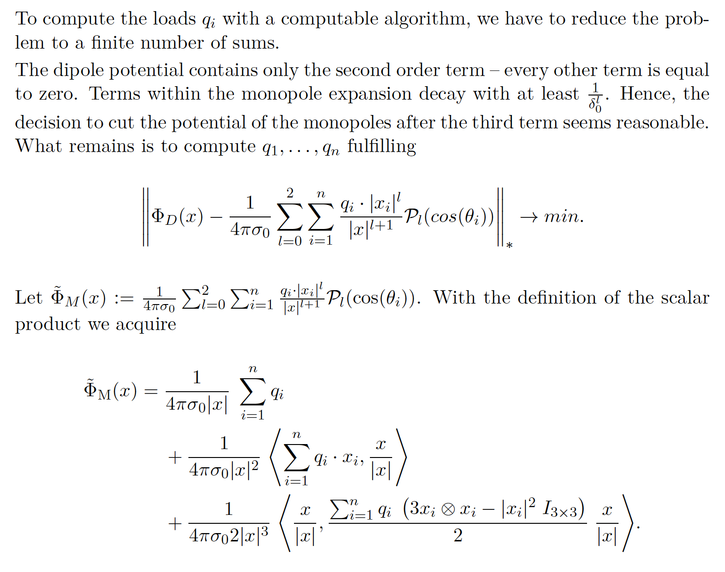
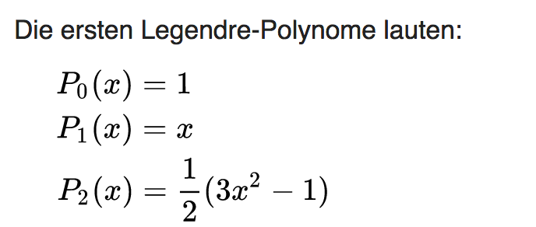
The Venant source model
[Hanrath, Dissertation in Maths, RWTH Aachen, 2019]
-1

Slide 9
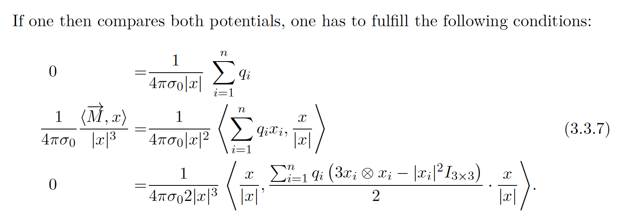
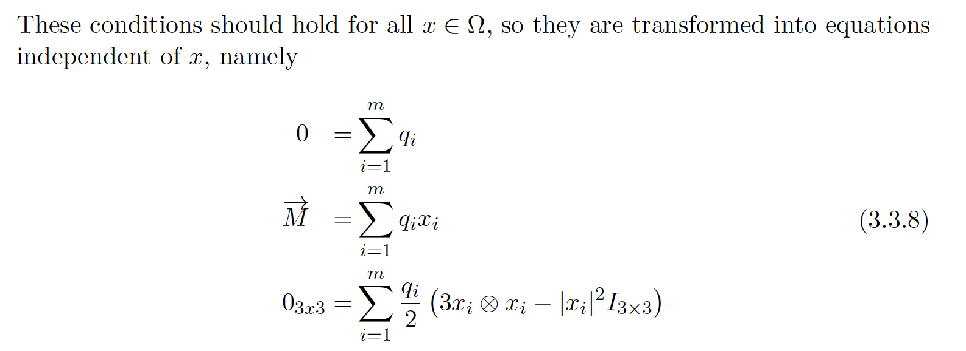
The Venant source model
[Hanrath, Dissertation in Maths, RWTH Aachen, 2019]
-1
n
n
n

Slide 10
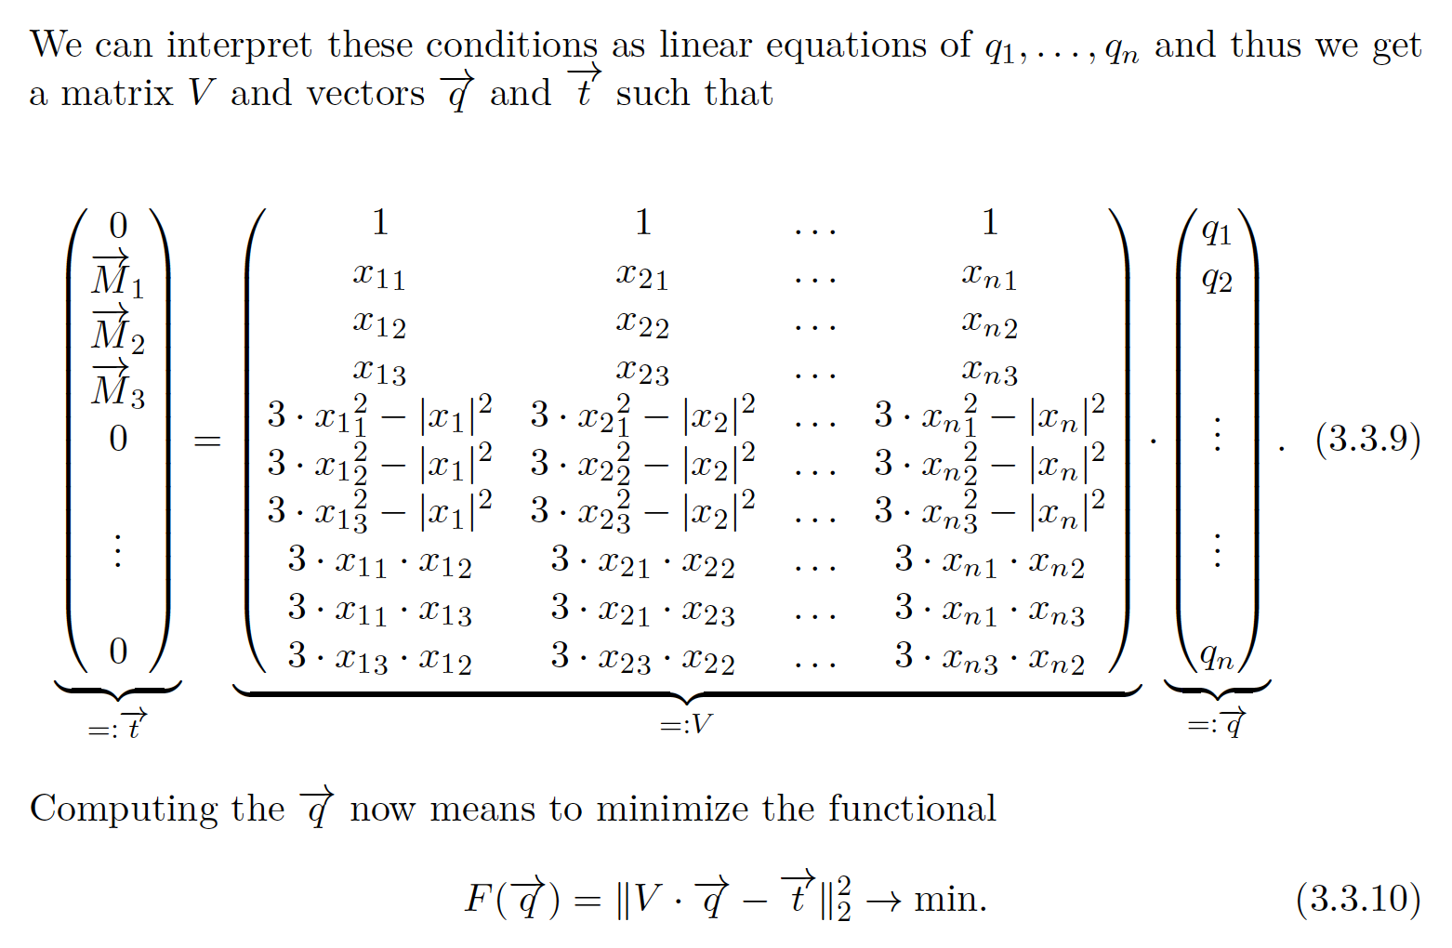
The Venant source model
[Hanrath, Dissertation in Maths, RWTH Aachen, 2019]
-1

Slide 11
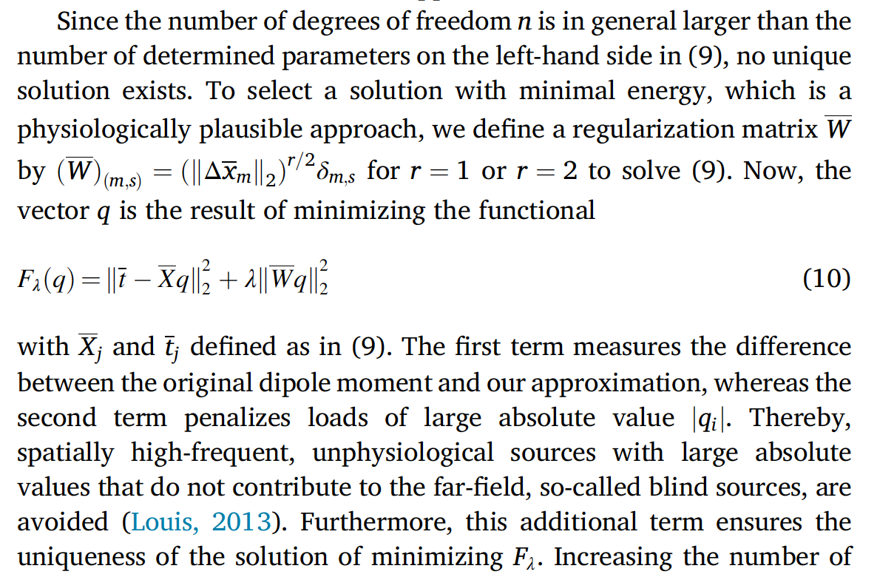
The Venant source model
[Vorwerk, Hanrath, Wolters & Grasedyck, NeuroImage, 2019]
-1

Slide 12
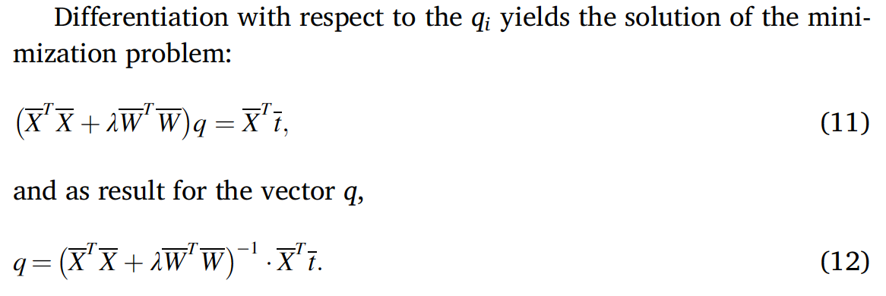
The Venant source model
[Vorwerk, Hanrath, Wolters & Grasedyck, NeuroImage, 2019]
-1

Slide 13
The Venant source model
[Wolters, Lecture scriptum]
Right-hand side vector has only about 27 (for tetrahedra models) non-zero entries and can be computed similarly fast as PI.
Notes:
PEBBLES: Parallel and Element Based grey Box Linear Equation Solver

Slide 14
Whitney source modeling approach
Notes:
PEBBLES: Parallel and Element Based grey Box Linear Equation Solver

Slide 15
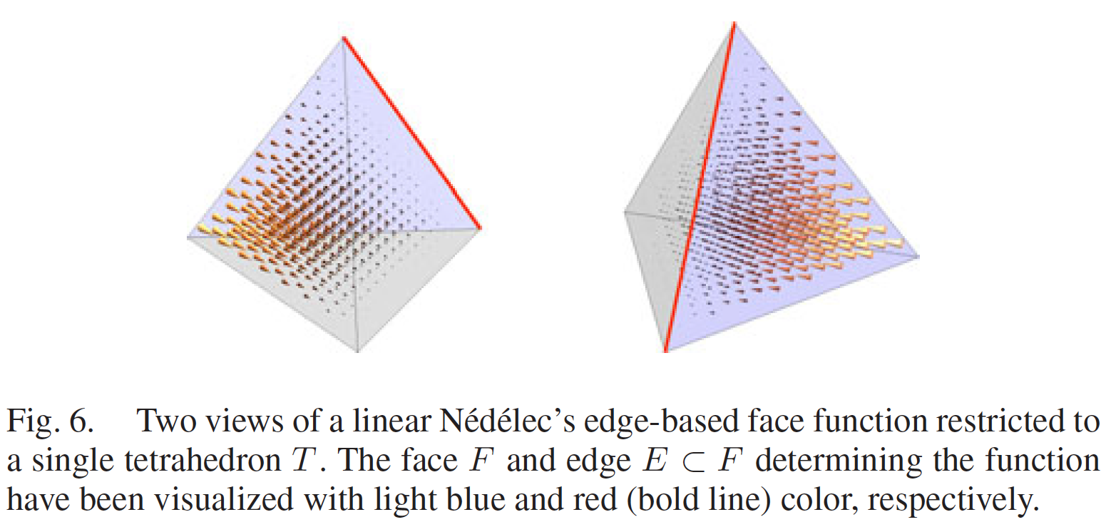
[Bauer, Pursiainen, Vorwerk, Köstler & Wolters, IEEE TBME, 2015]
[Pursiainen, Vorwerk & Wolters, Phys Med Biol, 2016]
[Miinalainen, Rezaei, Us, Nüßing, Engwer, Wolters & Pursiainen, NeuroImage, 2019]
Whitney source model
One of the three edge based face functions of a Whitney source model

Slide 16
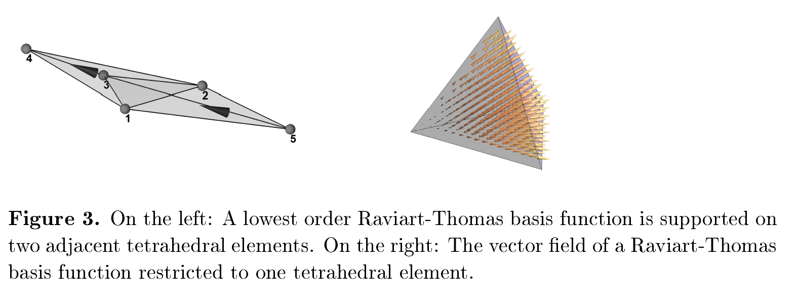
[Bauer, Pursiainen, Vorwerk, Köstler & Wolters, IEEE TBME, 2015]
[Pursiainen, Vorwerk & Wolters, Phys Med Biol, 2016]
[Miinalainen, Rezaei, Us, Nüßing, Engwer, Wolters & Pursiainen, NeuroImage, 2019]
Whitney source model
On the right: Whitney source built up of all three edge-based face functions (each weighted with 1/3)

Slide 17
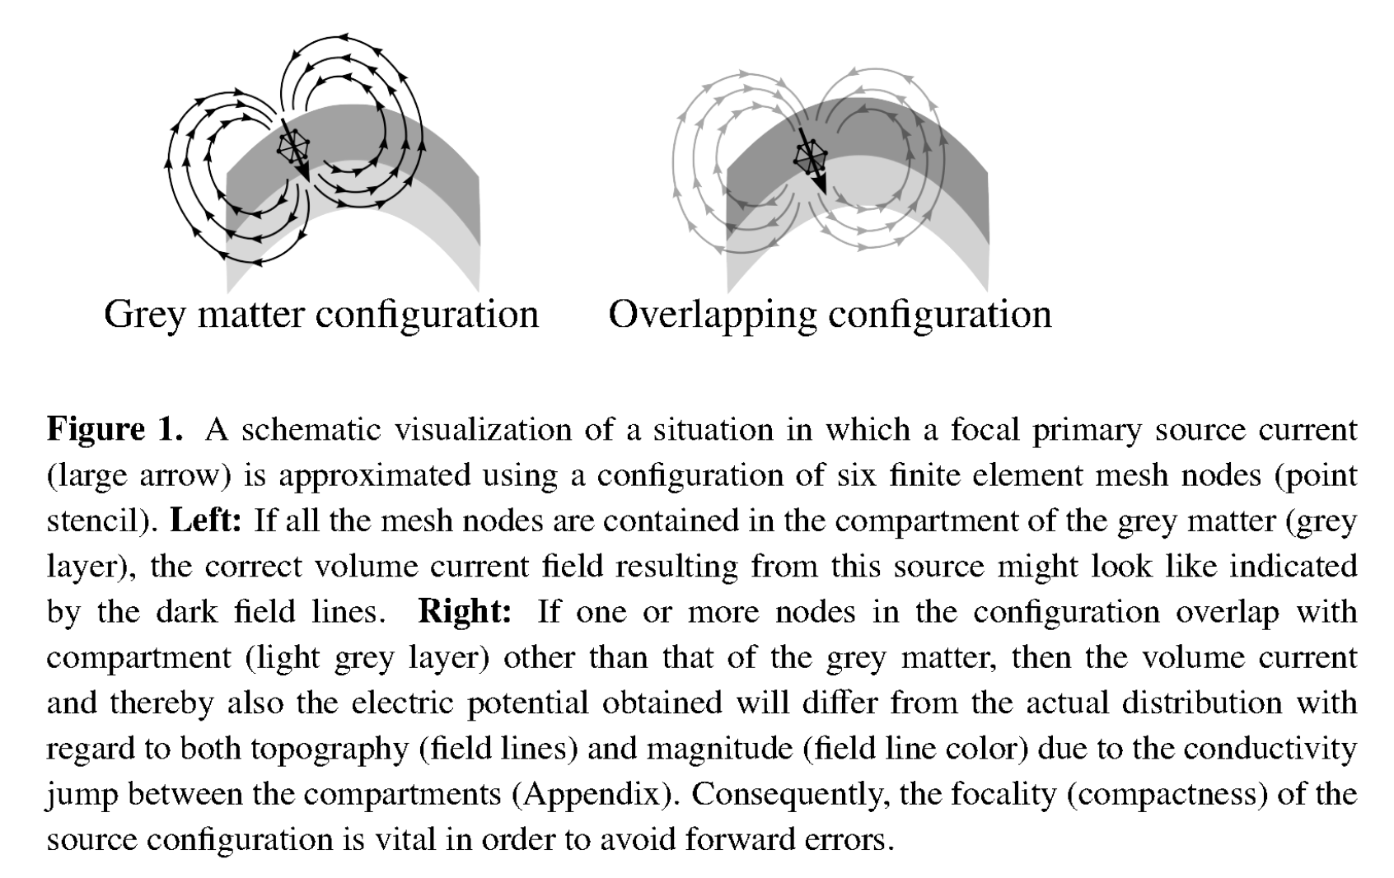
[Pursiainen, Vorwerk & Wolters, Phys Med Biol, 2016]
Source model extent

Slide 18
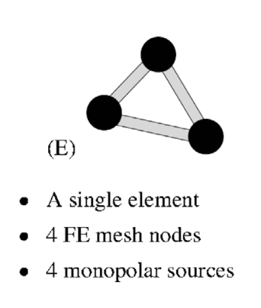
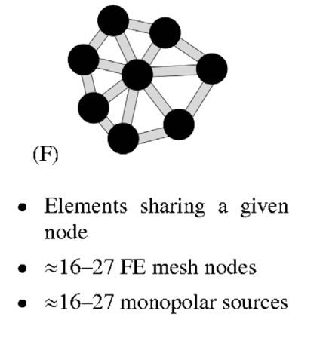
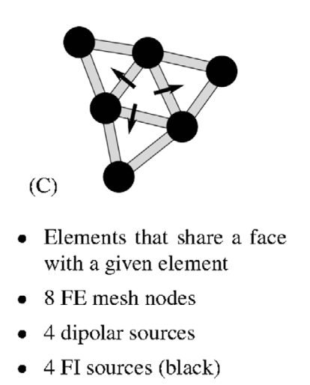
[Pursiainen, Vorwerk & Wolters, Phys Med Biol, 2016]
Source model extent
PI
Venant
Whitney

Slide 19
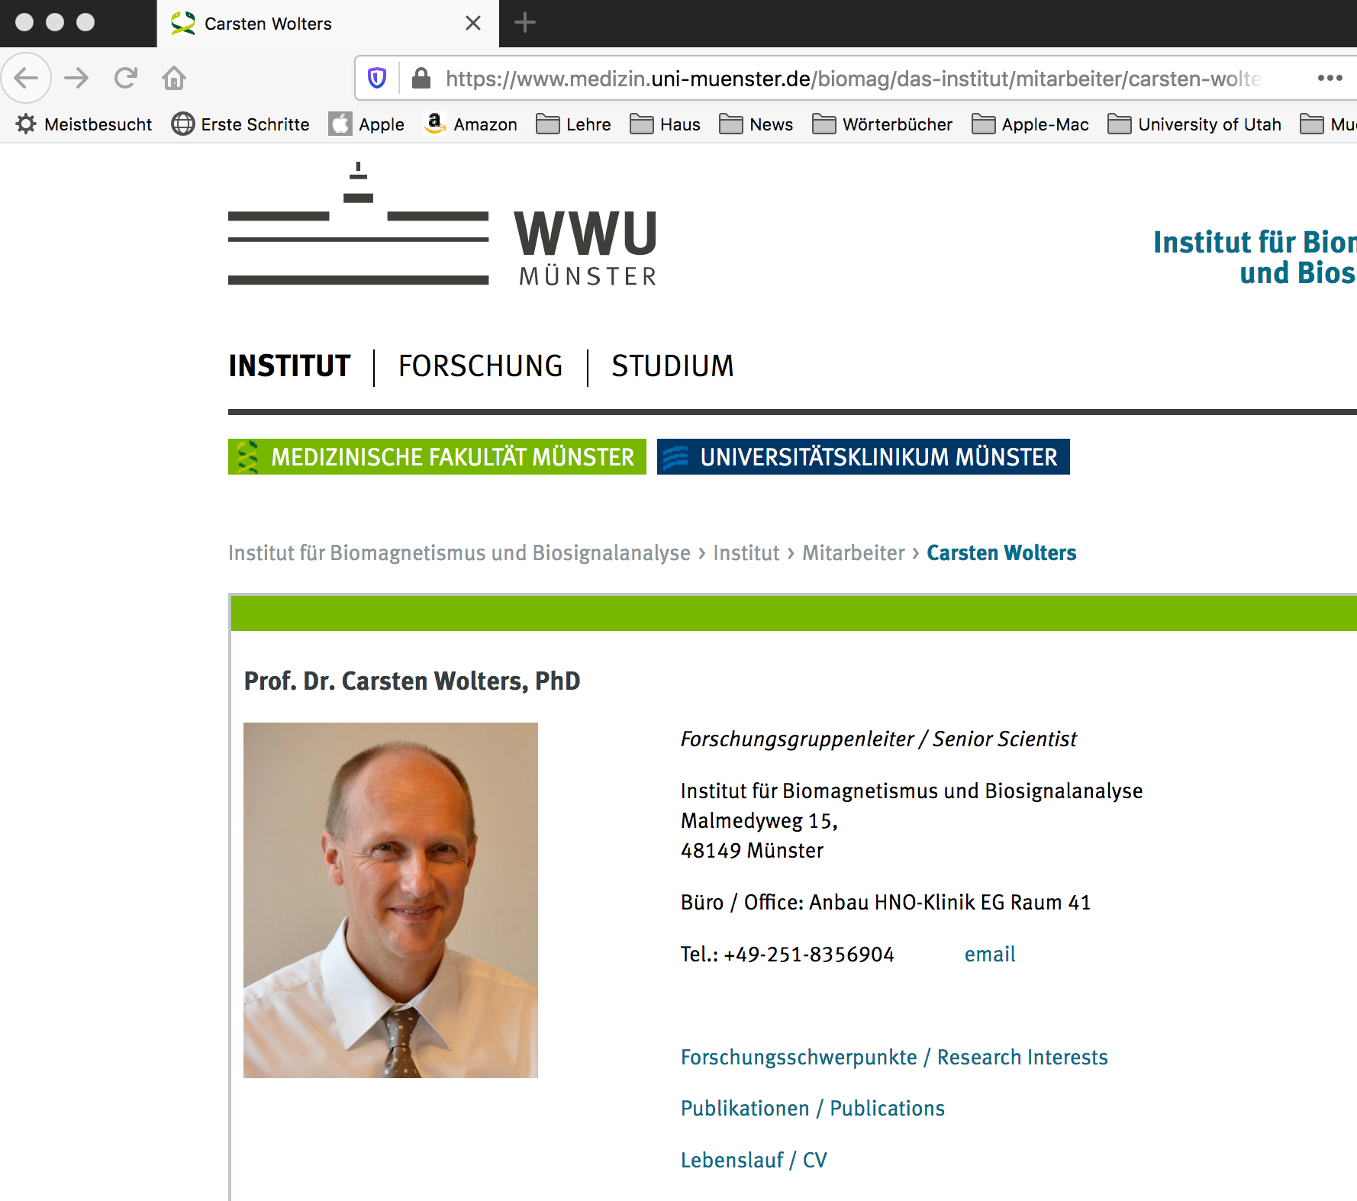
Summary: FEM source models
Links to all
Bachelor/Master/PhD theses
All own publications
Notes:
PEBBLES: Parallel and Element Based grey Box Linear Equation Solver

Slide 20
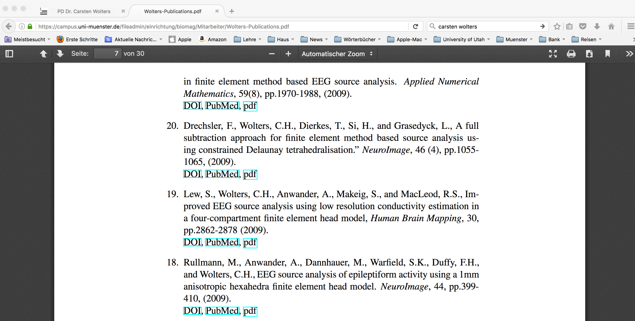
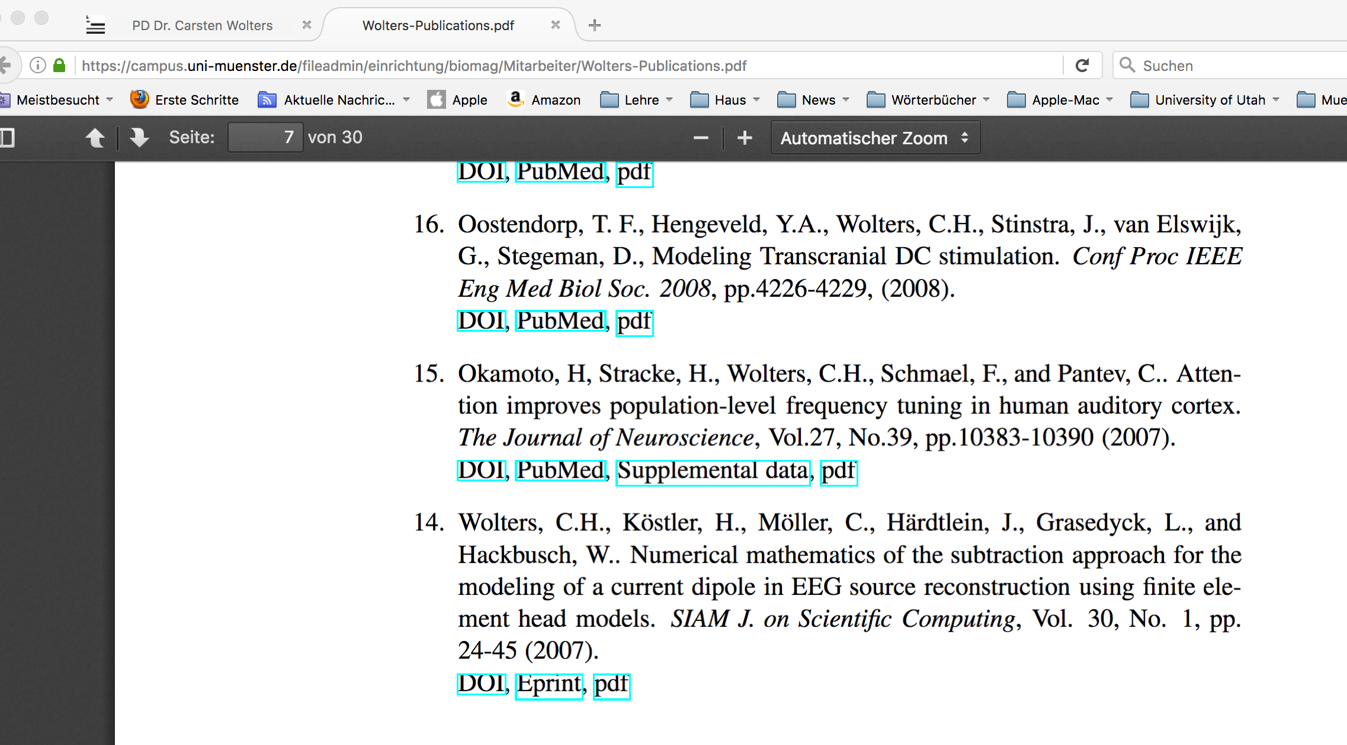
Summary: FEM source models
For FEM based forward modeling, the following source models exist:
Subtraction source model (Höltershinken et al., SIAM SISC, 2024; Drechsler et al., NeuroImage, 2009; Wolters et al., SIAM SISC, 2007)
Notes:
PEBBLES: Parallel and Element Based grey Box Linear Equation Solver

Slide 21
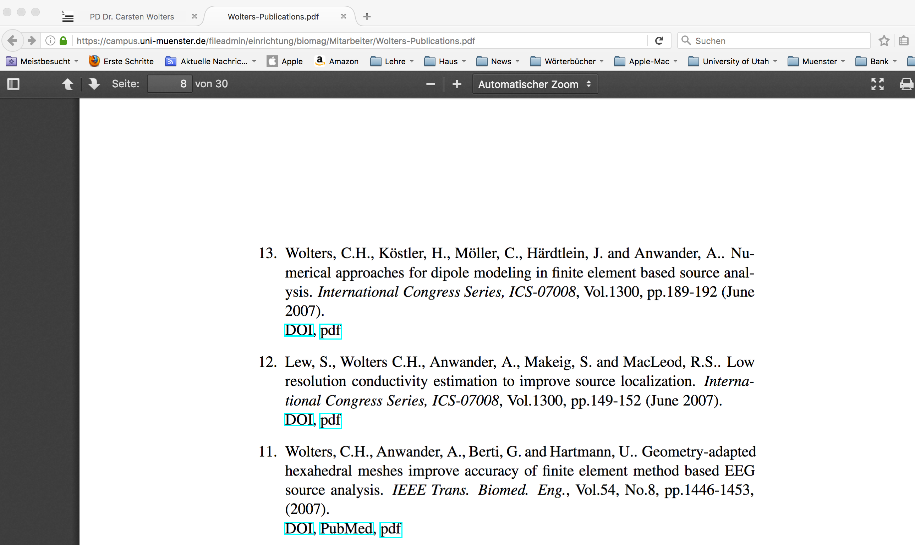
Summary: FEM source models
For FEM based forward modeling, the following source models exist:
Subtraction source model
Partial integration (PI) source model (Wolters et al., ICS, 2007)
Notes:
PEBBLES: Parallel and Element Based grey Box Linear Equation Solver

Slide 22
Summary: FEM source models
For FEM based forward modeling, the following source models exist:
Subtraction source model
Partial integration (PI) source model
Venant source model (Hanrath, 2019; Vorwerk et al., 2019)
Notes:
PEBBLES: Parallel and Element Based grey Box Linear Equation Solver

Slide 23
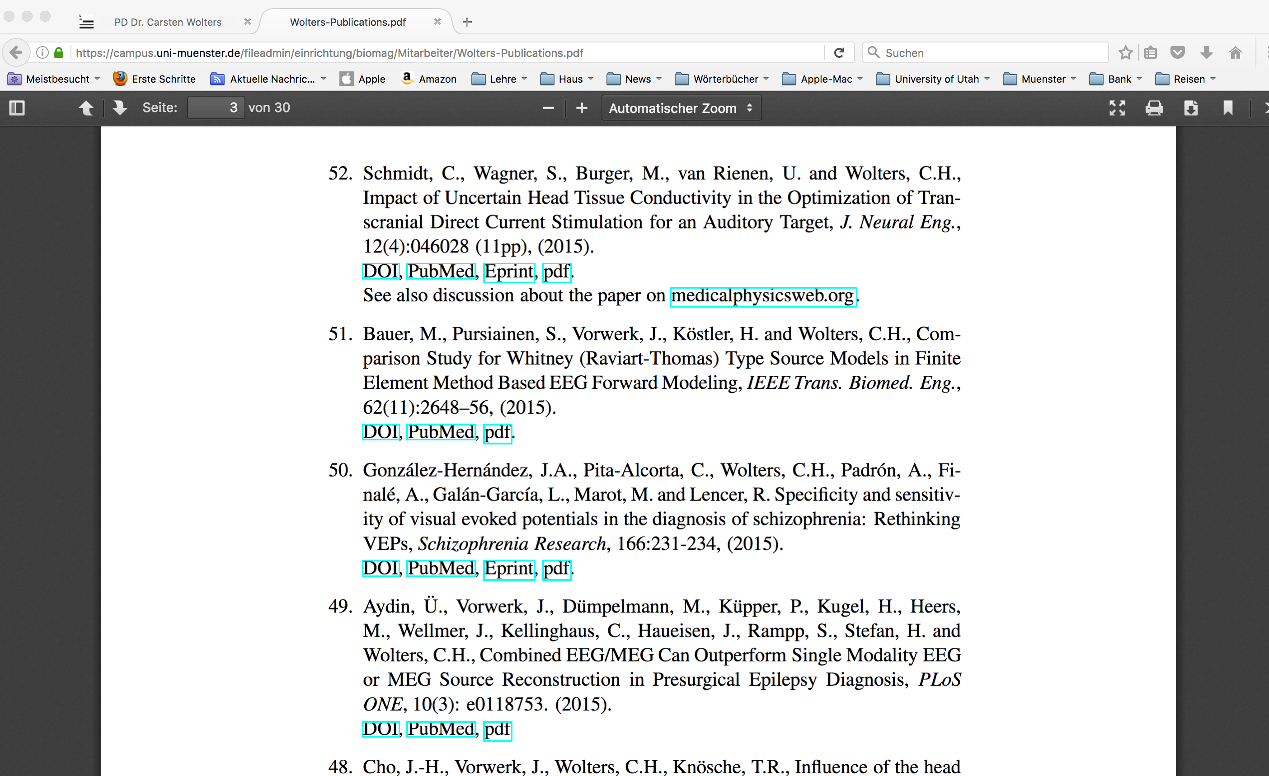
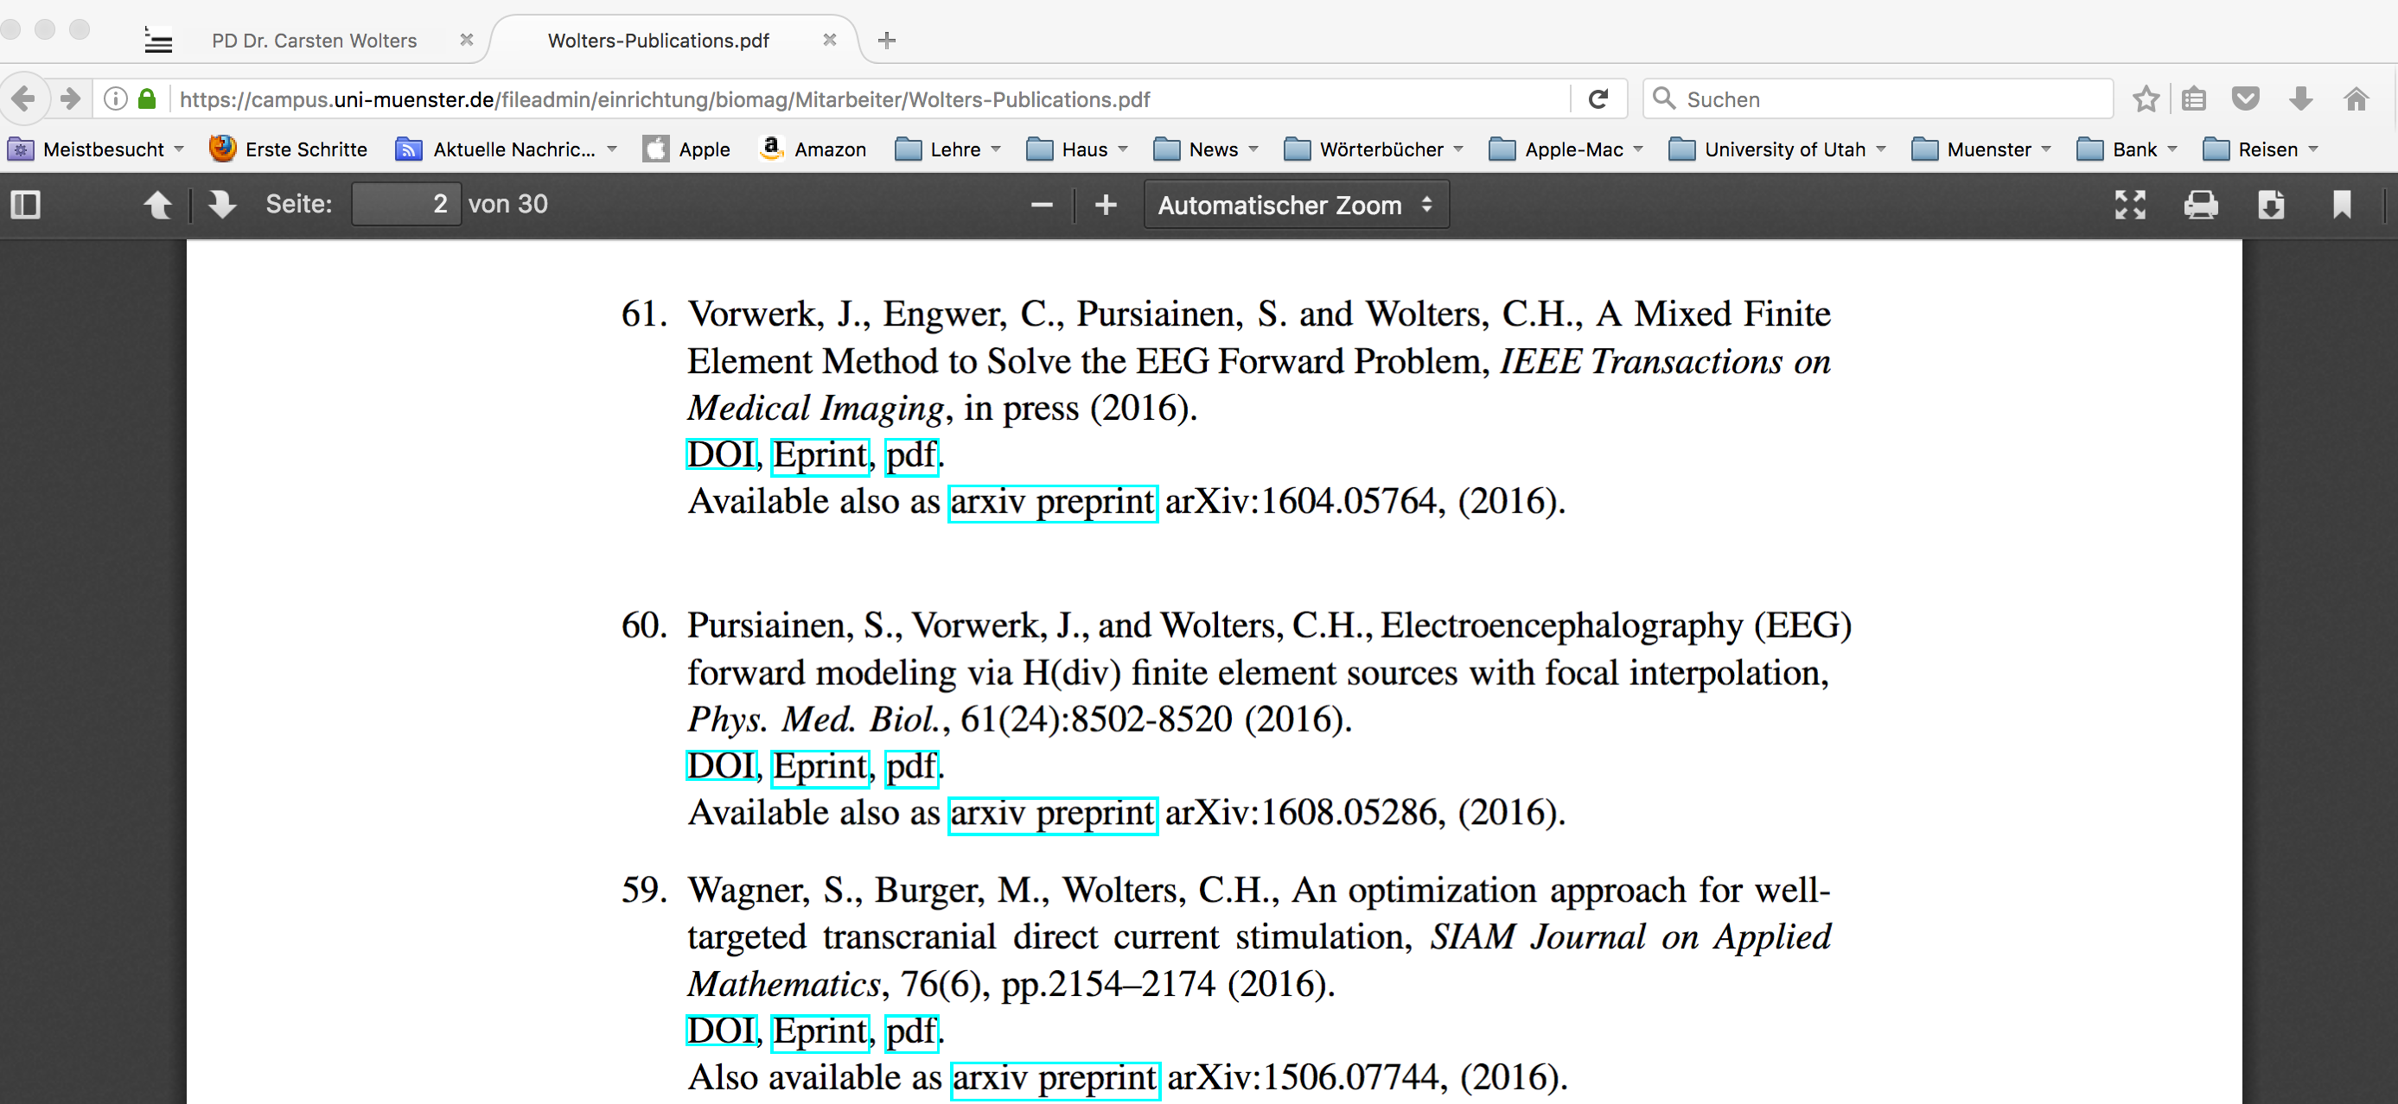
Summary: FEM source models
For FEM based forward modeling, the following source models exist:
Subtraction source model
Partial integration (PI) source model
Saint-Venant source model
Whitney source model (Bauer et al., 2015; Pursiainen et al., 2016; Miinalainen et al., 2019)
Notes:
PEBBLES: Parallel and Element Based grey Box Linear Equation Solver

Slide 24
Structure of the lecture
Convergence analysis for FEM subtraction approach (sections 6.5.1-6.5.3 of lecture scriptum)
Other source models (section 6.5.4 of lecture scriptum)
Overview: Multi-layer sphere model (section 6.2 of lecture scriptum)
Forward modeling results

Slide 25
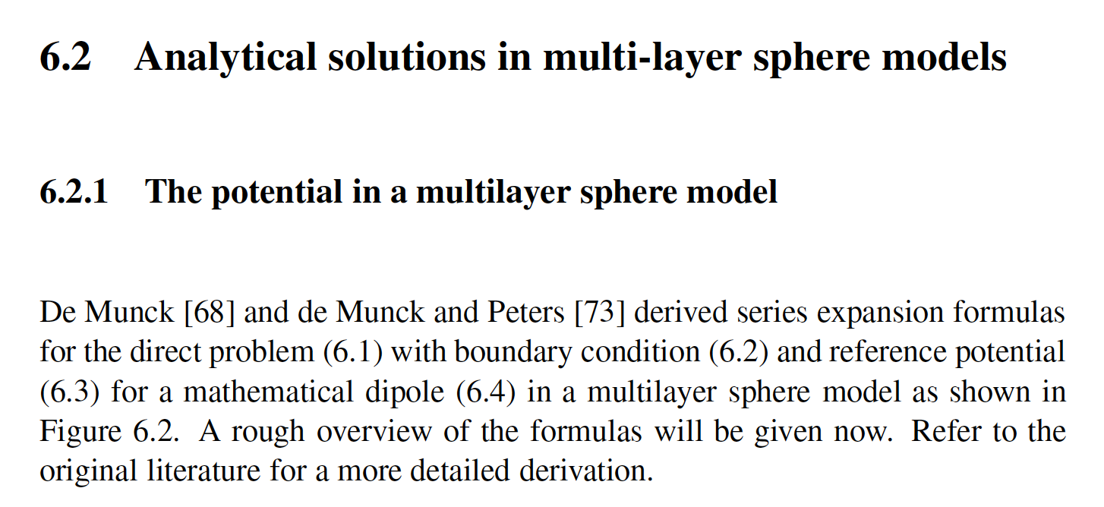
The multi-layer sphere model
[de Munck and Peters, IEEE TBME, 1993]
[Wolters, Lecture scriptum]

Slide 26
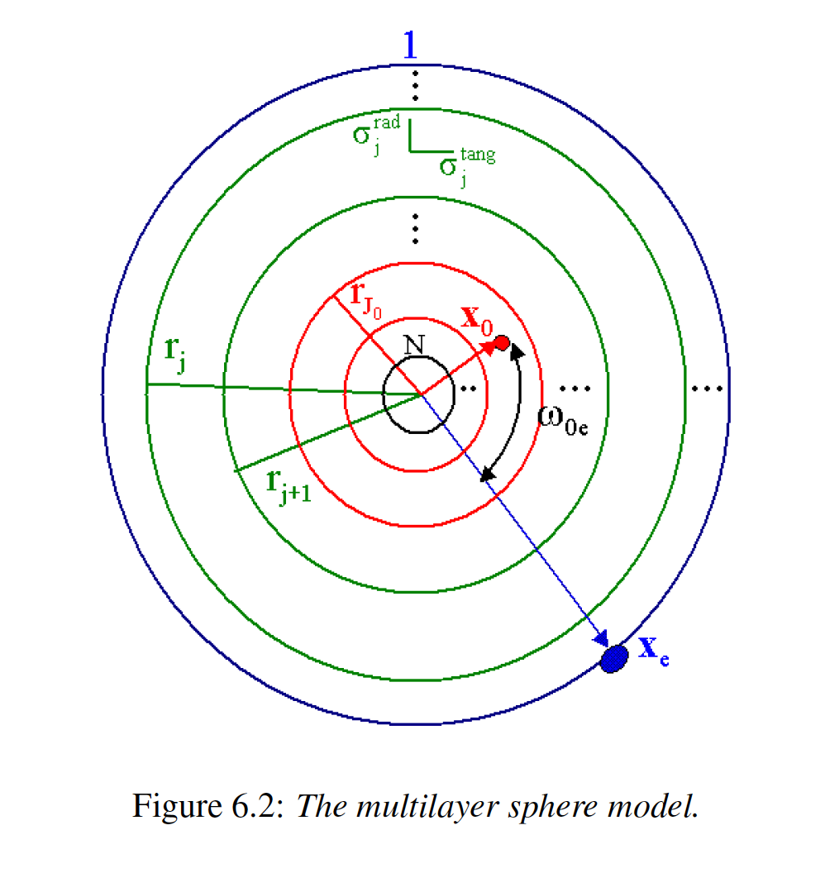
The multi-layer sphere model
[de Munck and Peters, IEEE TBME, 1993]
[Wolters, Lecture scriptum]

Slide 27
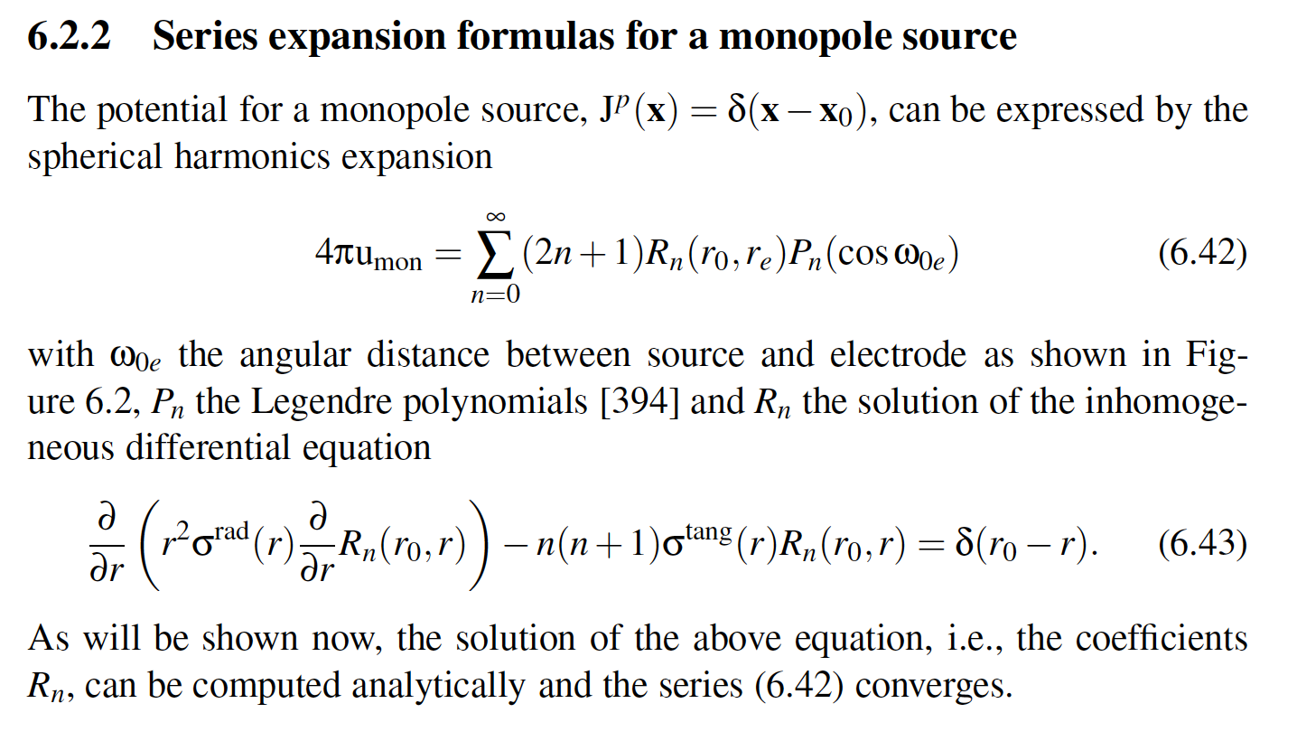
The multi-layer sphere model
[de Munck and Peters, IEEE TBME, 1993]
[Wolters, Lecture scriptum]

Slide 28
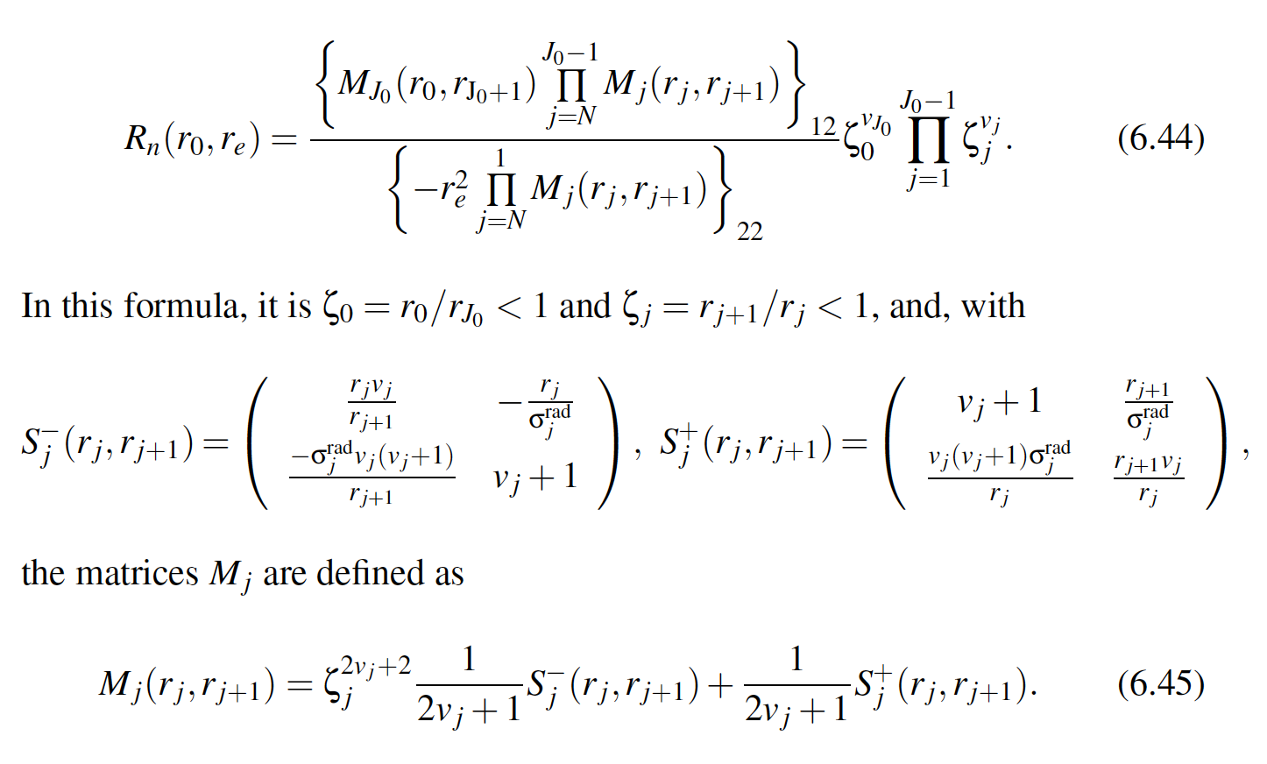
The multi-layer sphere model
[de Munck and Peters, IEEE TBME, 1993]
[Wolters, Lecture scriptum]

Slide 29
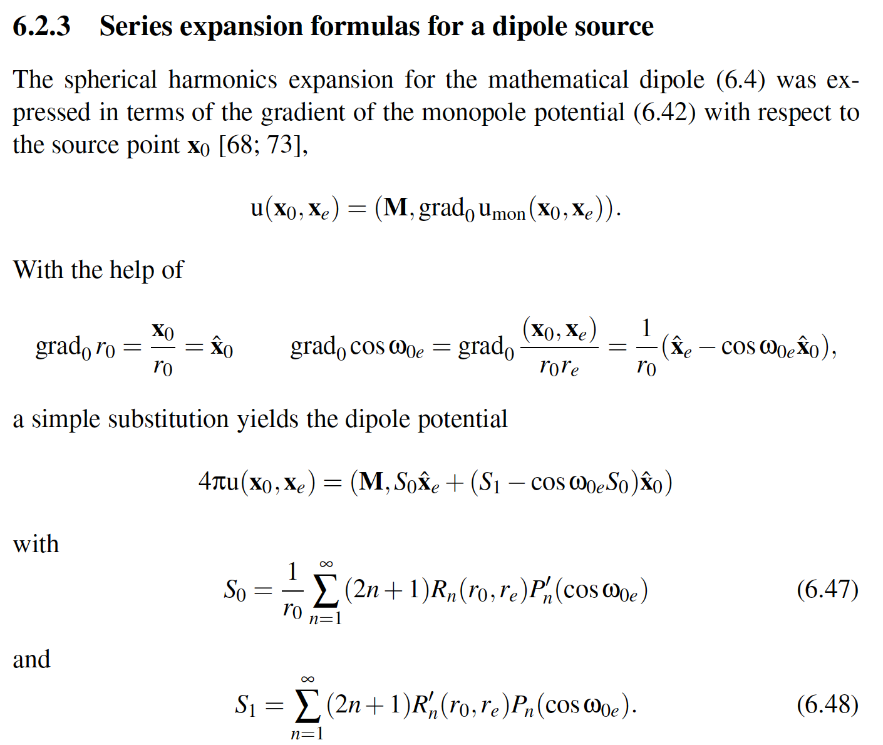
The multi-layer sphere model
[de Munck and Peters, IEEE TBME, 1993]
[Wolters, Lecture scriptum]

Slide 30
The multi-layer sphere model
[de Munck and Peters, IEEE TBME, 1993]
[Wolters, Lecture scriptum]

Slide 31
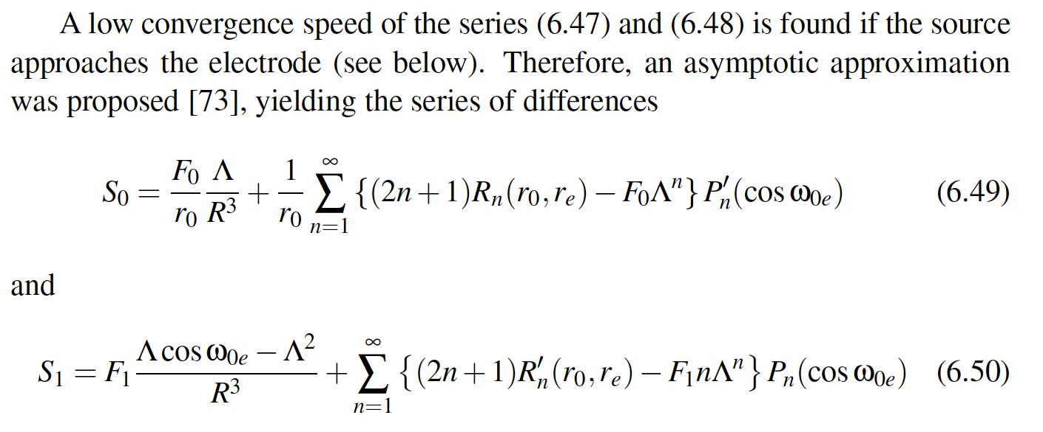
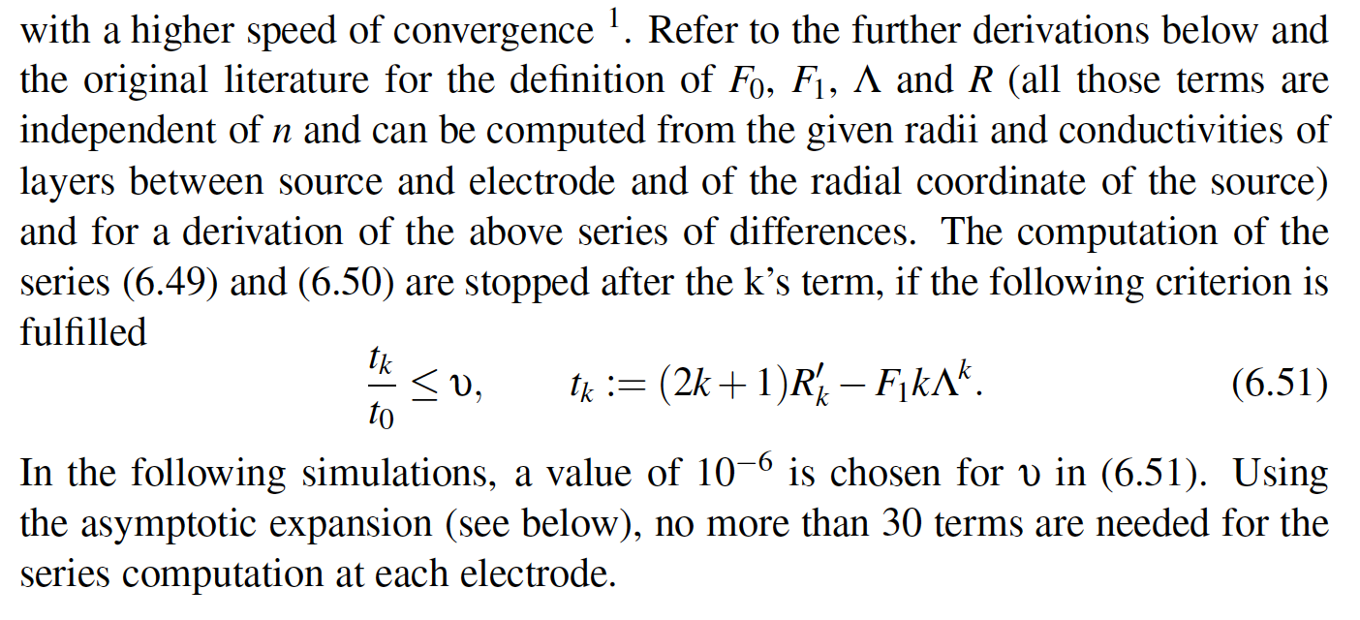
The multi-layer sphere model
[de Munck and Peters, IEEE TBME, 1993]
[Wolters, Lecture scriptum]

Slide 32
Structure of the lecture
Convergence analysis for FEM subtraction approach (sections 6.5.1-6.5.3 of lecture scriptum)
Other source models (section 6.5.4 of lecture scriptum)
Overview: Multi-layer sphere model (section 6.2 of lecture scriptum)
Forward modeling results
The local subtraction approach

Slide 33
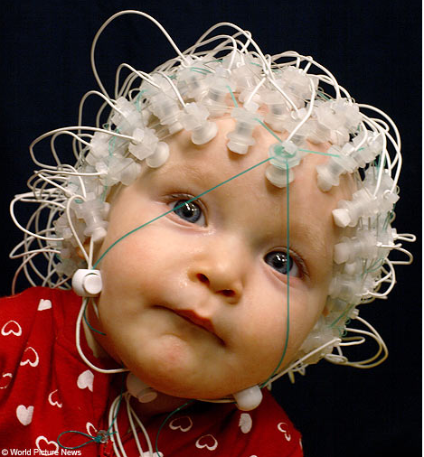
Cortical thickness in infants
[Li et al., NeuroImage, 2014]
The cortical thickness in infants is smaller than in adults
Important for our developments in EU-project www.childbrain.eu (2015-2019)
Notes:
PEBBLES: Parallel and Element Based grey Box Linear Equation Solver

Slide 34
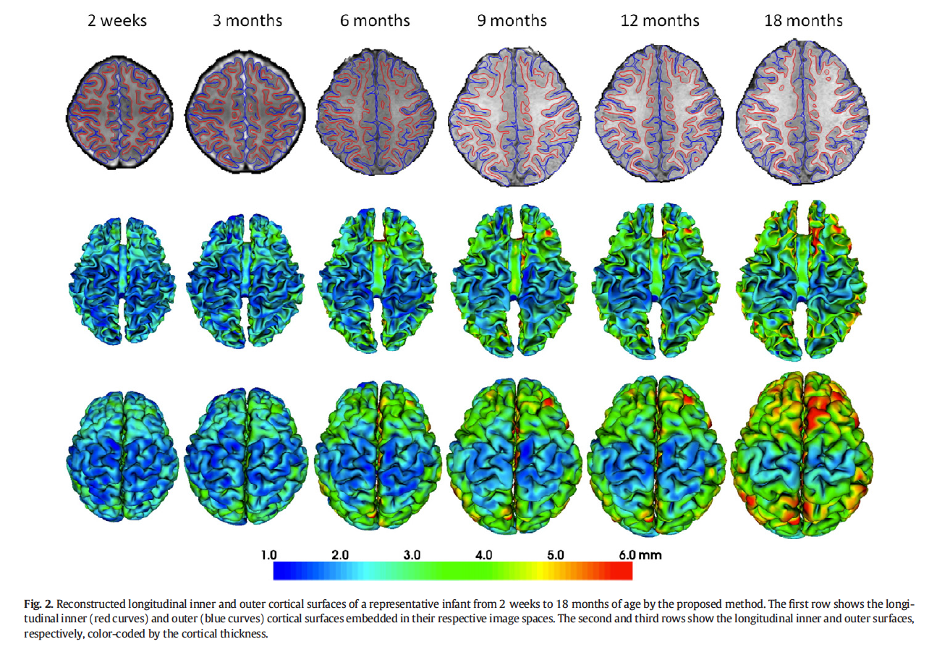
Development of cortical thickness
[Li et al., NeuroImage, 2014]
Notes:
PEBBLES: Parallel and Element Based grey Box Linear Equation Solver

Slide 35
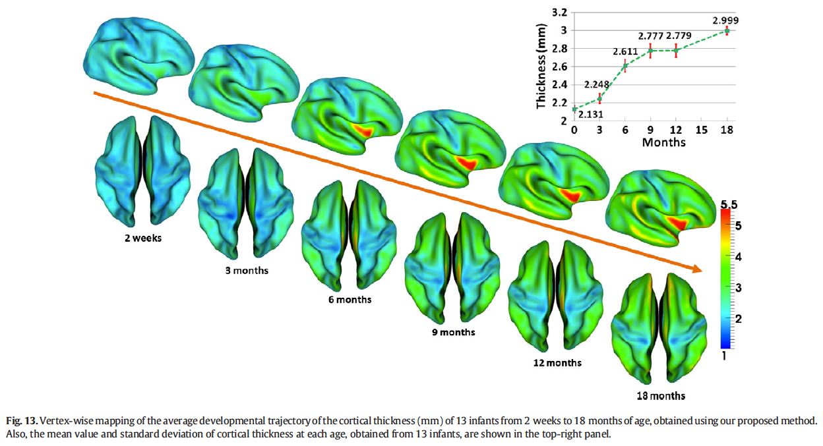
Development of cortical thickness
[Li et al., NeuroImage, 2014]
Notes:
PEBBLES: Parallel and Element Based grey Box Linear Equation Solver

Slide 36
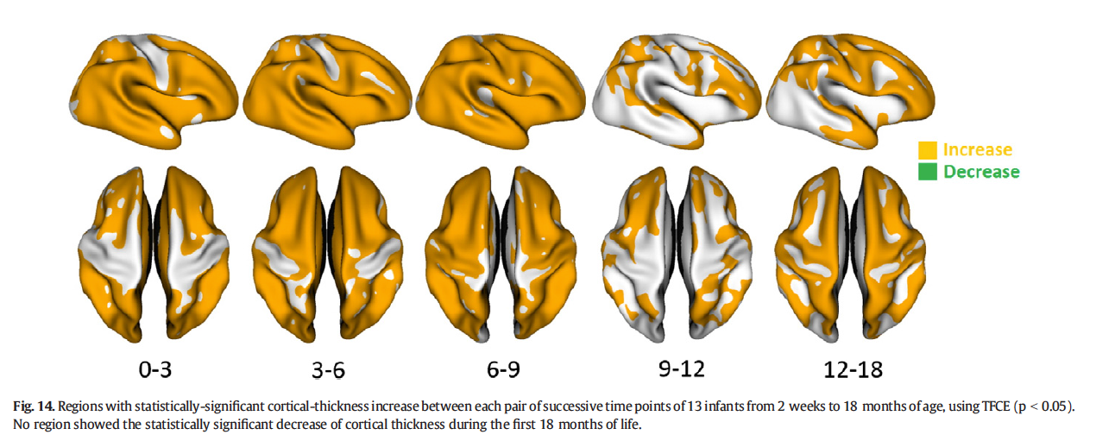
Development of cortical thickness
[Li et al., NeuroImage, 2014]
Notes:
PEBBLES: Parallel and Element Based grey Box Linear Equation Solver

Slide 37
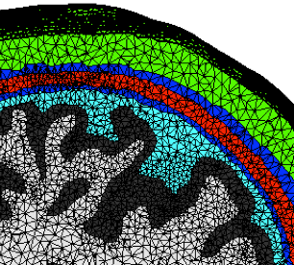
Cortical thickness in infants
If cortical thickness is smaller than in adults, it might also be smaller relative to the resolution of MRI and resulting FEM volume conductor models
Therefore, appropriate FEM source models are needed especially for infants
Distance of the sources to the next conductivity jump at the interface brain/CSF might go down to less than 2 mm, possibly even only 1 mm
However, highly eccentric sources are known to cause modeling errors
Notes:
PEBBLES: Parallel and Element Based grey Box Linear Equation Solver

Slide 38
PI, Venant, full subtraction and projected (or approx.) subtraction source models
Notes:
PEBBLES: Parallel and Element Based grey Box Linear Equation Solver

Slide 39
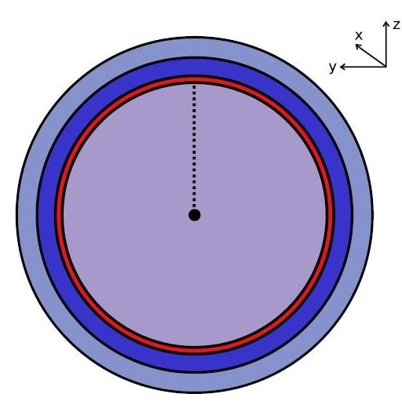
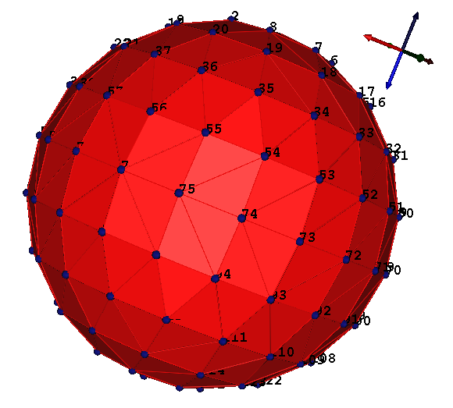
Model and sensors
[Drechsler, Wolters, Dierkes & Grasedyck, NeuroImage, 2009]
[Wolters, Lecture scriptum, 2016]
4-layer sphere model:
Radii: 92, 86, 80, 78mm;
Cond.: 0.33, 0.0042:0.042, 1.79, 0.33 S/m
Sources:
Depth of 1mm below CSF up to midpoint
748 regularly distributed electrodes:
On a sphere with radius: 92mm
Needle electrode (“point in space”)
Notes:
D: electric displacement
rho: electric free charge density
E: electric field
B: magnetic induction
mu: magnetic permeability (vacuum)
j: electric current density
Phi: electric scalar potential
Psi: magnetic flux
A: magnetic vector potential
divA=0: Coulomb’s gauge
conductor loop

Slide 40
Validation: Error measures
[Meijs, Peters, Boom & Lopes da Silva, Med.& Biol. Eng.&Comput., 1988]
[Meijs, Weier, Peters & van Oosterom, IEEE Trans. Biomed. Eng., 1989]
Relative error
Topography error
Magnitude error
Notes:
D: electric displacement
rho: electric free charge density
E: electric field
B: magnetic induction
mu: magnetic permeability (vacuum)
j: electric current density
Phi: electric scalar potential
Psi: magnetic flux
A: magnetic vector potential
divA=0: Coulomb’s gauge
conductor loop

Slide 41
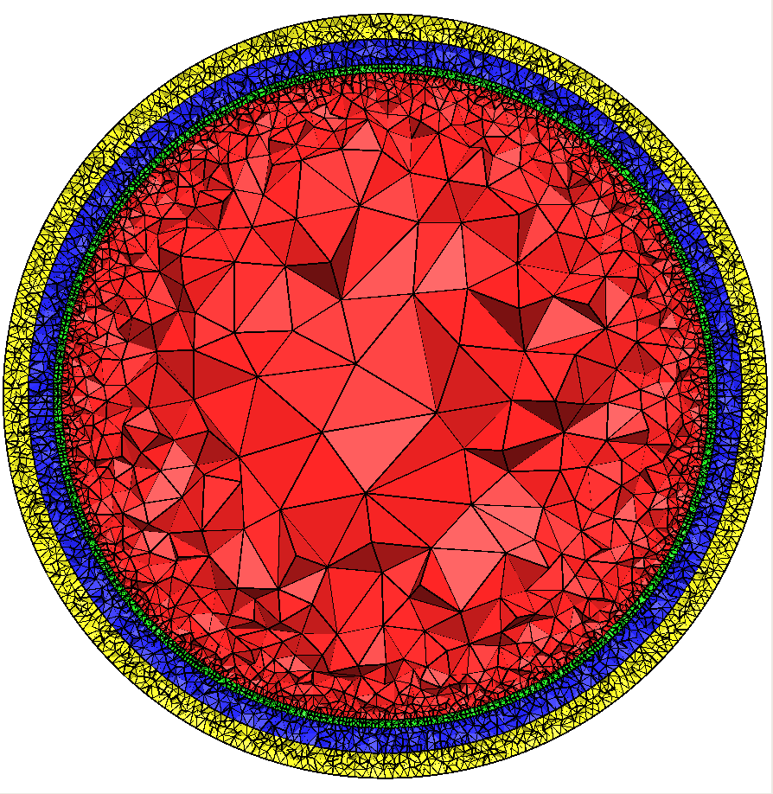
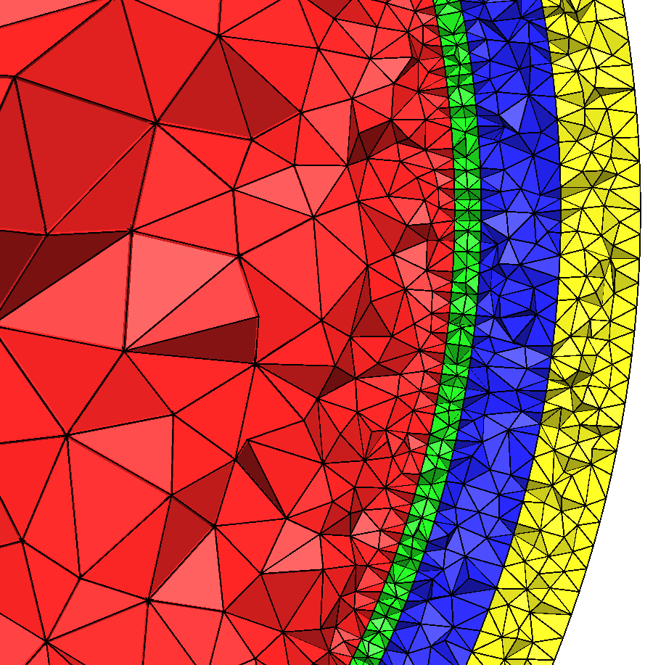
[Drechsler, Wolters, Dierkes & Grasedyck, NeuroImage, 2009]
[Wolters, Lecture scriptum, 2016]
“Optimal” FE mesh for the subtraction approach
Tetrahedra mesh: Coarse in brain, fine in CSF/skull/skin compartment:
Nodes: 360,056
Elements: 2,165,281
Notes:
D: electric displacement
rho: electric free charge density
E: electric field
B: magnetic induction
mu: magnetic permeability (vacuum)
j: electric current density
Phi: electric scalar potential
Psi: magnetic flux
A: magnetic vector potential
divA=0: Coulomb’s gauge
conductor loop

Slide 42
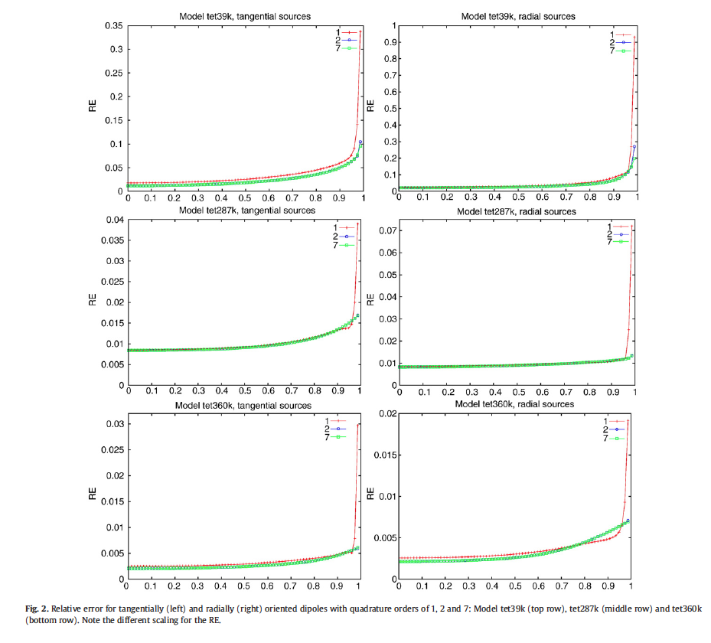
Quadrature order for full subtraction approach
[Drechsler, Wolters, Dierkes & Grasedyck, NeuroImage, 2009]
[Wolters, Lecture scriptum, 2016]
Notes:
Cohen et al. measured first MEG in 1968: alpha-activity is about 10^7 times weaker than the earth magnetic field

Slide 43
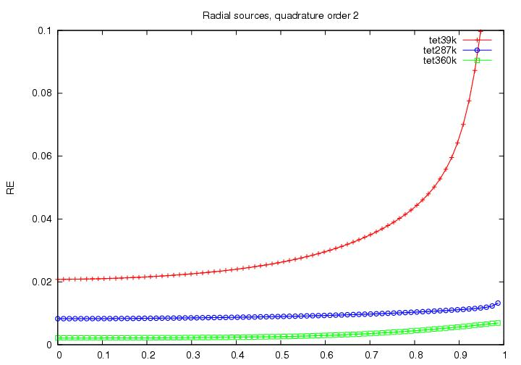
Convergence behavior of full subtraction
[Drechsler, Wolters, Dierkes & Grasedyck, NeuroImage, 2009]
[Wolters, Lecture scriptum, 2016]
Notes:
Cohen et al. measured first MEG in 1968: alpha-activity is about 10^7 times weaker than the earth magnetic field

Slide 44
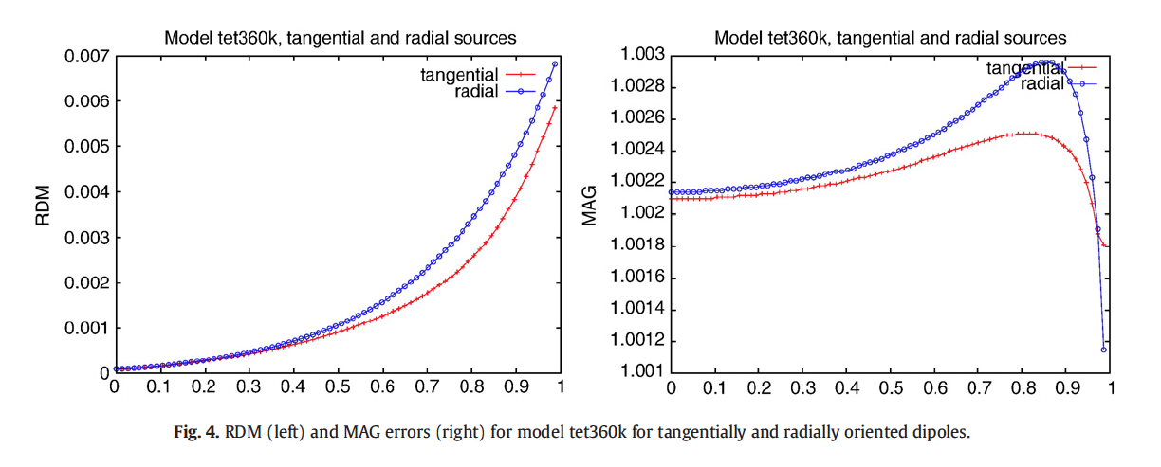
RDM and MAG of full subtraction approach
[Drechsler, Wolters, Dierkes & Grasedyck, NeuroImage, 2009]
[Wolters, Lecture scriptum, 2016]
Notes:
Cohen et al. measured first MEG in 1968: alpha-activity is about 10^7 times weaker than the earth magnetic field

Slide 45
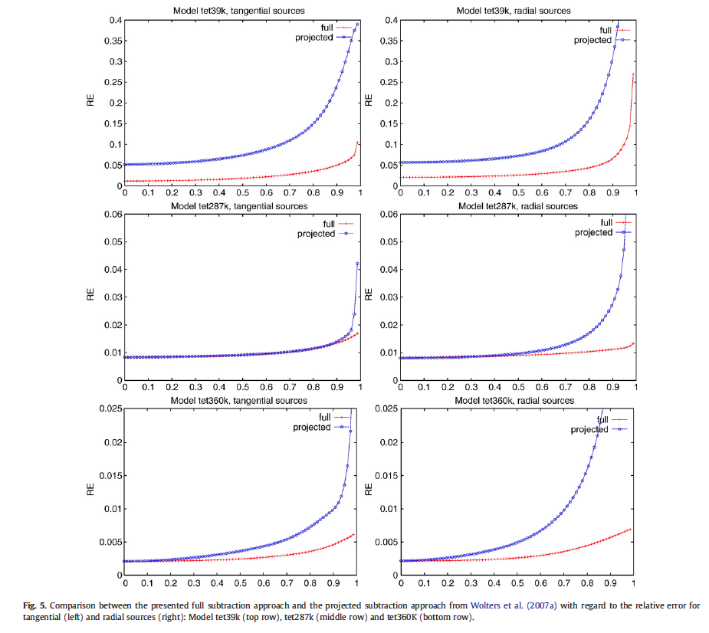
Full against projected subtraction approach
[Drechsler, Wolters, Dierkes & Grasedyck, NeuroImage, 2009]
[Wolters, Lecture scriptum, 2016]
Notes:
Cohen et al. measured first MEG in 1968: alpha-activity is about 10^7 times weaker than the earth magnetic field

Slide 46
[Drechsler, Wolters, Dierkes & Grasedyck, NeuroImage, 2009]
[Wolters, Lecture scriptum, 2016]
“Optimal” FE mesh for the subtraction approach
Tetrahedra mesh: Coarse in brain, fine in CSF/skull/skin compartment:
Nodes: 360,056
Elements: 2,165,281
Notes:
D: electric displacement
rho: electric free charge density
E: electric field
B: magnetic induction
mu: magnetic permeability (vacuum)
j: electric current density
Phi: electric scalar potential
Psi: magnetic flux
A: magnetic vector potential
divA=0: Coulomb’s gauge
conductor loop

Slide 47
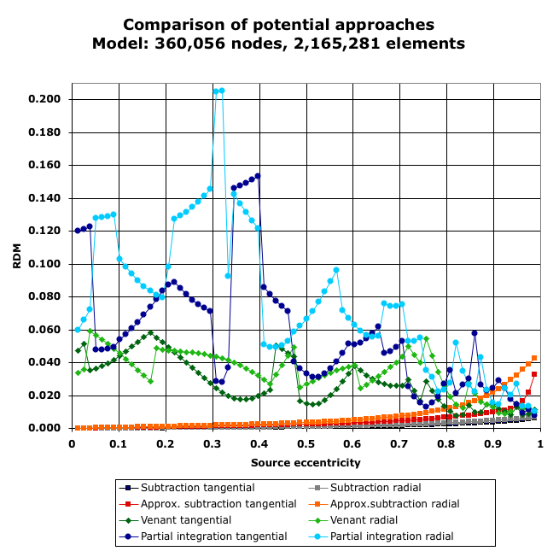
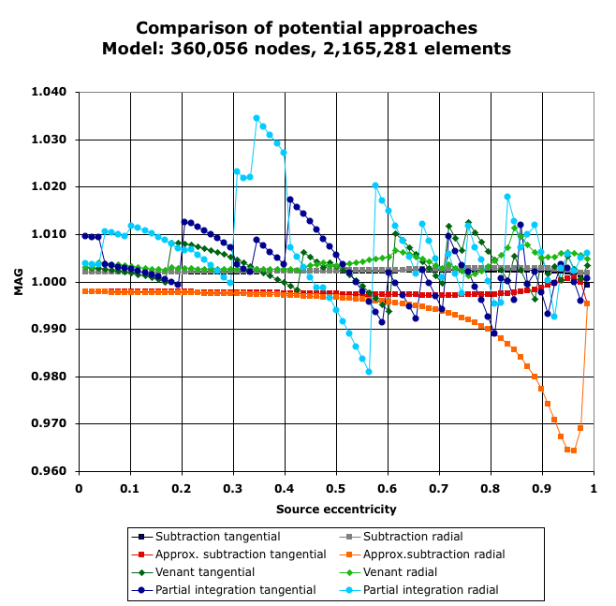
“Optimal” FE mesh for the subtraction approach
TETGEN tetrahedra mesh, coarse in brain, fine in CSF/skull/skin compartment:
Nodes: 360,056
Elements: 2,165,281
Notes:
D: electric displacement
rho: electric free charge density
E: electric field
B: magnetic induction
mu: magnetic permeability (vacuum)
j: electric current density
Phi: electric scalar potential
Psi: magnetic flux
A: magnetic vector potential
divA=0: Coulomb’s gauge
conductor loop

Slide 48
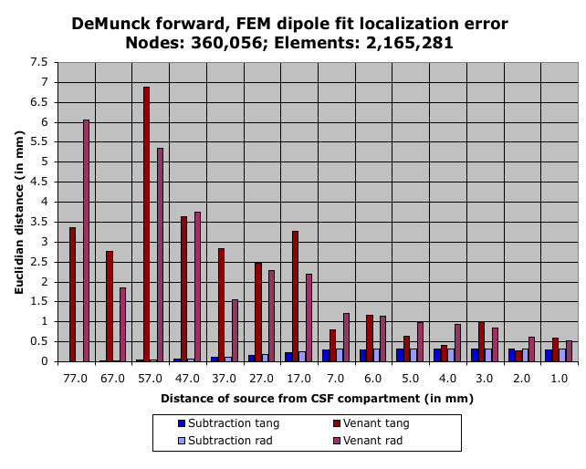
Dipole fit localization error
Notes:
D: electric displacement
rho: electric free charge density
E: electric field
B: magnetic induction
mu: magnetic permeability (vacuum)
j: electric current density
Phi: electric scalar potential
Psi: magnetic flux
A: magnetic vector potential
divA=0: Coulomb’s gauge
conductor loop

Slide 49
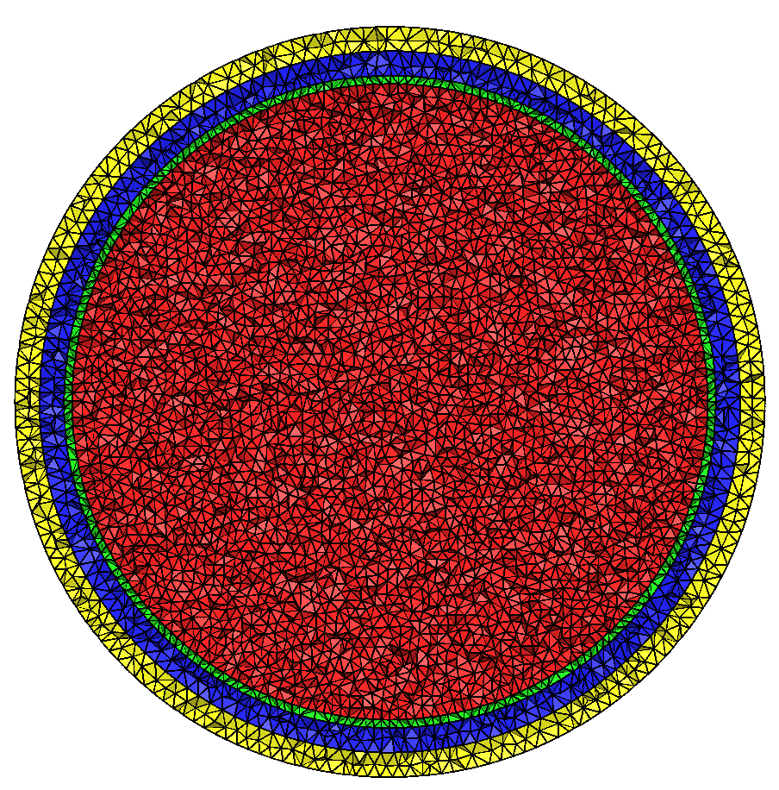
“Optimal” FE mesh for the direct potential approaches
Tetrahedra mesh, regularly refined in all 4 compartments:
Nodes: 161,086
Elements: 987,582
Notes:
D: electric displacement
rho: electric free charge density
E: electric field
B: magnetic induction
mu: magnetic permeability (vacuum)
j: electric current density
Phi: electric scalar potential
Psi: magnetic flux
A: magnetic vector potential
divA=0: Coulomb’s gauge
conductor loop

Slide 50
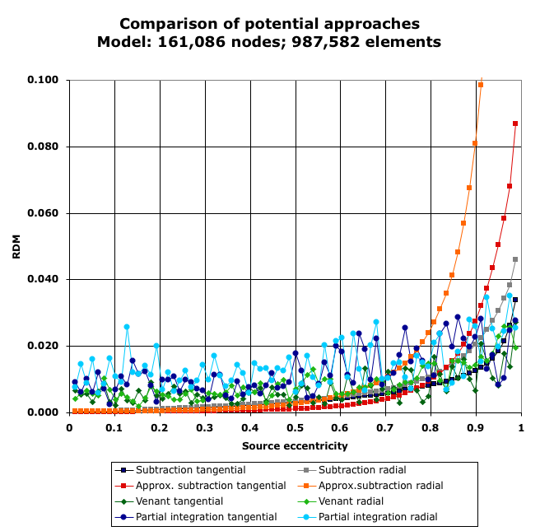
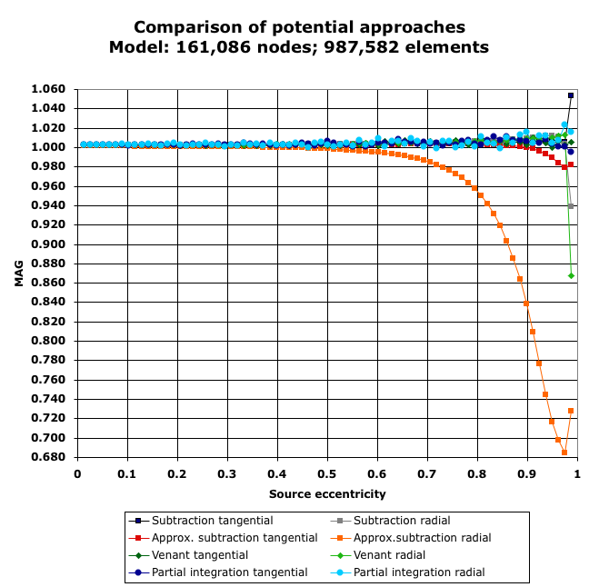
“Optimal” FE mesh for the direct potential approaches
TETGEN tetrahedra mesh, volume constraint of 5 in all 4 compartments:
Nodes: 161,086
Elements: 987,582
Notes:
D: electric displacement
rho: electric free charge density
E: electric field
B: magnetic induction
mu: magnetic permeability (vacuum)
j: electric current density
Phi: electric scalar potential
Psi: magnetic flux
A: magnetic vector potential
divA=0: Coulomb’s gauge
conductor loop

Slide 51
Dipole fit localization error
Notes:
D: electric displacement
rho: electric free charge density
E: electric field
B: magnetic induction
mu: magnetic permeability (vacuum)
j: electric current density
Phi: electric scalar potential
Psi: magnetic flux
A: magnetic vector potential
divA=0: Coulomb’s gauge
conductor loop

Slide 52
Higher degree FEM basis functions for full subtraction source model
Notes:
PEBBLES: Parallel and Element Based grey Box Linear Equation Solver

Slide 53
Reminder: Link for literature to own work: https://campus.uni-muenster.de/biomag/das-institut/mitarbeiter/carsten-wolters/
[Florian Grüne, Master thesis Mathematics, University of Münster, 2014]
Notes:
PEBBLES: Parallel and Element Based grey Box Linear Equation Solver

Slide 54
Florian Grüne
[Florian Grüne, Master thesis Mathematics, University of Münster, 2014]
Notes:
54
54

Slide 55
4 layer sphere model and meshes
[Florian Grüne, Master thesis Mathematics, University of Münster, 2014]
Notes:
PEBBLES: Parallel and Element Based grey Box Linear Equation Solver

Slide 56
4 layer sphere model and meshes
[Florian Grüne, Master thesis Mathematics, University of Münster, 2014]
Notes:
PEBBLES: Parallel and Element Based grey Box Linear Equation Solver

Slide 57
4 layer sphere model and meshes
[Florian Grüne, Master thesis Mathematics, University of Münster, 2014]
Notes:
PEBBLES: Parallel and Element Based grey Box Linear Equation Solver

Slide 58
4 layer sphere model and meshes
[Florian Grüne, Master thesis Mathematics, University of Münster, 2014]
Notes:
PEBBLES: Parallel and Element Based grey Box Linear Equation Solver

Slide 59
Difference measures between analytical and numerical EEG forward solution
[Florian Grüne, Master thesis Mathematics, University of Münster, 2014]
RDM(%)=RDM / 2*100
Notes:
PEBBLES: Parallel and Element Based grey Box Linear Equation Solver

Slide 60
Boxplots
[Florian Grüne, Master thesis Mathematics, University of Münster, 2014]
Notes:
PEBBLES: Parallel and Element Based grey Box Linear Equation Solver

Slide 61
Boxplots
[Florian Grüne, Master thesis Mathematics, University of Münster, 2014]
Notes:
PEBBLES: Parallel and Element Based grey Box Linear Equation Solver

Slide 62
Higher order basis functions for subtraction
[Florian Grüne, Master thesis Mathematics, University of Münster, 2014]
0.99 means 0.78 mm to CSF
Notes:
PEBBLES: Parallel and Element Based grey Box Linear Equation Solver

Slide 63
Higher order basis functions for subtraction
[Florian Grüne, Master thesis Mathematics, University of Münster, 2014]
18.4%
6.8%
2.4%
0.9%
Notes:
PEBBLES: Parallel and Element Based grey Box Linear Equation Solver

Slide 64
Higher order basis functions for subtraction
[Florian Grüne, Master thesis Mathematics, University of Münster, 2014]
7.4%
2.7%
1%
0.37%
0.13%
0.05%
0.018%
Notes:
PEBBLES: Parallel and Element Based grey Box Linear Equation Solver

Slide 65
Higher order basis functions for subtraction
[Florian Grüne, Master thesis Mathematics, University of Münster, 2014]
18.4%
6.8%
2.4%
0.9%
Notes:
PEBBLES: Parallel and Element Based grey Box Linear Equation Solver

Slide 66
Higher order basis functions for subtraction
[Florian Grüne, Master thesis Mathematics, University of Münster, 2014]
2.7%
1%
0.37%
0.13%
0.05%
0.018%
Notes:
PEBBLES: Parallel and Element Based grey Box Linear Equation Solver

Slide 67
Higher order basis functions for subtraction
[Florian Grüne, Master thesis Mathematics, University of Münster, 2014]
18.4%
6.8%
2.4%
0.9%
Notes:
PEBBLES: Parallel and Element Based grey Box Linear Equation Solver

Slide 68
Higher order basis functions for subtraction
[Florian Grüne, Master thesis Mathematics, University of Münster, 2014]
2.7%
1%
0.37%
Notes:
PEBBLES: Parallel and Element Based grey Box Linear Equation Solver

Slide 69
Higher order basis functions for subtraction
[Florian Grüne, Master thesis Mathematics, University of Münster, 2014]
18.4%
6.8%
2.4%
Notes:
PEBBLES: Parallel and Element Based grey Box Linear Equation Solver

Slide 70
Computational amount of work for subtraction source model
[Florian Grüne, Master thesis Mathematics, University of Münster, 2014]
Notes:
PEBBLES: Parallel and Element Based grey Box Linear Equation Solver

Slide 71
Computational amount of work for subtraction source model in DUNEuro
[Florian Grüne, Master thesis Mathematics, University of Münster, 2014]
SSORk-CG was used for non-overlapping domain decomposition as a solver.
AMG-CG solver might further decrease computational speed
Notes:
PEBBLES: Parallel and Element Based grey Box Linear Equation Solver

Slide 72
PI, Venant and Whitney source models
Notes:
PEBBLES: Parallel and Element Based grey Box Linear Equation Solver

Slide 73
Introduction
[Bauer, Pursiainen, Vorwerk, Köstler & Wolters, IEEE TBME, 2015]

Slide 74
Reminder: Link for literature to own work: https://campus.uni-muenster.de/biomag/das-institut/mitarbeiter/carsten-wolters/
[Bauer, Pursiainen, Vorwerk, Köstler & Wolters, IEEE TBME, 2015]
Notes:
PEBBLES: Parallel and Element Based grey Box Linear Equation Solver

Slide 75
Introduction
[Pursiainen, Vorwerk & Wolters, Phys Med Biol, 2016]

Slide 76
Reminder: Link for literature to own work: https://campus.uni-muenster.de/biomag/das-institut/mitarbeiter/carsten-wolters/
[Pursiainen, Vorwerk & Wolters, Phys Med Biol, 2016]
Notes:
PEBBLES: Parallel and Element Based grey Box Linear Equation Solver

Slide 77
[Bauer, Pursiainen, Vorwerk, Köstler & Wolters, IEEE TBME, 2015]
Source model extent and number of right-hand side
non-zeros/computational amount of work
For free source orientation :

Slide 78
[Bauer, Pursiainen, Vorwerk, Köstler & Wolters, IEEE TBME, 2015]
4 layer sphere model
FEM mesh generation: Constrained Delaunay Tetrahedralization with maximal tetrahedra volume of 1.12 mm³ using TetGen, resulting in a tetrahedral mesh with 801K nodes
200 electrodes, regularly distributed over the outer surface
200 sources for each of the following eccentricities: 0.2, 0.4, 0.6, 0.8, 0.99

Slide 79
Difference measures between analytical and numerical/simulated EEG forward solution
[Bauer, Pursiainen, Vorwerk, Köstler & Wolters, IEEE TBME, 2015]
Relative Difference Measure (topography difference)
MAGnitude error
Notes:
PEBBLES: Parallel and Element Based grey Box Linear Equation Solver

Slide 80
[Bauer, Pursiainen, Vorwerk, Köstler & Wolters, IEEE TBME, 2015]
Synthetic dipole location and position for Whitney model

Slide 81
[Bauer, Pursiainen, Vorwerk, Köstler & Wolters, IEEE TBME, 2015]
Whitney source model: Best synthetic source position
=> (D) is best!
in % error

Slide 82
[Bauer, Pursiainen, Vorwerk, Köstler & Wolters, IEEE TBME, 2015]
Whitney source model with arbitrary or fixed orientation

Slide 83
[Bauer, Pursiainen, Vorwerk, Köstler & Wolters, IEEE TBME, 2015]
Comparison of source models:
Part I: Synthetic source positions and orientations
in % error

Slide 84
[Bauer, Pursiainen, Vorwerk, Köstler & Wolters, IEEE TBME, 2015]
Comparison of source models:
Part II: Random source positions and orientations

Slide 85
Discussion: Subtraction source model
Pro:
Theoretically well understood
Localized subtraction is also very fast (Höltershinken et al., 2023)
Contra:
Highest sensitivity/inaccuracy for high eccentricities: For model with 519K nodes and P2 basis functions still up to 8% maximal RDM and 1.5% MAG at 0.99 eccentricity (0.78 mm to CSF): Such errors might cause trouble in applications
Full subtraction is computationally very expensive (will need newest generation of computers, parallelization)
Less realistic source model (mathematical point-dipole)
Notes:
PEBBLES: Parallel and Element Based grey Box Linear Equation Solver

Slide 86
Discussion: PI source model
Pro:
Very local, fits in one element
Computationally very fast
With less than 2% RDM and 1.5% MAG at 0.99 eccentricity (0.78 mm to CSF) good enough for application
Even more realistic than the mathematical point-dipole
Contra:
Slightly less accurate than Whitney or Venant
No resolution within an element when using P1 basis functions
Notes:
PEBBLES: Parallel and Element Based grey Box Linear Equation Solver

Slide 87
Discussion: Venant source model
Pro:
With less than 1.7% RDM and 1% MAG at 0.99 eccentricity (0.78 mm to CSF) very accurate source modeling approach
Computationally very fast
Even more realistic than the mathematical point-dipole
Contra:
Less local, needs about 27 nodes that have to fit into the cortex, which might get difficult in infant models
Notes:
PEBBLES: Parallel and Element Based grey Box Linear Equation Solver

Slide 88
Discussion: Whitney source model
Pro:
Theoretically well understood
Computationally very fast
Even more realistic than the mathematical point-dipole
Contra:
In (Bauer et al., 2015) still slightly less accurate than Venant, but this was solved by face and edge-based bases functions in (Pursiainen et al., 2016), however, on the cost of a larger extent
Notes:
PEBBLES: Parallel and Element Based grey Box Linear Equation Solver

Slide 89
Structure of the lecture
Convergence analysis for FEM subtraction approach (sections 6.5.1-6.5.3 of lecture scriptum)
Other source models (section 6.5.4 of lecture scriptum)
Overview: Multi-layer sphere model (section 6.2 of lecture scriptum)
Forward modeling results
The local subtraction approach

Slide 90
Notes:
PEBBLES: Parallel and Element Based grey Box Linear Equation Solver

Slide 91
[Höltershinken, Lange,…, Engwer & Wolters, SIAM SISC, 2024]
The local subtraction approach

Slide 92
[Höltershinken, Lange,…, Engwer & Wolters, SIAM SISC, 2024]
The local subtraction approach

Slide 93
[Höltershinken, Lange,…, Engwer & Wolters, SIAM SISC, 2024]
[Beltrachini, J Neur Eng, 2019]
The local subtraction approach

Slide 94
[Höltershinken, Lange,…, Engwer & Wolters, SIAM SISC, 2024]
The local subtraction approach

Slide 95
[Höltershinken, Lange,…, Engwer & Wolters, SIAM SISC, 2024]
The local subtraction approach

Slide 96
[Höltershinken, Lange,…, Engwer & Wolters, SIAM SISC, 2024]
The local subtraction approach

Slide 97
[Höltershinken, Lange,…, Engwer & Wolters, SIAM SISC, 2024]
The local subtraction approach

Slide 98
[Höltershinken, Lange,…, Engwer & Wolters, SIAM SISC, 2024]
The localized subtraction approach

Slide 99
Thank you for your attention!
SIM-NEURO work-group at IBB
Notes:
99
99

