Slide 1


Basics of EEG and MEG source analysis
Carsten H. Wolters
Lecture, Oct.15, 2024
Notes:
Tensor weiter erlaeutern
Zeitableitung
Programmlaenge, 1Mill.
WM-Rendering->5000 nodes
1:10 raus und anfangs erwaehnen

Slide 2
Structure of this lecture
Some more basics of EEG and MEG
Validation of EEG and MEG source analysis techniques
Source analysis of somatosensory (SEP/SEF), auditory (AEP/AEF) and visually evoked potentials and fields (VEP/VEF)
Clinical application of SEP/SEF source analysis: Functional mapping
Applications in presurgical epilepsy diagnosis

Slide 3
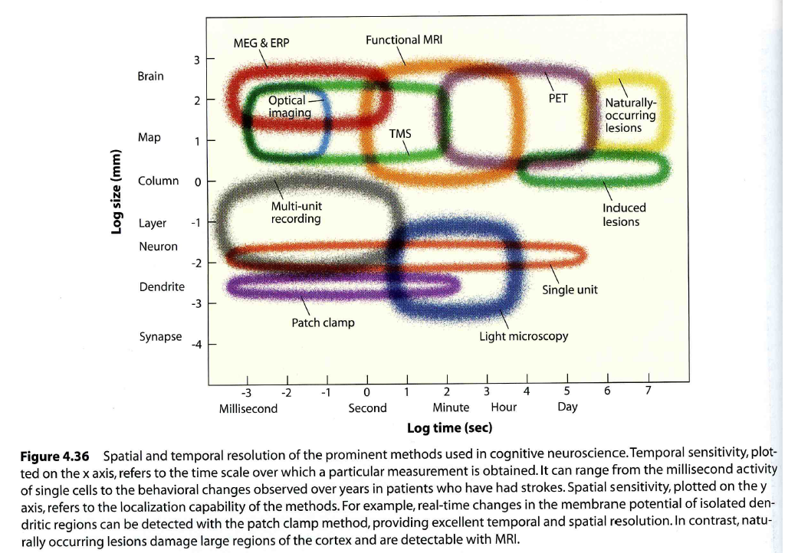
Spatial and temporal resolution of brain imaging methods
[Gazzaniga, Ivry & Mangun, Cognitive Neuroscience, 2nd ed., W.W.Norton & Company, 2002]

Slide 4
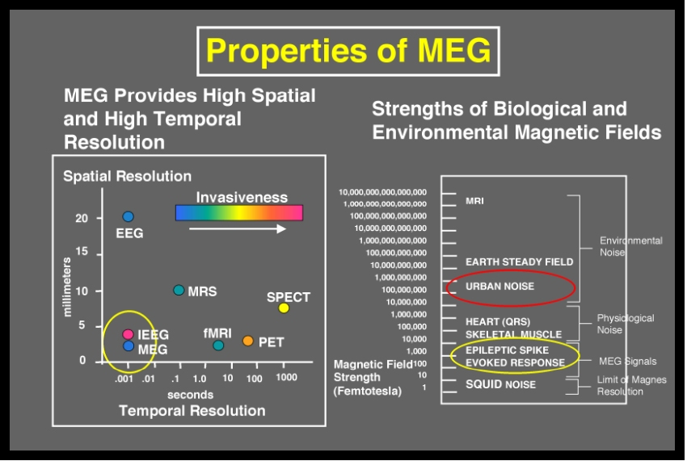
Basics - MEG
MEG registers non-invasively magnetic fields of neuronal activity
Similar to EEG: Registration of neuronal activity
MEG and EEG measure activity of the same generators
PET or fMRI: Indirect measurement of neuronal activity
4D Neuroimaging, San Diego, CA, USA

Slide 5
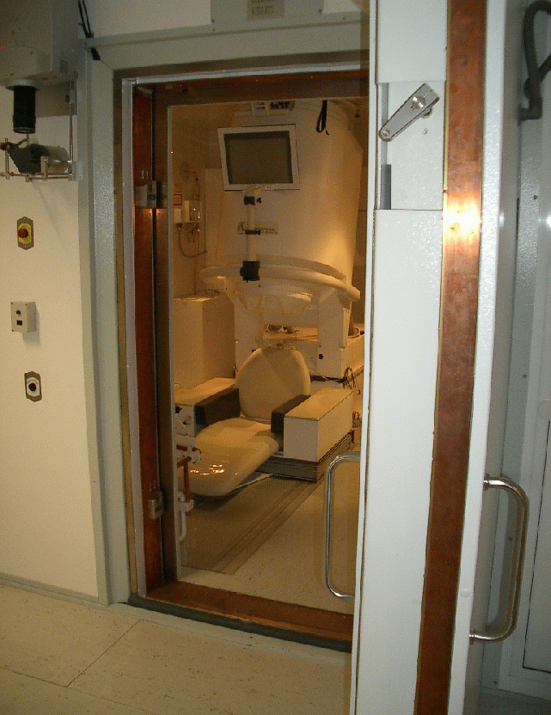
Magnetically shielded room

Slide 6
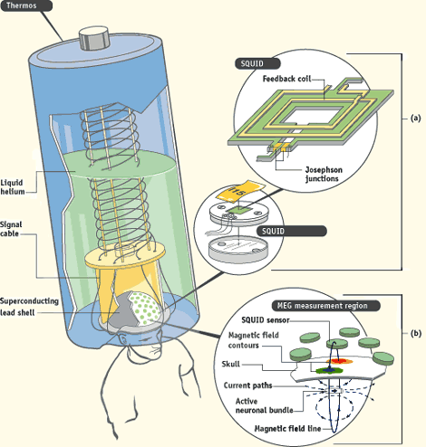
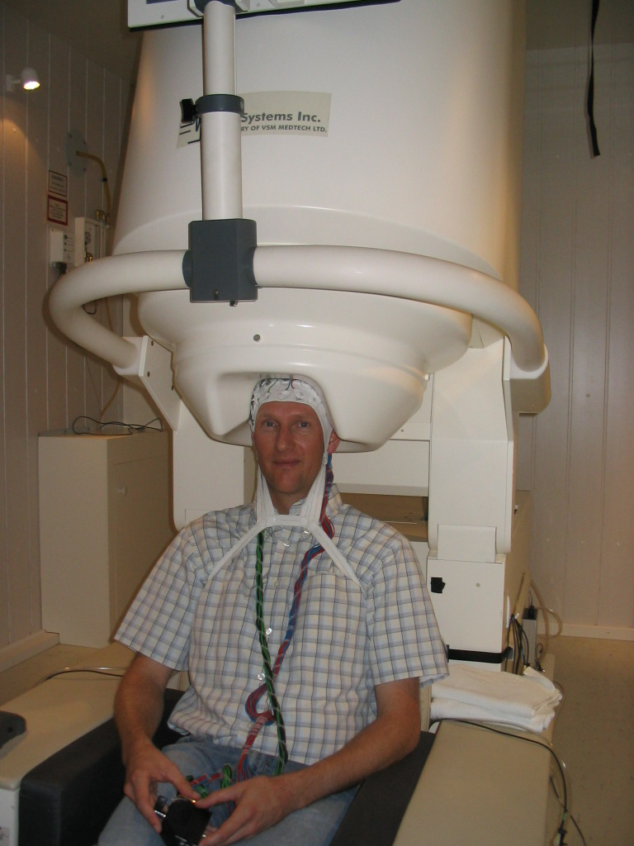
MEG Interna

Slide 7
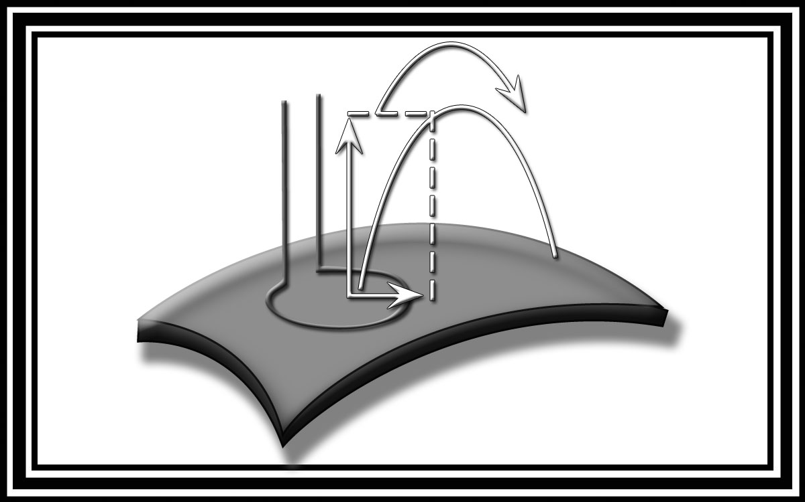
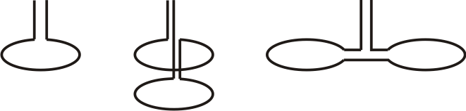
Registration of the magnetic flux
Magnetometer
Superconducting quantum interference device (SQUID)
Axiales Gradiometer
Planares Gradiometer
Papanicolaou (Ed.): Clinical Magnetoencephalography and Magnetic Source Imaging

Slide 8
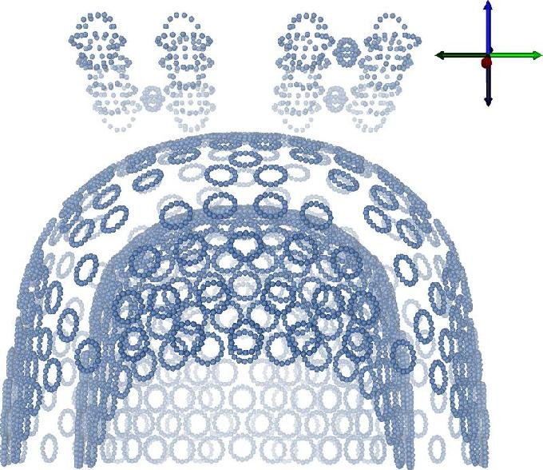
[Lanfer, diploma thesis, 2007]
MEG-system at IBB, Uni Münster
Finite Element nodes for MEG sensor description
Notes:
8

Slide 9
Structure of this lecture
Some more basics of EEG and MEG
Validation of EEG and MEG source analysis techniques
Source analysis of somatosensory (SEP/SEF), auditory (AEP/AEF) and visually evoked potentials and fields (VEP/VEF)
Clinical application of SEP/SEF source analysis: Functional mapping
Applications in presurgical epilepsy diagnosis

Slide 10
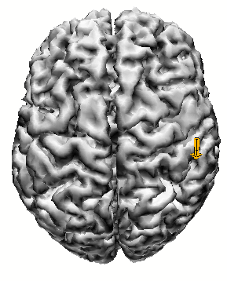
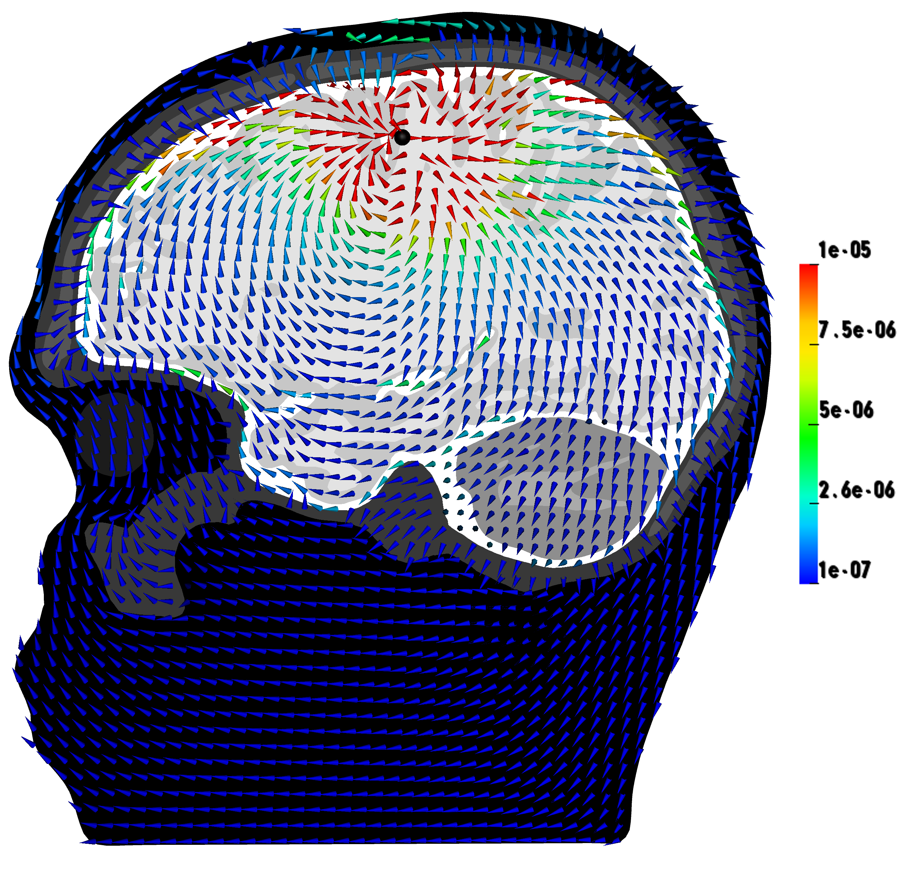
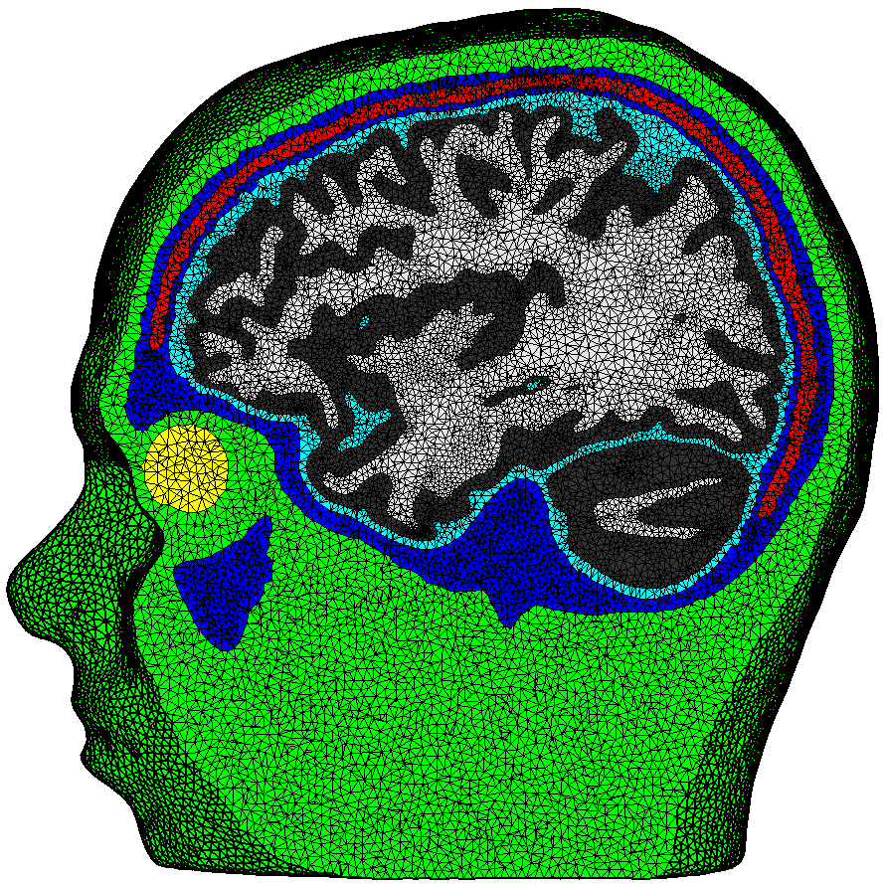
Reminder to the forward problem in EEG/MEG
[Wolters & de Munck, Scholarpedia, 2007]
[de Munck, Wolters & Clerc, In: Handbook of neural activity measurement, 2012]
Simulate
potential distribution
or current
Notes:
10

Slide 11
Step 1 in validation of forward modeling: Computer simulations in multi-layer sphere models

Slide 12
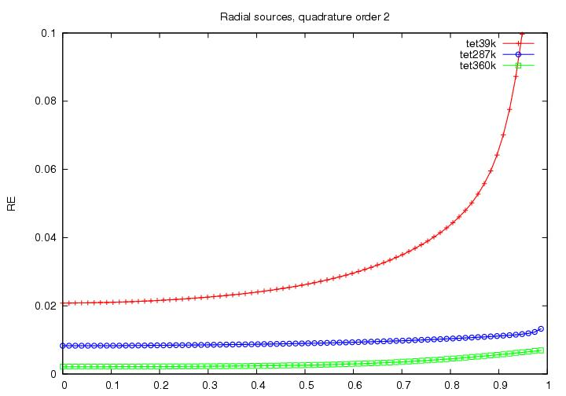
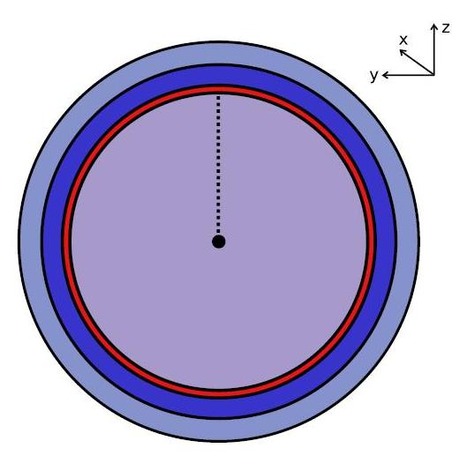
Analytical solutions in multilayer sphere model
[de Munck & Peters, IEEE Trans Biomed. Eng., 1993]
[Wolters, Köstler, Möller, Härtlein, Grasedyck & Hackbusch, SIAM Journal on Scientific Computing, 2007]
4-layer sphere model with 3-layer skull:
Radii: 92, 86:84:82:80, 78mm;
Cond.: 0.33, 0.0062:0.021:0.0049, 1.79, 0.33 S/m
Sources:
Depth from midpoint to CSF boundary
Notes:
D: electric displacement
rho: electric free charge density
E: electric field
B: magnetic induction
mu: magnetic permeability (vacuum)
j: electric current density
Phi: electric scalar potential
Psi: magnetic flux
A: magnetic vector potential
divA=0: Coulomb’s gauge
conductor loop

Slide 13
Next step in validation of source analysis techniques: Animal model

Slide 14
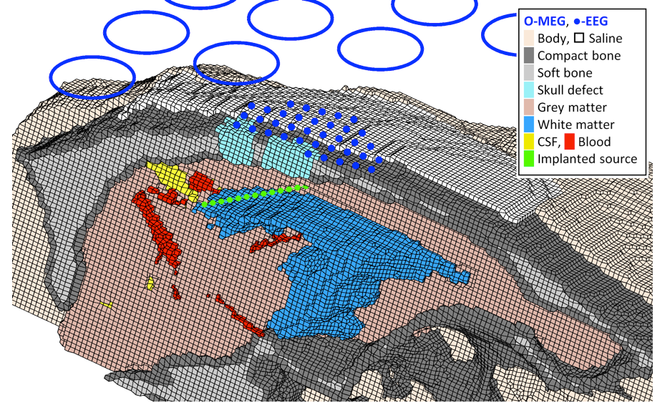
[Lau, Güllmar, Flemming, Grayden, Cook,Wolters & Haueisen, Frontiers in Neuroscience, 2016]
Validation in rabbit investigations

Slide 15
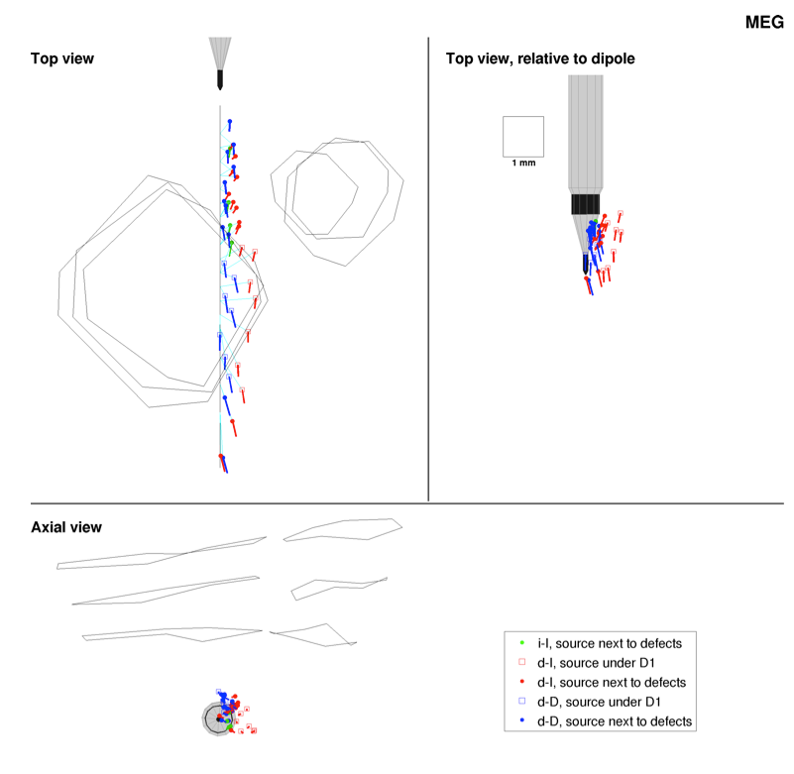
[Lau, Güllmar, Flemming, Grayden, Cook,Wolters & Haueisen, Frontiers in Neuroscience, 2016]
Validation in rabbit investigations

Slide 16
Structure of this lecture
Some more basics of EEG and MEG
Validation of EEG and MEG source analysis techniques
Source analysis of somatosensory (SEP/SEF), auditory (AEP/AEF) and visually evoked potentials and fields (VEP/VEF)
Clinical application of SEP/SEF source analysis: Functional mapping
Applications in presurgical epilepsy diagnosis

Slide 17
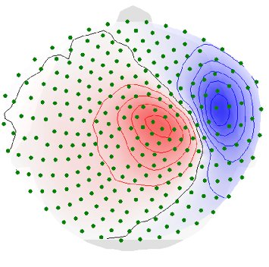
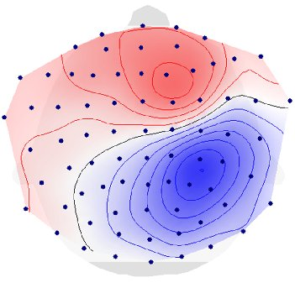
[Aydin, Vorwerk, Küpper, Heers, Kugel, Galka, Hamid, Wellmer, Kellinghaus, Rampp & Wolters, PLOS ONE, 2014]
Source analysis: The inverse Problem
SEF-P20
Reconstruct
source
SEP-P20

Slide 18
[Aydin, Vorwerk, Küpper, Heers, Kugel, Galka, Hamid, Wellmer, Kellinghaus, Rampp & Wolters, PLOS ONE, 2014]
Source analysis: The inverse Problem
SEF-P20
Reconstruct
source
SEP-P20

Slide 19
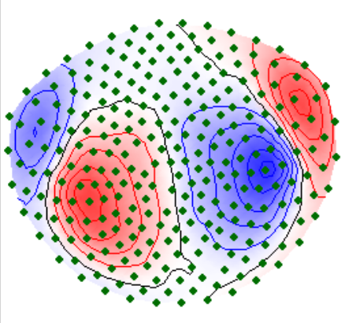
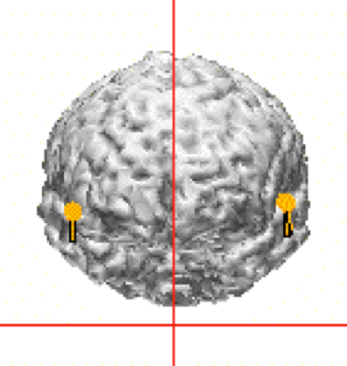
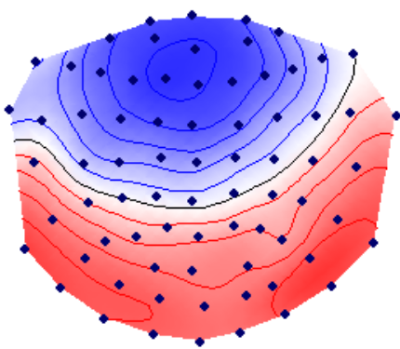
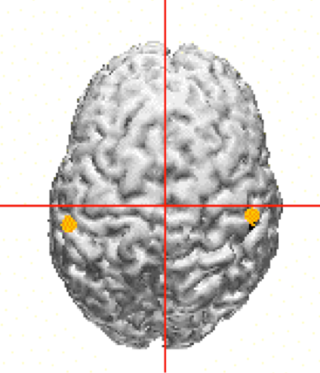
[Okamoto, Stracke, Wolters, Schmael & Pantev, J Neurosci, 2007]
[Lucka, Burger, Pursiainen & Wolters, NeuroImage, 2012]
Source analysis: The inverse Problem
AEF-N100
Reconstruct
sources
AEP-N100

Slide 20
[Okamoto, Stracke, Wolters, Schmael & Pantev, J Neurosci, 2007]
[Lucka, Burger, Pursiainen & Wolters, NeuroImage, 2012]
Source analysis: The inverse Problem
AEF-N100
Reconstruct
sources
AEP-N100

Slide 21
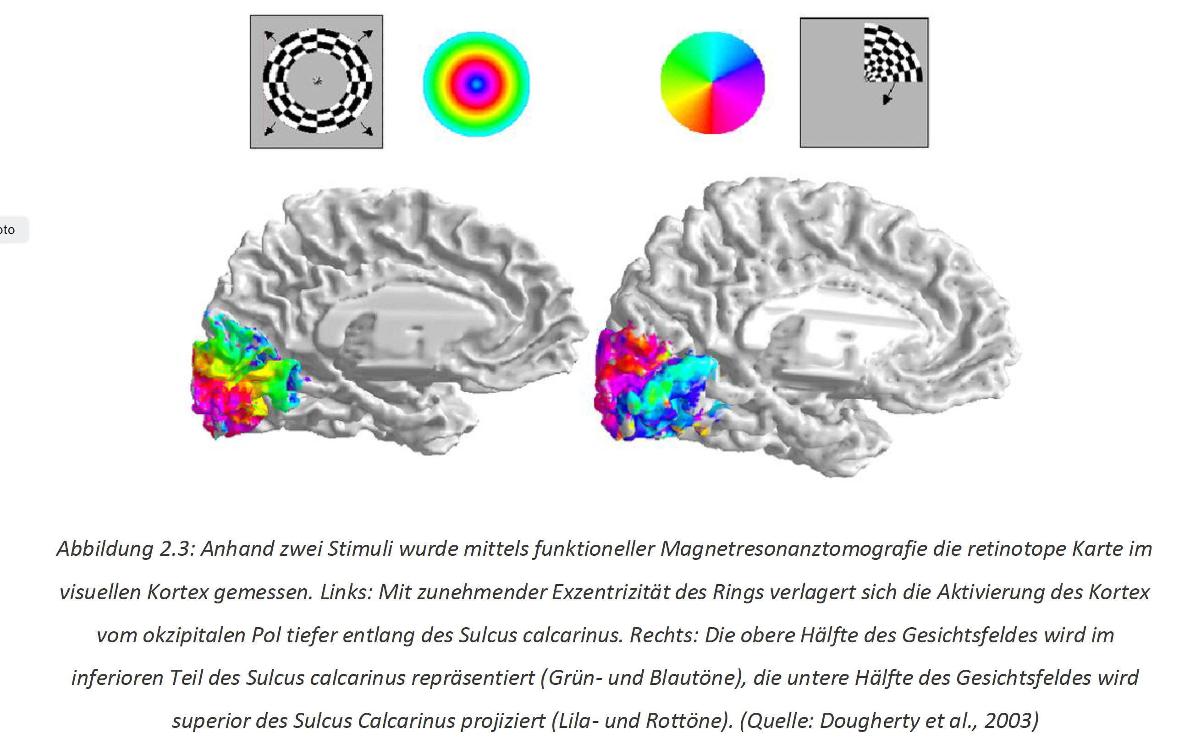
Visually evoked potentials (VEP) and Fields (VEF)
[Rutz, Bachelor Thesis in Biomed Eng, 2022]

Slide 22
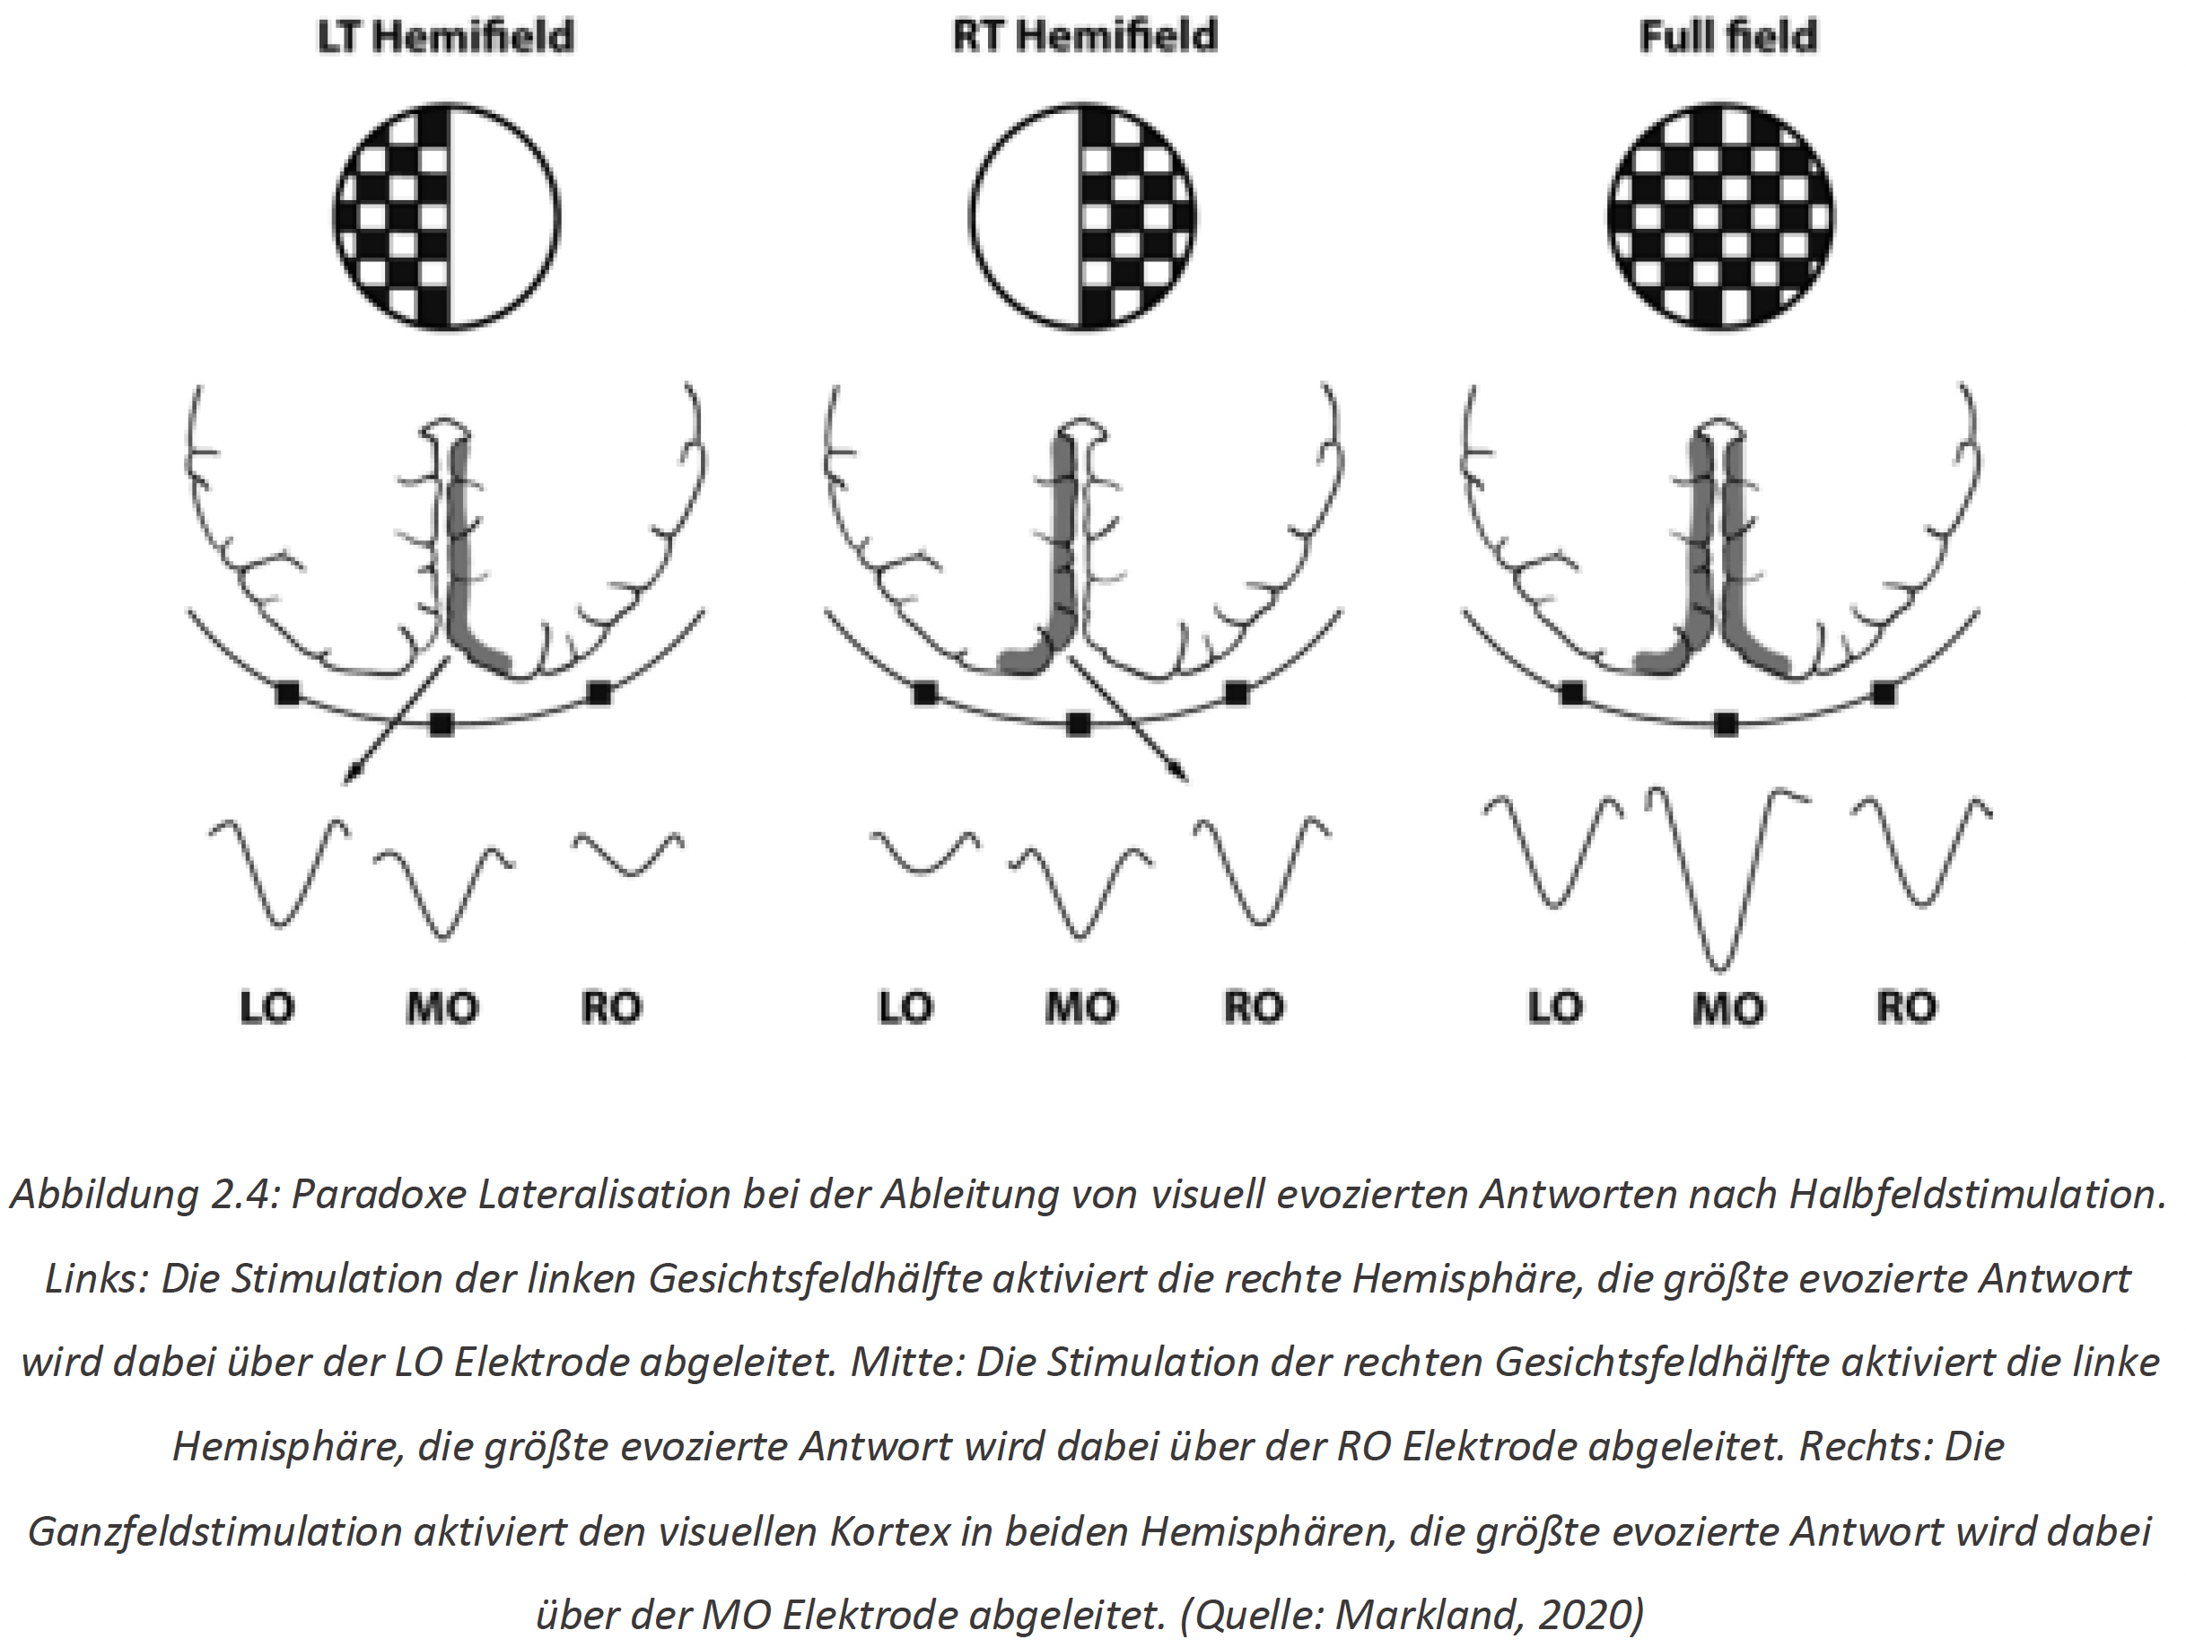
Visually evoked potentials (VEP) and Fields (VEF)
[Rutz, Bachelor Thesis in Biomed Eng, 2022]

Slide 23
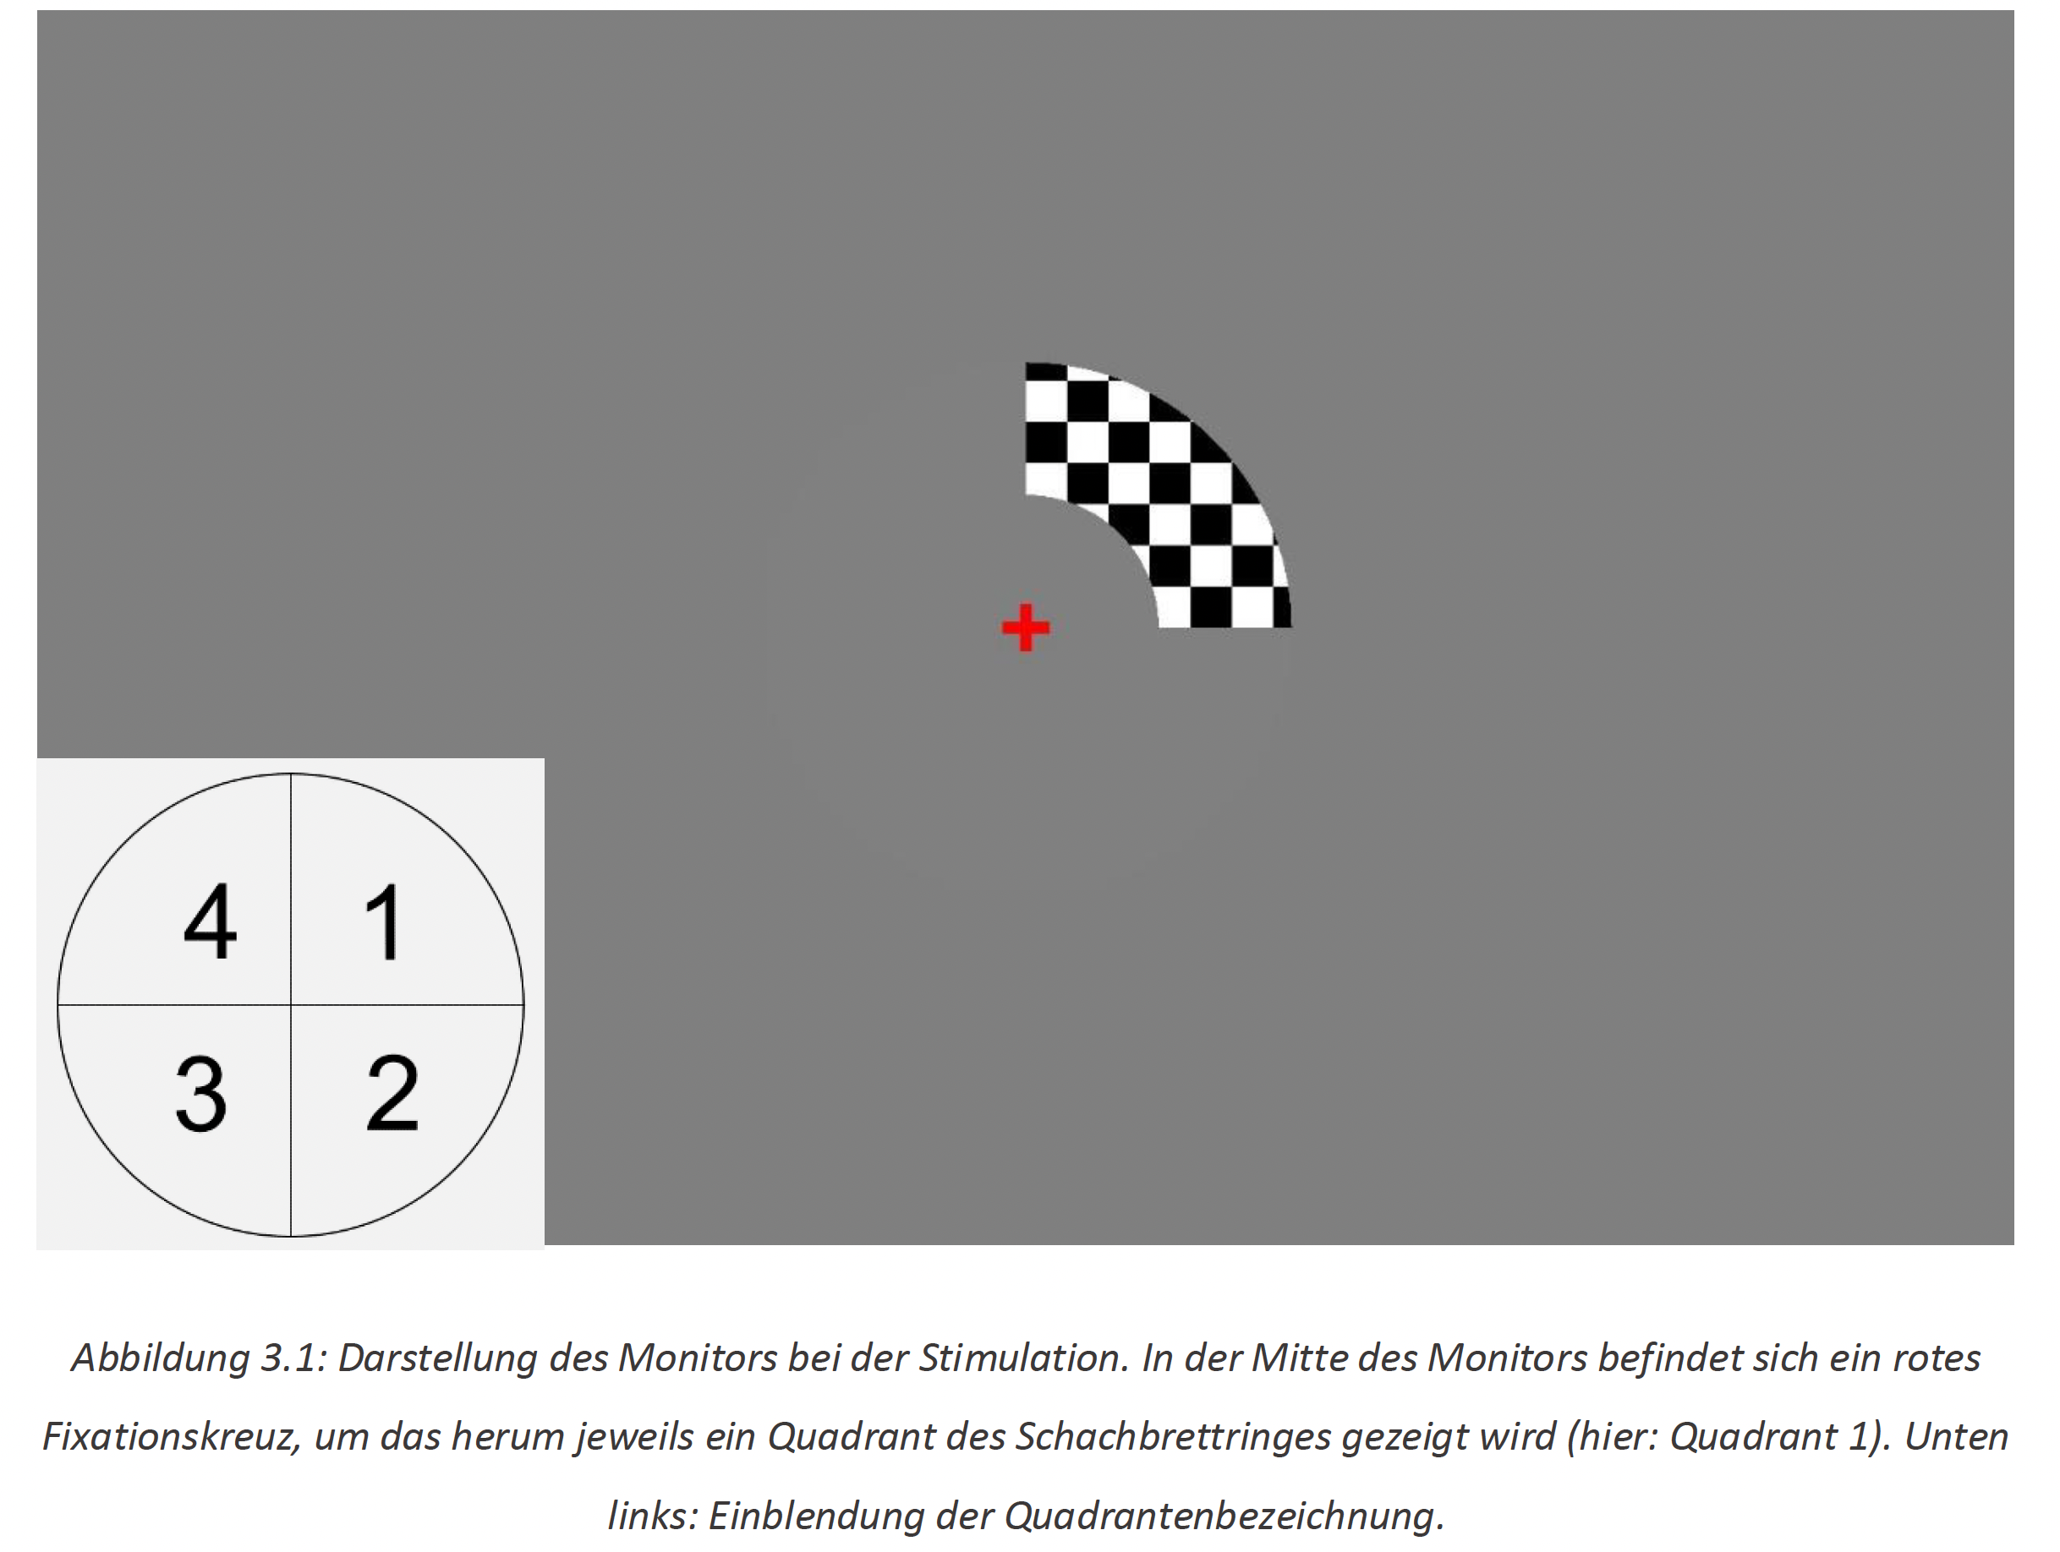
Visually evoked potentials (VEP) and Fields (VEF)
[Rutz, Bachelor Thesis in Biomed Eng, 2022]

Slide 24
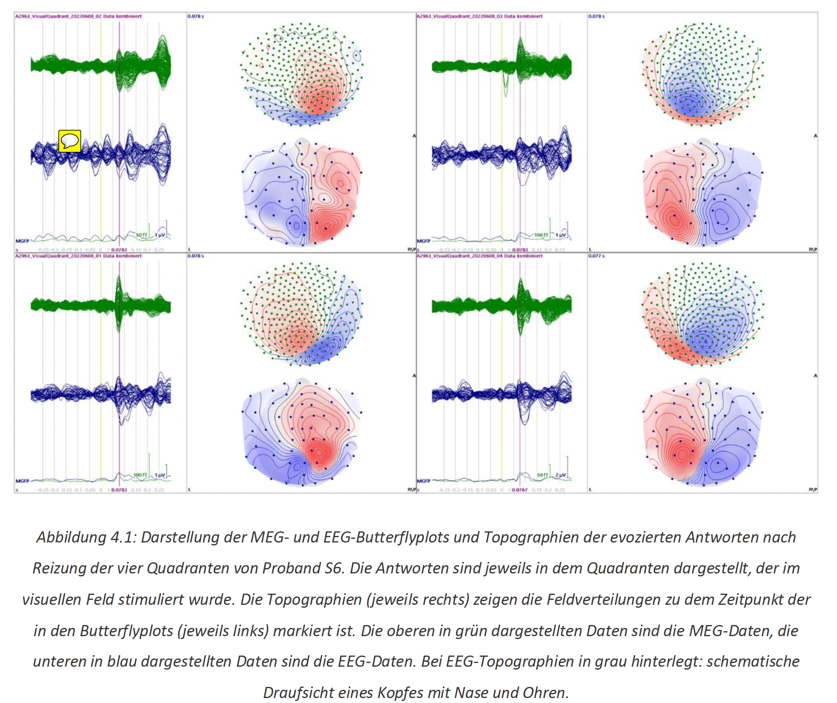
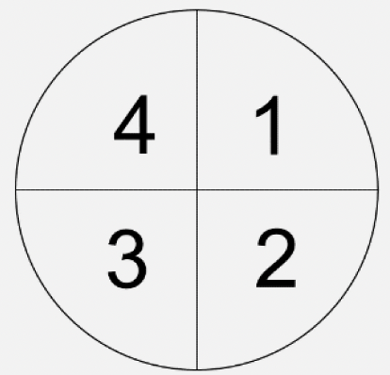
Visually evoked potentials (VEP) and Fields (VEF)
[Rutz, Bachelor Thesis in Biomed Eng, 2022]

Slide 25
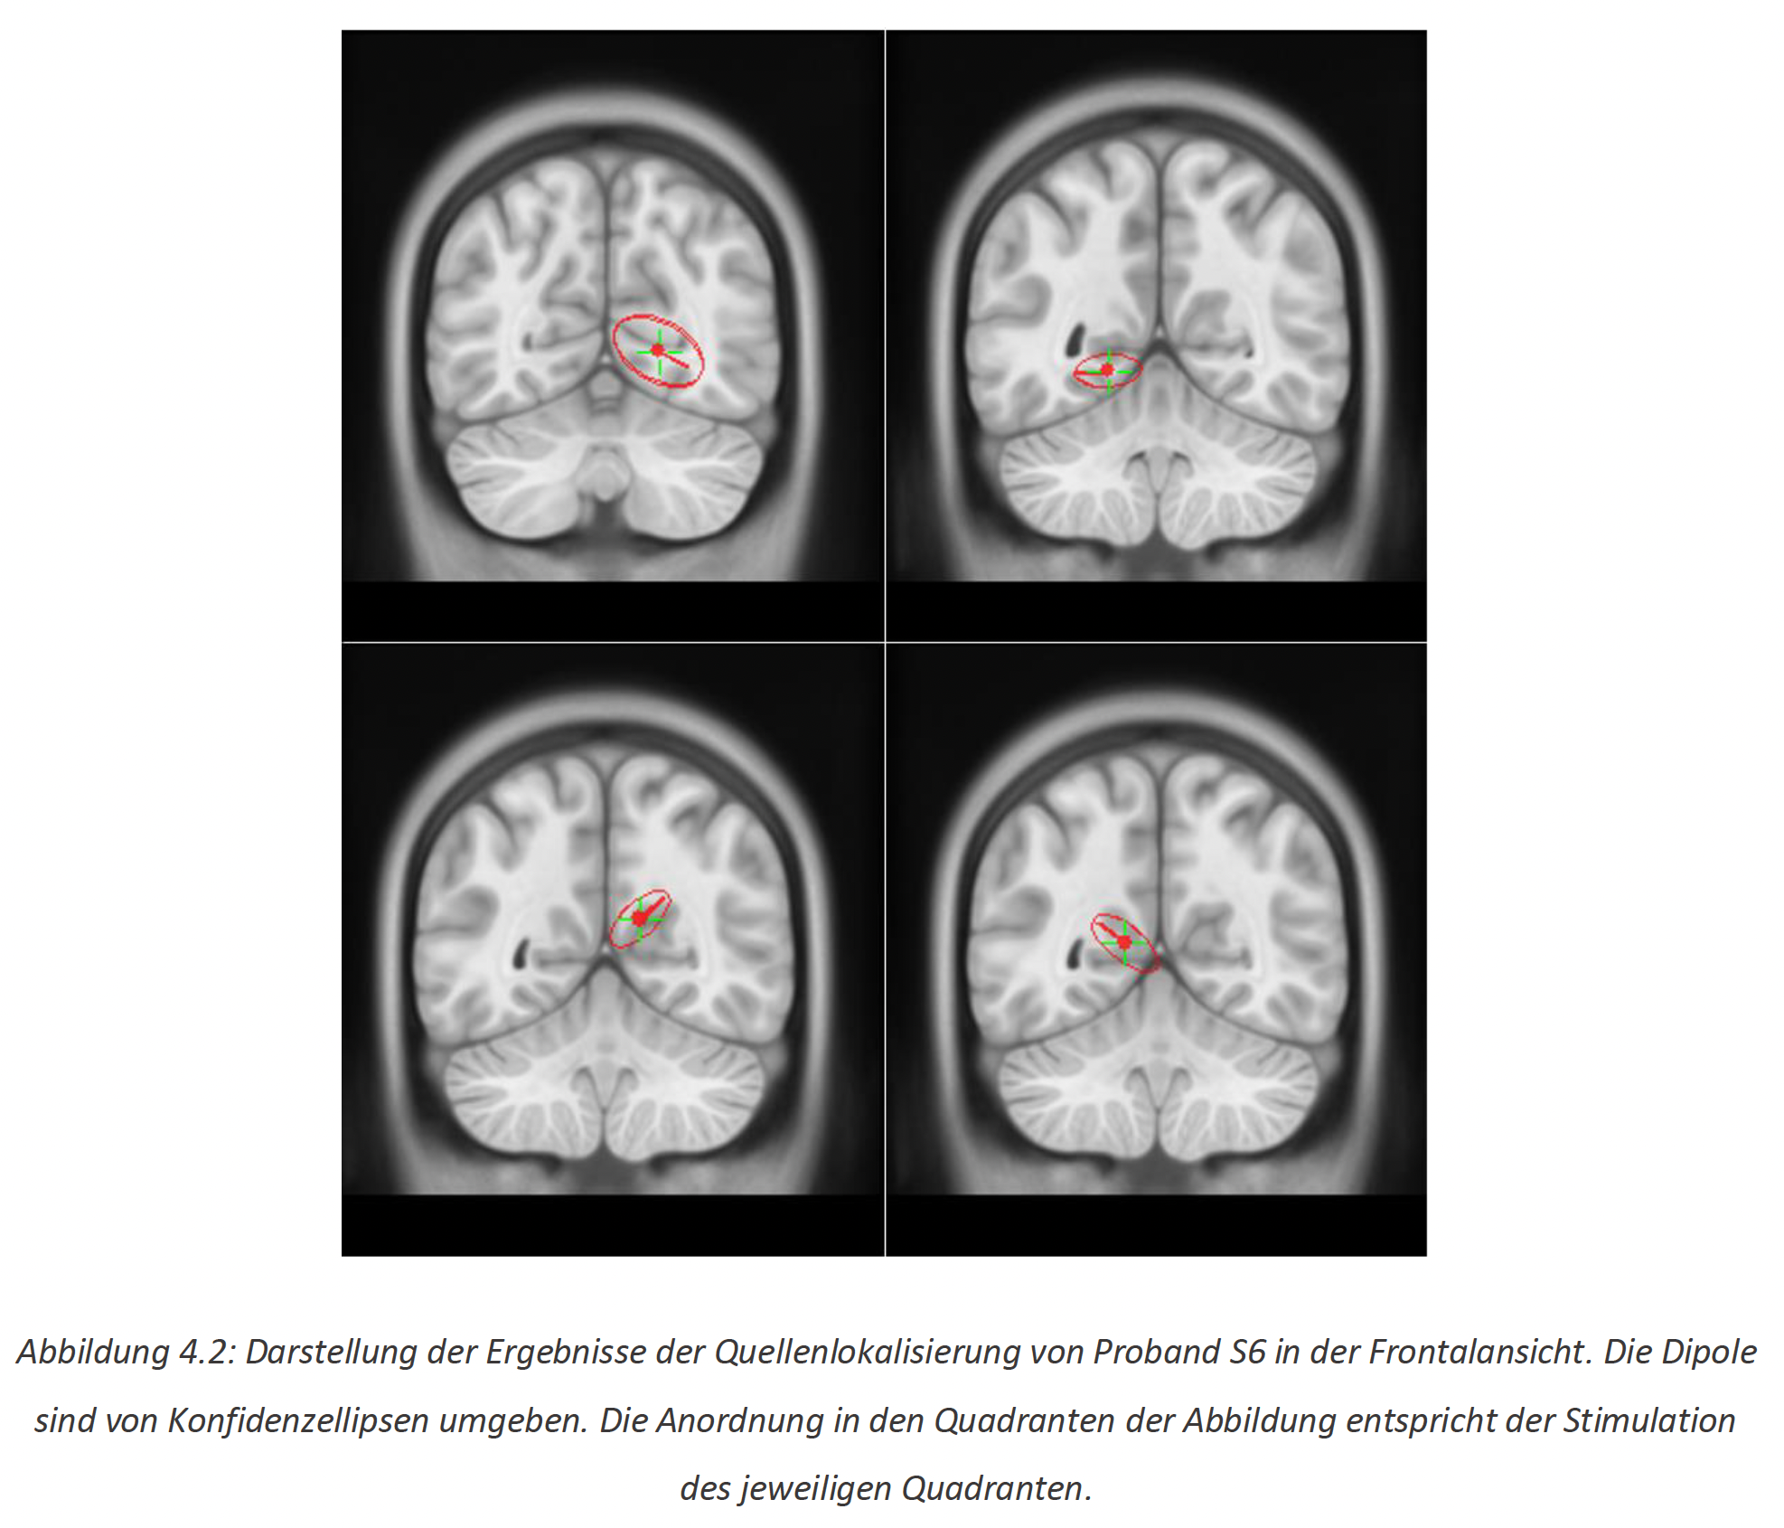
Visually evoked potentials (VEP) and Fields (VEF)
[Rutz, Bachelor Thesis in Biomed Eng, 2022]

Slide 26
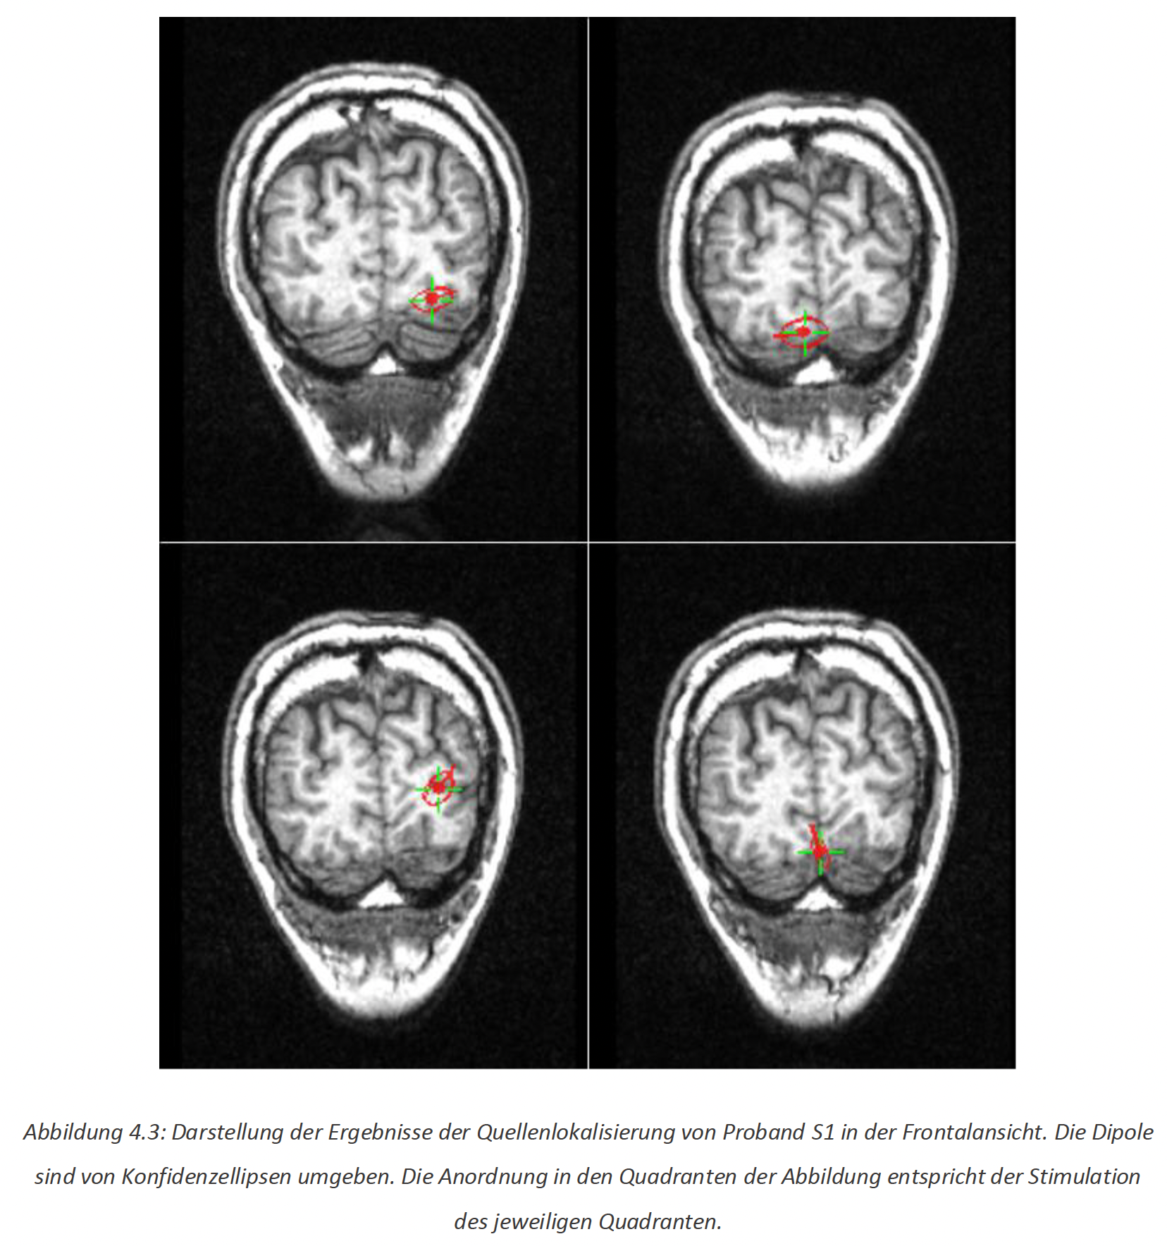
Visually evoked potentials (VEP) and Fields (VEF)
[Rutz, Bachelor Thesis in Biomed Eng, 2022]

Slide 27
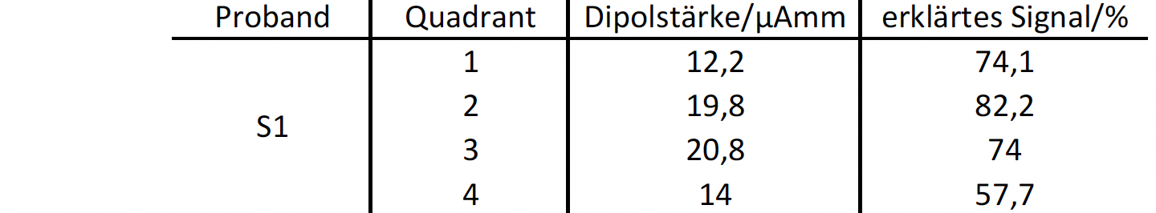
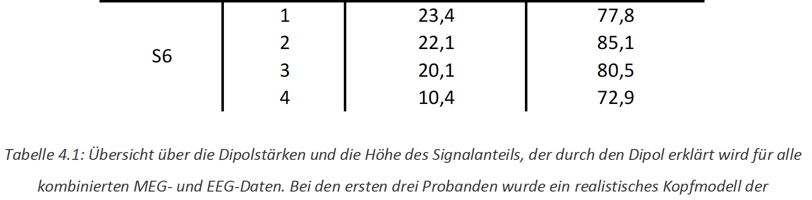
Visually evoked potentials (VEP) and Fields (VEF)
[Rutz, Bachelor Thesis in Biomed Eng, 2022]

Slide 28
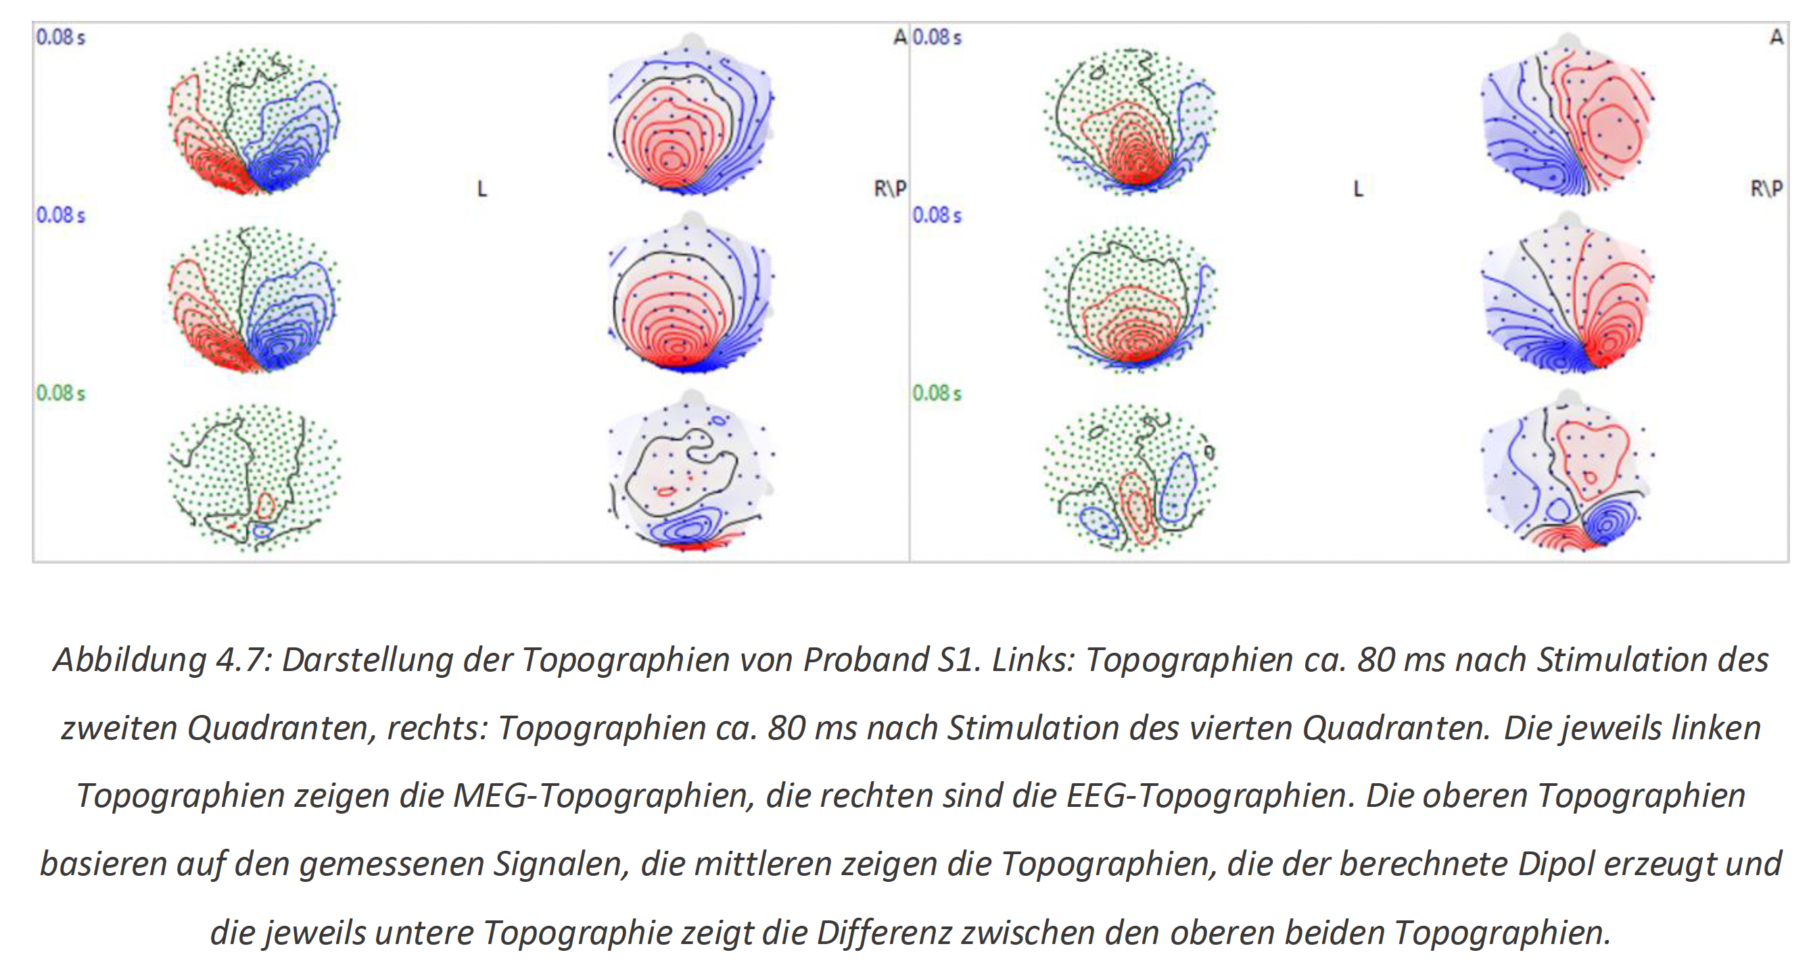
Visually evoked potentials (VEP) and Fields (VEF)
[Rutz, Bachelor Thesis in Biomed Eng, 2022]

Slide 29
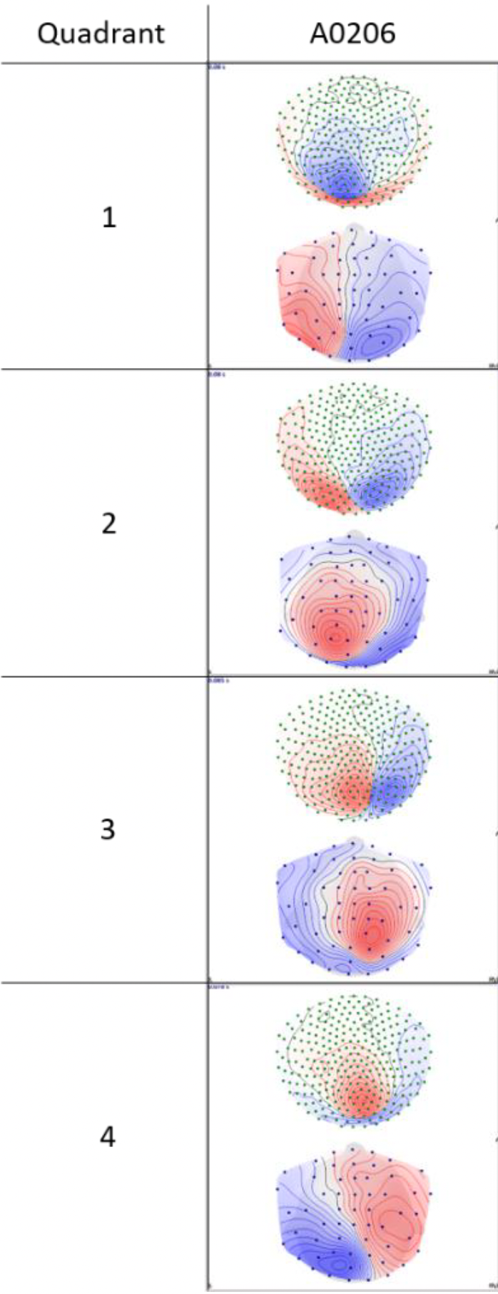
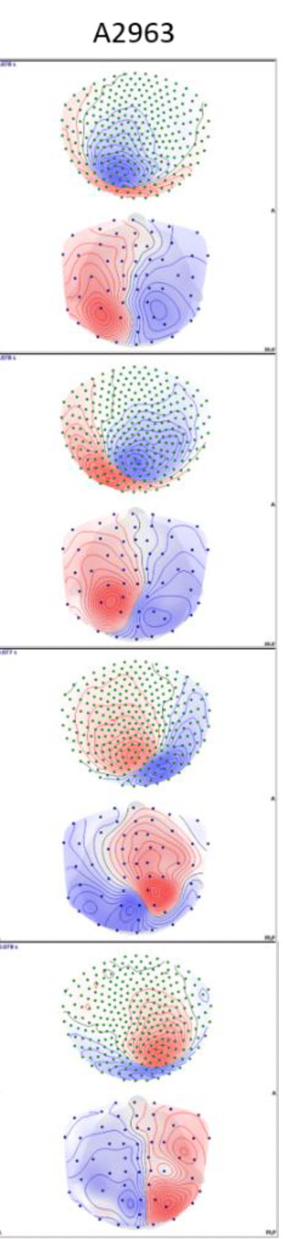
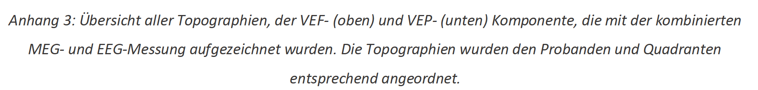
Visually evoked potentials (VEP) and Fields (VEF)
[Rutz, Bachelor Thesis in Biomed Eng, 2022]

Slide 30
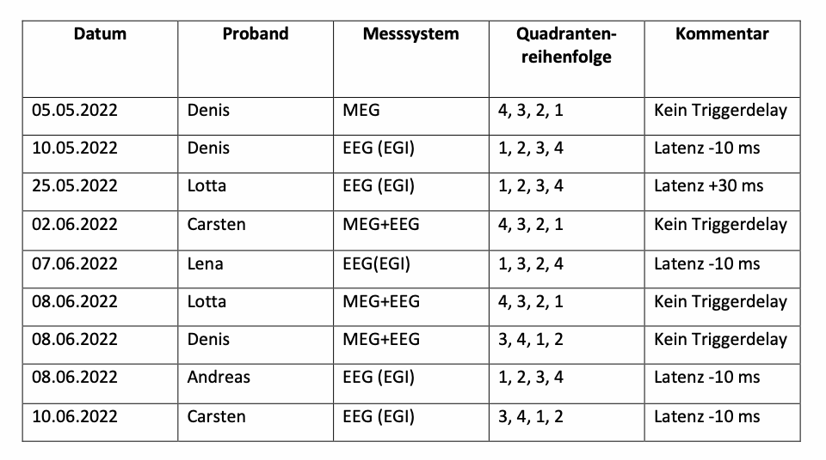
Visually evoked potentials (VEP) and Fields (VEF)
[Rutz, Bachelor Thesis in Biomed Eng, 2022]

Slide 31
Structure of this lecture
Some more basics of EEG and MEG
Validation of EEG and MEG source analysis techniques
Source analysis of somatosensory (SEP/SEF), auditory (AEP/AEF) and visually evoked potentials and fields (VEP/VEF)
Clinical application of SEP/SEF source analysis: Functional mapping
Applications in presurgical epilepsy diagnosis

Slide 32
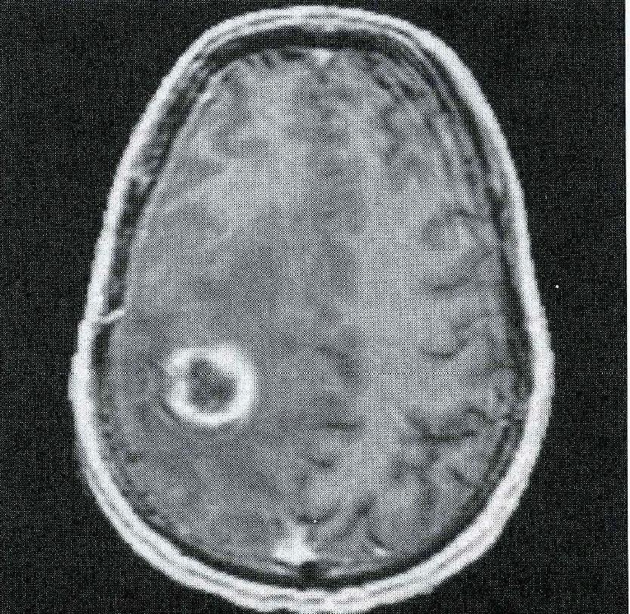
[Roberts, Poeppel and Rowley, MEG and magnetic source imaging, Neuropsychiatry Neuropsych.Behav.Neurol., 11, pp.49-64, 1998]
Clinical applicability of SEP/SEF source analysis
Tumor near the central sulcus

Slide 33
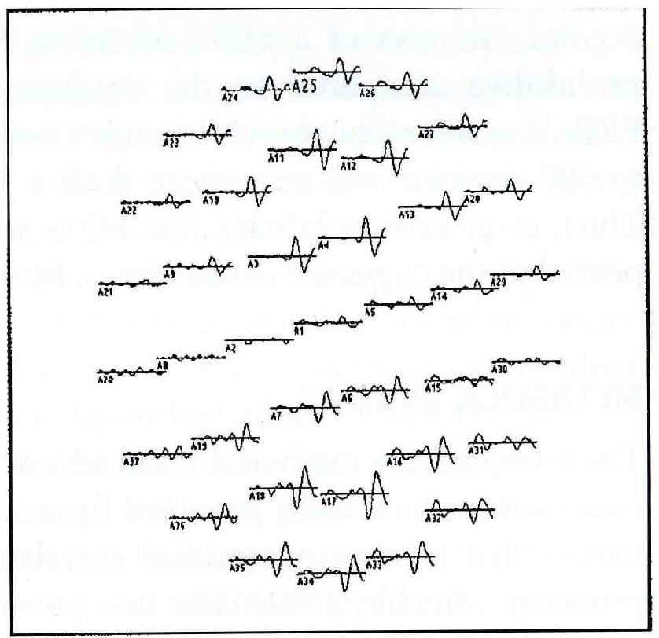
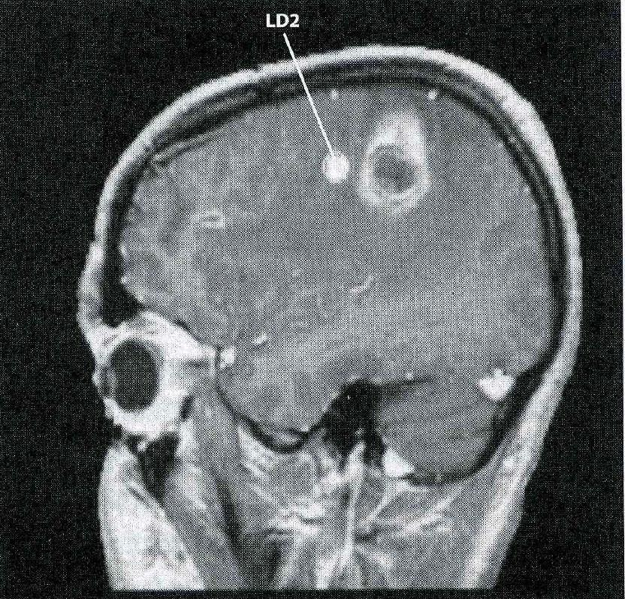
[Roberts, Poeppel and Rowley, MEG and magnetic source imaging, Neuropsychiatry Neuropsych.Behav.Neurol., 11, pp.49-64, 1998]
Clinical applicability of SEP/SEF source analysis
Tactile stimulation of the right index finger: SEF (left) and fitted dipole (right)

Slide 34
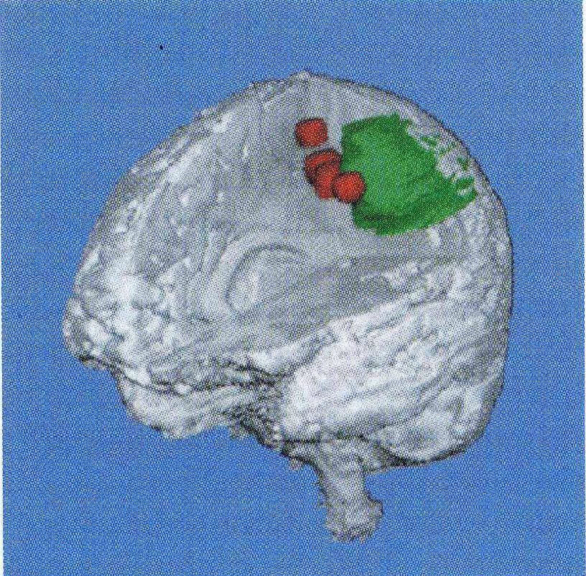
[Roberts, Poeppel and Rowley, MEG and magnetic source imaging, Neuropsychiatry Neuropsych.Behav.Neurol., 11, pp.49-64, 1998]
Clinical applicability of SEP/SEF source analysis
Tumor (green) and MEG dipole fits (red) for continuous stimulation of fingers and toes

Slide 35
Structure of this lecture
Some more basics of EEG and MEG
Validation of EEG and MEG source analysis techniques
Source analysis of somatosensory (SEP/SEF), auditory (AEP/AEF) and visually evoked potentials and fields (VEP/VEF)
Clinical application of SEP/SEF source analysis : Functional mapping
Applications in presurgical epilepsy diagnosis

Slide 36
Source analysis in presurgical epilepsy diagnosis
0.5%-1% of world population suffers from epilepsy, most of them from focal epilepsy
70-80% of patients successfully treated with drugs
For those who are still pharma-resistent after 2-3 drugs
  Probability of success of a further different drug: 6% (Wiebe et al 2001)
  Probability of success of a surgical treatment: 50% (Wiebe et al 2001)
Indispensable prerequisite for surgery: Focal epilepsy->Localization
  Gold standard: Video-monitoring and visual inspection of the EEG (Wilson 1996)
  MRI: Identification of an underlying lesion
  PET and Neuropsychology: Localization of a functional deficit
  Source analysis of
    EEG seizure (ictal) activity (Plummer et al., 2008)
    EEG/MEG interictal activity: “irritative zone” (Stefan et. al., 2003)
Notes:
PEBBLES: Parallel and Element Based grey Box Linear Equation Solver

Slide 37
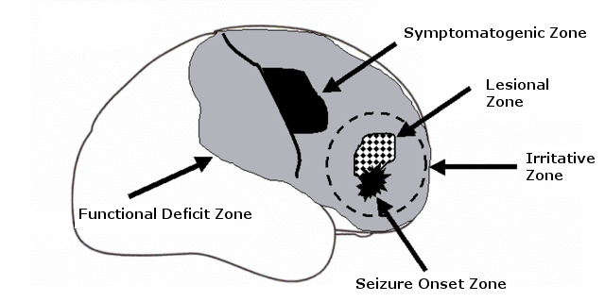
Zone-concept in epilepsy diagnosis
EEG(/MEG) registration during a seizure (ictal)
Interictal spikes in EEG/MEG
Notes:
Analysis of seizure semiology determines the identification of the symptomatogenic zone. In addition, the EEG recording during a seizure (ictal) is needed to detect the seizure onset zone, the magnetic resonance imaging (MRI) localizes an underlying lesion, and the functional deficit zone is determined by nuclear imaging (PET) and/or corresponding deficits in neuropsychological testing (Rosenow and Lüders, 2001).

Slide 38
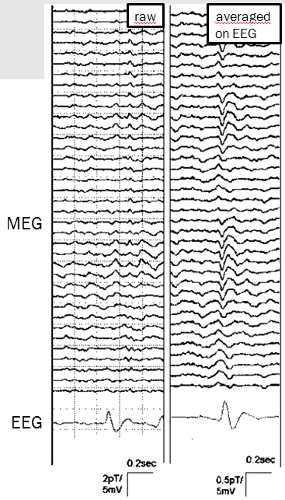
Epileptic spikes in EEG and MEG
Clear spike in EEG
Nearly no/no signal in MEG

Slide 39
Epileptic spikes in EEG and MEG
Clear spike in EEG
Nearly no/no signal in MEG
Deep source
Strongly radially oriented source

Slide 40
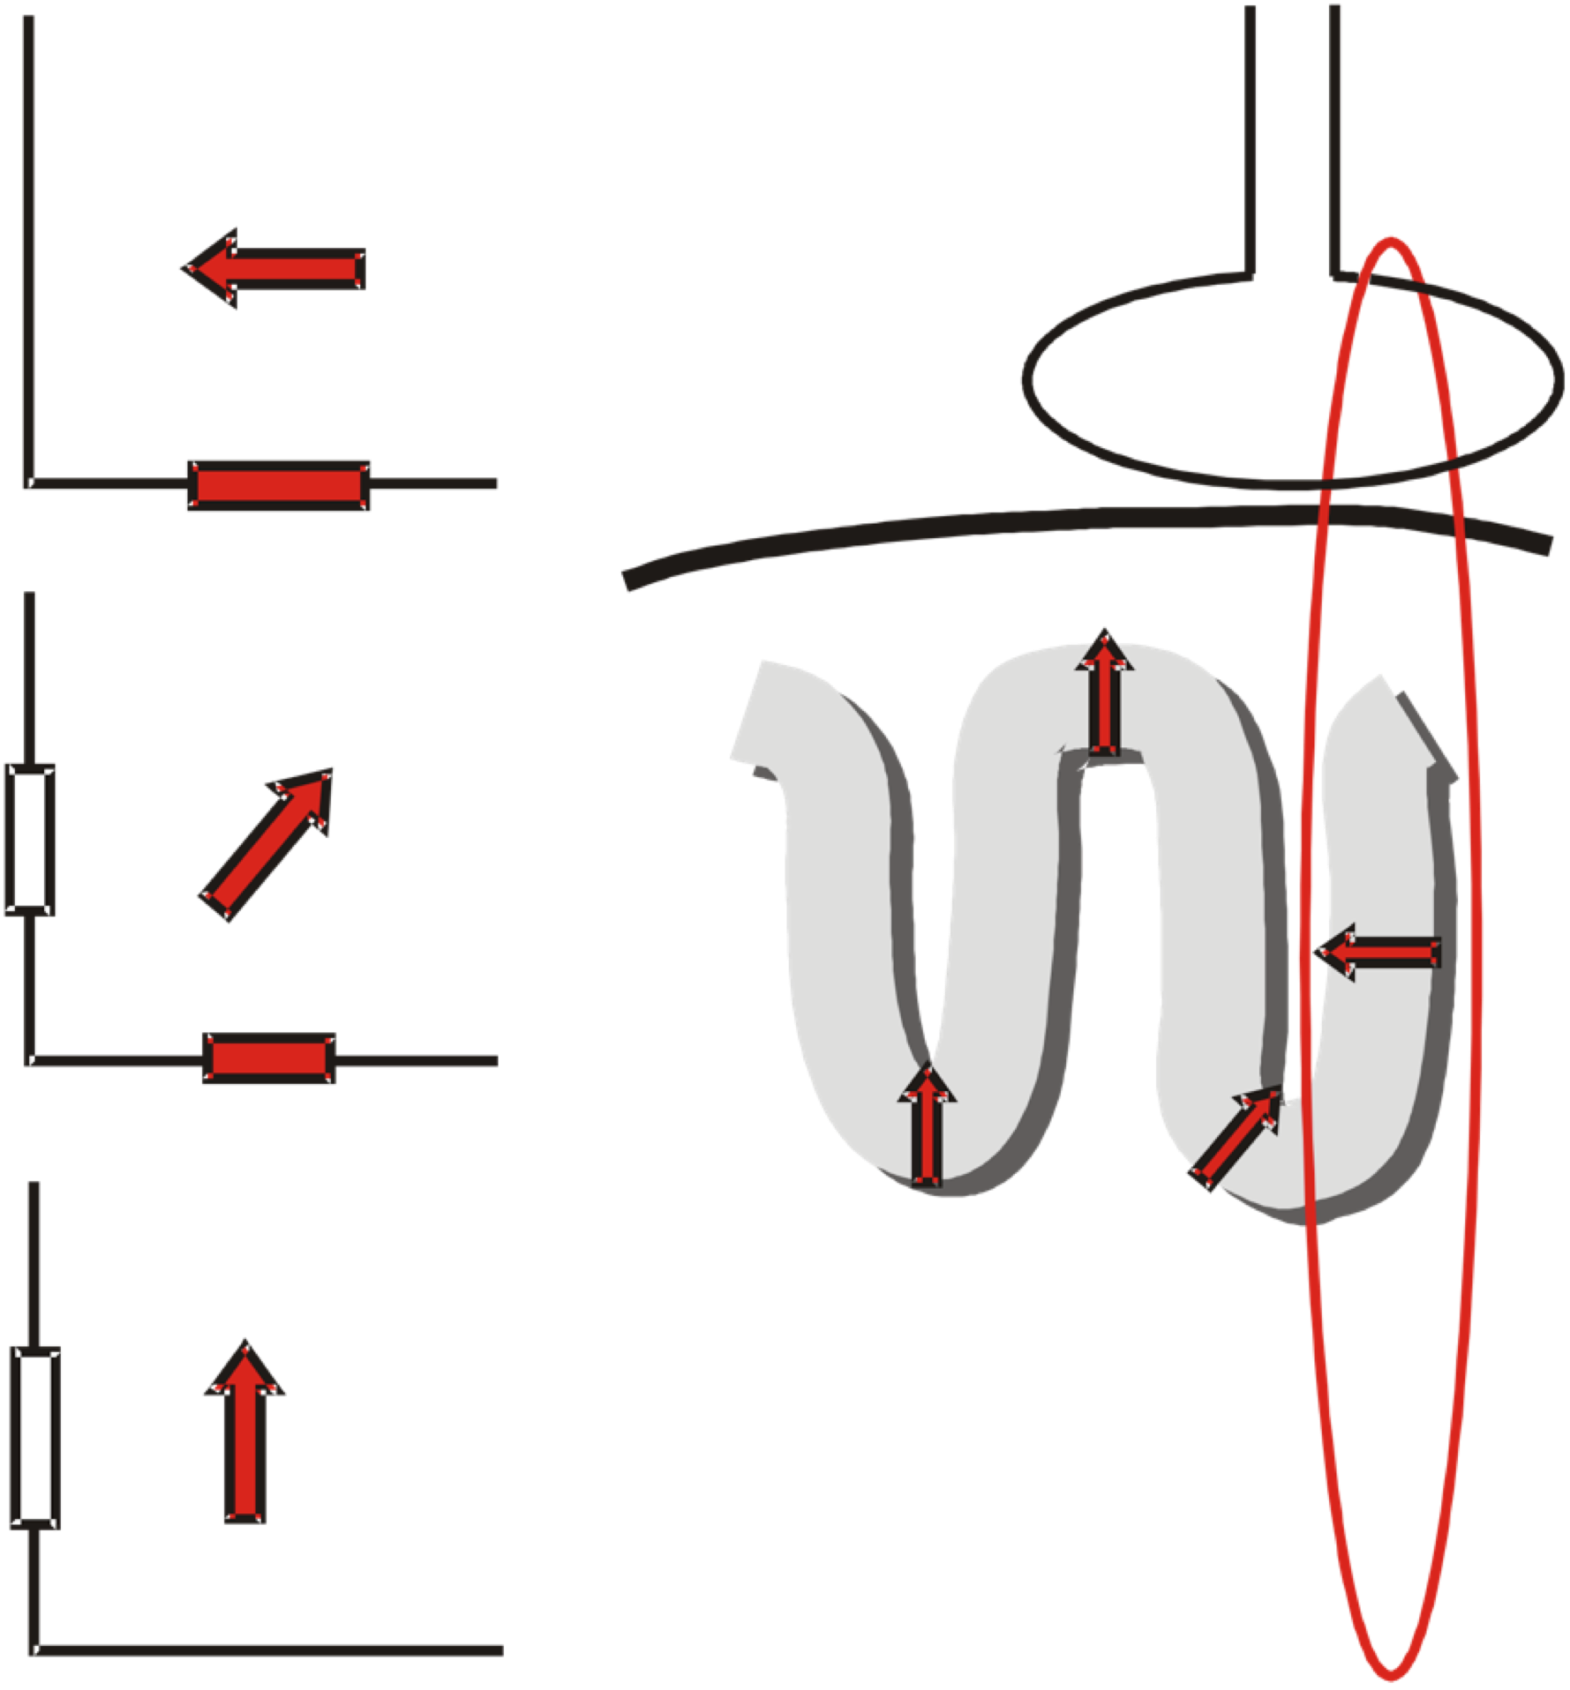
Sensitivity for radial and tangential sources
MEG registers mainly tangential source components: Sulci-walls: tangential pyramidal cells
-> High amplitudes
„Diagonal“ orientation
-> Medium amplitude
Radial sources hardly produce an MEG: Depth and crown of sulci: radial pyramidal cells
-> Low contribution

Slide 41
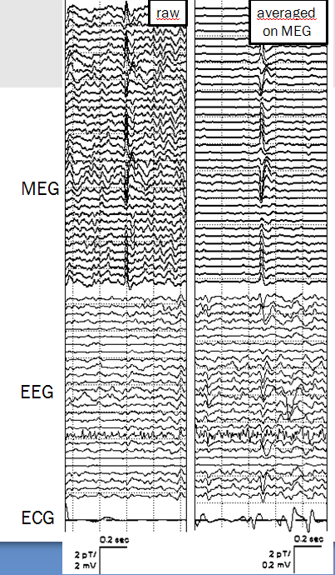
Epileptic spikes in
EEG and MEG
Clear signal in MEG,
poor signal in EEG
Explanation?

Slide 42
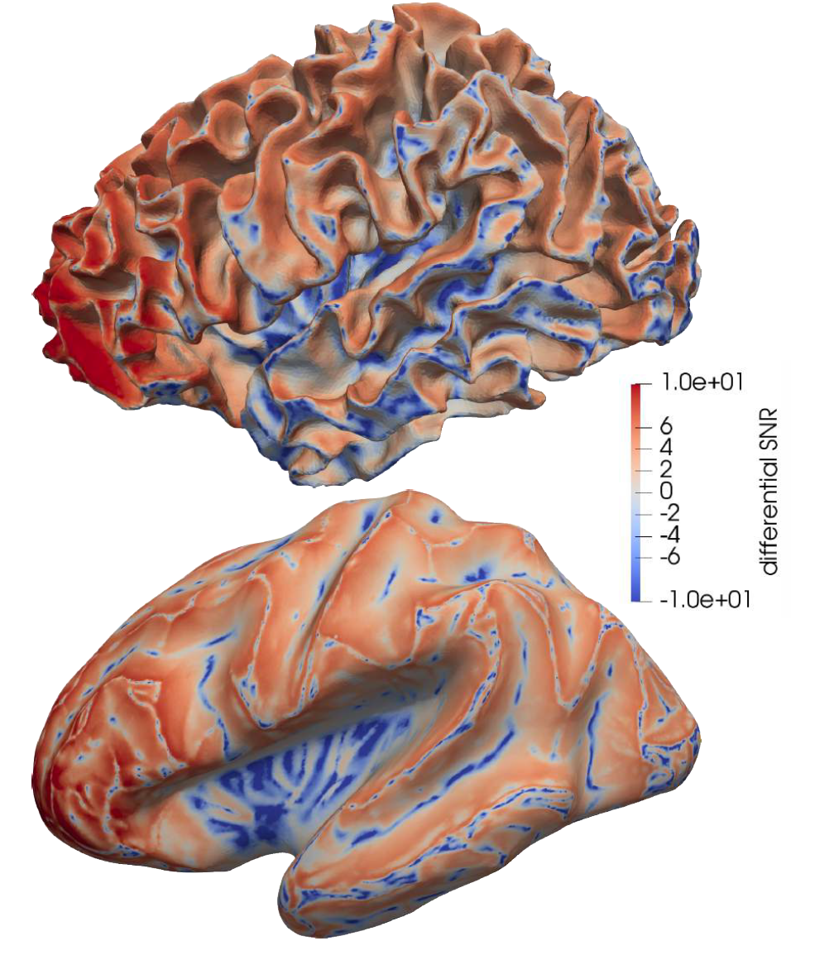
Sensitivity
[Piastra,… & Wolters, in preparation for submission]
Blue: Sensitivity EEG > MEG
for radial and deep sources
Red: Sensitivity MEG > EEG
in sulcal wall areas
Goldenholz et al., 2009

Slide 43
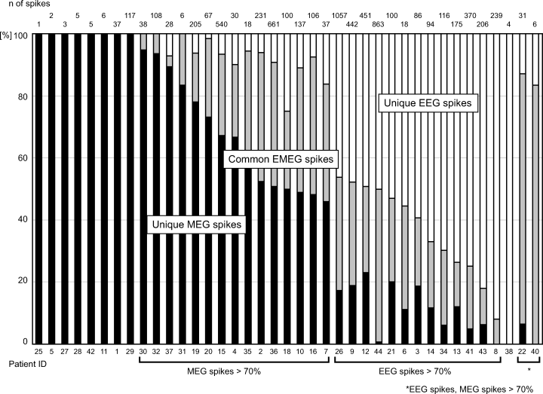
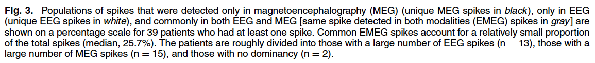
Complementarity of EEG and MEG
Iwasaki et al 2005:
  EEG/MEG: 72% (31/43 pat)
  Only EEG: 2% (1/43 pat)
  Only MEG: 19% (8/43 pat)
  None: 7% (3/43 pat)
Knake et al 2006:
  EEG/MEG: 75% (50/67 pat)
  Only EEG: 3% (2/67 pat)
  Only MEG: 13% (9/67 pat)
  None: 25% (17/67 pat)
What should we use?
MEG instead of EEG? Only EEG?

Slide 44
Combined EEG and MEG
275 channel axial gradiometer whole-cortex MEG
128 channel EEG
Notes:
Cohen et al. measured first MEG in 1968: alpha-activity is about 10^7 times weaker than the earth magnetic field

Slide 45
Patient study 1: Source analysis of interictal spikes in presurgical epilepsy diagnosis

Slide 46
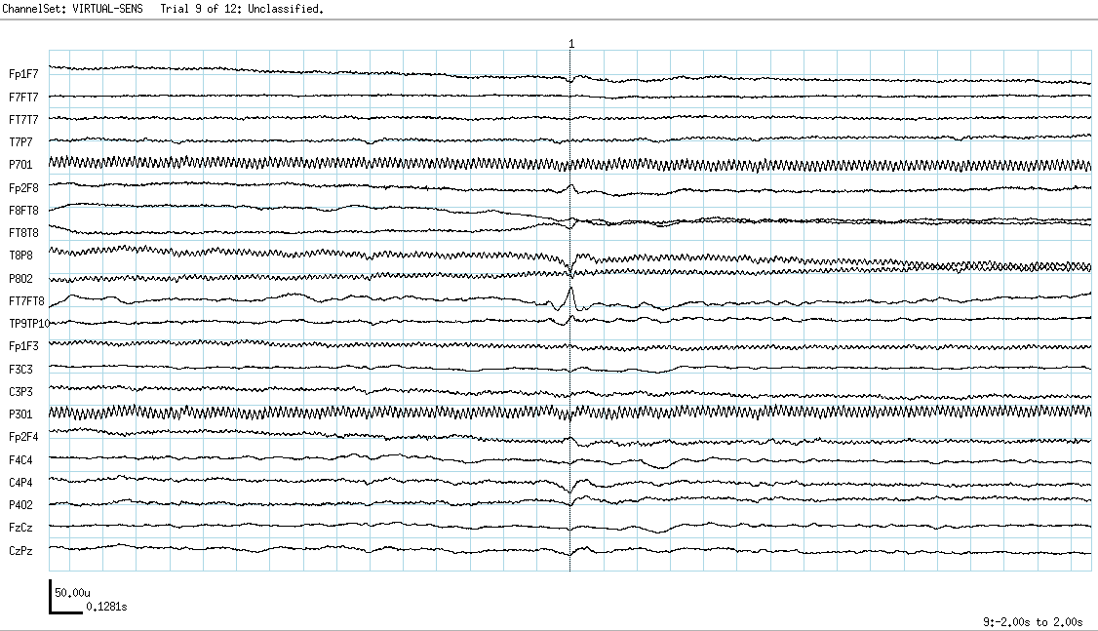
Averaged interictal EEG spikes
[Wolters & Kellinghaus, 2006]
Measure EEG and/or MEG
Notes:
About 0.25% of the world population suffers from drug-resistnt epilepsy and bout 10-15% would profit from a surgical removl of the epileptogenic tissue.
42 year old female suffering from medically intractable complex partial seizures of mesial-temporal origin
Seizures had duration of up to 10 minutes and a frequency of twice to 5 times a month
Measurements:
=========
A short-term barbiturate (Schlafmittel), known to provoke epileptiform activity
-> 60-channel EEG montage with reference at the ear contralateral to the epileptic focus
Source reconstruction:
==============
Single dipole fit at signal peak
->Localization of the secondary activations, propagating along the temporal cortical surface
->Primary activity in the hippocampus and the amygdala (cannot be measured outside)
Therapy:
======
Selective amygdalohippocampectomy
-> Patient free of seizures

Slide 47
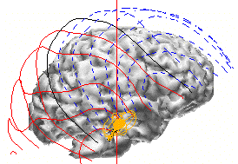
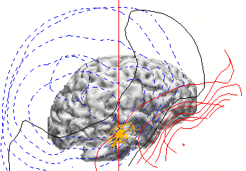
Results of combined EEG/MEG dipole fit
[Wolters & Kellinghaus, 2006]
EEG data and (transparent) cortex
MEG data and (transparent) cortex
Inverse method: Single current dipole
Notes:
42 year old female suffering from medically intractable complex partial seizures of mesial-temporal origin
Seizures had duration of up to 10 minutes and a frequency of twice to 5 times a month
Measurements:
=========
A short-term barbiturate (Schlafmittel), known to provoke epileptiform activity
-> 60-channel EEG montage with reference at the ear contralateral to the epileptic focus
Source reconstruction:
==============
Single dipole fit at signal peak
->Localization of the secondary activations, propagating along the temporal cortical surface
->Primary activity in the hippocampus and the amygdala (cannot be measured outside)
Therapy:
======
Selective amygdalohippocampectomy
-> Patient free of seizures

Slide 48
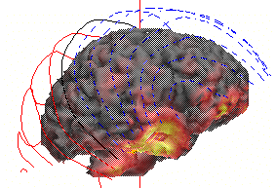

Results of combined EEG/MEG L1 norm current density reconstruction
[Wolters & Kellinghaus, 2006]
EEG data and (nontransparent) cortex
MEG data and (nontransparent) cortex
Inverse method: L1 norm current density
Notes:
42 year old female suffering from medically intractable complex partial seizures of mesial-temporal origin
Seizures had duration of up to 10 minutes and a frequency of twice to 5 times a month
Measurements:
=========
A short-term barbiturate (Schlafmittel), known to provoke epileptiform activity
-> 60-channel EEG montage with reference at the ear contralateral to the epileptic focus
Source reconstruction:
==============
Single dipole fit at signal peak
->Localization of the secondary activations, propagating along the temporal cortical surface
->Primary activity in the hippocampus and the amygdala (cannot be measured outside)
Therapy:
======
Selective amygdalohippocampectomy
-> Patient free of seizures

Slide 49







  Thank you for your attention!
SIM-NEURO
work-group

