Slide 1
The finite element method and convergence theory for the EEG forward problem solution
Carsten H. Wolters
Institut für Biomagnetismus und Biosignalanalyse, Westf. Wilhelms-Universität Münster, Germany
Lectures on Nov.12, 2024

Slide 2
Structure of the lecture
Convergence analysis for FEM subtraction approach (sections 6.5.1-6.5.3 of lecture scriptum)
Other source models (section 6.5.4 of lecture scriptum)
Overview: Multi-layer sphere model (section 6.2 of lecture scriptum)
Forward modeling results
The local subtraction approach

Slide 3
Overview: Subtraction approach
[Wolters et al., SIAM J Sci Comp, 2007]
[Drechsler et al., NeuroImage, 2009]
[Wolters, Lecture scriptum]

Slide 4
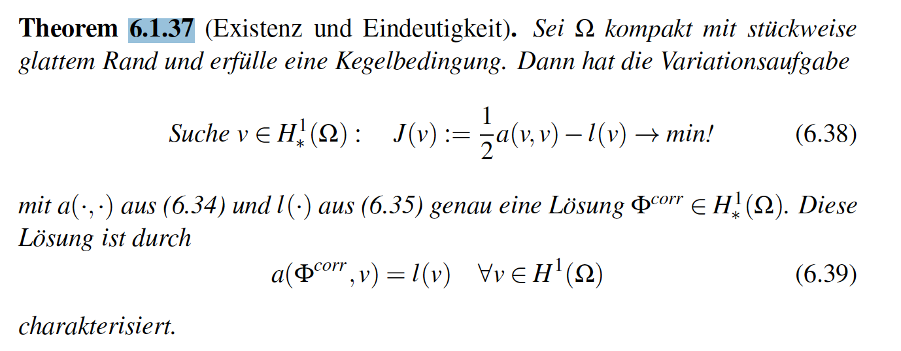
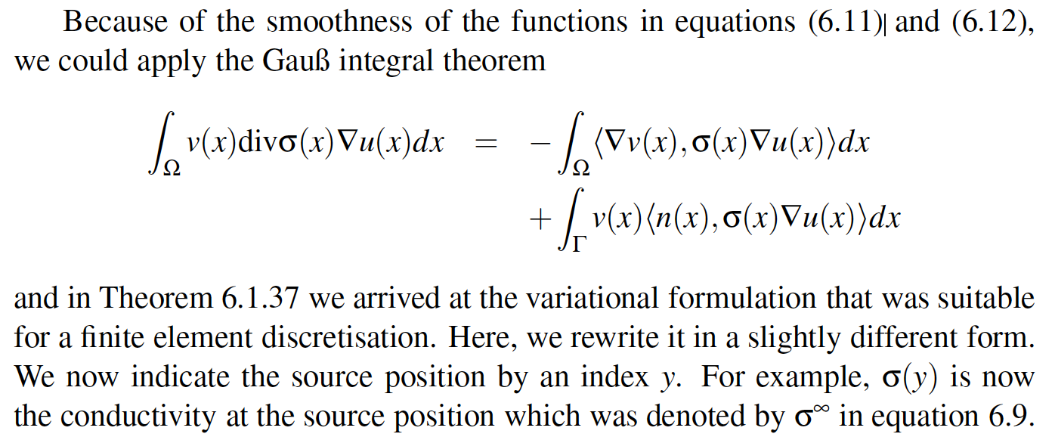
Subtraction finite element approach
[Wolters et al., SIAM J Sci Comp, 2007]
[Drechsler et al., NeuroImage, 2009]
[Wolters, Lecture scriptum]

Slide 5
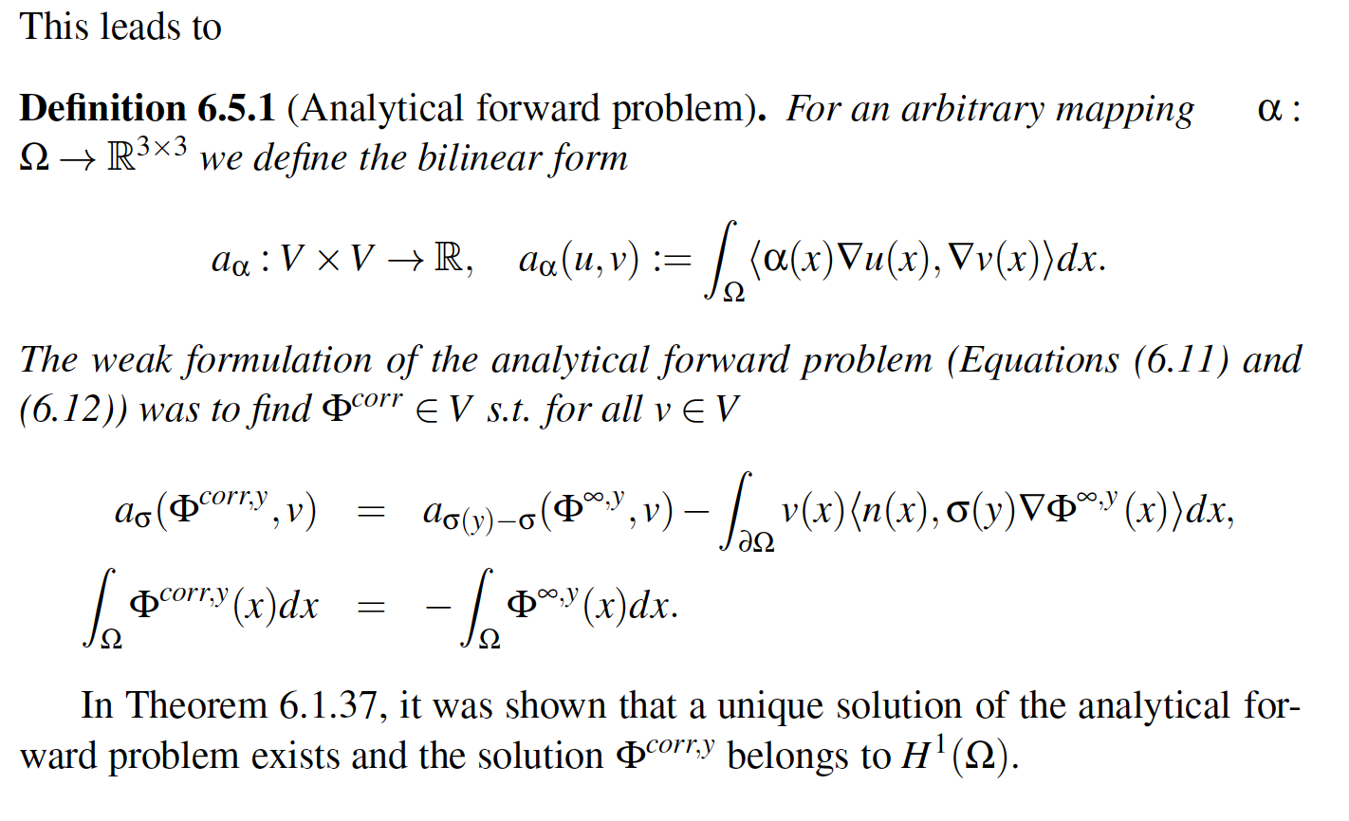
Subtraction finite element approach
[Wolters et al., SIAM J Sci Comp, 2007]
[Drechsler et al., NeuroImage, 2009]
[Wolters, Lecture scriptum]

Slide 6
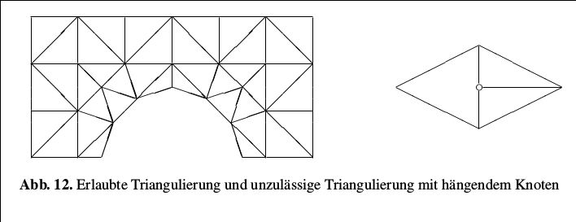
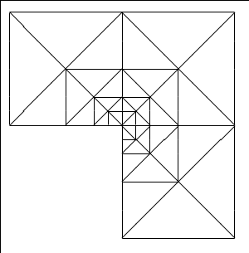
FEM basis functions and meshing aspects
[Braess, Finite Elemente, 2007]

Slide 7
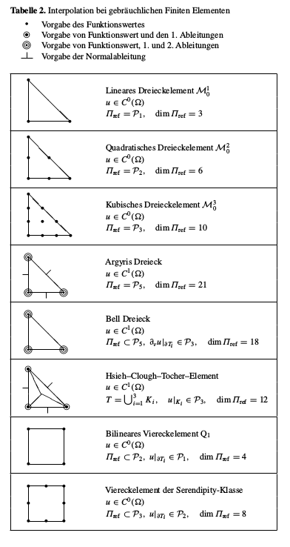
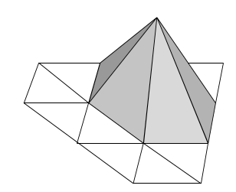
FEM basis functions and meshing aspects
[Braess, Finite Elemente, 2007]

Slide 8
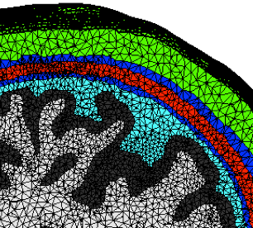
FEM basis functions and meshing aspects
[Wolters et al., SIAM J Sci Comp, 2007]
[Drechsler et al., NeuroImage, 2009]
[Wolters, Lecture scriptum]

Slide 9
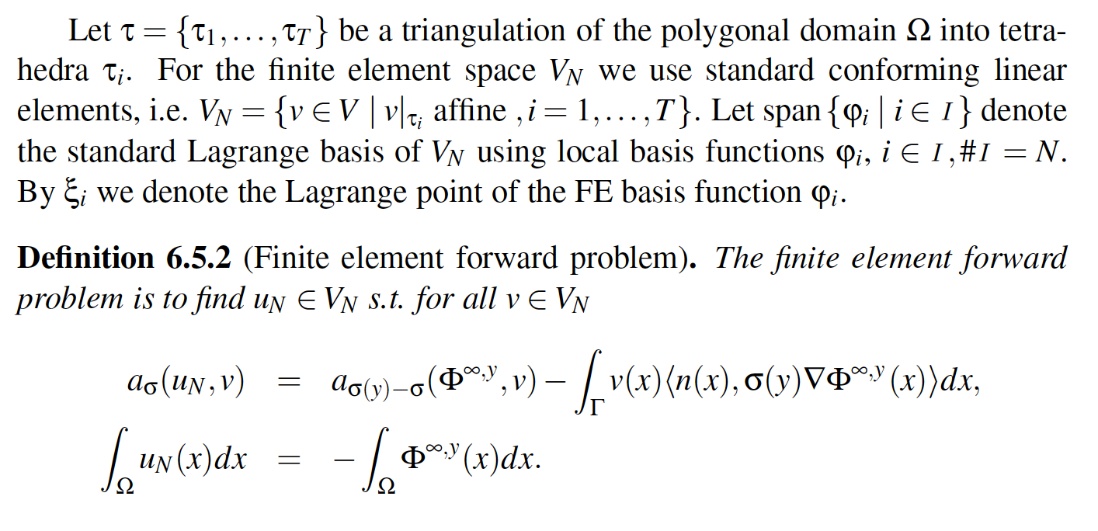
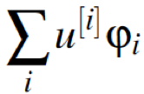
Subtraction FEM approach
[Wolters et al., SIAM J Sci Comp, 2007]
[Drechsler et al., NeuroImage, 2009]
[Wolters, Lecture scriptum]

Slide 10
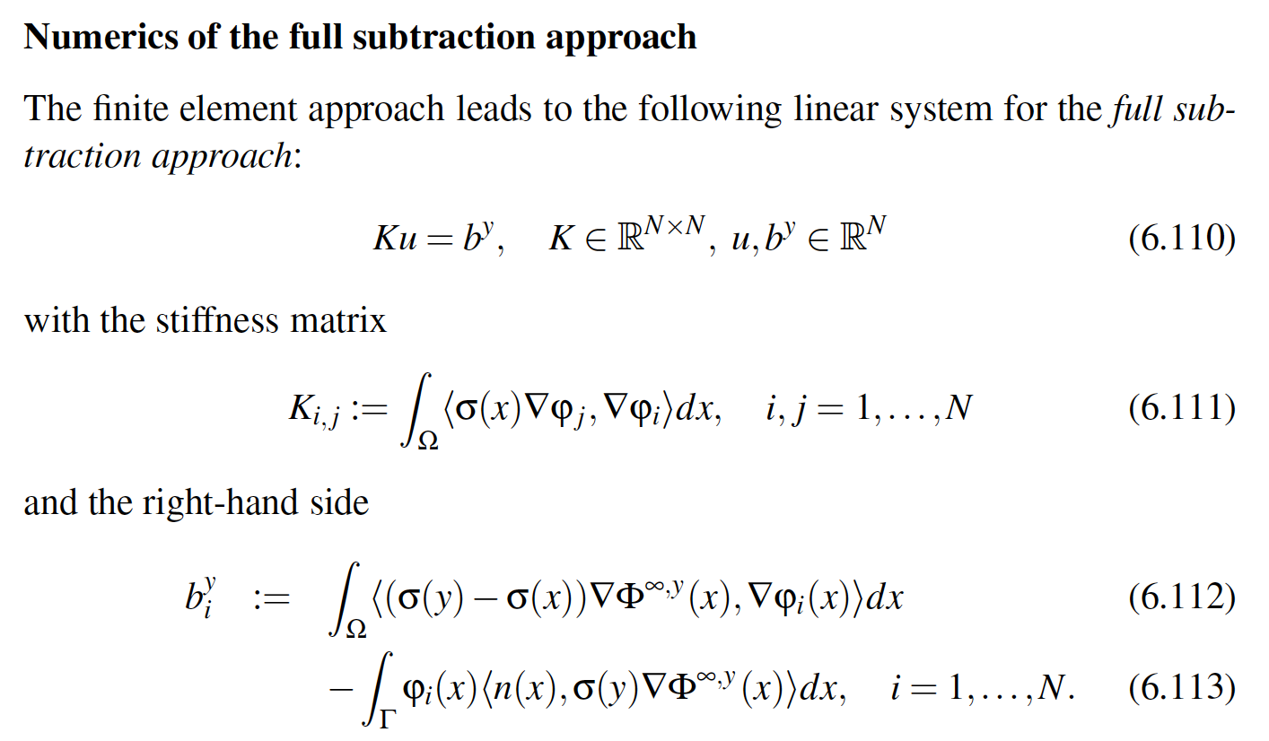
Subtraction FEM approach
[Wolters et al., SIAM J Sci Comp, 2007]
[Drechsler et al., NeuroImage, 2009]
[Wolters, Lecture scriptum]

Slide 11
Subtraction FEM approach
[Wolters et al., SIAM J Sci Comp, 2007]
[Drechsler et al., NeuroImage, 2009]
[Wolters, Lecture scriptum]

Slide 12
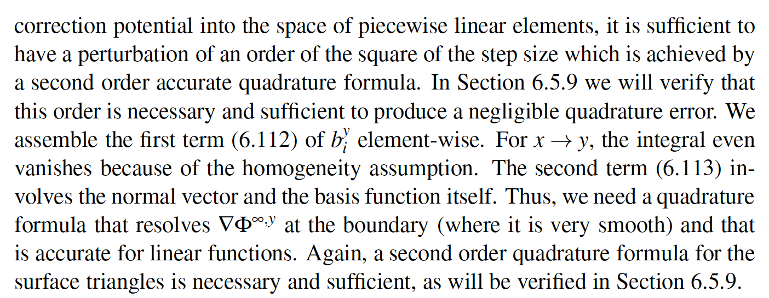
Full subtraction approach
[Wolters et al., SIAM J Sci Comp, 2007]
[Drechsler et al., NeuroImage, 2009]
[Wolters, Lecture scriptum]

Slide 13
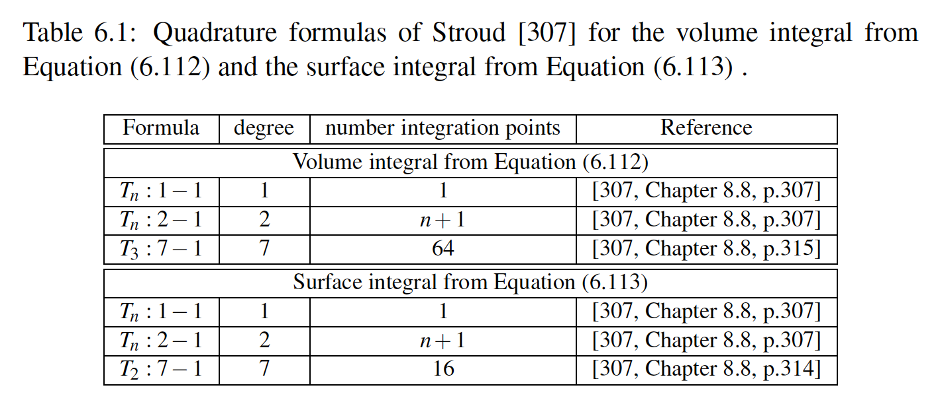
Full subtraction approach
[Wolters et al., SIAM J Sci Comp, 2007]
[Drechsler et al., NeuroImage, 2009]
[Wolters, Lecture scriptum]

Slide 14
Projected (or approx.) subtraction source modeling approach
Notes:
PEBBLES: Parallel and Element Based grey Box Linear Equation Solver

Slide 15
Projected subtraction FEM
[Wolters et al., SIAM J Sci Comp, 2007]
[Drechsler et al., NeuroImage, 2009]
[Wolters, Lecture scriptum]

Slide 16
Projected subtraction FEM
[Wolters et al., SIAM J Sci Comp, 2007]
[Drechsler et al., NeuroImage, 2009]
[Wolters, Lecture scriptum]

Slide 17
Convergence analysis
[Wolters et al., SIAM J Sci Comp, 2007]
[Drechsler et al., NeuroImage, 2009]
[Wolters, Lecture scriptum]

Slide 18
Convergence analysis
[Wolters et al., SIAM J Sci Comp, 2007]
[Drechsler et al., NeuroImage, 2009]
[Wolters, Lecture scriptum]

Slide 19
Convergence analysis
[Wolters et al., SIAM J Sci Comp, 2007]
[Drechsler et al., NeuroImage, 2009]
[Wolters, Lecture scriptum]

Slide 20
Convergence analysis
[Wolters et al., SIAM J Sci Comp, 2007]
[Drechsler et al., NeuroImage, 2009]
[Wolters, Lecture scriptum]

Slide 21
Convergence analysis
[Wolters et al., SIAM J Sci Comp, 2007]
[Drechsler et al., NeuroImage, 2009]
[Wolters, Lecture scriptum]

Slide 22
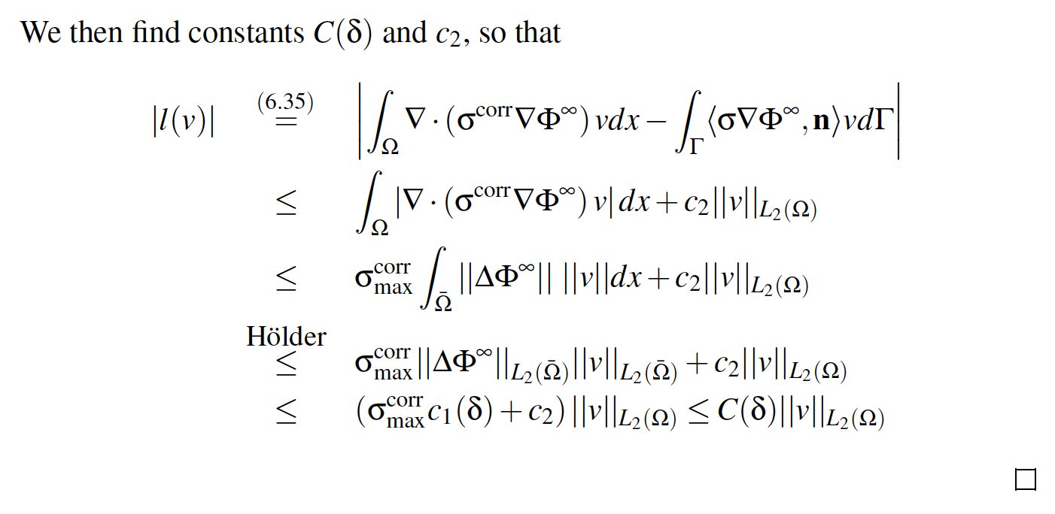
Convergence analysis
[Wolters et al., SIAM J Sci Comp, 2007]
[Drechsler et al., NeuroImage, 2009]
[Wolters, Lecture scriptum, 2016]

Slide 23
Convergence analysis
[Wolters et al., SIAM J Sci Comp, 2007]
[Drechsler et al., NeuroImage, 2009]
[Wolters, Lecture scriptum]

Slide 24
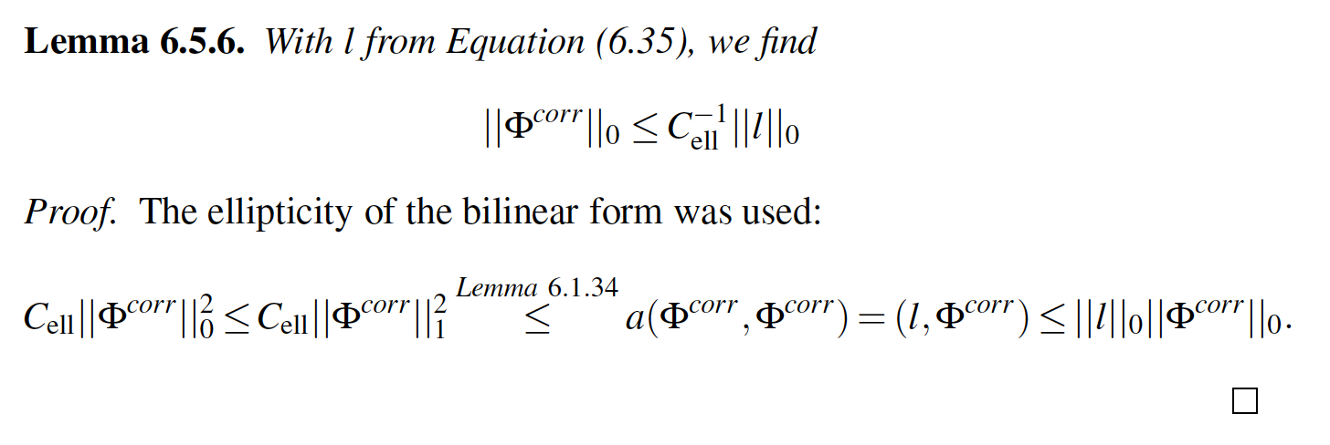
Convergence analysis
[Wolters et al., SIAM J Sci Comp, 2007]
[Drechsler et al., NeuroImage, 2009]
[Wolters, Lecture scriptum]

Slide 25
Convergence analysis
[Wolters et al., SIAM J Sci Comp, 2007]
[Drechsler et al., NeuroImage, 2009]
[Wolters, Lecture scriptum]

Slide 26
Structure of the lecture
Convergence analysis for FEM subtraction approach (sections 6.5.1-6.5.3 of lecture scriptum)
Other source models (section 6.5.4 of lecture scriptum)
Overview: Multi-layer sphere model (section 6.2 of lecture scriptum)
Forward modeling results
The local subtraction approach

Slide 27
Source models
[Wolters, Lecture scriptum]

Slide 28
Partial integration (PI) source modeling approach
Notes:
PEBBLES: Parallel and Element Based grey Box Linear Equation Solver

Slide 29
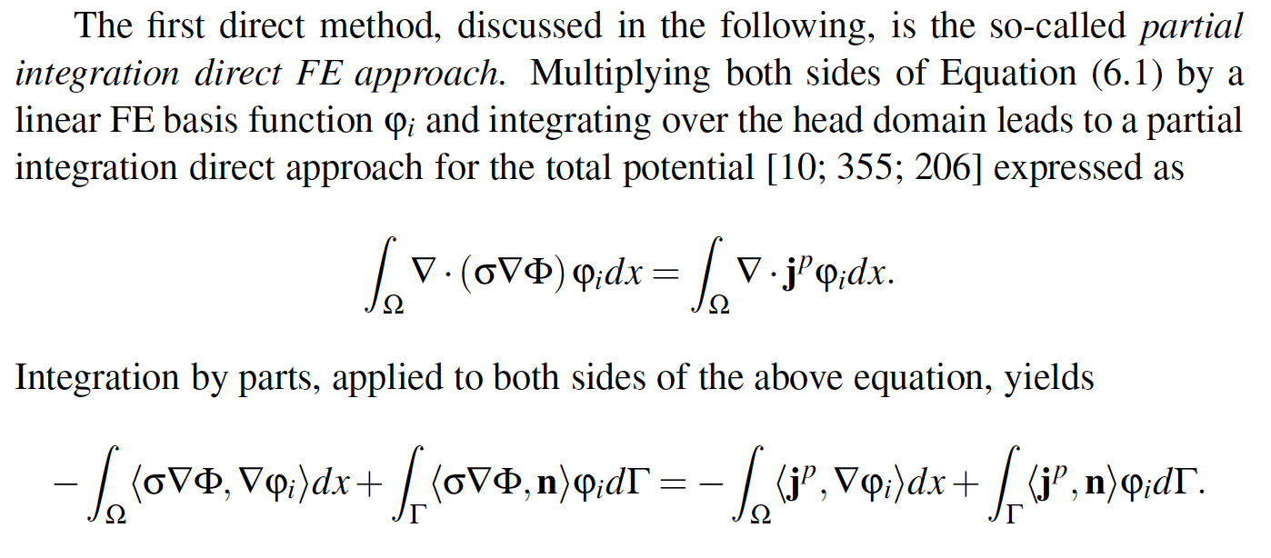
Partial integration (PI)
[Wolters, Lecture scriptum]

Slide 30
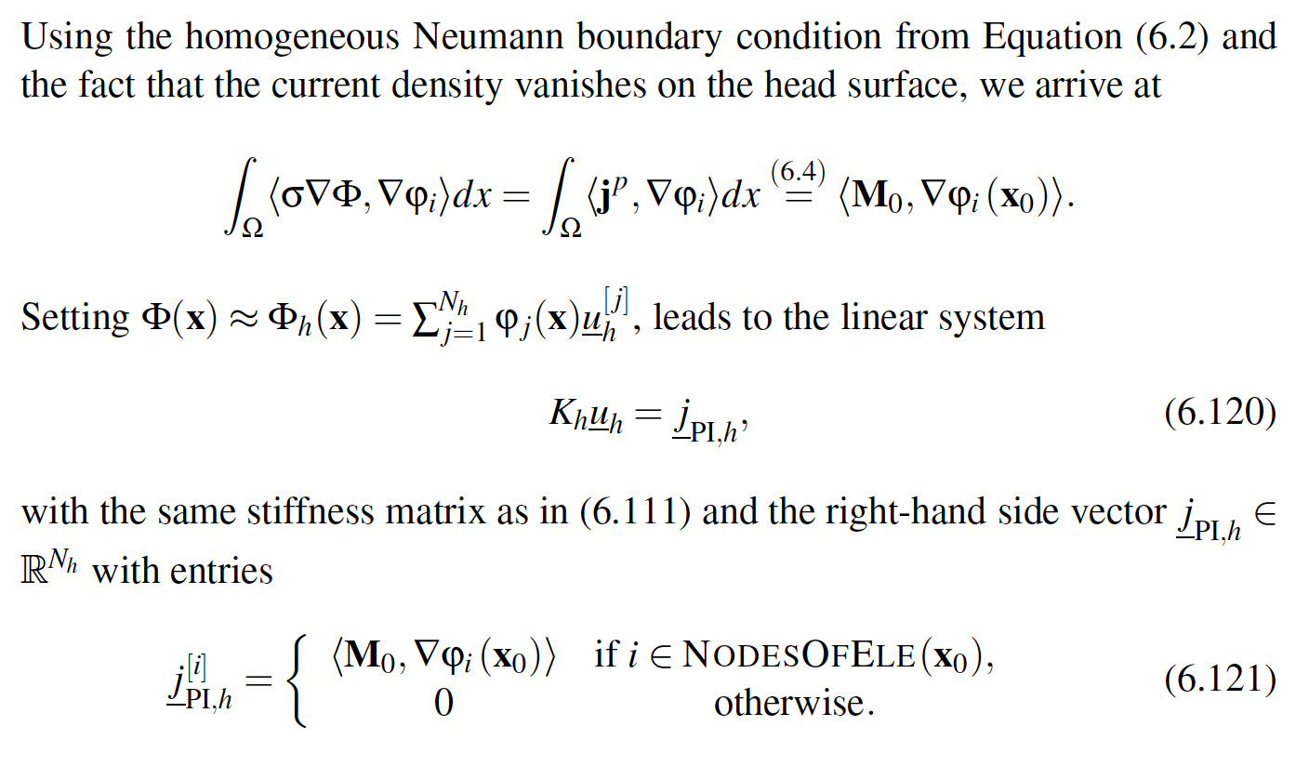
[Wolters, Lecture scriptum]
Partial integration (PI)

Slide 31
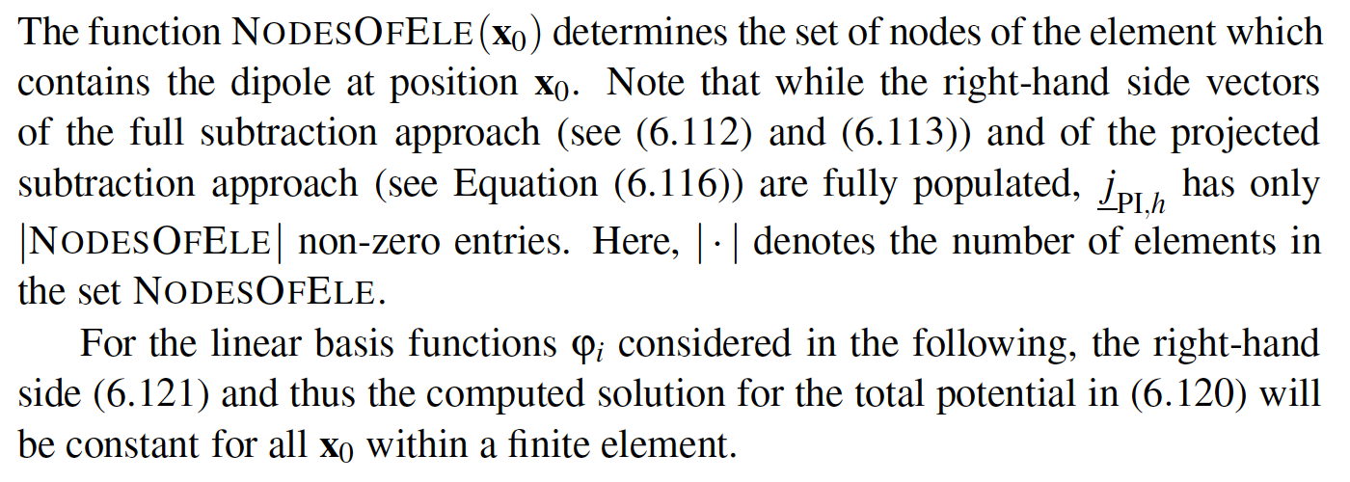
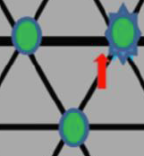
The partial integration source model
[Wolters, Lecture scriptum]
Right-hand side vector has only 4 (for tetrahedra models)
non-zero entries and can be computed very fast
Notes:
PEBBLES: Parallel and Element Based grey Box Linear Equation Solver

Slide 32
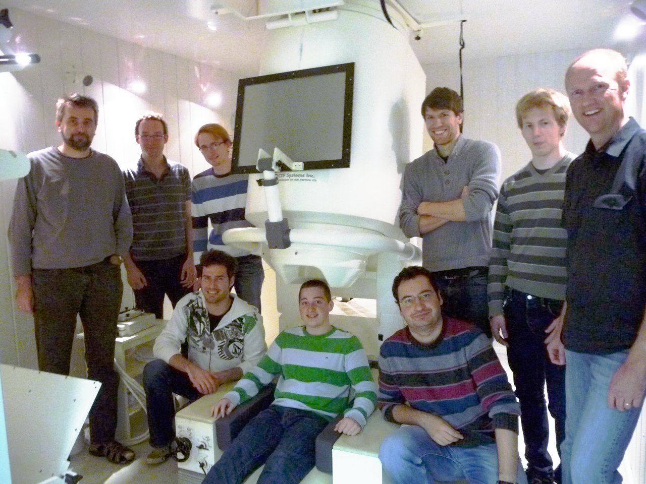
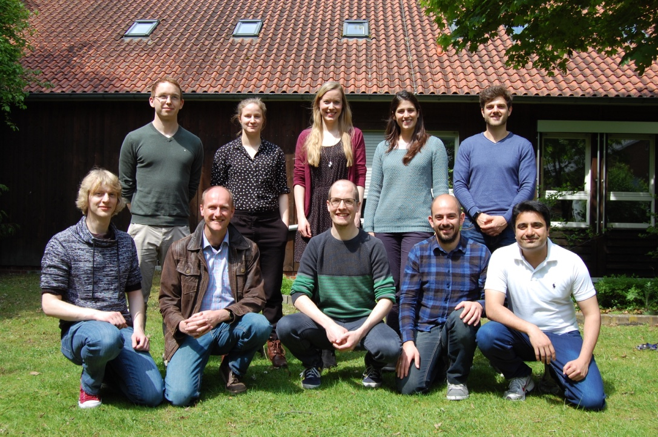
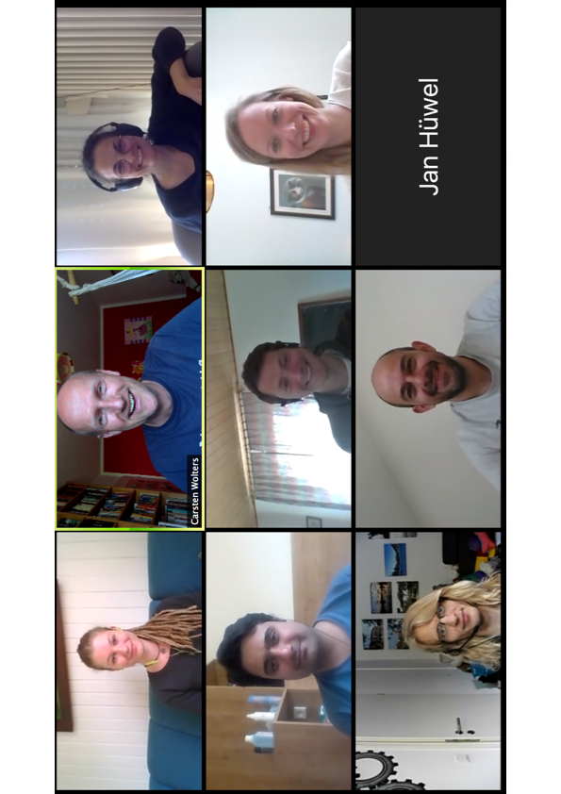
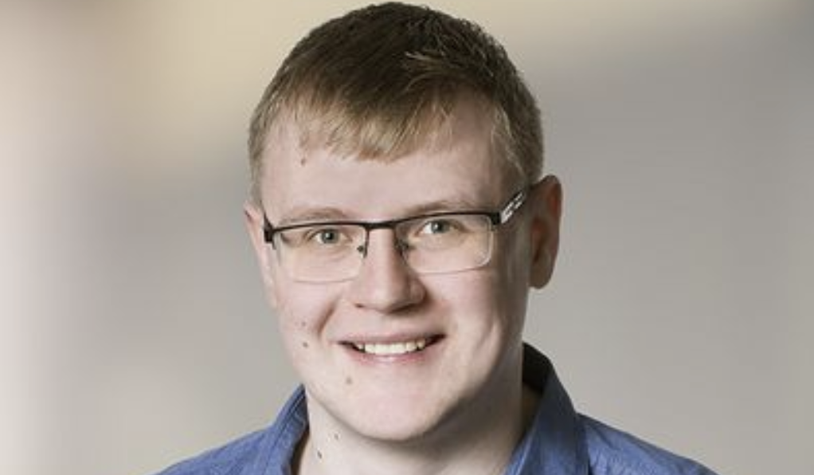
Thank you for your attention!
SIM-NEURO work-group at IBB
Notes:
32
32

