Slide 1
Further topics in EEG and MEG forward modeling
Carsten Wolters
Lecture, Dec.10, 2024
Notes:
Tensor weiter erlaeutern
Zeitableitung
Programmlaenge, 1Mill.
WM-Rendering->5000 nodes
1:10 raus und anfangs erwaehnen

Slide 2
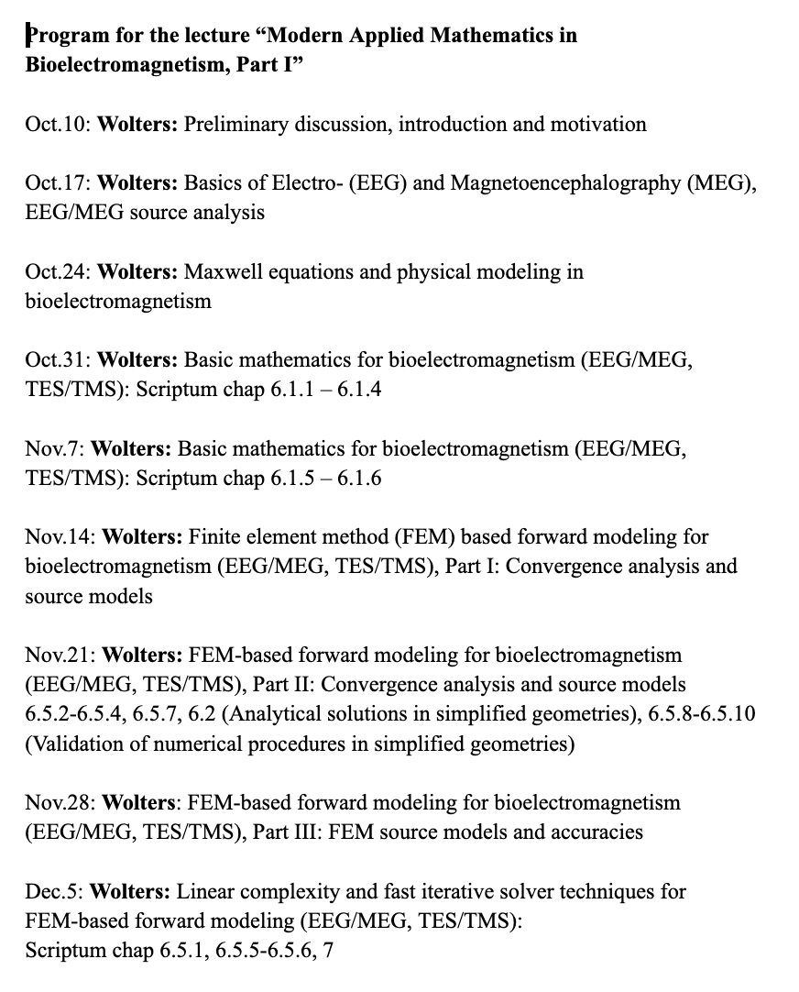
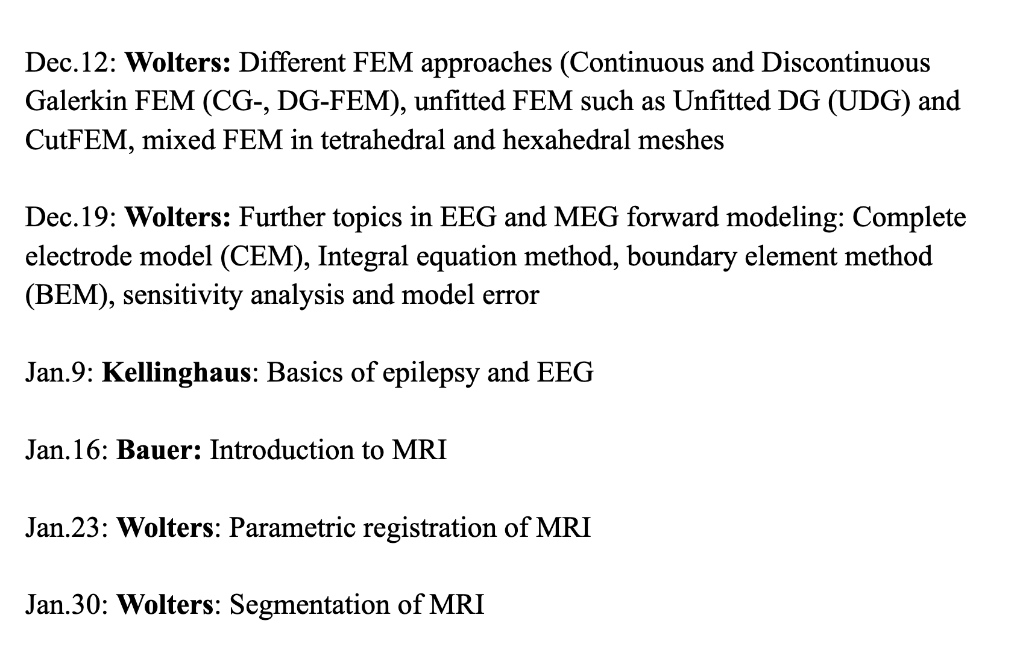
Lectures, part I:

Slide 3
Structure of the lecture
The complete electrode model (CEM)
Integral equation and the boundary element method (BEM)
Comparing BEM and FEM approaches

Slide 4
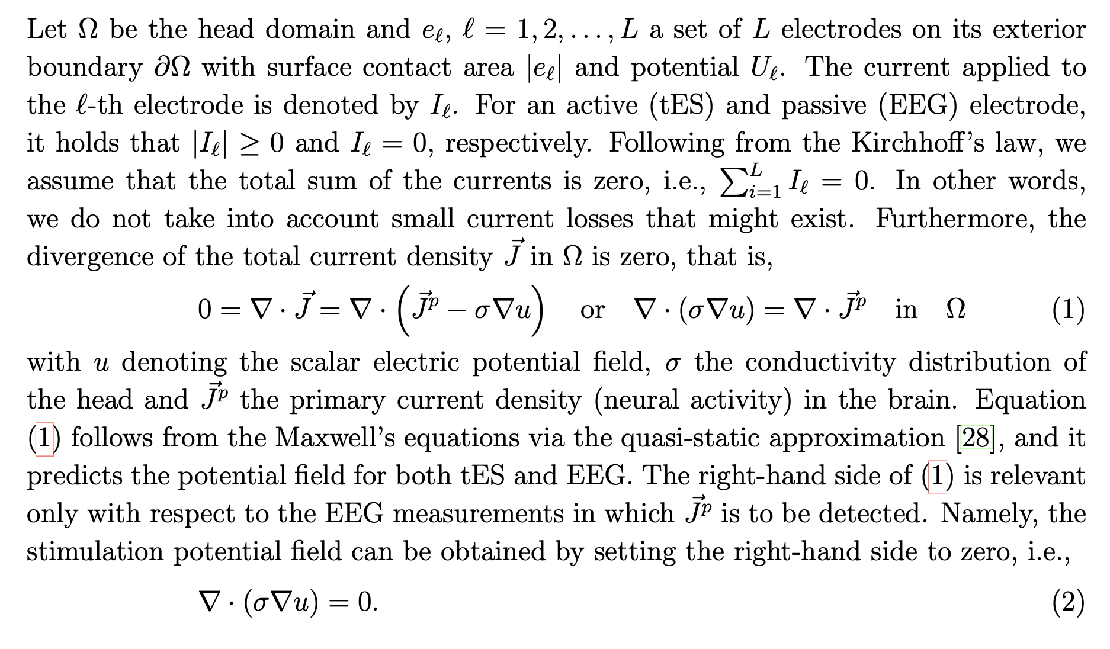
[Pursiainen, Agsten, Wagner & Wolters, IEEE Trans Neur Sys Rehab Eng, 2018]
The complete electrode model (CEM)

Slide 5
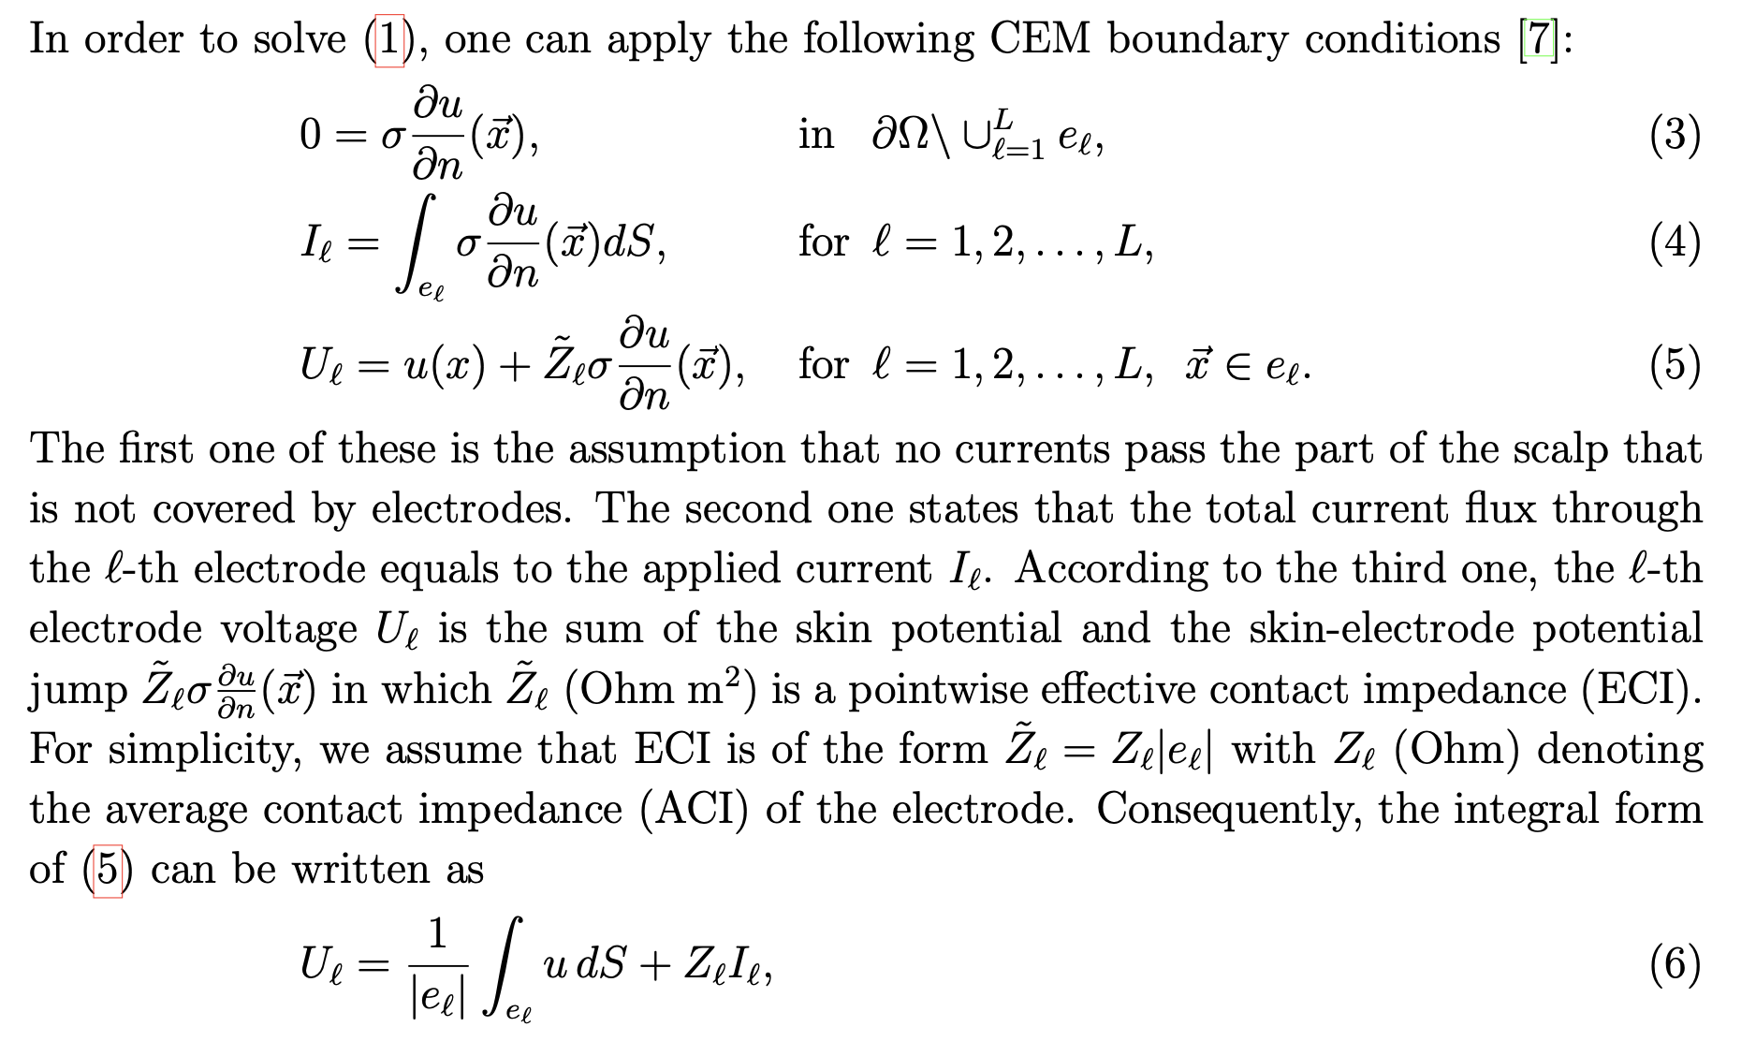
[Pursiainen, Agsten, Wagner & Wolters, IEEE Trans Neur Sys Rehab Eng, 2018]
The complete electrode model (CEM)

Slide 6
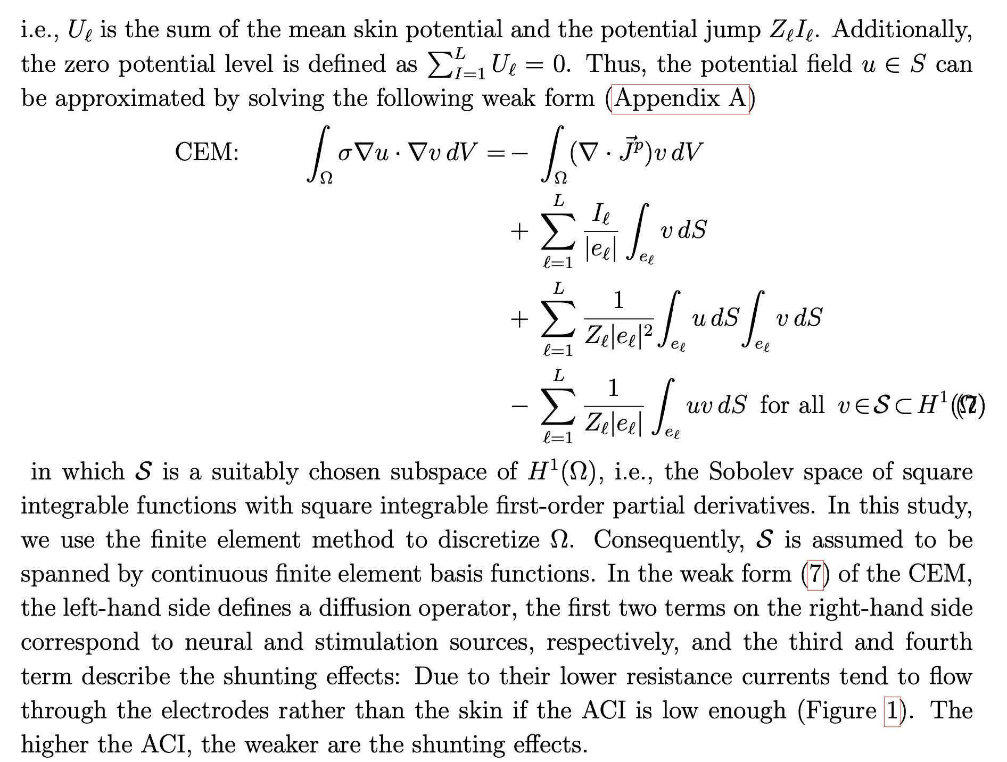
[Pursiainen, Agsten, Wagner & Wolters, IEEE Trans Neur Sys Rehab Eng, 2018]
The complete electrode model (CEM)

Slide 7
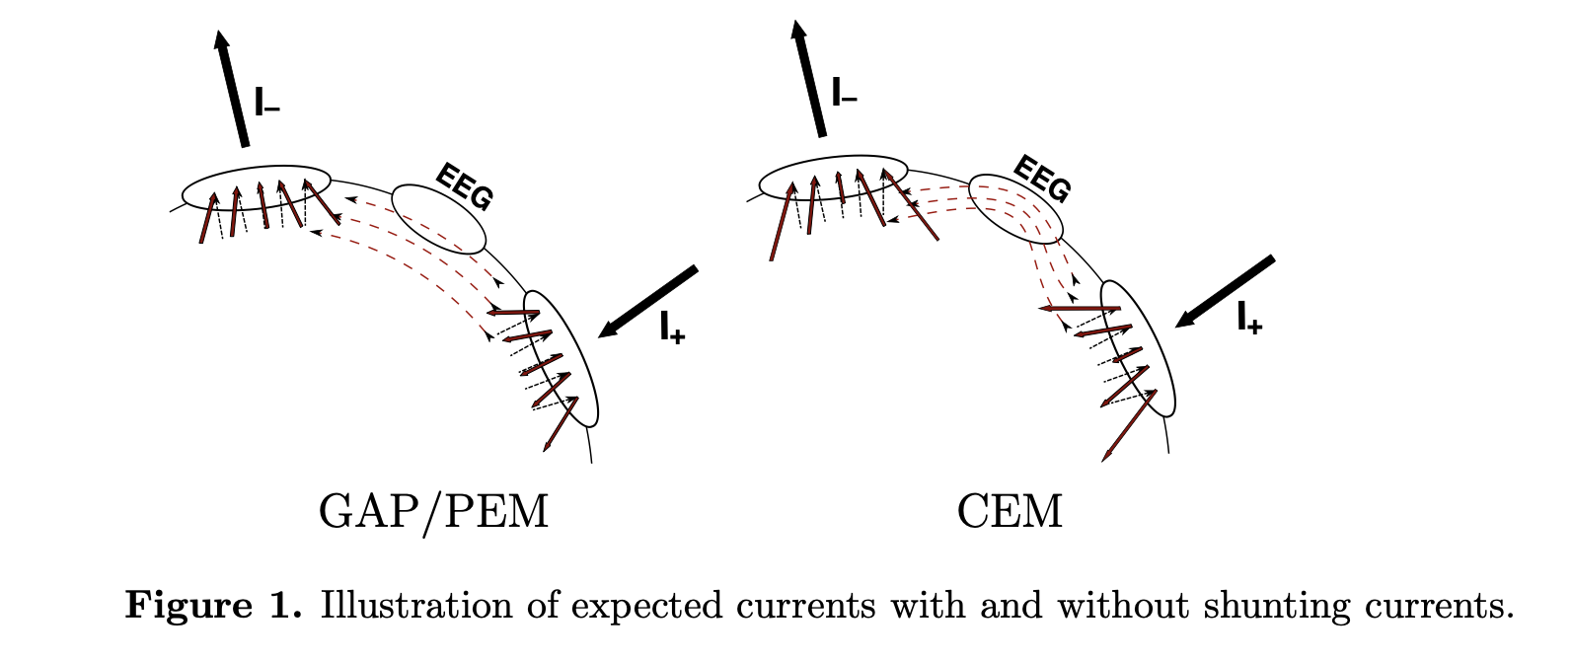
[Pursiainen, Agsten, Wagner & Wolters, IEEE Trans Neur Sys Rehab Eng, 2018]
The complete electrode model (CEM)

Slide 8
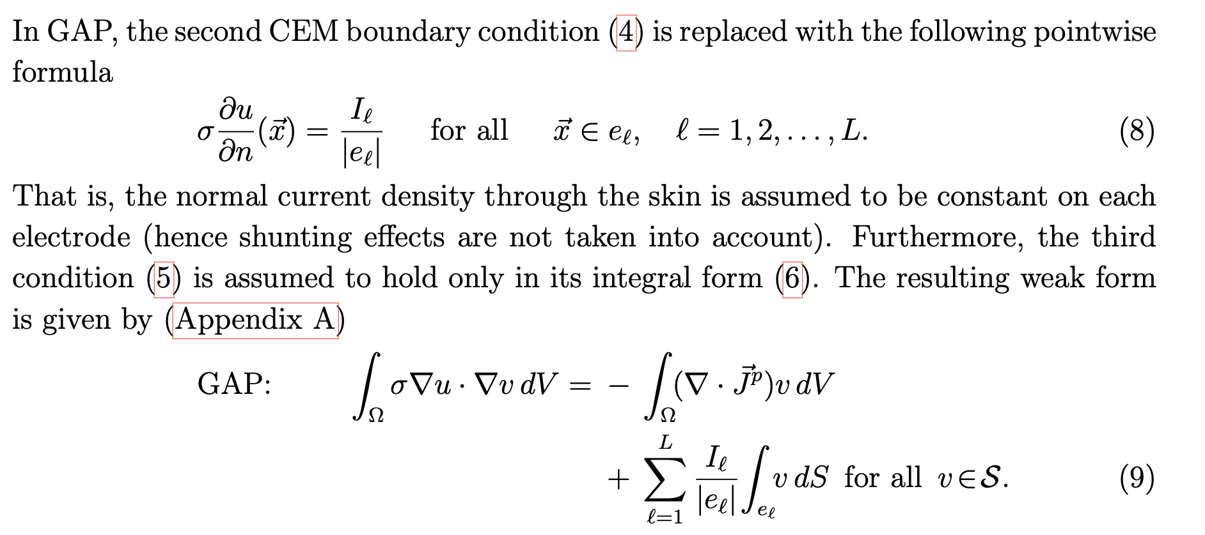
[Pursiainen, Agsten, Wagner & Wolters, IEEE Trans Neur Sys Rehab Eng, 2018]
The gap model (GAP)

Slide 9
[Pursiainen, Agsten, Wagner & Wolters, IEEE Trans Neur Sys Rehab Eng, 2018]
The point electrode model (PEM)

Slide 10
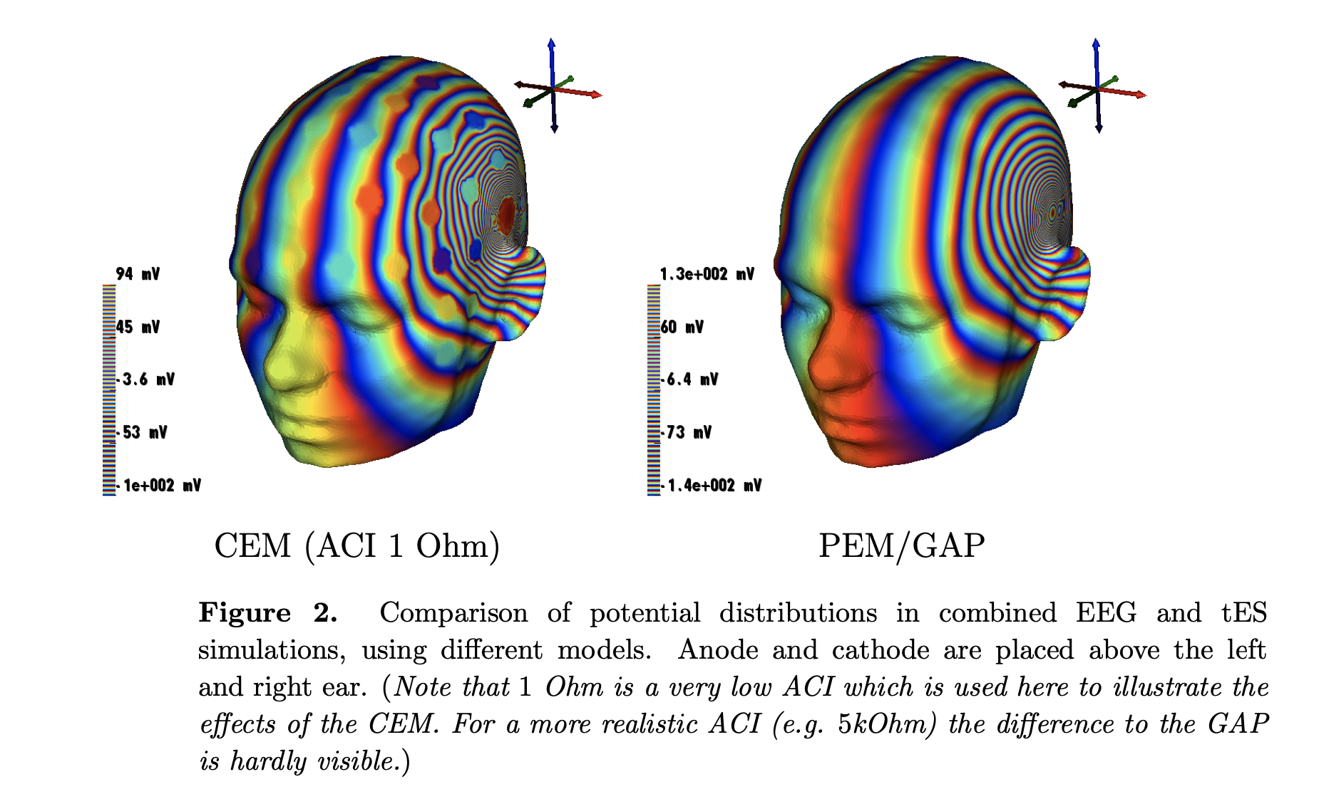
[Pursiainen, Agsten, Wagner & Wolters, IEEE Trans Neur Sys Rehab Eng, 2018]
Comparison of CEM, GAP and PEM

Slide 11
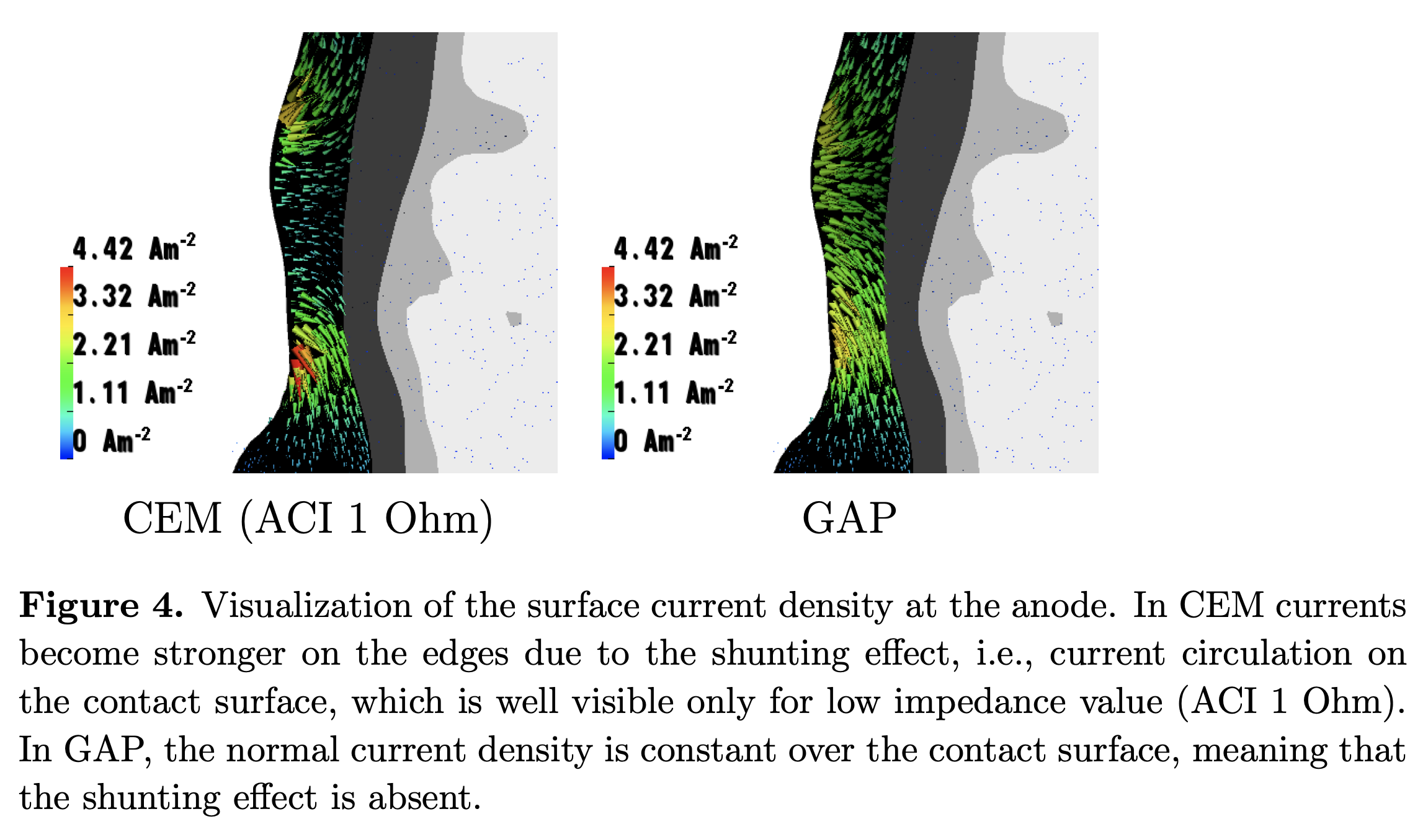
[Pursiainen, Agsten, Wagner & Wolters, IEEE Trans Neur Sys Rehab Eng, 2018]
Comparison of CEM, GAP and PEM

Slide 12
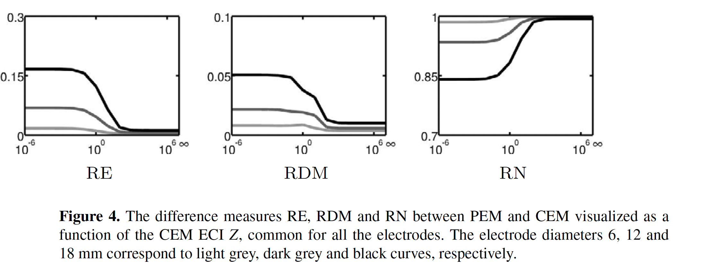
[Pursiainen, Lucka & Wolters, Phys Med Biol, 2012]
Comparison of CEM and PEM for EEG source analysis (no injection currents I)

Slide 13
Structure of the lecture
The complete electrode model (CEM)
Integral equation and the boundary element method (BEM)
Comparing BEM and FEM approaches

Slide 14
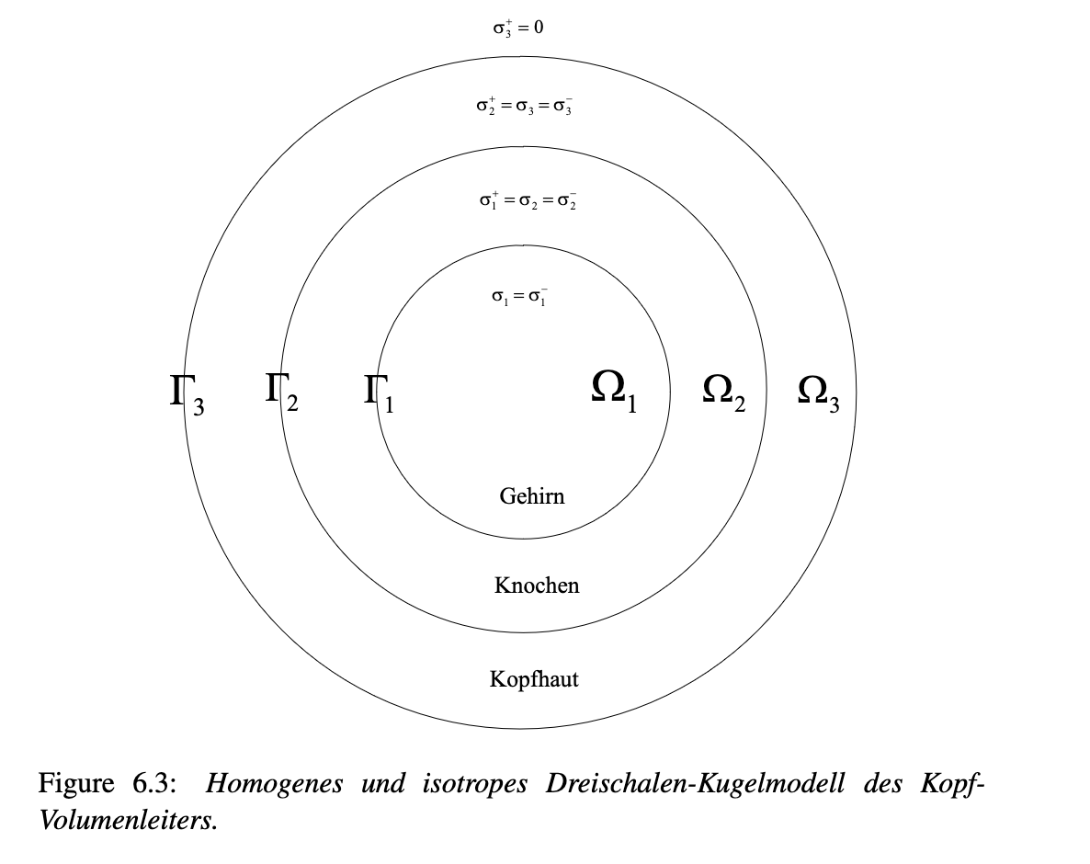
[Vorlesungsskriptum, Section 6.3, 2023]
The integral equation method and the boundary element method (BEM)

Slide 15
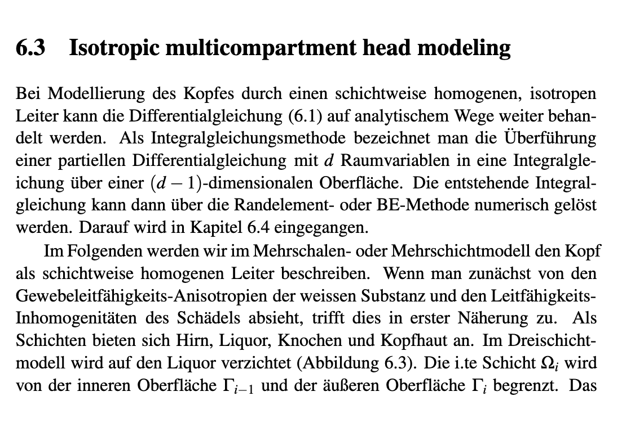
[Vorlesungsskriptum, Section 6.3, 2023]
The integral equation method for the EEG

Slide 16
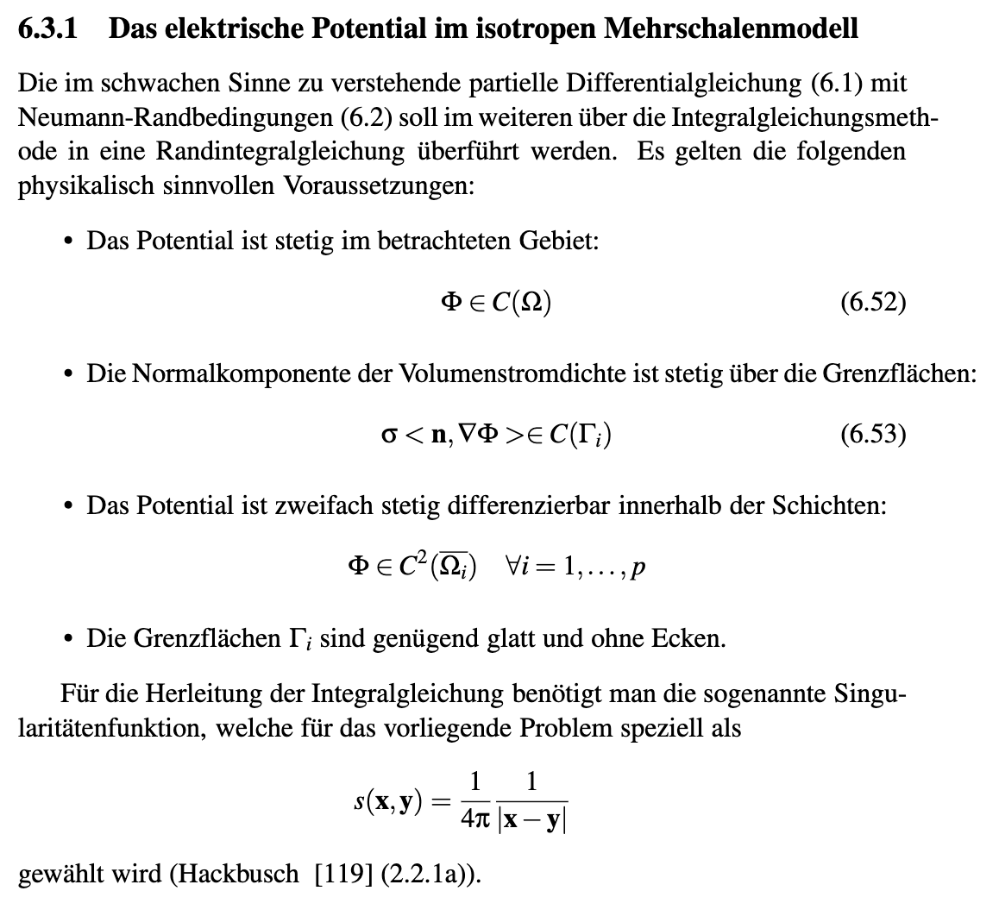
[Vorlesungsskriptum, Section 6.3, 2023]
The integral equation method for the EEG

Slide 17
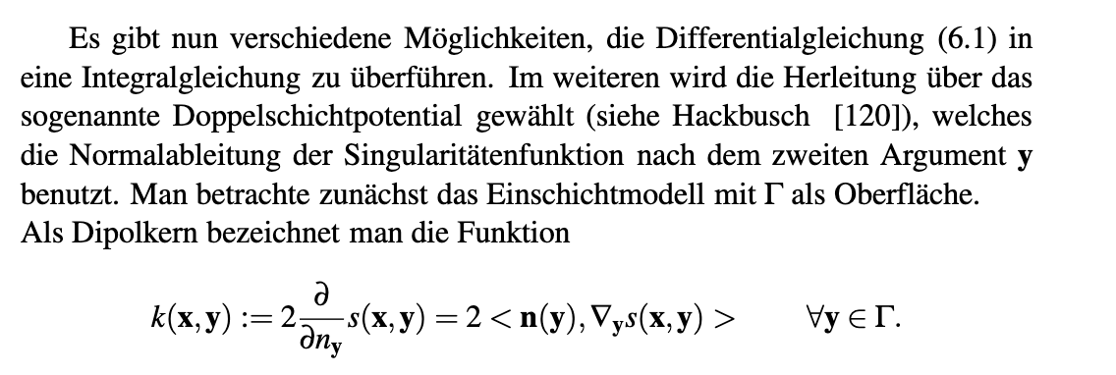
[Vorlesungsskriptum, Section 6.3, 2023]
The integral equation method for the EEG

Slide 18
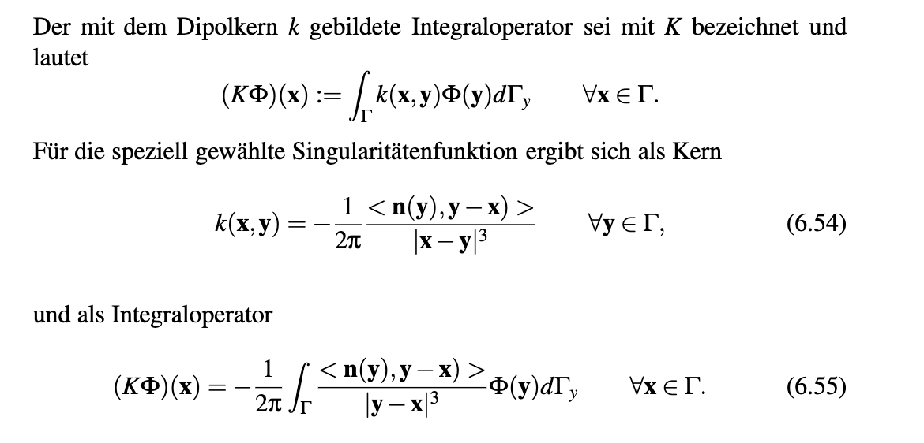
[Vorlesungsskriptum, Section 6.3, 2023]
The integral equation method for the EEG

Slide 19
[Vorlesungsskriptum, Section 6.3, 2023]
The integral equation method for the EEG

Slide 20
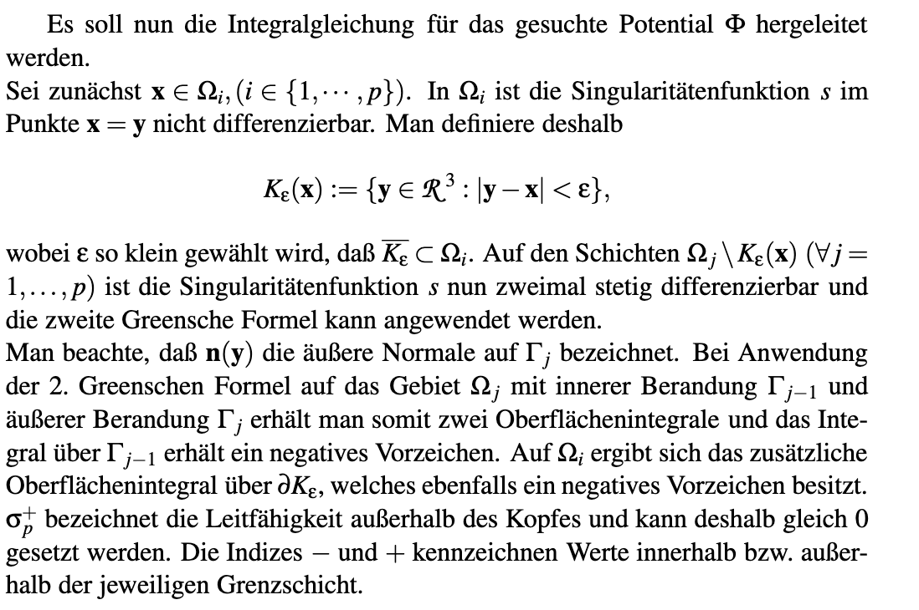
[Vorlesungsskriptum, Section 6.3, 2023]
The integral equation method for the EEG

Slide 21
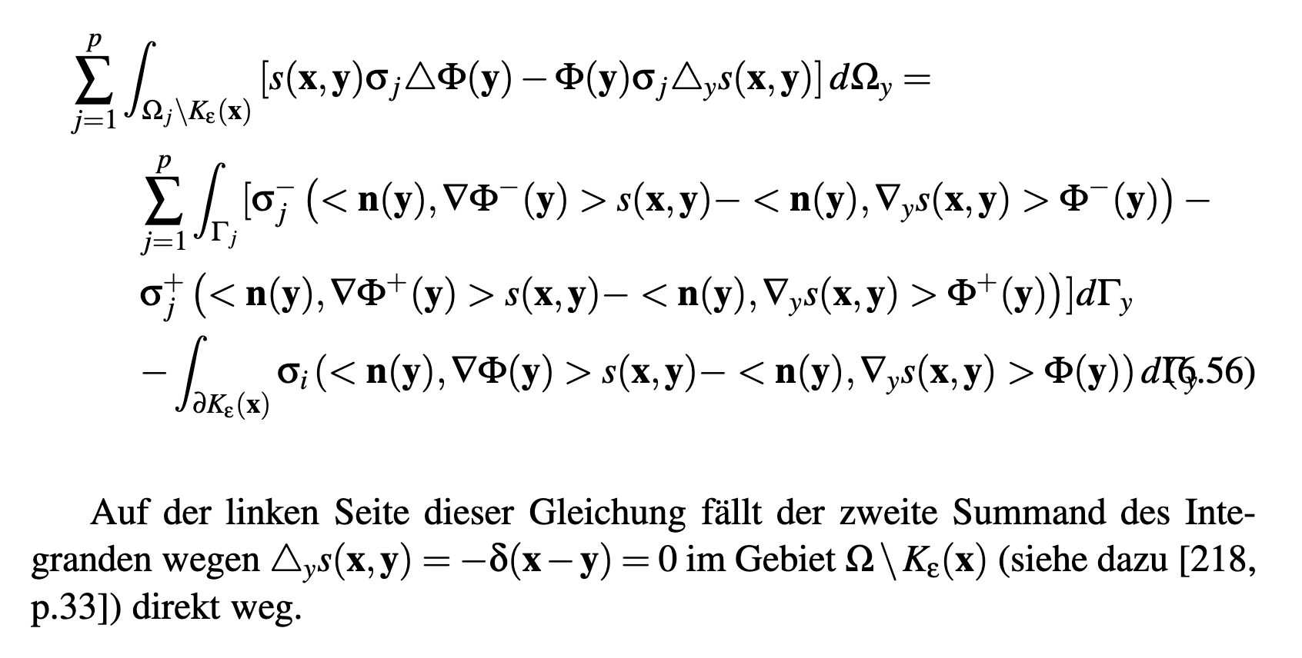
[Vorlesungsskriptum, Section 6.3, 2023]
The integral equation method for the EEG

Slide 22
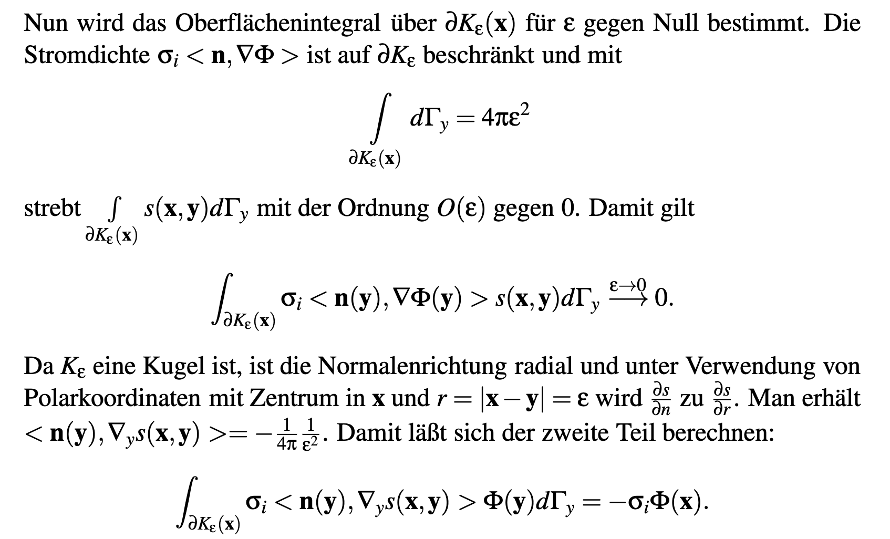
[Vorlesungsskriptum, Section 6.3, 2023]
The integral equation method for the EEG

Slide 23
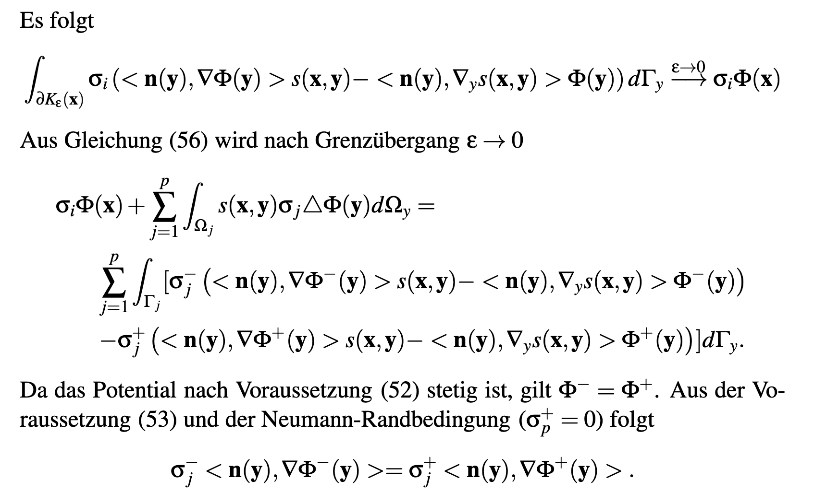
[Vorlesungsskriptum, Section 6.3, 2023]
The integral equation method for the EEG

Slide 24
[Vorlesungsskriptum, Section 6.3, 2023]
The integral equation method for the EEG

Slide 25
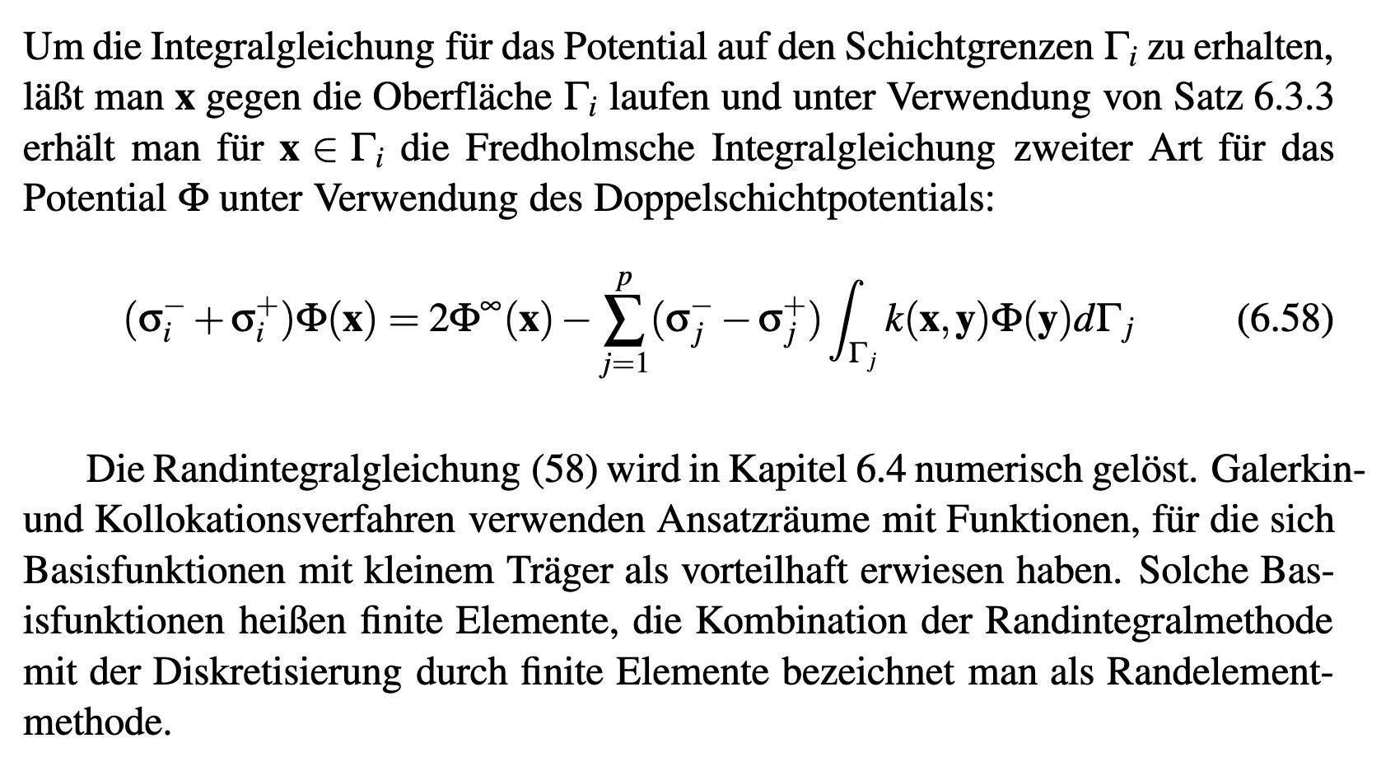
[Vorlesungsskriptum, Section 6.3, 2023]
The integral equation method for the EEG

Slide 26
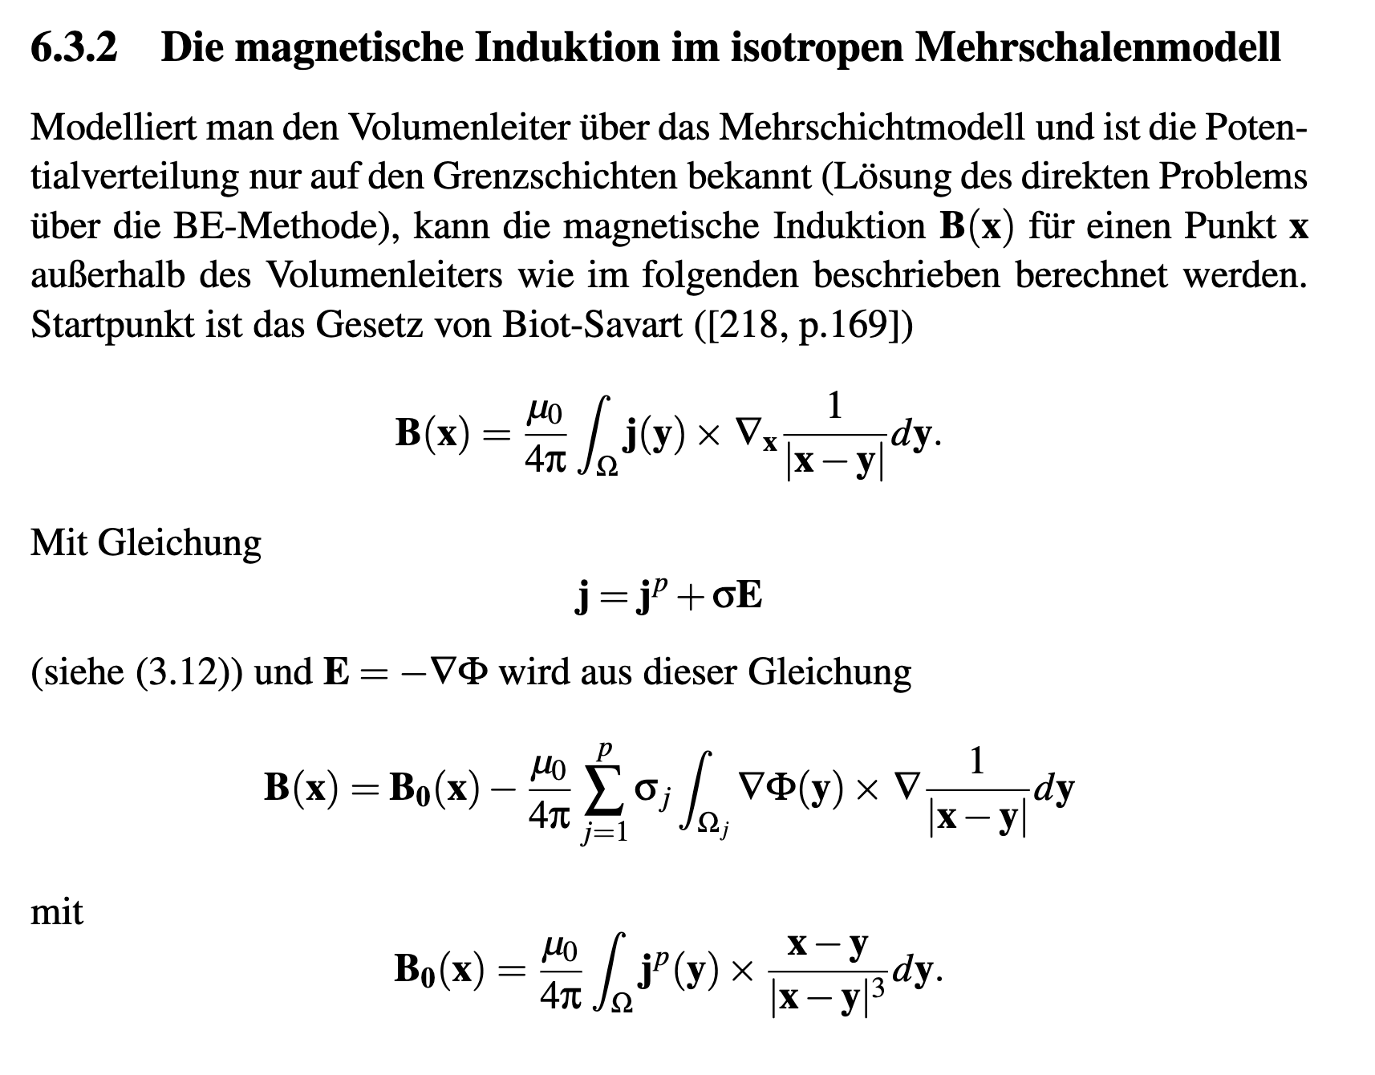
[Vorlesungsskriptum, Section 6.3, 2023]
The integral equation method for the MEG

Slide 27
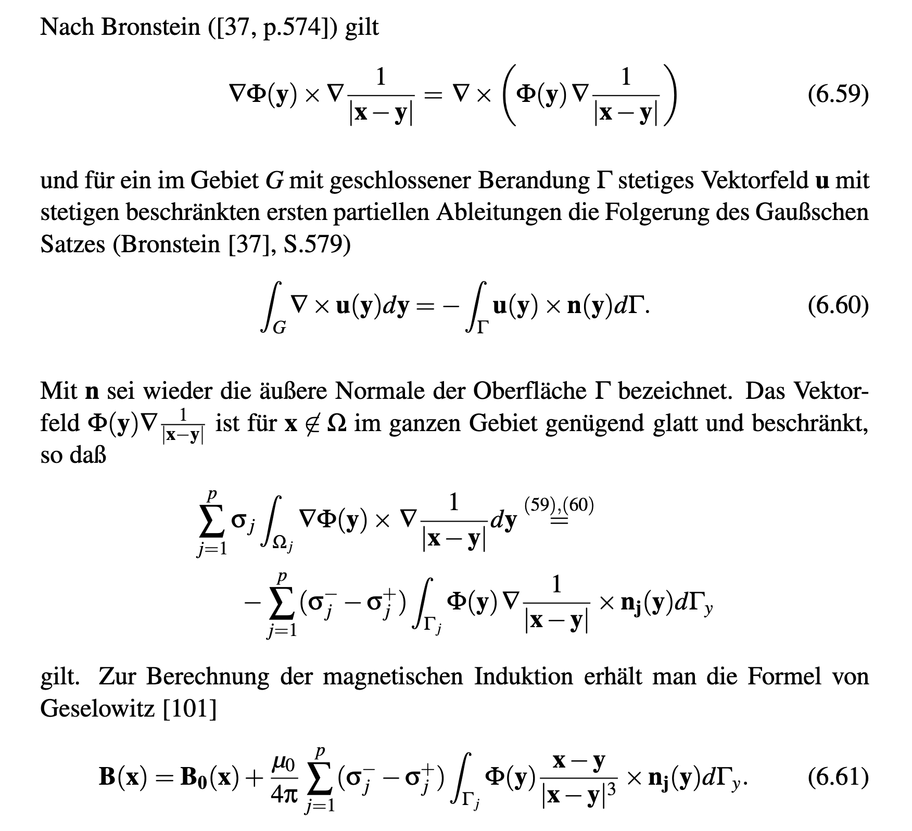
[Vorlesungsskriptum, Section 6.3, 2023]
The integral equation method for the MEG

Slide 28
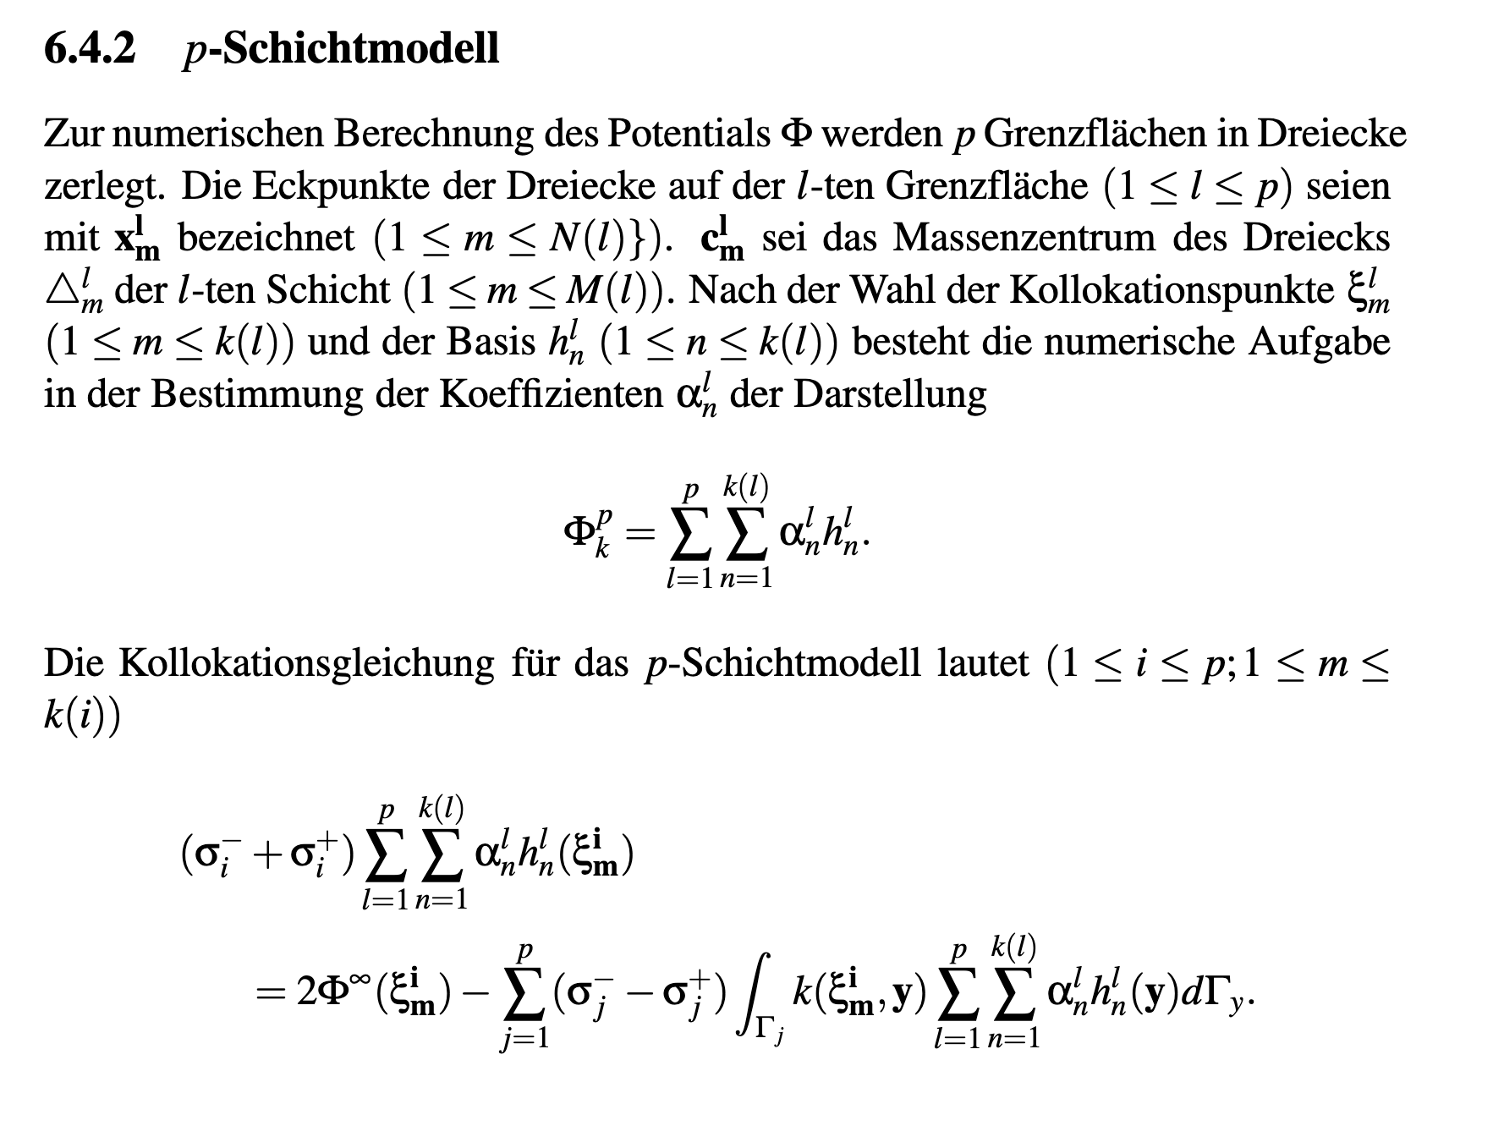
[Vorlesungsskriptum, Section 6.4, 2023]
The boundary element method (BEM)

Slide 29
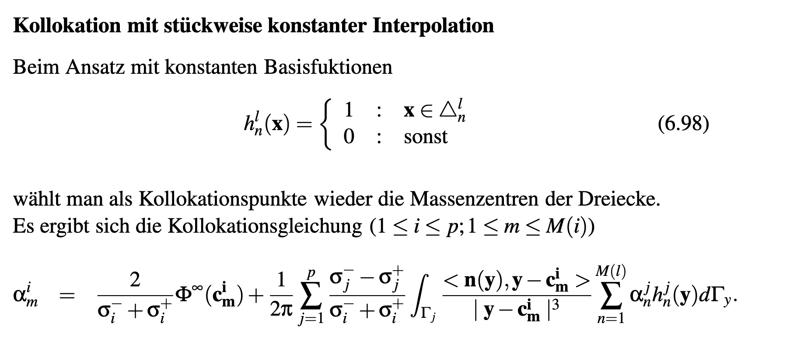
[Vorlesungsskriptum, Section 6.4, 2023]
The boundary element method (BEM)

Slide 30
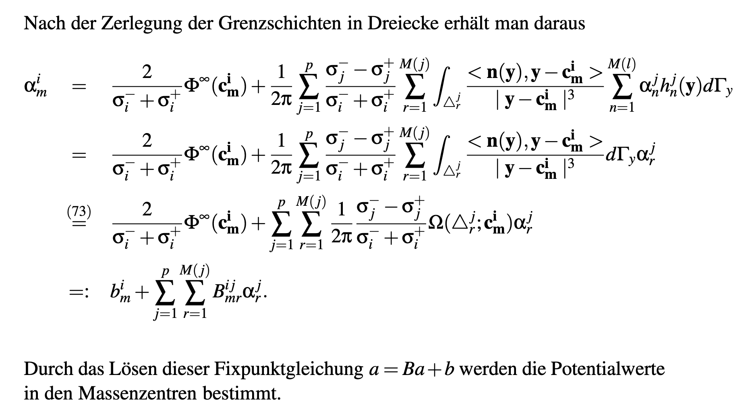
[Vorlesungsskriptum, Section 6.4, 2023]
The boundary element method (BEM)

Slide 31
Structure of the lecture
The complete electrode model (CEM)
Integral equation and the boundary element method (BEM)
Comparing BEM and FEM approaches

Slide 32
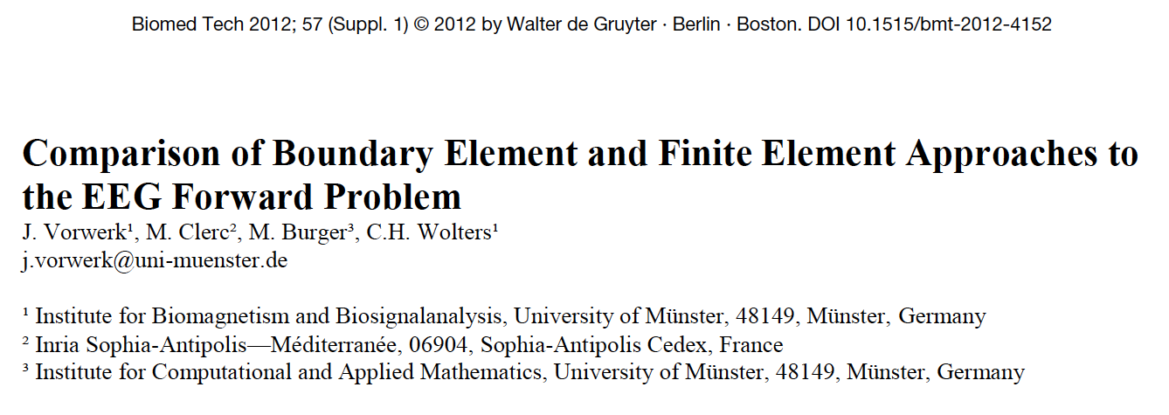
[Vorwerk et al., Biomed Eng., 2012]
Notes:
Biot-Savart: B(r)=

Slide 33
[Vorwerk et al., Biomed Eng., 2012]
Notes:
Biot-Savart: B(r)=

Slide 34
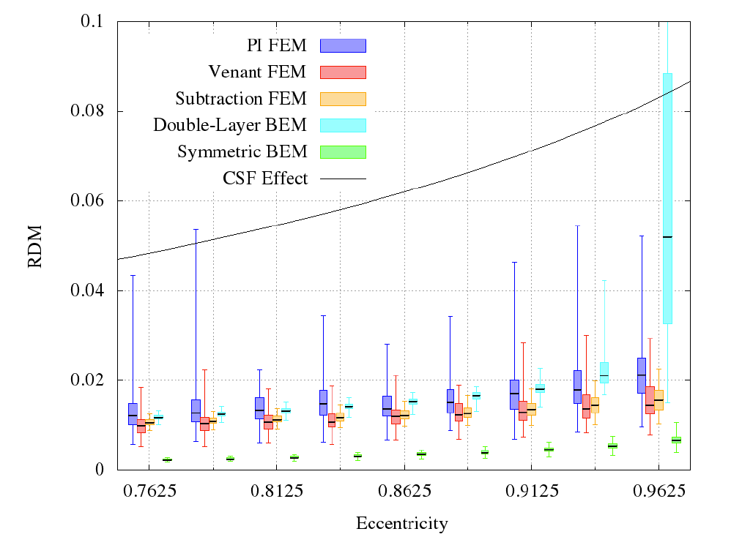
[Vorwerk et al., Biomed Eng., 2012]
Notes:
Biot-Savart: B(r)=

Slide 35
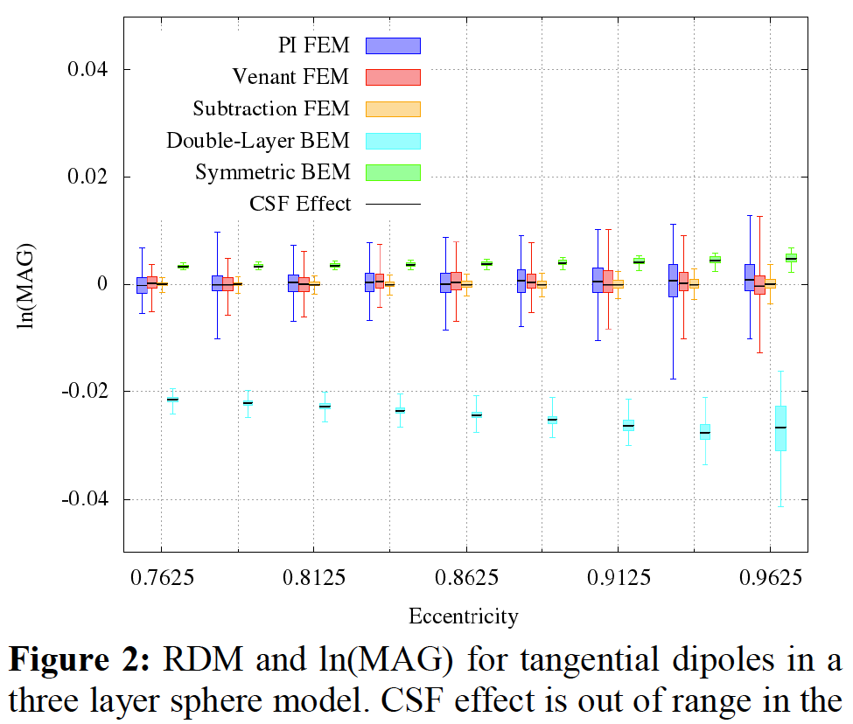
[Vorwerk et al., Biomed Eng., 2012]
1
Notes:
Biot-Savart: B(r)=

Slide 36
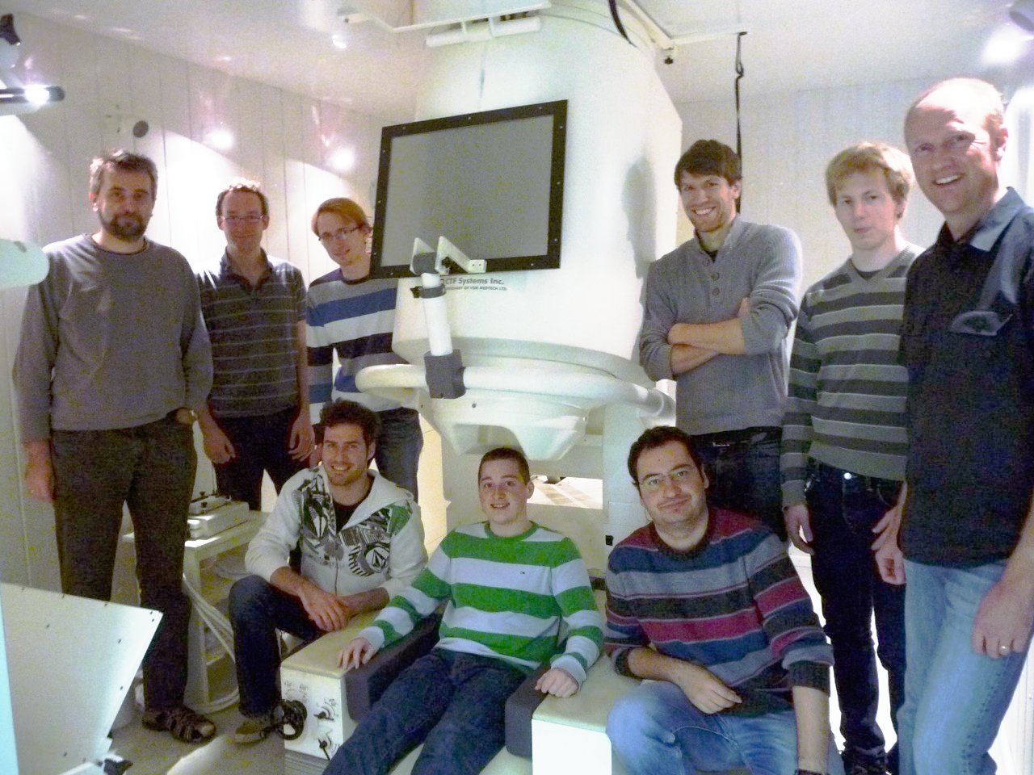
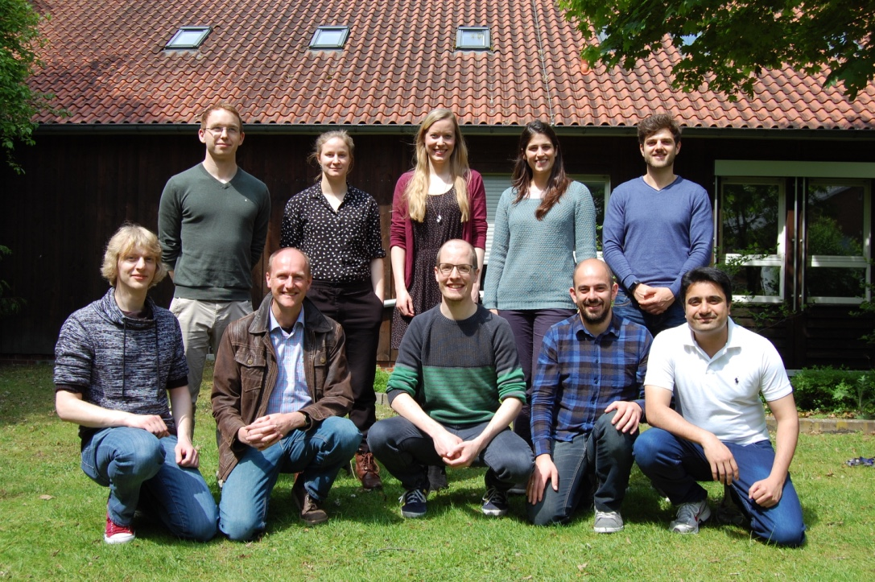
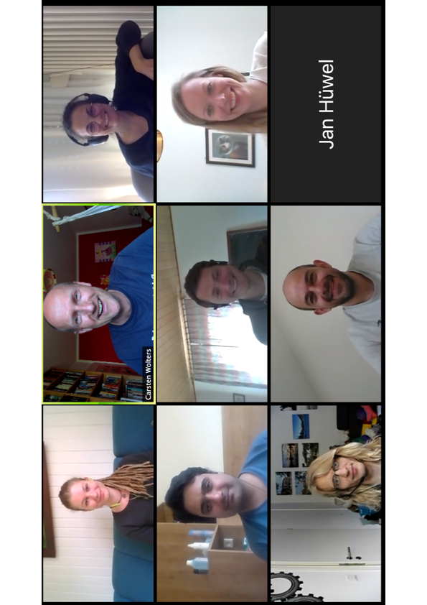
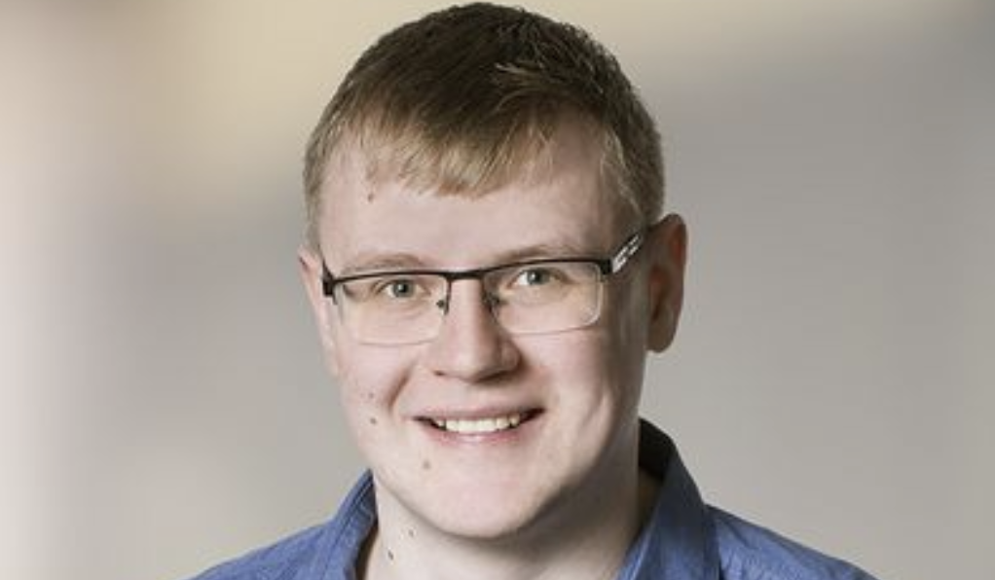
Thank you for your attention!
SIM-NEURO work-group at IBB
Notes:
36
36

