Slide 1
Mathematical Methods for the Segmentation of Medical Images and head model construction
Carsten Wolters
Institut für Biomagnetismus und Biosignalanalyse, Westfälische Wilhelms-Universität Münster
Lecture, April 29, 2025

Slide 2
Structure (segmentation)
Fuzzy segmentation techniques
Geometric deformable model reconstructions
Segmentation scripts

Slide 3
Unsupervised clustering
[G. Lohmann, Volumetric Image Analysis, John Wiley & Sons, 1998]
[C.Wolters, Vorlesungsskriptum]
Clustering methods classify voxels by simple intensity range partitioning
A clustering method is called unsupervised, if it automatically determines the intensity ranges for a user-given number of clusters
The ISODATA algorithm is a representative of unsupervised clustering, minimizing the following objective function:
Notes:
The influence of the boundary conditions is limited. Therefore, the implicit boundary conditions are often replaced
By explicit boundary conditions.

Slide 4
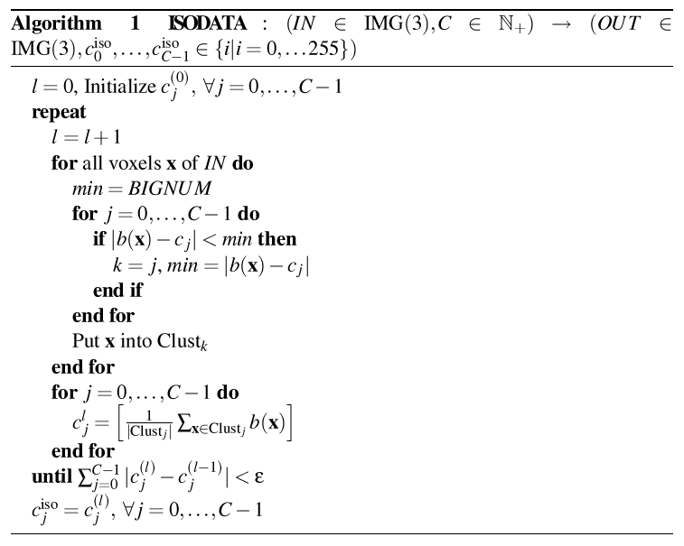
Unsupervised clustering: The ISODATA algorithm
[G. Lohmann, Volumetric Image Analysis, John Wiley & Sons, 1998]
[C.Wolters, Vorlesungsskriptum]
(l-1)
(l-1)

Slide 5
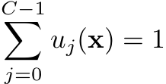
Fuzzy C-means segmentation
[J.K. Udupa & S. Samarasekera, Graph.Models and Image Processing, 58, 1999]
[C.Wolters, Vorlesungsskriptum]
Fuzzy C-Means (FCM) segmentation algorithms do not force a voxel to belong to exclusively one class, but assign a membership value with
FCM thus takes partial volume averaging effects into account.
FCM minimizes the following objective function:
Notes:
The influence of the boundary conditions is limited. Therefore, the implicit boundary conditions are often replaced
By explicit boundary conditions.

Slide 6
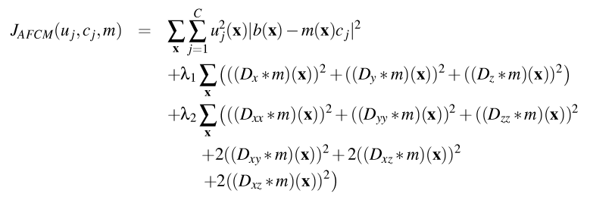
Adaptive Fuzzy C-means segmentation
[D.L. Pham & J.L. Prince, Pattern Recognition Letters, 20, 1999]
[C.Wolters, Vorlesungsskriptum]
The following factors cause intensity inhomogeneities in MRI:
Radio frequency excitation field inhomogeneity (McVeigh et al., Med.Phys., 1986)
eddy current driven field gradients (Simmons et al., Magn.Reson.Med., 1994)
RF penetration and standing wave effects (Bottomley & Andrew, Phys.Med.Biol., 1978)
Inhomogeneities are well modeled by the product of the original image with a smoothly varying multiplier field (Dawant et al., IEEE Trans.Med.Imag., 1993)
Functional of the adaptive fuzzy C-means (AFCM) algorithm:

Slide 7
AFCM: Derivation of the algorithm (centroids c)

Slide 8
AFCM: Derivation of the algorithm (membership function u)

Slide 9
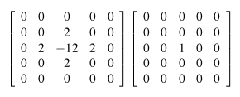
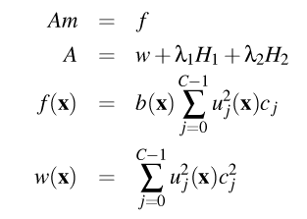
AFCM: Derivation of the algorithm (multiplier m)
[D.L. Pham & J.L. Prince, Pattern Recognition Letters, 20, 1999]
Notes:
If A is symmetric and strictly diagonally dominant with positive diagonal elements, then A is SPD and, e.g., scaled CG converges.
It is easy to show that A is diagonally dominant if w_i>60\lambda_2.
MG, when tuned appropriately, can also solve indefinite and even unsymmetric problems and is of order O(N).

Slide 10
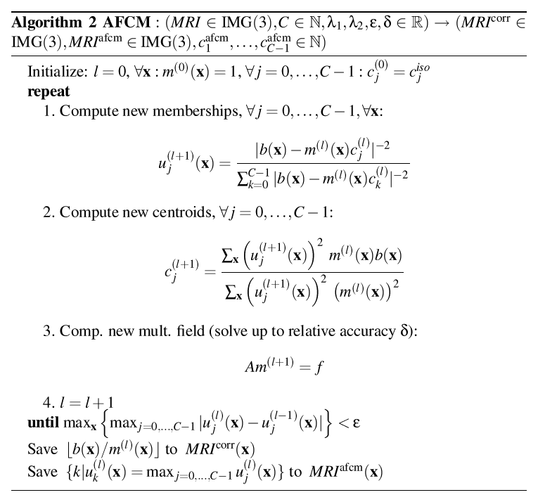
AFCM: The algorithm
[D.L. Pham & J.L. Prince, Pattern Recognition Letters, 20, 1999]
[C.Wolters, Vorlesungsskriptum]

Slide 11
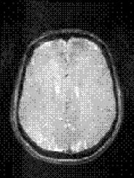
Example (PD-MRI): Results of ISODATA and AFCM
[C.Wolters, Vorlesungsskriptum]
Notes:
unsupervised clustering methods: trying to minimize the distance of the intensity of each voxel to its class
Intensity inhom. are inherent caused by such factors as RF excitation field inhom., non-uniform reception coil sensitivity, eddy currents driven by field gradients, RF penetration and standing wave effects
inhom. are well modeled by the product of the originl image with a smoothly varying multiplier field

Slide 12
Example (PD-MRI): Results of ISODATA and AFCM
[C.Wolters, Vorlesungsskriptum]
Segmentation result ISODATA (C=2)
Notes:
unsupervised clustering methods: trying to minimize the distance of the intensity of each voxel to its class
Intensity inhom. are inherent caused by such factors as RF excitation field inhom., non-uniform reception coil sensitivity, eddy currents driven by field gradients, RF penetration and standing wave effects
inhom. are well modeled by the product of the originl image with a smoothly varying multiplier field

Slide 13
Example (PD-MRI): Results of ISODATA and AFCM
[C.Wolters, Vorlesungsskriptum]
Segmentation result ISODATA (C=2)
Segmentation result AFCM (C=2)
Notes:
unsupervised clustering methods: trying to minimize the distance of the intensity of each voxel to its class
Intensity inhom. are inherent caused by such factors as RF excitation field inhom., non-uniform reception coil sensitivity, eddy currents driven by field gradients, RF penetration and standing wave effects
inhom. are well modeled by the product of the originl image with a smoothly varying multiplier field

Slide 14
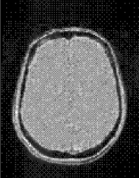
Example (PD-MRI): Results of ISODATA and AFCM
[C.Wolters, Vorlesungsskriptum]
Corrected Images (AFCM)
Segmentation result ISODATA (C=2)
Segmentation result AFCM (C=2)
Notes:
unsupervised clustering methods: trying to minimize the distance of the intensity of each voxel to its class
Intensity inhom. are inherent caused by such factors as RF excitation field inhom., non-uniform reception coil sensitivity, eddy currents driven by field gradients, RF penetration and standing wave effects
inhom. are well modeled by the product of the originl image with a smoothly varying multiplier field

Slide 15
Example (T1-MRI): Results of ISODATA and AFCM
[C.Wolters, Vorlesungsskriptum]
Notes:
unsupervised clustering methods: trying to minimize the distance of the intensity of each voxel to its class
Intensity inhom. are inherent caused by such factors as RF excitation field inhom., non-uniform reception coil sensitivity, eddy currents driven by field gradients, RF penetration and standing wave effects
inhom. are well modeled by the product of the originl image with a smoothly varying multiplier field

Slide 16
Example (T1-MRI): Results of ISODATA and AFCM
[C.Wolters, Vorlesungsskriptum]
Segmentation result ISODATA (C=3)
Notes:
unsupervised clustering methods: trying to minimize the distance of the intensity of each voxel to its class
Intensity inhom. are inherent caused by such factors as RF excitation field inhom., non-uniform reception coil sensitivity, eddy currents driven by field gradients, RF penetration and standing wave effects
inhom. are well modeled by the product of the originl image with a smoothly varying multiplier field

Slide 17
Example (T1-MRI): Results of ISODATA and AFCM
[C.Wolters, Vorlesungsskriptum]
Segmentation result ISODATA (C=3)
Segmentation result AFCM (C=3)
Notes:
unsupervised clustering methods: trying to minimize the distance of the intensity of each voxel to its class
Intensity inhom. are inherent caused by such factors as RF excitation field inhom., non-uniform reception coil sensitivity, eddy currents driven by field gradients, RF penetration and standing wave effects
inhom. are well modeled by the product of the originl image with a smoothly varying multiplier field

Slide 18
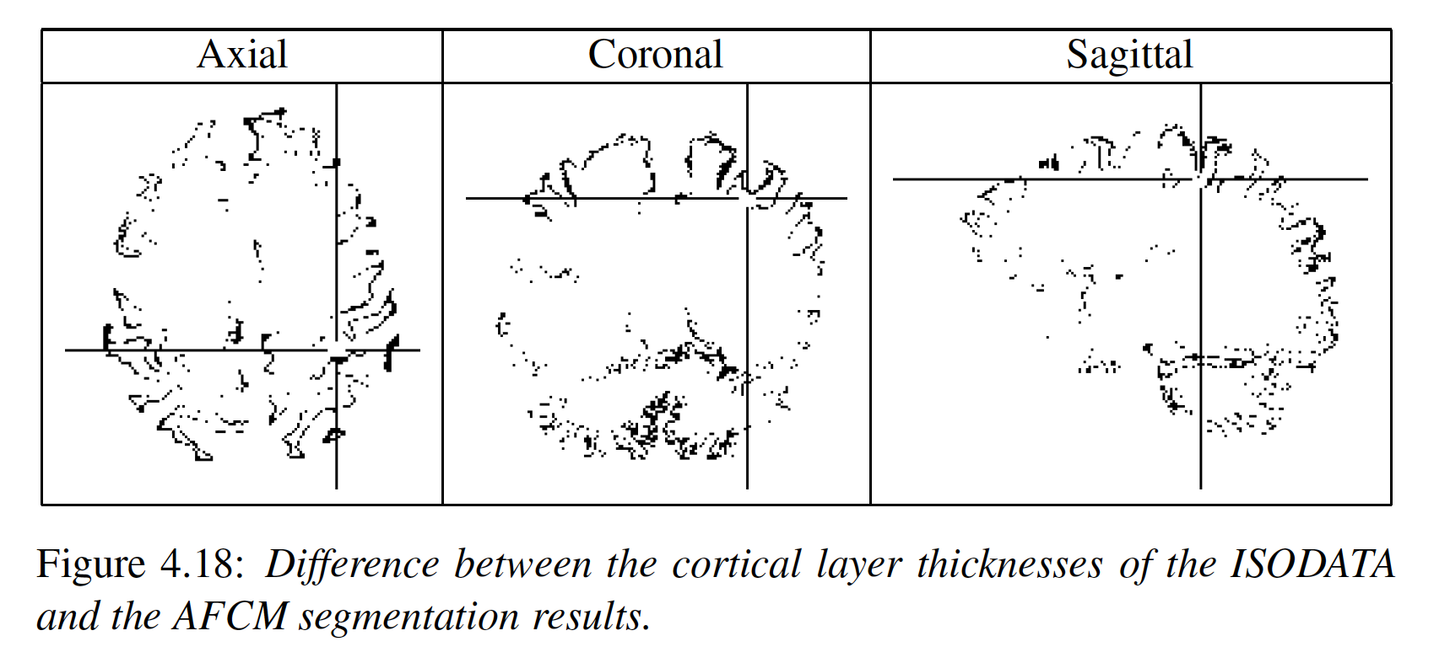
Cortical segmentation: Differences between ISODATA and AFCM
[C.Wolters, Vorlesungsskriptum]
Notes:
unsupervised clustering methods: trying to minimize the distance of the intensity of each voxel to its class
Intensity inhom. are inherent caused by such factors as RF excitation field inhom., non-uniform reception coil sensitivity, eddy currents driven by field gradients, RF penetration and standing wave effects
inhom. are well modeled by the product of the originl image with a smoothly varying multiplier field

Slide 19
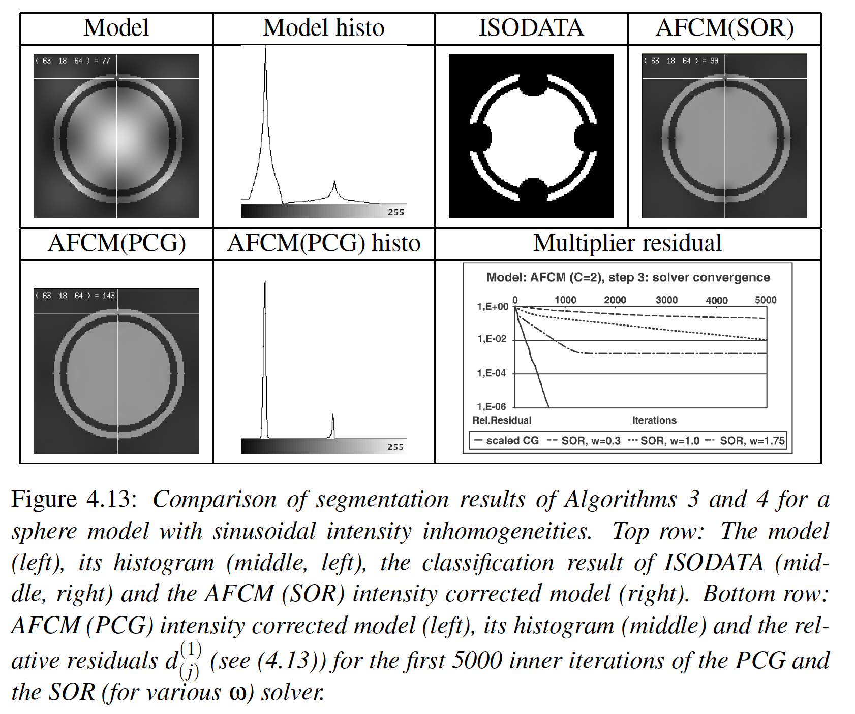
Importance of preconditioned conjugate gradient (PCG) solver for AFCM
[C.Wolters, Vorlesungsskriptum]
Notes:
unsupervised clustering methods: trying to minimize the distance of the intensity of each voxel to its class
Intensity inhom. are inherent caused by such factors as RF excitation field inhom., non-uniform reception coil sensitivity, eddy currents driven by field gradients, RF penetration and standing wave effects
inhom. are well modeled by the product of the originl image with a smoothly varying multiplier field

Slide 20
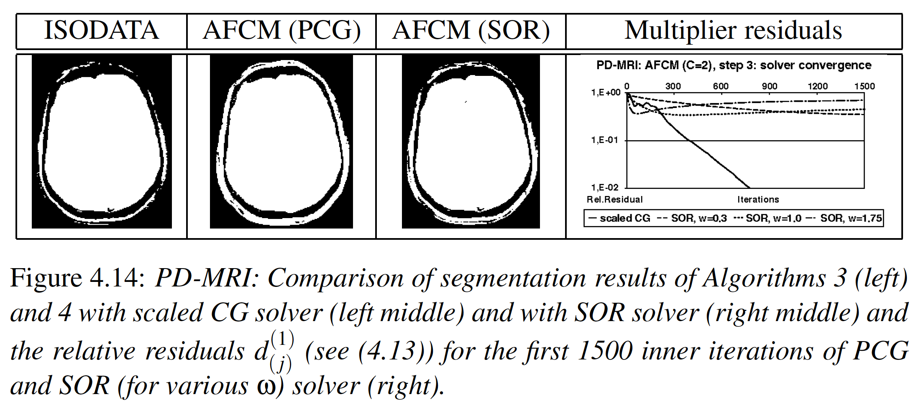
Importance of preconditioned conjugate gradient (PCG) solver for AFCM
[C.Wolters, Vorlesungsskriptum]
Notes:
unsupervised clustering methods: trying to minimize the distance of the intensity of each voxel to its class
Intensity inhom. are inherent caused by such factors as RF excitation field inhom., non-uniform reception coil sensitivity, eddy currents driven by field gradients, RF penetration and standing wave effects
inhom. are well modeled by the product of the originl image with a smoothly varying multiplier field

Slide 21
Structure
Fuzzy segmentation techniques
Geometric deformable model reconstructions
Segmentation scripts

Slide 22
Geometric deformable models
[Han, Xu and Prince, IEEE Trans.Pattern Anal.Mach.Intell., 25, 2003]
[Han, Pham, Tosun, Rettmann, Xu & Prince, NeuroImage, 23, 2004]
[M.Burger, Talk at IBB, May 2008]
Geometric deformable models are based on the theory of front evolution and are implemented using the level set numerical method (Osher & Sethian, 1988; Sethian, 1999)
The level set technique represents the boundary contour of a domain implicitly as the zero level of a level set function :
In a velocity field , each point evolves via the ODE

Slide 23
Geometric deformable models
[Han, Xu and Prince, IEEE Trans.Pattern Anal.Mach.Intell., 25, 2003]
[Han, Pham, Tosun, Rettmann, Xu & Prince, NeuroImage, 23, 2004]
[M.Burger, Talk at IBB, May 2008]
For any parametric representation and due to the definition of the level set function we find
By the chain rule:
We thus obtain:

Slide 24
Geometric deformable models
[Han, Xu and Prince, IEEE Trans.Pattern Anal.Mach.Intell., 25, 2003]
[Han, Pham, Tosun, Rettmann, Xu & Prince, NeuroImage, 23, 2004]
[M.Burger, Talk at IBB, May 2008]
For any parametric representation and due to the definition of the level set function we additionally find
By the chain rule:
Because is a tangential direction, has to be a radial direction:
Notes:
delta x / delta S can be approximated by 1/h(x(S+h,t)-x(S,t)) and since x(S+h,t) is also a point on Gamma(t), the vector x(S+h,t)-x(S,t) is for h->0 tangential on Gamma(t).

Slide 25
Geometric deformable models
[Han, Xu and Prince, IEEE Trans.Pattern Anal.Mach.Intell., 25, 2003]
[Han, Pham, Tosun, Rettmann, Xu & Prince, NeuroImage, 23, 2004]
[M.Burger, Talk at IBB, May 2008]
This finally leads to the so-called Hamilton-Jacobi equation
Notes:
Hamilton Jacobi equation
Da grad Phi eine radiale Richtung ist, gilt:
<V,grad Phi> = v < grad Phi / abs(grad Phi) , grad Phi>, wobei v die radiale Komponente von V ist

Slide 26
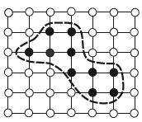
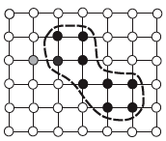
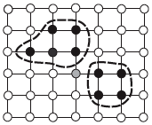
Example: Topology-preserving Geometric Deformable Model (TGDM)
[Han, Xu and Prince, IEEE Trans.Pattern Anal.Mach.Intell., 25, 2003]
For the reconstruction of the gray matter/white matter boundary of the human brain, a combination of an expansion/contraction speed R and the mean curvature κ was proposed for the normal velocity:
Choice of expansion/contraction speed:
TGDM: “Simple point” constraint that prevents topology-change
Original contour
Pass over simple point
Split at non-simple point
Notes:
\kappa(x,t)=div(n)=div(nabla\Phi / |\nabla\Phi |)

Slide 27
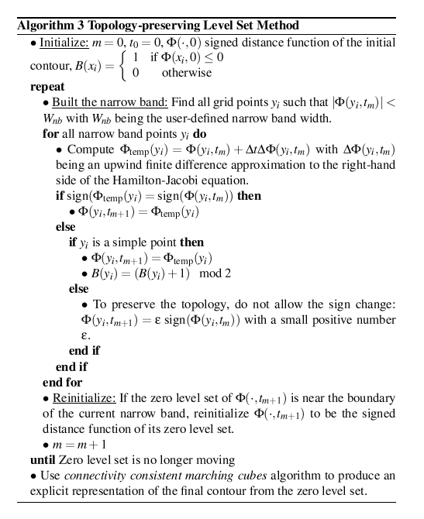
Geometric deformable models: The TGDM algorithm
[Han, Xu and Prince, IEEE Trans.Pattern Anal.Mach.Intell., 25, 2003]
[Han, Pham, Tosun, Rettmann, Xu & Prince, NeuroImage, 23, 2004]
Marching cubes: http://users.polytech.unice.fr/~lingrand/MarchingCubes/algo.html
Notes:
\kappa(x,t)=div(n)=div(nabla\Phi / |\nabla\Phi |)

Slide 28
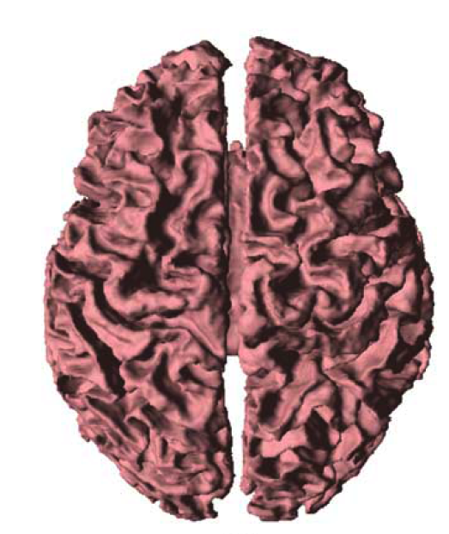
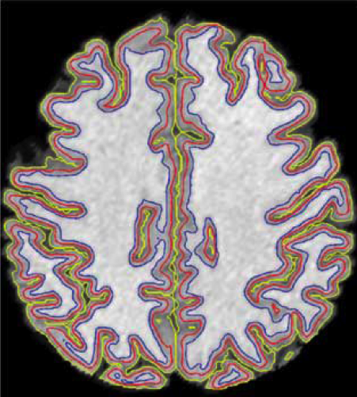
Example: Topology-preserving Geometric Deformable Model (TGDM)
[Han, Pham, Tosun, Rettmann, Xu & Prince, NeuroImage, 23, 2004]
Notes:
\kappa(x,t)=div(n)=div(nabla\Phi / |\nabla\Phi |)

Slide 29
Structure
Fuzzy segmentation techniques
Geometric deformable model reconstructions
Segmentation scripts

Slide 30
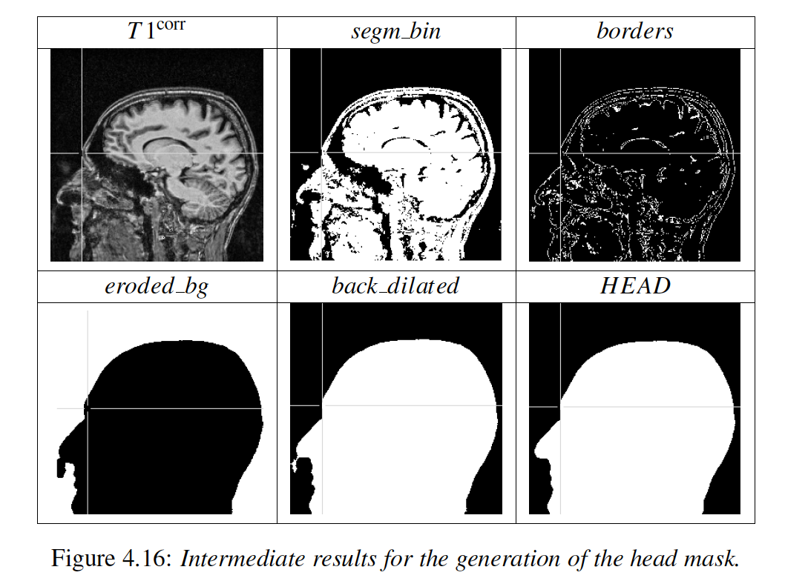
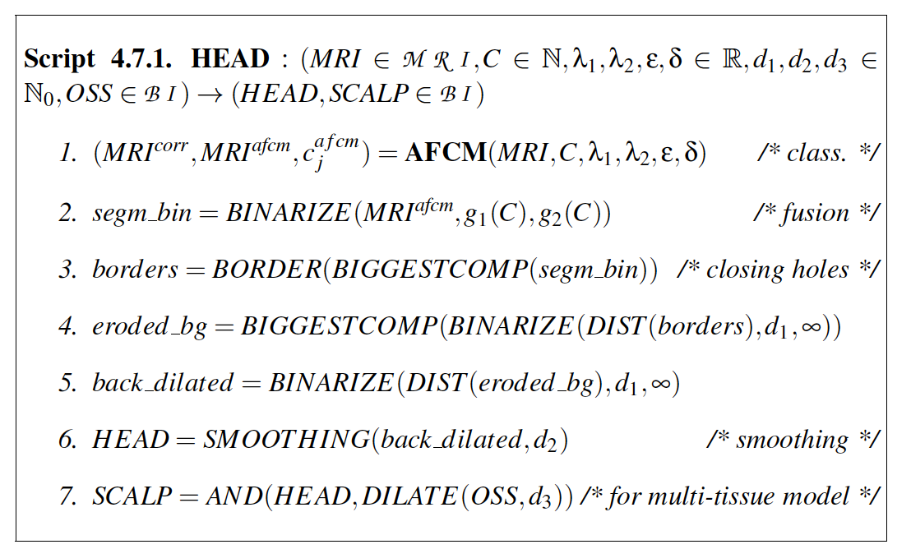
[C.Wolters, Vorlesungsskriptum]
Example of a segmentation script: We thus now furthermore need to learn about basic components such as, e.g., morphological operations

Slide 31
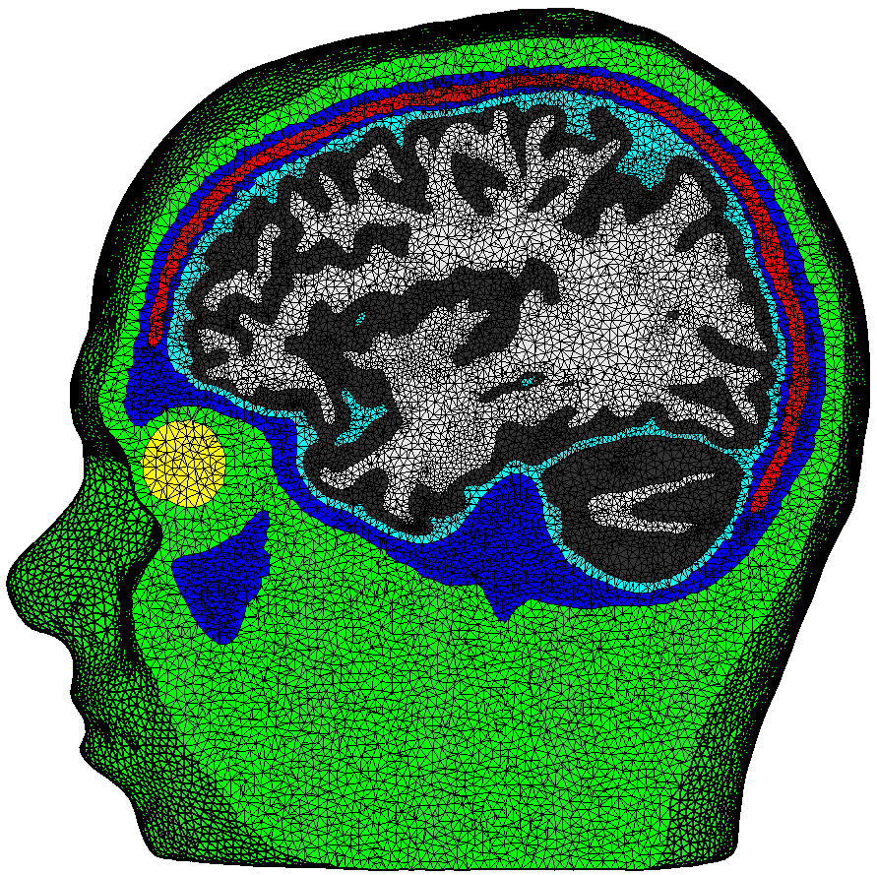
[Vorwerk et al., NeuroImage, 2014]
6 compartment FE head model
[Wolters, Anwander, Tricoche, Weinstein, Koch & MacLeod, NeuroImage, 2006]
[Vorwerk, Cho, Rampp, Hamer, Knösche & Wolters, NeuroImage, 2014]
[Wagner, Rampersad, Aydin, Vorwerk, Oostendorp, Neuling, Herrmann, Stegeman & Wolters, J. Neur. Eng., 2014]
Notes:
31

Slide 32
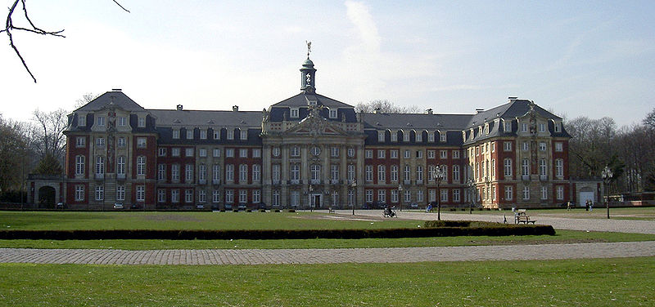
Thank you for your attention!
Notes:
32

Slide 33
Structure
Fuzzy segmentation techniques
Geometric deformable model reconstructions
Basic definitions and operations on images and meshes
Segmentation scripts

Slide 34
[C.Wolters, Vorlesungsskriptum]
Example of a segmentation script: We thus now furthermore need to learn about basic components such as, e.g., morphological operations

Slide 35
Literature
[C.Wolters, Vorlesungsskriptum]

Slide 36
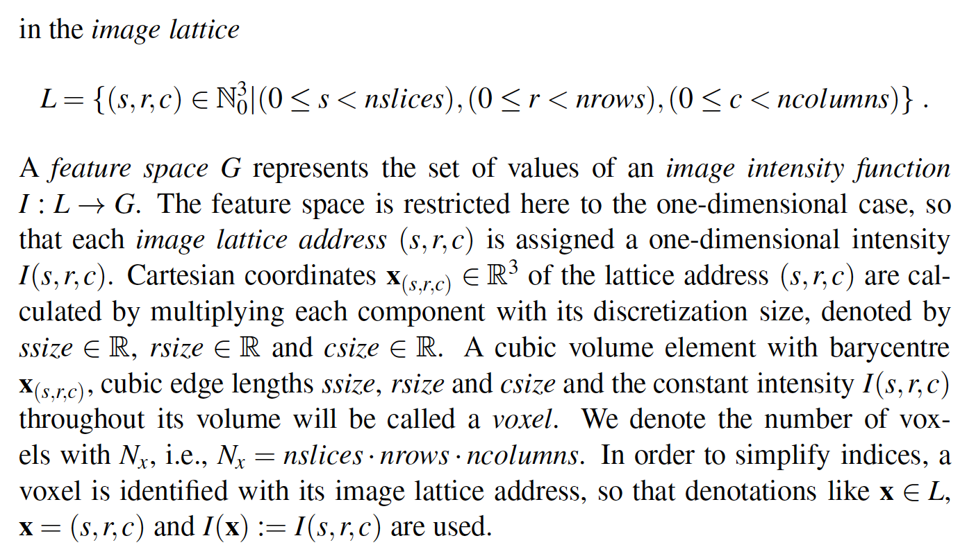
[C.Wolters, Vorlesungsskriptum]
Basic definitions

Slide 37
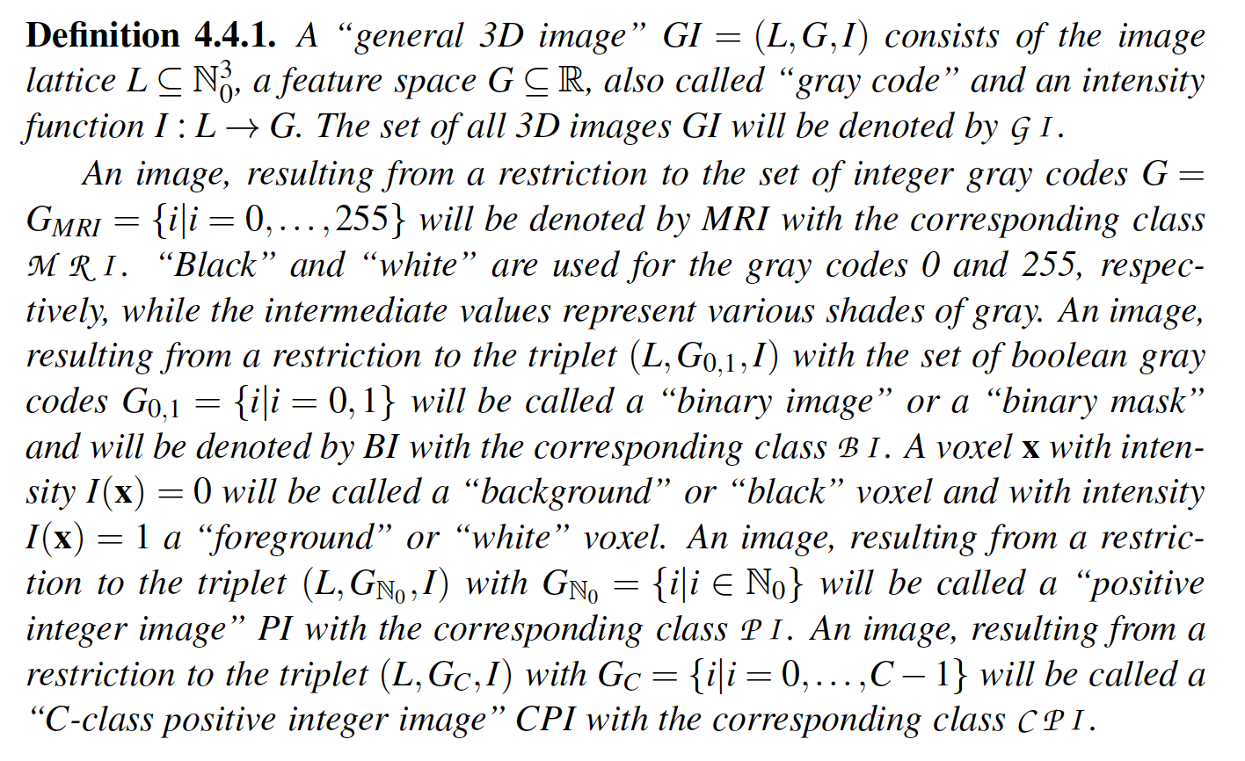
[C.Wolters, Vorlesungsskriptum]
Basic definitions

Slide 38
[C.Wolters, Vorlesungsskriptum]
Basic definitions

Slide 39
[C.Wolters, Vorlesungsskriptum]
Basic definitions

Slide 40
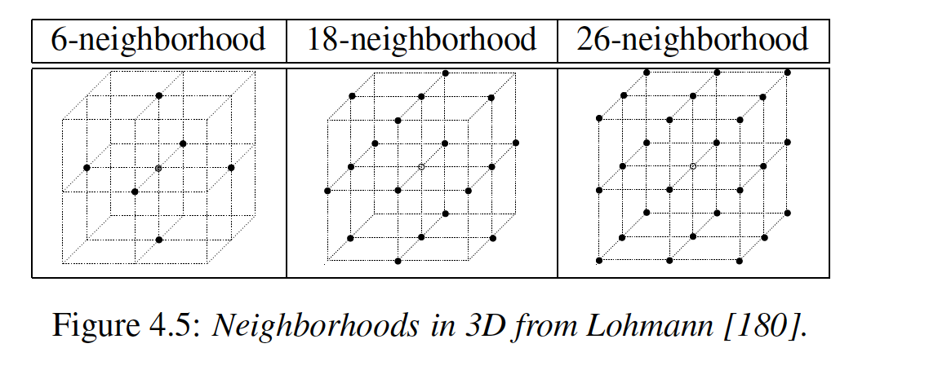
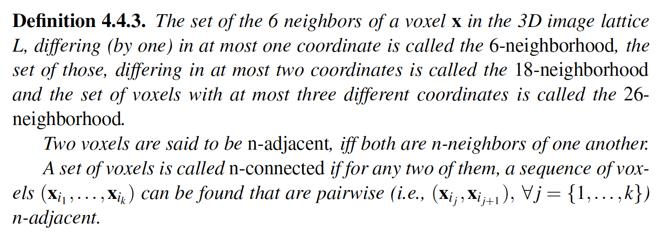
[C.Wolters, Vorlesungsskriptum]
Basic definitions

Slide 41
[C.Wolters, Vorlesungsskriptum]
Basic definitions
above

Slide 42
[C.Wolters, Vorlesungsskriptum]
Basic definitions

Slide 43
[C.Wolters, Vorlesungsskriptum]
Basic definitions
1

Slide 44
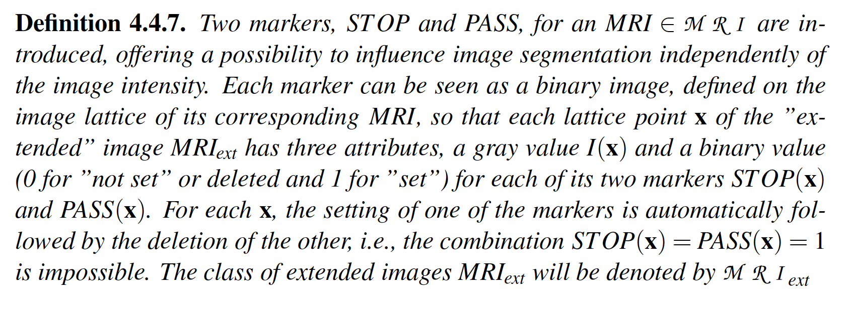
[C.Wolters, Vorlesungsskriptum]
Basic definitions

Slide 45
[C.Wolters, Vorlesungsskriptum]
Basic definitions

Slide 46
[C.Wolters, Vorlesungsskriptum]
Basic definitions

Slide 47
[C.Wolters, Vorlesungsskriptum]
Basic definitions

Slide 48
[C.Wolters, Vorlesungsskriptum]
Basic operations on images

Slide 49
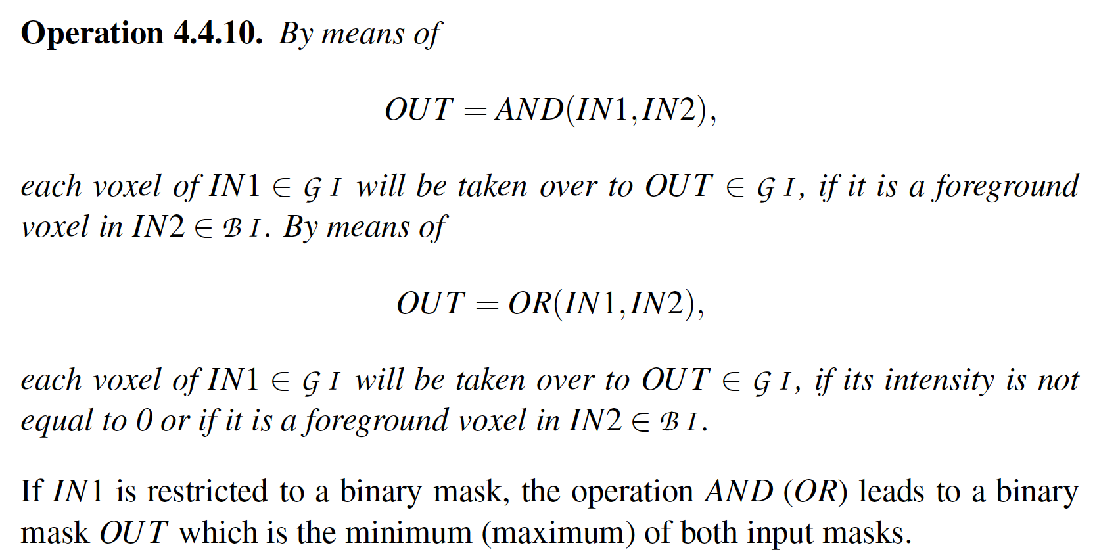
[C.Wolters, Vorlesungsskriptum]
Basic operations on images

Slide 50
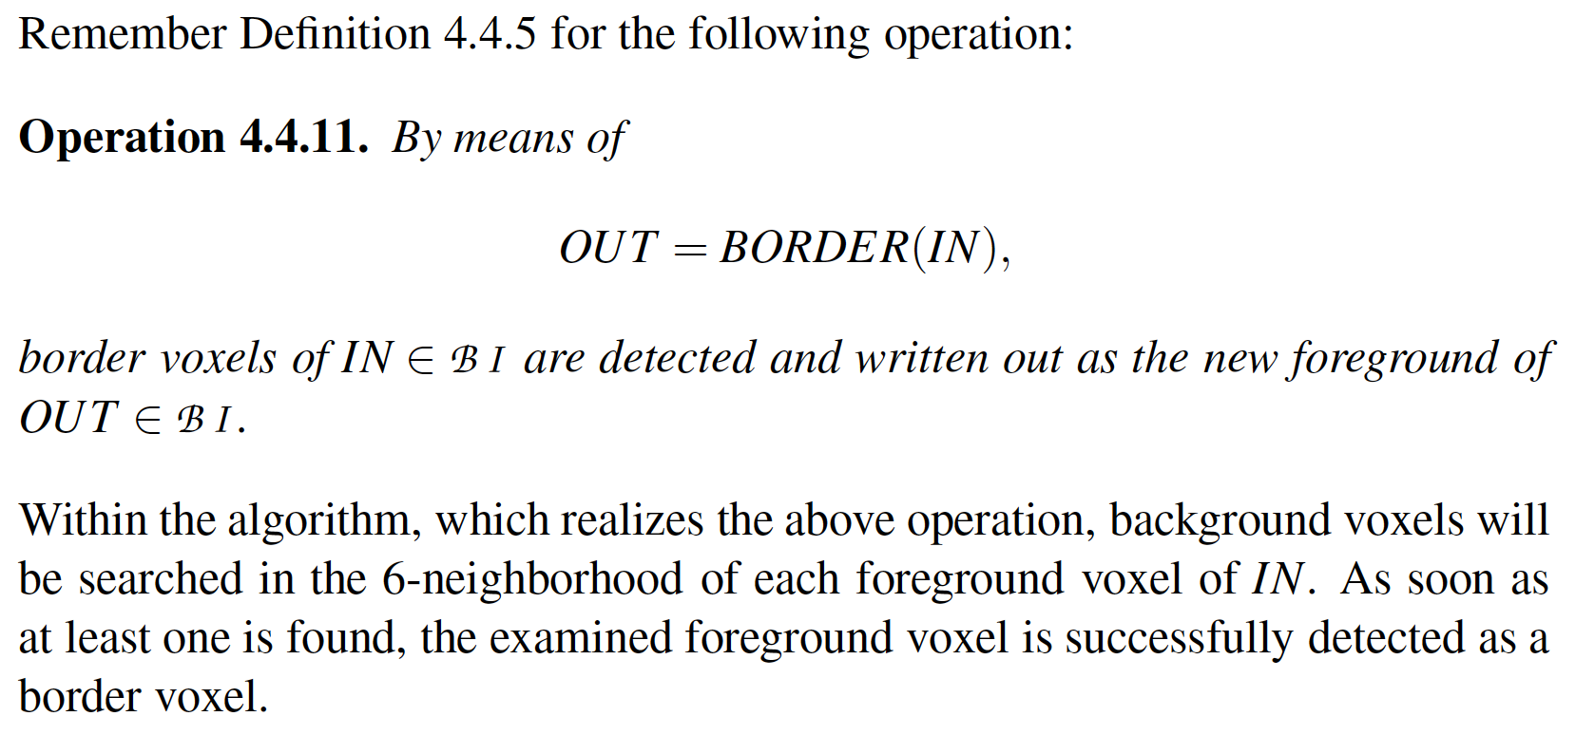
[C.Wolters, Vorlesungsskriptum]
Basic operations on images

Slide 51
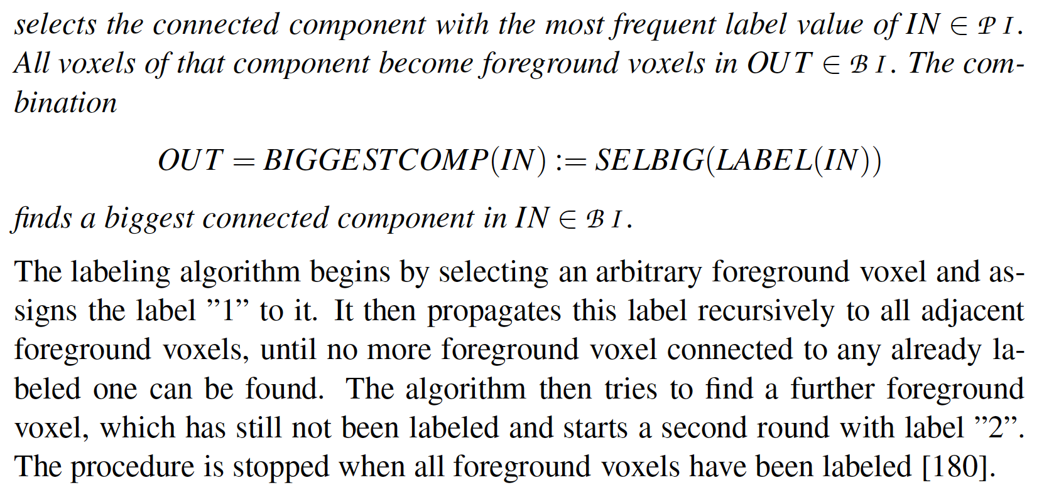
[C.Wolters, Vorlesungsskriptum]
Basic operations on images

Slide 52
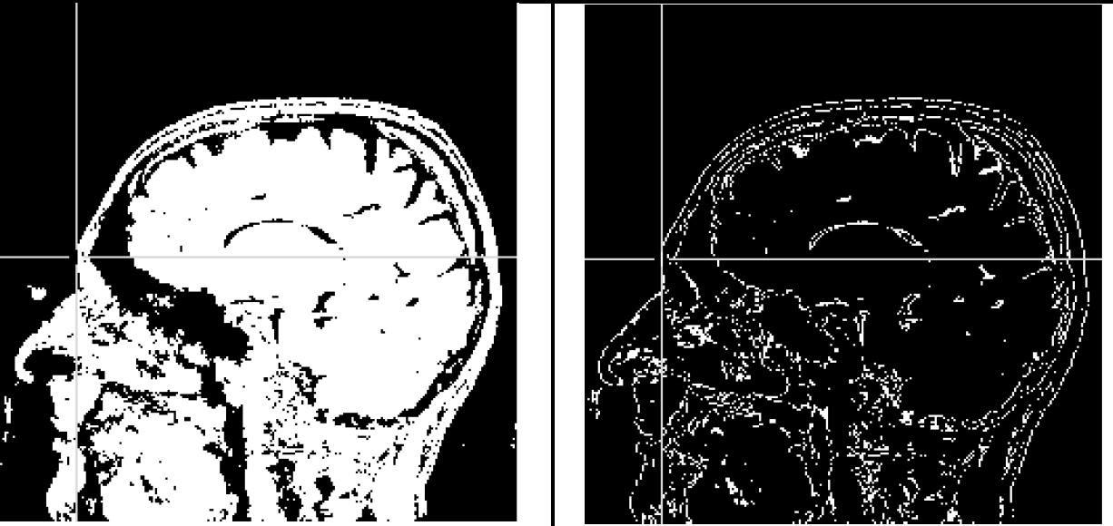
[C.Wolters, Vorlesungsskriptum]
Basic operations on images
OUT=BORDER(BIGGESTCOMP (IN))
IN
OUT

Slide 53
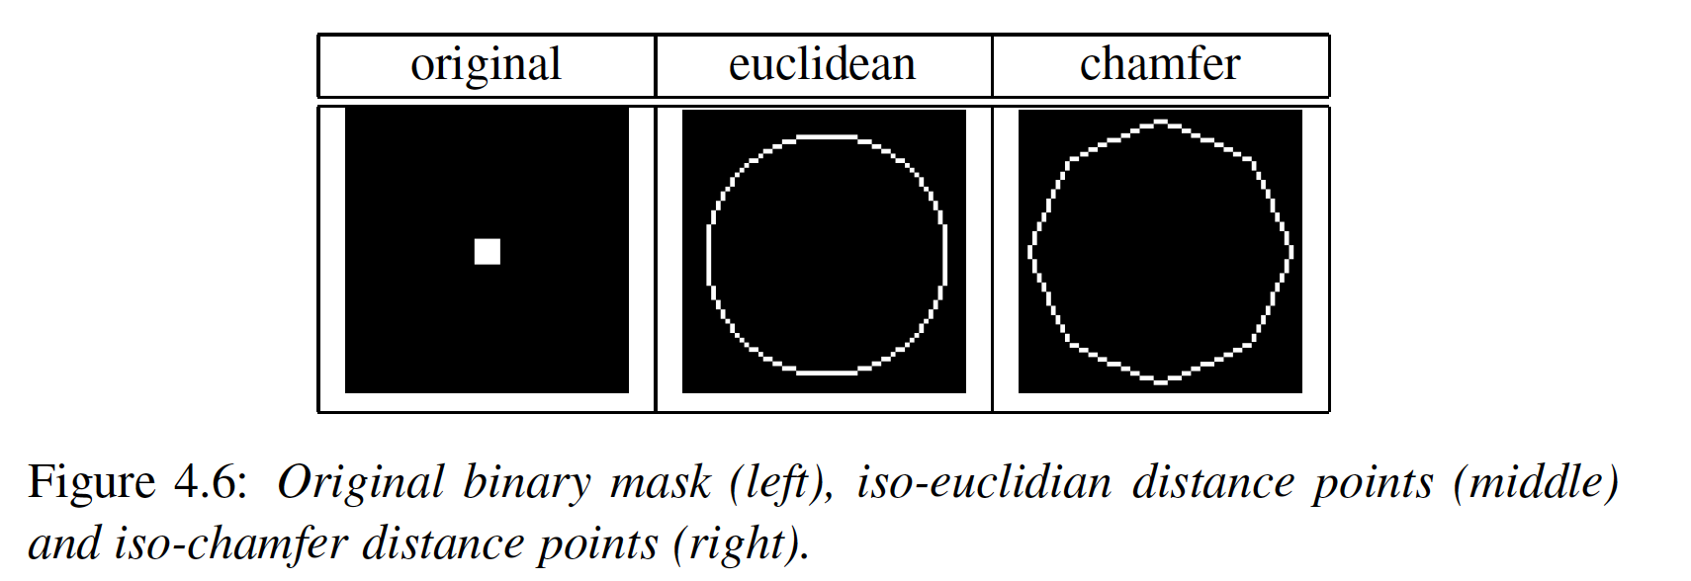
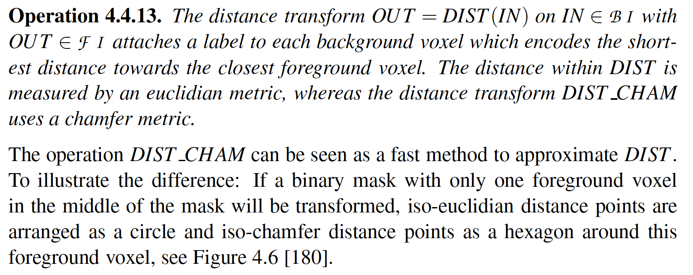
[C.Wolters, Vorlesungsskriptum]
Basic operations on images

Slide 54
[C.Wolters, Vorlesungsskriptum]
Basic operations on images
OUT=BINARIZE(DIST(IN),25,25)
IN
OUT

Slide 55
[C.Wolters, Vorlesungsskriptum]
Basic operations on images

Slide 56
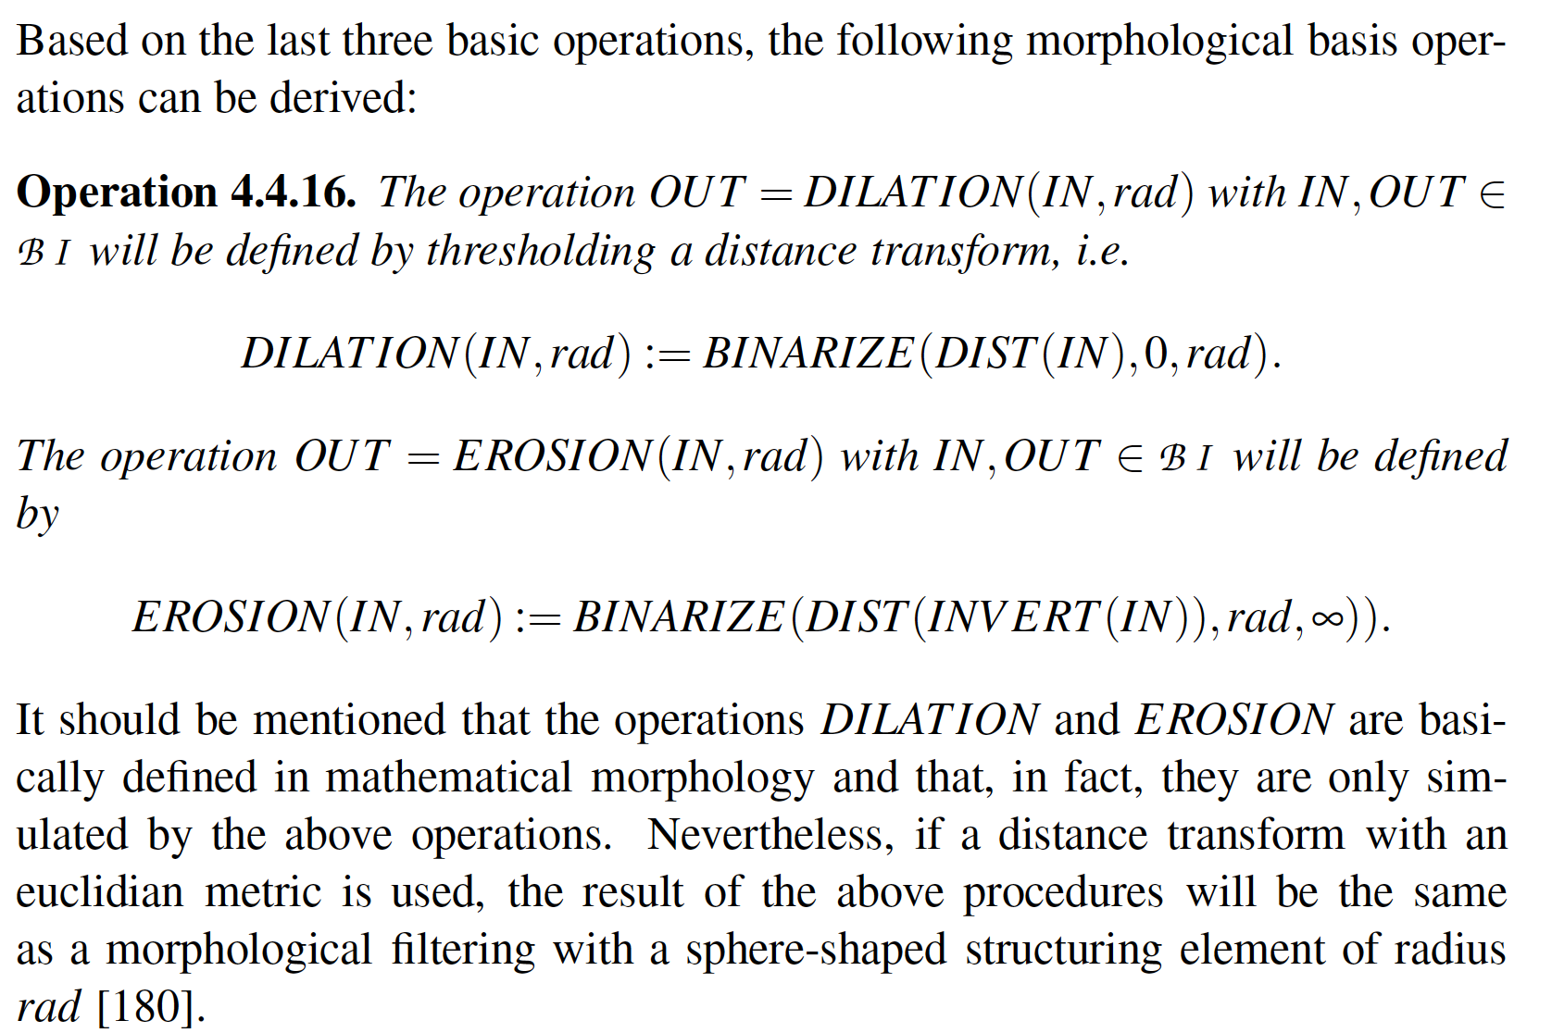
[C.Wolters, Vorlesungsskriptum]
Basic operations on images

Slide 57
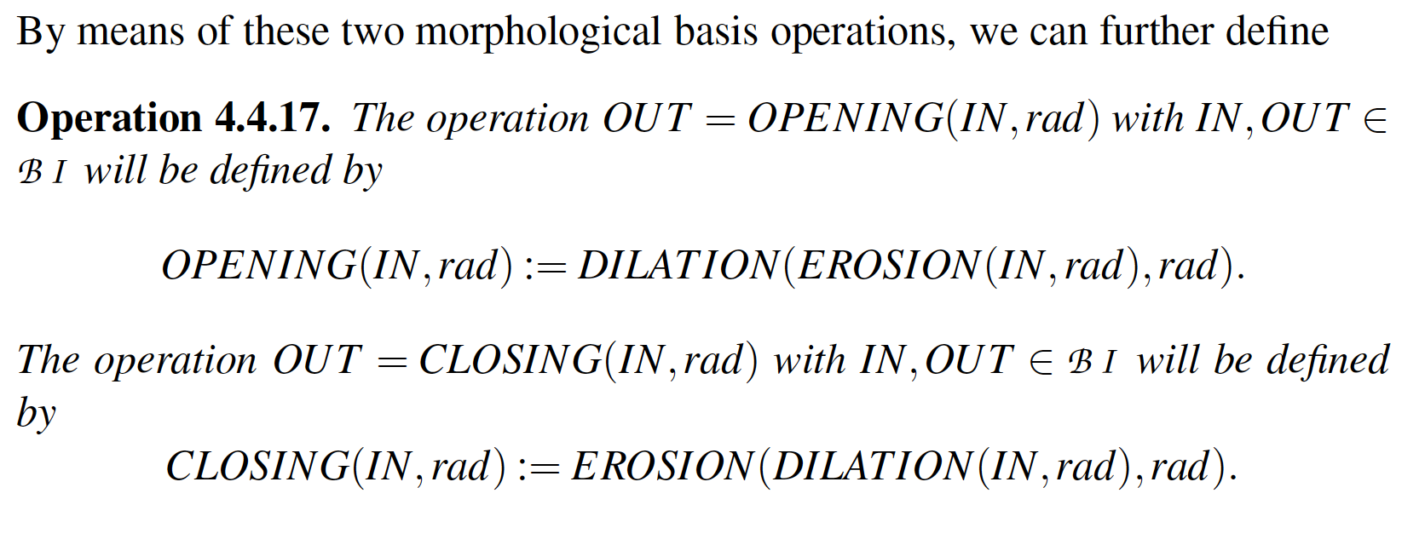
[C.Wolters, Vorlesungsskriptum]
Basic operations on images

Slide 58
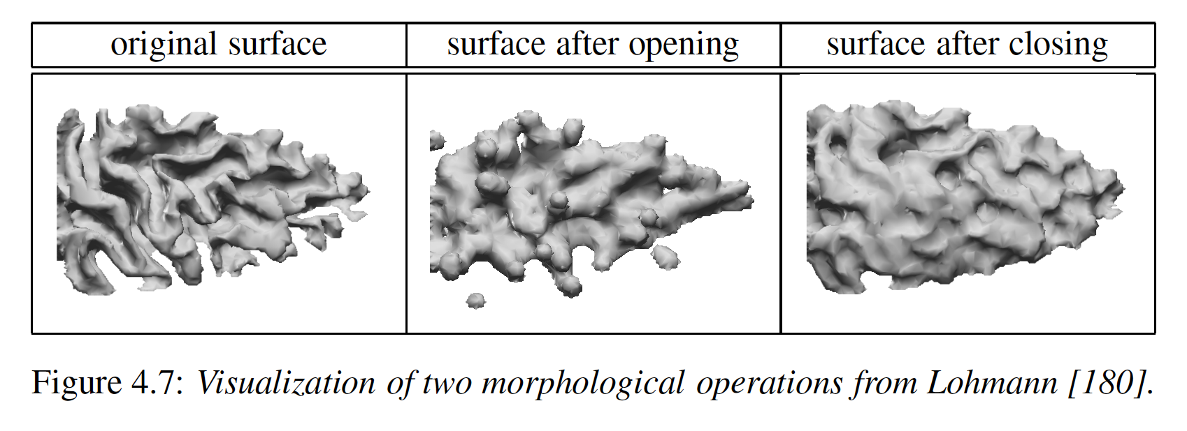
[C.Wolters, Vorlesungsskriptum]
Basic operations on images

Slide 59
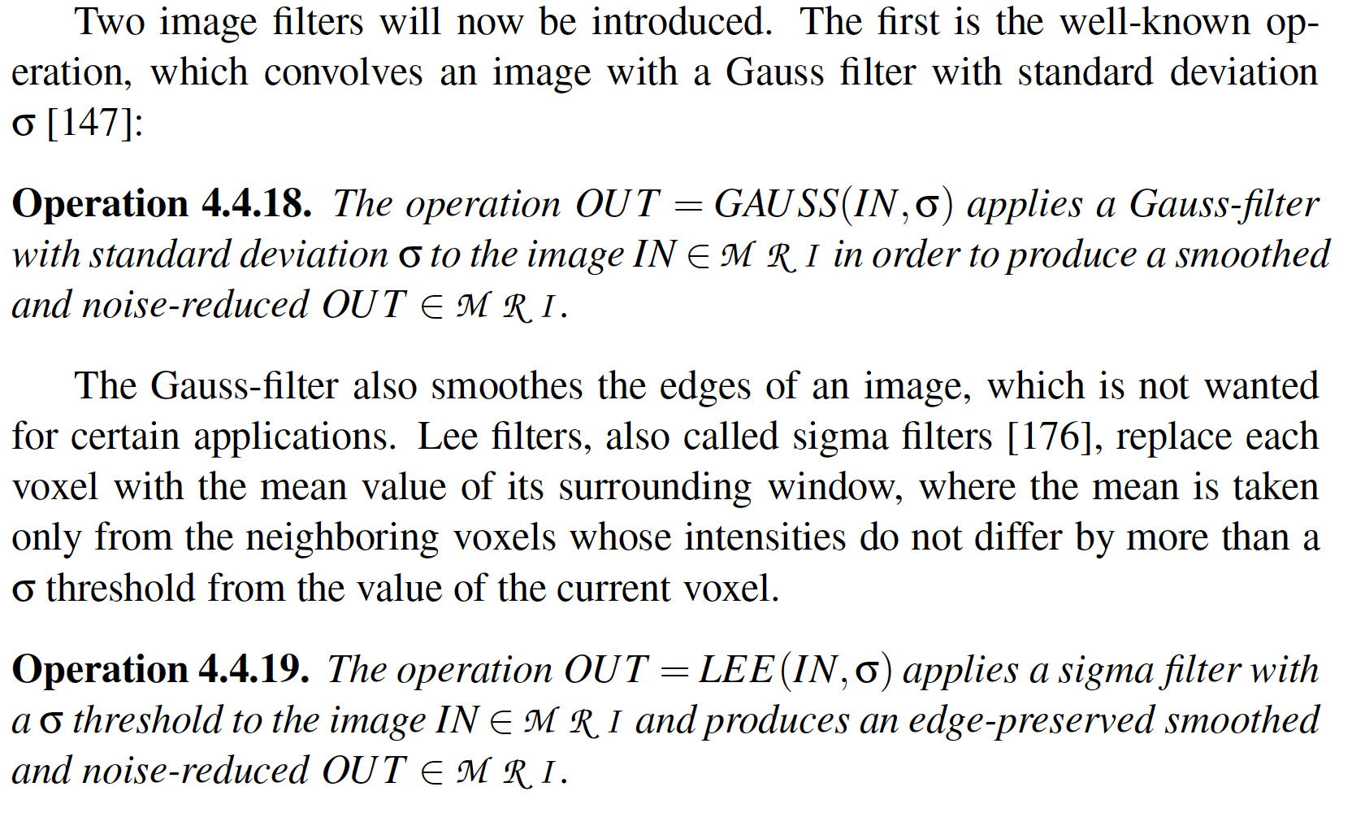
[C.Wolters, Vorlesungsskriptum]
Basic operations on images

Slide 60
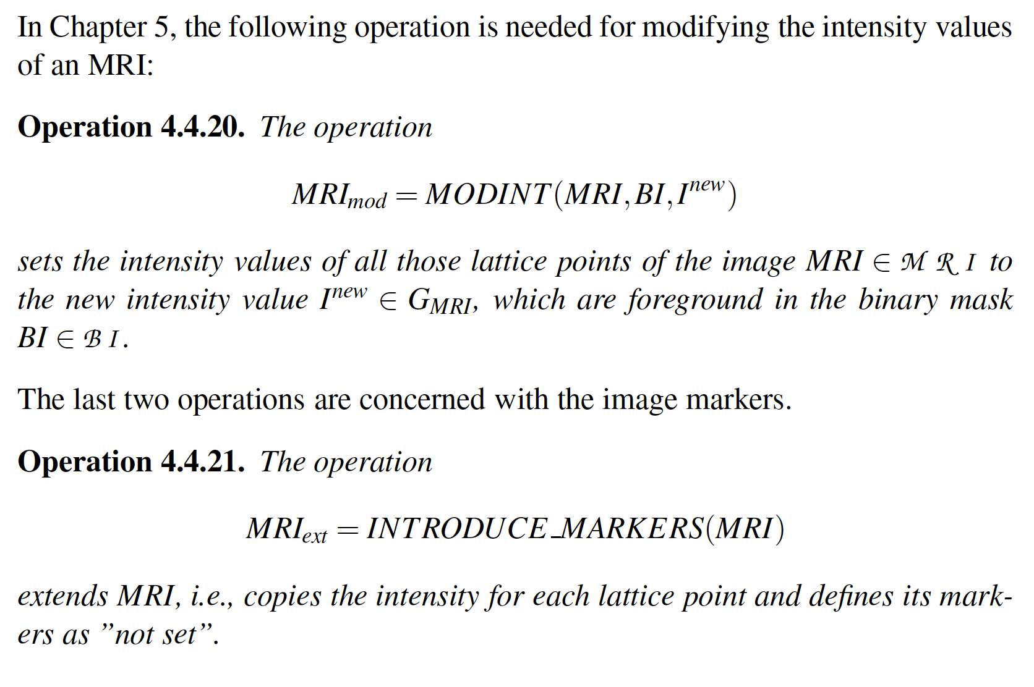
[C.Wolters, Vorlesungsskriptum]
Basic operations on images

Slide 61
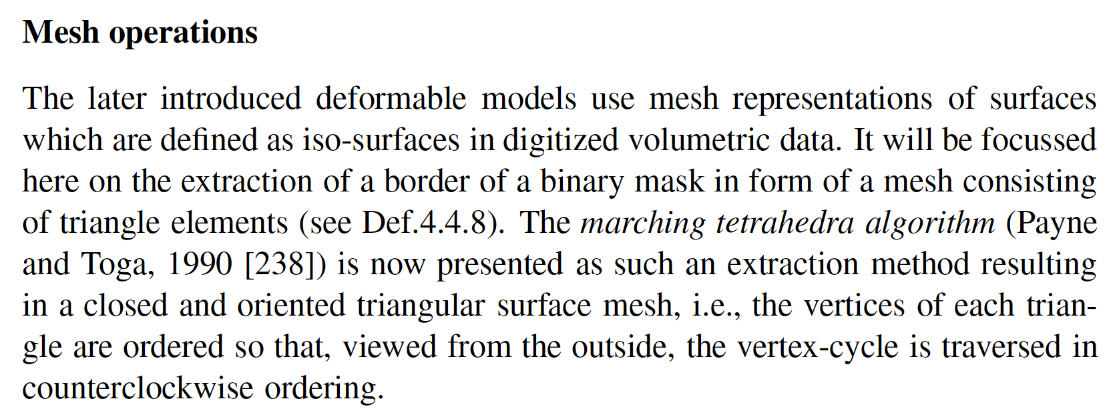
[C.Wolters, Vorlesungsskriptum]
Basic operations on meshes

Slide 62
[C.Wolters, Vorlesungsskriptum]
Basic operations on meshes

Slide 63
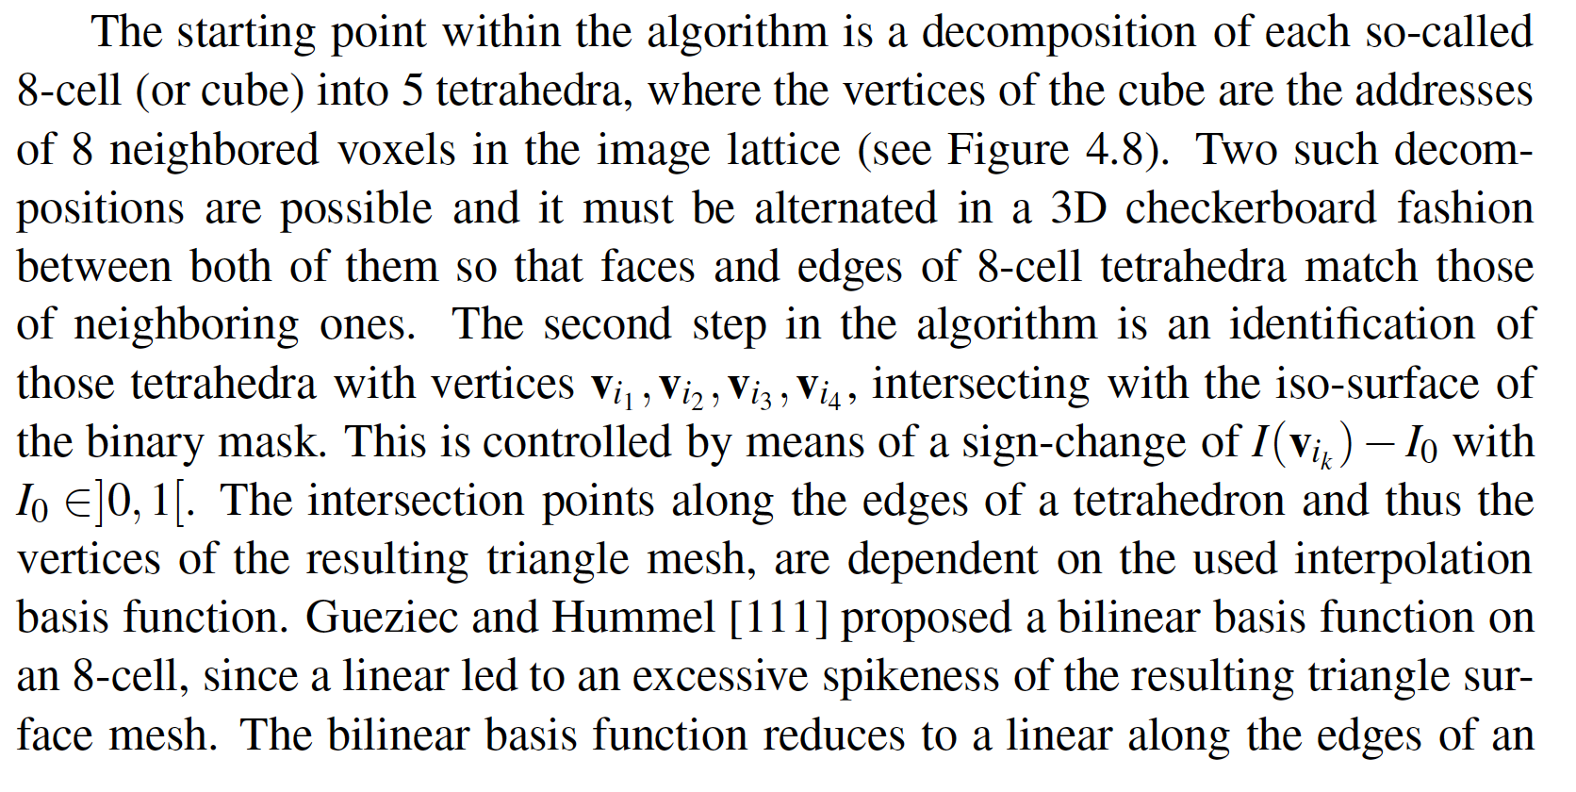
[C.Wolters, Vorlesungsskriptum]
Basic operations on meshes

Slide 64
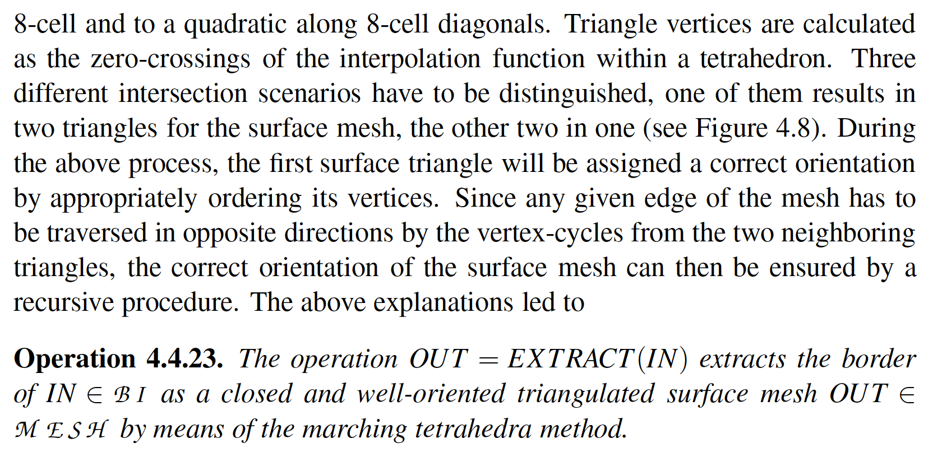
[C.Wolters, Vorlesungsskriptum]
Basic operations on meshes

Slide 65
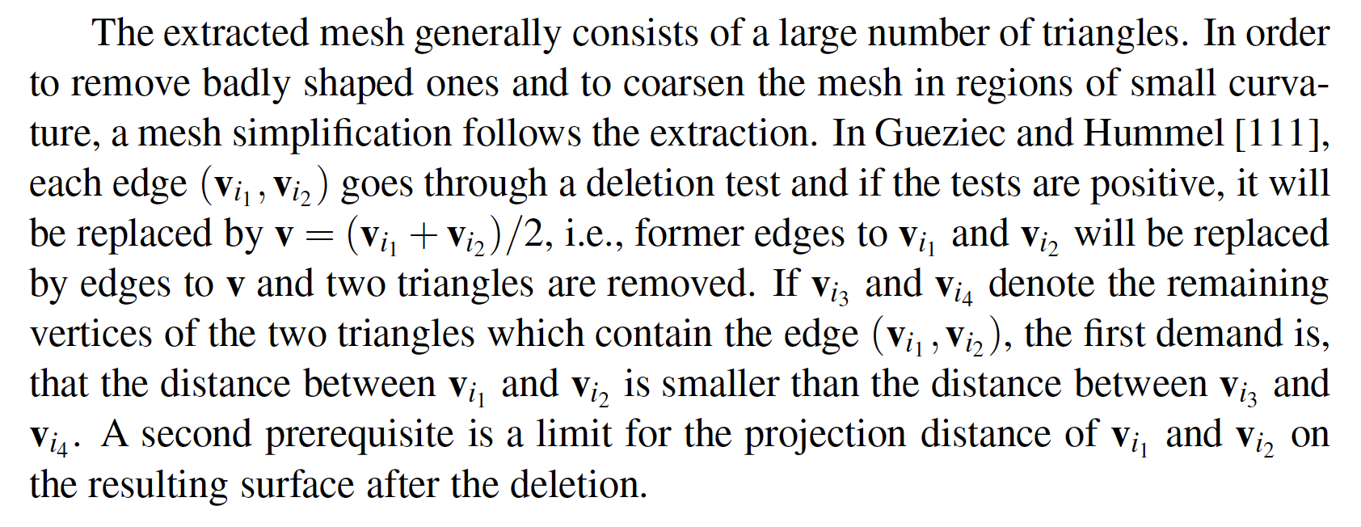
[C.Wolters, Vorlesungsskriptum]
Basic operations on meshes

Slide 66
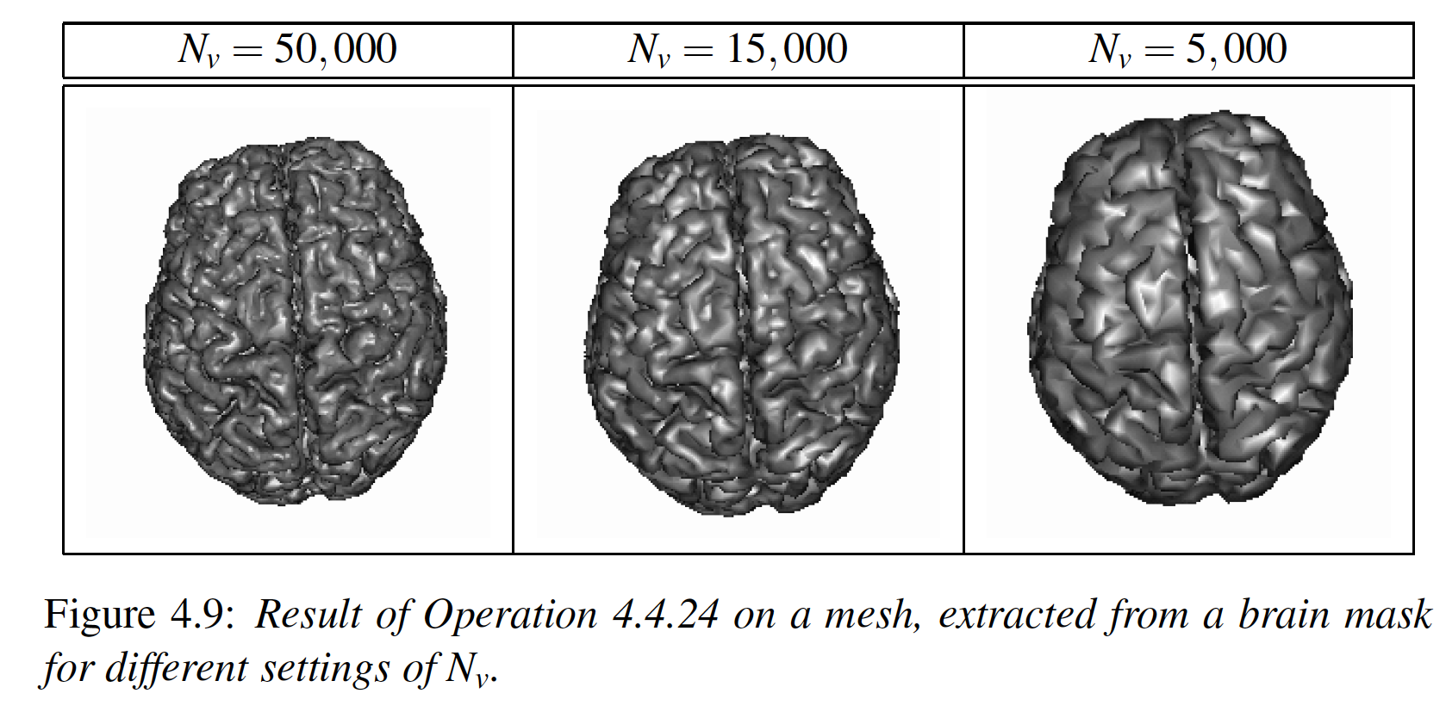
[C.Wolters, Vorlesungsskriptum]
Basic operations on meshes

Slide 67
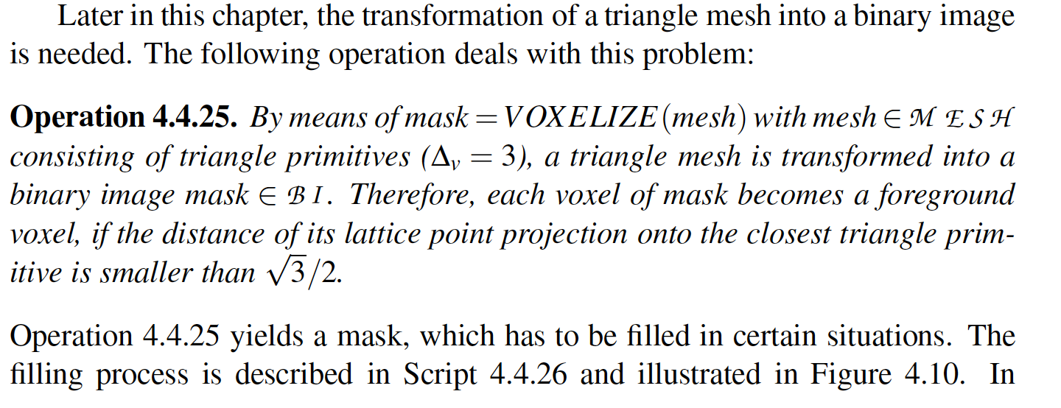
[C.Wolters, Vorlesungsskriptum]
Basic operations on meshes

Slide 68
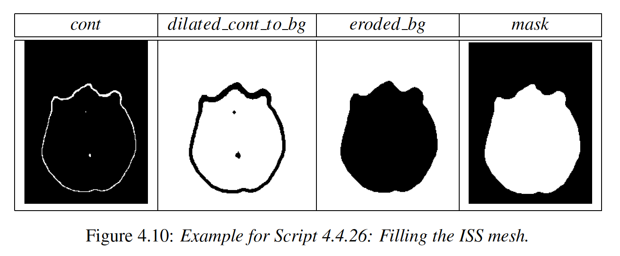
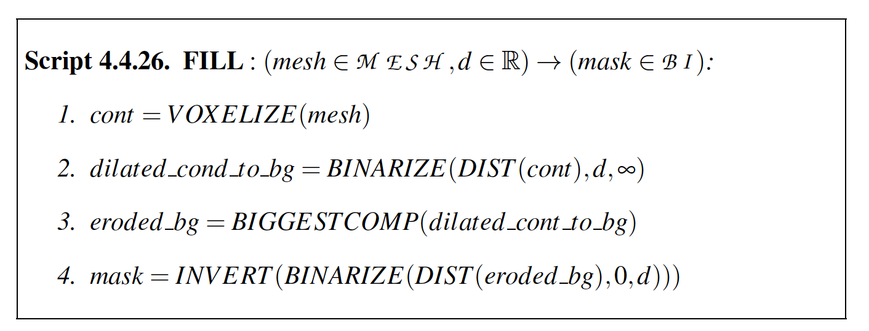
[C.Wolters, Vorlesungsskriptum]
Segmentation scripts for head modeling

Slide 69
Structure
Fuzzy segmentation techniques
Geometric deformable model reconstructions
Basic definitions and operations on images and meshes
Segmentation scripts

Slide 70
[C.Wolters, Vorlesungsskriptum]
Head mask
segmentation script

Slide 71
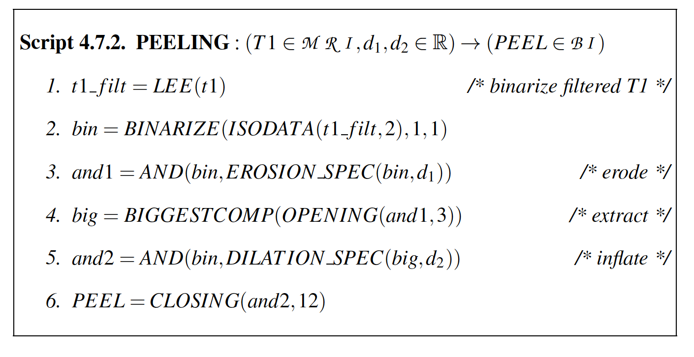
[C.Wolters, Vorlesungsskriptum]
Brain peeling segmentation script

Slide 72
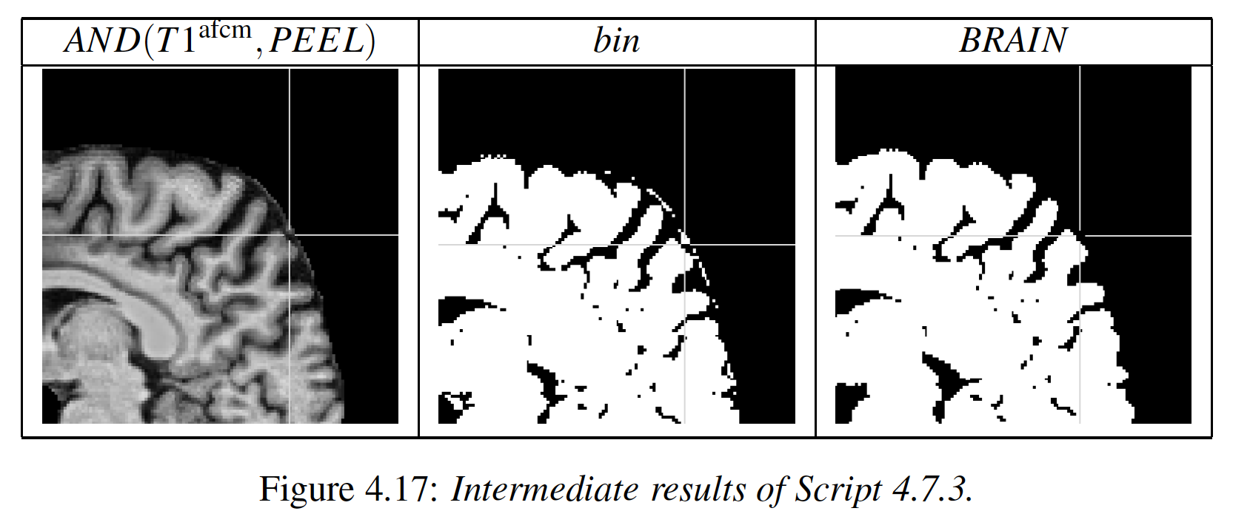
[C.Wolters, Vorlesungsskriptum]
Script for creating brain mask

Slide 73
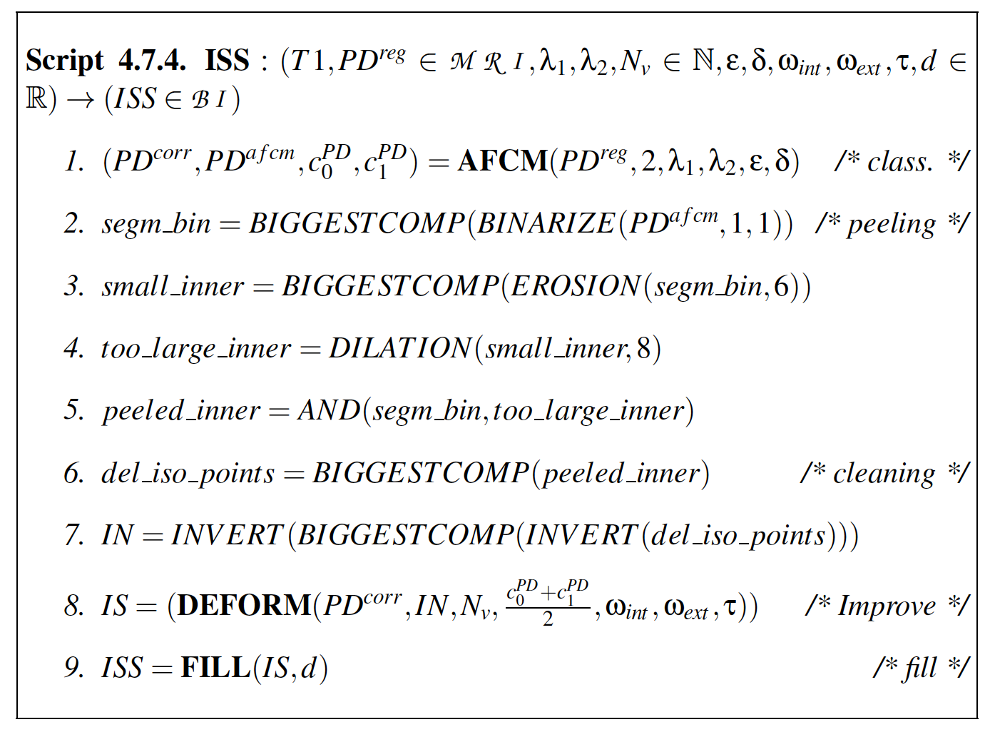
[C.Wolters, Vorlesungsskriptum]
Inner skull surface (ISS) segmentation script

Slide 74
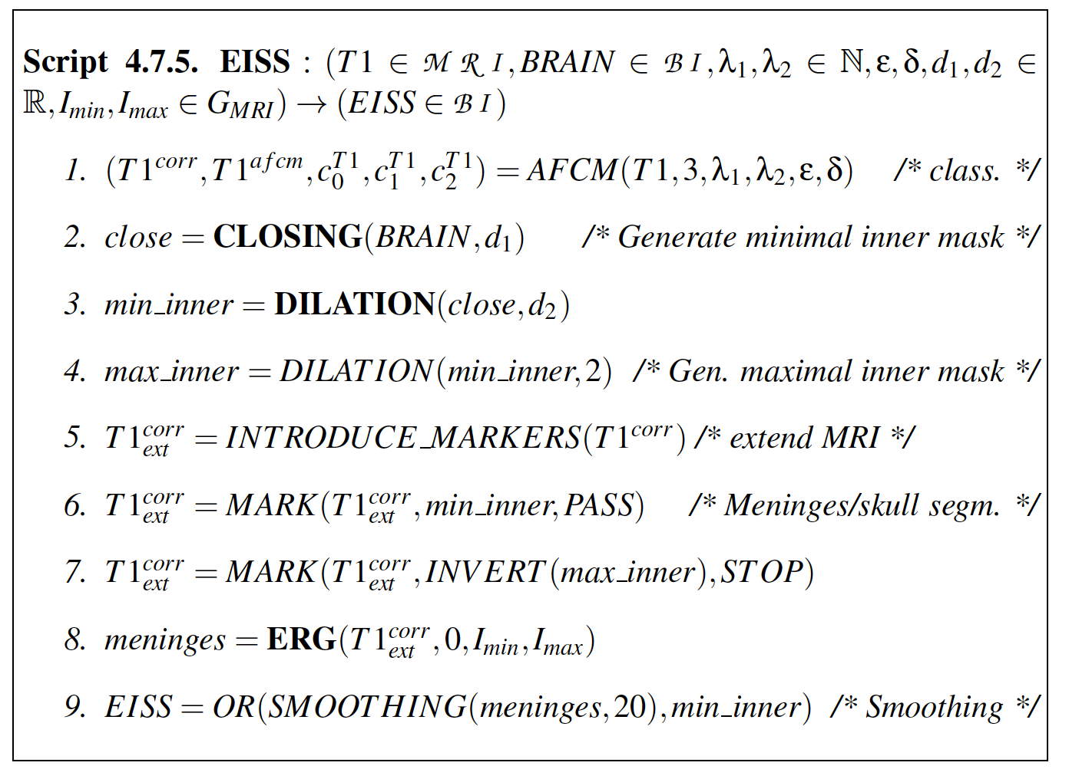
[C.Wolters, Vorlesungsskriptum]
Estimated (from T1-MRI) inner skull surface (EISS) segmentation scripts

Slide 75
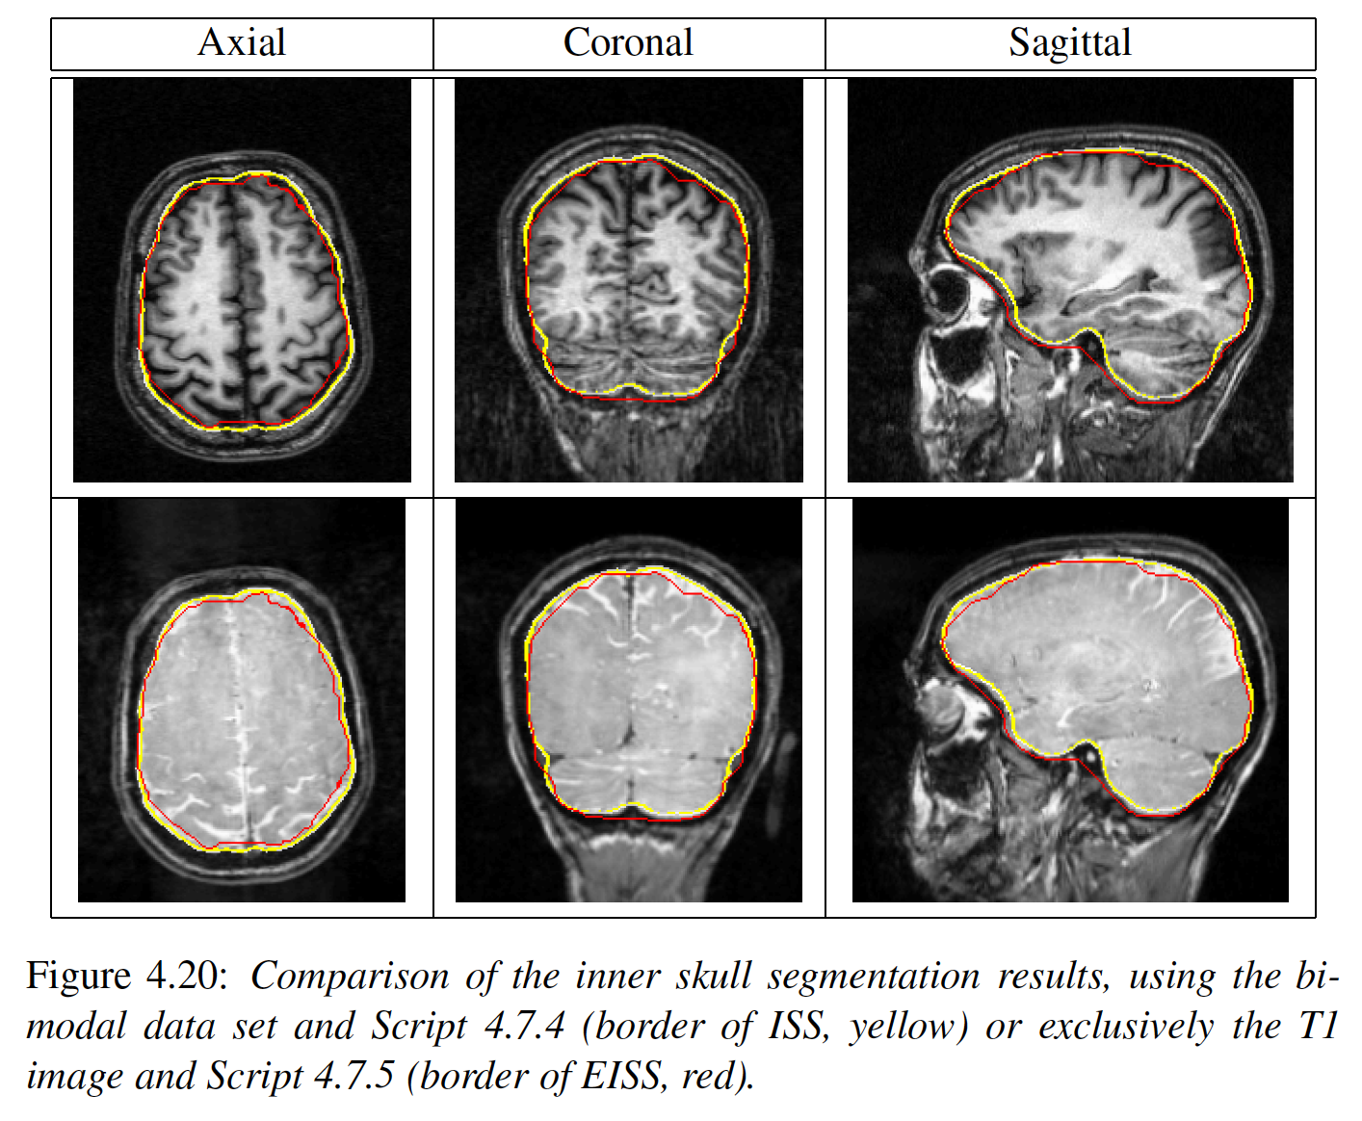
[C.Wolters, Vorlesungsskriptum]
Differences between ISS and EISS segmentation

Slide 76
[C.Wolters, Vorlesungsskriptum]
Differences between ISS and EISS segmentation

Slide 77
[C.Wolters, Vorlesungsskriptum]
Outer skull surface (OSS) segmentation script

Slide 78
[C.Wolters, Vorlesungsskriptum]
Outer skull surface (OSS) segmentation script

Slide 79
[C.Wolters, Vorlesungsskriptum]
3D rendering of segmented surfaces

Slide 80
[C.Wolters, Vorlesungsskriptum]
5 compartment head model

