Slide 1
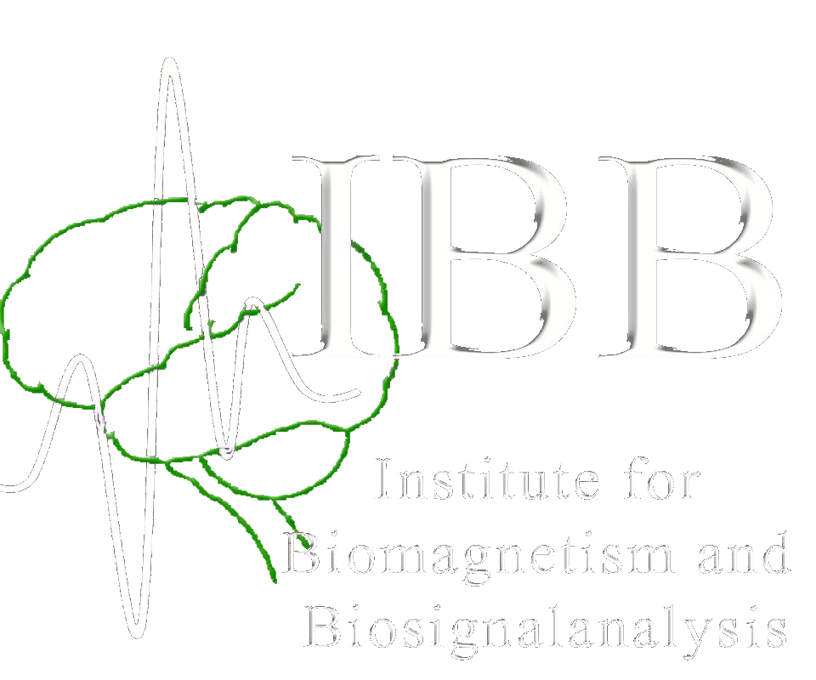
EEG and MEG source analysis in focal epilepsy
May 20, 2025
Carsten H. Wolters

Slide 2
Structure
Complementarity of EEG and MEG
How to exploit this complementarity in combined EEG/MEG source analysis
Focal epilepsy patient case studies
Summary
Notes:
Non-invasive source analysis a promising tool in presurgical epilepsy diagnosis (Bast et al., 2006; Stefan et al., 2003).
The results of EEG source analysis were shown to direct or avoid intracranial EEG recordings and in a significant percentage of patients, it proved to be a key element in the surgical decision process (Boon et al., 2002).
MEG was shown to help in characterizing potentially epileptogenic lesions and showed intrinsic epileptogenicity of malformations of cortical development (Bast et al., 2004; Morioka et al., 1999).
While most source analysis studies used either EEG or MEG data, we will present here a new strategy for combined EEG/MEG source reconstruction and, to the best of our knowledge, apply it for the first time to EEG/MEG data of an epilepsy patient.

Slide 3
Introduction
0.5%-1% of world population suffers from epilepsy and 70-80% of patients successfully treated with drugs
For those who are still pharma-resistent after 2-3 drugs
Probability of success of a further different drug: 6% (Wiebe et al 2001)
Probability of success of a surgical treatment: 50% (Wiebe et al 2001)
Indispensable prerequisite for surgery: Focal epilepsy->Localization
Gold standard: Video-monitoring and visual inspection of the EEG (Wilson 1996)
MRI: Identification of an underlying lesion
PET and Neuropsychology: Localization of a functional deficit
Source analysis of
EEG seizure (ictal) activity (Plummer et al., 2008; Rullmann et al., 2009)
EEG/MEG interictal activity: “irritative zone” (Stefan et. al., 2003; Aydin et al., 2015,2017)
Notes:
Non-invasive source analysis a promising tool in presurgical epilepsy diagnosis (Bast et al., 2006; Stefan et al., 2003).
The results of EEG source analysis were shown to direct or avoid intracranial EEG recordings and in a significant percentage of patients, it proved to be a key element in the surgical decision process (Boon et al., 2002).
MEG was shown to help in characterizing potentially epileptogenic lesions and showed intrinsic epileptogenicity of malformations of cortical development (Bast et al., 2004; Morioka et al., 1999).
While most source analysis studies used either EEG or MEG data, we will present here a new strategy for combined EEG/MEG source reconstruction and, to the best of our knowledge, apply it for the first time to EEG/MEG data of an epilepsy patient.

Slide 4
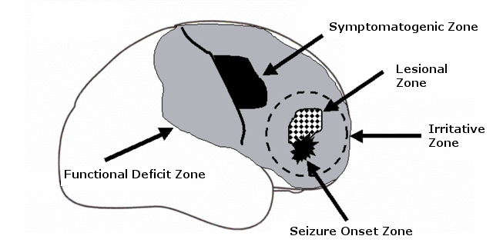
Zone-concept in epilepsy diagnosis
EEG(/MEG) registration during a seizure (ictal)
Interictal spikes in EEG/MEG
Notes:
Analysis of seizure semiology determines the identification of the symptomatogenic zone. In addition, the EEG recording during a seizure (ictal) is needed to detect the seizure onset zone, the magnetic resonance imaging (MRI) localizes an underlying lesion, and the functional deficit zone is determined by nuclear imaging (PET) and/or corresponding deficits in neuropsychological testing (Rosenow and Lüders, 2001).

Slide 5
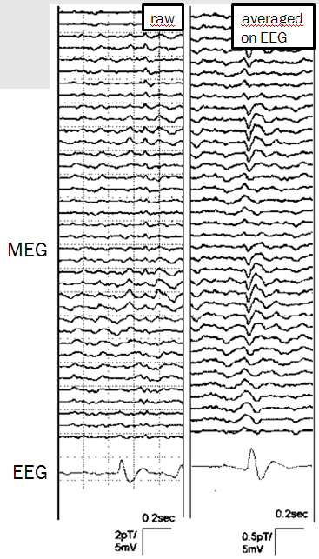
Introduction: Epileptic spikes in EEG and MEG
Clear spike in EEG
Nearly no/no signal in MEG
[Courtesy of Stefan Rampp]
Notes:
Non-invasive source analysis a promising tool in presurgical epilepsy diagnosis (Bast et al., 2006; Stefan et al., 2003).
The results of EEG source analysis were shown to direct or avoid intracranial EEG recordings and in a significant percentage of patients, it proved to be a key element in the surgical decision process (Boon et al., 2002).
MEG was shown to help in characterizing potentially epileptogenic lesions and showed intrinsic epileptogenicity of malformations of cortical development (Bast et al., 2004; Morioka et al., 1999).
While most source analysis studies used either EEG or MEG data, we will present here a new strategy for combined EEG/MEG source reconstruction and, to the best of our knowledge, apply it for the first time to EEG/MEG data of an epilepsy patient.

Slide 6
Introduction: Epileptic spikes in EEG and MEG
Clear spike in EEG
Nearly no/no signal in MEG
radially oriented or deep source
[Courtesy of Stefan Rampp]
Notes:
Non-invasive source analysis a promising tool in presurgical epilepsy diagnosis (Bast et al., 2006; Stefan et al., 2003).
The results of EEG source analysis were shown to direct or avoid intracranial EEG recordings and in a significant percentage of patients, it proved to be a key element in the surgical decision process (Boon et al., 2002).
MEG was shown to help in characterizing potentially epileptogenic lesions and showed intrinsic epileptogenicity of malformations of cortical development (Bast et al., 2004; Morioka et al., 1999).
While most source analysis studies used either EEG or MEG data, we will present here a new strategy for combined EEG/MEG source reconstruction and, to the best of our knowledge, apply it for the first time to EEG/MEG data of an epilepsy patient.

Slide 7
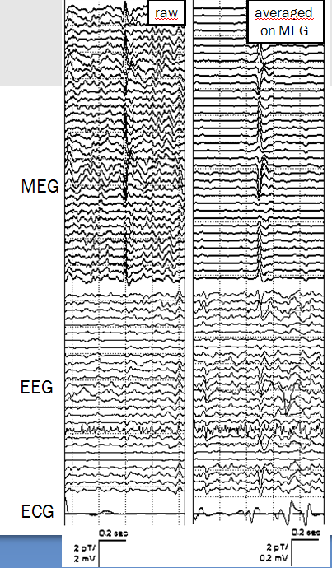
Introduction: Epileptic spikes in EEG and MEG
Clear signal in MEG,
poor signal in EEG
[Courtesy of Stefan Rampp]
Notes:
Non-invasive source analysis a promising tool in presurgical epilepsy diagnosis (Bast et al., 2006; Stefan et al., 2003).
The results of EEG source analysis were shown to direct or avoid intracranial EEG recordings and in a significant percentage of patients, it proved to be a key element in the surgical decision process (Boon et al., 2002).
MEG was shown to help in characterizing potentially epileptogenic lesions and showed intrinsic epileptogenicity of malformations of cortical development (Bast et al., 2004; Morioka et al., 1999).
While most source analysis studies used either EEG or MEG data, we will present here a new strategy for combined EEG/MEG source reconstruction and, to the best of our knowledge, apply it for the first time to EEG/MEG data of an epilepsy patient.

Slide 8
Introduction: Epileptic spikes in EEG and MEG
Clear signal in MEG,
poor signal in EEG
=>tangentially oriented source
[Courtesy of Stefan Rampp]
Notes:
Non-invasive source analysis a promising tool in presurgical epilepsy diagnosis (Bast et al., 2006; Stefan et al., 2003).
The results of EEG source analysis were shown to direct or avoid intracranial EEG recordings and in a significant percentage of patients, it proved to be a key element in the surgical decision process (Boon et al., 2002).
MEG was shown to help in characterizing potentially epileptogenic lesions and showed intrinsic epileptogenicity of malformations of cortical development (Bast et al., 2004; Morioka et al., 1999).
While most source analysis studies used either EEG or MEG data, we will present here a new strategy for combined EEG/MEG source reconstruction and, to the best of our knowledge, apply it for the first time to EEG/MEG data of an epilepsy patient.

Slide 9
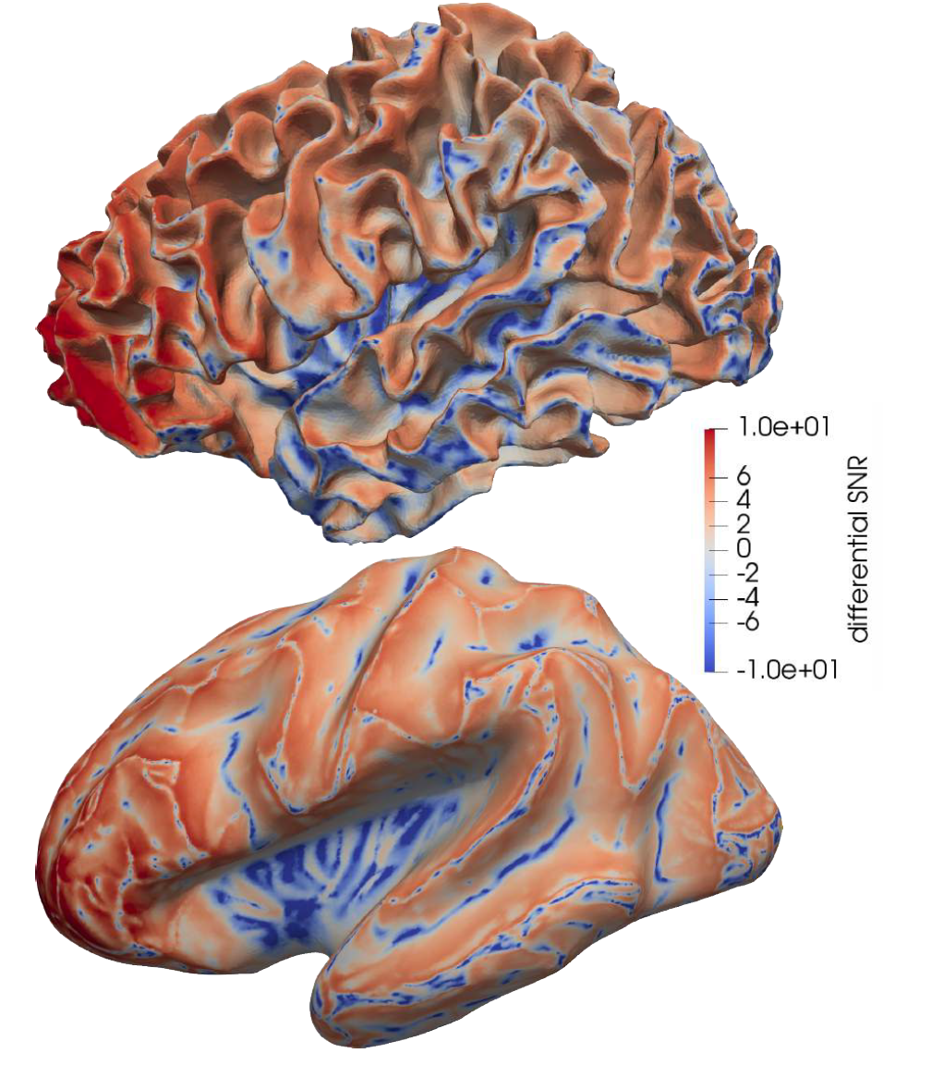
Introduction: Sensitivity of EEG and MEG
[Piastra, Nüßing, Vorwerk, Clerc, Engwer & Wolters, Human Brain Mapping, 2021]
Blue: Sensitivity EEG > MEG for radial and deep sources
Red: Sensitivity MEG > EEG in sulcal wall areas
Piastra,… & Wolters, 2018
Notes:
Non-invasive source analysis a promising tool in presurgical epilepsy diagnosis (Bast et al., 2006; Stefan et al., 2003).
The results of EEG source analysis were shown to direct or avoid intracranial EEG recordings and in a significant percentage of patients, it proved to be a key element in the surgical decision process (Boon et al., 2002).
MEG was shown to help in characterizing potentially epileptogenic lesions and showed intrinsic epileptogenicity of malformations of cortical development (Bast et al., 2004; Morioka et al., 1999).
While most source analysis studies used either EEG or MEG data, we will present here a new strategy for combined EEG/MEG source reconstruction and, to the best of our knowledge, apply it for the first time to EEG/MEG data of an epilepsy patient.

Slide 10
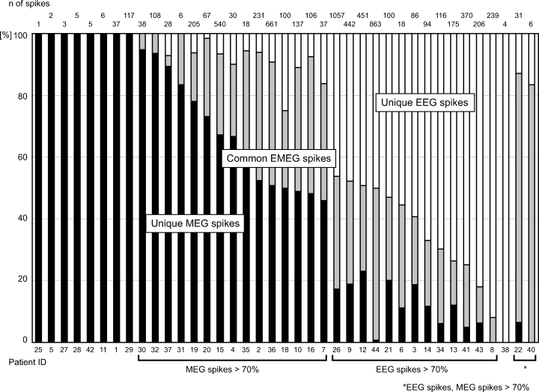
Introduction: Complementarity of EEG and MEG
Iwasaki et al 2005:
EEG/MEG: 72% (31/43 pat)
Only EEG: 2% (1/43 pat)
Only MEG: 19% (8/43 pat)
None: 7% (3/43 pat)
Knake et al 2006:
EEG/MEG: 75% (50/67 pat)
Only EEG: 3% (2/67 pat)
Only MEG: 13% (9/67 pat)
None: 25% (17/67 pat)
What should we use?
MEG instead of EEG? Only EEG?

Slide 11
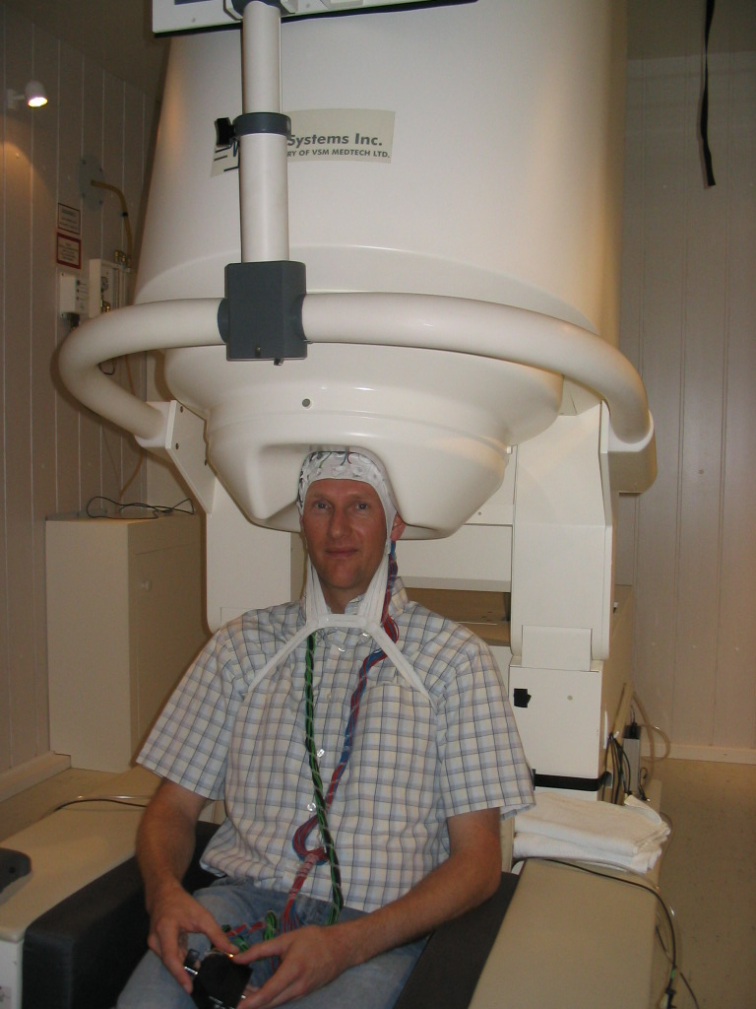
Introduction: Combined measurement of EEG and MEG
275 channel axial gradiometer whole-cortex MEG
128 channel EEG

Slide 12
Structure
Complementarity of EEG and MEG
How to exploit this complementarity in combined EEG/MEG source analysis
Focal epilepsy patient case studies
Summary
Notes:
Non-invasive source analysis a promising tool in presurgical epilepsy diagnosis (Bast et al., 2006; Stefan et al., 2003).
The results of EEG source analysis were shown to direct or avoid intracranial EEG recordings and in a significant percentage of patients, it proved to be a key element in the surgical decision process (Boon et al., 2002).
MEG was shown to help in characterizing potentially epileptogenic lesions and showed intrinsic epileptogenicity of malformations of cortical development (Bast et al., 2004; Morioka et al., 1999).
While most source analysis studies used either EEG or MEG data, we will present here a new strategy for combined EEG/MEG source reconstruction and, to the best of our knowledge, apply it for the first time to EEG/MEG data of an epilepsy patient.

Slide 13
SEP/SEF skull conductivity calibration
[Aydin, Vorwerk, Küpper, Heers, Kugel, Galka, Hamid, Wellmer, Kellinghaus, Rampp & Wolters, Plos One, 2014]
SEF
SEP
Notes:
Non-invasive source analysis a promising tool in presurgical epilepsy diagnosis (Bast et al., 2006; Stefan et al., 2003).
The results of EEG source analysis were shown to direct or avoid intracranial EEG recordings and in a significant percentage of patients, it proved to be a key element in the surgical decision process (Boon et al., 2002).
MEG was shown to help in characterizing potentially epileptogenic lesions and showed intrinsic epileptogenicity of malformations of cortical development (Bast et al., 2004; Morioka et al., 1999).
While most source analysis studies used either EEG or MEG data, we will present here a new strategy for combined EEG/MEG source reconstruction and, to the best of our knowledge, apply it for the first time to EEG/MEG data of an epilepsy patient.

Slide 14
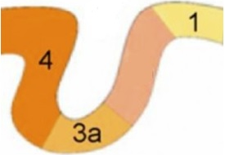
SEP/SEF skull conductivity calibration
[Aydin, Vorwerk, Küpper, Heers, Kugel, Galka, Hamid, Wellmer, Kellinghaus, Rampp & Wolters, Plos One, 2014]
SEP x, o₂ and m₃ → Residual Variance (RV)
SEF LS; x and o₂ fixed→ m₃
SEP Least Squares (LS); x fixed → orientation o₂ and magnitude m₂.
SEF GFS → location x, orientation o₁ and magnitude m₁.
Define a set of skull conductivity parameters: Σ={σ₁,σ₂,…,σ_{n}}
Select the conductivity that gives the lowest RV
Repeat for all predefined conductivities {σ₁,σ₂,…,σ_{n}}
Notes:
As shown above, skull conductivity is discussed quite controversially in the literature (see Table 1). However, an appropriate choice of it is important for successful source analysis of EEG and combined EEG/MEG data. While EEG source reconstructions are strongly influenced by changes in skull conductivity, the MEG is shown to be far less susceptible to it
In Step 2.a), our procedure uses the strength of the MEG to appropriately localize the primary somatosensory cortex even for less suitable skull conductivity parameters. Step 2.b) is necessary since o₁ and m₁ might be spurious in the case that the source is not optimally quasi-tangential. It uses the strength of the EEG to appropriately determine the source orientation. However, in case of inappropriate skull conductivity, m₂ will be spurious so that the SEF data are needed to determine the source magnitude in step 2.c).

Slide 15
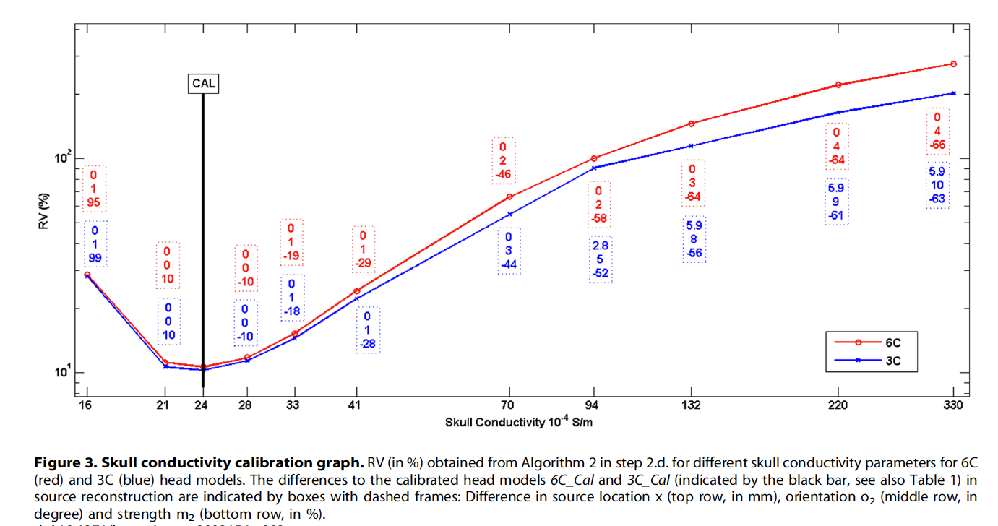
SEP/SEF skull conductivity calibration
[Aydin, Vorwerk, Küpper, Heers, Kugel, Galka, Hamid, Wellmer, Kellinghaus, Rampp & Wolters, Plos One, 2014]
Notes:
Non-invasive source analysis a promising tool in presurgical epilepsy diagnosis (Bast et al., 2006; Stefan et al., 2003).
The results of EEG source analysis were shown to direct or avoid intracranial EEG recordings and in a significant percentage of patients, it proved to be a key element in the surgical decision process (Boon et al., 2002).
MEG was shown to help in characterizing potentially epileptogenic lesions and showed intrinsic epileptogenicity of malformations of cortical development (Bast et al., 2004; Morioka et al., 1999).
While most source analysis studies used either EEG or MEG data, we will present here a new strategy for combined EEG/MEG source reconstruction and, to the best of our knowledge, apply it for the first time to EEG/MEG data of an epilepsy patient.

Slide 16
Skull-conductivity calibration: Individual calibration curves in a group study (20 subjects)
[Antonakakis, Schrader, Aydin, Khan, Gross, Zervakis, Rampp & Wolters, NeuroImage, 2020]
Notes:
Segmented MRI (upper row), T1 MRI (middle row) and the source space points (blue points) shown on T1 (lower row) MRI.
Sagittal (left column), coronal (middle column) and axial (right column) slices.
Please note that the slices selected in the lower row are different from the top two rows in order to better visualize the source space points.
The color codes for the 7CA tissues are scalp (green), skull compacta (brown), skull spongiosa (beige), dura mater (dark turquoise), CSF (light turquoise), gray matter (burgundy) and white matter (red).

Slide 17
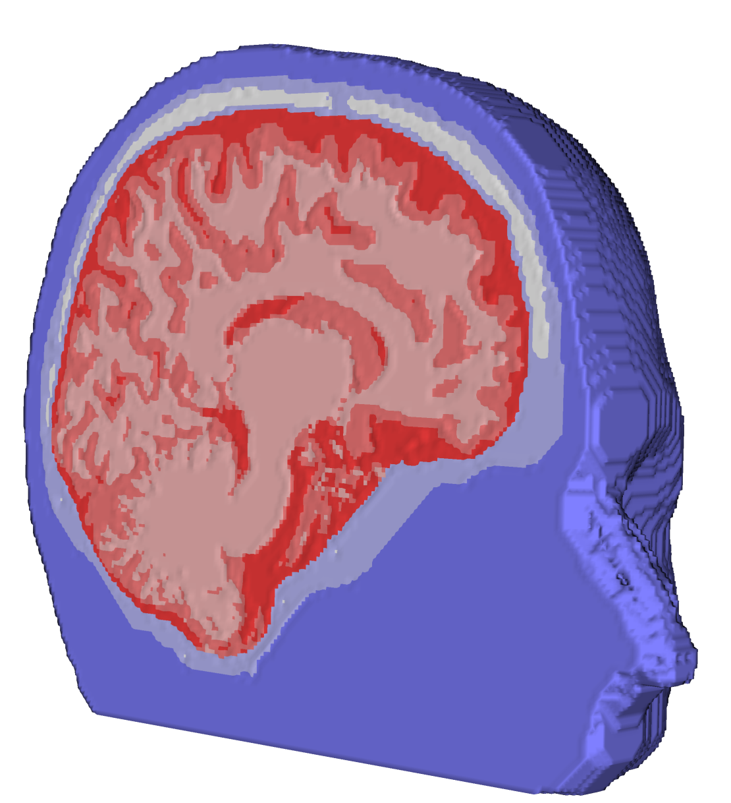
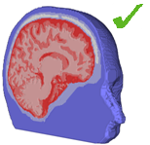
Combined EEG/MEG source analysis in calibrated head model
[Aydin, Vorwerk, Küpper, Heers, Kugel,Galka, Hamid, Wellmer, Kellinghaus, Rampp & Wolters, PLOS ONE, 2014]
[Antonakakis, Schrader, Aydin, Khan, Gross, Zervakis, Rampp & Wolters, NeuroImage, 2020]
[Schrader, Antonakakis, Rampp, Engwer & Wolters, Phys Med Biol, 2020]
Anisotropic
head model
Calibration for skull conductivity
Measurement and reconstruction of epileptic activity
MRI measurement
Segmentation
T1, T2, DTI (27 min)
Medianus-nerve stimulation (7 min)
Skull conductivity
High interindividual variability
EEG very sensitive
MEG nearly not influenced
Notes:
Segmented MRI (upper row), T1 MRI (middle row) and the source space points (blue points) shown on T1 (lower row) MRI.
Sagittal (left column), coronal (middle column) and axial (right column) slices.
Please note that the slices selected in the lower row are different from the top two rows in order to better visualize the source space points.
The color codes for the 7CA tissues are scalp (green), skull compacta (brown), skull spongiosa (beige), dura mater (dark turquoise), CSF (light turquoise), gray matter (burgundy) and white matter (red).

Slide 18
Structure
Complementarity of EEG and MEG
How to exploit this complementarity in combined EEG/MEG source analysis
Focal epilepsy patient case studies
EEG reconstruction of ictal activity
Reconstruction of propagation pathway
Multifocal epilepsy
Broca epilepsy
Epilepsy and pregnancy
Summary
Notes:
Non-invasive source analysis a promising tool in presurgical epilepsy diagnosis (Bast et al., 2006; Stefan et al., 2003).
The results of EEG source analysis were shown to direct or avoid intracranial EEG recordings and in a significant percentage of patients, it proved to be a key element in the surgical decision process (Boon et al., 2002).
MEG was shown to help in characterizing potentially epileptogenic lesions and showed intrinsic epileptogenicity of malformations of cortical development (Bast et al., 2004; Morioka et al., 1999).
While most source analysis studies used either EEG or MEG data, we will present here a new strategy for combined EEG/MEG source reconstruction and, to the best of our knowledge, apply it for the first time to EEG/MEG data of an epilepsy patient.

Slide 19
Patient
[Rullmann, Anwander, Dannhauer, Warfield, Duffy & Wolters, NeuroImage, 44(2), 2009]
In 2009: 11 year old boy
In 2001: In the age of 3
diagnosis of refractory (pharmaco-resistent) focal epilepsy and dysembryoplastic neuroepithelial tumor (DNET)
DNET- and focus-resection
In 2009
again epileptic seizures
DNET-relapse anterior to the motor-cortex close to resection-area from first surgery

Slide 20
MRI segmentation
[Rullmann, Anwander, Dannhauer, Warfield, Duffy & Wolters, NeuroImage, 44(2), 2009]
Notes:
Segmentierung per Hand angepasst
Vergitterung: jedes gewebe eigenes Label
Eogentliche gitter ist feiner (1mm) hier nur 3mm dargestellt

Slide 21
Modeling of brain conductivity anisotropy
[Rullmann, Anwander, Dannhauer, Warfield, Duffy & Wolters, NeuroImage, 44(2), 2009]
Original DTI data
FA-map after registration
FA-map on T1-MRI
Effective medium approach model (DTI <-> CTI):
Model DTI<->Conductivity Tensor Image (CTI) [Tuch et al., Ann. NYAS, 1999]
Linear model DTI<->CTI [Tuch et al., PNAS, 2001]
Validation of DTI<->CTI model in silk yarn phantom [Oh et al., ISMRM, 2006]
Improved DTI artifact correction and registration [Ruthotto et al., Phys Med Biol, 2012]
Notes:
About 0.25% of the world population suffers from drug-resistnt epilepsy and bout 10-15% would profit from a surgical removl of the epileptogenic tissue.
42 year old female suffering from medically intractable complex partial seizures of mesial-temporal origin
Seizures had duration of up to 10 minutes and a frequency of twice to 5 times a month
Measurements:
=========
A short-term barbiturate (Schlafmittel), known to provoke epileptiform activity
-> 60-channel EEG montage with reference at the ear contralateral to the epileptic focus
Source reconstruction:
==============
Single dipole fit at signal peak
->Localization of the secondary activations, propagating along the temporal cortical surface
->Primary activity in the hippocampus and the amygdala (cannot be measured outside)
Therapy:
======
Selective amygdalohippocampectomy
-> Patient free of seizures

Slide 22
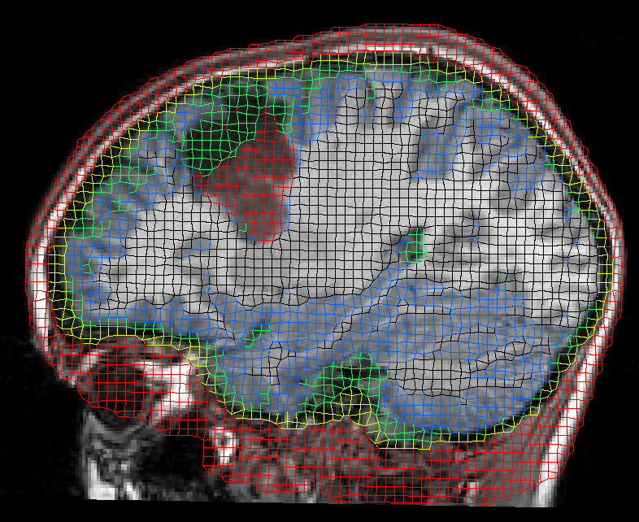
Finite element method (FEM) mesh generation
[Rullmann, Anwander, Dannhauer, Warfield, Duffy & Wolters, NeuroImage, 44(2), 2009]
Notes:
Segmentierung per Hand angepasst
Vergitterung: jedes gewebe eigenes Label
Eogentliche gitter ist feiner (1mm) hier nur 3mm dargestellt

Slide 23
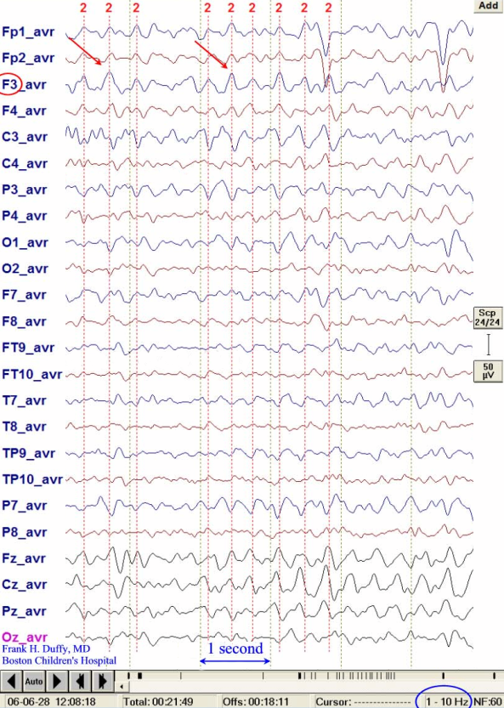
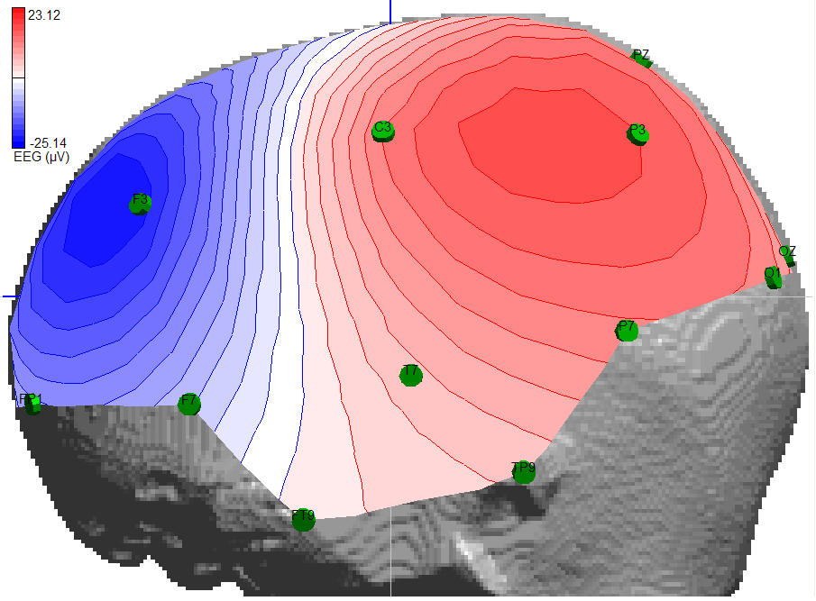
EEG preprocessing
[Rullmann, Anwander, Dannhauer, Warfield, Duffy & Wolters, NeuroImage, 44(2), 2009]
Notes:
Nächste Folie kommen Ergebnisse!

Slide 24
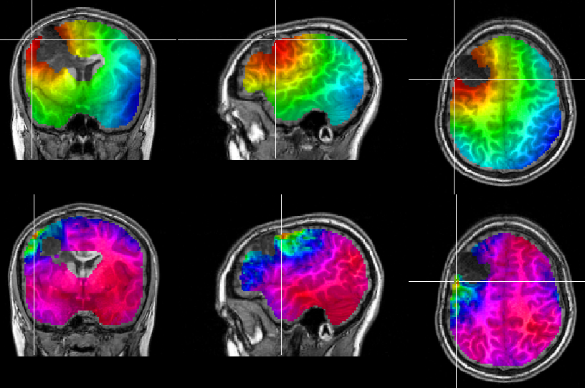
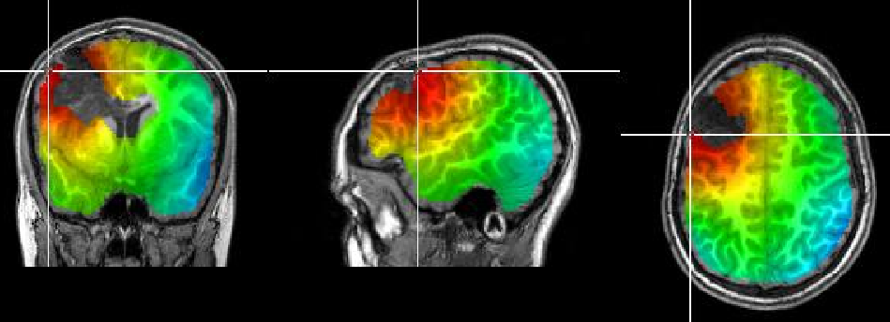
[Rullmann, Anwander, Dannhauer, Warfield, Duffy & Wolters, NeuroImage, 44(2), 2009]
Presurgical EEG source analysis
Goal function scan
(Mosher, 1992; Knösche, 1997)
MNE
(Hämäläinen & Ilmoniemi, 1984)
sLORETA
(Pascual-Marqui, 2002)
Dipole fit
(Scherg and von Cramon, 1985)
Result: Posterior to the lesion in lateral premotor cortex
Notes:
Nächste Folie kommen Ergebnisse!

Slide 25
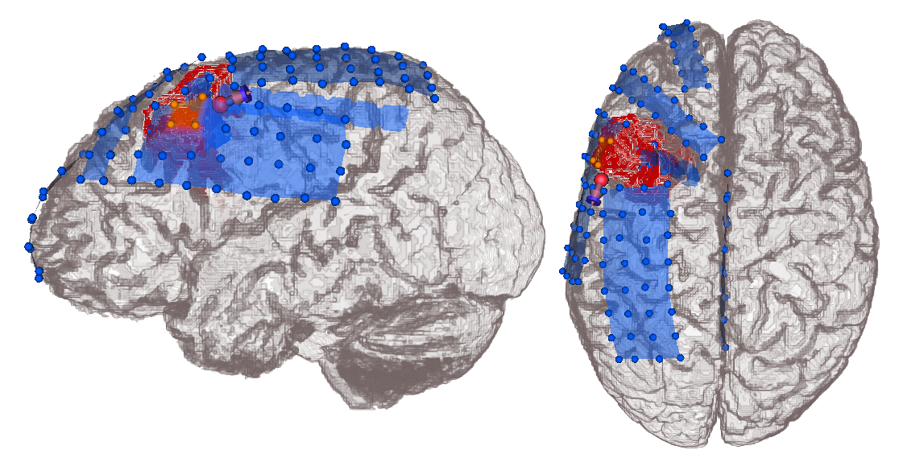
Validation using intracranial EEG
[Rullmann, Anwander, Dannhauer, Warfield, Duffy & Wolters, NeuroImage, 44(2), 2009]
ECoG peaking electrodes
EEG dipole fit result
Notes:
Was sind ictal und interictal Spikes?

Slide 26
Comparison with more homogenized head models
[Rullmann, Anwander, Dannhauer, Warfield, Duffy & Wolters, NeuroImage, 44(2), 2009]
Notes:
Was sind ictal und interictal Spikes?

Slide 27
Summary
[Rullmann, Anwander, Dannhauer, Warfield, Duffy & Wolters, NeuroImage, 44(2), 2009]
First study in highly-resolved (1mm) 6-compartment anisotropic head model plus tumor modeling using accurate and fast FEM-methods
Significant localization and orientation differences to standard 3-compartment head model
Recommendation to use different inverse approaches (“converging evidence”) for a more reliable detection of the epileptogenic focus
Presurgical source localization was evaluated with post-surgical intracranial EEG: Only small differences, most probably due to craniotomy and resulting post-surgical brain shift
Source orientation in posterior direction, i.e., in direction of the epileptogenic tissue, in agreement with (Salayev et al., 2006), who postulated this for central and interhemispheric epileptic activity

Slide 28
Structure
Complementarity of EEG and MEG
How to exploit this complementarity in combined EEG/MEG source analysis
Focal epilepsy patient case studies
EEG reconstruction of ictal activity
Reconstruction of propagation pathway
Multifocal epilepsy
Broca epilepsy
Epilepsy and pregnancy
Summary
Notes:
Non-invasive source analysis a promising tool in presurgical epilepsy diagnosis (Bast et al., 2006; Stefan et al., 2003).
The results of EEG source analysis were shown to direct or avoid intracranial EEG recordings and in a significant percentage of patients, it proved to be a key element in the surgical decision process (Boon et al., 2002).
MEG was shown to help in characterizing potentially epileptogenic lesions and showed intrinsic epileptogenicity of malformations of cortical development (Bast et al., 2004; Morioka et al., 1999).
While most source analysis studies used either EEG or MEG data, we will present here a new strategy for combined EEG/MEG source reconstruction and, to the best of our knowledge, apply it for the first time to EEG/MEG data of an epilepsy patient.

Slide 29
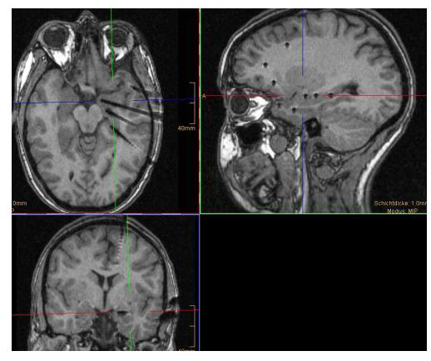
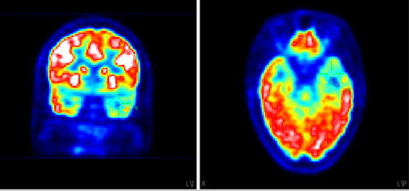
Patient history
[Aydin, Vorwerk, Dümpelmann, Küpper, Kugel, Heers, Wellmer, Kellinghaus, Haueisen, Rampp, Stefan & Wolters, PLOS ONE, 2015]
[Aydin, Vorwerk, Küpper, Heers, Kugel, Galka, Hamid, Wellmer, Kellinghaus, Rampp & Wolters, PLOS ONE, 2014]
17 year old female suffering from pharmaco-resistant focal epilepsy,
MRI Negative,
FDG-PET: a diffuse and extended left fronto-temporal hypometabolism.
Stereo-EEG: 14 intracerebral depth electrodes, 167 contacts
Notes:
This subselection has been carried out to improve the SNR of the MEG spike data and the GOF of the MEG DSs. The SNR and GOF improvement was only possible for the MEG because the MEG spike dipolar patterns are more focal with both negative and positive poles included in the chosen subset of MEG sensors, thus reducing effectively the influence of the spontaneous activity from the right brain hemisphere, while for the EEG the spike negative and positive poles are in different hemispheres.

Slide 30
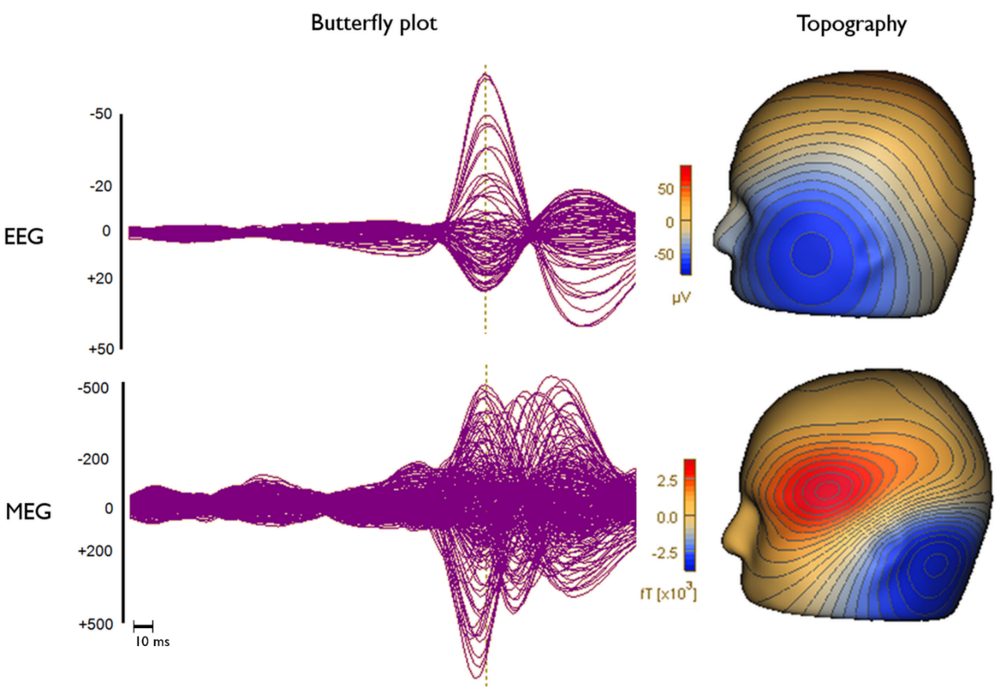
Spike detection
[Aydin, Vorwerk, Dümpelmann, Küpper, Kugel, Heers, Wellmer, Kellinghaus, Haueisen, Rampp, Stefan & Wolters, PLOS ONE, 2015]
[Aydin, Vorwerk, Küpper, Heers, Kugel, Galka, Hamid, Wellmer, Kellinghaus, Rampp & Wolters, PLOS ONE, 2014]
Select 10 clear spikes and average
Template matching
Visual control
200 spikes
“Knowing where a spike or seizure originates from is more important than where it goes. The importance of MEG localization increases if it precedes or is at least synchronous with the correlate EEG spike.” (Ebersole & Ebersole 2010)

Slide 31
Sub-averaging procedure
[Aydin, Vorwerk, Dümpelmann, Küpper, Kugel, Heers, Wellmer, Kellinghaus, Haueisen, Rampp, Stefan & Wolters, PLOS ONE, 2015]
[Aydin, Vorwerk, Küpper, Heers, Kugel, Galka, Hamid, Wellmer, Kellinghaus, Rampp & Wolters, PLOS ONE, 2014]
Av1
Av2
Av3
Random sub-averages of 200 single spikes:
200 → Av1
200 → Av5
200 → Av10
200 → Av15
200 → Av20
200 → Av25
200 → Av30
200 → Av35
200 → Av40
200 → Av45
200 → Av50
For EEG, MEG, EMEG and 11 time instants
→ 72600 localization
1
1,2
1,2,4
2
1,3
1,2,5
3
2,3
3,4,5
4
1,4
1,4,2
5
3,5
3,5,4
Same spike is not allowed to appear
in the same sub-average twice.
Notes:
Non-invasive source analysis a promising tool in presurgical epilepsy diagnosis (Bast et al., 2006; Stefan et al., 2003).
The results of EEG source analysis were shown to direct or avoid intracranial EEG recordings and in a significant percentage of patients, it proved to be a key element in the surgical decision process (Boon et al., 2002).
MEG was shown to help in characterizing potentially epileptogenic lesions and showed intrinsic epileptogenicity of malformations of cortical development (Bast et al., 2004; Morioka et al., 1999).
While most source analysis studies used either EEG or MEG data, we will present here a new strategy for combined EEG/MEG source reconstruction and, to the best of our knowledge, apply it for the first time to EEG/MEG data of an epilepsy patient.

Slide 32
Example sEEG and EEG spikes
[Aydin, Vorwerk, Dümpelmann, Küpper, Kugel, Heers, Wellmer, Kellinghaus, Haueisen, Rampp, Stefan & Wolters, PLOS ONE, 2015]
The union of green and red spheres shows the sEEG leads measuring interictal activity, and red spheres alone show the leads measuring seizure onset.

Slide 33
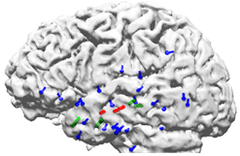
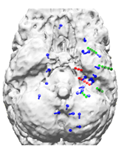
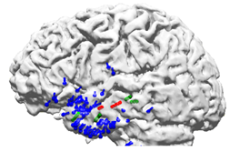
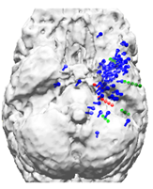
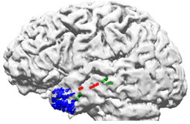
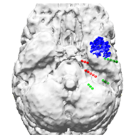
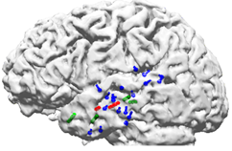
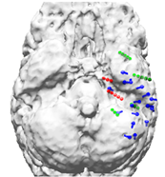
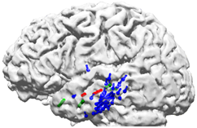
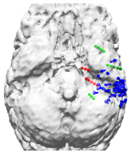
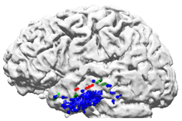
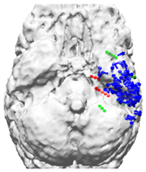
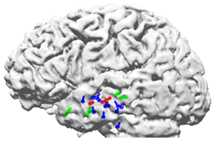
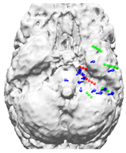
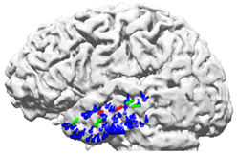
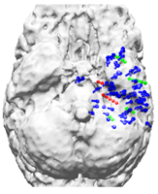
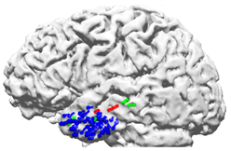
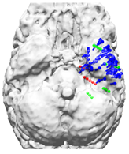
Source reconstructions of Av10 at different instants of time
[Aydin, Vorwerk, Dümpelmann, Küpper, Kugel, Heers, Wellmer, Kellinghaus, Haueisen, Rampp, Stefan & Wolters, PLOS ONE, 2015]
-33 ms
-23 ms
-3 ms
EEG
MEG
EMEG
EEG, MEG and EMEG dipole scan peaks of Av10 for different time points. Blue dipoles illustrate the noninvasive reconstructions, both green and red spheres show the sEEG leads where frequent interictal activity can be measured, and only red spheres show seizure onset leads.

Slide 34
Structure
Complementarity of EEG and MEG
How to exploit this complementarity in combined EEG/MEG source analysis
Focal epilepsy patient case studies
EEG reconstruction of ictal activity
Reconstruction of propagation pathway
Multifocal epilepsy
Epilepsy and pregnancy
Broca epilepsy
Summary
Notes:
Non-invasive source analysis a promising tool in presurgical epilepsy diagnosis (Bast et al., 2006; Stefan et al., 2003).
The results of EEG source analysis were shown to direct or avoid intracranial EEG recordings and in a significant percentage of patients, it proved to be a key element in the surgical decision process (Boon et al., 2002).
MEG was shown to help in characterizing potentially epileptogenic lesions and showed intrinsic epileptogenicity of malformations of cortical development (Bast et al., 2004; Morioka et al., 1999).
While most source analysis studies used either EEG or MEG data, we will present here a new strategy for combined EEG/MEG source reconstruction and, to the best of our knowledge, apply it for the first time to EEG/MEG data of an epilepsy patient.

Slide 35
Patient
[Aydin, Rampp, Wollbrink, Kugel, Cho, Knösche, Grova, Wellmer & Wolters, Brain Topography, 2017]
[Ümit Aydin, PhD dissertation in Biomed.Eng., 2015]
49 years old woman, suffering since 47 years under pharmaco-resistent focal epilepsy
8 different drugs and still 100-200 seizures per month
Seizure-semiology: Tingling in right anterior chest-area, rising nausea, loss of conscience, tonic and hypermotoric movements of right arm and leg

Slide 36
Skull-conductivity calibrated realistic head model and cortical source space
[Aydin, Rampp, Wollbrink, Kugel, Cho, Knösche, Grova, Wellmer & Wolters, Brain Topography, 2017]
[Ümit Aydin, PhD dissertation in Biomed.Eng., 2015]
Notes:
Segmented MRI (upper row), T1 MRI (middle row) and the source space points (blue points) shown on T1 (lower row) MRI.
Sagittal (left column), coronal (middle column) and axial (right column) slices.
Please note that the slices selected in the lower row are different from the top two rows in order to better visualize the source space points.
The color codes for the 7CA tissues are scalp (green), skull compacta (brown), skull spongiosa (beige), dura mater (dark turquoise), CSF (light turquoise), gray matter (burgundy) and white matter (red).

Slide 37
10 averaged spikes at maximum global field power: Time-point 0 ms
[Aydin, Rampp, Wollbrink, Kugel, Cho, Knösche, Grova, Wellmer & Wolters, Brain Topography, 2017]
[Ümit Aydin, PhD dissertation in Biomed.Eng., 2015]
Notes:
Ten epileptic spikes (maximum negativity at F6 in EEG), marked by a clinical reviewer, were averaged and used for source reconstruction.
The time points at 0 ms (peak of the spike) and -23 ms (the preceding peak on MEG) are indicated by dashed vertical lines in butterfly plots.
The increments between contour lines for each map are shown on the upper left corners.
The units for EEG and MEG are μV and fT respectively.
Letters in topographies indicate the orientation (L: Left, R: Right, A: Anterior, P: Posterior).

Slide 38
EMEG source analysis at -7 ms (radiological convention)
[Aydin, Rampp, Wollbrink, Kugel, Cho, Knösche, Grova, Wellmer & Wolters, Brain Topography, 2017]
[Ümit Aydin, PhD dissertation in Biomed.Eng., 2015]
Notes:
Source localizations at -7 ms.
In the left column the sLORETA results projected to the FLAIR MRI are shown (only results obtained with a threshold of 85 % for the maximum F-value are shown).
In the right column, the FLAIR image without the localizations is shown.

Slide 39
3D-FLAIR 3T-MRI and morphometric analysis
[Aydin, Rampp, Wollbrink, Kugel, Cho, Knösche, Grova, Wellmer & Wolters, Brain Topography, 2017]
[Ümit Aydin, PhD dissertation in Biomed.Eng., 2015]
Retrospectively visible in 3D-FLAIR a subtle right-frontal „bottom of sulcus“ focal cortical dysplasia (FCD)...
...that was confirmed in morphometric analysis (MAP07: Huppertz et al., 2005)...
Notes:
ZOOMitMRI for the localization cluster (detected with sLORETA) at the left frontocentral region.
The green arrows show the FCD and the white letters on MRIs indicate the orientation (L: Left, R: Right, A: Anterior, P: Posterior).
When the patient was measured with ZOOMit MRI a small FCD at the place of the left fronto-central localization was found.

Slide 40
ZOOMit MRI in pre-localized ROI at -7 ms
[Aydin, Rampp, Wollbrink, Kugel, Cho, Knösche, Grova, Wellmer & Wolters, Brain Topography, 2017]
[Ümit Aydin, PhD dissertation in Biomed.Eng., 2015]
...as well as when using a 3T MRI
T2 ZOOMit „parallel transmit“ sequence with 0.5 mm isotropic resolution (Siemens, Erlangen; Riffel et al., 2015).
Notes:
Source localizations at -7 ms.
In the left column the sLORETA results projected to the FLAIR MRI are shown (only results obtained with a threshold of 85 % for the maximum F-value are shown).
In the right column, the FLAIR image without the localizations is shown.
In most cases, these findings would have been sufficient to decide on the resection of the right frontal FCD because the interictal spikes showed right frontal activity near the peak and a clear FCD was detected with MRI.
However, the seizure semiology (tingling (kribbeln) feeling at the right anterior torso, ascending feeling of nausea (Übelkeit), then loss of consciousness, hypermotor movement, tongue bite, enuresis (Bettnässen)) of the patient was pointing to the left hemisphere as the epileptogenic zone.

Slide 41
MEG and EEG topographies and EMEG source analysis at -23 ms
[Aydin, Rampp, Wollbrink, Kugel, Cho, Knösche, Grova, Wellmer & Wolters, Brain Topography, 2017]
[Ümit Aydin, PhD dissertation in Biomed.Eng., 2015]
Notes:
Source localizations at -23 ms (timepoint of the preceding MEG peak in the butterfly plot).
Slices selected according to the left hemispheric activity.
In the left column, the sLORETA results registered to the FLAIR MRI are shown (only results obtained with a threshold of 85 % for the maximum F-value are shown).
In the left column, the FLAIR image without localizations is shown.
Two main sLORETA source localization clusters were detected: in left fronto-central and right central regions. The cluster in the left fronto-central region was especially intriguing, since it was in a good
agreement with the seizure semiology and the results of FLAIR MRI at the place of this localization were suspicious.

Slide 42
3T MRI (3D-FLAIR) and morphometric analysis
[Aydin, Rampp, Wollbrink, Kugel, Cho, Knösche, Grova, Wellmer & Wolters, Brain Topography, 2017]
[Ümit Aydin, PhD dissertation in Biomed.Eng., 2015]
Even retrospectively in 3D-FLAIR hardly visible „left supra-insular “ FCD...
...that could also only weakly be confirmed by morphometric analysis (MAP07: Huppertz et al., 2005)...
Notes:
ZOOMitMRI for the localization cluster (detected with sLORETA) at the left frontocentral region.
The green arrows show the FCD and the white letters on MRIs indicate the orientation (L: Left, R: Right, A: Anterior, P: Posterior).
When the patient was measured with ZOOMit MRI a small FCD at the place of the left fronto-central localization was found.

Slide 43
ZOOMit MRI in pre-localized ROI at -23 ms (radiological convention)
[Aydin, Rampp, Wollbrink, Kugel, Cho, Knösche, Grova, Wellmer & Wolters, Brain Topography, 2017]
[Ümit Aydin, PhD dissertation in Biomed.Eng., 2015]
..., but a little bit better visible in the T2 ZOOMit.
Notes:
ZOOMitMRI for the localization cluster (detected with sLORETA) at the left frontocentral region.
The green arrows show the FCD and the white letters on MRIs indicate the orientation (L: Left, R: Right, A: Anterior, P: Posterior).
When the patient was measured with ZOOMit MRI a small FCD at the place of the left fronto-central localization was found.

Slide 44
DTI tractography between both localized FCDs
[Aydin, Rampp, Wollbrink, Kugel, Cho, Knösche, Grova, Wellmer & Wolters, Brain Topography, 2017]
[Ümit Aydin, PhD dissertation in Biomed.Eng., 2015]
Notes:
Case studies describing a superior to inferior propagation of the epileptic spikes in frontal gyrus in just 14 ms were recently described in the literature [197].
The propagation of the epileptic activity could also explain the results of the current study.
Thus, it was decided to search for an anatomical pathway that might support the hypothesis of propagation. For this purpose, DTI tractography was performed.
This figure illustrates the results of DTI tractography, fiber connections (green paths) between the two FCDs (blue spheres) might explain the very fast propagation of epileptic activity from the left fronto-central FCD to the right frontal FCD.

Slide 45
Overview: EMEG source analysis
[Aydin, Rampp, Wollbrink, Kugel, Cho, Knösche, Grova, Wellmer & Wolters, Brain Topography, 2017]
[Ümit Aydin, PhD dissertation in Biomed.Eng., 2015]
Notes:
EMEG localizations at -23 ms (left column) and -7 ms (right column).
Only the results that passed 85 % threshold of the maximum F-value are shown.
The FCDs detected with MRI are indicated by the blue spheres.
In EMEG, the localizations were coinciding well with the FCD positions at both time instances.

Slide 46
Information in single modality EEG or MEG too noisy
[Aydin, Rampp, Wollbrink, Kugel, Cho, Knösche, Grova, Wellmer & Wolters, Brain Topography, 2017]
[Ümit Aydin, PhD dissertation in Biomed.Eng., 2015]
Notes:
EEG and MEG localizations at -23 ms (left column) and -7 ms (right column).
Only the results that passed 85 % threshold of the maximum F-value are shown.
The FCDs detected with MRI are indicated by the blue spheres.
At -7 ms in EEG and MEG the localizations were not as close to the FCDs as in case of EMEG, however, they were still within the close proximity of the FCD.
In contrast, at -23 ms both EEG and MEG localizations were far away from the left fronto-central FCD.
These results are in a good agreement with the findings of the other study indicating that EMEG benefits from the complementary information of EEG and MEG to stabilize the source reconstructions, especially in case of low SNR.
Based on the findings presented in this study, the patient was operated on the left fronto-central FCD and she is seizure free for 4 months, so from Aug.-Dec. 2014.

Slide 47
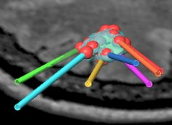
[Wellmer, Parpalev, Rampp, Popkirov, Kugel, Aydin, Wolters, von Lehe, Voges, Epilepsy Research, 2016]
Radio-frequency thermo-coagulation (RFTC)
Patient got RFTC in left supra-insular FCD and positive outcome supported our diagnosis
Notes:
EEG and MEG localizations at -23 ms (left column) and -7 ms (right column).
Only the results that passed 85 % threshold of the maximum F-value are shown.
The FCDs detected with MRI are indicated by the blue spheres.
At -7 ms in EEG and MEG the localizations were not as close to the FCDs as in case of EMEG, however, they were still within the close proximity of the FCD.
In contrast, at -23 ms both EEG and MEG localizations were far away from the left fronto-central FCD.
These results are in a good agreement with the findings of the other study indicating that EMEG benefits from the complementary information of EEG and MEG to stabilize the source reconstructions, especially in case of low SNR.
Based on the findings presented in this study, the patient was operated on the left fronto-central FCD and she is seizure free for 4 months, so from Aug.-Dec. 2014.

Slide 48
Structure
Complementarity of EEG and MEG
How to exploit this complementarity in combined EEG/MEG source analysis
Focal epilepsy patient case studies
EEG reconstruction of ictal activity
Reconstruction of propagation pathway
Multifocal epilepsy
Broca epilepsy
Epilepsy and pregnancy
Summary
Notes:
Non-invasive source analysis a promising tool in presurgical epilepsy diagnosis (Bast et al., 2006; Stefan et al., 2003).
The results of EEG source analysis were shown to direct or avoid intracranial EEG recordings and in a significant percentage of patients, it proved to be a key element in the surgical decision process (Boon et al., 2002).
MEG was shown to help in characterizing potentially epileptogenic lesions and showed intrinsic epileptogenicity of malformations of cortical development (Bast et al., 2004; Morioka et al., 1999).
While most source analysis studies used either EEG or MEG data, we will present here a new strategy for combined EEG/MEG source reconstruction and, to the best of our knowledge, apply it for the first time to EEG/MEG data of an epilepsy patient.

Slide 49
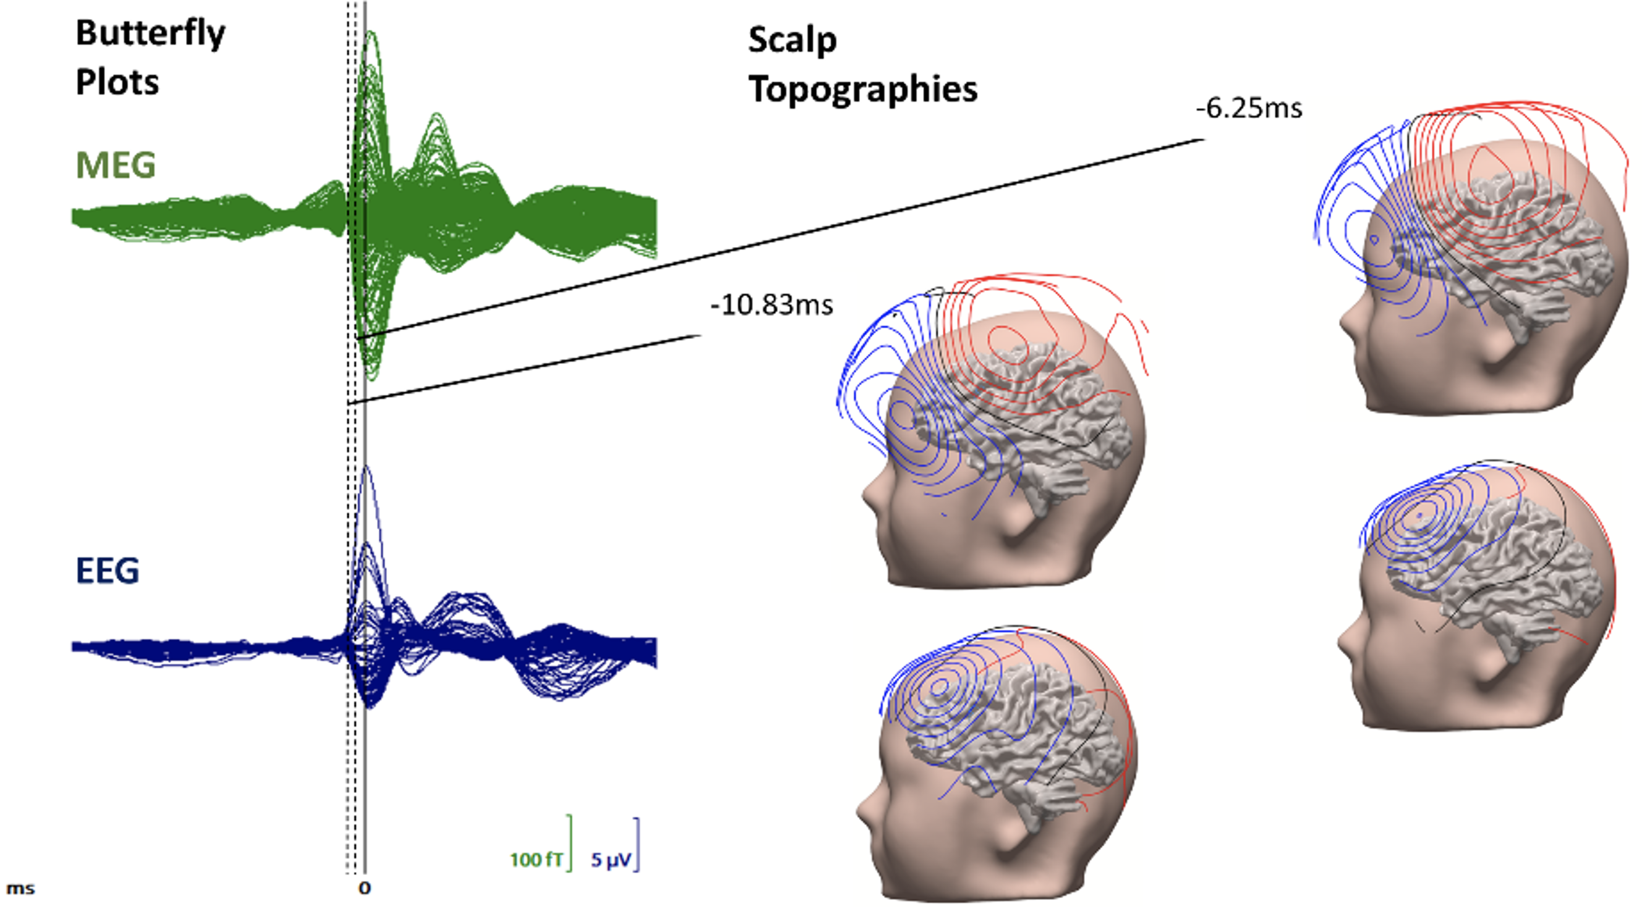
PerEpi non-invasive diagnosis: EEG and MEG of averaged 1050 interictal epileptiform discharges (IEDs)
[Antonakakis, Kaiser, Rampp, Kovac, Wiendl, Stummer, Gross, Kellinghaus, Khaleghi-Ghadiri, Möddel, Wolters, Brain Stimulation, 2024]

Slide 50
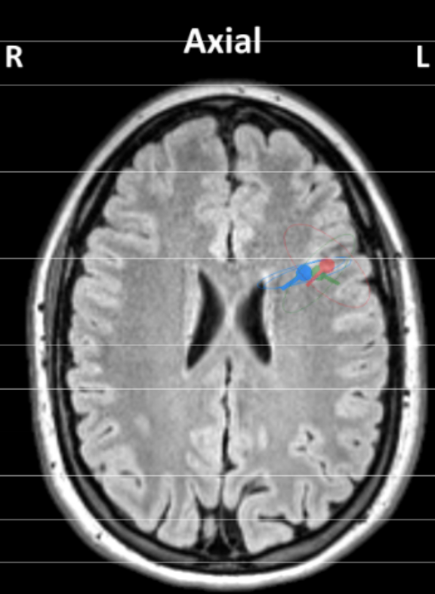
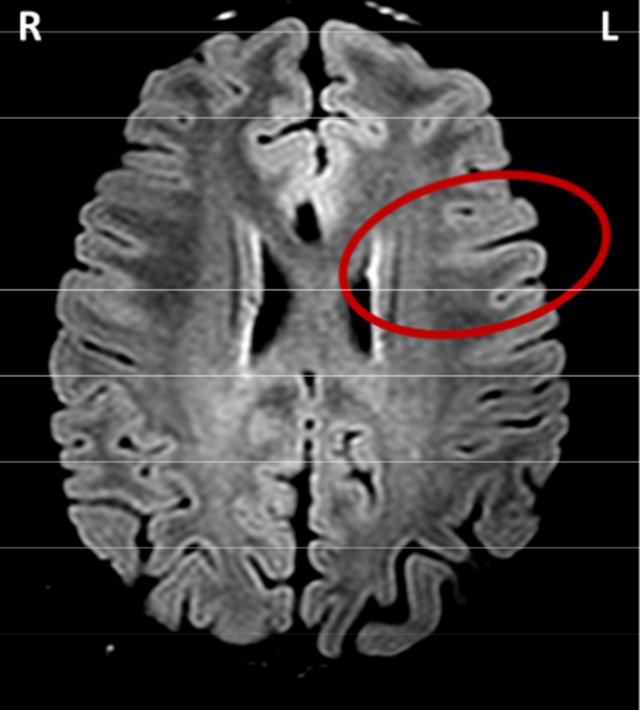
[Antonakakis, Kaiser, Rampp, Kovac, Wiendl, Stummer, Gross, Kellinghaus, Khaleghi-Ghadiri, Möddel, Wolters, Brain Stimulation, 2024]
EEG and MEG source analysis of the subaveraged IEDs
Source reconstruction led to detection of focal cortical dysplasia (FCD) of type IIb, which was not described earlier by the neuroradiologist
Lesion close to Broca's area
Single dipole scan centroid and spread spheres for EEG/MEG/EMEG of >1000 subaverages of 10 spikes
Retrospective MRI analysis showed
an FCD type IIb

Slide 51
Structure
Complementarity of EEG and MEG
How to exploit this complementarity in combined EEG/MEG source analysis
Focal epilepsy patient case studies
EEG reconstruction of ictal activity
Reconstruction of propagation pathway
Multifocal epilepsy
Broca epilepsy
Epilepsy and pregnancy
Summary
Notes:
Non-invasive source analysis a promising tool in presurgical epilepsy diagnosis (Bast et al., 2006; Stefan et al., 2003).
The results of EEG source analysis were shown to direct or avoid intracranial EEG recordings and in a significant percentage of patients, it proved to be a key element in the surgical decision process (Boon et al., 2002).
MEG was shown to help in characterizing potentially epileptogenic lesions and showed intrinsic epileptogenicity of malformations of cortical development (Bast et al., 2004; Morioka et al., 1999).
While most source analysis studies used either EEG or MEG data, we will present here a new strategy for combined EEG/MEG source reconstruction and, to the best of our knowledge, apply it for the first time to EEG/MEG data of an epilepsy patient.

Slide 52
Patientin
28 Jahre alte Frau, pharmako-resistente Epilepsie seit dem 8.Lebensjahr (2-3 x /Nacht, selten tagsüber)
Anfallstyp 1 (häufig): Rumpfvorbeugung, Hin- und Herwerfen des Oberkörpers, Vokalisationen für 30 – 60 Sek.
Anfallstyp 2 (seltener): Bewegungsarrest, Starren, Schmatzen
Nicht-invasive prächirurgische Diagnostik 2000 an einem großen/bekannten Epilepsiezentrum (14. LJ):
MRT: leichtgradige Hippokampussklerose rechts
Interiktuale Epilepsie-typische Potentiale rechts temporal
EEG-Anfallsbeginn rechts temporal

Slide 53
Neurochirurgie 2000 (nicht am UKM)
Anteriore Temporallappenresektion rechts inkl. Amygdala-Hippokampektomie (14. LJ / 2000)
Post-operativ anfallsfrei bzgl. Anfallstyp 2
Anfallstyp 1 unverändert
Notes:
Source localizations at -23 ms (timepoint of the preceding MEG peak in the butterfly plot).
Slices selected according to the left hemispheric activity.
In the left column, the sLORETA results registered to the FLAIR MRI are shown (only results obtained with a threshold of 85 % for the maximum F-value are shown).
In the left column, the FLAIR image without localizations is shown.
Two main sLORETA source localization clusters were detected: in left fronto-central and right central regions. The cluster in the left fronto-central region was especially intriguing, since it was in a good
agreement with the seizure semiology and the results of FLAIR MRI at the place of this localization were suspicious.

Slide 54
Ab 2014 am UKM
Im Alter von 28.Jahren: Verheiratet und Kinderwunsch, aber bei der hohen Dosierung von Valproat ca. 10% Risiko für kindliche Fehlbildungen
2x Versuch, Valproat auszuschleichen scheiterte
Notes:
Source localizations at -23 ms (timepoint of the preceding MEG peak in the butterfly plot).
Slices selected according to the left hemispheric activity.
In the left column, the sLORETA results registered to the FLAIR MRI are shown (only results obtained with a threshold of 85 % for the maximum F-value are shown).
In the left column, the FLAIR image without localizations is shown.
Two main sLORETA source localization clusters were detected: in left fronto-central and right central regions. The cluster in the left fronto-central region was especially intriguing, since it was in a good
agreement with the seizure semiology and the results of FLAIR MRI at the place of this localization were suspicious.

Slide 55
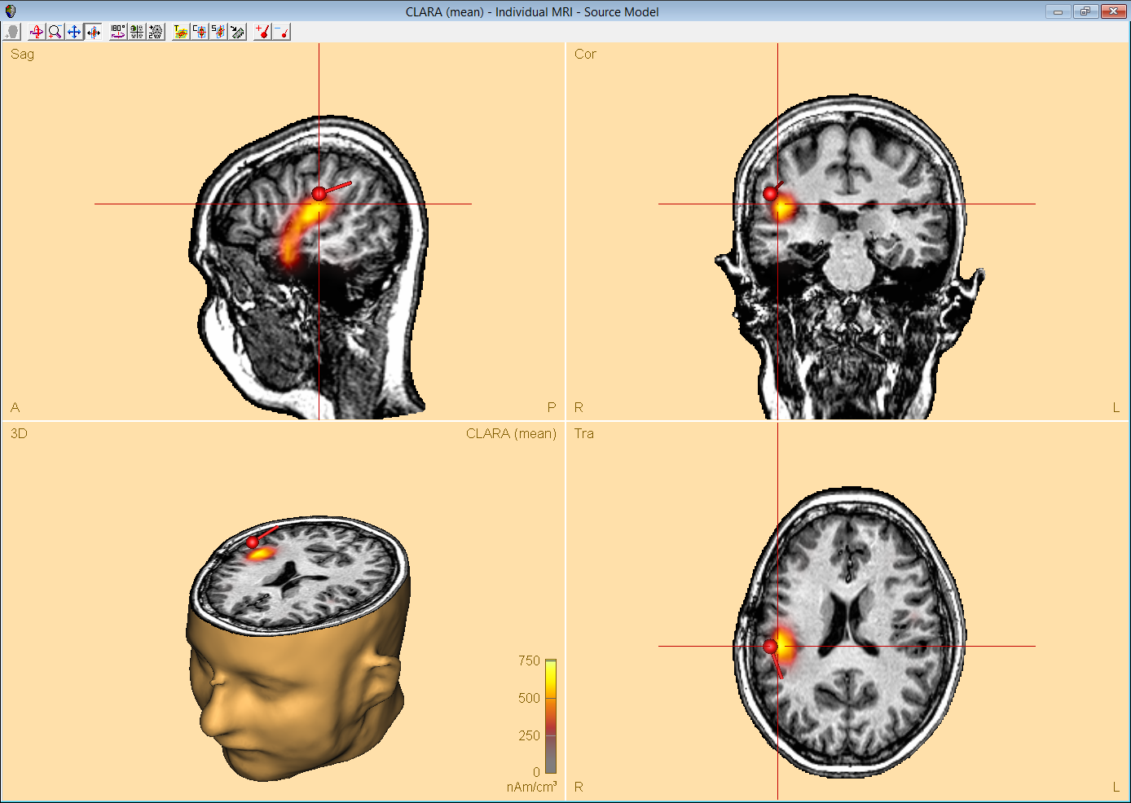
Nicht-invasive prächirurgische Diagnostik 2014
MEG-Quellenanalyse aus 9 gemittelten MEG-Spikes am Spike-Onset rechts-fronto-lateral organisiert
Dipol-Fit (roter Pfeil)
Stromdichte-Rekonstruktion (gelb-rotes Patch)

Slide 56
Nicht-invasive prächirurgische Diagnostik 2014
MRT (3T, 3D FLAIR): mögliche FCD rechts fronto-lateral

Slide 57
Neurochirurgie 2015
Invasive Diagnostik mit 2 Tiefenelektroden: Anfallsbeginn in der FCD
Wada-Test (Injektion eines Narkose-Mittels in die Hirnschlagader): Sprachbereiche nicht betroffen
Empfehlung zur erweiterten Läsionektomie
Navigationsgestützte Resektion 07/2015
Histologie: FCD Typ II B

Slide 58
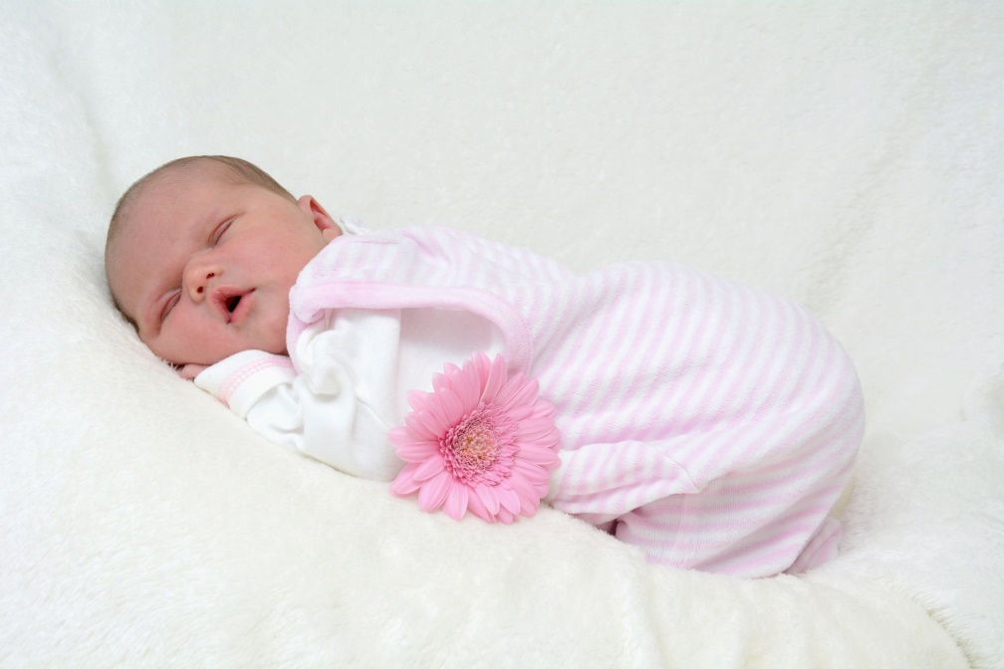
Postoperatives Ergebnis
Kein klinisch-neurologisches Defizit
Post-operativ komplett anfallsfrei
Da Valproat bereits vor OP abgesetzt wurde, stand einer möglichen Schwangerschaft nichts mehr im Wege
Emilia *07/2016

Slide 59
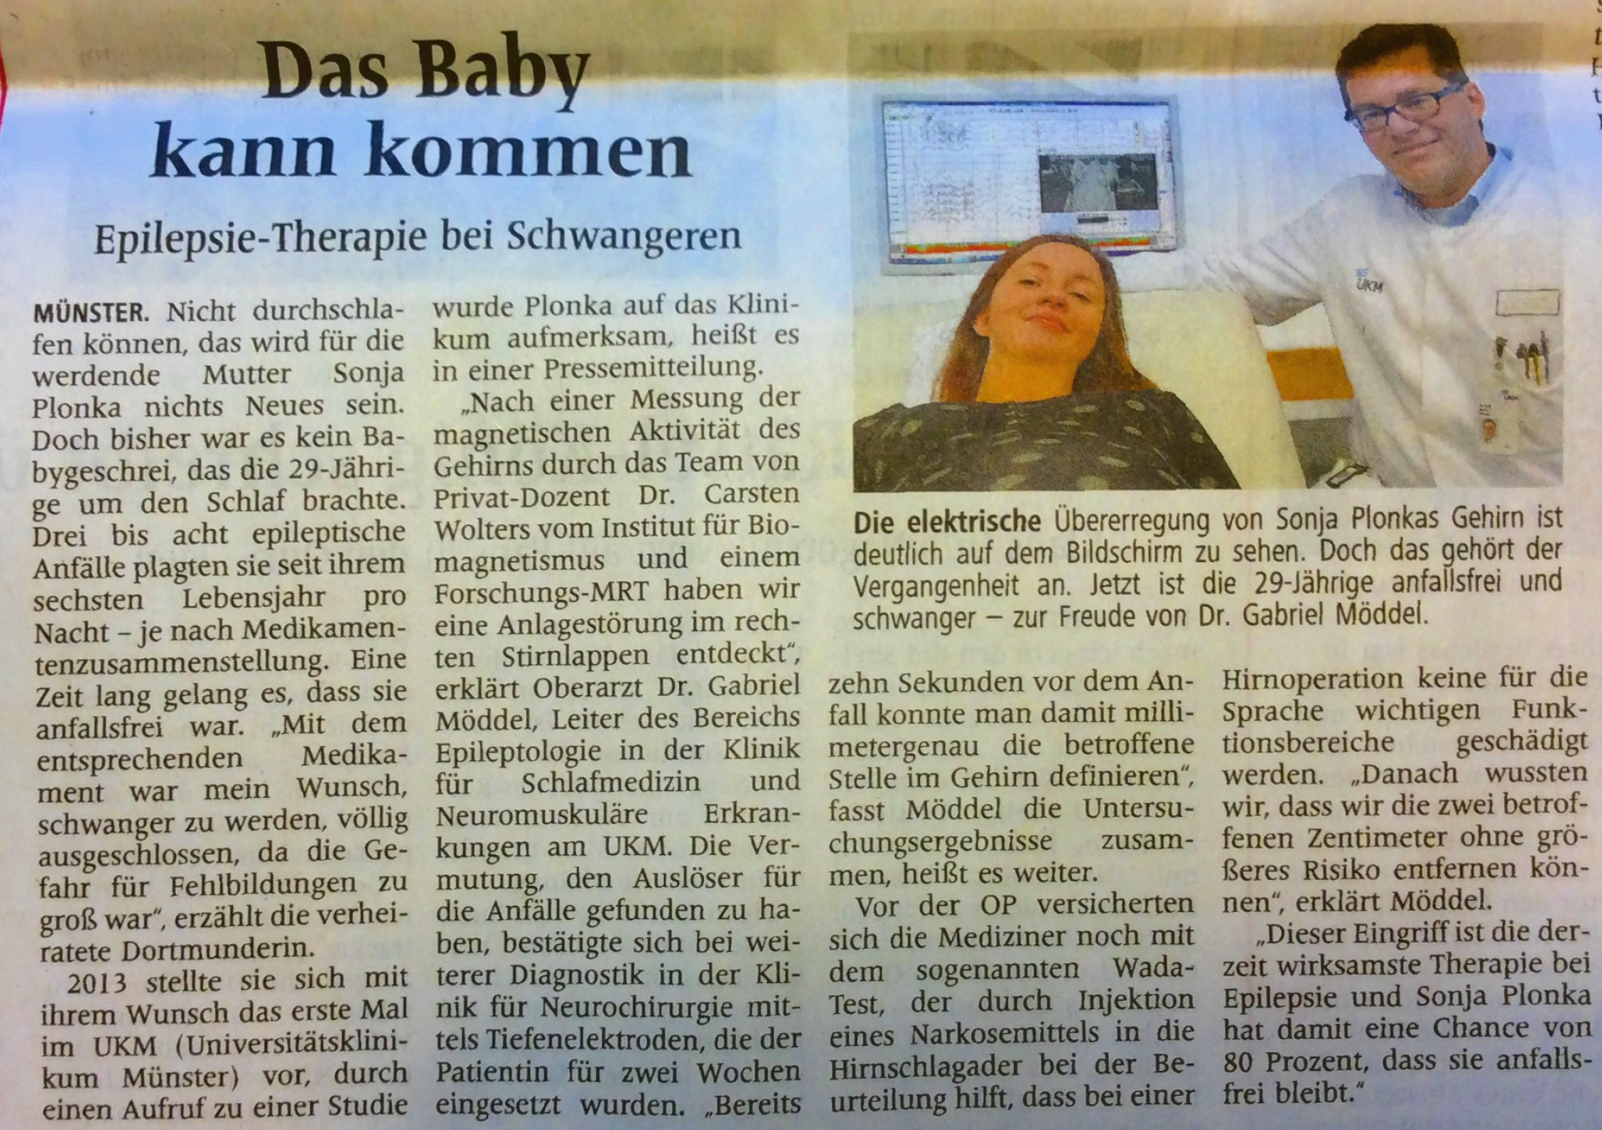
Operation statt Medikamente bei Epilepsie und Schwangerschaft
[Westfälische Nachrichten, 18.März 2016]

Slide 60
Zusammenfassung
MEG-Quellenanalyse kann einen wichtigen Beitrag zur prächirurgischen Epilepsie-Diagnostik leisten
Könnte zukünftig Patienten u.U. invasive Diagnostik ersparen!?
MEG weniger durch Knochenlücken beeinflusst als EEG: MEG also insbesondere von Nutzen bei vor-operierten Patienten
Individuelles FEM-Kopfmodell kann Modellierung des „breach-rhythm“ und damit auch EEG und kombinierte EEG/MEG Quellenanalyse ermöglichen

Slide 61
Structure
Complementarity of EEG and MEG
How to exploit this complementarity in combined EEG/MEG source analysis
Focal epilepsy patient case studies
Summary
Notes:
Non-invasive source analysis a promising tool in presurgical epilepsy diagnosis (Bast et al., 2006; Stefan et al., 2003).
The results of EEG source analysis were shown to direct or avoid intracranial EEG recordings and in a significant percentage of patients, it proved to be a key element in the surgical decision process (Boon et al., 2002).
MEG was shown to help in characterizing potentially epileptogenic lesions and showed intrinsic epileptogenicity of malformations of cortical development (Bast et al., 2004; Morioka et al., 1999).
While most source analysis studies used either EEG or MEG data, we will present here a new strategy for combined EEG/MEG source reconstruction and, to the best of our knowledge, apply it for the first time to EEG/MEG data of an epilepsy patient.

Slide 62
Summary:
EEG and MEG are modalities with complementary sensitivities
Combined EEG/MEG source analysis can significantly stabilize the accuracy and confidence of reconstructions (Antonakakis et al., 2019,2020), especially at early (noisy) time points (Aydin et al., 2015,2017)
The use of earlier activity than spike-peak and spike sub-averaging strategies can avoid mis-localizations due to propagation (Aydin et al., 2015,2017)
EEG/MEG source analysis for determination of region of interest (ROI) and then morphometric analysis and ZOOMit-MRI in ROI seems a very promising new method (use of “converging evidence”) (Aydin et al., 2017)
A combined EEG/MEG source analysis should be based on realistic multi-compartment anisotropic head models with individually-calibrated skull conductivity (Aydin et al., 2014, 2015, 2017; Vorwerk et al., 2019; Antonakakis et al., 2019,2020)

Slide 63
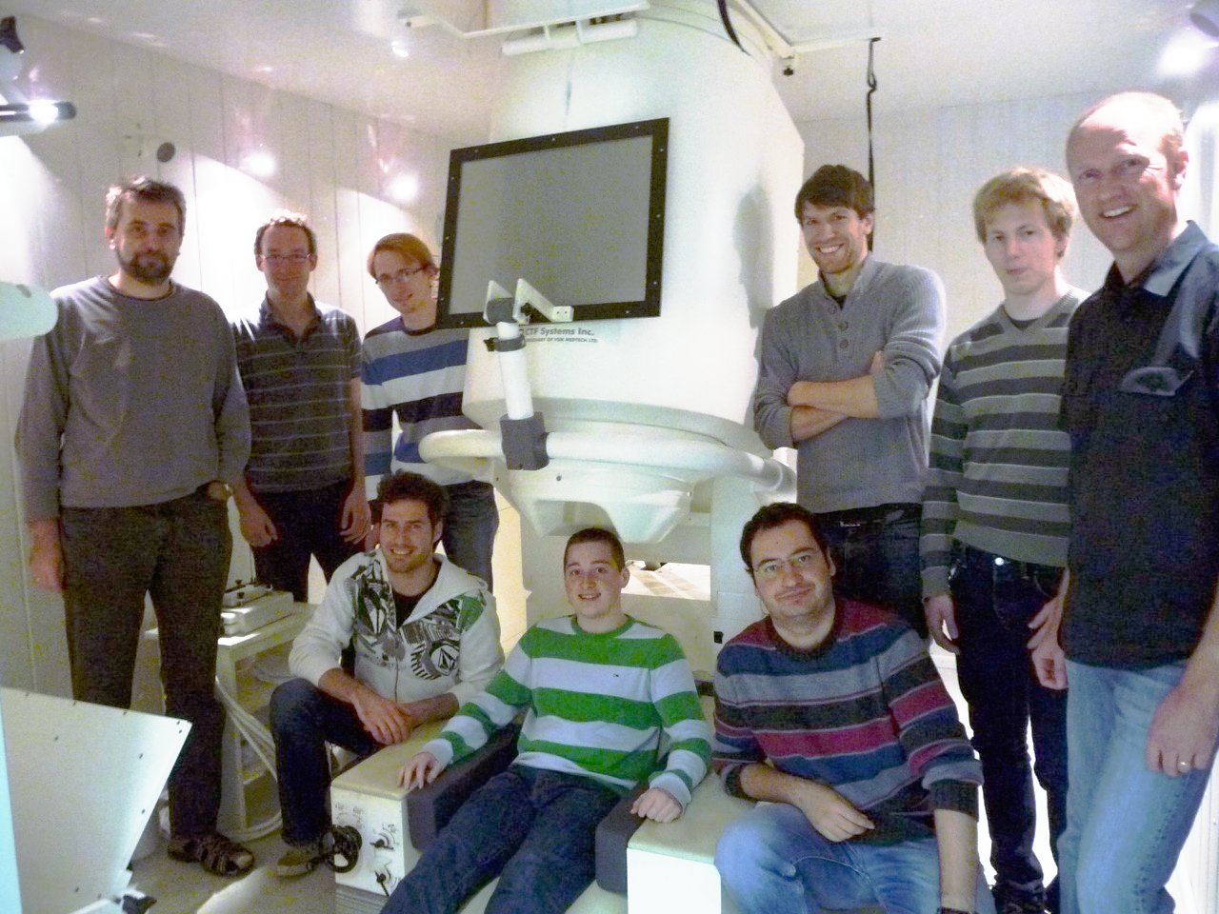
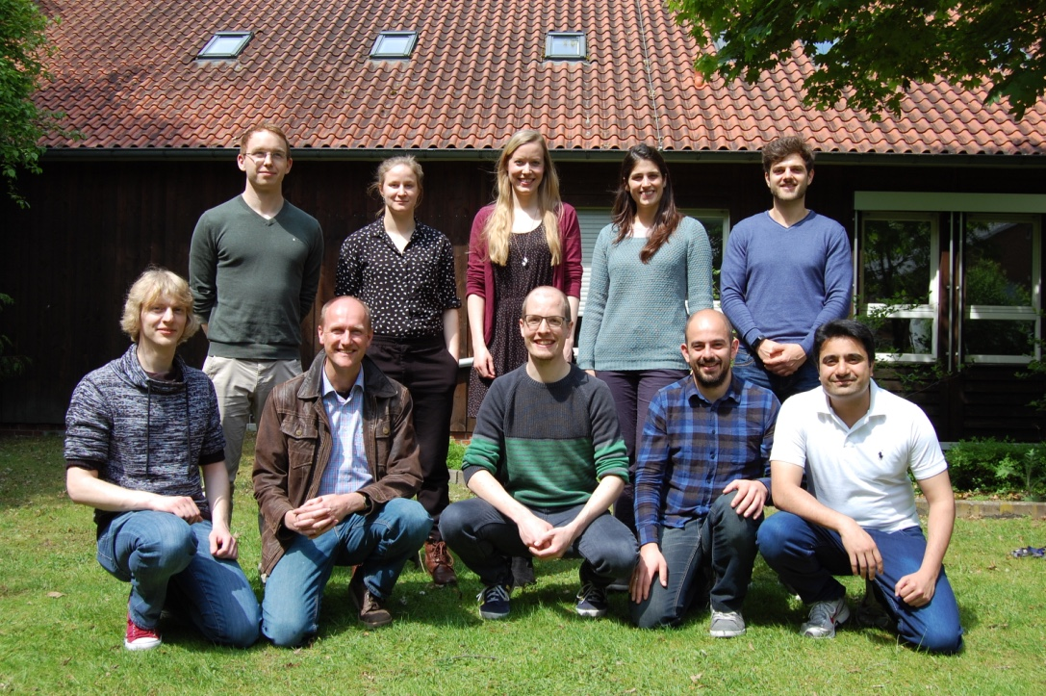
Thanks for your attention!
since 2016
2010-2016
IBB’s SIM-NEURO work-group
Notes:
63
63

