Slide 1
Size Matters
Revealing Small Scale Structures in Large Data
T. Fogal, J. Krüger

Slide 2
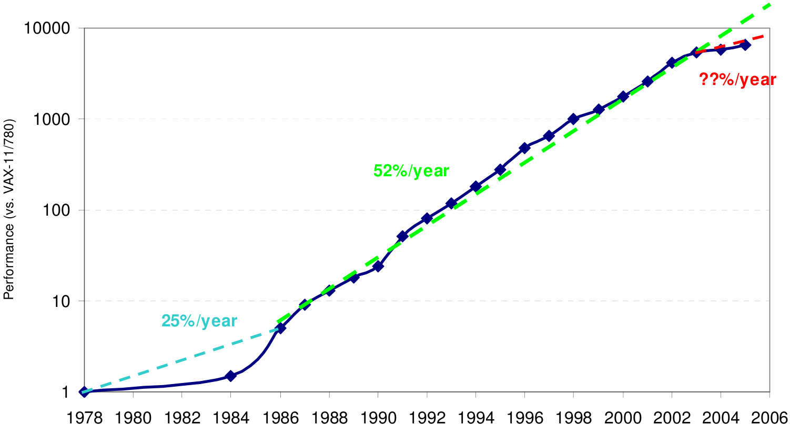
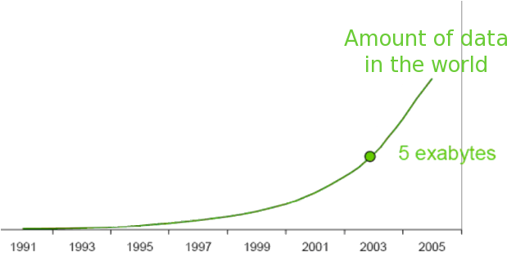
Large Data
Data are growing faster than we can process them
Relative CPU Performance
Growth of Data

Slide 3
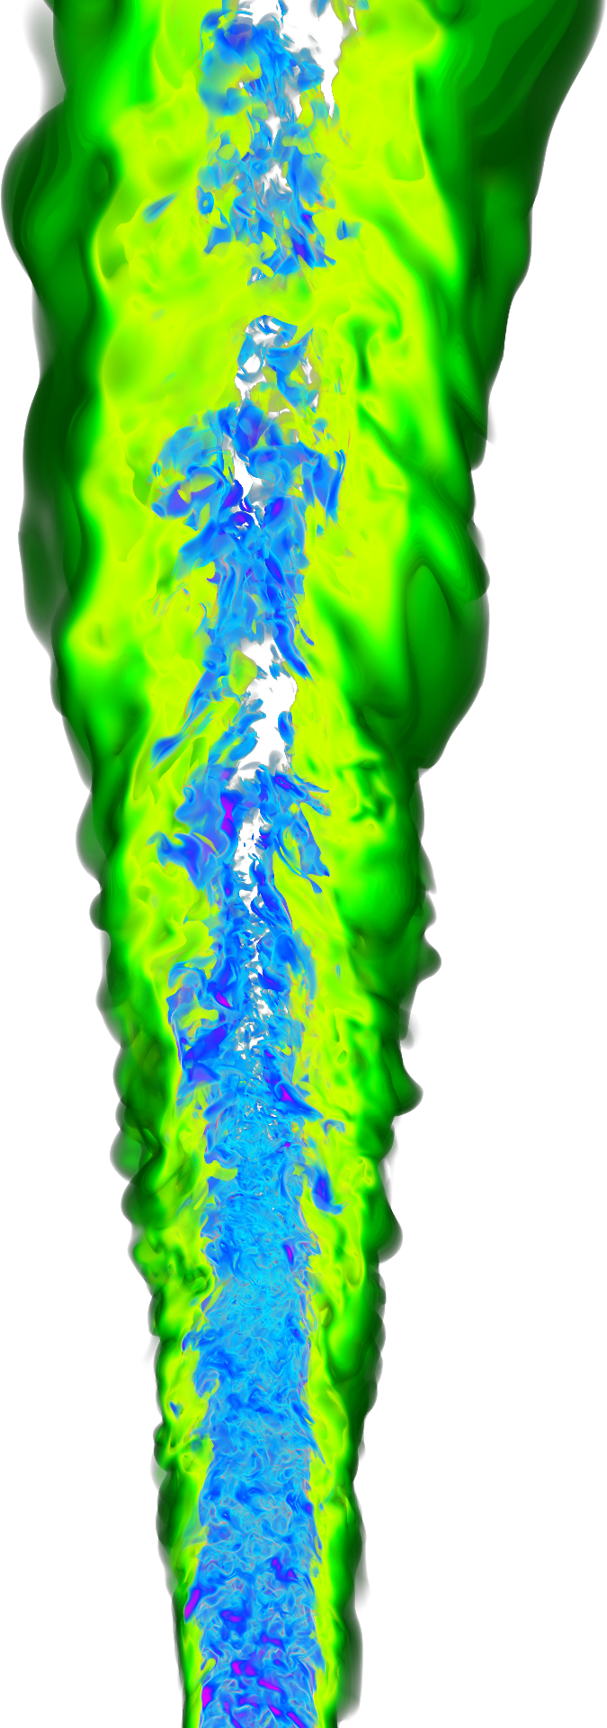
Visualizing High-Res Data
Previous solutions have undesirable side effects
Downsample – loses high frequency features
Subset – Context information lost; global properties and features lost.
Both approaches require additional processing time
Obtaining high resolution data takes resources

Slide 4
The Need for High Resolution Visualization
Low resolution
High Resolution

Slide 5
The Need for High Resolution Visualization (cont’d)

Slide 6
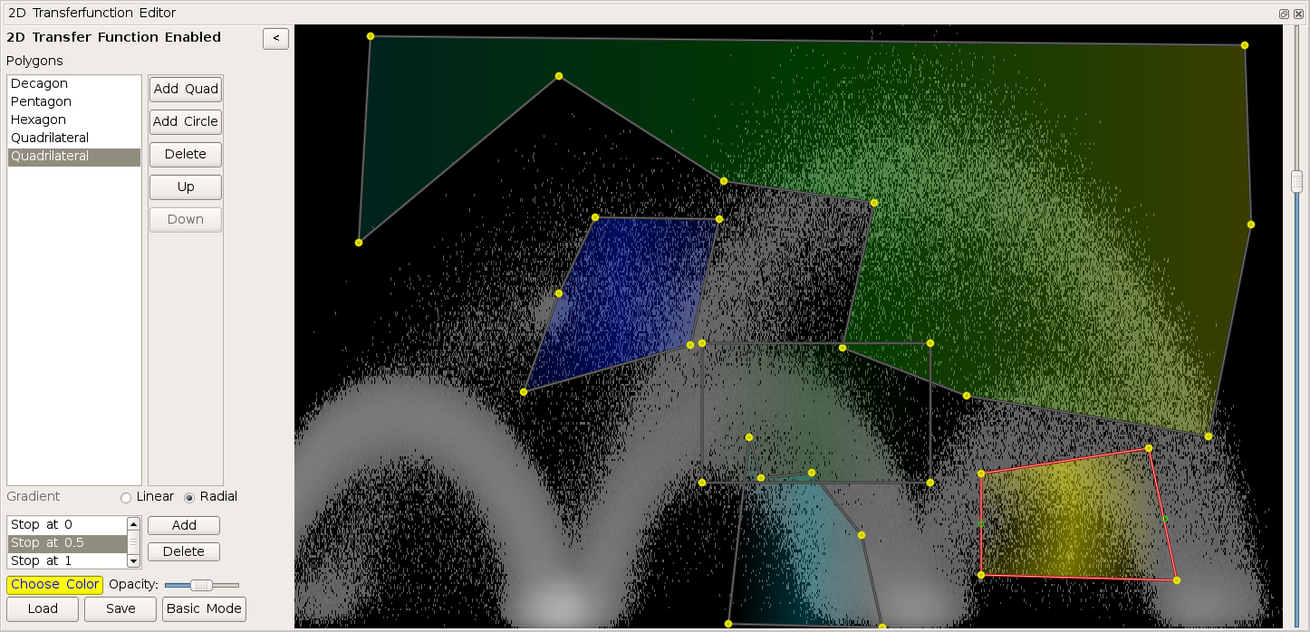
Visualization Interfaces
Bottom line: visualization should help users identify new and interesting features of their data
Slow (batch) interfaces: focus on known features
Real time interaction enables exploratory visualization

Slide 7
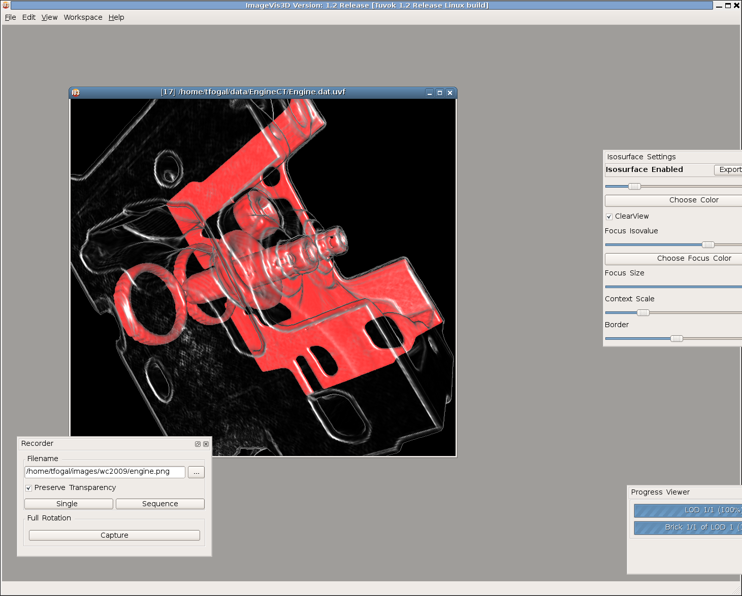
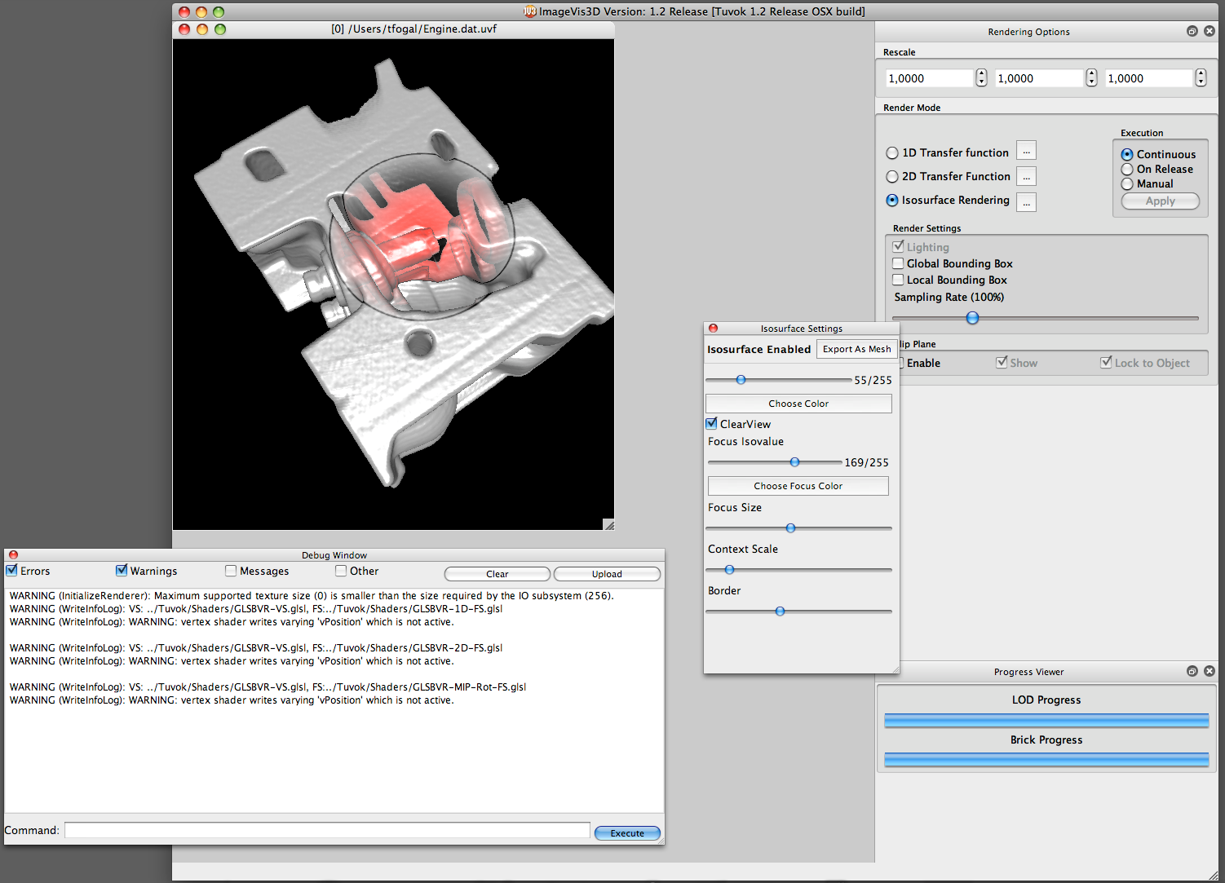
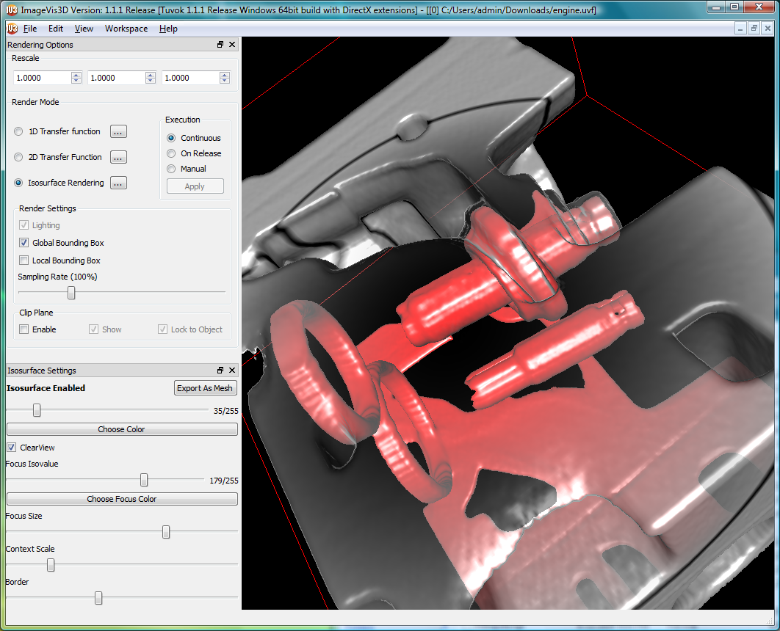
ImageVis3D
Cross platform, multiresolution bricked volume rendering application
Always interactive
Workstation memory does not limit dataset size

Slide 8
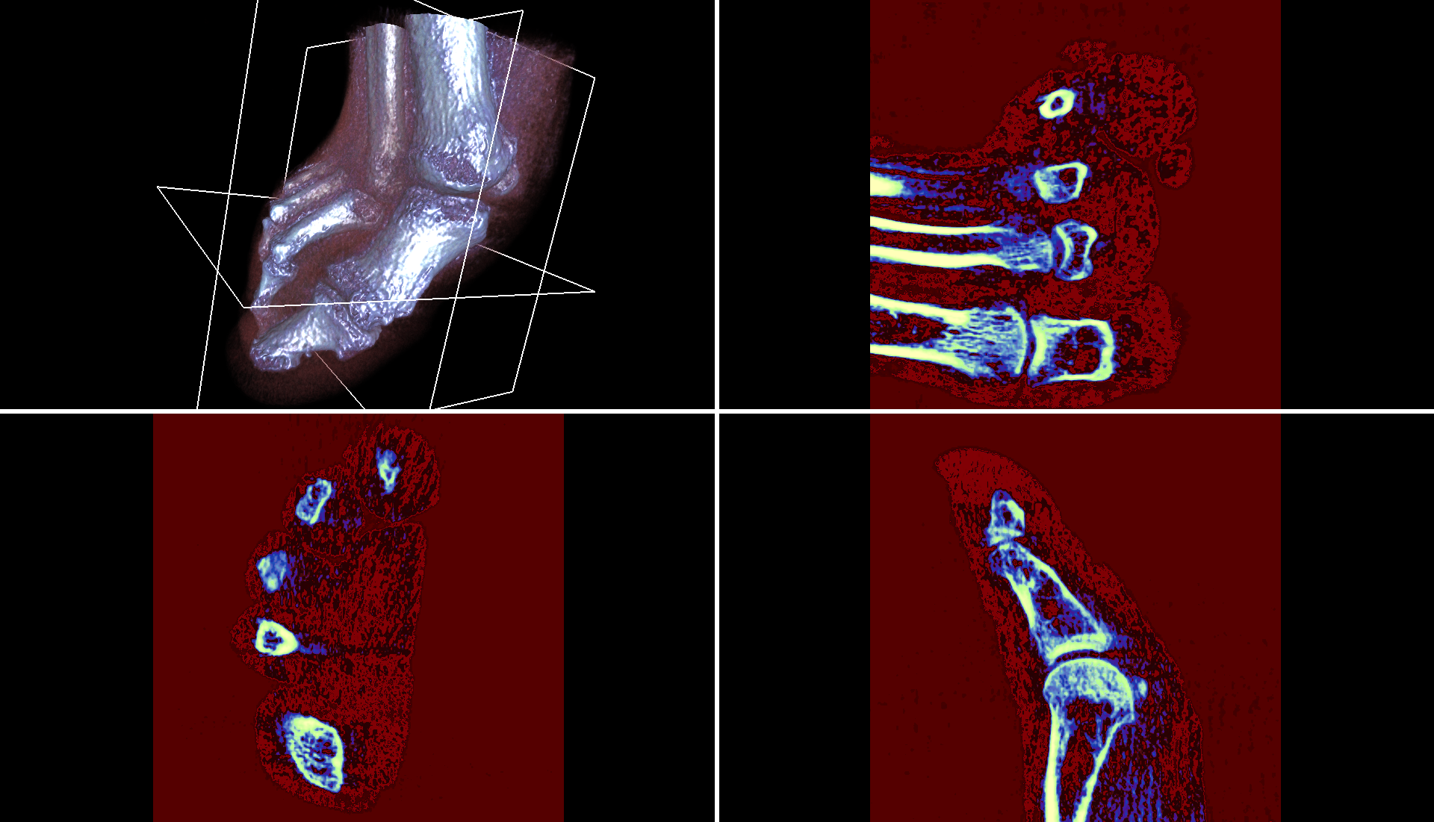
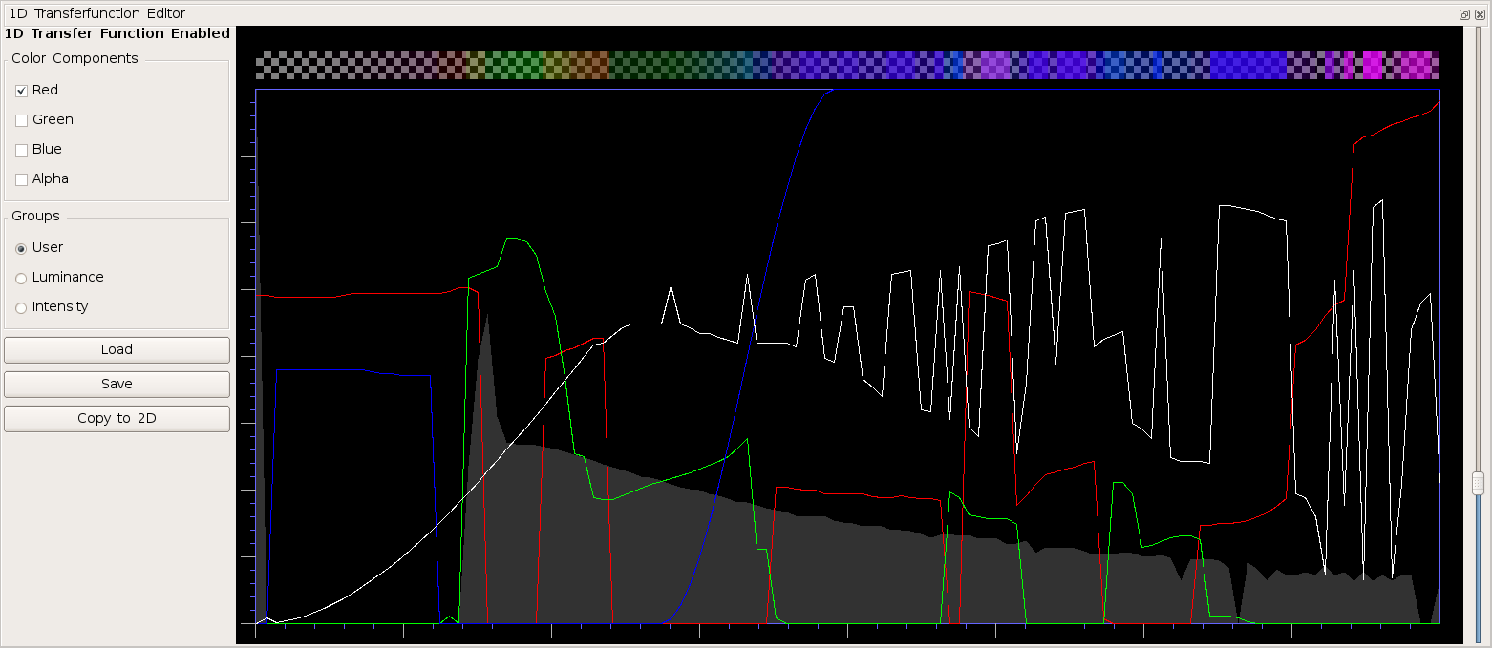
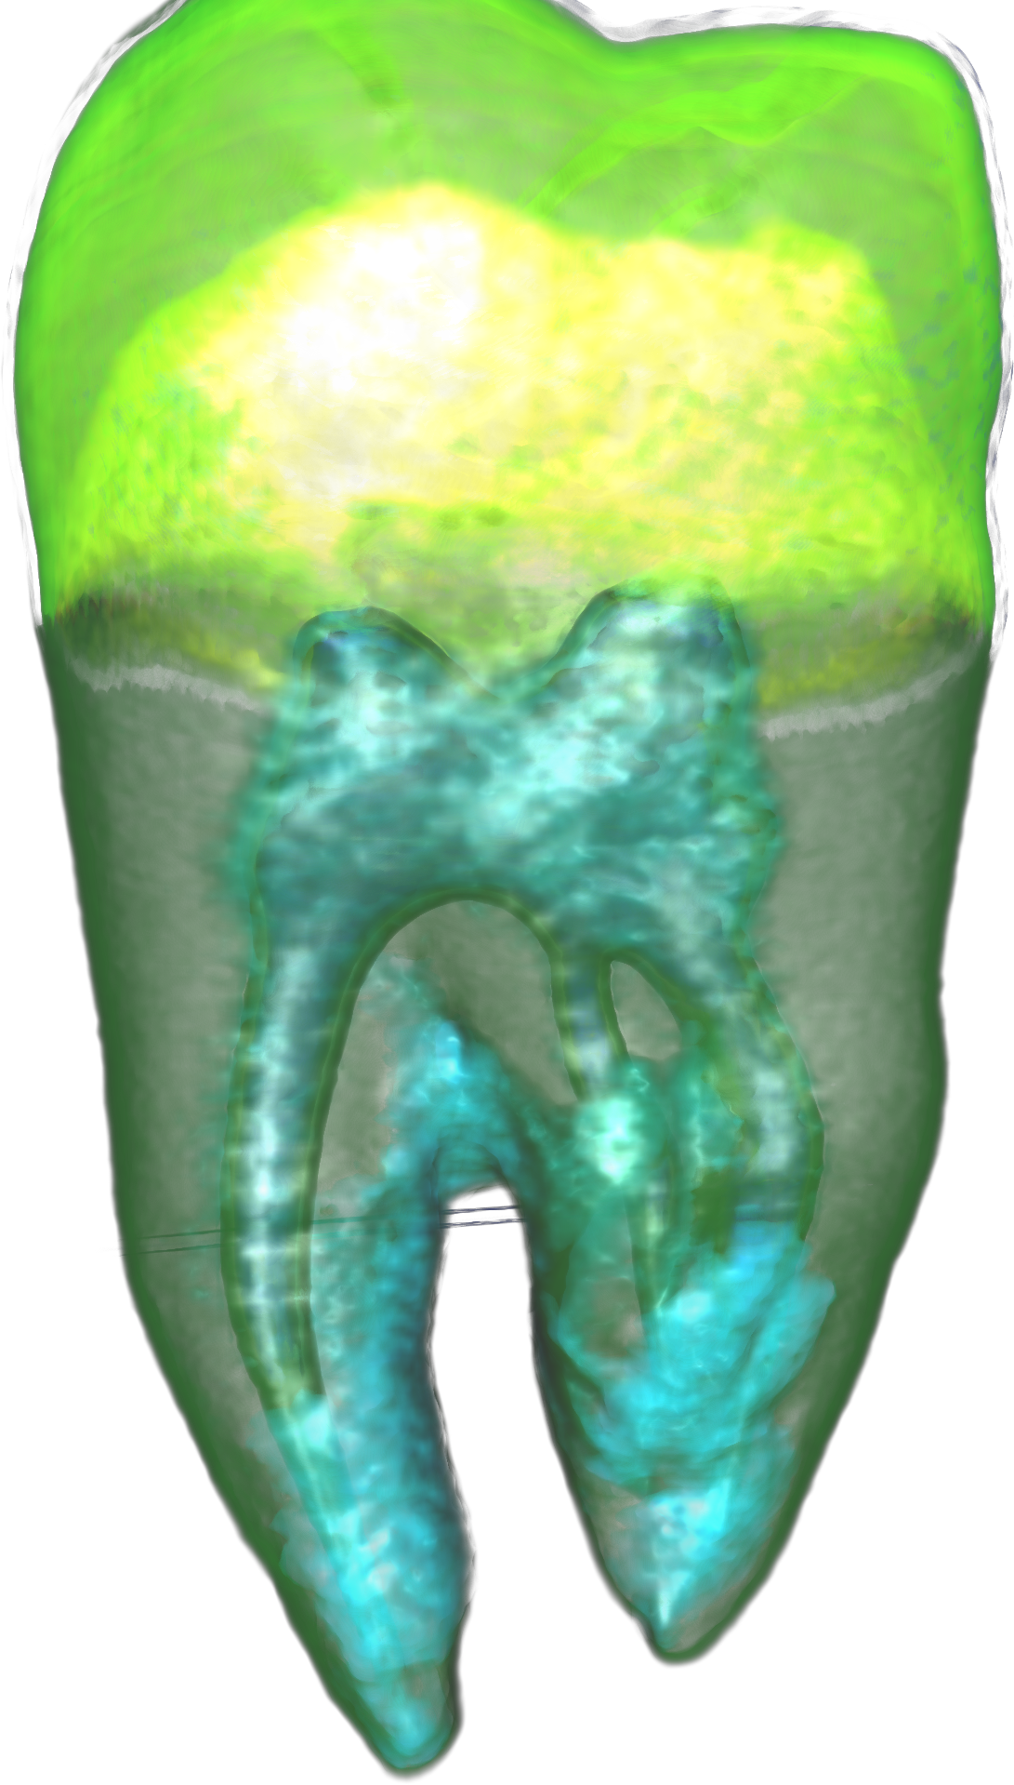
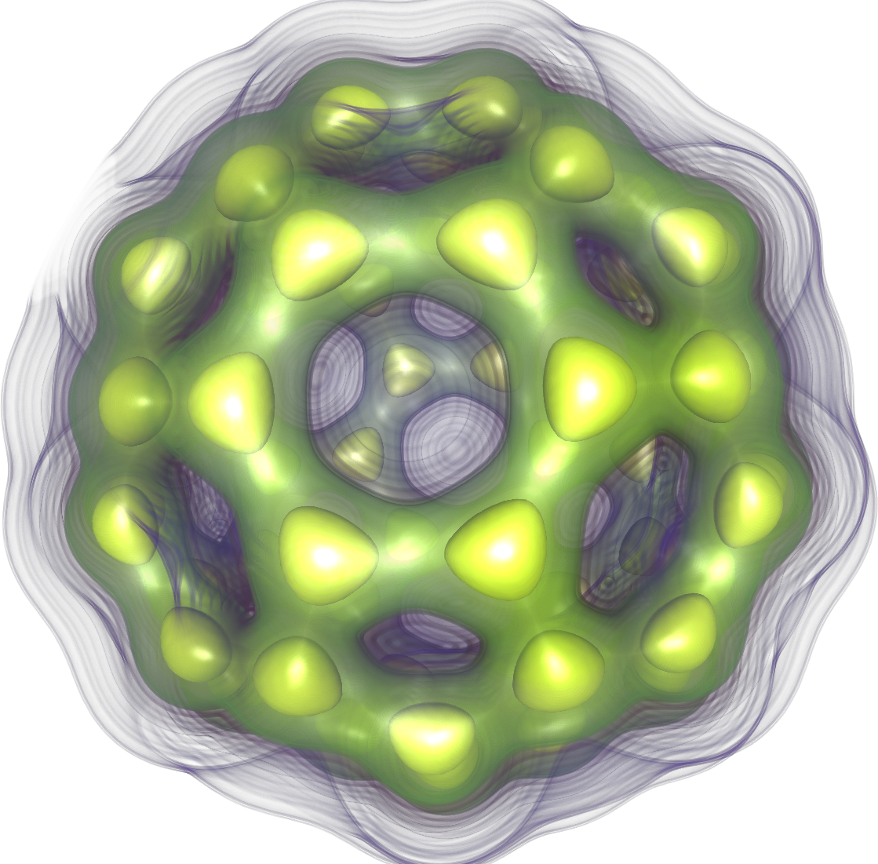
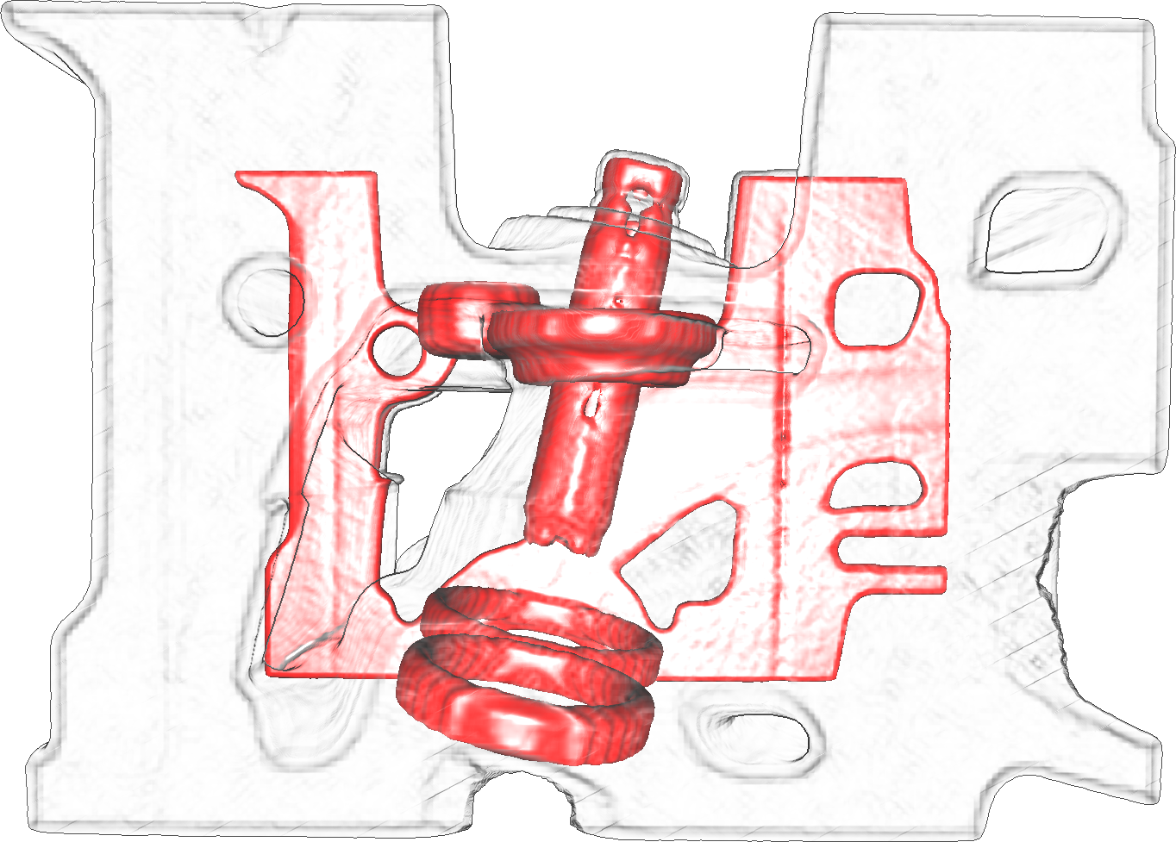
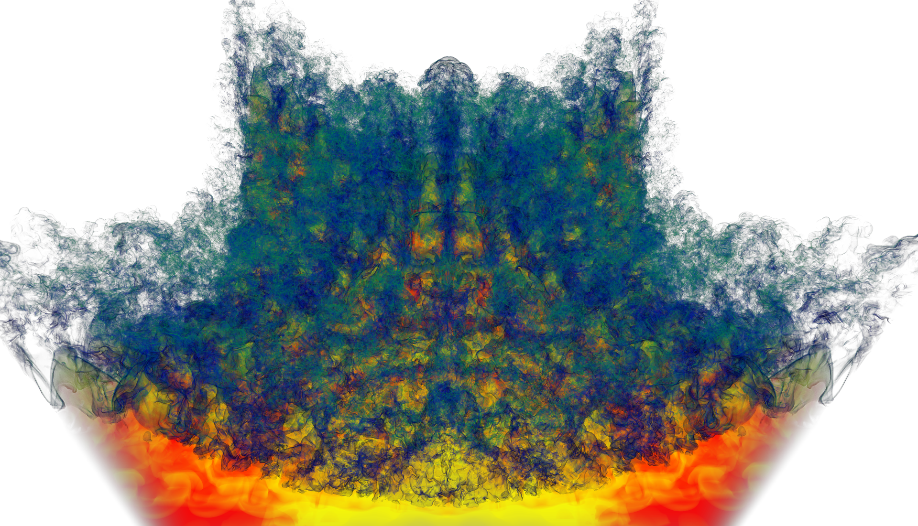
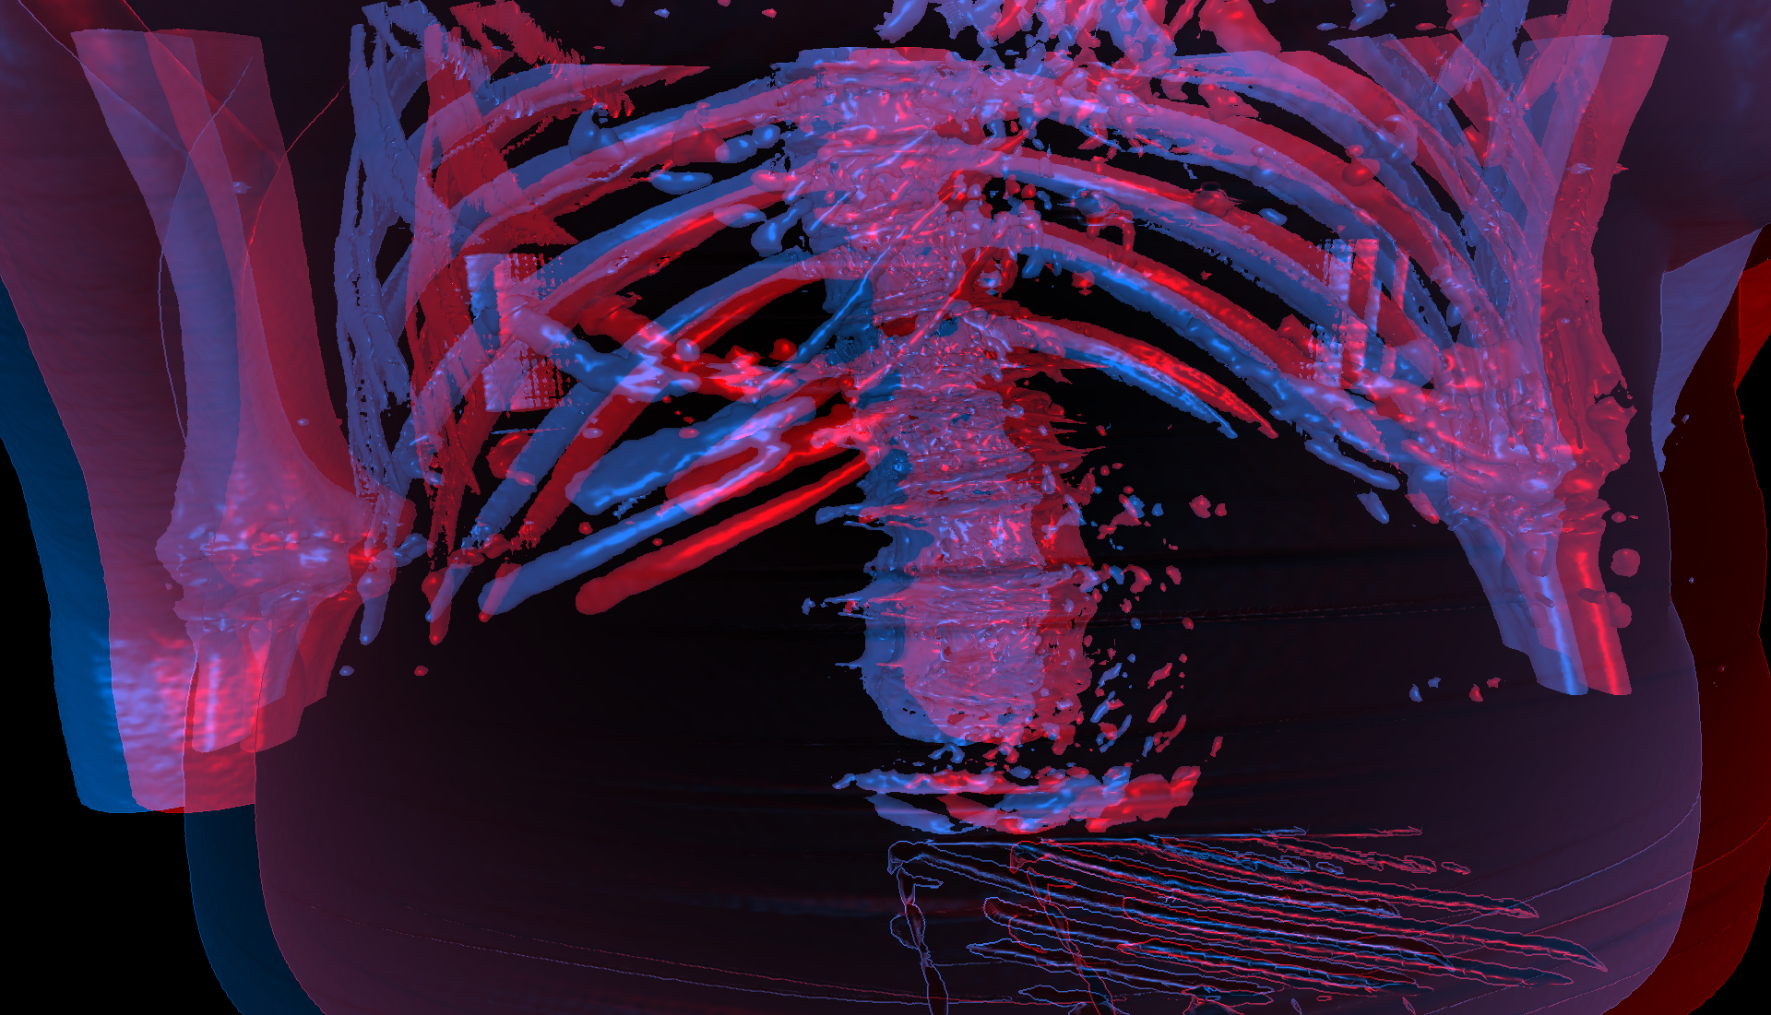
ImageVis3D

Slide 9
ImageVis3D
Questions?

