Slide 1
Tuvok, an Architecture for Large Scale Volume Rendering
Thomas Fogal and Jens Krüger
DFKI logo?
SCI logo?

Slide 2
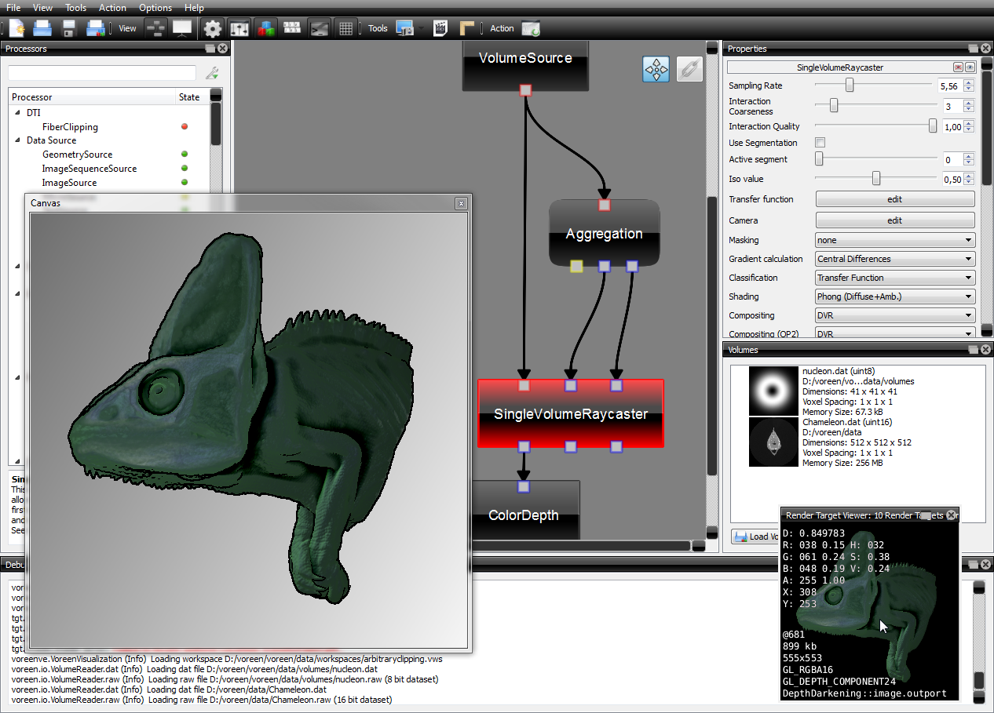
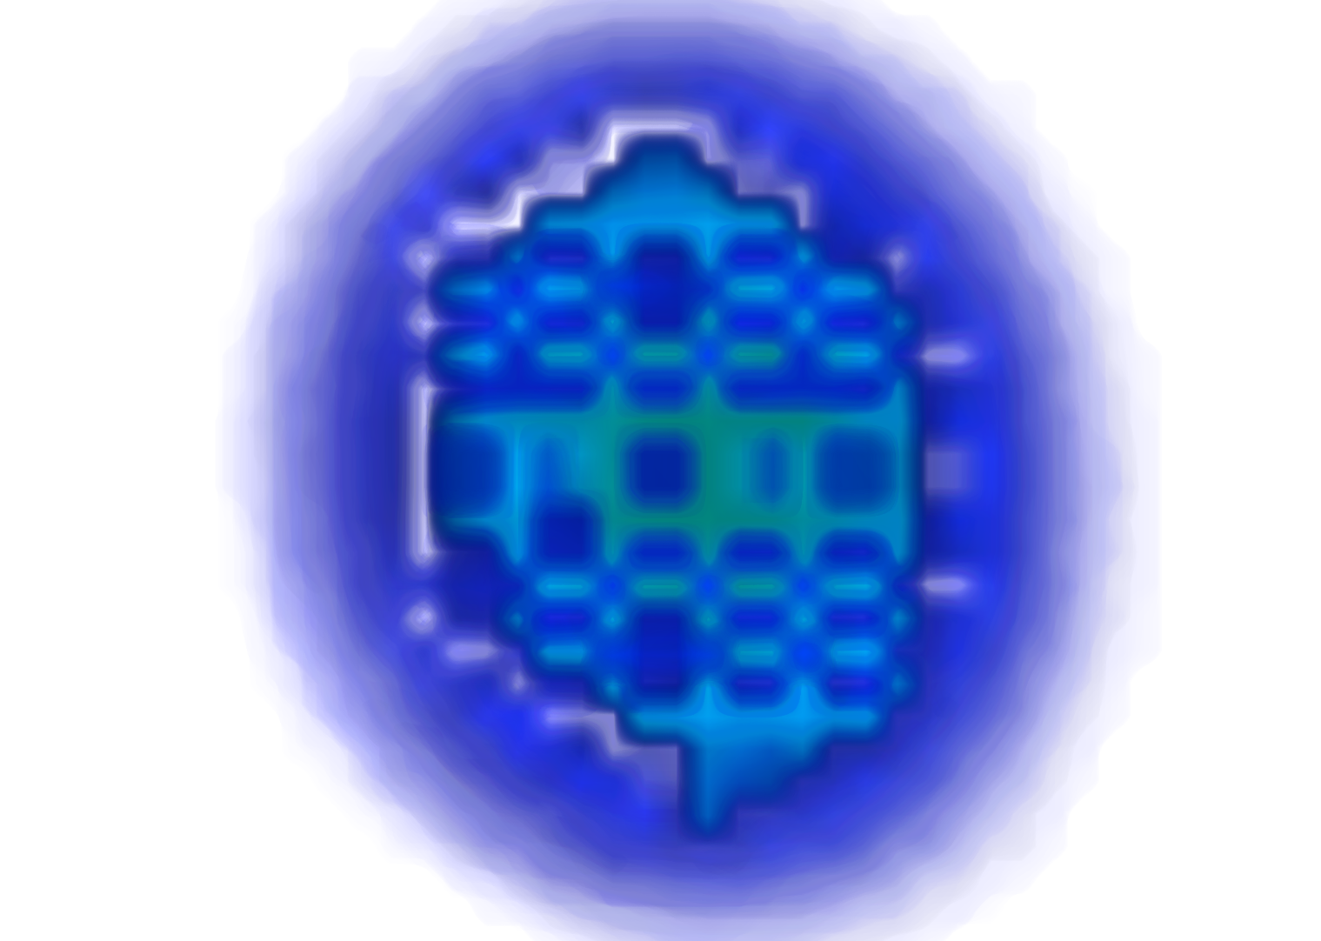
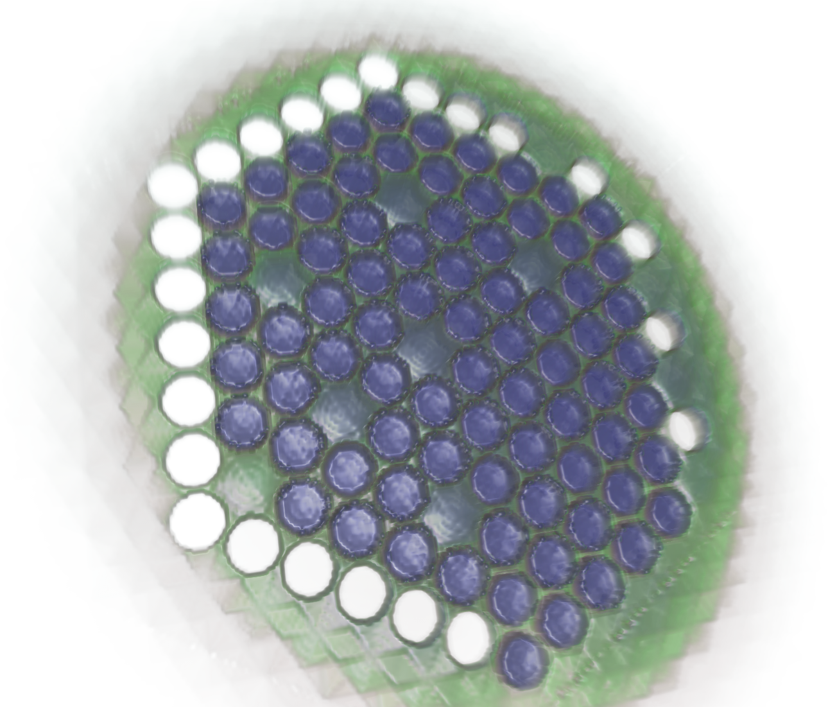
Existing Tools
Voreen
VisIt
other rendering system example images?
Tuvok
Insert paraview image here
Notes:
There are a variety of existing tools which can perform volume rendering on modern systems. Unfortunately, all of them fall short of our goals for one reason or another.
Voreen makes the underlying data flow network visible to the user. Through our experience with SCIRun, we recognize that while such networks are great to provide flexibility for the types of people in this room, they are not suitable for end-user interaction.
VisIt's volume rendering capabilities are severely lacking. VisIt processes data in-core, limiting the scalability unless supercomputing resources are obtained. Even with extensive compute capabilities available, VisIt's volume rendering tools are extraordinarily slow in comparison with Tuvok.
ParaView ... does not make effective use of modern GPUs.
Some tools used to fill the current gap, but have since been discontinued. VolPack, the Simian system, OGLE and OpenQVis are examples in this category.
There are a variety of commercial tools (AVS2, Amira, Ensight, syngo, VGStudio Max, AltaViewer), but such programs are less amenable to customization than open source solutions, and require costly purchases.
... and of course, a great many "research tools", all of which tend to go unmaintained after a publication is complete.

Slide 3
Tuvok
Scales
Portable: OpenGL / GLSL
tested on many GPUs
multiple render modes
Modular
Self contained
Provenance
Open Source
I would grab that section of our 2009 winning IV3D SciDAC video, where we have the 4 components in each corner, and use that as the images on this slide.
Notes:
Tuvok scales extremely well. We have used the system to volume render 2.1 terabytes of data, and an external user has visualized 1 gigabyte brain images on their desktop using the system.
We have run Tuvok on just about every GPU available on the market today; it is extremely portable. Multiple rendering modes allow the system to tailor itself to the available GPU; high end systems with good drivers can utilize the ray caster, and low end GPUs can make use of our 2D slice stack approach. Each renderer has been tailored to deal with specific, beyond-the-standard issues we have encountered on certain GPU and driver combinations.
The system is modular. IO components are distinct from the renderer, and the renderer itself is unaware of any particular windowing system components. The design allows users to pick and choose pieces of the system to utilize in their own work.
Only a single third party library is required to compile Tuvok: Qt. This makes it very easy to jump in and modify Tuvok to implement your own research ideas.
The renderer has a mechanism to register a provenance system with itself, and notify the system when salient components of the visualization have changed.
Tuvok is open source software, released under the MIT license. In a nutshell, this means: do whatever you'd like with the source or binaries we provide.˜

Slide 4
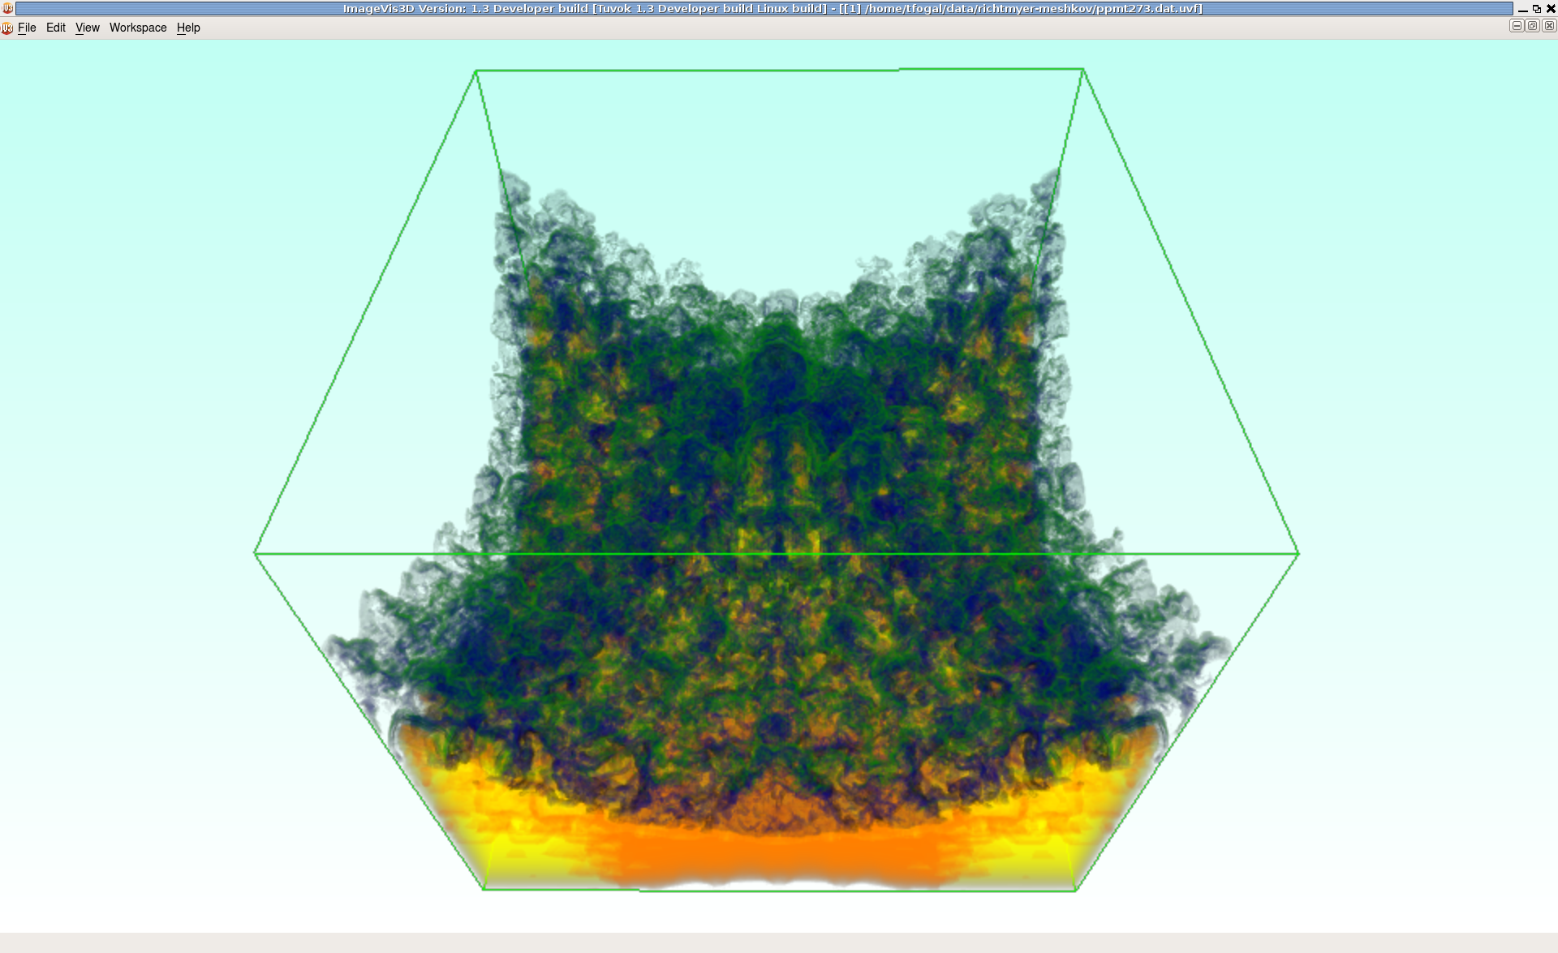
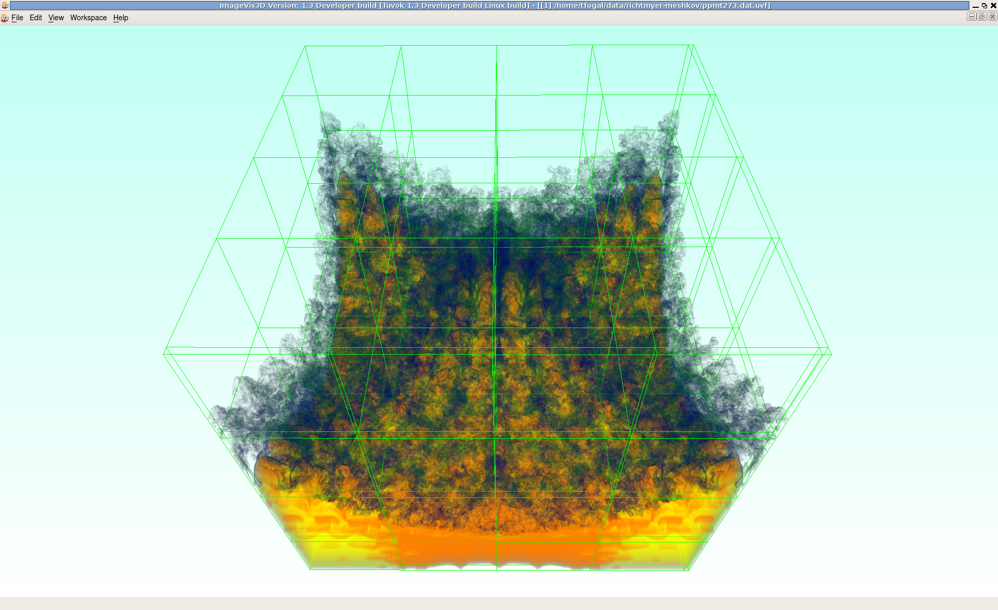
Interactivity
Notes:
Though volume data can be arbitrarily large, Tuvok can be configured to remain interactive. We do this via a progressive rendering system.
The left image is what the user sees while they are rotating the volume; this can be rendered at 60+ fps on modern systems. The right image is what the user sees

Slide 5
Multiresolution
...
...
...
... and so on..
.. and so on. But use brick outlines instead of the garbage i've used here... maybe hack IV3D to render the RM instability, except don't render the data, just the BBoxes?
Draw the multiresolution hierarchy for, say, the richtmyer-meshkov DS, in tree form along with bounding boxes connecting each level of the tree.

Slide 6
Frame Planning
SubFrame 0
...
...
SubFrame 1
... and so on..
Frame
You might consider leaving the BBoxes from the previous slide up here, but make them behind the "SubFrame" boxes or really transparent (or both)

Slide 7
MRU, LRU, Who RU?
Cache
0,0 | 1,0 | 2,0 | 3,0 | 0,1 | 1,1 | 2,1 | 3,1 | 0,2 | 1,2 | 2,2
When was a brick last used?
... bleh, need more imagery here but I dunno what to put. somehow visually depict one of the cases – i.e. using MRU to replace a brick when we're inside a single frame.
another idea is to specifically depict using plain LRU, to demonstrate how abysmally bad that strategy performs.
Notes:
Each entry of our cache contains a brick. The question is: when do we throw bricks away?
Every time a brick enters the cache, we record the frame and subframe that we are currently rendering. When we need a cache entry for a new brick, we evict an existing brick according to the MRU strategy within a frame, and the LRU strategy between frames.
The future use of a brick is dependent on where we are in a rendering. Between frames, we use an LRU strategy. This strategy will tend to drop bricks that are no longer needed, which may happen (for example) if the user applies a clip plane, or a transfer function with 0 opacity for some segment of the data values.
If we're within a frame, we haven't rendered the entire data set yet. However, we do know that any portion of the data that we have rendered won't be needed again until the user changes a visualization parameter. Thus as soon as we finish a brick, we should endeavor to throw it away as soon as possible. The exception to this is bricks at the lower (coarser) LOD levels: these bricks tend to get used a lot, because users interact in a burst manner, changing visualization parameters frequently and then stopping when they think they've got something good. Assuming our cache can store at least a few bricks, however, such bricks will naturally remain in the cache due to the application of the inter-frame LRU strategy.

Slide 8
IO
optional slide for you to rant that transfer time is all that matters and seek time is basically irrelevant. We do have a short section on this in the paper, so it could make sense to bring it up here. You might decide you don't want to bring it up at all, though, since we'll be doing that EGPGV paper.

Slide 9
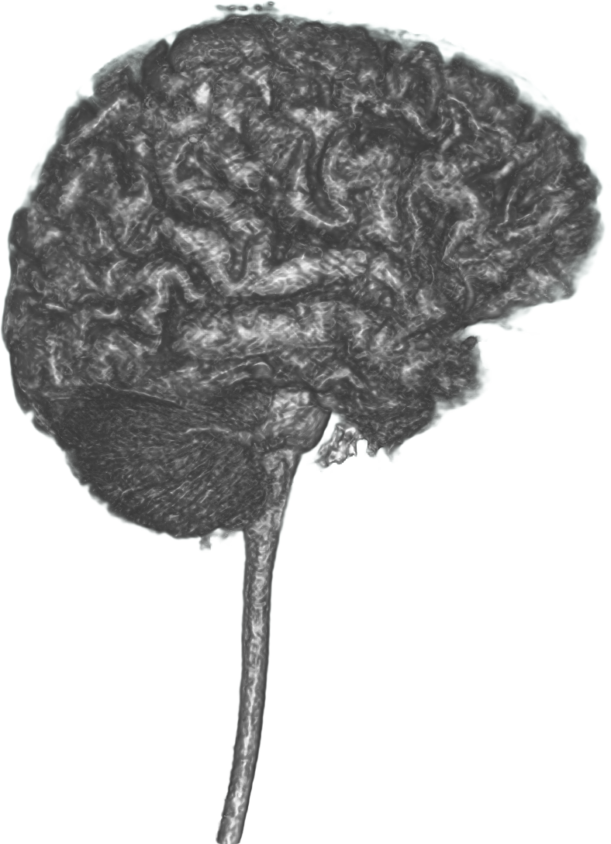
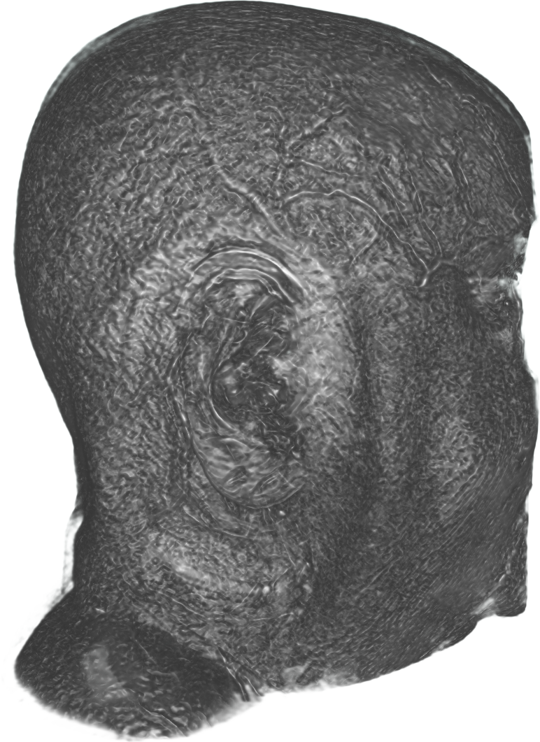
Volume Arithmetic
+
=
Notes:
One feature we have added since publication is the ability to combine multiple volumes in arbitrary ways. This functionality is of course generic to any sort of combination, but the driving use case is really to allow segmentations to be loaded. Doing this operation in batch mode also provides a mechanism for 'thresholding' the data: the quantization can optionally be recomputed, easing the creation of transfer functions for resultant data sets.

Slide 10
Extensions
Notes:
Tuvok or components of it have been integrated into a few different rendering tools.
AltaViewer is a proprietary application for visualizing CT scans.
SCIRun is a problem solving environment based on data flow networks.
VisIt is a parallel application for generic visualization and analysis of extremely large data. Tuvok has been integrated into VisIt to volume render datasets of up to 8192 cubed.

