Slide 1
Proposed research

Slide 2
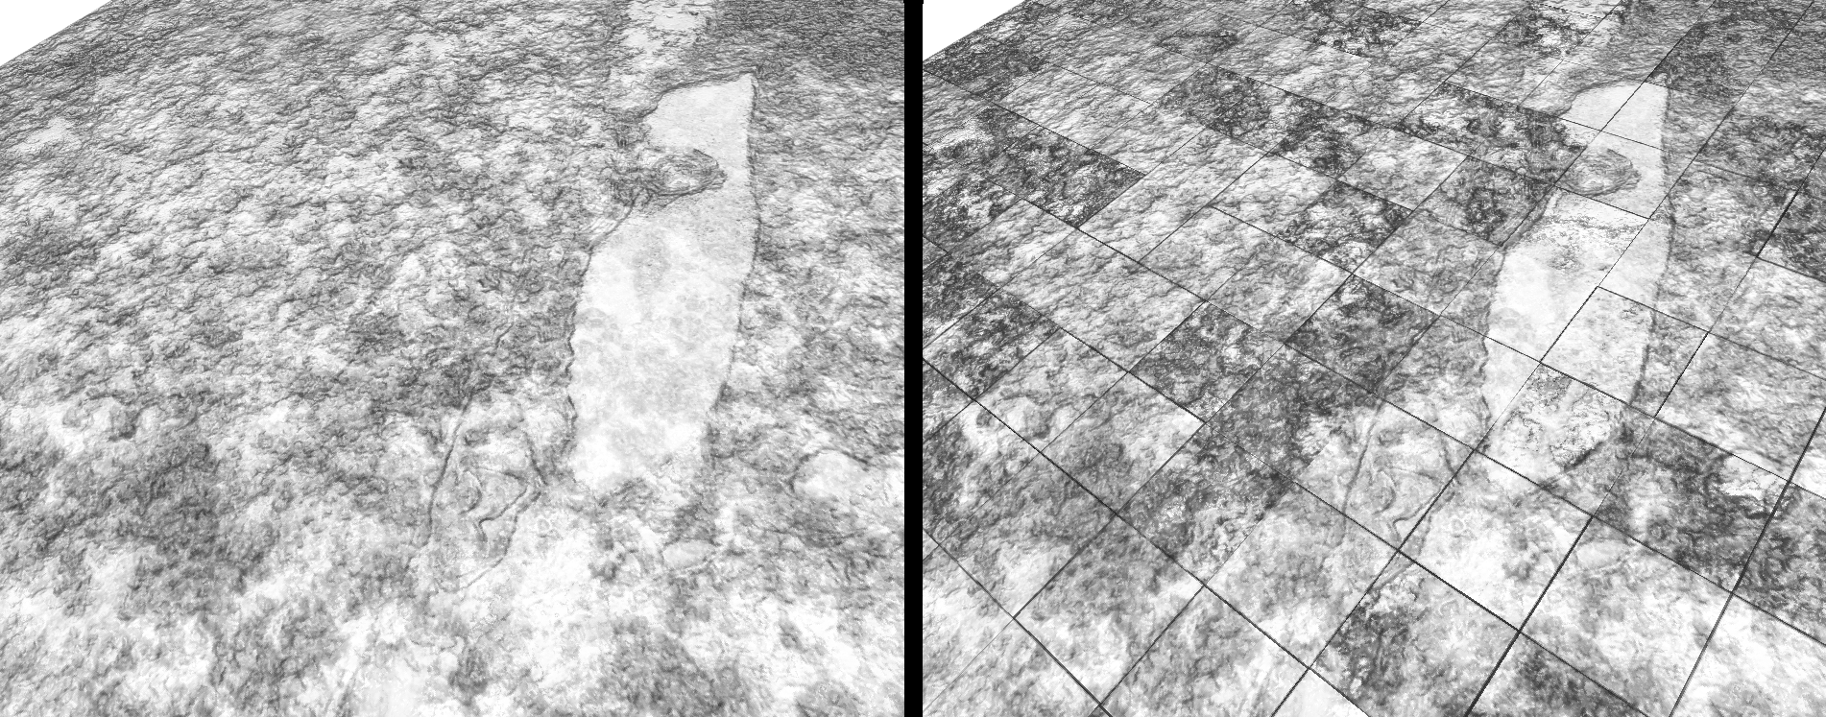
No conversion step
Notes:
One of the biggest problems plaguing large data visualization in tools like ImageVis3D is the data conversion step. This can often take weeks or even months for large, complex data sets like this 5 terabyte rabbit eye.
We are experimenting with conversionless methods that build the required structures completely at runtime, without any sort of preprocessing. Performance is promising, but there are a number of artifacts (such as the block boundary and intensity ones shown in the right image, here) that must be addressed before we could release such a feature.

Slide 3
sPDF volumes
Notes:
Sparse PDF volumes store the volume as a series of histograms. During downsampling, we sum up the histograms instead of a normal box filter, which allows one to maintain the value distribution of the data, even at lower resolution levels.
The utility of this approach is evident at lower resolution: note that in the “standard” downsampling scenario, above, details such as the (blue) teeth are filtered out by the downsampling. In the bottom, sPDF-volume-based downsampling, however, this fine-scale feature is preserved.
More work is needed to be able to create these representations in a reasonable amount of time, as well as to integrate it into our existing solutions.

Slide 4
Recent progress

Slide 5
Notes:
This is ImageVis3D working with a 5 terabyte rabbit volume; note how responsive the UI is, despite the tremendous amount of data it is moving from the disk into the rendering.
Recent performance improvements were instrumental in getting data of these scale to perform acceptably in ImageVis3D.

Slide 6
Infrastructure progress

Slide 7
Trinity
I/O
Rendering
Display
Notes:
Trinity: The basic idea of our visualization architecture is to separate the three basic components, I/O, Rendering, and Display by simple well defined string-based interfaces. This allows any trinity-application to connect such those components no matter where they are located; local or on the network. Tuvok TNG (the next generation) is written using the trinity concept; this allows the ImageVis3D TNG volume rendering application to work as ImageVis3D did before, e.g., the user loads a local volume and visualizes it. On a notebook with a slow GPU ImageVis3D TNG could also connect to a render service in the cloud and stream the rendered results, regardless were the datasets are located.

Slide 8
Progress
Trinity
API: complete
prototype implementation: complete
Tuvok TNG
IO: work in progress
Rendering
in core GPU based raycasting: complete
out of core GPU based grid leaper: in progress
Display (ImageVis3D TNG)
simple display: complete
MUI enabled demonstrator: in progress
full Qt IU: start pending
Java-Script UI: start pending
iOS version: start pending
Notes:
Work on Trinity is mainly complete, we have a prototype implementation of the communication framework which we will test and complete using Tuvok TNG in the next couple of weeks.
Tuvok TNG:
IO
components will be reeused from Tuvok and are currently being adjusted to fit the trinity model (to be released as beta in mid March)
renderer
for trinity tests we have implemented a simple GPU based raycaster which will only be used during development, this is complete actively used for testing
for the final system we are currently adjusting the grid-leaper code to trinity (to be released as beta in mid March)
display
for trinity tests we have implemented a simple display frontend which will only be used during development, this is complete actively used for testing
for the final system we plan to release a number of display nodes, including:
a Morphable UI enabled display node, targeted towards large scale display installations (e.g. display walls, caves, domes, etc.) this system is currently in development and is trinity to be released as beta in mid March)
a Qt-based UI much like (if not indistinguishable) from the current ImageVis3D application, work on this system will start once the first node is complete
a browser based implementation using websockets and java script, work on this system will start once the first node is complete
a native IOS (and possibly Android) version, work on this system will start once the first node is complete

