Slide 1
Chronophotographic Visualization for Time-Dependent Data Sets
Thomas Fogal and Jens Krüger

Slide 2

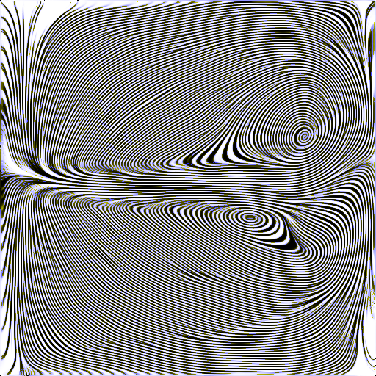
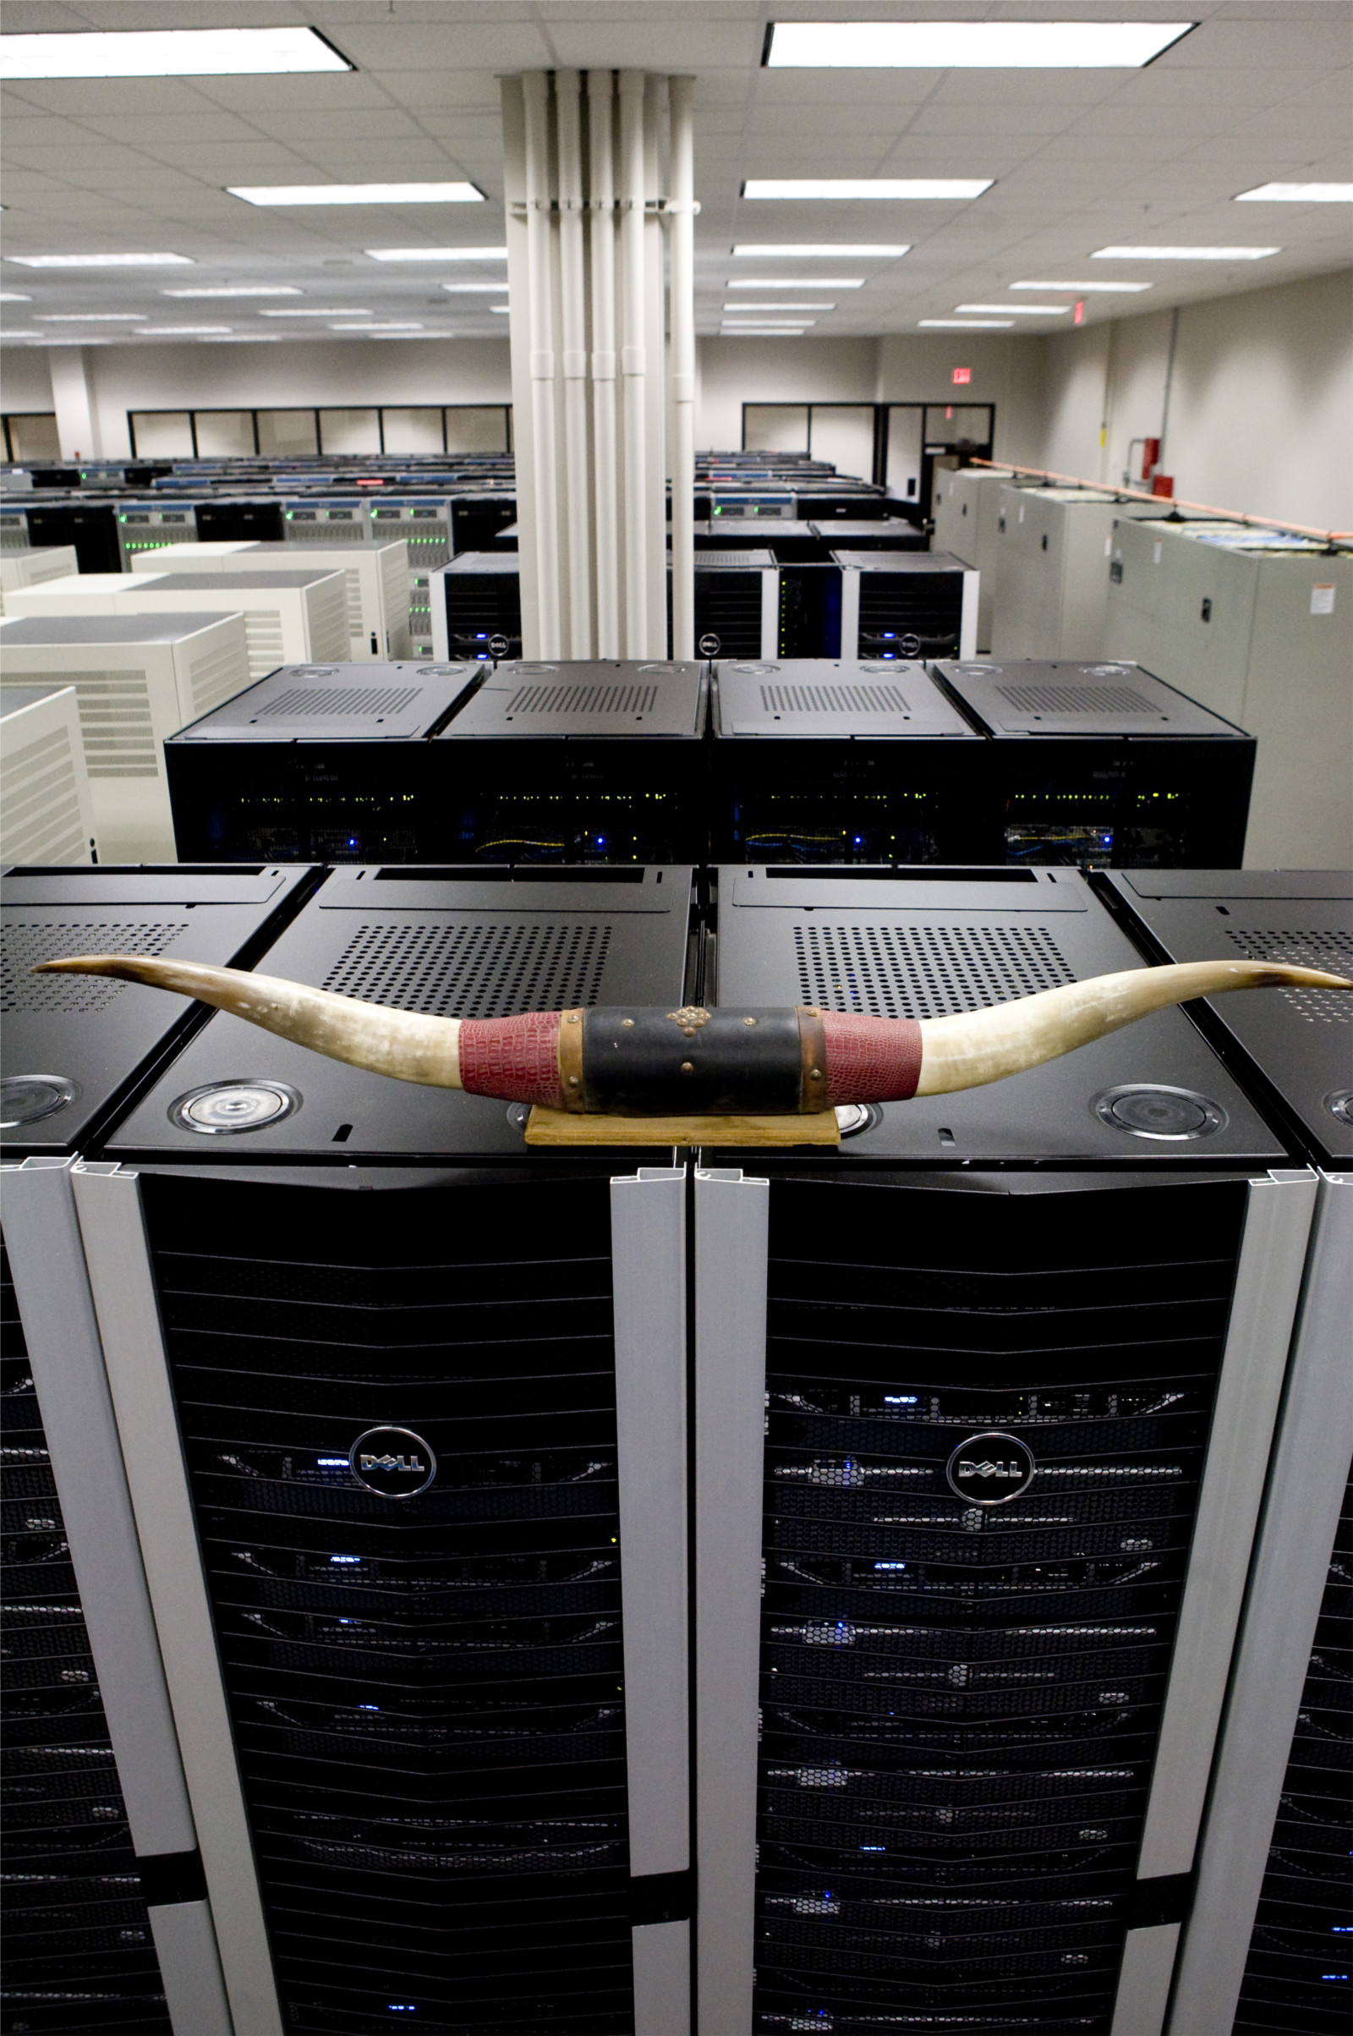
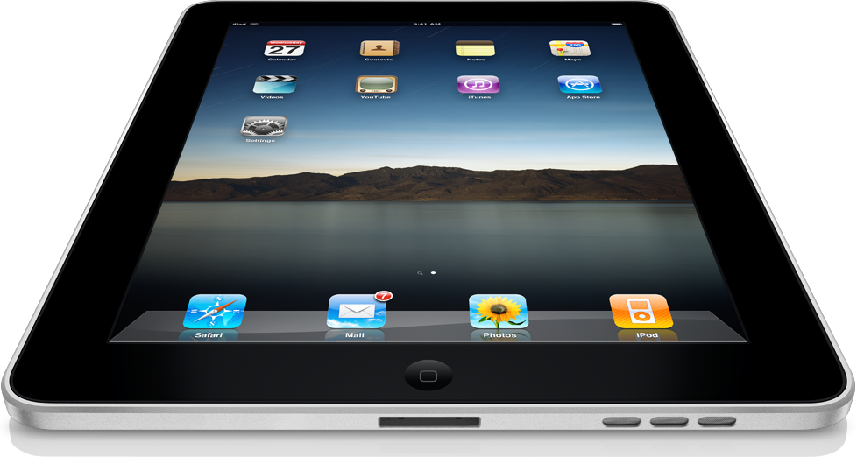

Slide 3
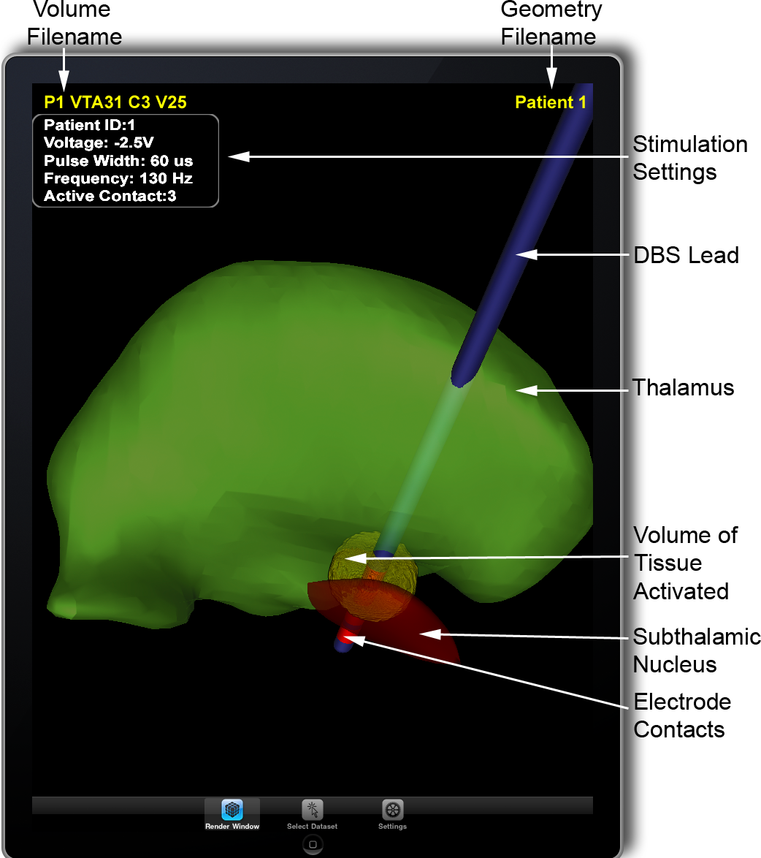
Mobile Visualization

Slide 4
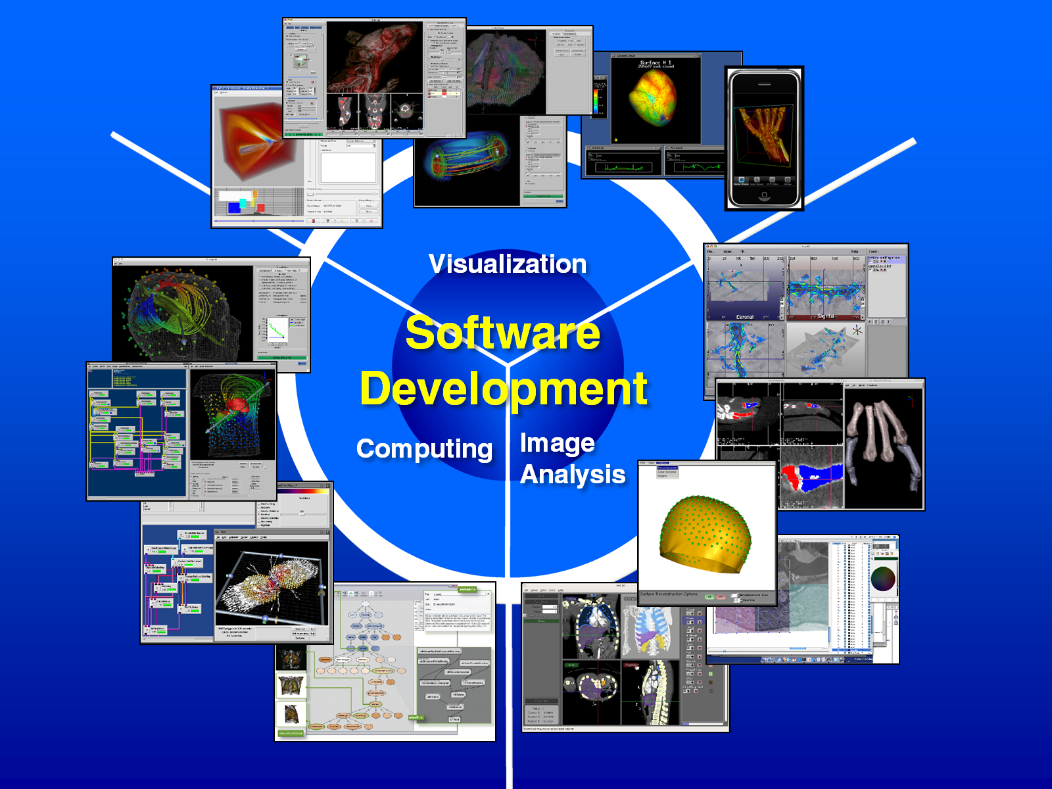

SCI

Slide 5
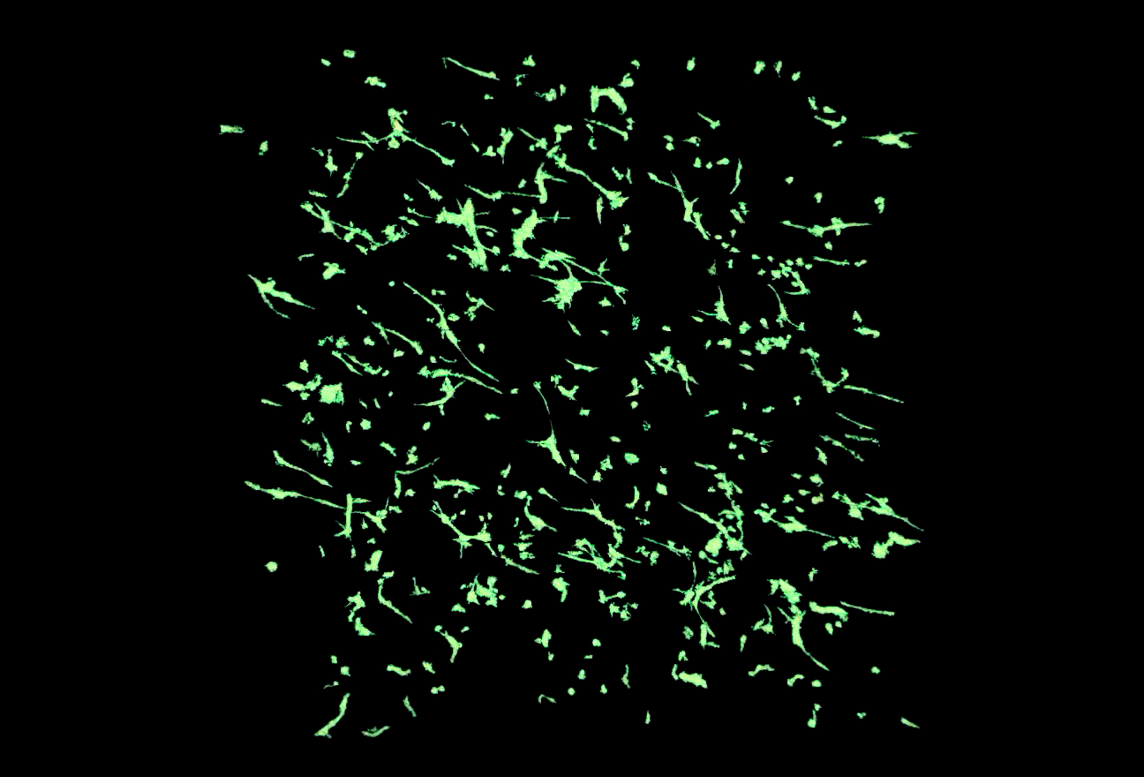
Angiogenesis

Slide 6
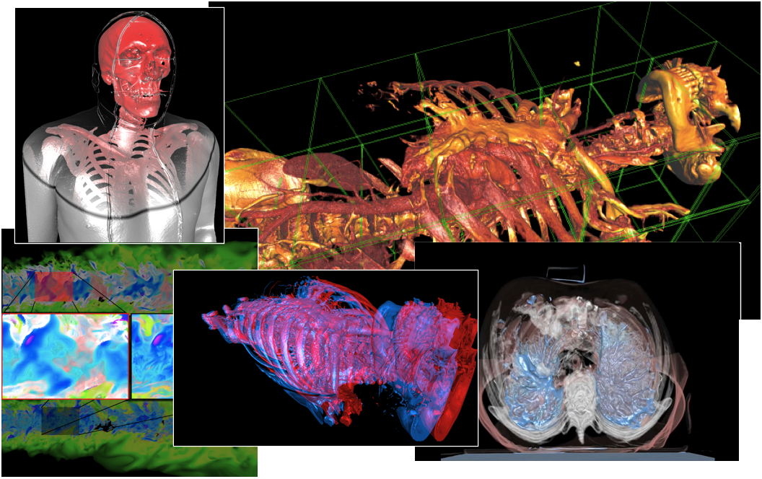
Volume Rendering

Slide 7

ImageVis3D
Demo
  (hand)
  1d transfer functions / mappings
  Histograms

Slide 8
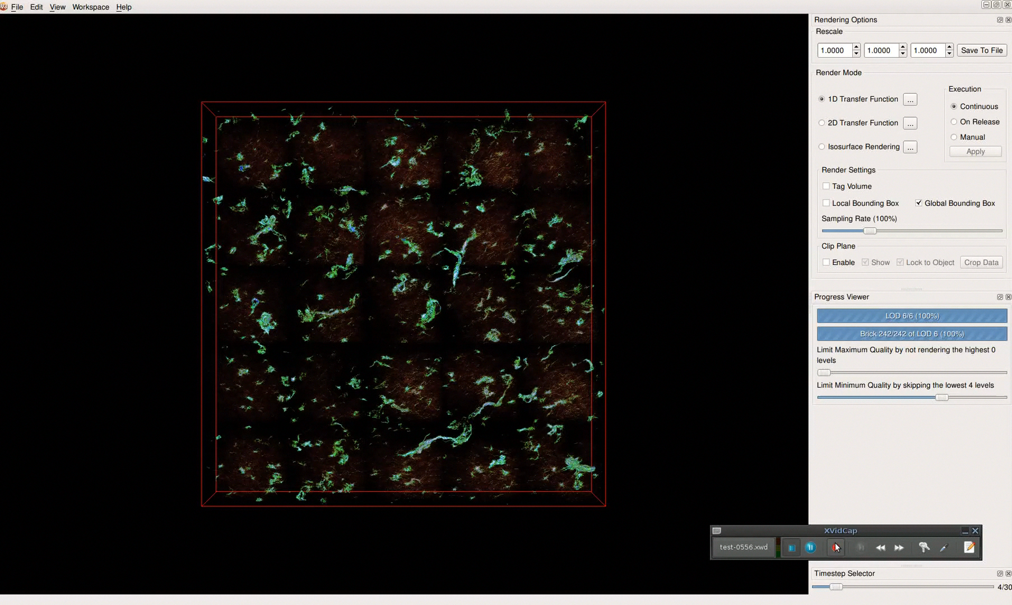
Time Dependent Vis

Slide 9
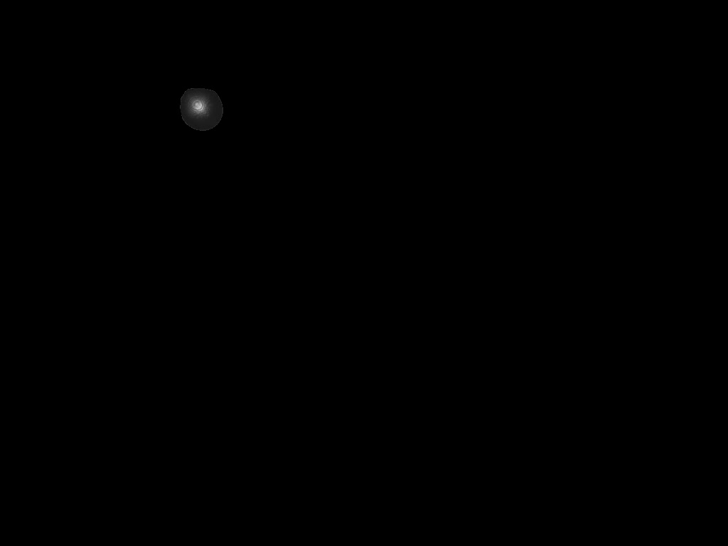
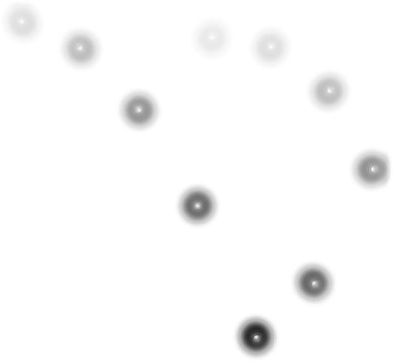
Chronophotographic Visualization

Slide 10
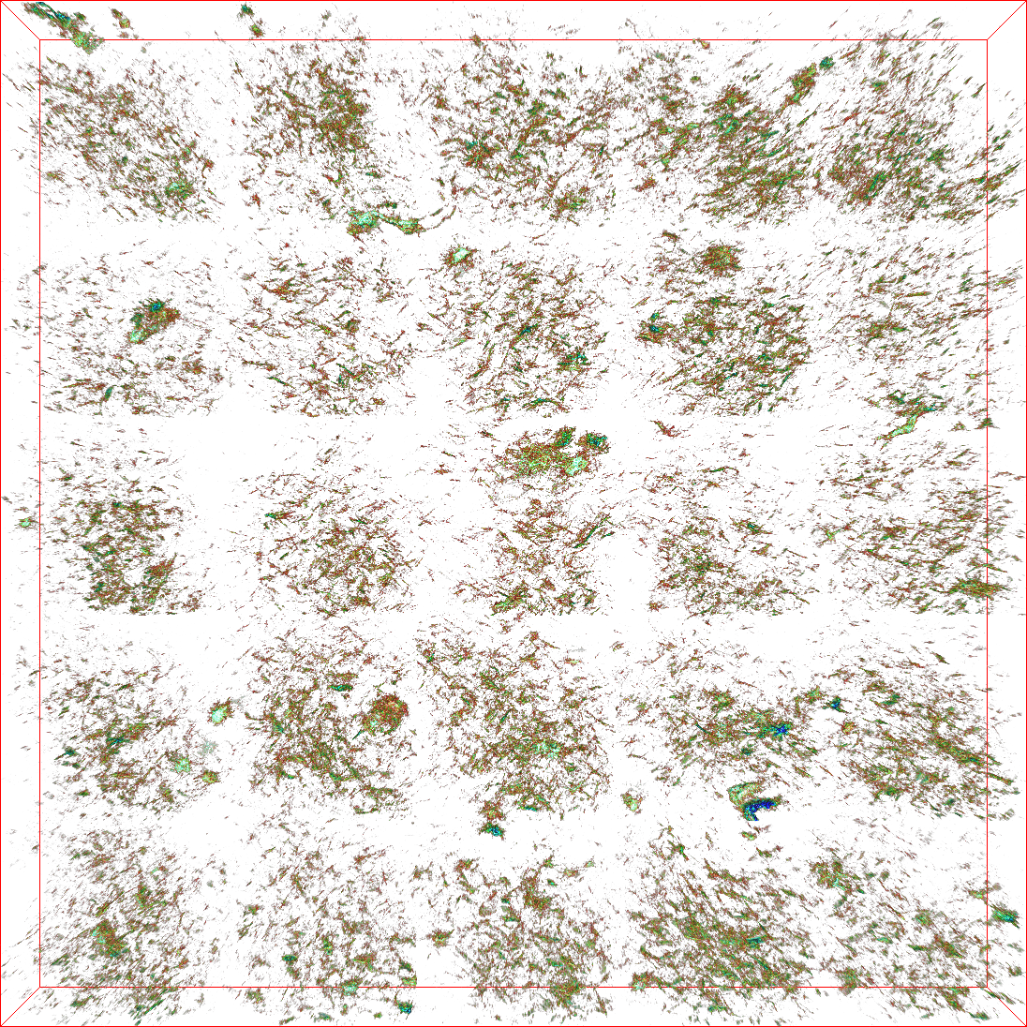
Angiogenesis Properties
Notes:
Multi-channel data
60 gb orig; 100+ gb now
70+ timesteps!

Slide 11
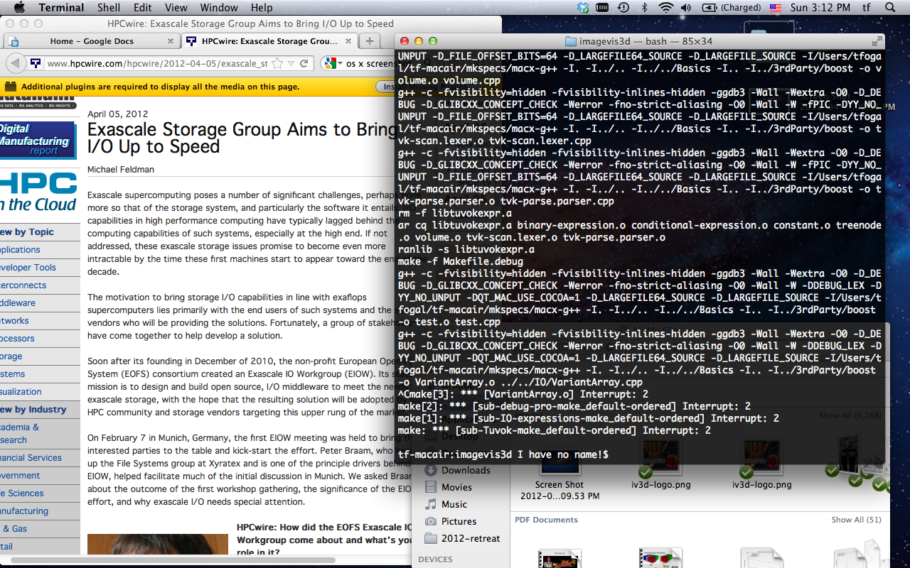
Large Data, Little Screen
Notes:
1280*800*4bpp < 4 megabytes.

Slide 12
ImageVis3D Renderer
Notes:
We have this single large texture with all the data in it, *click* and we keep an index around so we know how everything is packed in. Then we do normal ray casting just like in many other volume renderers, except that we might not have the resolution we need. If that happens, we make a quick note of it *click* and then continue on. We’ll come back in a subsequent rendering pass to fix that resolution issue.

Slide 13
Related Work

Slide 14
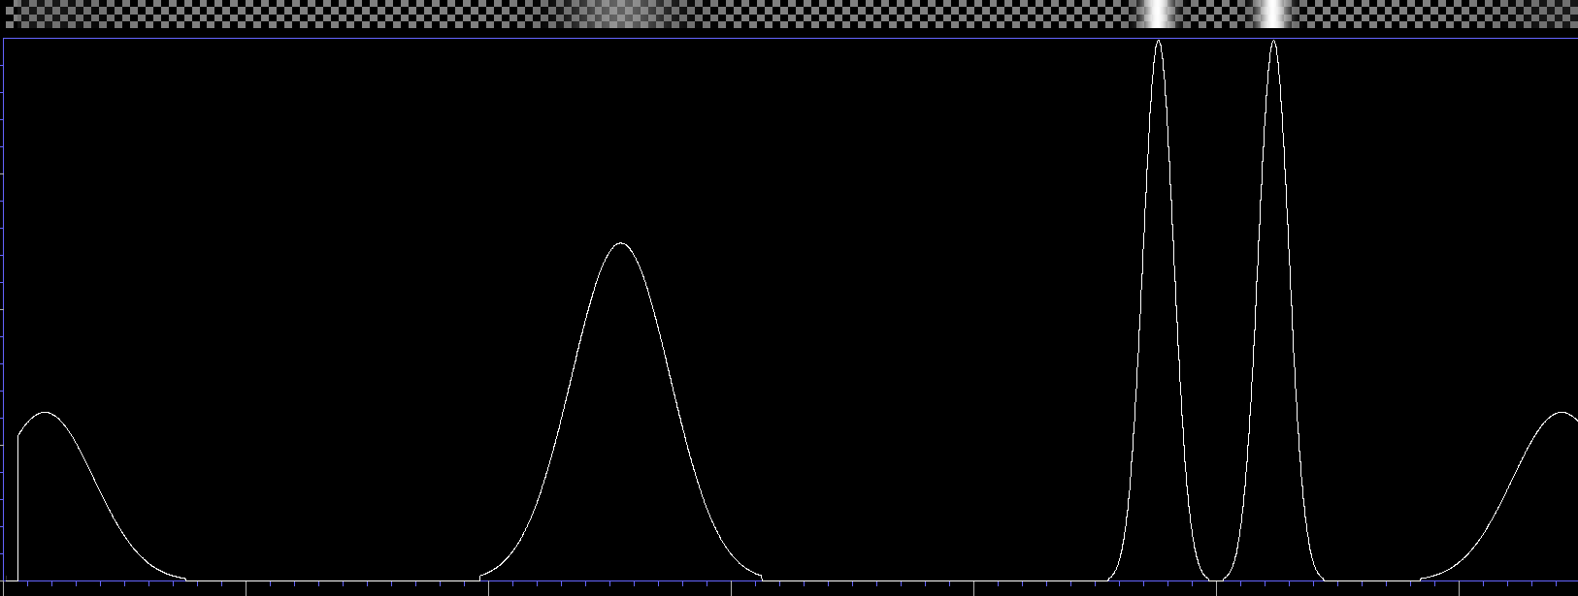
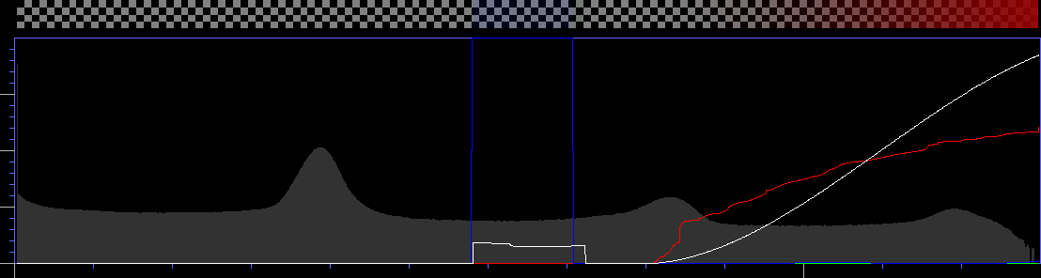
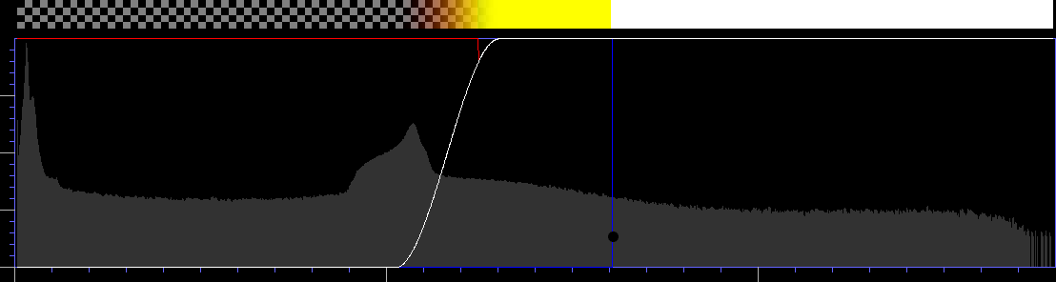
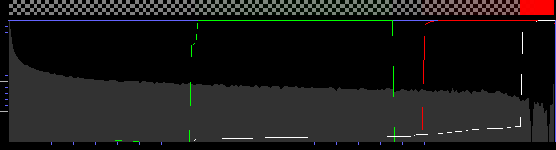
3D + 1D

Slide 15
3D + 1D

Slide 16
Conclusion

Slide 17

?

