Slide 1
Norse Myths
Riddhish Bhalodia

Slide 2
Vikings came into picture when
They invaded Lindisfarne Abbey
and killed lot of monks in Britain.
“Never before in Britain
has such a terror appeared”
Enough Intro now lets go into
Myths :D

Slide 3
Creation of the universe
Niflheim
Ginnungagap
Muspelheim
Not even silence existed in ginnungagap!

Slide 4
Two Beings were created by the mixing of Nilfheim and Muspelheim
YMIR
First of mountain giants
Drank milk from audhumbla
AUDHUMBLA
The cow who licked ice
Made milk rivers
Uncovered a man called Buri from ICE
Burning Ice Biting Flame, That’s How Life Began

Slide 5
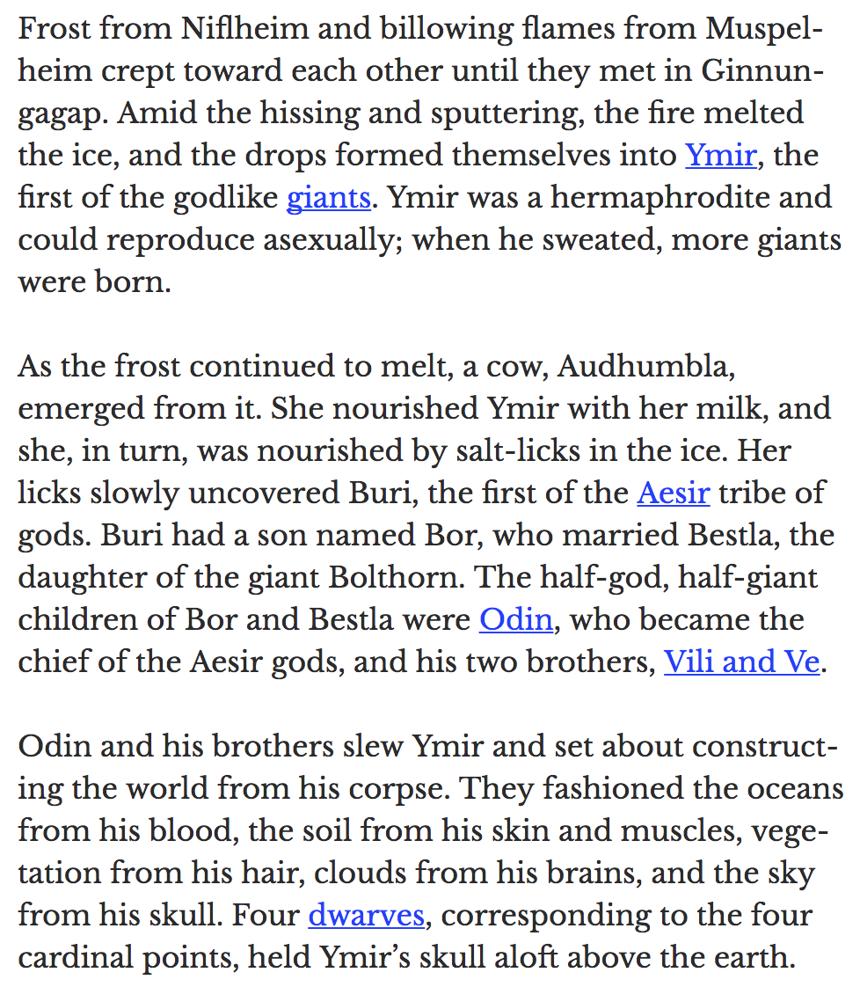
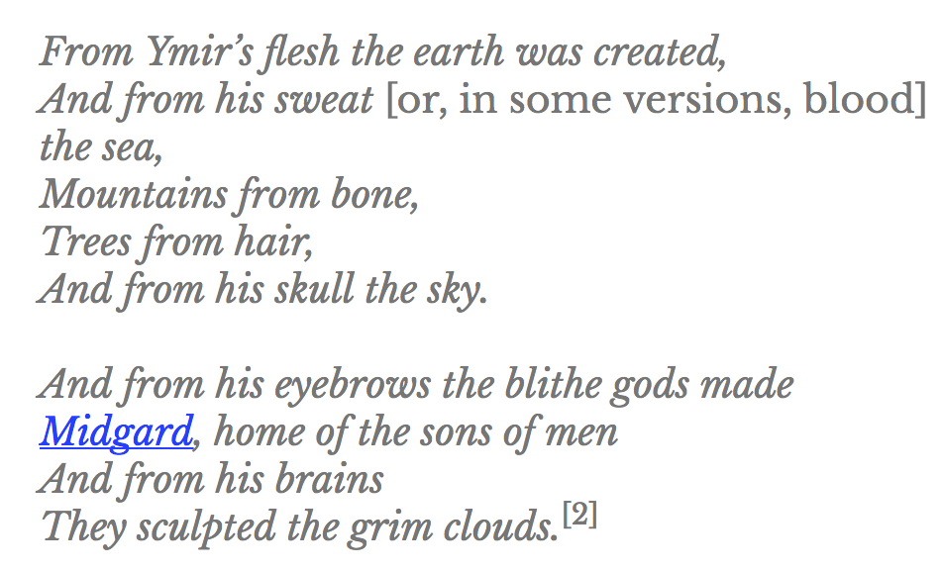

Slide 6
Building of Asgard Wall (time when loki mothered a horse)
Wall was destroyed in Asier-Vanir War and needed to be rebuilt
Odin Put out a request to all
http://norse-mythology.org/tales/the-fortification-of-asgard/
https://www.youtube.com/watch?v=YKq5OOKdTCY

Slide 7
Loki’s Children and Binding of Fenrir
Loki Also Fathered 3 monster children with a giantess
1) Jomungand (giant serpent)
2) Hel (Giant half pink half rotten)
3) Fenrir (The strongest of wolf)
All three were prophesied to play a pivotal role in bringing the ragnarok or the doomsday

Slide 8
Two little less important ones
Hel was cast to nieflhiem → She made her poisonous kingdom, basically ran kidnapping and extortion ring
Jormundgand was thrown to ocean and it lay curled around midgard (human world) and is said to kill thor during ragnarok. (Thor fished him out once just for kicks)

Slide 9
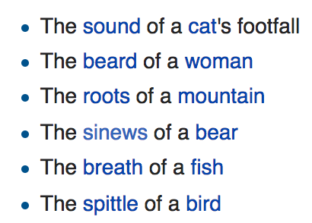
Fenrir
Eldest and terrifying, gods wanted to be sure of what he does.
Was said to kill odin during ragnarok
Bound him using Glephnir (tricked him )

Slide 11
Thor’s fishing trip
Now for some of the most amazing VFX in history :D
https://youtu.be/rvarTmoDKms?t=638

Slide 12
Theft of MJOLNIR
https://youtu.be/rvarTmoDKms?t=1327
http://www.odins-gift.com/poth/2stories/thetheftofthorshammer.htm

Slide 13
Ragnarok (‘Fate of the gods’)
After many more such mythical events, Ragnarok will come and following are the signs
Let’s end in a morbid mood :P
https://www.youtube.com/watch?v=GqeDwZgsP1M&t=51s

