Slide 1
Valerio Pascucci: Short Bio
MS in EE University of Rome “La Sapienza”, Italy
PhD in Computer Science at Purdue University
Computer Scientist, Project Leader, Group Leader at Lawrence Livermore National Laboratory
Professor of Computer Science at the School of Computing of the University of Utah
Associate Director of the Scientific Computing and Imaging of the University of Utah
Associate Editor for IEEE TVCG
Founder of ViSUS LLC
Edited book on Topological Methods in Data Analysis and Visualization
Over 130 articles published in journals, book chapters, and conference proceedings
Chaired and PC member of over 40 conferences

Slide 2
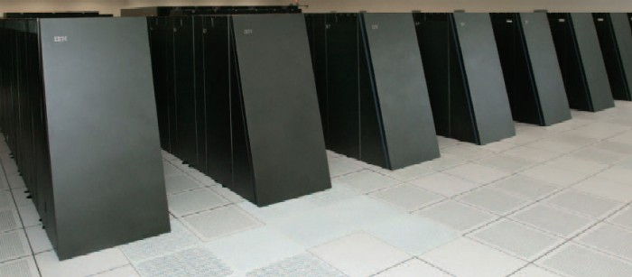
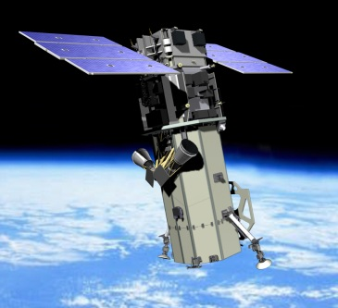
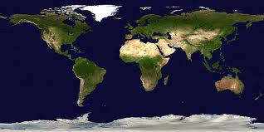
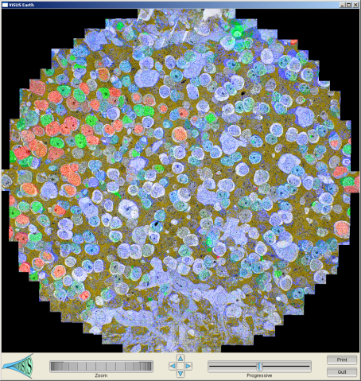
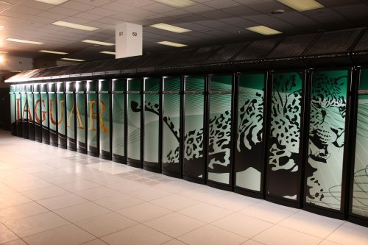
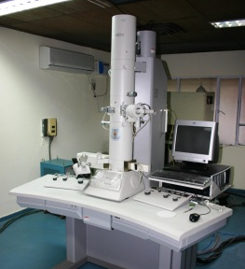
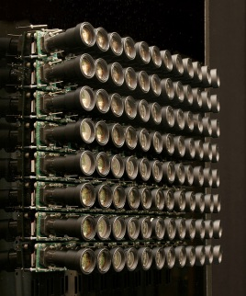
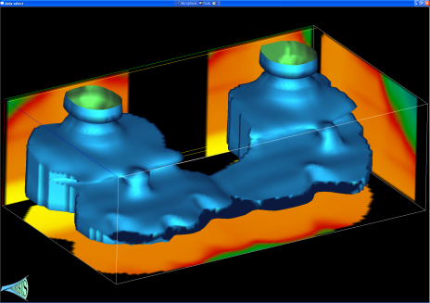
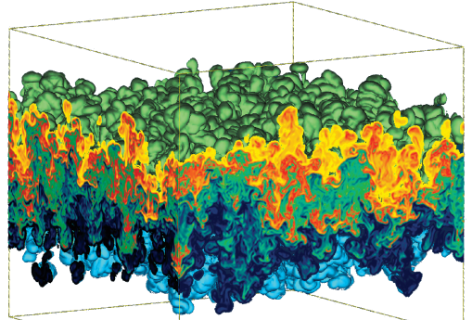
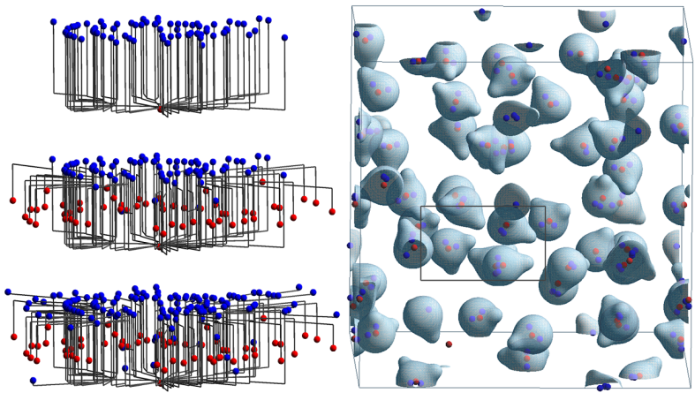
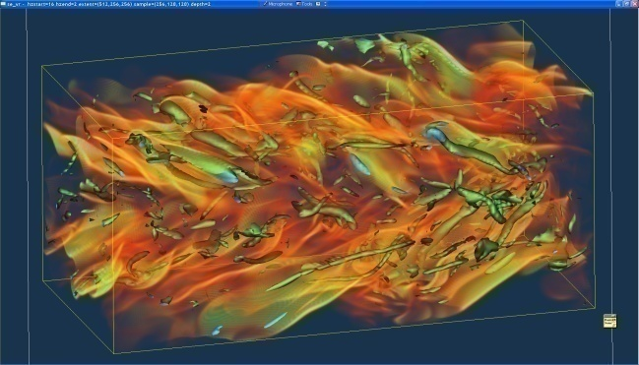
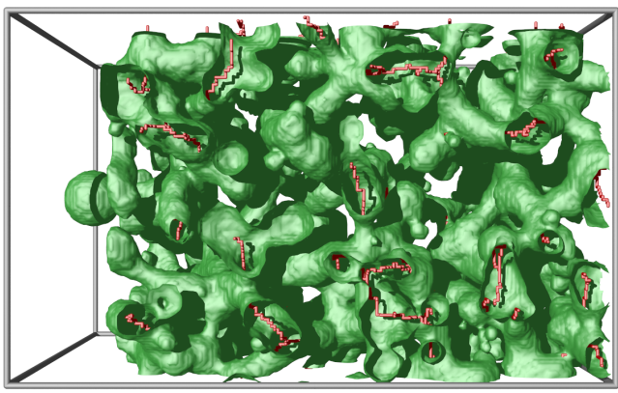
Research Interests: Management, Processing, Analysis, and Visualization of Large Data
Satellite
BlueGene/L
EM
Earth Images
Retinal Connectome
Cameras
Jaguar
Carbon Seq. (Subsurface)
Hydrodynamic Inst.
Molecular Dynamics
Climate
Turbulent
Combustion
Photography
Porous Materials

Slide 3
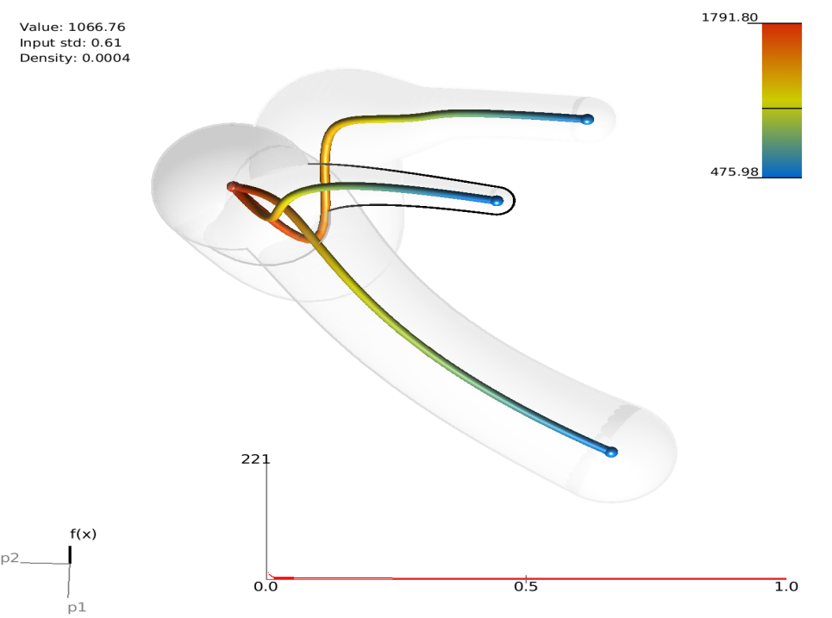
Integrated Data Management, Analysis and Visualization is Crucial for Science Discovery
Analysis of global warming trends
over two hundred years
10 dimensional data set describing the heat release a family of simulations
Local extinction
Pure
oxidizer
Clean Burning
Pure fuel
CMIP Climate Ensemble
S3D Combustion Simulations

Slide 4
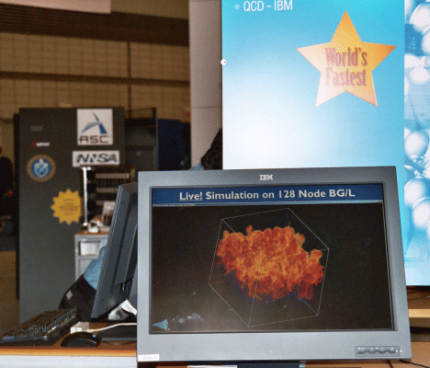
Current Project
Center for Extreme Data Management, Analysis and Visualization

Slide 5
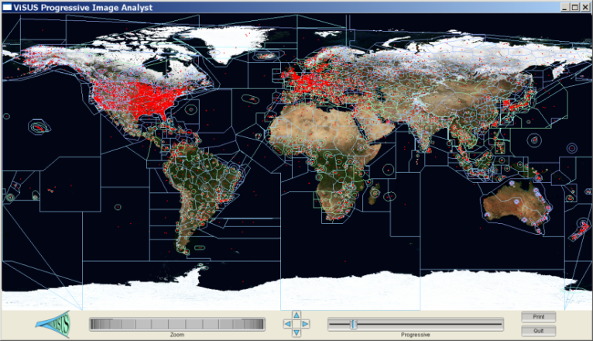
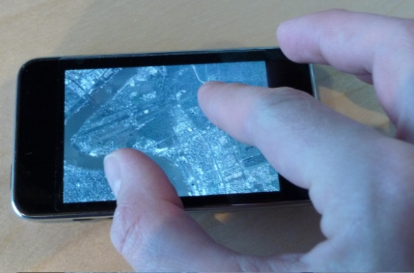
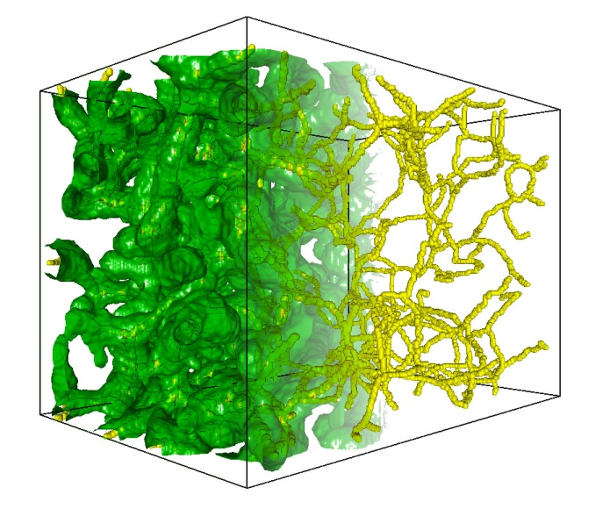
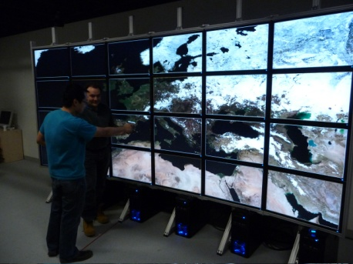
CEDMAV Mission
Research Future Technologies for Knowledge Extraction from Extreme Sized Data
Deployment and Application of State of the Art Tools in Data Intensive Science Discovery
Education of the Next Generation Workforce Supporting Data Intensive Science and Engineering

