Slide 1
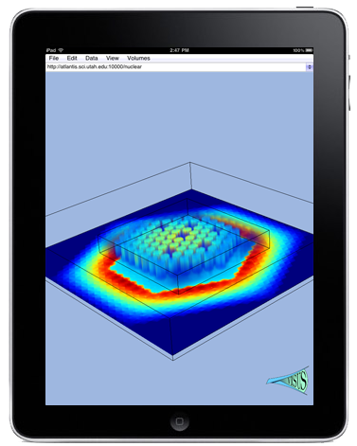
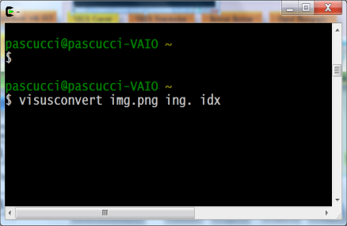
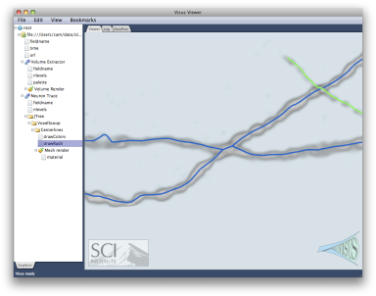
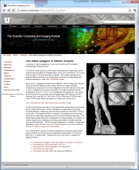
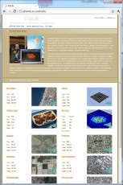
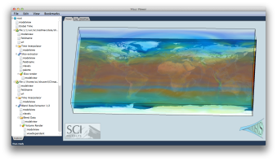
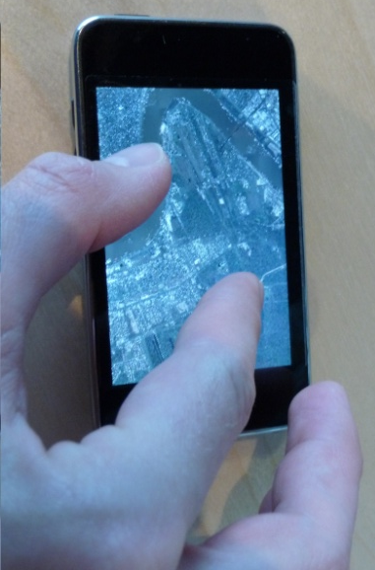
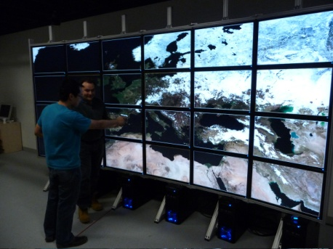
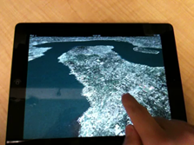
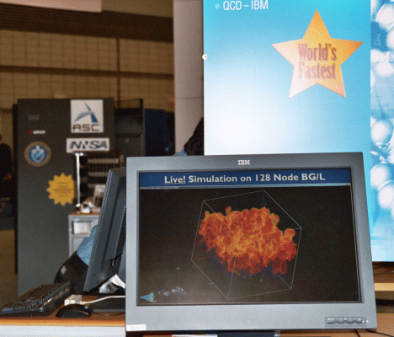
ViSUS Convert
(command line)
ViSUS Neurotracker
Web Browser Plug-in
Digital Photography
Web Server (Apache plug-in)
Handheld Devices
Analysis of Climate Data
High Resolution Displays
ViSUS framework
Required Compilation Dependency (A requires B)
Data Base
ViSUS AppKit
Medical Data
B
A
ViSUS I/O
Scenegraph
Streaming Data Flow
Border Control
Optional Dependency
(A may use B)
ViSUS Kernel
ViSUS OpenGL
ViSUS GUI
B
A
External Libraries
Monitoring Simultions
External SQL and other ...
FreeImage
zlib
curl
Threading (pthreads/windows-native)
glew
opengl
GUI library (Juce)
ViSUS Apps with GUI

Slide 2
ViSUS Convert
(command line)
ViSUS Neurotracker
Web Browser Plug-in
Digital Photography
Web Server (Apache plug-in)
Handheld Devices
Analysis of Climate Data
High Resolution Displays
ViSUS framework
Required Compilation Dependency (A requires B)
Data Base
ViSUS AppKit
B
A
ViSUS I/O
Medical Data
Scenegraph
Streaming Data Flow
Optional Dependency
(A may use B)
B
A
ViSUS Kernel
ViSUS OpenGL
ViSUS GUI
ViSUS Apps with GUI
External Libraries
External SQL and other …q
FreeImage
zlib
curl
Threading (pthreads/windows-native)
glew
opengl
GUI library (Juce)

Slide 3
ViSUS Convert
(command line)
ViSUS Neurotracker
Web Browser Plug-in
Digital Photography
Web Server (Apache plug-in)
Handheld Devices
Analysis of Climate Data
High Resolution Displays
ViSUS framework
Required Compilation Dependency (A requires B)
Data Base
ViSUS AppKit
B
A
Medical Data
ViSUS I/O
Streaming Data Flow
Optional Dependency
(A may use B)
Scenegraph
ViSUS Kernel
ViSUS OpenGL
ViSUS GUI
B
A
ViSUS Apps with GUI
External Libraries
External SQL and other …q
FreeImage
zlib
curl
Threading (pthreads/windows-native)
glew
opengl
GUI library (Juce)

