Slide 1
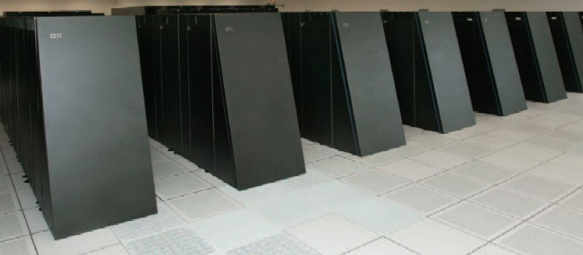
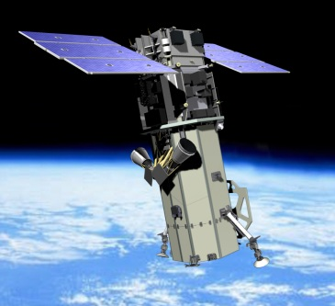
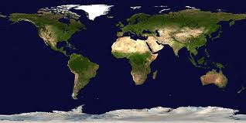
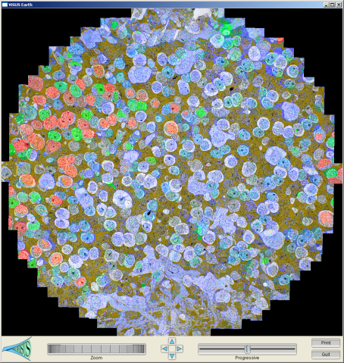
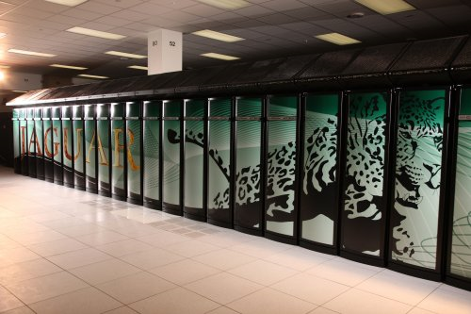
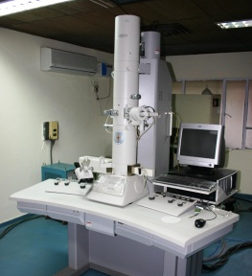
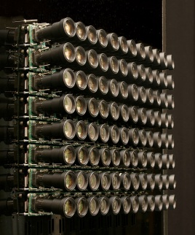
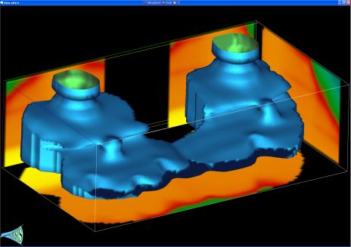
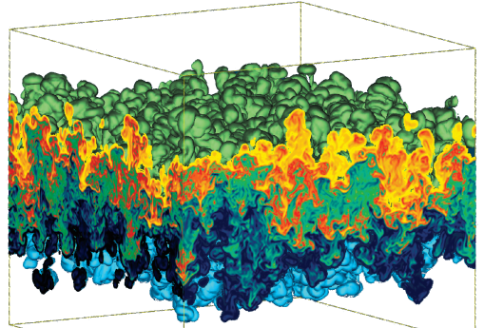
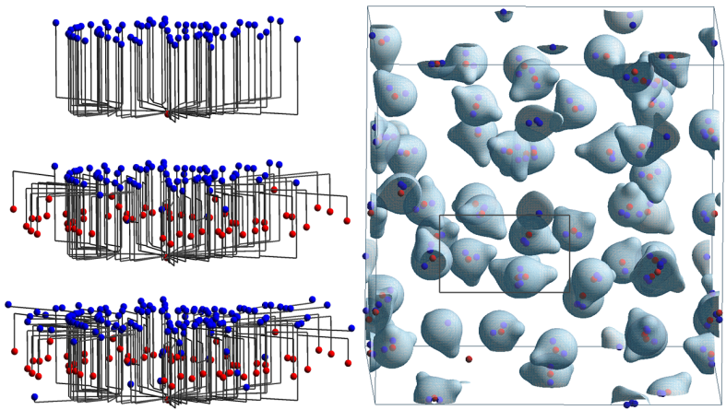
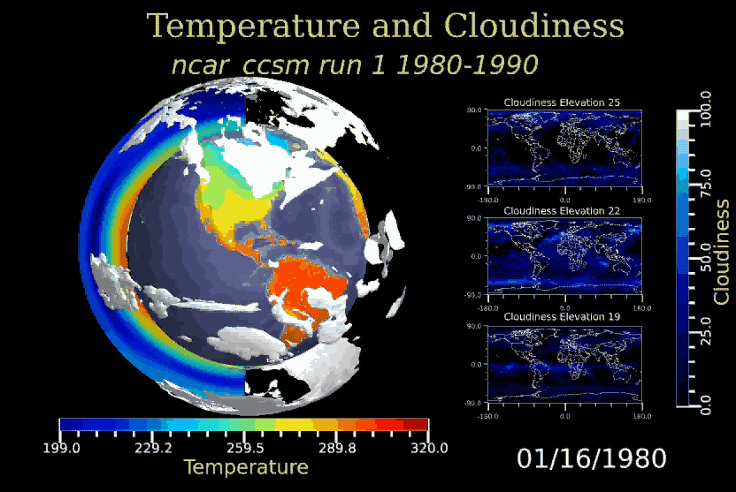
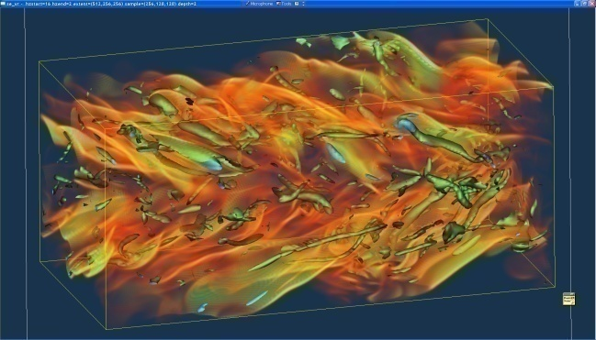
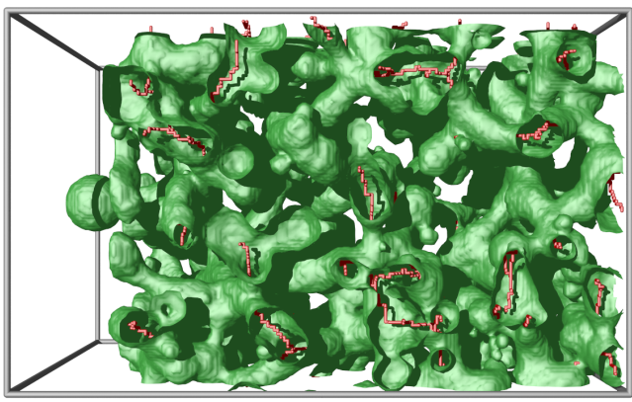
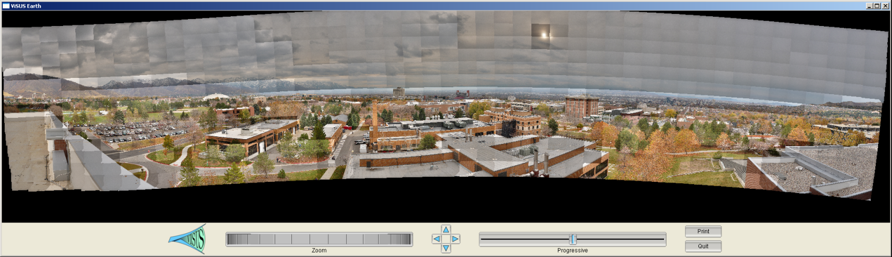
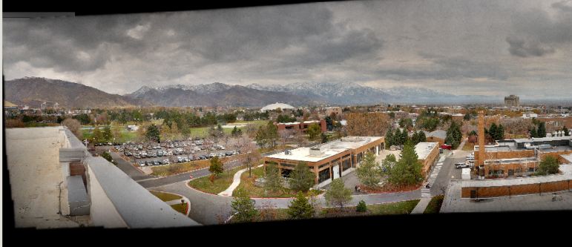
Massive Simulation and Sensing Devices Generate
Great Challenges and Opportunities
Satellite
BlueGene/L
EM
Earth Images
Retinal Connectome
Cameras
Jaguar
Carbon Seq. (Subsurface)
Hydrodynamic Inst.
Molecular
Dynamics
Climate
Turbulent
Combustion
Photography
Porous Materials

Slide 2
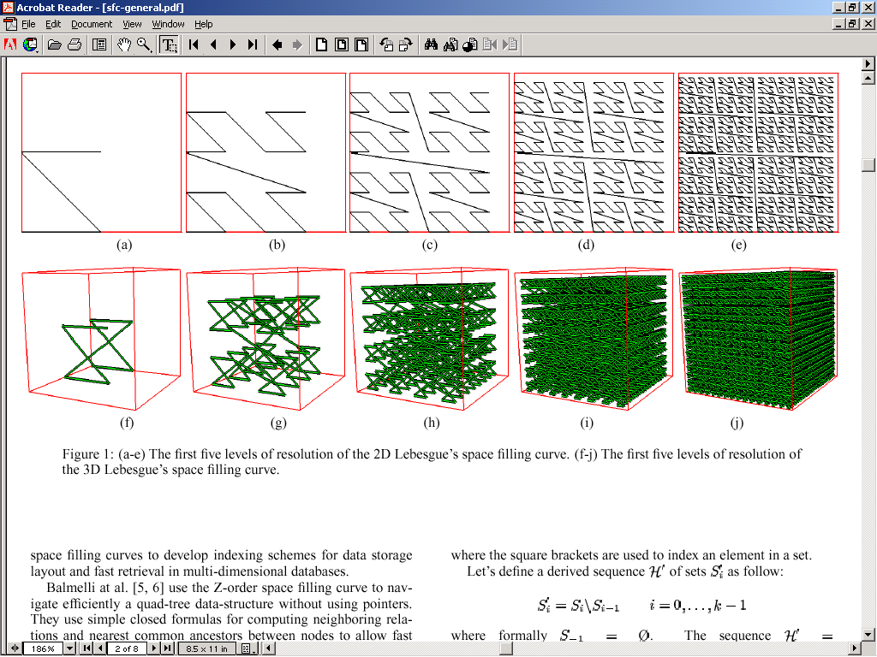
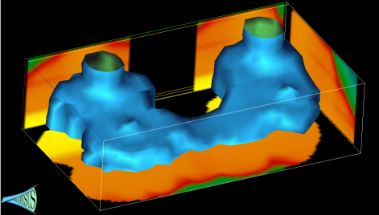
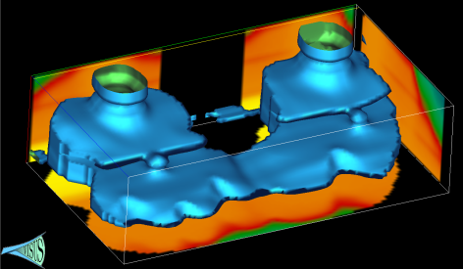

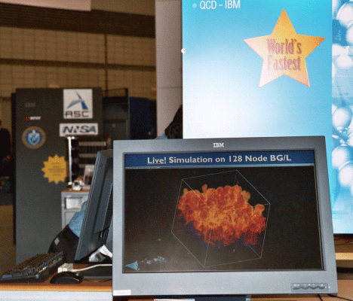
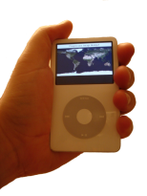
A Cyberinfrastructure Requires Efficient
Data Management and Processing
Advanced data storage techniques:
  Data re-organization.
  Compression.
Advanced algorithmic techniques:
  Streaming.
  Progressive multi-resolution.
  Out of core computations.
Scalability across a wide range of running conditions:
  From laptop, to office desktop,
  to cluster of PC, to BG/L.
  Memory, to disk, to remote
  data access.

Slide 3
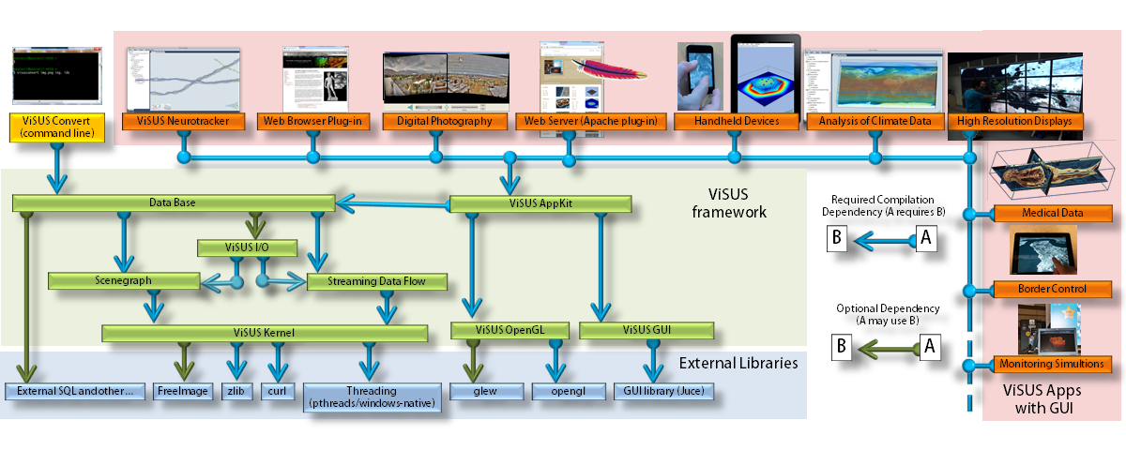
ViSUS Framework for Flexible Application Development and Deployment

Slide 4
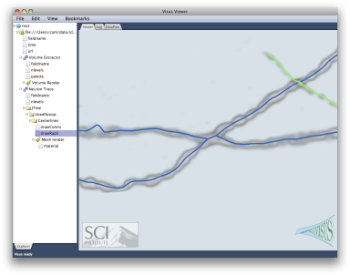
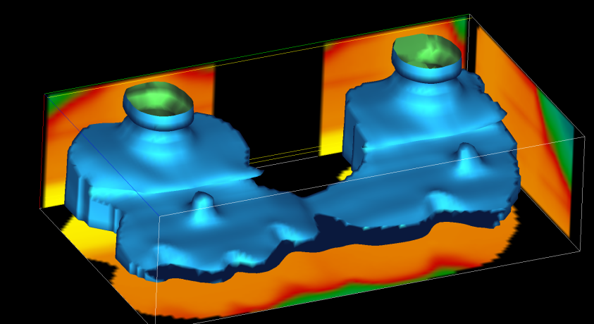
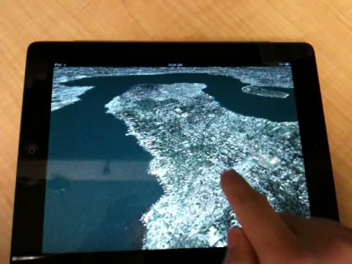
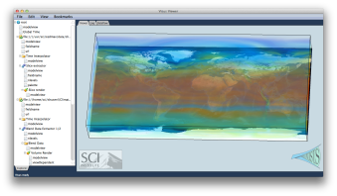
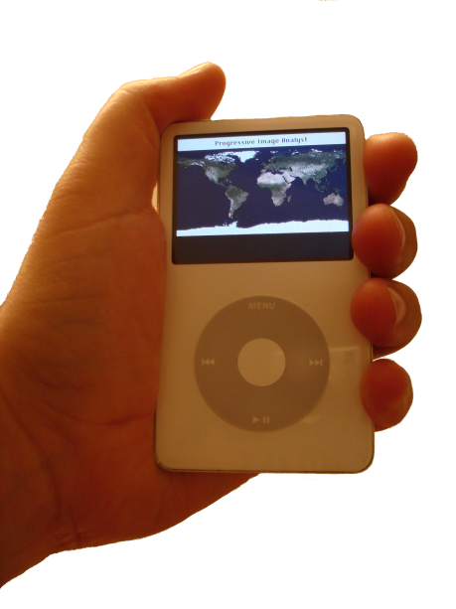
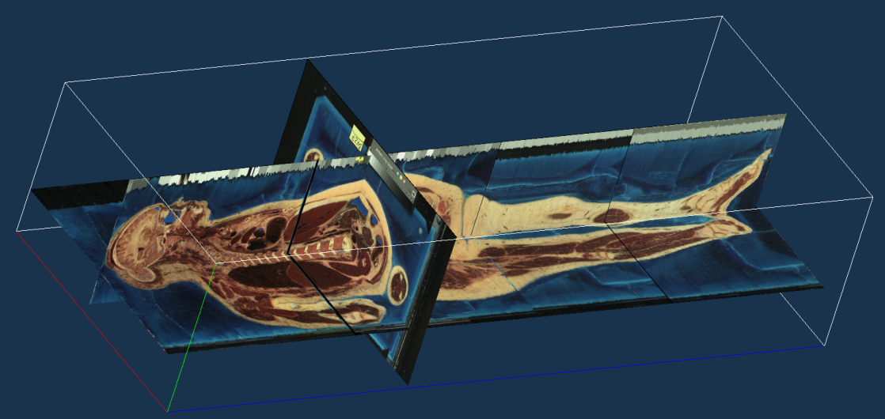
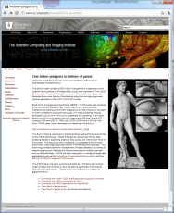
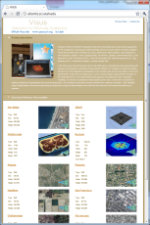
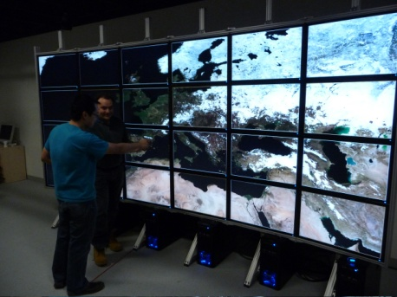
ViSUS (cyber)infrastructure
TeleMedicine
Outcrop Training (Oil and Gas)
Neurotracker
Digital Photography
Border Control
Climate
Handheld Devices
TeleMedicine
Monitoring Simulations
High-Res Displays
Web Client/Server

Slide 5
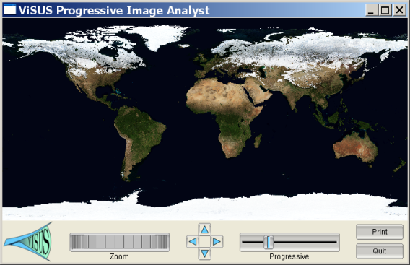
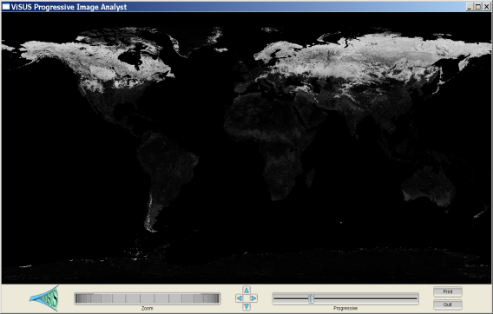
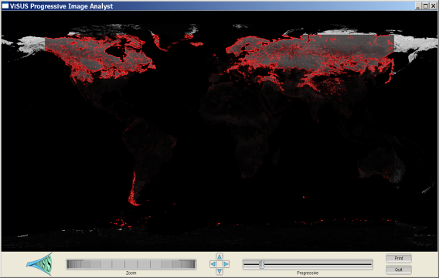
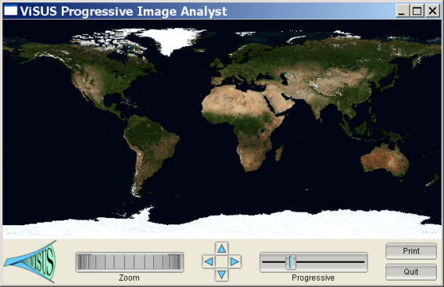
We Allow Distributed Computations at
Different Stages of the Data Stream
Progressive Image Differencing + Editable GPU filter.
Two data sources
(11 GB each)
Progressive differencing
Computed in real-time.
Streaming edge
detection on the GPU.

Slide 6
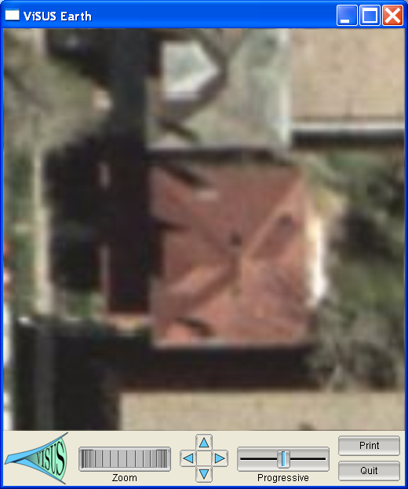
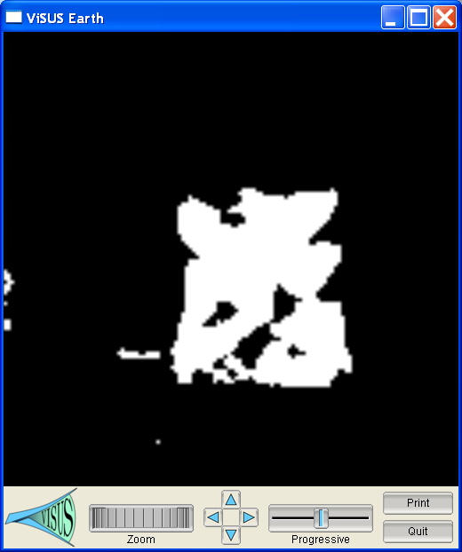
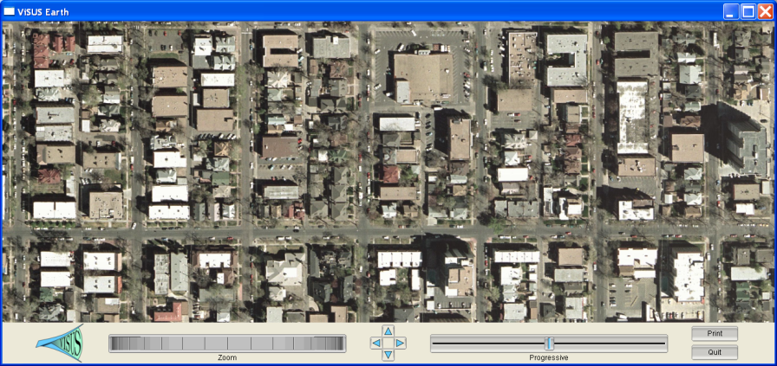
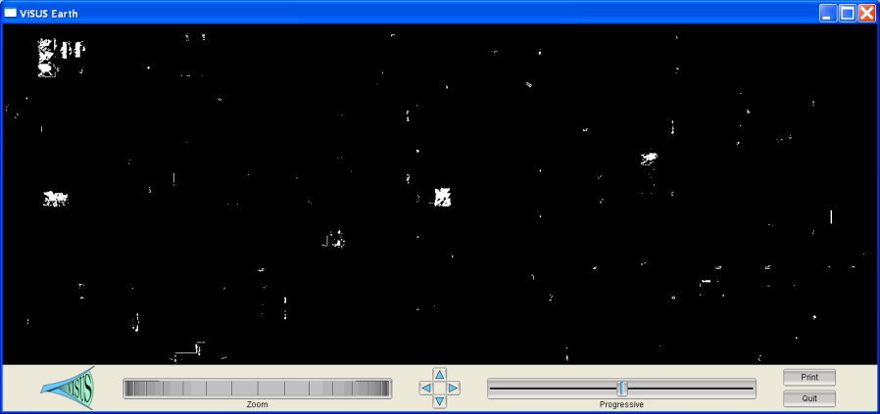
We are Developing Progressive Scheme for Content Based Image Processing
Hypothesis:
Progressive Analysis:

Slide 7
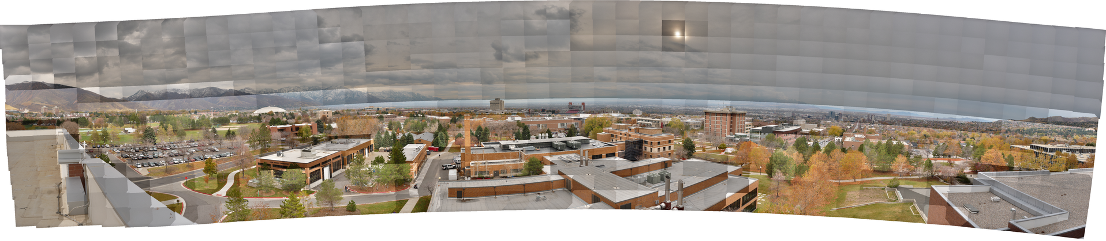
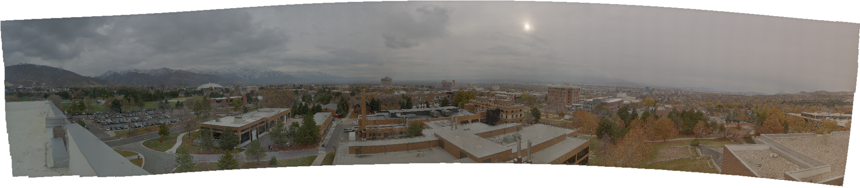
Poisson Solver for Image Cloning in Massive Image Collections
Color correction of 600+ images in real time

Slide 8
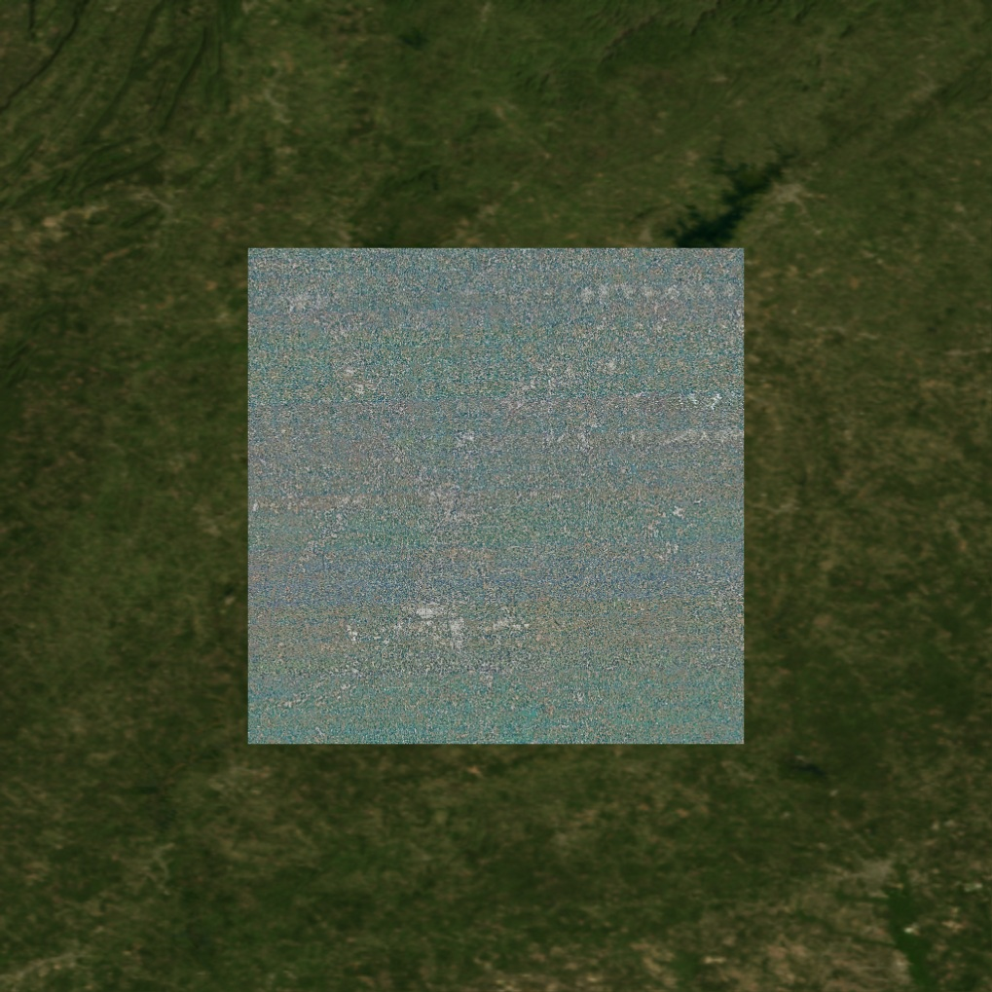
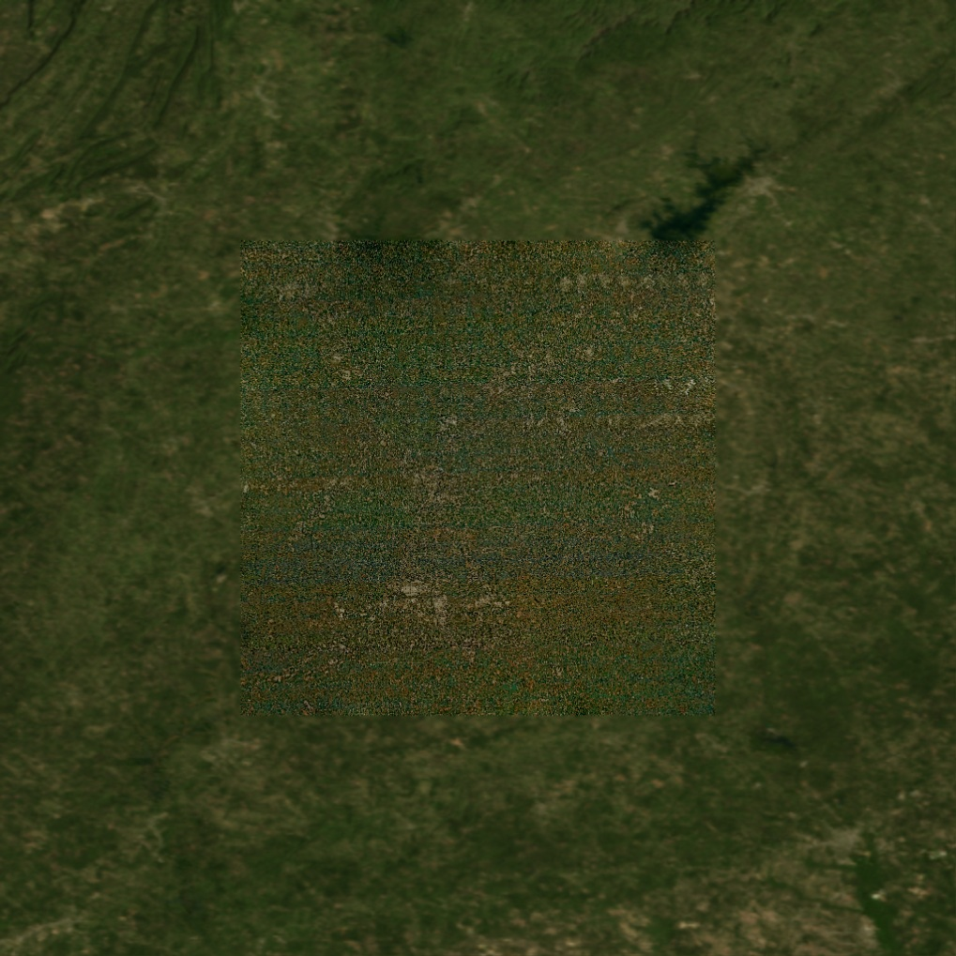
Poisson Solver for Image Cloning in Massive Image Collections
Pasting a 300GB satellite image of a city in background world map merged in real time

Slide 9
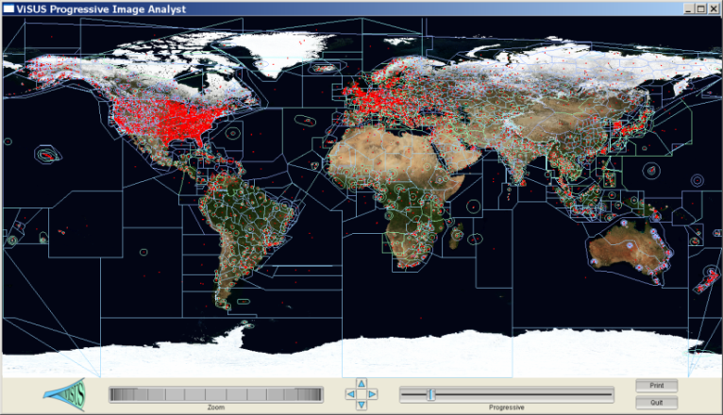
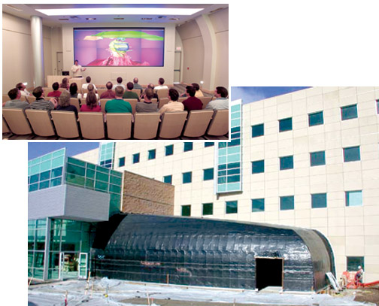
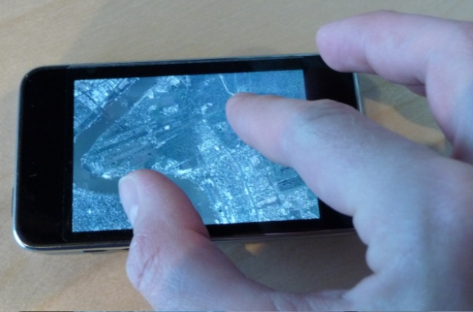
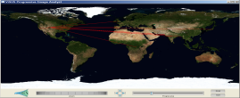


We Demonstrated Performance and Scalability in a Variety of Applications

Slide 10
We Demonstrated Performance and Scalability in a Variety of Applications
We are starting to redesign simulations based
on the new algorithmic techniques

Slide 11
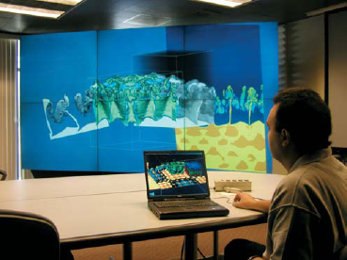

We Are Moving Towards a Distributed
Storage and Processing Environment
Distributed storage
Data redundancy
Security
Heterogeneous collaborative
infrastructure
Multi-scale collaborative
interfaces accessing shared
data sources:
  data collection and validation
  interactive analytics
  decision making

Slide 12

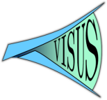
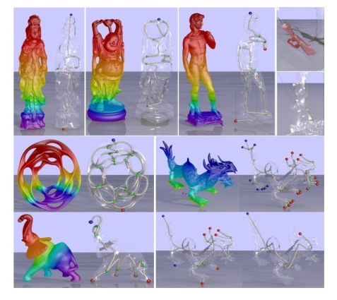
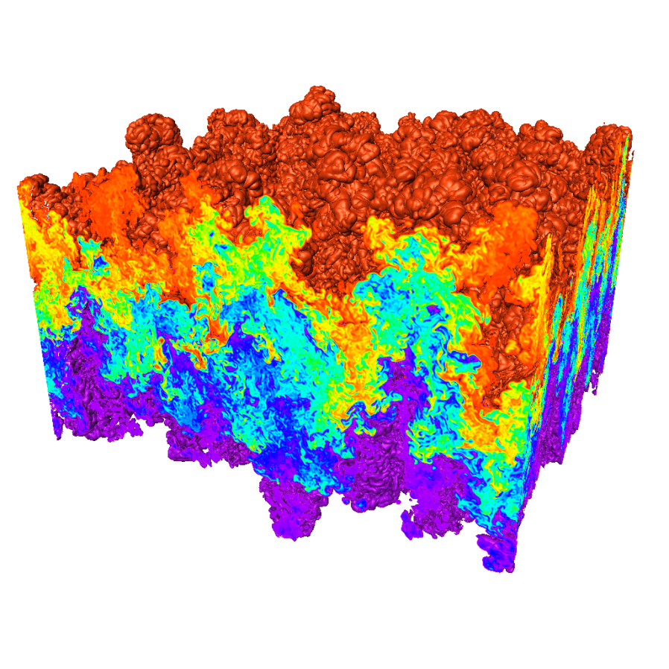


A Data Analysis and Visualization Center Can be a Catalyst for a Virtuous Cycle of Collaborative Activities
Tight cycle of :
  basic research,
  software deployment
  user support
Coordination among eight projects:
  unified techniques for several applications
Strong University-Lab-Industry collaboration
Focused technical approach:
  performance tools for fast data access
  general purpose data exploration
  error bounded quantitative analysis
  feature extraction and tracking
Interdisciplinary collaboration with domain scientists (from math to physics):
  motivating the work
  formal theoretical approaches
  feedback to specific disciplines

