Slide 1
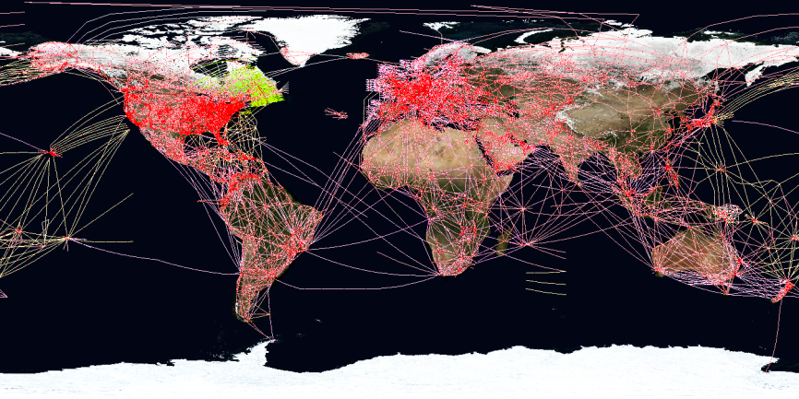
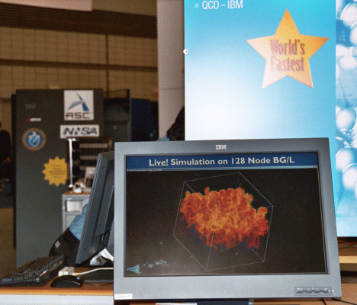
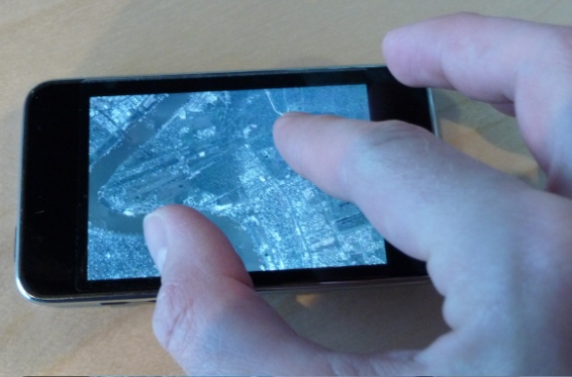
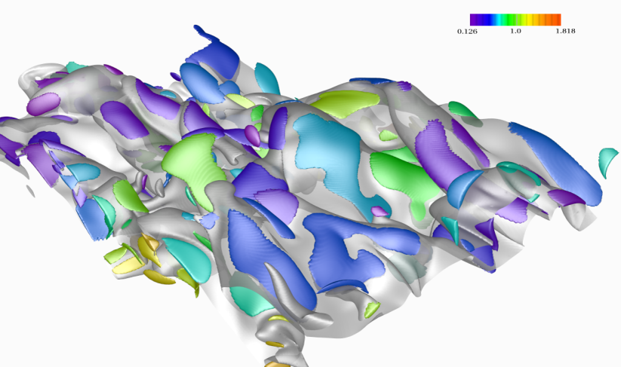
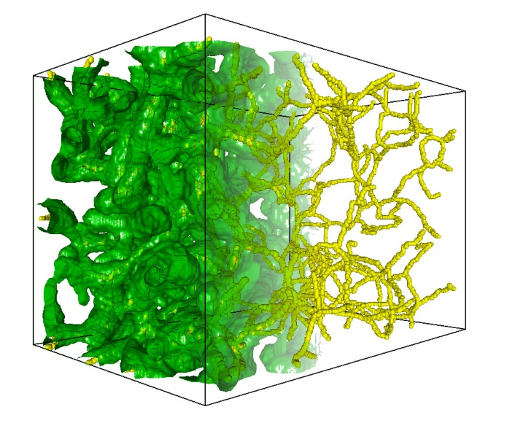
Massive Data Management, Analysis, and Visualization: Scaling From Handheld Devices to Supercomputers
Valerio Pascucci
Director, CEDMAV
Professor, SCI Institute & School of Computing Laboratory Fellow, PNNL
Notes:
1
1
1
Thank co-authors

Slide 2
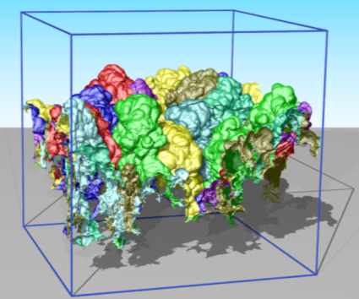
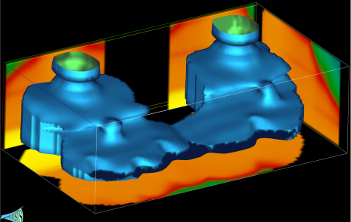
Center for Extreme Data Management, Analysis and Visualization
Notes:
1
1
1
Thank co-authors

Slide 3
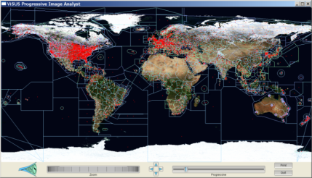
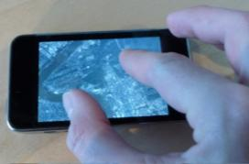
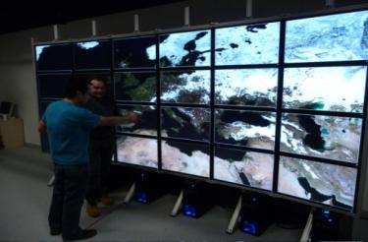
Mission
Research Future Technologies for Knowledge Extraction from Extreme Sized Data
Deployment and Application of State of the Art Tools in Data Intensive Science Discovery
Education of the Next Generation Workforce Supporting Data Intensive Science and Engineering

Slide 4
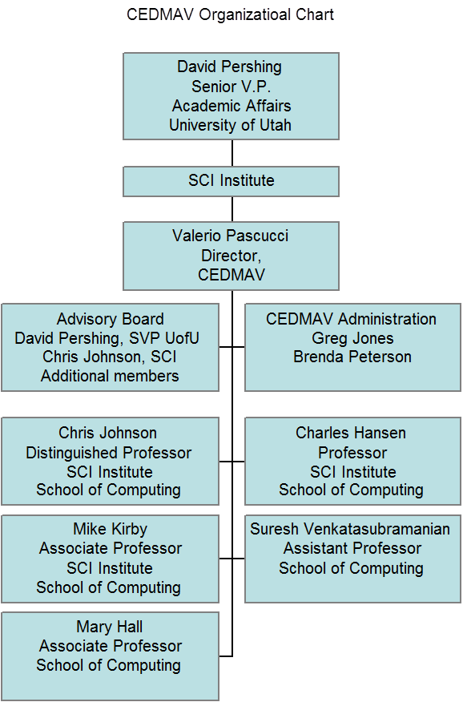
CEDMAV Organization Chart
joint appointments with partner institution

Slide 5
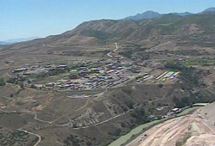
CEDMAV External Partnerships
Technical Collaborations with
Other National Laboratories
$1.6B NSA data center in Utah (1.5 million-square-foot facility)
Collaboration with NSA Data
Center for the Creation of
a Data Center Curriculum
IRTG International Research Training Group

Slide 6
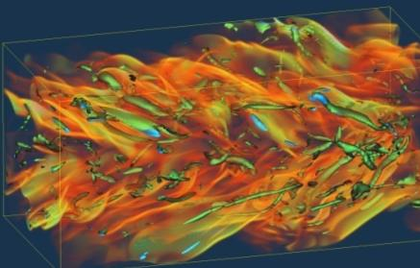
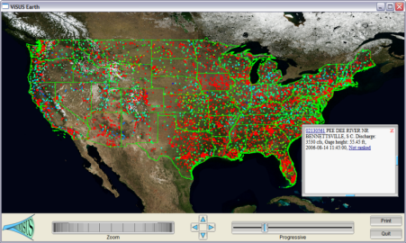
Research Scope
Data management , analysis and visualization for exploring and extracting knowledge from massive amounts of data (images, graphs, vector fields, text, geospatial, …..)
Enable science discovery driven by large scale simulations and high resolution sensing devices
Increase awareness of events and patterns underlying massive and complex data feeds
Develop theoretical foundations for unified cross disciplinary technology

Slide 7
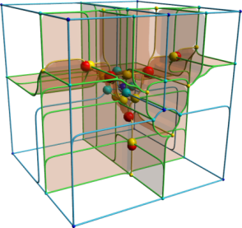
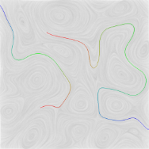
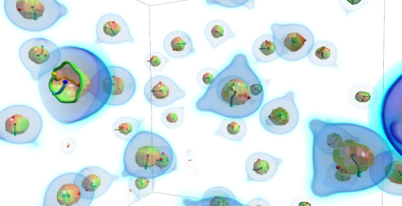
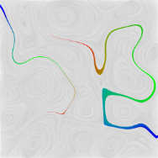
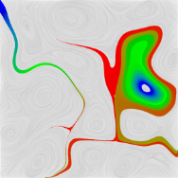
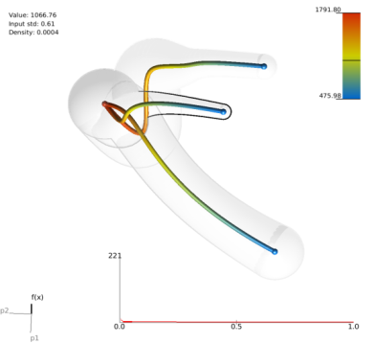
Research Areas
Mathematics of scalar, vector, and tensor fields
Discrete methods for graphs and text
Uncertainty
Statistics
Topology
High dimensional models
Infrastructure for data movements
Parallel computing for data analysis
Scalable Visualization techniques
Building data abstractions
10 dimensional data set describing the heat release in a family of simulations

Slide 8
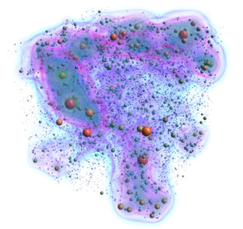
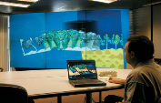
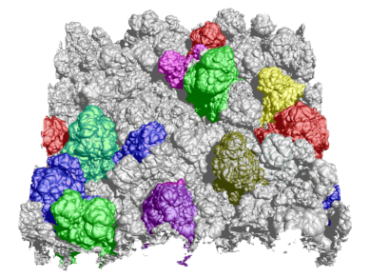
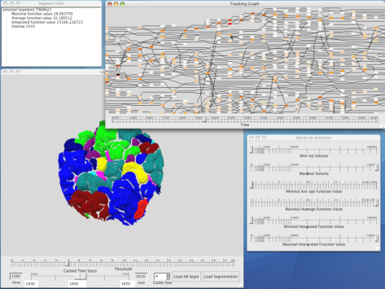
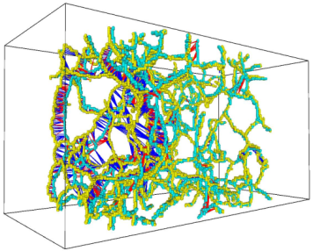
Deployment
Software infrastructure for distributed data access and visualization
Collaborative tools for large, distributed teams solving problems jointly
Tracking of Information Evolution and Decision making
Scalable data analysis tools exploiting HPC resources
Ad hoc interfaces for specialized tasks

Slide 9
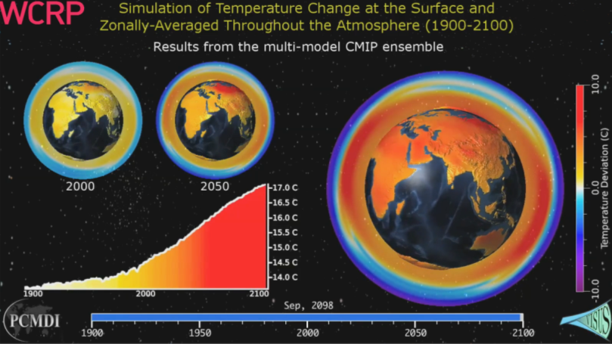
Applications
Embedded collaboration with science teams to best design solutions
Specialize software tools to address specific science challenges
Develop focus areas such as:
Large scale image processing
Climate Modeling
Combustion Chemistry
Molecular Dynamics
Physics
Earth Sciences
Medicine
Power grid
…..

