Slide 1

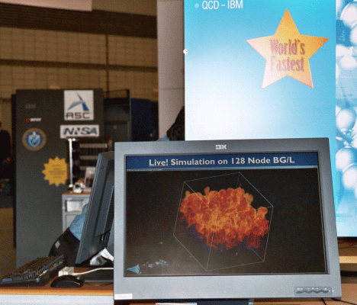
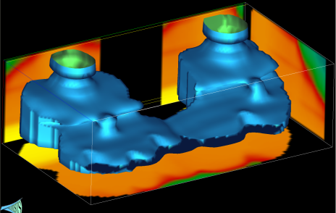
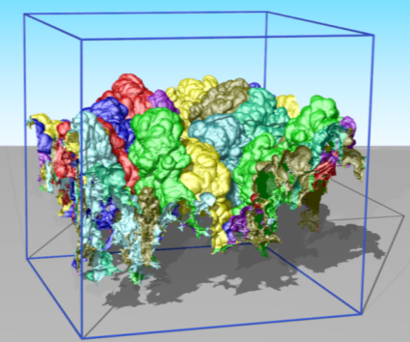
Center for Extreme Data Management Analysis and Visualization
Valerio Pascucci
Notes:
1
1
1
Thank co-authors

Slide 2
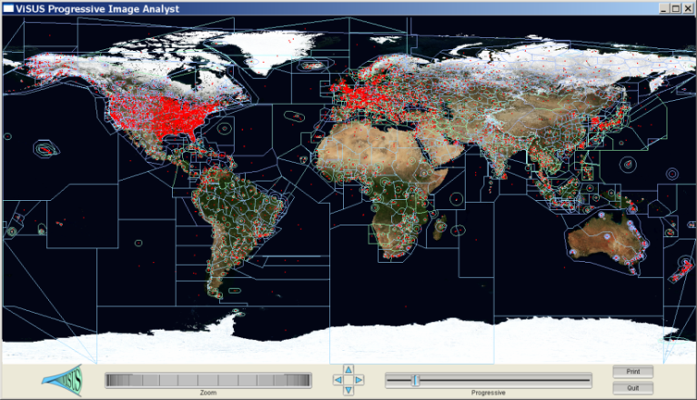
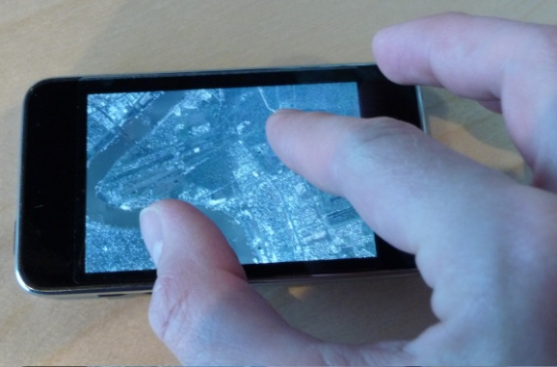
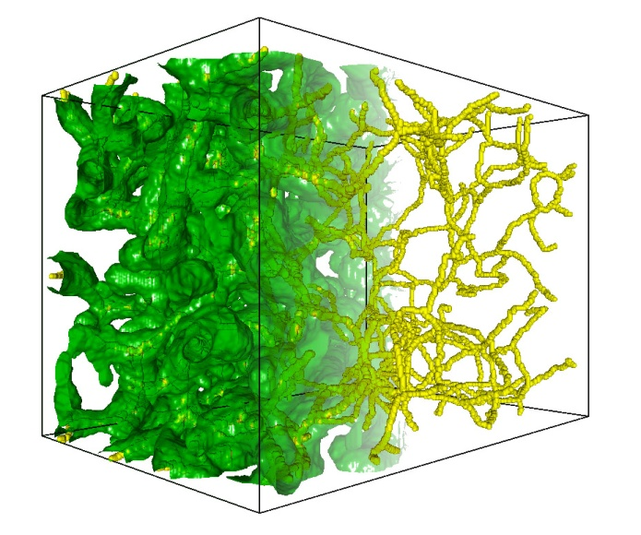
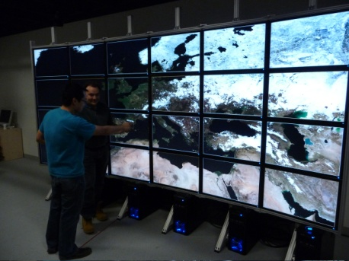
CEDMAV Mission
Research Future Technologies for Knowledge Extraction from Extreme Sized Data
Deployment and Application of State of the Art Tools in Data Intensive Science and Engineering
Education of the Next Generation Workforce Supporting Data Intensive Science and Engineering

Slide 3
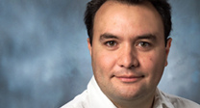



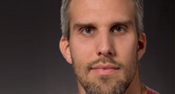


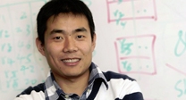




CEDMAV Members

Slide 4
CEDMAV Organization
CEDMAV Advisory Board
CEDMAV
Director
V. Pascucci
Administration
G. Jones
P.-T. Bremer
B. Peterson
Partner
Institutions
CEDMAV Faculty
Research Scientists
Staff Developers
Affiliated Application
Scientists

Slide 5
CEDMAV Advanages
Critical Mass for Developing Large Projects
Facilitate Access to Funding Sources
Facilitate Access to Institutions
Facilitate New Technical Collaborations
Share Technology
More Time to Focus on Technical Work
Facilitate Technology Transfer and Commercialization

Slide 6
CEDMAV Advisory Board
Chair: Chris Johnson
Dave Pershing (UofU)
David Winberg (NSA)
Enrico Serafini (Battelle)
Mark Dobin (Exxonmobil) ?
Will Schroeder (Kitware) ?
Mark Duchaine (Google) ?
What is the right size?
Who should we invite?

Slide 7
Relationship with NSA Data Center
Initial Interest is in the Development of Data Center Engineering Curriculum (in progress)
Involved the in a Consortium (Greg and Steve can say more)
Plans for a SCIF will Allow to Engage Them in Research Collaborations
NSA Representative in our AB

Slide 8
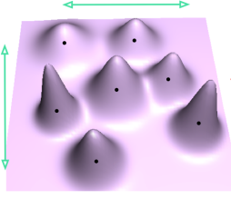
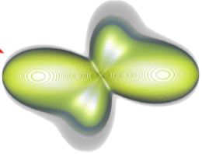
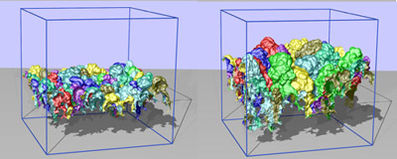
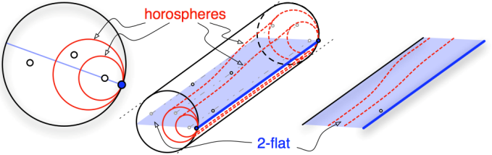
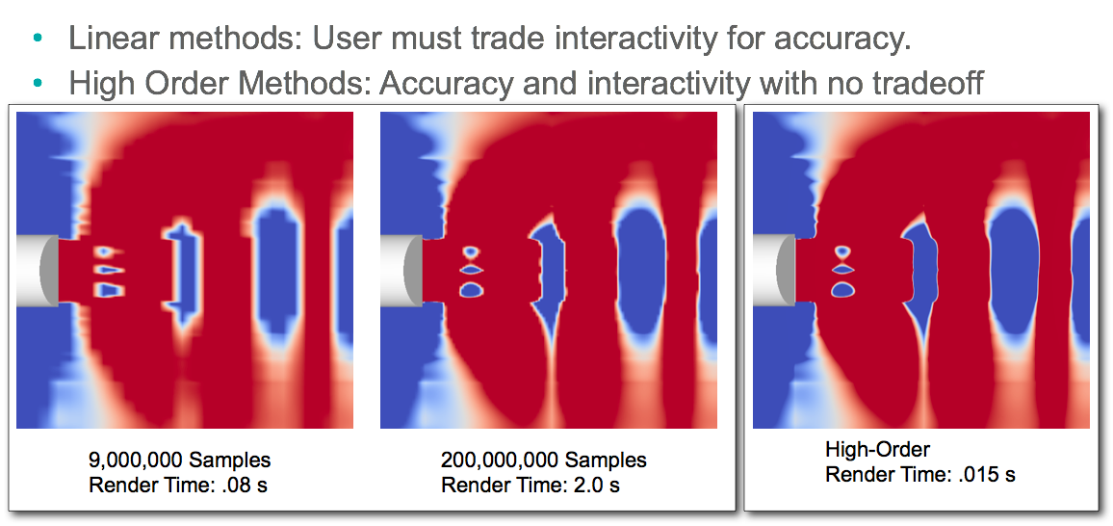
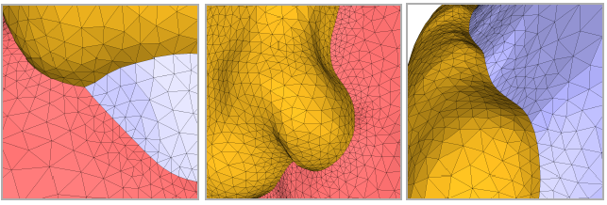
CEDMAV Research Spans a Broad Range of Topics, Applications, and Subfields
Theory
Application
Modeling of uncertainty
Positive definite spaces
Jacobi sets
Large-scale data analysis
Scientific visualization
Mesh generation

Slide 9
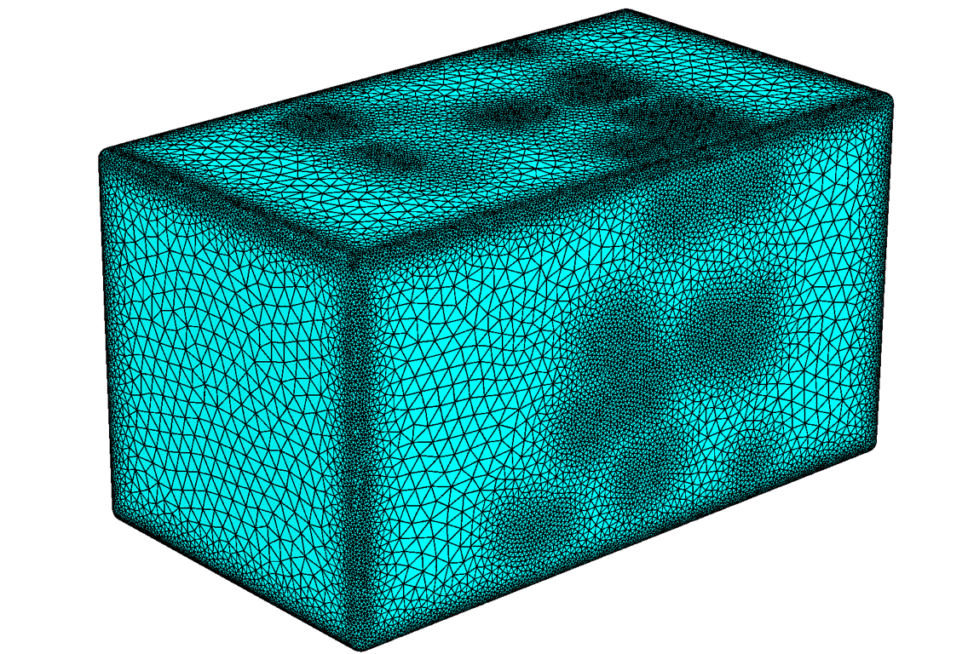
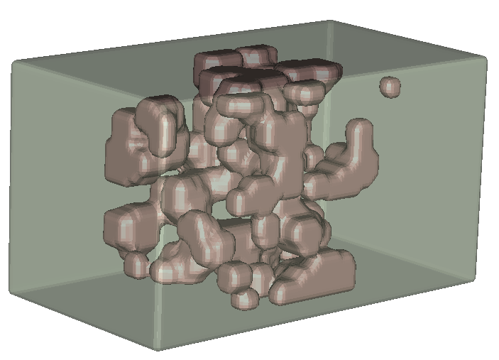
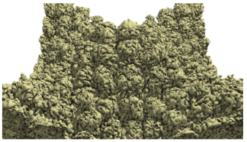
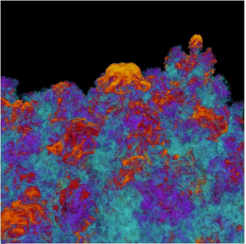
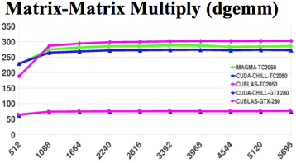
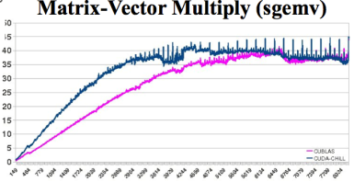
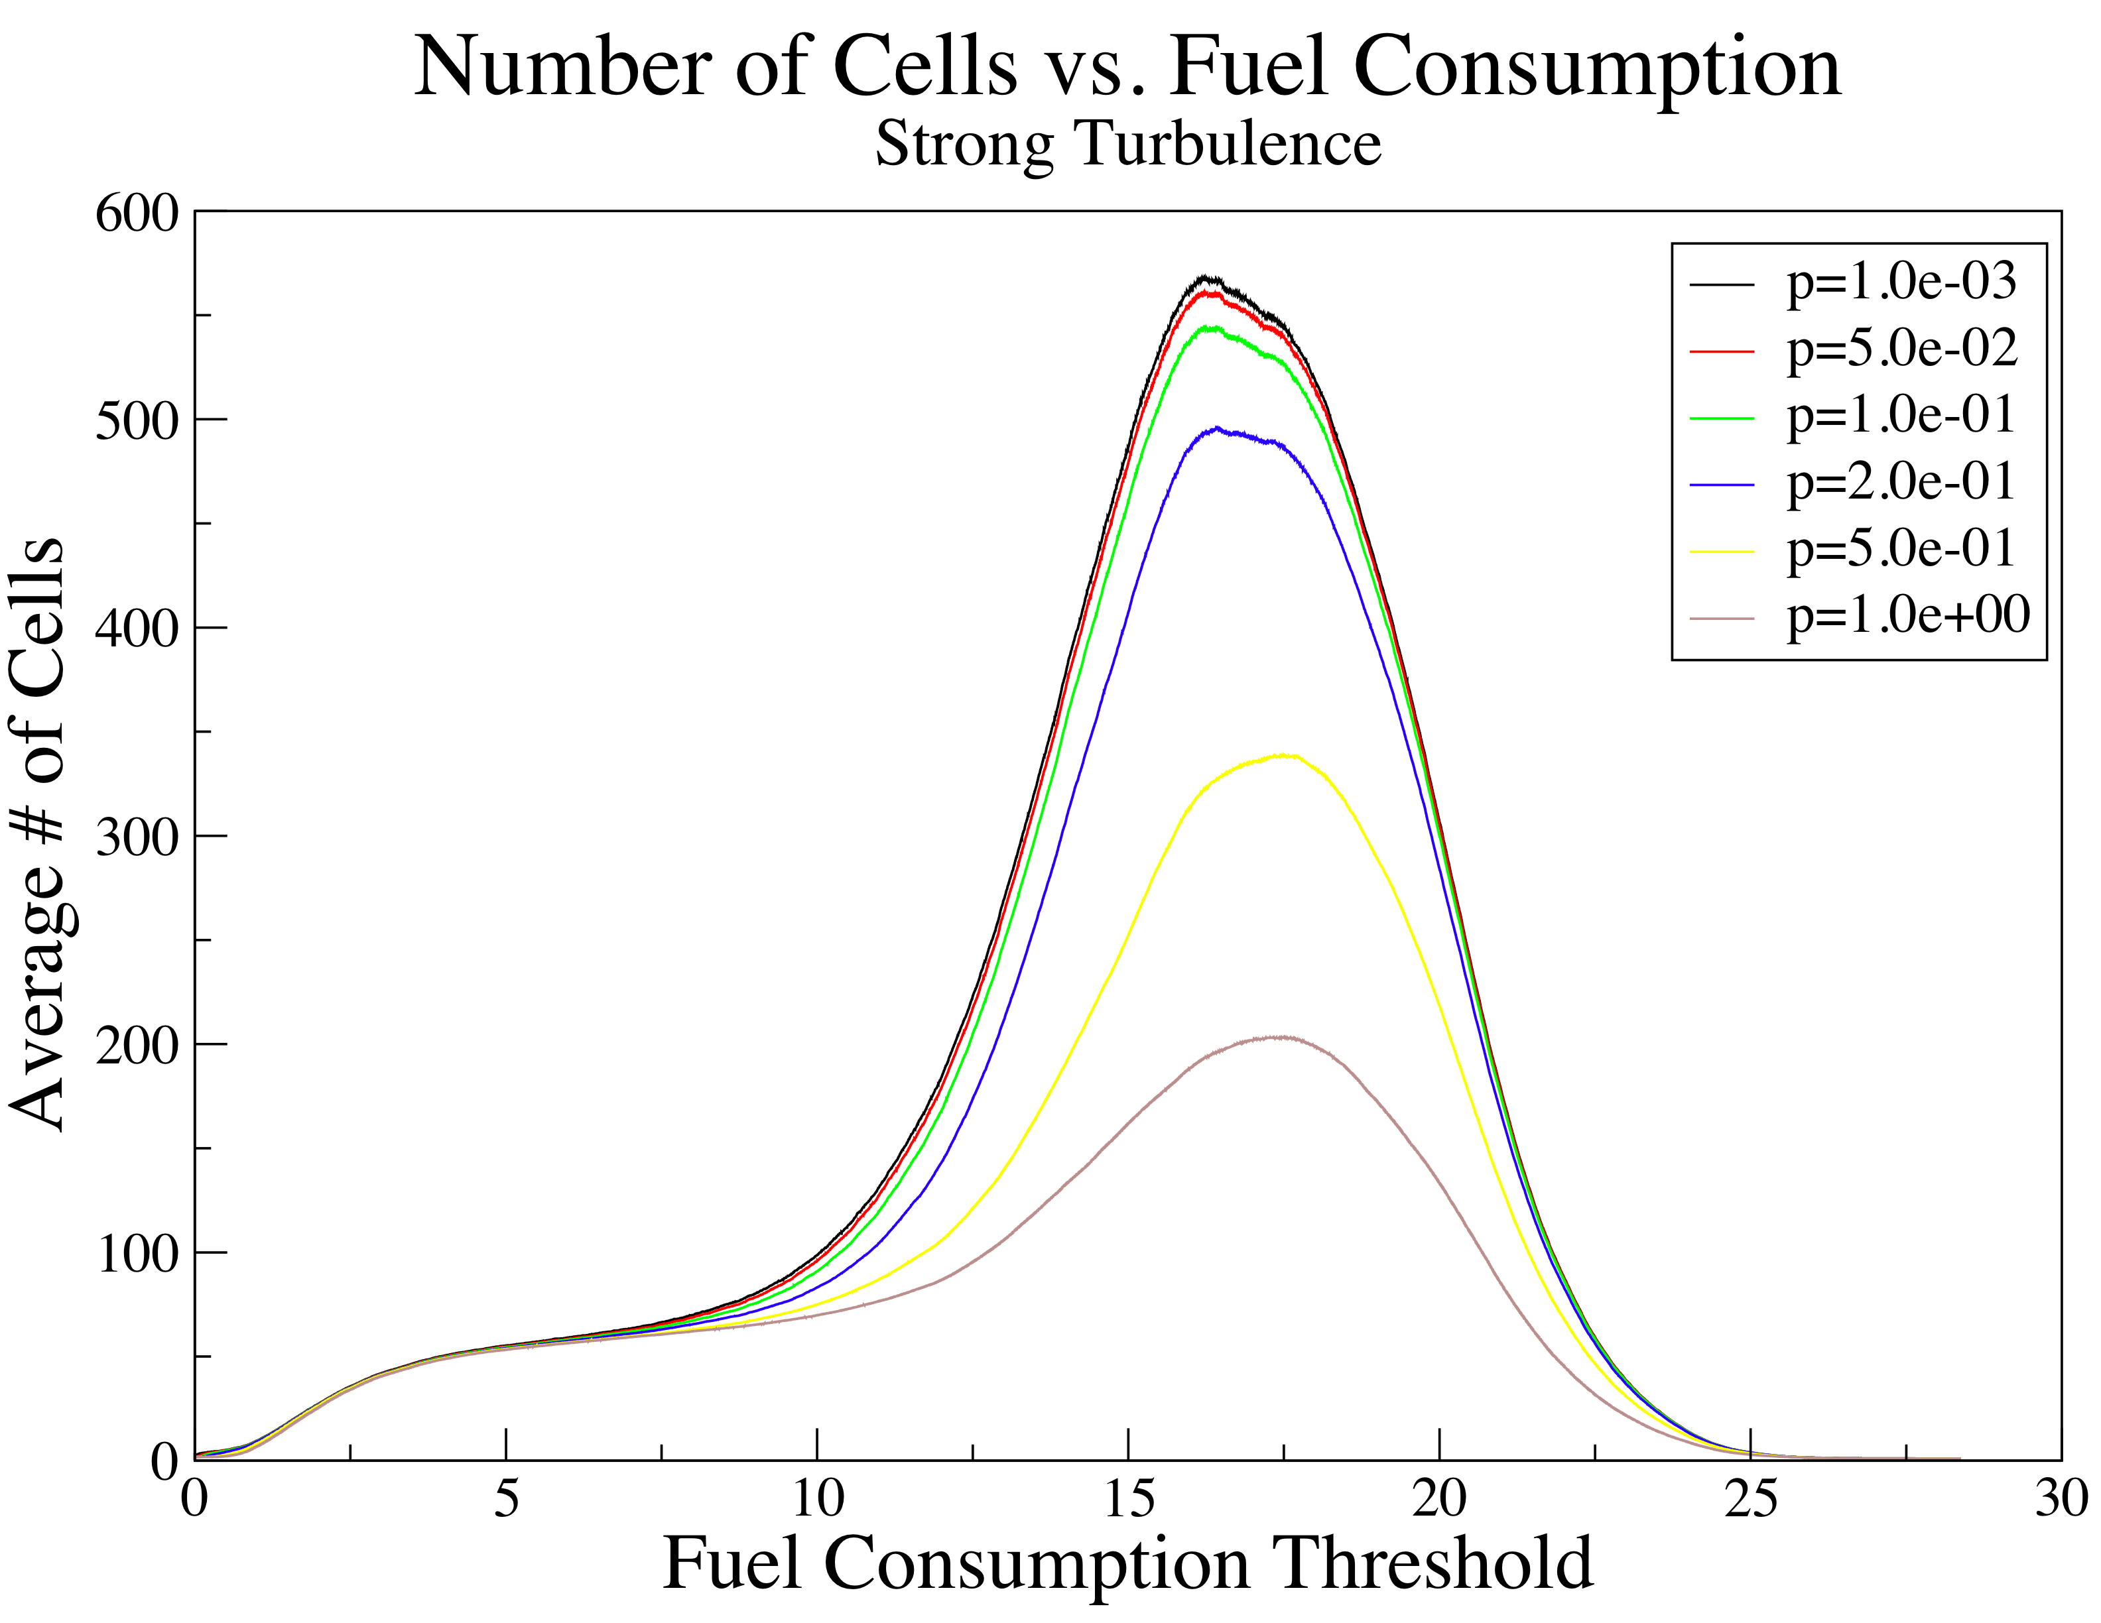
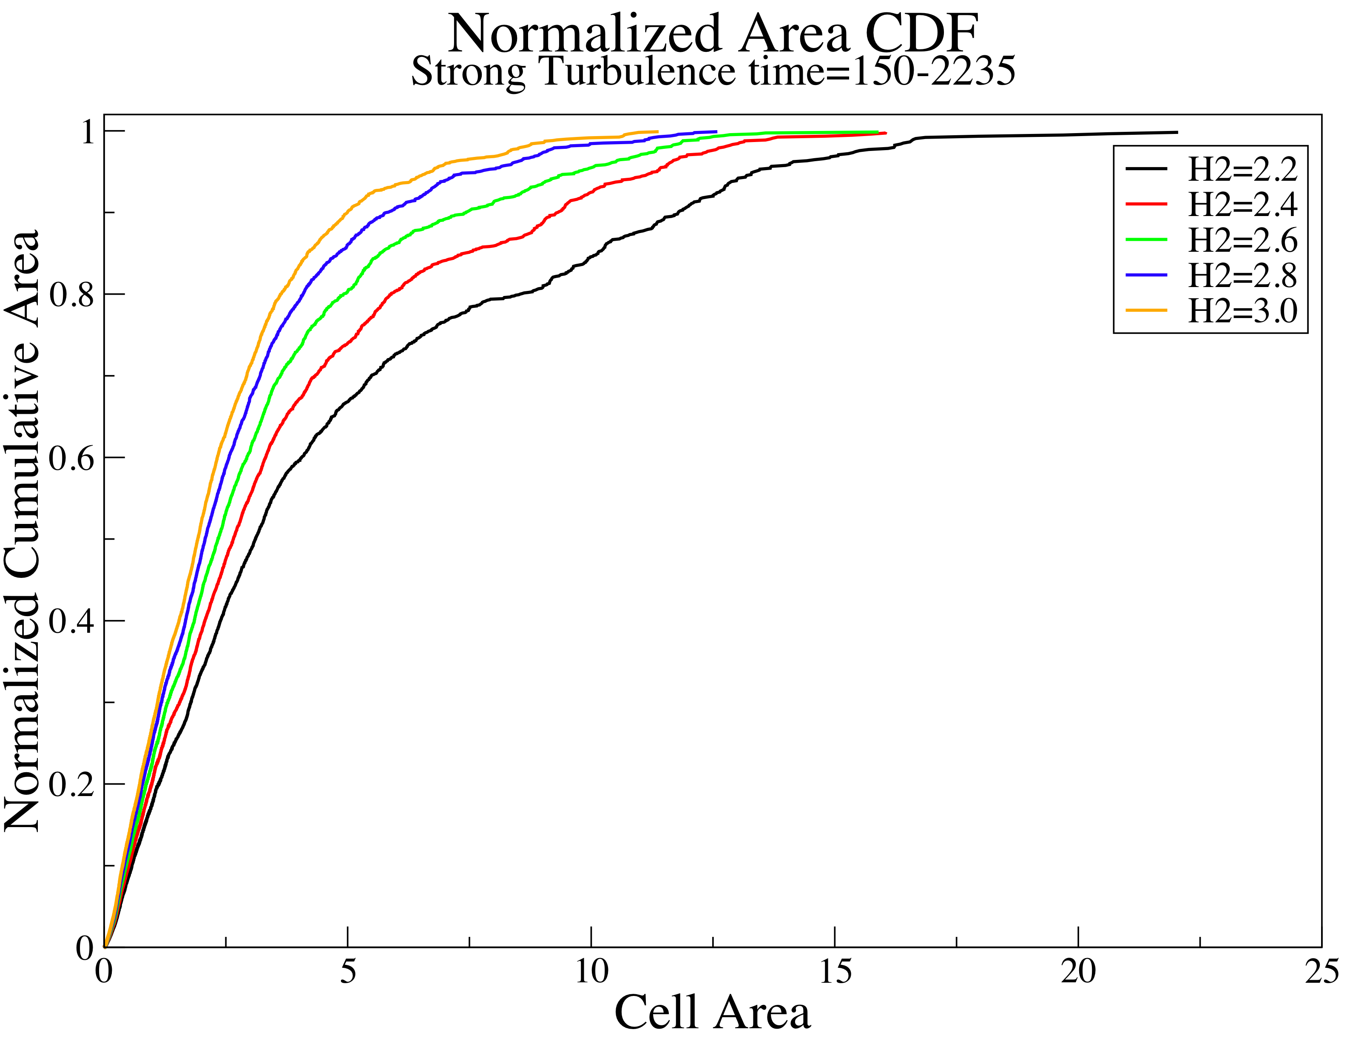
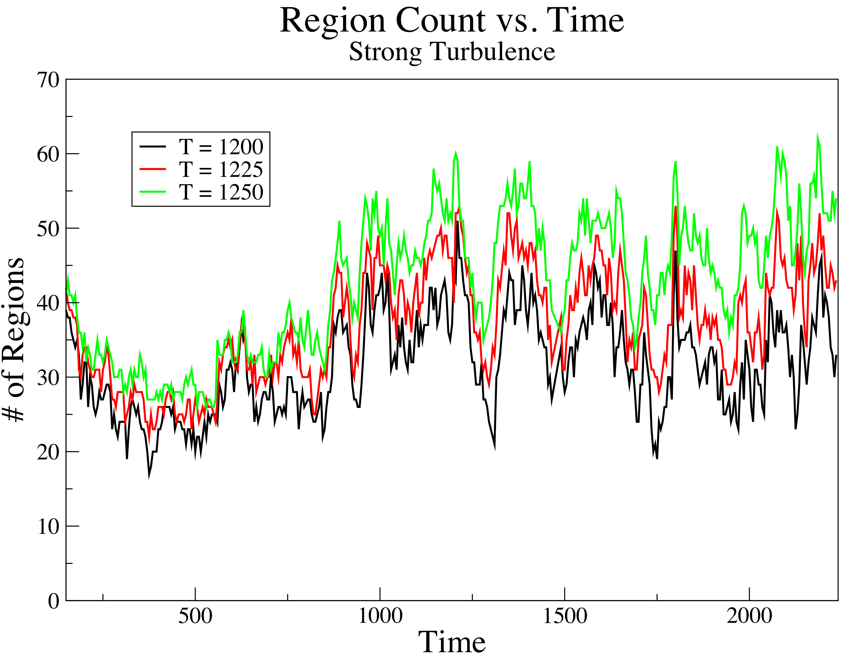
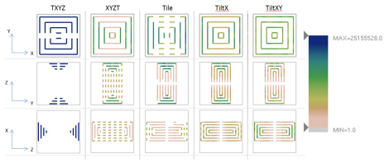
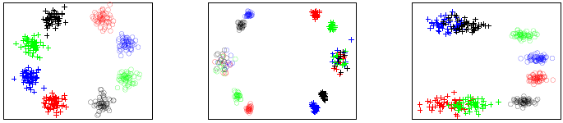
CEDMAV Research Spans a Broad Range of Topics, Applications, and Subfields
Simulations
Analysis
Scientific computing
Auto-tuning codes
Performance analysis
Large-scale visualization
Parallel statistics
Clustering

Slide 10
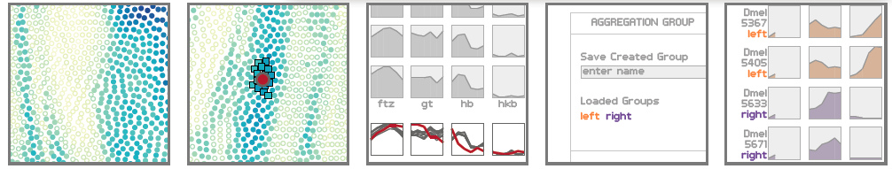
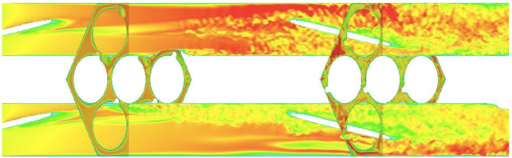
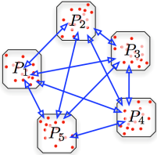
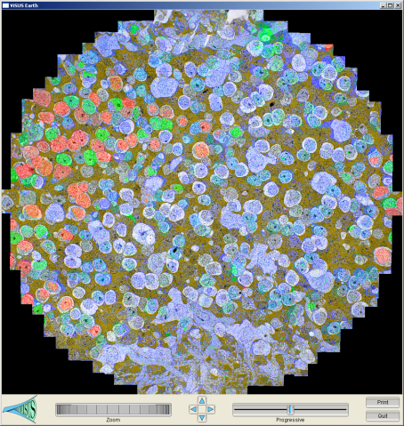
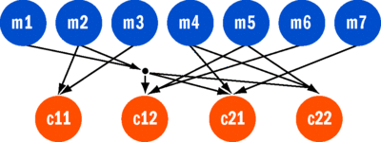
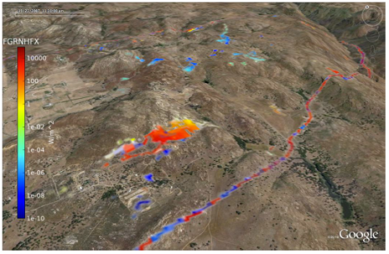
CEDMAV Research Spans a Broad Range of Topics, Applications, and Subfields
Abstract
Concrete
Information visualization
High-dimensional data
Concurrent programming
Nek 5000
Microscopy
Wild fire modeling

Slide 11
CEDMAV Combined Expertise Covers an Ever Growing List of Areas
Rendering and CG
Info Vis
Parallel computing
Higher order techniques
Auto tuning
Algorithms for new architectures
Computational geometry
Computational topology
Data mining
Machine learning
Uncertainty quantification
Concurrent programming
Large-scale analysis
High-dimensional analysis
Uncertainty visualization
Performance analysis
Large-scale visualization
:
:

Slide 12
CEDMAV is More Than its Collection of Parts
Notes:
We excel at creating new connections and new collaborations between different areas

Slide 13
CEDMAV’s Structure as a Source for Well Integrated, Diverse Research Teams is an Ideal Setup
Projects are becoming larger and more diverse
By guidance from funding agencies (DoE, NIH, NSF,…)
By the nature of the problem
For example:
Co-Design: hardware, system software, compilers, applied math, parallel computing, data analysis, visualization
Mathematical Multifaceted Integrated Capability Centers: “… an interrelated set of mathematical research challenges that require new integrated, iterative processes across multiple mathematical disciplines…” with applications such as facility management.
SDAV: Data management, data analysis, visualization, for Office of science code, projects, and applications.
Notes:
This will provide ample opportunities to engage fellow CEDMAV members in larger collaborations
This will make us all more attractive since we can provide missing expertise

Slide 14
How and Where can we Extent CEDMAV to Make us More Relevant ?
Data bases, data representations, …
Statistics
:
:

Slide 15

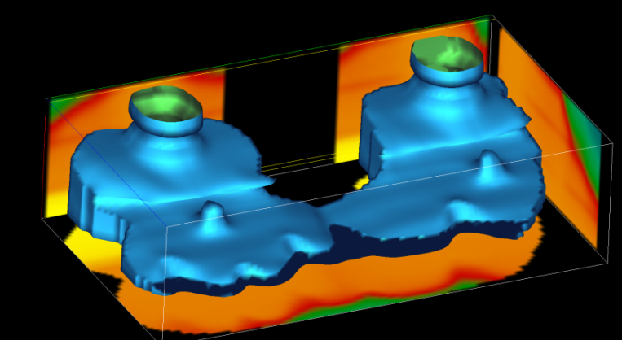
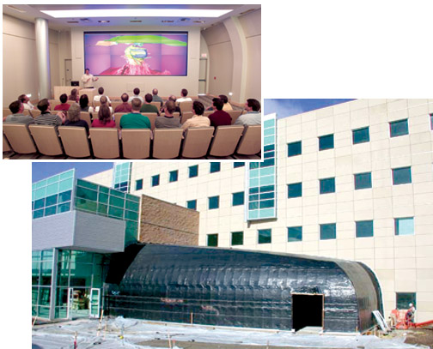
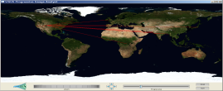
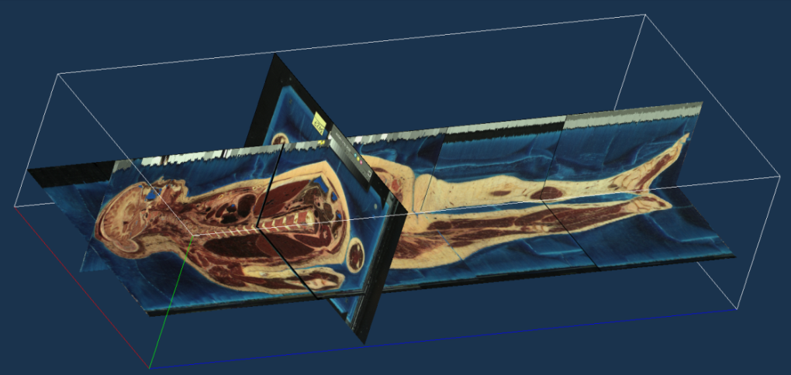
ViSUS Scalable Visualization: Across Domains, Devices, and Networks

Slide 16
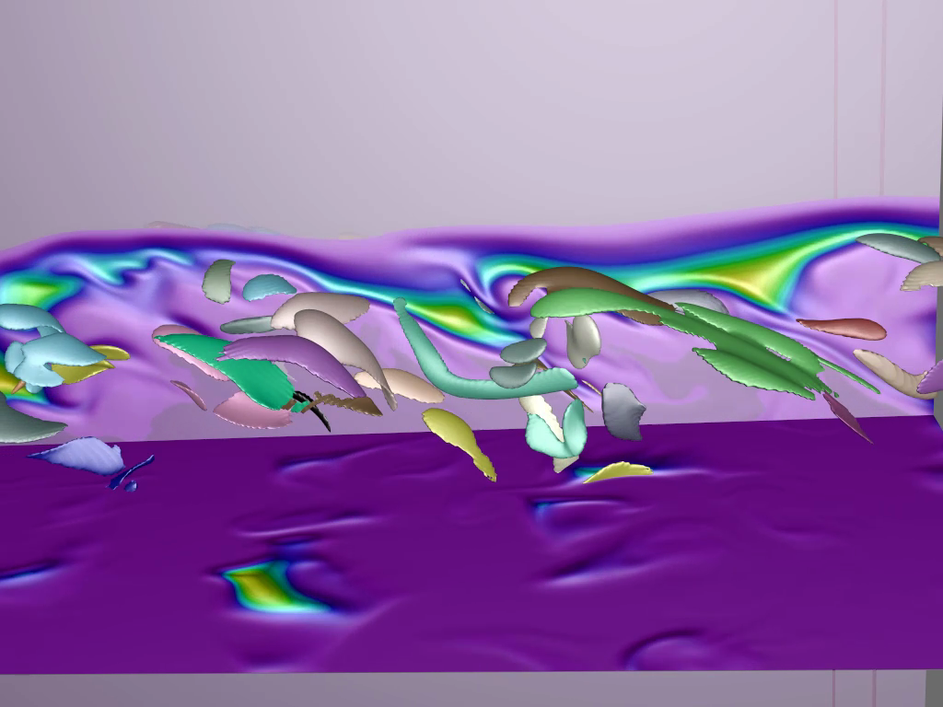
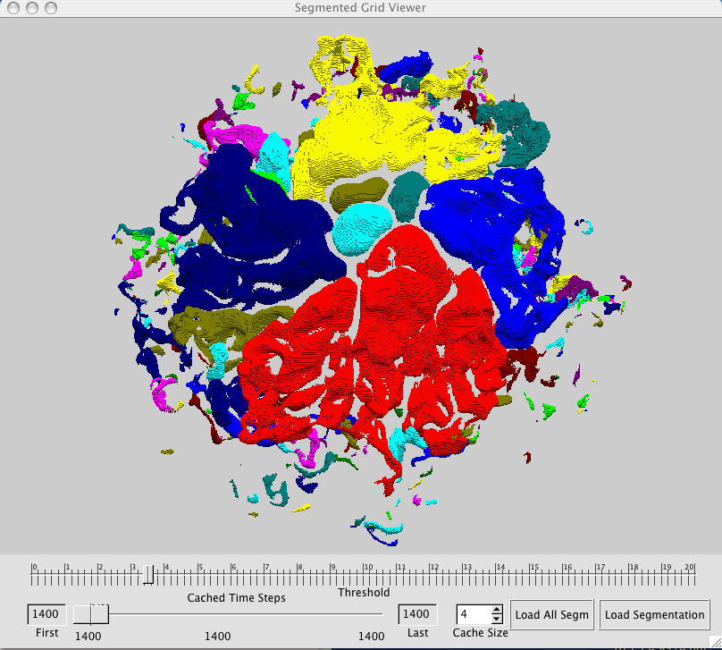
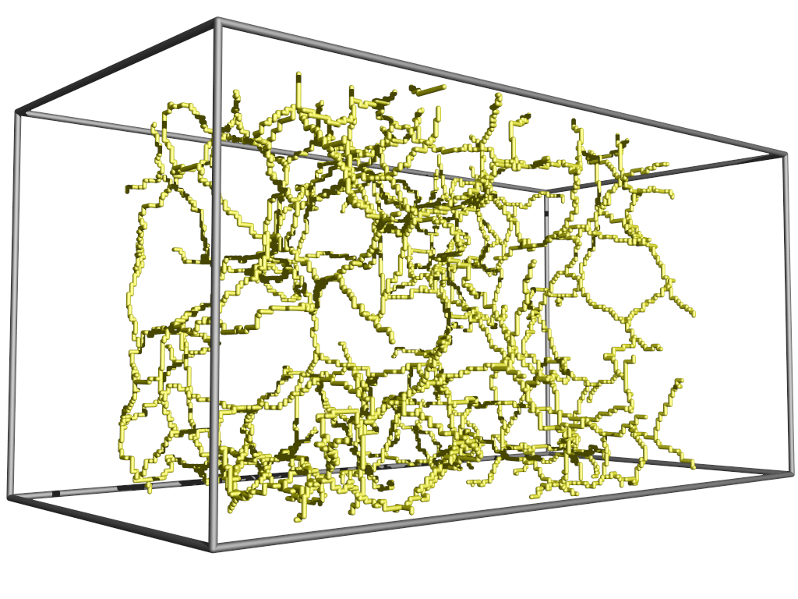
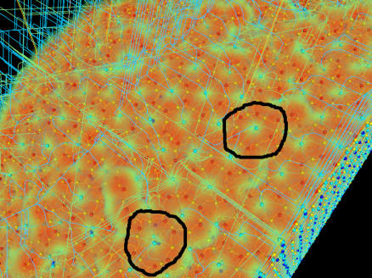
We are Developing Large-Scale Analysis Tools for a Wide Variety of Applications
Pre-mixed combustion: Jackie Chen (SNL)
Non-premixed combustion: John Bell (LBL)
Porous Media: Eduardo Bringa (LLNL)
Material Science: Kah Chun Lau (ANL)
Neuro Science: Alessandra Angelucci (U. of Utah)
Combustion (Unitah), Astrophysics, Airport Security, …

Slide 17

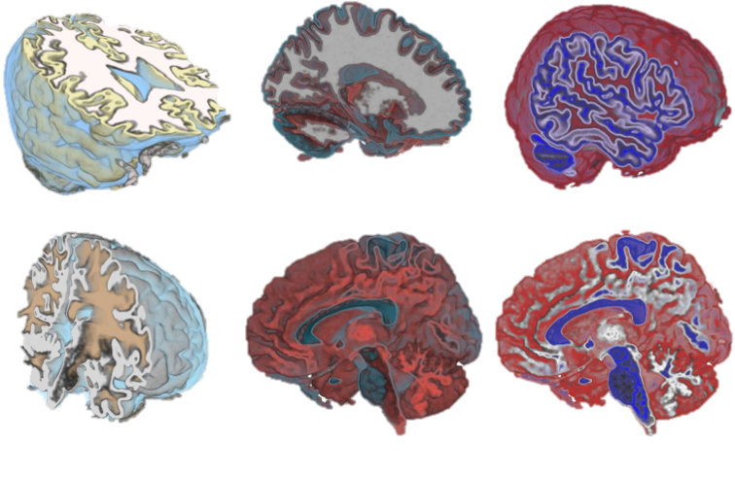
Visualizing Uncertainty
Fuzzy
Sensitivity
Uncertainty

Slide 18
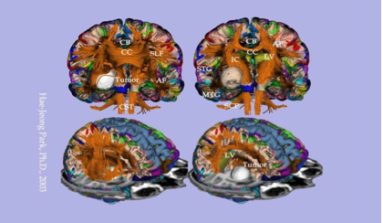
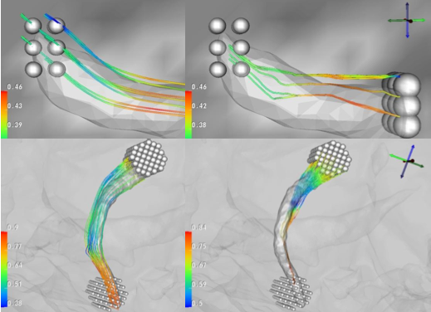
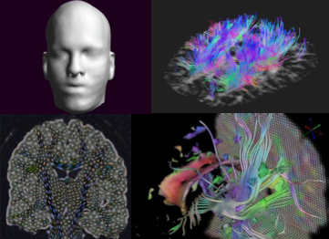
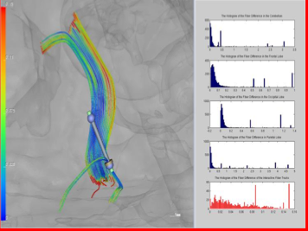
White Matter Tracks

Slide 19

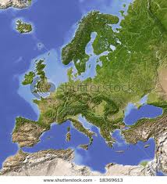
Chuck Hansen
Visualization
Multi-Field analysis
In-situ statistics

Slide 20

Mike Kirby’s Research Areas
Computational Science and Engineering
High-Order Methods: Algorithm Development and Applications
Scientific Visualization
Concurrent Programming: Verification and Applications
High Performance Computing

Slide 21
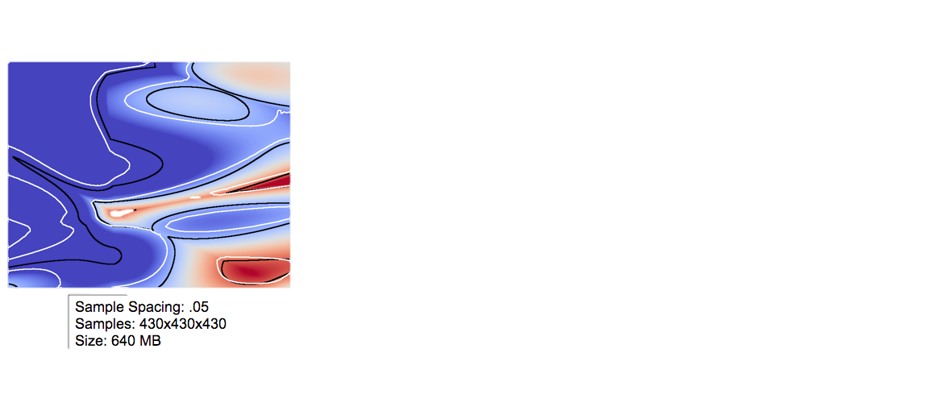
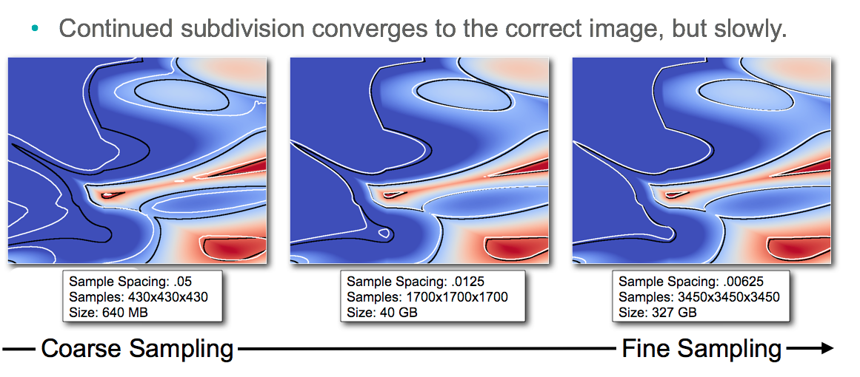
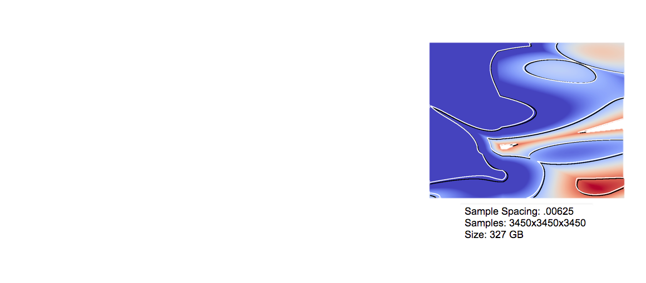
Visualization of High-Order Methods
Linear methods: user must trade interactivity for accuracy
High order methods: accuracy and interactivity with no tradeoff
Continued subdivision converges to the correct image but slowly

Slide 22





Efficient Use of Streaming Architectures for Scientific Computing
Lens
Blobs
Lens
Blobs
Run-time (in seconds) of all methods on Meshes 4 and 5. The “Speed up VS. FMM” column lists the speed-up of all methods compared to FMM with negative numbers denoting that the method is slower than FMM

Slide 23

Suresh Venkatasubramanian
Clustering the clusters
Combine different clusterings of data to find interesting answers.
The Data Flip
Validate the results of clustering from a user’s perspective.
Kernel Learning:
Find the right geometry for data so that learning tasks can be solved accurately.
Models for distributed learning:
Learn with minimal communication with huge amounts of data scattered across different nodes.

Slide 24


The Geometry of Data Spaces
Dimensionality reduction:
Squash data down to a small number of features while retaining structure.
Non-Euclidean geometry:
Interesting data spaces are not Euclidean (flat) - Design good geometric algorithms for data analysis in these spaces.
Data Analysis Analysis of Geometry

Slide 25

Software Challenges
Data movement costs $$
User byte transferred to data center generates a Gbyte within or across data centers [Astfalk 2009]
Energy efficiency comes from limiting data movement
Reliability increasingly a concern
Need to detect/correct errors efficiently
New technologies impact software
Malleable memories, NVRAM and PIM

Slide 26
Approach to Software Development
Provide interface to system for expert developer, and higher-level abstraction layer for common user
Key technology: autotuning
Manage data movement
Data placement in heterogeneous memory hierarchy
Affinity to parallel computation
Dynamic interaction with runtime environment
Consider execution context

Slide 27


Feifei Li - Ouq r Research

Slide 28

Models for Massive Data

Slide 29
What we do
Theory and Algorithm
Big data algorithmic
Database theory
Database and System
database kernels (for structured data)
data management systems, parallel and distributed processing (e.g., MapReduce)
cloud storage and cloud-based data management
semi-structued, untructured, and uncertain data (e.g., RDF graphs, text corpus, logs)
General Data Management Problems
distributed data management
security and privacy issues in data management systems
spatial and temporal data, large data in high dimensions

Slide 30

Problem-Driven Visualization Research for Biological Data
Target specific biological problems
Close collaboration with biologists
Rapid, iterative prototyping
Focus on genomic and molecular data

Slide 31

Problem-Driven Visualization Research for Biological Data
Pathline
MizBee
InSite
MulteeSum

Slide 32
Problem-Driven Visualization Research for Biological Data
Biological impact:
Refinement of computational biology algorithms
Validation of data collection methods
Generation of new hypotheses
Insight into biological systems
Computational impact:
New visual representations
Creation of new visualization toolkits
Development of new methods and methodology

Slide 33




Modeling Uncertainty of Complex Objects
Process uncertain and represent the uncertainty in output.
Represent output as uncertain distribution
Rigorous time and size vs. accuracy trade-offs

Slide 34

Summarizing Massive Data
Data set P may be too large to fit in memory or on disk
Create subset Q that is representative of P, a coreset
Rigorous size vs. accuracy tradeoff
Size depends only on accuracy, not P
Efficient distributed computation of Q

Slide 35

Communication-Bound Distributed Computation
Data set P distributed on many devices P = P₁ P₂ . . . P_{k} . Goal: Compute/maintain statistic f(P) across devices
use minimal inter-device communication.
Summarizing data
Learning classifiers
Monitoring streams
Publish/subscribe systems
Rigorous size vs. accuracy tradeoff
“Communication is quickly becoming the main bottleneck in large-scale distributed systems.”

Slide 36

Facilitating CEDMAV research
New downtown data center
1.15 MW for CHPC and research colocation
Tier-3 power (150 kW) for disk arrays, network, etc.
Available late this summer
Advanced networking
Science DMZ – NSF CC-NIE proposal (5/30)
SLC metro optical network
Planning for 100-Gbps upgrade to Internet2
Software Defined Networking (SDN)

Slide 37
Leveraging CEDMAV research
NSA Utah Data Center collaboration
CoE data center management curriculum
Capstone course
Utah Data Center Consortium (UDDC)
Public/private forum to discuss best practices
Internship conduit
Campus-wide Big Data Initiatives
Campus CI Council, AVPIT/HSC, Marriott and HS Libraries, Astrophysics
SC12 – Salt Lake City – November 10-16

Slide 38



Epinome
Facilitate investigation infectious disease outbreaks
High-fidelity and large scale simulations
Multiple scenarios with multiple decision points
Display evolves as the user focus changes

Slide 39
The Conceptual Model
An abstract representation
Visualization of meta-data (tags) not raw data
Number of tags is much smaller than number of data items
Automatic layout based on temporal relations
Suggests correlations between tags
Dynamic evolving queries
Employ information scent to reduce information overload

Slide 40

The CommonGround Prototype

Slide 41
CEDMAV Internship and Residency Program
Coordinate a pool of students each year for summer internships
Quality students
Technical alignment
Precedence given to continuing projects
Practical development of common technology with extended time visits of faculty a and scientists to facilitate continuing remote collaborations

Slide 42
Curriculum Under Development
Big Data PhD Track at the School of Computing
Big Data Professional Master
Data Center Engineering Program with involvement of three departments:
School of Computing
Electrical Engineering
Mechanical Engineering

Slide 43
Curriculum Under Development
Combination of Certificate, MS, BS.
Certificate in Data Center Engineering
CS
ECE
ME EN

