Slide 1
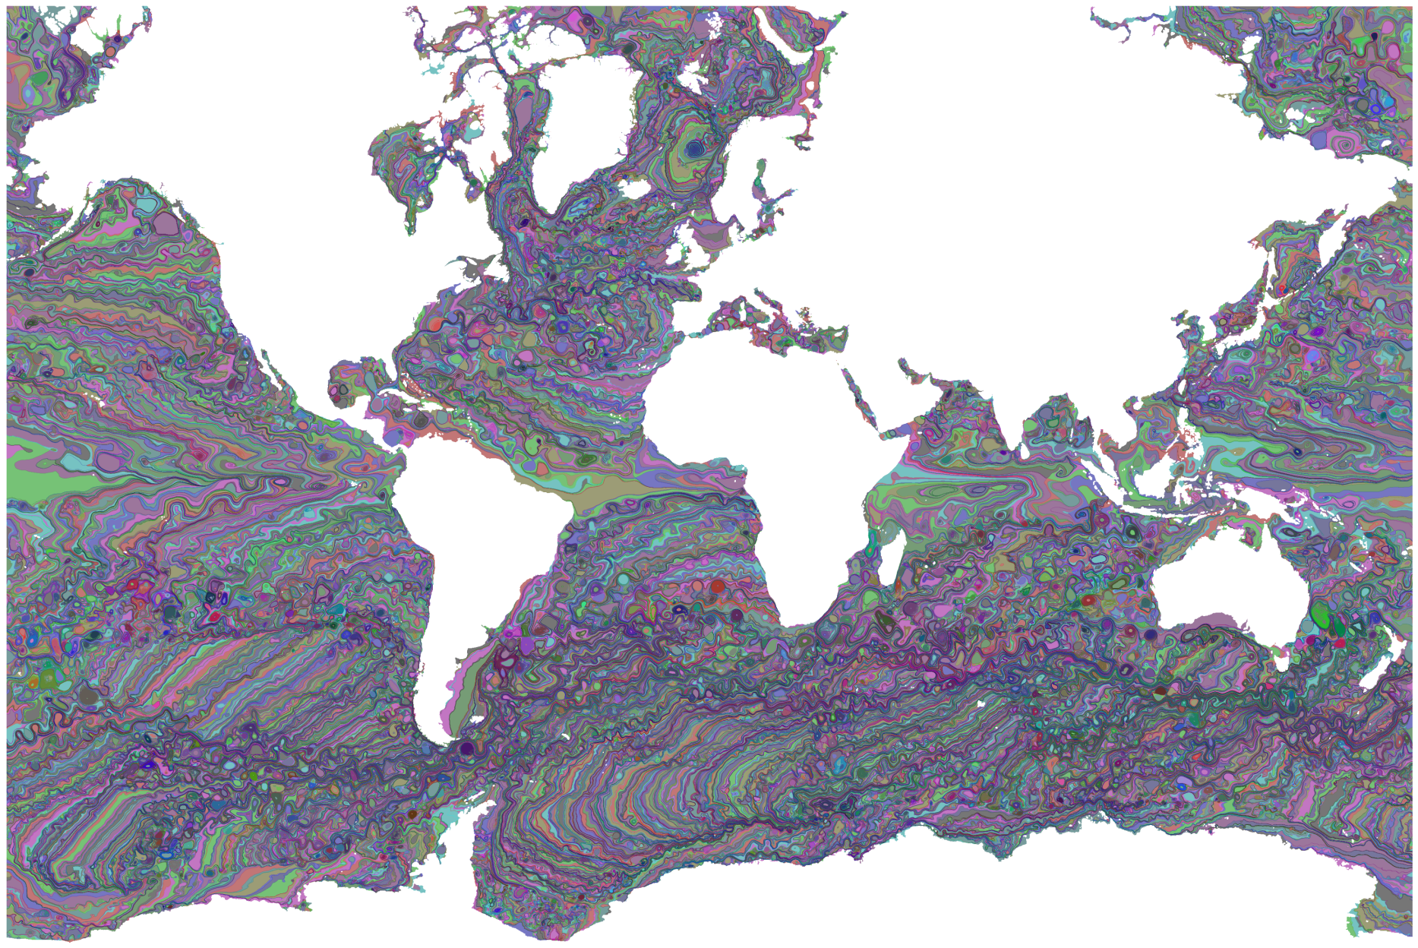
A Quantized Boundary Representation of 2D Flow
Joshua A. Levine^{1,2}, in collaboration with
Shreeraj Jadhav^{1,2}, Harsh Bhatia^{1,2,3},
Valerio Pascucci^{1,2,4}, and Peer-Timo Bremer^{1,2,3}
¹
²
³
⁴

Slide 2
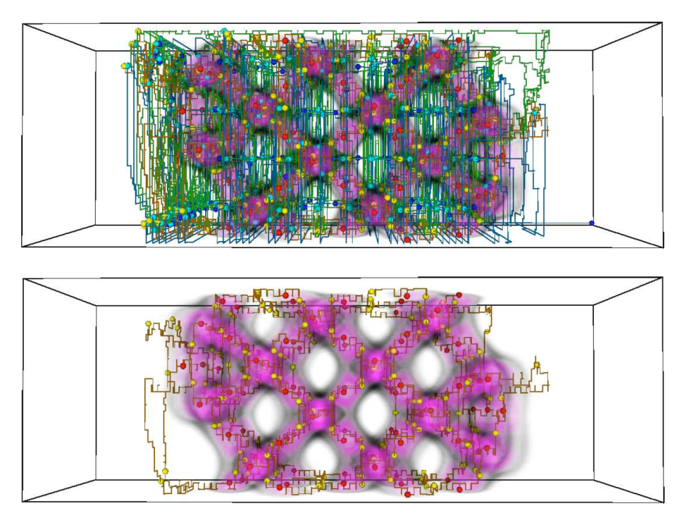
Applying to 2D Vector Fields Lessonx Learned from Scalar Field Analysis
Representation: discrete models can allow building consistent representations
Processing: combinatorial algorithms allow maintaining consistency
Accuracy: scalar fields can be converted to discrete models with know error bounds.
Lesson: robustness can be achieved with combinatorial processing of discrete models while managing accuracy.
A. Gyulassy, V. Natarajan, V. Pascucci, P.-T. Bremer, B. Hamann. A topological approach to simplification of three-dimensional scalar functions. IEEE Trans. Vis. Comp. Grap. 2006.

Slide 3
Applying a Lesson Learned from Scalar Field Analysis to 2D Vector Fields
Lesson: Robustness guarantees rely on the representations!
Representation: Scalar data is converted to a discrete gradient field.
Allows the detection and simplification of features.
A. Gyulassy, V. Natarajan, V. Pascucci, P.-T. Bremer, B. Hamann. A topological approach to simplification of three-dimensional scalar functions. IEEE Trans. Vis. Comp. Grap. 2006.

Slide 4
State-of-the-Art in VF Discretizations
Geometrically Accurate
A, Globus, C. Levit, T. Lasinski. A tool for visualizing the topology of three-dimensional vector fields. In IEEE Visualization, 1991.
X Tricoche, G. Scheuermann, H. Hagen. Continuous topology simplification of planar vector fields. In Proc. Of IEEE Visualization, 2001.
T. Wischgoll, G. Scheuermann. Detection and visualization of closed streamlines in planar flows. IEEE TVCG, 2001.
H. Theisel, T. Weinkauf, H.-C. Hege, H.-P. Seidel. Saddle connectors - an approach to visualizing the topological skeleton of complex 3D vector fields. In Proc. of IEEE Visualization, 2003.
Z. Liu, R. J. Moorhead II. Robust loop detection for interactively placing evenly spaced streamlines. Computing in Science and Engineering, 2007.
…and many more
Inconsistent computations
Continuous
Sampled
Continuous

Slide 5
State-of-the-Art in VF Discretizations
Computationally Robust
G. Chen, K. Mischaikow, R. S. Laramee, E. Zhang. Efficient Morse decompositions of vector fields. IEEE TVCG, 2008.
J. Reininghaus, C. Löwen, I. Hotz. Fast combinatorial vector field topology. IEEE TVCG, 2011.
A. Szymczak, E. Zhang. Robust Morse decompositions of piecewise constant vector fields. IEEE TVCG, 2012.
G. Chen, Q. Deng, A. Szymczak, R. S. Laramee, E. Zhang. Morse set classification and hierarchical refinement using Conley index. IEEE TVCG, 2012.
…and many more ongoing!
Coarse Geometry
Continuous
Sampled
Continuous
Combinatorial /
Forman*-style
*R. Forman, “Combinatorial vector fields and dynamical systems,” Mathematische Zeitschrift, 228(4),1998.

Slide 6
State-of-the-Art in VF Discretizations
Geometrically Accurate
Computationally Robust
Inconsistent computations
Coarse Geometry
?
Continuous
Sampled
Continuous
Hybrid?
Combinatorial /
Forman-style

Slide 7
Contributions: A New Representation
Provides a combinatorial representation of flow that still maintains a geometric fidelity to an input field;
Is constructed with an embarrassingly parallelizable algorithm using any given streamline computation;
Supports user-defined levels of approximation which control the level of geometric fit; and
Utilizes a compact, memory efficient data structure.

Slide 8
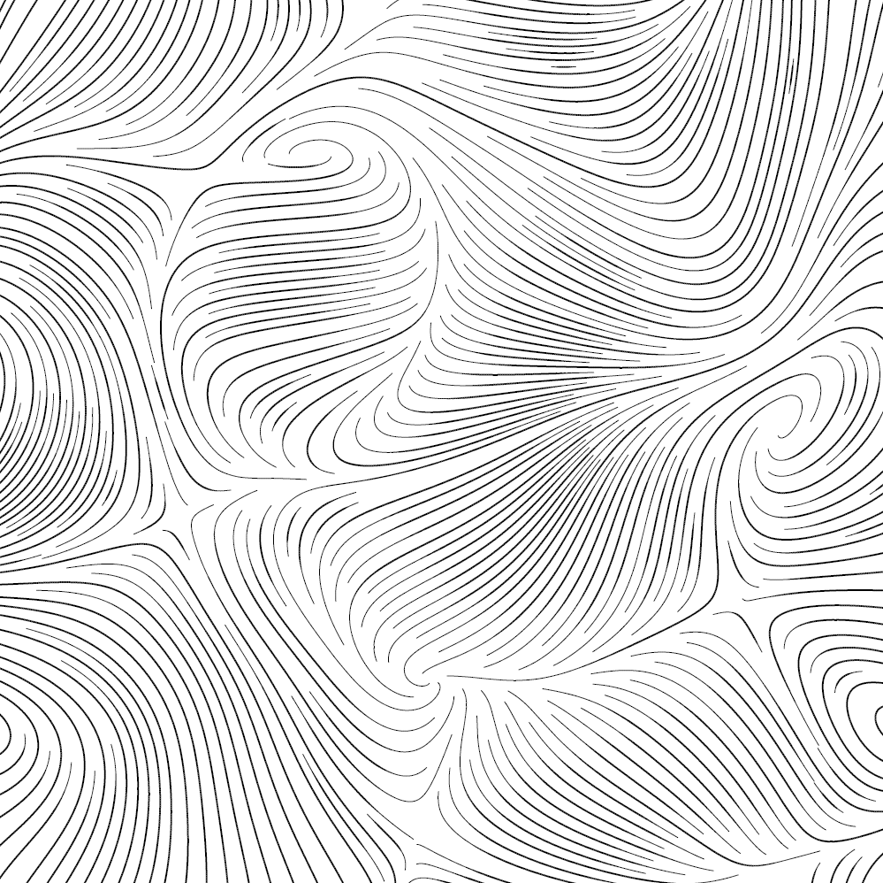
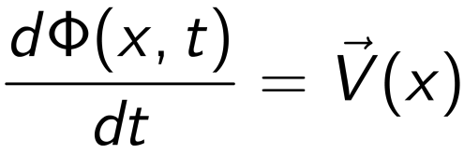
What to Represent: Focus on Discretizing Flow
Input: a mesh with samples of
Goal: Encode the flow
where
The flow encodes the set of
streamlines which run tangent to
the vector field.
A. Mebarki, P. Alliez, O. Devillers. Farthest Point Seeding for Efficient Placement of Streamlines. IEEE Visualization 2005

Slide 9
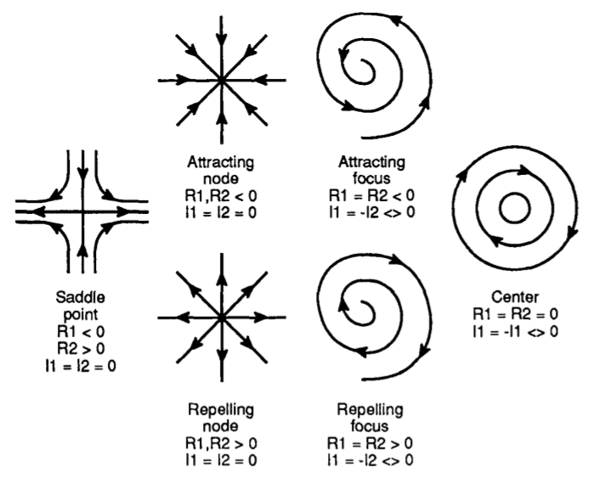
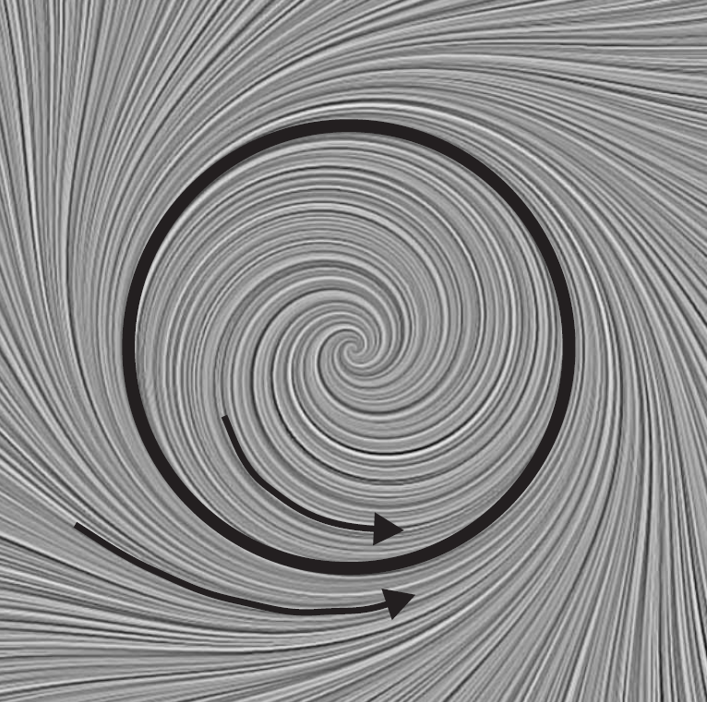
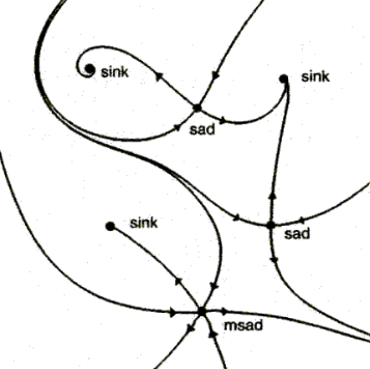
Encoding Must Explicitly Capture Flow’s Topological Features
H. Theisel, T. Weinkauf, H.-C. Hege, H.-P. Seidel. Grid-independent Detection of Closed Stream Lines in 2D Vector Fields. VMV 2004.
J. L. Helman and L. Hesselink. Representation and Display of Vector Field Topology in Fluid Flow Data Sets. IEEE Computer, 1989.
G. Scheuermann, X. Tricoche. Topological Methods in Flow Visualization. Visualization Handbook, 2004

Slide 10
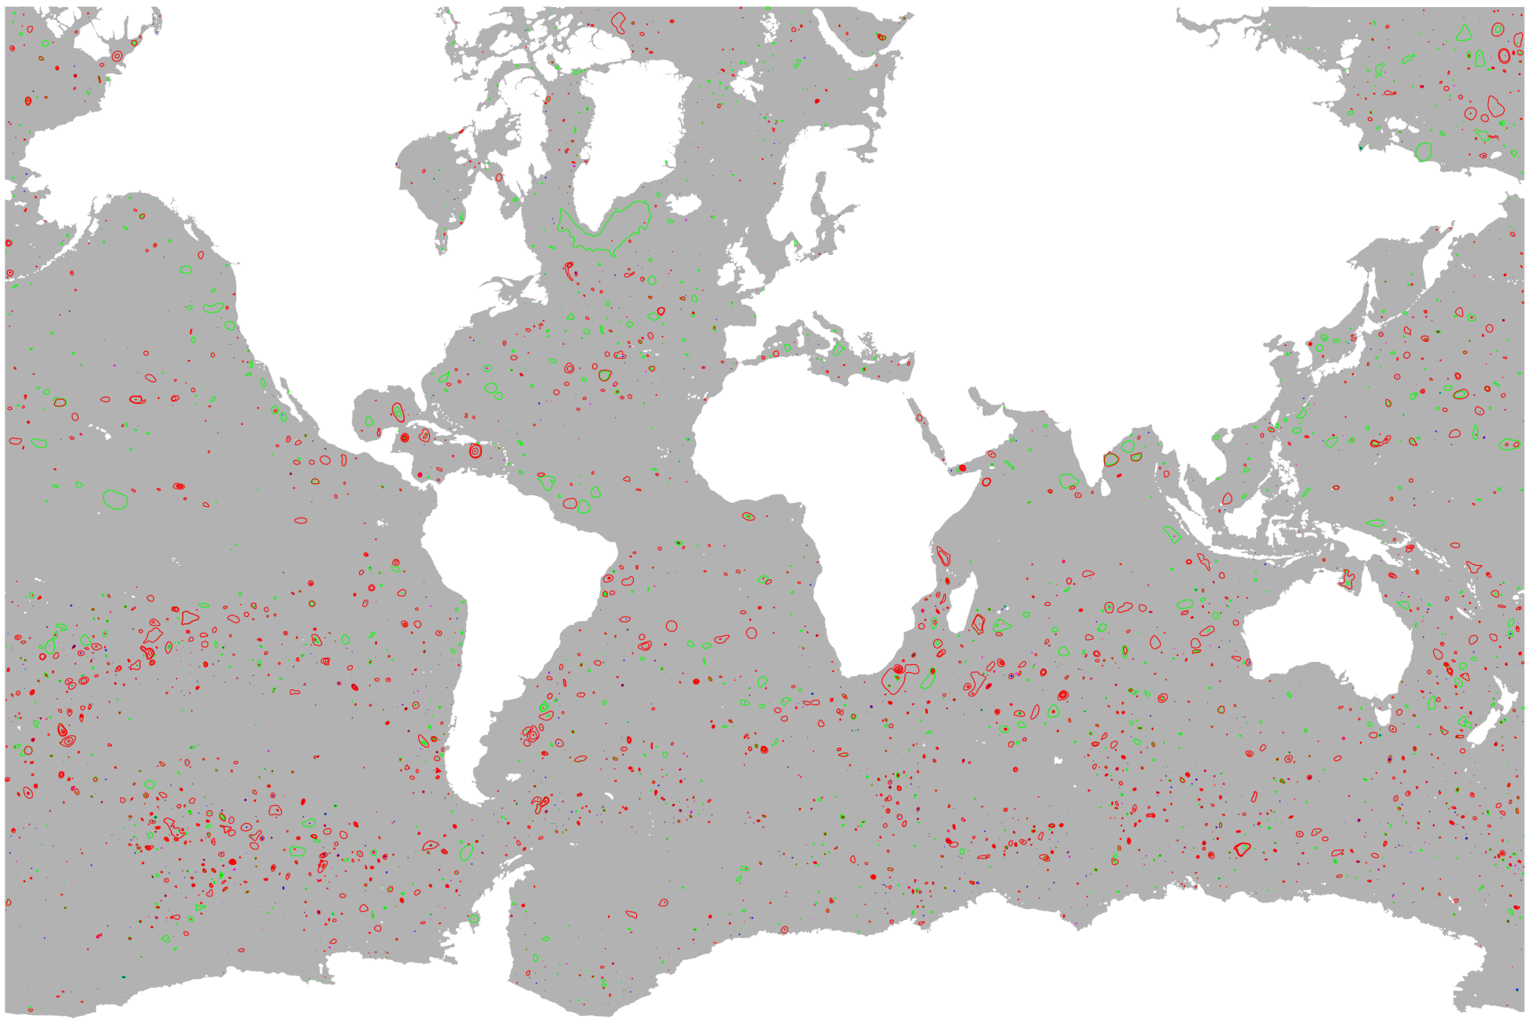
Detecting Features Robustly Is Essential
Data Credit: Mathew Maltrud from the Climate, Ocean and Sea Ice Modelling program at Los Alamos National Laboratory (LANL) and the BER Office of Science UV-CDAT team

Slide 11
Solution: Sample Flow Instead of Vector Values
Represent streamlines as discrete set of
edge crossings

Slide 12
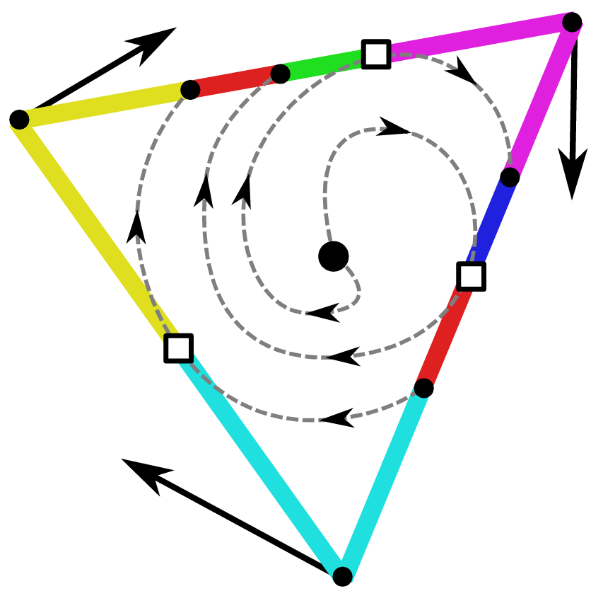
Flow Structure Encoded per Triangle
Pair regions of edges which flow through triangle, called links
Flow switches from one link to the next at transition points

Slide 13
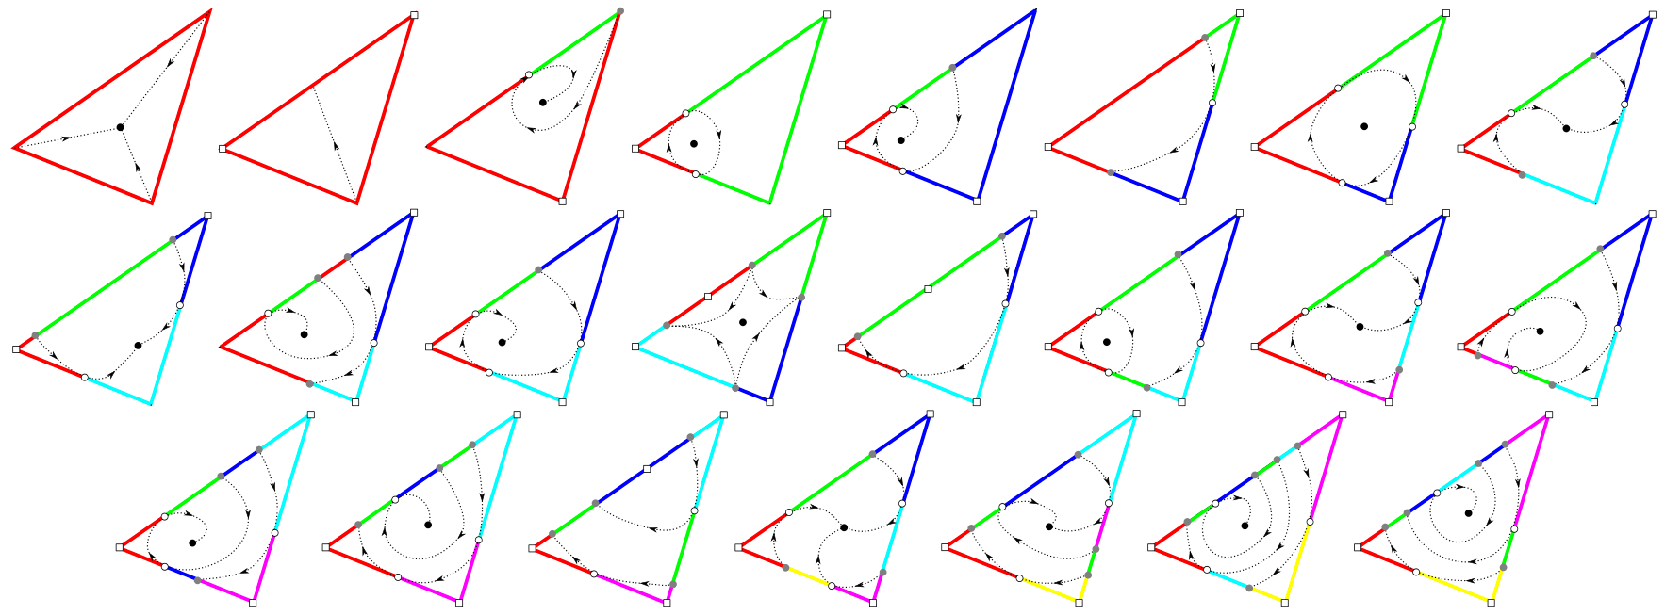
These Flow Structures Are Edge Maps
H. Bhatia, S. Jadhav, P.-T. Bremer, G. Chen, J. A. Levine, L. G. Nonato, and V. Pascucci. Edge maps: Representing flow with bounded error. In 4th Pacific Visualization Symp., 2011.
S. Jadhav, H. Bhatia, P.-T. Bremer, J. A. Levine, L. G. Nonato, and V. Pascucci. Consistent approximation of local flow behavior for 2D vector fields using edge maps. In Topological Methods in Data Analysis and Visualization II - Theory, Algorithms, and Applications. Springer, 2011.

Slide 14
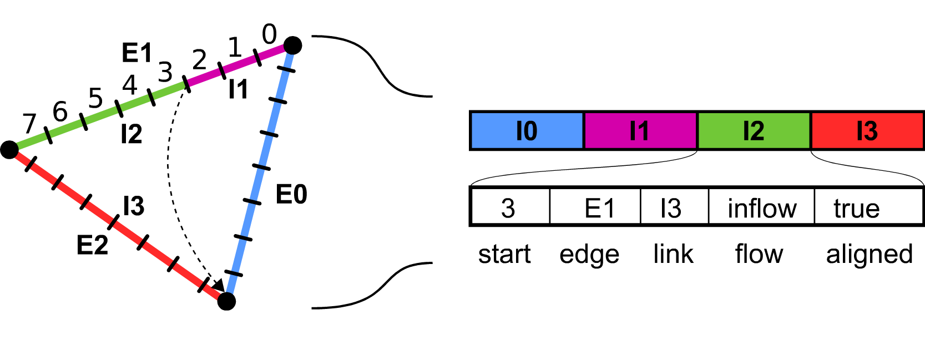
Quantizing Streamlines and Quantized Edge Maps
Edges are discretized into a fixed number of bins (typically 2³²).
Each triangle stores its link structure
Key Idea: Streamlines cannot cross
in the integer mapping

Slide 15
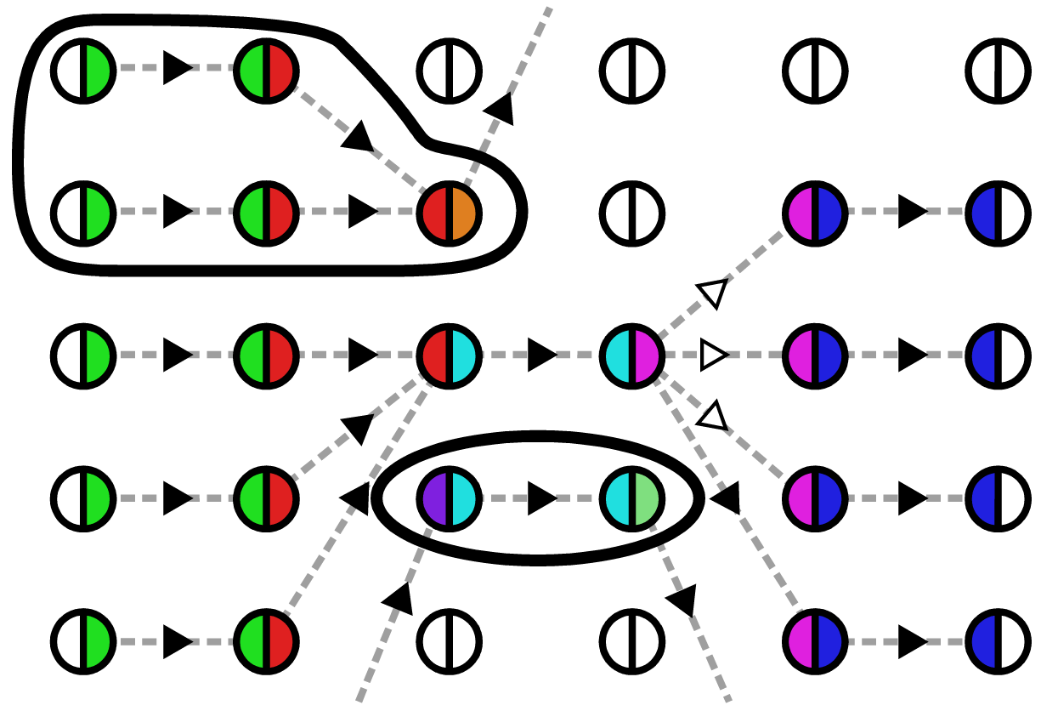
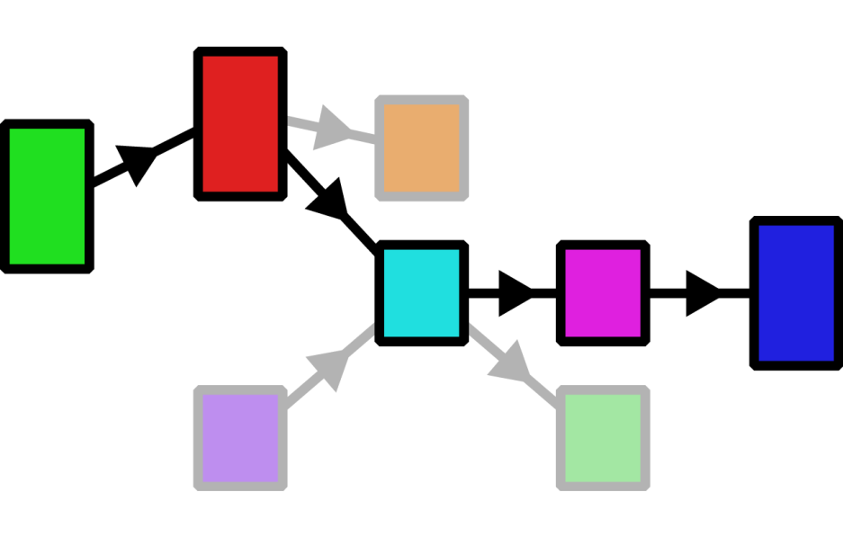
Quantized Features: Closed Orbits
Graph-based cycle detection algorithm
Prune for strongly-connected components
Bin Graph
Link Graph

Slide 16
Classification of Closed Orbits
Attracting
Neutral
Repelling

Slide 17
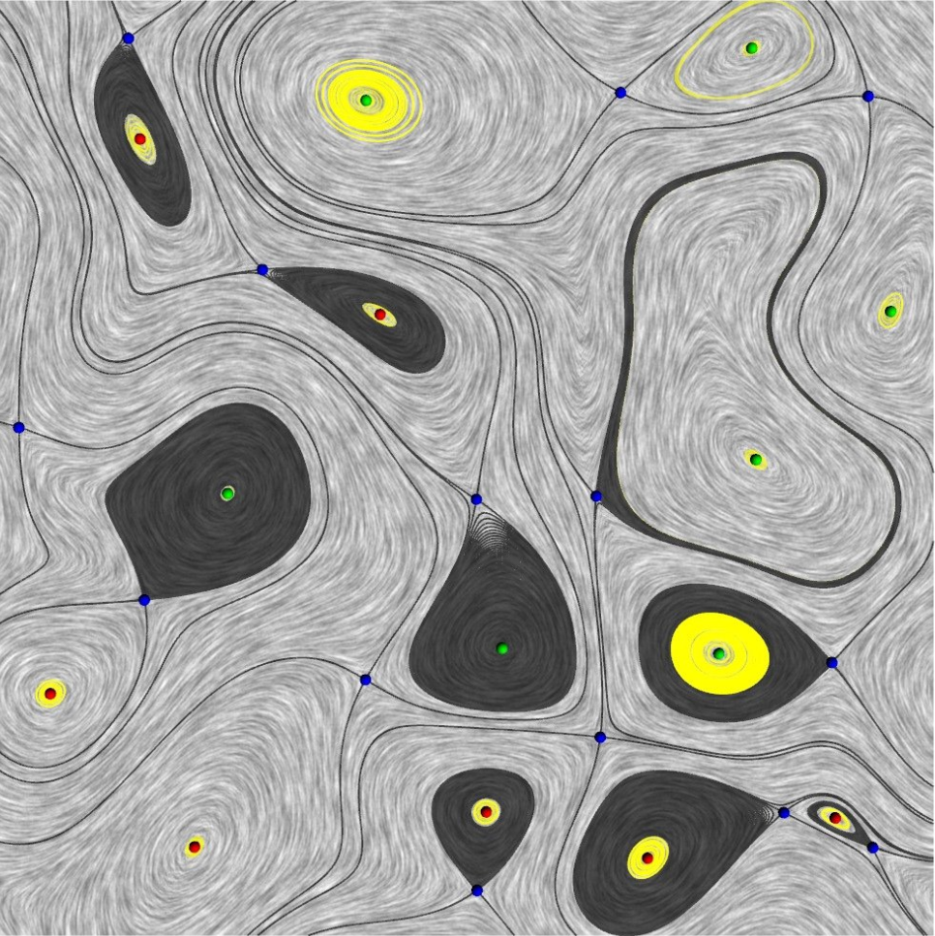
Quantized Features: Topological Decompositions
Stable Manifolds
Topological Skeletons

Slide 18
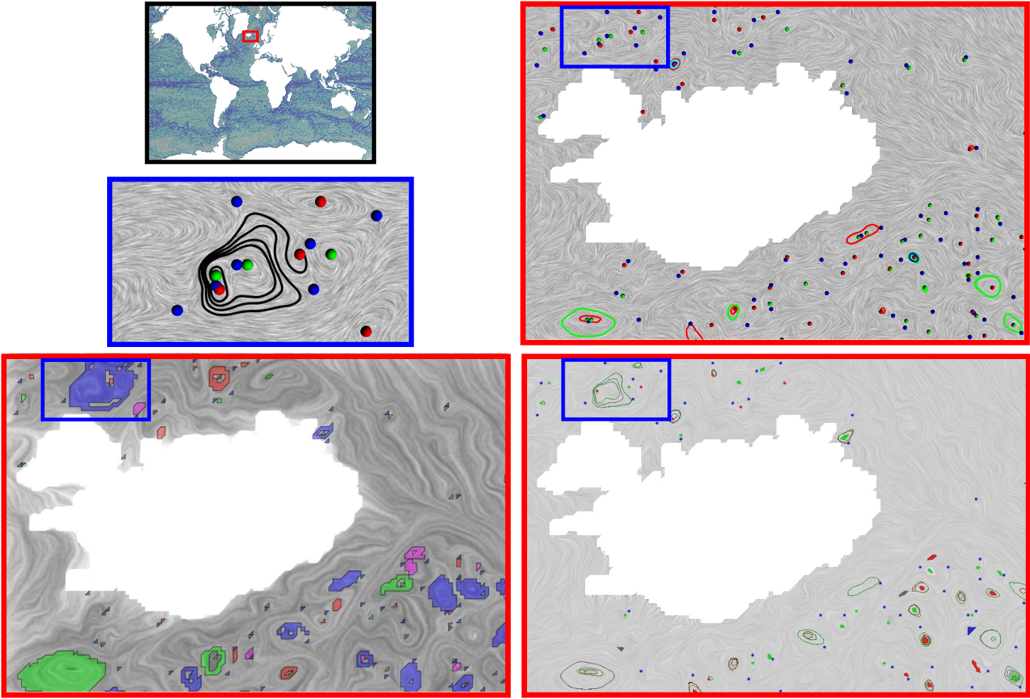
Comparison to Other Discretizations
Morse Sets
G. Chen, Q. Deng, A. Szymczak, R. S. Laramee, E. Zhang. Morse set classification and hierarchical refinement using the Conley index. IEEE TVCG, 2011.
PC Morse Sets
A. Szymczak. Stable Morse Decompositions for piecewise constant vector fields on surfaces. CGF 2011.

Slide 19
Stable Manifolds of Ocean Data
1 time, depth slice:
3600x2400 mesh
30-40 mins / 3GB mem
~25k critical points
~39k cycles

Slide 20
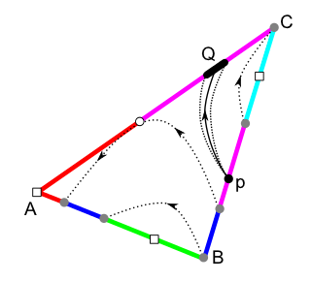
Discussions
Quantized flow combines discrete algorithms with approximation power of interpolated fields.
Extensions:
Higher order interpolants, meshes with non-triangular elements
Encoding uncertainty in flow, similar to study of spatial/temporal errors with Edge Maps*
Challenges: 3D and Time-varying
*H. Bhatia, S. Jadhav, P.-T. Bremer, G. Chen, J. A. Levine, L. G. Nonato, and V. Pascucci. Flow visualization with quantified spatial and temporal errors using edge maps. IEEE TVCG, 2011.

