Slide 1
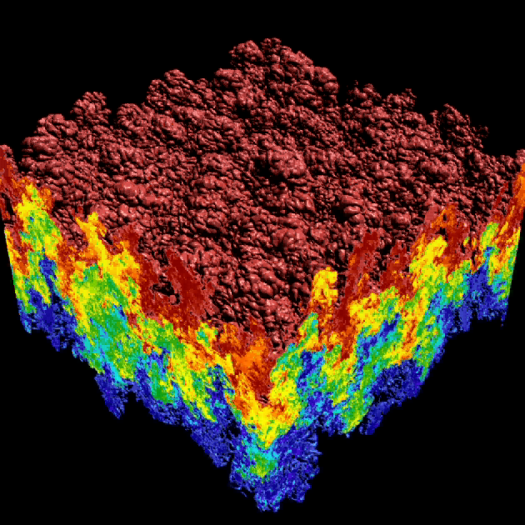
Understanding the Dynamics of Rayleigh-Taylor instabilities
Rayleigh-Taylor instabilities arise in fusion, super-novae, and other fundamental phenomena:
start: heavy fluid above, light fluid below
gravity drives the mixing process
the mixing region lies between the upper envelope surface (red) and the lower envelope surface (blue)
25 to 40 TB of data from simulations

Slide 2
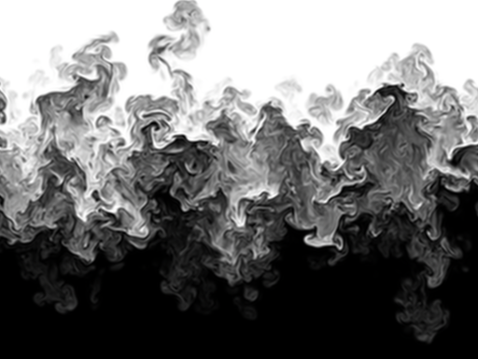
We Provide the First Quantification of Known Stages of the Mixing Process
mixing
transition
1.0 (9524 bubbles)
0.5
0
linear growth
-0.5
slope 1.536
-1
Mode-Normalized Bubble Count (log scale)
Derivative of Bubble Count
0.1
slope 1.949
-1.5
-2
strong
turbulence
slope 2.575
-2.5
Bubble Count
0.01
Derivative
weak turbulence
-3
1
2
3
4
5
6
7
8
9
10
20
30
40
t/τ (log scale)

Slide 3
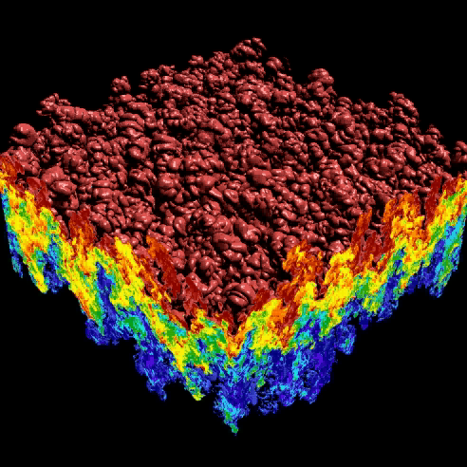
We Provided the First Feature-Based Validation of a LES with Respect to a DNS
LES (Large Eddy Simulation)
Mode-Normalized Bubble Count
DNS (Direct Numerical Simulation)
Normalized Time

Slide 4
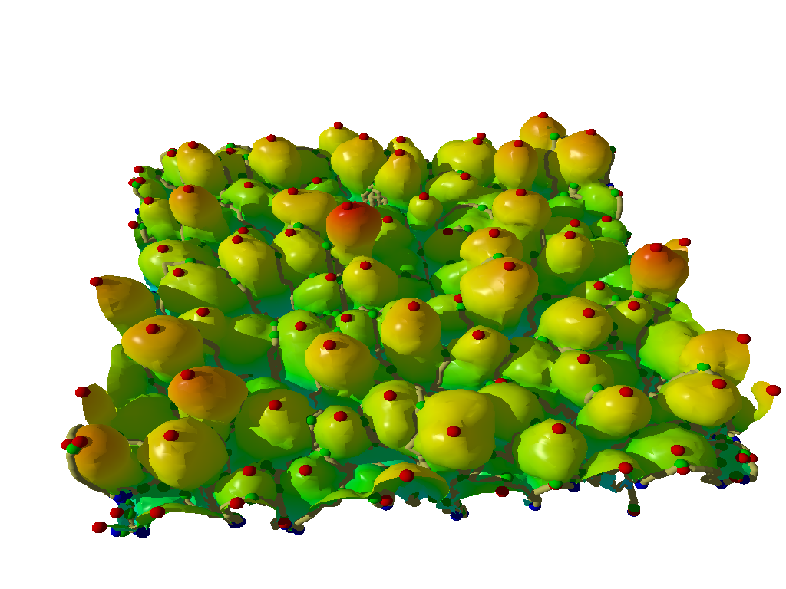
We Analyze High-Resolution Rayleigh–Taylor Instability Simulations
maximum
bubble
Large eddy simulation run on Linux cluster: 1152 x 1152 x 1152
~ 40 G / dump
759 dumps, about 25 TB
Direct numerical simulation run on BlueGene/L: 3072 x 3072 x Z
Z depends on width of mixing layer
More than 40 TB
Bubble-like structures are observed in laboratory and simulations
Bubble dynamics are considered an important way to characterize the mixing process
Mixing rate =
There is no prevalent formal definition of bubbles

Slide 5
We Compute the Morse–Smale Complex of the Upper Envelope Surface
F(x) = z
Maximum
F(x) on the surface is aligned against the direction of gravity which drives the flow
Morse complex cells drawn in distinct colors
In each Morse complex cell, all steepest ascending lines converge to one maximum

Slide 6
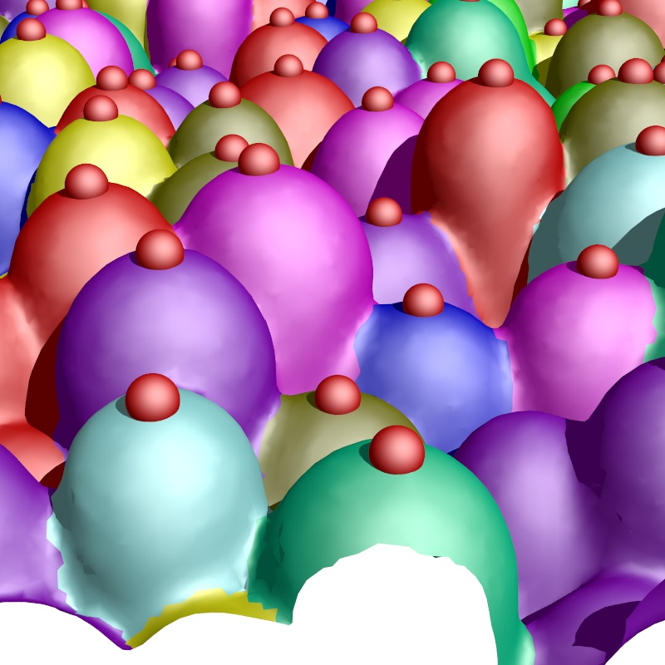
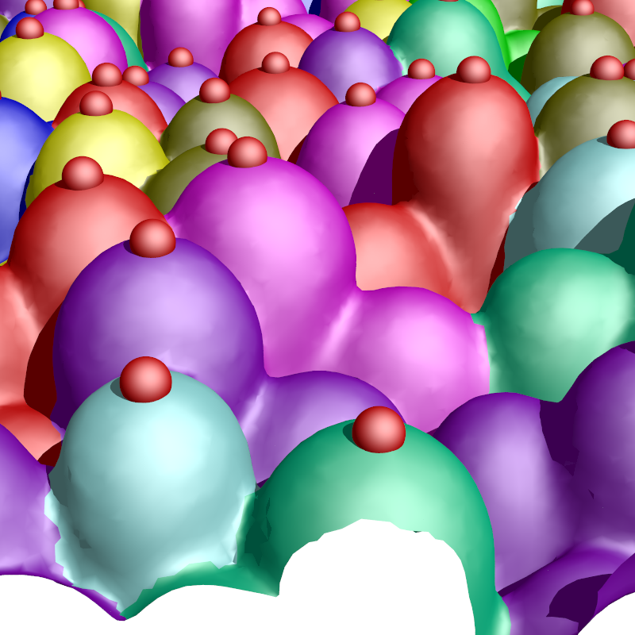
A Hierarchal Model is Generated by Simplification of Critical Points
Persistence is varied to annihilate pairs of critical points and produce coarser segmentations
Critical points with higher persistence are preserved at the coarser scales
Saddle
p₁
p₂

Slide 7
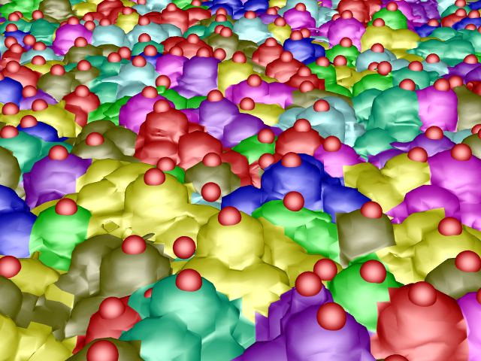
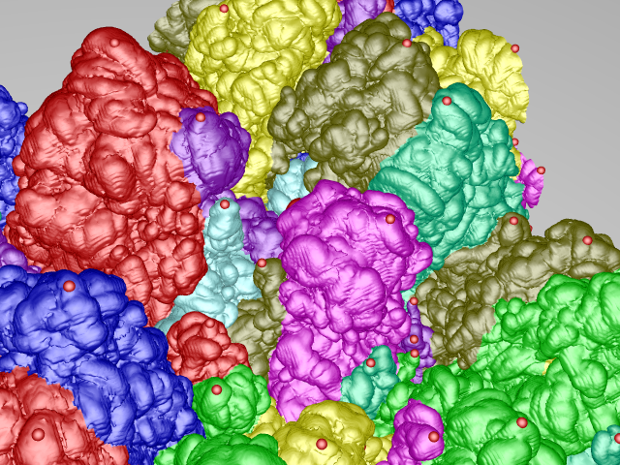
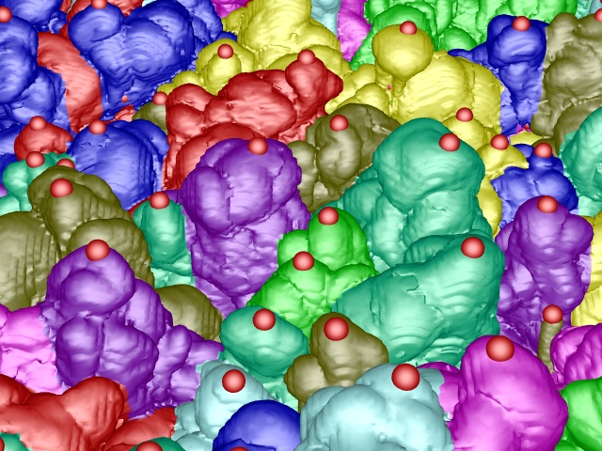
The Segmentation Method is Robust From Early Mixing to Late Turbulence
T=100
T=700
T=353

Slide 8
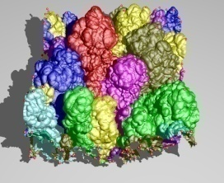
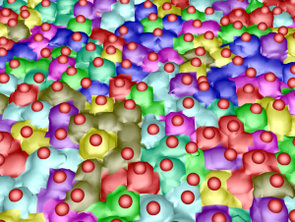
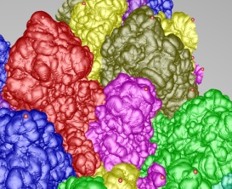
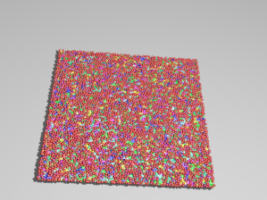
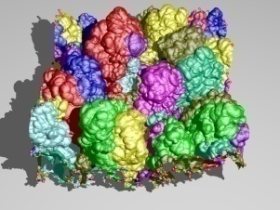
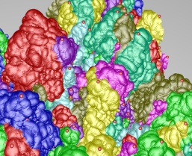
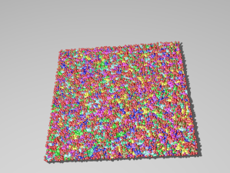
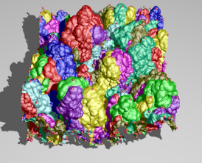
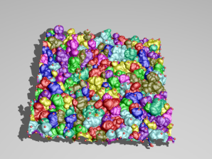
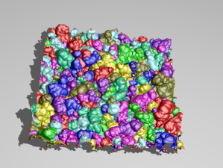
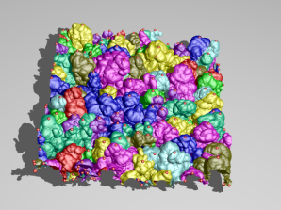
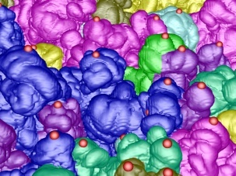
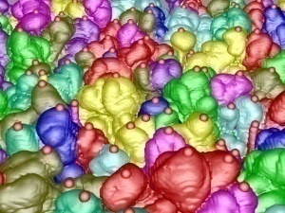
We Evaluated Our Quantitative Analysis at Multiple Scales
Under-segmented
Coarse scale
Medium scale
Number of bubbles
Over-segmented
Timestep
Fine scale

Slide 9
We Characterize Events that Occur in the Mixing Process

Slide 10
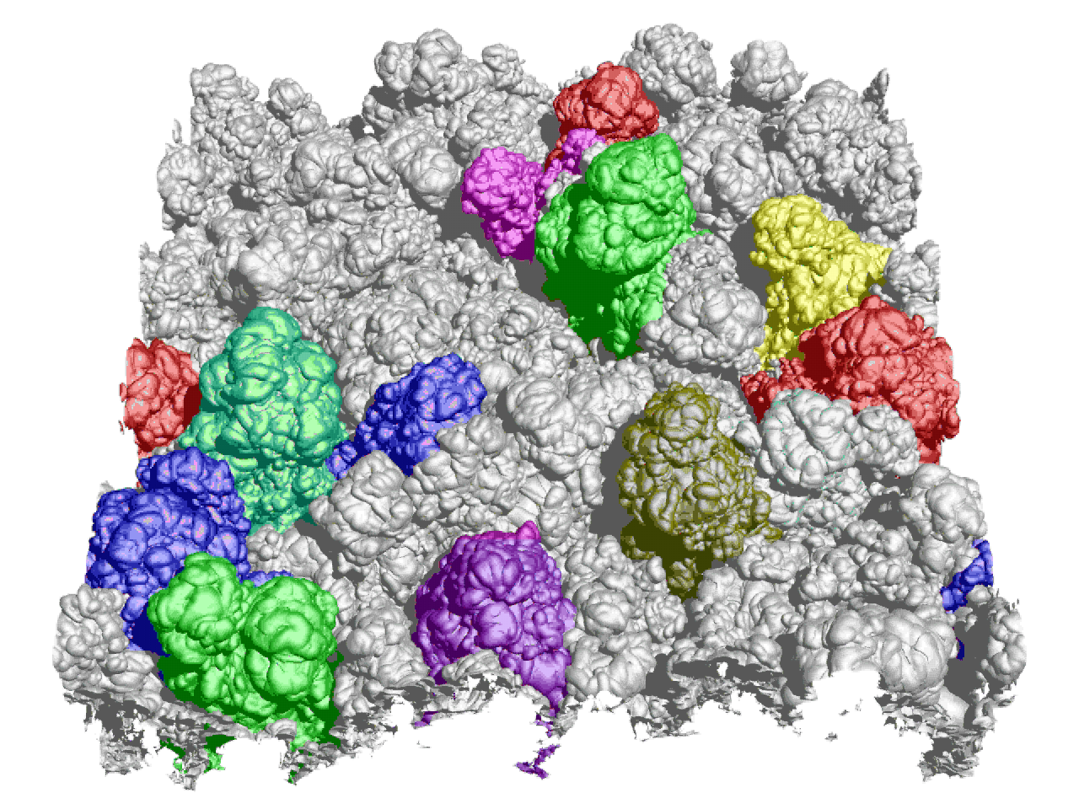
First Robust Bubble Tracking From Beginning to Late Turbulent Stages

Slide 11
First Time Scientists Can Quantify Robustly Mixing Rates by Bubble Count
0.5
1.0 (9524 bubbles)
0
-0.5
slope 1.536
-1
Mode-Normalized Bubble Count (log scale)
Derivative of Bubble Count
0.1
slope 1.949
-1.5
-2
slope 2.575
-2.5
Bubble Count
0.01
Derivative
-3
1
2
3
4
5
6
7
8
9
10
20
30
40
t/τ (log scale)

