Slide 1
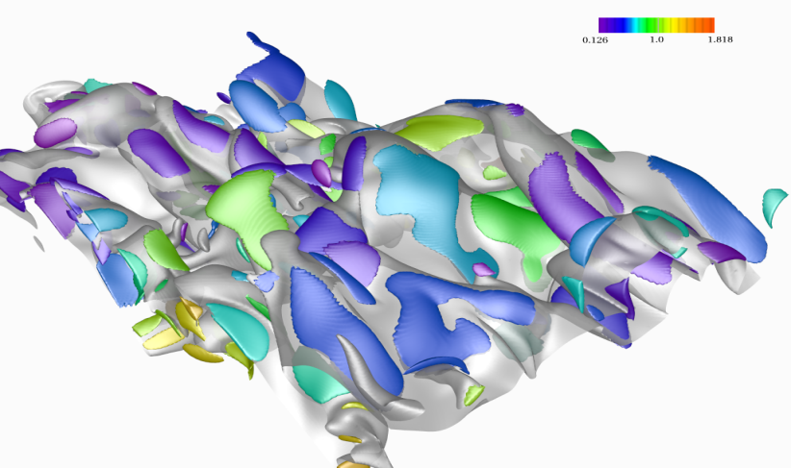
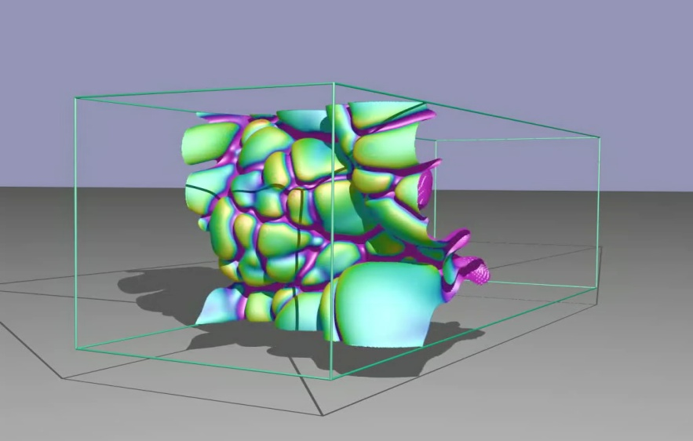
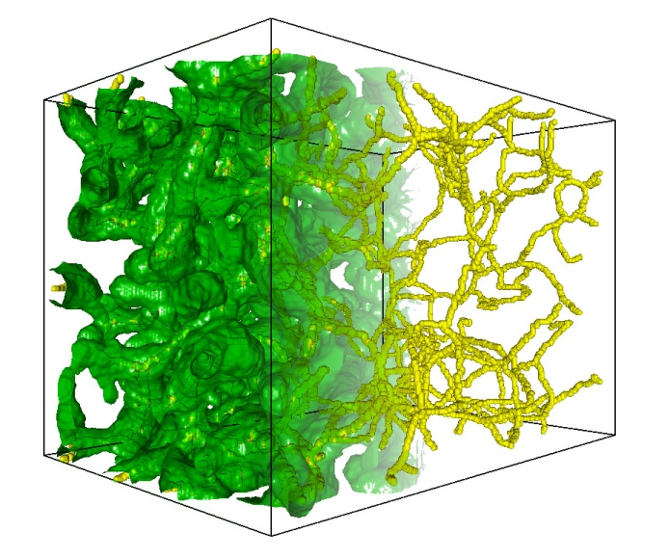
Multi-Resolution Streams of Big Scientific Data: Scaling Visualization Tools from Handheld Devices to In-Situ Processing
Valerio Pascucci
Director, Center for Extreme Data Management Analysis and Visualization
Professor, SCI institute and School of Computing, University of Utah
Laboratory Fellow, Pacific Northwest National Laboratory

Slide 2
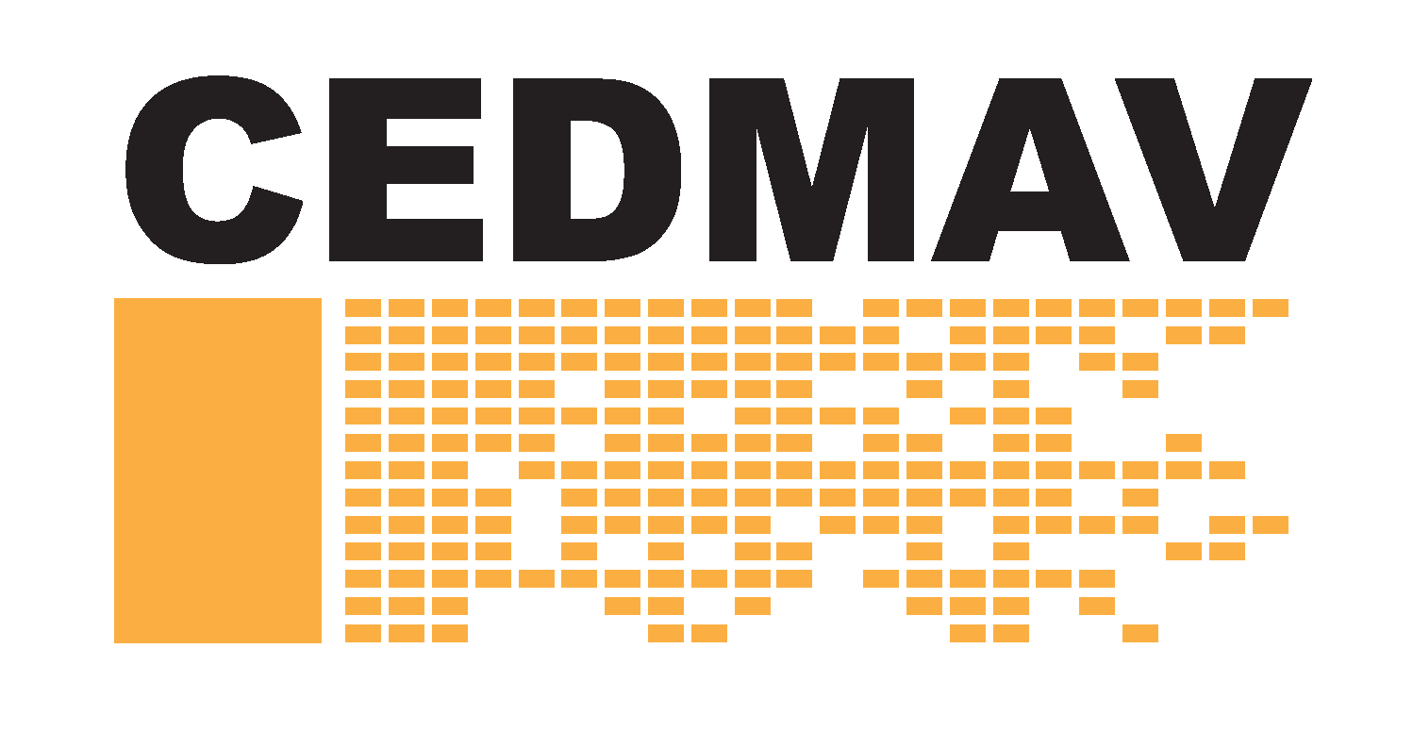
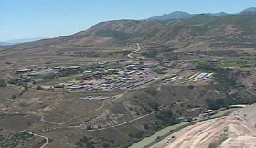
Center for Extreme Data Management, Analysis, and Visualization
10 Faculty + scientists, developers, students, …
Primary partners: UU & PNNL
Other partnerships: NSA, INL, LLNL, ANL, Battelle, ….
Involvement in national Initiatives
$1.6B NSA data center (1.5 million-square-foot facility)
Notes:
1
1
1
Thank co-authors

Slide 3
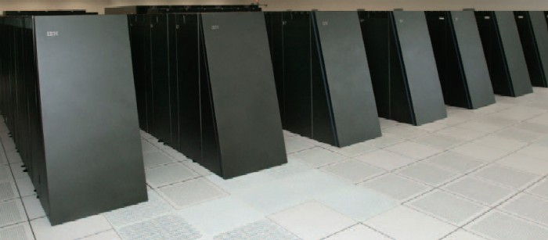
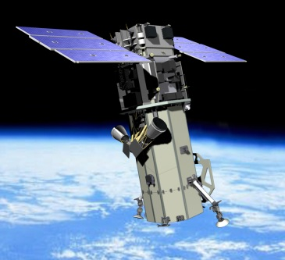
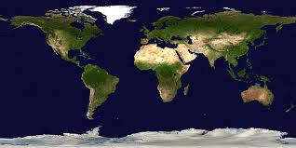
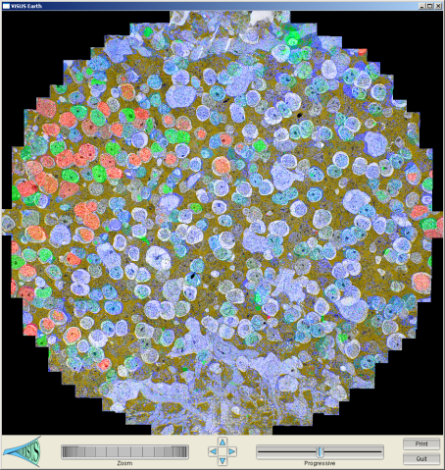
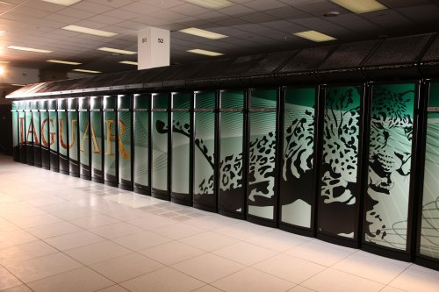
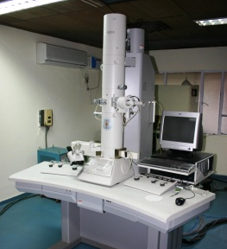
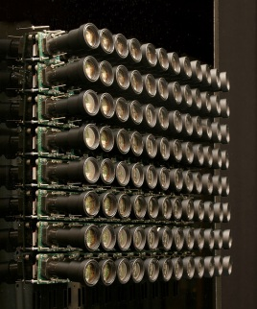
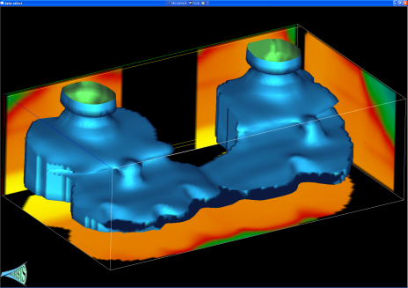
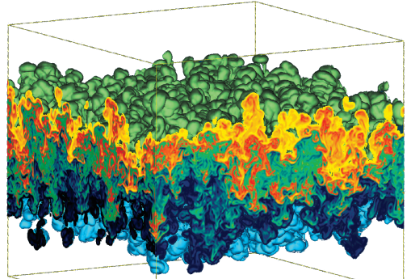
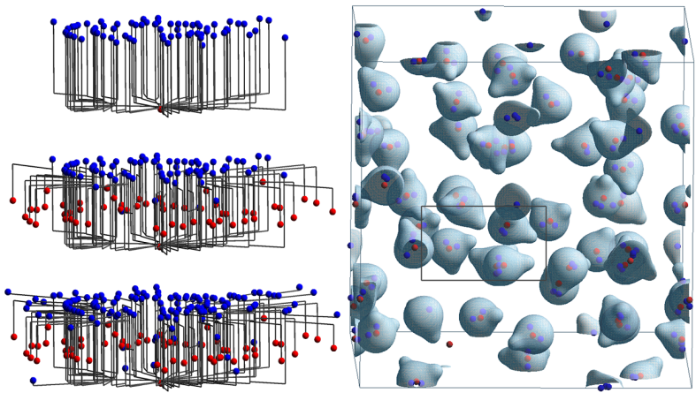
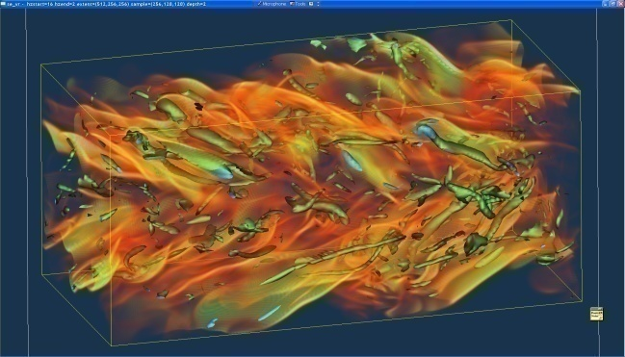
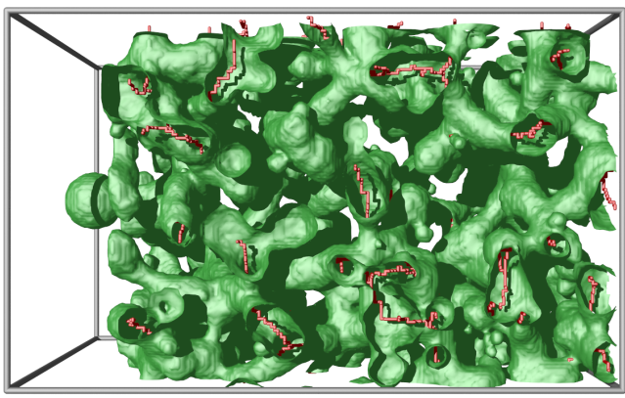
Massive Simulation and Sensing Devices Generate Great Challenges and Opportunities
Satellite
BlueGene/L
EM
Earth Images
Retinal Connectome
Cameras
Jaguar
Carbon Seq. (Subsurface)
Hydrodynamic Inst.
Molecular Dynamics
Climate
Turbulent Combustion
Photography
Porous Materials

Slide 4
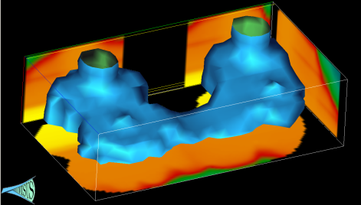
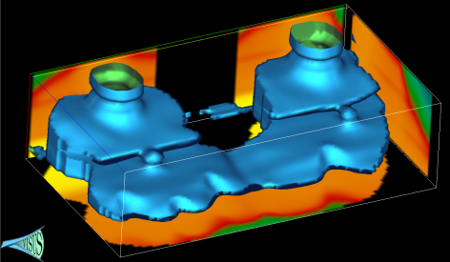
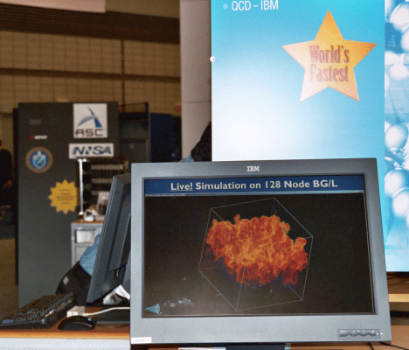
A Science Cyberinfrastructure Requires Efficient Big Data Management and Processing
Advanced data storage techniques:
Data re-organization.
Compression.
Advanced algorithmic techniques:
Streaming.
Progressive multi-resolution.
Out of core computations.
Scalability across a wide range of running conditions:
From laptop, to office desktop, to cluster of PC, to BG/L.
Memory, to disk, to remote data access.

Slide 5
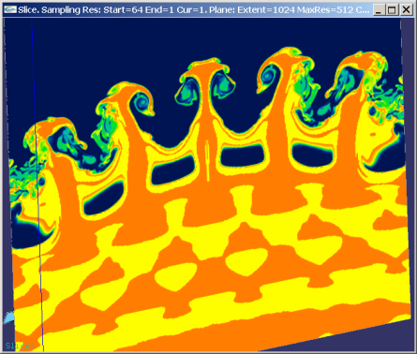
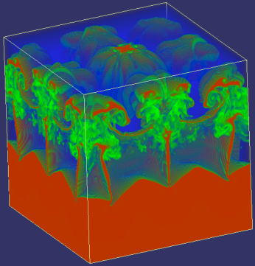
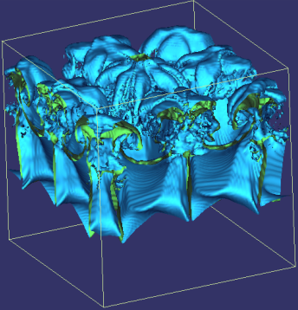
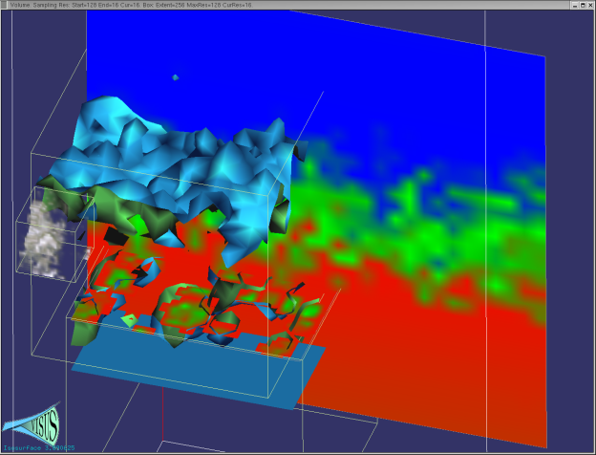
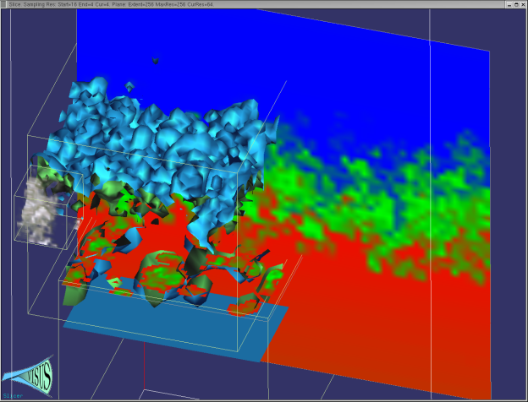
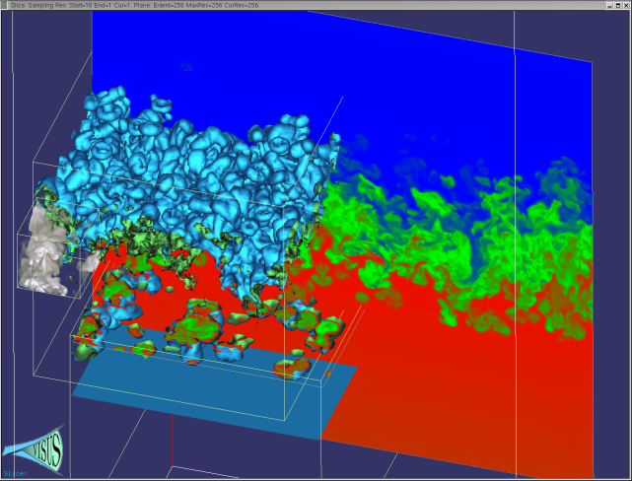
We Redesigned the Data Management and Visualization Pipeline with New Principles
Basic core techniques:
Slicing, Volume rendering, Iso-surfaces
Topology
Statistics
Cache-oblivious out-of-core processing optimizing access locality for any size of data blocks
Pipelines of progressive algorithms
Coarse-to-fine construction of multi-resolution models
Remote data streaming

Slide 6
We Consider the Three Main Components Defining a Computing Infrastructure
Processing Network (Data Access Path)
Data Layout (Cache Oblivious)
Algorithm Design
(Progressive Processing)

Slide 7
We Characterize Algorithmic Classes Based on Effect in a Processing Network

Slide 8
The use of top-down and bottom-up processes have a strong impact on the data stream
Benefit: pipeline of progressive modules
Progressive refinement: coarse representation immediately available
Input
Output
Input
Output
Speed
Decimation:
full resolution data needed first
Challenge:
minimize the quality differential
Accuracy

Slide 9
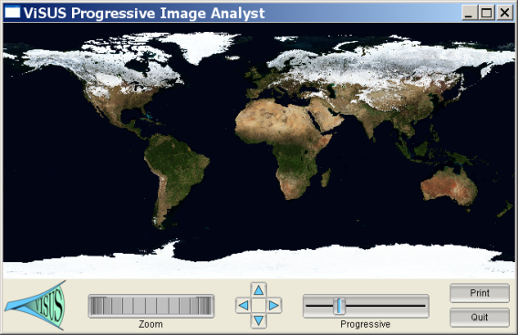
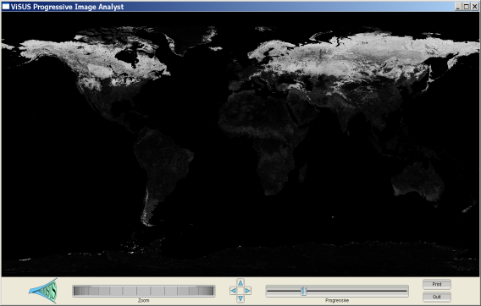
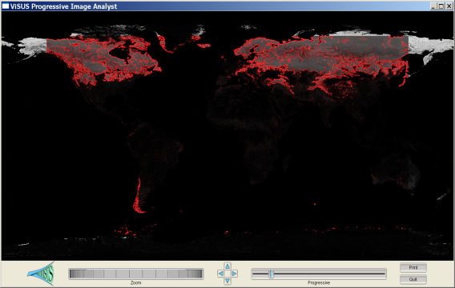
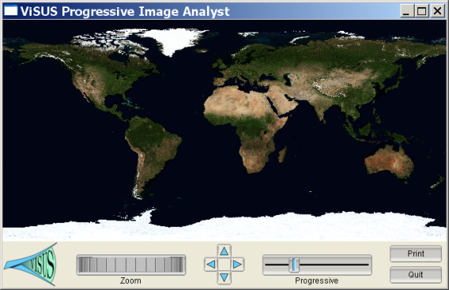
We Allow Distributed Computations at Different Stages of the Data Stream
Progressive Image Differencing + Editable GPU filter.
Two data sources (11 GB each)
Progressive differencing
Computed in real-time.
Streaming edge detection on the GPU.

Slide 10
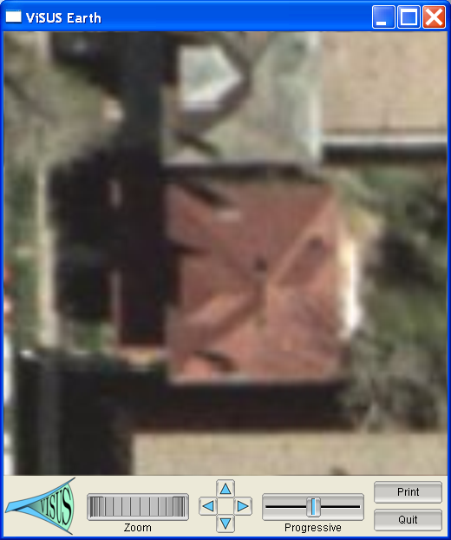
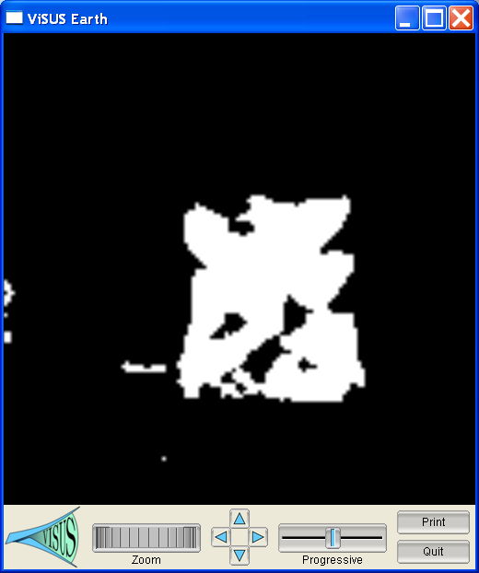
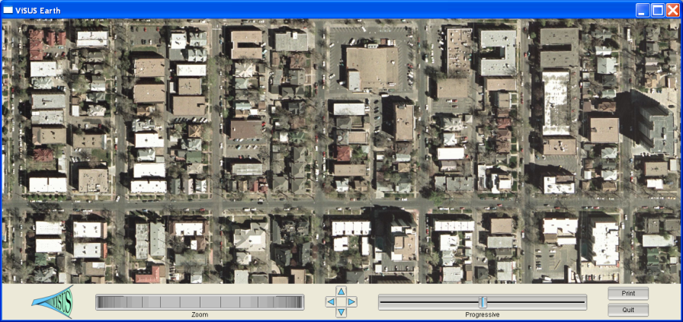
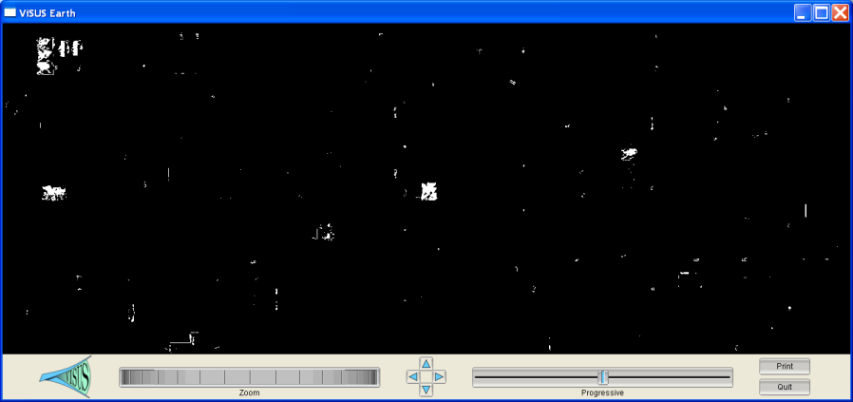
We are Developing Progressive Scheme for Content Based Image Processing
Hypothesis:
Progressive Analysis:

Slide 11
Poisson Solver for Image Cloning in Massive Image Collections
Color correction of 600+ images in real time

Slide 12
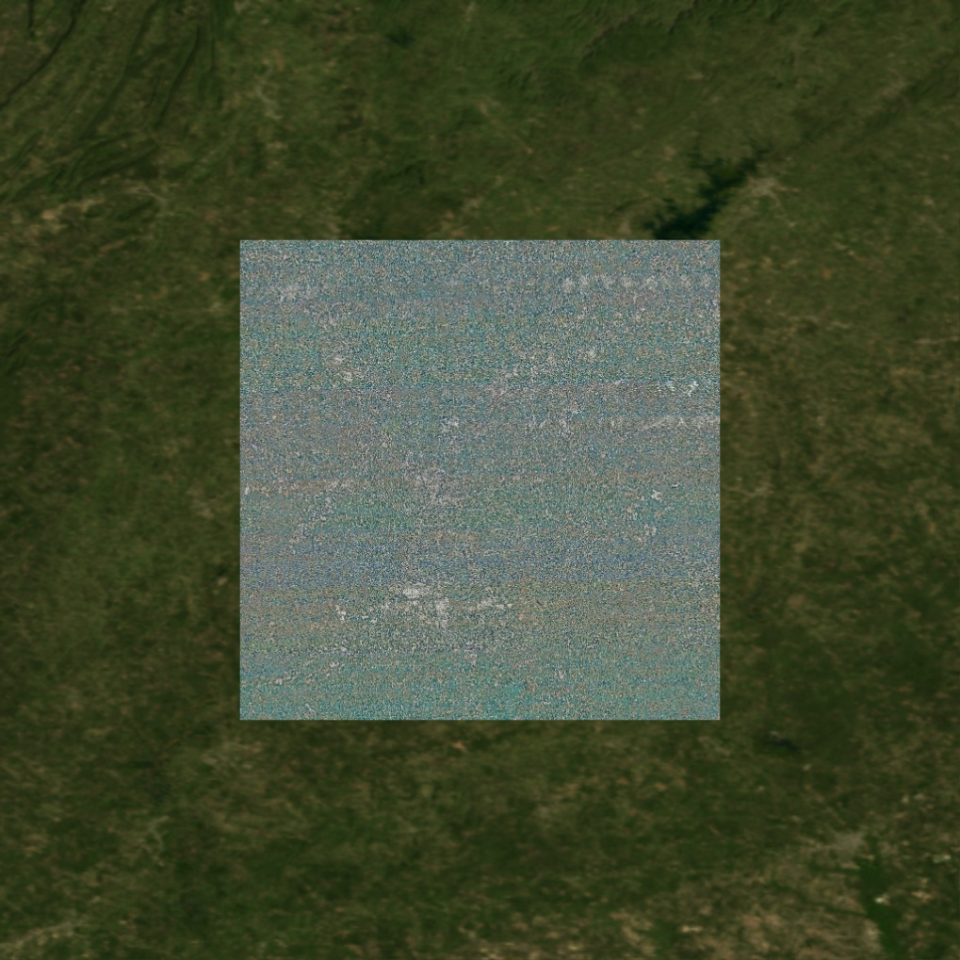
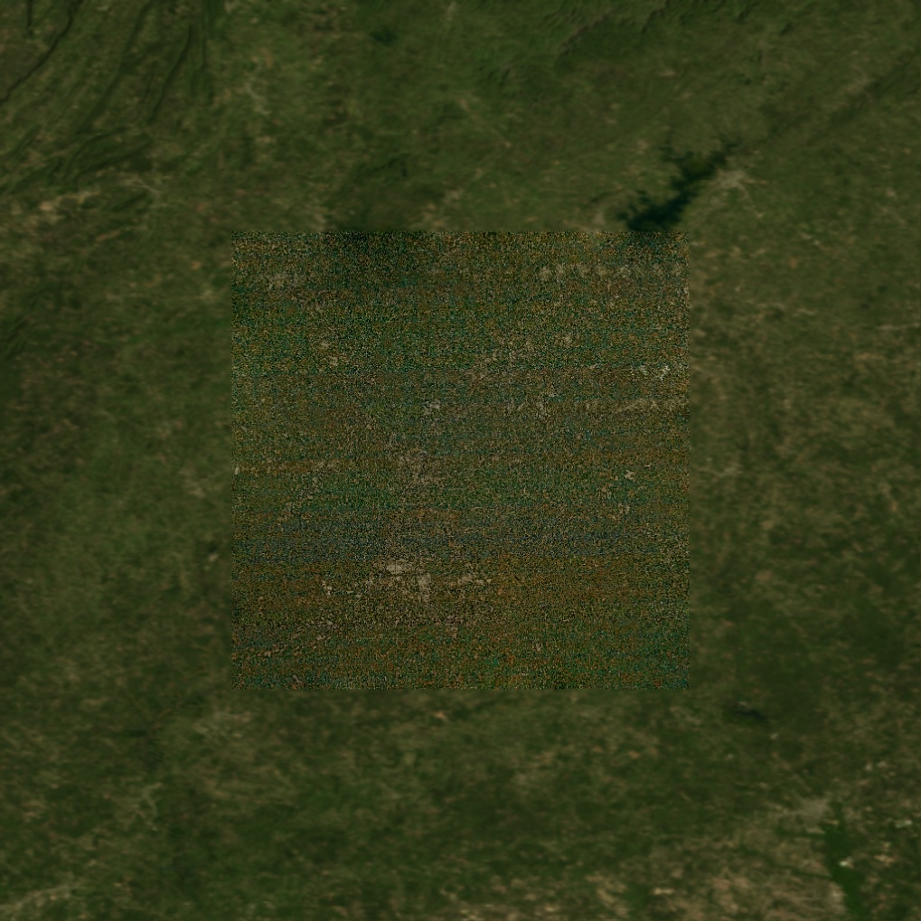
Poisson Solver for Image Cloning in Massive Image Collections
Pasting a 300GB satellite image of a city in background world map merged in real time

Slide 13
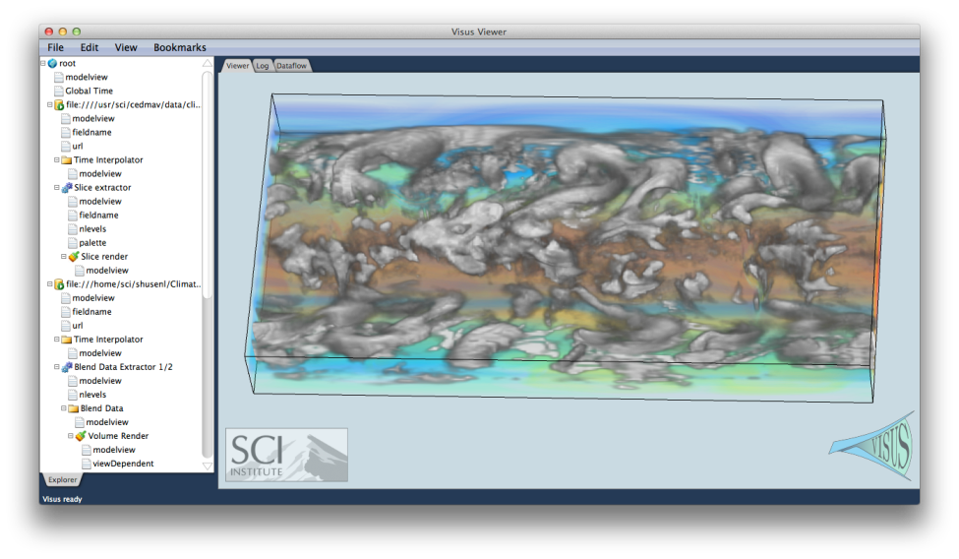
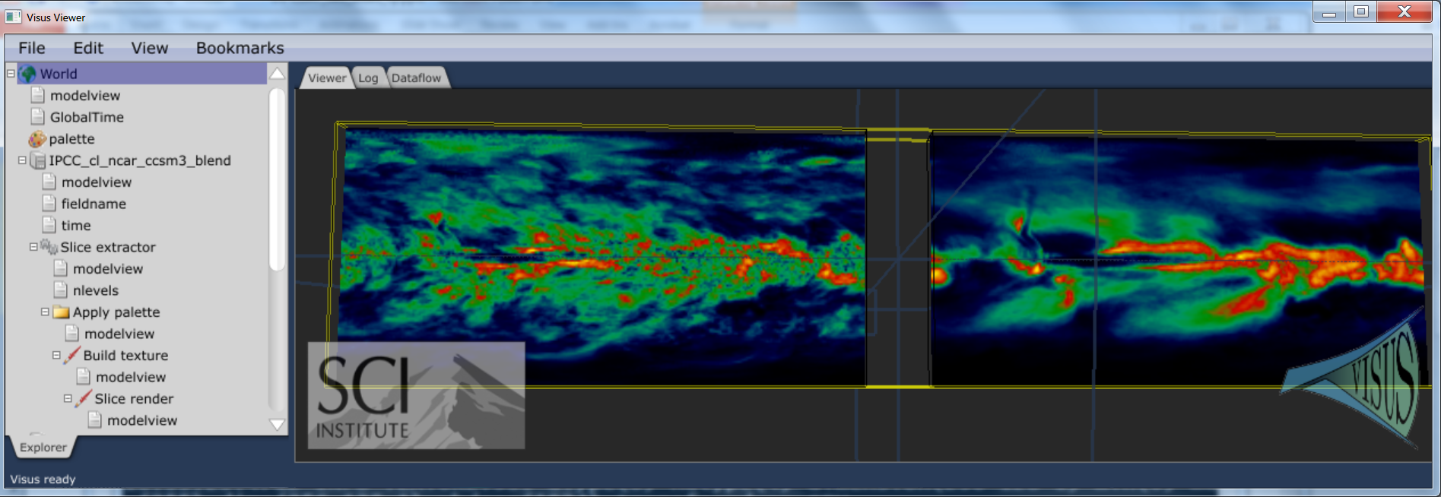
ViSUS Remote climate Data Analysis and Visualization
ViSUS data streams allow to merging multiple datasets in real time
Time interpolation of and concurrent visualization of climate data ensembles defined on different time scales
Server side and client side computation of statistical functions such as median, average, standard deviation, …….
Standard Deviation and Average of ten climate models

Slide 14
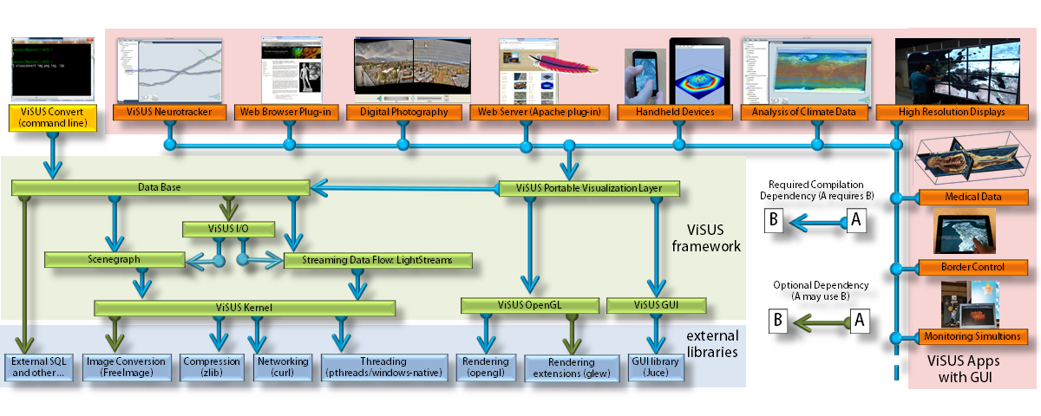
Scalable Software Infrastructure

Slide 15
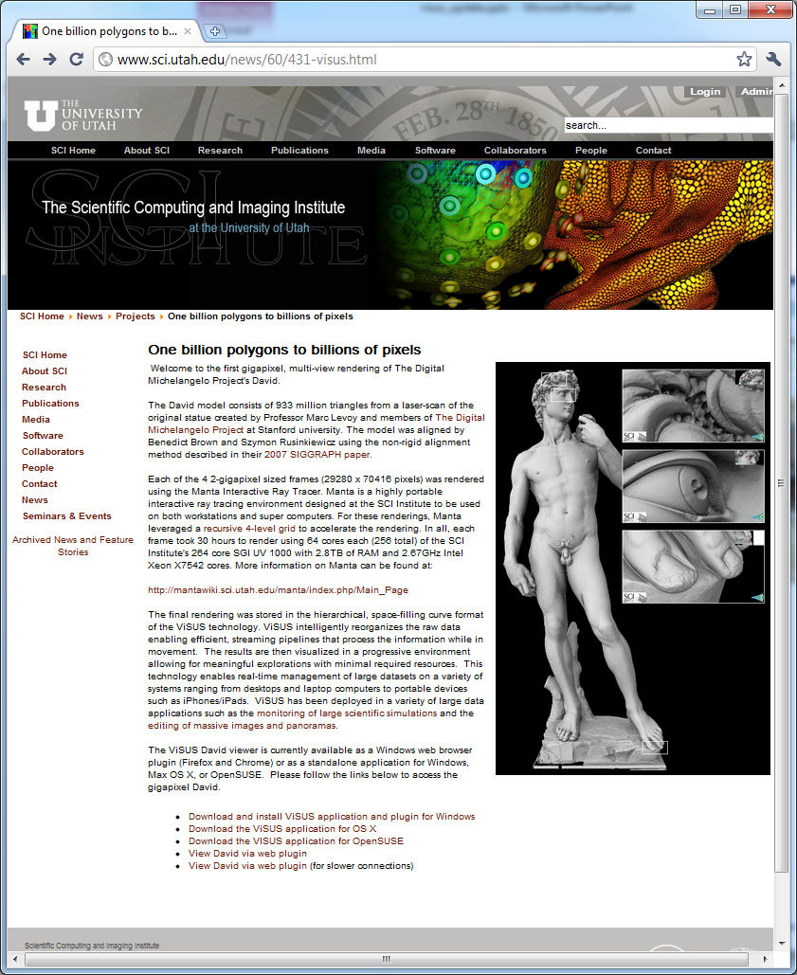
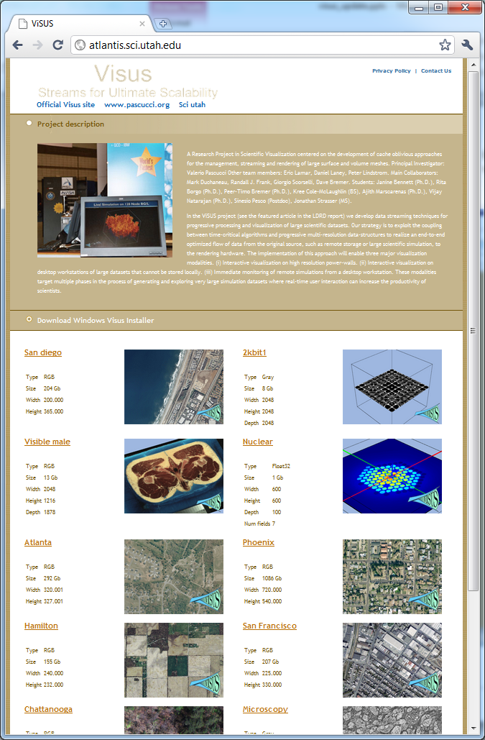
Server can be wrapped in Apache plug-in Client can be run in a web browser

Slide 16
Geospatial Data Rendering on iPad
Both client and SERVER run of handheld devices, e.g. multiple iPhones can be clients and servers for each other to share information on the field

Slide 17
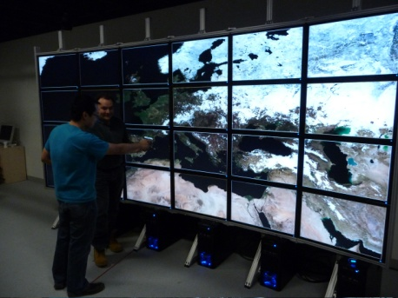
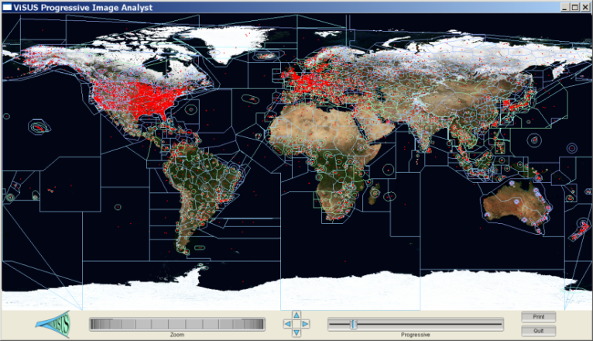
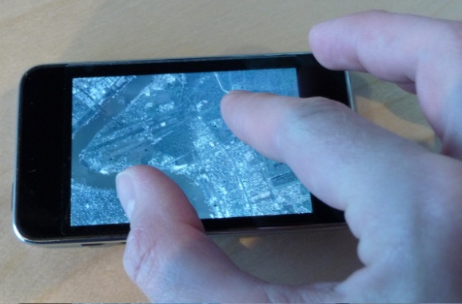
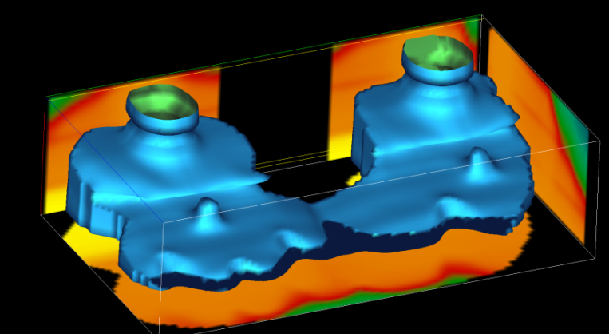
We Demonstrated Performance and Scalability in a Variety of Applications

Slide 18
We Demonstrated Performance and Scalability in a Variety of Applications
We are starting to redesign simulations based on the new algorithmic techniques

Slide 19
Streaming IDX directly from large scale (S3D) simulations
Web Server
STORAGE NODES
Hopper COMPUTE NODES
VISUALIZATION

Slide 20
The ViSUS Parallel I/O Infrastructure (PIDX) Adopts a 3–Phase Data Transfer Model
Three-Phase I/O:
(C).1 Data restructuring among processes transforms irregular data blocks at processes P0, P1 and P2 to regular data blocks at processes P0 and P2.
(C).2 HZ encoding of regular blocks leading to dense and non-overlapping data buffer.
(C).3 Data transfer from in-memory HZ ordered data to an aggregation buffer involving fewer large sized data packets.
(C).4 I/O writes from aggregation buffer to a IDX file.
One-Phase I/O:
(A).1 HZ encoding of irregular data set leads to sparse data buffers interleaved across processes.
(A).2 I/O writes to underlying IDX file by each process, leading to a large number of small accesses to each file.
Two-Phase I/O:
(B).1 HZ encoding of irregular data set leads to sparse data buffers interleaved across processes.
(B).2 Data transfer from in-memory HZ ordered data to an aggregation buffer involving large number of small sized data packets.
(B).3 Large sized aligned I/O writes from aggregation buffer to the IDX file.

Slide 21
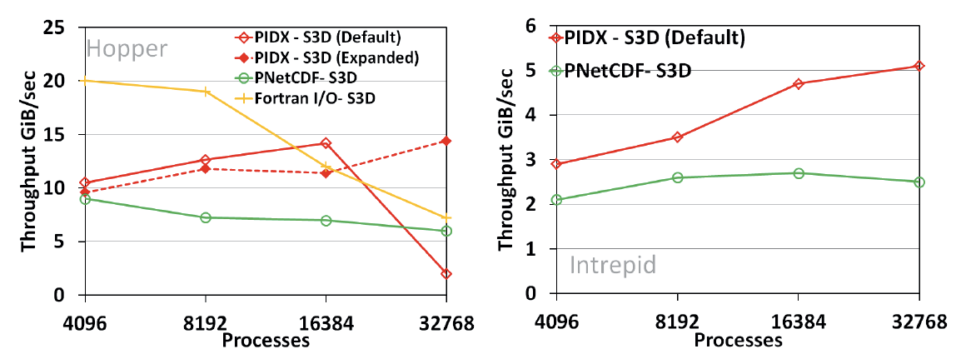
Strong Scaling Results Comparing PIDX Performance with PNetCDF and Fortrain I/O on Two Major Platforms
The PIDX Infrastructures Achieves Better Scalability than Competing Frameworks While Maintaining Advantageous Hierarchical Data Representation
Scaling Results on Hopper Cray XE6 architecture at NERSC (LBNL)
Scaling Results on Intrepid BGP architecture at ALCF (ANL)

Slide 22
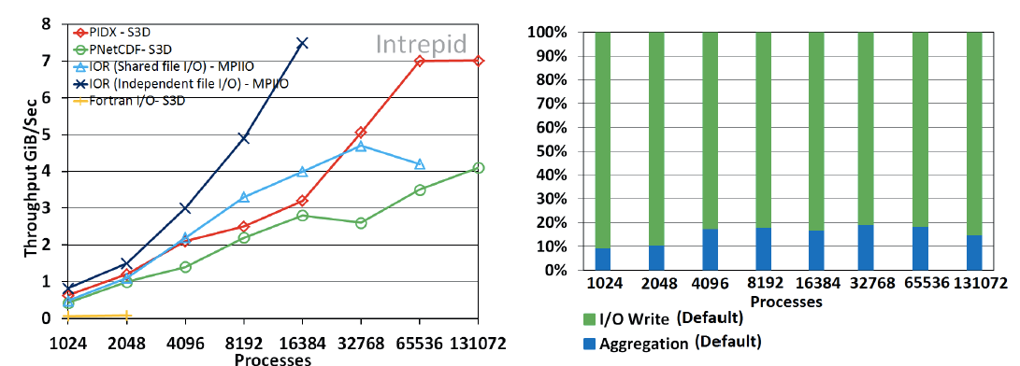
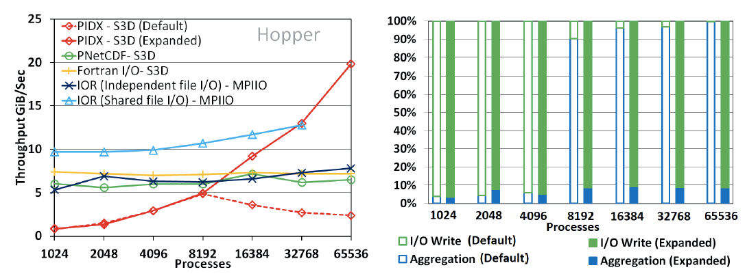
Weak Scaling Results Comparing PIDX Performance with Major Competing Techniques
Weak Scaling Results on Intrepid BGP architecture at ALCF (ANL)
Weak Scaling Results on Hopper Cray XE6 architecture at NERSC (LBNL)

Slide 23
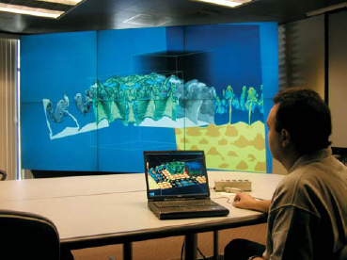
We Are Moving Towards a Distributed Storage and Processing Environment
Distributed storage
Data redundancy
Security
Heterogeneous collaborative infrastructure
Multi-scale collaborative interfaces accessing shared data sources:
data collection and validation
interactive analytics
decision making

Slide 24
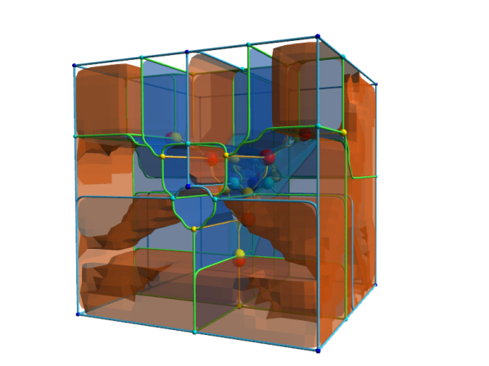
Topological Methods Have Been Successful for Analysis and Visualization of Massive Scientific Data
Molecular Analysis
(simulated)
Materials Analysis
(simulated)
Turbulent Mixing Analysis
(simulated)
Materials Analysis
(simulated)
Molecular Analysis
(simulated)
Materials Analysis
(imaged)
Biomedical Analysis
(imaged)
Cosmology Analysis
(simulated)
Combustion Analysis
(simulated)

Slide 25
Parallel Topological Analysis with Morse-Smale Complex
We developed a parallel Morse-Smale complex omputation algorithm and characterized its performance at leadership scale
Tunable parameters for blocking, merging, and simplification.
Performance characterization based on data size, complexity, and process count
Demonstrated strong scalability on combustion and hydrodynamic instability problems
Morse-Smale Complex provides a compact roadmap into scalar data
By mapping behavior into critical points and regions of uniform gradient flow
At a fraction of the data size of the original dataset (see table below)
Morse-Smale complexes in quantum chemistry (upper) and combustion (lower)
Application | Data Reduction
Hydrodynamics data | 2.4X
Chemistry data | 7X
Combustion data | 14X
Synthetic test data | 400X
Factor reduction in data size of Morse-Smale Complex compared to original dataset
Rayleigh-Taylor mixing problem and strong scaling for generating its Morse-Smale Complex
Notes:
Participants
-Attila Gyulassy, Tom Peterka, Valerio Pascucci, Rob Ross
Problem
Topology-based techniques are useful for multiscale exploration of the feature space of scalar-valued large-scale simulations. The Morse-Smale Complex allows robust identification of gradient-based features and is suitable for analysis tasks in a wide range of application domains, for example physics, combustion, and chemistry. Computing the complex independently in parallel can result in output as large as the original dataset, and conceal features of interest. A multi-resolution representation is needed to simplify this complex, but requires resolution of global features: this has never been done in parallel for the Morse-Smale Complex.
Solution
We designed and implemented an algorithm to construct the Morse-Smale Complex in parallel with tunable parameters that allow trade-offs in use of resources, output size and accuracy.
These parameters include blocking strategy, merging strategy, and simplification level of the topology.
We performed parameter studies on artificial data designed to test best-case and worst-case performance, where feature size and count are varied in a range of data sizes and processor counts.
We ran strong scaling studies on data from large-scale simulations of combustion and hydrodynamic instabilities.
Impact
Proven scalability on Argonne Blue Gene/P: 35% strong scaling efficiency from 2K to 32K processes on Rayleigh-Taylor mixing problem. This efficiency is for end-to-end time to read the dataset from storage, compute and simplify the Morse-Smale Complex, and write the complex to storage.
-Similar scalability for combustion problem
-Being able to scale the generation of the Morse-Smale complex in parallel to the same scale as simulation enables the technique to be deployed in situ
-The simplified Morse-Smale complex requires only a fraction of the storage of the original dataset, up to 14X reduction in our tests of actual datasets. Even more aggressive reduction rates are possible, we reduced up to 400X in our synthetic tests.
-Unlike ordinary compression, the Morse-Smale complex is an intelligent compression guided by the complexity of the original data and the desired level of simplification. Such techniques that provide data-driven, adjustable multiresolution reduction will be absolutely essential going forward to exascale datasets. Parallelizing the Morse-Smale Complex is a major step in that direction.
-Another way to view the the Morse-Smale complex is as a roadmap into the dataset. It can be used to detect features, as an index into the dataset, or to query the data.

Slide 26
Artifacts and Data Partitioning for Paralelization

Slide 27
Artifacts and Data Partitioning for Paralelization

Slide 28
Artifacts and Data Partitioning for Paralelization

Slide 29
Artifacts and Data Partitioning for Paralelization

Slide 30
Artifacts and Data Partitioning for Paralelization

Slide 31
Artifacts and Data Partitioning for Paralelization

Slide 32
Preliminary Scaling Results
352 million vertices, 1.344GB data

Slide 33
Scatter Phase – Components that Need to be Evaluated by Both SST Micro and SST Macro Simulations
Potential for:
Streaming processing
Bulk processing
Adjustable hierarchy width
Scatter phase can be interleaved with gather
Trade-off between computation and data movement
Granularity of communication vs. amount of data transfer
Synchronous vs. asynchronous

Slide 34
We are Creating a Flexible Data Analysis Pipeline to Explore the Exascale Design Space
The analytics layer is split into four stages:
Local computation
Gather phase
Scatter phase
Feature-based statistics
For each phase there are different algorithms
Phases can be combined in different ways
Phases can be distributed among heterogeneous resource
We are starting to explore different use cases

Slide 35
Local Computation: options that need to be evaluated by SST Micro Simulation
Fundamentally a union-find approach
Options:
Sort -> Filter -> Compute
Filter -> Sort -> Compute
Scan -> Traverse
Potential for
GPU based sorting and filtering (greater data transfer cost)
Multi-threading (shared memory)

Slide 36
Gather Phase – Distributed Data Communication Layer that Needs Evaluation by SST Macro Simulation
Fundamentally a merge-sort approach
Potential for:
Streaming processing
Bulk processing
Adjustable hierarchy width

Slide 37
Initial Use Cases Targeted
Local scan -> ADIOS -> Serial Compute
Local compute -> ADIOS -> Serial Merge/Gather/Statistics
Local compute -> Merge
Threaded Computation

Slide 38
Topological Analysis of Massive Combustion Simulations
Non-premixed DNS combustion (J. Chen, SNL): Analysis of the time evolution of extinction and reignition regions for the design of better fuels

Slide 39
A Data Analysis and Visualization Center Can be a Catalyst for a Virtuous Cycle of Collaborative Activities
Tight cycle of :
basic research,
software deployment
user support
Coordination among eight projects:
unified techniques for several applications
Strong University-Lab-Industry collaboration
Focused technical approach:
performance tools for fast data access
general purpose data exploration
error bounded quantitative analysis
feature extraction and tracking
Interdisciplinary collaboration with domain scientists (from math to physics):
motivating the work
formal theoretical approaches
feedback to specific disciplines

