Slide 1

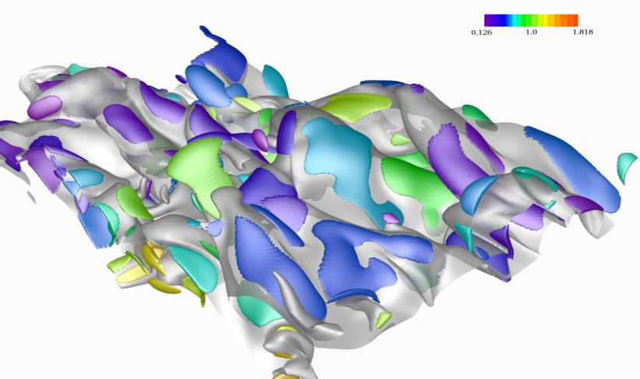
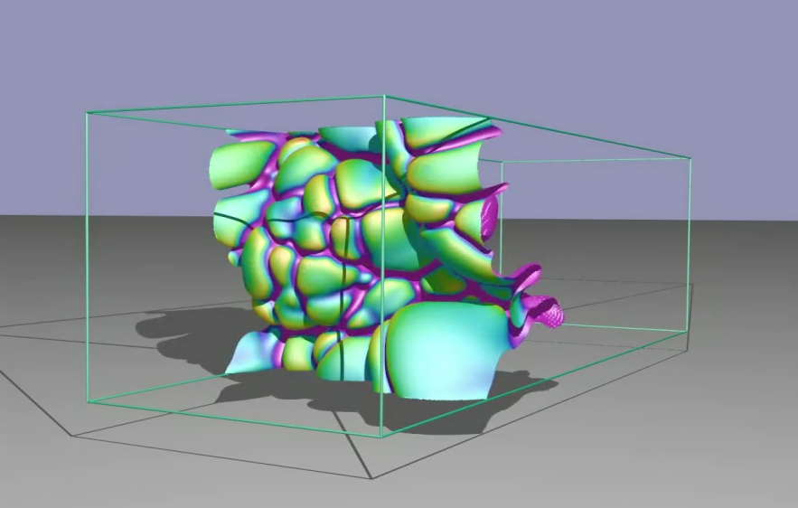
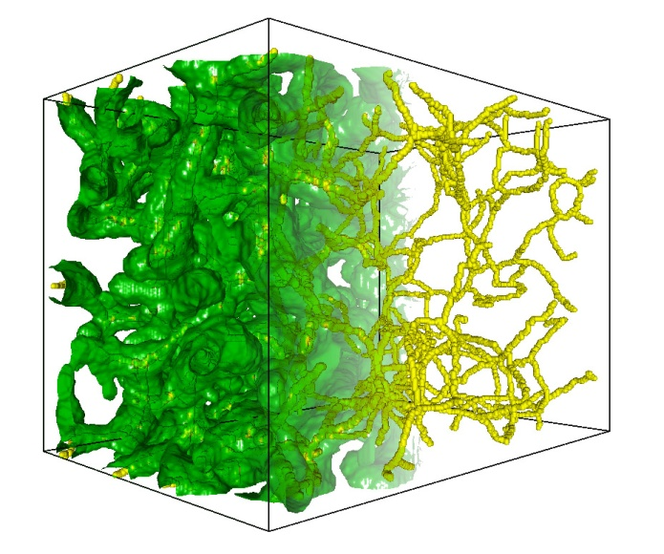
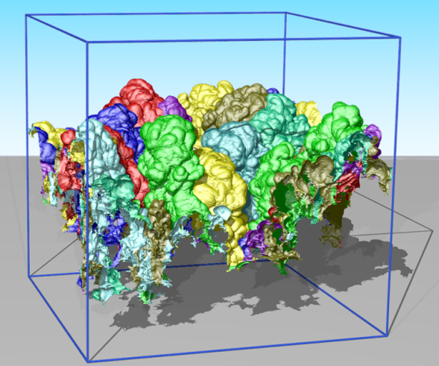
Multi-Resolution Streams of Big Scientific Data:
Scaling Visualization Tools from Handheld Devices to In-Situ Processing
Valerio Pascucci
Director, Center for Extreme Data Management Analysis and Visualization
Professor, SCI institute and School of Computing, University of Utah
Laboratory Fellow, Pacific Northwest National Laboratory

Slide 2





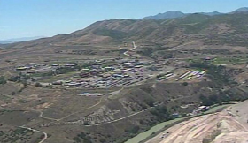


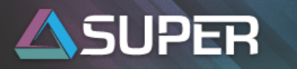


Center for Extreme Data
Management, Analysis, and Visualization
10 Faculty + scientists,
developers, students, …
Primary partners:
UU & PNNL
Other partnerships:
NSA, INL, LLNL, ANL,
Battelle, ….
Involvement in national Initiatives
$1.6B NSA data center
(1.5 million-square-foot facility)
Notes:
1
1
1
Thank co-authors

Slide 3
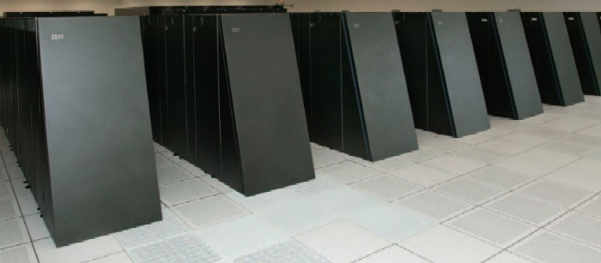
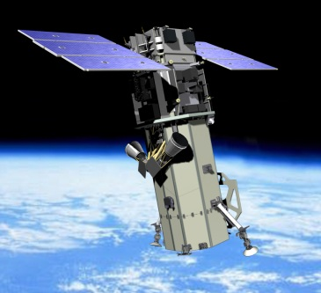

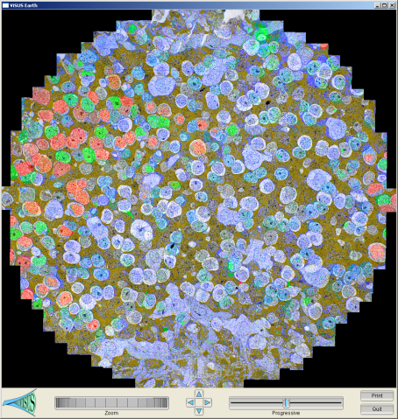
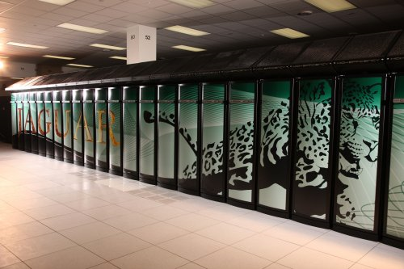
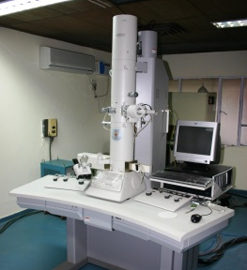
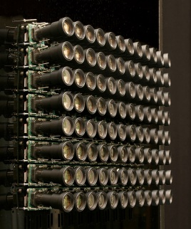
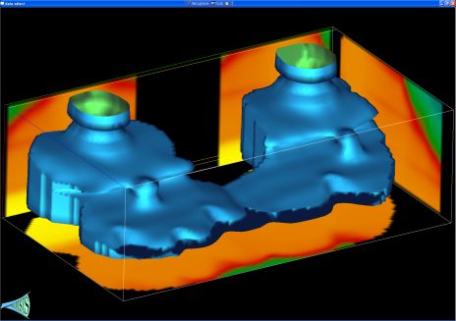
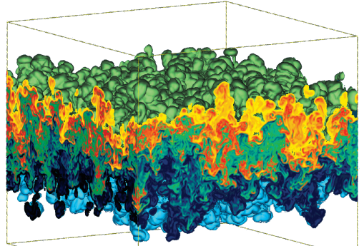
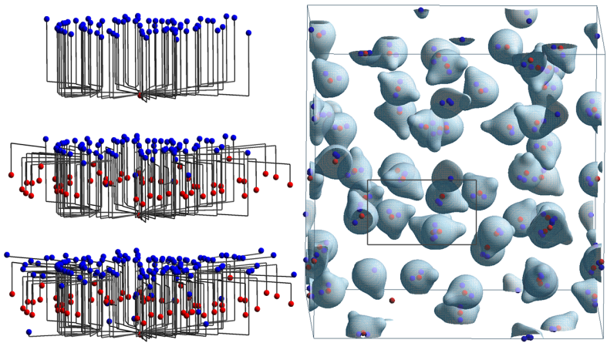
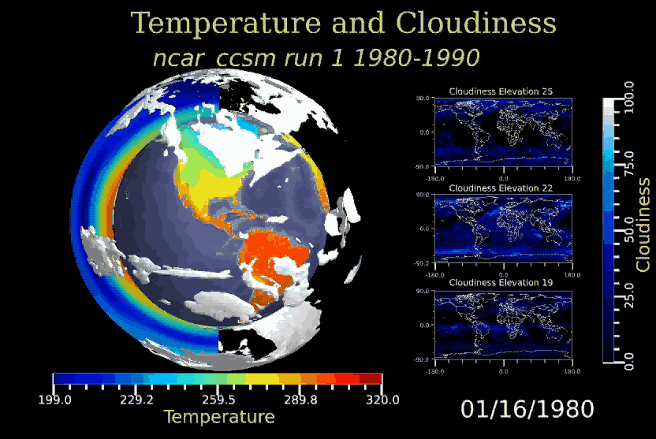
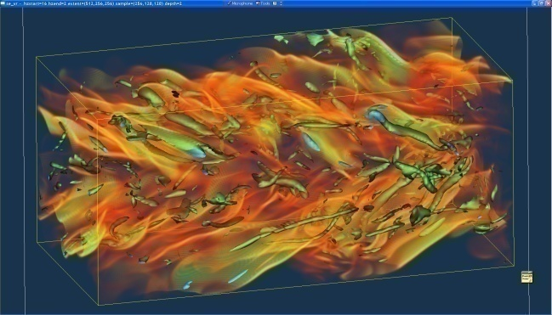
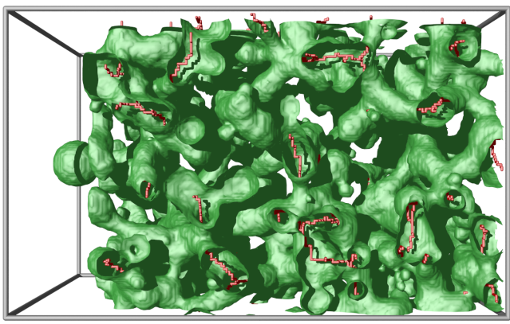
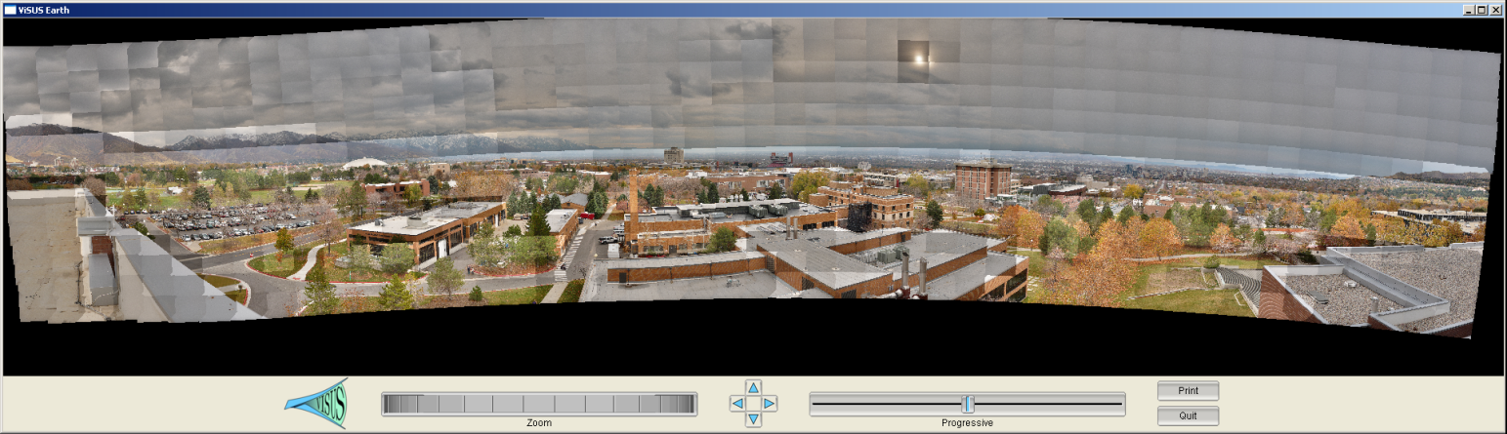
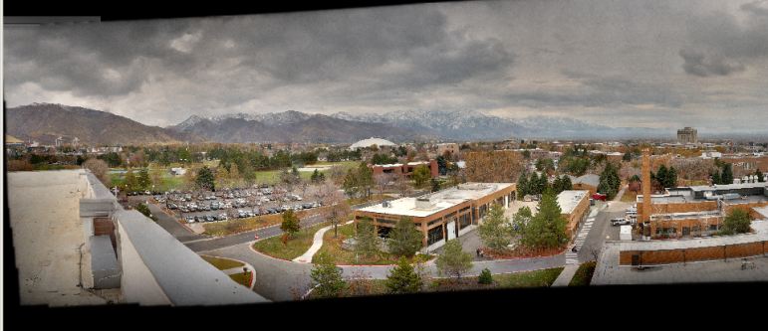
Massive Simulation and Sensing Devices Generate
Great Challenges and Opportunities
Satellite
BlueGene/L
EM
Earth Images
Retinal Connectome
Cameras
Jaguar
Carbon Seq. (Subsurface)
Hydrodynamic Inst.
Molecular
Dynamics
Climate
Turbulent Combustion
Photography
Porous Materials

Slide 4
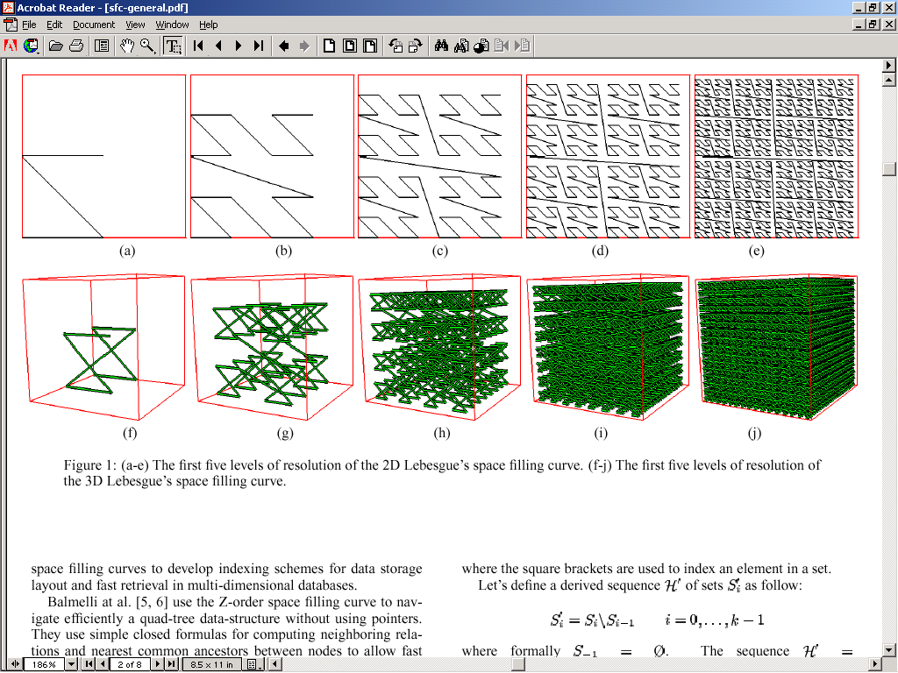
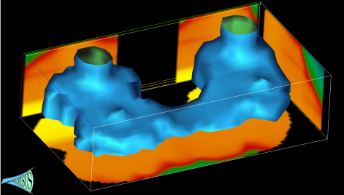
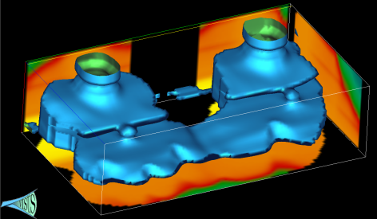

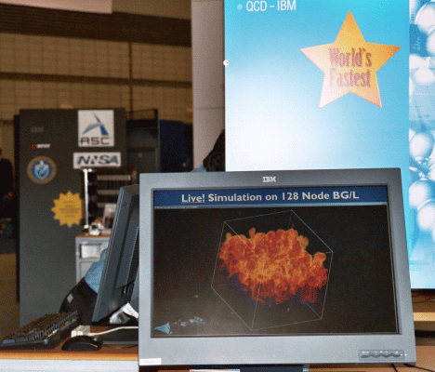

A Cyberinfrastructure Requires Efficient
Data Management and Processing
Advanced data storage techniques:
  Data re-organization.
  Compression.
Advanced algorithmic techniques:
  Streaming.
  Progressive multi-resolution.
  Out of core computations.
Scalability across a wide range of running conditions:
  From laptop, to office desktop,
  to cluster of PC, to BG/L.
  Memory, to disk, to remote
  data access.

Slide 5
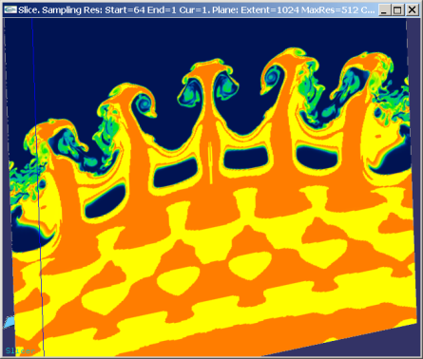
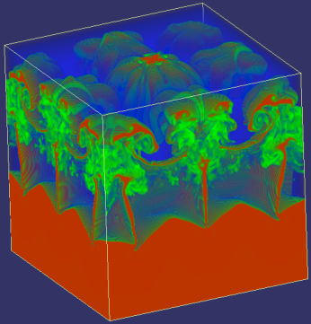
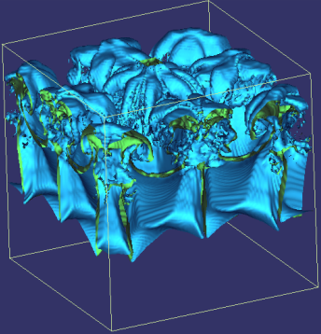
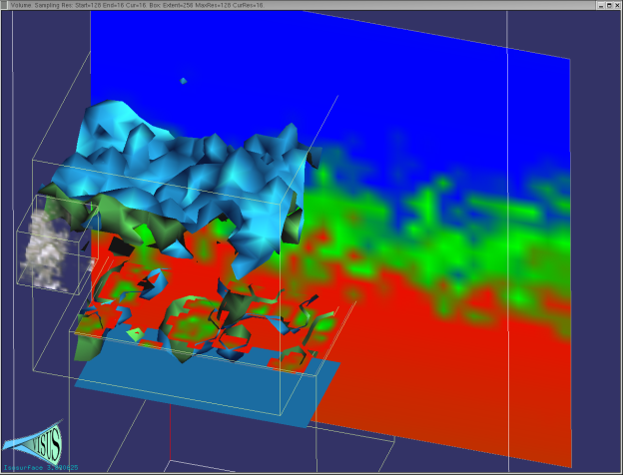
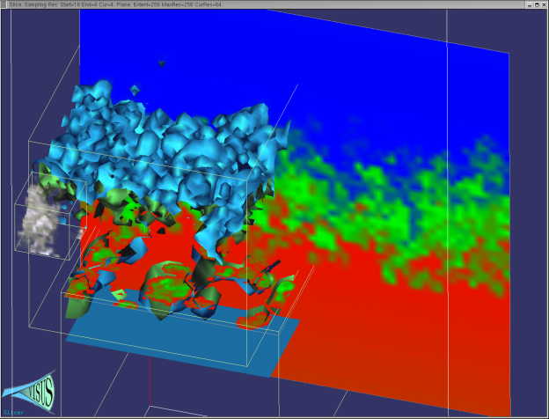
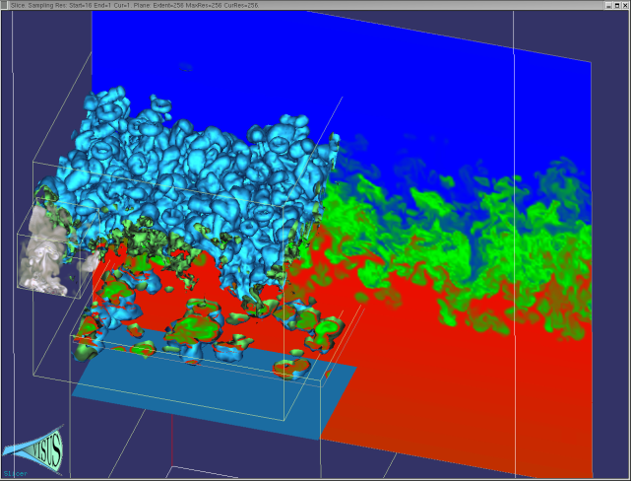
We Redesigned the Data Management and Visualization Pipeline with New Principles
Basic core techniques:
  Slicing, Volume
  rendering, Iso-surfaces
  Topology
  Statistics
Cache-oblivious out-of-core
processing optimizing access
locality for any size of data blocks
Pipelines of progressive algorithms
Coarse-to-fine construction of
multi-resolution models
Remote data streaming

Slide 6
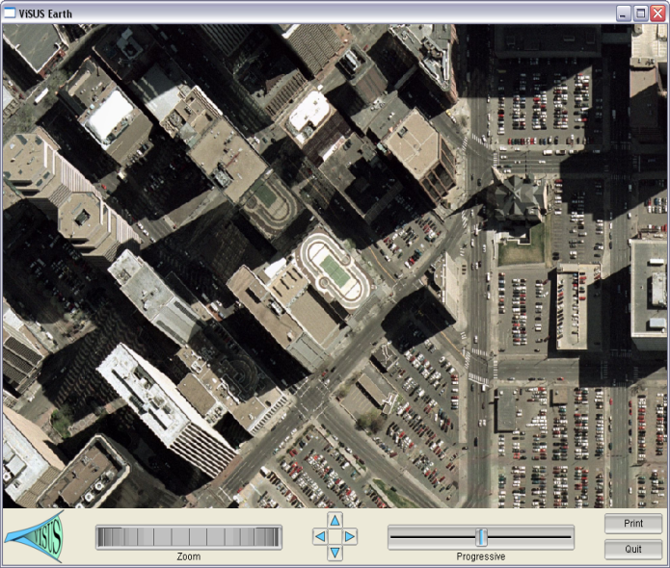
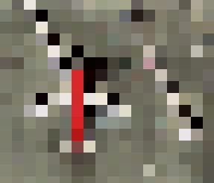
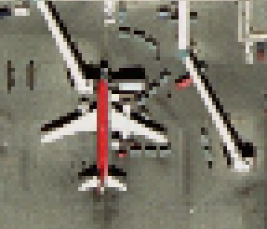
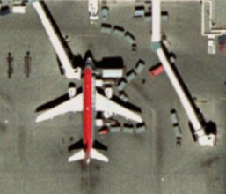
We Consider the Three Main Components
Defining a Computing Infrastructure
Processing Network
(Data Access Path)
Data Layout
(Cache Oblivious)
Algorithm Design
(Progressive Processing)

Slide 7
We Characterize Algorithmic Classes Based on Effect in a Processing Network

Slide 8
The use of top-down and bottom-up processes have a strong impact on the data stream
Benefit: pipeline of progressive modules
Progressive refinement:
coarse representation
immediately available
Input
Output
Input
Output
Speed
Decimation:
full resolution data needed first
Challenge:
minimize the quality differential
Accuracy

Slide 9
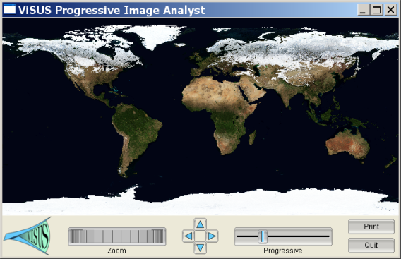
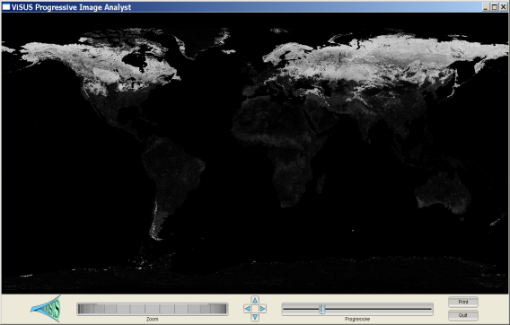
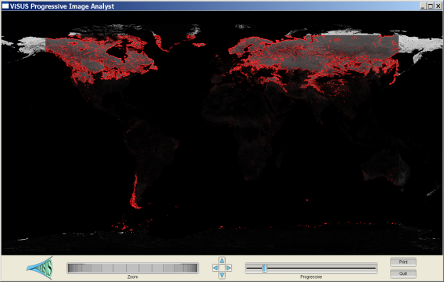
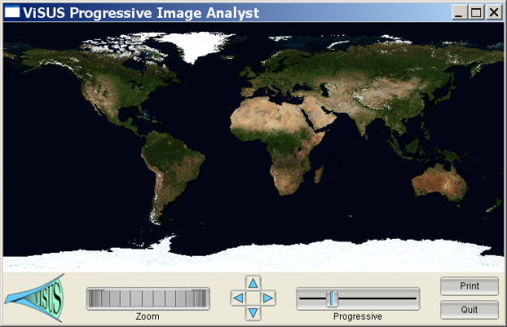
We Allow Distributed Computations at
Different Stages of the Data Stream
Progressive Image Differencing + Editable GPU filter.
Two data sources
(11 GB each)
Progressive differencing
Computed in real-time.
Streaming edge
detection on the GPU.

Slide 10
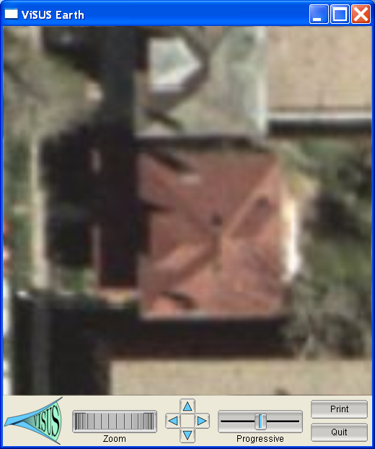
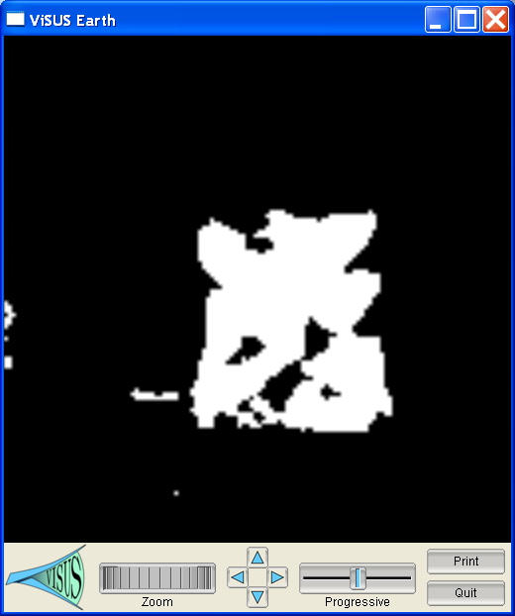
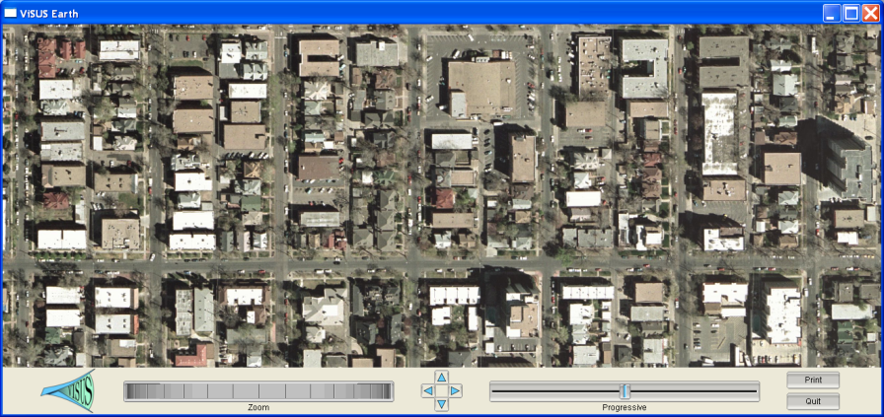
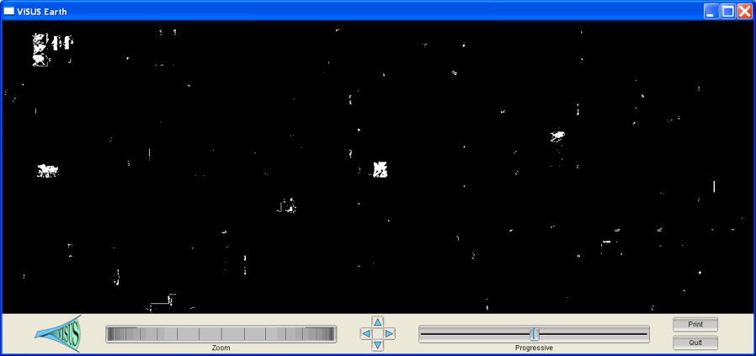
We are Developing Progressive Scheme for Content Based Image Processing
Hypothesis:
Progressive Analysis:

Slide 11
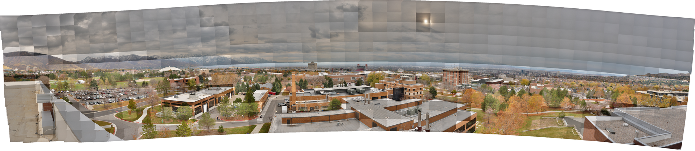
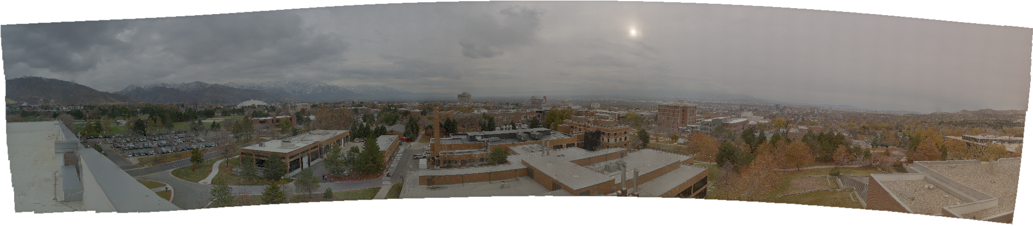
Poisson Solver for Image Cloning in Massive Image Collections
Color correction of 600+ images in real time

Slide 12
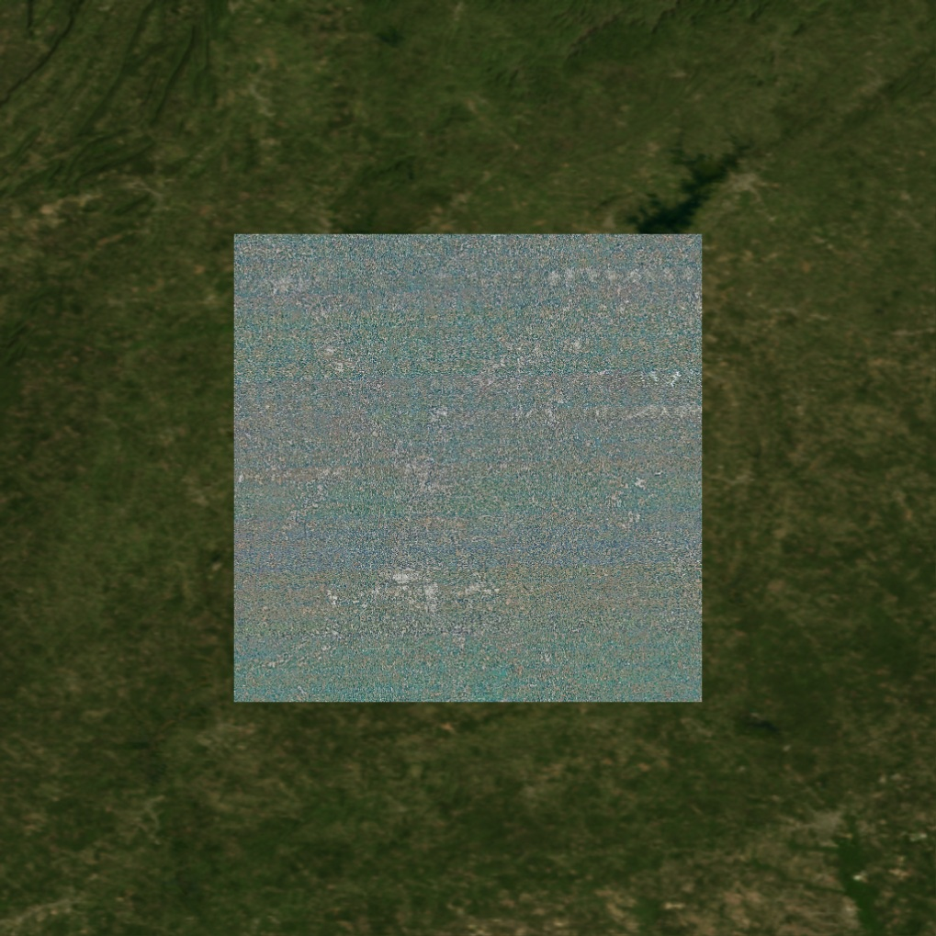
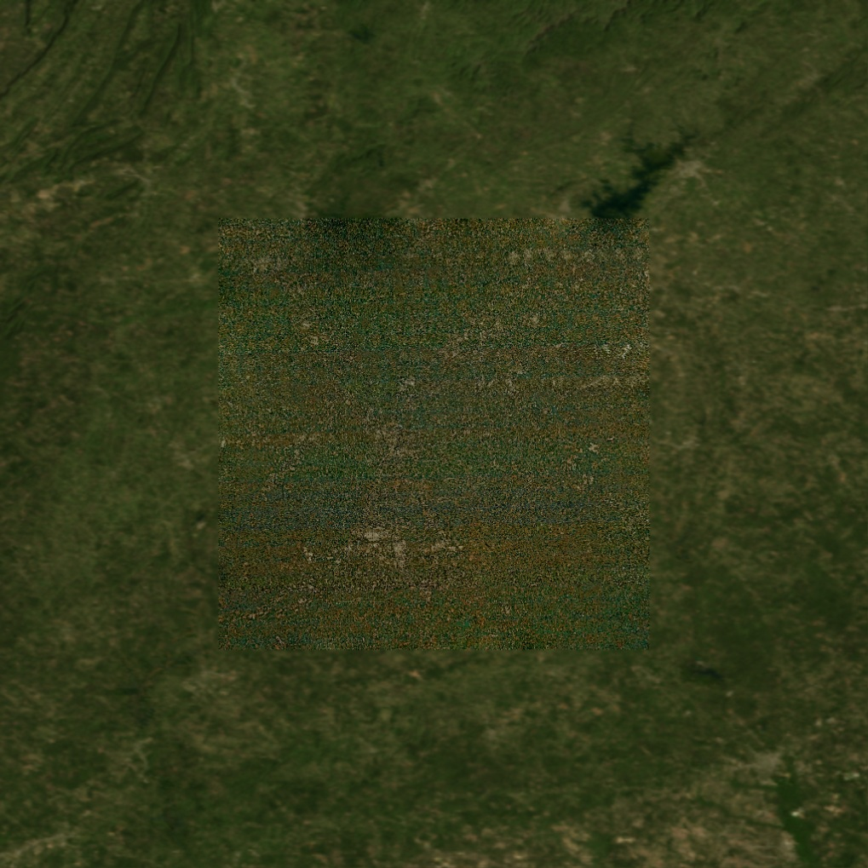
Poisson Solver for Image Cloning in Massive Image Collections
Pasting a 300GB satellite image of a city in background world map merged in real time

Slide 13
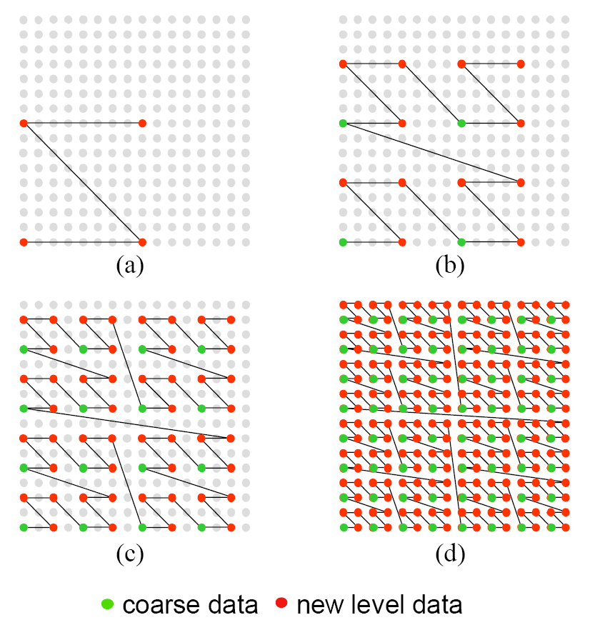
We Introduced Multi-resolution Cache
Oblivious Layouts for Image Data
Z-order curve used to define a hierarchical sub-sampling over a grid
Improve access locality:
  Interleaving hierarchical levels
  Maintaining geometric proximity
Data layout is independent
of the traversal of the data
Can be used with different block sizes

Slide 14
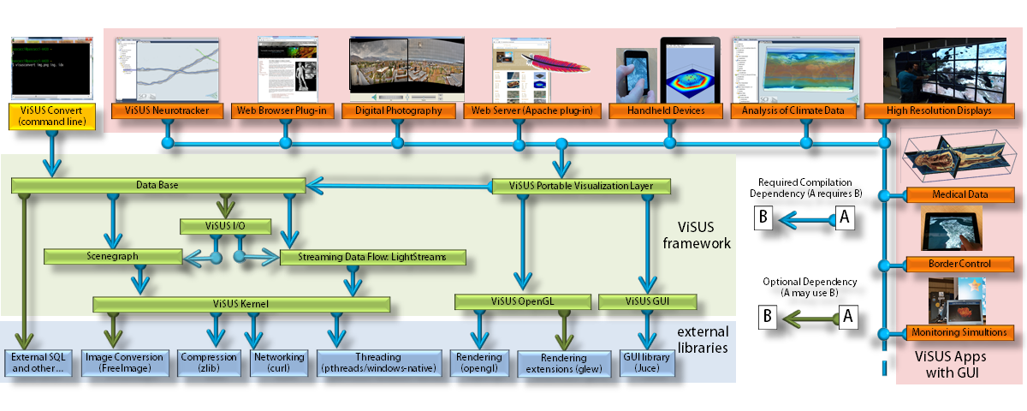
Scalable Software Infrastructure

Slide 15

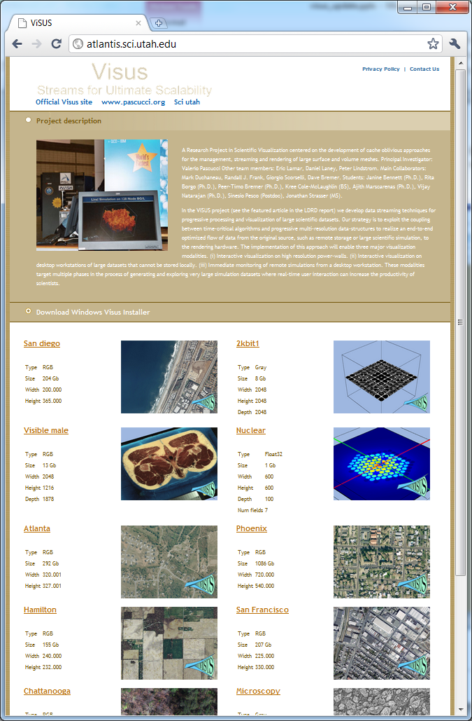
Server can be wrapped in Apache plug-in
Client can be run in a web browser

Slide 16
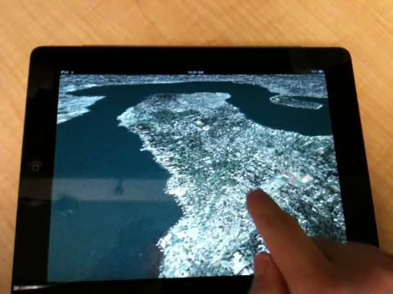
Geospatial Data Rendering on iPad
Both client and SERVER run of handheld devices, e.g. multiple iPhones can be clients and servers for each other to share information on the field

Slide 17







We Demonstrated Performance and Scalability in a Variety of Applications

Slide 18
We Demonstrated Performance and Scalability in a Variety of Applications
We are starting to redesign simulations based
on the new algorithmic techniques

Slide 19




Parallel Topological Analysis with Morse-Smale Complex
Topological methods provide critical scientific insight
  Physics, chemistry, combustion, and many other applications generate data that cannot be readily understood with traditional visualization methods.
  Topological analysis can be used to detect features, query data, and provide multiresolution views of these data.
  A Morse-Smale Complex is one of the most powerful topological representations, but
  Computing the Morse-Smale Complex has never been successfully parallelized before.
We developed a parallel Morse-Smale complex omputation algorithm and characterized its performance at leadership scale
  Tunable parameters for blocking, merging, and simplification.
  Performance characterization based on data size, complexity, and process count
  Demonstrated strong scalability on combustion and hydrodynamic instability problems
Morse-Smale complexes in quantum chemistry (upper) and combustion (lower)
Morse-Smale Complex provides a compact roadmap into scalar data
  By mapping behavior into critical points and regions of uniform gradient flow
  At a fraction of the data size of the original dataset (see table below)
Application | Data Reduction
Hydrodynamics data | 2.4X
Chemistry data | 7X
Combustion data | 14X
Synthetic test data | 400X
Factor reduction in data size of Morse-Smale Complex compared to original dataset
Rayleigh-Taylor mixing problem and strong scaling for generating its Morse-Smale Complex
Notes:
Participants
-Attila Gyulassy, Tom Peterka, Valerio Pascucci, Rob Ross
Problem
Topology-based techniques are useful for multiscale exploration of the feature space of scalar-valued large-scale simulations. The Morse-Smale Complex allows robust identification of gradient-based features and is suitable for analysis tasks in a wide range of application domains, for example physics, combustion, and chemistry. Computing the complex independently in parallel can result in output as large as the original dataset, and conceal features of interest. A multi-resolution representation is needed to simplify this complex, but requires resolution of global features: this has never been done in parallel for the Morse-Smale Complex.
Solution
We designed and implemented an algorithm to construct the Morse-Smale Complex in parallel with tunable parameters that allow trade-offs in use of resources, output size and accuracy.
These parameters include blocking strategy, merging strategy, and simplification level of the topology.
We performed parameter studies on artificial data designed to test best-case and worst-case performance, where feature size and count are varied in a range of data sizes and processor counts.
We ran strong scaling studies on data from large-scale simulations of combustion and hydrodynamic instabilities.
Impact
Proven scalability on Argonne Blue Gene/P: 35% strong scaling efficiency from 2K to 32K processes on Rayleigh-Taylor mixing problem. This efficiency is for end-to-end time to read the dataset from storage, compute and simplify the Morse-Smale Complex, and write the complex to storage.
-Similar scalability for combustion problem
-Being able to scale the generation of the Morse-Smale complex in parallel to the same scale as simulation enables the technique to be deployed in situ
-The simplified Morse-Smale complex requires only a fraction of the storage of the original dataset, up to 14X reduction in our tests of actual datasets. Even more aggressive reduction rates are possible, we reduced up to 400X in our synthetic tests.
-Unlike ordinary compression, the Morse-Smale complex is an intelligent compression guided by the complexity of the original data and the desired level of simplification. Such techniques that provide data-driven, adjustable multiresolution reduction will be absolutely essential going forward to exascale datasets. Parallelizing the Morse-Smale Complex is a major step in that direction.
-Another way to view the the Morse-Smale complex is as a roadmap into the dataset. It can be used to detect features, as an index into the dataset, or to query the data.

Slide 20

We are Creating a Flexible Data Analysis Pipeline to Explore the Exascale Design Space
The analytics layer is split into four stages:
  Local computation
  Gather phase
  Scatter phase
  Feature-based statistics
For each phase there are
different algorithms
Phases can be combined
in different ways
Phases can be distributed
among heterogeneous resource
We are starting to explore different use cases

Slide 21

Local Computation: options that need to be evaluated by SST Micro Simulation
Fundamentally a union-find approach
Options:
  Sort -> Filter -> Compute
  Filter -> Sort -> Compute
  Scan -> Traverse
Potential for
  GPU based sorting and
  filtering (greater data transfer cost)
  Multi-threading (shared memory)

Slide 22

Gather Phase – Distributed Data Communication Layer that Needs Evaluation by SST Macro Simulation
Fundamentally a merge-sort approach
Potential for:
  Streaming processing
  Bulk processing
  Adjustable
  hierarchy width

Slide 23


Scatter Phase – Components that Need to be Evaluated by Both SST Micro and SST Macro Simulations
Potential for:
  Streaming processing
  Bulk processing
  Adjustable hierarchy width
Scatter phase can be
interleaved with gather
Trade-off between minimal
computation and minimal data movement
Granularity of communication vs.
amount of data transfer
Synchronous vs. asynchronous

Slide 24

Initial Use Cases Targeted
Local scan -> ADIOS -> Serial Compute
Local compute -> ADIOS -> Serial Merge/Gather/Statistics
Local compute -> Merge
Threaded Computation

Slide 25


Streaming IDX directly from large scale (S3D) simulations
Web Server
STORAGE
NODES
BG/P COMPUTE
NODES
VISUALIZATION

Slide 26


We Are Moving Towards a Distributed
Storage and Processing Environment
Distributed storage
Data redundancy
Security
Heterogeneous collaborative
infrastructure
Multi-scale collaborative
interfaces accessing shared
data sources:
  data collection and validation
  interactive analytics
  decision making

Slide 27






A Data Analysis and Visualization Center Can be a Catalyst for a Virtuous Cycle of Collaborative Activities
Tight cycle of :
  basic research,
  software deployment
  user support
Coordination among eight projects:
  unified techniques for several applications
Strong University-Lab-Industry collaboration
Focused technical approach:
  performance tools for fast data access
  general purpose data exploration
  error bounded quantitative analysis
  feature extraction and tracking
Interdisciplinary collaboration with domain scientists (from math to physics):
  motivating the work
  formal theoretical approaches
  feedback to specific disciplines

Slide 28

ViSUS Framework for Scalable Data Management Analysis and Visualization

Slide 29
ViSUS Applications Demonstrated High Performance and Scalability in a Variety of Applications

Slide 30

The ViSUS Parallel I/O Infrastructure (PIDX)
Adopts a 3–Phase Data Transfer Model
Three-Phase I/O:
(C).1 Data restructuring among processes transforms irregular data blocks at processes P0, P1 and P2 to regular data blocks at processes P0 and P2.
(C).2 HZ encoding of regular blocks leading to dense and non-overlapping data buffer.
(C).3 Data transfer from in-memory HZ ordered data to an aggregation buffer involving fewer large sized data packets.
(C).4 I/O writes from aggregation buffer to a IDX file.
One-Phase I/O:
(A).1 HZ encoding of irregular data set leads to sparse data buffers interleaved across processes.
(A).2 I/O writes to underlying IDX file by each process, leading to a large number of small accesses to each file.
Two-Phase I/O:
(B).1 HZ encoding of irregular data set leads to sparse data buffers interleaved across processes.
(B).2 Data transfer from in-memory HZ ordered data to an aggregation buffer involving large number of small sized data packets.
(B).3 Large sized aligned I/O writes from aggregation buffer to the IDX file.

Slide 31

Strong Scaling Results Comparing PIDX Performance with PNetCDF and Fortrain I/O on Two Major Platforms
The PIDX Infrastructures Achieves Better Scalability than Competing Frameworks While Maintaining Advantageous Hierarchical Data Representation
Scaling Results on Hopper
Cray XE6 architecture at NERSC (LBNL)
Scaling Results on Intrepid
BGP architecture at ALCF (ANL)

Slide 32


Weak Scaling Results Comparing PIDX Performance with Major Competing Techniques
Weak Scaling Results
on Intrepid BGP architecture
at ALCF (ANL)
Weak Scaling Results on Hopper
Cray XE6 architecture at NERSC (LBNL)

Slide 33


The Scaling Characteristics of PIDX Allow to Achieving Real Time Visualization and Analysis of Massive Simulations
Distributed storage
Heterogeneous collaborative infrastructure
Multi-scale collaborative interfaces accessing
shared data sources
Server: Apache Plug-In or Independent App
Client: Web Based or Independent App

Slide 34




ViSUS Neurotracker for Interactive Visualization and Segmentation of Massive Neuronal Microscopy Volumes
The ViSUS data streaming architecture enables efficient storage, access and processing of massive datasets accessible from any platform

Slide 35


ViSUS Remote climate Data Analysis and Visualization
ViSUS data streams allow to merging multiple datasets in real time
Time interpolation of and concurrent visualization of climate data ensembles defined on different time scales
Server side and client side computation of statistical functions such as median, average, standard deviation, …….
Standard Deviation and Average of ten climate models

Slide 36










Topological Methods Have Been Successful for Analysis and Visualization of Massive Scientific Data
Molecular
Analysis
(simulated)
Turbulent Mixing
Analysis
(simulated)
Materials Analysis
(simulated)
Materials Analysis
(imaged)
Materials Analysis
(simulated)
Molecular
Analysis
(simulated)
Combustion
Analysis
(simulated)
Biomedical
Analysis
(imaged)
Cosmology
Analysis
(simulated)

Slide 37



Parallel Topological Computation is Key in Deployment of Future In-Situ Analysis Frameworks

Slide 38


New Parallel Topological Computations Achieve High Performance at Scale (see session 11)
Computation + I/O
Pure Computation

Slide 39


Topological Analysis of Massive Combustion Simulations
Non-premixed DNS
combustion (J. Chen, SNL):
Analysis of the time evolution
of extinction and reignition
regions for the design
of better fuels

Slide 40

Topological Analysis of Massive Climate Simulations
Robust extraction and
analysis of ocean eddies
(simulation by P. Jones,
LANL):
combinatorial
techniques allow to
achieve definition and
extraction of ocean eddies
with guarantees of no
numerical approximation
while allowing for new
interactive exploration
and querying of the
ocean data

Slide 41

Analysis and Visualization of Complex Performance Information Collected from Massively Parallel Simulations
The HAC model: mapping the
performance information
between different as components
of a HPC environment to henance
user intuition
H: Hardware domain (physical
computing devices used)
A: Application domain where
the physics of a simulation
is designed
C: Communication domain
(logical communication
such as MPI
communicators)

Slide 42

Interactive Linked Views Highlight Performance Characteristics in the Domain that is More Intuitive

Slide 43

HAC Case Study: Performance Understanding for a Poisson Solver Applied to Digital Photography

Slide 44

HAC Case Study: Performance Understanding for a Poisson Solver Applied to Digital Photography
Application Domain
Hardware Mapped on Application Domain

