Slide 1
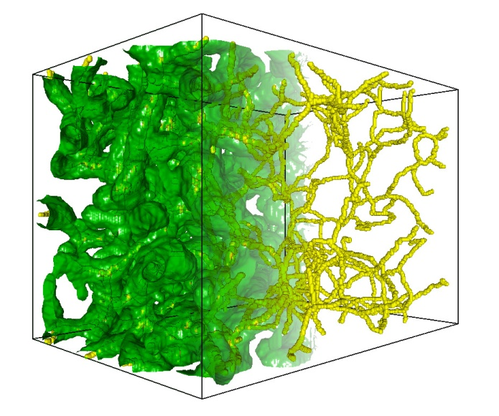
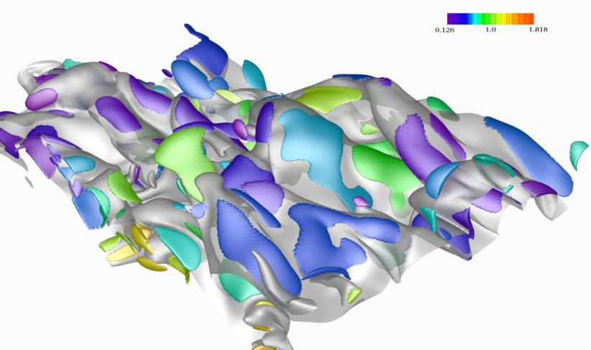
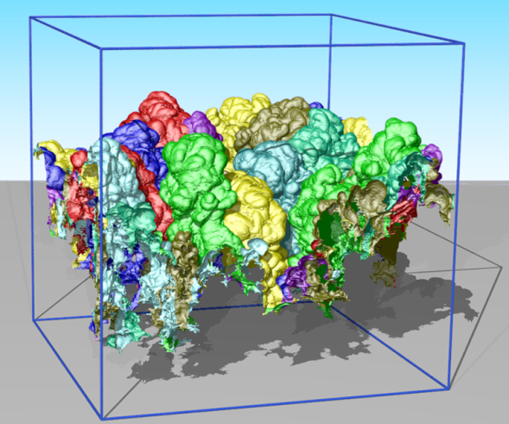
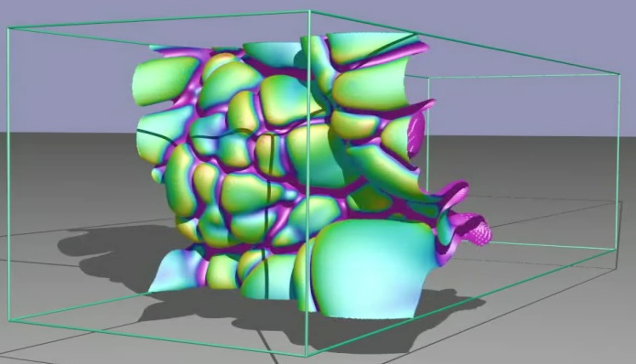


Multi-scale data streaming for interactive exploration of massive scientific data
Valerio Pascucci
Scientific Computing and Imaging Institute
School of Computing
University of Utah
Notes:
1
1
1
Thank co-authors

Slide 2
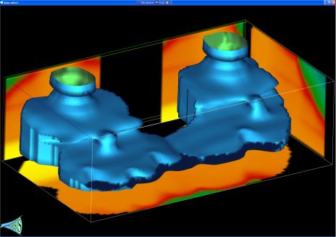
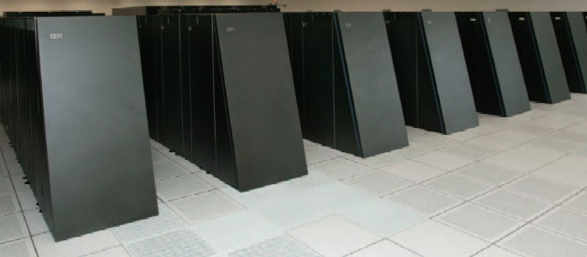
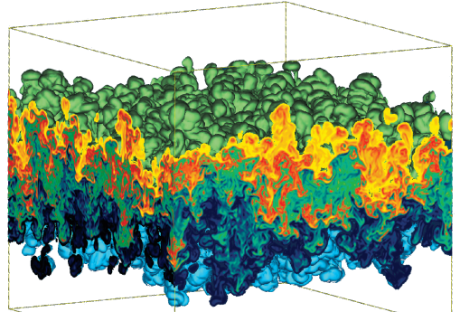
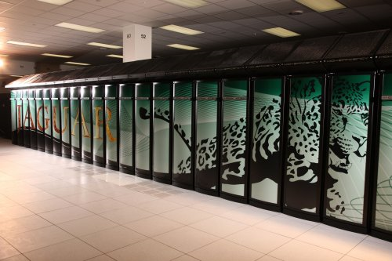
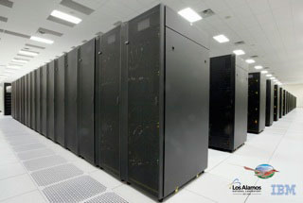
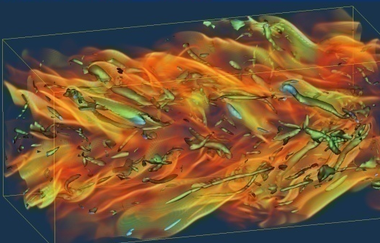
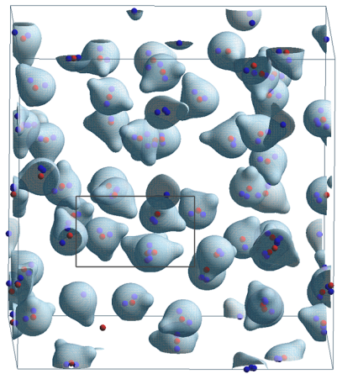
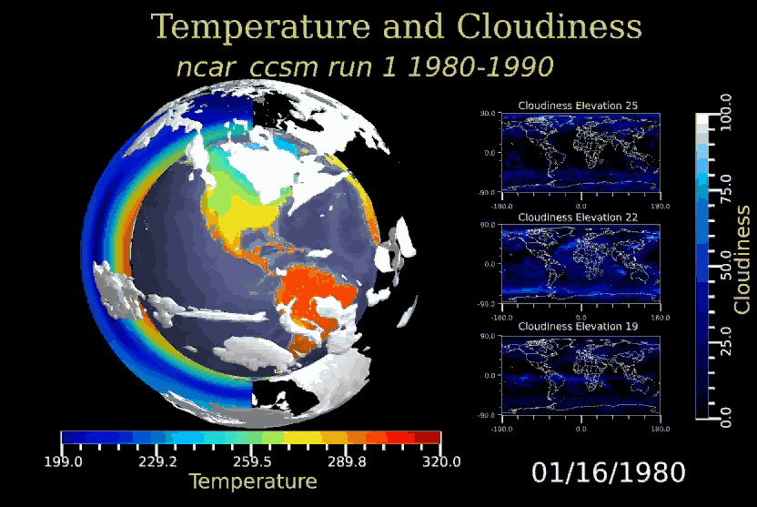
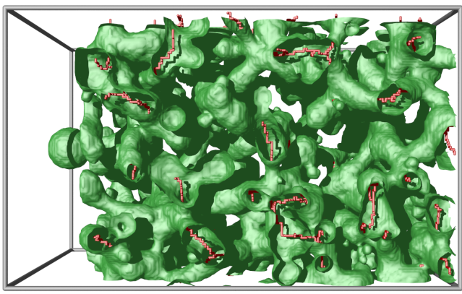
Massive Scientific Simulations are Source of Great Challenges and Opportunities
BlueGene/L
Subsurface
Modeling
Hydrodynamic
Instabilities
Jaguar
Roadrunner
Combustion Simulations
Molecular Dynamics
Material Sciences
Climate Modeling

Slide 3
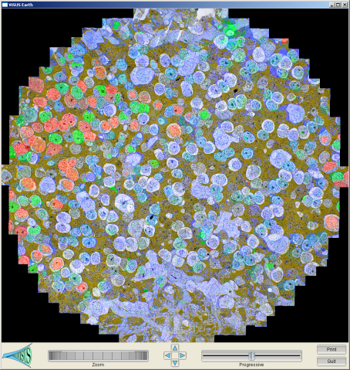
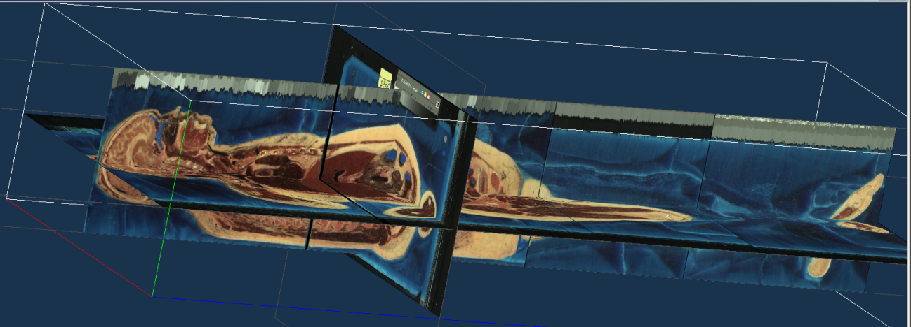
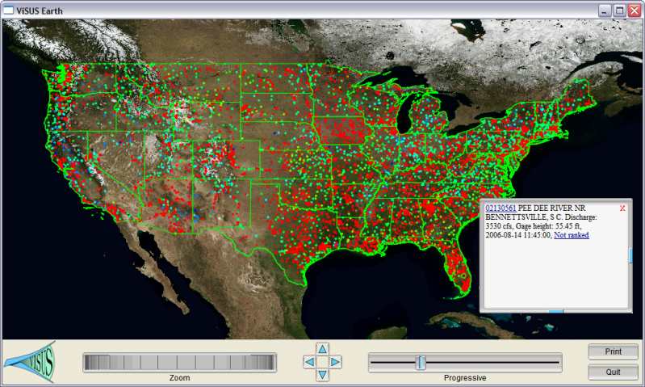
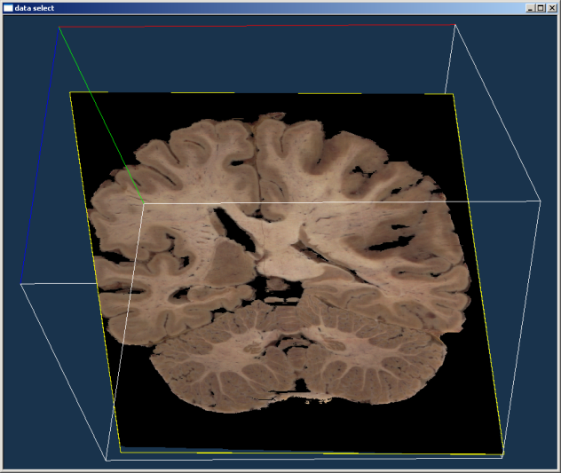
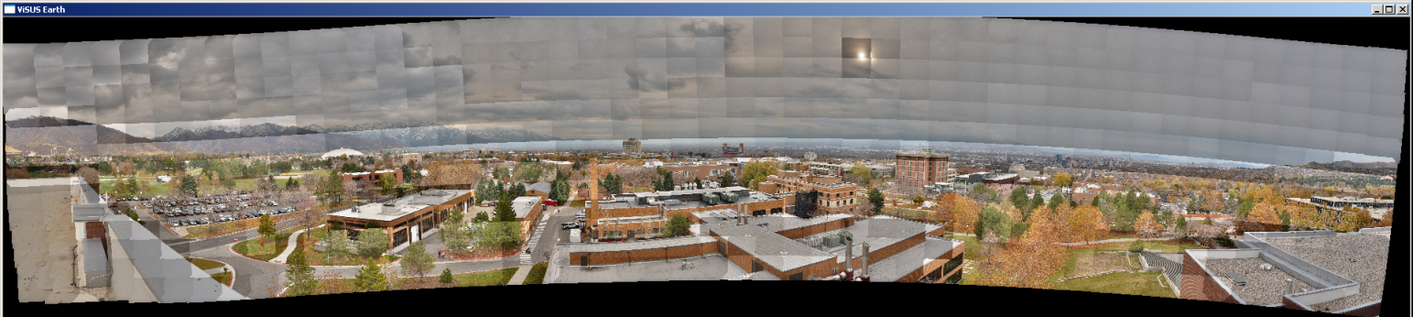
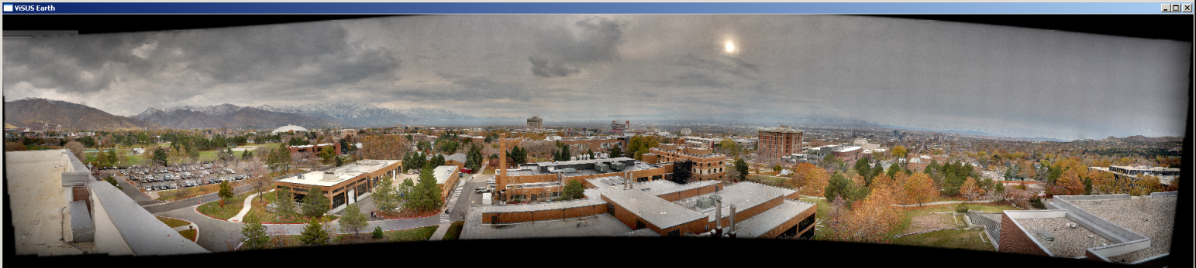
Sources of Large Data are Becoming More Diverse and Ubiquitous

Slide 4
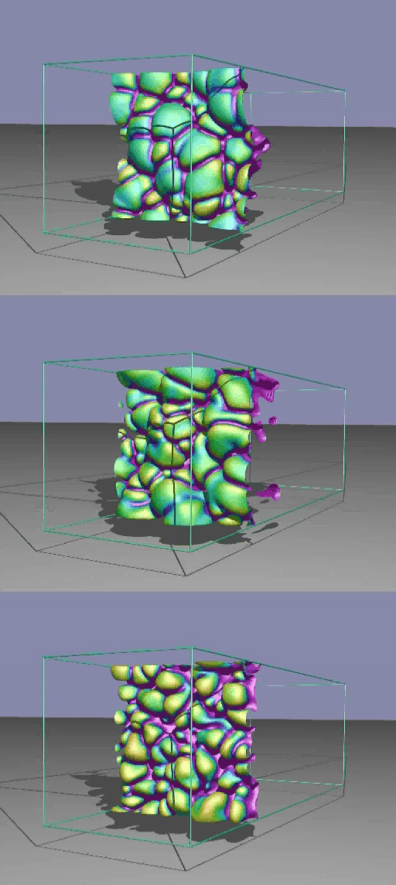
Given Three Burning Hydrogen Flames, Rank Them by Level of Turbulence
Understanding combustion processes over a broad range of burning conditions is an important problem for designing engines and power plants:
Increase efficiency in energy production
Reduce pollutants in the emission
Technical problems:
Simulation with high resolution AMR mesh.
Simulations of lean premixed hydrogen flames with three degrees of turbulence.
Can we identify precisely and track in time burning regions?
Can we discriminate the degree of turbulence from a quantitative analysis?

Slide 5
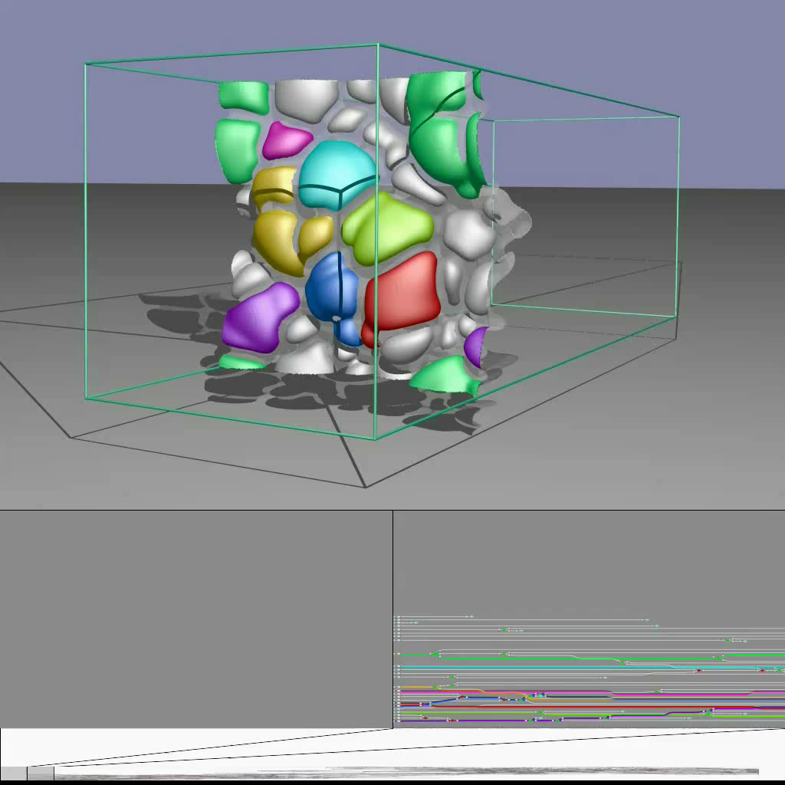
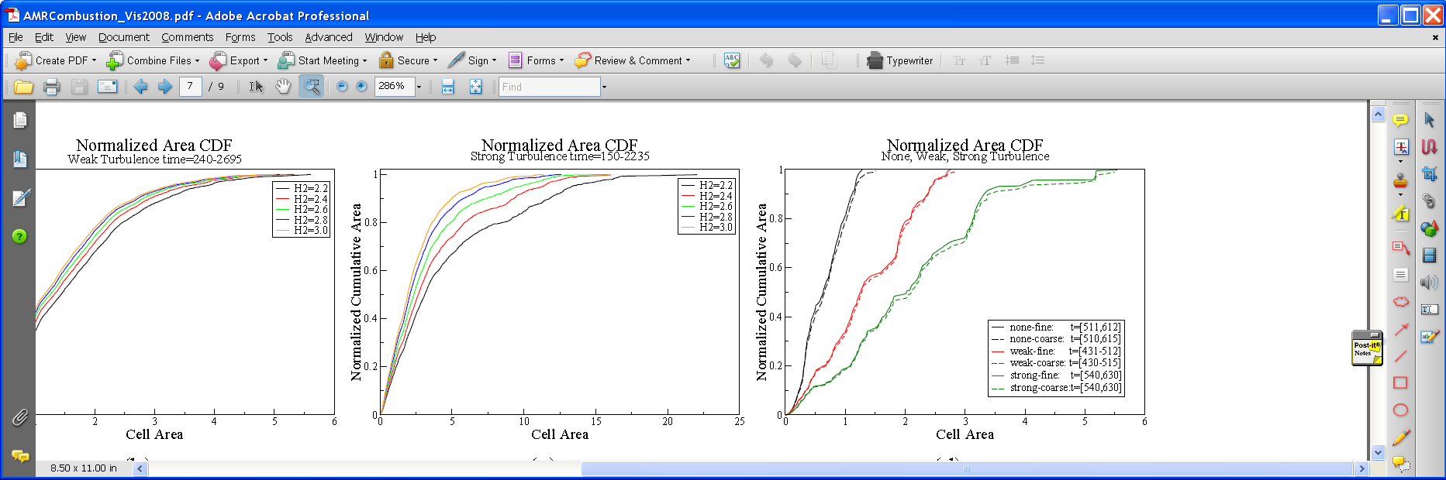
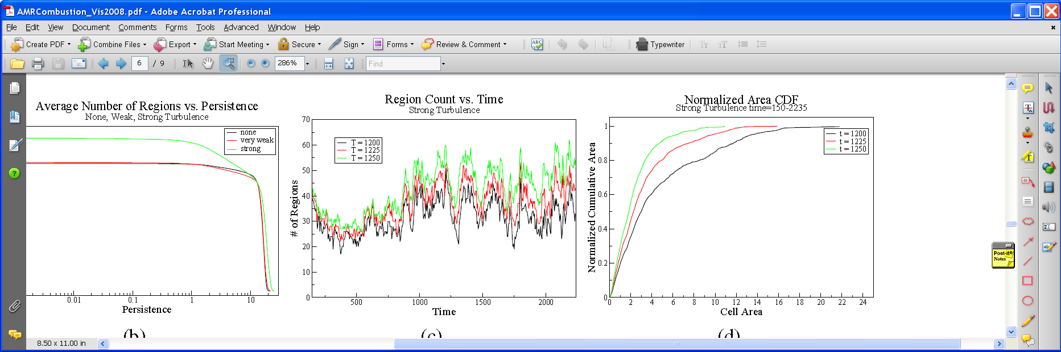
We Segment and Track Individual Features and Provide a Global Quantitative Analysis

Slide 6

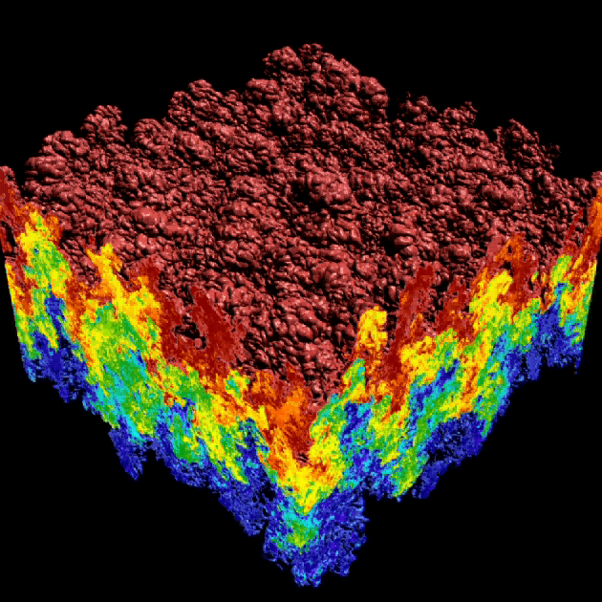
Understanding the Dynamics of Rayleigh-Taylor instabilities
Rayleigh-Taylor instabilities arise in fusion, super-novae, and other fundamental phenomena:
  start: heavy fluid above, light fluid below
  gravity drives the mixing process
  the mixing region lies between the upper envelope surface (red) and the lower envelope surface (blue)
  25 to 40 TB of data from simulations

Slide 7




We Provide the First Quantification of Known Stages of the Mixing Process
mixing
transition
1.0
(9524 bubbles)
0.5
0
linear
growth
-0.5
slope 1.536
-1
Mode-Normalized Bubble Count
(log scale)
Derivative of Bubble Count
0.1
slope 1.949
-1.5
-2
strong
turbulence
slope 2.575
-2.5
Bubble Count
0.01
Derivative
weak
turbulence
-3
1
2
3
4
5
6
7
8
9
10
20
30
40
t/τ (log scale)

Slide 8
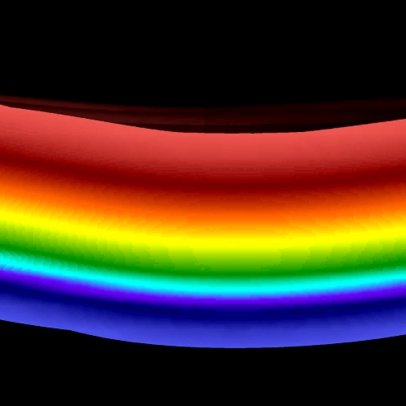
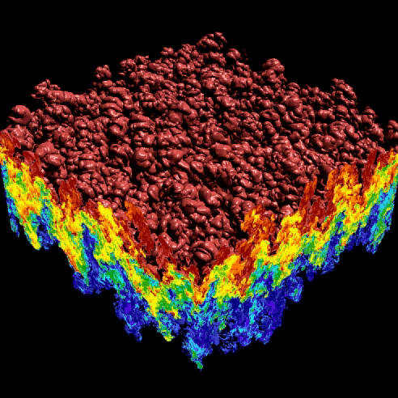
We Provided the First Feature-Based Validation of a LES with Respect to a DNS
LES (Large Eddy Simulation)
Mode-Normalized
Bubble Count
DNS (Direct Numerical Simulation)
Normalized Time

Slide 9
What is the Long Term Impact of Human Activities on the Global Climate?

Slide 10
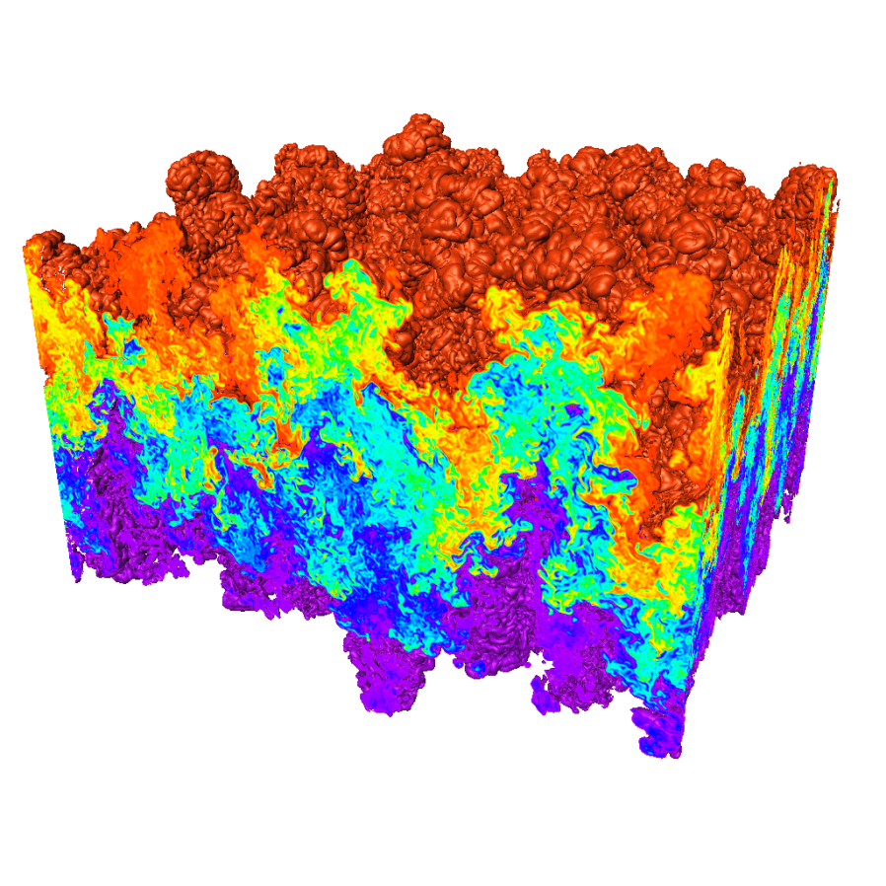
Traditional Data Exploration Tools are
Often Ineffective for Massive Models
Massive models are challenging:
  Sheer volume of information
  Complexity of the
  information represented
  Complexity of presentation
Tools do not scale with the
data sizes
Tools do not use effectively
diverse computing resources
Difficult to collaborate in a distributed team
Difficulty in providing error bounds associated
with the coarse scale analysis
Need higher level of abstractions to represent the data
Rayleigh–Taylor instability (Miranda)
Notes:
In addition to difficulties of bringing out important features, current visualization techniques have some limitations when applied to 3D data. In large simulations like the RT instability simulation shown at right, the geometric complexity is so great that isosurfaces and even slice planes are not able to provide more than a qualitative view of the data. In the image at right the top isosurface occludes itself. Such occlusion can occur in small data sets given non-trivial geometries. In addition, visualization tools treat time-varying data as a set of discrete snaphots. Scientists that want to see the temporal features of their data must create a resonable visualization on one time step and create an animation. This process is slow, and usually must be iterated to get the right set of parameters for the entire time sequence. Our solution is to apply topological analysis to extract representations of the shape of data sets that are independent of the mesh, and thus do not need to be embedded in the 3D space of the simulation data. These representations can also be used to represented an entire time sequence, giving a scientist to investigate the temporal properties of their data directly.

Slide 11
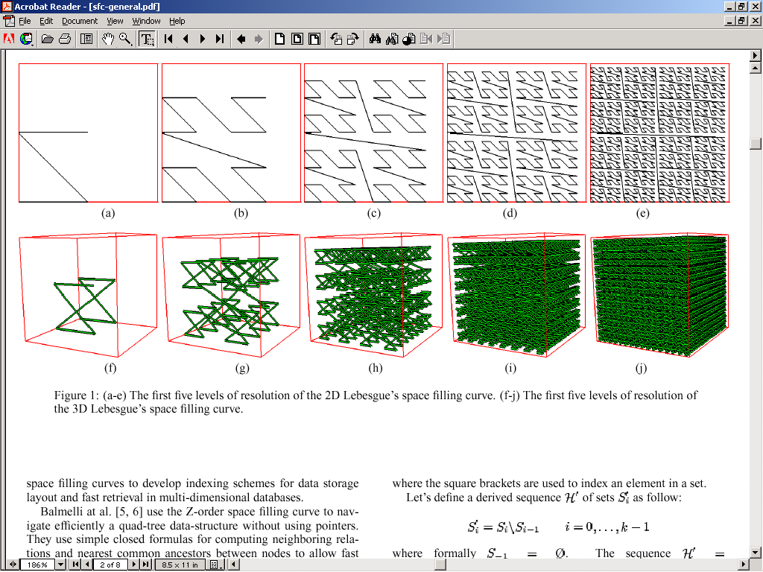
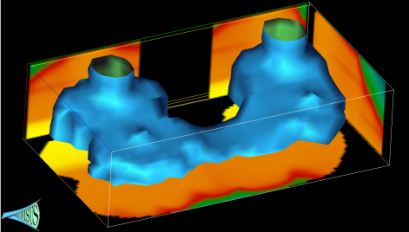
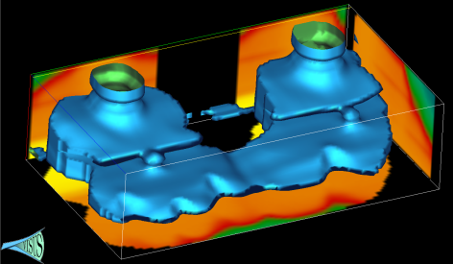

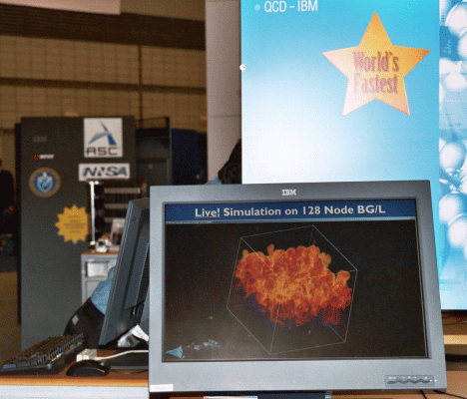

A Cyberinfrastructure Requires Efficient
Data Management and Processing
Advanced data storage techniques:
  Data re-organization.
  Compression.
Advanced algorithmic techniques:
  Streaming.
  Progressive multi-resolution.
  Out of core computations.
Scalability across a wide range of running conditions:
  From laptop, to office desktop,
  to cluster of PC, to BG/L.
  Memory, to disk, to remote
  data access.

Slide 12
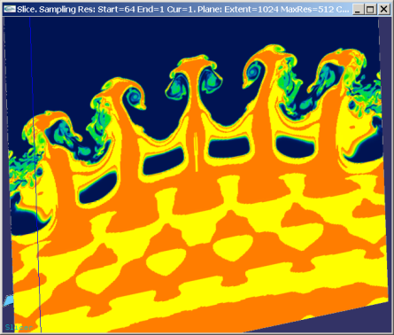
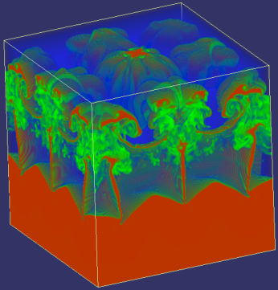
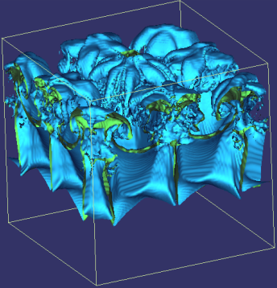
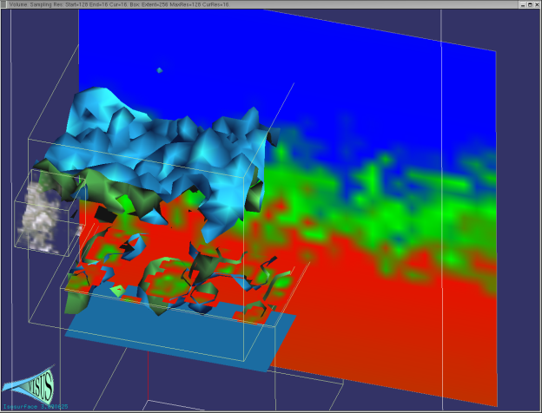
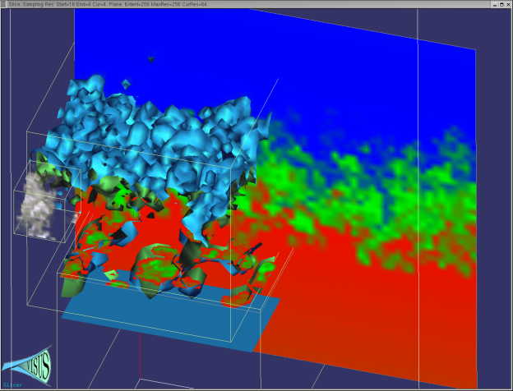
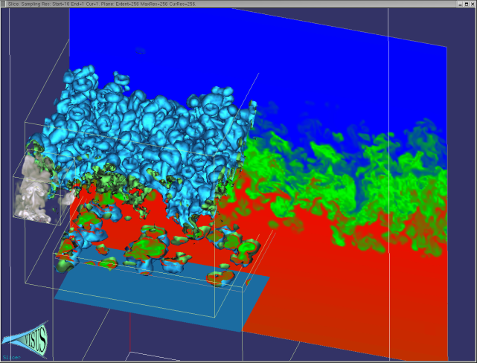
We Redesigned the Data Management and Visualization Pipeline with New Principles
Basic core techniques:
  Slicing
  Volume rendering
  Iso-surfaces
Cache-oblivious out-of-core
processing optimizing access
locality for any size of data blocks
Pipelines of progressive algorithms
Coarse-to-fine construction of
multi-resolution models
Remote data streaming

Slide 13
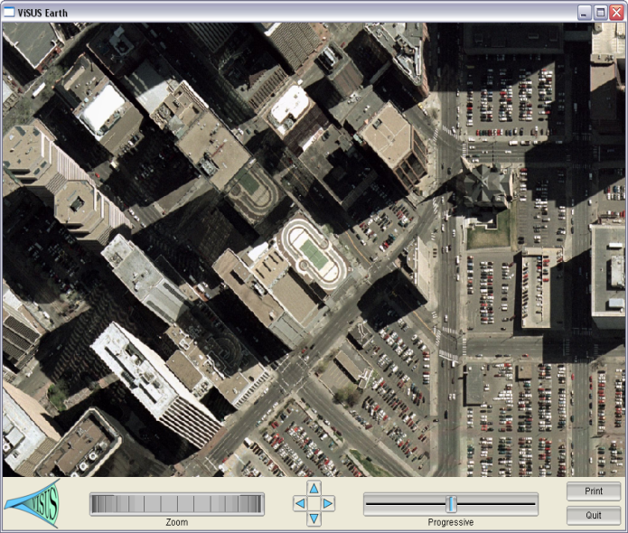
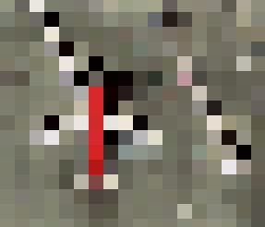
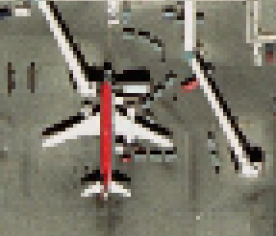
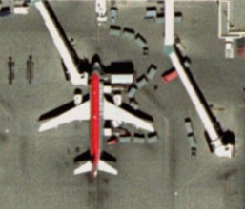
We Consider the Three Main Components
Defining a Computing Infrastructure
Processing Network
(Data Access Path)
Data Layout
(Cache Oblivious)
Algorithm Design
(Progressive Processing)

Slide 14
We Characterize Algorithmic Classes Based on Effect in a Processing Network

Slide 15
We Characterize Algorithmic Classes Based on Effect in a Processing Network

Slide 16
The use of top-down and bottom-up processes have a strong impact on the data stream
Benefit: pipeline of progressive modules
Progressive refinement:
coarse representation
immediately available
Input
Output
Input
Output
Speed
Decimation:
full resolution data needed first
Challenge:
minimize the quality differential
Accuracy

Slide 17
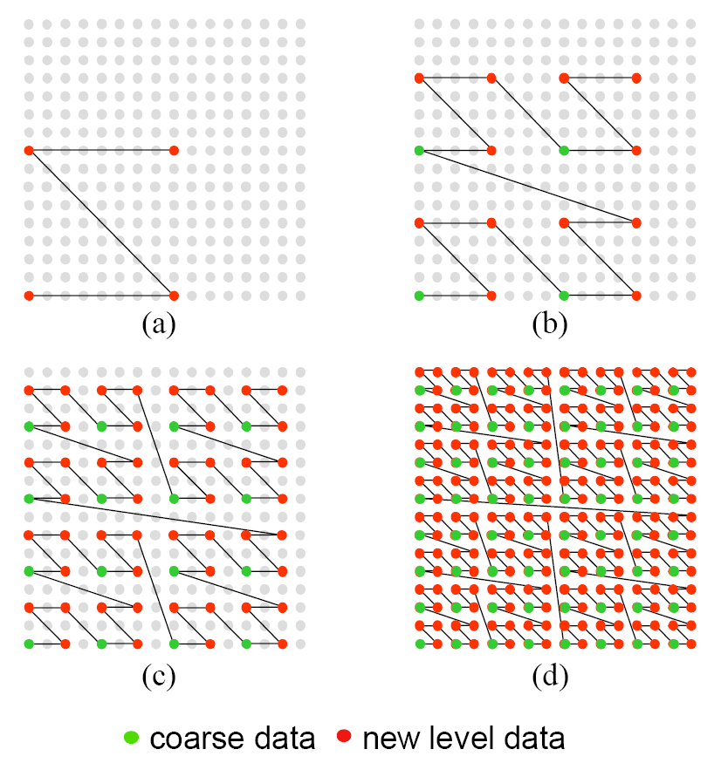
We Introduced Multi-resolution Cache
Oblivious Layouts for Image Data
Z-order curve used to define a hierarchical sub-sampling over a grid
Improve access locality:
  Interleaving hierarchical levels
  Maintaining geometric proximity
Data layout is independent
of the traversal of the data
Can be used with different block sizes

Slide 18
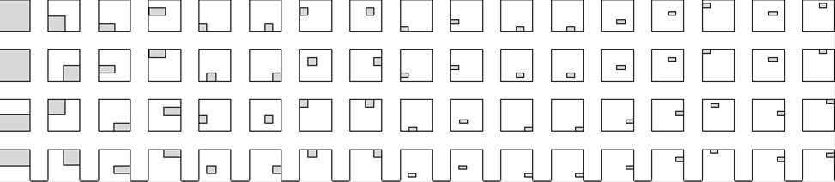
We Introduced a Progressive Range Query Avoiding Unnecessary Data Access
Blocks touched by the region
Layout of blocks on disk
0
1
2
3
4
5
6
7
8
query
data in the block
image
0
1
2
3
Layout of blocks on the image

Slide 19
We Introduced a Progressive Range Query Avoiding Unnecessary Data Access
Blocks touched by the region
Layout of blocks on disk
0
1
2
3
4
5
6
7
8
query
data in the block
image
0
1
2
3
Layout of blocks on the image

Slide 20
We Provided a Fast Address Computation Based on Simple Bit Manipulation
Simple bit manipulations to convert row major to hierarchical Z-order
3D version (also nD): basic Z shape replaced by a connected pair of Z shapes
?

Slide 21
Cache-Oblivious Data Layouts Scale Well Across Different Storage Blocking Factors
Formal analysis
predicts performance
and scalability
Performance improved
by orders of magnitude
Independence of
architecture
and storage
characteristics
32KB Disk Block Size
64KB Disk Block Size
subsampling rate
subsampling rate
Desktop Performance
Laptop Performance
subsampling rate
subsampling rate

Slide 22
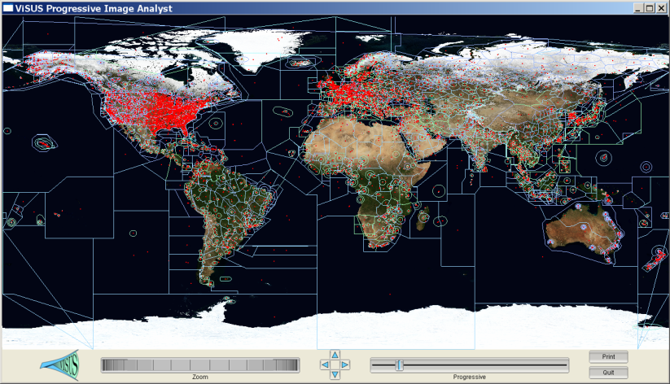
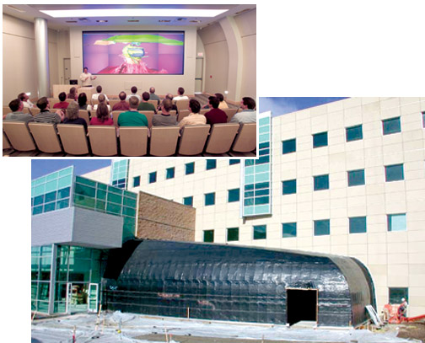


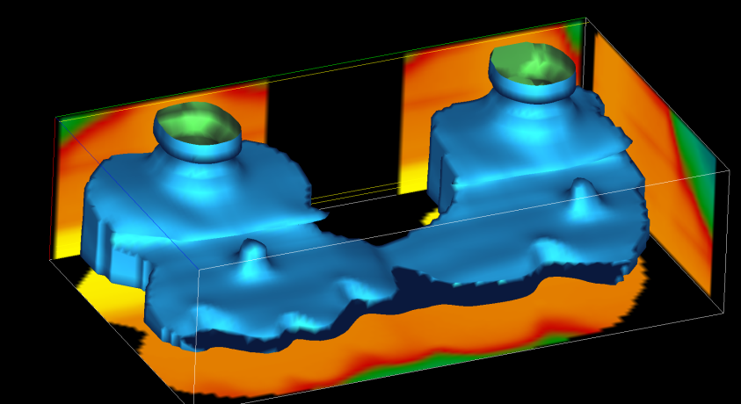
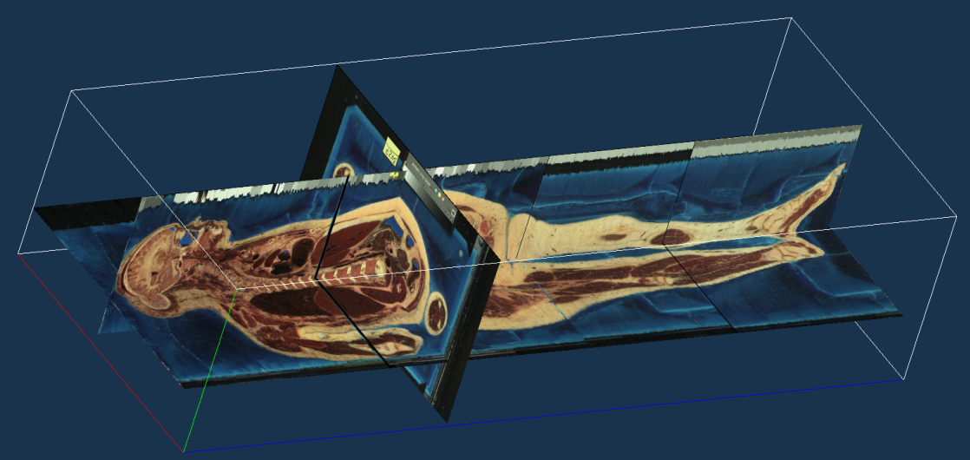
We Demonstrated Performance and Scalability in a Variety of Applications

Slide 23
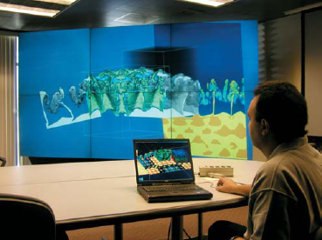

We Are Moving Towards a Distributed
Storage and Processing Environment
Distributed storage
Data redundancy
Security
Heterogeneous collaborative
infrastructure
Multi-scale collaborative
interfaces accessing shared
data sources:
  data collection and validation
  interactive analytics
  decision making

Slide 24
There is a Desperate Need for
Scalable Algorithms and Infrastructures
Data formats that minimize I/O and memory transfer for most frequent operations
New algorithms and data structures for management of large collections of
time dependent information
New theoretical models that predict the behavior of modern architectures
New algorithms that are “intrinsically scalable” with respect to:
  Processing capabilities
  Diversity of hardware available
  Locality of data
Can benefit a variety of tools
Scalable system infrastructures

Slide 25
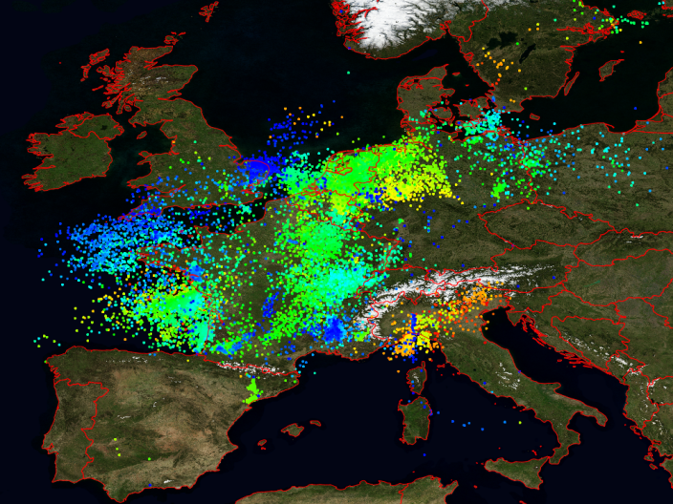
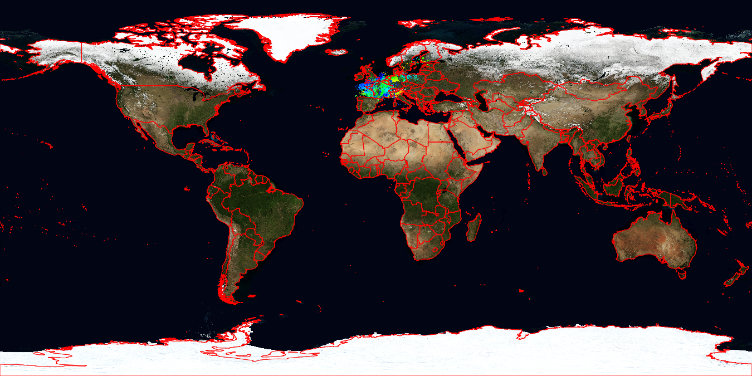
We provide real-time access to large scale time dependent data and sensory data
Blue Marble Earth (next generation) provided by NASA:
  Twelve months in 2004 (11GB per month)
  Resolution: 86400 x 43200 pixels (500 meters per pixel)
Lightning events from distributed sensing devices over Central Europe (Blitzortung.org)

Slide 26




We Allow Distributed Computations at
Different Stages of the Data Stream
Progressive Image Differencing + Editable GPU filter.
Two data sources
(11 GB each)
Progressive differencing
Computed in real-time.
Streaming edge
detection on the GPU.

Slide 27




We are Developing Progressive Scheme for Content Based Image Processing
Hypothesis:
Progressive Analysis:

Slide 28


Capability to query database servers for retrieving original information for validation
Implemented functionalities to query the database servers established for the Proteus and Wormhole projects
Interactively query image database to retrieve original imagery in GeoTIFF and NITF formats

Slide 29


Our Preliminary Tests Show Potential for
Orders of Magnitude in Performance Gains
We are extending the ViSUS/NAPA tools with KML interpretation and visualization capability (faster than Google Earth).
We have incorporated basic management of geo-tagged points, lines, and polygons with time stamps
1TB of imagery can be presented instantly while 20MB of KML data takes 20 seconds.

Slide 30







We Are Moving Towards Support of a Combination of Different Data Types
Concurrent access to several information sources requires similar techniques for a variety of data types.
COMMERCIAL AIRWAYS
AIRSPACE BOUNDARIES
Algorithmic directions:
  integration with other frameworks
  progressive streaming infrastructure for
  “vector data” (points, lines, polygons);
  uncertainty/incompleteness in the data
  progressive resolution of queries
  with quantification and visualization of error/confidence;
  on-line update of internal data structures to render
  new data immediately available.
BOUNDARIES OF US COUNTIES

Slide 31
Our Paradigm: Multi-resolution Models Built by Successive Refinements
Benefit: pipeline of progressive modules
input
output
Progressive refinement:
coarse representation
immediately available
PA1
PA2
Performance
input
output
Challenge:
minimize the quality differential
hierarchical model constructed
bottom-up
Decimation: full
resolution data
needed first
Accuracy

Slide 32
We Globally Optimize the Data Flow Pipeline From Input Data Source to Final Output
operational diagram
F(x)
w₀
F ⁻¹(w₀ )
data
source
Collecting
Data
Data
Processing
Data
Presentation
output
device
data flow diagram

Slide 33
The Data Layout is Based a Pyramidal Multi-resolution with high degree of locality

Slide 34
We Exploit the Correlation of 2^{n}-trees with the Lebesgue Space-filling Curves
The Lebesgue curve is also known as Z-order, Morton, …. Curve.
  Special case of the general definition given by Guiseppe Peano in 1890.

Slide 35

The Samples of a Grid are Reordered by Resolution and Spatial proximity
Coarser data
(even samples)
New level data
(odd samples)
1D order:
at each level store the green samples first (recursively);
keep the Z order for red samples (as much as possible).

Slide 36
The Pixel in Each Data Block is Maintained Local at All Levels of Resolution
Locality independent of the block size: cache oblivious approach.
Layout of blocks on disk
0
1
2
3
4
5
6
7
8
image
data in block 20
0
1
2
3
Layout of blocks on the image

Slide 37
We Achieve a Progressive Range Query Avoiding Unnecessary Data Access
Blocks touched by the region
Layout of blocks on disk
0
1
2
3
4
5
6
7
8
query
data in the block
image
0
1
2
3
Layout of blocks on the image

Slide 38
We Determine the Efficiency as the Ratio Between Data Loaded and Data Used
Blocks touched by the region
Layout of blocks on disk
0
1
2
3
4
5
6
7
8
query
data in the block
image
0
1
2
3
Layout of blocks on the image

Slide 39
We Provided a Fast Address Computation Based on Simple Bit Manipulation
Simple bit manipulations to convert row major to hierarchical Z-order
3D version (also nD): basic Z shape replaced by a connected pair of Z shapes
?
inline int remap(register int i)
{
i |= last_bit_mask; // set leftmost one
i /= i&-i; // remove trailing zeros
return (i>>1); // remove rightmost one
}

Slide 40
Cache-Oblivious Data Layouts Scale Well Across Different Storage Blocking Factors
Formal analysis
predicts performance
and scalability
Performance improved
by orders of magnitude
Independence of
architecture
and storage
characteristics
32KB Disk Block Size
64KB Disk Block Size
subsampling rate
subsampling rate
Desktop Performance
Laptop Performance
subsampling rate
subsampling rate

Slide 41

We Demonstrated Performance and Scalability in a Variety of Applications

Slide 42

We Generalize Streaming and Cache Oblivious Layouts From to Unstructured Meshes
interactive queries and rendering require random access:
  e.g. slice plane, range query, adaptive refinement, …
  stream layout: ideal for compatible access pattern, otherwise poor
  cache-oblivious layout: ideal when access pattern not known a priori
Multi-scale optimization used to turn and unstructured mesh into and cache oblivious space-filling layout
Streaming and cache oblivious
layouts for grids
Streaming (row-by-row)
streaming order
row-by-row order
space-filling order
query slice
structured
unstructured

Slide 43

We use streaming of unstructured meshes for on-line processing
The mesh is processed incrementally using
only the elements within a given sliding window
Only a small portion of the mesh maintained in-core

Slide 44



We use streaming simplification to reduce the working set of downstream processing
Streaming simplification of a tetrahedral mesh.

Slide 45





We achieve faster lower-memory processing within known error bounds
Iso-surfaces extracted from the PPM dataset consisting of more than a billion tetrahedra

Slide 46
Problem Statement
Vertex layout of G = (V, E)
  One-to-one mapping of vertices to positions
Find a
  Minimizes the number of cache misses
Notes:
A vertex layout of an undirected graph G = (V;E) is a one-to-one mapping
of vertices to positions in the layout.
Our goal is to find a mapping, which minimizes the number of cache misses during accesses on the mesh represented as the graph.

Slide 47
Multilevel Minimization
Coarsening step
  Simply 5 vertices into one
Ordering at coarsest graph
  Consists of 5 vertices
Refining step
  Expand vertices and perform local permutation
Notes:
Instead, we use a multilevel minimization algorithm which performs local permutations to compute a
locally optimal layout.
Multilevel min. consists of 3 main steps.
First, we coarse the input graph by simplify 5 vertices into one.
At its coarsest graph, we compute vertices ordering.
Then, as we reconstruct the coarsest graph, we refine vertices ordering by usning local permutation given our approximate metric.

Slide 48
View-Dependent Rendering
Peak performance: 145 M tri / s
 | Model complexity | Cache-oblivious layout | Layout of Quick-VDR
Isosurface | 100M | 106 M/s | 23 M/s
St. matthew | 372M | 90 M/s | 20 M/s
double eagle | 82M | 47 M/s | 22 M/s
4.5X
2.1X
Notes:
We compare rendering throughput of cache-oblivious layout with layout of Quick-VDr, (Simplification layout), which is ordering of output of simplication.
We are able to achieve 4.5 times improvement over simplification layout in Isosurface and St.
And 2.1 speedup. Moreover, we are able to achieve 145M/s as a peak performance.

Slide 49

We Achieved a 4X Speedup for Large Models Without Changing the Application

Slide 50

We Achieved a 4X Speedup for Large Models Without Changing the Application

Slide 51

Isocontour Extraction
Contour tree [van Kreveld et al. 97]
  Compute seed sets based on the tree
  Traversal triangles is bottleneck
Puget sound,
134 M triangles
Notes:
We also applied our layouts to an isocontour extraction.
We used contour tree, which provides us seed sets. In this application, traversal triangles from computed see set is bottleneck.
We test our application with various models including a puget sound model consisting of 134M triangles.
Line shown with black is an isocontour given a height value.
(This model is unstructured model.)

Slide 52
Comparison
Different layouts | Z-level Contour (Speedup over CO)
Cache-oblivious | 1 (1)
X-axis sorted | 8.9 (455)
Y-axis sorted | 8.3 (430)
Z-axis sorted | 0.42 (1.2)
Spectral sequencing | 5.7 (254)
Time taken:
26s (0.5s)
Optimal
layout
Notes:
We compare the running time of extracting isocontour that are parallel to z –level, which is height in the terrain model.
Z-axis sorted layout is optimal given access patterns.
In this case, cache-oblivious layouts takes 26sec for the first time extracting and 0.5 sec, shown in parenthesis, for the second time same extraction.
Even though best performance at first computation is achieved when ordering of traversal matched with a z-ordering,
Cache-oblivious layout shows upto one or two order magnitude improvement over other layouts.
Also, this data shows that our cache-oblivious layout is very close to optimal layouts given access patterns.

Slide 53


Cache Oblivious Layouts Yield a
Large Number of Short Edges
Edges connecting vertices of index differing by 1
spectral layout: 4.6K edges
cache-oblivious layout: 245K edges

Slide 54


Data Analysis Examples

Slide 55

We Analyze High-Resolution
Rayleigh–Taylor Instability Simulations
maximum
bubble
Large eddy simulation run on
Linux cluster: 1152 x 1152 x 1152
  ~ 40 G / dump
  759 dumps, about 25 TB
Direct numerical simulation run
on BlueGene/L: 3072 x 3072 x Z
  Z depends on width of mixing layer
  More than 40 TB
Bubble-like structures are observed in laboratory
and simulations
Bubble dynamics are considered an important
way to characterize the mixing process
  Mixing rate =
There is no prevalent formal definition of bubbles

Slide 56



We Compute the Morse–Smale
Complex of the Upper Envelope Surface
F(x) = z
Maximum
F(x) on the surface is aligned against the direction of gravity
which drives the flow
Morse complex cells drawn in distinct colors
In each Morse complex cell, all steepest ascending lines converge to one maximum

Slide 57


A Hierarchal Model is Generated by Simplification of Critical Points
Persistence is varied to annihilate pairs of critical points and produce coarser segmentations
Critical points with higher persistence are preserved at the coarser scales
Saddle
p₁
p₂

Slide 58



The Segmentation Method is Robust
From Early Mixing to Late Turbulence
T=100
T=700
T=353

Slide 59
















We Evaluated Our Quantitative
Analysis at Multiple Scales
Under-segmented
Coarse scale
Medium scale
Number of
bubbles
Over-segmented
Timestep
Fine scale

Slide 60
We Characterize Events that
Occur in the Mixing Process

Slide 61


First Robust Bubble Tracking From Beginning to Late Turbulent Stages

Slide 62
First Time Scientists Can Quantify
Robustly Mixing Rates by Bubble Count
0.5
1.0
(9524 bubbles)
0
-0.5
slope 1.536
-1
Mode-Normalized Bubble Count
(log scale)
Derivative of Bubble Count
0.1
slope 1.949
-1.5
-2
slope 2.575
-2.5
Bubble Count
0.01
Derivative
-3
1
2
3
4
5
6
7
8
9
10
20
30
40
t/τ (log scale)

Slide 63




Quantitative Analysis of the Impact of a Micrometeoroid in a Porous Medium
Many possible applications:
  NASA’s Stardust Spacecraft
  National Ignition Facility Targets
  Light and Robust Materials
  many more...
Micrometeoroid
impact
direction

Slide 64



The Topological Reconstruction Method is Validated with a Controlled Test Shape
Challenge: robust reconstruction of the structure of a porous medium
Preparation: we develop control test data to validate the approach

Slide 65





We Report the Distribution of Topological Features in the Full Resolution Data
maximum
saddle
q
p
(f(p), f(q))

Slide 66

The Hierarchical Morse-Smale Complex
Has Very Good Reconstruction Properties

Slide 67


We Compute the Complete Morse-Smale Complex for the Porous Medium

Slide 68

Need to Find Proper Threshold Values and Characterize the Stability of the Solution

Slide 69
Need to Find Proper Threshold Values and Characterize the Stability of the Solution

Slide 70


We Obtain a Robust Reconstruction of the Filament Structures in the Material

Slide 71






We Track the Evolution of the Filament Structure of the Material Under Impact
Time comparison of the reconstructions

Slide 72



The Extracted Structures Allow to Quantify the Change in Porosity of the Material
Density profiles
Decay in porosity of the material

Slide 73
We Target Specific Data Analysis Problems in Support of Science Applications
Understanding combustion processes over a broad range of burning conditions is an important problem for designing engines and power plants.
  Simulation with AMR mesh.
  Simulations of lean premixed hydrogen flames with three degrees of turbulence.
  Can we identify precisely and track in time burning regions?
  Can we discriminate the degree of turbulence from a quantitative analysis?

Slide 74


We build a hierarchical Morse complex of H2 consumption on an isotermal surface
domain
hierarchy

Slide 75
A detailed tracking graph shows the evolution of each burning regions

Slide 76

In the region of interest the cell count is stable wrt fuel consumption threshold

Slide 77

The count of number of regions is stable wrt the persistence simplification

Slide 78

For different isotermal domains we derive the same trends

Slide 79

The analysis is stable wrt two levels of resolution in the AMR code

Slide 80


Our quantitative analysis shows distinctive trends for different turbulence

Slide 81


Analysis of Massive Scientific Data Provide Great Challenges and Opportunities
Tight cycle of :
  basic research,
  software deployment
  user support
Coordination among eight projects:
  unified techniques for several applications
Strong University-Lab collaboration
Focused technical approach:
  performance tools for fast data access
  general purpose data exploration
  error bounded quantitative analysis
  feature extraction and tracking
Interdisciplinary collaboration with domain scientists (from math to physics):
  motivating the work
  formal theoretical approaches
  feedback to specific disciplines

