Slide 1
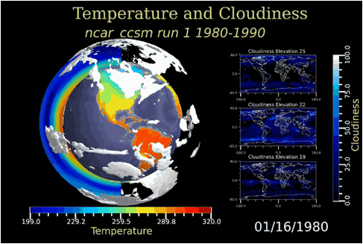
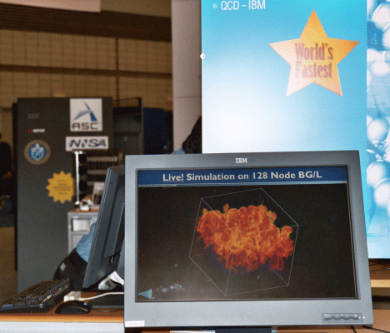
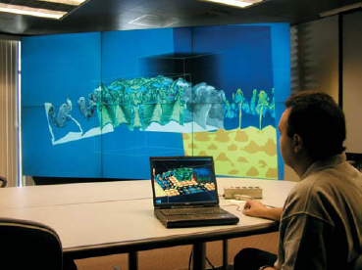
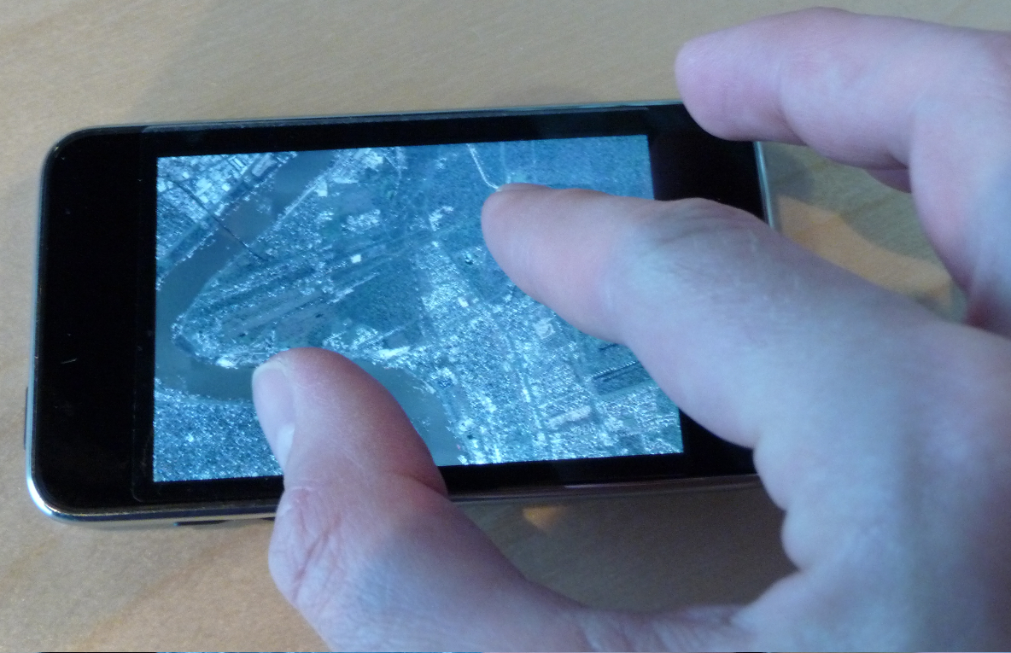
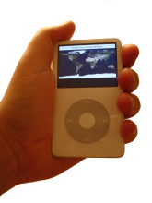
We Are Moving Towards a Distributed Storage and Processing Environment
Distributed storage
Data availability
Stream processing
Scalable infrastructure
for heterogeneous resources
Multi-scale collaborative interfaces accessing shared data sources:
remote interactive analytics
petascale simulation monitoring

