Slide 1
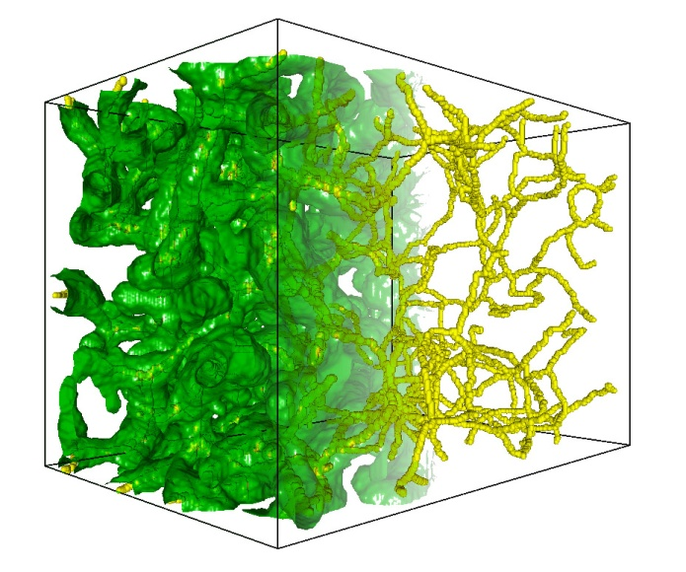
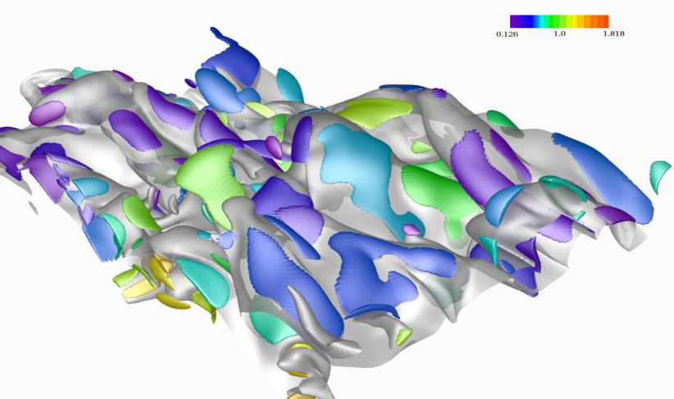
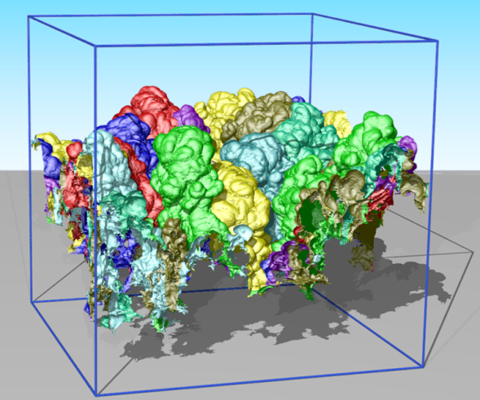
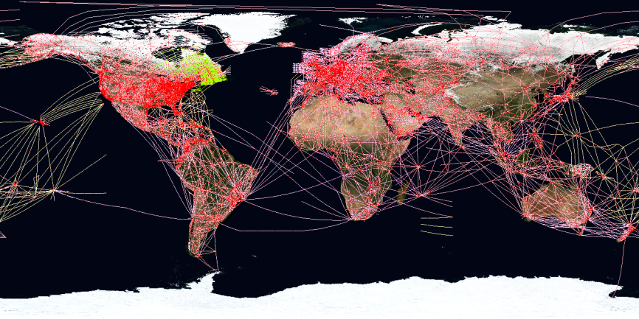


Multi-scale data streaming for interactive exploration of massive scientific data
Valerio Pascucci
Scientific Computing and Imaging Institute School of Computing University of Utah
Notes:
1
1
1
Thank co-authors

Slide 2
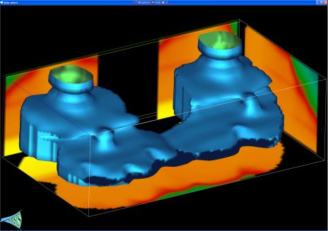
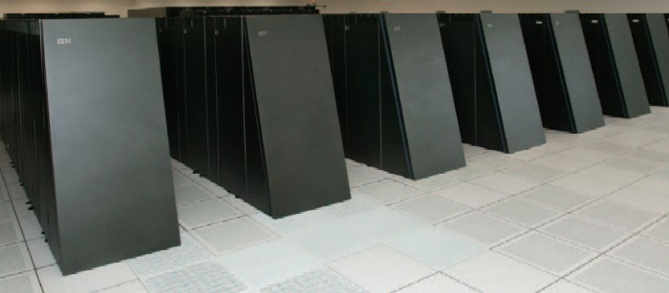
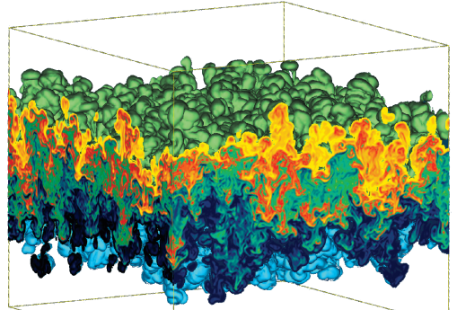
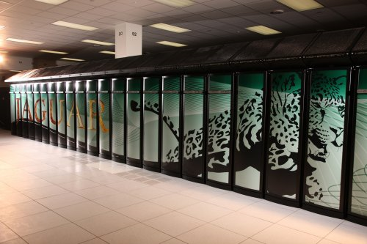
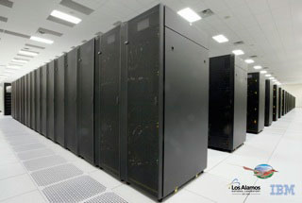
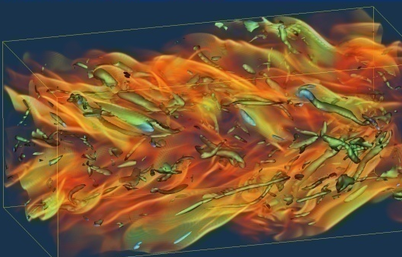
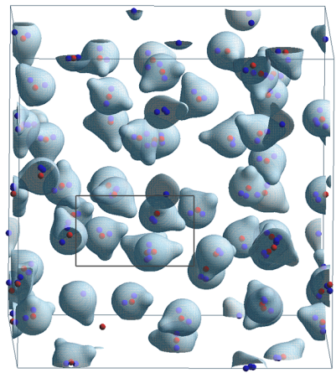
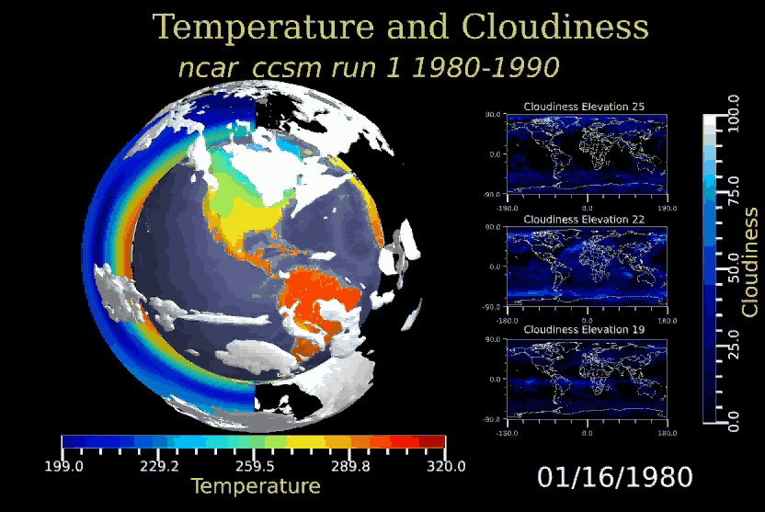
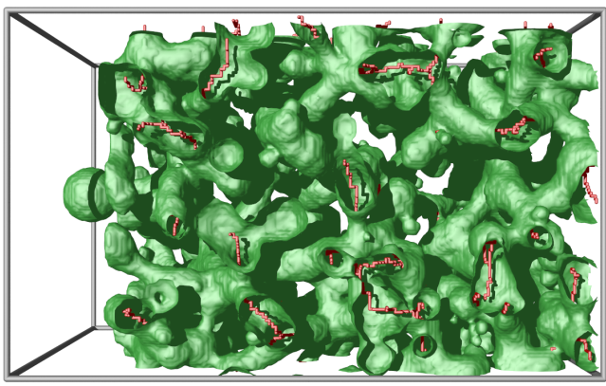
Massive Scientific Simulations are Source of Great Challenges and Opportunities
BlueGene/L
Subsurface Modeling
Hydrodynamic Instabilities
Jaguar
Roadrunner
Combustion Simulations
Molecular Dynamics
Material Sciences
Climate Modeling

Slide 3
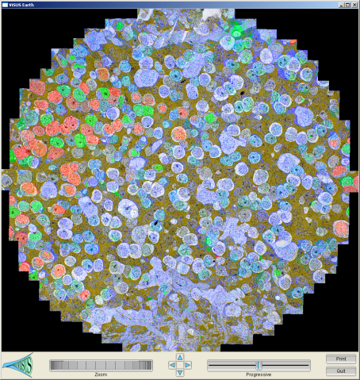
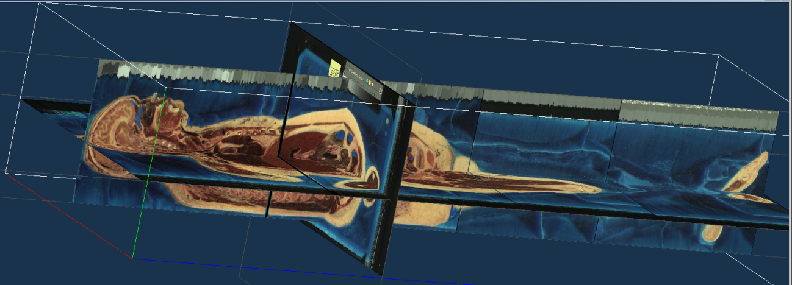
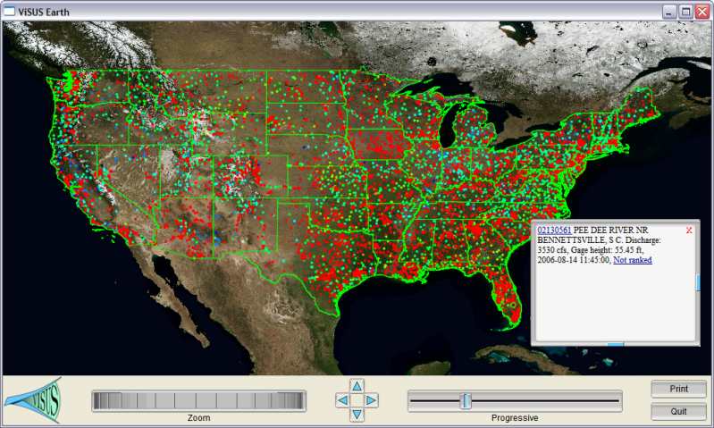
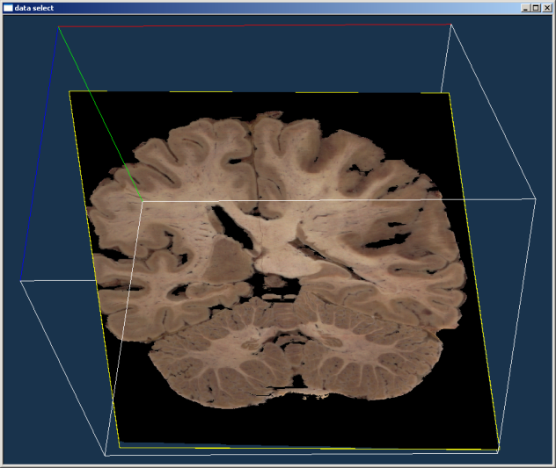
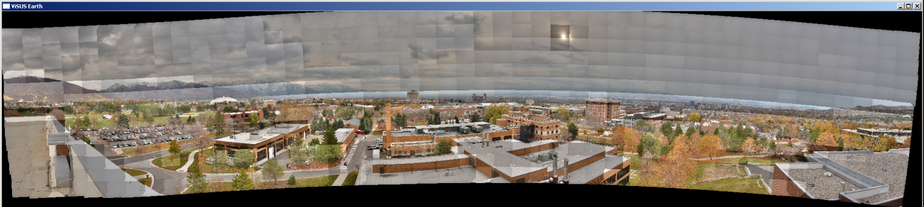
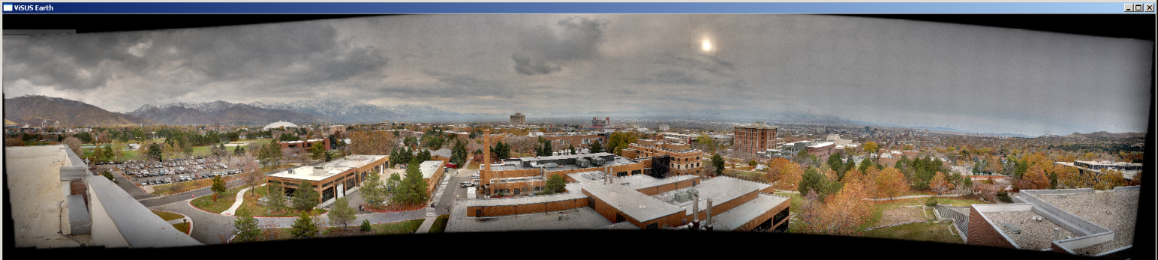
Sources of Large Data are Becoming More Diverse and Ubiquitous

Slide 4
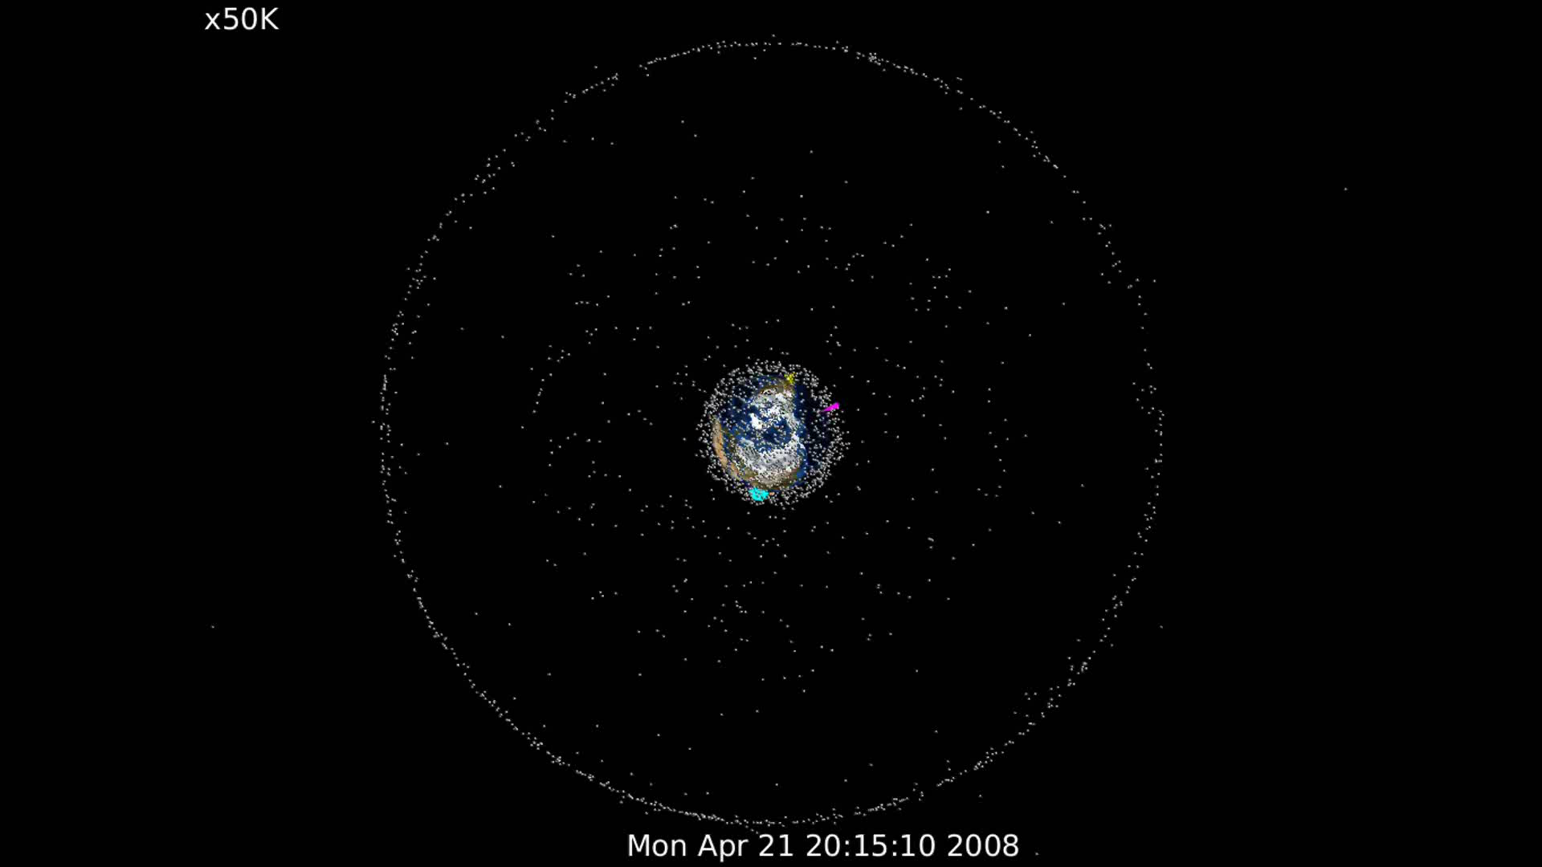
Application to Space Awarness

Slide 5
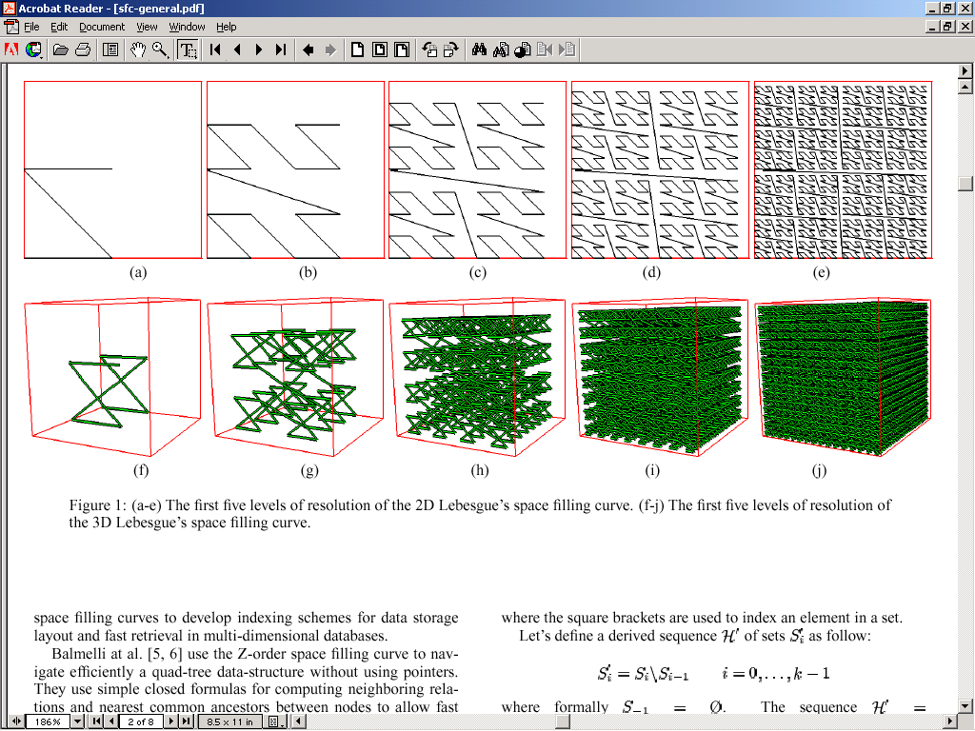
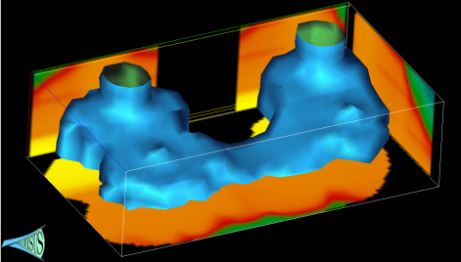
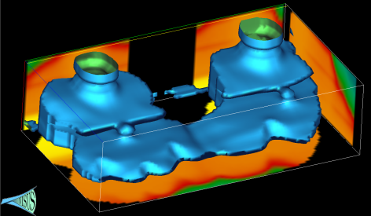



A Cyberinfrastructure Requires Efficient Data Management and Processing
Advanced data storage techniques:
Data re-organization.
Compression.
Advanced algorithmic techniques:
Streaming.
Progressive multi-resolution.
Out of core computations.
Scalability across a wide range of running conditions:
From laptop, to office desktop, to cluster of PC, to BG/L.
Memory, to disk, to remote data access.

Slide 6
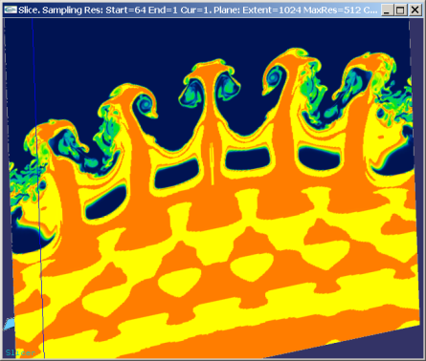
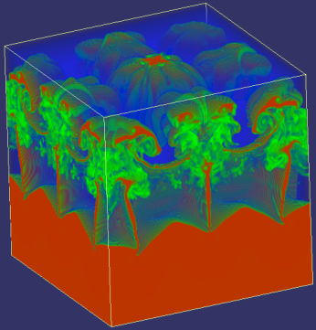
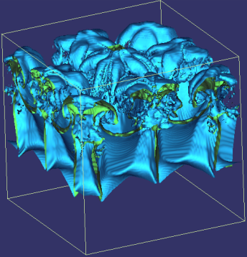
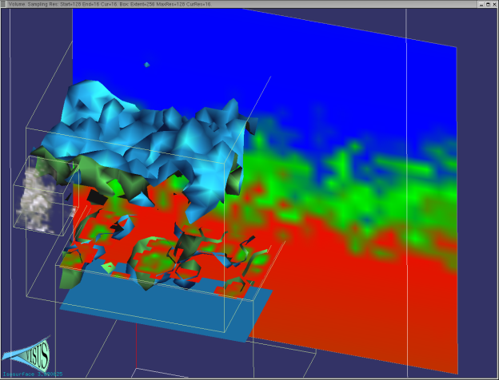
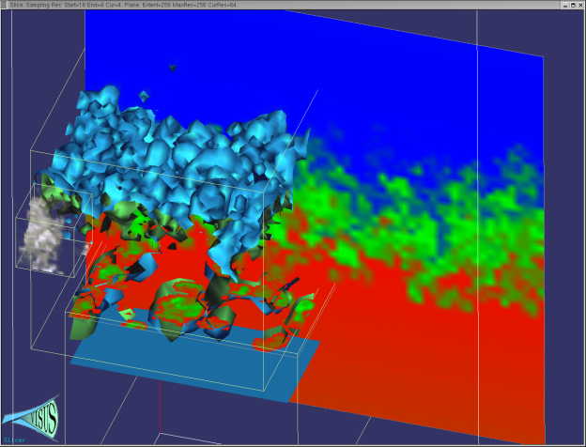
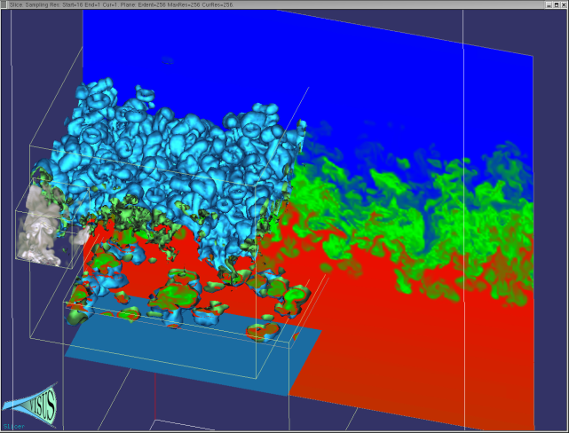
We Redesigned the Data Management and Visualization Pipeline with New Principles
Basic core techniques:
Slicing
Volume rendering
Iso-surfaces
Cache-oblivious out-of-core processing optimizing access locality for any size of data blocks
Pipelines of progressive algorithms
Coarse-to-fine construction of multi-resolution models
Remote data streaming

Slide 7
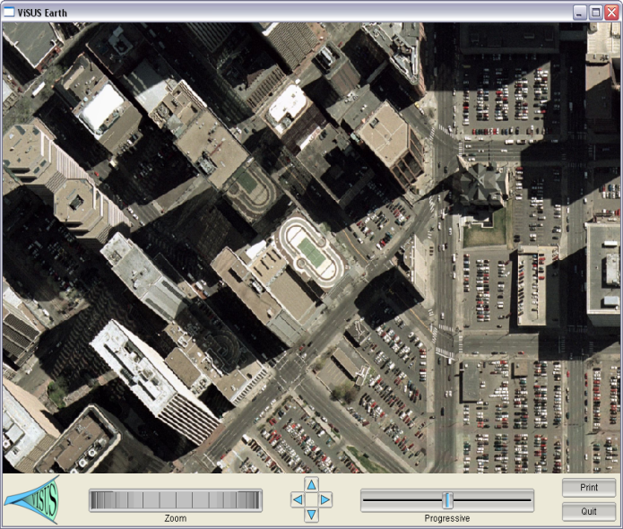
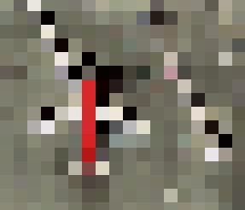
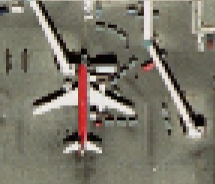
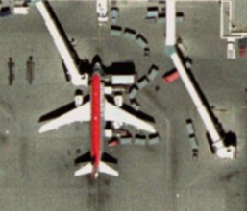
We Consider the Three Main Components Defining a Computing Infrastructure
Processing Network (Data Access Path)
Data Layout (Cache Oblivious)
Algorithm Design
(Progressive Processing)

Slide 8
We Characterize Algorithmic Classes Based on Effect in a Processing Network

Slide 9
We Characterize Algorithmic Classes Based on Effect in a Processing Network

Slide 10
The use of top-down and bottom-up processes have a strong impact on the data stream
Benefit: pipeline of progressive modules
Progressive refinement: coarse representation immediately available
Input
Output
Input
Output
Speed
Decimation:
full resolution data needed first
Challenge:
minimize the quality differential
Accuracy

Slide 11
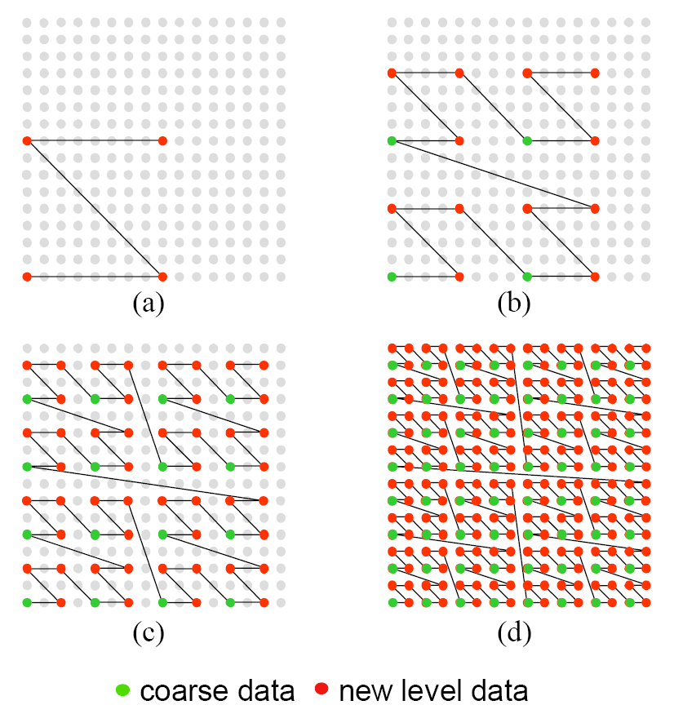
We Introduced Multi-resolution Cache Oblivious Layouts for Image Data
Z-order curve used to define a hierarchical sub-sampling over a grid
Improve access locality:
Interleaving hierarchical levels
Maintaining geometric proximity
Data layout is independent of the traversal of the data
Can be used with different block sizes

Slide 12
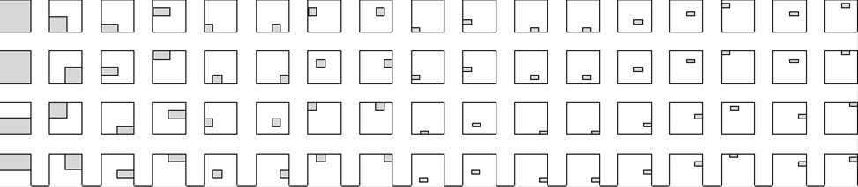
We Introduced a Progressive Range Query Avoiding Unnecessary Data Access
Blocks touched by the region
Layout of blocks on disk
0
1
2
3
4
5
6
7
8
query
data in the block
image
0
1
2
3
Layout of blocks on the image

Slide 13
We Introduced a Progressive Range Query Avoiding Unnecessary Data Access
Blocks touched by the region
Layout of blocks on disk
0
1
2
3
4
5
6
7
8
query
data in the block
image
0
1
2
3
Layout of blocks on the image

Slide 14
We Provided a Fast Address Computation Based on Simple Bit Manipulation
Simple bit manipulations to convert row major to hierarchical Z-order
3D version (also nD): basic Z shape replaced by a connected pair of Z shapes
?

Slide 15
Cache-Oblivious Data Layouts Scale Well Across Different Storage Blocking Factors
Formal analysis predicts performance and scalability
Performance improved by orders of magnitude
Independence of architecture and storage characteristics
32KB Disk Block Size
64KB Disk Block Size
subsampling rate
subsampling rate
Desktop Performance
Laptop Performance
subsampling rate
subsampling rate

Slide 16
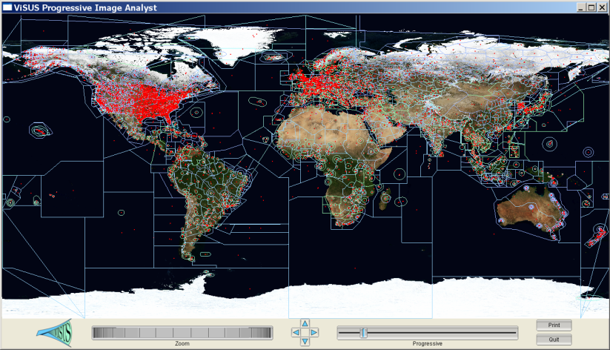
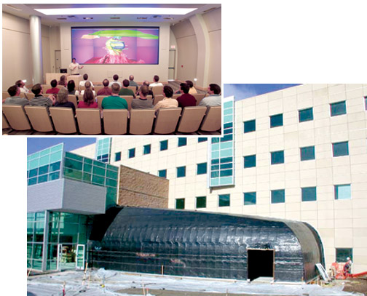
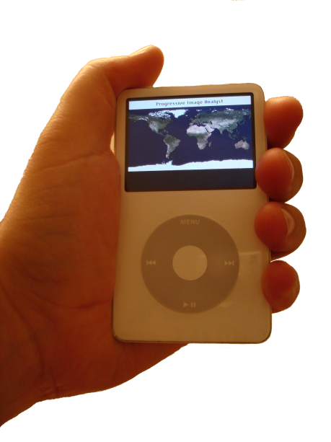
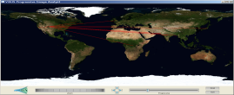
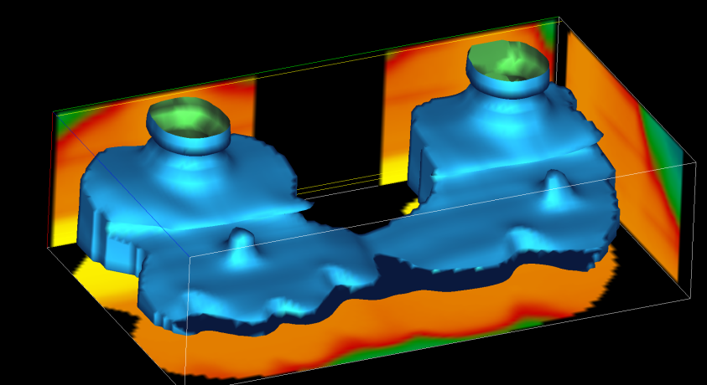
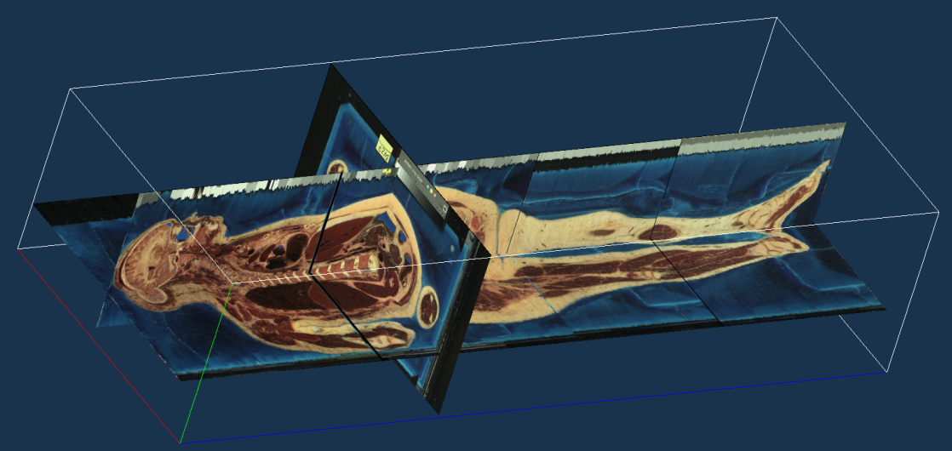
We Demonstrated Performance and Scalability in a Variety of Applications

Slide 17
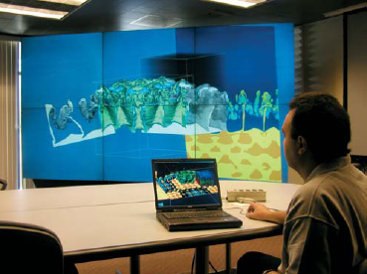

We Are Moving Towards a Distributed Storage and Processing Environment
Distributed storage
Data redundancy
Security
Heterogeneous collaborative infrastructure
Multi-scale collaborative interfaces accessing shared data sources:
data collection and validation
interactive analytics
decision making

Slide 18
We Address the Need for Scalable Algorithms and Infrastructures
Data formats that minimize I/O and memory transfer for most frequent operations
New algorithms and data structures for management of large collections of time dependent information
New theoretical models that predict the behavior of modern architectures
New algorithms that are “intrinsically scalable” with respect to:
Processing capabilities
Diversity of hardware available
Locality of data
Can benefit a variety of tools
Scalable system infrastructures

Slide 19
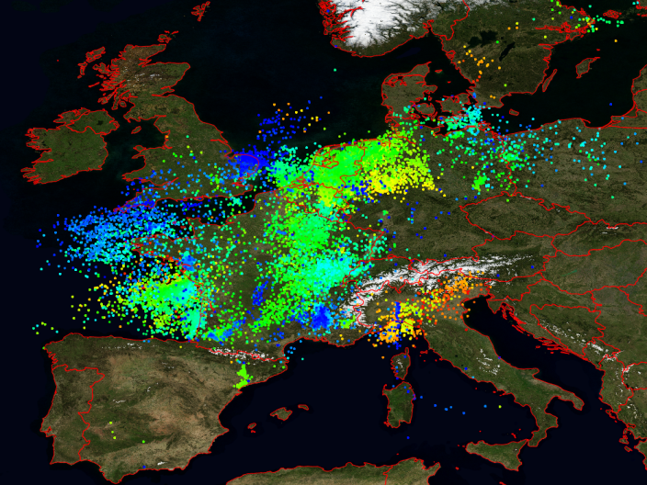
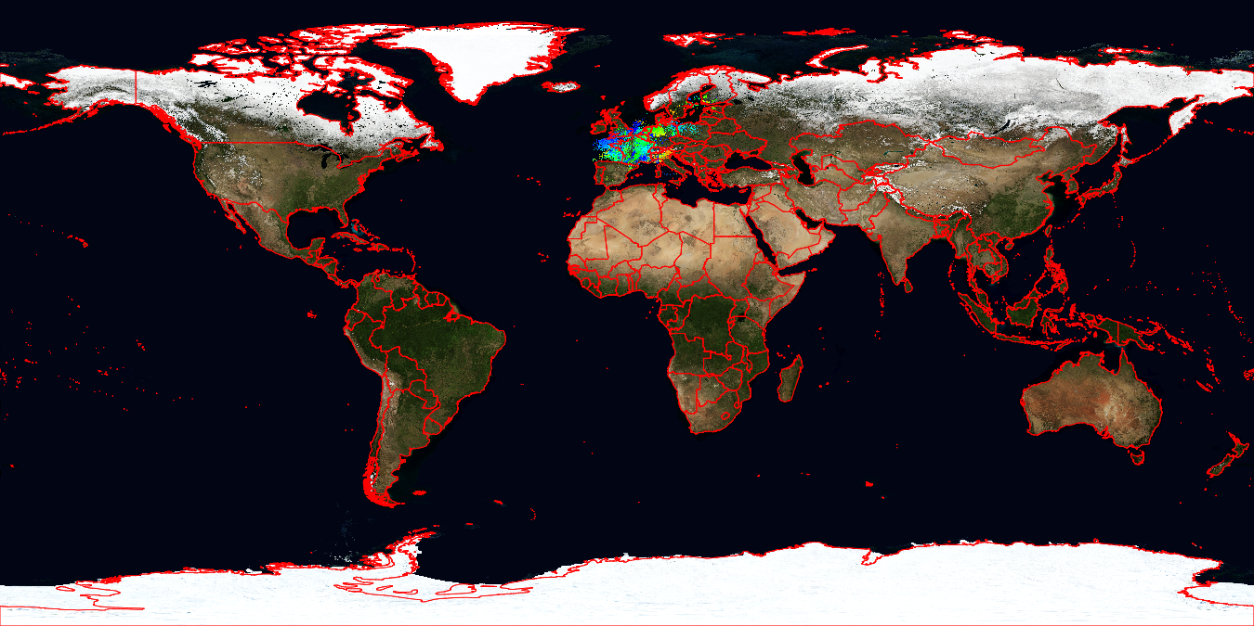
We provide real-time access to large scale time dependent data and sensory data
Blue Marble Earth (next generation) provided by NASA:
Twelve months in 2004 (11GB per month)
Resolution: 86400 x 43200 pixels (500 meters per pixel)
Lightning events from distributed sensing devices over Central Europe (Blitzortung.org)

Slide 20
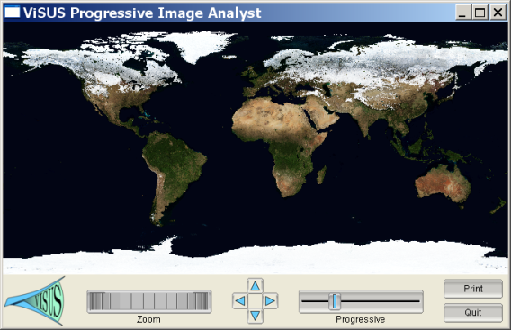
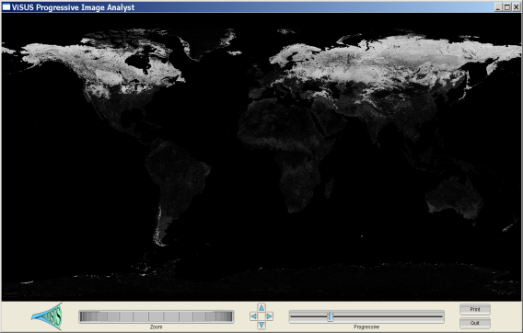
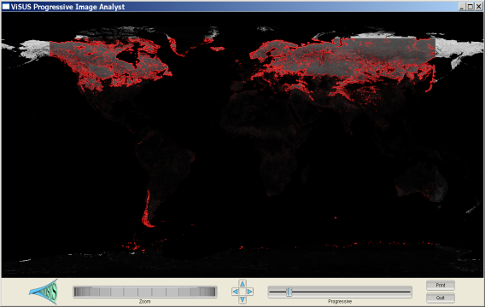
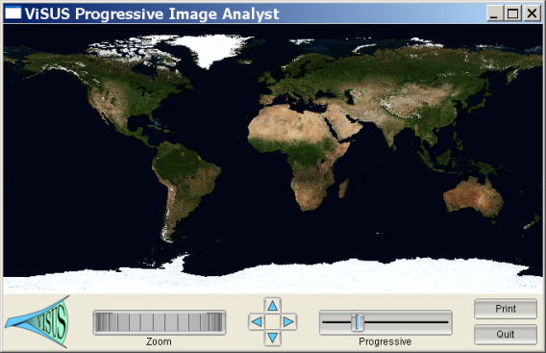
We Allow Distributed Computations at Different Stages of the Data Stream
Progressive Image Differencing + Editable GPU filter.
Two data sources (11 GB each)
Progressive differencing
Computed in real-time.
Streaming edge detection on the GPU.

Slide 21
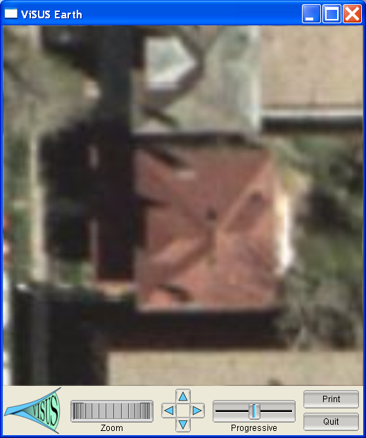
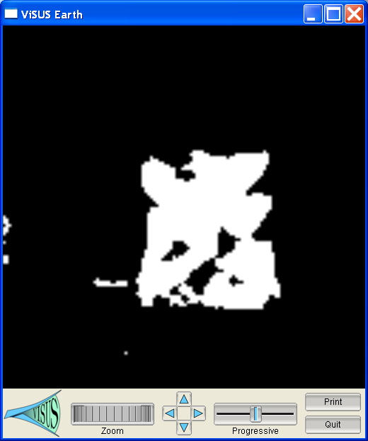


We are Developing Progressive Scheme for Content Based Image Processing
Hypothesis:
Progressive Analysis:

Slide 22


Capability to query database servers for retrieving original information for validation
Implemented functionalities to query the database servers established for the Proteus and Wormhole projects
Interactively query image database to retrieve original imagery in GeoTIFF and NITF formats

Slide 23


Our Preliminary Tests Show Potential for Orders of Magnitude in Performance Gains
We are extending the ViSUS tools with KML interpretation and visualization capability (faster than Google Earth).
We have incorporated basic management of geo-tagged points, lines, and polygons with time stamps
1TB of imagery can be presented instantly while 20MB of KML data takes 20 seconds.

Slide 24







We Are Moving Towards Support of a Combination of Different Data Types
Concurrent access to several information sources requires similar techniques for a variety of data types.
COMMERCIAL AIRWAYS
AIRSPACE BOUNDARIES
Algorithmic directions:
integration with other frameworks
progressive streaming infrastructure for “vector data” (points, lines, polygons);
uncertainty/incompleteness in the data
progressive resolution of queries with quantification and visualization of error/confidence;
on-line update of internal data structures to render new data immediately available.
BOUNDARIES OF US COUNTIES

