Slide 1
Uncertainty in Analysis and Visualization Topology and Statistics
V. Pascucci
Scientific Computing and Imaging Institute,
University of Utah
in collaboration with
D. C. Thompson, J. A. Levine, J. C. Bennett, P.-T. Bremer, A. Gyulassy, P. E. Pébay

Slide 2
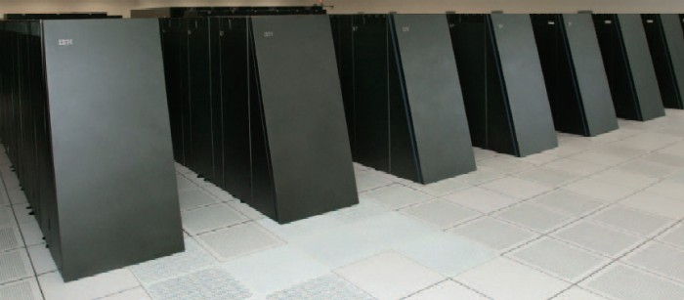
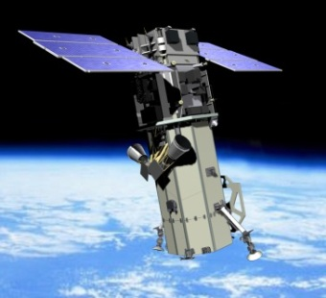
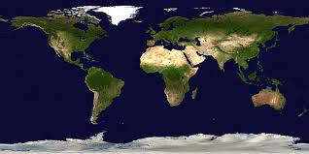
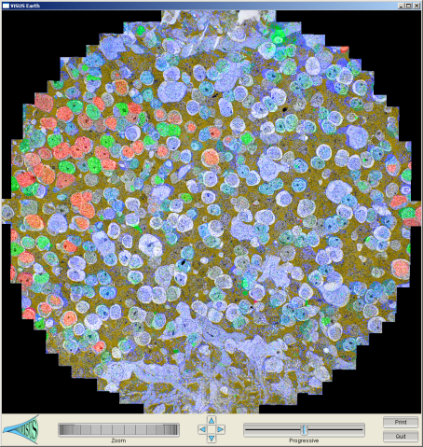
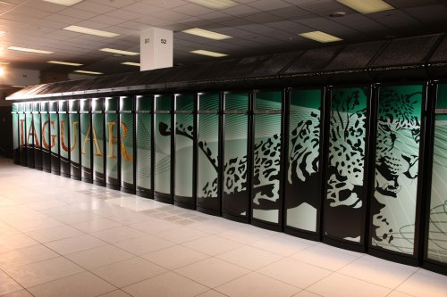
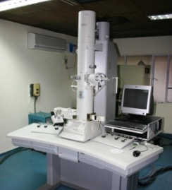
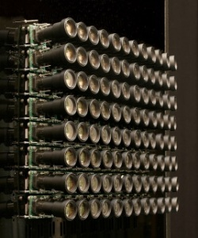
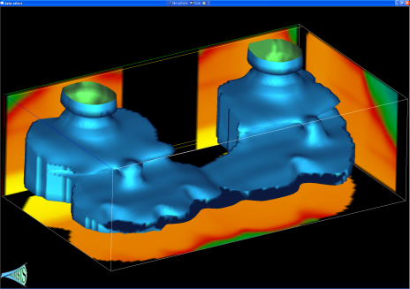
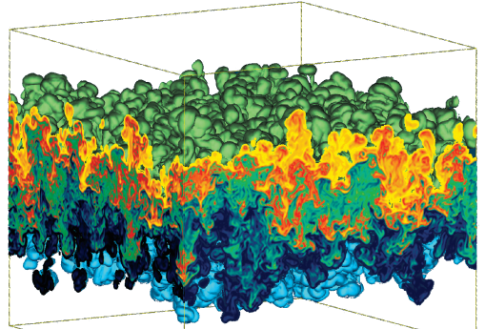
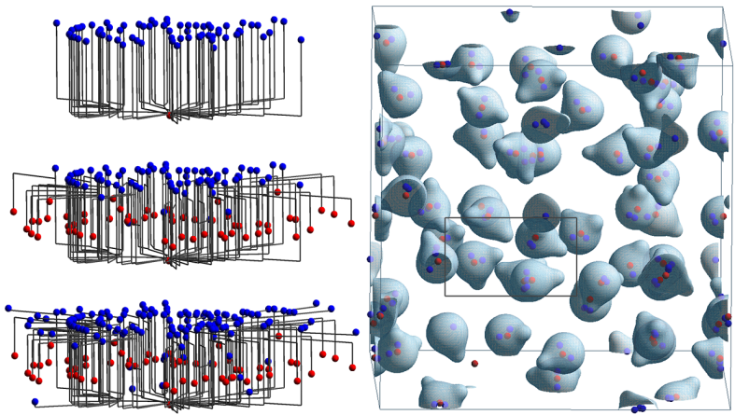
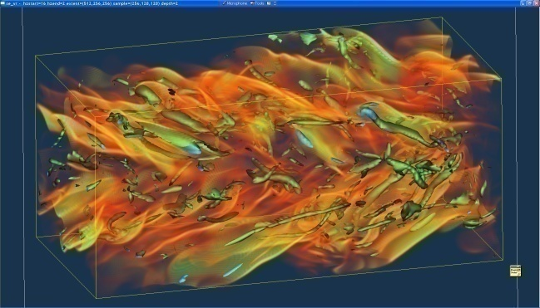
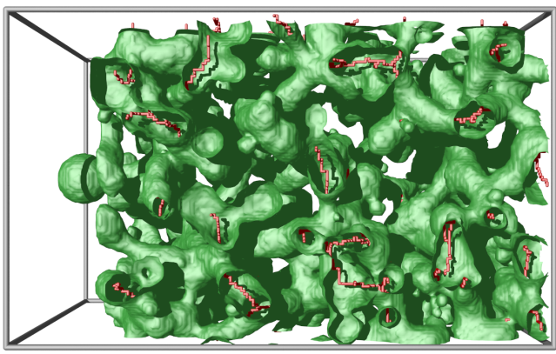
Massive Simulation and Sensing Devices Generate Great Challenges and Opportunities
Satellite
BlueGene/L
EM
Earth Images
Retinal Connectome
Cameras
Jaguar
Carbon Seq. (Subsurface)
Hydrodynamic Inst.
Molecular Dynamics
Climate
Turbulent
Combustion
Photography
Porous Materials

Slide 3
Data from Many Sources
Where is data “uncertain” coming from?
High Spatial Resolution (Massive grids)
Varying parameters, Time (Ensembles)
Many fields (pressure, temperature, ….)
Stochastic Simulations (Distributions/point)

Slide 4
Many Techniques Apply
Honest assessment of data driven information
Analysis Parameter Space
Streamline A
Streamline B
Unstable Manifolds
Simulation Parameter Space

Slide 5
Hixels: A Possible Unified Representation
Hixels:
A pixel/voxel that stores a histogram of values
Can be used to:
Compress blocks of large data
Encode the ensembles of runs per location
Discretize the distribution
Trade data size/complexity for uncertainty

Slide 6
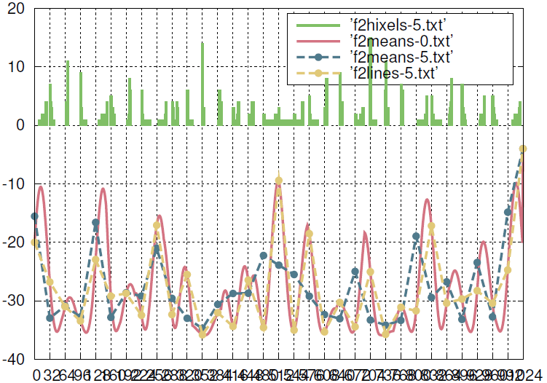
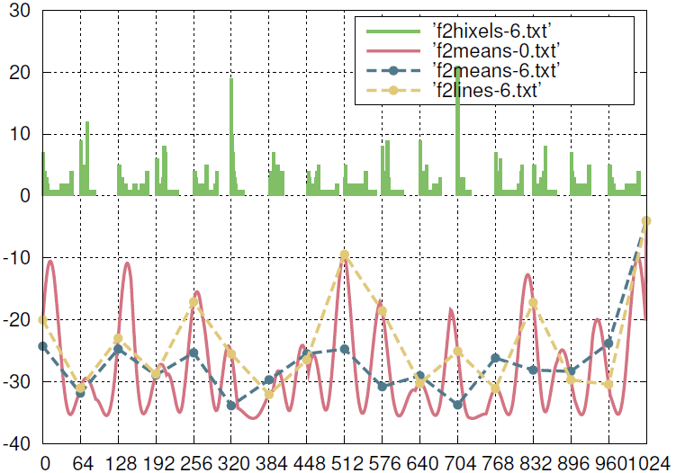
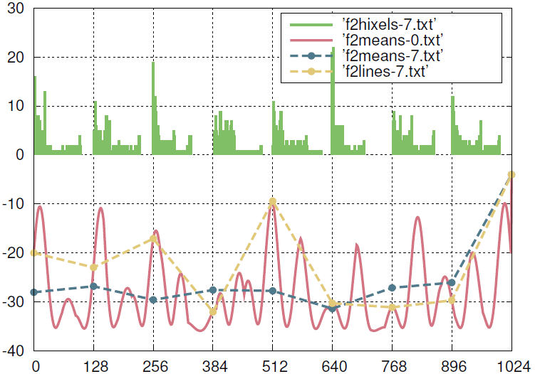
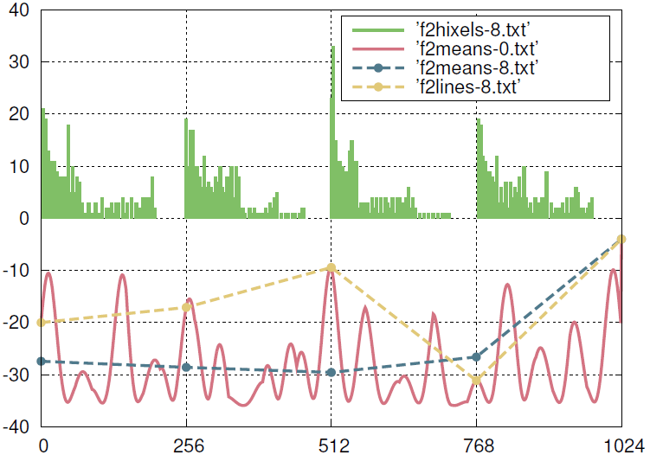
Hixels: 1d Example

Slide 7
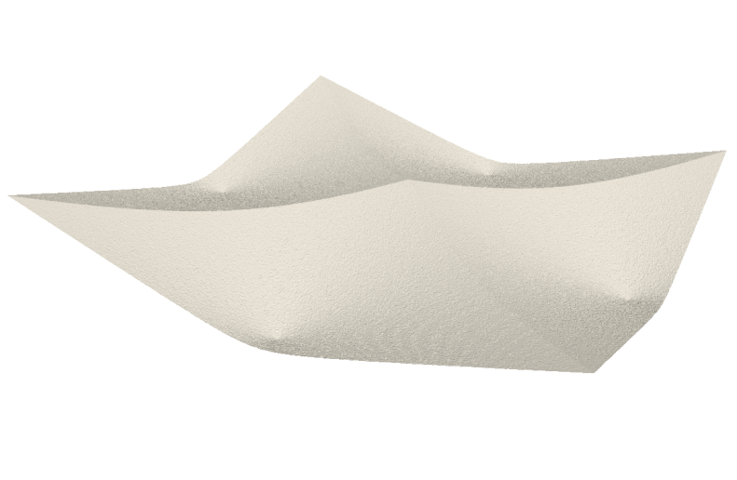
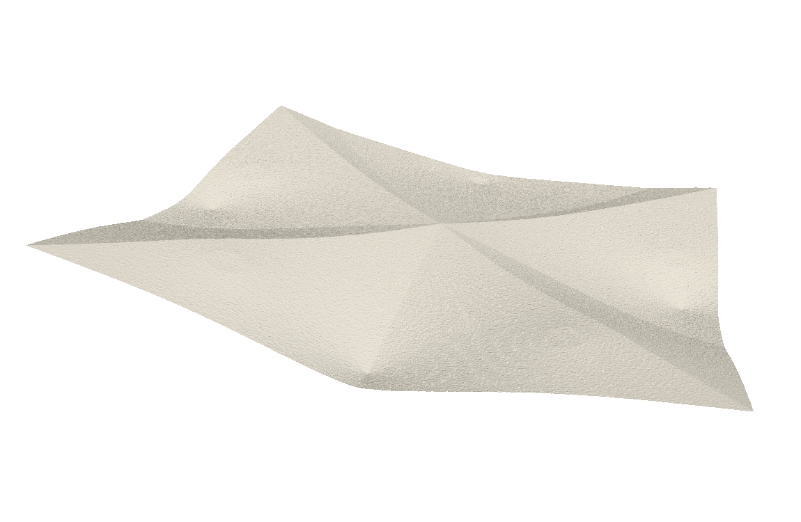
Hixels: 2d Example (Ensemble)
Normal x9600
Mean
Poisson x3200
Hixels (Histogram drawn vertically)

Slide 8
Hixels: 2d Example (Ensemble)
Normal x9600
Mean
Poisson x3200
Hixels (Histogram drawn vertically)

Slide 9
Some Basic Manipulations of the Hixels Representation
Re-Sampling
Bucketing Hixels
Analyzing Statistical Dependence of Hixels
Fuzzy Isosurfacing
…… suggestions for more?

Slide 10
Re-Sampling from Hixels
One way to represent a scalar field is by sampling the hixels per location.
Generate (many) instances V_{i} of downsampled data by selected a value for each hixel at random using the distribution.
Treat this as a scalar field, apply various techniques to analyze.
Initial basic assumption (probably not true): hixel data is independent.

Slide 11
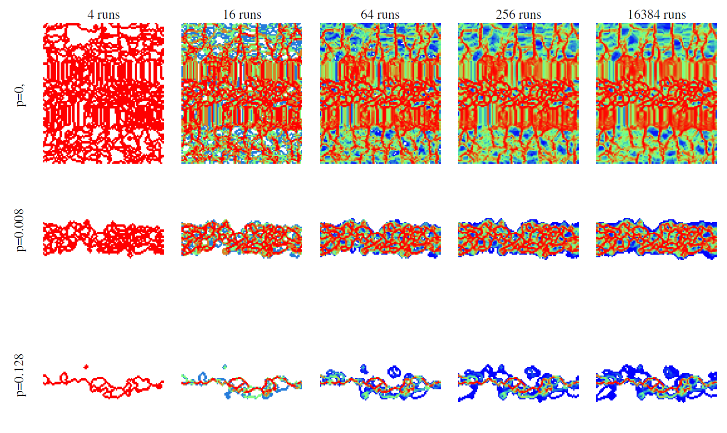
Convergence of Sampled Topology
8x8 Hixels
Persistence
Distribution of Topological Boundaries Over Many Realizations

Slide 12
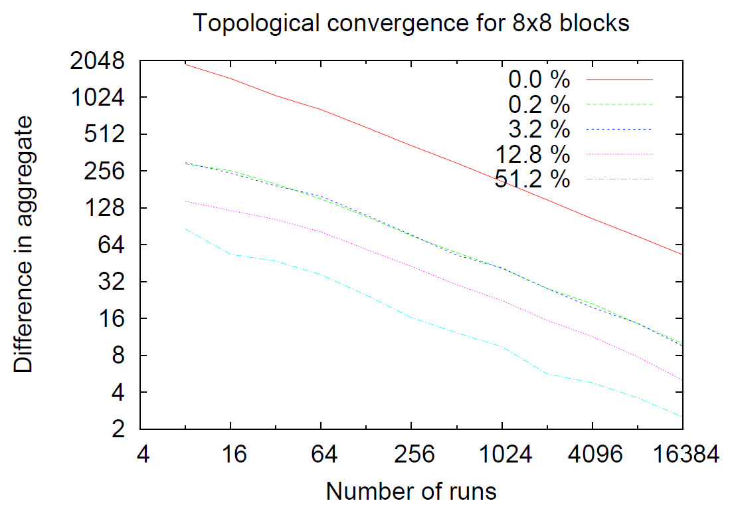
Convergence for 8x8 hixels

Slide 13
Convergence for 16x16 hixels

Slide 14
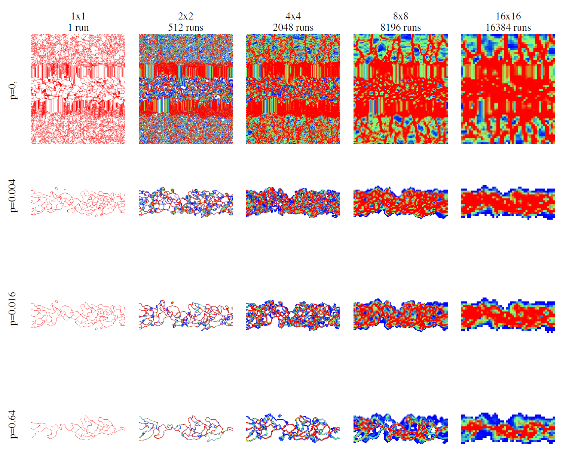
Convergence of Sampled Topology
Persistence
Distribution of Converged Topological Boundaries Over Data Simplification

Slide 15
Statistically Associated Sheets
Not all values in hixels are independent
Consider data as an ensemble
Each “sample” is per run, not per location
There may be certain (statistical) associations between neighboring values
Use contingency tables to represent which values in adjacent hixels are related

Slide 16
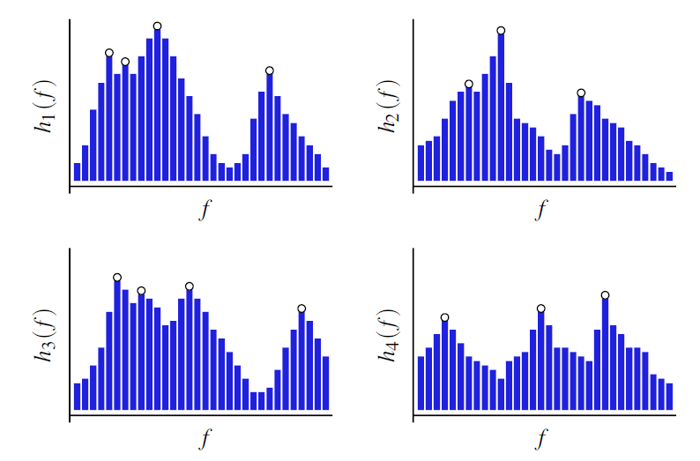
Bucketing Hixels

Slide 17
Topological Bucketing of Hixels
Ordering pairs of critical points by the area between them (hypervolume persistence ). Eliminates peaks by the probability associated with them.

Slide 18
Bucketing Hixels
Hixels of size 16x16x16
256 bins/histogram
Hypervolume Persistence varied from 16 to 512 by powers of 2
hp=16
hp=32
hp=64
hp=128
hp=256
hp=512

Slide 19
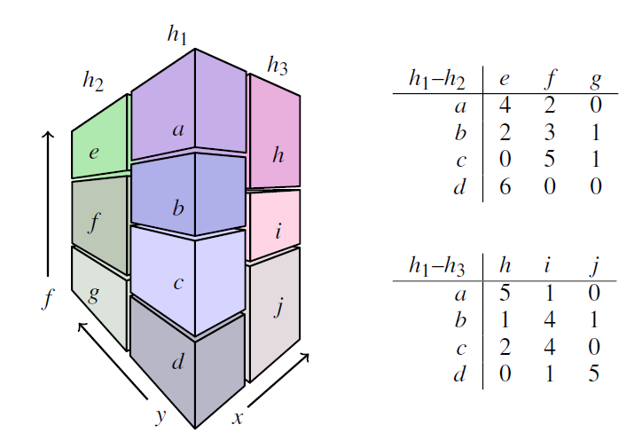
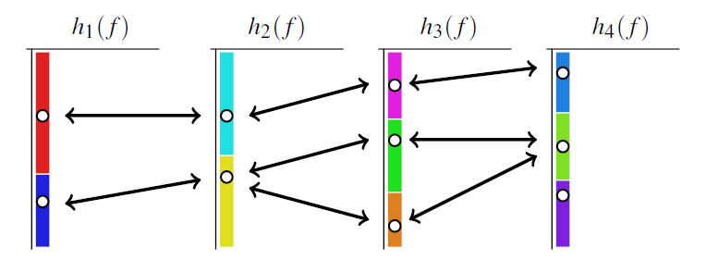
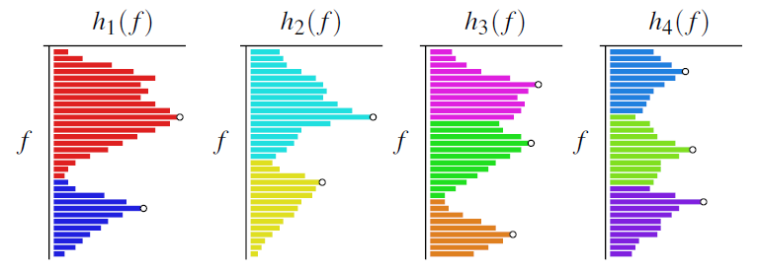
Contingency Tables: Pointwise Mutual Information
pmi(x,y)=0 => x independent y

Slide 20
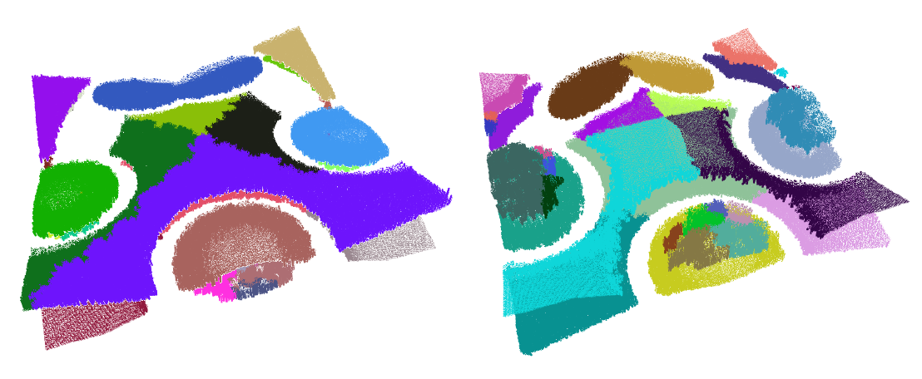
Sheets
Basins of Minima
Basins of Maxima

Slide 21
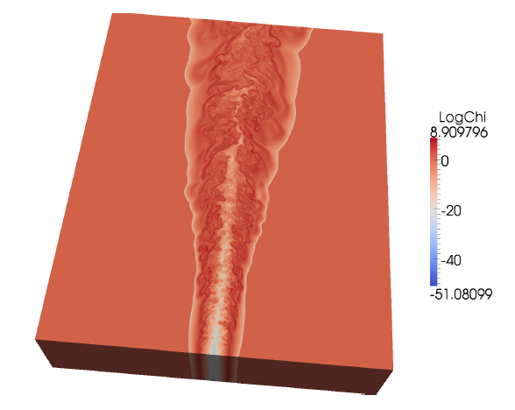
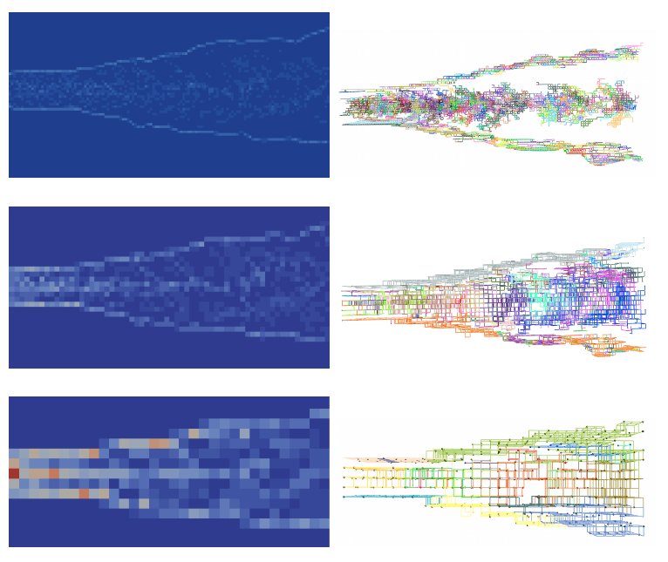
More Sheets
16³ Hixels
32³ Hixels
64³ Hixels
Red = 27 buckets/hixels Blue = 1/bucket/hixel

Slide 22
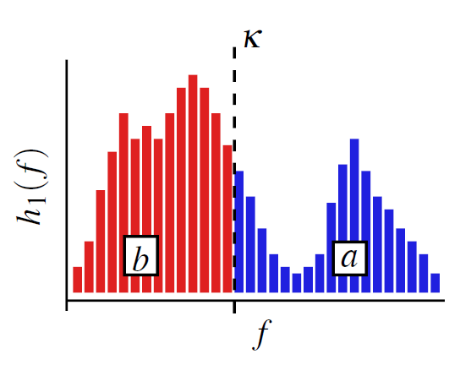
Fuzzy Isosurfaces
Slicing histograms:
$a=b \underset{⇒}{}g=0$
$a>b \underset{⇒}{}g>0$
$a<b \underset{⇒}{}g<0$

Slide 23
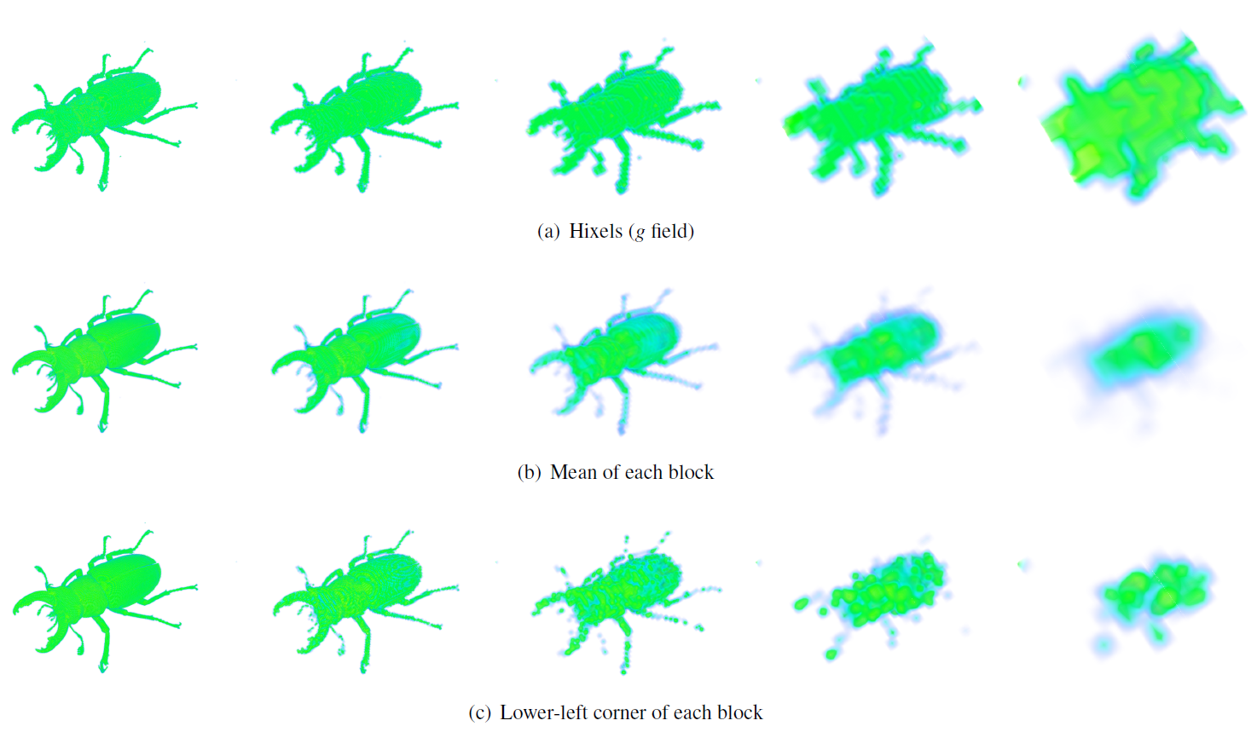
Fuzzy Isosurfaces

Slide 24
Comparison
Stag Beetle with 16³ hixels
Vs. mean & lower-left isosurfaces
Isovalue 580
Original size 832x832x494

Slide 25
Questions?
Jet with 2³, 8³, and 32³ hixels
Isovalue 0.506
Original size: 768x896x512

