Slide 1
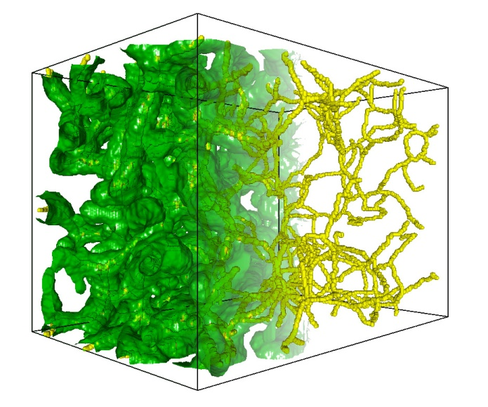
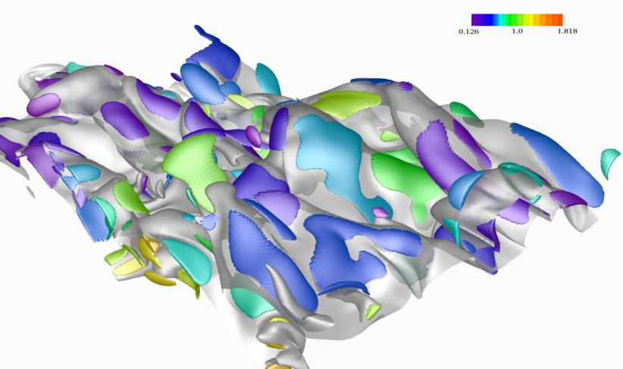
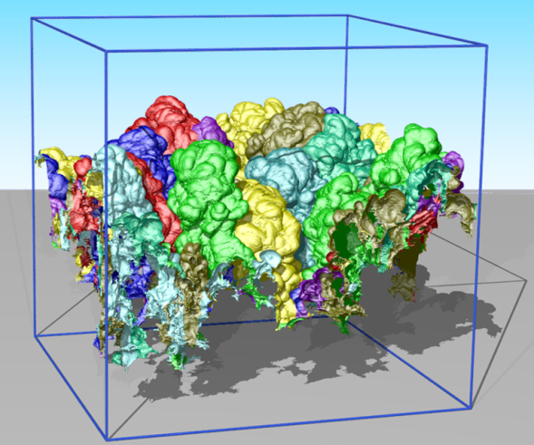
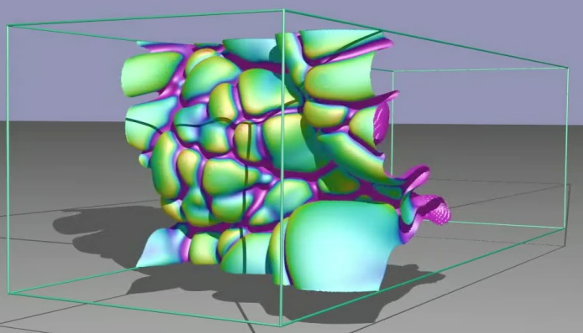


Multi-scale data streaming for interactive exploration of massive scientific data
Valerio Pascucci
Scientific Computing and Imaging Institute
School of Computing
University of Utah
Notes:
1
1
1
Thank co-authors

Slide 2
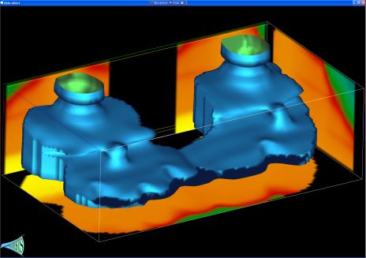
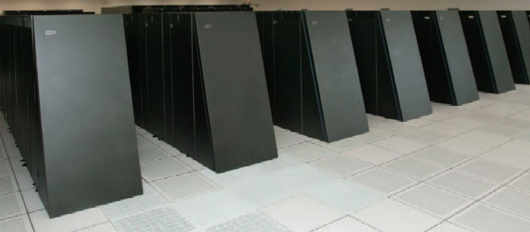
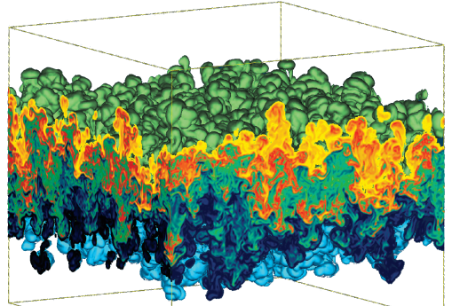
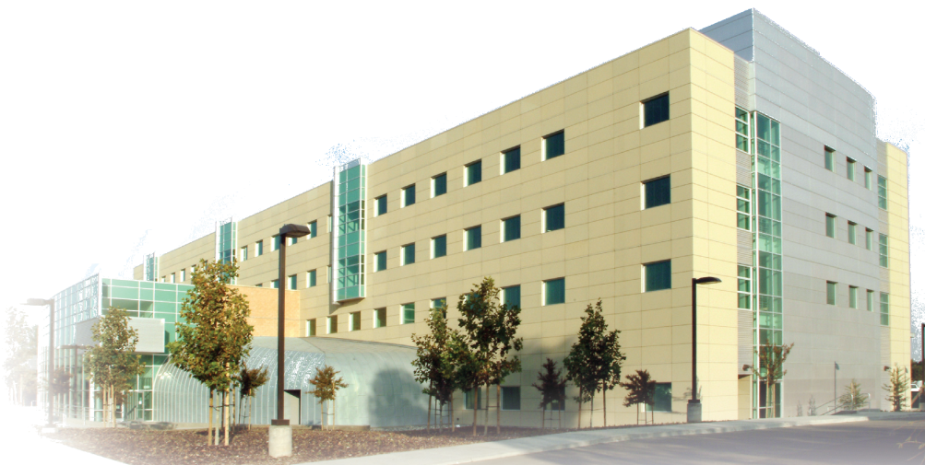
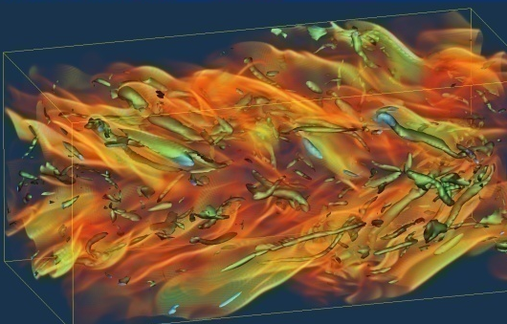
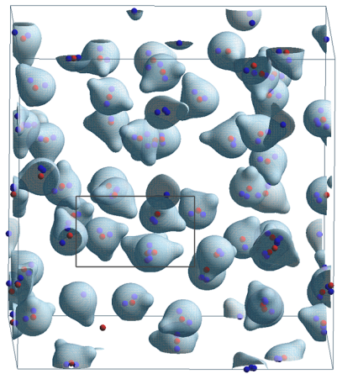
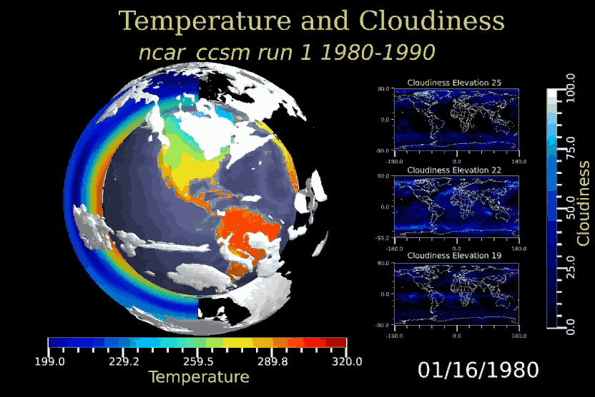
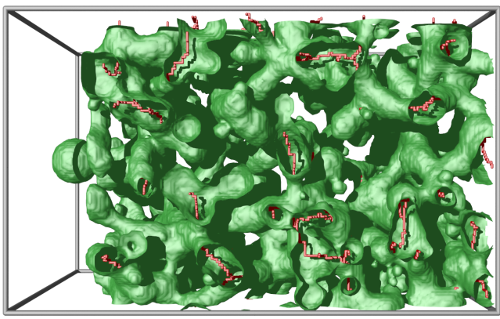
Massive Scientific Models are Source of Great Challenges and Opportunities
Subsurface
Modeling
BlueGene/L
Hydrodynamic
Instabilities
Combustion Simulations
Molecular Dynamics
Material Sciences
Climate Modeling

Slide 3
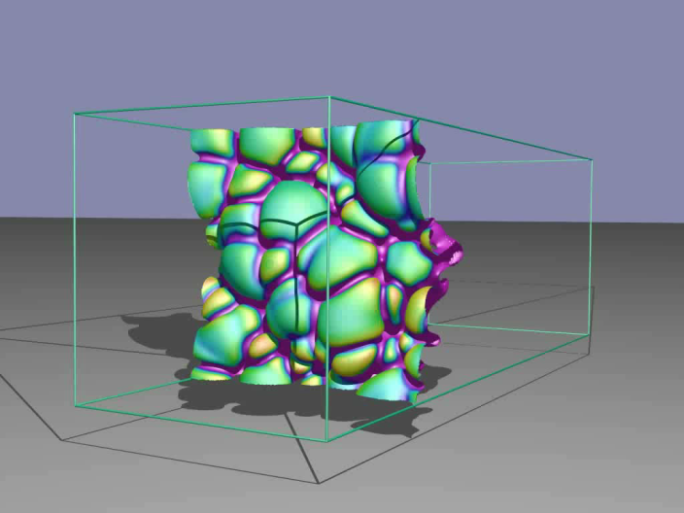
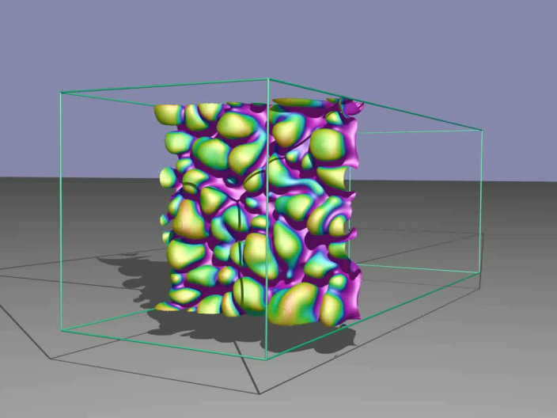
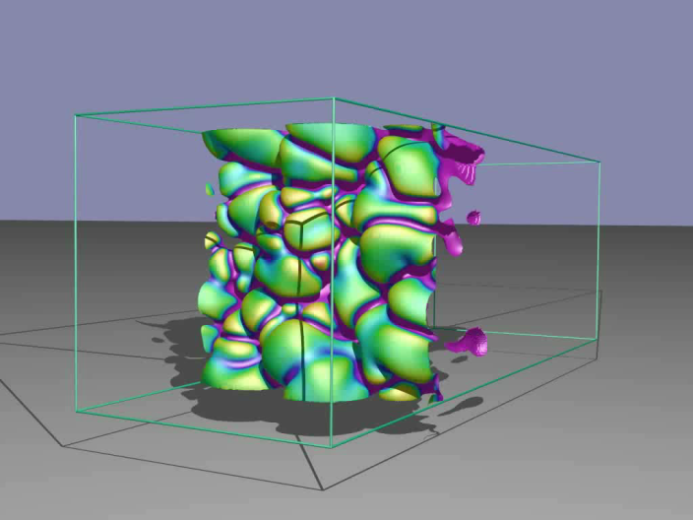
Given Three Burning Hydrogen Flames, Rank Them by Level of Turbulence

Slide 4

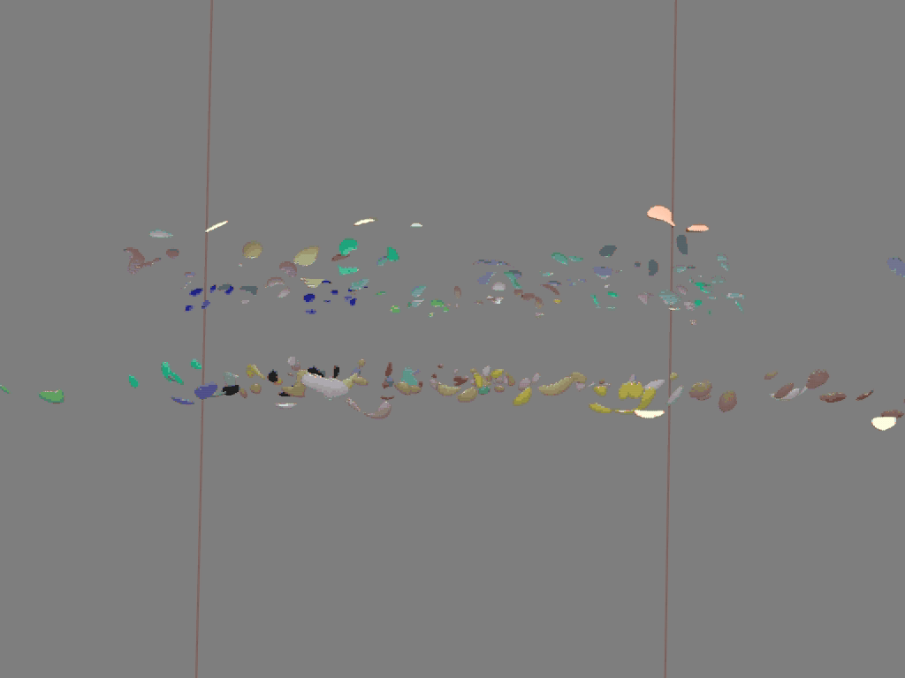
What Conditions Cause Extinction and Reignition in Premixed Hydrogen Flames

Slide 5
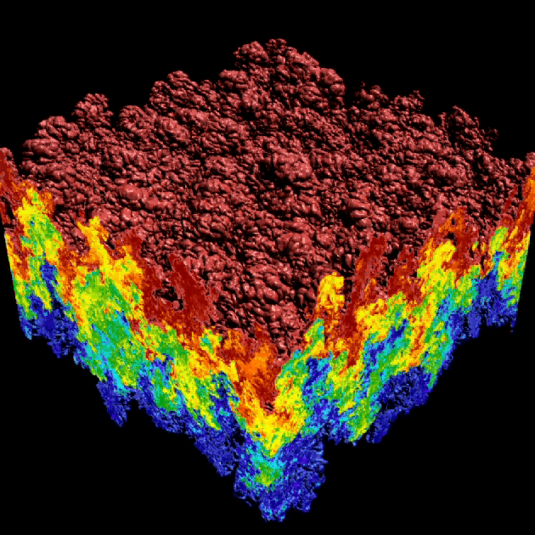
Count the Number of Bubbles in a Rayleigh–Taylor Instability

Slide 6

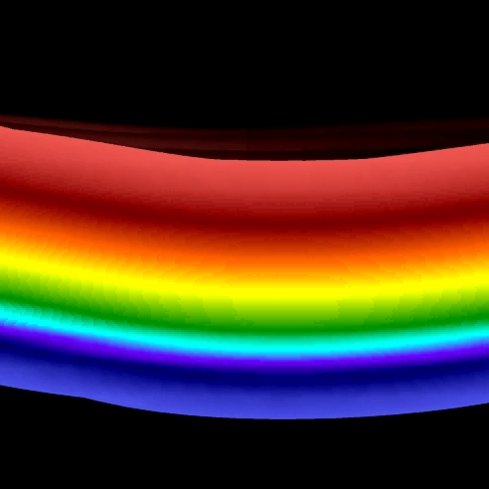
Compare a LES and a DNS simulations with different initial and domain
LES
Large Eddy Simulation
DNS
Direct Numerical Simulation

Slide 7
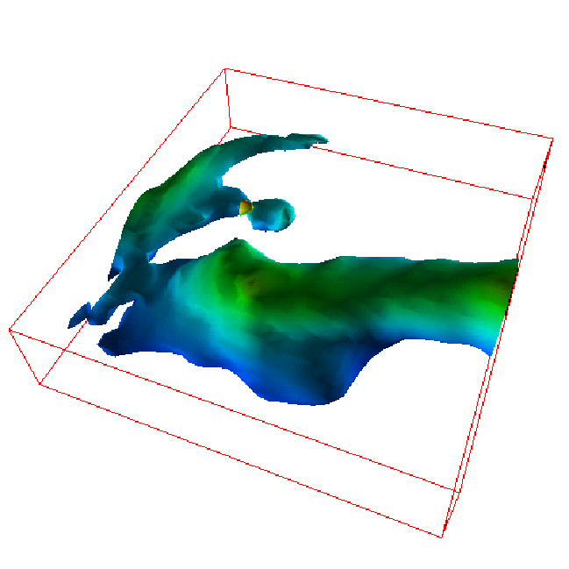
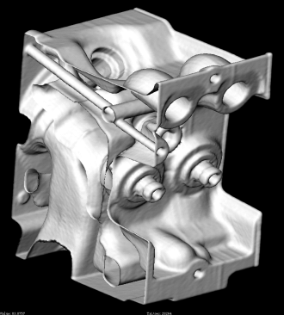
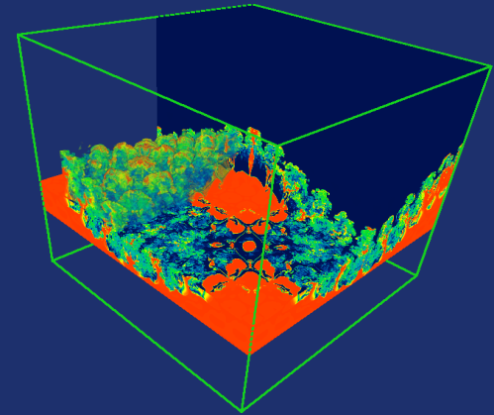
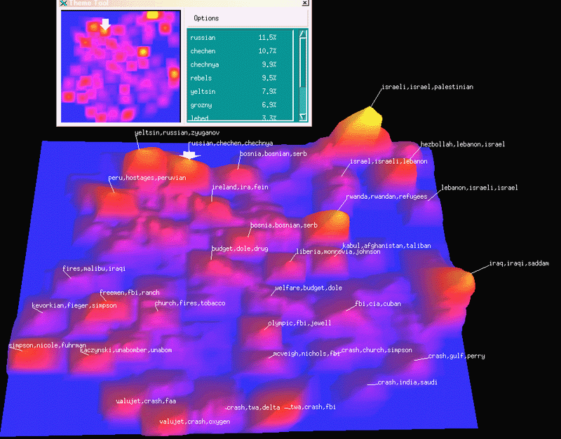
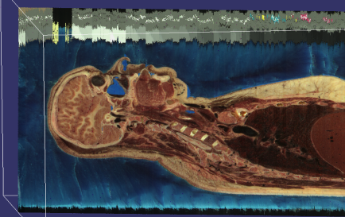
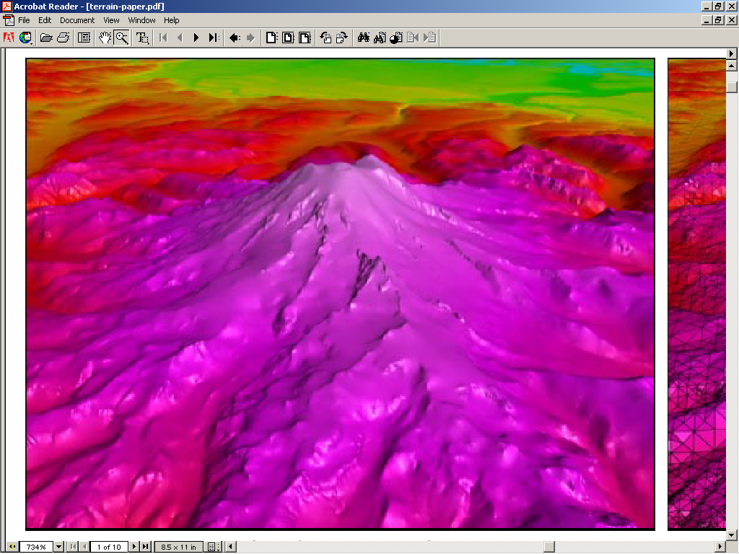
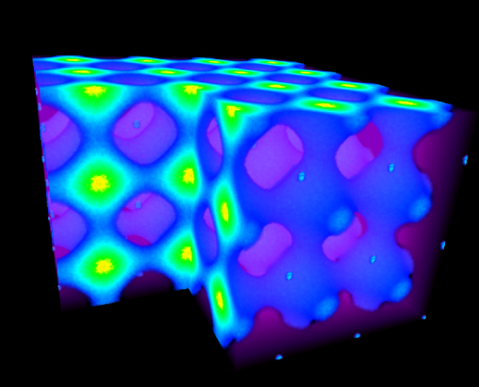
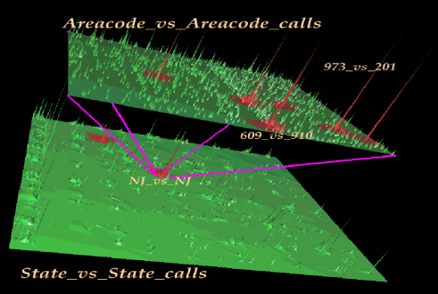
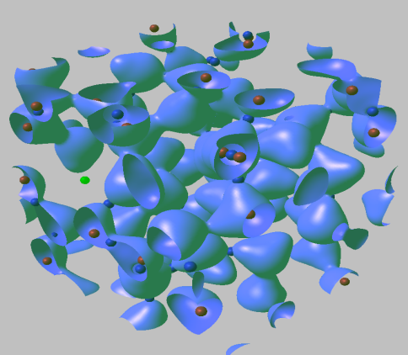
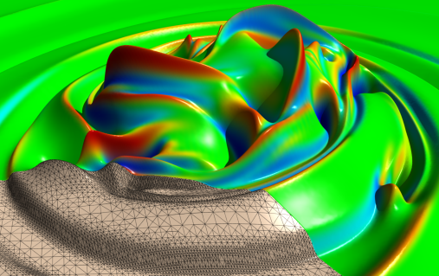
We Develop General Purpose Tools for
Efficient and Reliable Data Understanding
Real functions are ubiquitous
in the representation of
scientific information.

Slide 8
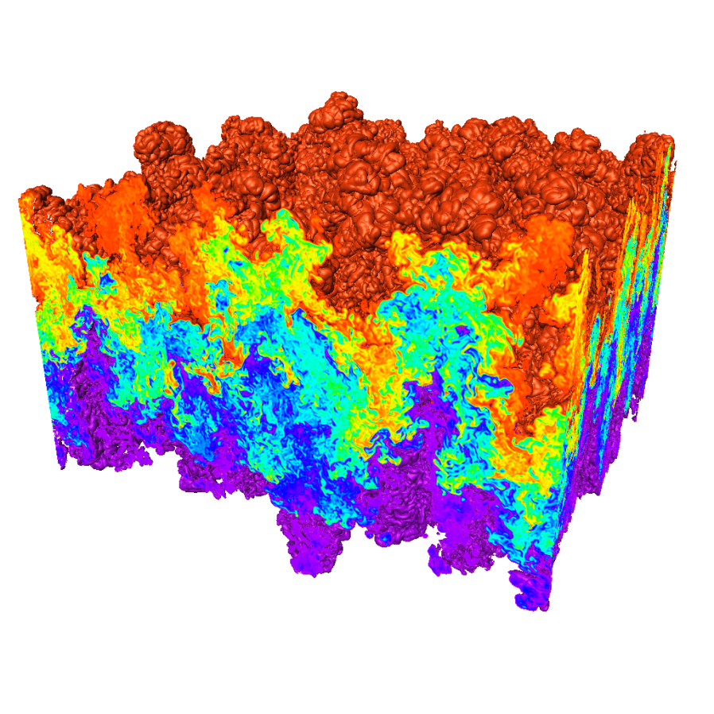
Traditional Data Analysis Tools are
Often Ineffective for Massive Models
Massive models are challenging:
  Sheer volume of information
  Complexity of the
  information represented
  Complexity of presentation
Tools do not scale with the
data sizes
Difficult to capture multiple scales
Numerical methods unstable and sensitive to noise
Difficulty in providing error bounds associated
with the coarse scale analysis
Nee new abstractions and metaphors to covey information reliably and efficiently
Rayleigh–Taylor instability (Miranda)
Notes:
In addition to difficulties of bringing out important features, current visualization techniques have some limitations when applied to 3D data. In large simulations like the RT instability simulation shown at right, the geometric complexity is so great that isosurfaces and even slice planes are not able to provide more than a qualitative view of the data. In the image at right the top isosurface occludes itself. Such occlusion can occur in small data sets given non-trivial geometries. In addition, visualization tools treat time-varying data as a set of discrete snaphots. Scientists that want to see the temporal features of their data must create a resonable visualization on one time step and create an animation. This process is slow, and usually must be iterated to get the right set of parameters for the entire time sequence. Our solution is to apply topological analysis to extract representations of the shape of data sets that are independent of the mesh, and thus do not need to be embedded in the 3D space of the simulation data. These representations can also be used to represented an entire time sequence, giving a scientist to investigate the temporal properties of their data directly.

Slide 9
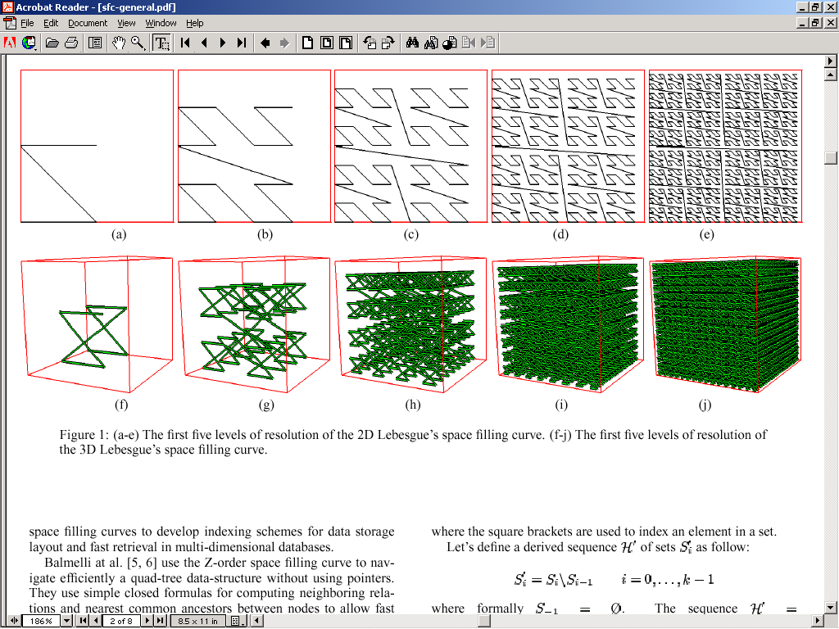
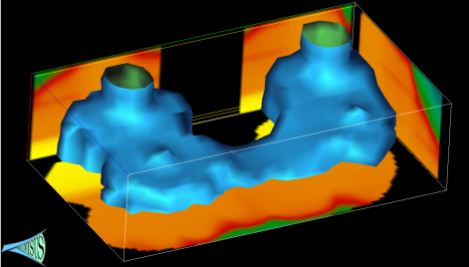
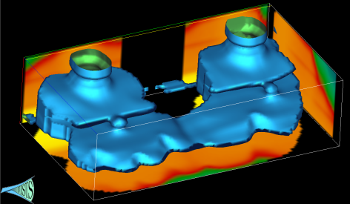

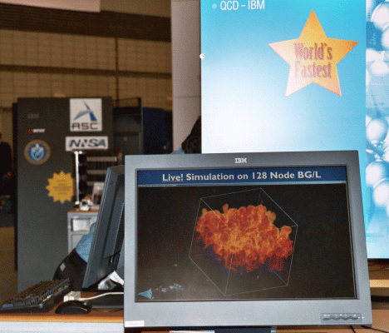

We Develop New Techniques for Efficient
Data Management and Presentation
Advanced data storage techniques:
  Data re-organization.
  Compression.
Advanced algorithmic techniques:
  Streaming.
  Progressive multi-resolution.
  Out of core computations.
Scalability across a wide range of running conditions:
  From laptop, to office desktop,
  to cluster of PC, to BG/L.
  Memory, to disk, to remote
  data access.

Slide 10
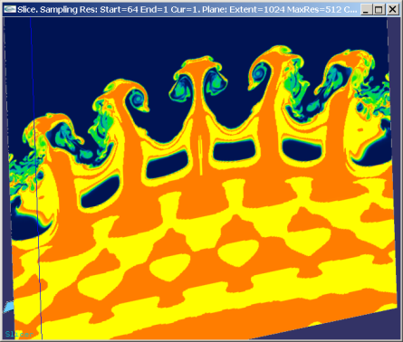
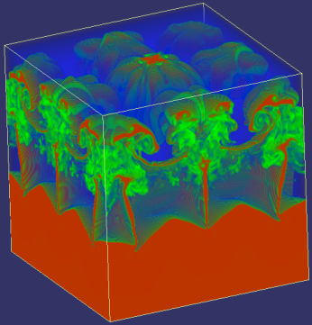
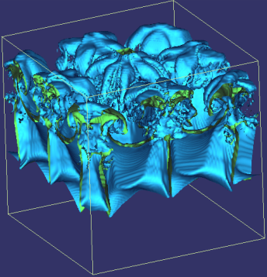
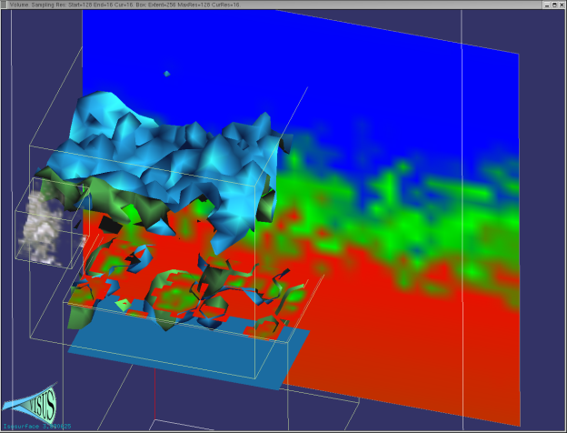
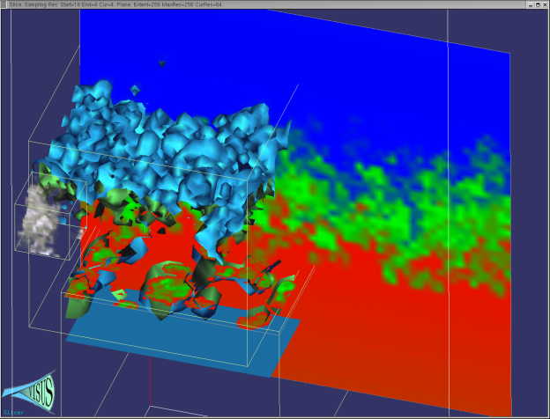
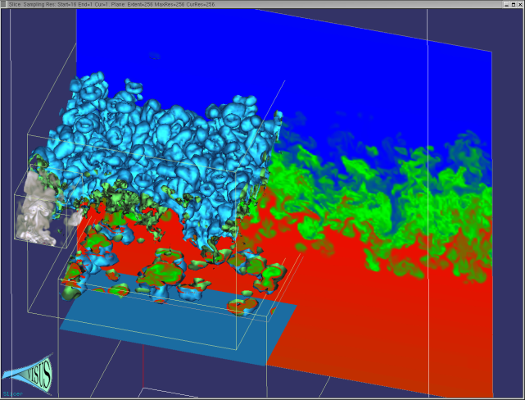
We Redesigned the Data Management and Visualization Pipeline with New Principles
Basic core techniques:
  Slicing
  Volume rendering
  Iso-surfaces
Cache-oblivious out-of-core
processing optimizing access
locality for any size of data blocks
Pipelines of progressive algorithms
Coarse-to-fine construction of
multi-resolution models
Remote data streaming

Slide 11
Our Paradigm: Multi-resolution Models Built by Successive Refinements
Benefit: pipeline of progressive modules
input
output
Progressive refinement:
coarse representation
immediately available
PA1
PA2
Performance
input
output
Challenge:
minimize the quality differential
hierarchical model constructed
bottom-up
Decimation: full
resolution data
needed first
Accuracy

Slide 12
We Globally Optimize the Data Flow Pipeline From Input Data Source to Final Output
operational diagram
F(x)
w₀
F ⁻¹(w₀ )
data
source
scalar
field
isosurface
extraction
adaptive
rendering
output
device
data flow diagram

Slide 13
The Data Layout is Based a Pyramidal Multi-resolution with high degree of locality

Slide 14
We Exploit the Correlation of 2^{n}-trees with the Lebesgue Space-filling Curves
The Lebesgue curve is also known as Z-order, Morton, …. Curve.
  Special case of the general definition given by Guiseppe Peano in 1890.

Slide 15
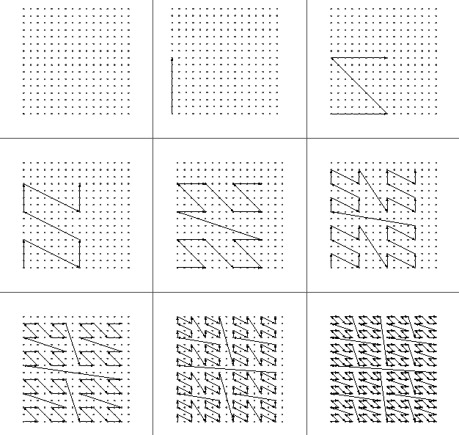
The Samples of a Grid are Reordered by Resolution and Spatial proximity
Coarser data
(even samples)
New level data
(odd samples)
1D order:
at each level store the green samples first (recursively);
keep the Z order for red samples (as much as possible).

Slide 16
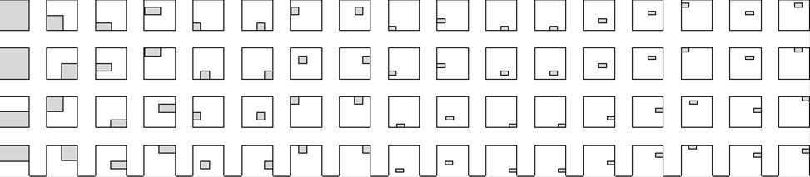
The Pixel in Each Data Block is Maintained Local at All Levels of Resolution
Locality independent of the block size: cache oblivious approach.
Layout of blocks on disk
0
1
2
3
4
5
6
7
8
image
data in block 20
0
1
2
3
Layout of blocks on the image

Slide 17
We Achieve a Progressive Range Query Avoiding Unnecessary Data Access
Blocks touched by the region
Layout of blocks on disk
0
1
2
3
4
5
6
7
8
query
data in the block
image
0
1
2
3
Layout of blocks on the image

Slide 18
We Determine the Efficiency as the Ratio Between Data Loaded and Data Used
Blocks touched by the region
Layout of blocks on disk
0
1
2
3
4
5
6
7
8
query
data in the block
image
0
1
2
3
Layout of blocks on the image

Slide 19
We Provided a Fast Address Computation Based on Simple Bit Manipulation
Simple bit manipulations to convert row major to hierarchical Z-order
3D version (also nD): basic Z shape replaced by a connected pair of Z shapes
?
inline int remap(register int i)
{
i |= last_bit_mask; // set leftmost one
i /= i&-i; // remove trailing zeros
return (i>>1); // remove rightmost one
}

Slide 20
Cache-Oblivious Data Layouts Scale Well Across Different Storage Blocking Factors
Formal analysis
predicts performance
and scalability
Performance improved
by orders of magnitude
Independence of
architecture
and storage
characteristics
32KB Disk Block Size
64KB Disk Block Size
subsampling rate
subsampling rate
Desktop Performance
Laptop Performance
subsampling rate
subsampling rate

Slide 21
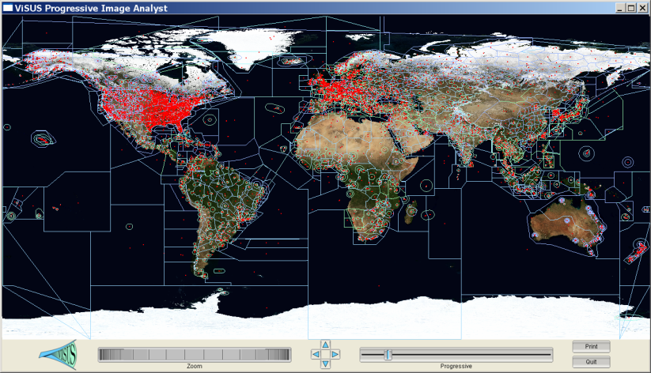
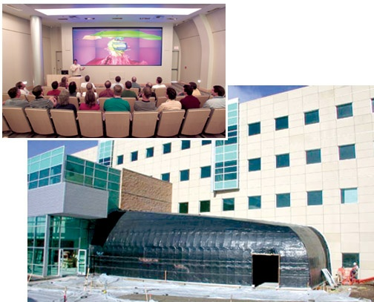

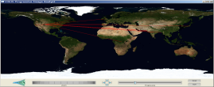
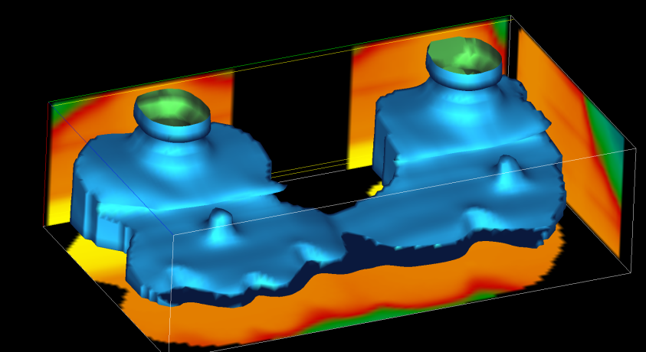
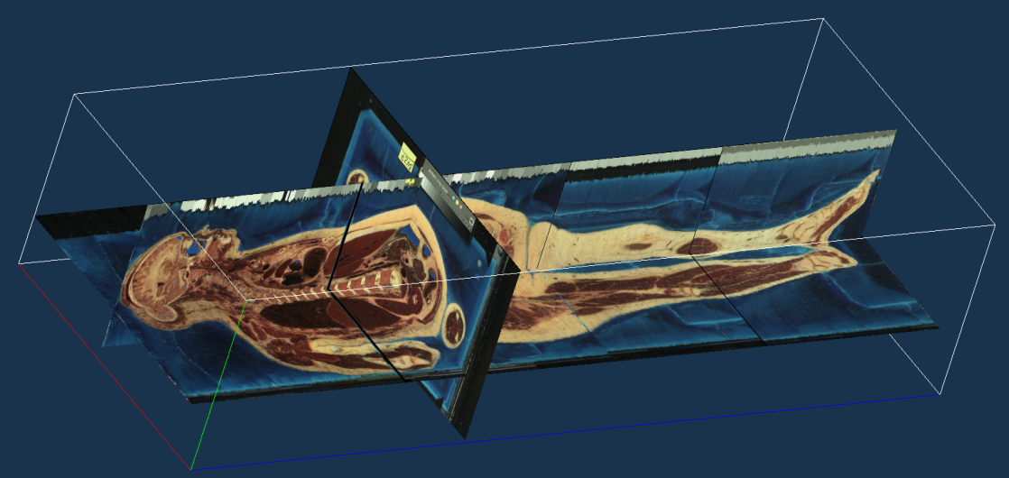
We Demonstrated Performance and Scalability in a Variety of Applications

Slide 22
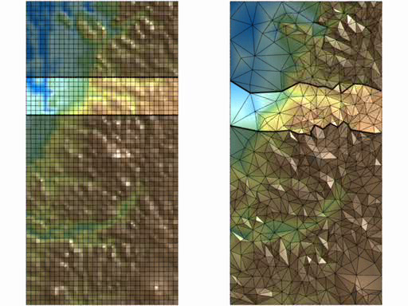
We Generalize Streaming and Cache Oblivious Layouts From to Unstructured Meshes
interactive queries and rendering require random access:
  e.g. slice plane, range query, adaptive refinement, …
  stream layout: ideal for compatible access pattern, otherwise poor
  cache-oblivious layout: ideal when access pattern not known a priori
Multi-scale optimization used to turn and unstructured mesh into and cache oblivious space-filling layout
Streaming and cache oblivious
layouts for grids
Streaming (row-by-row)
streaming order
row-by-row order
space-filling order
query slice
structured
unstructured

Slide 23
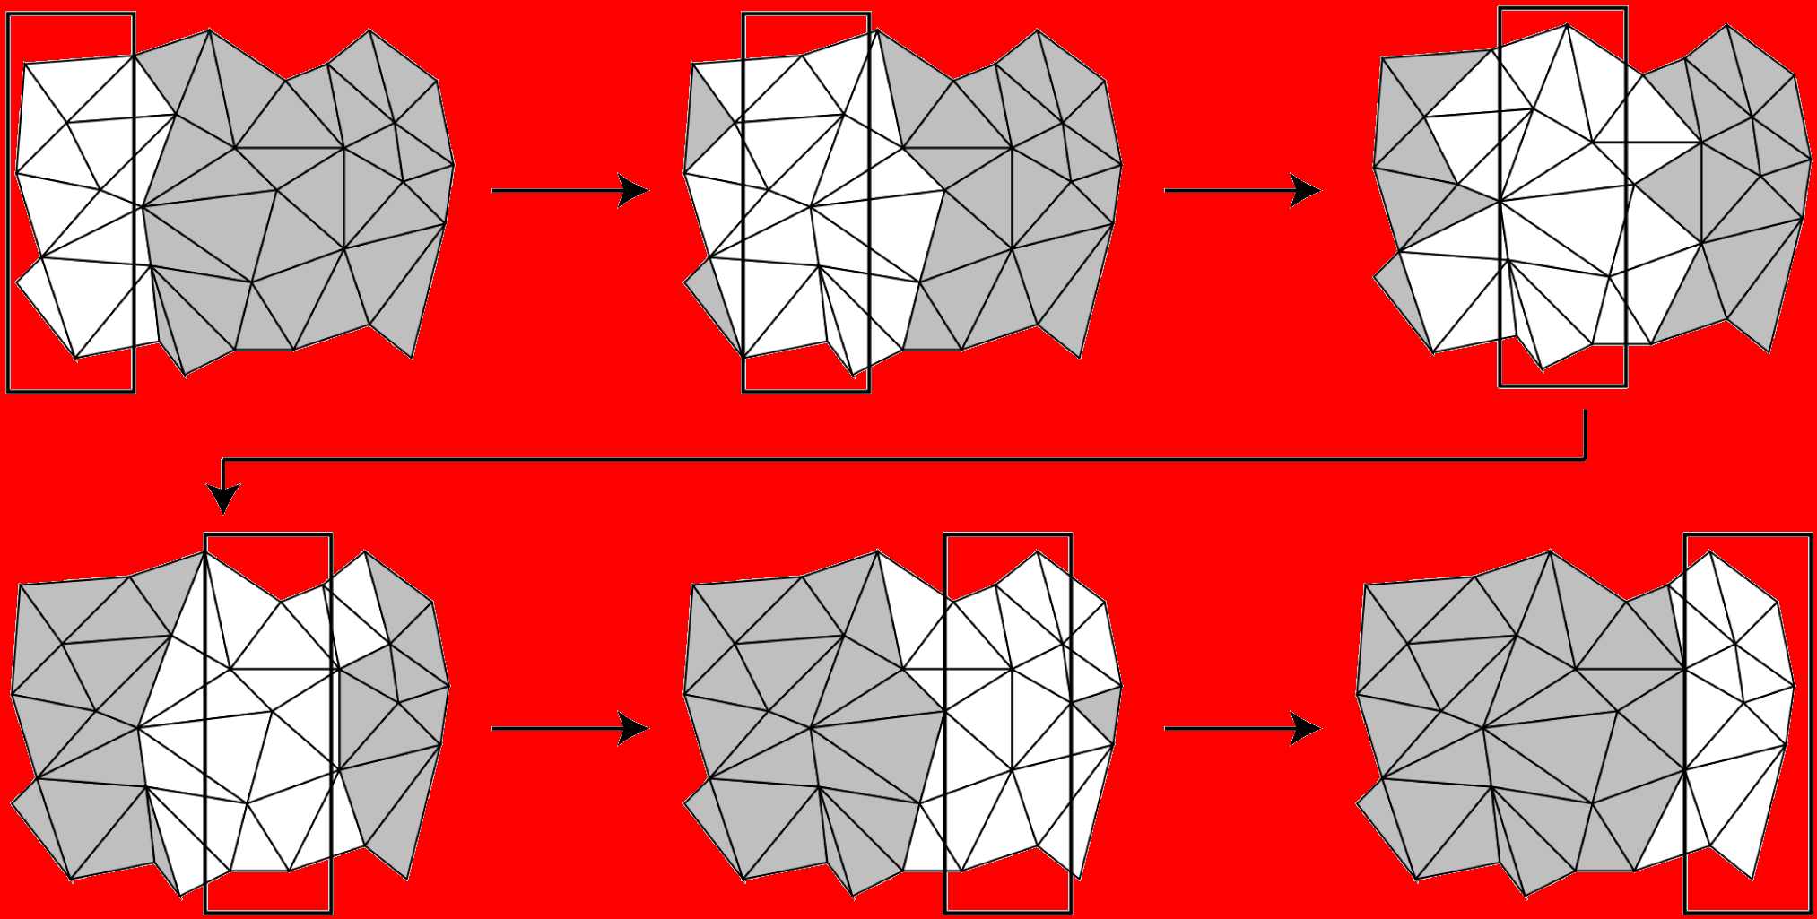
We use streaming of unstructured meshes for on-line processing
The mesh is processed incrementally using
only the elements within a given sliding window
Only a small portion of the mesh maintained in-core

Slide 24
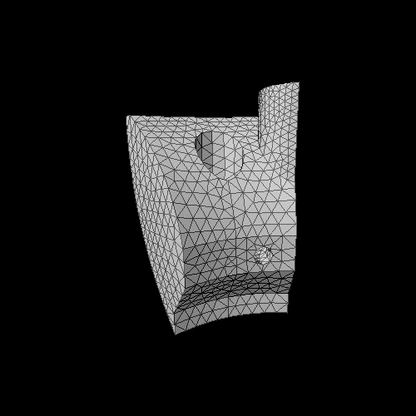
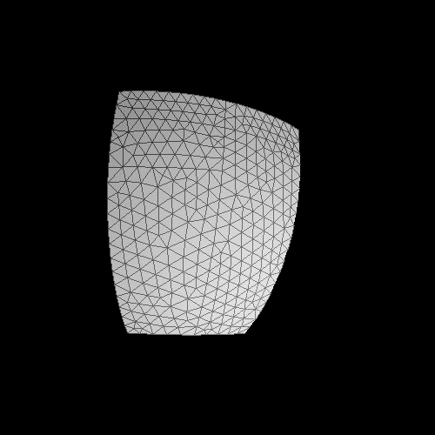

We use streaming simplification to reduce the working set of downstream processing
Streaming simplification of a tetrahedral mesh.

Slide 25





We achieve faster lower-memory processing within known error bounds
Iso-surfaces extracted from the PPM dataset consisting of more than a billion tetrahedra

Slide 26
Problem Statement
Vertex layout of G = (V, E)
  One-to-one mapping of vertices to positions
Find a
  Minimizes the number of cache misses
Notes:
A vertex layout of an undirected graph G = (V;E) is a one-to-one mapping
of vertices to positions in the layout.
Our goal is to find a mapping, which minimizes the number of cache misses during accesses on the mesh represented as the graph.

Slide 27
Multilevel Minimization
Coarsening step
  Simply 5 vertices into one
Ordering at coarsest graph
  Consists of 5 vertices
Refining step
  Expand vertices and perform local permutation
Notes:
Instead, we use a multilevel minimization algorithm which performs local permutations to compute a
locally optimal layout.
Multilevel min. consists of 3 main steps.
First, we coarse the input graph by simplify 5 vertices into one.
At its coarsest graph, we compute vertices ordering.
Then, as we reconstruct the coarsest graph, we refine vertices ordering by usning local permutation given our approximate metric.

Slide 28
View-Dependent Rendering
Peak performance: 145 M tri / s
 | Model complexity | Cache-oblivious layout | Layout of Quick-VDR
Isosurface | 100M | 106 M/s | 23 M/s
St. matthew | 372M | 90 M/s | 20 M/s
double eagle | 82M | 47 M/s | 22 M/s
4.5X
2.1X
Notes:
We compare rendering throughput of cache-oblivious layout with layout of Quick-VDr, (Simplification layout), which is ordering of output of simplication.
We are able to achieve 4.5 times improvement over simplification layout in Isosurface and St.
And 2.1 speedup. Moreover, we are able to achieve 145M/s as a peak performance.

Slide 29

We Achieved a 4X Speedup for Large Models Without Changing the Application

Slide 30

We Achieved a 4X Speedup for Large Models Without Changing the Application

Slide 31

Isocontour Extraction
Contour tree [van Kreveld et al. 97]
  Compute seed sets based on the tree
  Traversal triangles is bottleneck
Puget sound,
134 M triangles
Notes:
We also applied our layouts to an isocontour extraction.
We used contour tree, which provides us seed sets. In this application, traversal triangles from computed see set is bottleneck.
We test our application with various models including a puget sound model consisting of 134M triangles.
Line shown with black is an isocontour given a height value.
(This model is unstructured model.)

Slide 32
Comparison
Different layouts | Z-level Contour (Speedup over CO)
Cache-oblivious | 1 (1)
X-axis sorted | 8.9 (455)
Y-axis sorted | 8.3 (430)
Z-axis sorted | 0.42 (1.2)
Spectral sequencing | 5.7 (254)
Time taken:
26s (0.5s)
Optimal
layout
Notes:
We compare the running time of extracting isocontour that are parallel to z –level, which is height in the terrain model.
Z-axis sorted layout is optimal given access patterns.
In this case, cache-oblivious layouts takes 26sec for the first time extracting and 0.5 sec, shown in parenthesis, for the second time same extraction.
Even though best performance at first computation is achieved when ordering of traversal matched with a z-ordering,
Cache-oblivious layout shows upto one or two order magnitude improvement over other layouts.
Also, this data shows that our cache-oblivious layout is very close to optimal layouts given access patterns.

Slide 33


Cache Oblivious Layouts Yield a
Large Number of Short Edges
Edges connecting vertices of index differing by 1
spectral layout: 4.6K edges
cache-oblivious layout: 245K edges

Slide 34




We Introduced Robust Topological
Methods for Quantitative Data Analysis
Provably robust computation
Provably complete feature extraction and quantification
Hierarchical topological structures used to capture multiple scales
Error-bounded approximations associated with each scale
Formal mathematical definition associated with each analysis
Scalable performance in association with streaming techniques
Hierarchical topology of a
2D Miranda vorticity field
Coarse scale:
blue = molecules
Medium scale:
red-blue = dipoles
Molecular dynamics simulation (left) with abstract graph representation of its features at two scales (right)
Notes:
We are developing new algorithms for extracting and representing topological information as hierarchical graphs. These graphs become visualization road-maps, providing a mesh-independent summary of all relevant features in a data set. Such road maps are necessary due to the large 3D data sets produced by codes like KULL, Raptor/Geodyn, and Hydra in which 3D features may occlude each other. Often users rely on simple orthogonal slices and small numbers of scalar fields to understand such data. We envision smart visualization tools that utilize topological information to enable users to prune away uninteresting parts of their data so that interesting areas can be revealed.

Slide 35

We Developed a Combinatorial Morse Theory for Provably Correct Computations
Classical mathematical
definitions
Simulation of
differentiability
domain
smooth manifold
simplicial complex
function
infinitely differentiable
PL-extension of
critical
point
numerical
combinatorial
1D
2D
3D
Independent local computation yield globally consistent results

Slide 36




We Introduced New Techniques for Critical Point Classification
type | index
 | 0
 | d-1
 | d
The Morse Lemma
Minimum
There are d+1 types
of critical points
Saddle
Maximum
Minimum
Maximum
Minimum
Saddle
Maximum
Minimum
1-saddle
2-saddle
Maximum
numerical
combinatorial

Slide 37









We Introduced the Morse–Smale
Complex for Complete Data Analysis
The Morse–Smale complex partitions the domain of f in regions of uniform gradient
Generalizes the notion of monotonic interval
Dimension of a region equal index difference of source and destination
Remove inconsistency of local gradient evaluations
Minimum
Saddle
Maximum
1D
2D
3D

Slide 38







We Mapped the Index Lemma to a
Morse–Smale Complex Simplification
Index Lemma: critical points can be created or destroyed in pairs that differ by one in index
Approximation: error = persistence/2 (proven lower bound)
Multiscale: consistent gradient segmentation at all scales
persistence p
1D:
2D:
cancellation=contraction
cancellation=contraction + edge removal
3D
Time

Slide 39



Contraction of extrema with saddles allows to simplify the MS-complex.
0.5% persistence filter
1.0% persistence filter
20% persistence filter

Slide 40


Contraction of extrema with saddles allows to simplify the MS-complex.
0.5% persistence filter

Slide 41
Contraction of extrema with saddles allows to simplify the MS-complex.
1.0% persistence filter

Slide 42

Contraction of extrema with saddles allows to simplify the MS-complex.
20% persistence filter

Slide 43
We are using Morse-Smale complexes for surface segmentation and re-meshing
Morse-Smale complexes of the eigenfields of a mesh.

Slide 44

We are using Morse-Smale complexes for surface segmentation and re-meshing
Morse-Smale of the myosin protein were we extract automatically its two semi-rigid components.
Morse-Smale complexes of the eigenfields of a mesh.

Slide 45



Topological Constructs Allow Building Effective and Succinct Shape Descriptors
The Reeb graph is the graph obtained by continuous contraction of all the contours in a scalar field, where each contour is collapsed to a distinct point.

Slide 46
Topological Simplification of the Electron
Density Distribution of an Hydrogen Atom

Slide 47

Topological Simplification for the Neghip Dataset

Slide 48

Topological Simplification for the
Fuel Injection Dataset

Slide 49


We Use Streaming Techniques to Achieve High Performance Analysis of Shapes

Slide 50


We Exploit the Existing Locality of the Input Mesh to Avoid Costly Reordering
Computation of the Reeb graph for two layouts of the same model

Slide 51










We Develop Shape Signatures to Find Defects in Large Scale Geometric Models
Notes:
Write persistence clearly

Slide 52












Practical Tests Confirm Robustness and Show Virtually Linear Scalability
100MB
100Ks
10MB
10Ks
1MB
1hour
1ks
100KB
10KB
100s
1min
1KB
10s
100B
1s
10B
0.1s
1B
1Kt
10Kt
100Kt
1Mt
10Mt
100Mt
1Gt

Slide 53


Data Analysis Examples

Slide 54

We Analyze High-Resolution
Rayleigh–Taylor Instability Simulations
maximum
bubble
Large eddy simulation run on
Linux cluster: 1152 x 1152 x 1152
  ~ 40 G / dump
  759 dumps, about 25 TB
Direct numerical simulation run
on BlueGene/L: 3072 x 3072 x Z
  Z depends on width of mixing layer
  More than 40 TB
Bubble-like structures are observed in laboratory
and simulations
Bubble dynamics are considered an important
way to characterize the mixing process
  Mixing rate =
There is no prevalent formal definition of bubbles

Slide 55



We Compute the Morse–Smale
Complex of the Upper Envelope Surface
F(x) = z
Maximum
F(x) on the surface is aligned against the direction of gravity
which drives the flow
Morse complex cells drawn in distinct colors
In each Morse complex cell, all steepest ascending lines converge to one maximum

Slide 56


A Hierarchal Model is Generated by Simplification of Critical Points
Persistence is varied to annihilate pairs of critical points and produce coarser segmentations
Critical points with higher persistence are preserved at the coarser scales
Saddle
p₁
p₂

Slide 57



The Segmentation Method is Robust
From Early Mixing to Late Turbulence
T=100
T=700
T=353

Slide 58
















We Evaluated Our Quantitative
Analysis at Multiple Scales
Under-segmented
Coarse scale
Medium scale
Number of
bubbles
Over-segmented
Timestep
Fine scale

Slide 59
We Characterize Events that
Occur in the Mixing Process

Slide 60


First Robust Bubble Tracking From Beginning to Late Turbulent Stages

Slide 61
First Time Scientists Can Quantify
Robustly Mixing Rates by Bubble Count
0.5
1.0
(9524 bubbles)
0
-0.5
slope 1.536
-1
Mode-Normalized Bubble Count
(log scale)
Derivative of Bubble Count
0.1
slope 1.949
-1.5
-2
slope 2.575
-2.5
Bubble Count
0.01
Derivative
-3
1
2
3
4
5
6
7
8
9
10
20
30
40
t/τ (log scale)

Slide 62




We Provide the First Quantification of Known Stages of the Mixing Process
mixing
transition
1.0
(9524 bubbles)
0.5
0
linear
growth
-0.5
slope 1.536
-1
Mode-Normalized Bubble Count
(log scale)
Derivative of Bubble Count
0.1
slope 1.949
-1.5
-2
strong
turbulence
slope 2.575
-2.5
Bubble Count
0.01
Derivative
weak
turbulence
-3
1
2
3
4
5
6
7
8
9
10
20
30
40
t/τ (log scale)

Slide 63

We Provided the First Feature-Based Validation of a LES with Respect to a DNS
LES (Large Eddy Simulation)
Mode-Normalized
Bubble Count
DNS (Direct Numerical Simulation)
Normalized Time

Slide 64




Quantitative Analysis of the Impact of a Micrometeoroid in a Porous Medium
Many possible applications:
  NASA’s Stardust Spacecraft
  National Ignition Facility Targets
  Light and Robust Materials
  many more...
Micrometeoroid
impact
direction

Slide 65



The Topological Reconstruction Method is Validated with a Controlled Test Shape
Challenge: robust reconstruction of the structure of a porous medium
Preparation: we develop control test data to validate the approach

Slide 66





We Report the Distribution of Topological Features in the Full Resolution Data
maximum
saddle
q
p
(f(p), f(q))

Slide 67

The Hierarchical Morse-Smale Complex
Has Very Good Reconstruction Properties

Slide 68


We Compute the Complete Morse-Smale Complex for the Porous Medium

Slide 69

Need to Find Proper Threshold Values and Characterize the Stability of the Solution

Slide 70
Need to Find Proper Threshold Values and Characterize the Stability of the Solution

Slide 71


We Obtain a Robust Reconstruction of the Filament Structures in the Material

Slide 72






We Track the Evolution of the Filament Structure of the Material Under Impact
Time comparison of the reconstructions

Slide 73



The Extracted Structures Allow to Quantify the Change in Porosity of the Material
Density profiles
Decay in porosity of the material

Slide 74

We Target Specific Data Analysis Problems in Support of Science Applications
Understanding combustion processes over a broad range of burning conditions is an important problem for designing engines and power plants.
  Simulation with AMR mesh.
  Simulations of lean premixed hydrogen flames with three degrees of turbulence.
  Can we identify precisely and track in time burning regions?
  Can we discriminate the degree of turbulence from a quantitative analysis?

Slide 75


We build a hierarchical Morse complex of H2 consumption on an isotermal surface
domain
hierarchy

Slide 76
A detailed tracking graph shows the evolution of each burning regions

Slide 77

In the region of interest the cell count is stable wrt fuel consumption threshold

Slide 78

The count of number of regions is stable wrt the persistence simplification

Slide 79

For different isotermal domains we derive the same trends

Slide 80

The analysis is stable wrt two levels of resolution in the AMR code

Slide 81


Our quantitative analysis shows distinctive trends for different turbulence

Slide 82



We Segment and Track Individual Features and Provide a Global Quantitative Analysis

Slide 83


Analysis of Massive Scientific Data Provide Great Challenges and Opportunities
Tight cycle of :
  basic research,
  software deployment
  user support
Coordination among eight projects:
  unified techniques for several applications
Strong University-Lab collaboration
Focused technical approach:
  performance tools for fast data access
  general purpose data exploration
  error bounded quantitative analysis
  feature extraction and tracking
Interdisciplinary collaboration with domain scientists (from math to physics):
  motivating the work
  formal theoretical approaches
  feedback to specific disciplines

