Slide 1
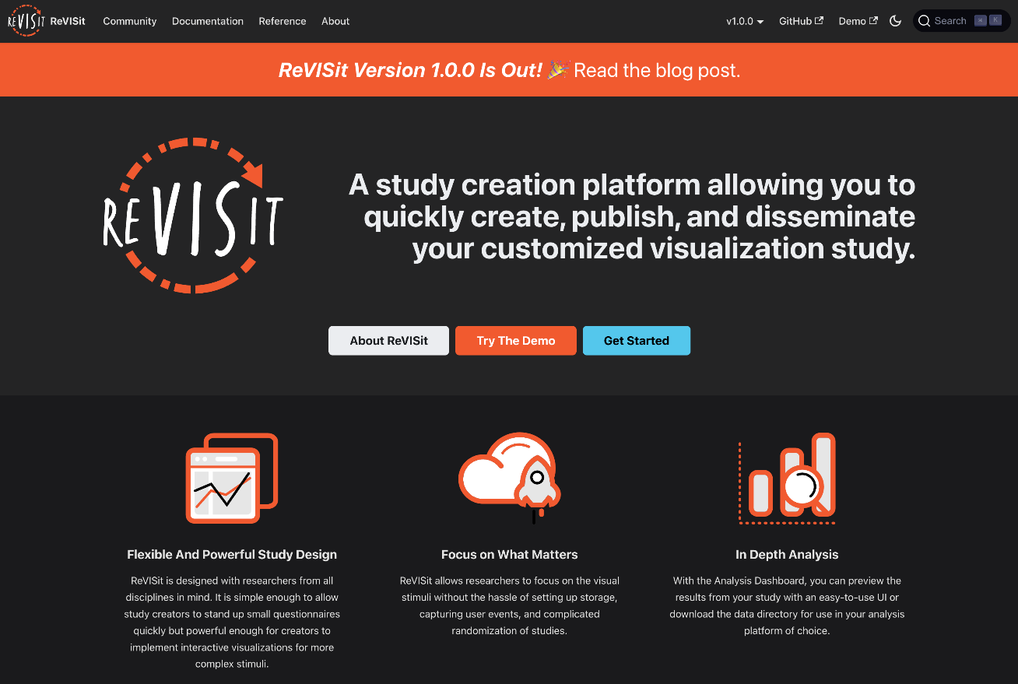
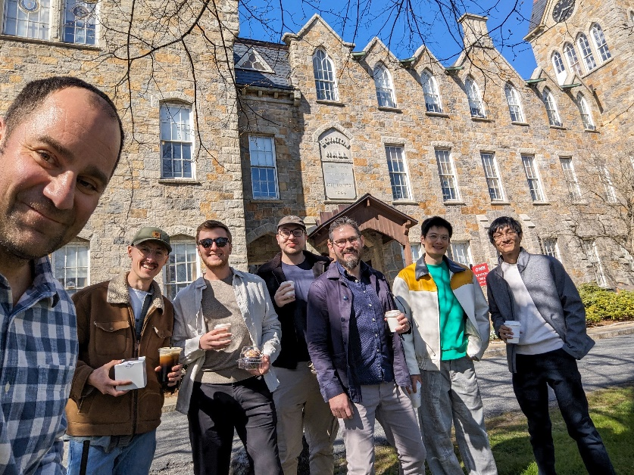
FACULTY MEMBER
Alexander Lex
PROJECT SPOTLIGHT
reVISit: A pioneering open-source platform that allows researchers to create & share customized visualization studies
GOALS / IMPACT
Build a free, open-source alternative to commercial tools
Give researchers sovereignty over their data
Break down barriers for doing open, reproducible
science and democratize visualization studies
FUNDING
$2M from NSF starting in 2022
COLLABORATORS
Worcester Polytechnic Institute, University of Toronto
Top: The reVISit website.
Left: The reVISit team during a hackathon at Worcester Polytechnic Institute in April.

Slide 2
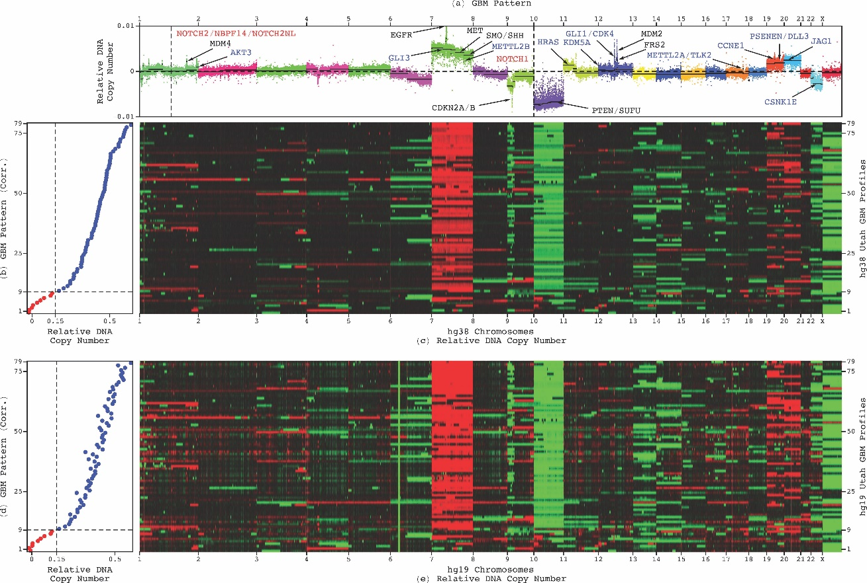
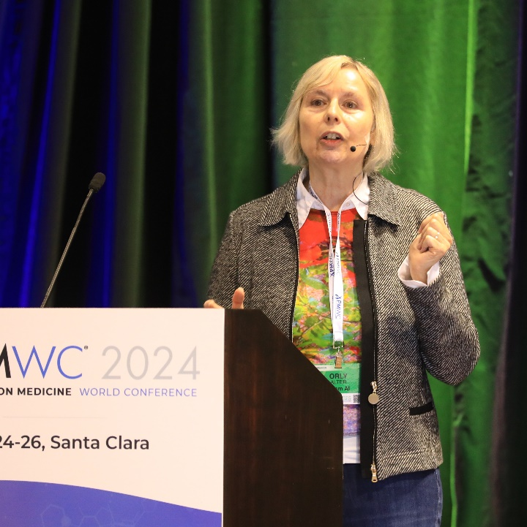
FACULTY MEMBER
Orly Alter
PROJECT SPOTLIGHT
Multi-Tensor AI/ML Uniquely Suited for Prediction from Small-Cohort and Noisy, High-Dimensional Multi-Omic Clinical Data
IMPACT
Enabling precision medicine by correctly predicting
a patient’s response to a drug and a drug’s effectiveness for a patient, and helping all phases of a clinical trial succeed (current rate is <10%).
FUNDING
$3.4M from the National Cancer Institute (NCI)
COLLABORATORS
Emory University, Frederick National Laboratory, NCI, Prism AI Therapeutics, University of Southern California
Top: Multi-tensor AI/ML-derived glioblastoma predictor was validated to be most accurate and precise in a recent clinical trial. For 70 years before, the best indicator has remained age.

Slide 3
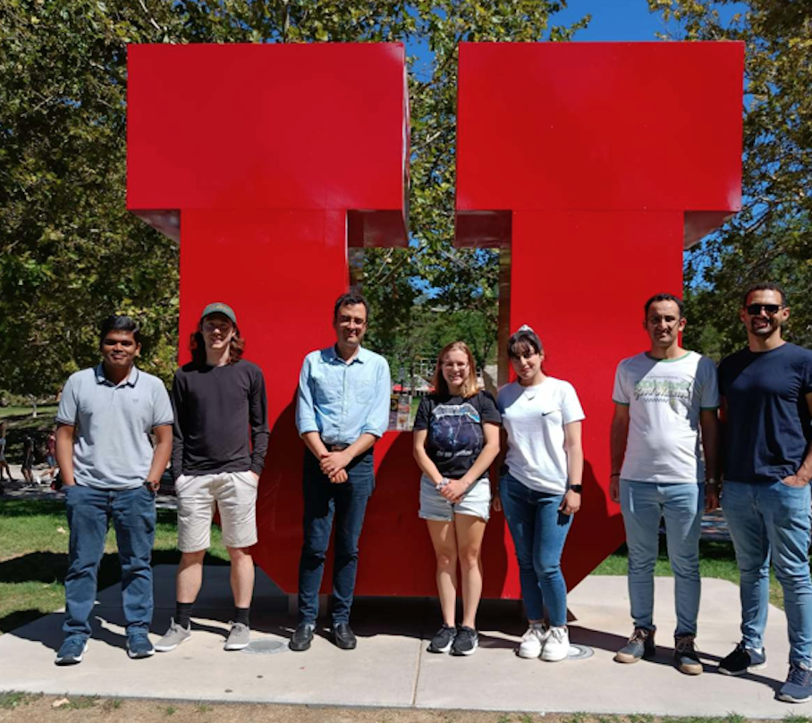
FACULTY MEMBER
Amir Arzani
PROJECT SPOTLIGHT
Synergistic physics-based and data-driven cardiovascular flow modeling
GOALS / IMPACT
Integrate scientific deep learning
with traditional blood flow modeling
Use deep learning for a fundamental
understanding of physics
Develop a new engineering education program integrating storytelling and visualization
FUNDING
$508K NSF CAREER Award
COLLABORATORS
UW-Milwaukee, Los Alamos National Lab

Slide 4
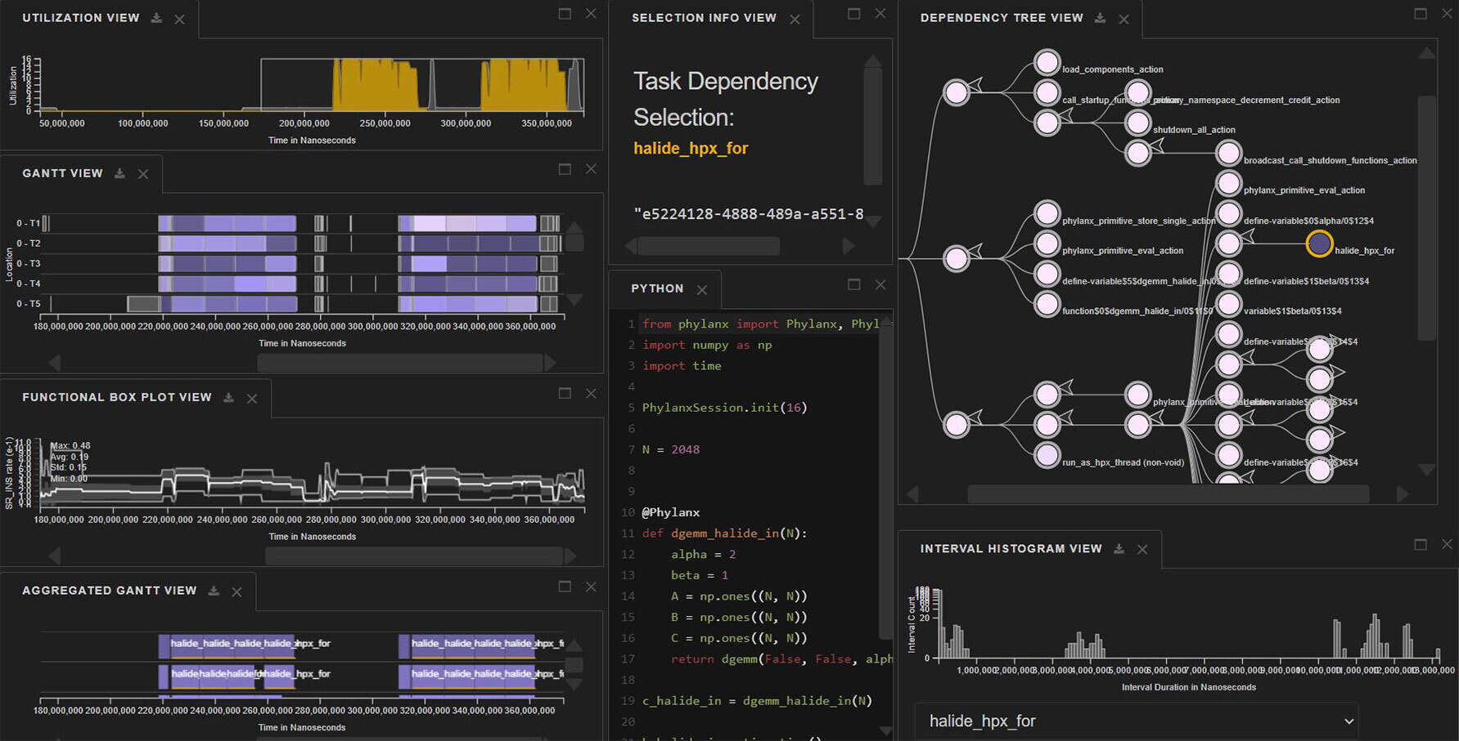
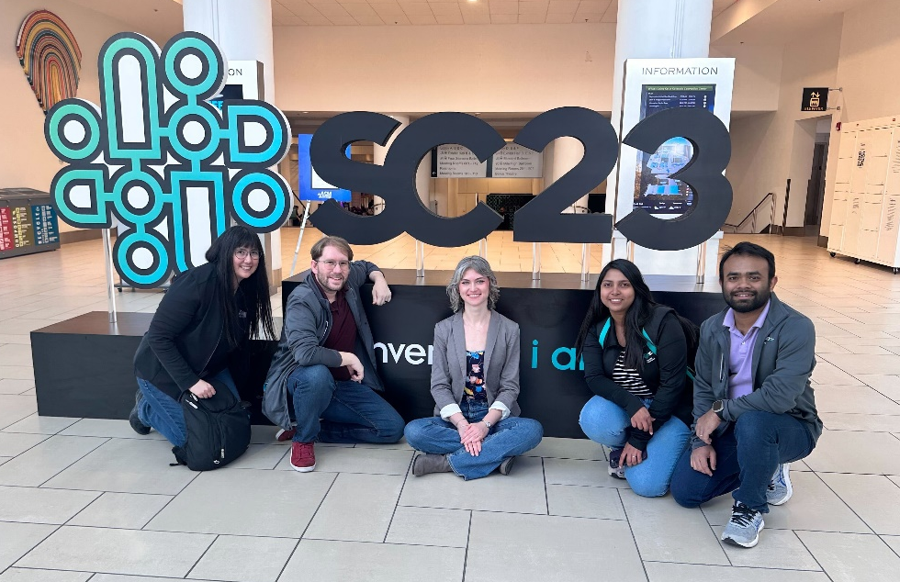
FACULTY MEMBER
Kate Isaacs
PROJECT SPOTLIGHT
Node-to-Code: Interactive
Visualizations to Improve
Supercomputer-Scale Science
GOALS
Design new ways to "see" into
massive supercomputing programs
Make these methods fast for supercomputing-sized data
Empower supercomputing researchers and users alike towards efficient science
FUNDING
$750K from DOE
Top: Traveler, an interactive tool that shows what a program is doing on a supercomputer in time—nanosecond scale actions across all the individual compute units running at the same time.
Left: Dr. Isaacs (left) and four Utah students she advises at the 2023 Supercomputing conference.

Slide 5
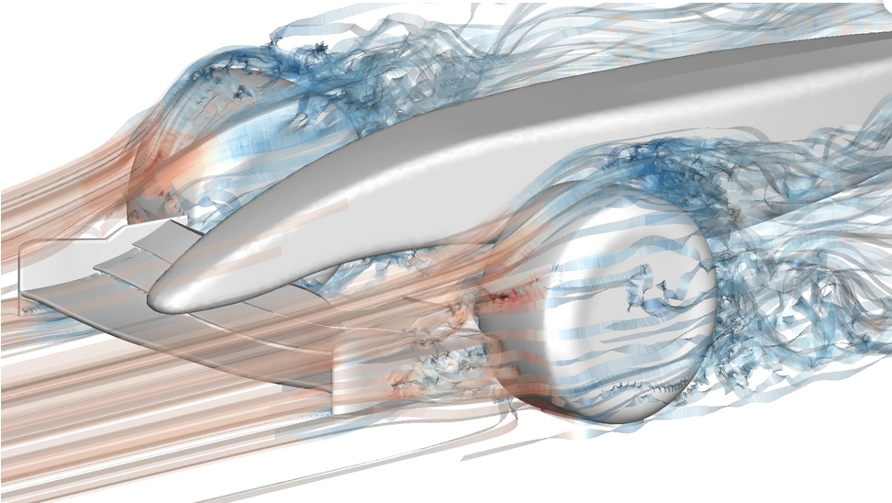
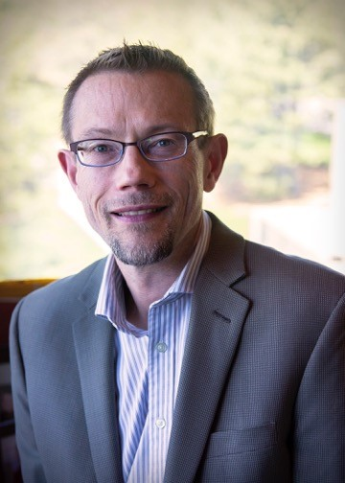
FACULTY MEMBER
Mike Kirby
PROJECT SPOTLIGHT
Nektar++: High-Order Finite Element Open-Source Software
IMPACT
Used for the development of high-fidelity solvers
for partial differential equations and simulations
in fluid dynamics, aeronautics, heat transfer,
biomedicine, renewable energy, and more
One of the tools used by Formula 1’s McLaren Racing to simulate air flow
FUNDING
Variety of sources, e.g., NSF, DOD, and industry
COLLABORATORS
Imperial College London

Slide 6
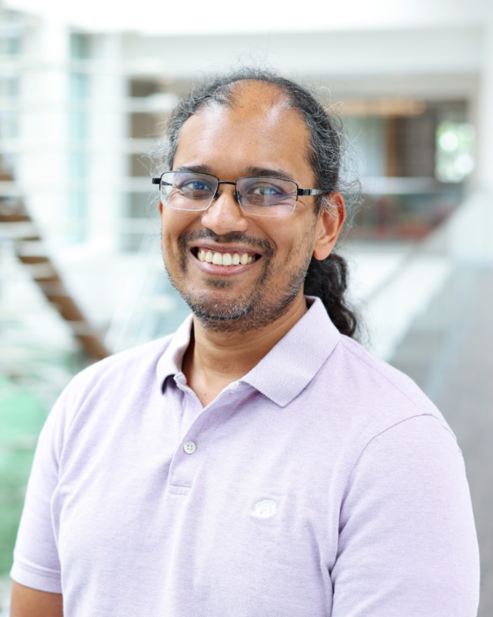
FACULTY MEMBER
Akil Narayan
PROJECT SPOTLIGHT
CERTANN: Certifiable and Trustworthy deep operator learning using Artificial Neural Networks
GOALS / IMPACT
Develop trustworthy mathematical foundations
for deep operator learning
Build robust algorithms to implement
function-to-function operator mappings
Provide certifiable error guarantees
for scientific machine learning
COLlABORATORS / FUNDING
Sandia National Labs LDRD subcontract:
$300K to Utah, $1.5M overall

Slide 7
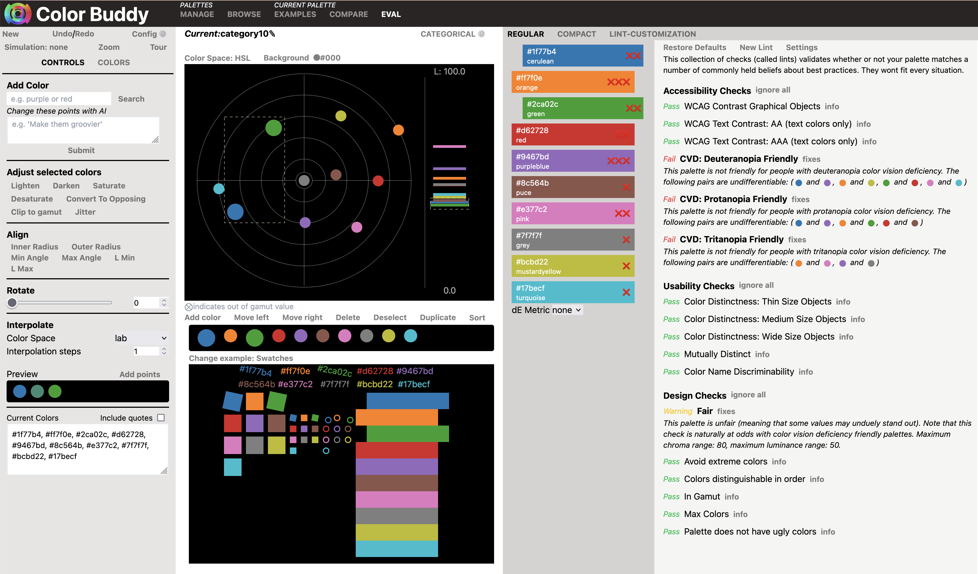
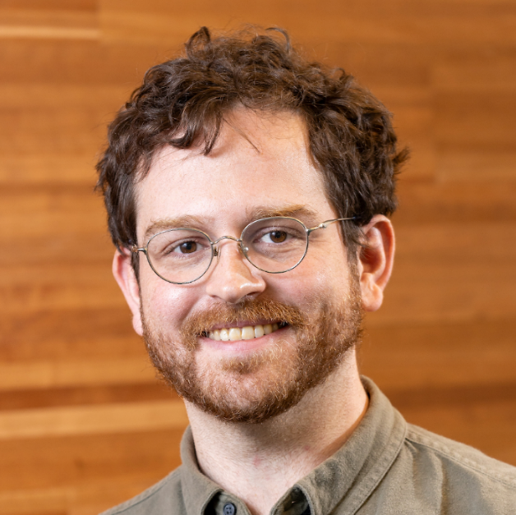
FACULTY MEMBER
Andrew McNutt
PROJECT SPOTLIGHT
Towards Provably Effective
Visualization Design
GOALS
Develop theoretical advances
in visualization reasoning
Build open-source tools to catch errors in real-world domains (e.g., color palette design, computational notebooks)
Make visualization recommendation systems more powerful, useful, sustainable, and contextual
COLLABORATORS
University of Washington
Top: A color palette design system with automated guidance.

Slide 8
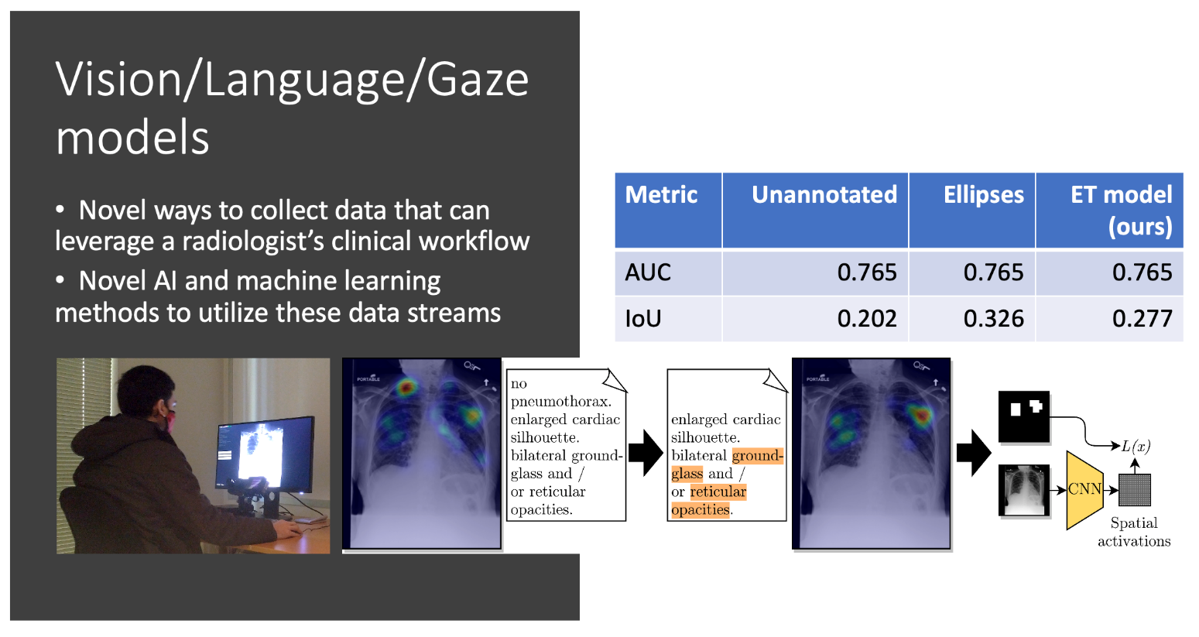
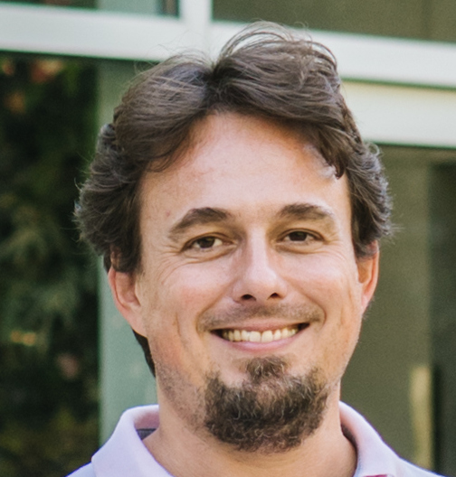
FACULTY MEMBER
Tolga Tasdizen
PROJECT SPOTLIGHT
REFLACX: Reports and
Eye-Tracking Data for Localization
of Abnormalities in Chest X-rays
GOALS / IMPACT
Gather data to improve machine learning:
In medical image analysis, machine learning
typically learns from labeled data. In radiology,
labeled data is rare and text reports abound. We leverage radiologists' clinical workflow to gain data in a novel way: we track their eyes as they review chest
X-rays and align that with text reports to provide supervision for machine learning.
Aid radiologists and improve diagnostics: Ultimately, this project could lead to a new tool for radiologists, helping them work more efficiently.
FUNDING
$400K from NIH (2020-22)

Slide 9
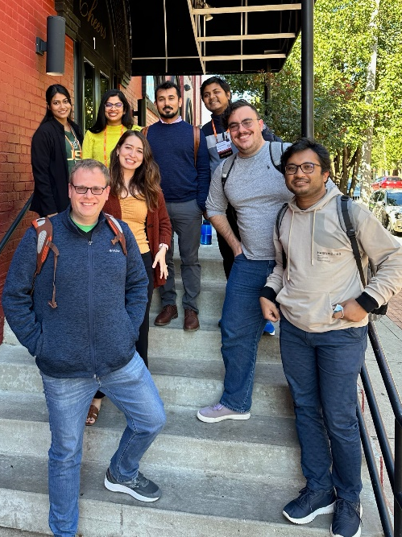
FACULTY MEMBER
Paul Rosen
PROJECT SPOTLIGHT
Discovering Structure in Uncertainty: Improving the Clarity and Trustworthiness of Data Visualizations
GOALS / IMPACT
Large, complex, and noisy data make visualizations difficult
to interpret and impact trustworthiness.
Using a combination of human perception and mathematically robust techniques, we develop methods that clearly present important data features.
Building barrier-reducing tools for scientists and the general public that improve scientific communication and data transparency.
Opportunities to pair techniques with AI to provide context-optimized data visualizations.
FUNDING
NSF $550K, NSF $1.05M, DOD $900K
COLLABORATORS
Ridge National Lab, Univ. of Oklahoma, UNC Chapel Hill, Georgia Tech, Univ. of South Florida
Top: Example results from published tools.
Left: Current and former team members having a group lunch at the IEEE VIS conference in Oklahoma City in October 2022.

Slide 10
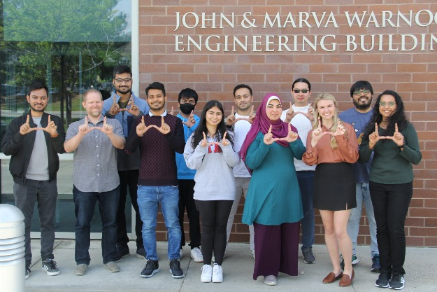
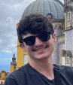
FACULTY MEMBER
Shireen Elhabian
PROJECT SPOTLIGHT
ShapeWorks: An Integrated Suite for Quantifying and Analyzing Anatomies
GOAL & IMPACT
Usable, functional, and scalable
standard tool in medicine
Objective and reproducible metrics for
anatomy evaluation to improve patient outcomes
FUNDING
$10.7M since 2019 from NIH and EOS imaging
COLLABORATORS
Orthopaedic Research Laboratory, CVRTI, Children’s
Hospital of Pittsburgh, kitware, Tulane University, and more

Slide 11
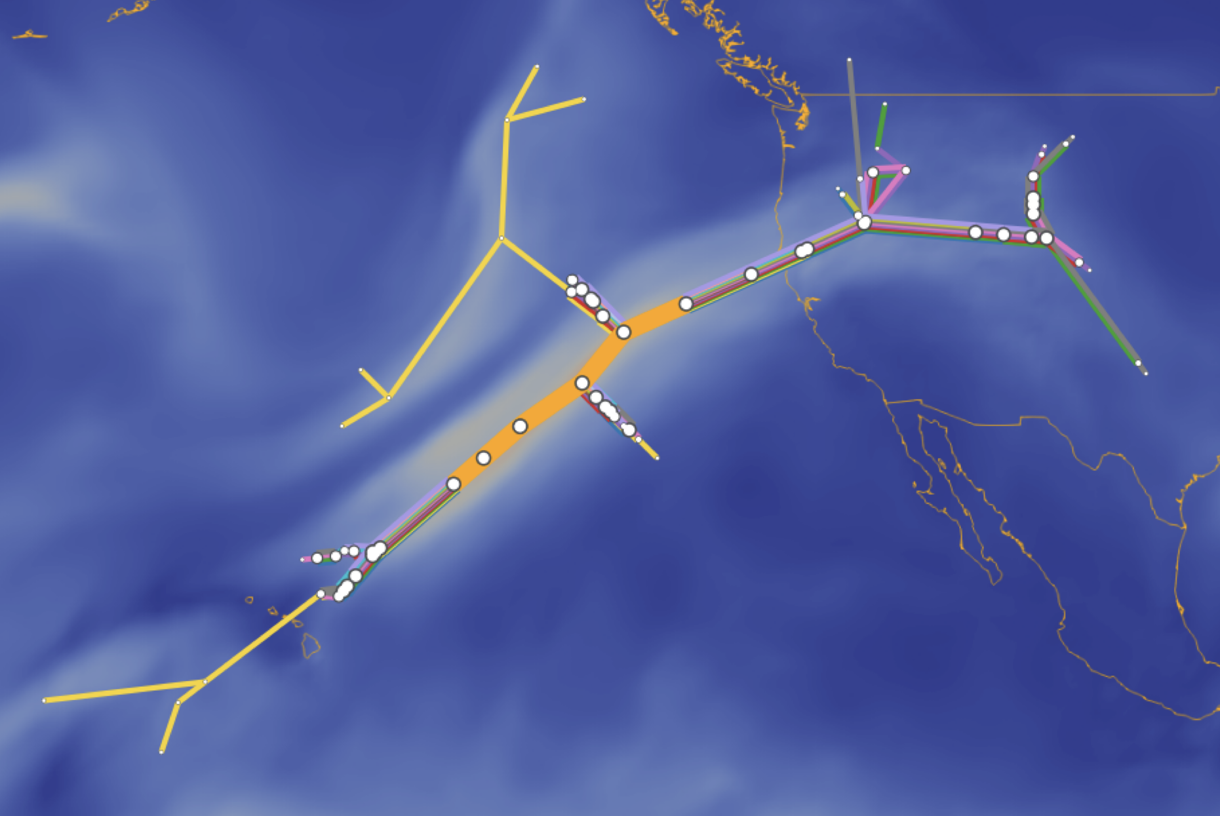
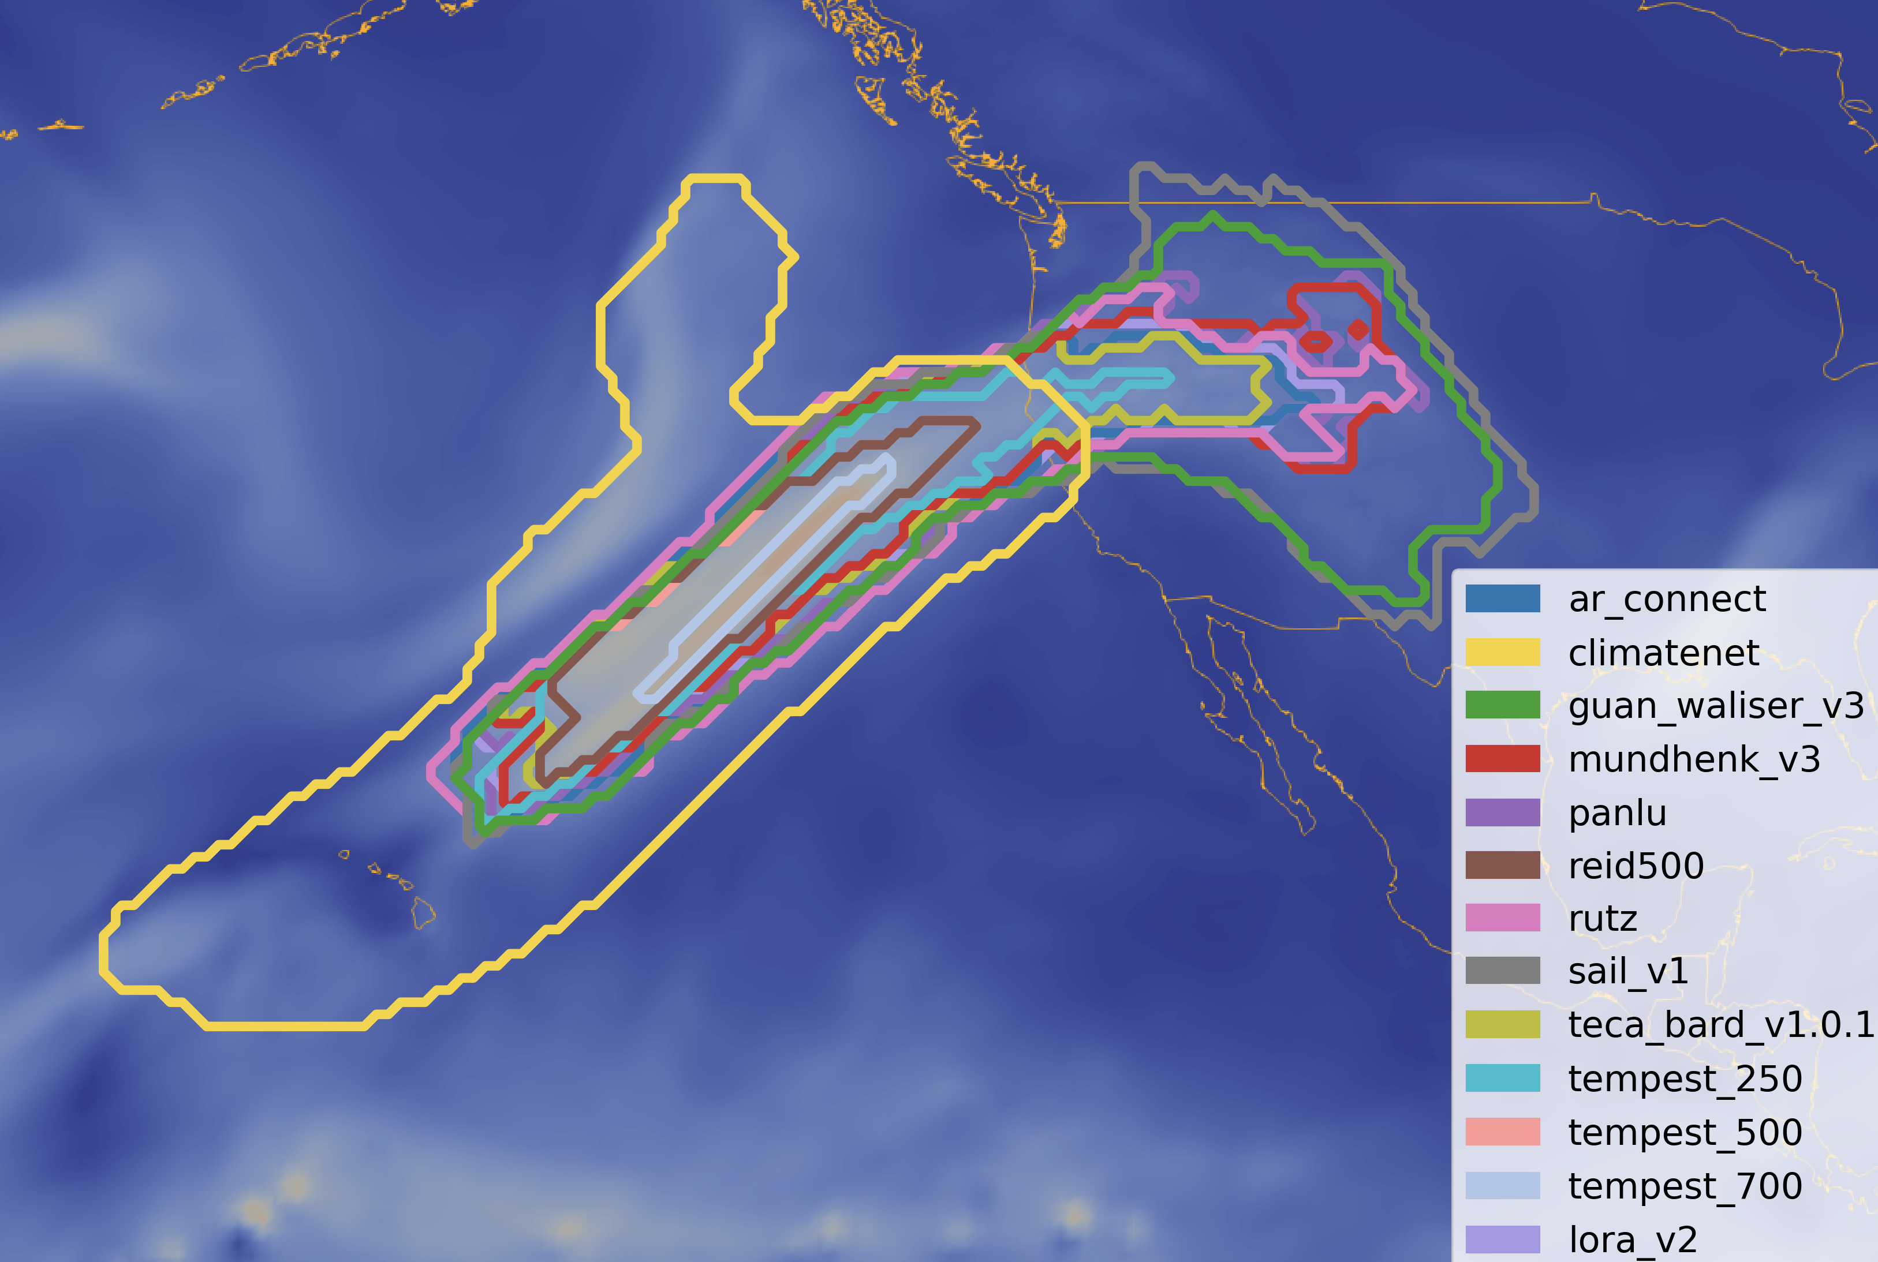
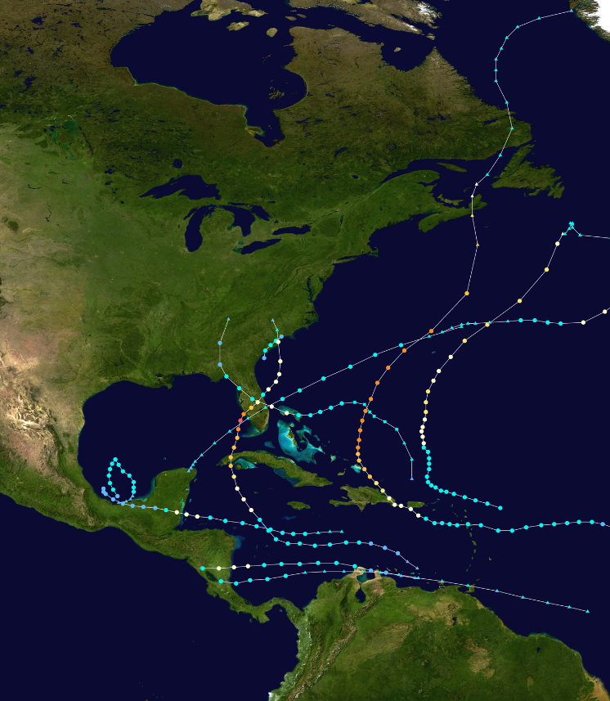
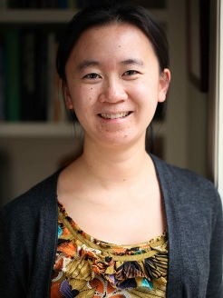
FACULTY MEMBER
Bei Wang Phillips
PROJECT SPOTLIGHT
Topological Characterization
and Uncertainty Visualization
of Atmospheric Rivers (ARs)
GOALS / IMPACT
Improve understanding of large-scale scientific simulations
Example 1: study structural variations of ARs to improve
the predictability of AR impacts (such as flooding)
Example 2: develop robust ways to track tropical cyclones
FUNDING
$800K from DOE Early Career Research Program since 2020
Topology-Preserving Data Sketching for Scientific Visualization
COLLABORATORS
National Laboratories (ANL, LBNL), etc.
Top left: Interior variation of ARs.
Top right: Boundary structural variations of ARs from an ensemble of AR detection tools.
Bottom: Trajectories of potential tropical cyclones

Slide 12
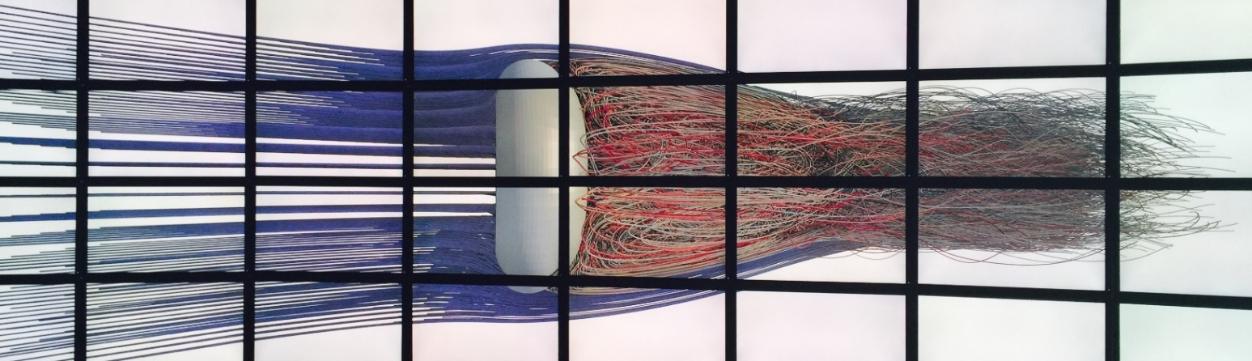
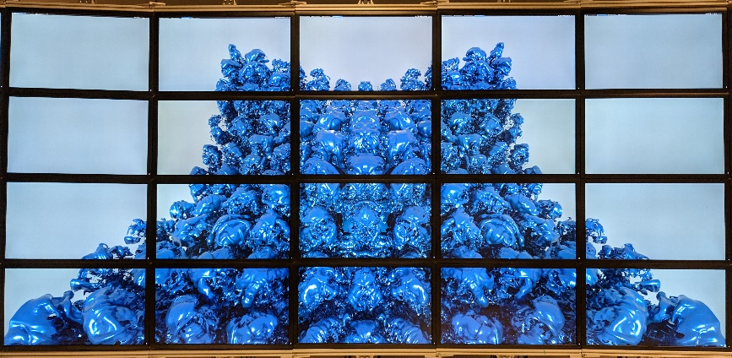
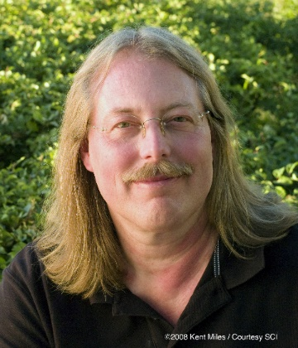
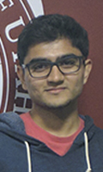


FACULTY MEMBER
Chris Johnson
PROJECT SPOTLIGHT
Intel oneAPI Center of Excellence
Intel Graphics and Visualization
Institute of Excllence
GOALS / IMPACT
Advancing research, development and teaching of the latest visual computing innovations and using oneAPI to accelerate compute across heterogeneous architectures with the OpenViSUS and Uintah frameworks to efficiently manage, store, analyze, and visualize scientific data.
FUNDING
$500K from Intel
COLLABORATORS
Martin Berzins, Valerio Pascucci, Intel Researchers
Top: Streamlines computed on flow past a torus.
Middle: Isosurface of a Richtmeyer Meshkov simulation.
From left: Chris Johnson and graduate students Tark Patel, Mengjiao Han, and Nathan Marshak.

Slide 13
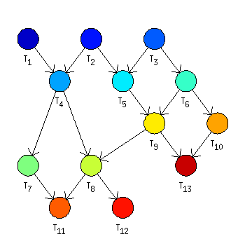
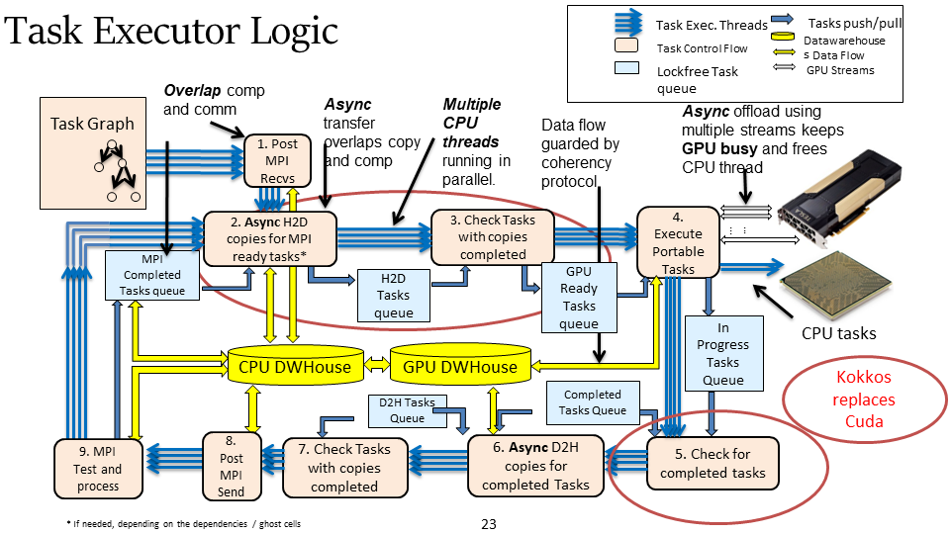
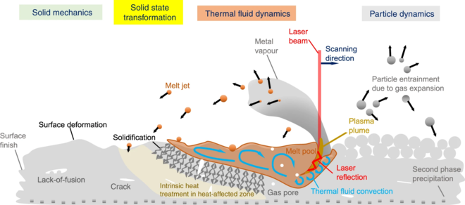
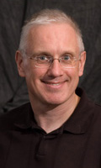
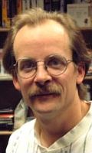
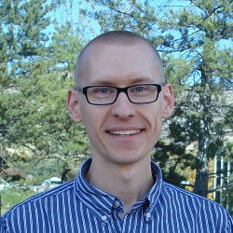

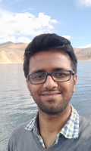

FACULTY MEMBER
Martin Berzins
PROJECT SPOTLIGHT
PPPSC: Portable Performant
Post-Exascale Scalable Computing
A software task-graph base that allows applications to take advantage of next-generation post exascale computers with >$10^{18}$ flops
GOALS / IMPACT
Developed with DOE automated task-and runtime system- based Utah software that runs well on DOE exascale computers based on GPUs,
Extended NIST software that is best in class (high peak performance) for using GPUs to more general architectures
Apply these ideas to challenging additive manufacturing problems (right) studied by NIST
FUNDING
$1M from NIST, NSF and Intel
COLLABORATORS
NIST Gaithersburg, DOE Argonne, DOE Oak Ridge Intel
Top left: Task graph
Top right: Runtime system
Middle: Additive manufacturing detail
Left: The team: Martin Berzins, Allen Sanderson, John Hollmen (now at ORNL), Sree Kadiyala, Nitish Shingde.

Slide 14
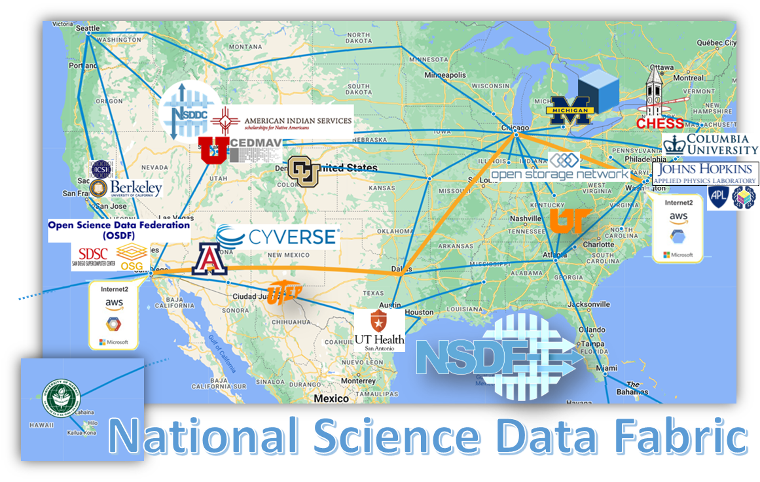
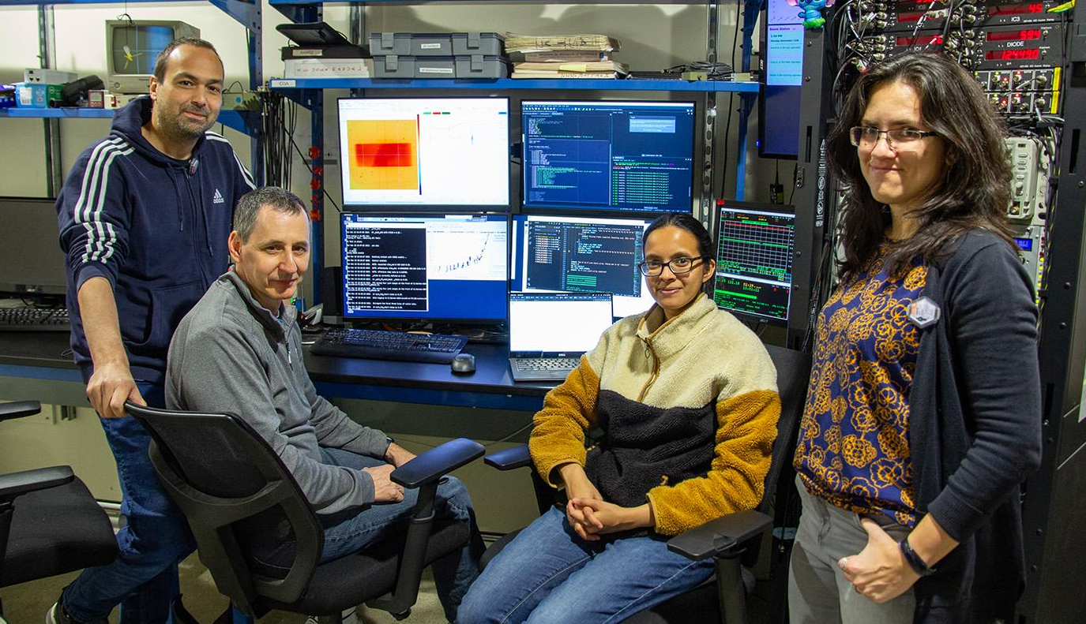
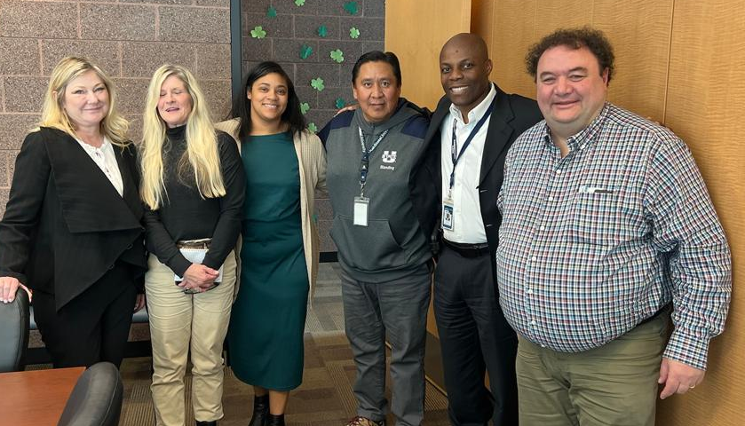
FACULTY MEMBER
Valerio Pascucci
PROJECT SPOTLIGHT
National Science Data Fabric (NSDF):
Develop critical technologies to provide
equitable access to data-driven sciences
from national facilities to local communities
GOALS / IMPACT
Democratize science with easy access to
large-scale data and use with commodity computing resources
Industry consortium to share resources and technology
Applications in materials science, dark matter research,
climate modeling, manufacturing, and energy production
FUNDING
$5.6 million from NSF starting in 2021
COLLABORATORS
SDSC, JHU, UT Knoxville, Michigan
Above: Real-time remote dashboards for Cornell’s Synchrotron Light Source.
Left: NSDF also supports Indigenous communities.

Slide 15

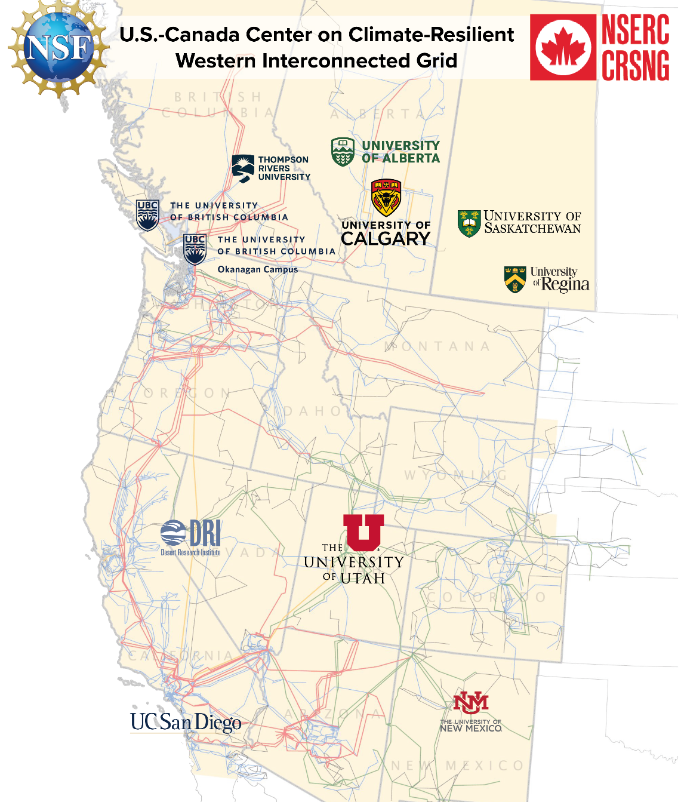
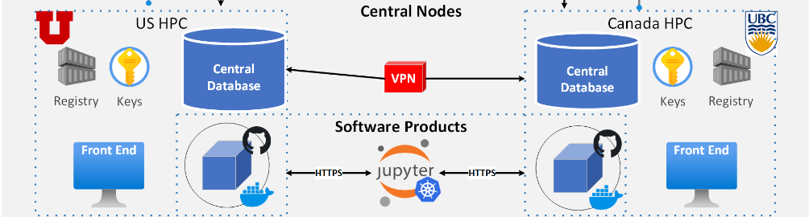
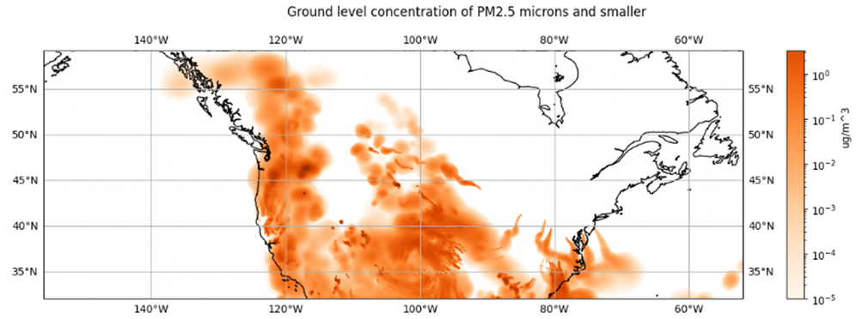
FACULTY MEMBER
Valerio Pascucci (co-PI), Manish Parashar
PROJECT SPOTLIGHT
Study climate-related impacts on the power grid serving nearly 80 million people across two Canadian provinces and 11 Western U.S. states.
GOALS / IMPACT
Foster cross-border collaboration between communities
Reimagine a resilient and equitable power grid
Develop a sustainable and prosperous future
INTERNATIONAL
CYBERINFRASTRUCTURE
IMPACT OF SMOKE
FROM WILDFIRES
FUNDING
$5 million from NSF
$4 million from NSERC
Starting in 2023
PARTNER INSTITUTIONS

Slide 16
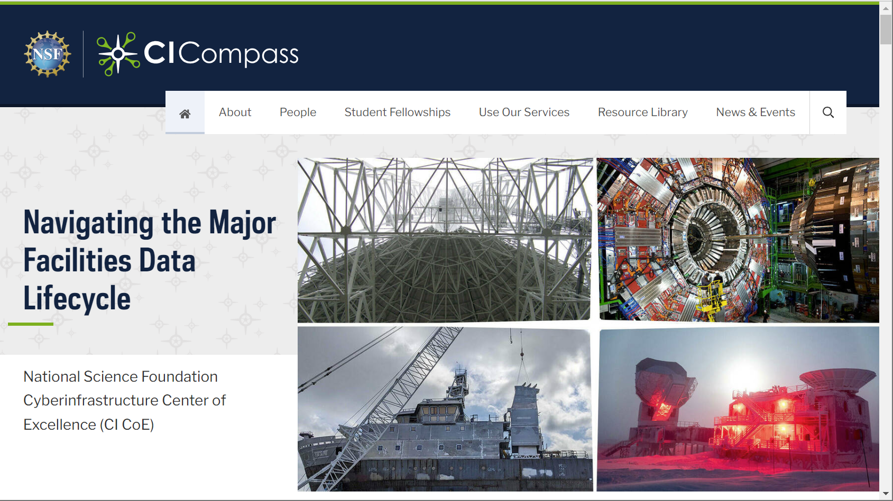
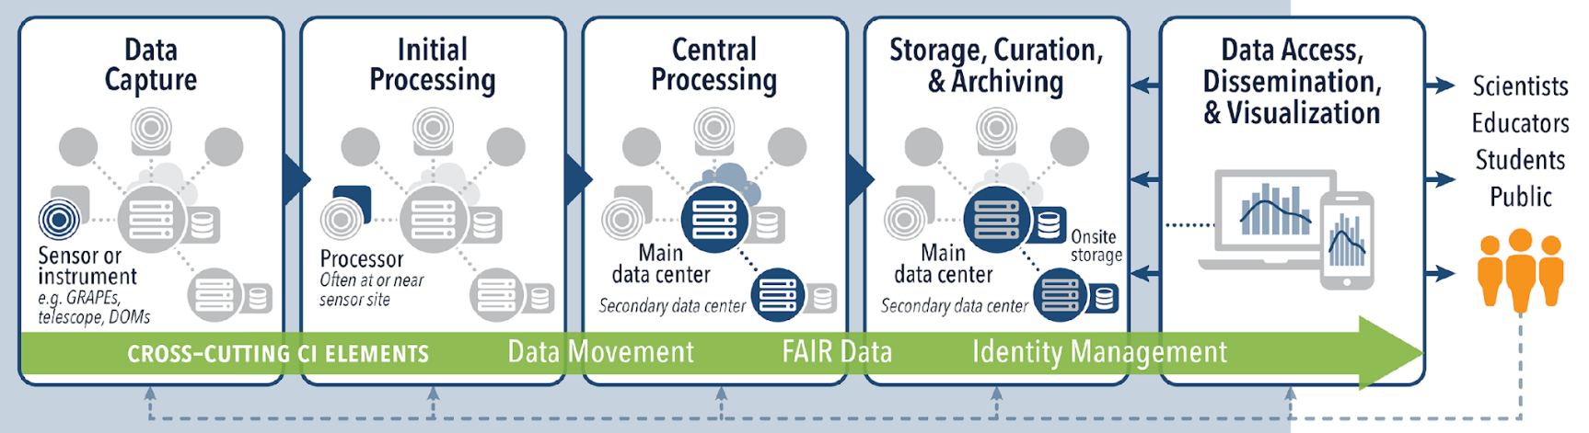
FACULTY MEMBER
Valerio Pascucci (co-PI)
PROJECT SPOTLIGHT
We provide cyberinfrastructure expertise NSF Major Facilities to accelerate research and discovery
GOALS / IMPACT
Organize Major Facilities Workshops
Technical Engagements for Specific Needs
Training of Students and CI Professionals
Community Building Activities
FUNDING
$9 million from NSF starting in 2021
COLLABORATORS
U. of Southern California, RENCI, Indiana U.
U. of Notre Dame, Texas Tech University
CI Compass website.
Major Facilities Data Lifecycle

Slide 17

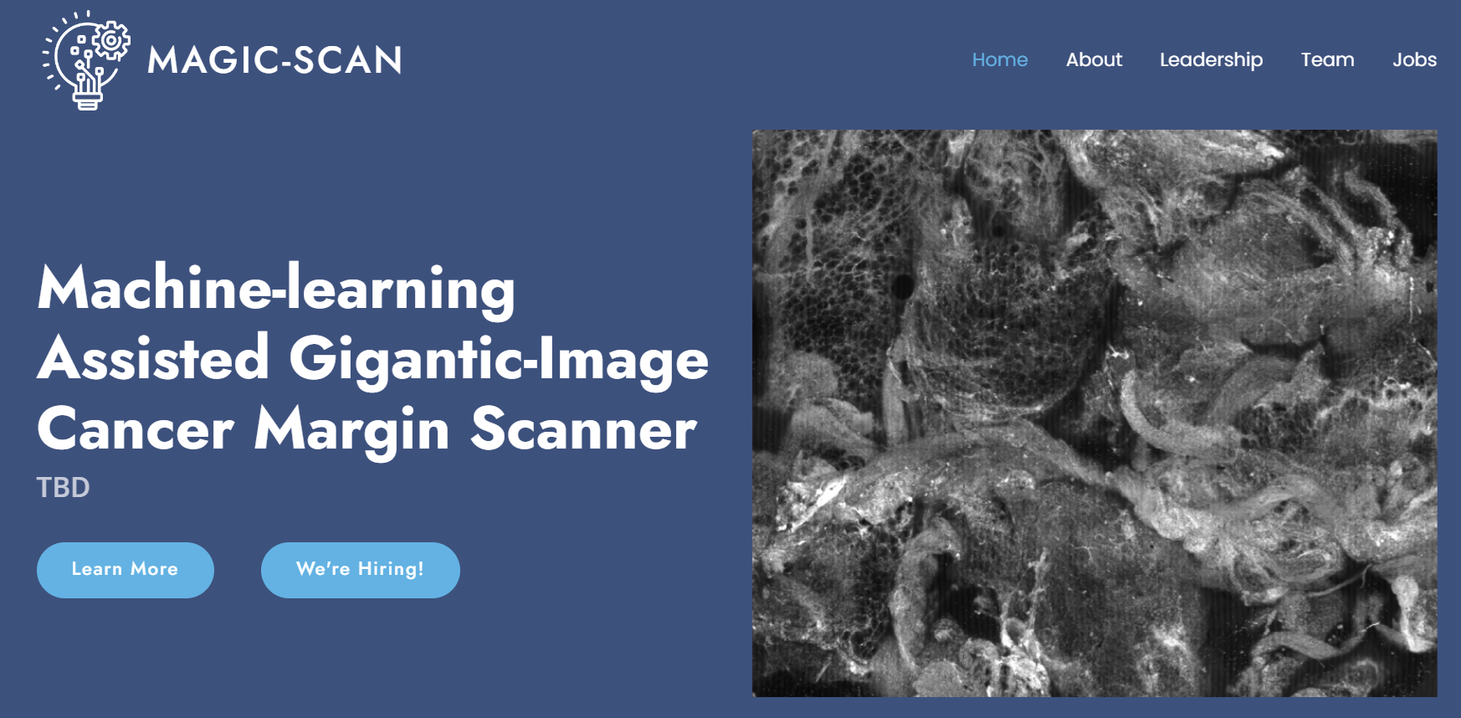
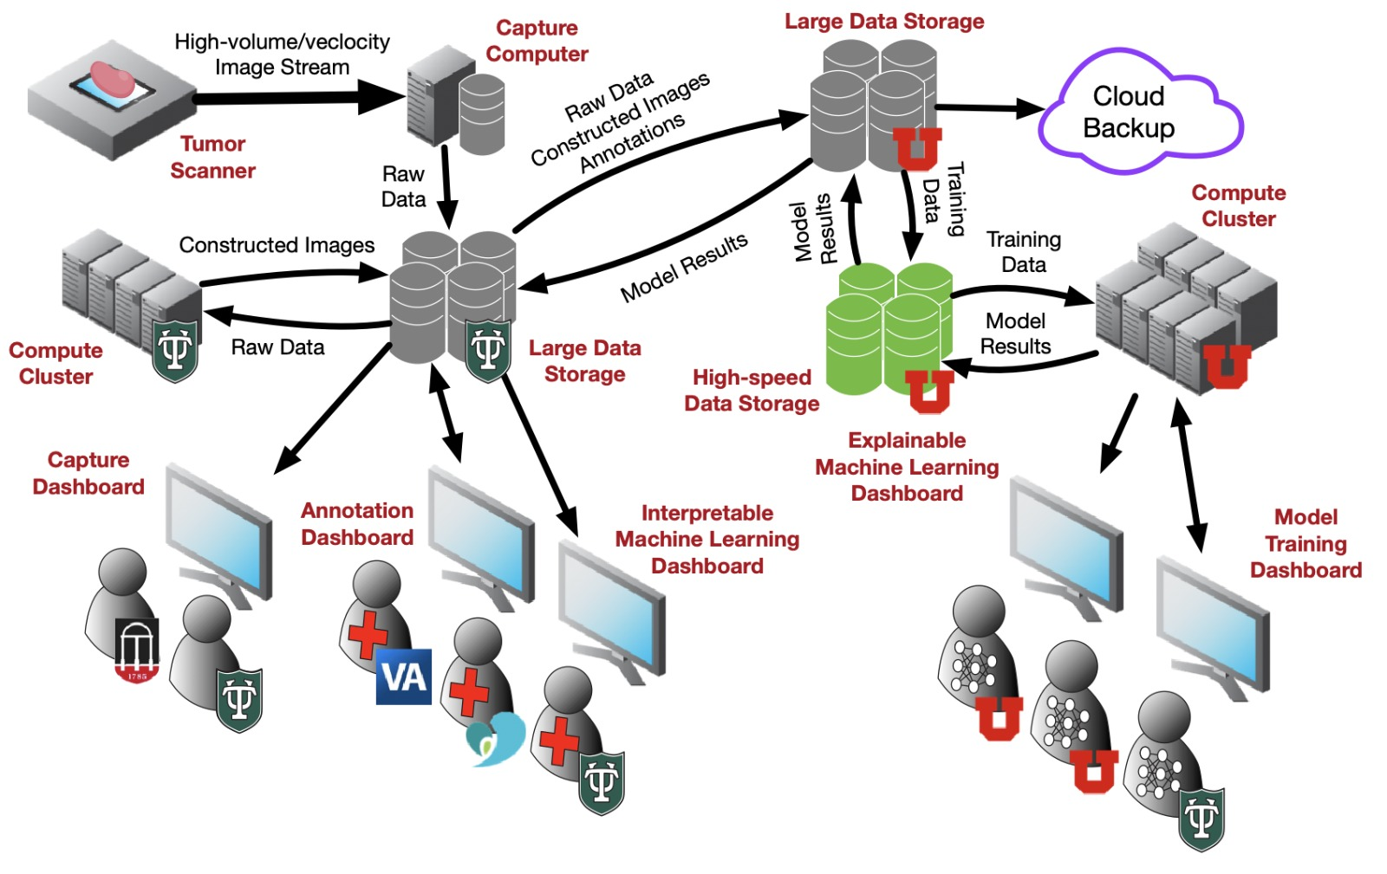
FACULTY MEMBER
Valerio Pascucci (co-PI)
PROJECT SPOTLIGHT
Improve Patient Outcomes by Detecting Residual Cancer Cells with Machine Learning Tools in the Operating Room
Scalable Cyberinfrastructure for Cancer Research & Clinical Deployment
The MAGIC-SCAN website.
GOALS / IMPACT
Automatically prepare, handle, and scan the
complete surface of removed cancerous organs
Detect the presence of any residual cancer cells
Visualization of residual cancer location for the
surgeon in the operating room within 15 minutes
FUNDING
$23 million from ARPA-H (NIH) starting in 2024
COLLABORATORS
Tulane University, University of Georgia,
New Orleans VA, Cedars-Sinai Medical Center, Instapath Inc., Delta Pathology, LCMC Health

Slide 18
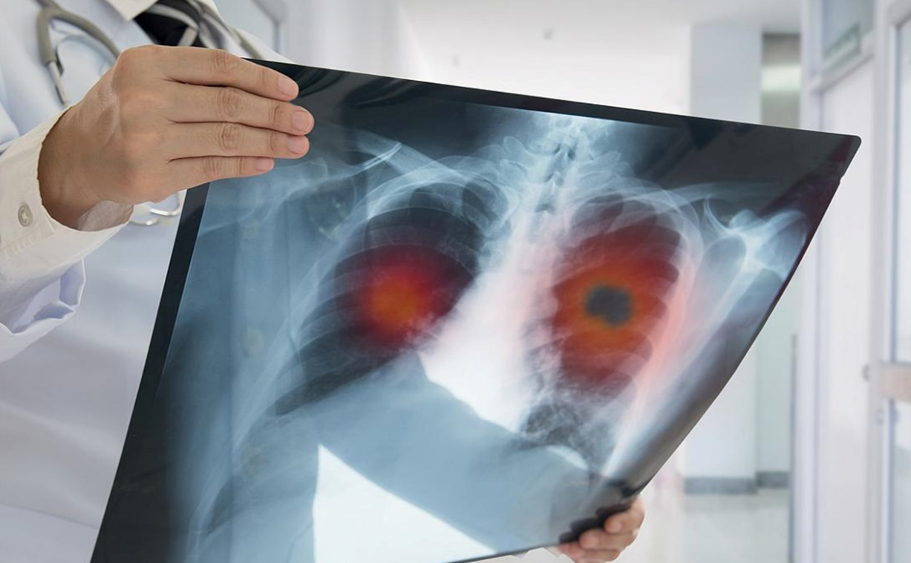
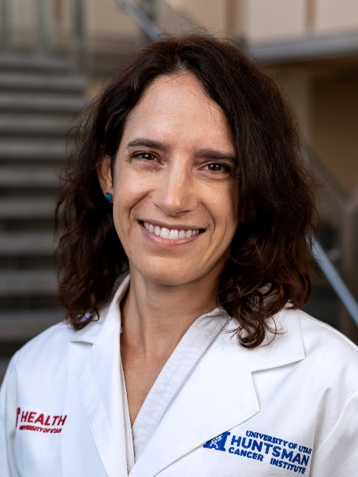
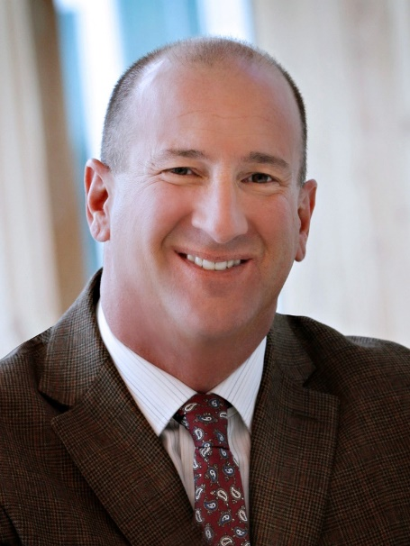
FACULTY MEMBER
Jeff Weiss
PROJECT SPOTLIGHT
Mechanical Stress and Lung Tumor Progression
IMPACT
Research how tension in lung tissue affects the growth and distribution of tumors. This innovative approach could uncover new mechanisms for understanding how lung cancer develops.
FUNDING
$2.6M from the National Institutes of Health
COLLABORATORS
Michelle Mendoza, PhD, Huntsman Cancer Institute

Slide 19
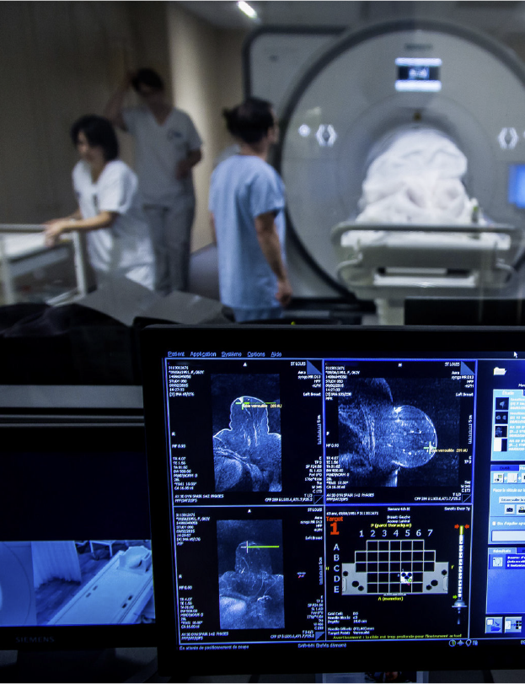
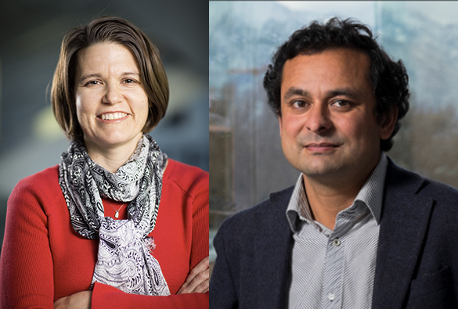
FACULTY MEMBER
Sarang Joshi
PROJECT SPOTLIGHT
MRgFUS: A tissue viability imaging biomarker for use in non-invasive breast cancer therapy
IMPACT
Provide accurate assessment of tissue viability during MRgFUS ablation treatments, revolutionizing minimally invasive breast cancer treatments and directly addressing the critical issue of overtreatment.
FUNDING
$2.9M from the National Cancer Institute (NCI)
COLLABORATORS
Allison Payne, - Utah Center for Advanced Imaging Research (UCAIR)

Slide 20
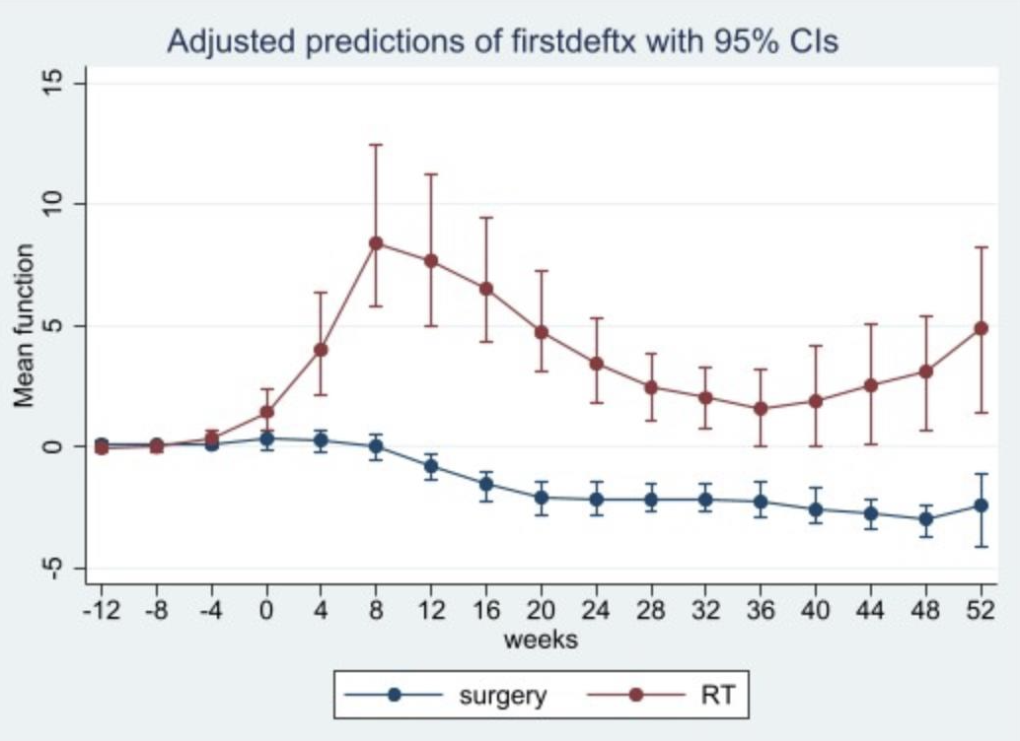
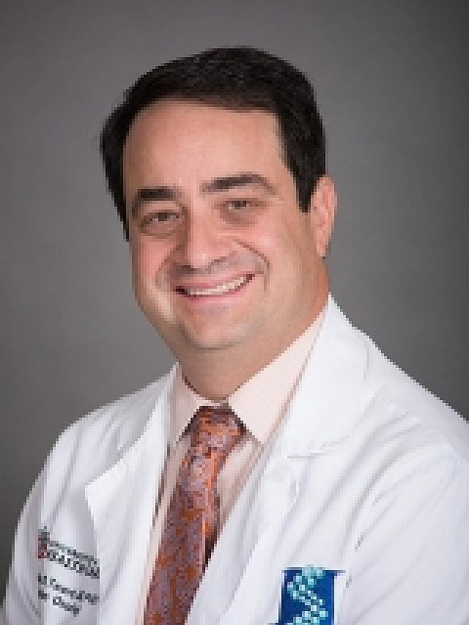
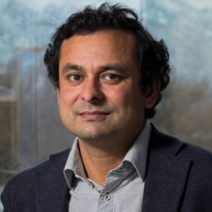
FACULTY MEMBER
Sarang Joshi
PROJECT SPOTLIGHT
Personalized Prostate Cancer Risk Stratification Using Multiparametric MRI with Deep Learning
FUNDING
CORI Huntsman-SCI Funding
COLLABORATORS
Dr. Johnathan Tward, Huntsman Cancer Institute

