Slide 1

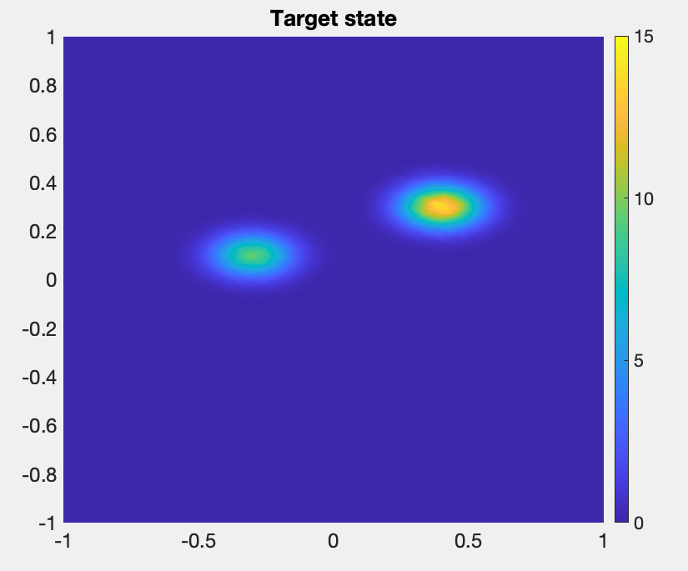
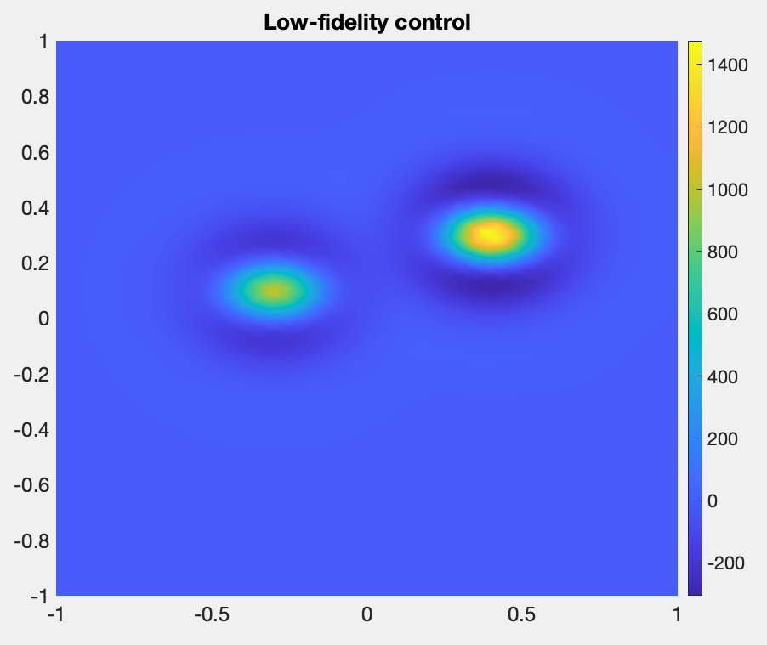
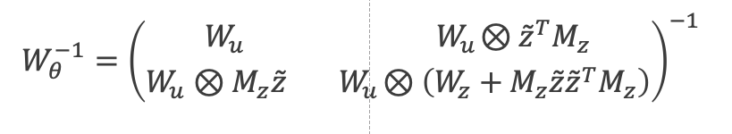
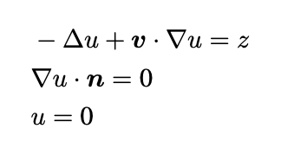
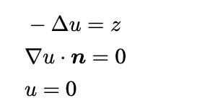
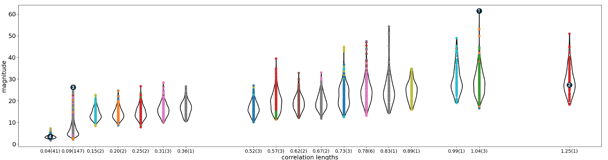
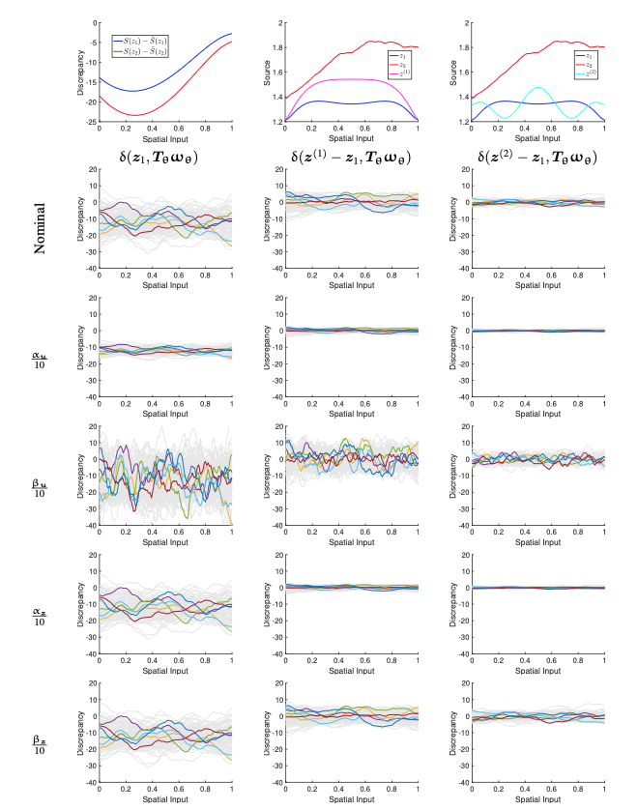
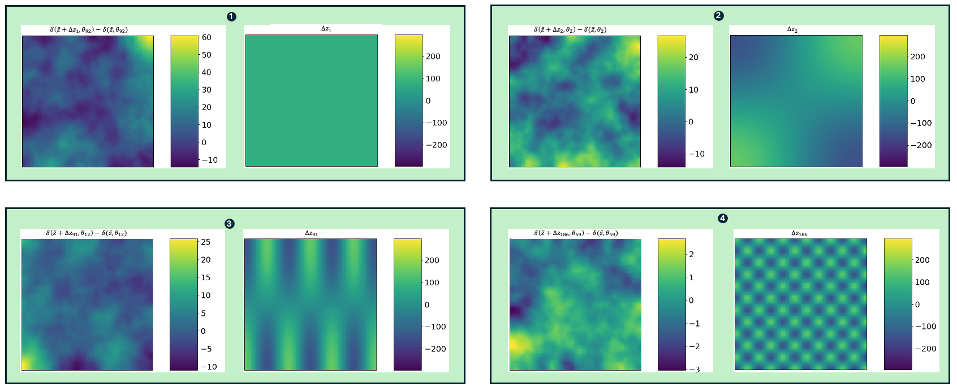
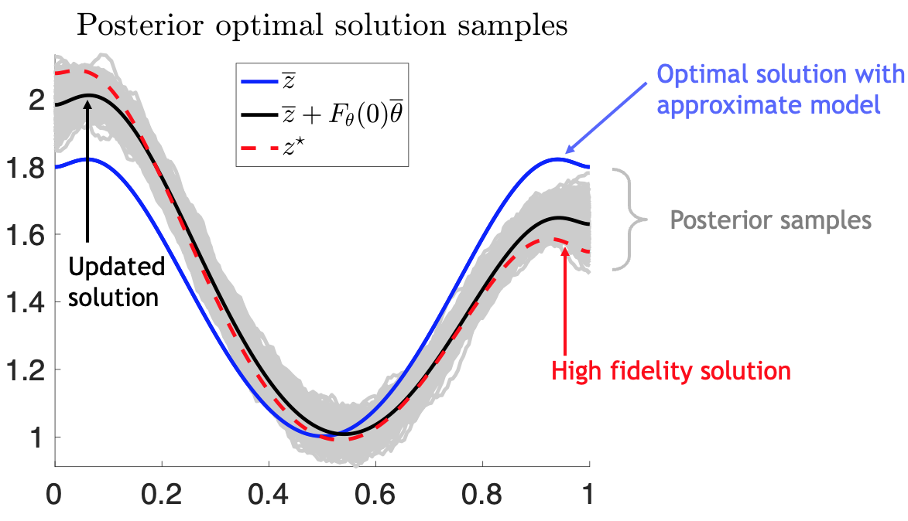

ASCR AIVIS: Visualization Insight for Hyper-Differential Sensitivity Analysis
Joseph Hart, Bart van Bloemen Waanders, Jixian Li, Timbwaoga A. J. Ouermi, & Chris Johnson
Hyper Differential Sensitivities
Calibration
Visualization for Hyperparameter Tuning
Low-Fidelity Optimization:
$\min_{z} J(\tilde{S}\left(z\right),z)$ (1)
Motivation:
Limited evaluations of high-fidelity models
Cannot compute derivatives
Cannot solve efficiently
Goal:
Update the solution of $(1)$ using a small number of evaluations of high-fidelity models
Prior Hyperparameters
Operator rather than a function
Prior/posterior high dimensional
Algorithm-based initialization
2D Convection Diffusion Problem
Hyperparameter initialization
Target state
Low-fidelity control
Discrepancy data
Algorithmic initialization
Prior Covariance :
Prior discrepancy samples
Prior hyper parameters
Depends on:
State/control variance, smoothness
Challenges
Initialization algorithm fails
Large visualization dimensions
Summary metrics
Interactive visualization
High-fidelity
Low-fidelity
Algorithmic approach
Hyperparameter verification
Approximate optimization solution
No update
Update 1
Update 2
Cross plot
Calibration
Post-optimality sensitivities
Optimization solution updates
Publications: Hyper-differential Sensitivity Analysis with Respect to Model Discrepancy: Prior distributions
Joseph Hart, Bart van Bloemen Waanders, Jixian Li, Timbwaoga Ouermi,& Chris Johnson, IJUQ, 2025 (in prep)
SAND2025-XXXXX

