Slide 1


Feature Extraction and Tracking using Vector Field Decompositions
Harsh Bhatia
Oct 21, 2018
This work was performed under the auspices of the U.S. Department of Energy by Lawrence Livermore National Laboratory (LLNL) under contract DE-AC52-07NA27344. LLNL-PRES-759730
This document was prepared as an account of work sponsored by an agency of the United States government. Neither the United States government nor Lawrence Livermore National Security, LLC, nor any of their employees makes any warranty, expressed or implied, or assumes any legal liability or responsibility for the accuracy, completeness, or usefulness of any information, apparatus, product, or process disclosed, or represents that its use would not infringe privately owned rights. Reference herein to any specific commercial product, process, or service by trade name, trademark, manufacturer, or otherwise does not necessarily constitute or imply its endorsement, recommendation, or favoring by the United States government or Lawrence Livermore National Security, LLC. The views and opinions of authors expressed herein do not necessarily state or reflect those of the United States government or Lawrence Livermore National Security, LLC, and shall not be used for advertising or product endorsement purposes.

Slide 2
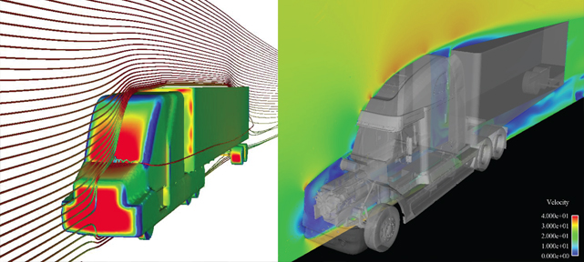
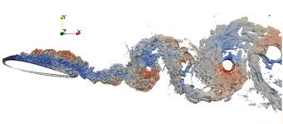
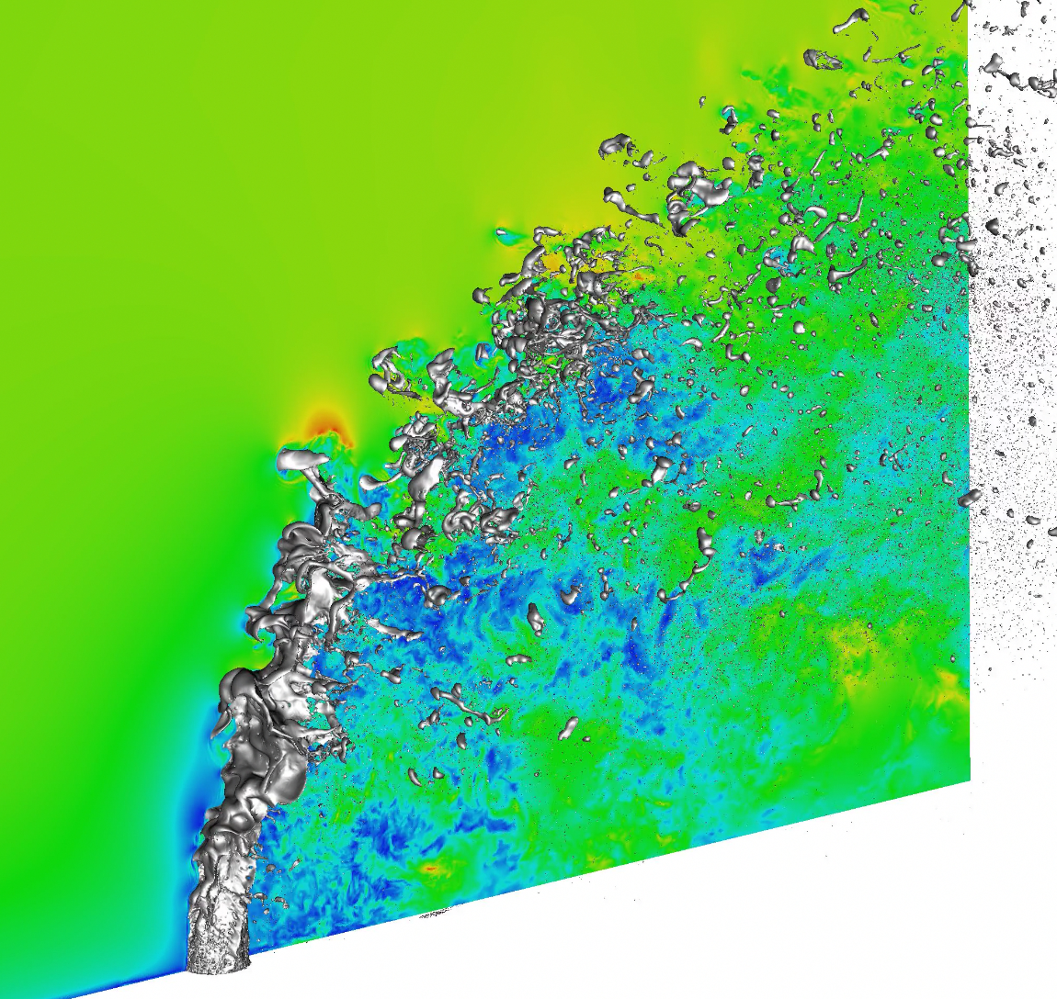
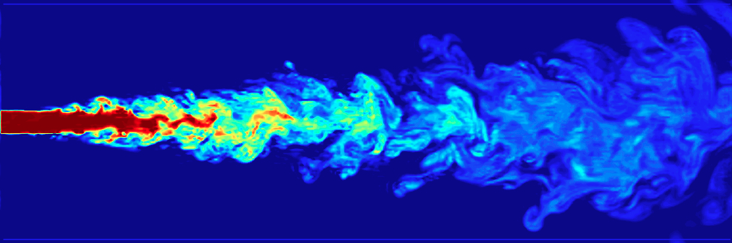
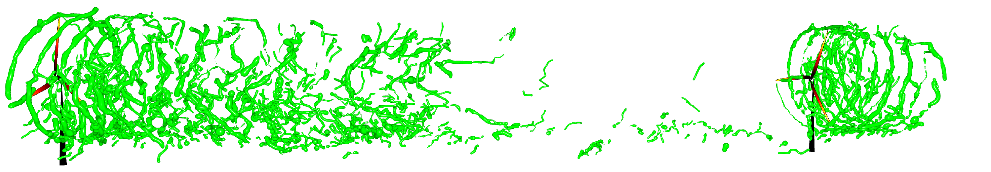
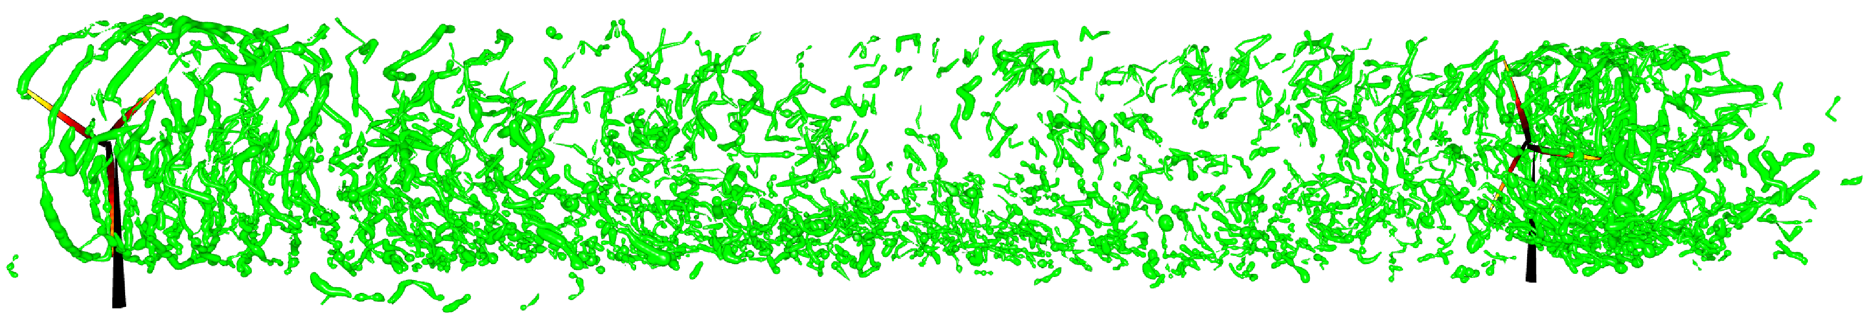

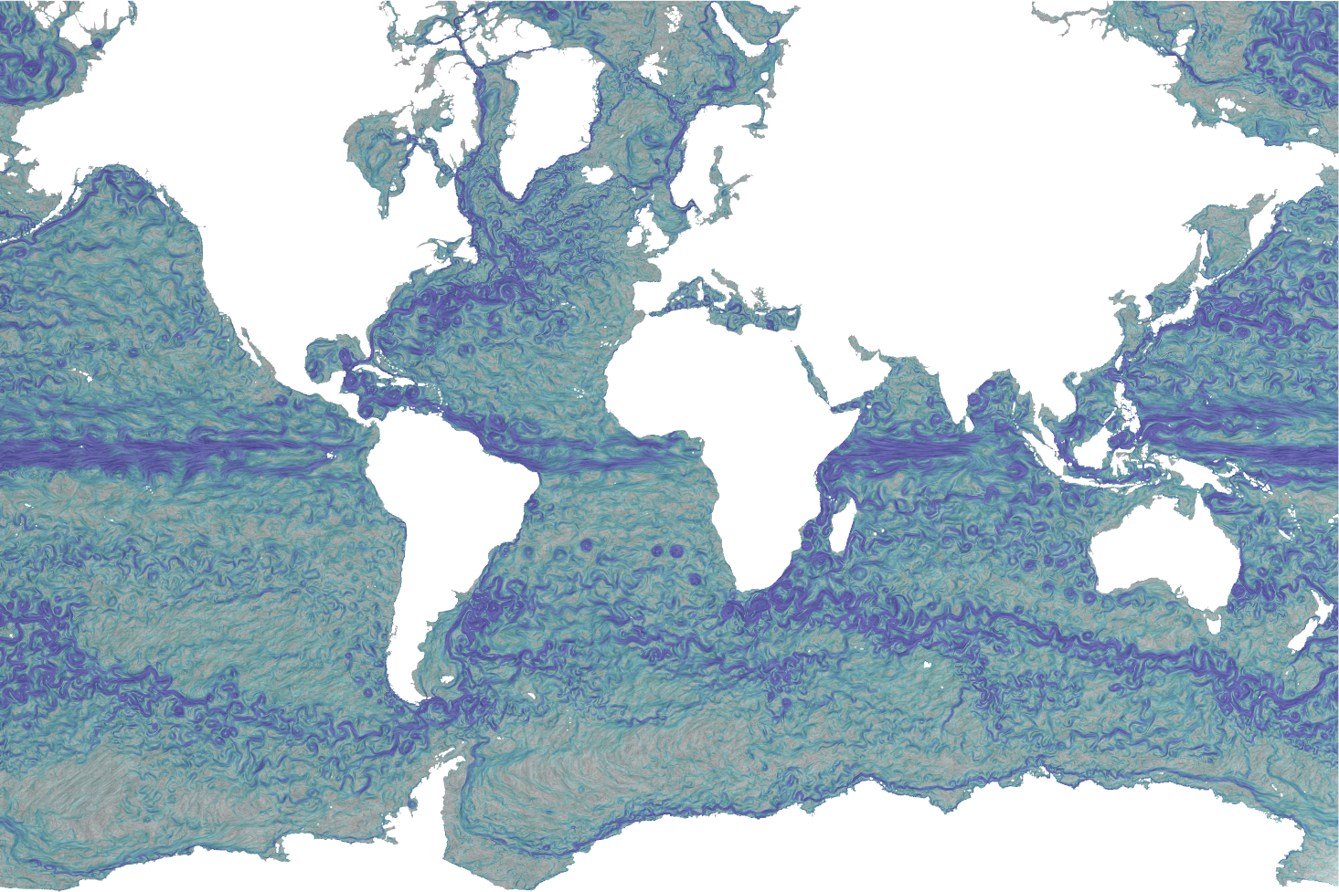
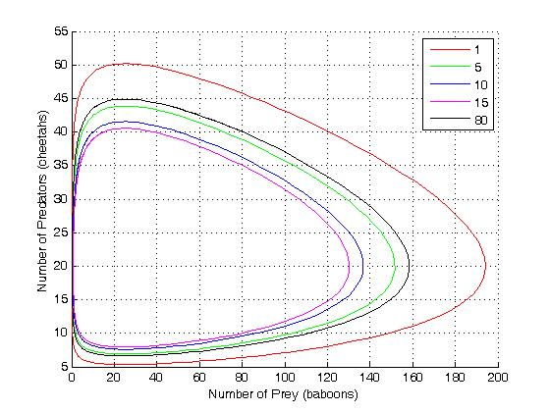
Vector fields are found everywhere around us
Mixing, transport, and
circulation phenomena
Aerodynamical designs
[LLNL]
[CTTC]
[LANL, UCD]
[SNL, LLNL]
[NASA]
Weather
Dynamical systems in nature
Astronomical events
[NCSU, UCD]
[Wiki]
[NASA]
[LANL]

Slide 3
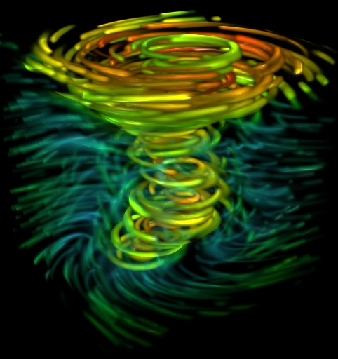
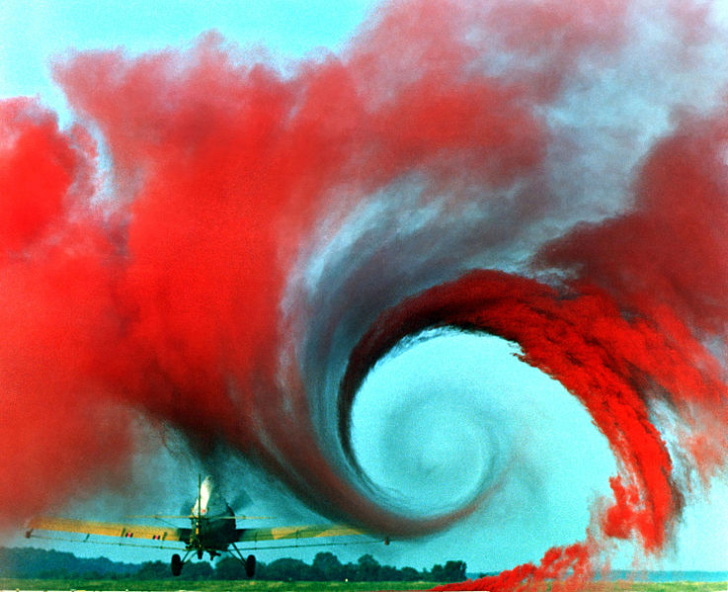
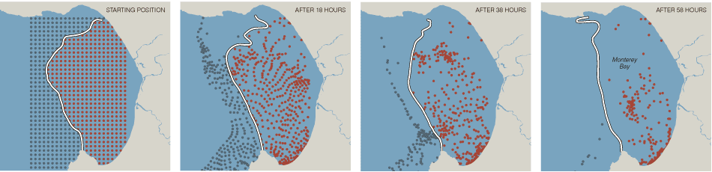
Feature extraction is critical to understand the underlying phenomena
Vortices
Critical points
[Lorenzi et al., 2012]
[Stuttgart]
[NASA]
Material boundaries / Lagrangian coherent structures
[Lekien et al., 2009]
Notes:
vortices which are intuitively the rotational structures in the flow. They are important to stimulate mixing of fluids, however, in other cases, they must be prevented, for example, around an aircraft, since they
can reduce lift.
critical points which convey, e.g., where material is created or destroyed,
separation and attachment lines

Slide 4
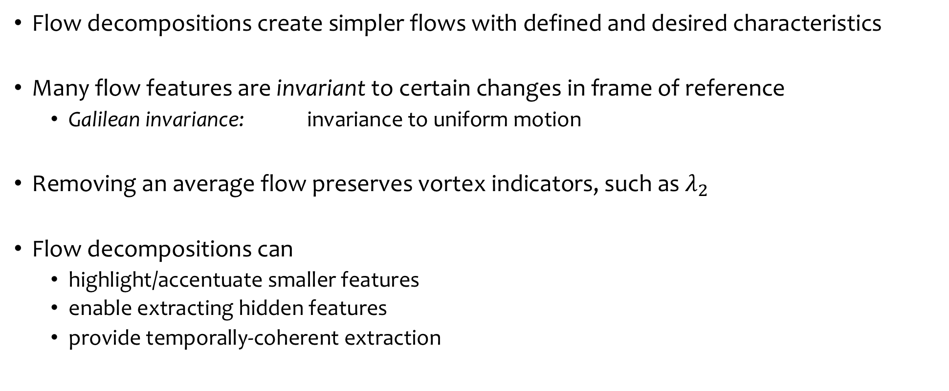
Flow decompositions can help in feature extraction
Flow decompositions create simpler flows with defined and desired characteristics
Many flow features are invariant to certain changes in frame of reference
  Galilean invariance: invariance to uniform motion
Removing an average flow preserves vortex indicators, such as $λ_{2}$
Flow decompositions can
  highlight/accentuate smaller features
  enable extracting hidden features
  provide temporally-coherent extraction

Slide 5
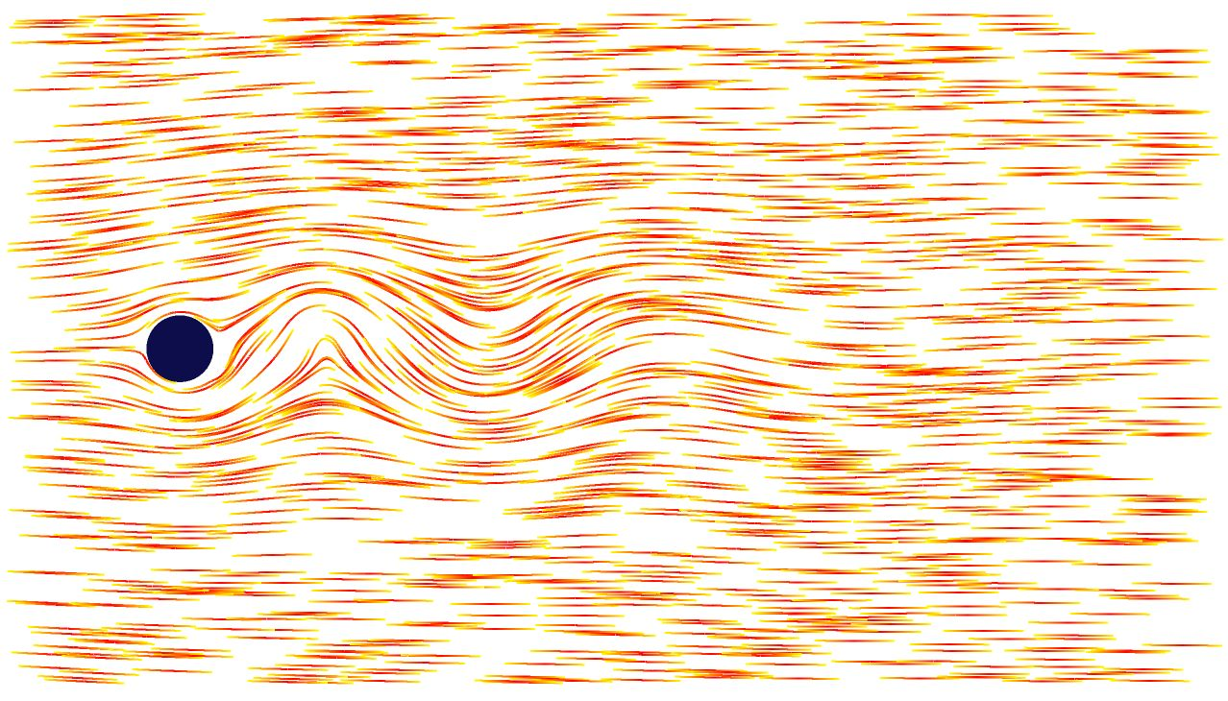
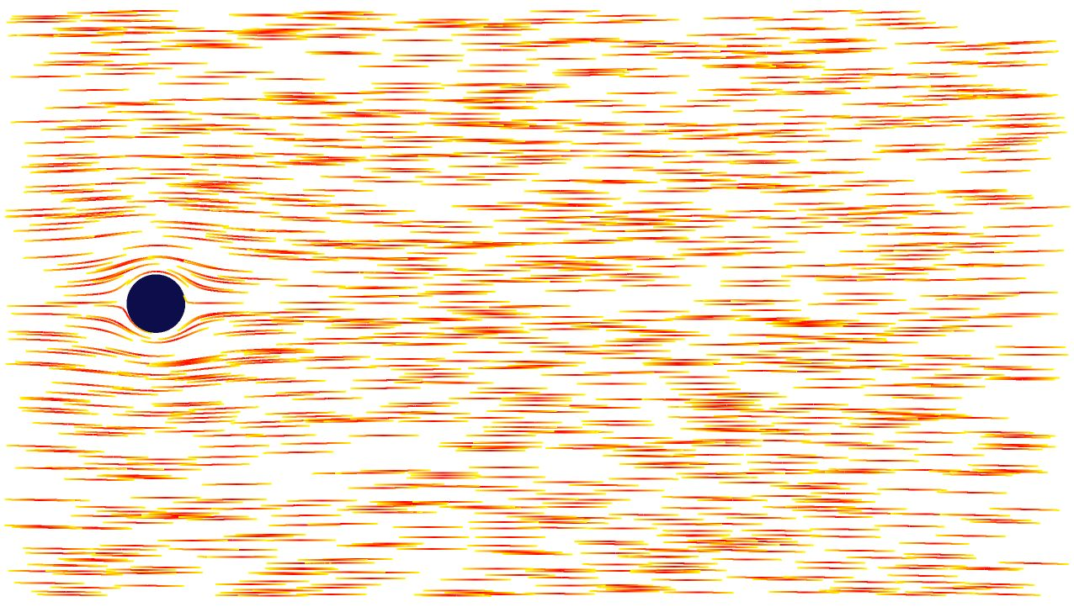
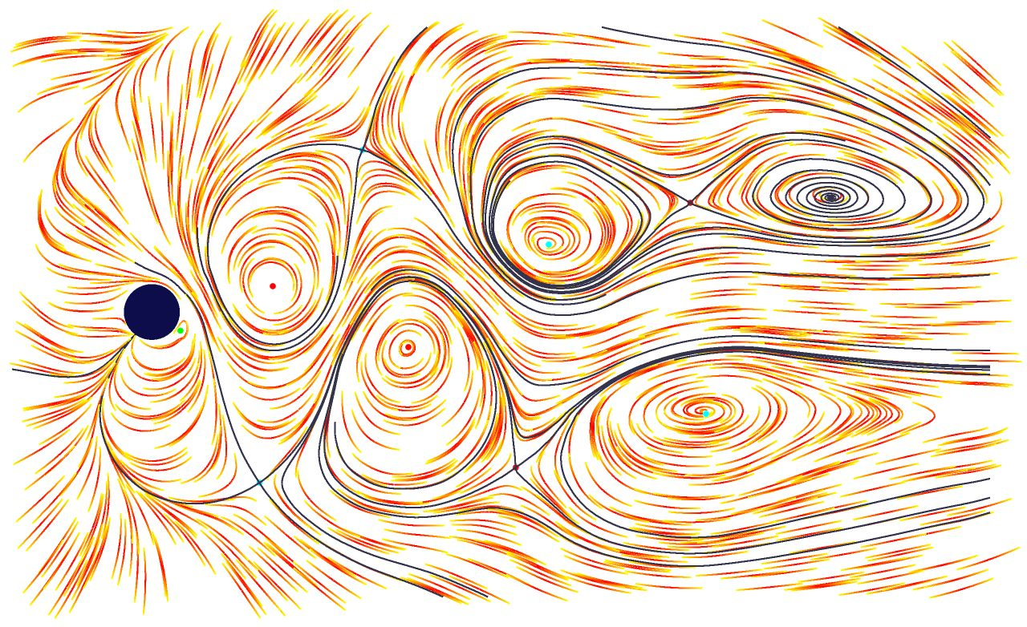




“Localized” flow allows understanding the contribution of a subregion
A given flow behind a cylinder
Potential flow
Localized flow
$$\vec{V}$$
$$∇u$$
$$\vec{V_{l}}=\vec{V}−∇u$$
$$∆u=0 on Ω \\ ∇u∙\vec{n}=\vec{V}∙\vec{n} on ∂Ω$$
[Wiebel et al., EuroVis 2005]
[Wiebel et al., TVCG 2007]

Slide 6
The Helmholtz-Hodge decomposition provides a more general framework for decomposing flows
$$\vec{V} = ∇D + ∇×\vec{R} + \vec{h}$$
given flow
irrotational
incompressible
harmonic
Solve two Poisson equations
Impose boundary conditions for a unique solution
Irrotational component is normal to the boundary
Incompressible component is parallel to the boundary

Slide 7
The HHD has a long successful history in many scientific fields
1858: Introduced by Helmholtz
[Helmholtz, J. für die reine und angewandte Mathematik, 1858]
1960’s: Gained popularity as “projection methods”
e.g., [Chorin, Math. Computations, 1968]
1990’s: Applications in image processing, graphics, etc.
2000’s: more application areas
e.g., [Polthier & Preuss, 2000]
Detailed survey: [Bhatia et al., TVCG 2013]

Slide 8

Critical points of the scalar potentials can be used for extracting features from vector fields
$D$ and $R$ are scalar potentials in 2D
Finite element discretization on triangulations
  Piecewise constant vector field
  Piecewise linear potential fields
Least squares
optimization
[Polthier and Preuß, Eurograph. W. Sci. Vis. 2000]
[Polthier and Preuß, Math. Vis. III, 2003]

Slide 9

This approach has been extended to 3D unstructured meshes
$D$ is scalar and $\vec{R}$ is vector potential in 3D
Solve three independent equations
for the three components of the
vector potential
Smooth the potentials to compute
a multiscale decomposition
[Tong et al., ACM Trans. Graph., 2003]

Slide 10
This approach has been simplified for 2D regular grids
Cardiac video analysis by decomposing motion fields defined on regular grids
[Guo et al., Patt. Rec. Lett., 2005]

Slide 11
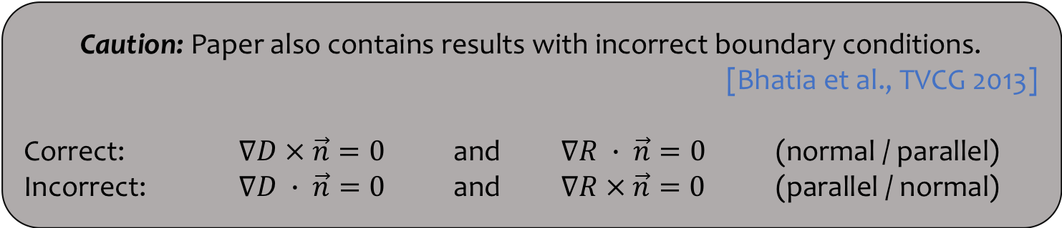
The HHD can be computed for 2D particle-based systems
Smoothed particle hydrodynamics (SPH) for solving the Poisson equations
Caution: Paper also contains results with incorrect boundary conditions.
[Bhatia et al., TVCG 2013]
Correct: $∇D × \vec{n}=0$ and $∇R ∙ \vec{n}=0$ (normal / parallel)
Incorrect: $∇D ∙ \vec{n}=0$ and $∇R × \vec{n}=0$ (parallel / normal)
[Petronetto et al., TVCG 2010]

Slide 12
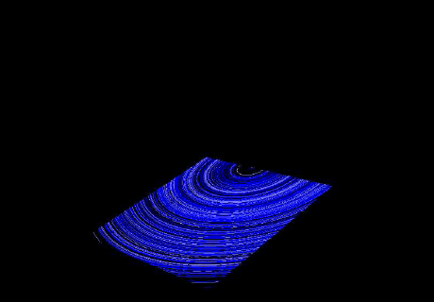
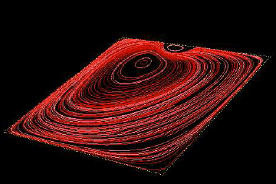
Even the “correct” boundary conditions may be unsuitable for analysis
The HHD boundary artifacts [Wiebel, 2004]
Boundary conditions used to create the data may not be known or may be incompatible with the HHD boundary conditions
Experiment or Simulation
The HHD
Analysis
Flow
Components
Boundary conditions
Boundary conditions

Slide 13






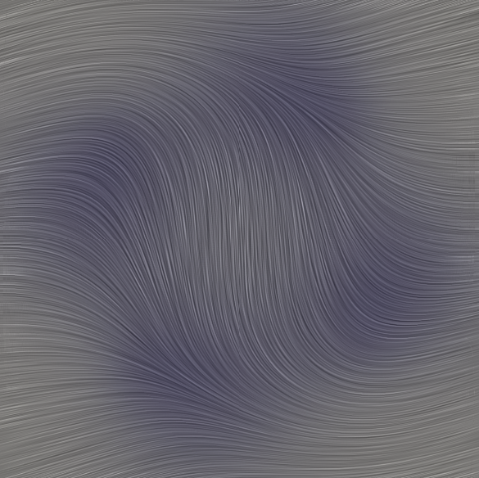

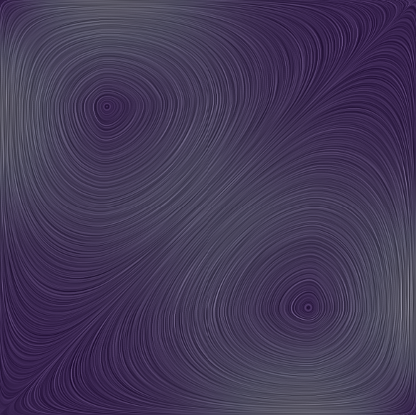

The natural HHD computes the decomposition without assuming boundary conditions
The natural HHD
[Bhatia et al., TVCG 2014]
Analytically created fields
The HHD with boundary conditions

Slide 14
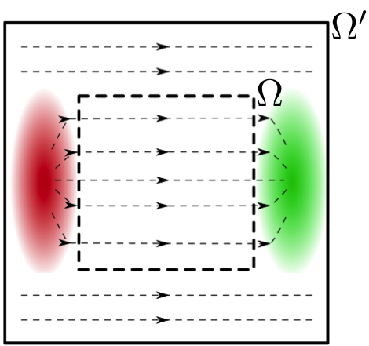


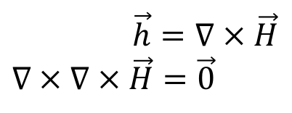
An alternate definition of harmonic flow facilitates the natural HHD
$$∇∙\vec{h}=0 \text{and} ∇×\vec{h}=\vec{0}$$
Usual definition:
Alternate: harmonic flow is always created by “external” divergence and curl
$\vec{h}=∇H$
$$∇^{2 }H=0$$
The translational flow in the smaller domain is harmonic with respect to this domain;
$\vec{h}=∇ × \vec{H}$
$$∇ × ∇ × \vec{H}=\vec{0}$$
but some of it is not harmonic with respect to the larger domain.

Slide 15
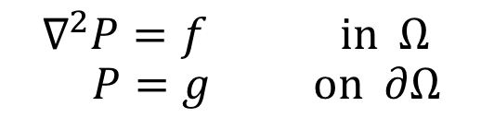
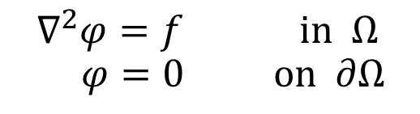

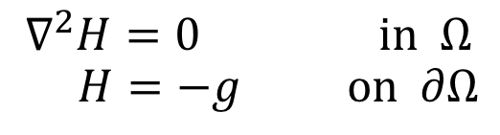
Using boundary conditions is equivalent to including assumed external influences in the solution
$$∇^{2}φ=f \text{in} Ω \\ φ=0 \text{o}\text{n} ∂Ω$$
$$φ=P+H$$
$$∇^{2}P=f \text{in} Ω \\ P=g \text{o}\text{n} ∂Ω$$
$$∇^{2}H=0 \text{in} Ω \\ H=−g \text{o}\text{n} ∂Ω$$

Slide 16

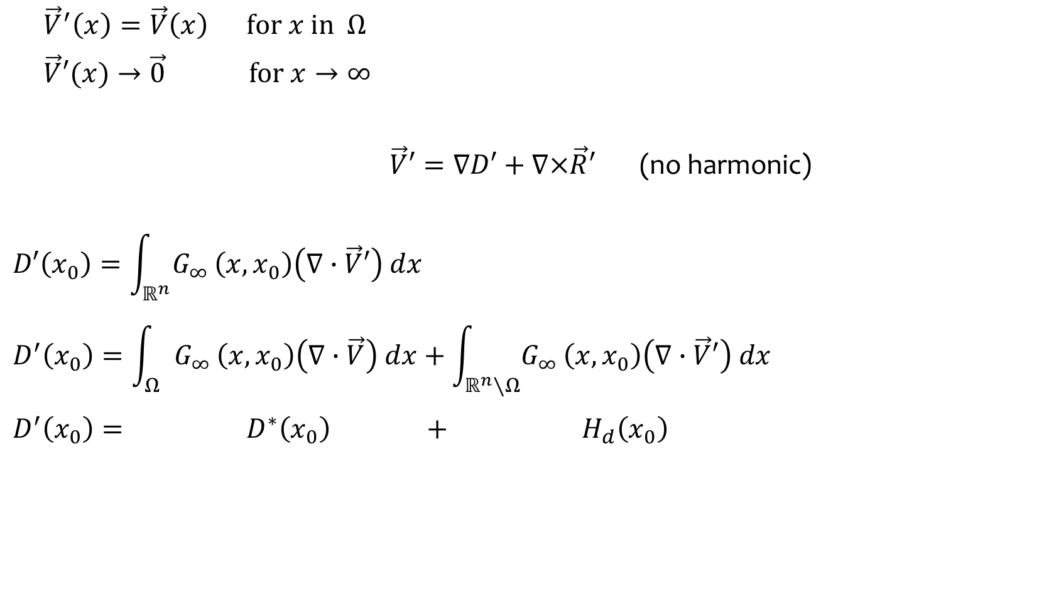

Integral solution allows a relief from boundary conditions
$$\vec{V}′ \text{on} ℝ^{n}$$
$$\vec{V}=∇D^{∗}+∇×{\vec{R}}^{∗}+{\vec{h}}^{∗}$$
${\vec{V}}^{′}\left(x\right)=\vec{V}\left(x\right) \text{for} x \text{in} Ω$
$\vec{V}′(x)→\vec{0} \text{for} x→∞$
$\vec{V}′=∇D′+∇×\vec{R}′$ (no harmonic)
$$D′\left(x_{0}\right)=\int_{ℝ^{n}}{G_{∞}}\left(x,x_{0}\right)\left(∇∙\vec{V}′\right) dx$$
$$D^{′}\left(x_{0}\right)=\int_{Ω}{G_{∞}}\left(x,x_{0}\right)\left(∇∙\vec{V}\right) dx+\int_{ℝ^{n}∖Ω}{G_{∞}}\left(x,x_{0}\right)\left(∇∙\vec{V}′\right) dx$$
$$D^{′}\left(x_{0}\right)= D^{∗}\left(x_{0}\right) + H_{d}\left(x_{0}\right)$$
$$\vec{V} \text{on} Ω⊂ ℝ^{n}$$

Slide 17
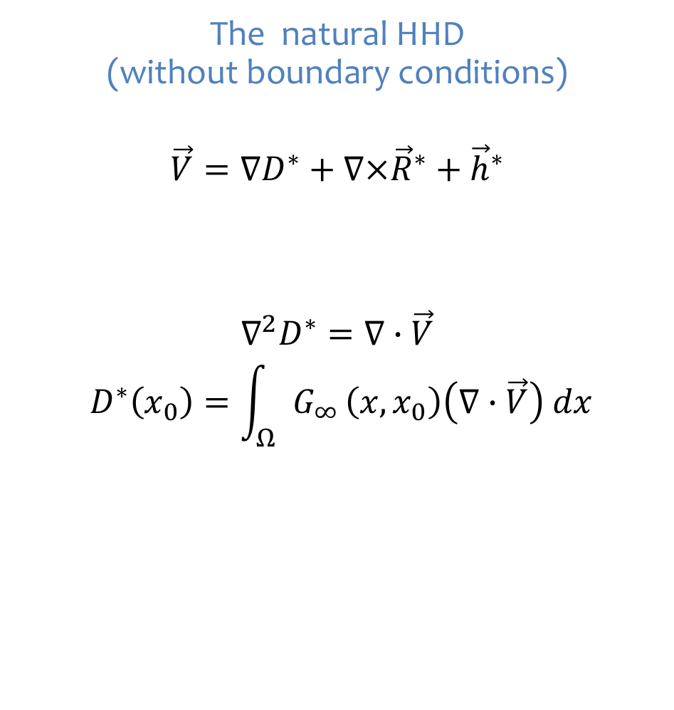
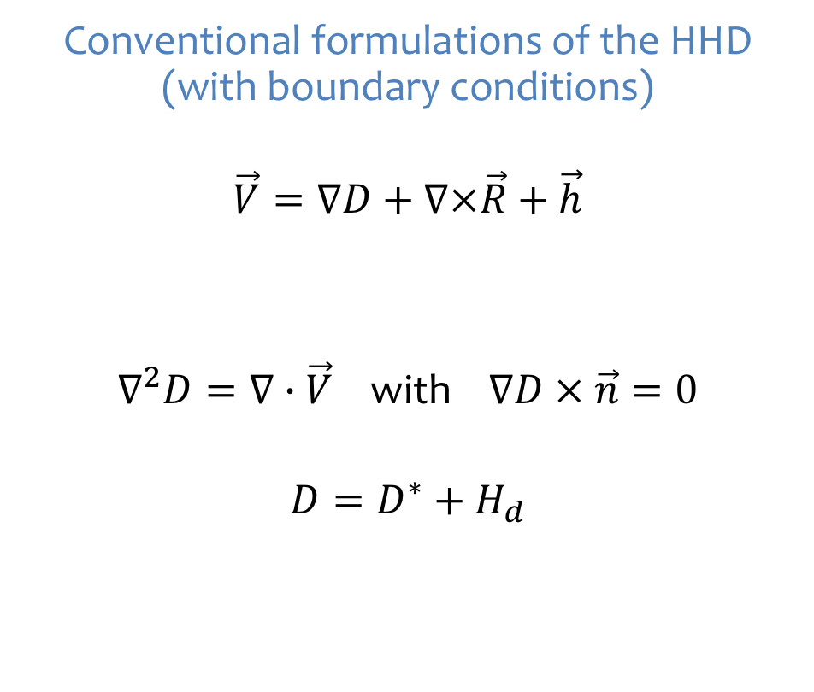
Integral solution allows a relief from boundary conditions
Conventional formulations of the HHD (with boundary conditions)
$$\vec{V}=∇D+∇×\vec{R}+\vec{h}$$
$∇^{2}D=∇∙\vec{V}$ with $∇D × \vec{n}=0$
$$D=D^{∗}+H_{d}$$
The natural HHD
(without boundary conditions)
$$\vec{V}=∇D^{∗}+∇×{\vec{R}}^{∗}+{\vec{h}}^{∗}$$
$∇^{2}D^{∗}=∇∙\vec{V}$
$$D^{∗}\left(x_{0}\right)=\int_{Ω}{G_{∞}}\left(x,x_{0}\right)\left(∇∙\vec{V}\right) dx$$
Compute everything internal using the available information.
This gives a unique solution
Assume what lies outside to compute
a unique solution

Slide 18
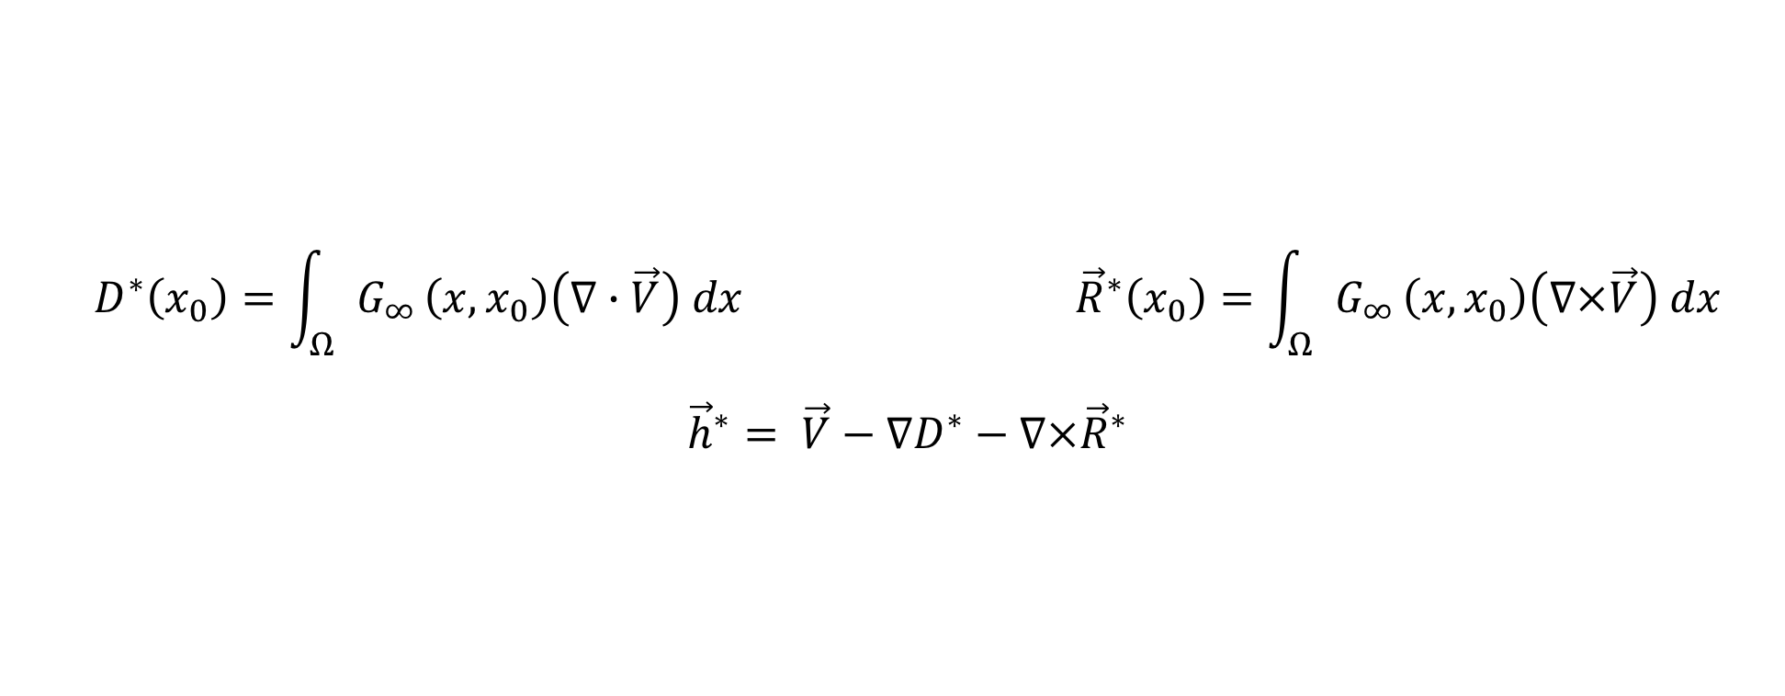
The natural HHD offers significant computational advantages
$$D^{∗}\left(x_{0}\right)=\int_{Ω}{G_{∞}}\left(x,x_{0}\right)\left(∇∙\vec{V}\right) dx {\vec{R}}^{∗}\left(x_{0}\right)=\int_{Ω}{G_{∞}}\left(x,x_{0}\right)\left(∇×\vec{V}\right) dx$$
${\vec{h}}^{∗}= \vec{V}−∇D^{∗}−∇×{\vec{R}}^{∗}$
unique without boundary conditions
split the flow into internal vs. external components
domain extension is conceptual only
  existing “open-boundary” approaches use a physical boundary layer [Söderström et al., 2010]
implementation requires differential and integral operators only
Green’s function is known in closed form

Slide 19
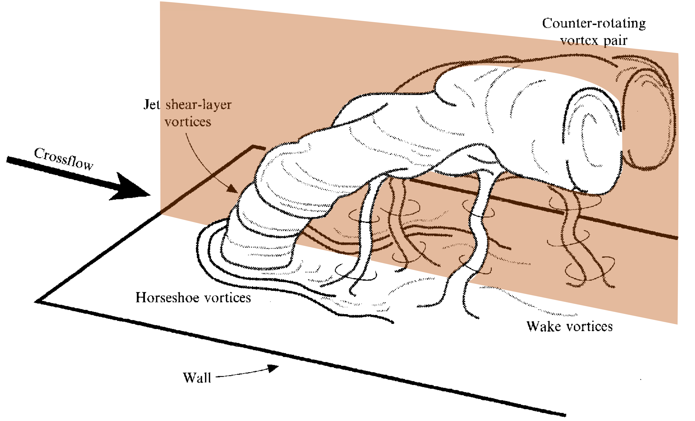
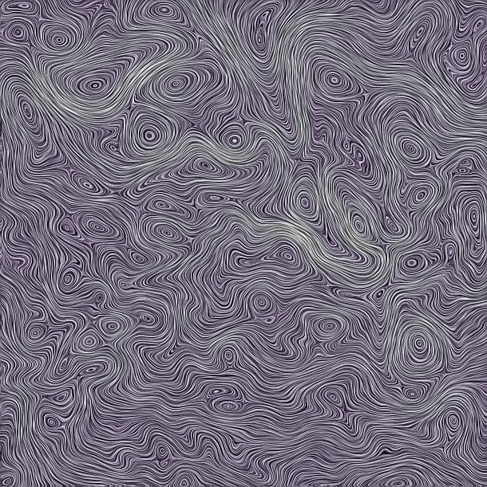
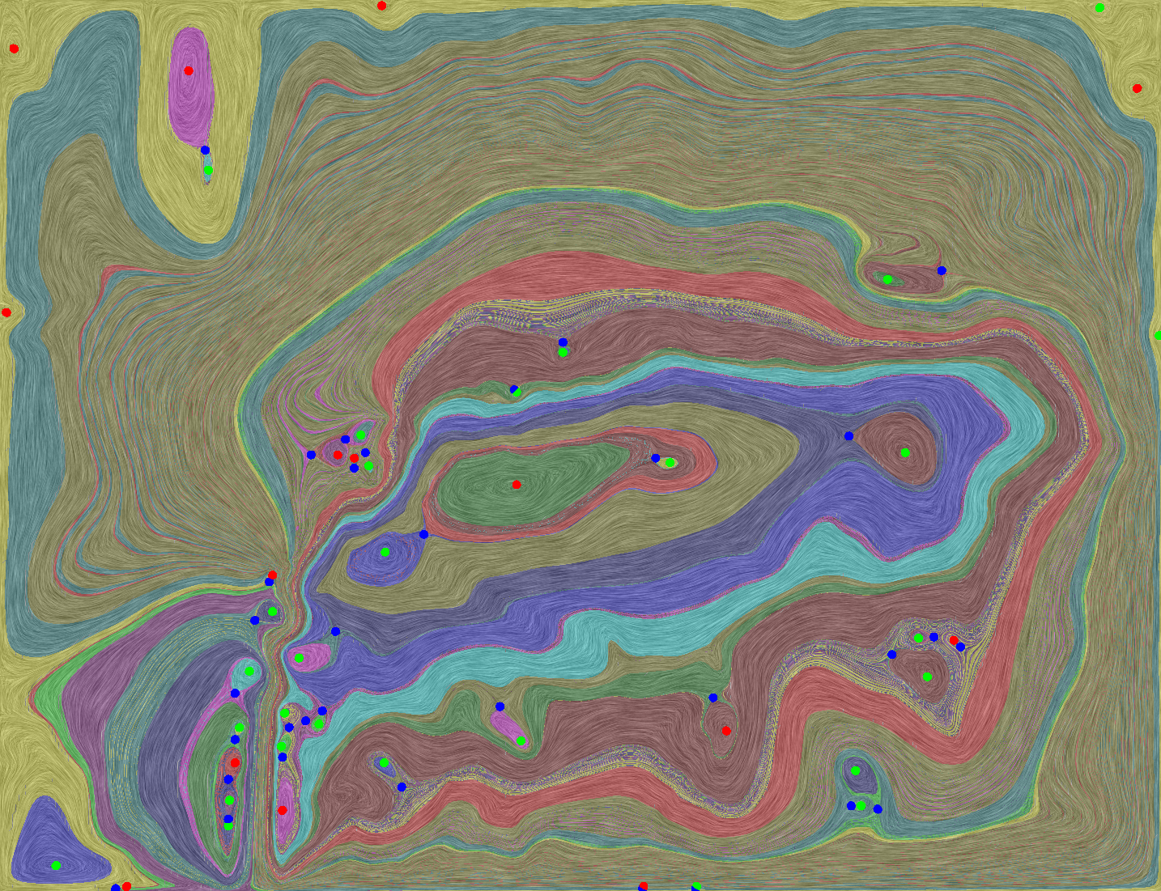
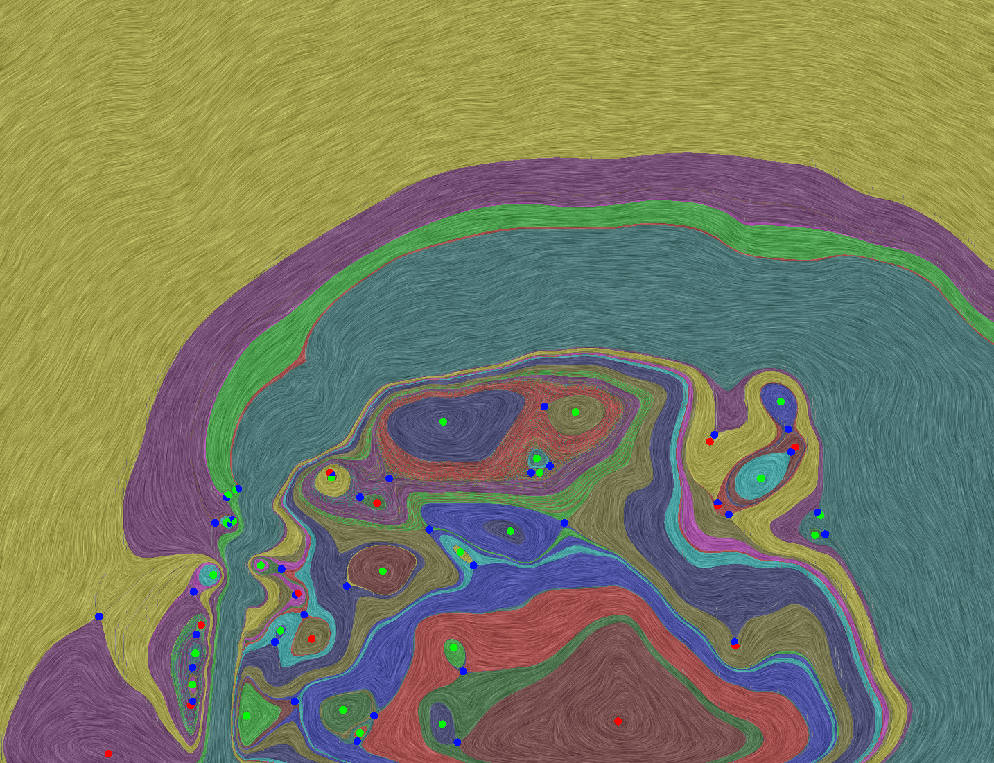
The natural HHD allows open-boundary analysis
The natural HHD is suitable if
  a localized analysis is needed
  an open boundary is needed
  the boundary conditions used in
  the simulation are not known
  boundary flow is an output of
  the simulation
  the boundary conditions used in
  the simulation do not match the
  HHD boundary conditions

Slide 20
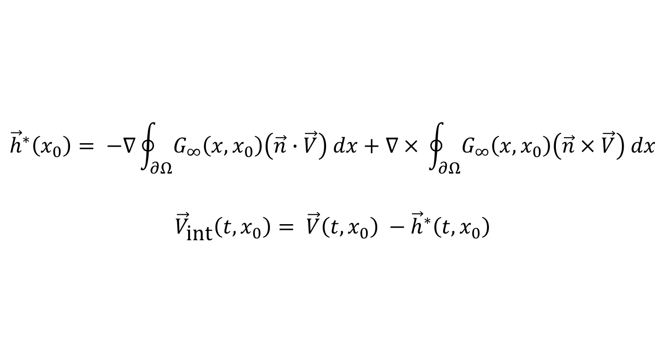
The natural HHD can be used to compute flow in internal frame
$$D^{∗}\left(x_{0}\right)=\int_{Ω}{G_{∞}}\left(x,x_{0}\right)\left(∇∙\vec{V}\right) dx {\vec{R}}^{∗}\left(x_{0}\right)=\int_{Ω}{G_{∞}}\left(x,x_{0}\right)\left(∇×\vec{V}\right) dx$$
${\vec{h}}^{∗}= \vec{V}−∇D^{∗}−∇×{\vec{R}}^{∗}$
$${\vec{h}}^{∗}\left(x_{0}\right)= −∇\oint_{∂Ω}{G_{∞}\left(x,x_{0}\right)\left(\vec{n}∙\vec{V}\right) dx}+∇ × \oint_{∂Ω}{G_{∞}\left(x,x_{0}\right)\left(\vec{n} × \vec{V}\right) dx}$$
${\vec{V}}_{\text{int}}\left({t,x}_{0}\right)= \vec{V}\left({t,x}_{0}\right) −$ ${\vec{h}}^{∗}\left(t,x_{0}\right)$
[Bhatia et al., EuroVis 2014]

Slide 21
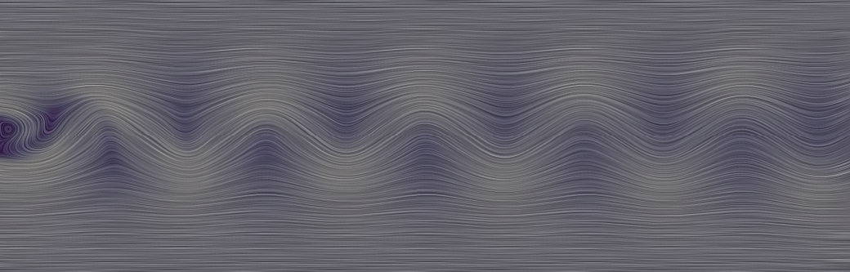

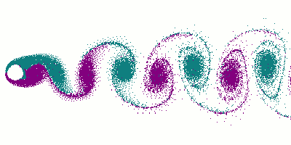
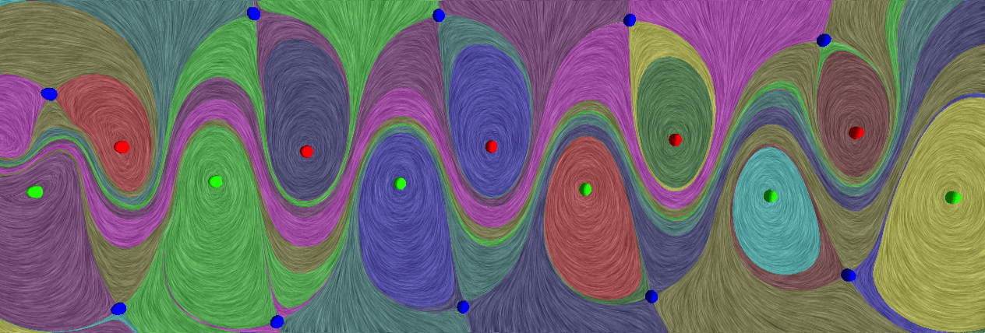

Streamline-based analysis in the internal frame reveals the hidden von Kármán vortex street
Flow in the simulation’s frame.
von Kármán vortex street.
The natural harmonic flow captures the background flow.
Topological analysis of the flow in the internal frame.

Slide 22
The internal frame is physically meaningful
Flow in 10% faster frame.
Flow in the internal frame.
Flow in 10% slower frame.

Slide 23
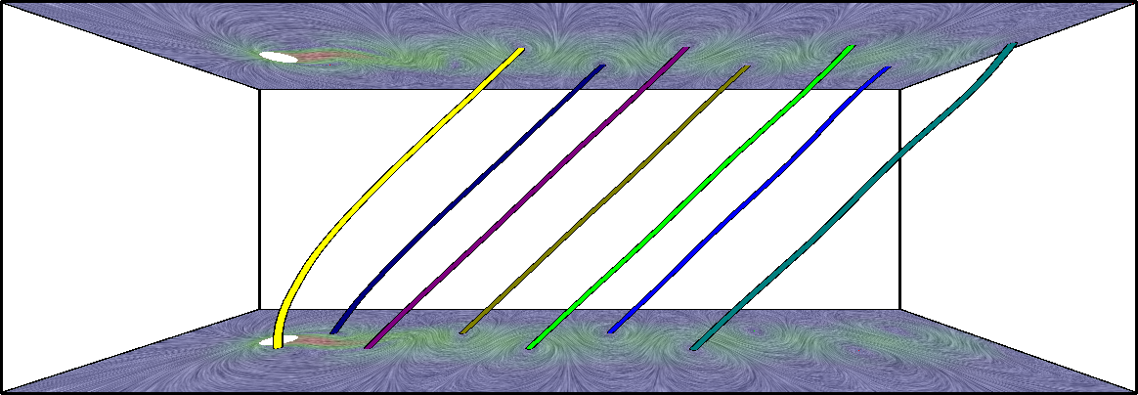
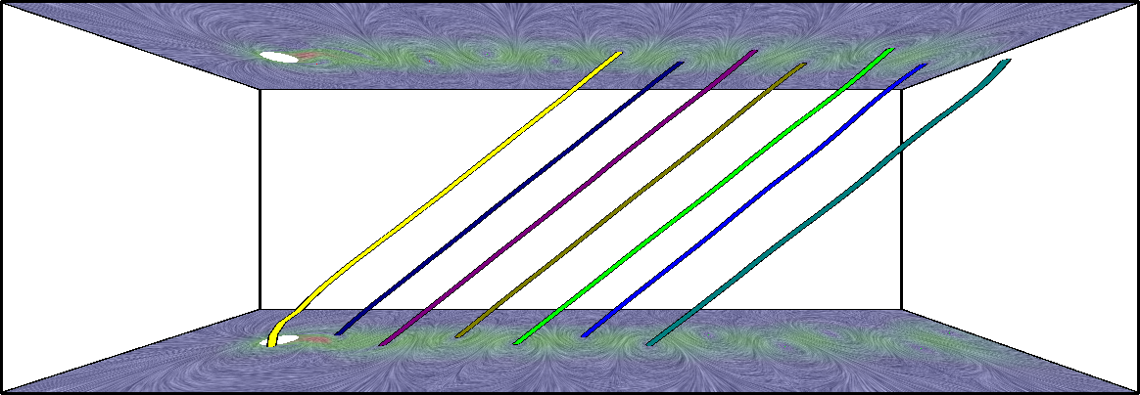
Temporal behavior of the von Kármán vortex street can be observed
Applying the streamline-based analysis on each time-step
  instantaneous features are tracked in time
Speed of vortices
  matches theoretical values (~ 91% of the inlet speed)
  increases with increasing Reynolds number (Re)
Time
Time
Re = 100
Re = 165

Slide 24
Lifted ethylene jet shows stable vortices extracted and tracked in the internal frame
Time

Slide 25
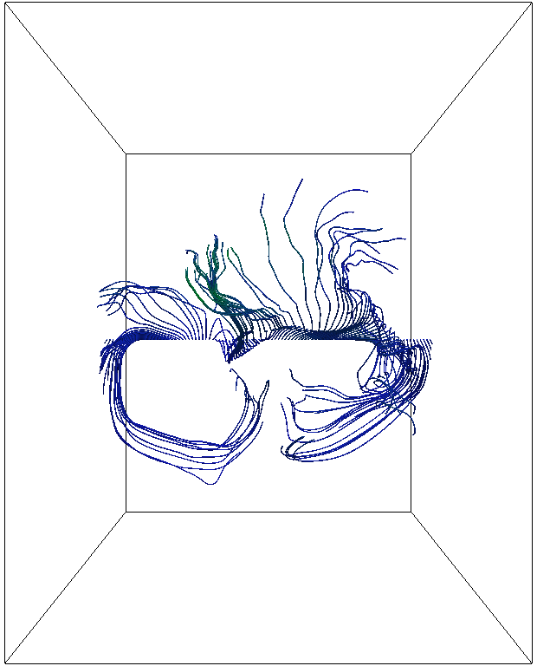
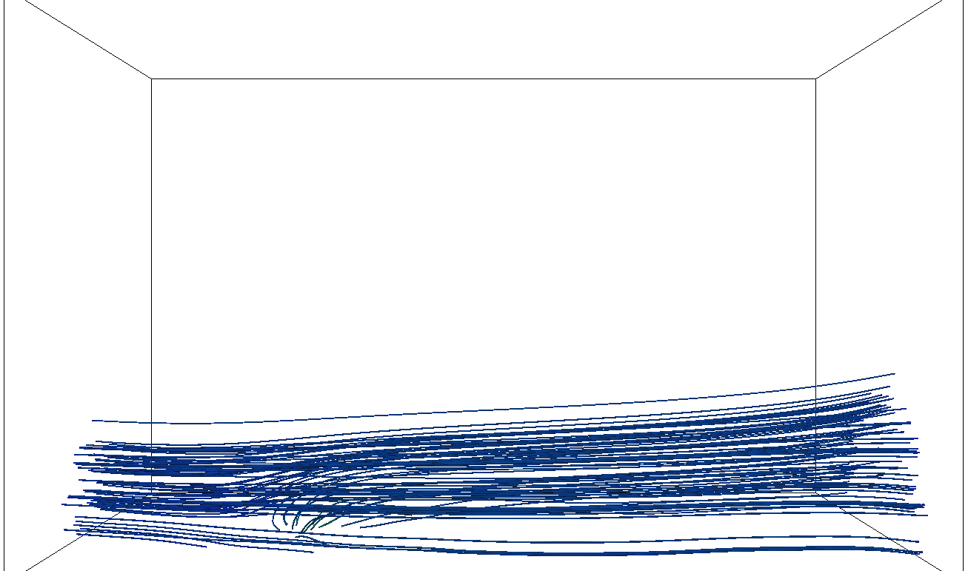
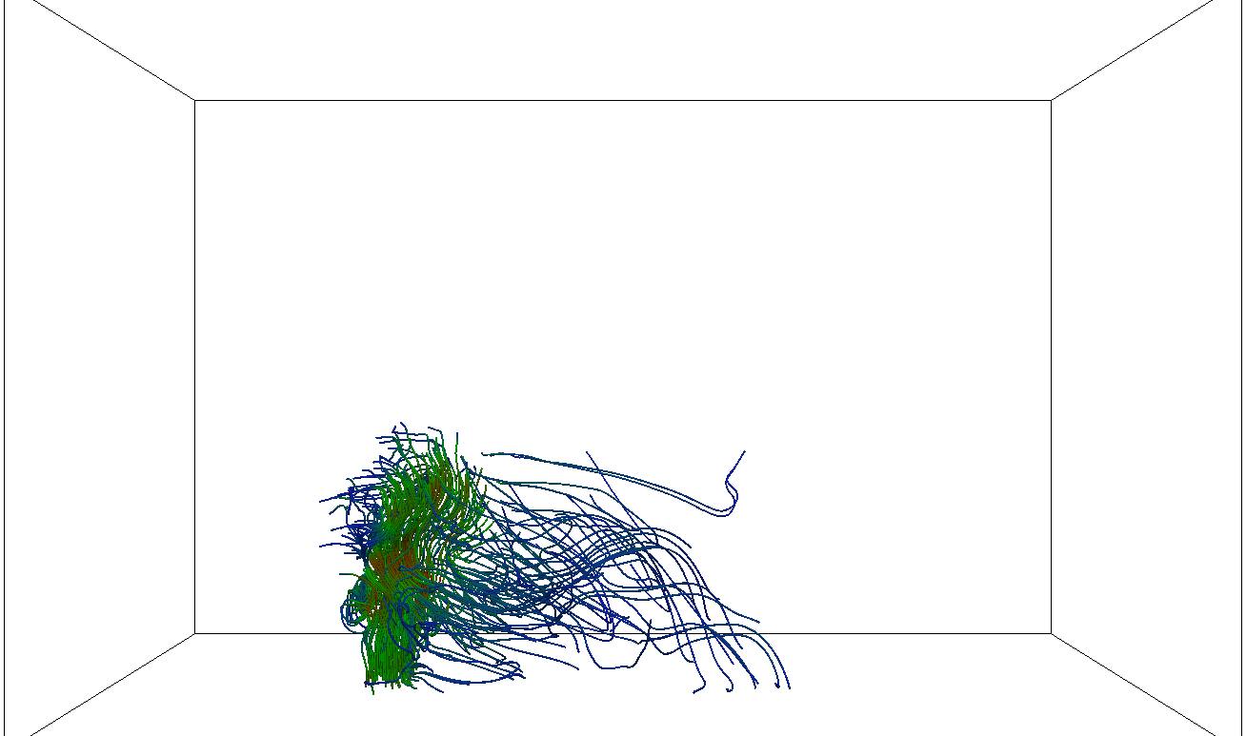
Elusive features of a jet in cross-flow become visible
The background (external) flow is more general than a simple uniform flow
“The counter-rotating vortex pair becomes visible for the first time”
The turbulence near the jet’s orifice is visible
Notes:
Point out that this is more general harmonic

Slide 26
Flow decompositions play a crucial role in simulation, analysis, and visualization
The HHD can decompose the flow into components with different characteristics
Boundary conditions used for the decomposition are important
Even the most commonly used boundary conditions create significant artifacts
The natural HHD does not impose boundary conditions and is more suitable for analysis
The flow in the internal frame can be used for extraction and tracking of flow features

Slide 27
Acknowledgements
My coauthors: Bremer, Pascucci, Kirby, Norgard
Many people I have cited and interacted over the course of this work
Nektar++ for flow simulations
U.S. Department of Energy

Slide 28
References
Python code to compute the natural HHD. https://github.com/bhatiaharsh/naturalHHD
H. Bhatia, V. Pascucci, and P.-T. Bremer. The Natural Helmholtz-Hodge Decomposition for Open-Boundary Flow Analysis. IEEE Transactions on Visualization and Computer Graphics (TVCG), vol. 20, no. 11, pp. 1566–1578, Nov. 2014. doi:10.1109/TVCG.2014.2312012.
H. Bhatia, V. Pascucci, R. M. Kirby, and P.-T. Bremer. Extracting Features from Time-Dependent Vector Fields Using Internal Reference Frames. Computer Graphics Forum (Proceedings of EuroVis), vol. 33, issue 3, pp. 21–39, Jun. 2014. doi:10.1111/cgf.12358.
H. Bhatia, G. Norgard, V. Pascucci, and P.-T. Bremer. The Helmholtz-Hodge Decomposition — A Survey. IEEE Transactions on Visualization and Computer Graphics (TVCG), vol. 19, no. 8, pp. 1386–1404, Aug. 2013. doi:10.1109/TVCG.2012.316.
H. Bhatia, G. Norgard, V. Pascucci, and P.-T. Bremer. Comments on the "Meshless Helmholtz-Hodge decomposition". IEEE Transactions on Visualization and Computer Graphics (TVCG), vol. 19, no. 3, pp. 527–528, Mar. 2013. doi:10.1109/TVCG.2012.62.
Y. Tong, S. Lombeyda, A. Hirani, and M. Desbrun, “Discrete Multiscale Vector Field Decomposition,” ACM Trans. Graphics, vol. 22, no. 3, pp. 445-452, 2003.
A. Wiebel, “Feature Detection in Vector Fields Using the Helmholtz-Hodge Decomposition,” Diploma thesis, Diplomarbeit, Univ. Kaiserslautern, 2004.
A. Wiebel, C. Garth, and G. Scheuermann, “Computation of Localized Flow for Steady and Unsteady Vector Fields and its Applications,” IEEE Trans. Visualization and Computer Graphics, vol. 13, no. 4, pp. 641-651, July/Aug. 2007.
K. Polthier and E. Preuß, “Variational Approach to Vector Field Decomposition,” Proc. Eurographics Workshop Scientific Visualiza- tion, 2000.
K. Polthier and E. Preuß, “Identifying Vector Fields Singula- rities Using a Discrete Hodge Decomposition,” Mathematical Visualization III, H.C. Hege, K. Polthier, eds., pp. 112-134, Springer, 2003.
F. Petronetto, A. Paiva, M. Lage, G. Tavares, H. Lopes, and T. Lewiner, “Meshless Helmholtz-Hodge Decomposition,” IEEE Trans. Visualization and Computer Graphics, vol. 16, no. 2, pp. 338- 342, Mar./Apr. 2010.
A. Wiebel, C. Garth, and G. Scheuermann, “Localized Flow Analysis of 2D and 3D Vector Fields,” in Data Visualization 2005: Proc. of Eurographics/IEEE-VGTC Symposium on Visualization 2005 (EuroVis 2005), K. Brodlie, D. Duke, and K. Joy, Eds. Eurographics Association, June 2005, pp. 143 – 150.

Slide 29
Feature Extraction and Tracking using Vector Field Decompositions
Harsh Bhatia
hbhatia@llnl.gov
https://github.com/bhatiaharsh/naturalHHD
This work was performed under the auspices of the U.S. Department of Energy by Lawrence Livermore National Laboratory (LLNL) under contract DE-AC52-07NA27344. LLNL-PRES-759730
This document was prepared as an account of work sponsored by an agency of the United States government. Neither the United States government nor Lawrence Livermore National Security, LLC, nor any of their employees makes any warranty, expressed or implied, or assumes any legal liability or responsibility for the accuracy, completeness, or usefulness of any information, apparatus, product, or process disclosed, or represents that its use would not infringe privately owned rights. Reference herein to any specific commercial product, process, or service by trade name, trademark, manufacturer, or otherwise does not necessarily constitute or imply its endorsement, recommendation, or favoring by the United States government or Lawrence Livermore National Security, LLC. The views and opinions of authors expressed herein do not necessarily state or reflect those of the United States government or Lawrence Livermore National Security, LLC, and shall not be used for advertising or product endorsement purposes.

