Slide 1


Multiscale Simulation Framework for Modeling of Structural Energetics
Justin B. Hooper, Grant D. Smith
Wasatch Molecular Incorporated
SLC, Utah
Dmitry Bedrov, Todd Harman
Department of Mechanical Engineering &
Department of Materials Science and Engineering
University of Utah
James Guilkey
Laird Avenue Consulting, SLC Utah

Slide 2
Objectives of Phase-I
Capitalize on our extensive experience in multiscale modeling simulations of energetic materials using and adopt/enhance this approach for investigation and design of structural energetic materials (SEMs).
Using this multiscale modeling approach to identify and study key phenomena (and their coupling) that define the response of SEM under various insult scenarios.

Slide 3
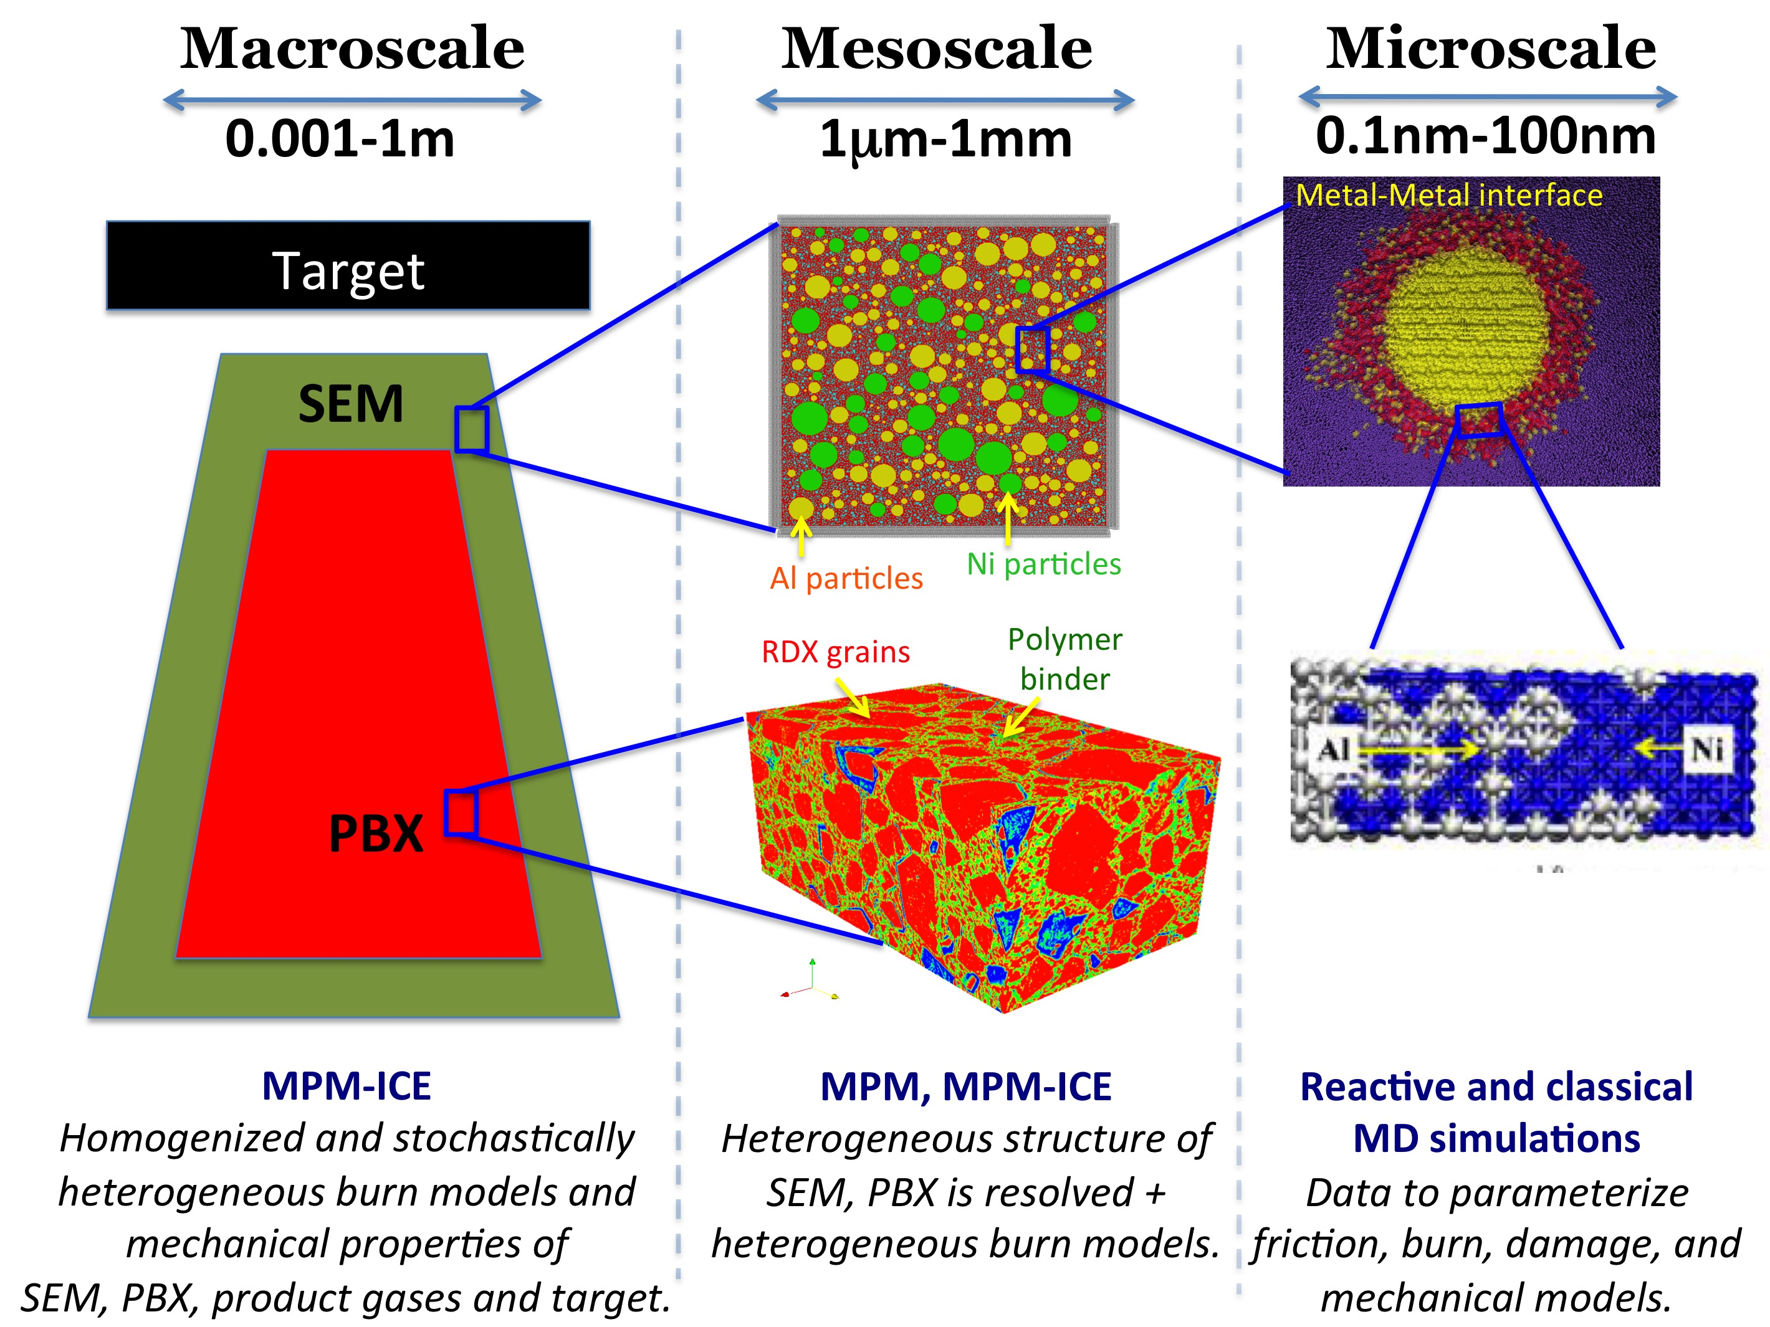
Multiscale modeling approach

Slide 4
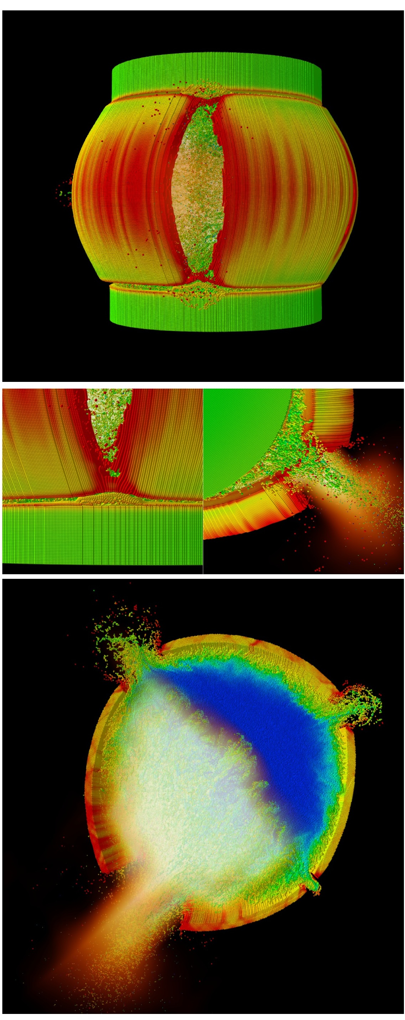
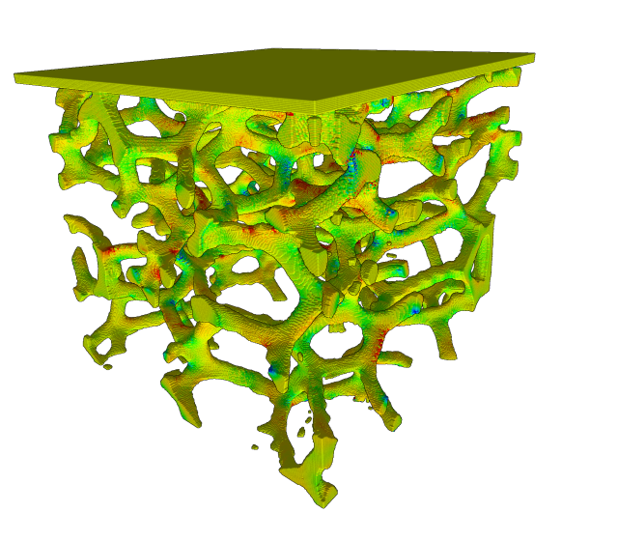
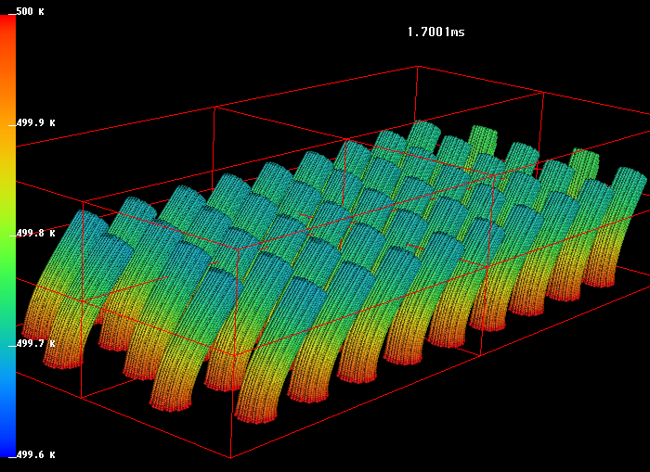
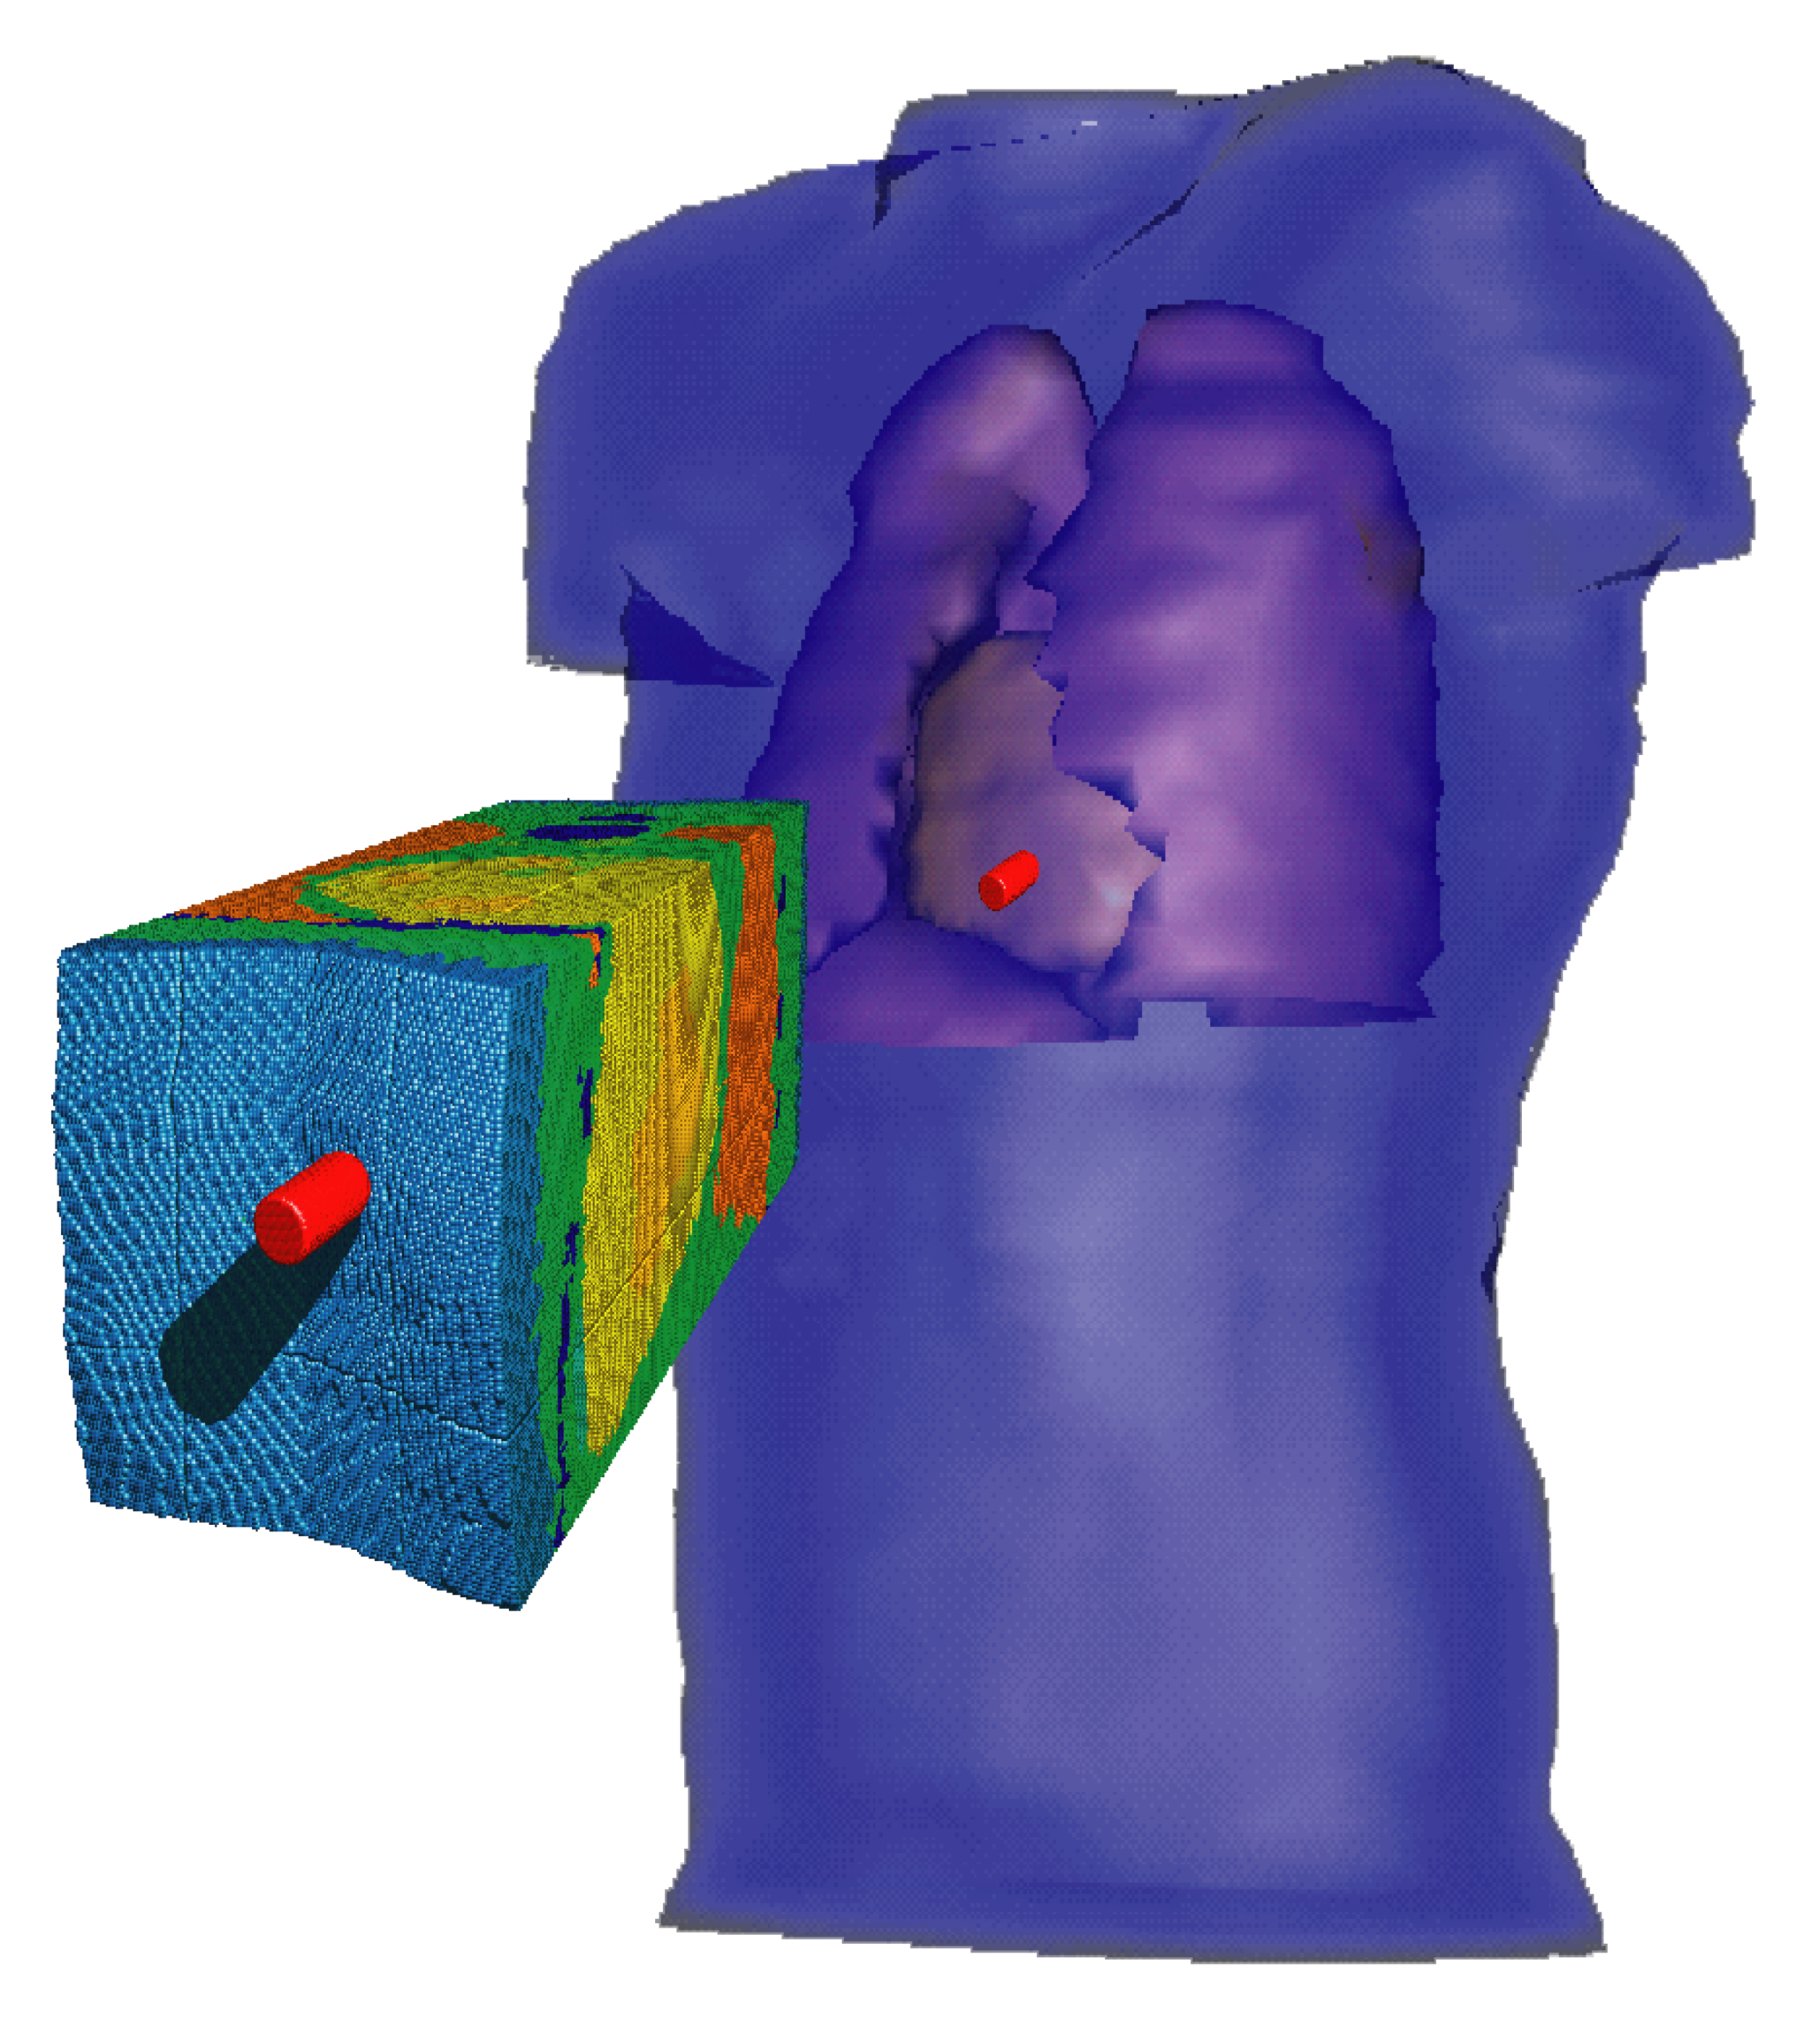
Explosion of container with explosive
Materials Point Method +
Uintah Computational Framework
(12+ years development under DOE ASCI program C-SAFE at UofU)
-MPM is a mixed grid /particle method
-Excellent for large deformations, multi-phase and multi-material systems
Includes coupling of fluid-solid interactions (MPM-ICE)
Adaptive mesh refinement
MPM+Uintah are highly scalable (up to 1M cores)
Projectile impact of human torso
Fluid-structure interaction in microfluidic device
Compaction of a foam

Slide 5
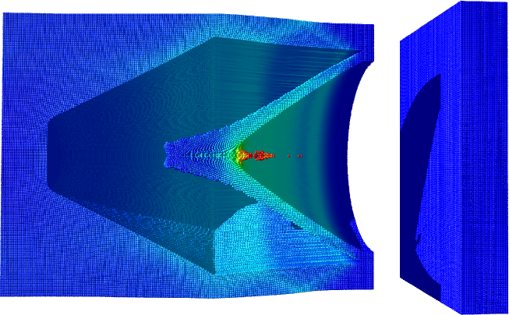
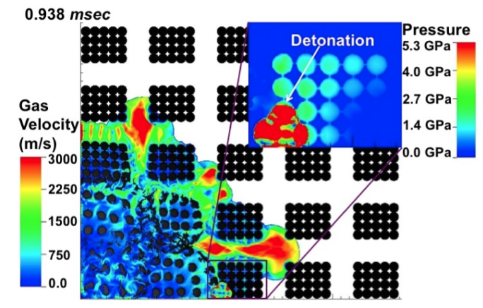
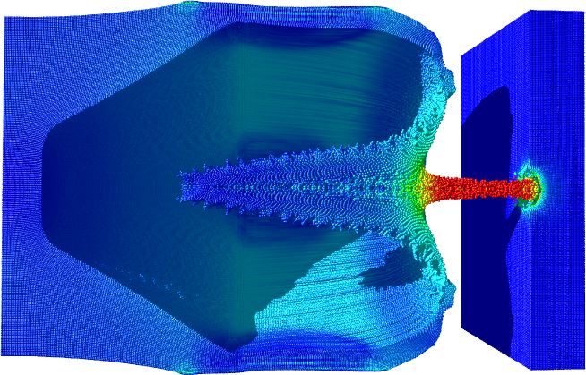
Materials Point Method + Uintah
(recent applications/developments)
MPM simulation of shape-charge driven penetration of tungsten particles into a granular quarts target.
Solid/gas interactions in an exploding array of homogenized PBX-9501 cylinders
Initial formation of the tungsten particle jet via explosive initiation (top) and high velocity impact of the tungsten particles due to cohesive acceleration via the shaped shockwave interaction (bottom). Coloration indicates velocity from low (blue) to high (red).

Slide 6

Atomistic MD simulations
-Atoms, molecules and reactions/interactions between them are resolved explicitly
Allow to obtain correlations between molecular scale structure and macroscopic properties
Provide crucial insight/properties for materials/conditions hardly accessible for experiments (e.g., mechanical and reaction properties of energetic materials, interfacial properties, etc).

Slide 7
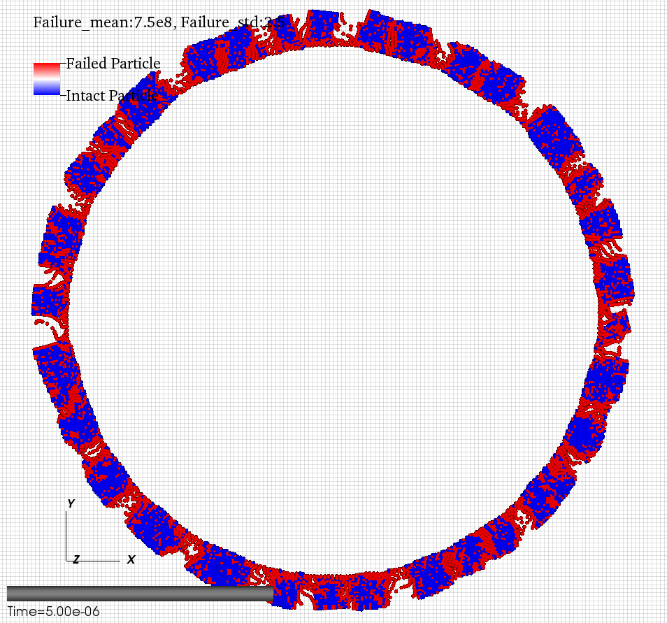
Phase I Objective: Develop and demonstrate multiscale modeling capabilities for the test case scenario:
- PBX ignites inside Al/Ni-based SEM container
- container fragments into pieces that fly away while interacting with surrounding gas/air
- Al/Ni interdiffusion/reactions are initiated upon initial shock of SEM and continue while fragments are flying
- reacting Al/Ni SEM fragments hit the target
Detonation
PBX
Target
Al/Ni SEM

Slide 8
Phase I Technical Objectives
TO-1: Generate representative mesoscale samples with high % of TMD model SEM geometries.
TO-2: Determine frictional response of metal grain contacts under loading.
TO-3: Determine mesoscopic response to uniaxial thermal and mechanical loading of model mesoscale samples.
TO-4: Develop initial Al-Ni reaction and thermodynamic transition models.
TO-5: Implement EOS, constitutive and damage models for macroscale simulations.
TO-6: Compare heterogeneous and homogeneous macroscale models.

Slide 9
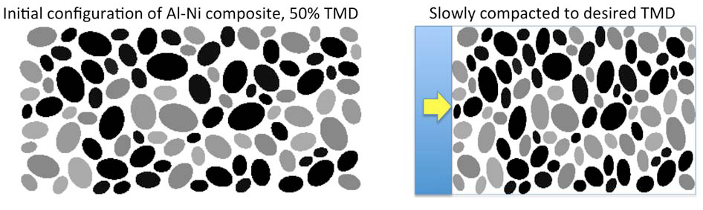
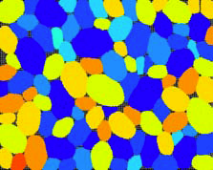
Generation of Mesoscale Structures of SEM
Mesoscale MPM simulations of representative SEM microstructures - - - Fully resolved Al and Ni grains
- Realistic size distributions
Final configuration from
preparation (“processing”)
96% TMD

Slide 10
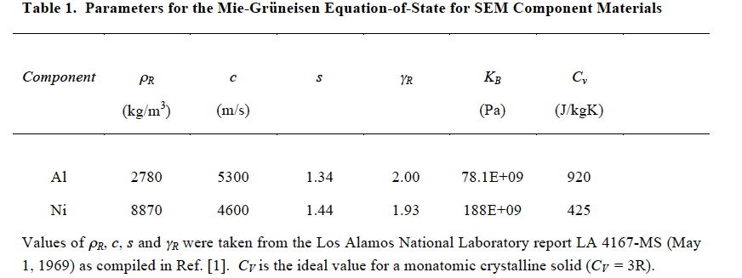
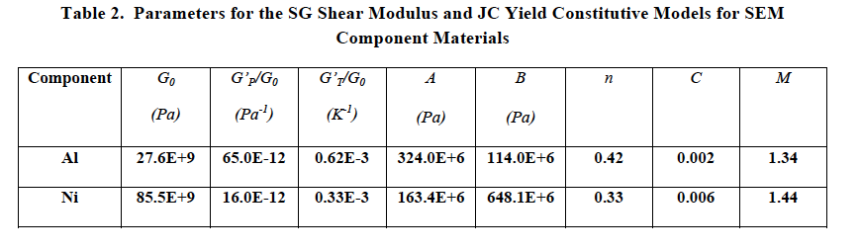
Selection of models for bulk properties of SEM components
- Mie-Grueneisen EOS for Al and Ni
- Steinberg-Cochran-Guinan shear modulus for Al and Ni
- Johnson-Cook failure model for Al and Ni

Slide 11
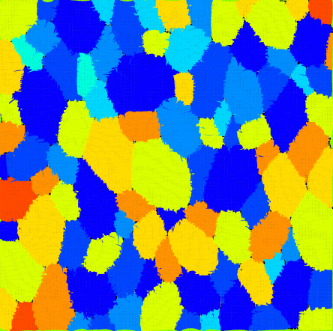
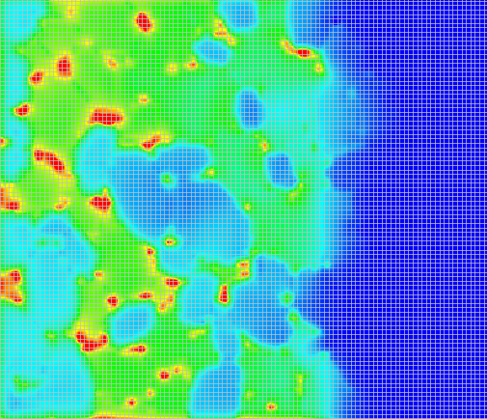
Uniaxial compression and shock of SEM
Quasistatic compression to 15GPa stress starting from a sample at 96%TMD
(strain rate 40,000 1/s)
Stress distribution in the same sample after 20ns of shock propagation
(shock velocity 700m/s, shock stress 15GPa)
Stress distribution

Slide 12
PVT behavior of SEM
- Typical behavior of granular material is observed
- Flat region is associated with “squeezing out” the void space
- The higher the strain rate the stiffer the dependence due to reduced ability of frictional sliding to allow for filling the voids
Quaistatic compression, rate 40,000/s
Sample with 96% TMD
Influence of strain rate

Slide 13
Mean temperature and temperature profiles: Quasistatic
Friction work and plastic deformation result in modest increase of mean temperature for the range of deformations investigated.
The mean temperature is well below the atmospheric melting temperature of aluminum (around 933 K) even for the largest deformation/highest pressures investigated.
Note, that melting temperature of aluminum increases by about 50 K for each GPa of pressure.

Slide 14
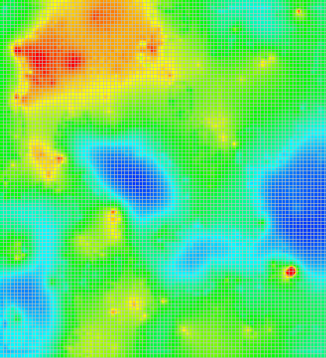
Mean temperature and temperature profiles: Quasistatic
Temperature profile from the standard model after 6.2 microseconds (25 GPa) of compression. Blue to green is below mean temperature while yellow to red is above mean temperature
- Even for the significant pressure of 25 GPa, the hottest hot spots are only around 800 K, about 300 K above the mean temperature and well below aluminum melting temperature.

Slide 15
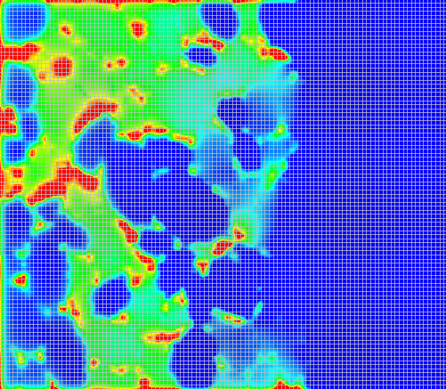
Mean temperature and temperature profiles: Shock
Shock compression results in slightly higher mean temperature but hot spot temperatures are still ~800 K.
Shock of samples with initially lower TMD (89%) leads to hot spots of ~850K

Slide 16

Influence of grain/grain friction
We compared the behavior of SEM composite with different grain/grain friction and perfect interface (no-friction) case.
The perfect interface case better represents intimate (partially reacted) interfaces between Al/Ni formed due to processing/preparation of SEM
In simulations with perfect interfaces the mean temperature is lower and the distribution is much more homogeneous (only 50K deviation from mean T) compared to simulations with friction

Slide 17
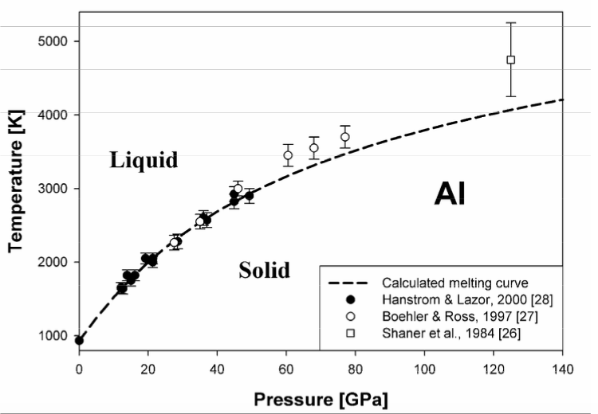
Key outcomes from mesoscale modeling of mechanical response of SEM materials:
Homogenized Mie-Grueneisen EOS and linear hardening model have been obtained for composite material → will be used in macroscale simulations where microstructure is not resolved.
Plastic deformations, mechanical work, and grain friction lead to modest increase of mean temperature and hot spots with T not higher than 800K.
Al
Ni
Not sufficient to cause Al melting, particularly taking into account pressure dependence of T_{m} of Al

Slide 18
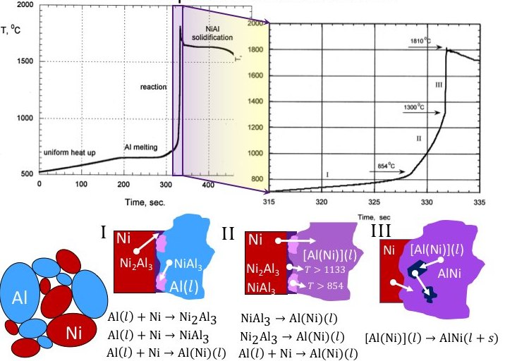
SEM reaction models in mesoscale MPM

Slide 19
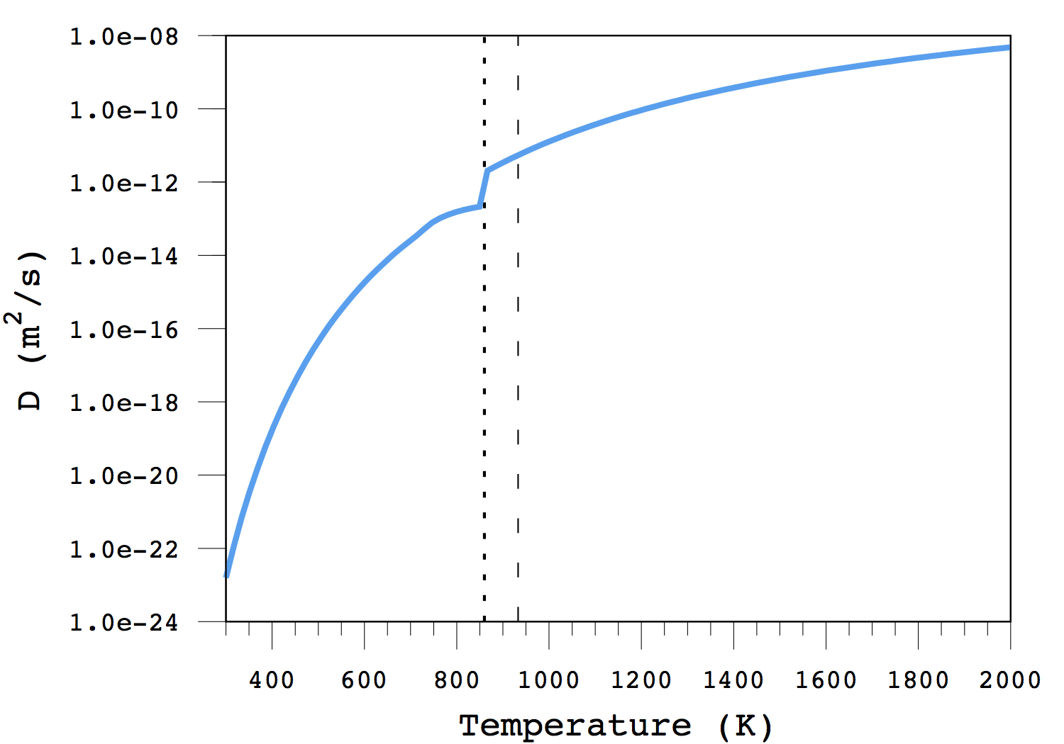
SEM reaction models in mesoscale MPM
Unreacted
Reacted
In MPM code we have coupled the following phenomena:
- Thermal heat conduction
Melting
Al(s)→Al(l), ΔH=10.7 kJ/mol
Ni(s)→Ni(l), ΔH=17.5 kJ/mol
Interdiffusion of species using temperature dependent diffusion coefficients
Reactions
currently all reaction steps
are combined into one with
ΔH = -152 kJ/mol
(K. Morsi, Mat. Sci. and Eng. A, 299, 1-15)
Diffusivity at Al/Ni Interface
933
T_{m}
Sraj et. al., J Appl. Phys. 115 023515 (2014).
860

Slide 20
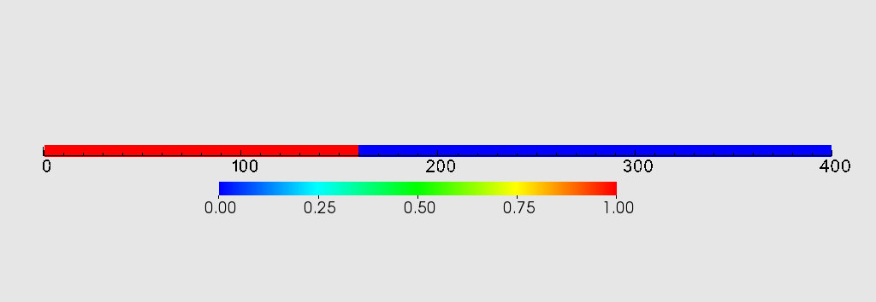
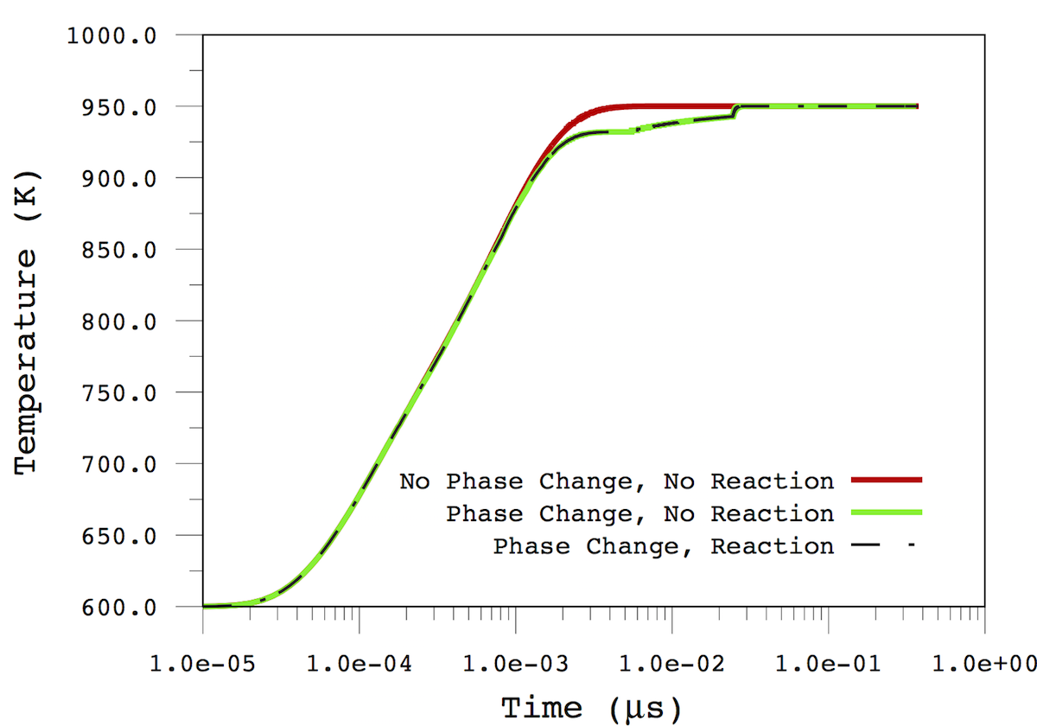
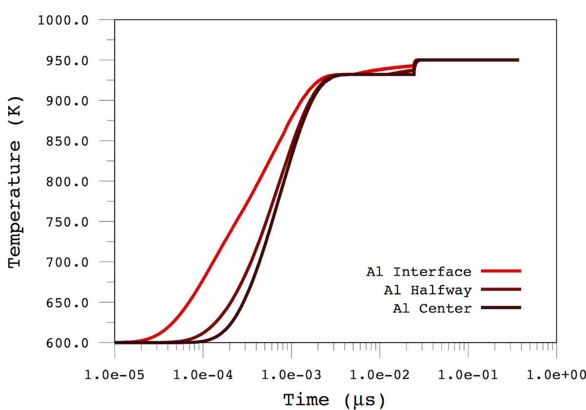

Coupled reaction, diffusion, and thermal transport in
mesoscale MPM
Initial Temperature: 600K
Relative Concentration of Ni
Boundary Fixed At 950K
Initial Concentration Profile
Different Levels of Simulation Fidelity
T vs. Layer Depth
Final concentration profile
  - No noticeable diffusion over temperature ramping time
  - Thermal equilibration ‘instantaneous’; reaction is diffusion limited

Slide 21
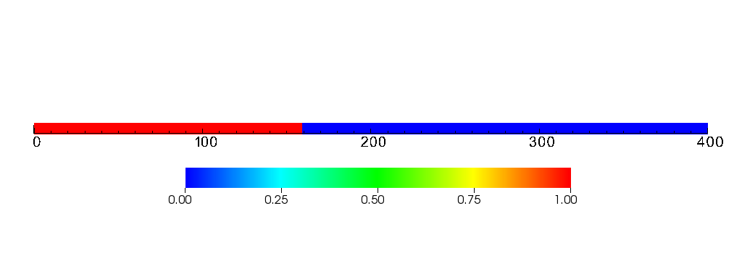
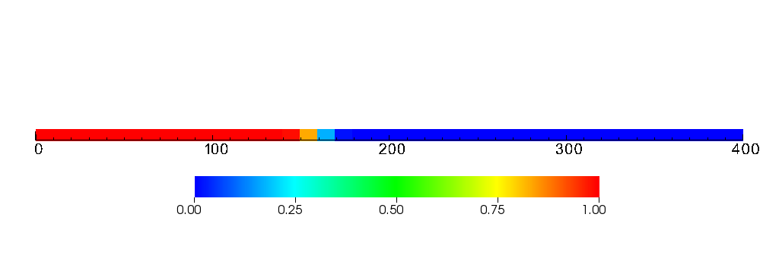
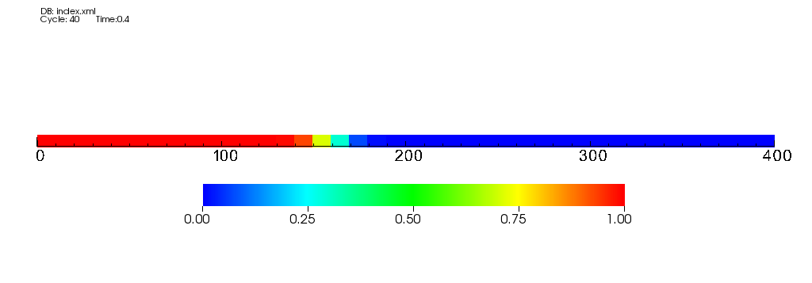
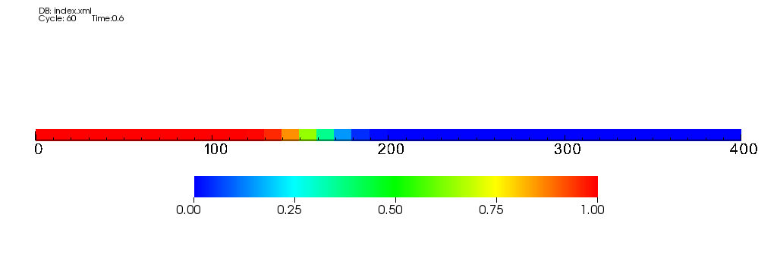
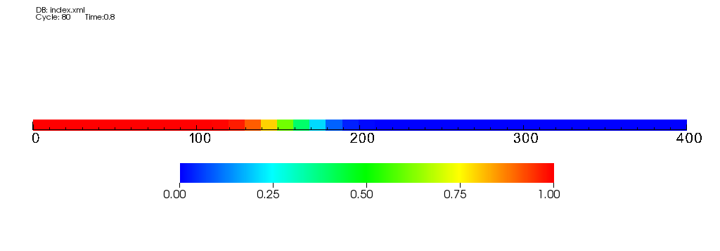

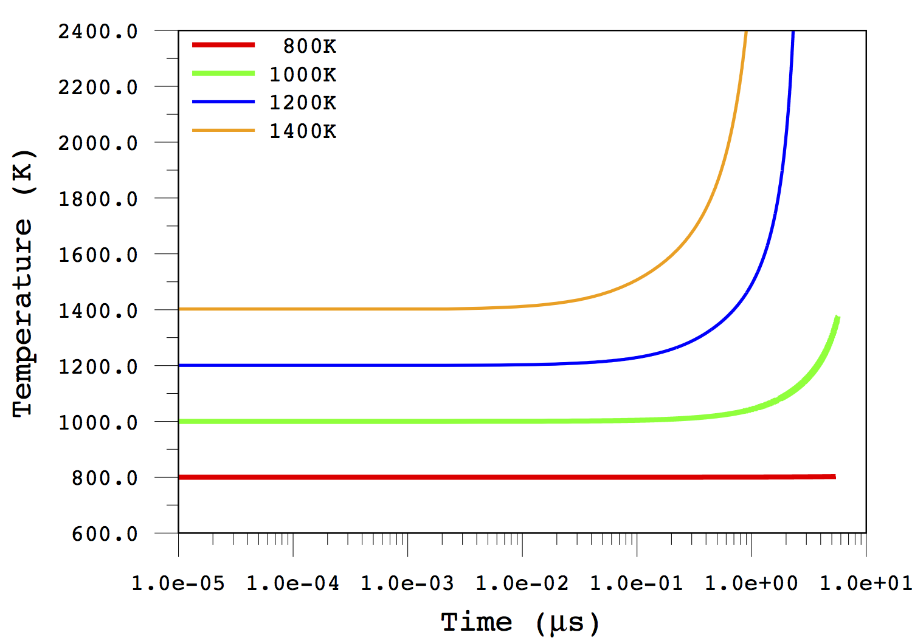
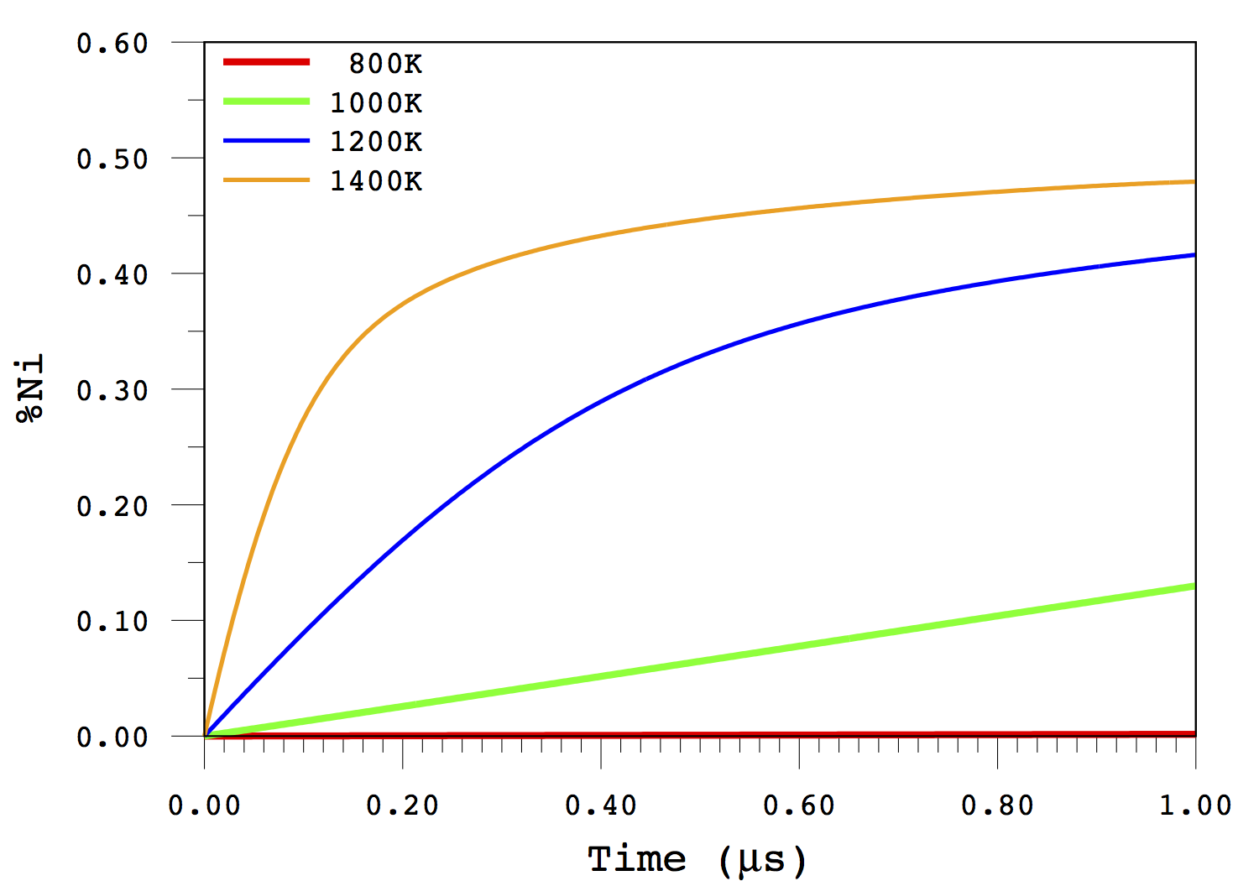
Coupled reaction, diffusion, and thermal transport in
mesoscale MPM
Initial Conditions:
- Block of Ni in contact with Al
- Thermally insulated boundaries
- Initial T= 800,1000, 1200, 1400 K
- Temperature change purely from reaction
Concentration of Ni
  - At higher initial temperatures the diffusion is fast enough to result in substantial heat release and reaction front acceleration.

Slide 22
Key outcomes from mesoscale modeling of thermal transport, diffusion, phase transformations, and reactions in Al/Ni system:
MPM simulation tool has been enhanced to couple interdiffusion, melting, reactions, and thermal dissipation. The code can handle arbitrary number of reactions (multiple stages) and transformations as well as temperature and material dependent parameters.
At low temperatures (<600K) if we start with an interface of pure Al and Ni, the interdiffusion of Al/Ni is so slow that the heat generated due to reactions will be easily dissipated and insufficient to generate runaway reactions
Runaway reactions (on time scale of 100s of microseconds to several milliseconds) can be expected if the initial temperature of the material is >800K or some initial premixing at Al/Ni interfaces (but only partially reacted) occurred during SEM preparation.
Note, these considerations do not take into account pressure effects on reactions and diffusion

Slide 23
Macroscale simulation of SEM container with PBX
In these simulations we use:
Homogenized properties of SEM obtained from sampling different configurations at mesoscale.
Heterogeneous nature of SEM material properties is taken into account by stochastic distributions.
These simulations allow us:
To determine the relevant range of conditions (stress distribution, temperature, fragment velocity) which SEM material is experiencing.
Establish correlations between molecular scale chemistry, mesoscale grain structure, failure mechanisms and the performance of the SEM-based device.
Probability
Observable

Slide 24
Homogenized engineering scale simulations
(Macroscale MPM and MPM-ICE)
Explosion of PBX inside container with no heterogeneity in the container properties
The container breaks into four large and symmetric pieces

Slide 25
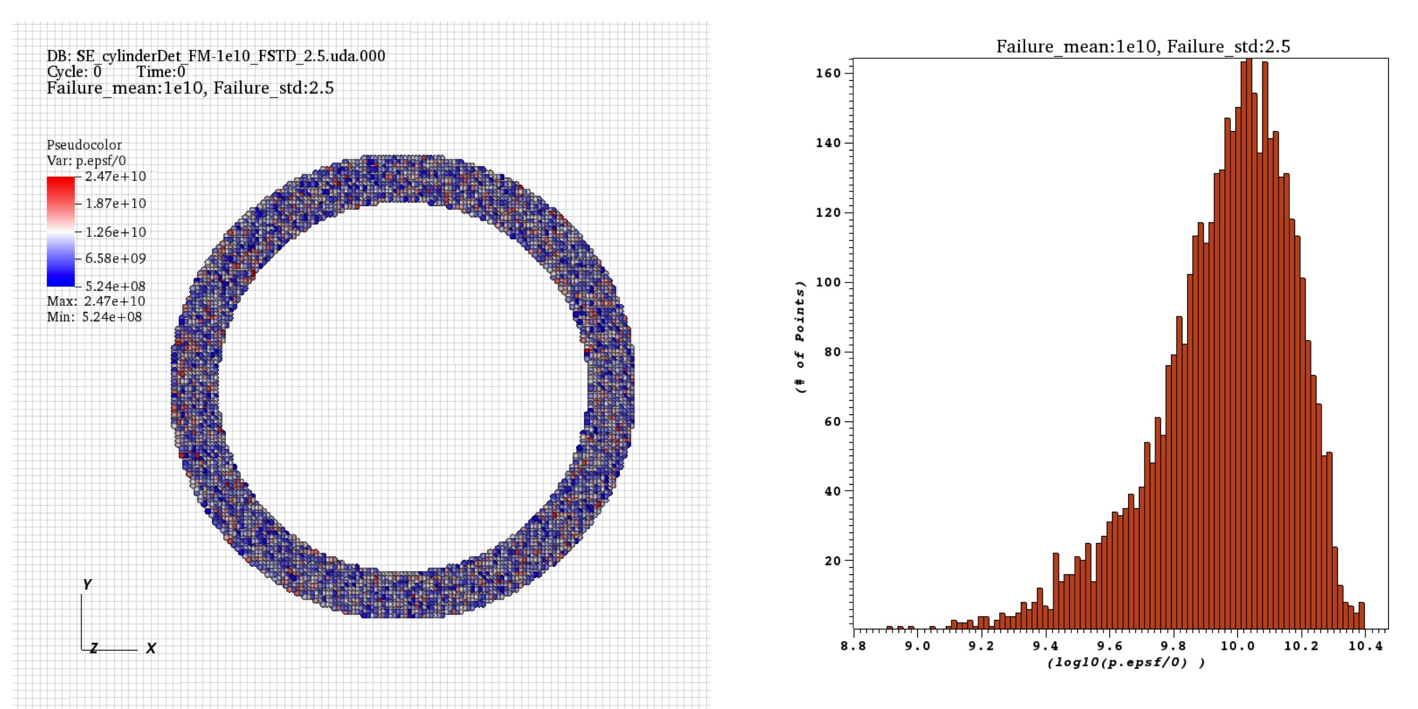
Homogenized engineering scale simulations with stochastic heterogeneity (Macroscale MPM and MPM-ICE)
Now lets have simulation where the failure stress for each material point is taken from a stochastic distribution
Probability
Failure stress

Slide 26
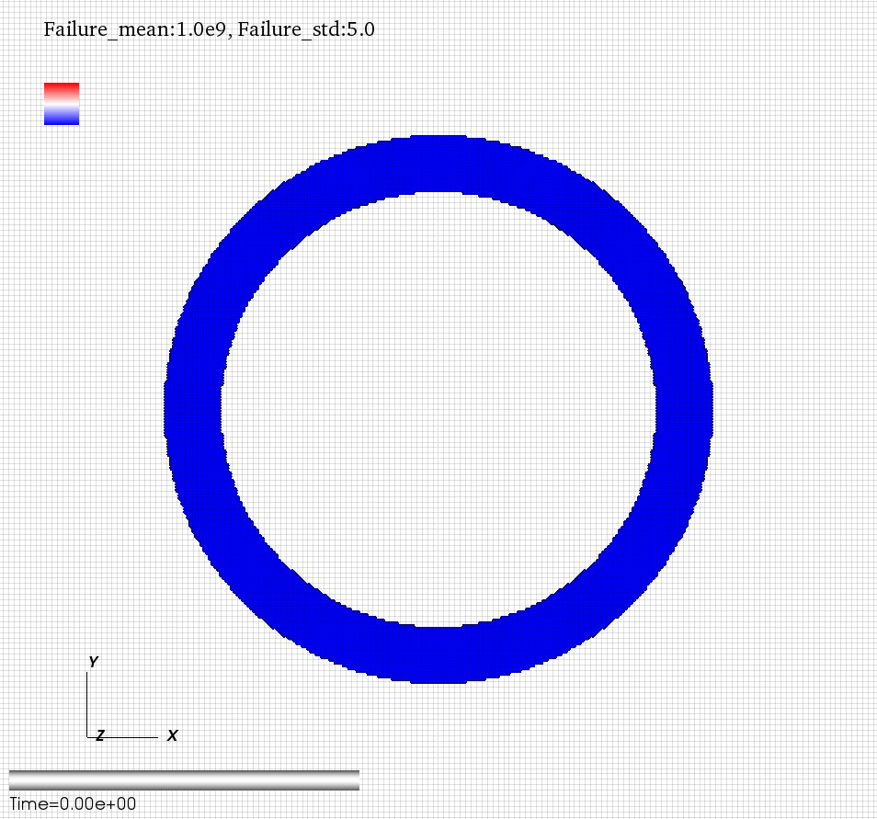

Homogenized engineering scale simulations with stochastic heterogeneity (Macroscale MPM and MPM-ICE)
Red points are “failed” points, i.e. points not supporting the stress
Case on the left has large mean value and narrower distribution of failure criteria

Slide 27
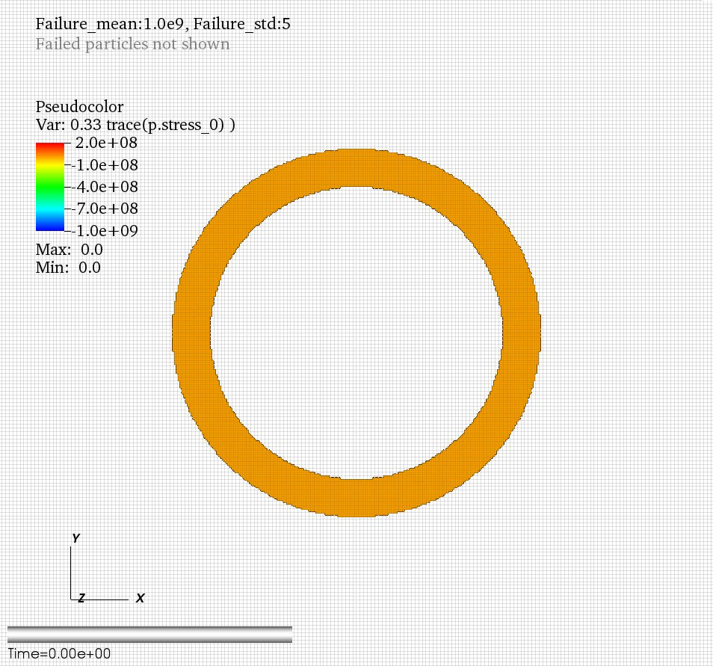
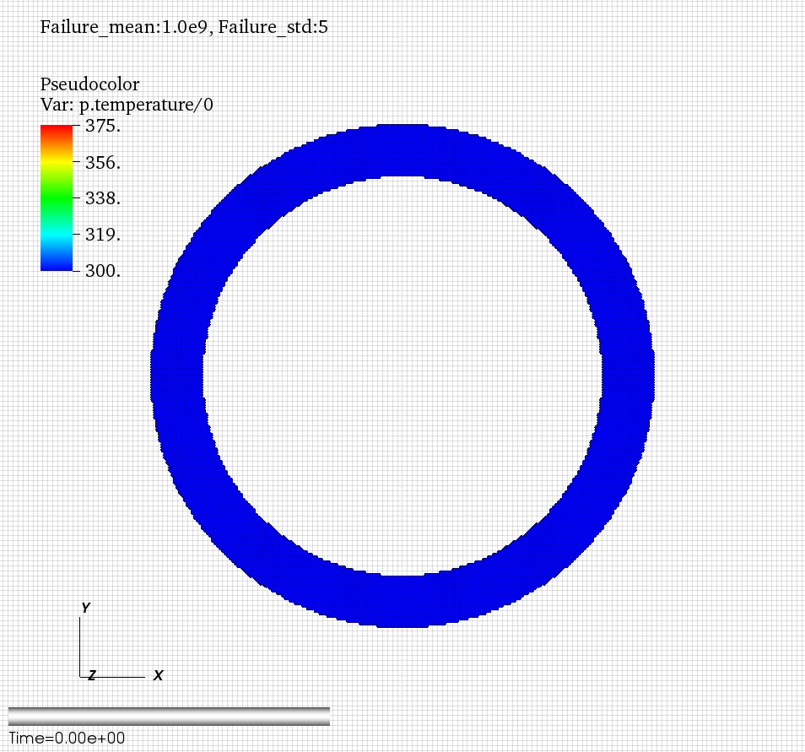
Homogenized engineering scale simulations with stochastic heterogeneity (Macroscale MPM and MPM-ICE)
Stress distribution
Temperature distribution

Slide 28
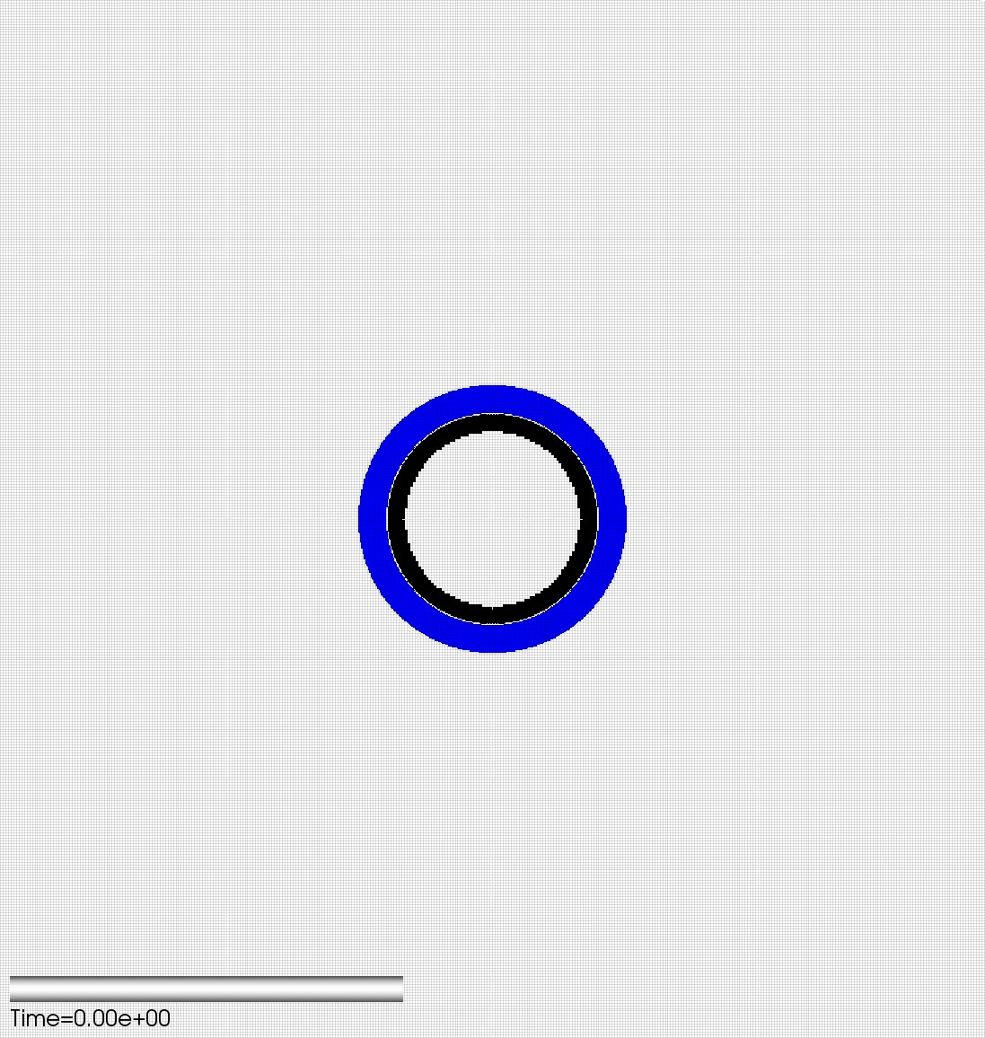
Homogenized engineering scale simulations with stochastic heterogeneity (Macroscale MPM and MPM-ICE)

Slide 29
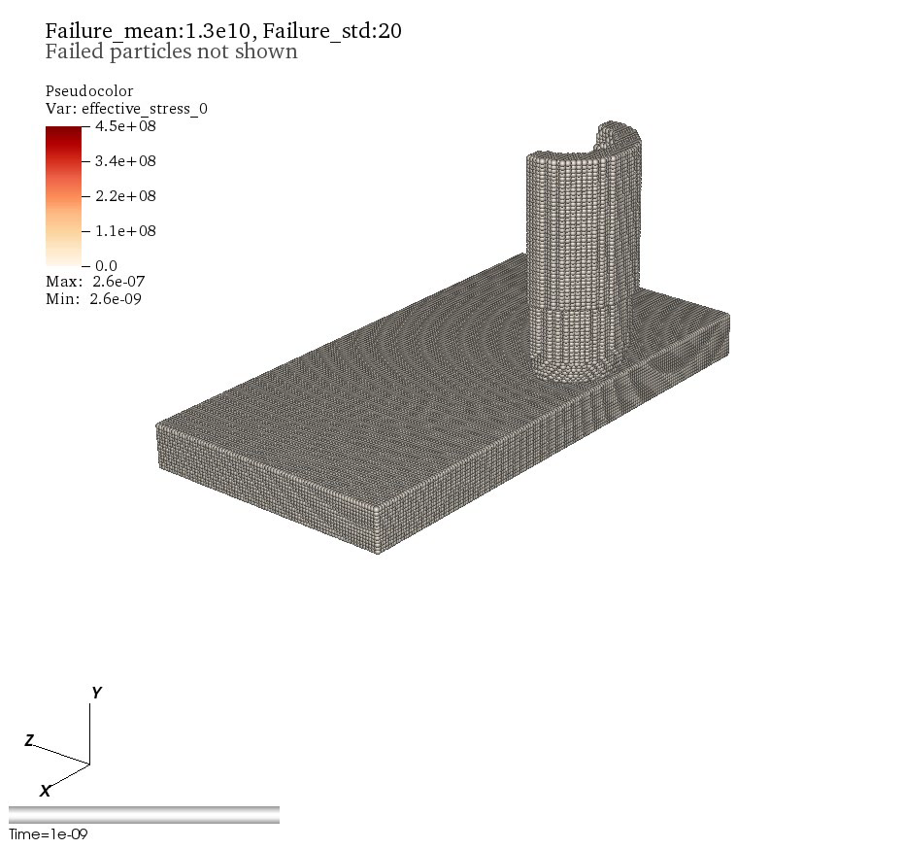
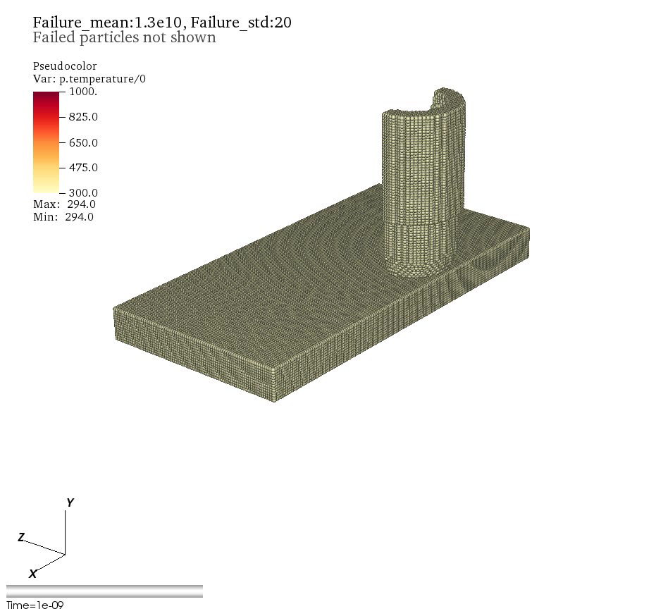
Tracking fragments and their impact (Macroscale MPM-ICE)
Stress distribution
Temperature distribution
By the time of impact (hundreds of microseconds or milliseconds) the SEM fragment can generate significant heat due reactions
Upon impact the fragment kinetic energy converts into thermal energy which can further boost ongoing reactions in SEM

Slide 30
Key outcomes from macroscale simulations
The material models and constitutive properties for these macroscale simulations come from atomistic/mesoscale simulations.
These simulations allow to determine key time scales and distribution of conditions/environments experienced by the SEM materials during insult scenario.
Include fluid/solid structure coupling. Are capable to deal with large deformations and multimaterial representation.
Allow to establish correlations/dependence between atomic scale reaction mechanisms, mesoscale microstructure of SEM, and the engineering scale device performance.

Slide 31
Moving forward to Phase II
Key issues to address:
Enhance reaction model description
Enhance damage/failure models
Take into account the role of initial SEM processing
Efficient coupling of phenomena with different time scales

Slide 32
Role of processing
Our simulations demonstrate that shock loading of high density SEMs (e.g., 90% + TMD) does not lead to reaction (e.g., hot spots are not sufficiently hot)
However, reactions are observed experimentally in many Al/Ni composites:
Shock loading (> 15 GPa) of low density (e.g., 50-60% TMD) materials with nanosized grains
  A lot of frictional heating
  A lot of interfaces, relatively little “bulk” material
Shock loading (> 15 Gpa) of high density SEM materials (granular and multilayer) that have experienced specific processing conditions
  Shock loading (< 15 GPa)
  Hot isostatic pressing (800 K +, several GPa ? )
  High shear
  Reactive milling

Slide 33
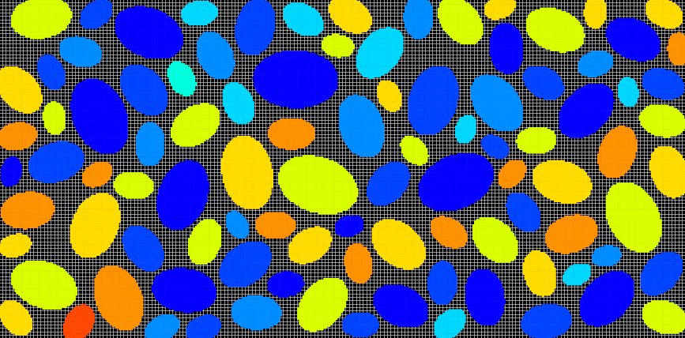
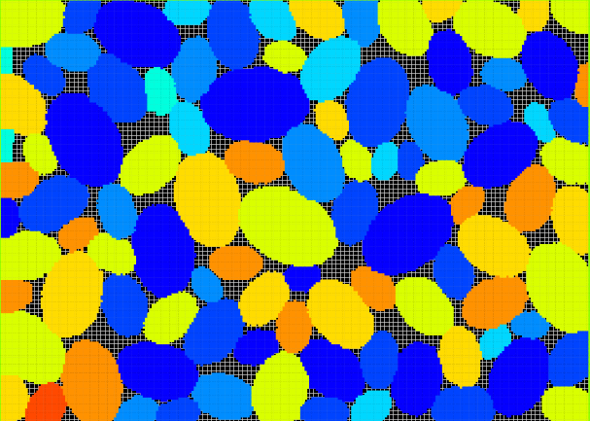
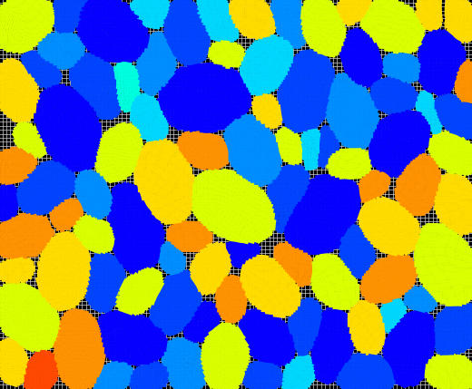
Where does the difference lie?
Role of processing
Our simulations have emulated hot isostatic pressing, but do not include changes in the Al/Ni interface that might occur during processing
It is known that the Al/Ni interfaces transform during processing
  resulting SEMs have good mechanical integrity
  experimental analysis of post-detonation fragments indicate that the failure does not occur preferentially at the grain/grain boundaries
Al/Ni composite at 60%, 89% and 96% TMD from MPM simulations

Slide 34
How Processing Influences SEM Reactivity?
Role of processing
Diffuse/partially reacted (intimate) Al/Ni interfaces are indicated
Our preliminary simulations indicate that such interfaces are much more susceptible to further reaction than pristine, sharp interfaces
In Phase II we will include diffusion/reaction effects in mesoscale MPM simulations of processing
  Informed by atomistic simulations
  Shock loading
  Hot isostatic compression
  Other
  Influence on performance and optimization

Slide 35
Enhancement of reaction/diffusion models:
Atomistic Simulations
EAM (embedded atom method) and/or ReaxFF will be used
Both have been used to study Al/Ni interfaces and reactions
No studies of the influence of pressure on diffusion and reaction have been performed

Slide 36
Enhancement of reaction/diffusion models:
Atomistic Simulations
MD simulations will play a key role in Phase II:
  Quantify the influence of pressure on Al/Ni interdiffusion
  Quantify the influence of pressure on Al/Ni reaction (mechanisms and heats of reaction)
  Understand the nature of the Al/Ni interface, including structure, strength and fracture toughness
  Influence of pressure on Al melting T at Al/Ni interface

Slide 37
Enhancement of failure models: Damage Mechanics
The team will be enhanced by Pro. Nairn (Oregon State University) who is world expert in modeling of damage mechanics.
Damage mechanics has been developed as an alternative method for modeling damage evolution in complex materials.
In brief, damage mechanics replaces displacement discontinuities of explicit cracks with altered constitutive laws for the material.
Despite the attraction of damage mechanics models, the vast majority of implementations have a major drawback in that they resort to the special case of “isotropic” damage.
We claim that isotropic damage mechanics are inadequate. In contrast, our new methods include anisotropy and we have demonstrated a rigorous connection to fracture mechanics
When materials develop damage and cracks, they become anisotropic.

Slide 38
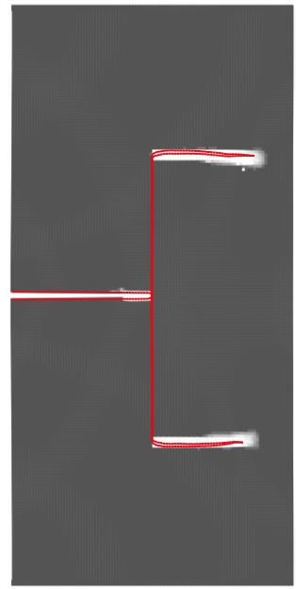

Enhancement of failure models: Damage Mechanics
Our claim is that it is vitally important that any numerical modeling approach to predicting cracks (e.g., damage mechanics) must demonstrate that it can reproduce explicit crack results when applied to the same problem.
Furthermore, this comparison/validation allows for parameterization of the ADaMM based upon fracture mechanics properties.
Pre-seeded crack-1
Growing crack-2
Superposed crack path results from an explicit crack model (red line) and a damage mechanics model (particles in white).

Slide 39
Open questions and desired input from the Air Force:
Should we work with model microstructures (as in Phase-I) or Air Force plans to provide specific SEM microstructures for Phase II?
Are there any fracture measurements/data for existing SEMs?
Can we get information on specific processing conditions that are typically considered to make SEMs with high % TMD?
Are their specific device performance characteristics that should be taken into account (e.g., fragments size distribution, flying time, impact properties, etc.)?
Is Air Force interested in using our simulation tools or should we focus on the development of more generic physics-based models that can be subsequently implemented into other codes?

Slide 40
Thank you!

Slide 41
Multiscale Modeling Approach: MPM
Material Point Method - is a mixed grid /particle method
1
2
1.Particles with properties (velocity, mass, etc)
2.Defined on a mesh
3.Particle properties mapped onto mesh points
4. Forces, accelerations, velocities
calculated on mesh points
5. Mesh point motion calculated.
6. Only the particles moved by mapping velocities back to particles
3
4
5
6

Slide 42
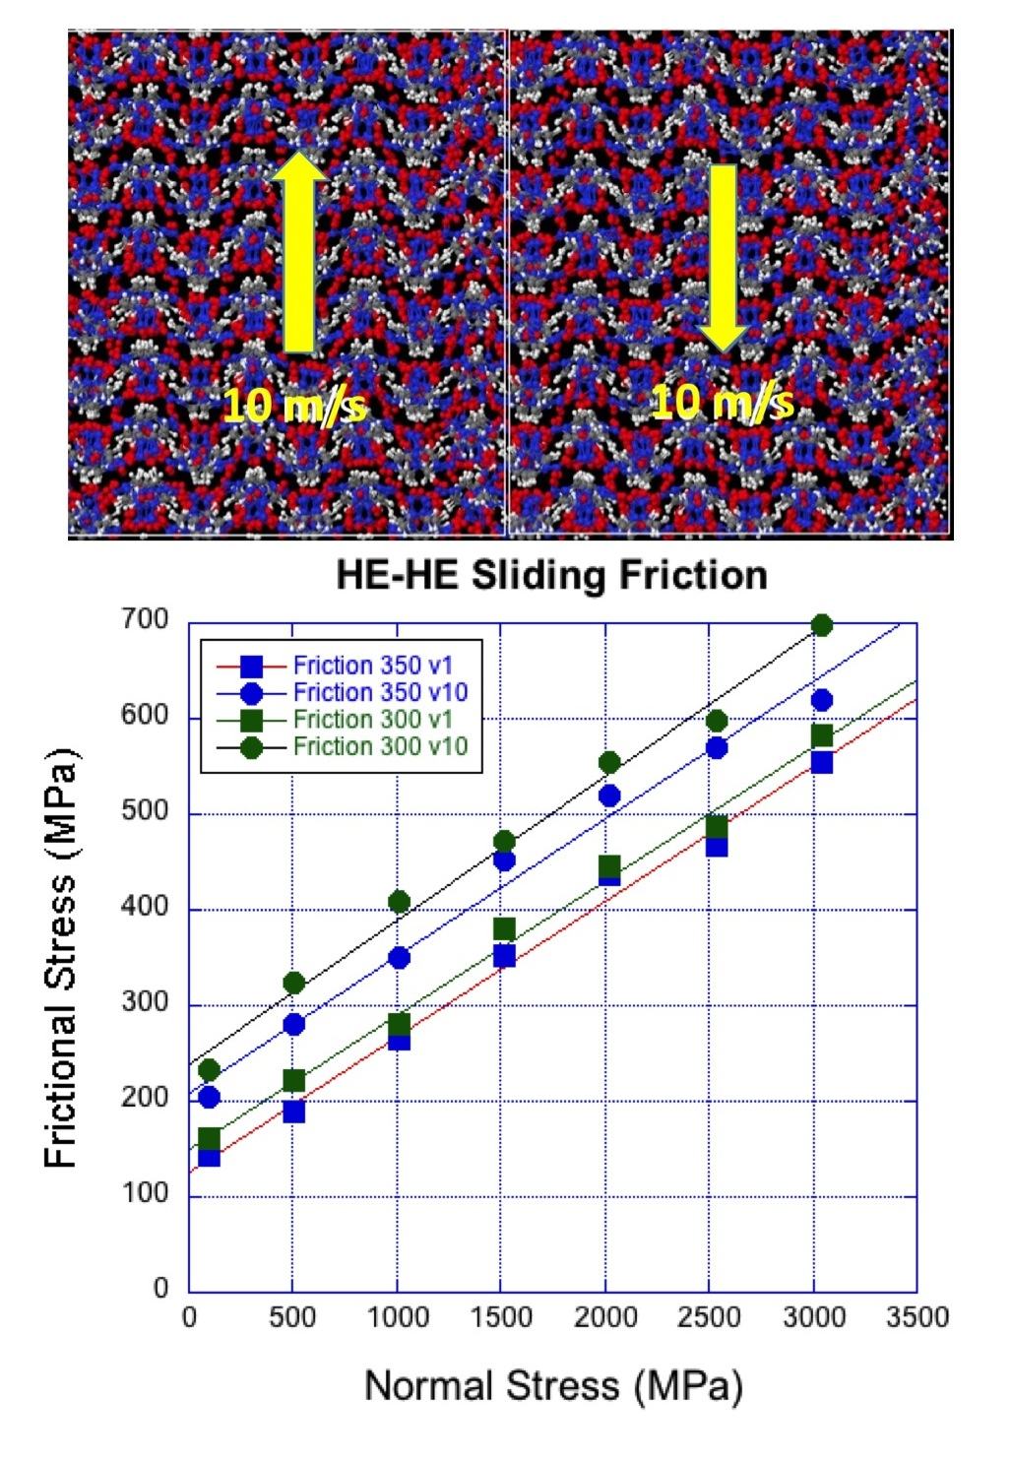
Parameters for Al-Ni friction model
- Friction models for Al/Al, Ni/Ni and Al/Ni from atomistic MD simulations using Embedded Atom Model (EAM)
P
V
Phase 1
P
P
Phase 2
P
Phase 1 = Al or Ni
Phase 2 = Al or Ni
P = normal load (0 to 5 GPa)
V = sliding velocity (1 m/s to 10 m/s)
T = 300 K to 900 K

