Slide 1
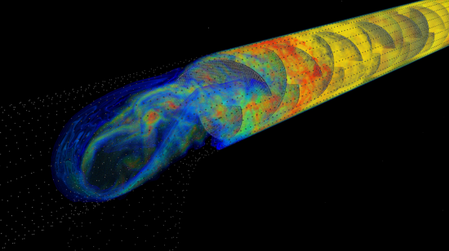
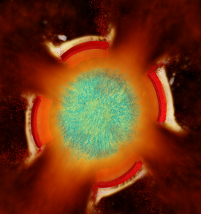
Radiation Modeling Using the Uintah Heterogeneous CPU/GPU Runtime System
Alan Humphrey, Qingyu Meng, Martin Berzins, Todd Harman
Scientific Computing and Imaging Institute & University of Utah
Uintah Overview
Emergence of Heterogeneous Systems
Modifying Uintah Runtime: CPU-GPU Scheduler
ARCHES Combustion Simulation Component
Developing a Radiation Transport Model
Results, Future Work and Conclusion
Thanks to:
John Schmidt, Jeremy Thornock, Isaac Hunsaker, J. Davison de St. Germain
Justin Luitjens and Steve Parker, NVIDIA
DoE for funding the CSAFE project from 1997-2010, DOE NETL, DOE NNSA, INCITE
NSF for funding via SDCI and PetaApps
Keeneland Computing Facility, supported by NSF under Contract OCI-0910735
Oak Ridge Leadership Computing Facility for access to TitanDev
http://www.uintah.utah.edu

Slide 2
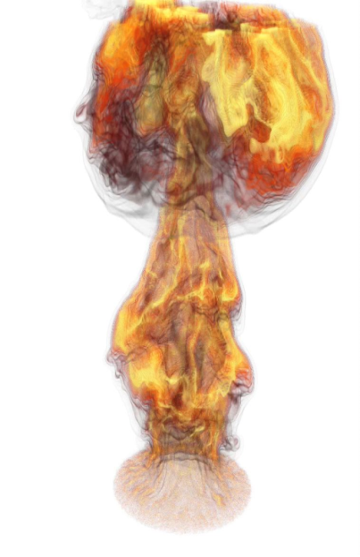
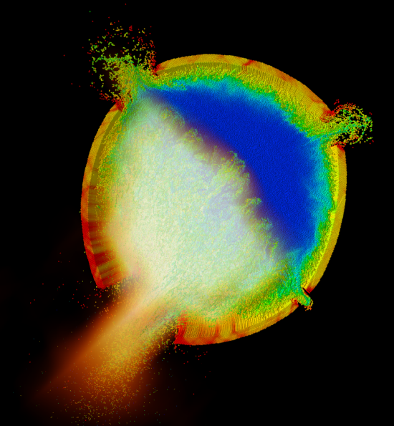
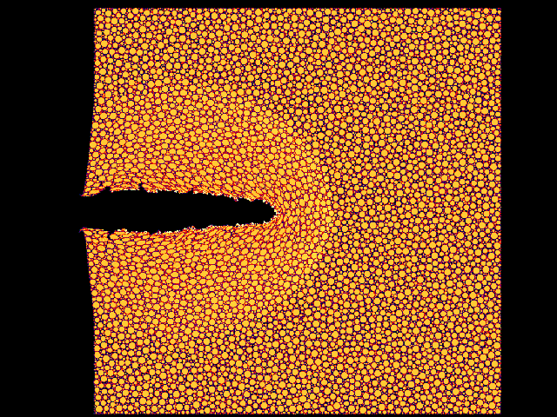
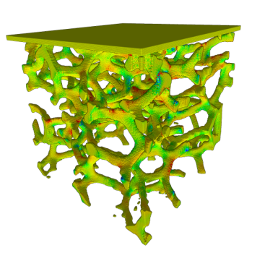
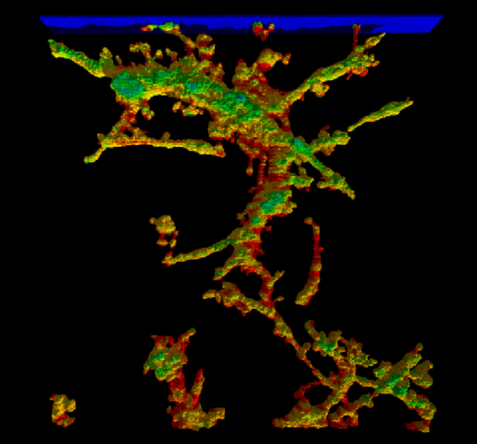
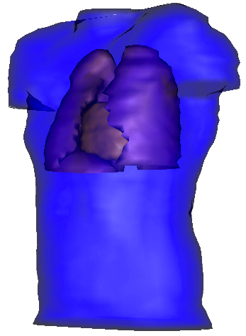
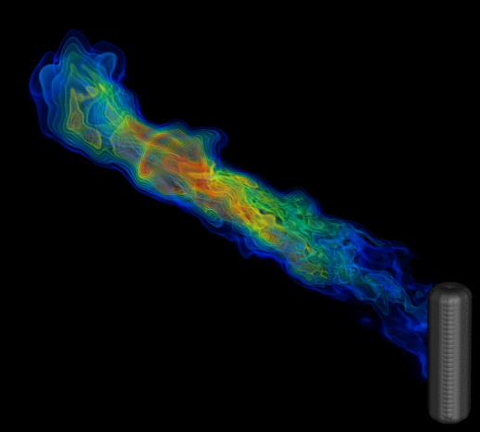
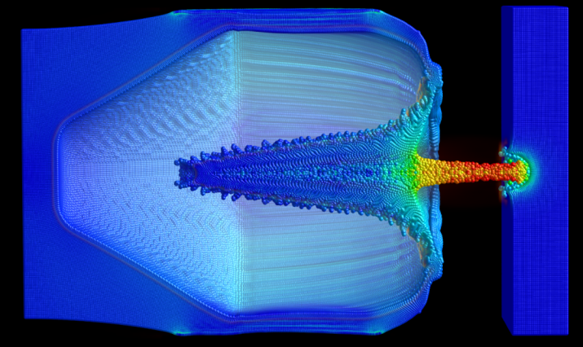
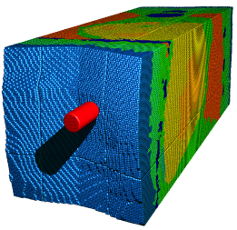
Uintah Overview
Parallel, adaptive multi-physics framework
Fluid-structure interaction problems
Patch-based AMR using:
particles and mesh-based fluid-solve
Plume Fires
Sandstone Compaction
Explosions
Angiogenesis
Foam Compaction
Virtual Soldier
Industrial Flares
Shaped Charges
Notes:
Target Problem: Fires, Explosions, Flares
Large Deformation: Compaction and Shaped Charges
Other Applications: Virtual Soldier, Angiogenesis, and Micropin flow

Slide 3
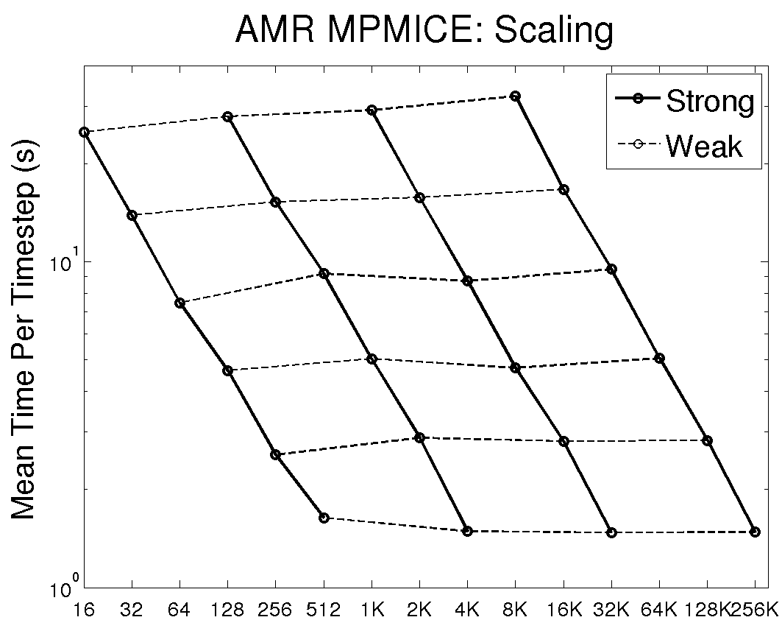
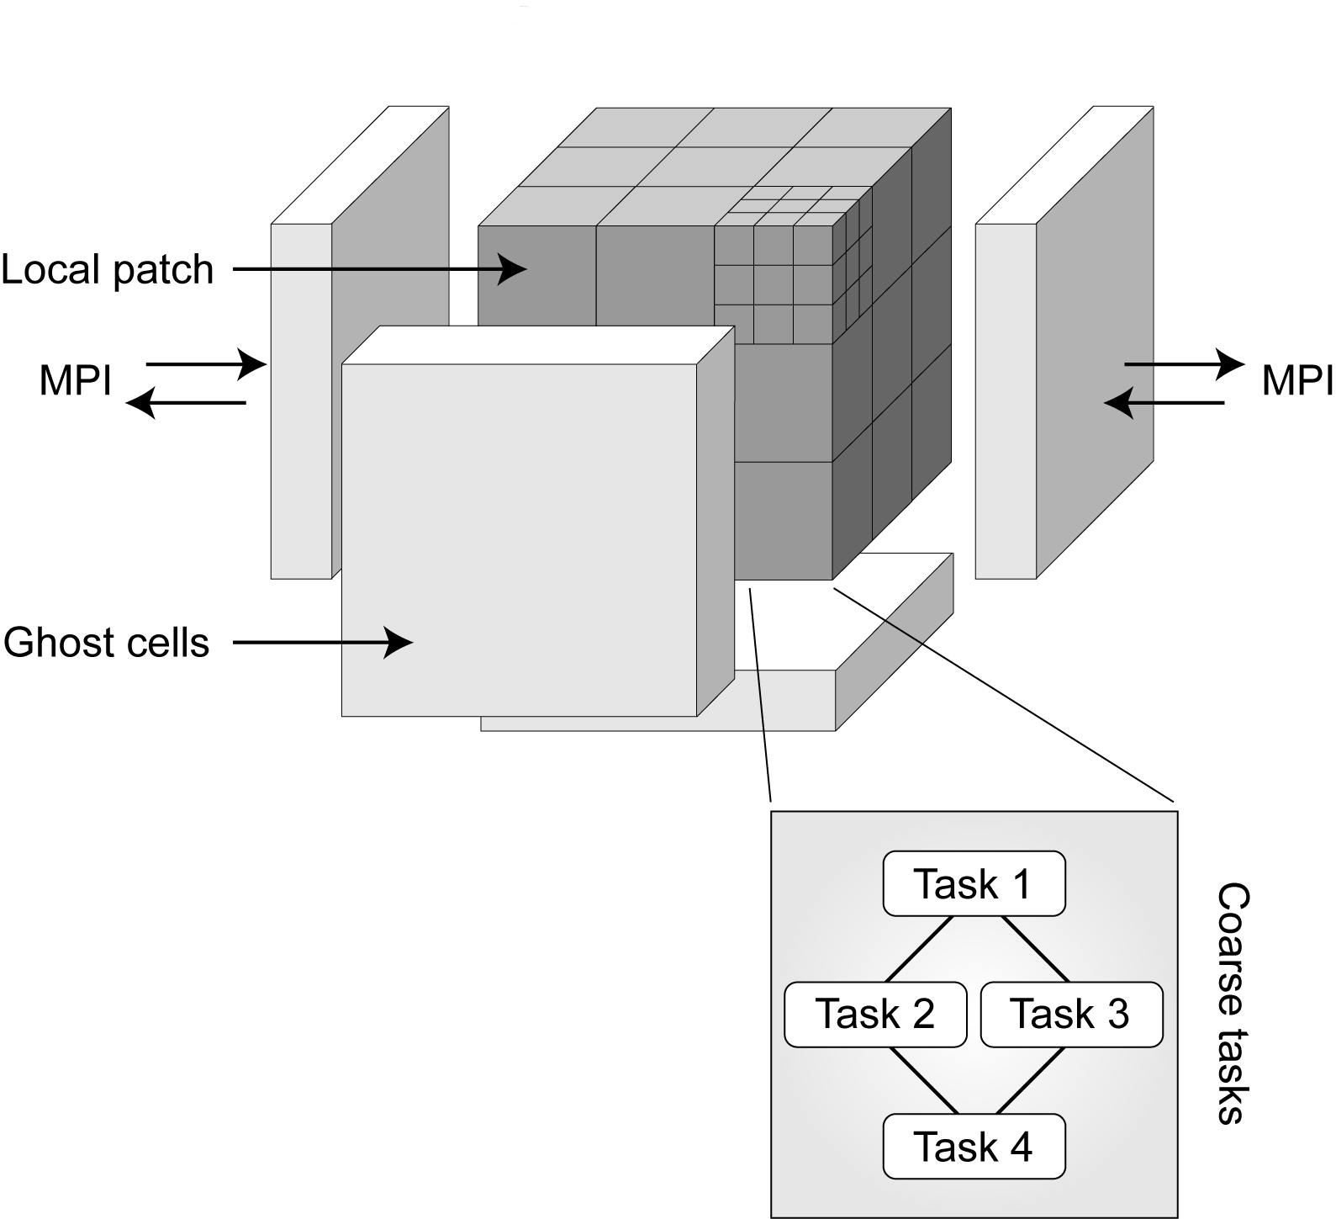
Uintah - Scalability
Patch-based domain decomposition
Asynchronous
task-based paradigm
Cores
256K cores – Jaguar XK6
95% weak scaling efficiency & 60% strong scaling efficiency
Multi-threaded MPI – shared memory model on-node¹
Scalable, efficient, lock-free data structures ²
Q. Meng, M. Berzins, and J. Schmidt. ”Using Hybrid Parallelism to Improve Memory Use in the Uintah Framework”. In Proc. of the 2011 TeraGrid Conference (TG11), Salt Lake City, Utah, 2011.
Q. Meng and M. Berzins. Scalable Large-scale Fluid-structure Interaction Solvers in the Uintah Framework via Hybrid Task-based Parallelism Algorithms. Concurrency and Computation: Practice and Experience 2012, Submitted

Slide 4
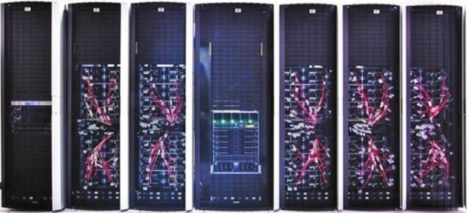
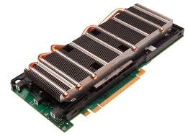
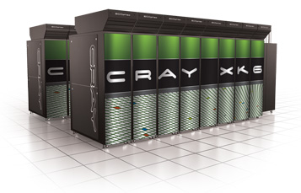
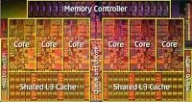
Emergence of Heterogeneous Systems
Nvidia M2070/90 Tesla GPU
+
Keeneland Initial Delivery System
360 GPUs
Multi-core CPU
DoE Titan
1000s of GPUs
Motivation - Accelerate Uintah Components
Utilize all on-node computational resources
Uintah’s asynchronous task-based approach well suited to take advantage of GPUs
Natural progression – GPU Tasks

Slide 5
When extending a general computational framework to GPUs, with over 700K lines of code …. where to start? …. Uintah’s asynchronous task-based approach makes this surprisingly manageable

Slide 6
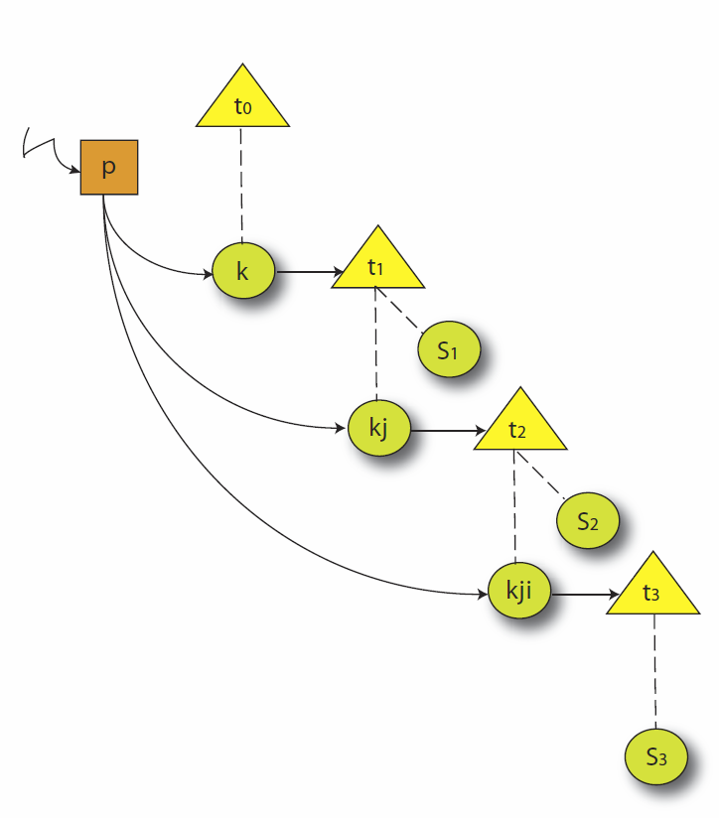
Other Graph Based Applications
1:1
1:2
1:3
1:4
2:2
2:3
2:4
Charm++: Object-based Virtualization
2:2
2:3
2:4
3:3
3:4
Intel CnC:
Language for
graph based parallelism
3:3
Plasma & Magma (Dongarra):
DAG based Parallel linear algebra software

Slide 7
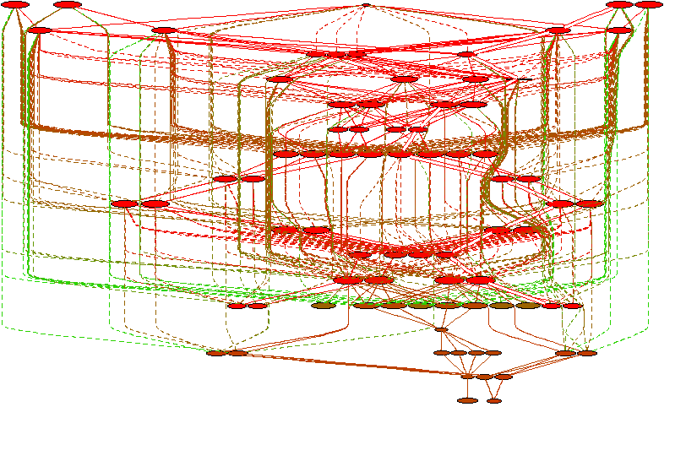
Uintah Task-Based Approach
Task Graph: Directed Acyclic Graph
Asynchronous, out of order execution of tasks - key idea
Task – basic unit of work
C++ method with computation
Allows Uintah to be generalized to support accelerators
Overlap communication/computation
GPU extension is realized without massive, sweeping code changes
Extend Task class (CPU & GPU call backs)
Design GPU task queue data structures
Infrastructure handles device API details
Mechanism to detect completion of async ops
Write GPU kernels for appropriate CPU tasks
4 patch single level ICE task graph

Slide 8
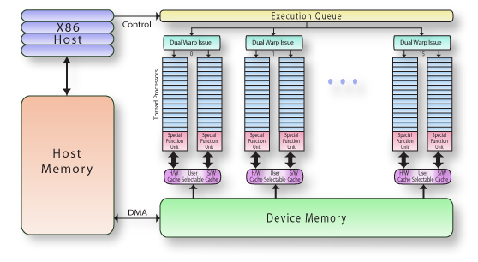
NVIDIA Fermi Overview
8GB/sec
144GB/sec
Host memory to Device memory is max 8GB/sec
Device memory to cores is 144GB/sec
Memory bound applications must hide PCIe latency

Slide 9
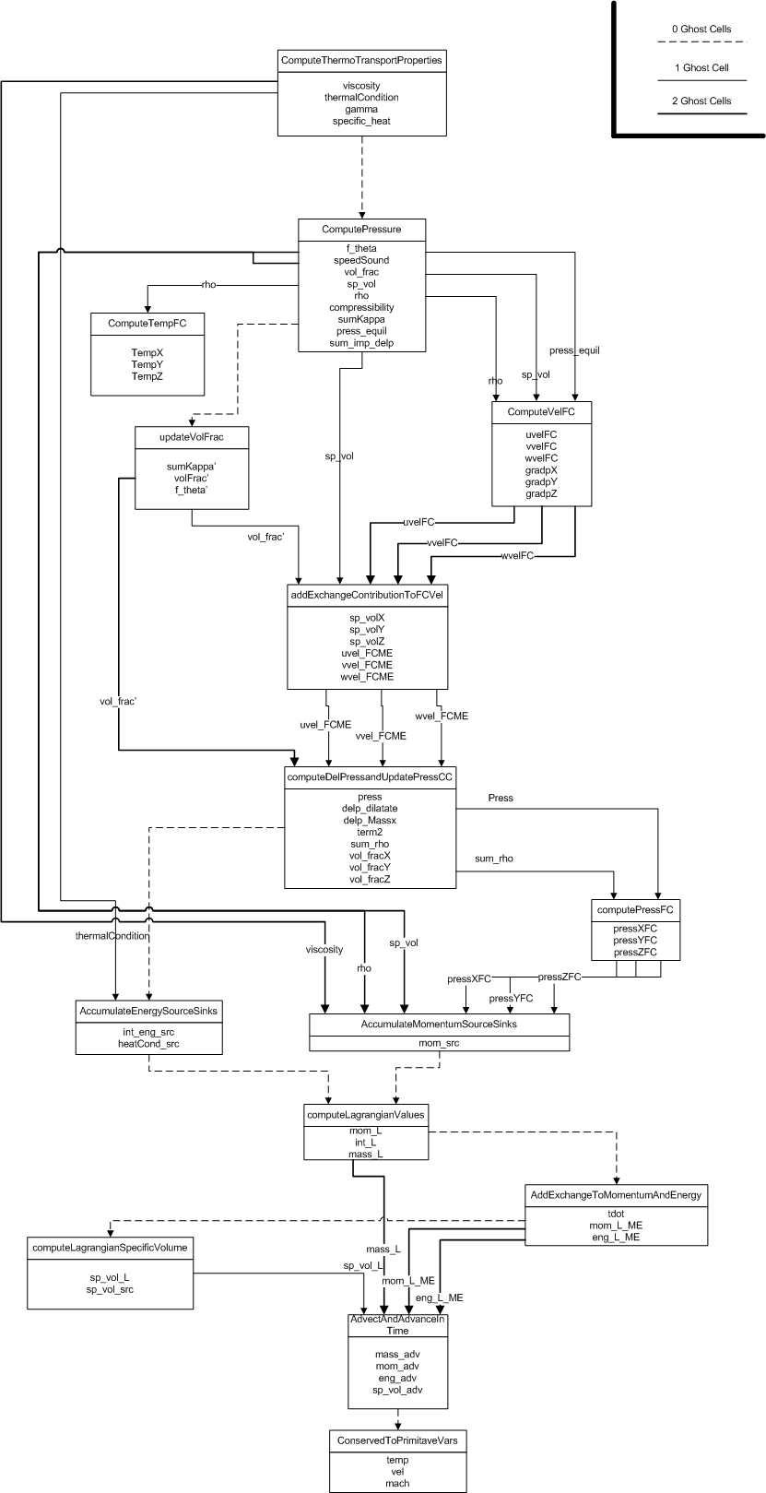
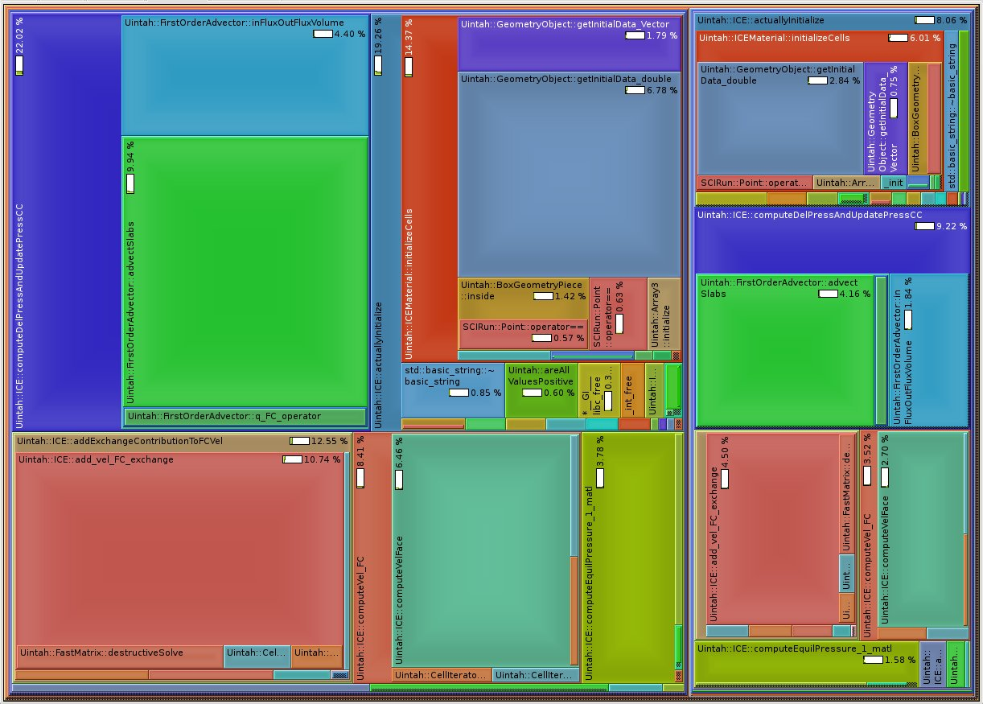
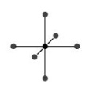
Fluid Solver Code (ICE)
1
2
2
1
Generated by Google profiling tool, visualized by Kcachegrind
2
FirstOrderAdvector Operators &
Significant portion of runtime (~ 20%)
Highly structured calculations
Stencil operations and other SIMD constructs
Map well onto GPU
High FLOPs:Byte ratio
1

Slide 10
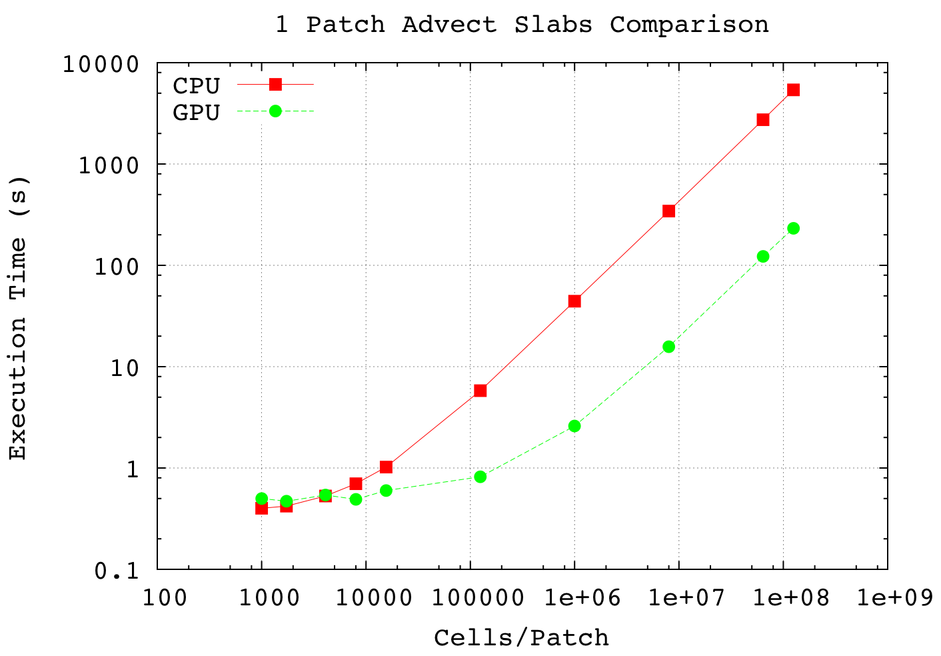
Results – Without Optimizations
GPU performance for stencil-based operations ~2x over multi-core CPU equivalent for realistic patch sizes
Worth pursuing, but need optimizations
Hide PCIe latency with asynchronous memory copies
Significant speedups for large patch sizes only

Slide 11
Hiding PCIe Latency
Nvidia CUDA Asynchronous API
Asynchronous functions provide:
Memcopies asynchronous with CPU
Concurrently execute a kernel and memcopy
Stream - sequence of operations that execute in order on GPU
Operations from different streams can be interleaved
Normal
Page-locked Memory
Data Transfer
Kernel Execution
Data Transfer
Kernel Execution

Slide 12
Multi-Threaded CPU Scheduler

Slide 13
Multi-Threaded CPU-GPU Scheduler

Slide 14
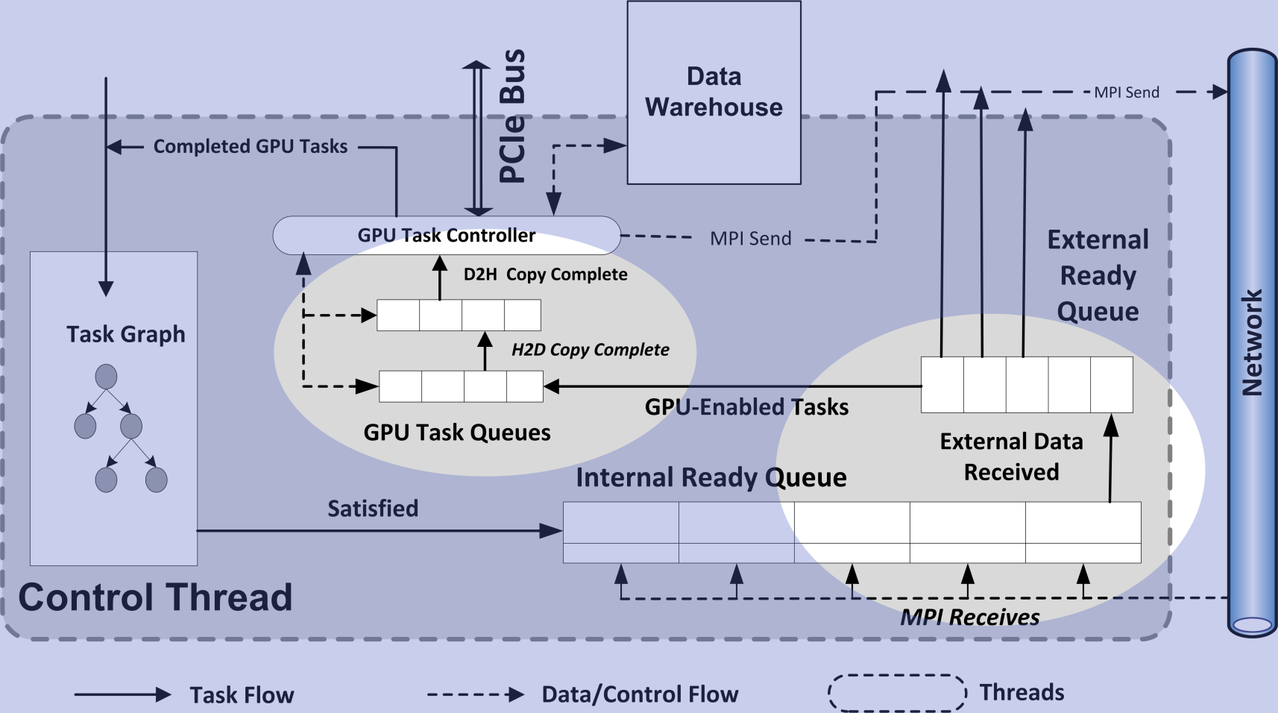
Multistage Task Queue Architecture
GPU Task Queues
Overlap computation with PCIe transfers and MPI communication
Automatically handles device memory ops and stream management
Enables Uintah to “pre-fetch” GPU data
Queries task-graph for task’s data requirements

Slide 15
Uintah CPU-GPU Scheduler Abilities
Now able to run capability jobs on:
Keeneland Initial Delivery System (NICS)
1440 CPU cores & 360 GPUs simultaneously
3 GPUs per node
TitanDev - Jaguar XK6 GPU partition (OLCF)
15360 CPU cores & 960 GPUs simultaneously
1 GPU per node
Shown speedups on fluid-solver code
High degree of node-level parallelism

Slide 16
ARCHES Combustion Component
Designed for simulating turbulent reacting flows with participating media radiation
Heat, mass, and momentum transport
3D Large Eddy Simulation (LES) code
Evaluate large clean coal boilers that alleviate CO₂ concerns
ARCHES is massively parallel & highly scalable through its integration with Uintah

Slide 17
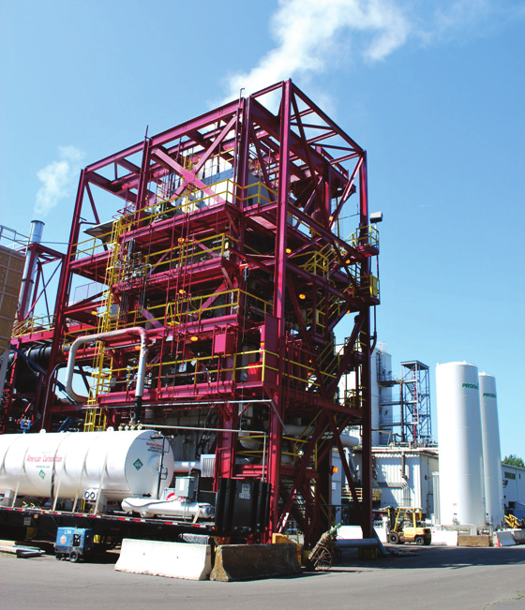
Exascale Problem Design of Alstom Clean Coal Boilers
O₂ concentrations
in a clean coal boiler
LES resolution needed for 350MW boiler problem
1mm per side for each computational volume = 9 x 10¹² cells
Based on initial runs - to simulate problem in 48 hours of wall clock time requires 50-100M fast cores.
Professor Phil Smith ICSE, Utah

Slide 18
Developing a Uintah Radiation Model
ARCHES Combustion Component
Need to approximate the radiation transfer equation
Methods considered:
Discrete Ordinates Method (DOM)
Reverse Monte Carlo Ray Tracing (RMCRT)
Both solve the same equation:
DOM: slow and expensive (solving linear systems) and is difficult to add more complex radiation physics (specifically scattering)
RMCRT: faster due to ray decomposition and naturally incorporates physics (such as scattering) with ease. No linear solve.

Slide 19
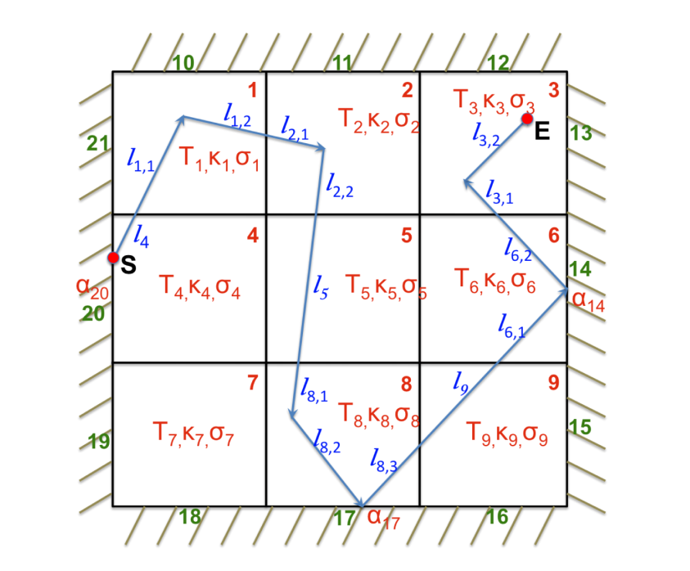
Reverse Monte Carlo Ray Tracing (RMCRT)
RMCRT Lends itself to scalable parallelism
Intensities of each ray are mutually exclusive
Multiple rays can be traced simultaneously at any given cell and time step
Rays traced backwards from computational cell, eliminating the need to track ray bundles that never reach that cell
Figure shows the back path of a ray from S to the emitter E, on a nine cell structured mesh patch

Slide 20
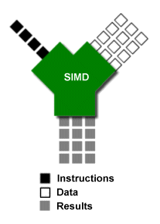
ARCHES GPU-Based RMCRT
RayTrace task comutationally intensive
Ideal for SIMD parallelization
Rays mutually exclusive
Can be traced simultaneously
Offload Ray Tracing and RNG to GPU(s)
Available CPU cores can perform other computation
RNG states on device, 1 per thread

Slide 21
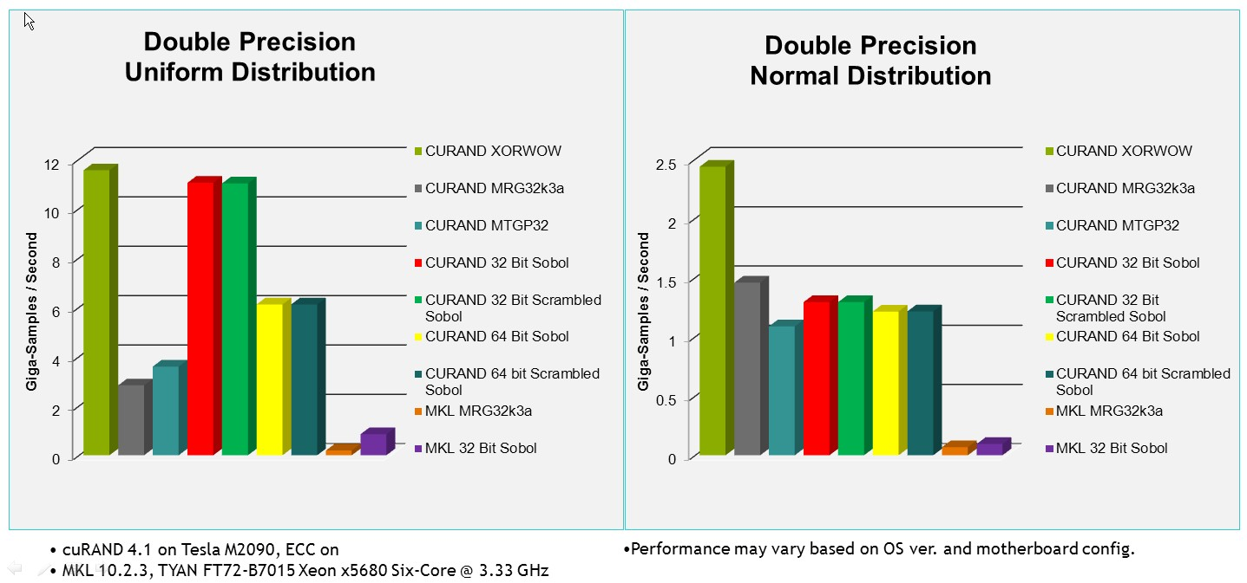
Random Number Generation
Using NVIDIA cuRAND Library
High performance GPU-accelerated random number generation (RNG)

Slide 22
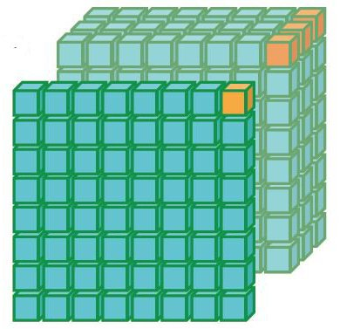
RMCRT Kernel - General Approach
Tile a 2D slice with 2D threadblocks
Slice in two fastest dimensions: x and y
Thread iterates along the slowest dimension
Each thread is responsible for one set of rays per cell in every Z-slice (the slowest dimension)
Single kernel launch (minimize overhead)
Good data reuse
GPU-side RNG (cuRAND library)
Uintah Patch

Slide 23
GPU RMCRT Speedup Results (Single Node)
Single CPU Core vs Single GPU
Machine | Rays | CPU (sec) | GPU (sec) | Speedup (x)
Keeneland 1-core Intel | 25 | 28.32 | 1.16 | 24.41
 | 50 | 56.22 | 1.86 | 30.23
 | 100 | 112.73 | 3.16 | 35.67
TitanDev 1-core AMD | 25 | 57.82 | 1.00 | 57.82
 | 50 | 116.71 | 1.66 | 70.31
 | 100 | 230.63 | 3.00 | 76.88
GPU – Nvidia M2090
Keeneland CPU Core – Intel Xeon X5660 (Westmere) @2.8GHz
TitanDev CPU Core – AMD Opteron 6200 (Interlagos) @2.6GHz

Slide 24
GPU RMCRT Speedup Results (Single Node)
All CPU Cores vs Single GPU
Machine | Rays | CPU (sec) | GPU (sec) | Speedup (x)
Keeneland 12-cores Intel | 25 | 4.89 | 1.16 | 4.22
 | 50 | 9.08 | 1.86 | 4.88
 | 100 | 18.56 | 3.16 | 5.87
TitanDev 16-cores AMD | 25 | 6.67 | 1.00 | 6.67
 | 50 | 13.98 | 1.66 | 8.42
 | 100 | 25.63 | 3.00 | 8.54
GPU – Nvidia M2090
Keeneland CPU Cores – Intel Xeon X5660 (Westmere) @2.8GHz
TitanDev CPU Cores – AMD Opteron 6200 (Interlagos) @2.6GHz

Slide 25
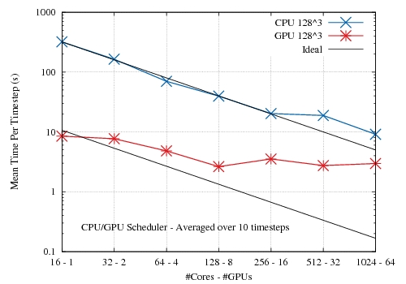
GPU-Based RMCRT Scalability
Mean time per timestep for GPU lower than CPU (up to 64 GPUs)
GPU implementation quickly runs out of work
All-to-all nature of problem limits size that can be computed due to memory constraints with large, highly resolved physical domains
Strong scaling results for both CPU and GPU implementations
Of RMCRT on TitanDev

Slide 26
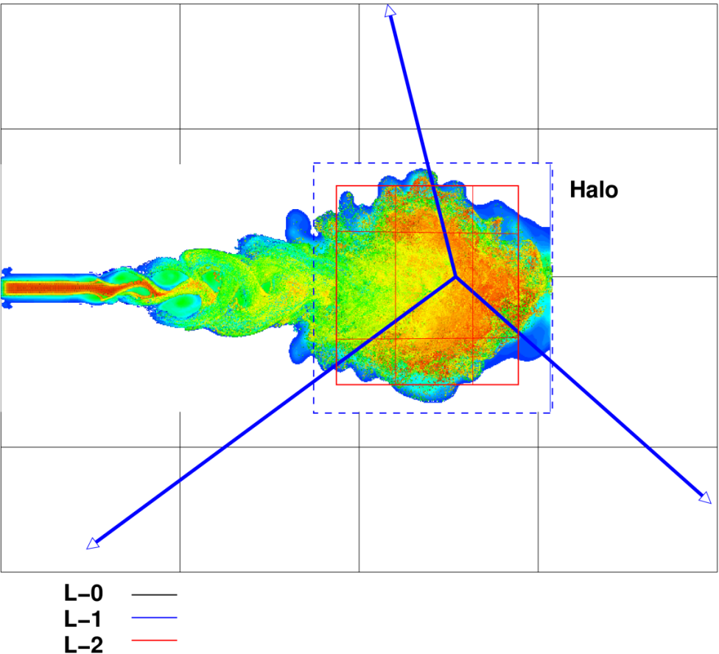
Addressing RMCRT Scalability
Use coarser representation of computational domain with multiple levels
Define Region of Interest (ROI)
Surround ROI with successively coarser grid
As rays travel away from ROI, the stride taken between cells becomes larger
This reduces computational cost and memory usage.
Multi-level Scheme

Slide 27
Future Work
Scheduler – Infrastructure
Decentralized task scheduler
GPU affinity for multi socket/GPU nodes
Support for Intel MIC (Xeon Phi)
Radiation Transport Model (RMCRT)
Scalability
Continue multi-level, data onion approach

Slide 28
Conclusion
Task-based paradigm makes extending Uintah to heterogeneous systems manageable
Radiation modelling is a difficult problem, with three fundamental scalability barriers:
Extremely expensive computation
All-to-all communication pattern
Exorbitant memory footprint
Offload computationally intensive RMCRT to the GPU.
Multi-level, Data Onion approach begins to address communication issues.
Uintah’s multi-threaded runtime system directly addresses reduction in memory footprint.

Slide 29
Questions?
Software Download http://www.uintah.utah.edu/

