Slide 1
ARCHES: GPU Ray Tracing
Motivation – Emergence of Heterogeneous Systems
Overview and Approach
Uintah Hybrid CPU/GPU Scheduler
Current Uintah Infrastructure GPU Abilities
Acknowledgements:
DoE for funding the CSAFE project from 1997-2012, DOE NETL, DOE NNSA, INCITE
NSF for funding via SDCI and PetaApps
Keeneland Computing Facility, supported by NSF under Contract OCI-0910735
Oak Ridge Leadership Computing Facility – DoE Jaguar XK6 System (GPU partition)
http://www.uintah.utah.edu

Slide 2
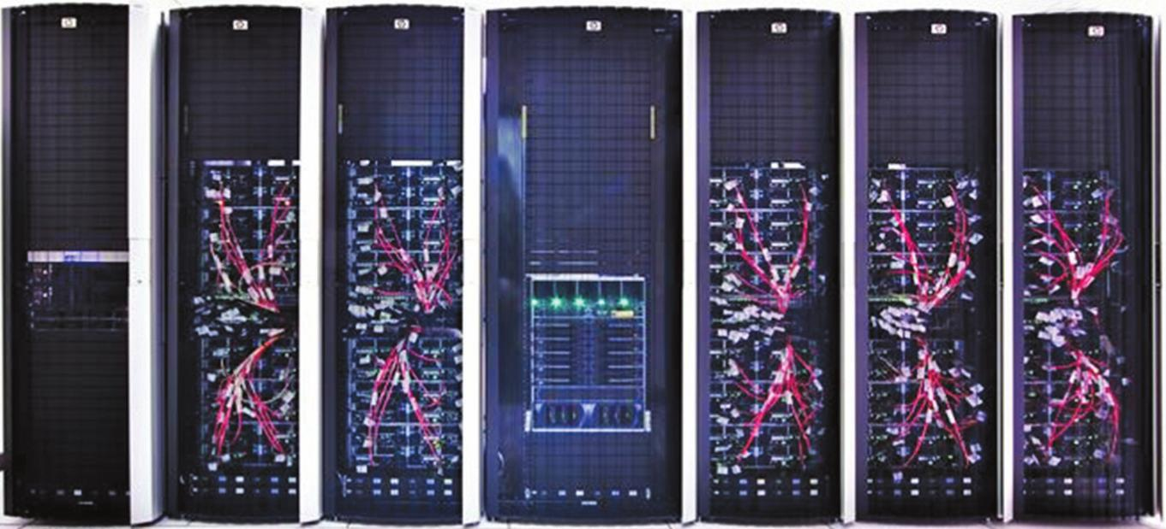
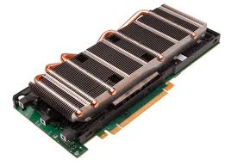
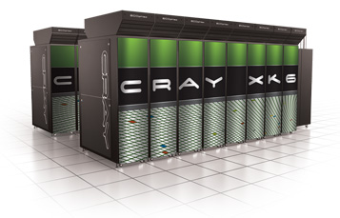
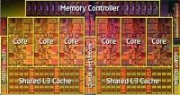
Emergence of Heterogeneous Systems
Nvidia M2070/90 Tesla GPU
+
Keeneland Initial Delivery System
360 GPUs
Multi-core CPU
DoE Titan
1000s of GPUs
Motivation - Accelerate Uintah Components:
ARCHES Ray Tracer
Want to utilize all hardware on these systems
Uintah’s asynchronous task-based approach is well suited to take advantage of GPUs

Slide 3
Overview and Approach
ARCHES Ray Tracer:
RayTrace task is computationally intensive
Ideal for parallelization on GPU
Offload Ray Tracing and RNG to GPU(s)
Available CPU cores can perform other computation.
Uintah infrastructure now supports GPU task scheduling and execution:
Can access multiple GPUs on-node
Uses Nvidia CUDA C/C++

Slide 4
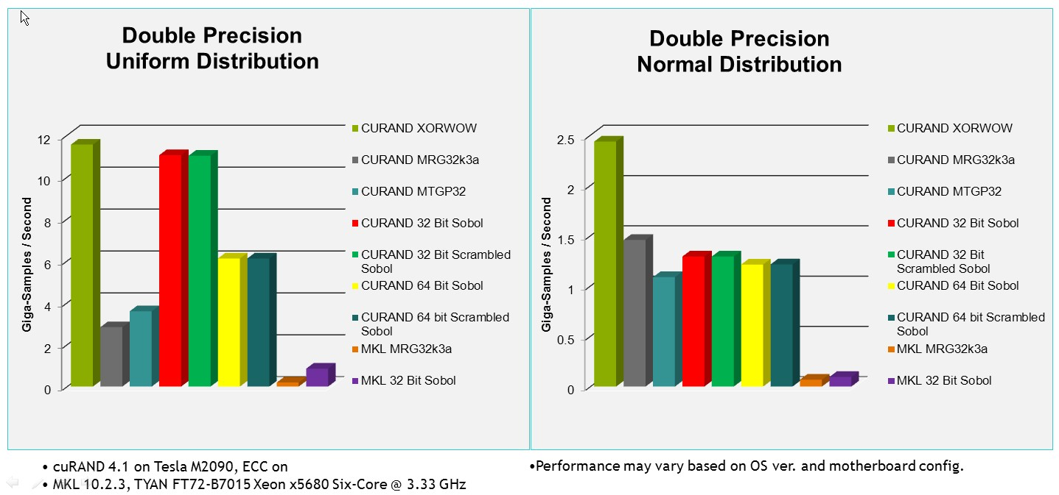
Random Number Generation
Using NVIDIA cuRAND Library
High performance GPU-accelerated random number generation (RNG)

Slide 5
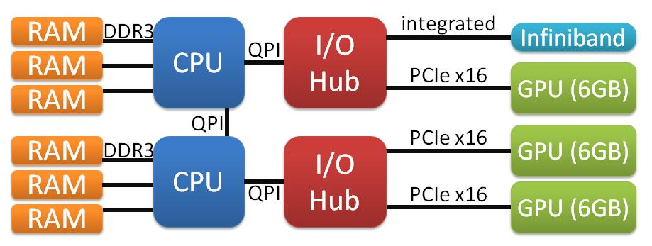
Uintah Hybrid CPU/GPU Scheduler
Create & schedule CPU & GPU tasks
Enables Uintah to “pre-fetch” GPU data
Uintah infrastructure manages:
Queues of CUDA Stream and Event handles
Device memory allocation and transfers
Utilize all available:
CPU cores and GPUs
Keenland IDS - HP SL390 Compute Node

Slide 6
Uintah CPU/GPU Scheduler Design

Slide 7
Uintah GPU Scheduler Abilities
Has now run capability jobs on:
Keeneland Initial Delivery System (NICS)
1440 CPU cores & 360 GPUs simultaneously
Jaguar - GPU partition (OLCF)
15360 CPU cores & 960 GPUs simultaneously
Shown speedups on fluid-solver code
Nearing Completion of GPU Ray Tracer Prototype
Will run on systems listed above

