Slide 1
Image Formation III
Chapter 1 (Forsyth&Ponce) Cameras “Lenses”
Guido Gerig
CS 6320 S2015
(Acknowledgements:
modified from Marc Pollefeys, UNC Chapel Hill
Some materials from Prof. Trevor Darrell, trevor@eecs.berkeley.edu

Slide 2
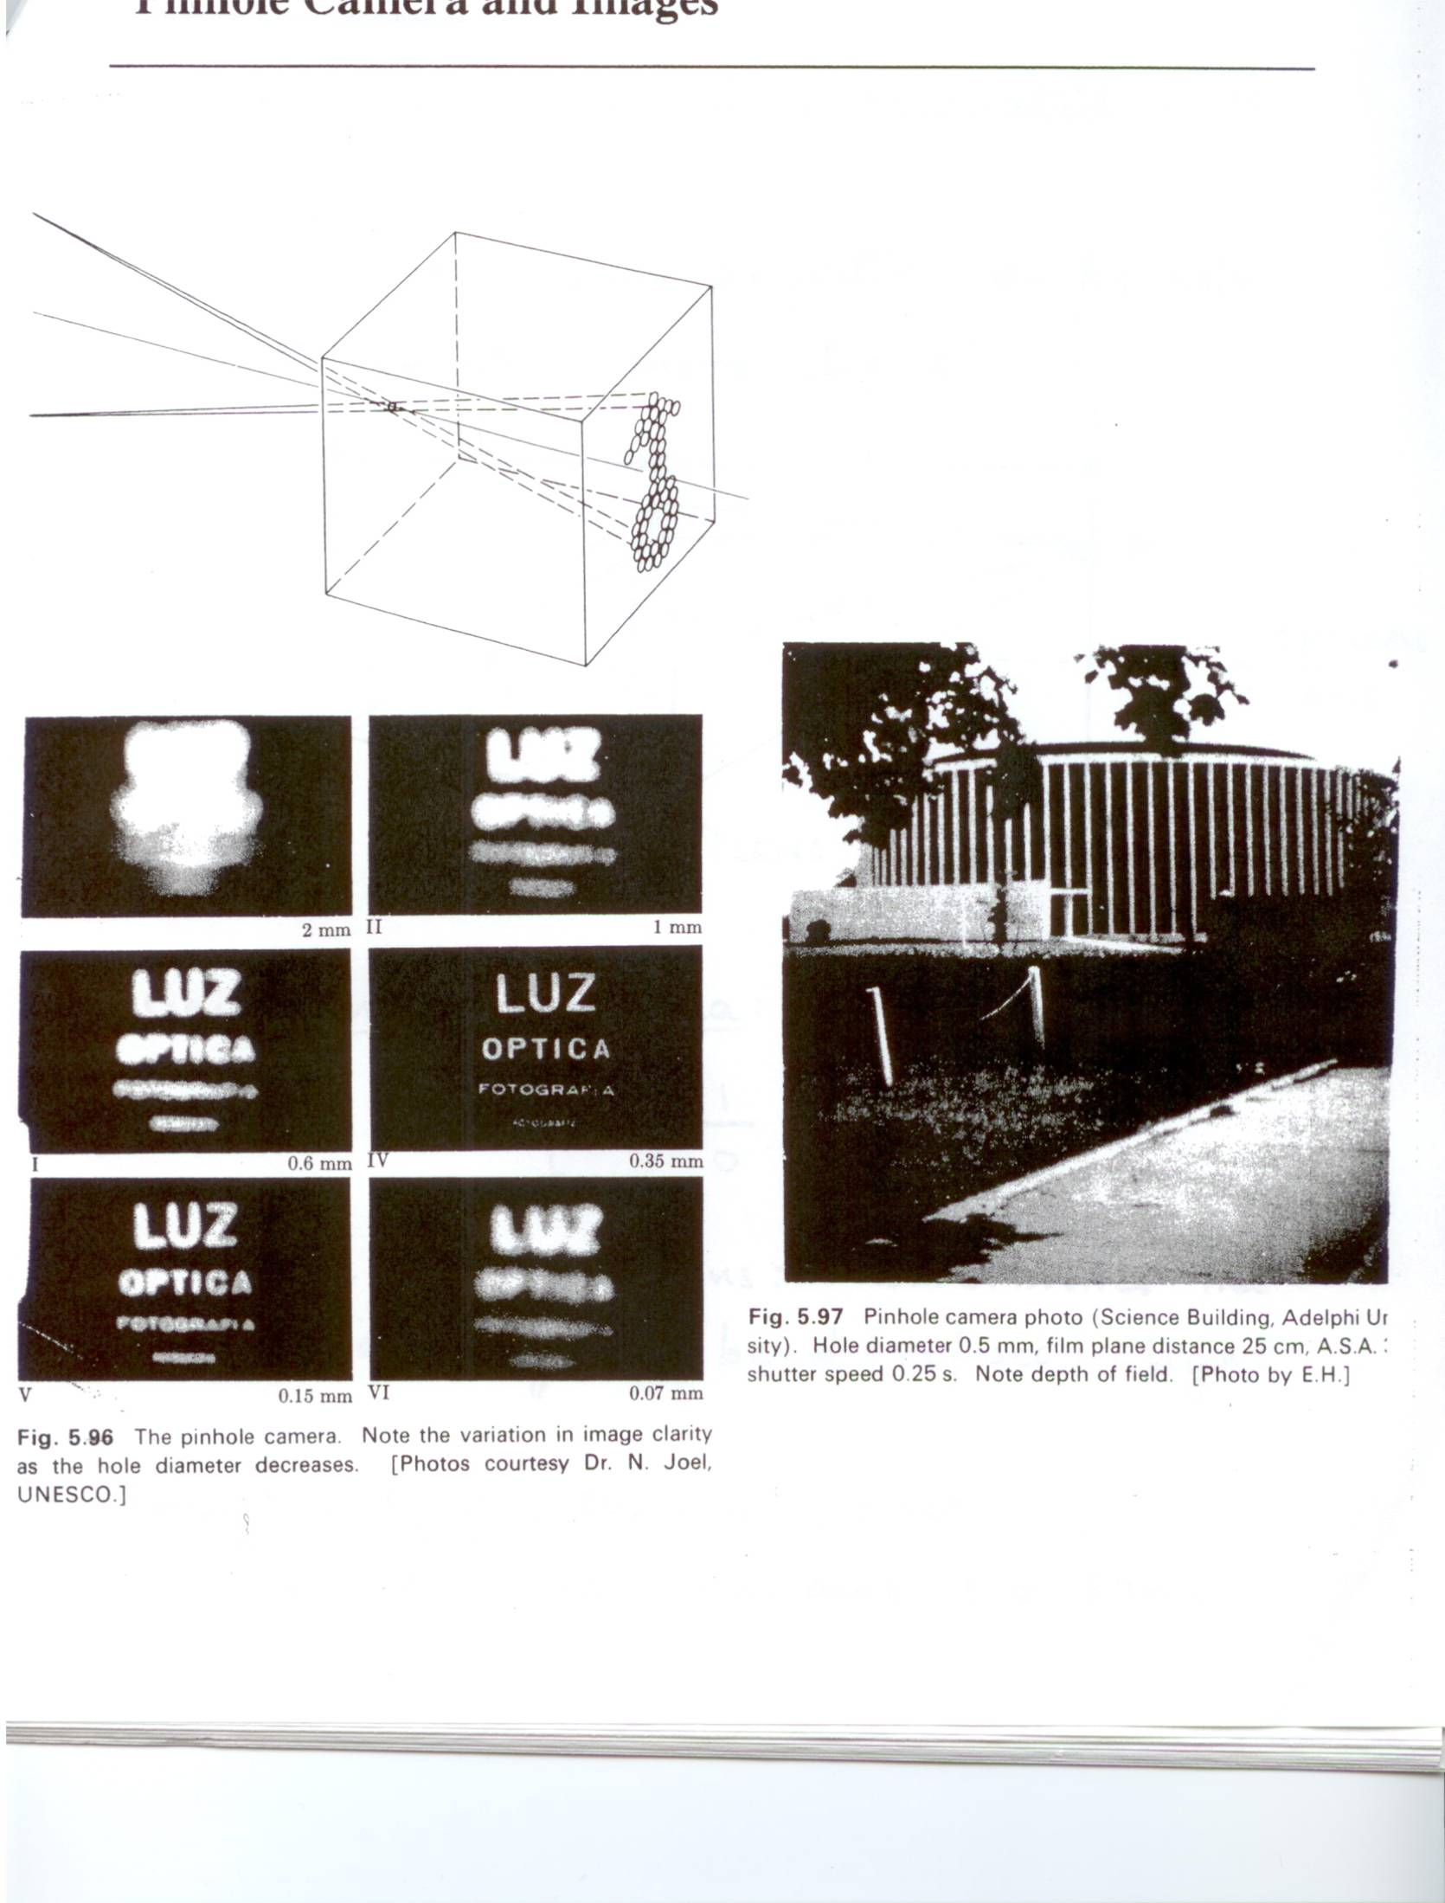
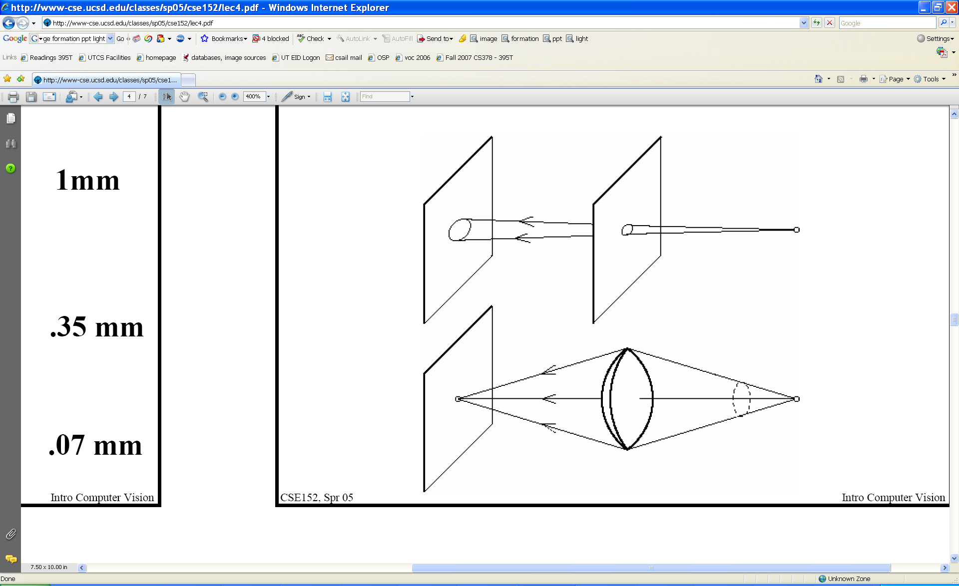
Pinhole size / aperture
How does the size of the aperture affect the image we’d get?
Larger
Smaller
K. Grauman

Slide 3
Pinhole vs. lens
Shrinking hole -> sharper, but less light
K. Grauman

Slide 4
Adding a lens
focal point
f
A lens focuses light onto the film
  Rays passing through the center are not deviated
  All parallel rays converge to one point on a plane located at the focal length f
Slide by Steve Seitz

Slide 5
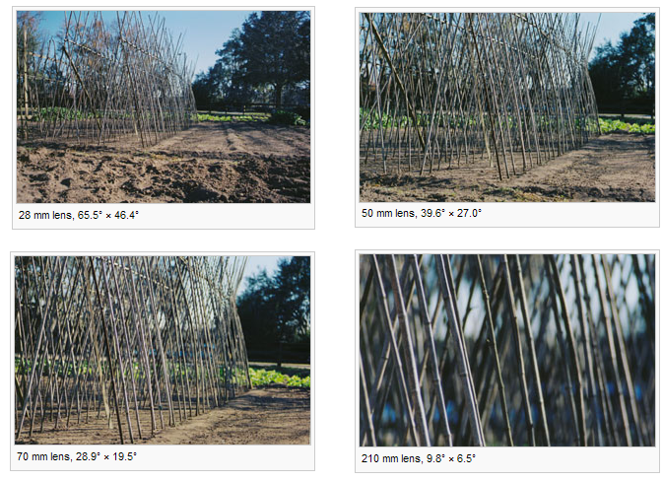
Field of view
Angular measure of portion of 3d space seen by the camera
Images from http://en.wikipedia.org/wiki/Angle_of_view
K. Grauman

Slide 6
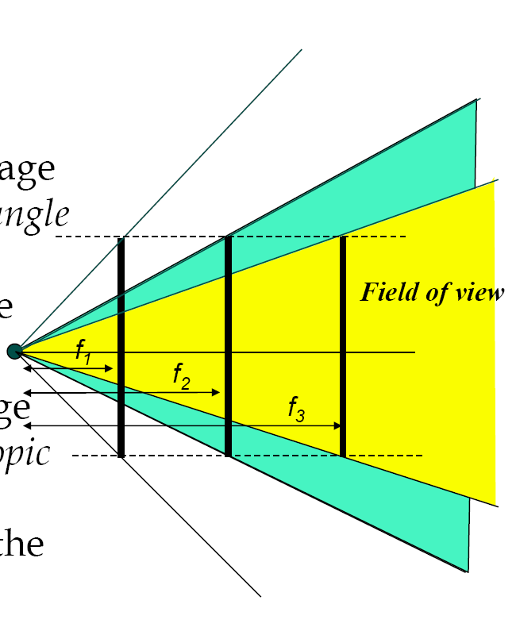
Field of view depends on focal length
As f gets smaller, image becomes more wide angle
  more world points project onto the finite image plane
As f gets larger, image becomes more telescopic
  smaller part of the world projects onto the finite image plane
from R. Duraiswami

Slide 7
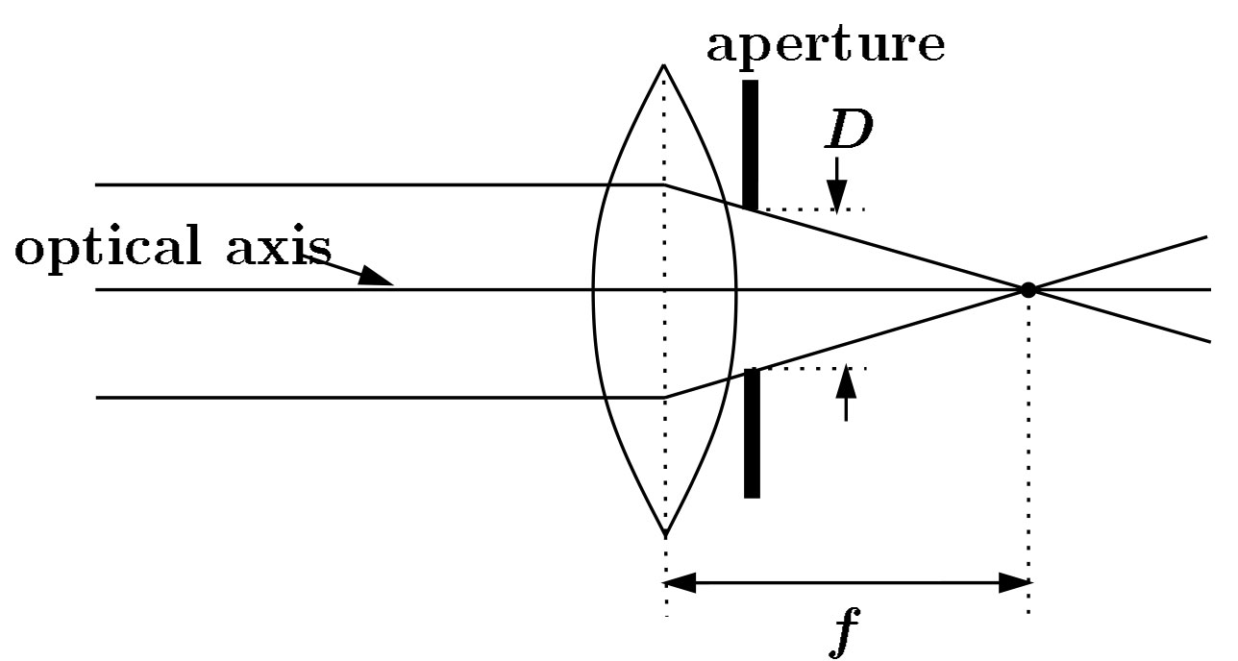
Cameras with lenses
F
focal point
optical center
(Center Of Projection)
A lens focuses parallel rays onto a single focal point
Gather more light, while keeping focus; make pinhole perspective projection practical
K. Grauman

Slide 8
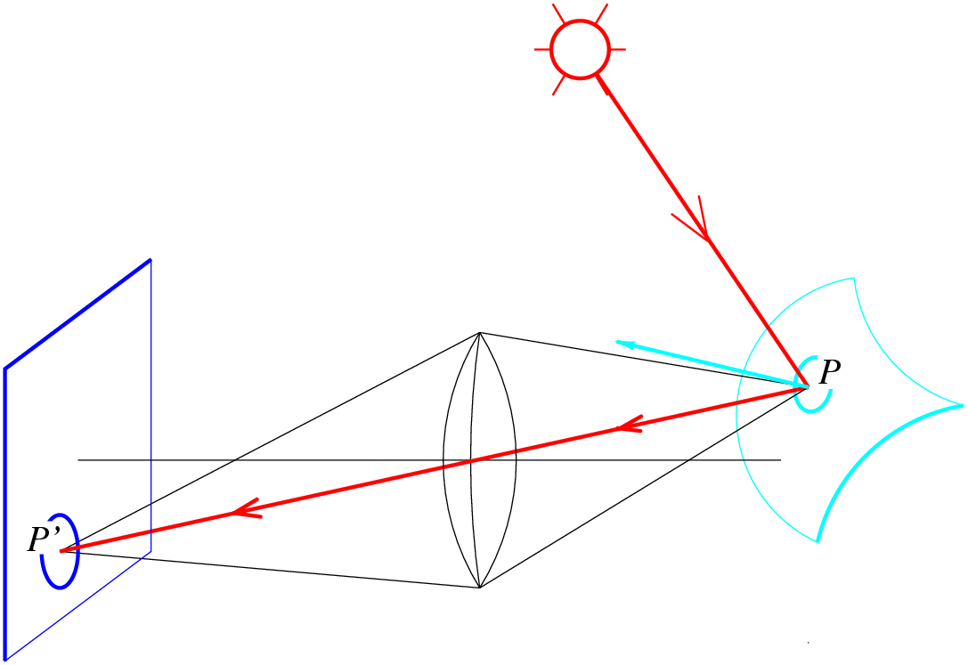
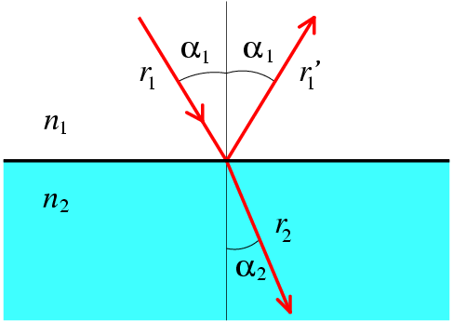
Lenses
Descartes’ law
Snell’s law,
Law of refraction
n₁ sin α₁ = n₂ sin α₂
n_{1,} n₂ : refraction indices

Slide 9
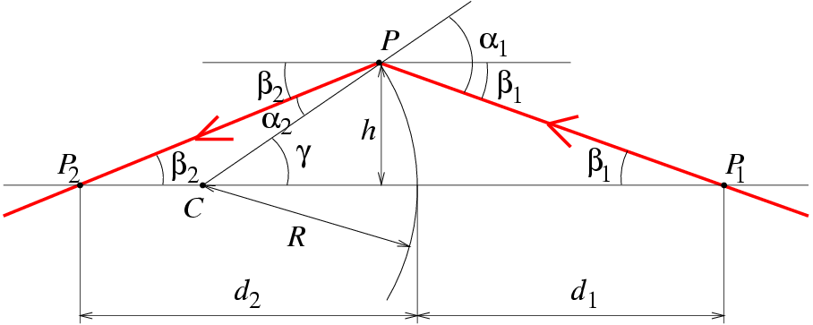
Paraxial (or first-order) optics
Snell’s law:
n₁ sin α₁ = n₂ sin α₂
Small angles:
n₁ α₁ ≈ n₂α₂

Slide 10
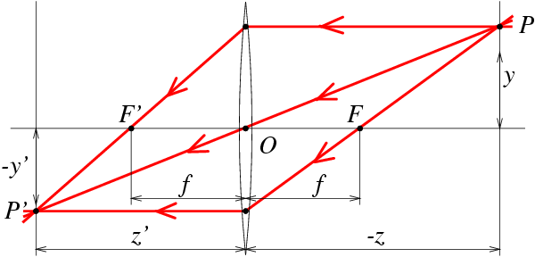
Thin Lenses
spherical lens surfaces; thickness << radii; same refractive index on both sides; all rays emerging from P and passing through the lens are focused at P’. Let n₁=1 (vaccuum) and n₂=n.

Slide 11
Thin Lenses
spherical lens surfaces; thickness << radii; same refractive index on both sides; all rays emerging from P and passing through the lens are focused at P’. Let n₁=1 (vacuum) and n₂=n.
http://www.phy.ntnu.edu.tw/java/Lens/lens_e.html

Slide 12
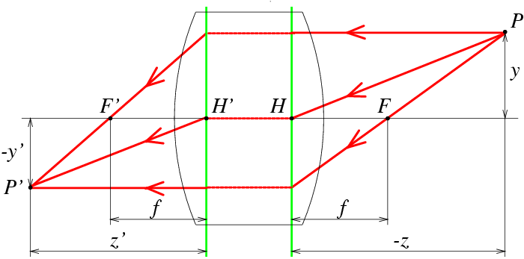
Thick Lens

Slide 13
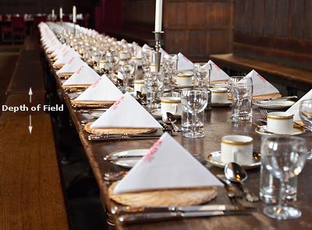
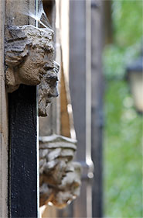
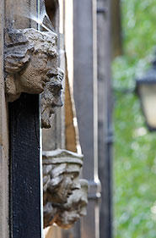
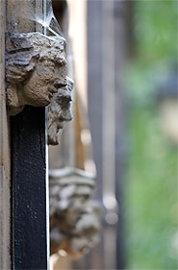
Focus and depth of field
Image credit: cambridgeincolour.com

Slide 14
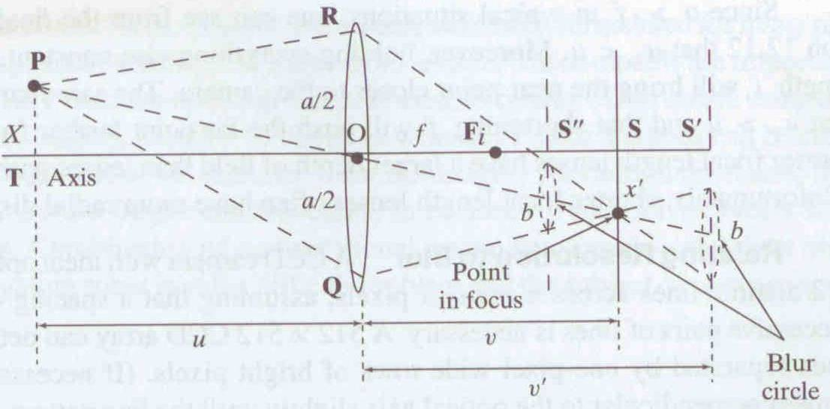
Focus and depth of field
Depth of field: distance between image planes where blur is tolerable
Thin lens: scene points at distinct depths come in focus at different image planes.
(Real camera lens systems have greater depth of field.)
“circles of confusion”
Shapiro and Stockman

Slide 15
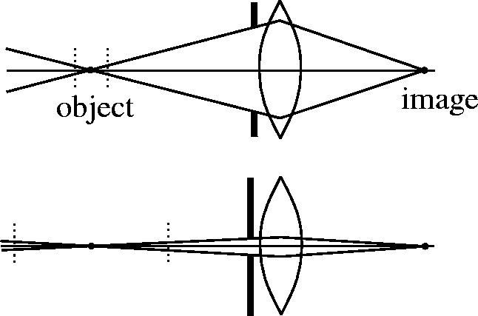


Focus and depth of field
How does the aperture affect the depth of field?
A smaller aperture increases the range in which the object is approximately in focus
Flower images from Wikipedia http://en.wikipedia.org/wiki/Depth_of_field
Slide from S. Seitz

Slide 16
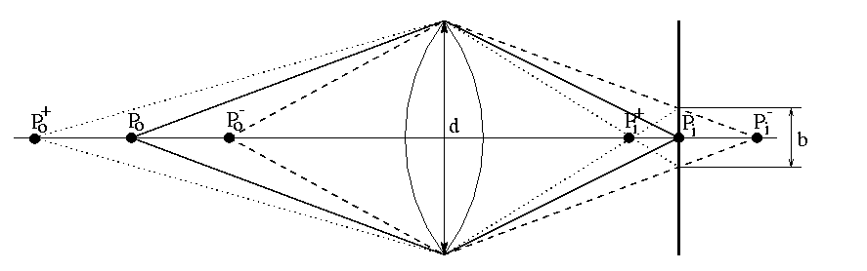
The depth-of-field
➔

Slide 17
The depth-of-field
➔

Slide 18
The depth-of-field
yields
Similar formula for
➔

Slide 19
The depth-of-field
decreases with d+, increases with Z₀+
strike a balance between incoming light and
sharp depth range
➔

Slide 20
Deviations from the lens model
3 assumptions :
1. all rays from a point are focused onto 1 image point
2. all image points in a single plane
3. magnification is constant
deviations from this ideal are aberrations
➔

Slide 21
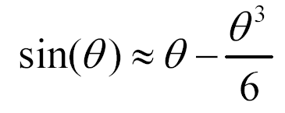
Aberrations
2 types :
1. geometrical
2. chromatic
geometrical : small for paraxial rays
study through 3rd order optics
chromatic : refractive index function of
wavelength
➔

Slide 22
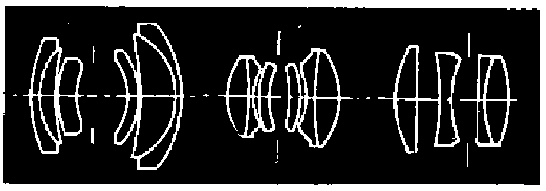
Geometrical aberrations
spherical aberration
astigmatism
distortion
coma
aberrations are reduced by combining lenses
➔

Slide 23
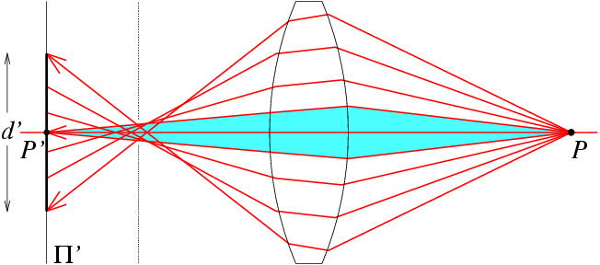
Spherical aberration
rays parallel to the axis do not converge
outer portions of the lens yield smaller
focal lenghts
➔

Slide 24
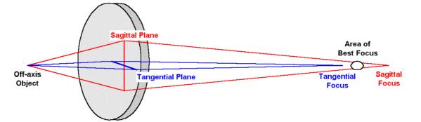
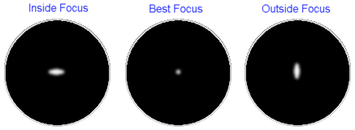
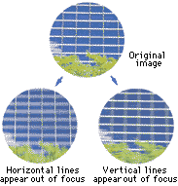
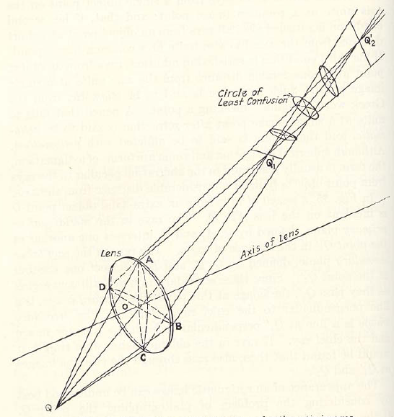
Astigmatism
Different focal length for inclined rays

Slide 25
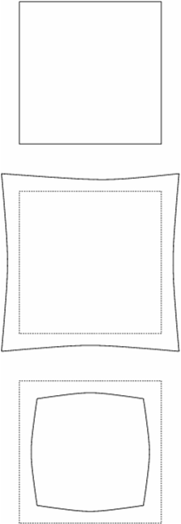
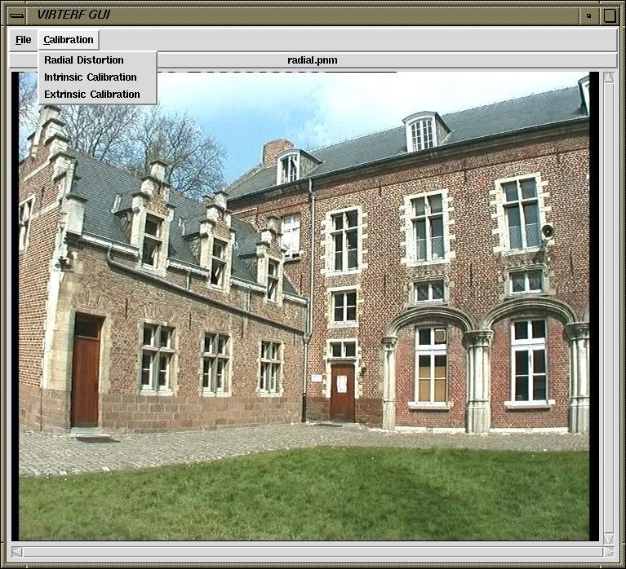
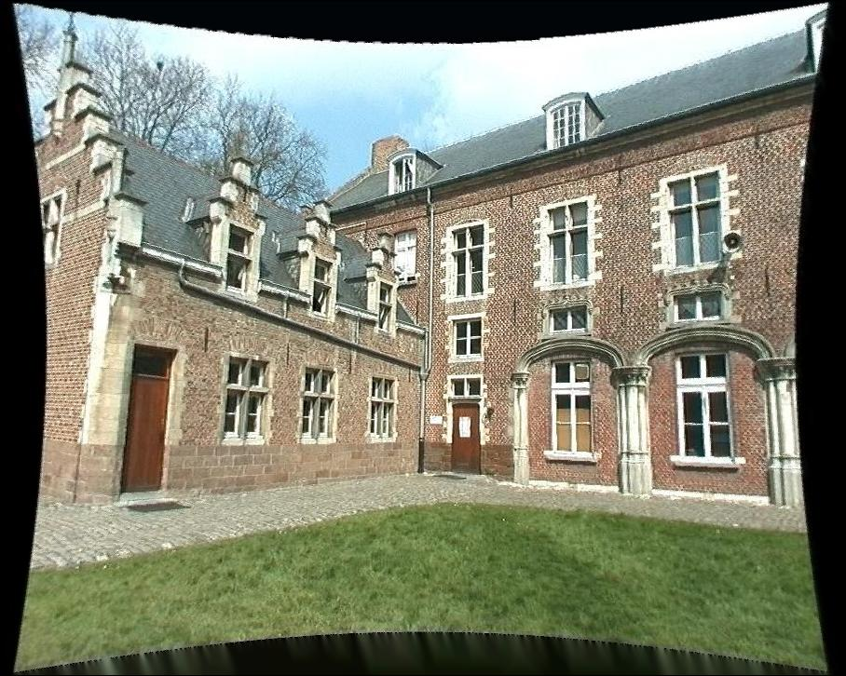
Distortion
magnification/focal length different
for different angles of inclination
pincushion
(tele-photo)
barrel
(wide-angle)
Can be corrected! (if parameters are know)

Slide 26
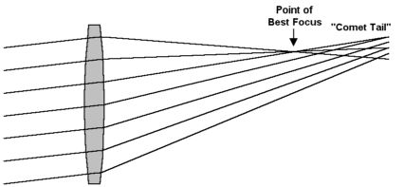
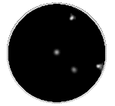
Coma
point off the axis depicted as comet shaped blob

Slide 27
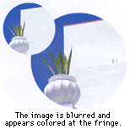
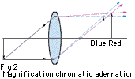

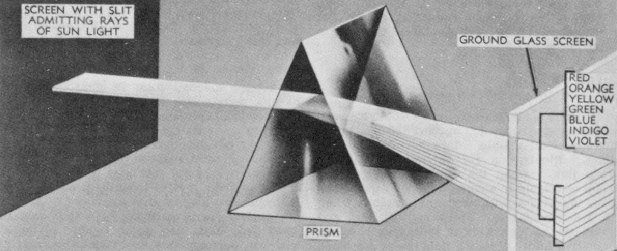
Chromatic aberration
rays of different wavelengths focused
in different planes
cannot be removed completely
sometimes achromatization is achieved for
more than 2 wavelengths
➔

Slide 28
Lens materials
reference wavelengths :
λ_{F} = 486.13nm
λ_{d} = 587.56nm
λ_{C} = 656.28nm
lens characteristics :
1. refractive index n_{d}
2. Abbe number V_{d}= (n_{d} - 1) / (n_{F} - n_{C})
typically, both should be high
allows small components with sufficient refraction
notation : e.g. glass BK7(517642)
n_{d} = 1.517 and V_{d}= 64.2
➔

Slide 29
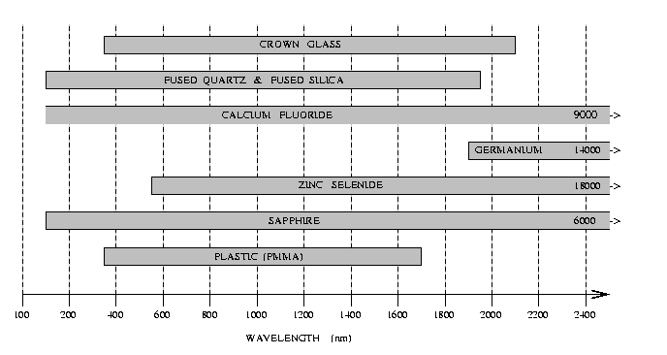
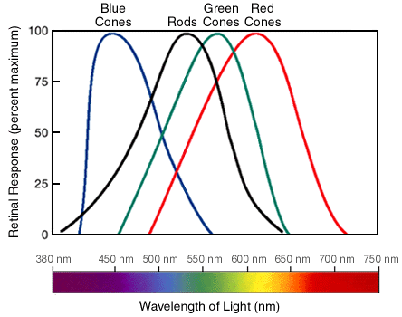
Lens materials
Crown Glass
Fused Quartz & Fused Silica
Calcium Fluoride
9000
Germanium 14000
Zinc Selenide
18000
Saphire
6000
Plastic (PMMA)
100 200 400 600 800 1000 1200 1400 1600 1800 2000 2200 2400
WAVELENGTH (nm)
additional considerations :
humidity and temperature resistance, weight, price,...
➔

Slide 30
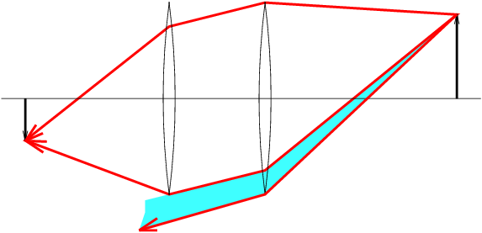
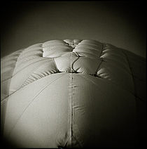

Vignetting

