Slide 1
Image Formation III
Chapter 1 (Forsyth&Ponce) Cameras “Lenses”
Guido Gerig
CS 6320 S2013
(slides modified from Marc Pollefeys, UNC Chapel Hill)

Slide 2
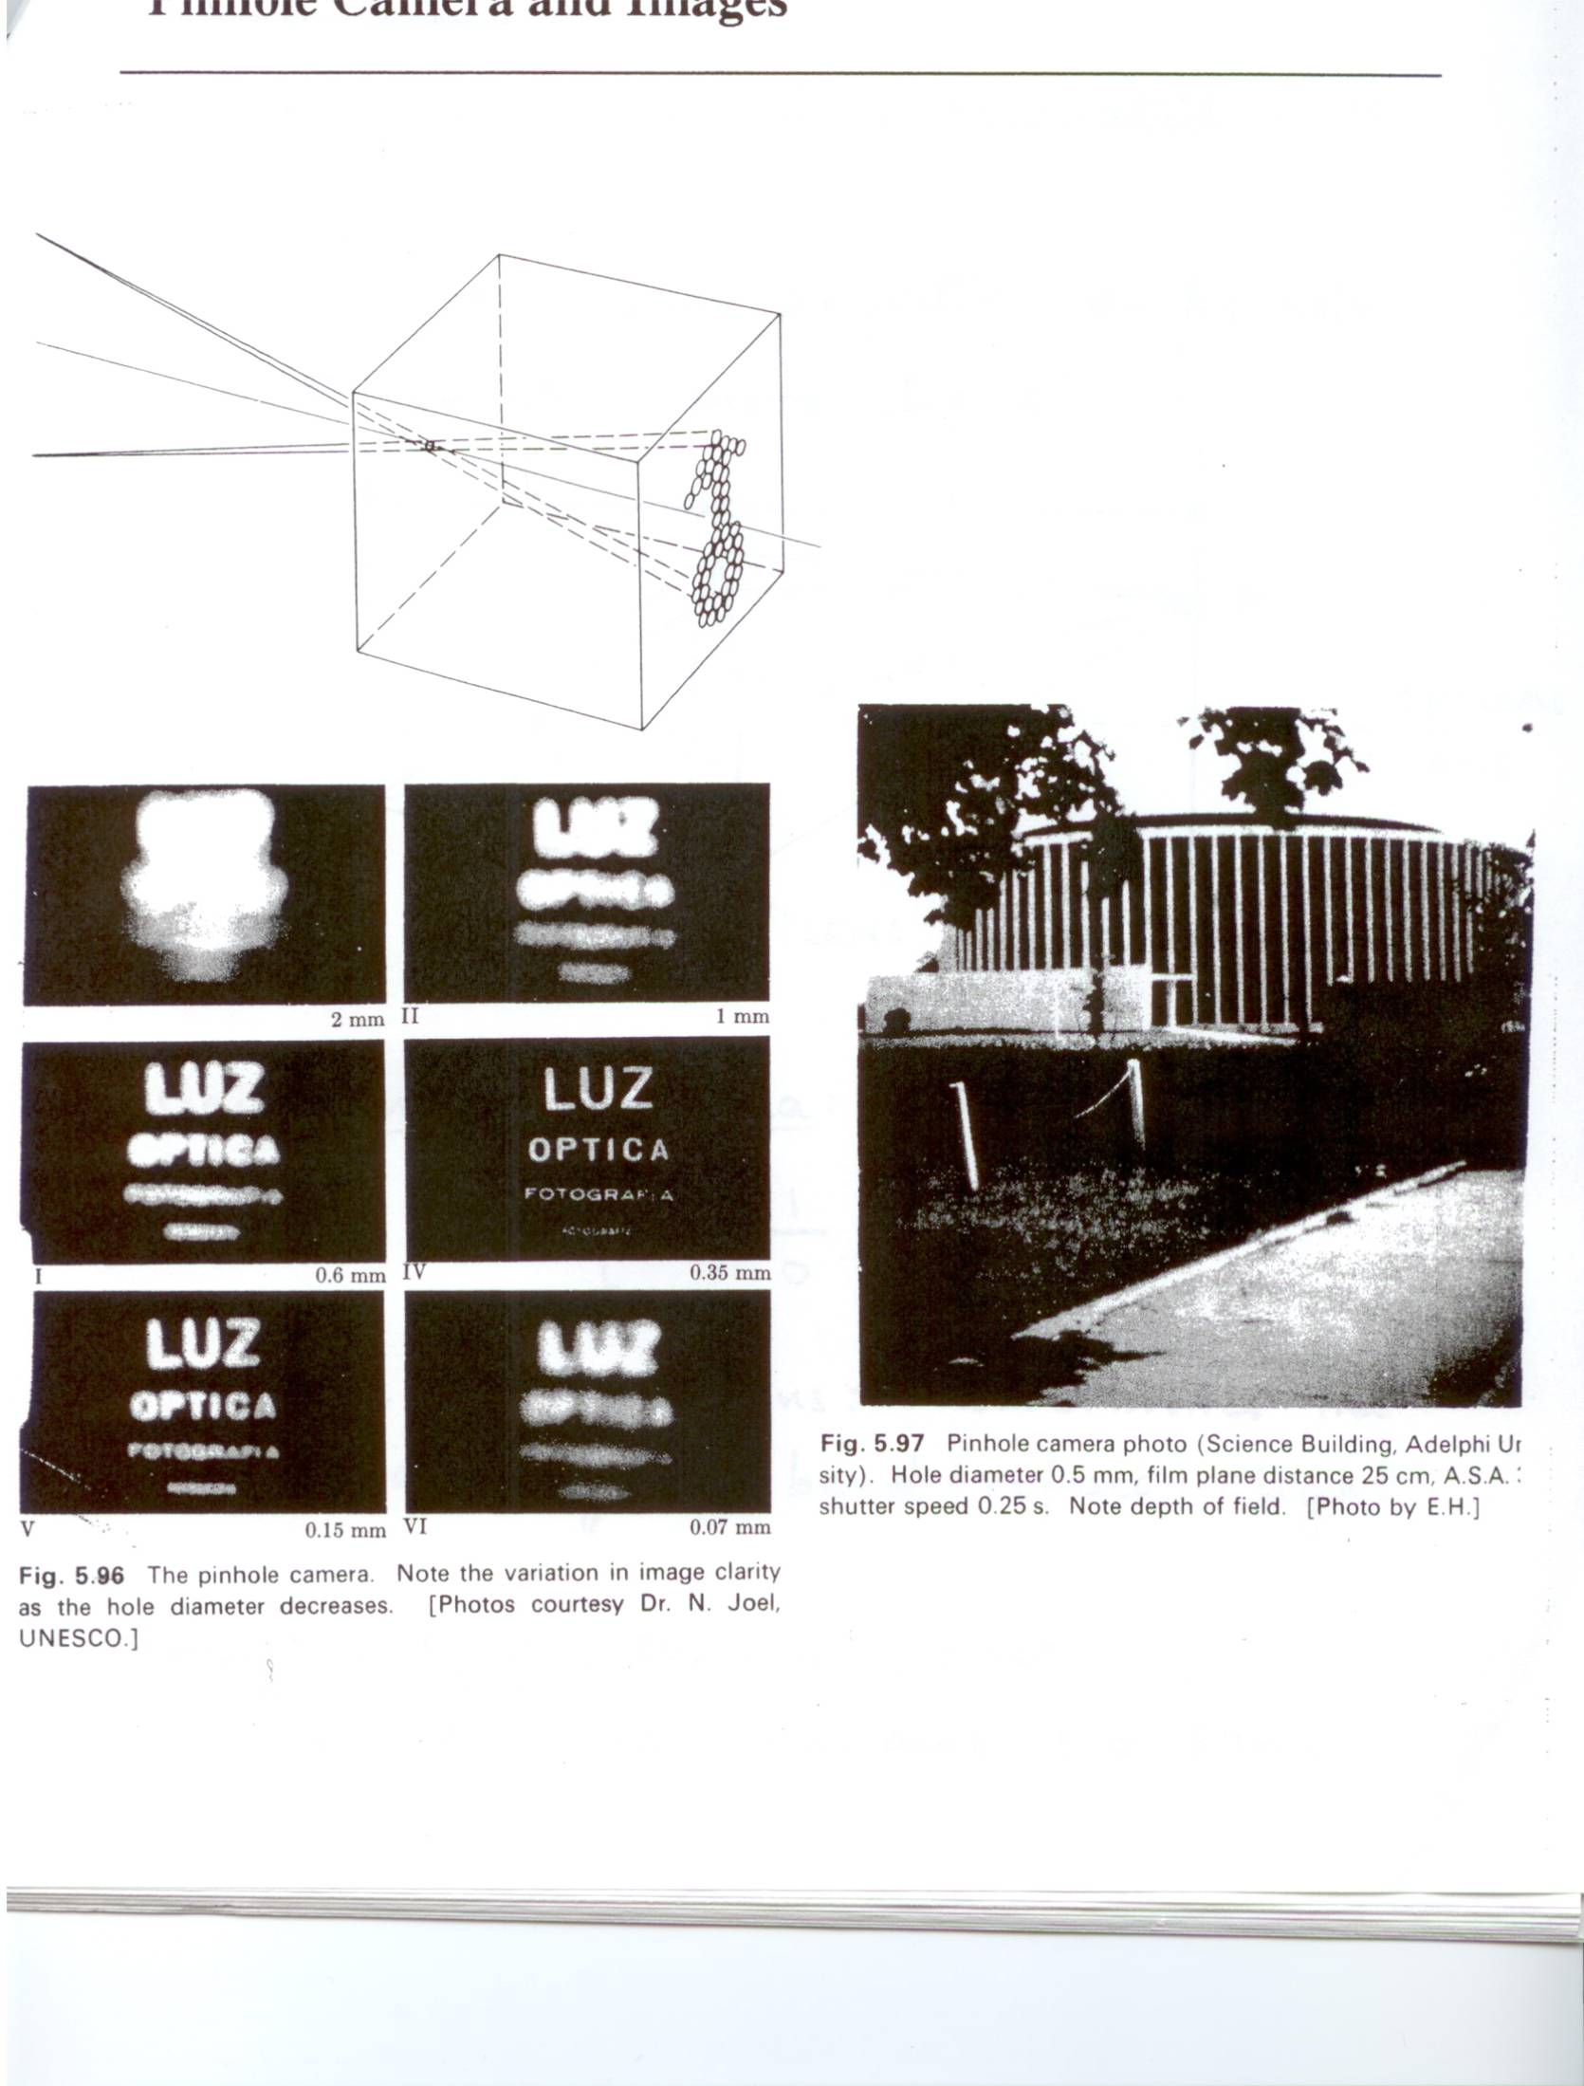
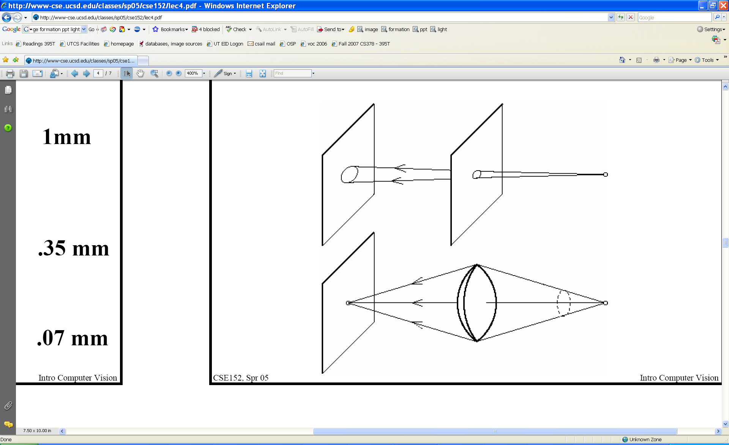
Pinhole size / aperture
How does the size of the aperture affect the image we’d get?
Larger
Smaller
K. Grauman

Slide 3
Pinhole vs. lens
K. Grauman

Slide 4
Adding a lens
focal point
f
A lens focuses light onto the film
  Rays passing through the center are not deviated
  All parallel rays converge to one point on a plane located at the focal length f
Slide by Steve Seitz

Slide 5
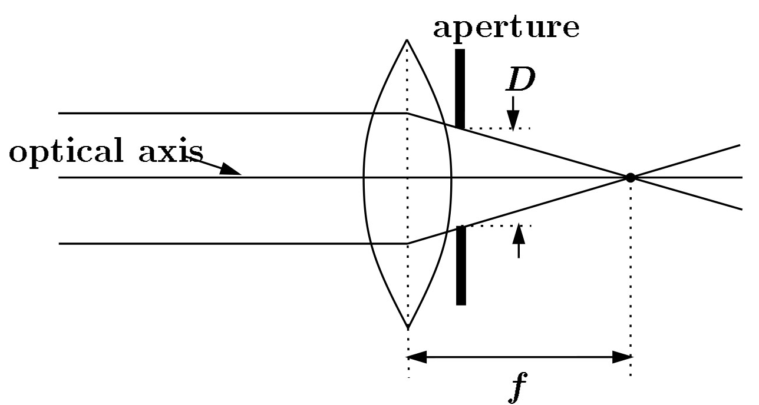
Cameras with lenses
F
focal point
optical center
(Center Of Projection)
A lens focuses parallel rays onto a single focal point
Gather more light, while keeping focus; make pinhole perspective projection practical
K. Grauman

Slide 6
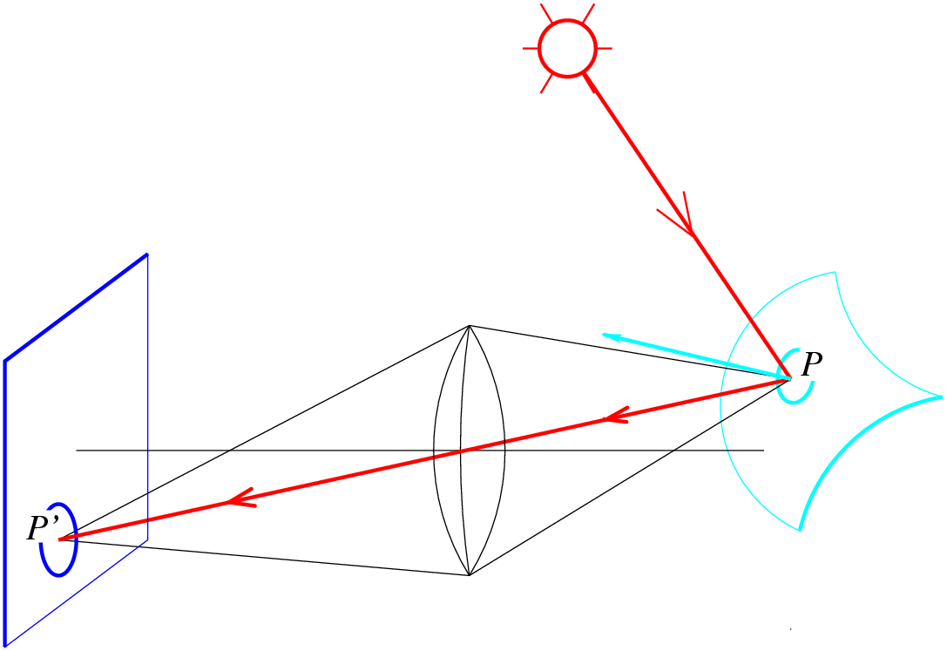
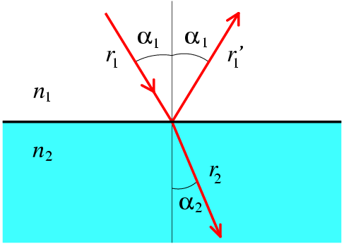
Lenses
Snell’s law
n₁ sin α₁ = n₂ sin α₂
Descartes’ law

Slide 7
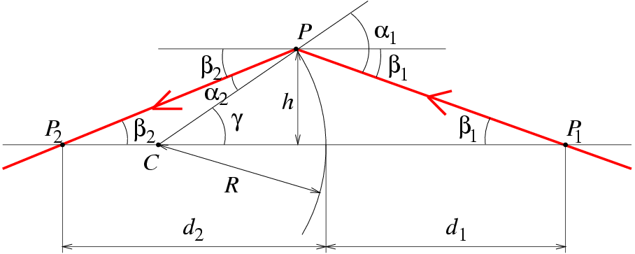
Paraxial (or first-order) optics
Snell’s law:
n₁ sin α₁ = n₂ sin α₂
Small angles:
n₁ α₁ ≈ n₂α₂

Slide 8
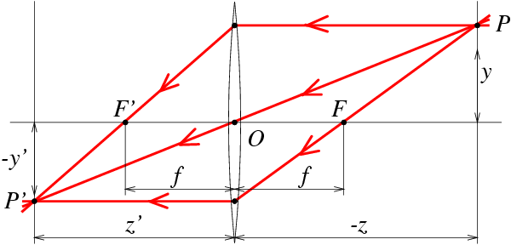
Thin Lenses
spherical lens surfaces; thickness << radii; same refractive index on both sides; all rays emerging from P and passing through the lens are focused at P’. Let n₁=1 (vaccuum) and n₂=n.

Slide 9
Thin Lenses
spherical lens surfaces; thickness << radii; same refractive index on both sides; all rays emerging from P and passing through the lens are focused at P’. Let n₁=1 (vaccuum) and n₂=n.
http://www.phy.ntnu.edu.tw/java/Lens/lens_e.html

Slide 10
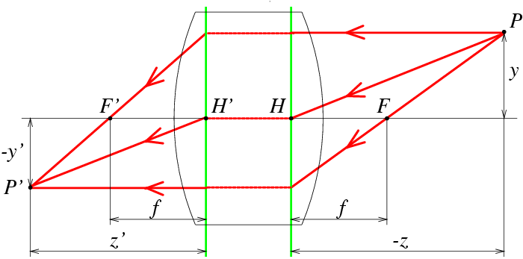
Thick Lens

Slide 11
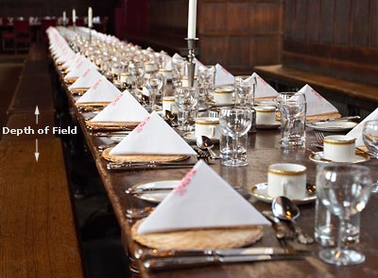
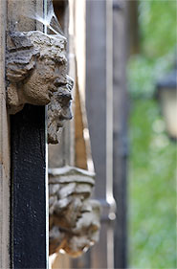
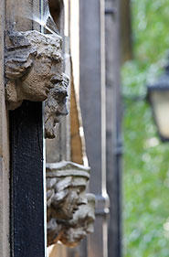
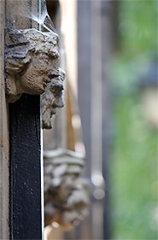
Focus and depth of field
Image credit: cambridgeincolour.com

Slide 12
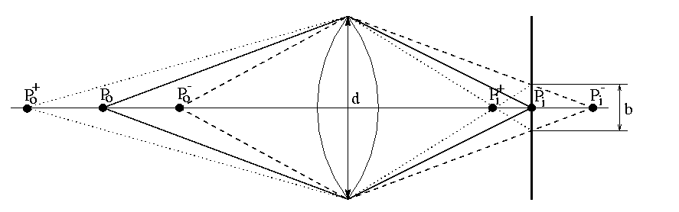
The depth-of-field
➔

Slide 13
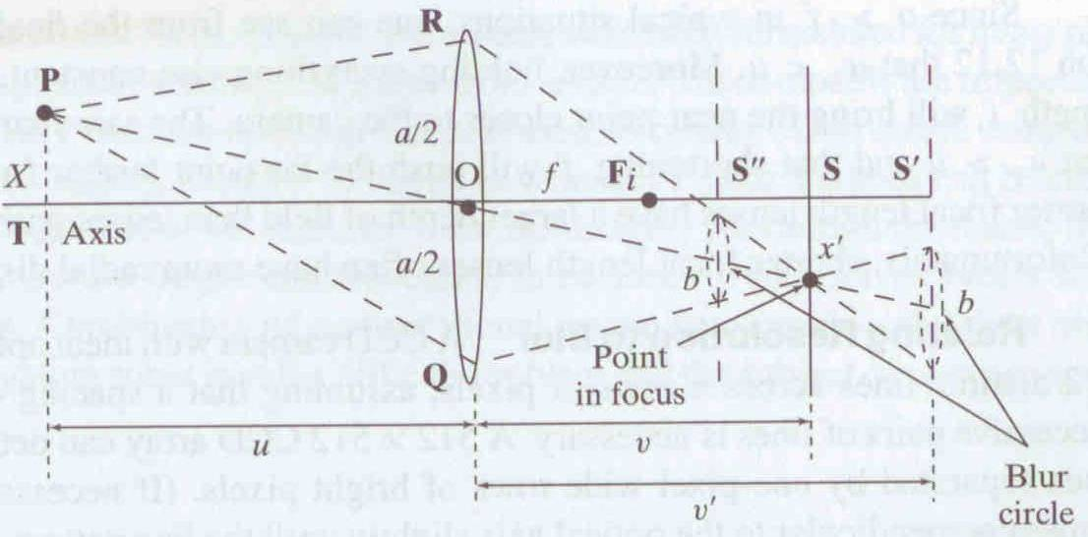
Focus and depth of field
Depth of field: distance between image planes where blur is tolerable
Thin lens: scene points at distinct depths come in focus at different image planes.
(Real camera lens systems have greater depth of field.)
“circles of confusion”
Shapiro and Stockman

Slide 14
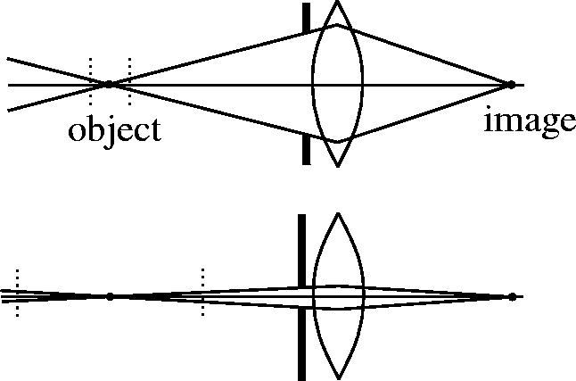
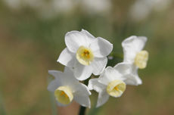
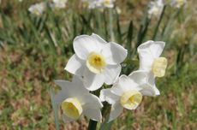
Focus and depth of field
How does the aperture affect the depth of field?
A smaller aperture increases the range in which the object is approximately in focus
Flower images from Wikipedia http://en.wikipedia.org/wiki/Depth_of_field
Slide from S. Seitz

Slide 15
The depth-of-field
➔

Slide 16
The depth-of-field
yields
Similar formula for
➔

Slide 17
The depth-of-field
decreases with d+, increases with Z₀+
strike a balance between incoming light and
sharp depth range
➔

Slide 18
Deviations from the lens model
3 assumptions :
1. all rays from a point are focused onto 1 image point
2. all image points in a single plane
3. magnification is constant
deviations from this ideal are aberrations
➔

Slide 19
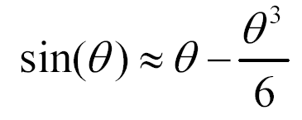
Aberrations
2 types :
1. geometrical
2. chromatic
geometrical : small for paraxial rays
study through 3rd order optics
chromatic : refractive index function of
wavelength
➔

Slide 20
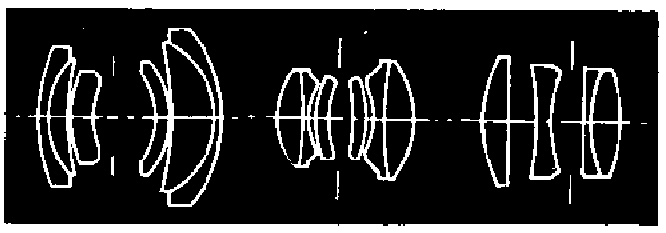
Geometrical aberrations
spherical aberration
astigmatism
distortion
coma
aberrations are reduced by combining lenses
➔

Slide 21
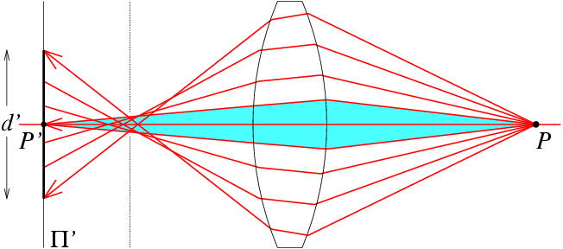
Spherical aberration
rays parallel to the axis do not converge
outer portions of the lens yield smaller
focal lenghts
➔

Slide 22
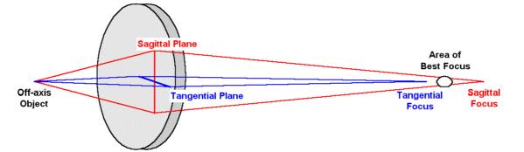
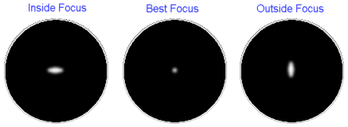
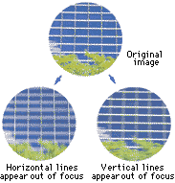
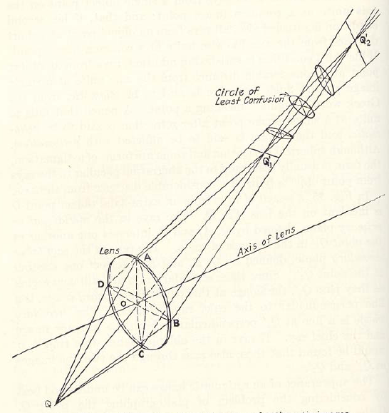
Astigmatism
Different focal length for inclined rays

Slide 23
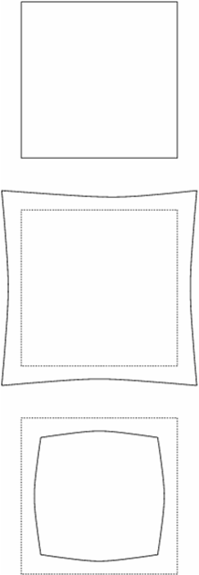
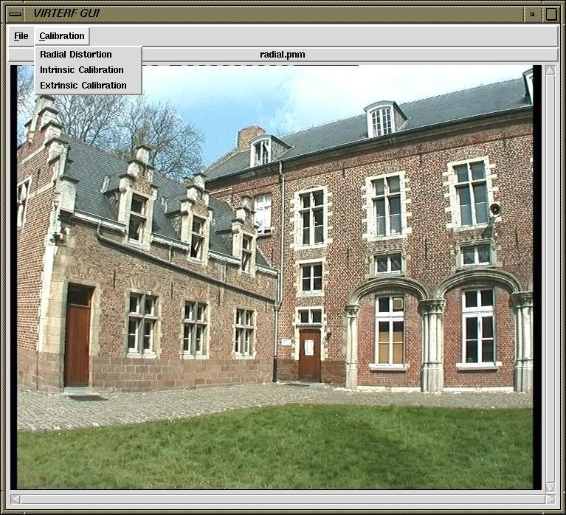
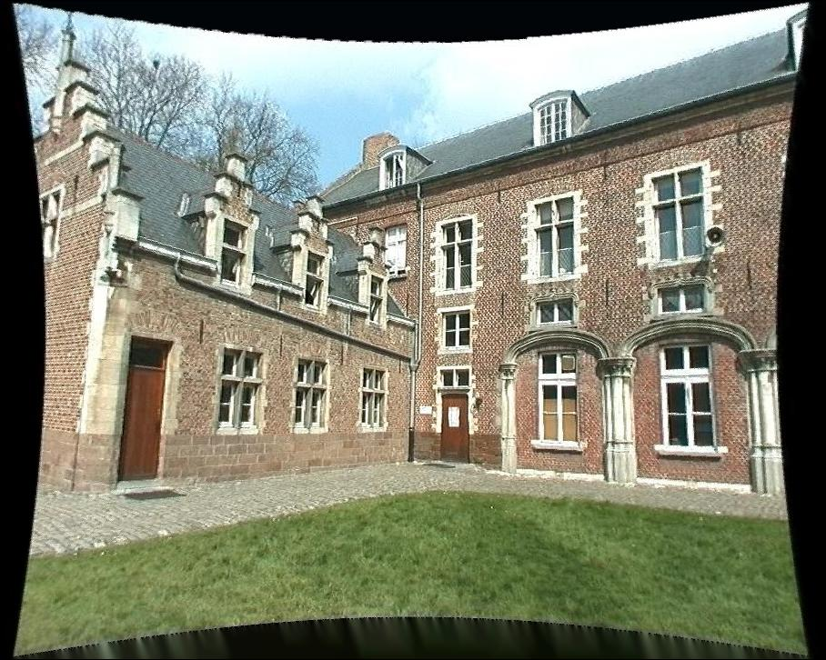
Distortion
magnification/focal length different
for different angles of inclination
pincushion
(tele-photo)
barrel
(wide-angle)
Can be corrected! (if parameters are know)

Slide 24
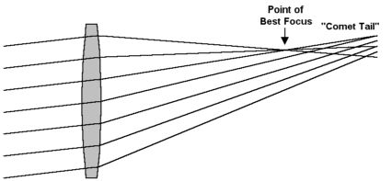
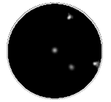
Coma
point off the axis depicted as comet shaped blob

Slide 25
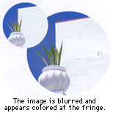
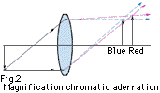

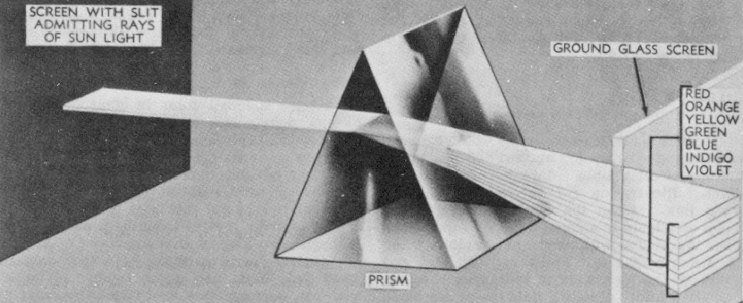
Chromatic aberration
rays of different wavelengths focused
in different planes
cannot be removed completely
sometimes achromatization is achieved for
more than 2 wavelengths
➔

Slide 26
Lens materials
reference wavelengths :
λ_{F} = 486.13nm
λ_{d} = 587.56nm
λ_{C} = 656.28nm
lens characteristics :
1. refractive index n_{d}
2. Abbe number V_{d}= (n_{d} - 1) / (n_{F} - n_{C})
typically, both should be high
allows small components with sufficient refraction
notation : e.g. glass BK7(517642)
n_{d} = 1.517 and V_{d}= 64.2
➔

Slide 27
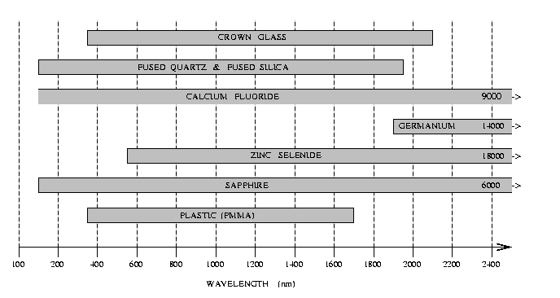
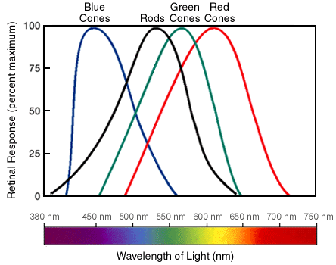
Lens materials
Crown Glass
Fused Quartz & Fused Silica
Calcium Fluoride
9000
Germanium 14000
Zinc Selenide
18000
Saphire
6000
Plastic (PMMA)
100 200 400 600 800 1000 1200 1400 1600 1800 2000 2200 2400
WAVELENGTH (nm)
additional considerations :
humidity and temperature resistance, weight, price,...
➔

Slide 28
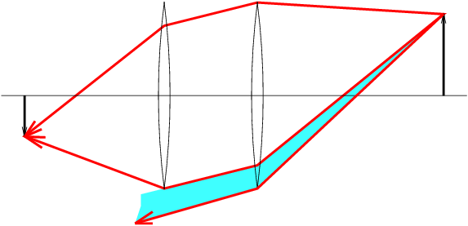
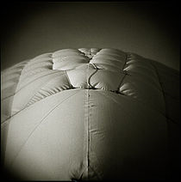

Vignetting

