Slide 1
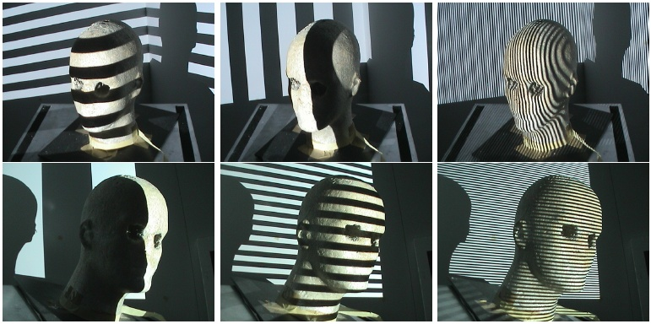
Structured Lighting
Guido Gerig
CS 6320, 3D Computer Vision
Spring 2012
(thanks: some slides S. Narasimhan CMU, Marc Pollefeys UNC)
http://www.cs.cmu.edu/afs/cs/academic/class/15385-s06/lectures/ppts/lec-17.ppt

Slide 2
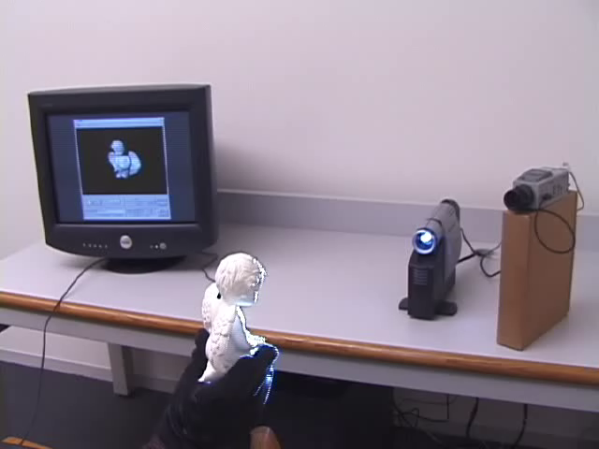
Real-Time 3D Model Acquisition
http://graphics.stanford.edu/papers/rt_model/
The SIGGRAPH Paper:
Full paper as PDF.
One-page abstract and Figure 1 as PDF.
Two-page abstract and Figure 1 as PDF.
A 5-minute video describing the system:
AVI file, 640 x 480 pixels (19MB)
RealVideo stream, 640 x 480 pixels, 1536 kbs
RealVideo stream, 320 x 240, 56 - 904 kbs
SIGGRAPH 2002 talk:
Talk as PPT
Embedded video clip: sig02_begin_m.avi
Embedded video clip: sig02_recap.avi
Embedded video clip: turtle2.avi
Link:
http://graphics.stanford.edu/papers/rt_model/
Notes:
[Video clip of hand moving object, then view of screen. 40 secs, no sound]
Here is a new pipeline that *is* designed for fast feedback to the user. The user moves the object around by hand (notice the black glove so we don’t get fingers in the scan). You can always see the current state of the model on the screen, and can move the object to fill any holes.

Slide 3
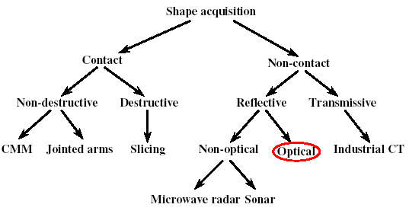
A Taxonomy

Slide 4
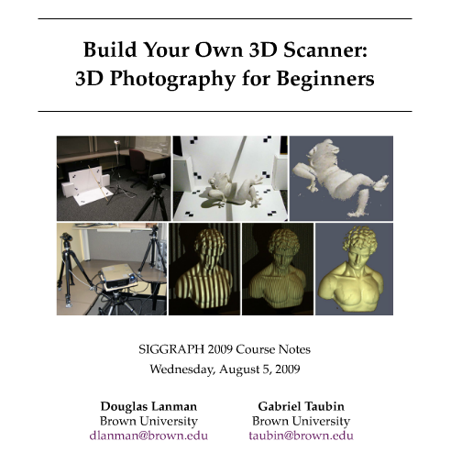
Excellent Additional Materials
Course notes: http://mesh.brown.edu/byo3d/notes/byo3D.pdf
Slides: http://mesh.brown.edu/byo3d/slides.html
Source code: http://mesh.brown.edu/byo3d/source.html

Slide 5
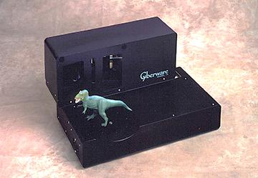
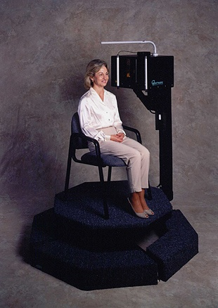
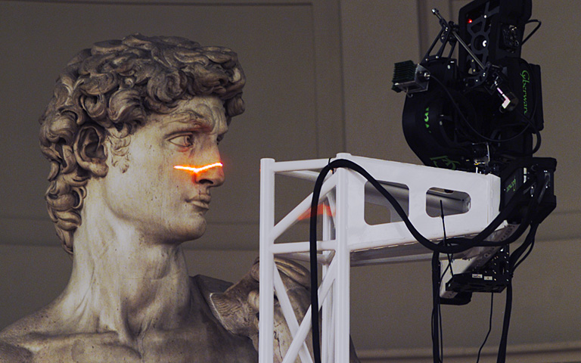
3D Scanning
Courtesy S. Narasimhan, CMU
Notes:
3D scanning becoming widely used, both in traditional areas like model building for movies and in new areas such as art history and archeology.

Slide 6
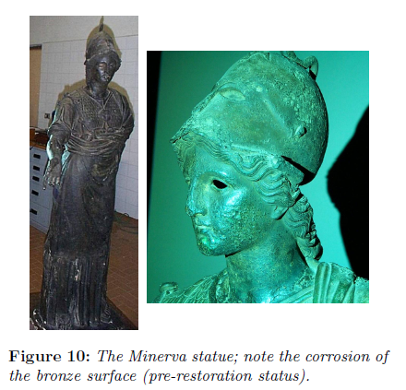
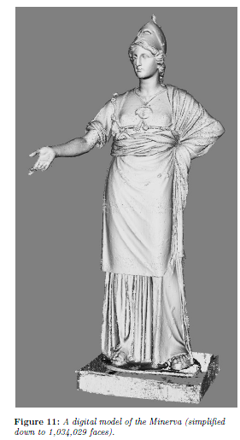
Typical Application

Slide 7
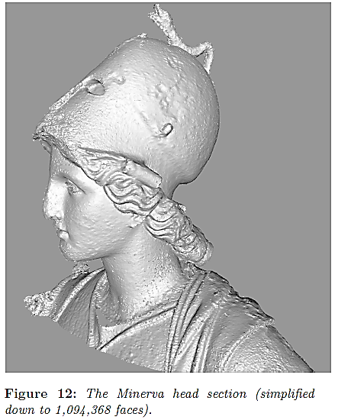

Slide 8
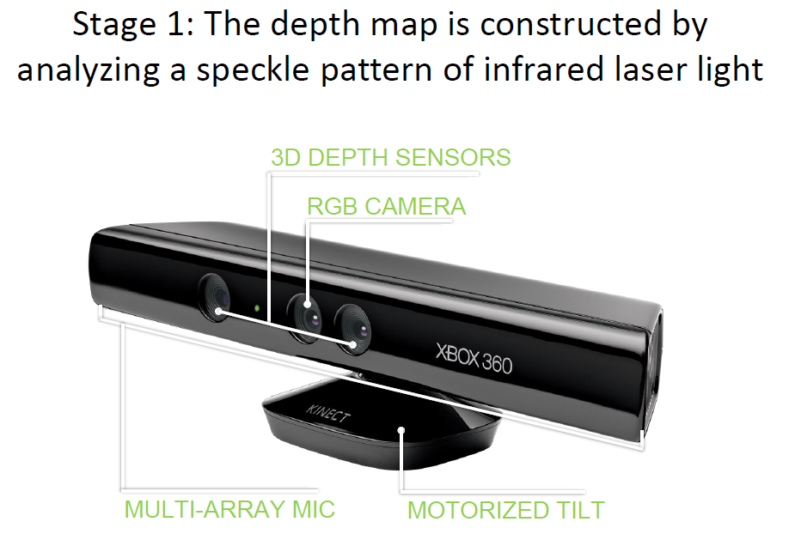
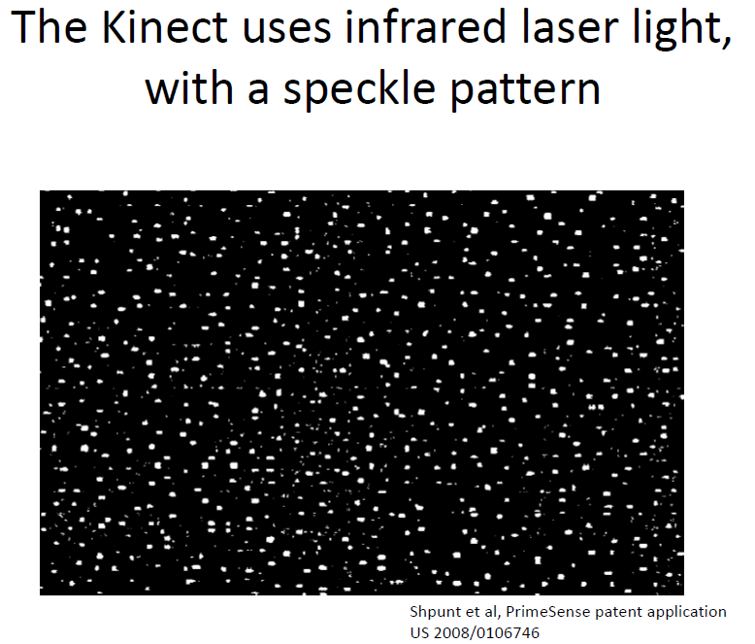
Microsoft Kinect
The Kinect combines structured light with two classic computer vision techniques: depth from focus, and depth from stereo.
http://users.dickinson.edu/~jmac/selected-talks/kinect.pdf

Slide 9
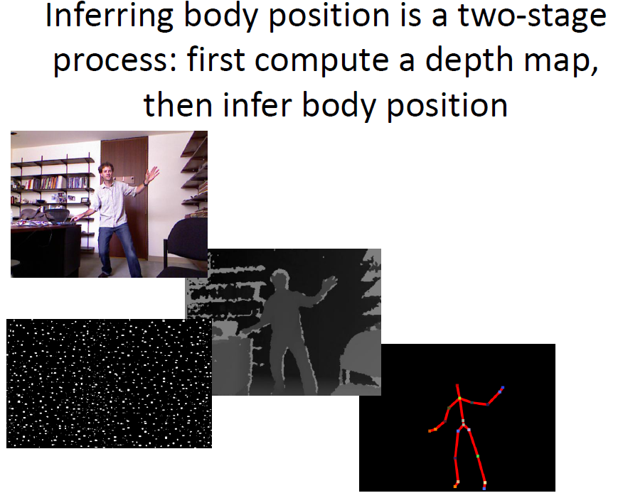
Microsoft Kinect
http://users.dickinson.edu/~jmac/selected-talks/kinect.pdf

Slide 10
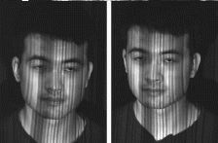
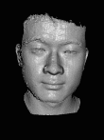
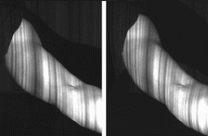
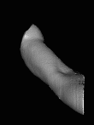
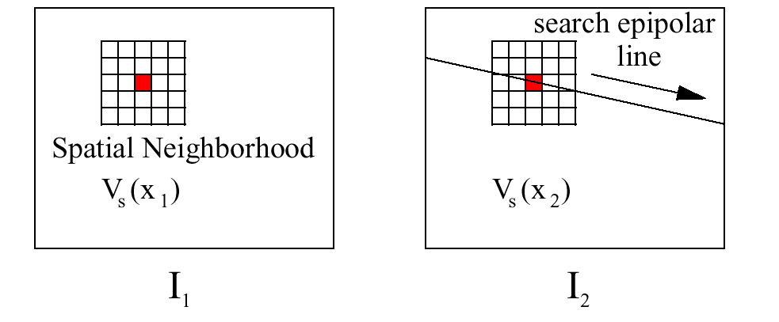
Space-time stereo
Zhang, Curless and Seitz, CVPR’03

Slide 11
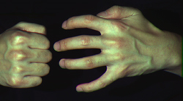
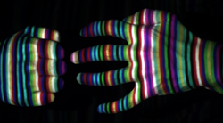
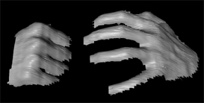
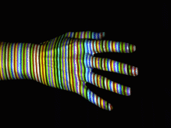
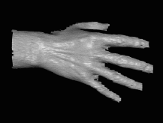
Real Time by Color Coding
Works despite complex appearances
Works in real-time and on dynamic scenes
Need very few images (one or two).
But needs a more complex correspondence algorithm
Zhang et al, 3DPVT 2002

Slide 12
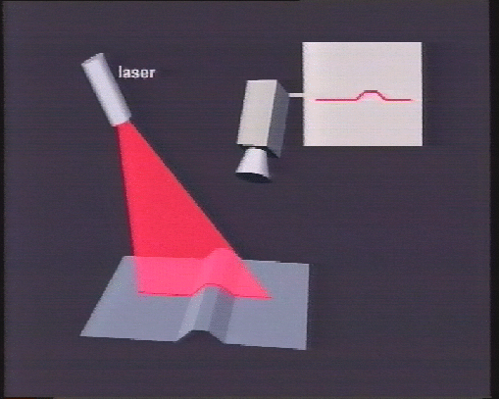
Concept: Active Vision
Active manipulation of scene: Project light pattern on object. Observe geometry of pattern via camera → 3D geometry

Slide 13
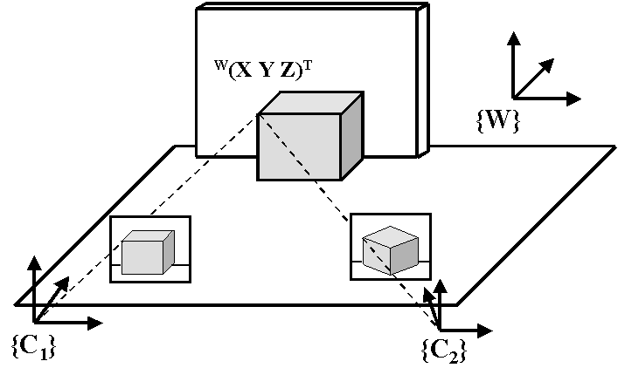
Passive triangulation: Stereo vision
Correspondence problem
Geometric constraints ⇒
search along epipolar lines
3D reconstruction of matched pairs by triangulation

Slide 14
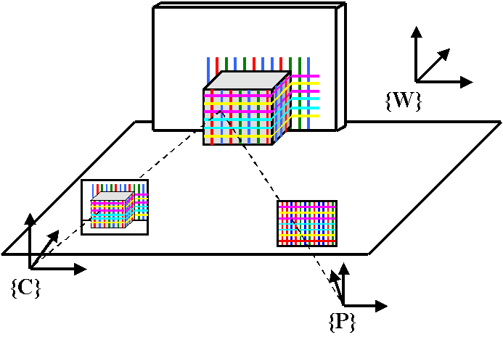
Active triangulation: Structured light
One of the cameras is replaced by a light emitter
Correspondence problem is solved by searching the pattern in the camera image (pattern decoding)
No geometric constraints

Slide 15
Overview
Background
General Setup
Light Point Projection 2D and 3D
Light Stripe Projection
Static Light Pattern Projection
  Binary Encoded Light Stripes
  Segmenting Stripes
3D Photography on Your Desk

Slide 16
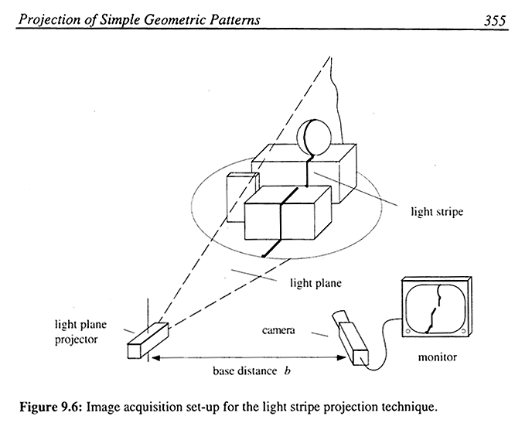
General Setup
one camera
one light source
  types
    slide projector
    laser
  projection
    spot
    stripe
    pattern

Slide 17
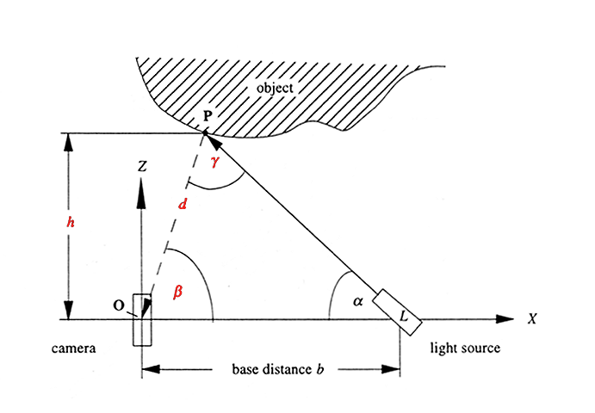
Light Spot Projection 2D
Assume point-wise illumination by laser beam, only 2D
image
plane

Slide 18
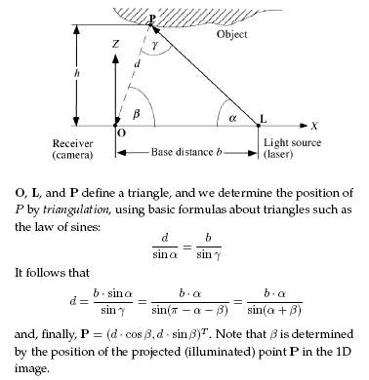
Light Spot Projection 2D

Slide 19
Light Spot Projection 2D
Coordinates found by triangulation
  β can be found by projection geometry
  d = b*sin(α)/sin(α + β)
  X₀ = d*cos(β)
  Z₀ = h = d*sin(β)
Concept:
  known b and α
  − β defined by projection geometry
  Given image coordinate u and focal length f -> calculate β
  Given b, α, β -> calculate d

Slide 20
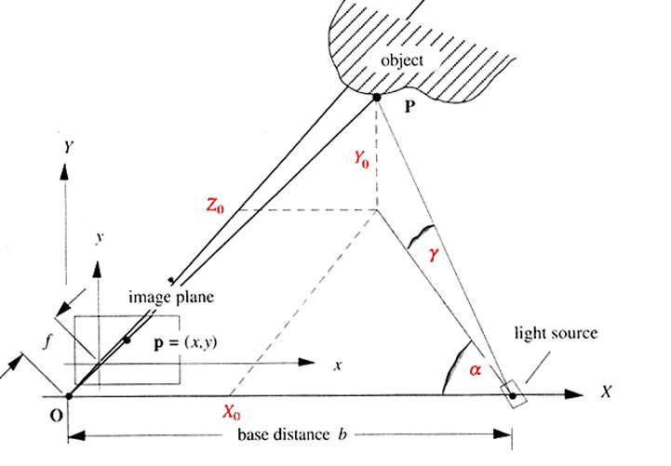
Light Spot Projection 3D
Z

Slide 21
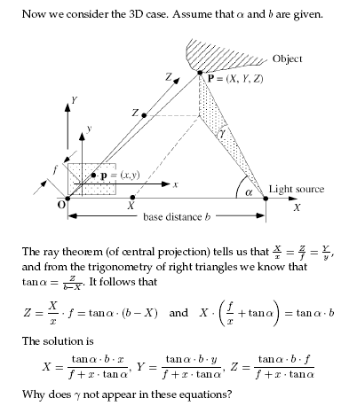
Light Spot Projection 3D

Slide 22
Light Spot Projection 3D
  X₀ = (tan(α)*b*x)/(f + x*tan(α))
  Y₀ = (tan(α)*b*y)/(f+x*tan(α))
  Z₀ = (tan(α)*b*f)/(f+x*tan(α))
OBSERVATION????
Angle gamma γ not used !!!! (Exercise)

Slide 23
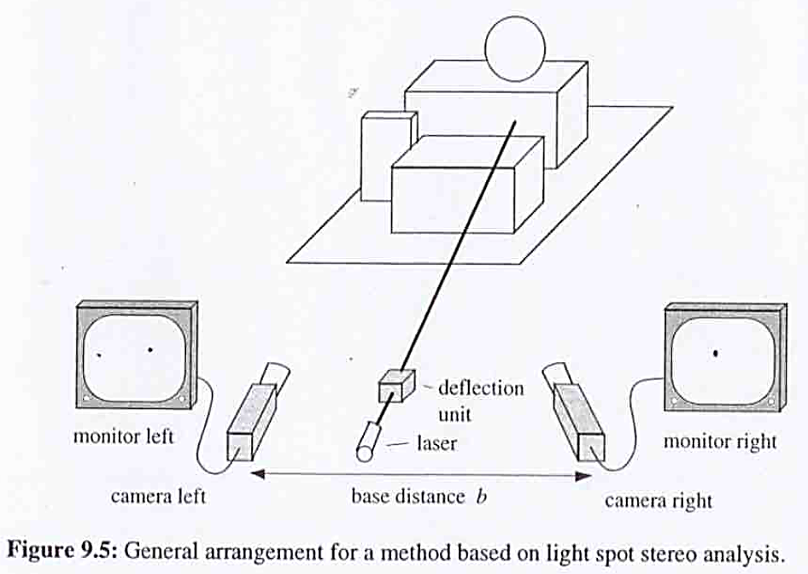
Special Case: Light Spot Stereo

Slide 24
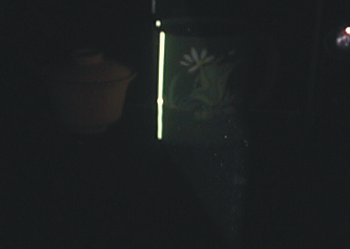
Light Stripe Scanning – Single Stripe
Light plane
Source
Camera
Surface
Optical triangulation
  Project a single stripe of laser light
  Scan it across the surface of the object
  This is a very precise version of structured light scanning
  Good for high resolution 3D, but needs many images and takes time
Courtesy S. Narasimhan, CMU

Slide 25
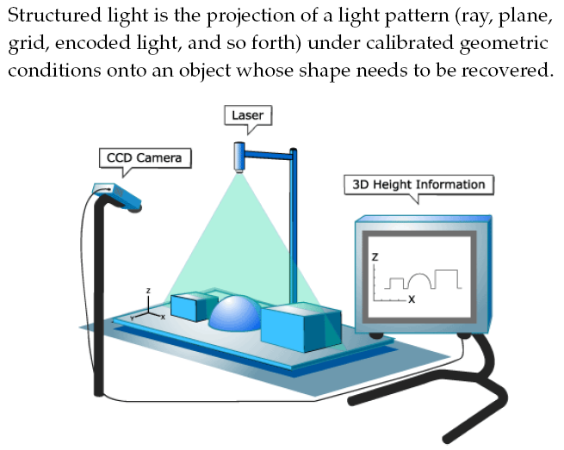
Light Stripe Projection

Slide 26
Triangulation
Light Plane
Object
Laser
Camera
Project laser stripe onto object
Courtesy S. Narasimhan, CMU
Notes:
The first stage in the real-time pipeline is the range scanner. It’s based on the idea of triangulation. In the simplest case, this consists of projecting a stripe of light onto a scene, looking at it from an angle…

Slide 27
Triangulation
Light Plane
Object
Laser
Image Point
Plug X, Y into plane equation to get Z
Camera
Depth from ray-plane triangulation:
  Intersect camera ray with light plane
Courtesy S. Narasimhan, CMU
Notes:
… and triangulating between a plane from the point of view of the light source and a ray from the point of view of the camera. In the simplest case of a laser triangulation scanner, this yields data from a single contour on the object at a time, and you can sweep the line across the surface to stack up a bunch of these contours and get a scan of an entire patch of surface.

Slide 28
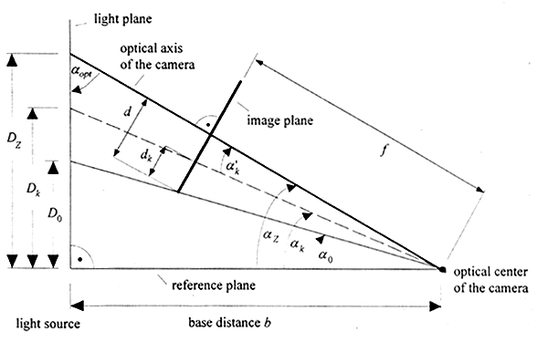
Light Stripe Projection: Calibration
Put calibration object into scene
Shift object along light plane
P

Slide 29
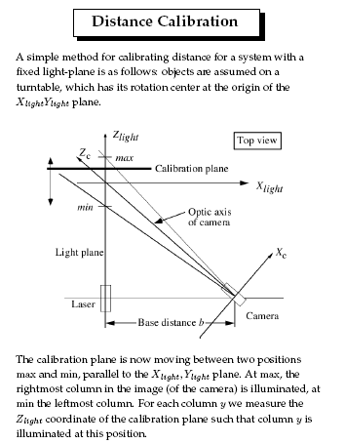
Light Stripe Projection: Calibration

Slide 30
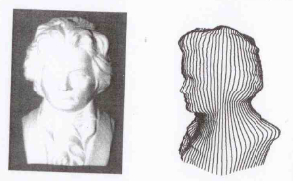
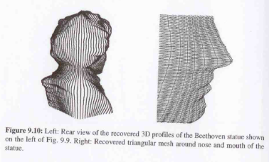
Straightforward: Single light stripe and rotating Object
Object on turntable:
Create P(X,Y,Z) profile for each rotation and fixed light slit
Rotate object in discrete intervals and repeat
Reconstruct 3D object by cylindric assembly of profiles → 3D mesh

Slide 31
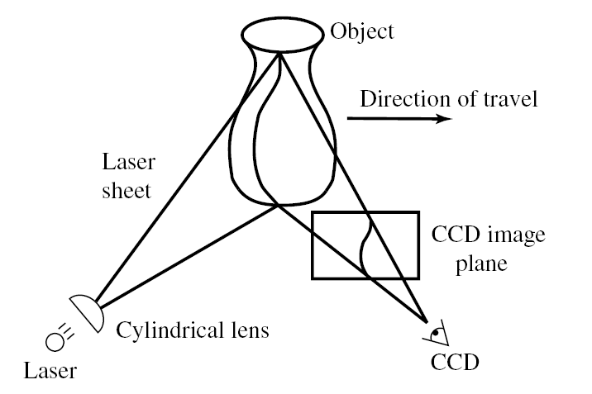
Example: Laser scanner
Cyberware® face and head scanner
+ very accurate < 0.01 mm
− more than 10sec per scan

Slide 32
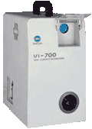
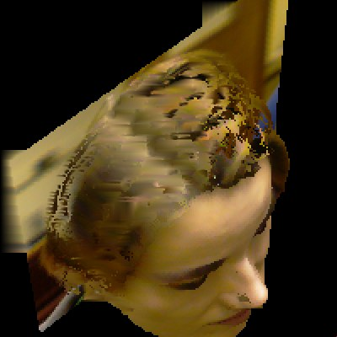

Portable 3D laser scanner (this one by Minolta)

Slide 33
Example: Laser scanner
Digital Michelangelo Project
http://graphics.stanford.edu/projects/mich/

Slide 34
Can we do it without expensive equipment?

Slide 35
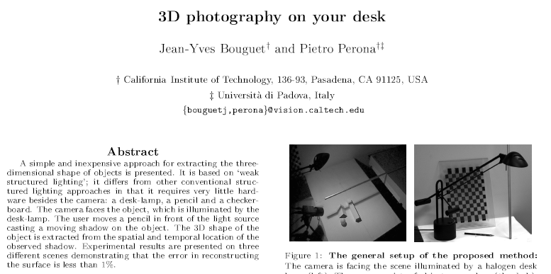
3D Acquisition from Shadows
Bouguet-Perona, ICCV 98

Slide 36
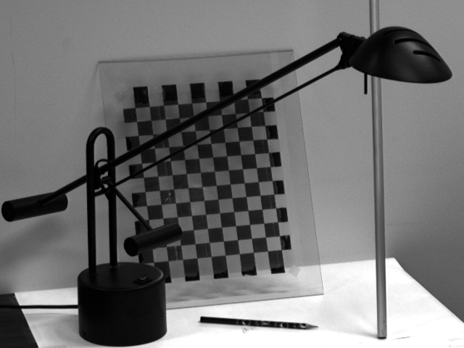
3D Photography on Your Desk
“Cheap” method that uses very common tools to do 3D photography
Requirements: PC, camera, stick, lamp, and a checker board
Uses “weak structured light” approach

Slide 37
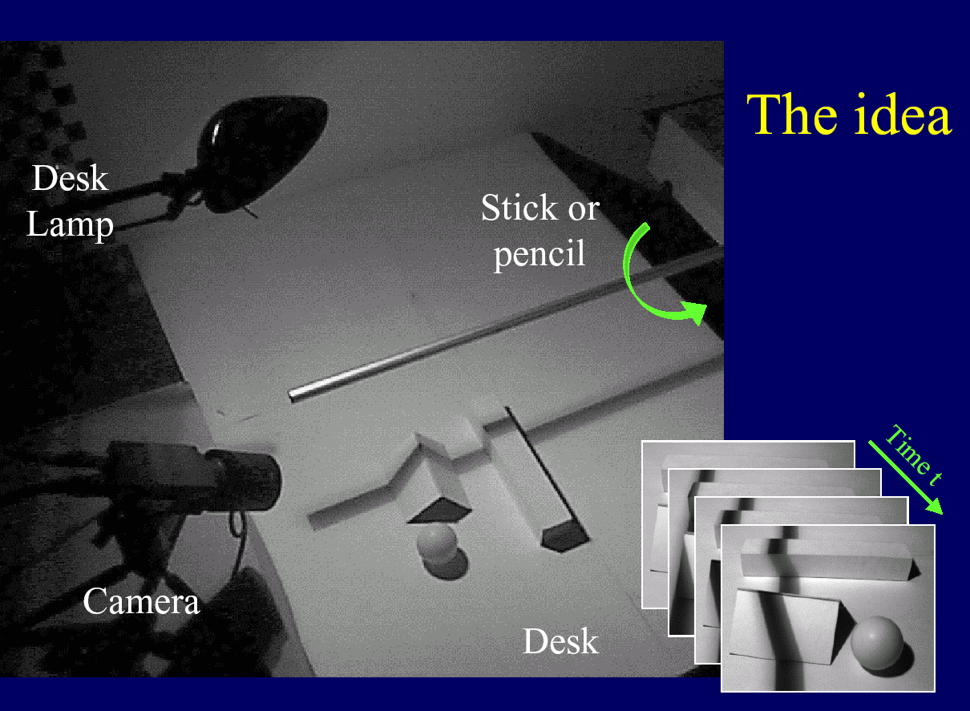

Slide 38
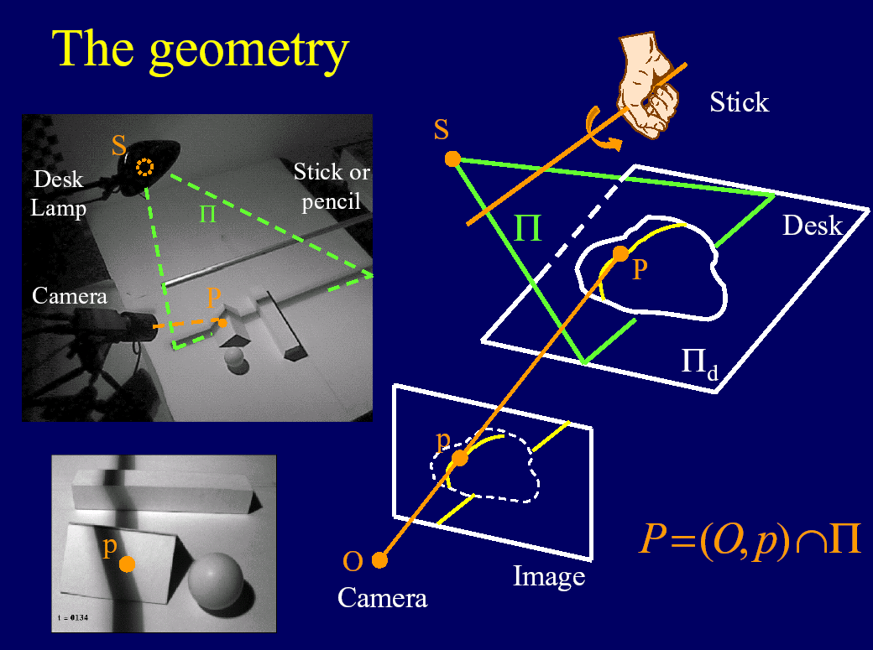

Slide 39
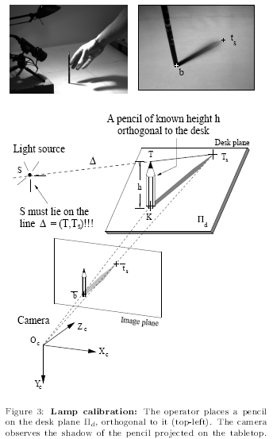
Lamp Calibration

Slide 40
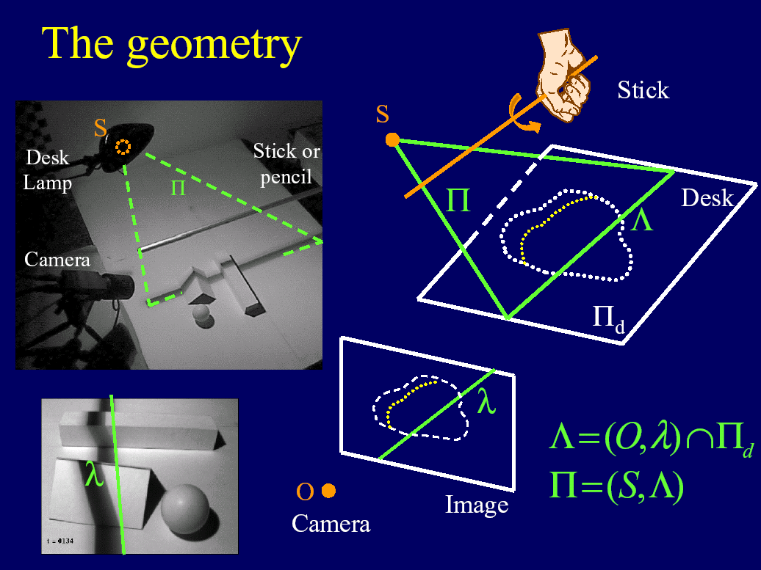

Slide 41
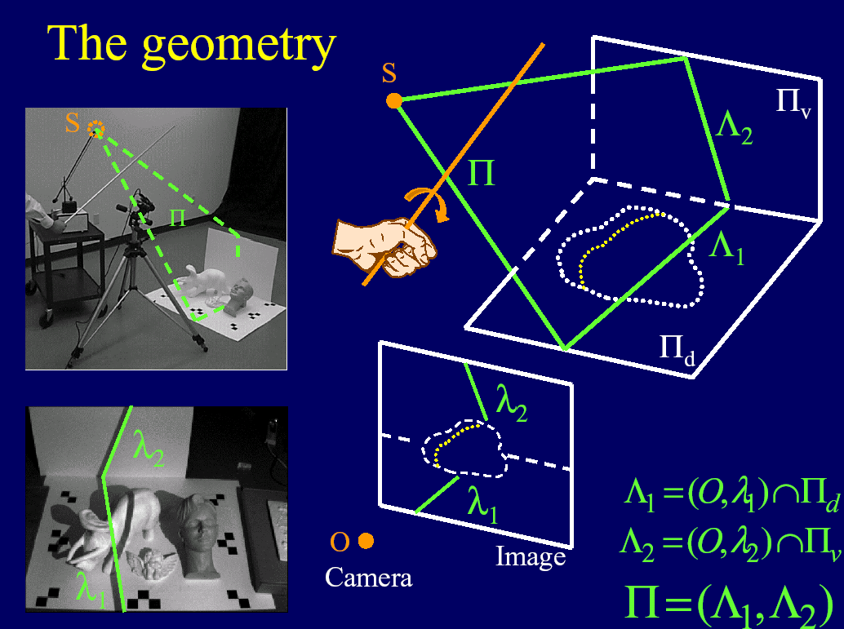

Slide 42
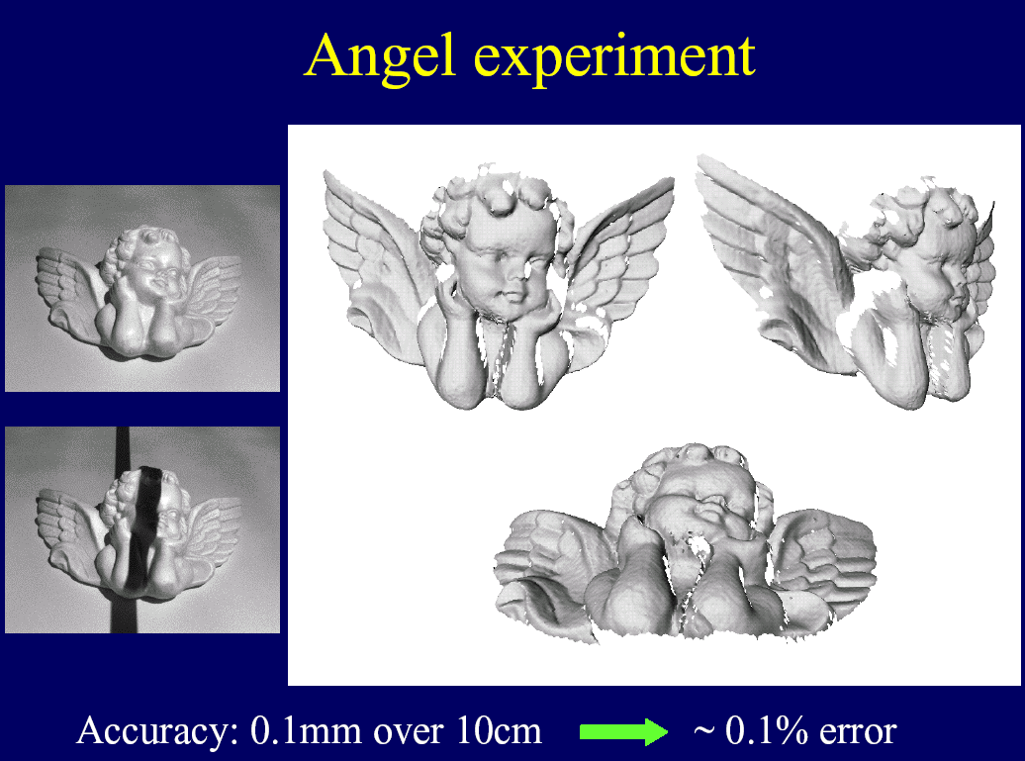

Slide 43
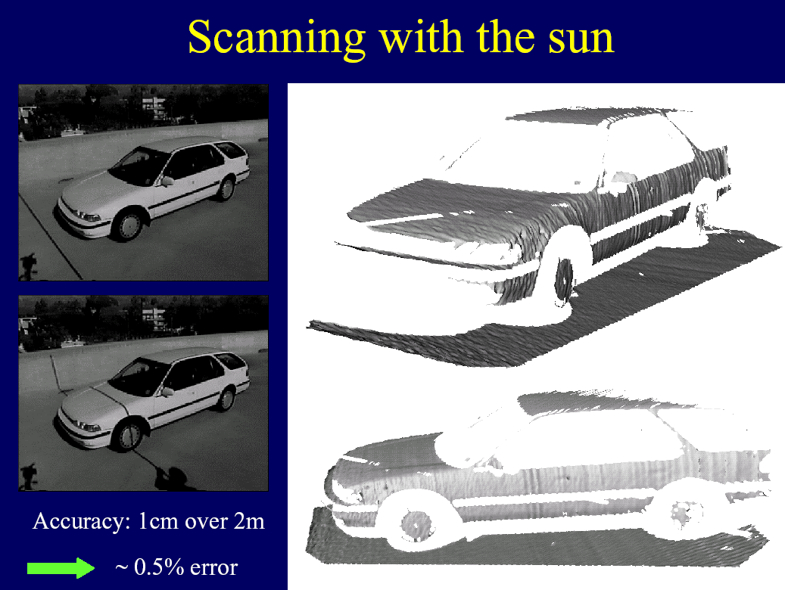

Slide 44





Low-Cost 3D Scanner for Everyone
http://www.david-laserscanner.com/

Slide 45





Low-Cost 3D Scanner for Everyone
http://www.david-laserscanner.com/wiki/user_manual/3d_laser_scanning

Slide 46

Image Processing Problem: Segmenting Stripes
New Problem: How can we find the stripes in the images?
Image thresholding is dependent on the contrast

Slide 47
Image Processing Problem: How to detect stripes in images?
Edge detection: Thresholding difficult
Line detection: Lines of different width
Solution: Project positive and negative strip pattern, detect intersections

Slide 48

Subpixel accuracy
Zero crossings of 2nd derivative
  Gradient filter width must be chosen
  Depends on stripe width
  Problem: Width changes with orientation of surface

Slide 49


Subpixel accuracy
Linear interpolation
  With fully lit and completely dark images determine dynamic threshold T
  P determined by intersecting threshold and image profile
  Robust against changes in contrast

Slide 50


Subpixel accuracy
+
Inverse stripe pattern intersection
  Also robust against slightly different width of black and white stripes
  No bias from isolating gap between adjacent stripes in LCD array

Slide 51
Image Processing Problem: How to detect stripes in images?
Edge detection
Line detection
Solution: Project positive and negative strip pattern, detect intersections
But: set of lines, uniqueness?, which part of the line corresponds to which light plane?

Slide 52

Next Lecture: Encoded Patterns
Any spatio-temporal pattern of light projected on a surface (or volume).
Cleverly illuminate the scene to extract scene properties (eg., 3D).
Avoids problems of 3D estimation in scenes with complex texture/BRDFs.
Very popular in vision and successful in industrial applications (parts assembly, inspection, etc).

