Slide 1
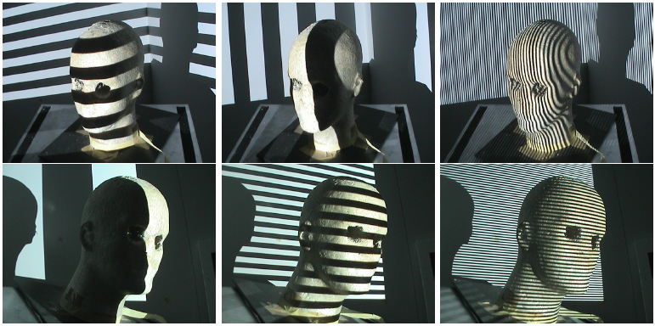
Structured Light II
Guido Gerig
CS 6320, Spring 2012
(thanks: slides Prof. S. Narasimhan, CMU, Marc Pollefeys, UNC)
http://www.cs.cmu.edu/afs/cs/academic/class/15385-s06/lectures/ppts/lec-17.ppt

Slide 2
Faster Acquisition?
Project multiple stripes simultaneously
Correspondence problem: which stripe is which?
Common types of patterns:
Binary coded light striping
Gray/color coded light striping
Notes:
For our real-time pipeline, though, we want to go faster – we need to get as much data at once as possible. The obvious way to do this is to project a bunch of stripes at once, but then we need to figure out which stripe is which.

Slide 3
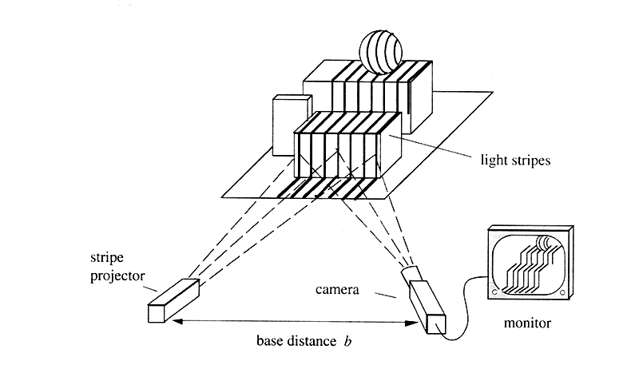
Static Light Pattern Projection

Slide 4
Static Light Pattern Projection
Project a pattern of stripes into the scene to reduce the total number of images required to reconstruct the scene.
Each stripe/line represents a specific angle α of the light plane.
Problem: How to uniquely identify light stripes in the camera image when several are simultaneously projected into the scene.

Slide 5
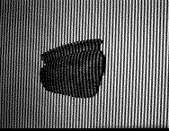
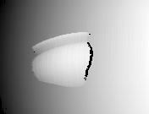
Time-Coded Light Patterns
Assign each stripe a unique illumination code over time [Posdamer 82]
#stripes = m^{n} : m gray levels, n images
Time
Space

Slide 6
Binary Coding: Bit Plane Stack
Assign each stripe a unique illumination code over time [Posdamer 82]
Time
Space
$$\begin{matrix}\begin{aligned}1 \\ 1\end{aligned} \\ 1 \\ 1\end{matrix}$$
$$\begin{matrix}\begin{aligned}1 \\ 1\end{aligned} \\ 1 \\ 0\end{matrix}$$
$$\begin{matrix}\begin{aligned}1 \\ 1\end{aligned} \\ 0 \\ 1\end{matrix}$$
$$\begin{matrix}\begin{aligned}1 \\ 1\end{aligned} \\ 0 \\ 0\end{matrix}$$
$$\begin{matrix}\begin{aligned}1 \\ 0\end{aligned} \\ 1 \\ 1\end{matrix}$$
$$\begin{matrix}\begin{aligned}1 \\ 0\end{aligned} \\ 1 \\ 0\end{matrix}$$
$$\begin{matrix}\begin{aligned}1 \\ 0\end{aligned} \\ 0 \\ 1\end{matrix}$$
$$\begin{matrix}\begin{aligned}1 \\ 0\end{aligned} \\ 0 \\ 0\end{matrix}$$
$$\begin{matrix}\begin{aligned}0 \\ 1\end{aligned} \\ 1 \\ 1\end{matrix}$$
$$\begin{matrix}\begin{aligned}0 \\ 1\end{aligned} \\ 1 \\ 0\end{matrix}$$
$$\begin{matrix}\begin{aligned}0 \\ 1\end{aligned} \\ 0 \\ 1\end{matrix}$$
$$\begin{matrix}\begin{aligned}0 \\ 1\end{aligned} \\ 0 \\ 0\end{matrix}$$
$$\begin{matrix}\begin{aligned}0 \\ 0\end{aligned} \\ 1 \\ 1\end{matrix}$$
$$\begin{matrix}\begin{aligned}0 \\ 0\end{aligned} \\ 1 \\ 0\end{matrix}$$
$$\begin{matrix}\begin{aligned}0 \\ 0\end{aligned} \\ 0 \\ 1\end{matrix}$$
$$\begin{matrix}\begin{aligned}0 \\ 0\end{aligned} \\ 0 \\ 0\end{matrix}$$
Notes:
Just as an example, here’s a very simple code based on binary numbers. If you look at a single position in space (i.e., a single pixel), you see a certain on/off pattern over these four frames. This conveys a code that tells you which stripe you are looking at, which gives you a plane in space with which you can then triangulate to find depths.

Slide 7
Binary Encoded Light Stripes
http://www.david-laserscanner.com/
Set of light planes are projected into the scene
Individual light planes are indexed by an encoding scheme for the light patterns
Obtained images form a bit-plane stack
Bit-plane stack is used to uniquely address the light plane corresponding to every image point

Slide 8
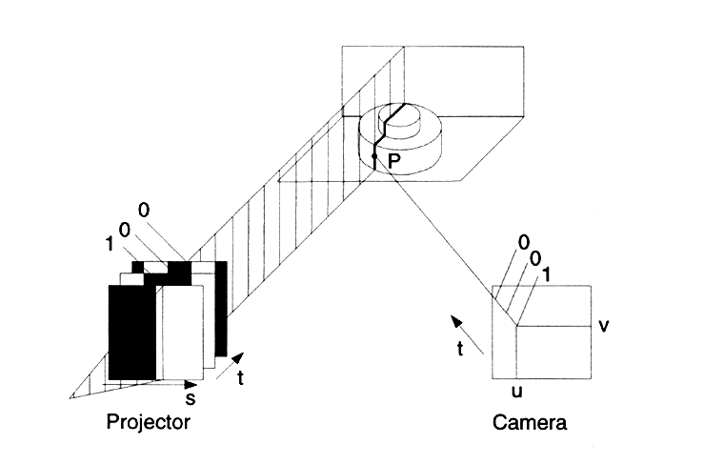
Binary Encoded Light Stripes

Slide 9
Time Multiplexing
A set of patterns are successively projected onto the measuring surface, codeword for a given pixel is formed by a sequence of patterns.
The most common structure of the patterns is a sequence of stripes increasing its width by the time → single-axis encoding
Advantages:
high resolution → a lot of 3D points
High accuracy (order of μm)
Robustness against colorful objects since binary patterns can be used
Drawbacks:
Static objects only
Large number of patterns
Projected over time
Example: 5 binary-encoded patterns which allows the measuring surface to be divided in 32 sub-regions

Slide 10
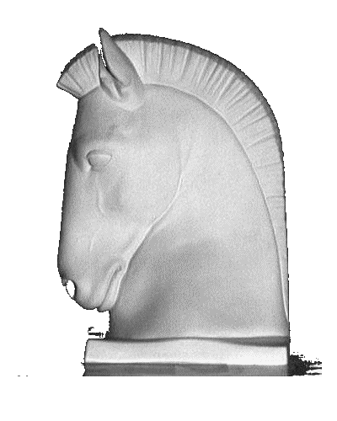
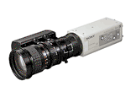
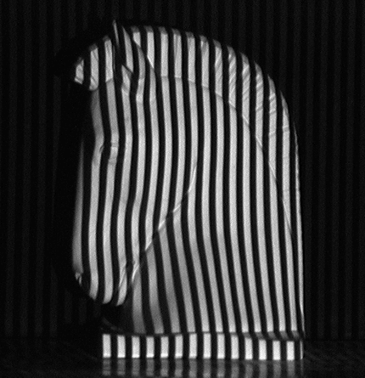
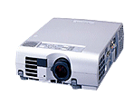
Binary Coding
Example: 7 binary patterns proposed by Posdamer & Altschuler
…
Projected over time
Pattern 3
Pattern 2
Pattern 1
Codeword of this píxel: 1010010 → identifies the corresponding pattern stripe

Slide 11
Binary Coding (II)
Binary coding
Only two illumination levels are commonly used, which are coded as 0 and 1.
Gray code can be used for robustness (adjacent stripes must only differ in 1 bit)
Every encoded point is identified by the sequence of intensities that it receives
n patterns must be projected in order to encode 2^{n} stripes
Advantages
Easy to segment the image patterns
Need a large number of patterns to be projected

Slide 12
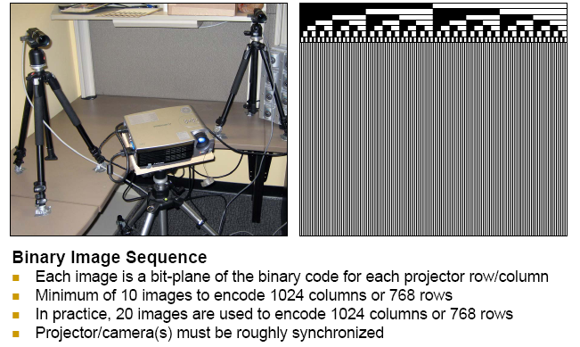
Binary Coding

Slide 13
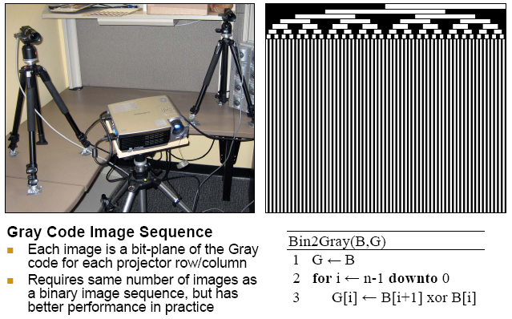
Gray Code
Frank Gray (-> name of coding sequence)
Code of neighboring projector pixels only differ by 1bit, possibility of error correction!

Slide 14
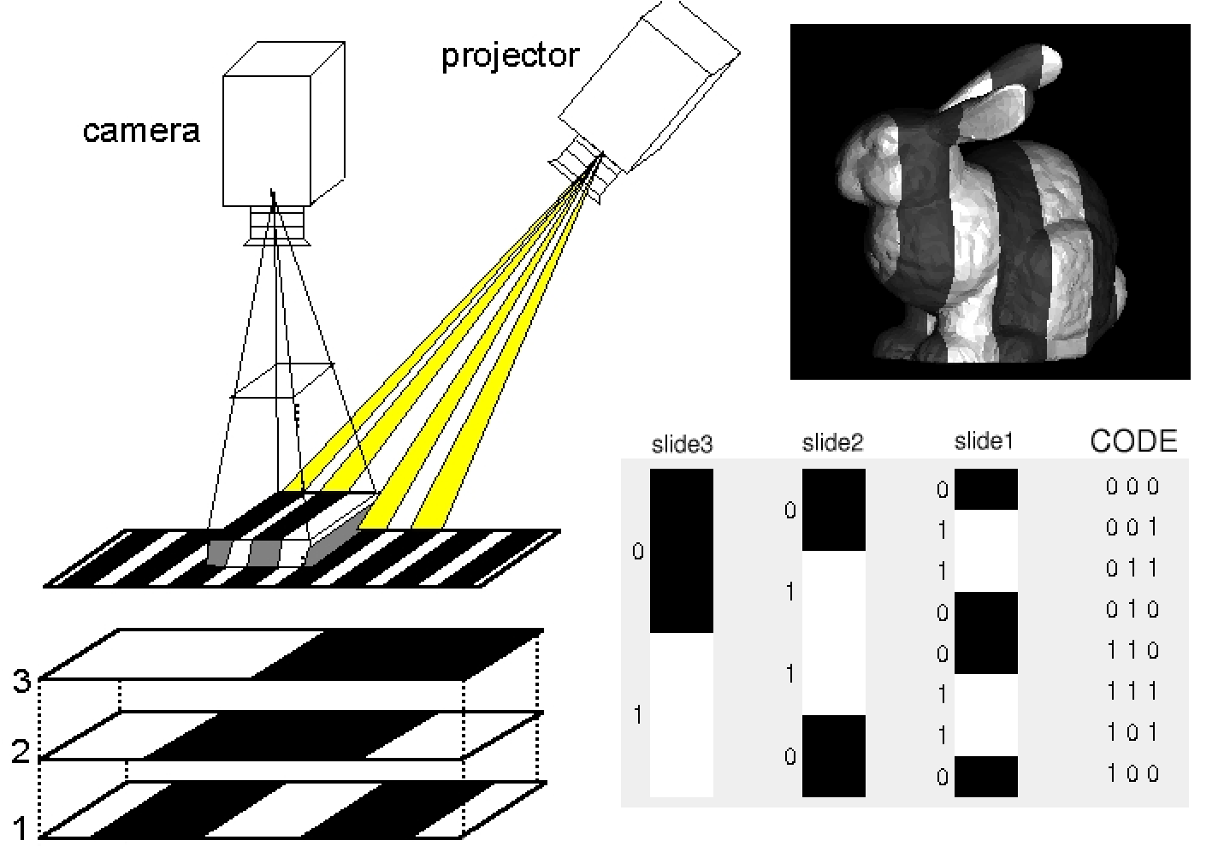
Concept Gray Code (adjacent stripes must only differ in 1 bit)

Slide 15
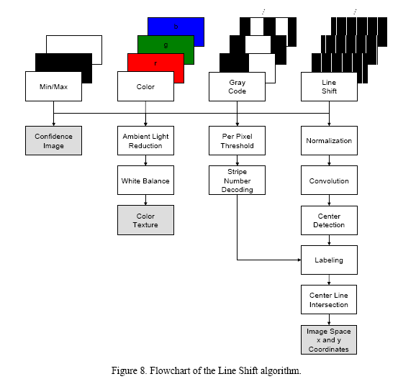
Alternatives

Slide 16
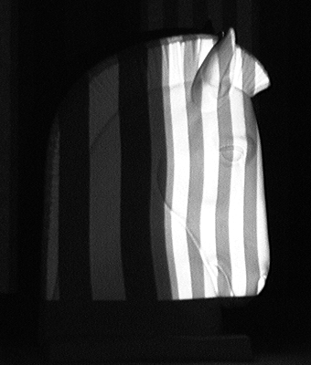
N-ary codes
Reduce the number of patterns by increasing the number of intensity levels used to encode the stripes.
Multi grey levels instead of binary
Multilevel gray code based on color.
Alphabet of m symbols encodes m^{n} stripes
3 patterns based on a n-ary code of 4 grey levels (Horn & Kiryati) → 64 encoded stripes

Slide 17
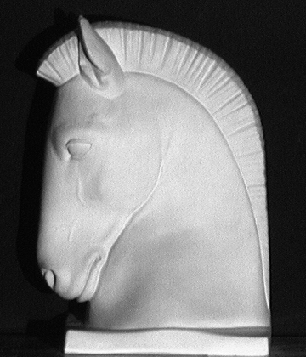
Gray Code + Phase Shifting (I)
A sequence of binary patterns (Gray encoded) are projected in order to divide the object in regions
Example: three binary patterns divide the object in 8 regions
Without the binary patterns we would not be able to distinguish among all the projected slits
An additional periodical pattern is projected
The periodical pattern is projected several times by shifting it in one direction in order to increase the resolution of the system → similar to a laser scanner
Every slit always falls in the same region
Gühring’s line-shift technique

Slide 18
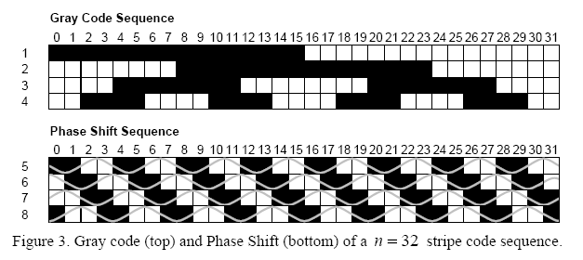
Phase Shift Method (Guehring et al)
Project set of patterns
Project sin functions
Interpolation between adjacent light planes
Yields for each camera pixel corresponding strip with sub-pixel accuracy!
See Videometrics01-Guehring-4309-24.pdf for details

Slide 19
Source: http://www.igp.ethz.ch/photogrammetry/education/lehrveranstaltungen/MachineVisionFS2011/coursematerial/MV-SS2011-structured.pdf

Slide 24
(or light stripe)
(or light stripes)

Slide 26
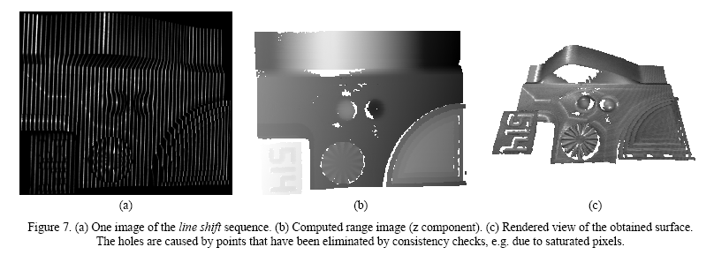
Example: Quality Control in Manufacturing

Slide 28
Coded structured light
Correspondence without need for geometrical constraints
For dense correspondence, we need many light planes:
Move the projection device
Project many stripes at once: needs encoding
Each pixel set is distinguishable by its encoding
Codewords for pixels:
Grey levels
Color
Geometrical considerations

Slide 29
Pattern encoding/decoding
A pattern is encoded when after projecting it onto a surface, a set of regions of the observed projection can be easily matched with the original pattern. Example: pattern with two-encoded-columns
The process of matching an image region with its corresponding pattern region is known as pattern decoding → similar to searching correspondences
Decoding a projected pattern allows a large set of correspondences to be easily found thanks to the a priori knowledge of the light pattern
Object scene
Pixels in red and yellow are directly matched with the pattern columns
Codification using colors

Slide 30
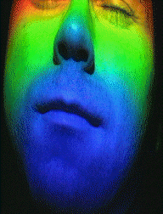
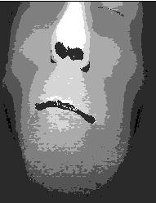
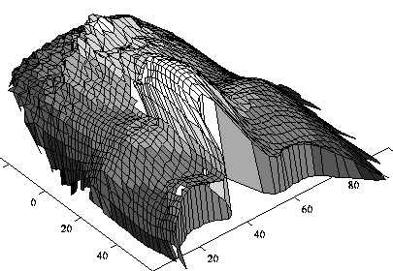
Rainbow Pattern
http://cmp.felk.cvut.cz/cmp/demos/RangeAcquisition.html
Assumes that the scene does not change the color of projected light.

Slide 31
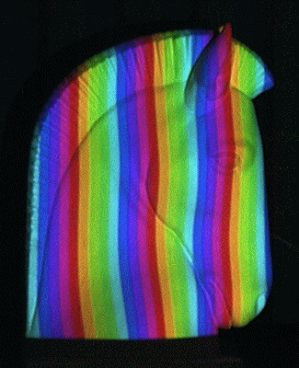
Direct encoding with color
Every encoded point of the pattern is identified by its colour
Tajima and Iwakawa rainbow pattern
(the rainbow is generated with a source of white light passing through a crystal prism)
T. Sato patterns capable of cancelling the object colour by projecting three shifted patterns
(it can be implemented with an LCD projector if few colours are projected)

Slide 32
Pattern encoding/decoding
Two ways of encoding the correspondences: single and double axis codification ⇒ it determines how the triangulation is calculated
Decoding the pattern means locating points in the camera image whose corresponding point in the projector pattern is a priori known
Single-axis encoding
Double-axis encoding
Triangulation by line-to-plane intersection
Triangulation by line-to-line intersection

Slide 35
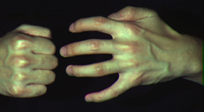
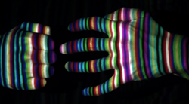
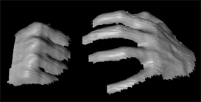
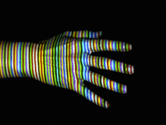
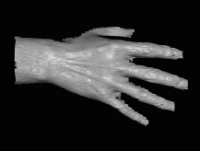
More complex patterns
Works despite complex appearances
Works in real-time and on dynamic scenes
Need very few images (one or two).
But needs a more complex correspondence algorithm
Zhang et al

Slide 36
Spatial Codification
Project a certain kind of spatial pattern so that a set of neighborhood points appears in the pattern only once. Then the codeword that labels a certain point of the pattern is obtained from a neighborhood of the point around it.
The codification is condensed in a unique pattern instead of multiplexing it along time
The size of the neighborhood (window size) is proportional to the number of encoded points and inversely proportional to the number of used colors
The aim of these techniques is to obtain a one-shot measurement system ⇒ moving objects can be measured
Drawbacks:
Discontinuities on the object surface can produce erroneous window decoding (occlusions problem)
The higher the number of used colours, the more difficult to correctly identify them when measuring non-neutral surfaces
Maximum resolution cannot be reached
Advantages:
Moving objects supported
Possibility to condense the codification to a unique pattern

Slide 37
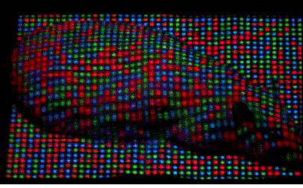
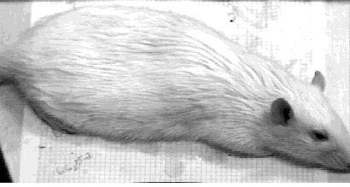
Local spatial Coherence
http://www.mri.jhu.edu/~cozturk/sl.html
Medical Imaging Laboratory Departments of Biomedical Engineering and Radiology Johns Hopkins University School of Medicine Baltimore, MD 21205

Slide 38
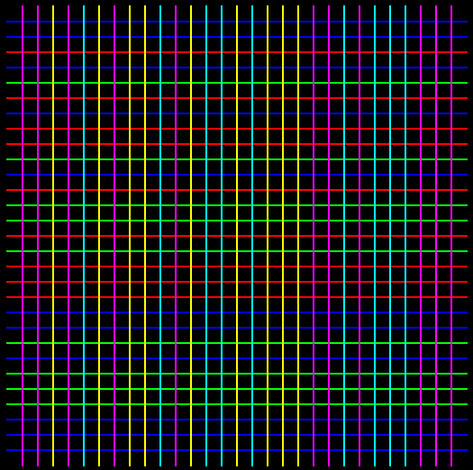
De Bruijn Sequences
A De Bruijn sequence (or pseudorandom sequence) of order m over an alphabet of n symbols is a circular string of length n^{m} that contains every substring of length m exactly once (in this case the windows are one-dimensional).
1000010111101001
The De Bruijn sequences are used to define colored slit patterns (single axis codification) or grid patterns (double axis codification)
In order to decode a certain slit it is only necessary to identify one of the windows in which it belongs to ) can resolve occlusion problem.
m=4 (window size)
n=2 (alphabet symbols)
Zhang et al.: 125 slits encoded with a De Bruijn sequence of 8 colors and window size of 3 slits
Salvi et al.: grid of 29×29 where a De Bruijn sequence of 3 colors and window size of 3 slits is used to encode the vertical and horizontal slits

Slide 39
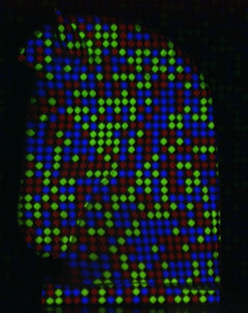
M-Arrays
An m-array is the bidimensional extension of a De Bruijn sequence. Every window of w×h units appears only once. The window size is related with the size of the m-array and the number of symbols used
0 0 1 0 1 0
0 1 0 1 1 0
1 1 0 0 1 1
0 0 1 0 1 0
Example: binary m-array of size 4×6 and window size of 2×2
Shape primitives used to represent every symbol of the alphabet
M-array proposed by Vuylsteke et al. Represented with shape primitives
Morano et al. M-array represented with an array of coloured dots

Slide 40
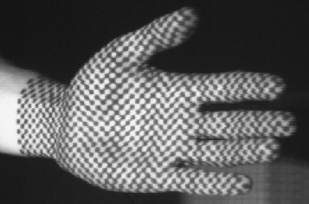
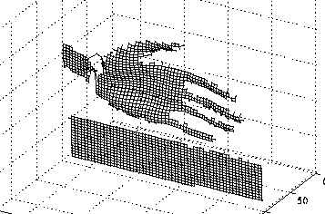
Binary spatial coding
http://cmp.felk.cvut.cz/cmp/demos/RangeAcquisition.html

Slide 41
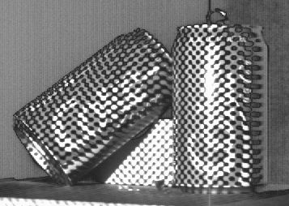
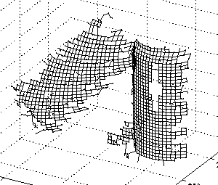
Problems in recovering pattern

Slide 42
Introducing color in coding
Allowing colors in coding is the same as augmenting code basis. This gives us more words with the same length.
If the scene changes the color of projected light, then information can be lost.
Reflectivity restrictions (neutral scene colors) have to be imposed to guarantee the correct decoding.

Slide 43
Examples

Slide 44
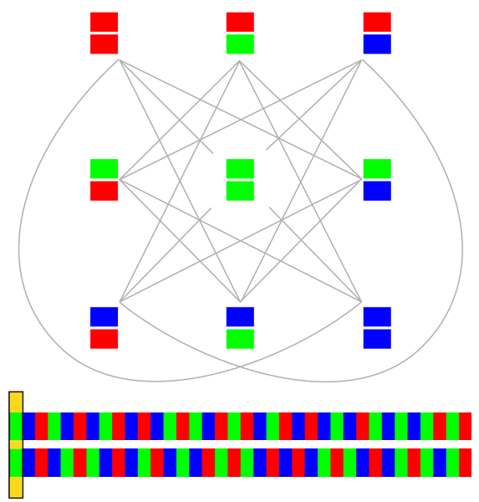
Decoding table

Slide 45
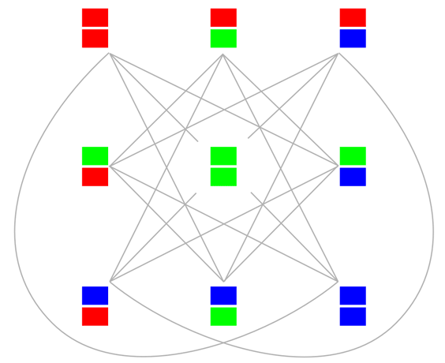
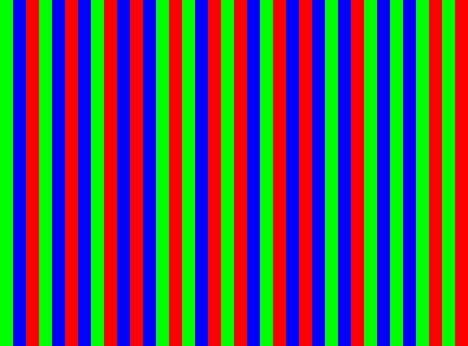
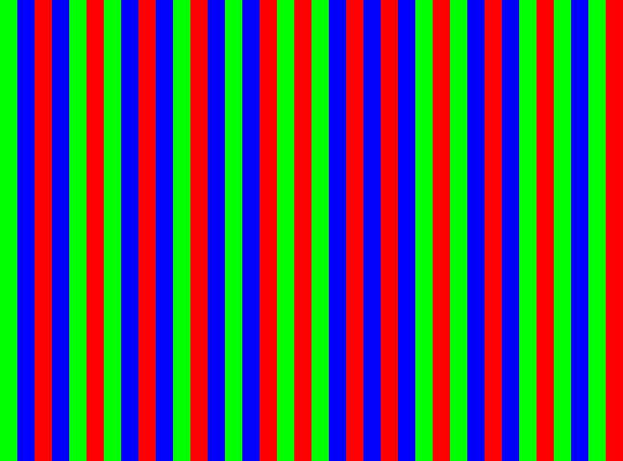
Decoding table
vertices | d(0) | d(1) | d(2) | d(3)
V(00) | 0 | 3 | 6 | 9
V(01) | 14 | 17 | 19 | 11
V(02) | 28 | 34 | 22 | 24
V(10) | 26 | 29 | 18 | 21
V(11) | 1 | 31 | 33 | 35
V(12) | 15 | 4 | 8 | 13
V(20) | 16 | 23 | 32 | 12
V(21) | 27 | 5 | 7 | 25
V(22) | 2 | 10 | 20 | 30
16th transition

Slide 46
Experiment

Slide 47
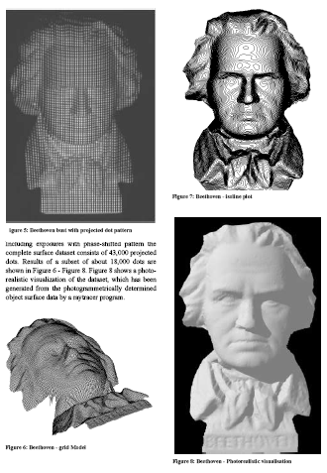
Results

Slide 48
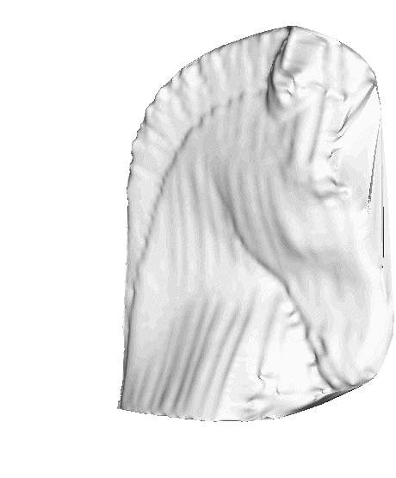
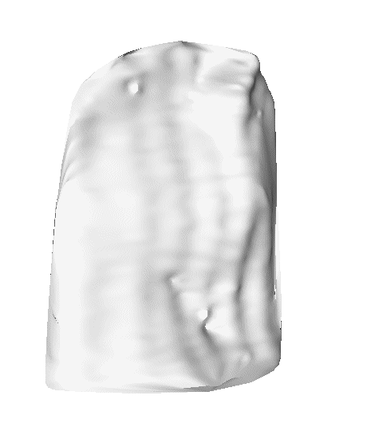
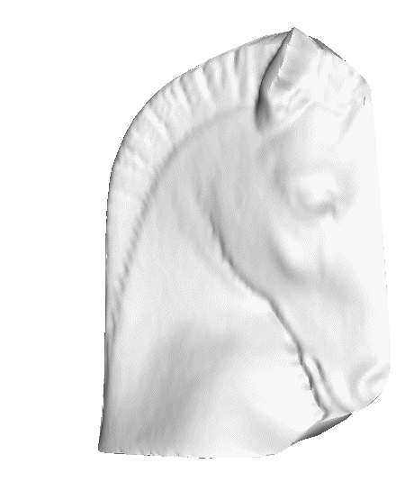
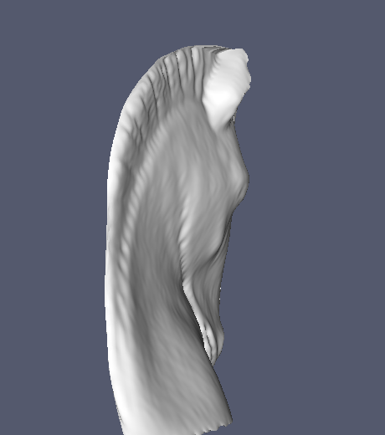
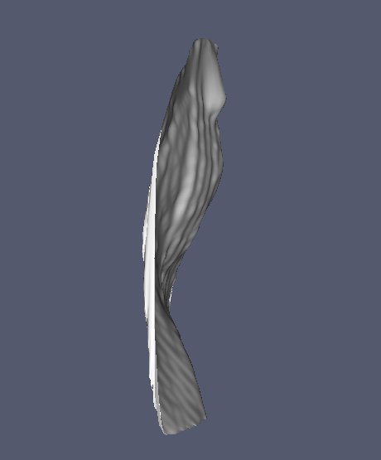
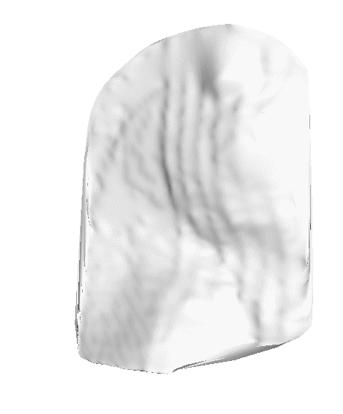
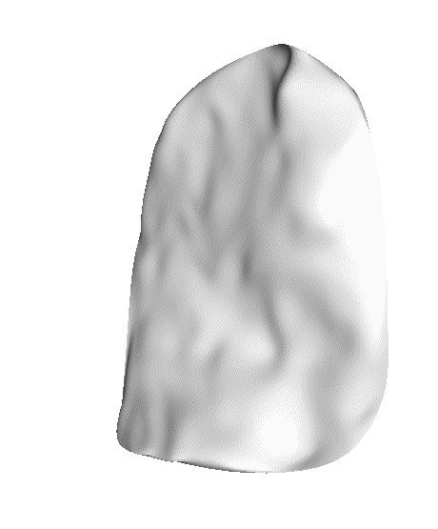
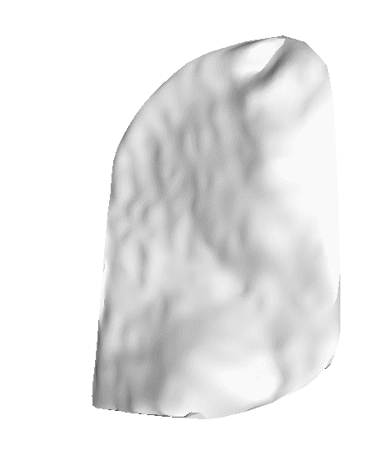
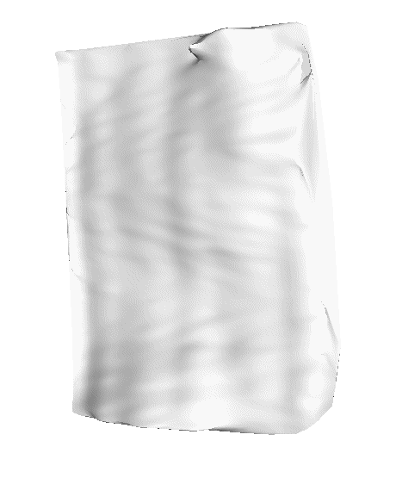
Experimental results
Gühring
Time-multiplexing | Posdamer (128 stripes) | Horn (64 stripes) | Gühring (113 slits)
De Bruijn
Spatial codification | De Bruijn (64 slits) | Salvi (29x29 slits) | Morano (45x45 dot array)
Direct codification | Sato (64 slits)

Slide 49
Conclusions
Types of techniques |  | 
Time-multiplexing | Highest resolution High accuracy Easy implementation | Inapplicability to moving objects Large number of patterns
Spatial codification | Can measure moving objects A unique pattern is required | Lower resolution than time-multiplexing More complex decoding stage Occlusions problem
Direct codification | High resolution Few patterns | Very sensitive to image noise Inapplicability to moving objects

Slide 50
Guidelines
Requirements | Best technique
High accuracy Highest resolution Static objects No matter the number of patterns | Phase shift + Gray code → Gühring’s line-shift technique
High accuracy High resolution Static objects Minimum number of patterns | N-ary pattern → Horn & Kiryati Caspi et al.
High accuracy Good resolution Moving objects | De Bruijn pattern → Zhang et al.

Slide 51
Additional Slides

Slide 52
Coded structured light
Correspondence without need for geometrical constraints
For dense correspondence, we need many light planes:
Move the projection device
Project many stripes at once: needs encoding
Each pixel set is distinguishable by its encoding
Codewords for pixels:
Grey levels
Color
Geometrical considerations

Slide 53
Codeword Classification
Time-multiplexing:
Binary codes
N-ary codes
Gray code + phase shift
Spatial Codification
De Bruijn sequences
M-arrays
Direct encoding
Grey levels
Colour

Slide 54
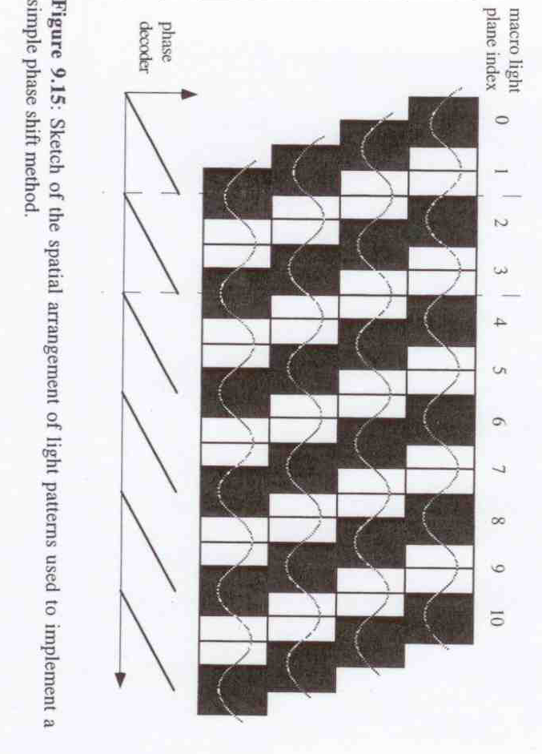
Gray Code + Phase Shifting (II)
Gray code + phase shifting
Grey code: easy codification, low resolution
Phase shifting: high resolution, neighborhood ambiguity
Gray code + phase shifting: robust codification, no ambiguity and high resolution, but increase the number of projecting patterns

Slide 55
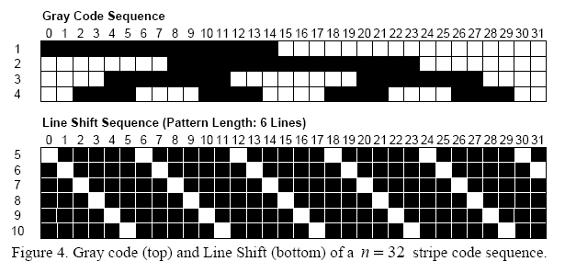
Line Shift Processing (Guehring et al.)
Project Gray Code sequence
Project set of 6 thin line patterns, detect line centers in image
Combine line center positions with gray code encoding to resolve for ambiguities
Obtain camera coordinates with subpixel accuracies for projector coordinates
See Videometrics01-Guehring-4309-24.pdf for details

Slide 56
Spatial Coherence
Coding in a single frame.
Spatial Coherence can be local or global.
The minimum number of pixels used to identify the projected code defines the accuracy of details to be recovered in the scene.

Slide 57
Some examples

Slide 58
Continuum of Triangulation Methods
Multi-stripe
Multi-frame
Single-stripe
Single-frame
Slow, robust
Fast, fragile
Notes:
There’s a continuum of methods we can use to establish these correspondences. At one extreme are single-stripe systems. These never have the problem of ambiguity, so they produce very high-quality data, but they take a long time to do it. At the other extreme are systems that try to get all the data at once by projecting lots of stripes (or, in this case, dots). They are fast, since they get everything with just a single frame, but they tend to be a lot more fragile and get confused by discontinuities. In the middle are methods that use a few frames to get depth, by flashing stripes on and off over time, and conveying a code about which stripe is which through this pattern of on/off flashing.

Slide 59
Direct Codification
Every encoded pixel is identified by its own intensity/color
Since the codification is usually condensed in a unique pattern, the spectrum of intensities/colors used is very large
Additional reference patterns must be projected in order to differentiate among all the projected intensities/colors:
Ambient lighting (black pattern)
Full illuminated (white pattern)
…

Slide 60
Direct Codification
Every encoded pixel is identified by its own intensity/color
Since the codification is usually condensed in a unique pattern, the spectrum of intensities/colors used is very large
Additional reference patterns must be projected in order to differentiate among all the projected intensities/colors:
Ambient lighting (black pattern)
Full illuminated (white pattern)
…
Advantages:
Reduced number of patterns
High resolution can be theoretically achieved
Drawbacks:
Very noisy in front of reflective properties of the objects, non-linearities in the camera spectral response and projector spectrum ⇒ non-standard light emitters are required in order to project single wave-lengths
Low accuracy (order of 1 mm)

