Slide 1
A Type and Effect System for Atomicity
Cormac Flanagan and Shaz Qadeer

Slide 2
Motivations
Multi-core systems and multithreaded programs are the future
Ensuring correctness for multithreaded programs is hard
  Complications caused by thread interleaving
  Synchronization bugs are non-deterministic
  Testing is not enough (small coverage)

Slide 3
Race Conditions
A common cause of bugs is race condition
  Two thread accessing a shared variable simultaneously, and at least one access is a write
Previous works detect race conditions using static and dynamic analyses

Slide 4
Race Conditions
Race-freedom is not necessary
int readBalance() {
return balance;
}
void withdraw(int amt) {
synchronized(this) {
balance = balance – amt;
}
}
The race condition in this case is benign

Slide 5
Race Conditions
Race-freedom is not sufficient
int readBalance() {
int t;
synchronized(this) { t = balance; }
return t;
}
void withdraw(int amt) {
int b = readBalance();
synchronized(this) { balance = b – amt; }
}
void deposit(int amt) {
synchronized(this) { balance = balance + amt; }
}

Slide 6
Atomicity
Race-freedom is neither necessary nor sufficient to ensure the absence of synchronization errors
A stronger non-interference property is atomicity
An atomic method can be assumed to execute “in one step”
  Arbitrary interleaving steps of other threads do not change the program’s behaviors
  Similar to linearizability in distributed systems
  A fundamental correctness property
Atomicity is more useful than race-freedom as a concept
  It’s a higher-level concept, thus more amenable to human reasoning
  If a method is atomic, it is race-free
  Enable reasoning about multithreaded programs in a sequential context
  Enable concise code documenting

Slide 7
Atomicity
int readBalance() {
return balance;
}
void withdraw(int amt) {
synchronized(this) {
balance = balance – amt;
}
}
Both methods are atomic even though there is a (falsely alarmed) race

Slide 8
Atomicity
Race-freedom is neither necessary nor sufficient
But the same thing can be said about atomicity
Atomicity is just a higher-level property than race-condition
  (As we shall see later) the type system to check for atomicity requires a previously developed type system to check for race-condition
Both atomicity and race-condition are rather low-level concepts
  Useful when checking low-level multithreaded code (e.g. libraries)
  Less useful when we go to higher levels of abstraction

Slide 9
Contributions
The first to use (static) program analysis to check for atomicity
  A type system for both specifying and checking atomicity properties
  Show that the type system is useful by confirming the atomicity and discovering real synchronization bugs in JDK’s methods
  Spawn quite a number future works that aim to solve the same problem using dynamic analysis, theorem proving, model checking, etc
Not the first to define the term atomicity
  It is a well-known concept
The type system is an extension from previous work

Slide 10
Atomicity
More formal definition: A method is atomic if for every interleaved execution, there is a corresponding serial (non-interleaved) execution of the method with equivalent behavior.
void deposit(int amt) {
synchronized(this) { balance = balance + amt; }
}
Non-interleave execution
  … -> x -> y -> acquire(this) -> r = balance -> balance = r + amt -> release(this) -> z -> …
Interleave execution
  … -> acquire(this) -> x -> r = balance -> y -> balance = r + amt -> z -> release(this) -> …

Slide 11
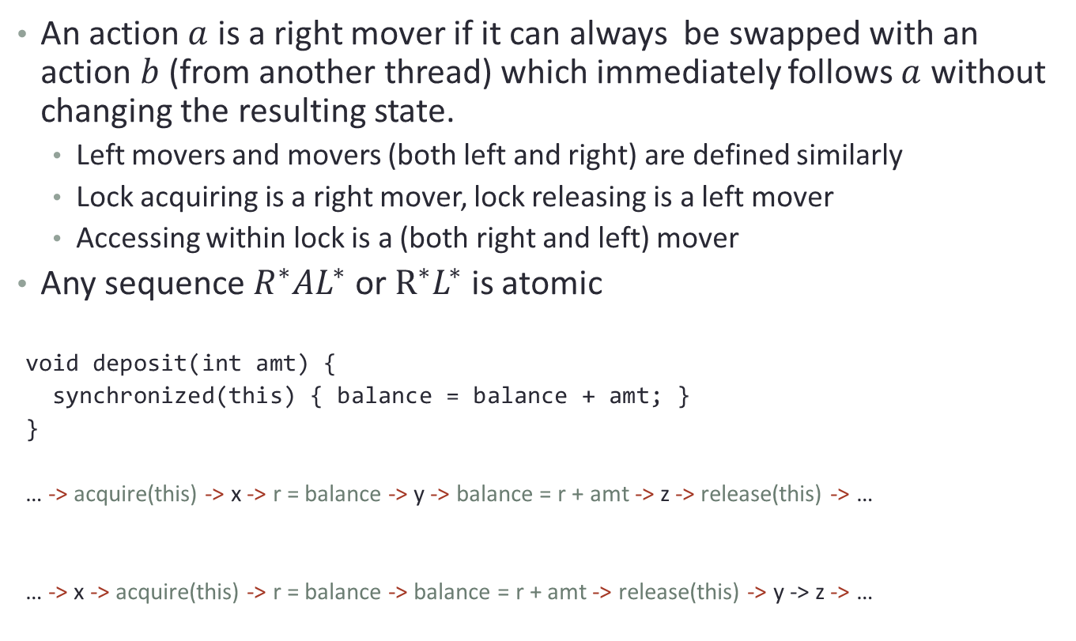
Lipton’s Theory of Reduction
An action $a$ is a right mover if it can always be swapped with an action $b$ (from another thread) which immediately follows $a$ without changing the resulting state.
  Left movers and movers (both left and right) are defined similarly
  Lock acquiring is a right mover, lock releasing is a left mover
  Accessing within lock is a (both right and left) mover
Any sequence $R^{∗}AL^{∗}$ or $R^{∗}L^{∗}$ is atomic
void deposit(int amt) {
synchronized(this) { balance = balance + amt; }
}
  … -> acquire(this) -> x -> r = balance -> y -> balance = r + amt -> z -> release(this) -> …
  … -> x -> acquire(this) -> r = balance -> balance = r + amt -> release(this) -> y -> z -> …

Slide 12
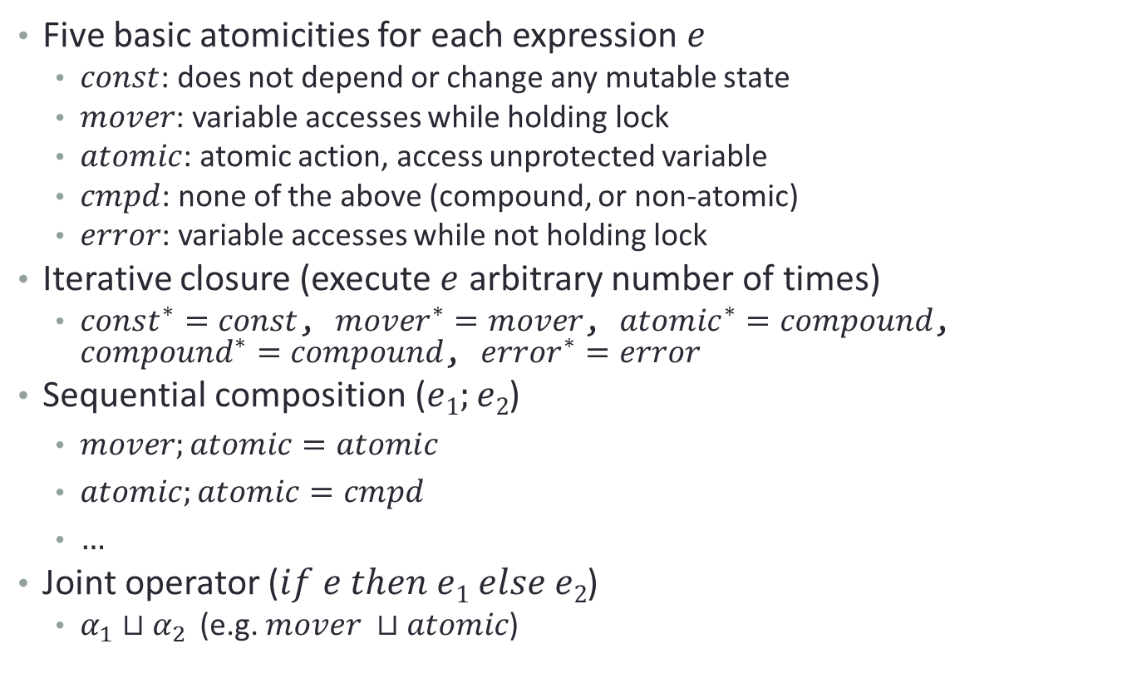
Type and Effect System – Basic types
Five basic atomicities for each expression $e$
  $const$: does not depend or change any mutable state
  $mover$: variable accesses while holding lock
  $atomic$: atomic action, access unprotected variable
  $cmpd$: none of the above (compound, or non-atomic)
  $error$: variable accesses while not holding lock
Iterative closure (execute $e$ arbitrary number of times)
  $const^{∗}=const$, $mover^{∗}=mover$, $atomic^{∗}=compound$, $compound^{∗}=compound$, $error^{∗}=error$
Sequential composition ($e1;e2$)
  $mover;atomic=atomic$
  $atomic;atomic=cmpd$
  $…$
Joint operator ($if e then e1 else e2$)
  $α_{1}⊔α_{2}$ (e.g. $mover ⊔atomic$)

Slide 13
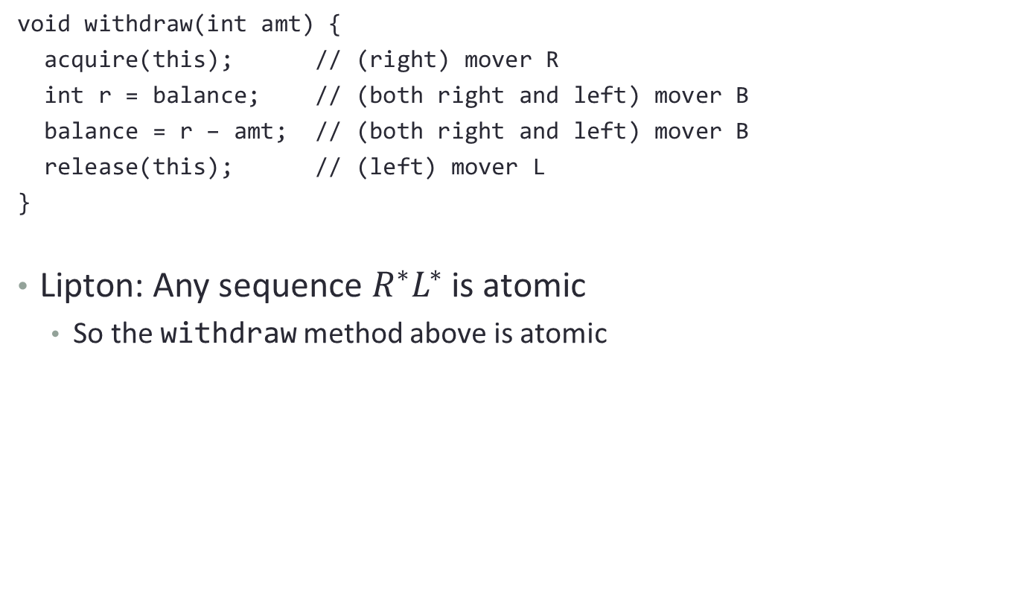
Basic Types - Example
void withdraw(int amt) {
acquire(this); // (right) mover R
int r = balance; // (both right and left) mover B
balance = r – amt; // (both right and left) mover B
release(this); // (left) mover L
}
Lipton: Any sequence $R^{∗}L^{∗}$ is atomic
  So the withdraw method above is atomic

Slide 14
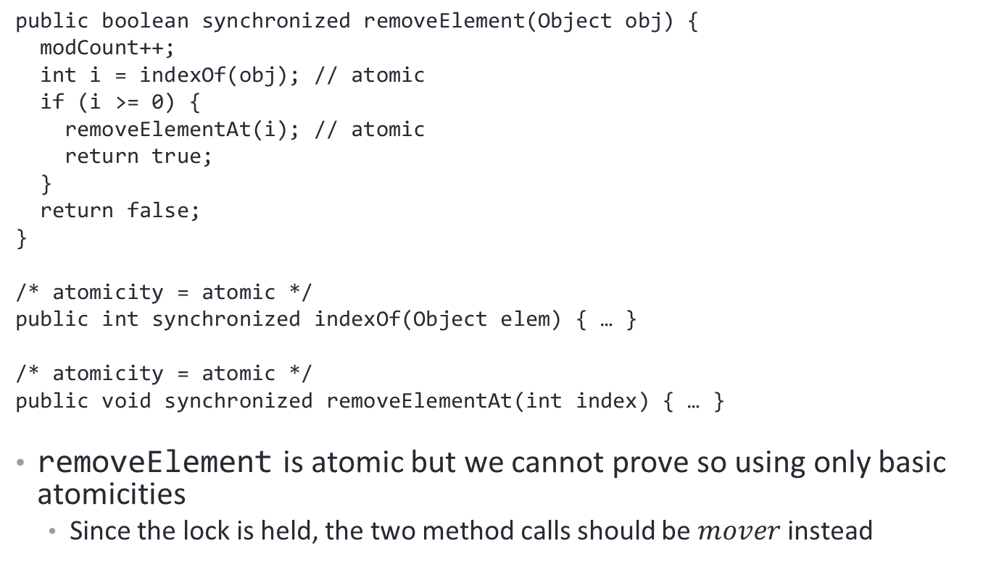
Conditional Atomicities
public boolean synchronized removeElement(Object obj) {
modCount++;
int i = indexOf(obj); // atomic
if (i >= 0) {
removeElementAt(i); // atomic
return true;
}
return false;
}
/* atomicity = atomic */
public int synchronized indexOf(Object elem) { … }
/* atomicity = atomic */
public void synchronized removeElementAt(int index) { … }
removeElement is atomic but we cannot prove so using only basic atomicities
  Since the lock is held, the two method calls should be $mover$instead

Slide 15
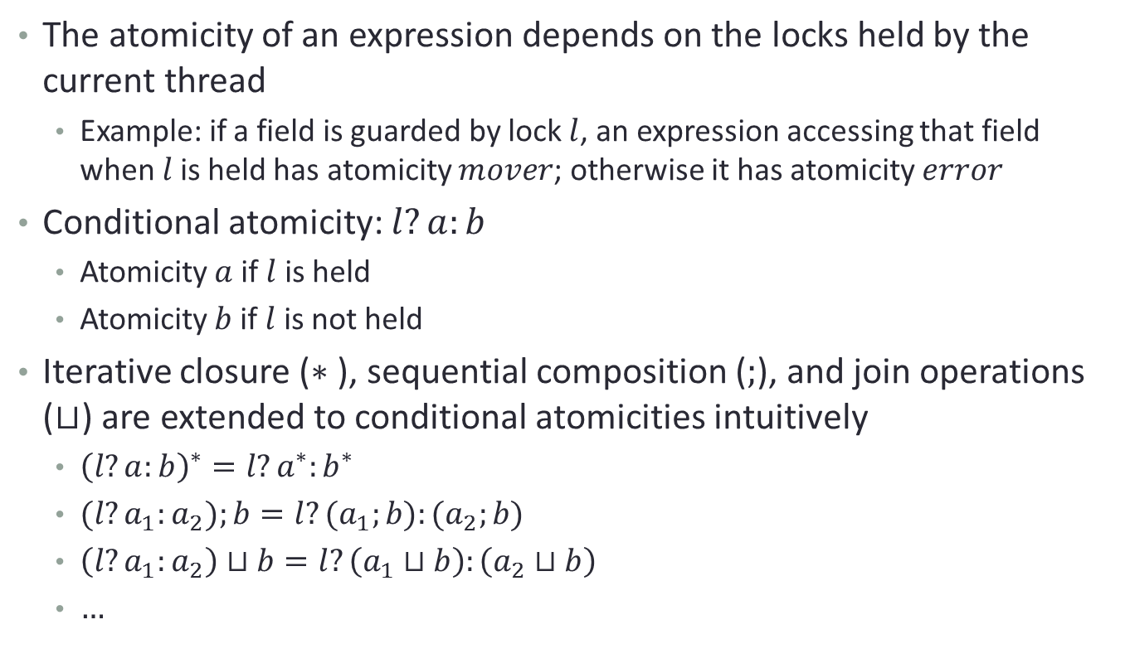
Conditional Atomicities
The atomicity of an expression depends on the locks held by the current thread
  Example: if a field is guarded by lock $l$, an expression accessing that field when $l$is held has atomicity $mover$; otherwise it has atomicity $error$
Conditional atomicity: $l?a:b$
  Atomicity $a$ if $l$ is held
  Atomicity $b$ if $l$ is not held
Iterative closure ($∗$), sequential composition ($;$), and join operations ($⊔$) are extended to conditional atomicities intuitively
  ${\left(l?a:b\right)}^{∗}=l?a^{∗}:b^{∗}$
  $(l?a_{1}:a_{2});b=l?(a_{1};b):(a_{2};b)$
  $\left(l?a_{1}:a_{2}\right)⊔b=l?\left(a_{1}⊔b\right):\left(a_{2}⊔b\right)$
  $…$

Slide 16
Conditional Atomicities
public boolean synchronized removeElement(Object obj) {
modCount++;
int i = indexOf(obj); // mover
if (i >= 0) {
removeElementAt(i); // mover
return true;
}
return false;
}
/* atomicity = this ? mover : atomic */
public int synchronized indexOf(Object elem) { … }
/* atomicity = this ? mover : atomic */
public void synchronized removeElementAt(int index) { … }
removeElement is now atomic since both method calls are mover inside lock

Slide 17
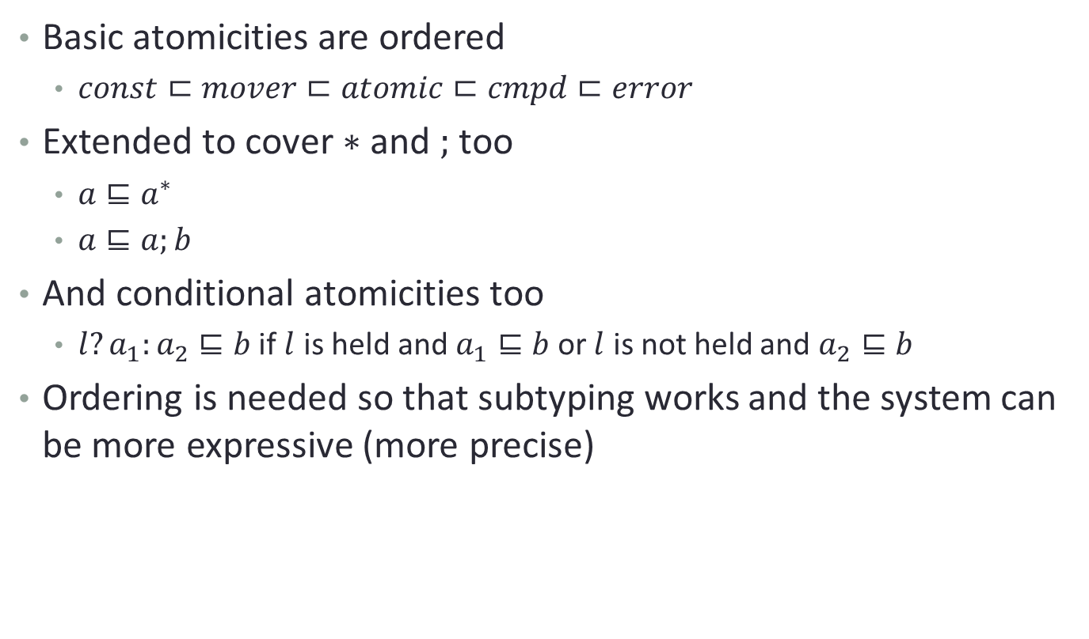
Atomicity Odering
Basic atomicities are ordered
  $const⊏mover⊏atomic⊏cmpd⊏error$
Extended to cover $∗$ and $;$ too
  $a⊑a^{∗}$
  $a⊑a;b$
And conditional atomicities too
  $l?a_{1}:a_{2}⊑b$ if $l$ is held and $a_{1}⊑b$ or $l$ is not held and $a_{2}⊑b$
Ordering is needed so that subtyping works and the system can be more expressive (more precise)

Slide 18

Other Rules for Manipulating Types
${\left(a^{∗}\right)}^{∗}≡a^{∗}$
$(a;b);c≡a;(b;c)$
$const;a≡a$
$a;const≡a$
$a;\left(b⊔c\right)≡a;b⊔a;c$
$\left(a⊔b\right);c≡a;c⊔b;c$
${\left(a⊔b\right)}^{∗}≡a^{∗}⊔b^{∗}$

Slide 19
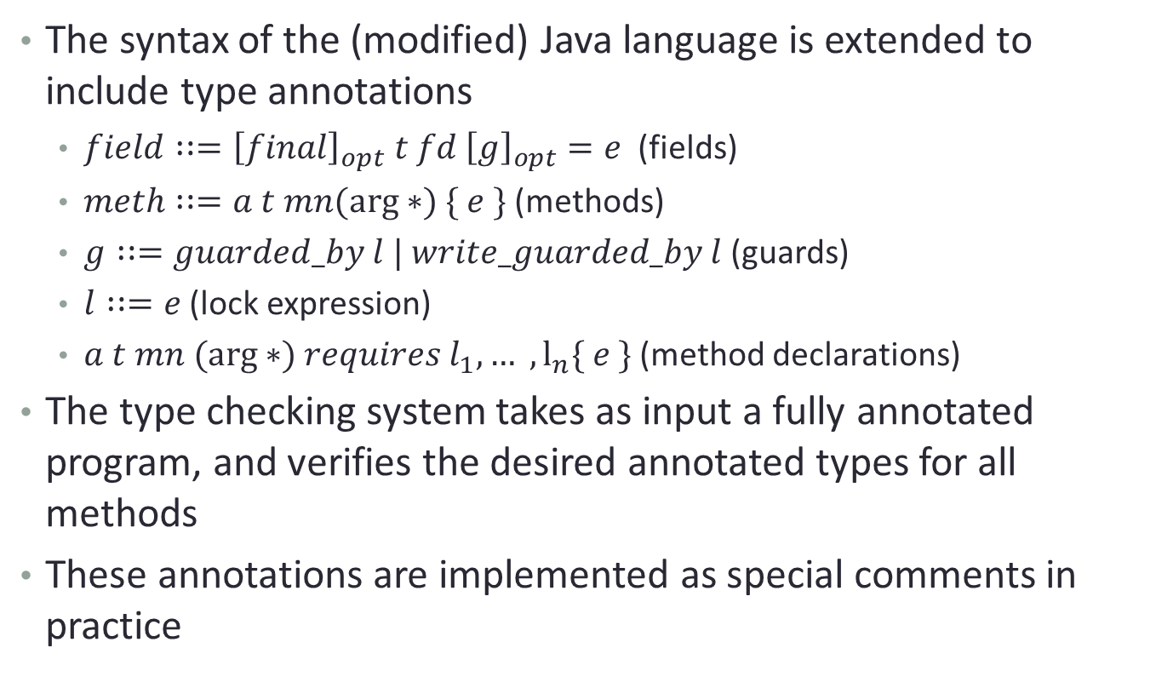
Type Annotations
The syntax of the (modified) Java language is extended to include type annotations
  $field∷={\left[final\right]}_{opt} t fd {\left[g\right]}_{opt}=e$ (fields)
  $meth∷=a t mn(arg∗) \{ e \}$ (methods)
  $g∷=guarded_by l | write_guarded_by l$ (guards)
  $l∷=e$ (lock expression)
  $a t mn (arg∗) requires l_{1}, … , l_{n}⁡\{ e \}$ (method declarations)
The type checking system takes as input a fully annotated program, and verifies the desired annotated types for all methods
These annotations are implemented as special comments in practice

Slide 20
Type Annotations - Example
public final class StringBuffer ... {
...
private int count /*# guarded_by this */;
/*# atomic */
public synchronized StringBuffer append(StringBuffer sb){
if (sb == null) { sb = NULL; }
int len = sb.length(); // len may be stale
int newcount = count + len;
if (newcount > value.length) expandCapacity(newcount);
sb.getChars(0, len, value, count); // use of stale len
count = newcount;
return this;
}
/*# atomic */
public synchronized int length() { return count; }
/*# atomic */
public synchronized void getChars(...) { ... }
}

Slide 21
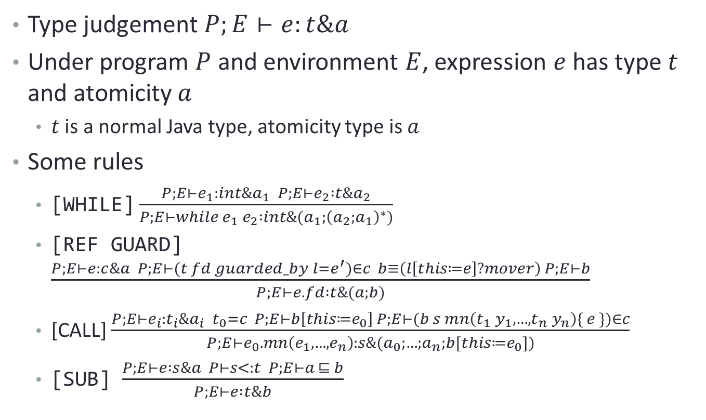
Type Checking Rules
Type judgement $P;E⊢e:t\&a$
Under program $P$ and environment $E$, expression $e$ has type $t$ and atomicity $a$
  $t$ is a normal Java type, atomicity type is $a$
Some rules
  [WHILE] $\frac{P;E⊢e_{1}:int\&a_{1} P;E⊢e_{2} :t\&a_{2}}{P;E⊢while e_{1} e_{2} :int\&(a_{1};{\left(a_{2};a_{1}\right)}^{∗})}$
  [REF GUARD] $\frac{P;E⊢e:c\&a P;E⊢(t fd guarded_by l=e^{′})∈c b≡\left(l\left[this≔e\right]?mover\right) P;E⊢b}{P;E⊢e.fd :t\&(a;b)}$
  [CALL] $\frac{P;E⊢e_{i}:t_{i}\&a_{i} t_{0}=c P;E⊢b\left[this≔e_{0}\right] P;E⊢(b s mn\left(t_{1} y_{1},…,t_{n} y_{n}\right)\{ e \})∈c}{P;E⊢e_{0}.mn\left(e_{1},…,e_{n}\right):s\&(a_{0};…;a_{n};b[this≔e_{0}])}$
  [SUB] $\frac{P;E⊢e :s\&a P⊢s<:t P;E⊢a ⊑ b}{P;E⊢e :t\&b}$

Slide 22
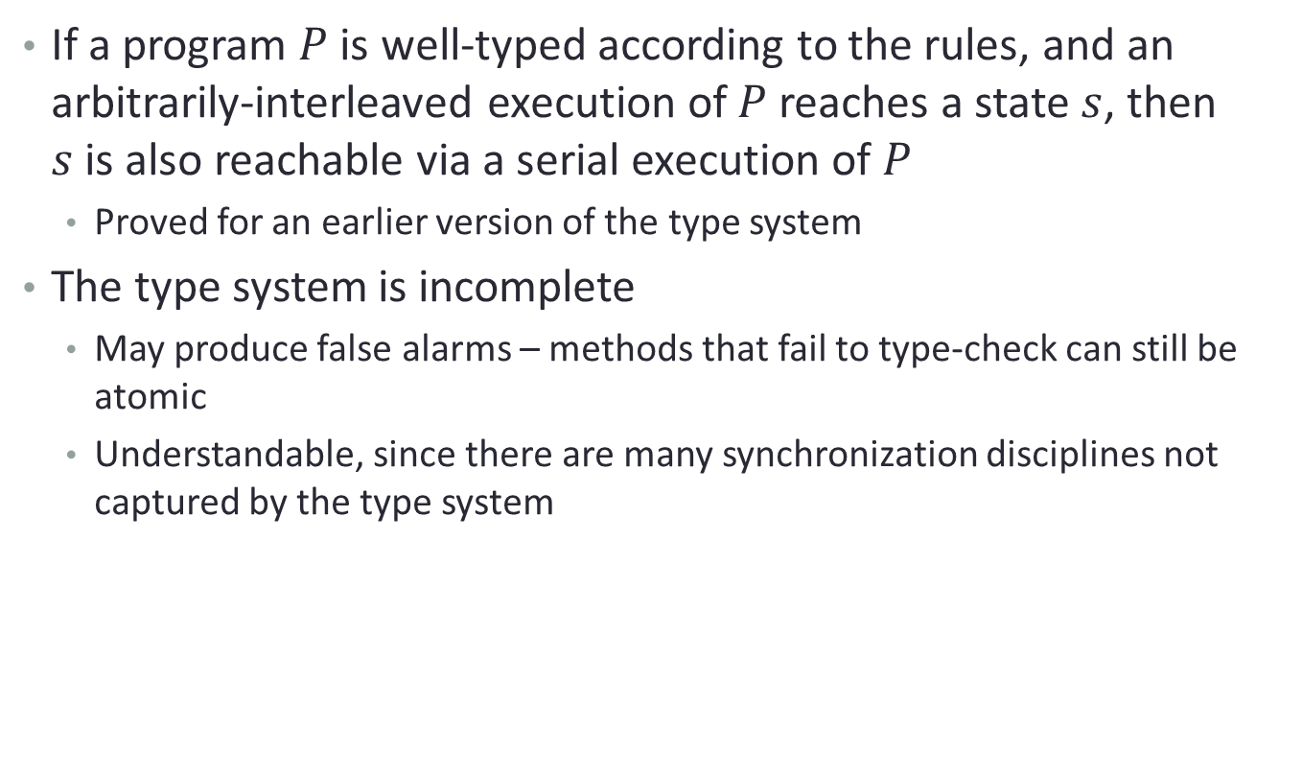
Soundness and Completeness
If a program $P$is well-typed according to the rules, and an arbitrarily-interleaved execution of $P$reaches a state $s$, then $s$is also reachable via a serial execution of $P$
  Proved for an earlier version of the type system
The type system is incomplete
  May produce false alarms – methods that fail to type-check can still be atomic
  Understandable, since there are many synchronization disciplines not captured by the type system

Slide 23
Evaluation – Atomicity Violations
Find bugs in JDK 1.4’s StringBuffer
public final class StringBuffer ... {
...
private int count /*# guarded_by this */;
/*# atomic */ // does not type check
public synchronized StringBuffer append(StringBuffer sb){
if (sb == null) { sb = NULL; }
int len = sb.length(); // len may be stale
int newcount = count + len;
if (newcount > value.length) expandCapacity(newcount);
sb.getChars(0, len, value, count); // use of stale len
count = newcount;
return this;
}
/*# atomic */
public synchronized int length() { return count; }
/*# atomic */
public synchronized void getChars(...) { ... }
}
Similar bug in java.lang.String.contentEquals

Slide 24
Evaluation – Annotation Density
On average: 23.3 manual annotations per KLOC (in 7186 LOC)
The number of annotations is not high, however one must understand the code well to add annotations, and that may take time
Also, the type-checking process makes use of another type system for race-freedom checking to reason about the set of locks held at each program point
  Both type systems need annotations, thus the actual number of annotations may be much higher than the one stated in the paper

Slide 25
Evaluation - Limitations
Cannot capture all synchronization mechanisms used in practice
  Relax the type system
  no_warn annotation to turn off warnings
  holds annotation to force lock assumption
  -constructor_hols_lock flag to eliminate spurious warnings
  Still fails in certain cases (e.g. rep-exposure problem in java.io.PrintWriter)
This is a trade-off, a sound type system is necessarily restrictive

Slide 26
Conclusion
Sound and incomplete type system to check for atomicity
Simplifies subsequent reasoning about program correctness
Helps programmers formally document (specify) and verify atomicity properties
Uncover atomicity violations in JDK which are not race-conditions
Complements software transactional memory well
  Can be used to verify these libraries
The need for heavy annotations is a major weakness
  Type inference can solve this problem
Another limitation is expressiveness
  The type system is not very precise
  Fails for some synchronization mechanisms
  Dynamic analysis can solve this problem

