Slide 1
Visualizing Frog and Toad Acoustic Data using 3D Spectrograms
CS6635 Scientific Visualization
Apr 25 2022
Yura Hwang, Pupul Pradhan, Nick Lord-Ender-Laing
Notes:
- Introduction

Slide 2
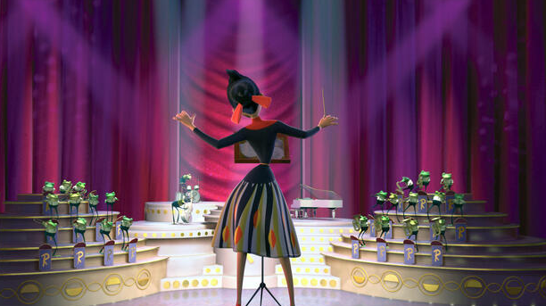
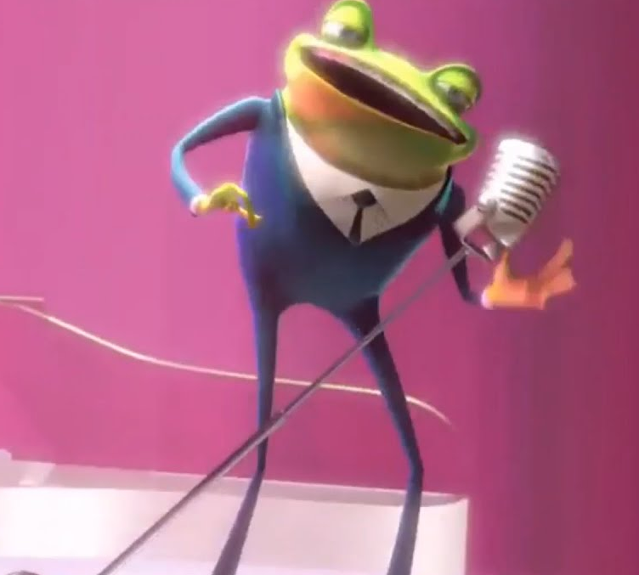
Frogs and Toads

Slide 3
Frogs and Toads
“Frogs have more musical ability than people.”

Slide 4
Visualizing the voices of frogs and toads

Slide 5
Visualizing the voices of frogs and toads

Slide 6
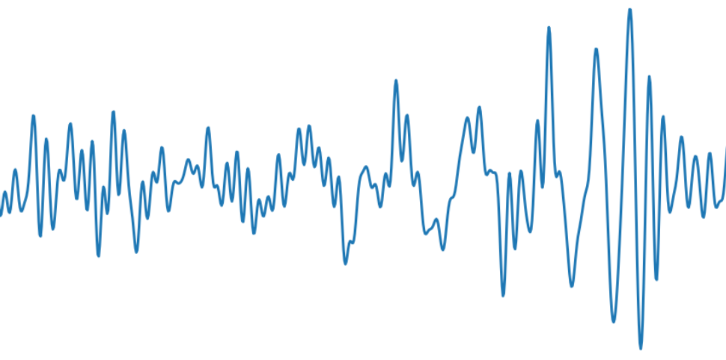
Visualizing the voices of frogs and toads

Slide 7
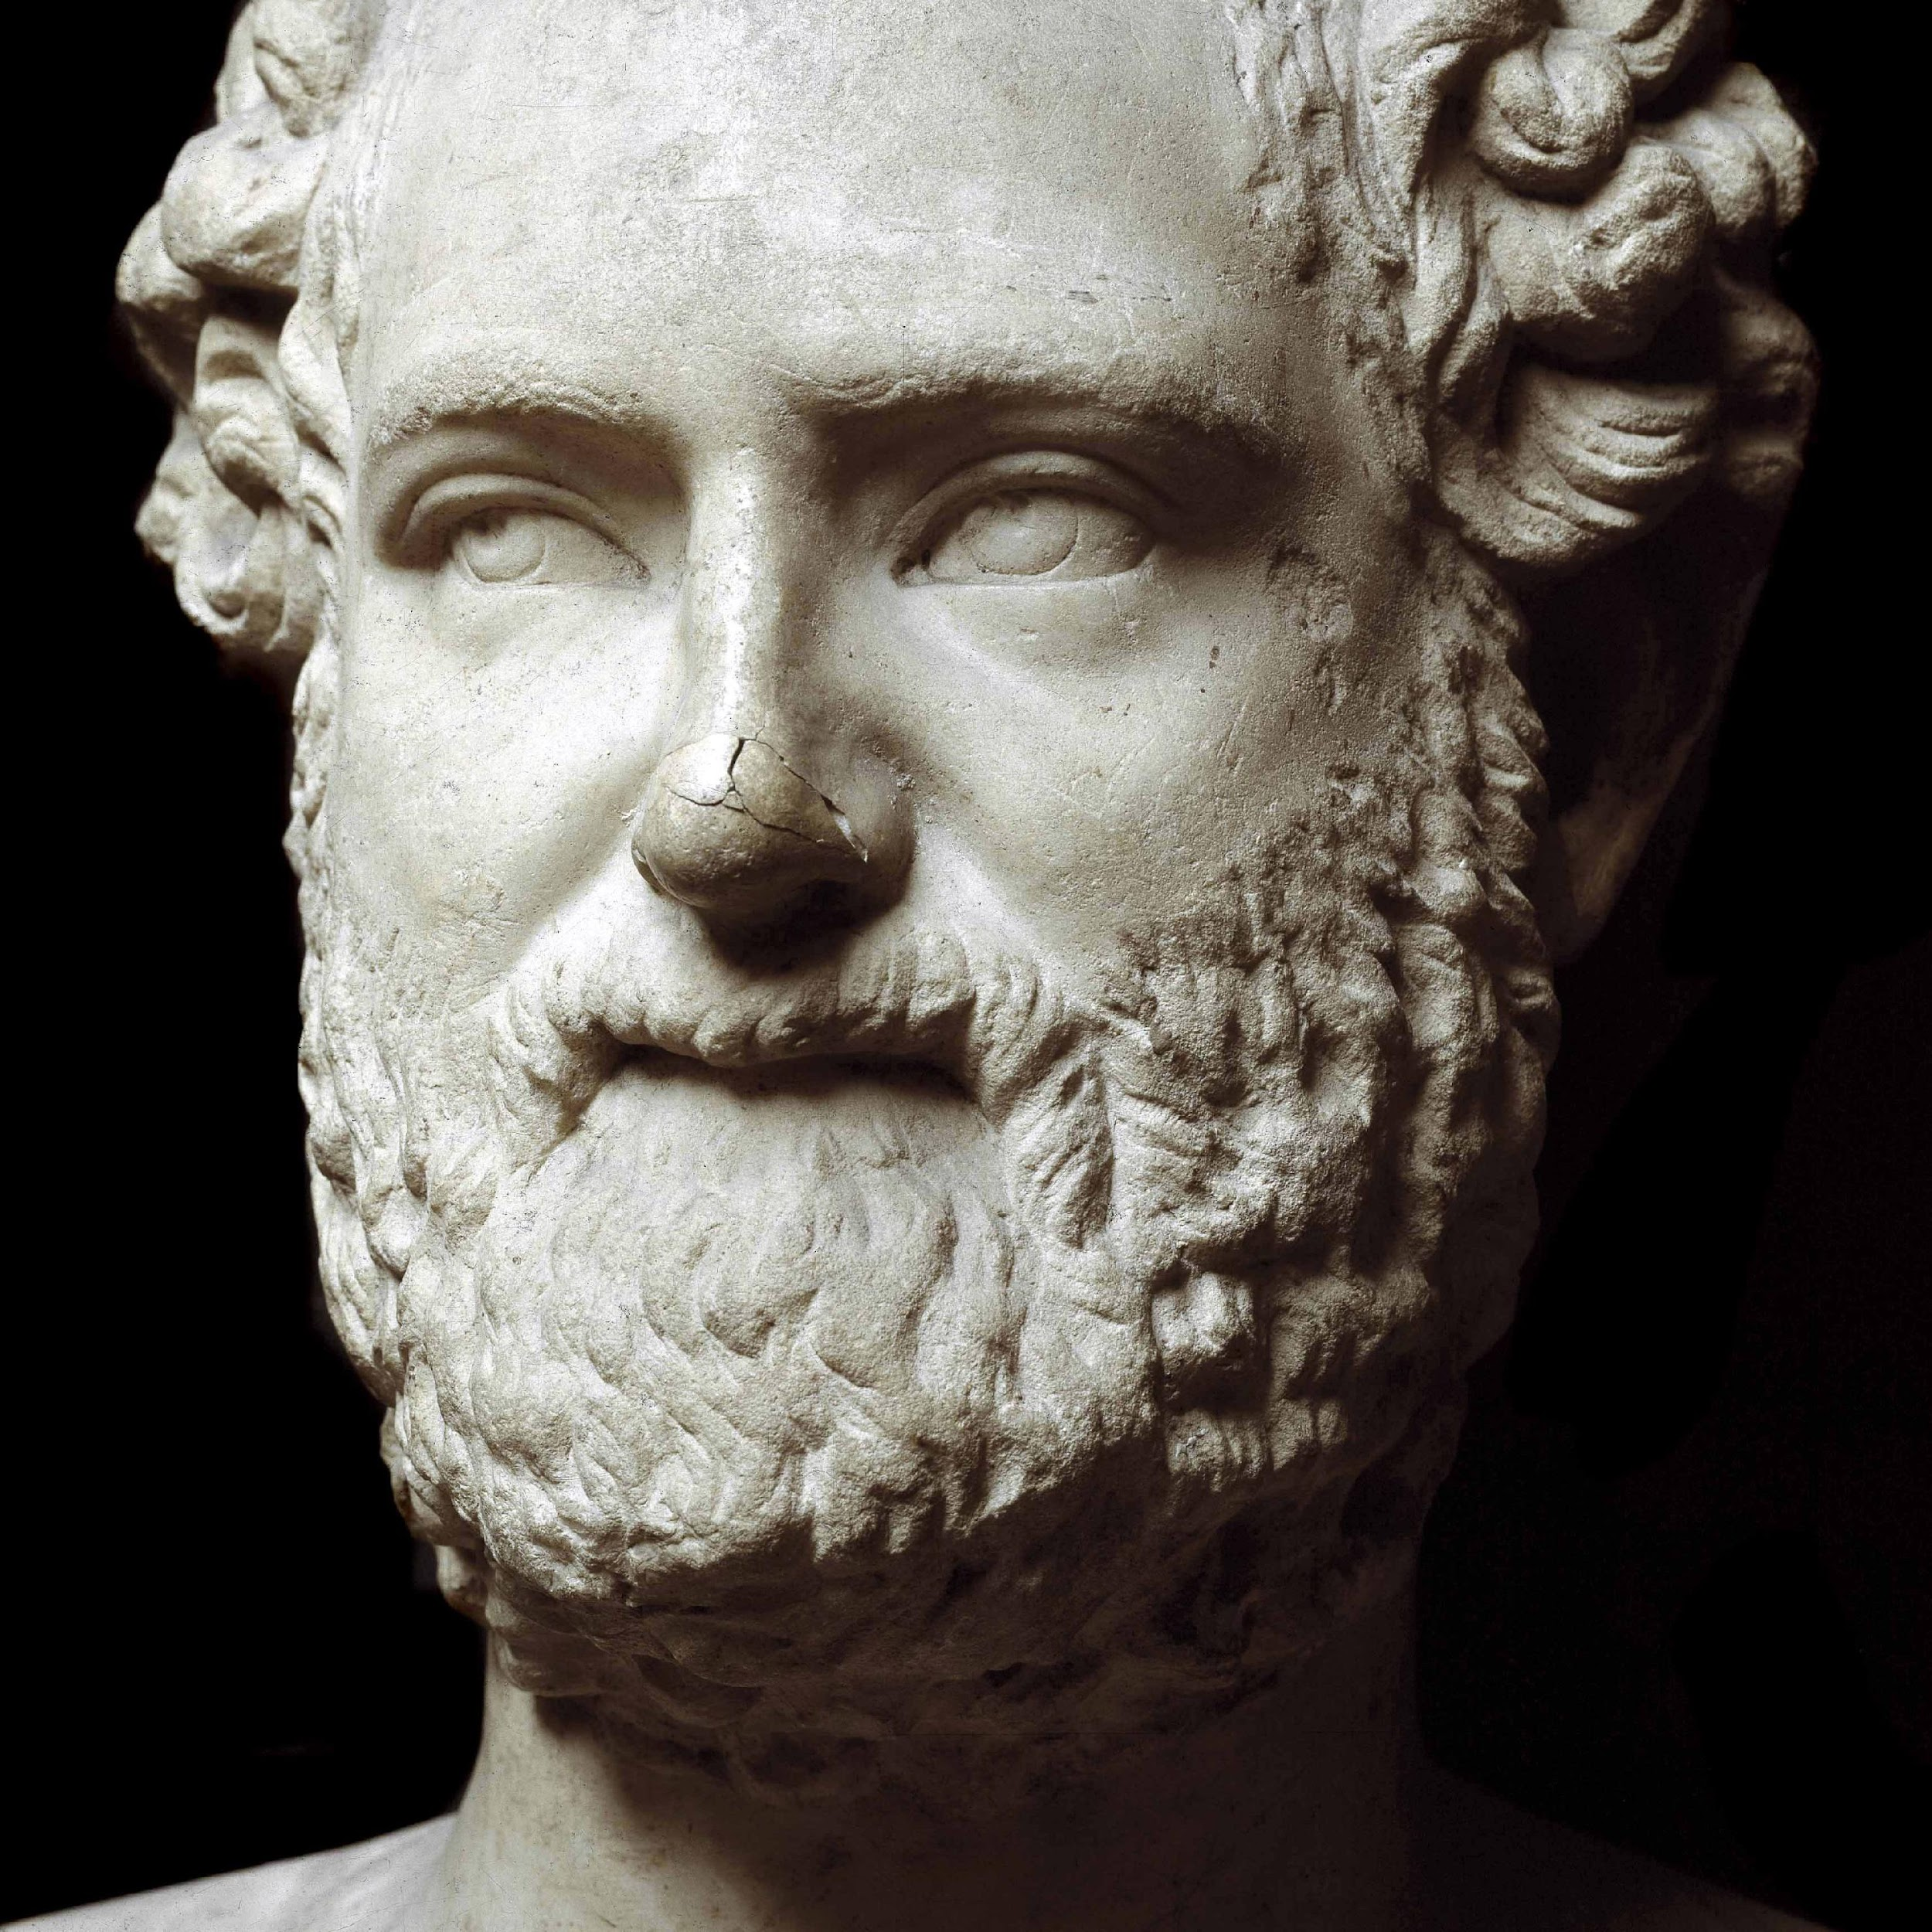
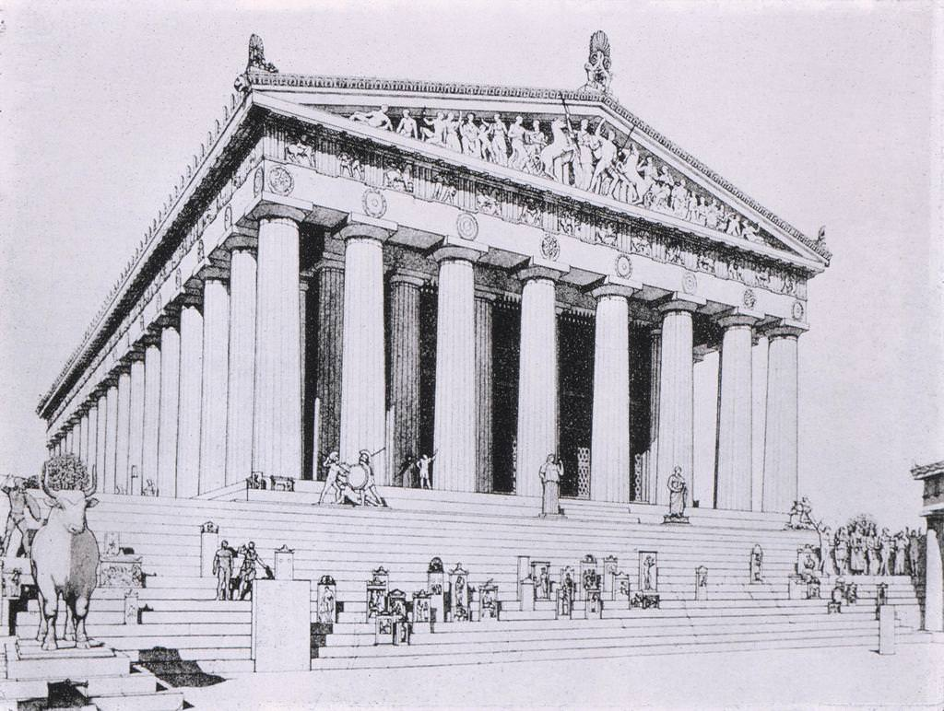
Visualizing the voices of frogs and toads

Slide 8
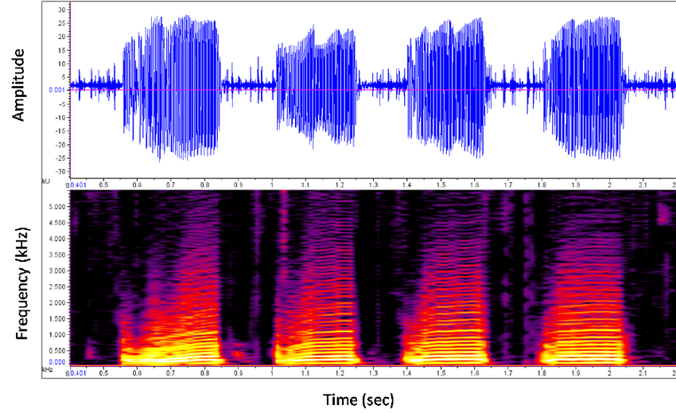
Problem
Acoustic data visualization not being supported in ParaView
Notes:
Problem 1. ParaView did not support spectrogram visualization

Slide 9
Problem
Acoustic data visualization not being supported in ParaView
Notes:
Problem 1. ParaView did not support spectrogram visualization

Slide 10
Problem
Acoustic data visualization not being supported in ParaView
Notes:
Problem 1. ParaView did not support spectrogram visualization

Slide 11
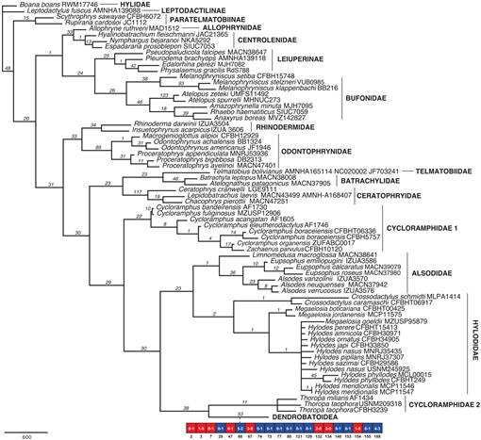
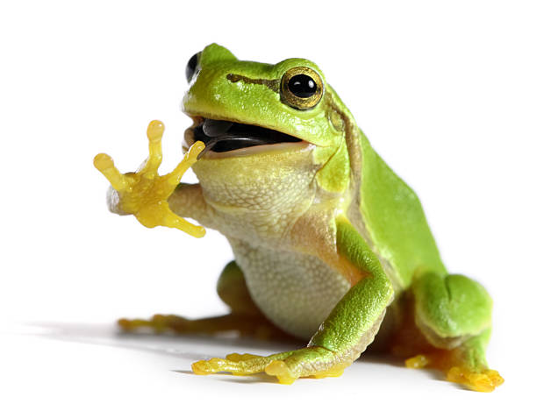
Problem
Current frog and toad taxonomy relies on physical traits

Slide 12
Problem
Current frog and toad taxonomy relies on physical traits
Number of vertebrae, existence of tail, tadpole etc.

Slide 13
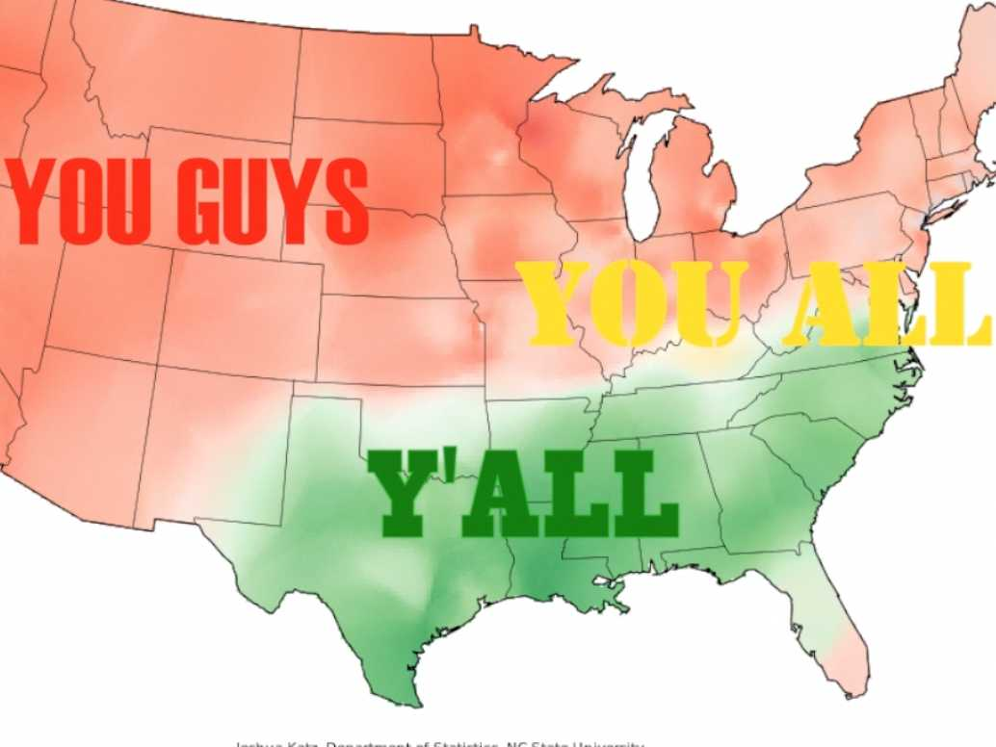
Problem
Current frog and toad taxonomy relied on physical traits

Slide 14
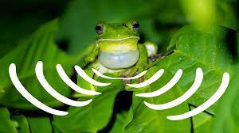
Problem
Current frog and toad taxonomy relied on physical traits

Slide 15
Problem
Current frog and toad taxonomy relied on physical traits

Slide 16
Objectives
Visualize acoustic data of frogs and toads
Preprocessing the acoustic data
3D spectrogram visualization in ParaView
Analysis on acoustic data
Analysis on acoustic patterns
A new classification based on acoustic traits

Slide 17
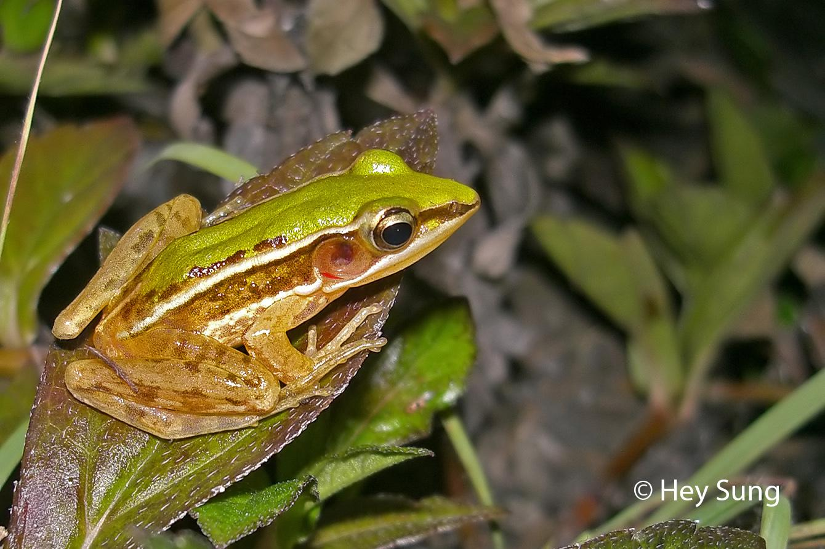
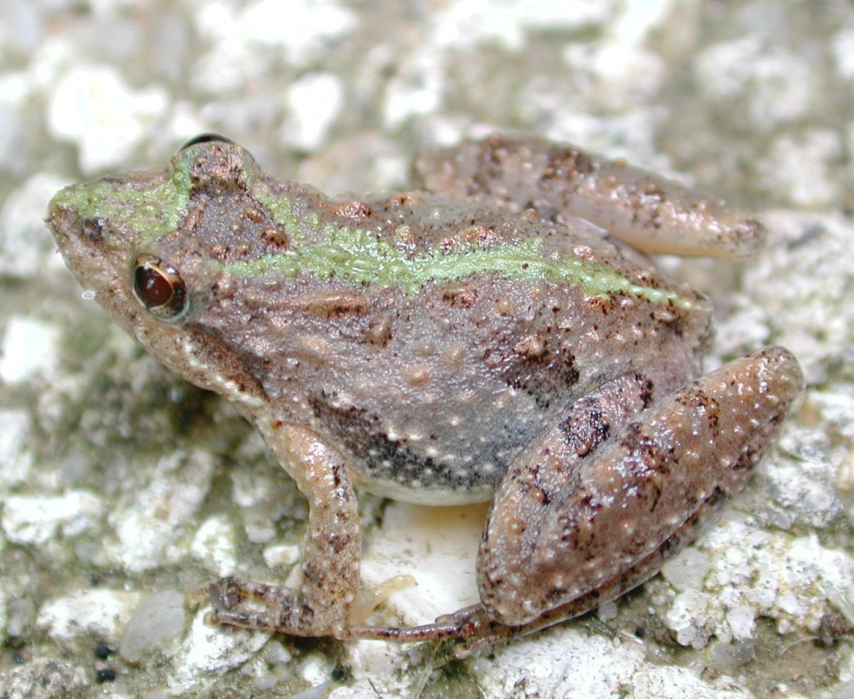
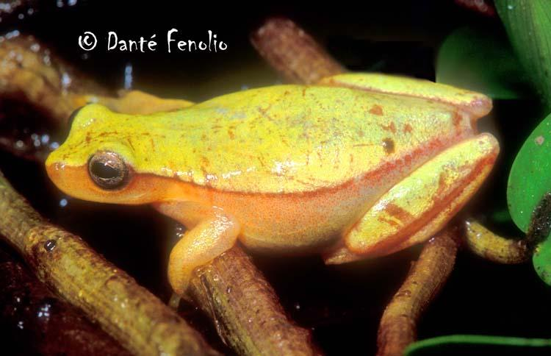
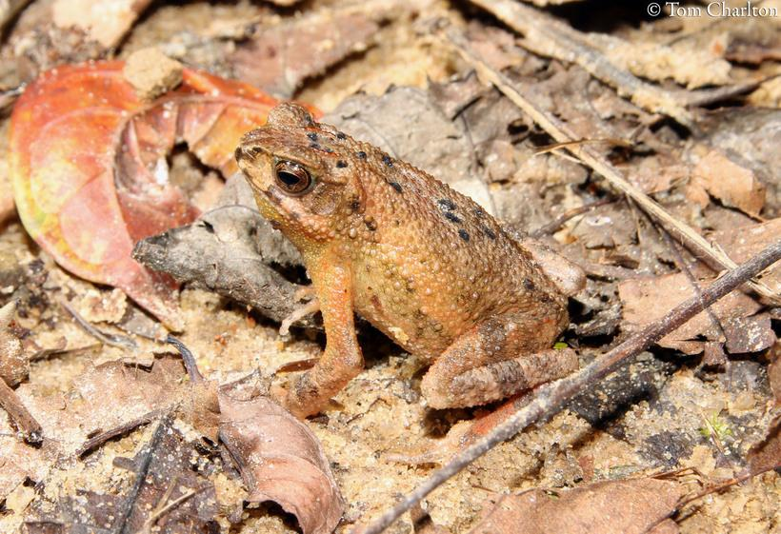
Data selection
Treefrogs (Hylidae)
True Frogs (Ranidae)
True Toads
(Bufonidae)

Slide 18
Preprocessing

Slide 19
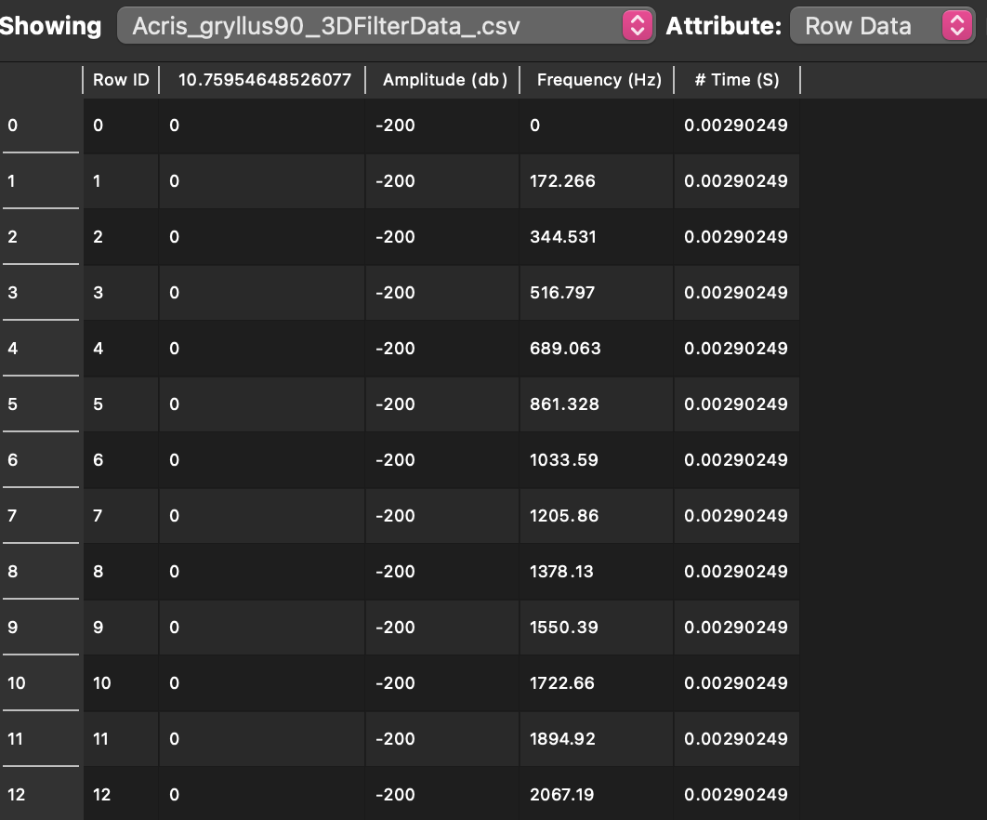
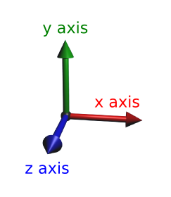
Spectrogram
Amplitude
Time
Frequency

Slide 20
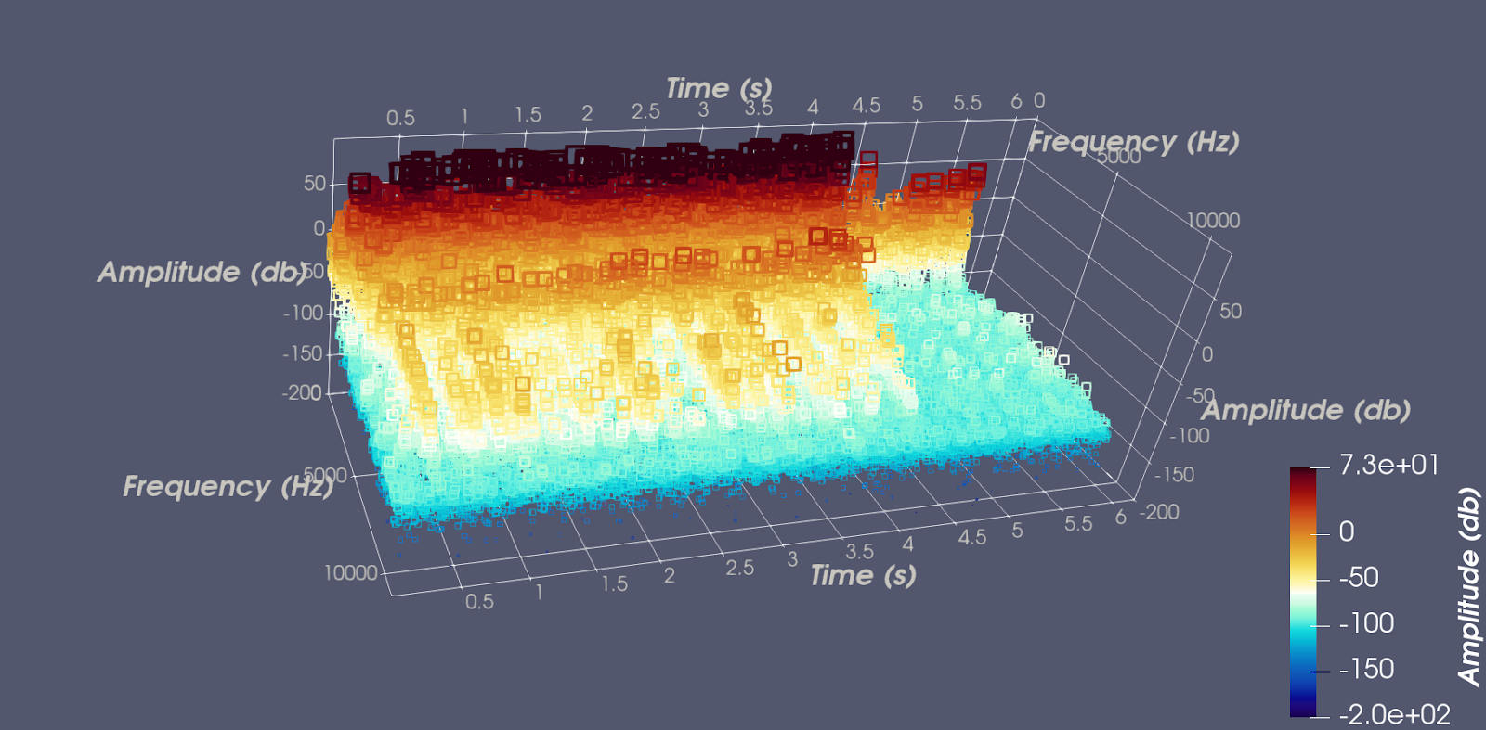
Spectrogram
Amplitude
Time
Frequency

Slide 21
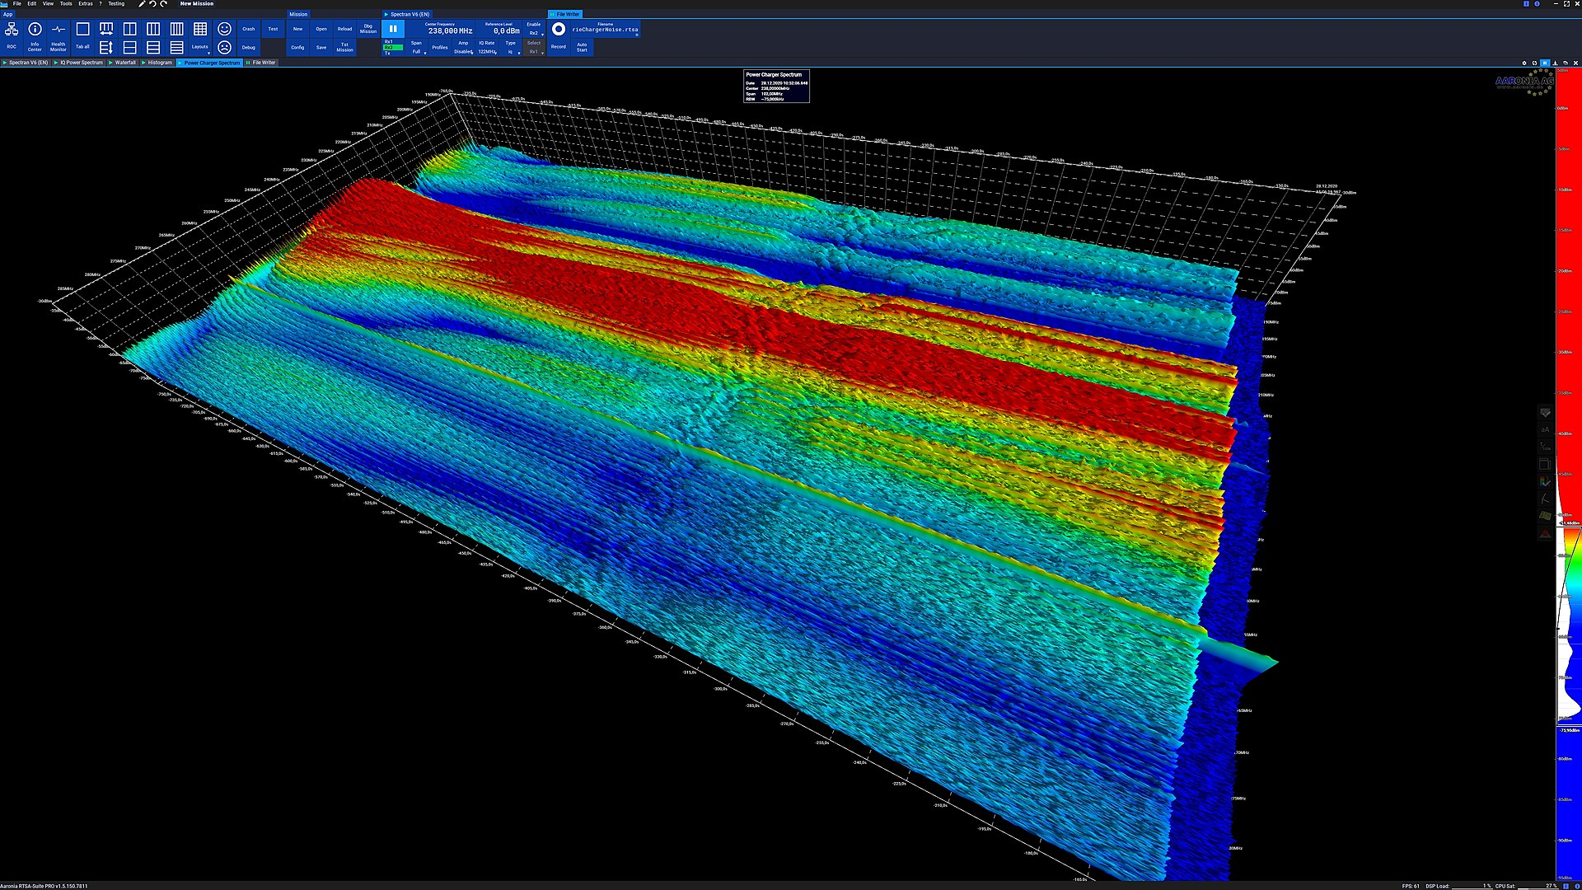
Spectrogram
Amplitude
Time
Frequency

Slide 22
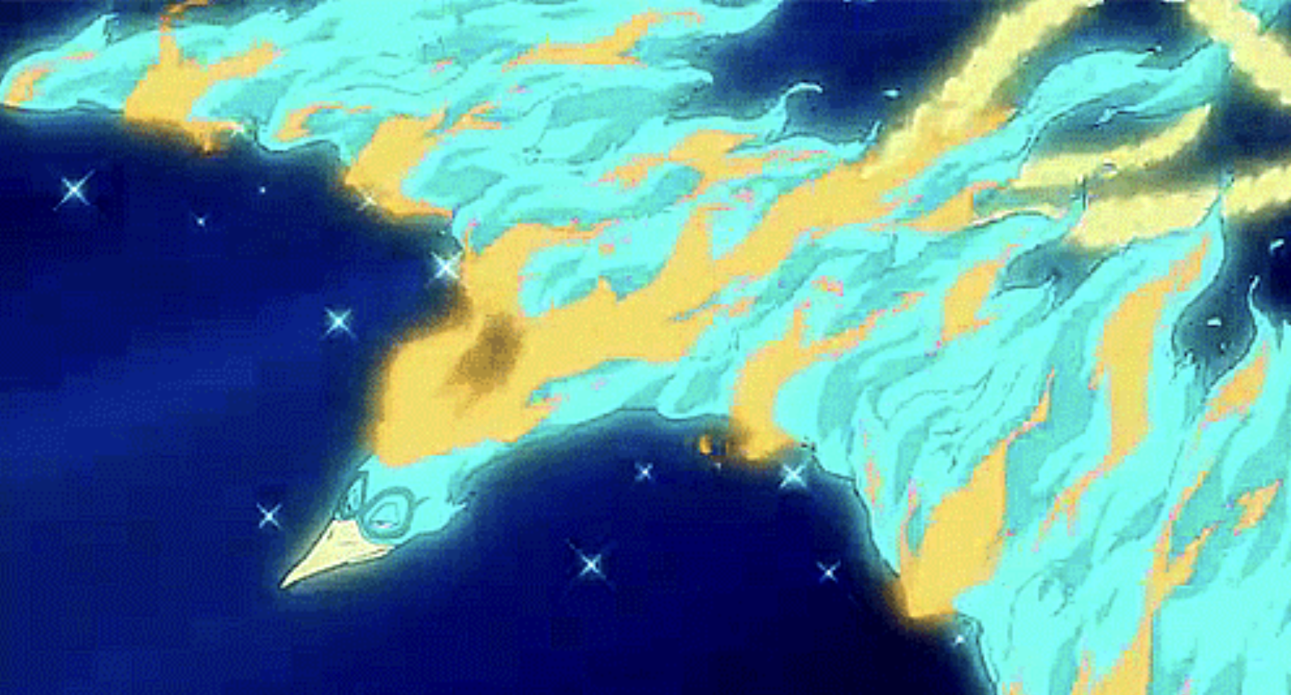
Spectrogram
Amplitude
Time
Frequency

Slide 23
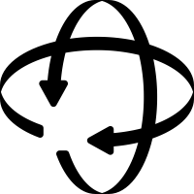
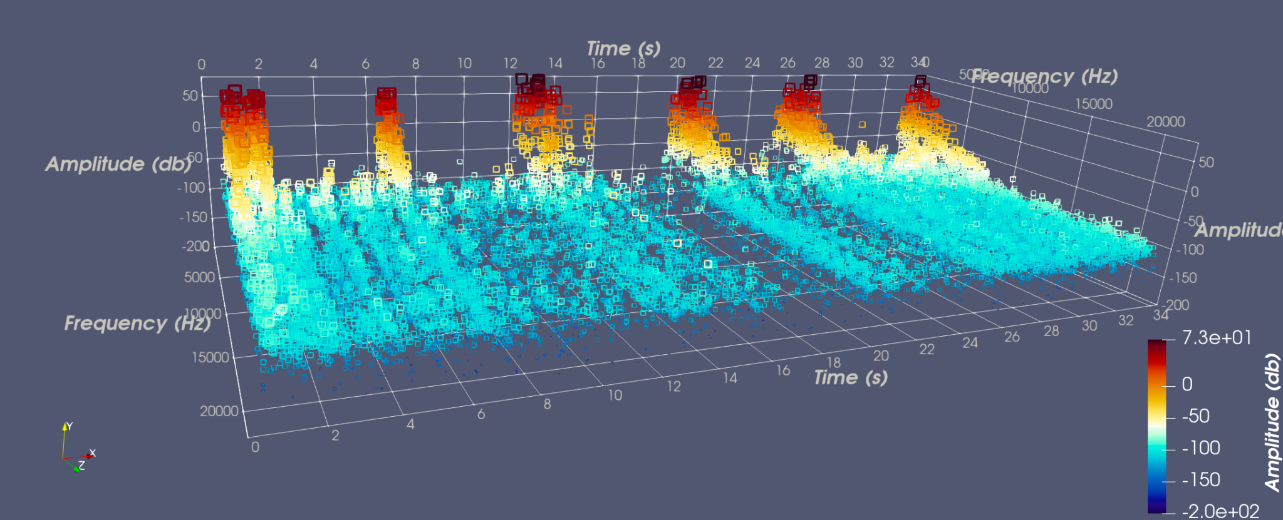
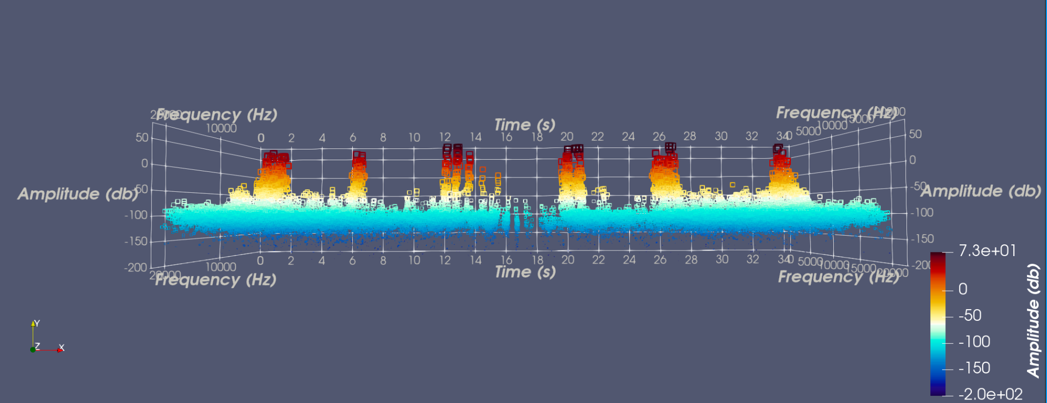
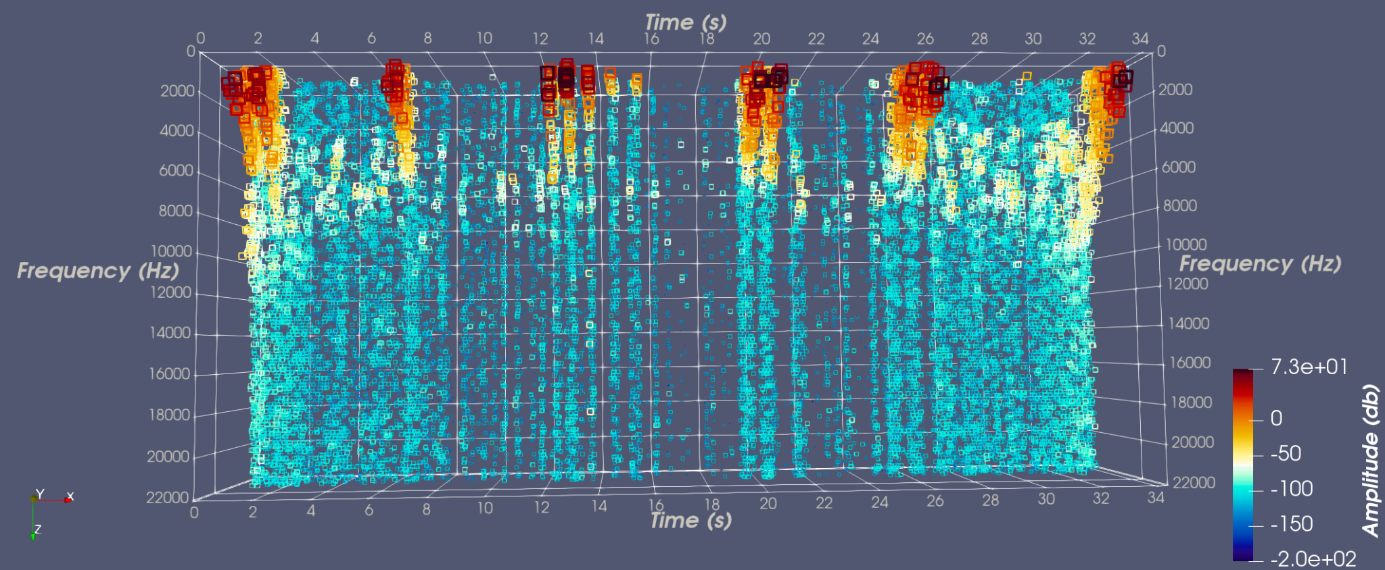
Spectrogram

Slide 24
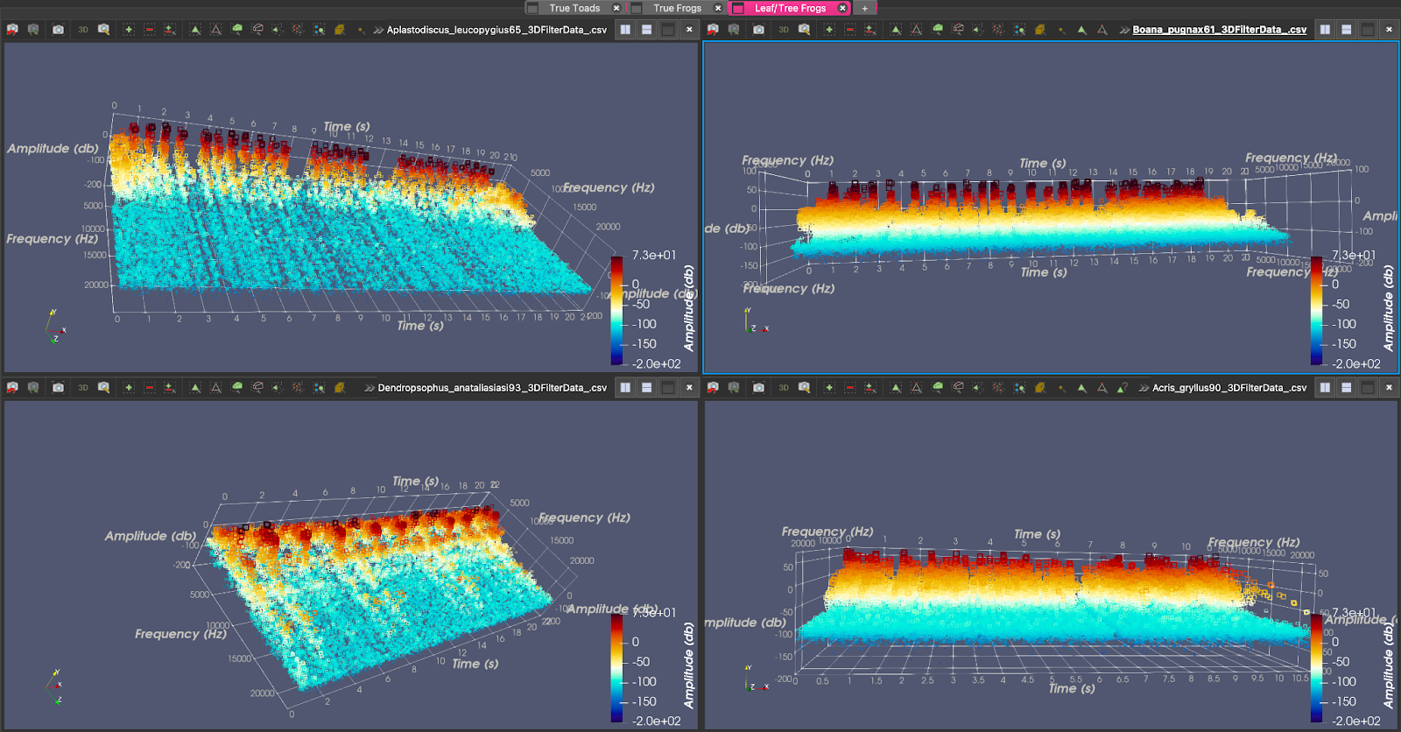
Spectrogram

Slide 25
Analysis
Sound Family Name | True Frog Specimen | Treefrog Specimen | True Toad Specimen
Discrete Narrow Level Consistent | Hyrcanian Wood Frog | Guinle Treefrog | Talysh Toad
Discrete Broad Level Consistent | Marsh Frog | Chirique-Flusse Treefrog | The Lesser Toad
Discrete Narrow Level Inconsistent | Rio Grande Leopard Frog
Joined Narrow Bumpy Inconsistent |  |  | Yosemite Toad
Joined Broad Level Consistent |  | Southern Cricket Frog
Joined Broad Bumpy Consistent |  |  | Amargosa Toad
Joined Broad Bumpy Inconsistent | Two-Striped Grass Frog | Goias Treefrog

Slide 26
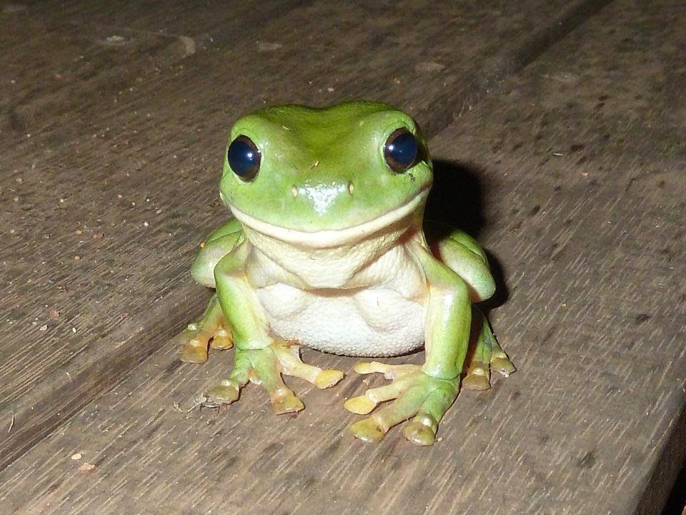
Evaluation
Strength
Acoustic data visualization
Multiple functions into one
Analysis delivery

Slide 27
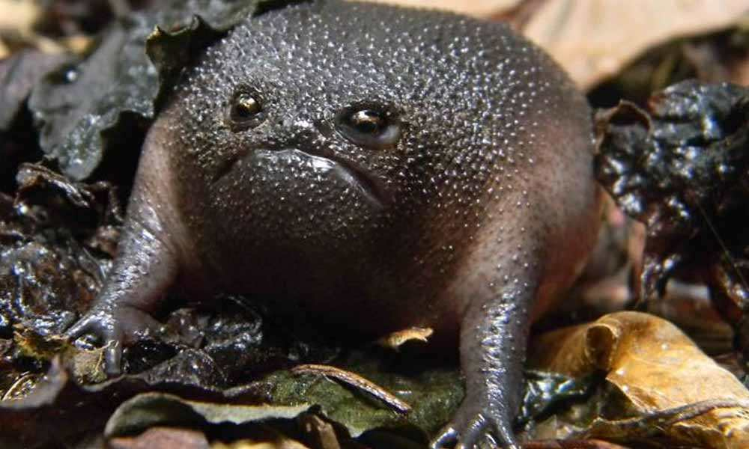
Evaluation
Weakness
Edge cases in preprocessing
ParaView and Python script
Incompatibility issue

Slide 28
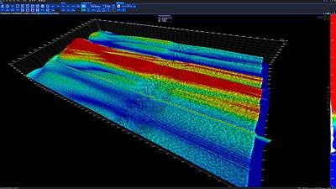
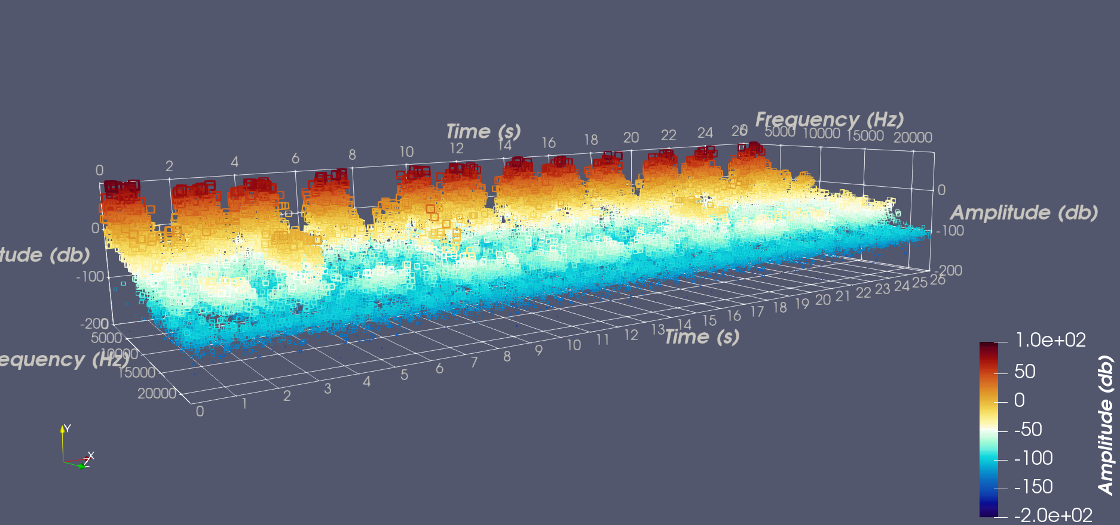
Conclusion
Overview
Sound Family Name | True Frog Specimen | Treefrog Specimen | True Toad Specimen
Discrete Narrow Level Consistent | Hyrcanian Wood Frog | Guinle Treefrog | Talysh Toad
Discrete Broad Level Consistent | Marsh Frog | Chirique-Flusse Treefrog | The Lesser Toad
Discrete Narrow Level Inconsistent | Rio Grande Leopard Frog
Joined Narrow Bumpy Inconsistent |  |  | Yosemite Toad
Joined Broad Level Consistent |  | Southern Cricket Frog
Joined Broad Bumpy Consistent |  |  | Amargosa Toad
Joined Broad Bumpy Inconsistent | Two-Striped Grass Frog | Goias Treefrog
New Classification System
Audio data analysis using Paraview

Slide 29
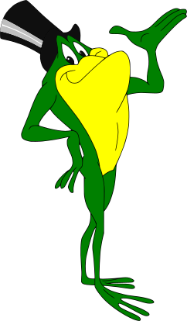
Thank you! ☺

