Slide 1
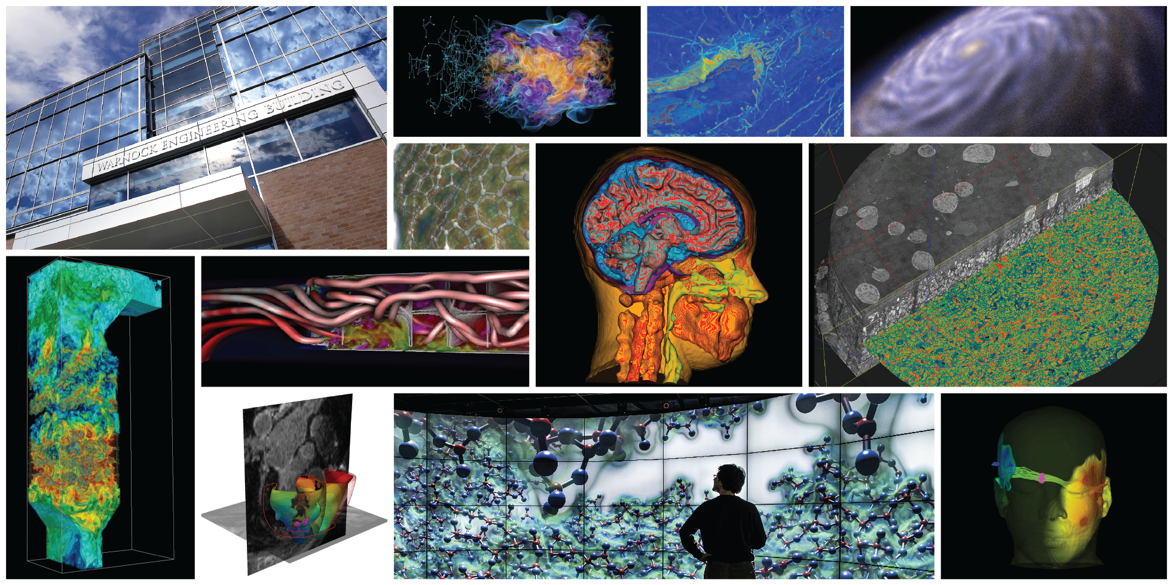
Uncertainty Visualization

Slide 2
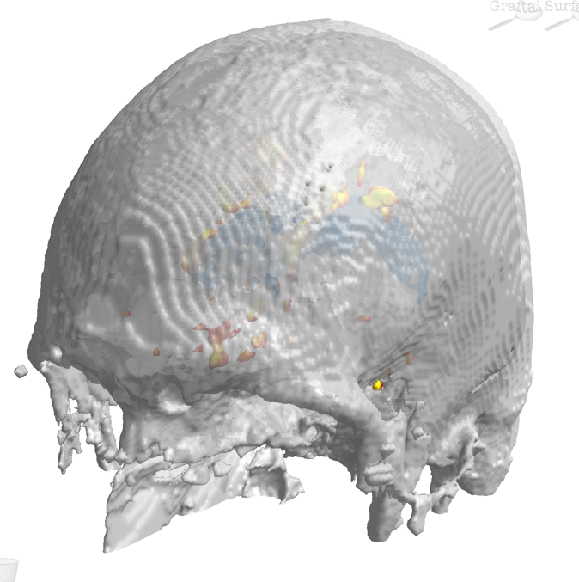
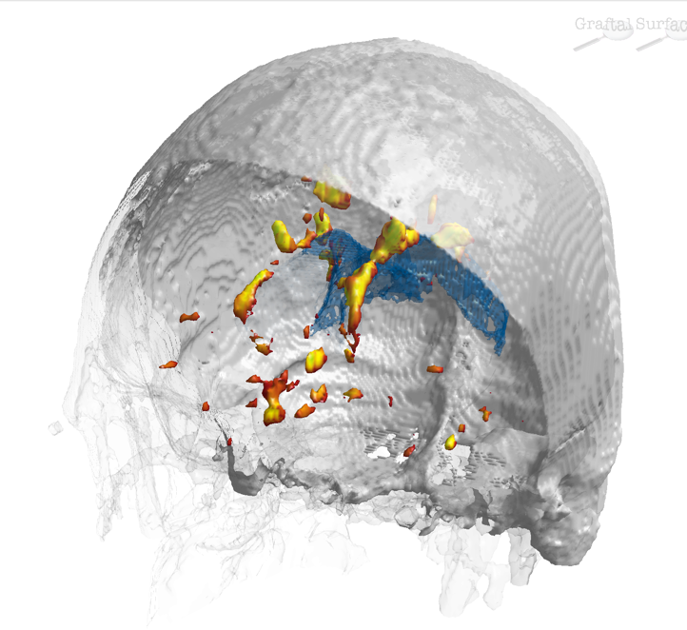
QuizLens: A Multi-lens approach for uncertainty exploration
Global information important for qualitative evaluation & context
Local information necessary for quantitative understanding
Interchangeable lenses to explore various data characteristics
Context
High Level Focus Lens
Uncertain Boundary
Fuzzy Volume Lens
Probability Slice

Slide 3
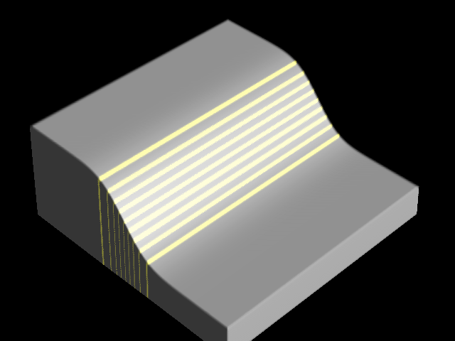
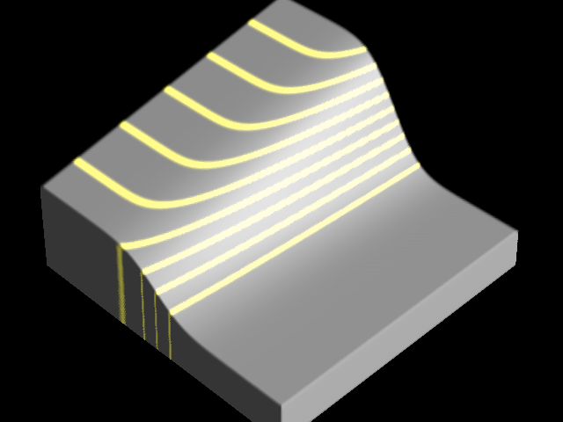
Isosurface uncertainty
Two kinds of boundaries
Flow-line curvature (ter Haar Romeny et al., 1991) for uncertainty visualization:
Material boundaries are intrinsic
If small Δ isovalue ⇒ big Δ isosurface orientation, isosurface probably not a good material boundary
Qualitative indicator of surface model uncertainty
Scientific Computing and Imaging Institute, University of Utah

Slide 4
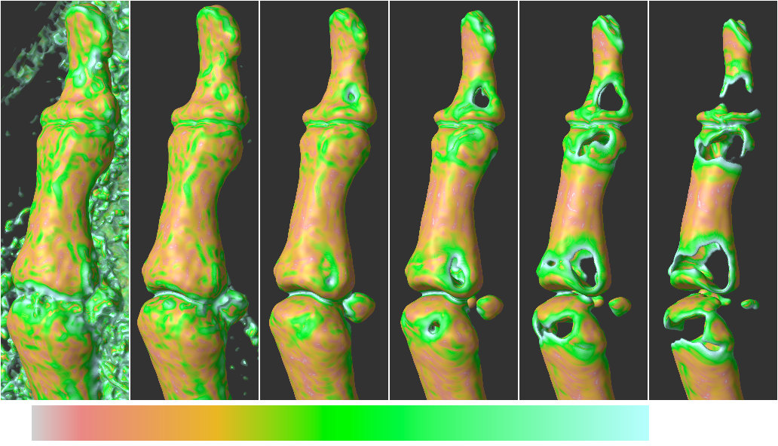
Flow-line curvature results
Thumb from Visible Human Female, fresh CT:
κ_{f}
f=1055
1095
1175
1255
1335
1405
Scientific Computing and Imaging Institute, University of Utah

Slide 5
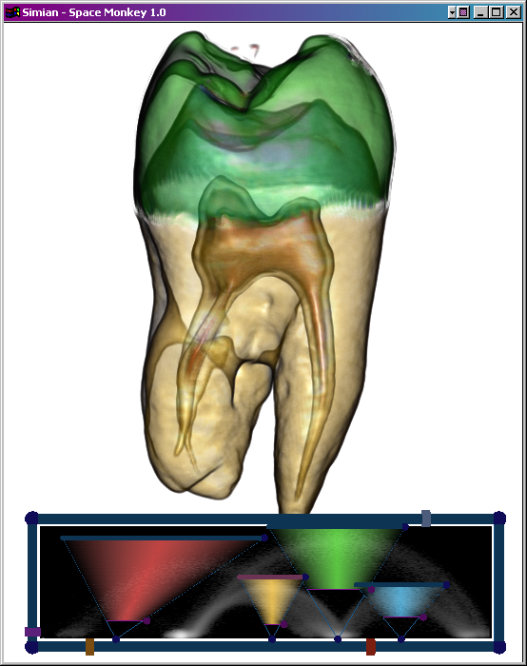
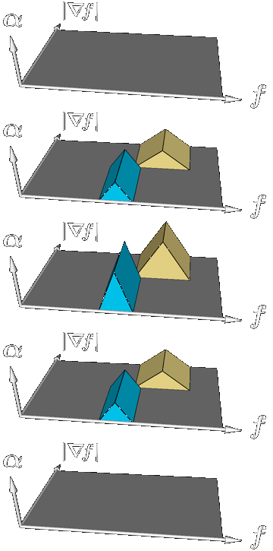
3D Transfer Function
+
0
-
Scientific Computing and Imaging Institute, University of Utah

Slide 6
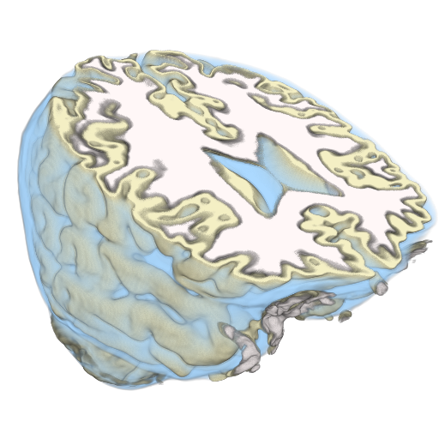
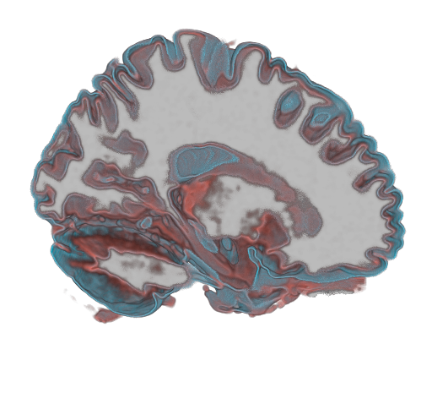
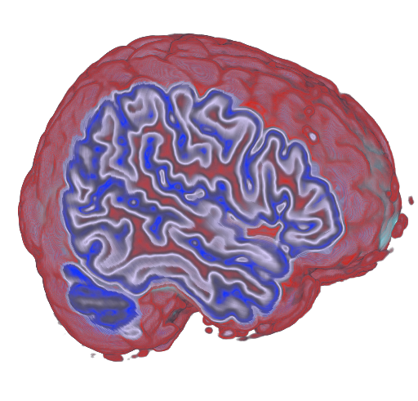
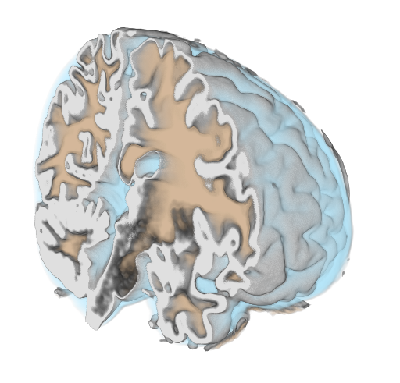
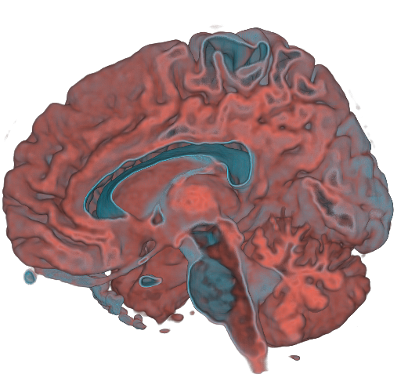
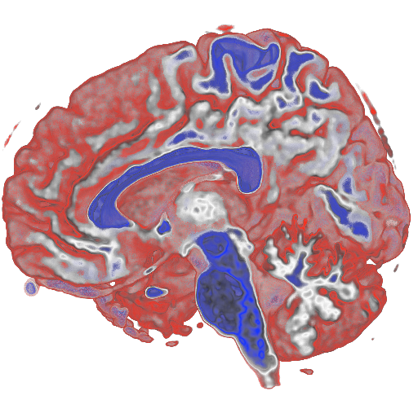
Visualizing Uncertainty Using Volume Rendering
Fuzzy
Sensitivity
Confidence
Scientific Computing and Imaging Institute, University of Utah
Notes:
More of a different kind. Make sure we have a demo here….

Slide 7
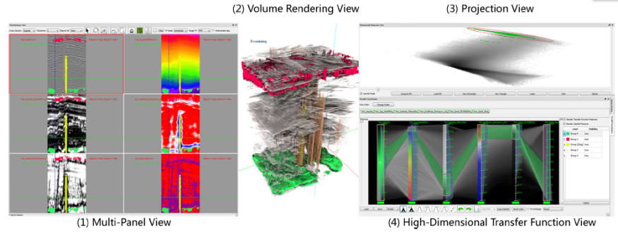
High Dimensional Transfer Functions
Create Transfer Functions (TFs) from user selected samples in spatial domain and error/uncertainty.
Multiple linked views.
Notes:
We propose to create TFs from …
A system with three stages and four linked views is proposed: … explain
Use the animation

Slide 9
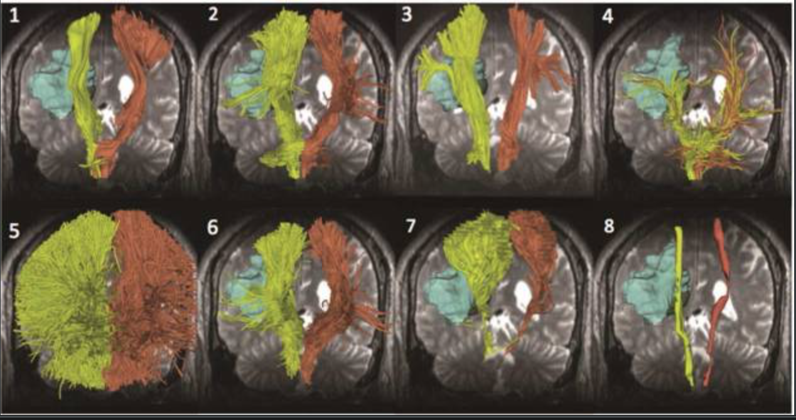
DTI Challenge

