Slide 1
Matrix Completion

Slide 2
Matrix Completion Example
Consider a survey of M people where each is asked Q questions.
It may not be possible to ask each person all Q questions.
Consider a matrix of size M by Q (each row is the set of questions asked to any given person).
This matrix is only partially filled (many missing entries).
Is it possible to infer the full matrix given just the recorded entries?

Slide 3
Matrix Completion Example
Some online shopping sites such as Amazon, Flipkart, Ebay, Netflix etc. have recommender systems.
These websites collect product ratings from users (especially Netflix).
Based on user ratings, these websites try to recommend other products/movies to the user that he/she will like with a high probability.
Consider a matrix with the number of rows equal to the number of users, and number of columns equal to the number of movies/products.
This matrix will be HIGHLY incomplete (no user has the patience to rate too many movies!!) – maybe only 5% of the entries will be filled up.
Can the recommender system infer user preferences from just the defined entries?

Slide 4
Matrix Completion in Practice: Scenario 2
Read about the Netflix Prize to design a better recommender system:
http://en.wikipedia.org/wiki/Netflix_Prize

Slide 5
Matrix Completion in Practice: Scenario 3
Consider an image or a video with several pixel values missing.
This is not uncommon in range imagery or remote sensing applications!
Consider a matrix whose each column is a (vectorized) patch of M pixels. Let the number of columns be K.
This M by K matrix will have many missing entries.
Is it possible to infer the complete matrix given just the defined pixel values?
If the answer were yes, note the implications for image compression!

Slide 6
Matrix Completion in Practice: Scenario 4
Consider a long video sequence of F frames.
Suppose I mark out M salient (interesting points) {P_{i}}, 1<=i<=M, in the first frame.
And try to track those points in all subsequent frames.
Consider a matrix Φ of size M x 2F where row j contains the X and Y coordinates of points on the motion trajectory of initial point P_{j}.
Unfortunately, many salient points may not be trackable due to occlusion or errors from the tracking algorithms.
So Φ is highly incomplete.
Is it possible to infer the true matrix from only the available measurements?

Slide 7
A property of these matrices
Scenario 1: Many people will tend to give very similar or identical answers to many survey questions.
Scenario 2: Many people will have similar preferences for movies (only a few factors affect user choices).
Scenario 3: Non-local self-similarity!
This makes the matrices in all these scenarios low in rank!

Slide 8
A property of these matrices
Scenario 4: The true matrix underlying Φ in question has been PROVED to be of low rank (in fact, rank 3) under orthographic projection (ref: Tomasi and Kanade, “Shape and Motion from Image Streams Under Orthography: a Factorization Method”, IJCV 1992) and a few other more complex camera models (up to rank 9).
Φ can be expressed as a product of two matrices – a rotation matrix of size 2F x 3, and a shape matrix of size 3 x P.
Φ is useful for many computer vision problems such as structure from motion, motion segmentation and multi-frame point correspondences.

Slide 9
Low-rank matrices are cool!
The answer to the four questions/scenarios is a big NO in the general case.
But it’s a big YES if we assume that the underlying matrix has low rank (and which, as we have seen, is indeed the case for all four scenarios).

Slide 10
Theorem 1 (Informal Statement)
Consider an unknown matrix Φ of size n₁ by n₂ having rank r < min(n₁, n₂).
Suppose we observe only a fraction of entries of Φ in the form of matrix Γ, where Γ(i,j) = Φ(i,j) for all (i,j) belonging to some set Ω and Γ(i,j) undefined elsewhere.
If (1) Φ has row and column spaces that are “sufficiently incoherent” with the canonical basis (i.e. identity matrix), (2) r is “sufficiently small”, and (3) Ω is “sufficiently large”, then we can accurately recover Φ from Γ by solving the following rank minimization problem:

Slide 11
Cool theorem, but … ☹
The afore-mentioned optimization problem is NP-hard (in fact, it is known to have double exponential complexity!)

Slide 12
Theorem 2 (Informal Statement)
Consider an unknown matrix Φ of size n₁ by n₂ having rank r < min(n₁, n₂).
Suppose we observe only a fraction of entries of Φ in the form of matrix Γ, where Γ(i,j) = Φ(i,j) for all (i,j) belonging to some set Ω and Γ(i,j) undefined elsewhere.
If (1) Φ has row and column spaces that are “sufficiently incoherent” with the canonical basis (i.e. identity matrix), (2) r is “sufficiently small”, and (3) Ω is “sufficiently large”, then we can accurately recover Φ from Γ by solving the following “trace-norm” minimization problem:

Slide 13
What is the trace-norm of a matrix?
The trace-norm of a matrix is the sum of its singular values.
It is also called nuclear norm.
It is a softened version of the rank of a matrix, just like the L1-norm of a vector is a softened version of the L0-norm of the vector.
Minimization of the trace-norm (even under the given constraints) is a convex optimization problem and can be solved efficiently (no local minima issues).
This is similar to the L1-norm optimization (in compressive sensing) being efficiently solvable.

Slide 14
More about trace-norm minimization
The efficient trace-norm minimization procedure is provably known to give the EXACT SAME result as the NP-hard rank minimization problem (under the same constraints and same conditions on the unknown matrix Φ and the sampling set Ω).
This is analogous to the case where L1-norm optimization yielded the same result as L0-norm optimization (under the same set of constraints and conditions).
Henceforth we will concentrate only on Theorem 2 (and beyond).

Slide 15
The devil is in the details
Beware: Not all low-rank matrices can be recovered from partial measurements!
Example consider a matrix containing zeroes everywhere except the top-right corner.
This matrix is low rank, but it cannot be recovered from knowledge of only a fraction of its entries!
Many other such examples exist.
In reality, Theorems 1 and 2 work for low-rank matrices whose singular vectors are sufficiently spread out, i.e. sufficiently incoherent with the canonical basis (i.e. with the identity matrix).

Slide 16
Coherence of a basis
The coherence of subspace U of R^{n} and having dimension r with respect to the canonical basis {e_{i}} is defined as:

Slide 17
Formal definition of key assumptions
Consider an underlying matrix M of size n₁ by n₂. Let the SVD of M be given as follows:
We make the following assumptions about M:
(A0)
(A1) The maximum entry in the n₁ by n₂ matrix is upper bounded by

Slide 18
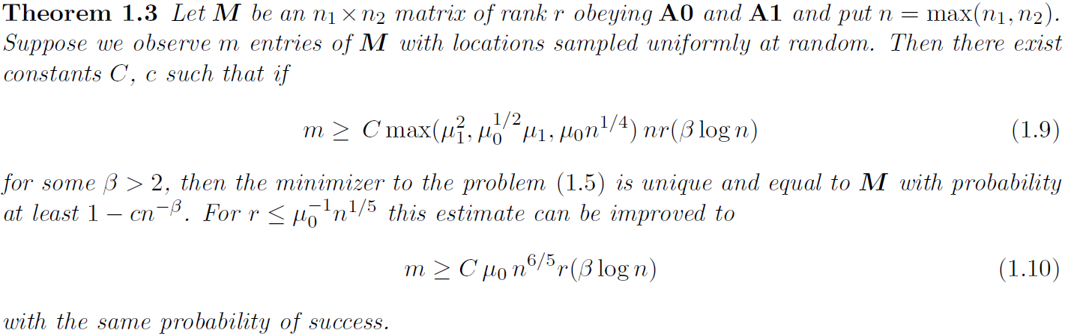
Theorem 2 (Formal Statement)
the trace-norm minimizer (in the informal statement of theorem 2)

Slide 19
Comments on Theorem 2
Theorem 2 states that more entries of M must be known (denoted by m) for accurate reconstruction if (1) M has larger rank r, (2) greater value of μ₀ in (A0), (3) greater value of μ₁ in (A1).
Example: If μ₀ = O(1) and the rank r is small, the reconstruction is accurate with high probability provided .

Slide 20
Comments on Theorem 2
It turns out that if the singular vectors of matrix M have bounded values, the condition (A1) almost always holds for the value μ₁ = O(log n)

Slide 21
Matrix Completion under noise
Consider an unknown matrix Φ of size n₁ by n₂ having rank r < min(n₁, n₂).
Suppose we observe only a fraction of entries of Φ in the form of matrix Γ, where Γ(i,j) = Φ(i,j) + Z(i,j) for all (i,j) belonging to some set Ω and Γ(i,j) undefined elsewhere.
Here Z refers to a white noise process which obeys the constraint that:

Slide 22
Matrix Completion under noise
In such cases, the unknown matrix Φ can be recovered by solving the following minimization procedure (called as a semi-definite program):

Slide 23
Theorem 3 (informal statement)
The reconstruction result from the previous procedure is accurate with an error bound given by:

Slide 24
A Minimization Algorithm
Consider the minimization problem:
There are many techniques to solve this problem (http://perception.csl.illinois.edu/matrix-rank/sample_code.html)
Out of these, we will study one method called “singular value thresholding”.

Slide 25
Singular Value Thresholding (SVT)
Ref: Cai et al, “A singular value thresholding algorithm for matrix completion”, SIAM Journal on Optimization, 2010.
The soft-thresholding procedure obeys the following property (which we state w/o proof).

Slide 26
Properties of SVT (stated w/o proof)
The sequence {Φ_{k}} converges to the true solution of the main problem provided the step-sizes {δ_{k}} all lie between 0 and 2.
This happens typically for large values of τ.

Slide 27
Results
The SVT algorithm works very efficiently and is easily implementable in MATLAB.
The authors report reconstruction of a 30,000 by 30,000 matrix in just 17 minutes on a 1.86 GHz dual-core desktop with 3 GB RAM and with MATLAB’s multithreading option enabled.

Slide 28
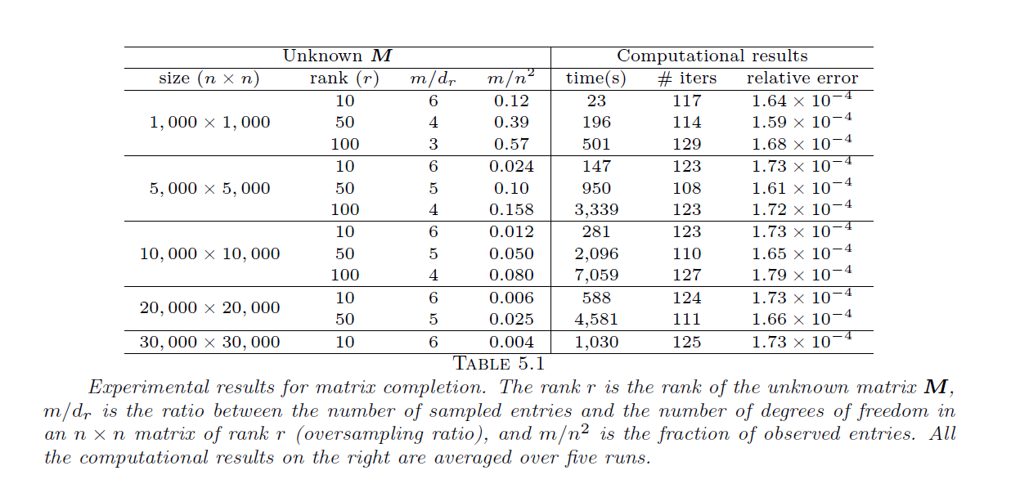
Results (Data without noise)

Slide 29
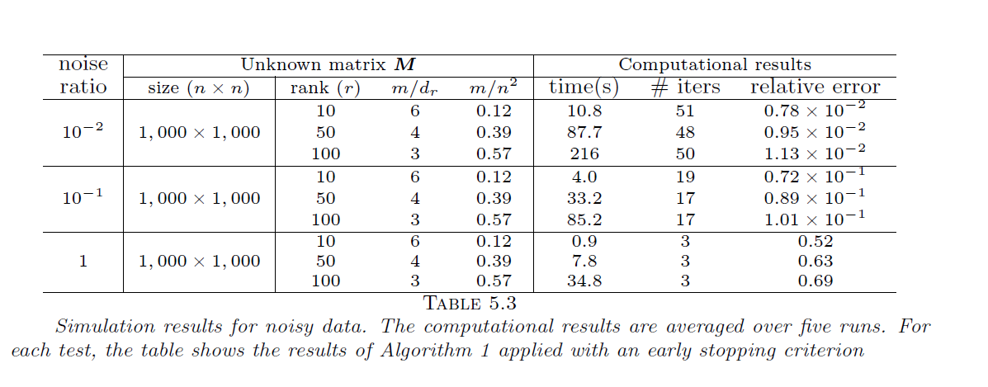
Results (Noisy Data)

Slide 30
Results on real data
Dataset consists of a matrix M of geodesic distances between 312 cities in the USA/Canada.
This matrix is of approximately low-rank (in fact, the relative Frobenius error between M and its rank-3 approximation is 0.1159).
70% of the entries of this matrix (chosen uniformly at random) were blanked out.

Slide 31
Results on real data
The underlying matrix was estimated using SVT.
In just a few seconds and a few iterations, the SVT produces an estimate that is as accurate as the best rank-3 approximation of M.

Slide 32
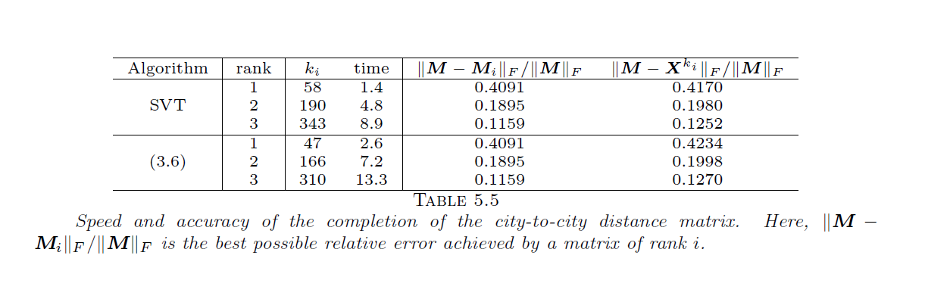
Results on real data

