Slide 1
The Pursuit of Low-dimensional Structures in High-dimensional (Visual) Data:
Formulation and Theory
John Wright Yi Ma
Electrical Engineering Visual Computing Group
Columbia University Microsoft Research Asia

Slide 2
THIS LECTURE – from application to theory
  Abstract Problem Formulation:
    - Recovering low-dimensional structures from imperfect observations.
  Solution: Convex Optimization
  Foundational Theoretical Results:
    - Convex programming heuristics guarantee to solve this problem.
  Extensions:
  - Decomposable structures.
Notes:
Today I will focus on one particular observation in automatic face recognition.

Slide 3
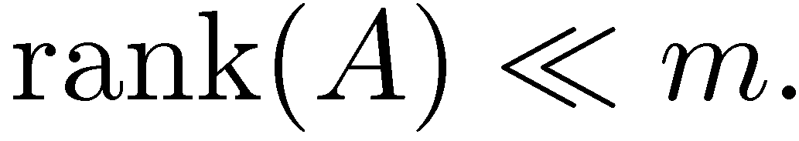
Problem Formulation
The data should be low-rank:
… but some of the observations are grossly corrupted:
… and all of the observations are noisy:
… and many of them are missing:
Notes:
Today I will focus on one particular observation in automatic face recognition.

Slide 4
Problem Formulation
The data should be low-rank:
… but some of the observations are grossly corrupted:
… and all of the observations are noisy:
… and many of them are missing:
Notes:
Today I will focus on one particular observation in automatic face recognition.

Slide 5
Problem Formulation
The data should be low-rank:
… but some of the observations are grossly corrupted:
… and all of the observations are noisy:
… and many of them are missing:
Notes:
Today I will focus on one particular observation in automatic face recognition.

Slide 6
Problem Formulation
The data should be low-rank:
… but some of the observations are grossly corrupted:
… and all of the observations are noisy:
… and many of them are missing:
Notes:
Today I will focus on one particular observation in automatic face recognition.

Slide 7
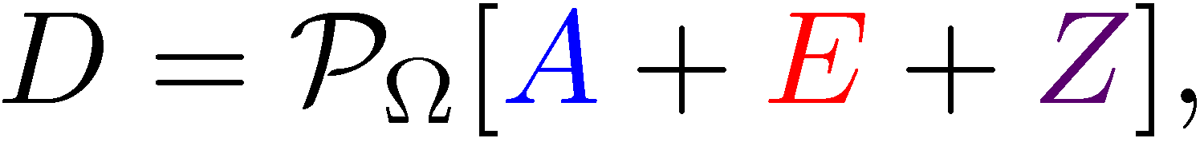



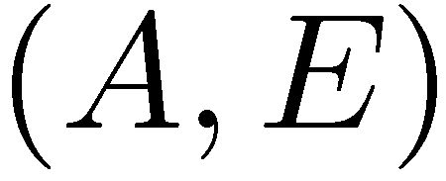

Our problem:
h
Given an observation with
low-rank,
sparse,
small, dense noise,
recover a good estimate of .
High-dimensional setting: Many more unknowns than
  observations . Can knowledge of the structure of make this problem well-posed?
Hugely active area…
Notes:
Today I will focus on one particular observation in automatic face recognition.

Slide 8
Our problem:
h
Given an observation with
low-rank,
sparse,
small, dense noise,
recover a good estimate of .
High-dimensional setting: Many more unknowns than
  observations . Can knowledge of the structure of make this problem well-posed?
Hugely active area…
Notes:
Today I will focus on one particular observation in automatic face recognition.

Slide 9
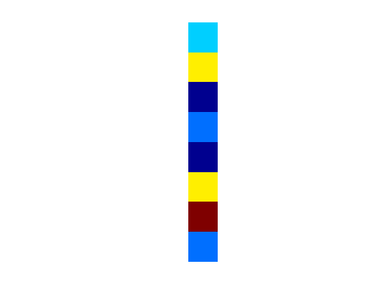
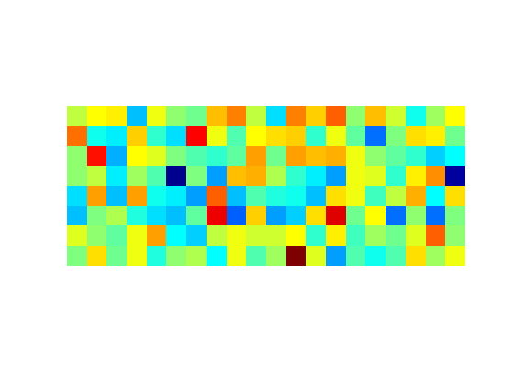
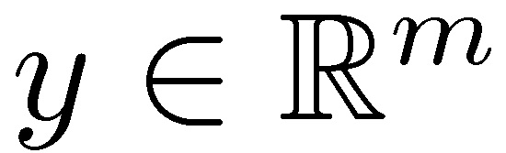
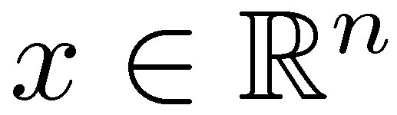
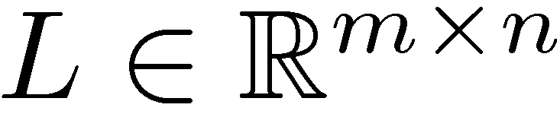
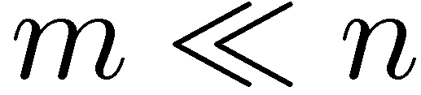
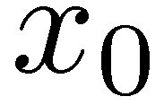

CONTEXT – Recent related progress
Sparse recovery:
Impossible in general ( )
Well-posed if is structured (sparse)
Tractable via convex optimization
… if is “nice” (random, incoherent, RIP)
Many contributors: Donoho+Huo ’01, Elad+Bruckstein ‘03, Candès+Tao ’04,’05, Tropp ’04, ‘06, Donoho ‘04, Fuchs ‘05, Zhao+Yu ‘06, Meinshausen+Buhlmann ‘06, Wainwright ‘09, Donoho+Tanner ‘09 … and many others
Notes:
Today I will focus on one particular observation in automatic face recognition.

Slide 10
Our problem:
h
Given an observation with
low-rank,
sparse,
small, dense noise,
recover a good estimate of .
High-dimensional setting: Many more unknowns than
  observations . Can knowledge of the structure of make this problem well-posed?
Hugely active area…
Notes:
Today I will focus on one particular observation in automatic face recognition.

Slide 11
Our problem:
h
Given an observation with
low-rank,
sparse,
small, dense noise,
recover a good estimate of .
High-dimensional setting: Many more unknowns than
  observations . Can knowledge of the structure of make this problem well-posed?
Hugely active area…
Notes:
Today I will focus on one particular observation in automatic face recognition.

Slide 12
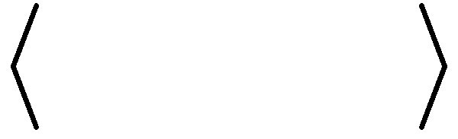
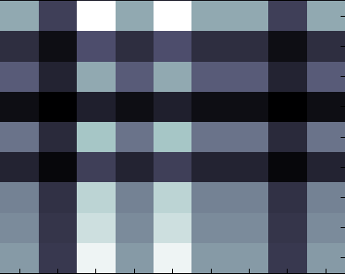
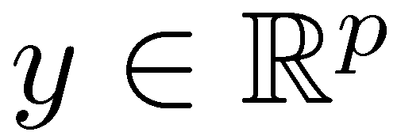
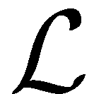
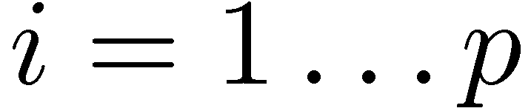
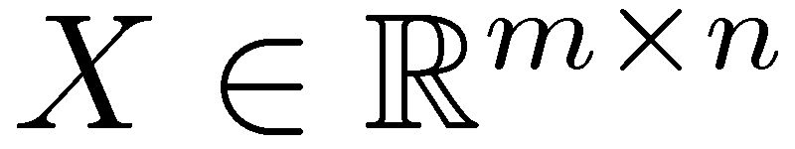
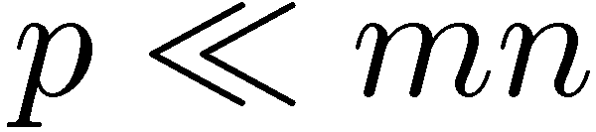
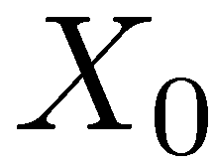
CONTEXT – Recent related progress
Low-rank sensing:
Impossible in general ( )
Well-posed if is structured (low-rank)
Tractable via convex optimization
… if is “nice” (random, rank-RIP)
Recht+Fazel+Parillo ‘07, Candès+Plan ’10, Mohan+Fazel ‘10, Recht+Xu+Hassibi ’11, Chandrasekaran+Recht+Parillo+Willsky ‘11, Negahban+Wainwright ’11 …
,
Notes:
Today I will focus on one particular observation in automatic face recognition.

Slide 13
Our problem:
h
Given an observation with
low-rank,
sparse,
small, dense noise,
recover a good estimate of .
High-dimensional setting: Many more unknowns than
  observations . Can knowledge of the structure of make this problem well-posed?
Hugely active area…
Notes:
Today I will focus on one particular observation in automatic face recognition.

Slide 14
Our problem:
h
Given an observation with
low-rank,
sparse,
small, dense noise,
recover a good estimate of .
Missing data
High-dimensional setting: Many more unknowns than
  observations . Can knowledge of the structure of make this problem well-posed?
Hugely active area…
Notes:
Today I will focus on one particular observation in automatic face recognition.

Slide 15



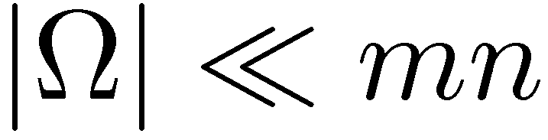
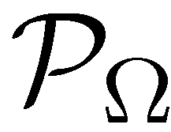
CONTEXT – Recent related progress
Matrix completion:
Impossible in general ( )
Well-posed if is structured (low-rank)
Tractable via convex optimization
  … if is “nice” (random subset) ...
  … and interacts “nicely” with ( incoherent – not “spiky”).
Candès+Recht ‘08, Keshevan+Oh+Montonari ‘09, Candès+Tao ‘09, Gross ‘10, Recht ‘10, Negahban+Wainwright ‘10
??
Notes:
Today I will focus on one particular observation in automatic face recognition.

Slide 16
Our problem:
h
Given an observation with
low-rank,
sparse,
small, dense noise,
recover a good estimate of .
High-dimensional setting: Many more unknowns than
  observations . Can knowledge of the structure of make this problem well-posed?
Hugely active area…
Notes:
Today I will focus on one particular observation in automatic face recognition.

Slide 17
Our problem:
h
Given an observation with
low-rank,
sparse,
small, dense noise,
recover a good estimate of .
Errors
High-dimensional setting: Many more unknowns than
  observations . Can knowledge of the structure of make this problem well-posed?
Hugely active area…
Notes:
Today I will focus on one particular observation in automatic face recognition.

Slide 18
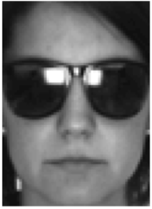
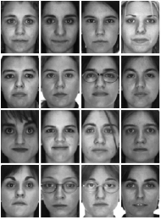
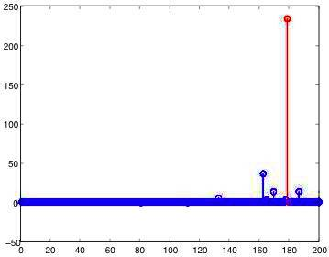
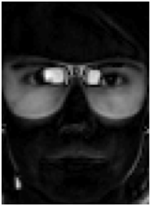


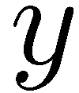


CONTEXT – Recent related progress
Robust recovery:
Impossible in general
Well-posed if is sparse, errors not too dense
Tractable: via convex optimization
… if is “nice” (cross and bouquet)
Cf: Wright+Ma ’10, Nguyen+Tran ‘11, Li ’11, also Candès+Tao ‘05.
Notes:
Today I will focus on one particular observation in automatic face recognition.

Slide 19
Our problem:
h
Given an observation with
low-rank,
sparse,
small, dense noise,
recover a good estimate of .
Numerous approaches in the literature:
  Random sampling [Fischler and Bolles ‘81]
  Multivariate trimming [Gnanadesikan and Kettering ‘72]
  Power Factorization [Wieber’70s, Shum & Ikeuchi’96]
  Alternating minimization [Ke and Kanade ‘03]
  Influence functions [de la Torre and Black ‘03]
Key concern: can we guarantee correctness with an efficient algorithm?
Notes:
Today I will focus on one particular observation in automatic face recognition.

Slide 20

The problem is hard: formally
low-rank
sparse
Matrix rigidity [Valiant ‘77]: How many entries do we need to change to
  decrease the rank?
Related to questions in computational complexity (fast evaluation of linear maps), communication complexity, ect.
Computing rigidity over finite fields is NP-hard [Deshpande ‘07].
Notes:
Look to the literature
PCA -> stable efficient algortih

Slide 21
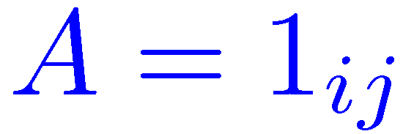

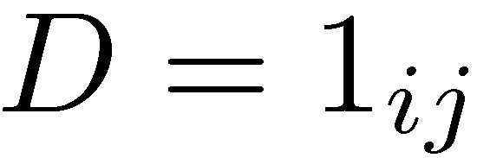


The problem is hard: intuitively
low-rank
sparse
Some very sparse matrices are also low-rank:
+
+
Ambiguity if the low rank term “looks sparse”.
Notes:
Today I will focus on one particular observation in automatic face recognition.

Slide 22

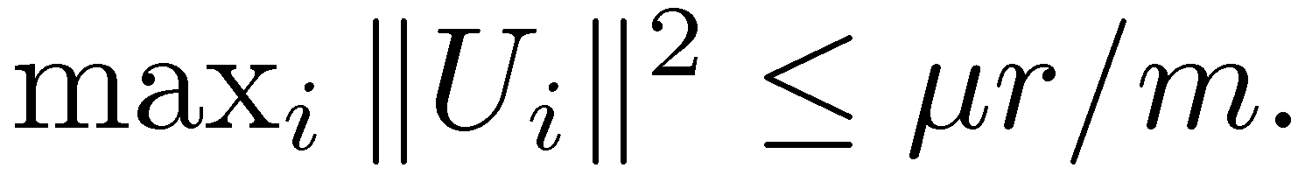
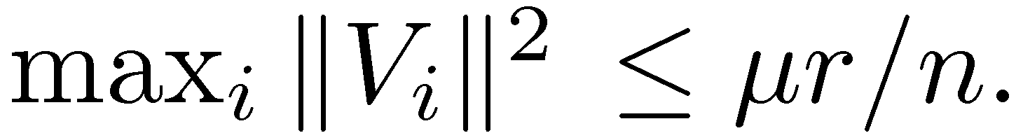

When is there hope?
low-rank
sparse
Can hope for success when is not too sparse. Formally, when the singular vectors of are incoherent:
Singular vectors are not too spiky:
… and not cross-correlated:
Incoherence condition: [Candès+Recht ‘08].
First condition bounds the maximum leverage score – used in robust
regression [McCoy+Tropp ‘11], approximate linear algebra [Mahoney ’11].
Notes:
Today I will focus on one particular observation in automatic face recognition.

Slide 23
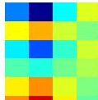


The problem is hard: intuitively
low-rank
sparse
Certain sparse error patterns E make recovering A impossible:
+
=
Here, cannot hope to recovery the second row of A.
Ambiguity when support of E is adversarial…
Notes:
Today I will focus on one particular observation in automatic face recognition.

Slide 24
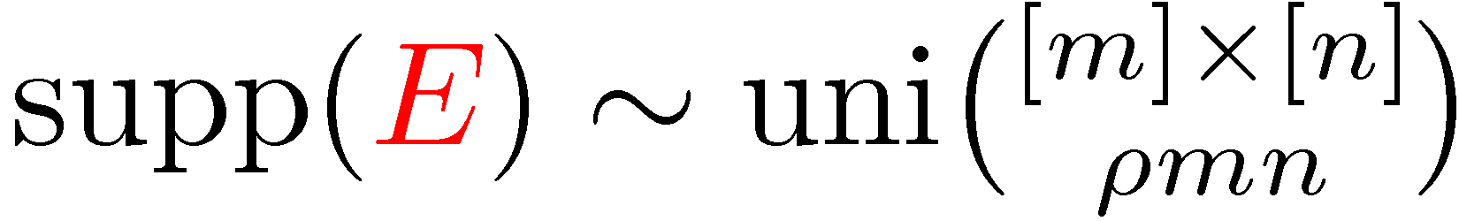
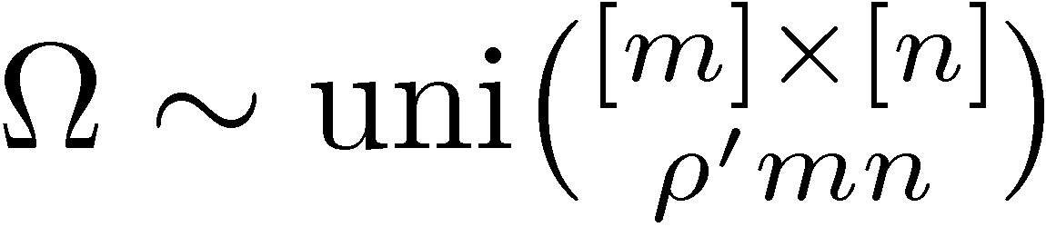
When is there hope?
low-rank
sparse
Can hope for success when E is not too concentrated on any row or column. Formalize this via a random error support model:
Uniform model on error support, signs and magnitudes arbitrary:
Other models, e.g. Markov Random Field, also possible.
Notes:
Today I will focus on one particular observation in automatic face recognition.

Slide 25

Disambiguating the solution…
low-rank
sparse
Singular vectors of A are incoherent, singular values arbitrary.
Error E has random support, signs and magnitudes arbitrary.
Noise is not too large:
Under these assumptions, problem is well-posed.
Notes:
Today I will focus on one particular observation in automatic face recognition.

Slide 26

… and how might we solve it?
Naïve optimization approach
Look for a low-rank A that agrees with the data up to some sparse error E:
Notes:
Today I will focus on one particular observation in automatic face recognition.

Slide 27
… and how might we solve it?
Naïve optimization approach
Look for a low-rank A that agrees with the data up to some sparse error E:
INTRACTABLE
Notes:
Today I will focus on one particular observation in automatic face recognition.

Slide 28


… and how might we solve it?
Naïve optimization approach
Look for a low-rank A that agrees with the data up to some sparse error E:
Convex relaxation
Nuclear norm heuristic: Fazel, Hindi, Boyd ’01; Recht, Fazel, Parillo ’08.
Notes:
Today I will focus on one particular observation in automatic face recognition.

Slide 29
… and how might we solve it?
Naïve optimization approach
Look for a low-rank A that agrees with the data up to some sparse error E:
Convex relaxation
Semidefinite program, solvable in polynomial time – “efficient” algorithm.
Practical thanks to very recent advances – second talk of this tutorial.
Notes:
Today I will focus on one particular observation in automatic face recognition.

Slide 30
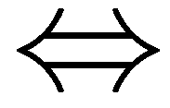
KEY QUESTION
Key question
  Does this practical surrogate actually solve the problem?
EQUIVALENT?
    Not always – original problem is NP-hard.
    But maybe it succeeds for the cases we care about?
Notes:
Today I will focus on one particular observation in automatic face recognition.

Slide 31
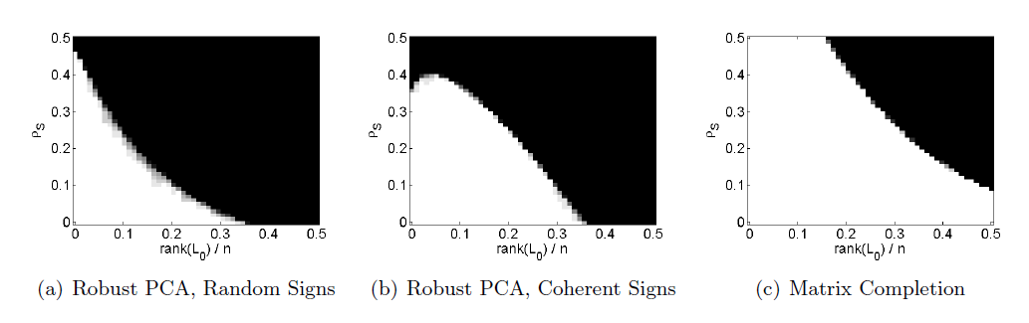

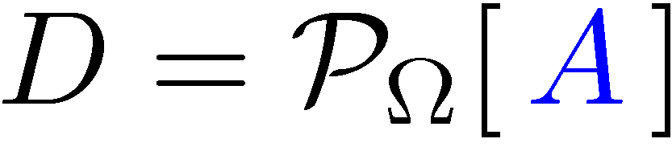
Does this actually work?
Apparently yes… white regions are problems with perfect recovery.
Correct recovery when A is indeed low-rank and E is indeed sparse?
Notes:
Today I will focus on one particular observation in automatic face recognition.

Slide 32

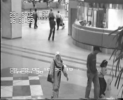
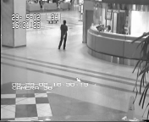
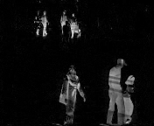
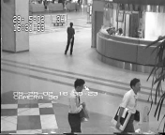

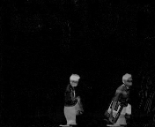
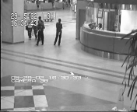
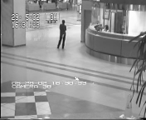
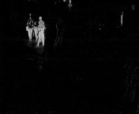
Does this actually work?
Video
Low-rank appx.
Sparse error
Apparently yes… it does interesting things on real data (more before).
Notes:
Today I will focus on one particular observation in automatic face recognition.

Slide 33
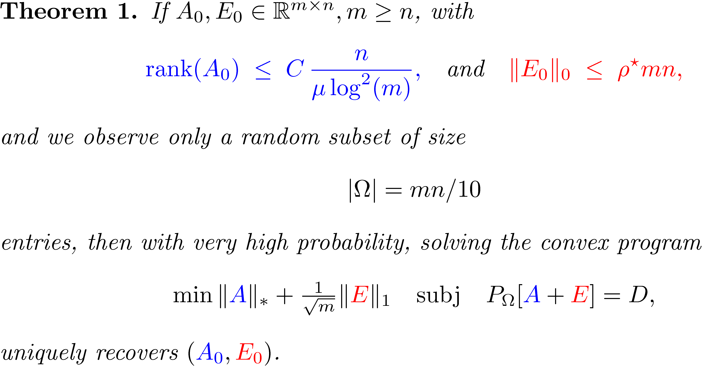
MAIN RESULT I: exact solution in noise-free case
Candès, Li, Ma, and W., JACM 2011.
Notes:
Today I will focus on one particular observation in automatic face recognition.

Slide 34
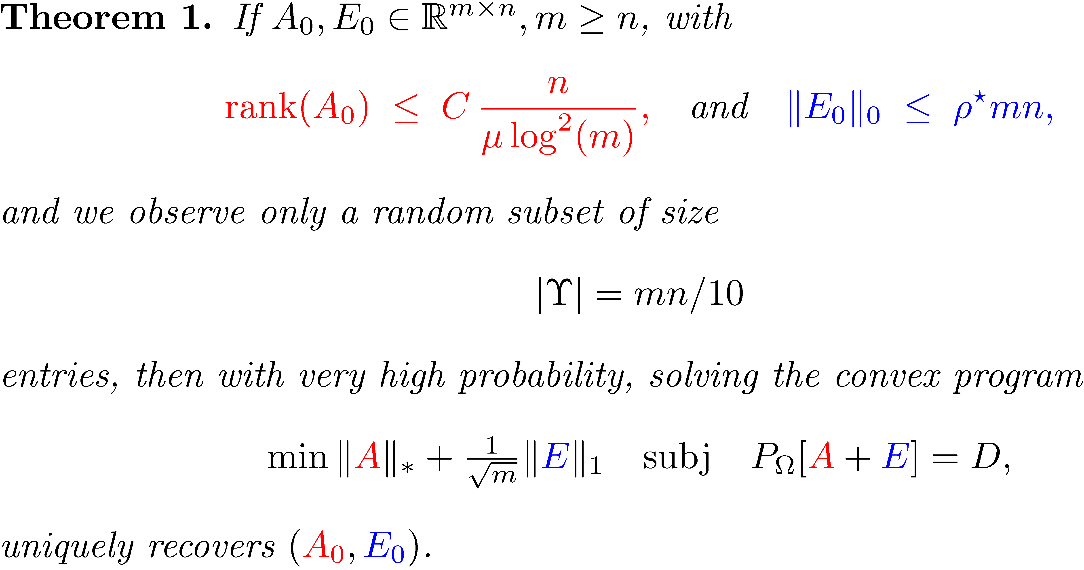
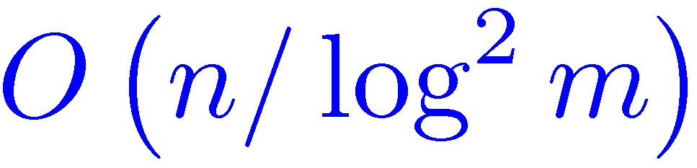
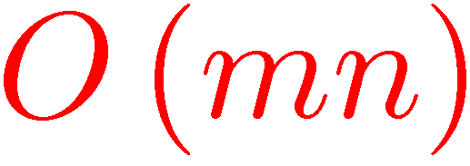
MAIN RESULT I: exact solution in noise-free case
“Convex optimization exactly recovers matrices of rank from errors, with large fractions of the observations missing!”
Candès, Li, Ma, and W., JACM 2011.
Notes:
Today I will focus on one particular observation in automatic face recognition.

Slide 35
MAIN RESULT I: exact solution in noise-free case
Non-adaptive weight factor
Candès, Li, Ma, and W., JACM 2011.
Notes:
Today I will focus on one particular observation in automatic face recognition.

Slide 36
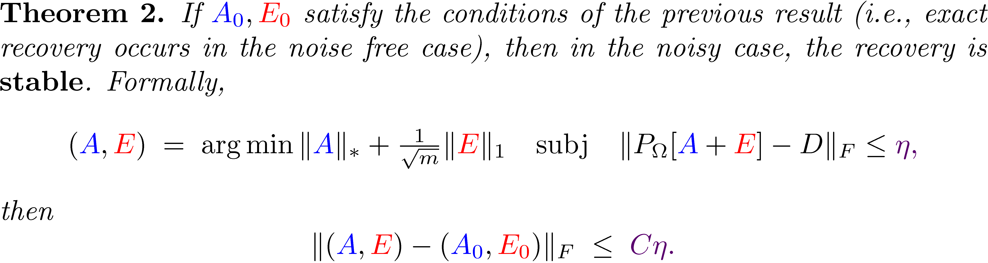
MAIN RESULT II: stability under noise
Zhou, Li, W., Candès, Ma, ISIT 2010.
Notes:
Today I will focus on one particular observation in automatic face recognition.

Slide 37
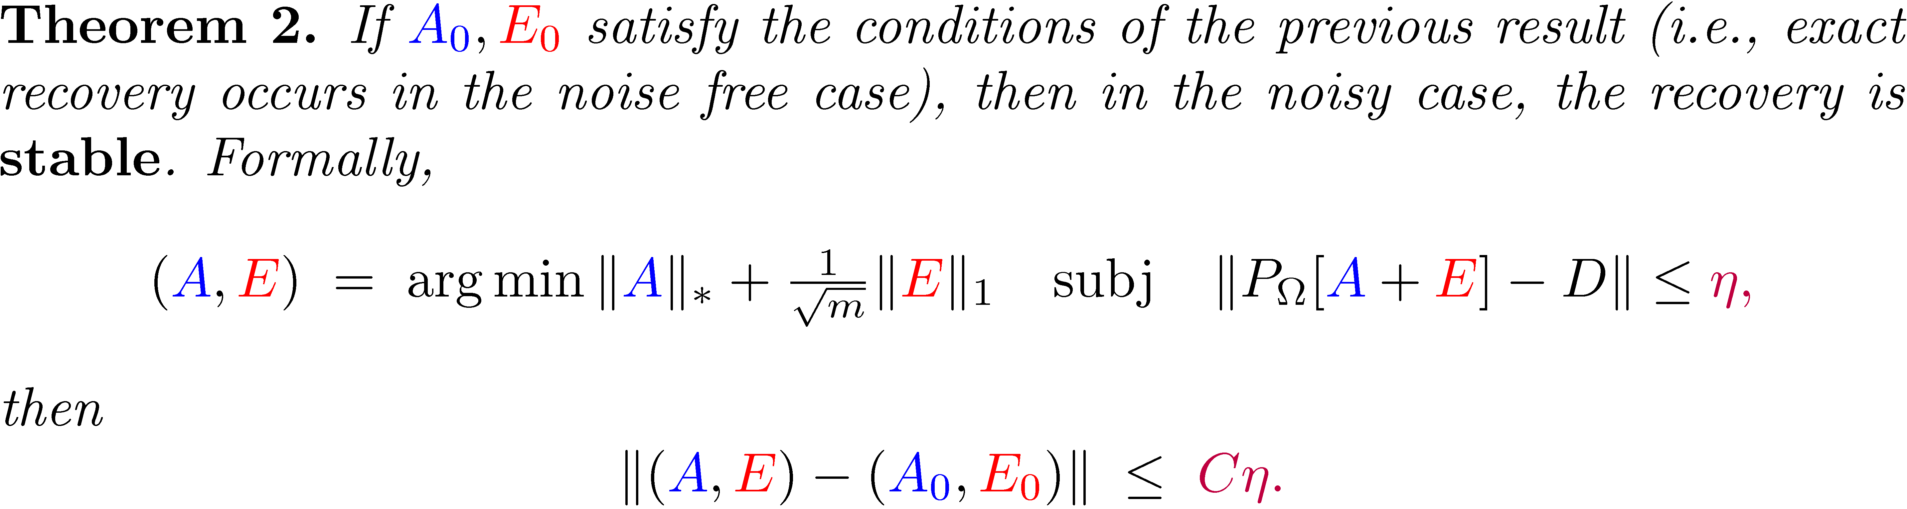
MAIN RESULT II: stability under noise
“Convex optimization recovers matrices of rank from errors, with large fractions of the observations missing, and the estimation error is proportional to the noise in the uncorrupted entries!”
Zhou, Li, Wright, Candès, Ma, ISIT 2010.
Notes:
Today I will focus on one particular observation in automatic face recognition.

Slide 38
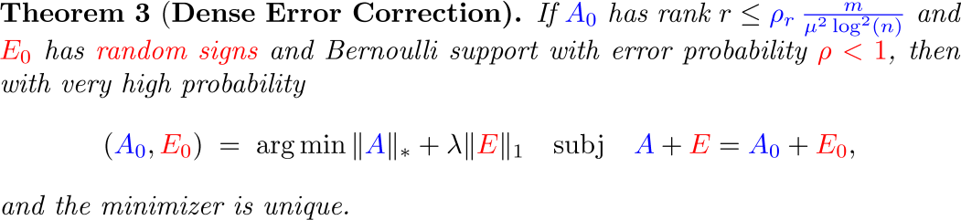
MAIN RESULT III: dense error correction
“Convex optimization corrects nearly 100% corruptions!”
Ganesh, Li, Wright, Candes, Ma, ISIT 2010
Notes:
Today I will focus on one particular observation in automatic face recognition.

Slide 39



ANALYSIS
No proofs in this tutorial. At a high level, arguments use ...
  … duality:
  … some cleverness:
    Golfing argument [D. Gross]
  … and some random operator theory:
    Noncommutative Khintchine Inequalities [F. Lust-Piquard]
    Matrix tail bounds [R. Alshwede + A. Winter, J. Tropp]
Notes:
Today I will focus on one particular observation in automatic face recognition.

Slide 40


















APPLICATIONS – Background modeling from video
Surveillance video: 250 frames, 128 x 160 pixels, with significant illumination variation
Video
By RPCA
Results of Black and de la Torre
Candès, Li, Ma, and W., JACM 2011.
Notes:
Today I will focus on one particular observation in automatic face recognition.

Slide 41











APPLICATIONS – Faces under varying illumination
58 images of one person under varying lighting:
…
Specularity
RPCA
…
Self-
shadowing
Candès, Li, Ma, and W., JACM 2011.

Slide 42










DETERMINISTIC GUARANTEES
For ,
Chandrasekaran+Sanghavi+Wilsky+Parrilo 2009: rank-sparsity
  incoherence conditions for correct recovery:
  success if
Hsu+Kakade+Zhang 2011: guarantees for incoherent ( small),
  deterministic : number of nonzeros per row, column bounded by
  . Roughly, correction of errors when
  .
Closing gap between deterministic and random analyses remains a topic of ongoing research…

Slide 43


Compressive Sensing of Low-rank and Sparse Structures
Transformed RPCA: Iteratively solving the linearized convex program::
Or reduced version:
which is equivalent to Compressive Principal Component Pursuit (CPCP)::
Under what conditions the above program works?
Wright, Ganesh, Min, and Ma, ISIT’12

Slide 44


Compressive Sensing of Low-rank and Sparse Structures
PCP without projection
CPCP with 30% measurements reduced. Exact recovery is still possible
Wright, Ganesh, Min, and Ma, ISIT’12

Slide 45

Compressive Sensing of Low-rank and Sparse Structures
CPCP with 25% measurements randomly reduced.
Wright, Ganesh, Min, and Ma, ISIT’12

Slide 46

Compressive Sensing of Low-rank and Sparse Structures
Wright, Ganesh, Min, and Ma, ISIT’12

Slide 47

Compressive Sensing of Low-rank and Sparse Structures
Open Question: when Jacobian of images is º-coherent?
Wright, Ganesh, Min, and Ma, ISIT’12

Slide 48

Compressive Sensing of Low-rank and Sparse Structures
A nearly optimal lower bound on minimum # of measurements!
Wright, Ganesh, Min, and Ma, ISIT’12

Slide 49








CONCLUSIONS – A Unified Theory for Sparsity and Low-Rank
Sparse Vector
individual signal
L₀ norm
L₁ norm
Low-Rank Matrix
correlated signals
Nuclear norm
Low-dimensionality of
Measure
Convex Surrogate
Compressed Sensing
Error Correction
Domain Transform
Mixed Structures
Joint NSF Project with Candes and Wright, 2010 - 2014
Notes:
Today I will focus on one particular observation in automatic face recognition.

Slide 50







EXTENSIONS – Other low-dimensional structures
Column sparse errors:
[McCoy+Tropp ’11, Xu+Caramanis+Sanghavi ‘11] L_{2,1} norm
Spatially structured errors:
[Zhou et. al. ‘09] Markov Random Fields
[Bach ‘10] submodular functions
[Zhou et. al. ‘09]
Efforts towards unified analysis:
    [Recht+Parillo+Chandrasekaran+Wilsky ’11] – compressed sensing of various structures
    [Negahban+Yu+Wainwright ’10] – geometric analysis of recovery
    [Becker+Candès+Grant ’10] – algorithmic templates
    [Candes + Recht’11] – decomposable structures
Notes:
Today I will focus on one particular observation in automatic face recognition.

Slide 51

Compressive Sensing of Low-complexity Structures
Take home message: Let the data and application tell you the structure…

Slide 52

Compressive Sensing of Mixed Low-Complexity Structures
A nearly optimal lower bound on minimum # of measurements!
Wright, Ganesh, Min, and Ma, ISIT’12

Slide 53
A Unified THEORY – A Suite of Powerful Regularizers
For compressive robust recovery of a family of low-dimensional structures:
[Zhou et. al. ‘09] Spatially contiguous sparse errors via MRF
[Bach ’10] – relaxations from submodular functions
[Negahban+Yu+Wainwright ’10] – geometric analysis of recovery
[Becker+Candès+Grant ’10] – algorithmic templates
[McCoy+Tropp ’11, Xu+Caramanis+Sanghavi ‘11] column sparse errors L_{2,1} norm
[Recht+Parillo+Chandrasekaran+Wilsky ’11] – compressive sensing of various structures
[Candes+Recht ’11] – compressive sensing of decomposable structures
[Wright+Ganesh+Min+Ma, ISIT’12] – superposition of decomposable structures
Hugely active research area for high-dim statistics and optimization…
Notes:
Today I will focus on one particular observation in automatic face recognition.

Slide 54
REFERENCES + ACKNOWLEDGEMENT
  Compressive Principal Component Pursuit, Wright, Ganesh, Min, Ma, ISIT 2012, submitted to Information and Inference, 2012.
  Robust Principal Component Analysis? Candès, Li, Ma, W., Journal of the ACM, 2011.
  Stable Principal Component Pursuit , Zhou, Li, Wright, Candes, Ma, ISIT 2010
  Dense Error Correction of Low-rank Matrices via PCP, Ganesh, Wright, Li, Candes, and Ma, ISIT 2010.
  For more information and references, please see: http://perception.csl.illinois.edu/matrix-rank/home.html
Collaborators:
  Prof. John Wright (Columbia)
  Prof. Emmanuel Candes
  (Stanford)
  Dr. Zhouchen Lin (PKU)
  Dr. Yasuyuki Matsushita
Minming Chen (CAS)
Yigang Peng (Tsinghua)
Wenxuan Liang (MSRA)
Zhengdong Zhang (MSRA)
Xiaodong Li (Stanford)
Arvind Ganesh (UIUC)
Kerui Min (UIUC)
Zihan Zhou (UIUC)

