Slide 1
The Pursuit of Low-dimensional Structures in High-dimensional (Visual) Data:
Fast and Scalable Algorithms
Zhouchen Lin Yi Ma
Peking University Microsoft Research Asia

Slide 2
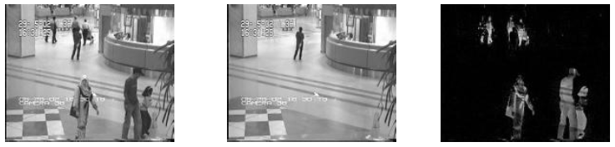
Why do we need new algorithms?
  High-dimensional, non-smooth convex optimization:
    2n² unknowns: 1000x1000 matrix → 2 millions unknowns!
Existing second-order (e.g., interior point) algorithms cannot solve moderate-to-large scale instances
  Complexity is O(n⁶).
  CVX (Stanford, Boyd) solves only up to 80x80 on a typical PC.
.
Notes:
For example, if we use CVX, then it can only solve RPCA at a scale of 80x80, as it uses an interior point algorithm to solve the PRCA. This is because in an interior point algorithm, one has to compute the Hessian, which requires O(n^4) storage.
Add figure for L1 norm showing the non-smooth nature of the objective function…

Slide 3
Existing work
L1-norm minimization:
Stanford university: Emmanuel Candès’06~’09
Rice university: Wotao Yin and Yin Zhang’08’09
National University of Singapore: K.C. Toh’09
Technion–Israel Institute of Technology: Amir Beck’08’09
Tel Aviv University: Marc Teboulle’08’09
University of Washington: Paul Tseng’08’09
Nuclear norm minimization:
Stanford university: Jianfeng Cai and Emmanuel Candès’08’09
Rice university: Wotao Yin and Yin Zhang’09
National University of Singapore: K.C. Toh , Zuowei Shen ‘09
Baptist university of Hong Kong: Xiaoming Yuan’09
Columbia University: Shiqian Ma, Donald Goldfarb, Lifeng Chen’09
… and many others!
Notes:
Add people on matrix completion and even L1 minimization
All groups are tackling the problem of developing fast, scalable algorithms for L1 or nuclear norm minimization…
Before our work, l1-minimization and nuclear-norm minimization are separated. We are the first to combine them.
These people are leading researchers in the field of sparse representation. However, they are mostly theoreticians. They don’t care about large scale problems as we do.

Slide 4
THIS TALK: exciting development of fast algorithms
Time required to solve a 1000x1000 PRCA problem:
Algorithms | Accuracy | Rank | ||E||_0 | # iterations | time (sec)
IT | 5.99e-006 | 50 | 101,268 | 8,550 | 119,370.3
DUAL | 8.65e-006 | 50 | 100,024 | 822 | 1,855.4
APG | 5.85e-006 | 50 | 100,347 | 134 | 1,468.9
APG_{P} | 5.91e-006 | 50 | 100,347 | 134 | 82.7
ALM_{P} | 2.07e-007 | 50 | 100,014 | 34 | 37.5
ADM_{P} | 3.83e-007 | 50 | 99,996 | 23 | 11.8
10,000
times
speedup!
We will see:
How to efficiently solve large matrix recovery problems by choosing the right first-order method (4 order of magnitude speedup!)
Ideas behind the algorithms that apply to many related problems.
Notes:
Add people on matrix completion and even L1 minimization
All groups are tackling the problem of developing fast, scalable algorithms for L1 or nuclear norm minimization…
Before our work, l1-minimization and nuclear-norm minimization are separated. We are the first to combine them.
These people are leading researchers in the field of sparse representation. However, they are mostly theoreticians. They don’t care about large scale problems as we do.

Slide 5
Why are scalable solutions possible?
The convergence rate of solving the convex generic problem:
Using second-order Newton method, # of iterations: O(log(1/²))
Using first-order methods depends strongly on the smoothness of f :
BAD NEWS: Our model problem
is large and nonsmooth.
Y. Nesterov, Introductory Lectures on Convex Optimization: A Basic Course, 2003.
Notes:
Here I give an sample to show to how impractical those algorithms by theoreticians are.
This algorithm is inspired by Candès et al.’s work on matrix completion, a closely related problem.

Slide 6
Why are scalable solutions possible?
GOOD NEWS: The RPCA problem has a special structure
KEY OBSERVATION: closed form solutions for the proximal minimizations:
Notes:
Here I give an sample to show to how impractical those algorithms by theoreticians are.
This algorithm is inspired by Candès et al.’s work on matrix completion, a closely related problem.

Slide 7
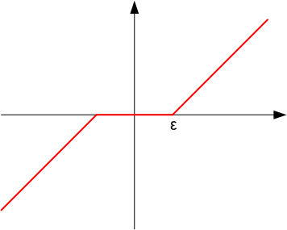
Why are scalable solutions possible?
GOOD NEWS: The RPCA problem has a special structure
KEY OBSERVATION: closed form solutions for the proximal minimizations:
Lemma. The solution to the above problem is given by applying the soft-thresholding operator
to each entry of the matrix Q.
q
W. Yin, S. Osher, D. Goldfarb, and J. Darbon, Bregman iterative algorithms for l1-minimization with applications to compressed sensing, SIAM Journal on Imaging Sciences,1 (2008), pp. 143-168.
Notes:
Here I give an sample to show to how impractical those algorithms by theoreticians are.
This algorithm is inspired by Candès et al.’s work on matrix completion, a closely related problem.

Slide 8
Why are scalable solutions possible?
GOOD NEWS: The RPCA problem has a special structure
KEY OBSERVATION: closed form solutions for the proximal minimizations:
Lemma. The solution to the above problem is given by applying the soft-thresholding operator to the singular values of
q
J.-F. Cai, E. J. Candes, and Z. Shen. A singular value thresholding algorithm for matrix completion. SIAM Journal on Optimization 20(4):1956-1982, 2008.
Notes:
Here I give an sample to show to how impractical those algorithms by theoreticians are.
This algorithm is inspired by Candès et al.’s work on matrix completion, a closely related problem.

Slide 9
Our Roadmap
Computing time ≈ #iterations × time for each iteration
Make the iterations as few as possible:
  Iterative Thresholding
  Accelerated Proximal Gradient
  Augmented Lagrange Multiplier
  Alternating Direction Method of Multipliers
Make the iterations as efficient as possible:
  Partial SVD O(rn²)
  Block Lanczos with Warm Start (BLWS)
Notes:
Here I give an sample to show to how impractical those algorithms by theoreticians are.
This algorithm is inspired by Candès et al.’s work on matrix completion, a closely related problem.

Slide 10
Our Roadmap
Computing time ≈ #iterations ×time for each iteration
Make the iterations as few as possible:
  Iterative Thresholding
  Accelerated Proximal Gradient
  Augmented Lagrange Multiplier
  Alternating Direction Method of Multipliers
Make the iterations as efficient as possible:
  Partial SVD O(rn²)
  Block Lanczos with Warm Start (BLWS)
Notes:
Here I give an sample to show to how impractical those algorithms by theoreticians are.
This algorithm is inspired by Candès et al.’s work on matrix completion, a closely related problem.

Slide 11
Iterative Thresholding
Model problem:
Convenient approximation (exact as ) :

Slide 12
Iterative Thresholding
Model problem:
Convenient approximation (exact as ) :
Lagrangian:
Algorithm (Iterative Thresholding):
Theorem [Wright et. al. ’09 ... ala … Cai et. al. 09]. Provided , the iterates converge to the unique optimal solution to the approximated problem.

Slide 13
A recurring theme…
Similar ideas appear in many places in the literature …
[Cai, Candes, Shen ‘09]
“A Singular Value Thresholding Algorithm for Matrix Completion”
[Osher, Mao, Dong, Yin ‘09]
“Fast linearized Bregman iteration for Compressive Sensing and sparse denoising”
relaxation
Solution via
Uzawa’s algorithm
Notes:
Ask Yi RE other examples

Slide 14
How do we solve the subproblem?
Key subproblem:
Using our previous observations …
Shrink singular values
Shrink absolute values
So … each iteration is relatively simple yet expensive ( ≈ cost of one SVD ).

Slide 15
Iterative Thresholding: Pros and Cons
Extremely simple algorithm for robust PCA:
Strong points: In practice, controls the rank of iterates A_{k}.
Scalable: can solve medium-large problems.
Weak point: Slow … many iterations for convergence.
E.g., recovering a 1,000 x 1,000 matrix of rank 50 from 10% errors,
requires >8,000 iterations and >27 hours on a standard PC.
Next: How can we cut the number of iterations?

Slide 16
Our Roadmap
Computing time ≈ #iterations ×time for each iteration
Make the iterations as few as possible:
  Iterative Thresholding
  Accelerated Proximal Gradient
  Augmented Lagrange Multiplier
  Alternating Direction Method of Multipliers
Make the iterations as efficient as possible:
  Partial SVD O(rn²)
  Block Lanczos with Warm Start (BLWS)
Notes:
Here I give an sample to show to how impractical those algorithms by theoreticians are.
This algorithm is inspired by Candès et al.’s work on matrix completion, a closely related problem.

Slide 17
Accelerated Proximal Gradient (APG) Method
The gradient descent:
The convergence rate is only !
Prior to 1983, best lower bound was (much smaller…)
… is it actually possible to achieve this?
Theorem [Nesterov ‘83]: Consider the problem
If f is differentiable with Lipschitz continuous gradient:
there exists a first-order algorithm with convergence
rate in function values.
Y. Nesterov. A method of solving a convex programming problem with convergence rate O(1/k²). Soviet Mathematics Doklady, 27(2):372–376, 1983.

Slide 18
Nesterov’s Optimal Gradient Method
Problem: , convex, differentiable, and L-Lipschitz.
First Idea: minimize sequence of quadratic approximations to :
Repeat:
(point where we form approx.)
Natural choice:
standard gradient algorithm
iterations for an -suboptimal solution

Slide 19
Nesterov’s Optimal Gradient Method
Problem: , convex, differentiable, and L-Lipschitz.
First Idea: minimize sequence of quadratic approximations to :
Repeat:
Non-obvious alternative:
iterations for an -suboptimal solution!
Y. Nesterov. A method of solving a convex programming problem with convergence rate O(1/k²). Soviet Mathematics Doklady, 27(2):372–376, 1983.

Slide 20
Generalization
with g, f convex,
We can still make quadratic approximations to the smooth part …
… and iteratively minimize them:
Theorem [Beck and Teboulle ‘09]: The above algorithm converges with rate
Moral: if we can solve the problem efficiently, we retain the
advantages of Nesterov’s algorithm, even though F contains a nonsmooth term.
Beck and M. Teboulle. A fast iterative shrinkage-thresholding algorithm for linear inverse problems. SIAM Journal on Imaging Sciences, 2(1):183–202, Mar 2009.

Slide 21
Beck and Teboulle’s APG method
[Beck + Teboulle ‘09]
“A fast iterative shrinkage-thresholding algorithm for linear inverse problems”
(theory + application to sparse recovery)
[Liu, Sun and Toh ‘09]
“An Implementable Proximal Point Algorithmic Framework for Nuclear Norm Minimization”
(application to matrix completion)
[Ganesh, Lin, Ma, Wu, Wright ‘09]
“Fast Algorithms for Recovering a Corrupted Low-Rank Matrix”
(application to robust PCA)

Slide 22
What about matrix recovery?
Model problem:
Penalized version (exact as ) :
Non-differentiable.
Smooth, Lipschitz gradient.

Slide 23
Solving the subproblem?
In our case,
It is not difficult to show that and .
So, we find that the update equations are again given by shrinkage…

Slide 24
APG: Pros and Cons
Strong points: Scalable: can solve medium-large problems.
Dramatically improved iteration complexity:
Cuts #iterations from >8,000 to 135 (!)
Weak point: Does not control the rank of the iterates
Requires continuation for very accurate solution:
Next: Are there better frameworks for continuation?

Slide 25
Our Roadmap
Computing time ≈ #iterations ×time for each iteration
Make the iterations as few as possible:
  Iterative Thresholding
  Accelerated Proximal Gradient
  Augmented Lagrange Multiplier
  Alternating Direction Method of Multipliers
Make the iterations as efficient as possible:
  Partial SVD O(rn²)
  Block Lanczos with Warm Start (BLWS)

Slide 26
Augmented Lagrange Multiplier (ALM) Method
Model problem:
We’ve seen two approximations … can we just efficiently solve the exact problem?
Can write as …
Lagrangian:
Augmented Lagrangian [Hestenes ‘69, Powell ’69]:
Penalty function
See, e.g., D. Bertsekas. Constrained Optimization and Lagrange Multiplier Methods, 1981

Slide 27
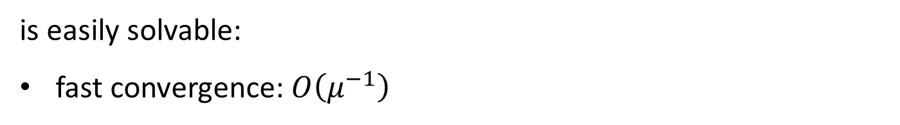
Augmented Lagrange Multiplier (ALM) Method
ALM is advantageous when the subproblem
is easily solvable:
fast convergence: $O\left(μ^{−1}\right)$
See, e.g., D. Bertsekas. Constrained Optimization and Lagrange Multiplier Methods, 1981
Notes:
Here I give an sample to show to how impractical those algorithms by theoreticians are.
This algorithm is inspired by Candès et al.’s work on matrix completion, a closely related problem.

Slide 28
ALM: Solving the Subproblem
Solve the subproblem :
Shrink singular values
repeat
Shrink absolute values
Then update Lagrange multiplier:
The inner loop slows down when grows! → The total number of SVDs grows!
Next: Do we need to solve the subproblem exactly?
Z. Lin, M. Chen, L. Wu, and Y. Ma, The Augmented Lagrange Multiplier Method for Exact Recovery of Corrupted Low-Rank Matrix, submitted to Mathematical Programming.

Slide 29
Our Roadmap
Computing time ≈ #iterations ×time for each iteration
Make the iterations as few as possible:
  Iterative Thresholding
  Accelerated Proximal Gradient
  Augmented Lagrange Multiplier
  Alternating Direction Method of Multipliers
Make the iterations as efficient as possible:
  Partial SVD O(rn²)
  Block Lanczos with Warm Start (BLWS)
Notes:
Here I give an sample to show to how impractical those algorithms by theoreticians are.
This algorithm is inspired by Candès et al.’s work on matrix completion, a closely related problem.

Slide 30
ADM for RPCA
Minimizing over simultaneously is nontrivial …
Minimizing with respect to just or is easy:
Solution: Alternating Direction Method of Multipliers [Gabay and Mercier ‘76]:
We only have to update A and E once before updating Y !

Slide 31
Convergence of ADM for RPCA
Classical theory: convergence provided is bounded.
In practice, increasing sequences yield much faster convergence.
Recently justified by Lin et. al.:
Z. Lin, M. Chen, L. Wu, and Y. Ma, The Augmented Lagrange Multiplier Method for Exact Recovery of Corrupted Low-Rank Matrix, submitted to Mathematical Programming.
Notes:
Here I give an sample to show to how impractical those algorithms by theoreticians are.
This algorithm is inspired by Candès et al.’s work on matrix completion, a closely related problem.

Slide 32
Summary of Representative Algorithms
IT:
Shrink singular values
repeat
Shrink absolute values
ADM:
Shrink singular values
repeat
Shrink absolute values

Slide 33
ADM: Pros and Cons
Strong points: Scalable: can solve medium-large problems.
Further improved iteration complexity: down to 20-25 iterations
Best algorithm for this problem, in our experience.
Weak point: Best convergence rate still open (at least O(k^{―1}) [X. Yuan et al.]).
Extensions to >2 terms still open. [X. Yuan and collaborators]
Z. Lin, M. Chen, L. Wu, and Y. Ma, The Augmented Lagrange Multiplier Method for Exact Recovery of Corrupted Low-Rank Matrix, submitted to Mathematical Programming.

Slide 34
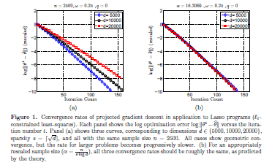
Convergence Rates of Gradient Algorithms in High-Dimension
Convergence rates for first-order gradient algorithms:
[Agarwal, Negahban, Wainwright, NIPS 2010]

Slide 35
Our Roadmap
Next: Can we reduce the complexity of each iteration?
Computing time ≈ #iterations × time for each iteration
Make the iterations as few as possible:
  Iterative Thresholding
  Accelerated Proximal Gradient
  Augmented Lagrange Multiplier
  Alternating Direction Method of Multipliers
Make the iterations as efficient as possible:
  Partial SVD O(rn²)
  Block Lanczos with Warm Start (BLWS)
Notes:
Here I give an sample to show to how impractical those algorithms by theoreticians are.
This algorithm is inspired by Candès et al.’s work on matrix completion, a closely related problem.

Slide 36
Using Partial SVD
ADM:
Shrink singular values
repeat
Shrink absolute values
Recall:
Only need singular values of that are larger than .
Cuts complexity from O(n³) to O(Kn²)!
PROPACK: http://soi.stanford.edu/~rmunk/PROPACK/
We have optimized it (http://research.microsoft.com/~zhoulin/optPROPACK.zip)
We also modified it (http://research.microsoft.com/~zhoulin/ThresholdLANSVD.zip)
Zhouchen Lin, Some Software Packages for Partial SVD Computation, arxiv: 1108.1548.

Slide 37
Lanczos Method for Partial SVD
Approximate Q as
and can be found by Lanczos procedure, with k steps.
is bi-diagonal.
The Lanczos procedure starts from a random vector.
Suppose the SVD of is , then the SVD of Q is approximately:
The leading singular values/vectors in , and converge to those of Q quickly when k increases.
The complexity is O(kn²+k³).
G. Golub et al. Matrix Computations, John Hopkins Univ. Press,1996.

Slide 38
Exciting development of fast algorithms
For a 1000x1000 matrix of rank 50, with 10% (100,000) entries randomly corrupted:
Algorithms | Accuracy | Rank | ||E||_0 | # iterations | time (sec)
IT | 5.99e-006 | 50 | 101,268 | 8,550 | 119,370.3
DUAL | 8.65e-006 | 50 | 100,024 | 822 | 1,855.4
APG | 5.85e-006 | 50 | 100,347 | 134 | 1,468.9
APG_{P} | 5.91e-006 | 50 | 100,347 | 134 | 82.7
ALM_{P} | 2.07e-007 | 50 | 100,014 | 34 | 37.5
ADM_{P} | 3.83e-007 | 50 | 99,996 | 23 | 11.8
10,000
times
speedup!
Provably Robust PCA at only a constant factor (≈20) more computation than conventional PCA!
Notes:
Highlight:
The algorithms are listed in a chronological order;
The number of iterations is constant;
Can run moderately sized data, e.g. 5kx5k, on a single PC.
Now we are able to compute 50kx50k matrices on a cluster.

Slide 39
Our Roadmap
Computing time ≈ #iterations × time for each iteration
Make the iterations as few as possible:
  Iterative Thresholding
  Accelerated Proximal Gradient
  Augmented Lagrange Multiplier
  Alternating Direction Method of Multipliers
Make the iterations as efficient as possible:
  Partial SVD O(rn²)
  Block Lanczos with Warm Start (BLWS)
Notes:
Here I give an sample to show to how impractical those algorithms by theoreticians are.
This algorithm is inspired by Candès et al.’s work on matrix completion, a closely related problem.

Slide 40
Key Observations for Acceleration
When solving the subproblem
usually slightly differs from .
  Computing partial SVD of independently does not utilize this information
We are seeking the principal singular subspace of .
Z. Lin and S. Wei, A Block Lanczos with Warm Start Technique for Accelerating Nuclear Norm Minimization Algorithms, submitted to Optimization Letters.

Slide 41
Drawbacks of Vector-Based Lanczos Method
The initial vector to start the Lanczos procedure does not carry enough information of the principal singular subspace.
  Even if is the largest singular vector of
Z. Lin and S. Wei, A Block Lanczos with Warm Start Technique for Accelerating Nuclear Norm Minimization Algorithms, submitted to Optimization Letters.

Slide 42
Key Ideas
Use Block-based Lanczos method for partial SVD
Use the principal singular subspace of to start the block Lanczos procedure
Code available at http://research.microsoft.com/~zhoulin/BLWS.zip
Z. Lin and S. Wei, A Block Lanczos with Warm Start Technique for Accelerating Nuclear Norm Minimization Algorithms, submitted to Optimization Letters.

Slide 43
Lanczos Method for Partial EVD
Suppose A is symmetric
It is to find the optimal leading/tailing eigen-subspace in a Krylov subspace:
By finding an orthonormal bases of we have:
where is tri-diagonal.
can be obtained by orthogonalizing
(Lanczos procedure, derived by comparing the left and right
sides of )
Suppose the EVD of is , then the EVD of A is approximately:
G. Golub et al. Matrix Computations, John Hopkins Univ. Press,1996.

Slide 44
Lanczos Method for Partial SVD
Implicitly apply the Lanczos method to
and to obtain
Then compute the SVD of to find the leading/tailing singular values/vectors of A.
G. Golub et al. Matrix Computations, John Hopkins Univ. Press,1996.

Slide 45
Block Lanczos Method for Partial EVD
Suppose A is symmetric
Derived by comparing the left and right sides of
where and the columns of are
orthonormal, each has r columns, and is block tri-diagonal:
Z. Lin and S. Wei, A Block Lanczos with Warm Start Technique for Accelerating Nuclear Norm Minimization Algorithms, submitted to Optimization Letters.

Slide 46
Block Lanczos Method for Partial EVD
Z. Lin and S. Wei, A Block Lanczos with Warm Start Technique for Accelerating Nuclear Norm Minimization Algorithms, submitted to Optimization Letters.

Slide 47
Caveat
Orthogonality is easily lost.
So we should keep k small so that expensive reorthogonalization can be waived.
  A small k also makes the size of T_{k} small, making the EVD/SVD of T_{k} economic.
Z. Lin and S. Wei, A Block Lanczos with Warm Start Technique for Accelerating Nuclear Norm Minimization Algorithms, submitted to Optimization Letters.

Slide 48
Summary of BLWS
Use Block Lanczos method for partial EVD/SVD
Use the principal eigen/singular subspace of to start the block Lanczos procedure
Iterate the block Lanczos procedure for only a few steps
  Typically, k=2
Code available at http://research.microsoft.com/~zhoulin/BLWS.zip
Z. Lin and S. Wei, A Block Lanczos with Warm Start Technique for Accelerating Nuclear Norm Minimization Algorithms, submitted to Optimization Letters.

Slide 49
Experimental Results - BLWS for RPCA
Z. Lin and S. Wei, A Block Lanczos with Warm Start Technique for Accelerating Nuclear Norm Minimization Algorithms, submitted to Optimization Letters.

Slide 50
Experimental Results - BLWS for MC
Z. Lin and S. Wei, A Block Lanczos with Warm Start Technique for Accelerating Nuclear Norm Minimization Algorithms, submitted to Optimization Letters.

Slide 51
Conclusions
State-of-the-art algorithms for RPCA and its many variations (10⁵ speedup on PC).
  GPU implementation gives another 5x speedup
  HPC cluster implementation using distributed SVD.
http://perception.csl.illinois.edu/matrix-rank/home.html

Slide 52
Extensions and Broad Applications of RPCA
Background Modeling
Image Alignment
Latent Semantic Indexing for Text Documents
Photometric Stereo
Image Tagging Refinement
Robust Filtering
Graphical Modeling Learning
Computational scale well beyond what is for TILT etc…

Slide 53
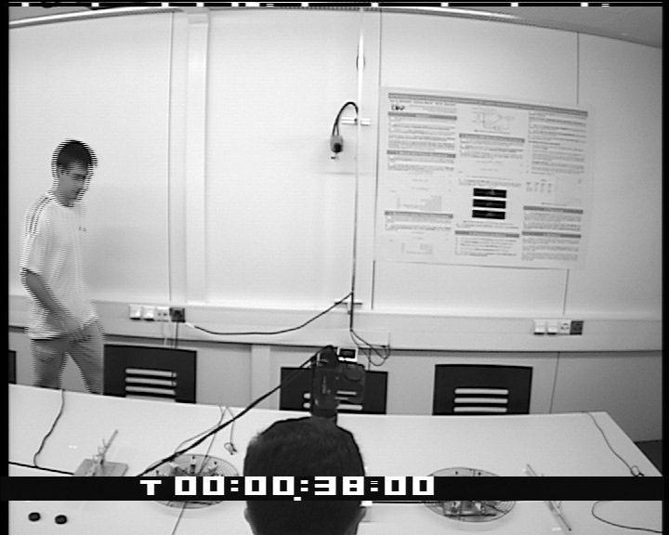
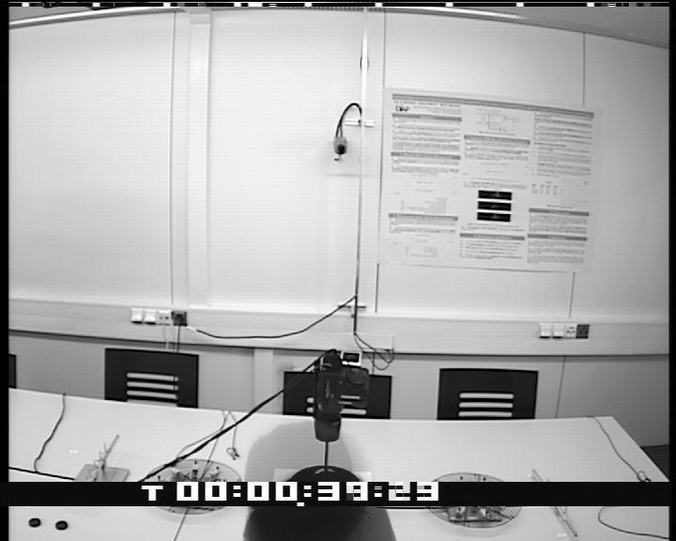
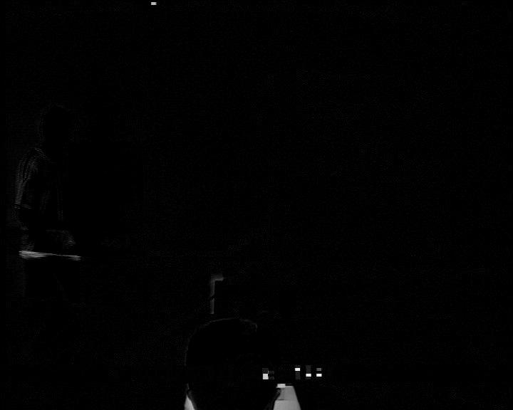
Computation Examples
Background modeling
  High-res video, 720x576, 102 frames, 1236.7s on a workstation (Intel Xeon E5540 2.53GHz CPU, 4 cores and 24GB memory)

Slide 54
Computation Examples
Face Alignment [Peng et al.]
  80x60, 48, 7min on a workstation

Slide 55
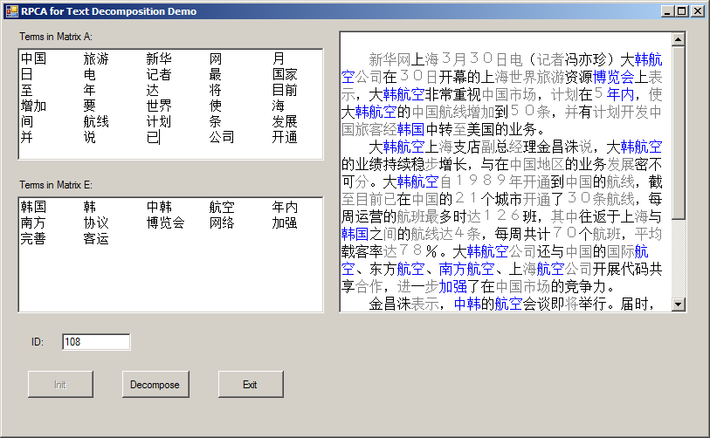
Computation Examples
Web document corpus analysis [Min et al.]
  D: tf-idf matrix, 42186 x 18320, 90.3h on an HPC cluster

Slide 56
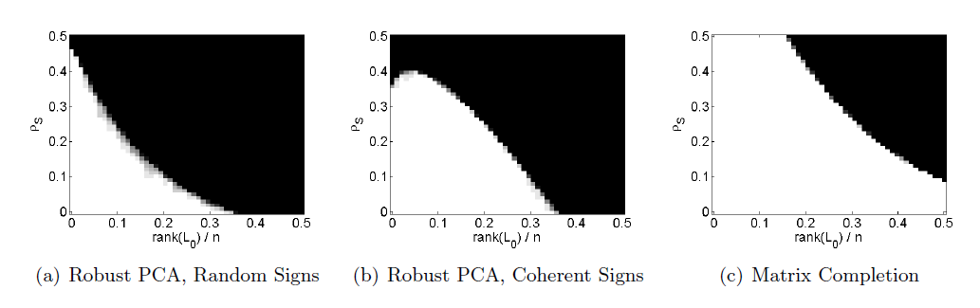

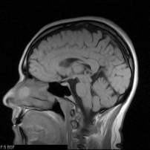
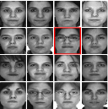
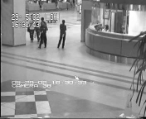
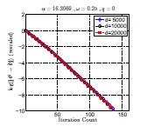
A Perfect Storm in the Cloud…
Mathematical Theory
(high-dimensional statistics,
measure concentration, combinatorics…)
Cloud Computing
(parallel, distributed, networked)
Massive Data
(images, videos,
texts, audios,
speeches, stocks,
user rankings…)
Applications
& Services
(data processing,
analysis, compression,
knowledge discovery,
search, recognition…)
Computational Methods
(convex optimization, first-order algorithms,
hashing, approximate solutions…)
Notes:
Today I will focus on one particular observation in automatic face recognition.

Slide 57














































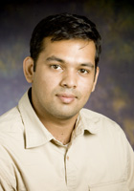
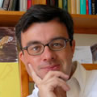
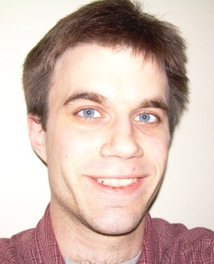
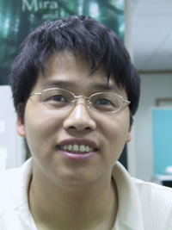

THANK YOU!
Questions, please?

