Slide 1


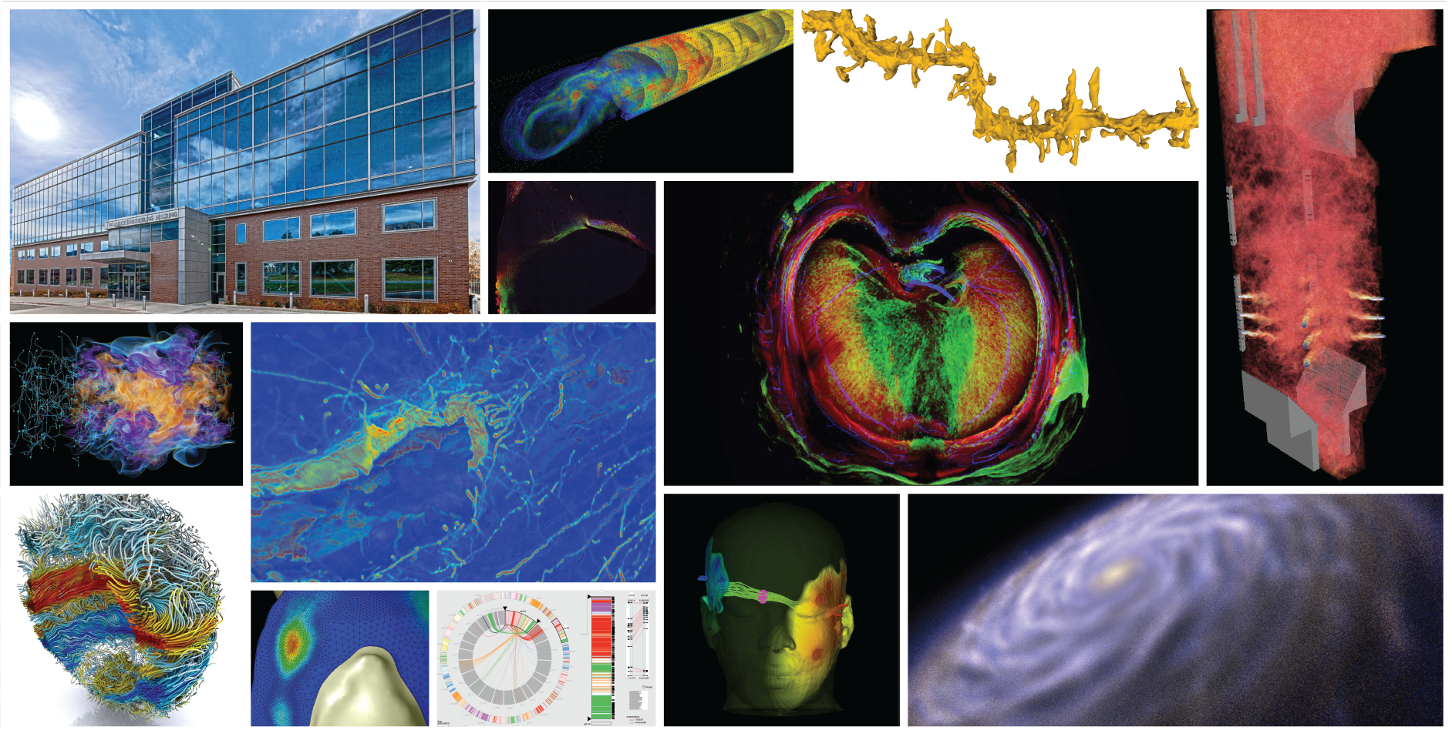
SCI Institute
Provost Report 2018

Slide 2
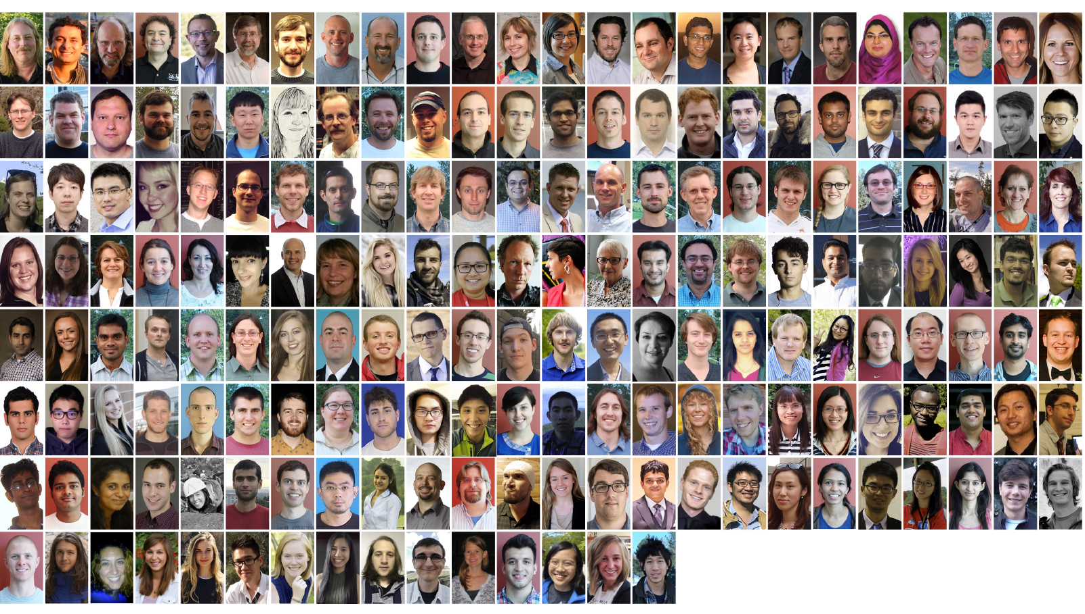
The Institute

Slide 3

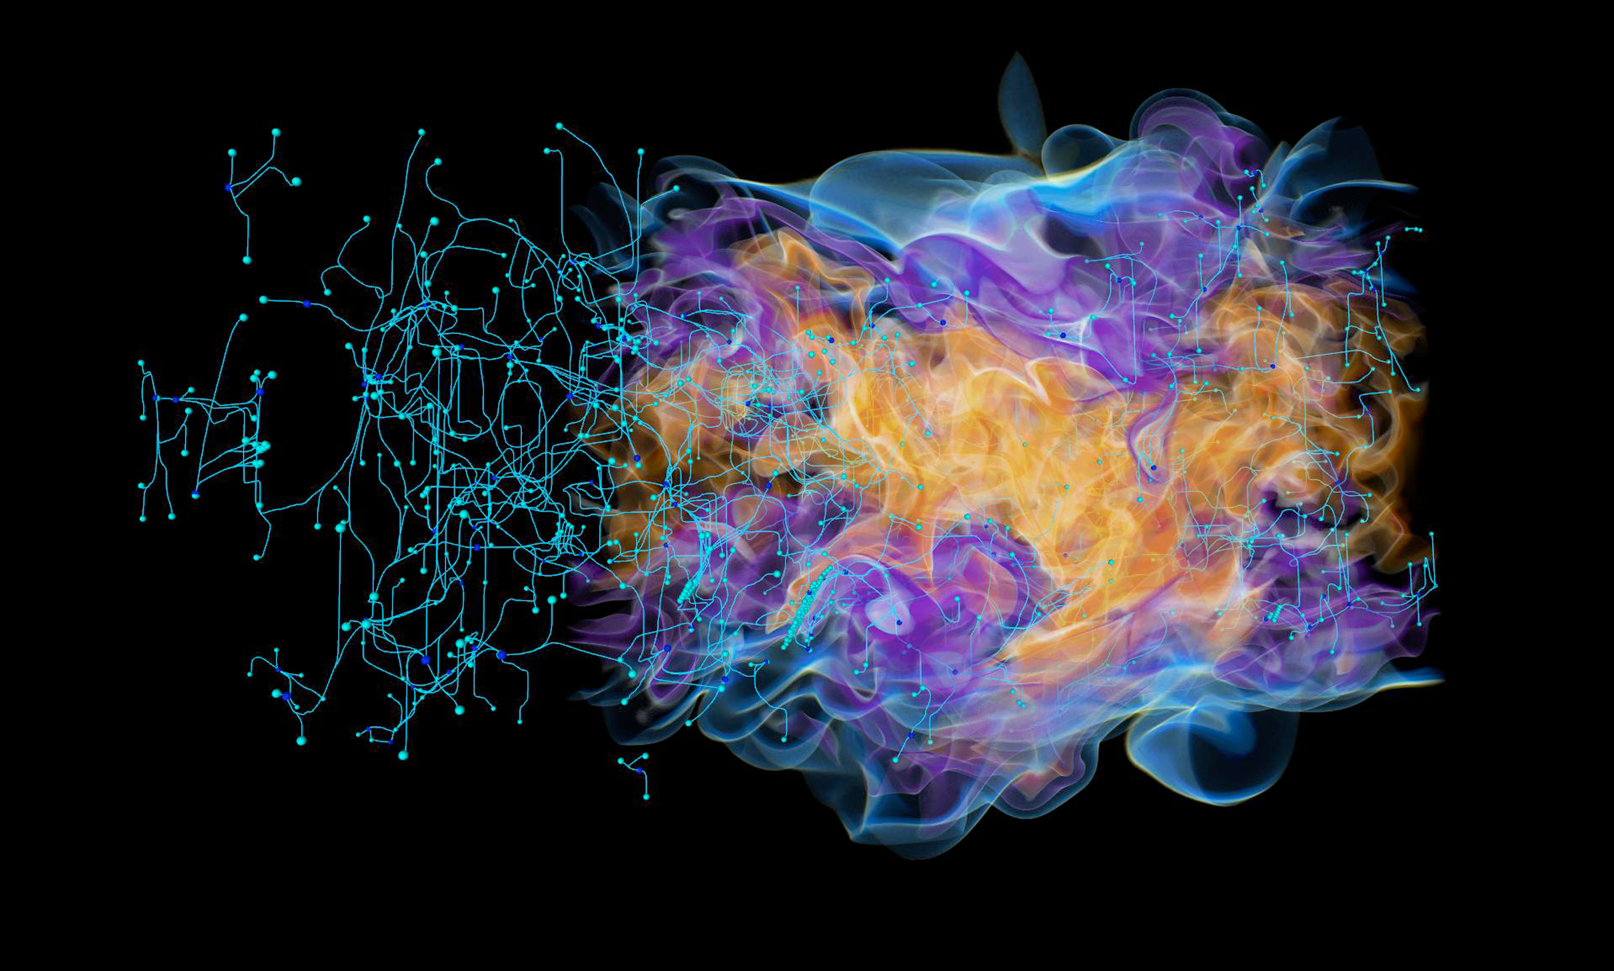
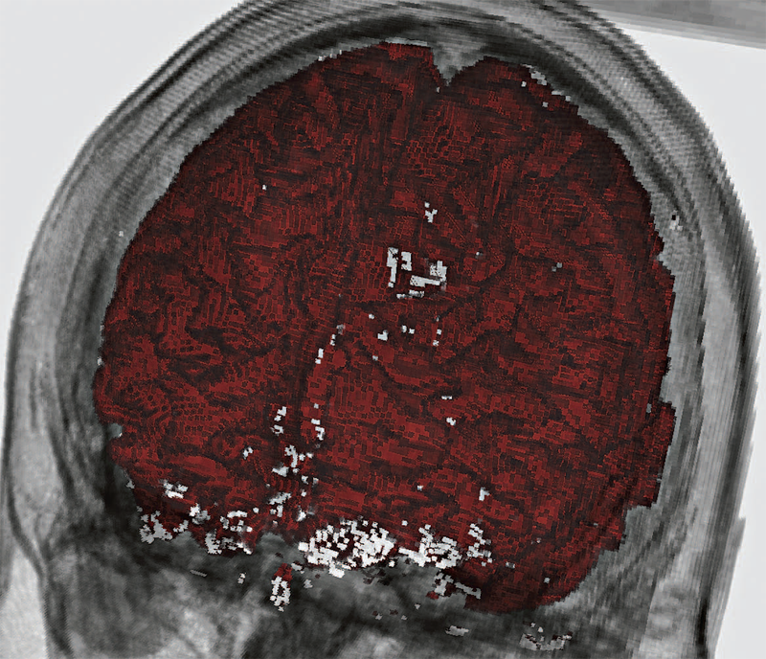
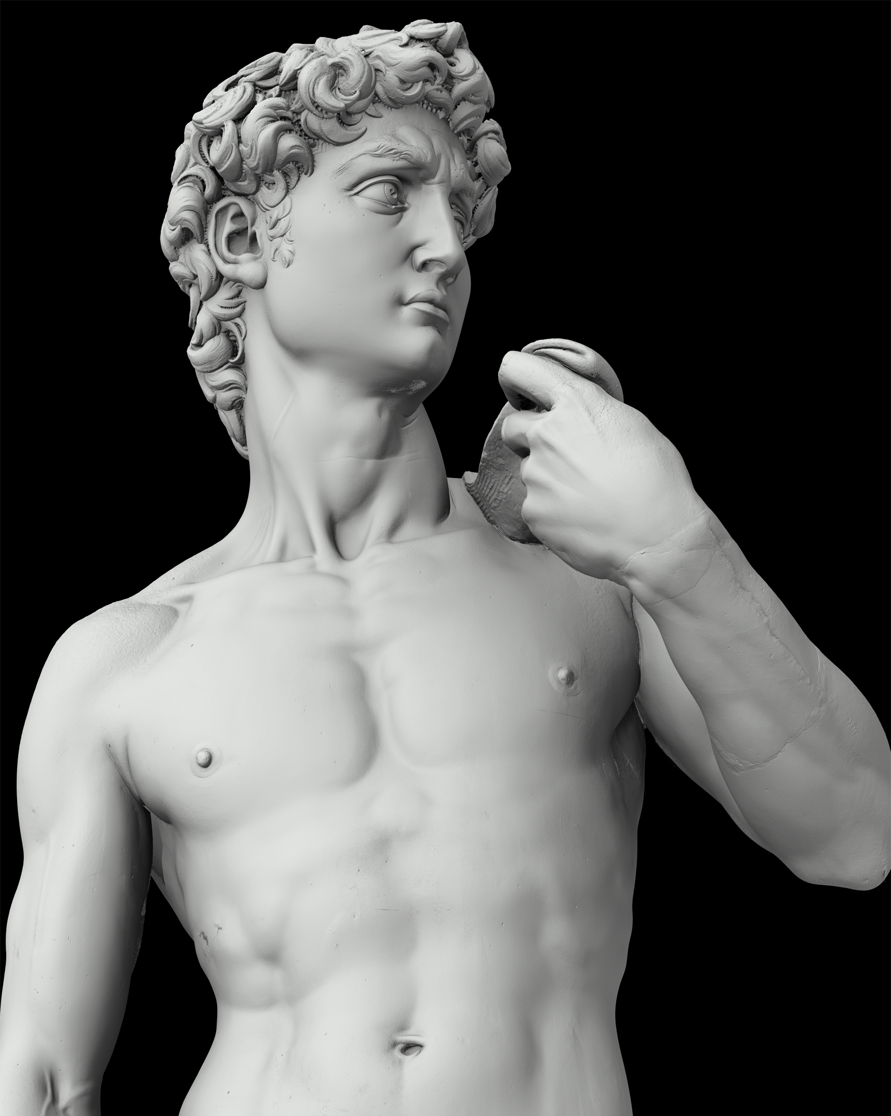
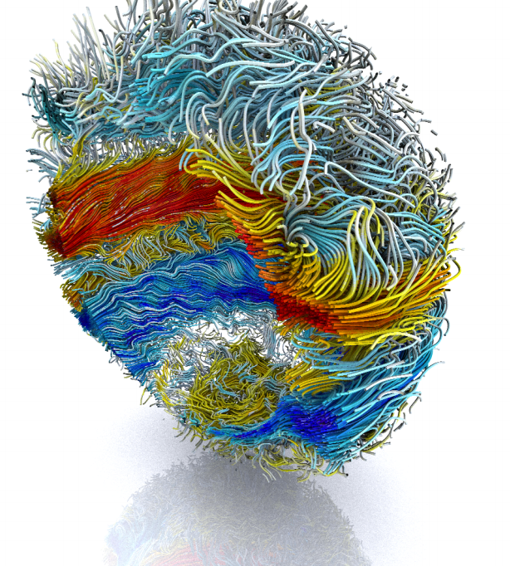
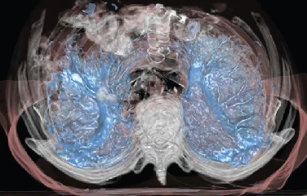
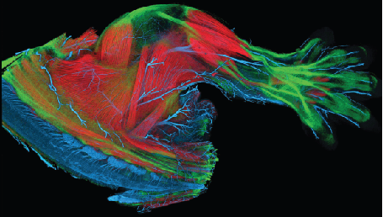
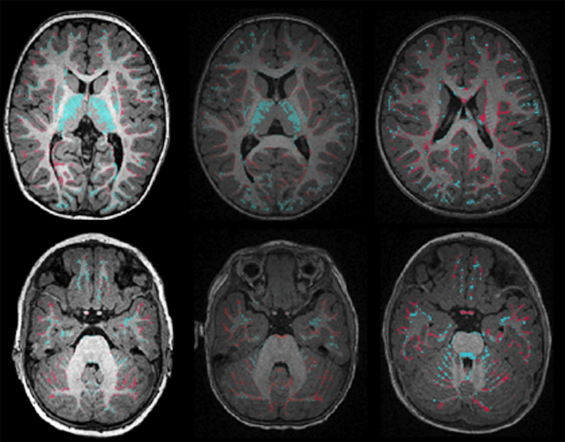
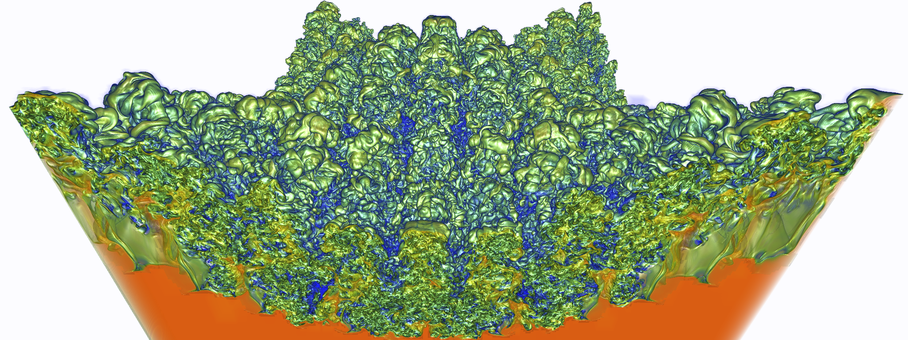
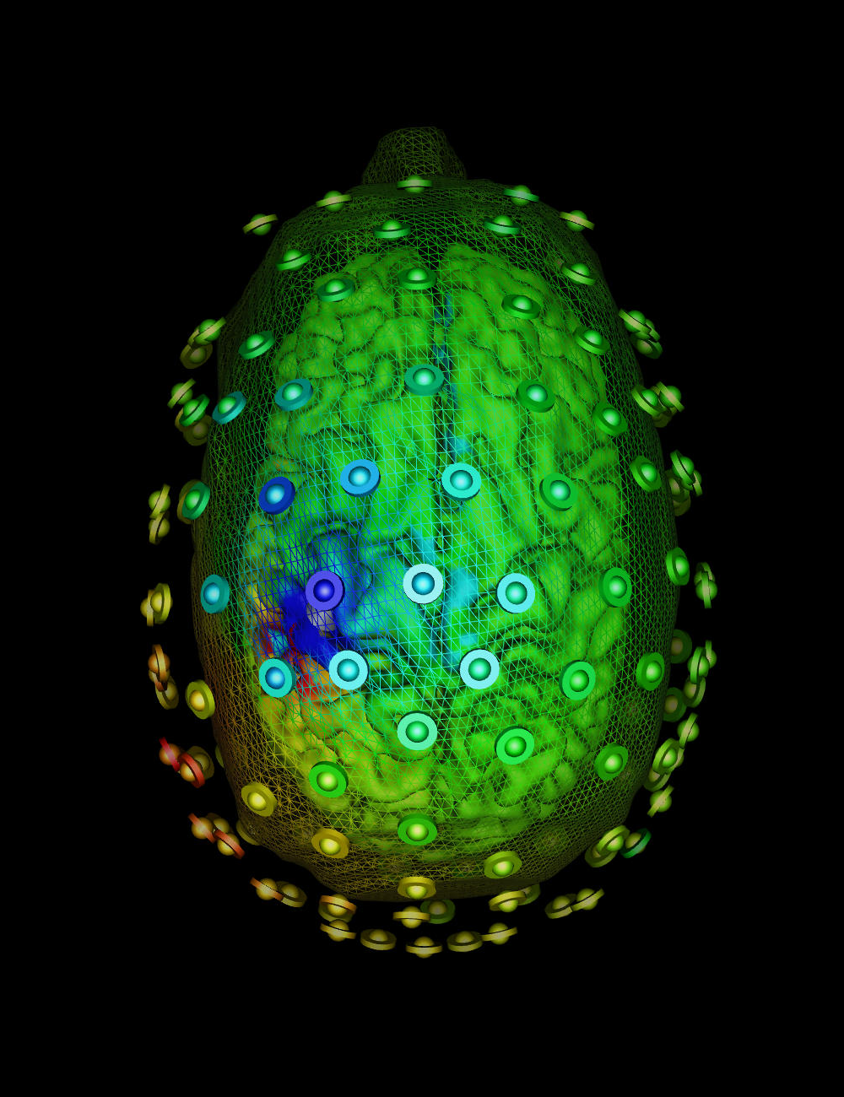
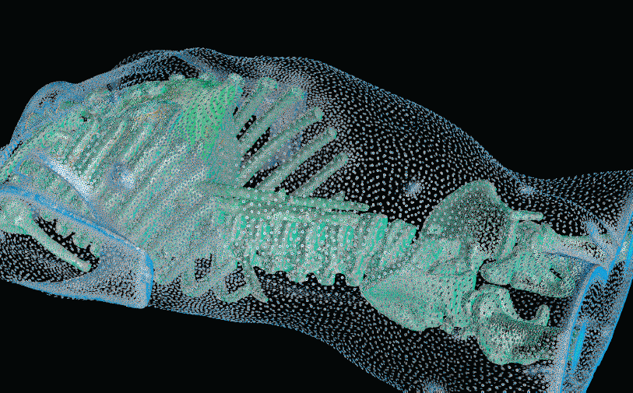
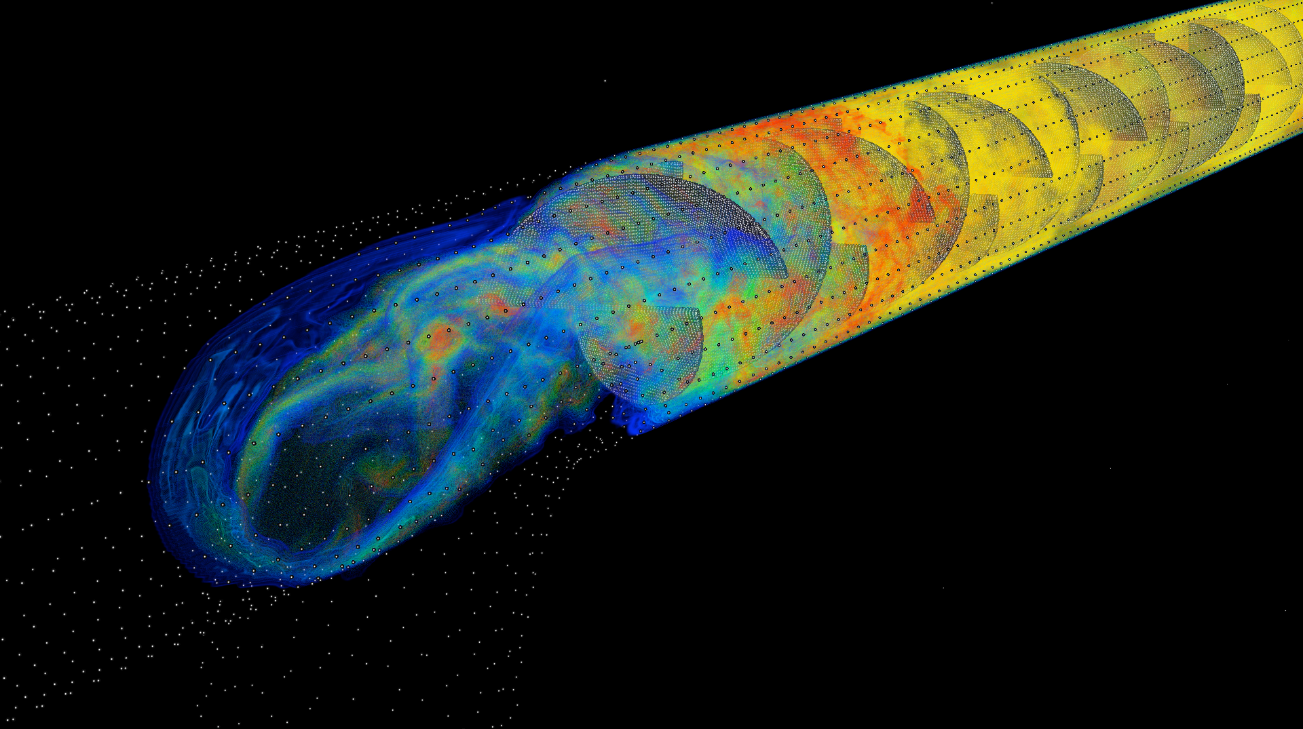
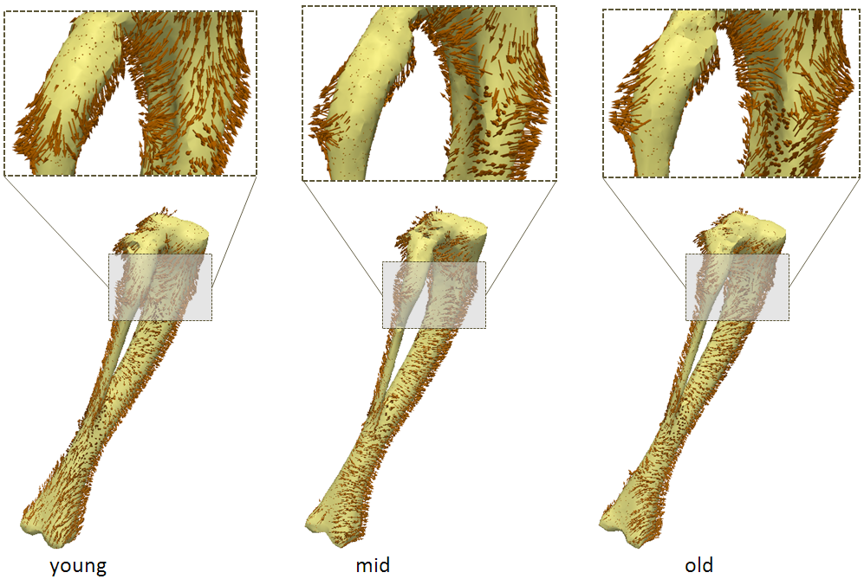
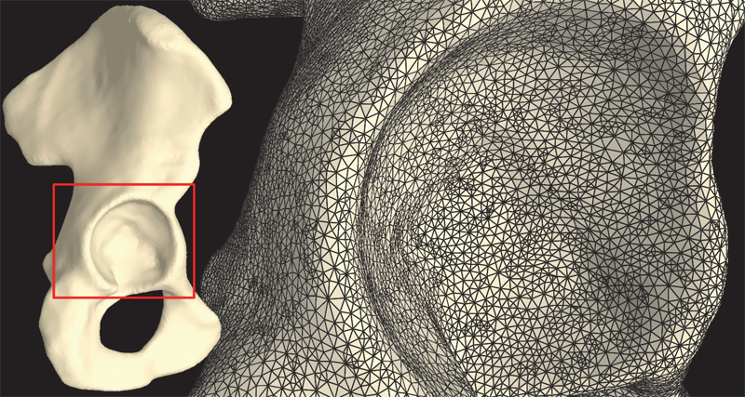
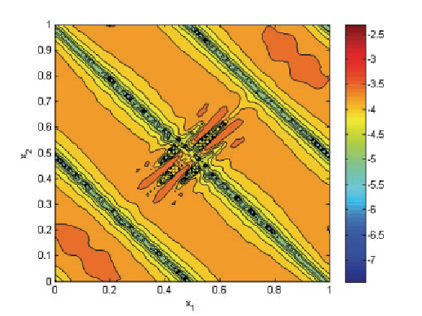
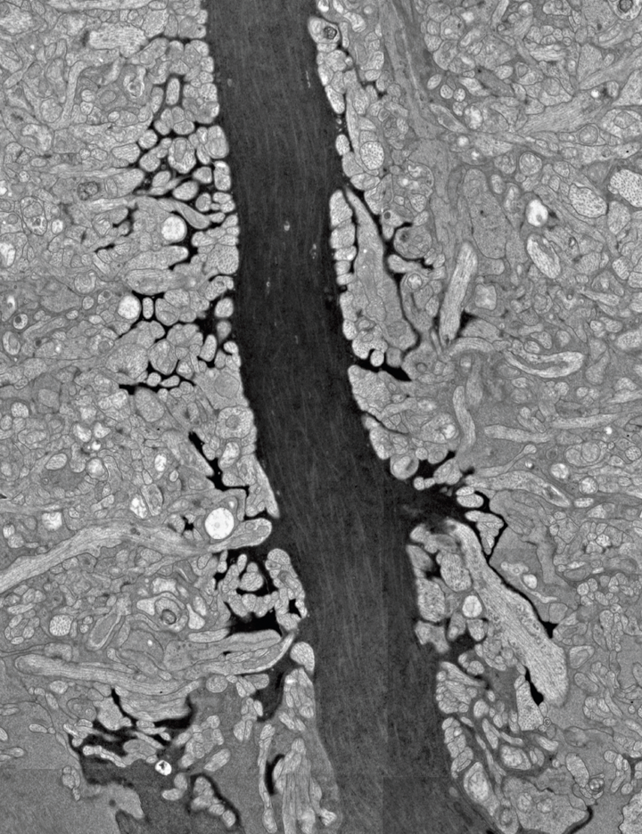
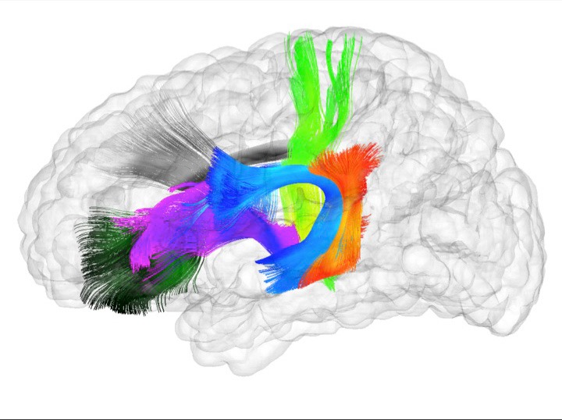
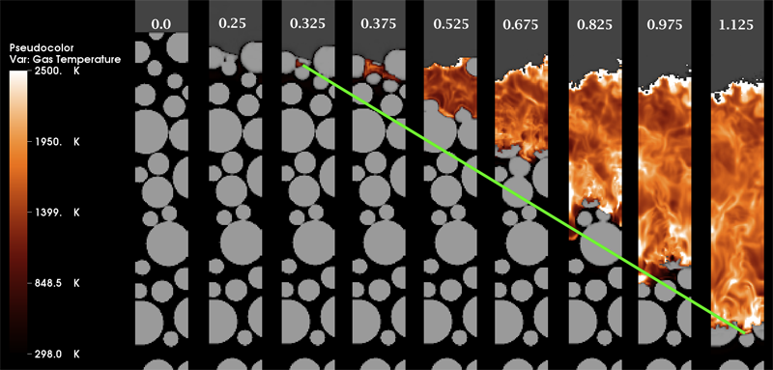
Research Cores
Visualization
Scientific Data
Management
Computing
Image
Analysis

Slide 4



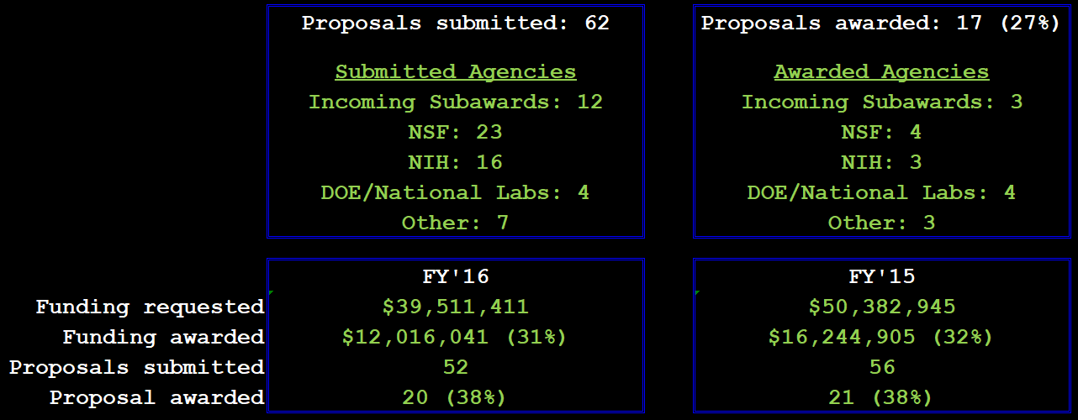
FY’17 Proposals Summary

Slide 5



Slide 6

FY2015 Proposals Summary
Funding requested: $50,382,945
Funding awarded: $16,244,905 (32%)
Submitted: 56
Incoming Subawards: 21
NSF: 14
NIH: 7
DOE/National Labs: 5
Other: 9
Awarded: 21 (38%)
Incoming Subawards: 5
DOE/National Labs: 5
NIH: 3
NSF: 3
Other: 5

Slide 7
SCI Institute Highlights 2017
Chuck receives IEEE Visualization Career Award
Valerio and Kree Receive IEEE Visualization 15 Year Test of Time Award
Alex receives NSF CAREER Award
Rob elected President of the Board of Directors for the Computing in Cardiology Society
Best Paper at the Fifth International Symposium on Computing and Networking 2017 (TAJO, Aaron, Mike and Martin)
Best Paper at IEEE ESPM2 2017 (Bradley, Alan, John, and Martin
Best Paper at SIGCSE 2017 (Nina and Erik Brunvand)
2017 NERSC Award for Innovative Use of HPC (Yarden et al.)
Technical Oscar (Thiago Ize)
CRA Outstanding Undergraduate Research Award Honorable Mention (Yiliang Shi)
SCI Institute history to appear in Cooley Collection (300+ pages)

Slide 8

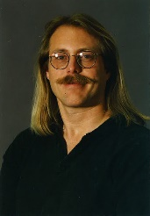
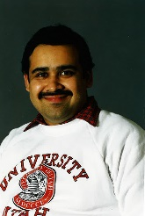
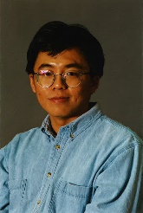
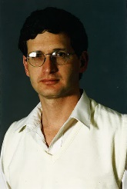
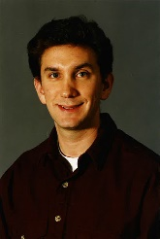
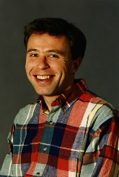
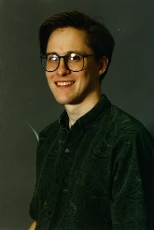
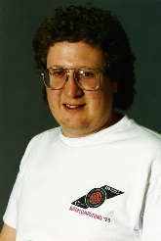

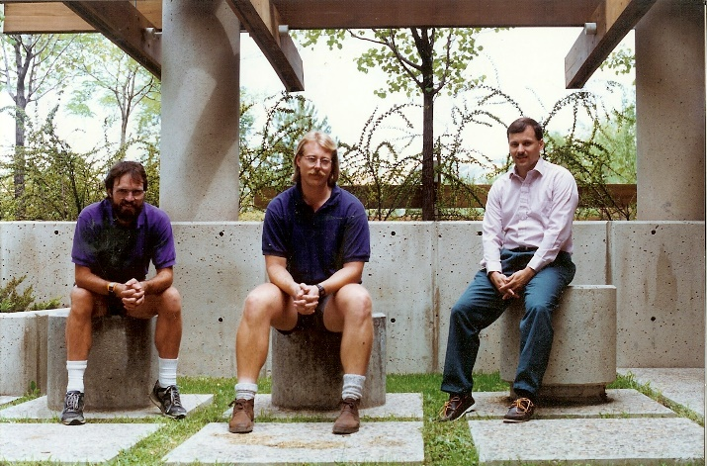
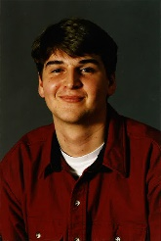
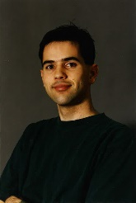
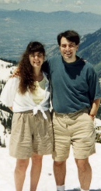
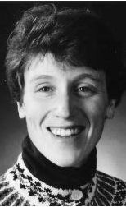
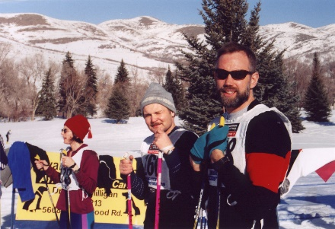
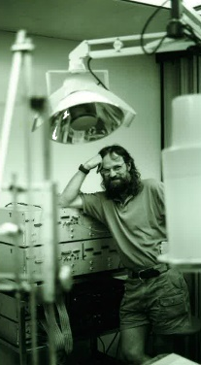
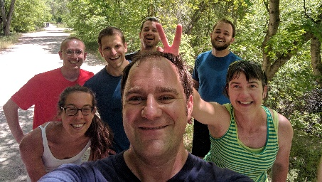
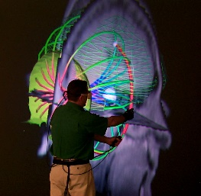

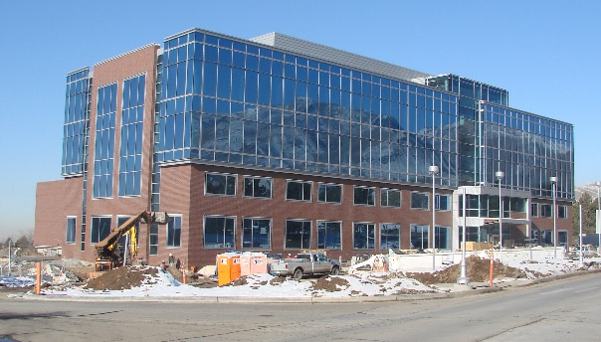
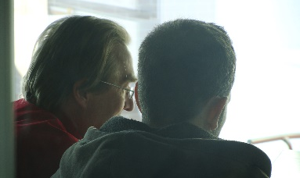
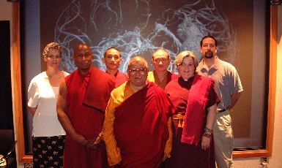
The Cooley Collection

Slide 9
Research Awards and Recognition
Over 49 Best Paper or Best Panel Awards
IEEE Technical Achievement Award for Visualization
2 IEEE Visualization Career Award
5 Fellows: American Institute for Medical and Biological Engineers
3 Fellows: Institute for Electrical and Electronic Engineers
Fellow: American Association for the Advancement of Science
Fellow: Society of Industrial and Applied Mathematics
Fellow: American Society of Mechanical Engineers
Fellow: Department of Energy
6 NSF CAREER Awards + 1 NSF NYI and 1 NSF PFF
3 Distinguished Alumni Awards
TR 35 Award
Microsoft Faculty Fellow
Charles Babbage Award
Sidney Fernbach Award
Rosenblatt Prize
IBM Faculty Awards
PopTech Science Fellow
TED Fellow
2 HPC Wire People to Watch

Slide 10
University Leadership
Rob MacLeod – Associate Director CVRTI and SCI and CARMA* and Director of UG BE
Martin Berzins – Director, ARL CDE3M*, Director of the SoC*, Director CES Program*
Mike Kirby – Director, ARL CDE3M, Director, CES Program*, Chair, Scientific Computing Ph.D. Program, Director of SoC Graduate Studies*, Associate Director, SoC
Valerio Pascucci – Chair, Graphics and Visualization Computing Degree Program*, Director, CEDMAV
Ross Whitaker – Director, SoC, Associate Director, SoC*
Chuck Hansen – Chair, Graphics and Visualization Computing Degree Program*
Chris Johnson – Director, SCI Institute, Director, SoC*, Director, CES Program*
* = Previous Position

Slide 11
National and International Leadership
DOE Advanced Scientific Computing Advisory Committee (ASCAC).
Board of Directors for the Computing in Cardiology Society
Flatiron Institute Advisory Board
Several Other National and International Advisory Boards
CRA Computing Community Consortium
CRA Board of Directors
CRA Awards Committee (Chair)
NSF HPC Committee
NSF Task Force on Software for Science and Engineering
NSF Task Force on Cyber Science and Engineering
CRA Education Committee
KAUST Advisory Committee
IEEE VGTC
DOE Advanced Scientific Computing Advisory Committee (ASCAC) Subcommittees
IEEE Fernbach and Cray Award Committees
SIAM Computational Science Awards Committee

Slide 12
National and International Research Center Leadership and Participation
NIH Center for Bioelectric Field Modeling, Simulation, and Visualization
NIH Center for Integrative Biomedical Computing
DOE ASCI Center for the Simulation of Accidental Fires and Explosions
DOE SciDAC Common Component Architecture
NIH National Alliance of Medical Image Computing
DOE Center for Exascale Simulation of Combustion in Turbulence
DOE Advanced Visualization Center
NIH Center for Biomedical Computing
DOE SciDAC Scientific Data Analysis and Visualization
DOE SciDAC Visualization and Analysis Center
NVIDIA Center of Excellence
Utah Center for Computational Earth Sciences
DOE PSAAP II
CDC Center for Decision Support for Infectious Disease Epidemiology
KAUST Institute for Applied Mathematics and Computational Science
DOD (ARL) Center for Computationally Designed Efficient Materials

Slide 13
Multi-Investigator, Multi-University Projects
DARPA Virtual Soldier
NSF Partners in Advanced Computational Infrastructure
DOE SciDAC Fusion Collaboratory
DARPA System Quantification of Uncertainty and Reliability at Extreme Scales
NCI Physical Sciences in Oncology Network
DARPA XDATA
NIH Central Thalamic Stimulation for Traumatic Brain Injury
NSF Collaborative Research: Optimization of Human Cortical Stimulation

Slide 14

SCI Institute - Utah Collaborations
Pediatrics
Psychiatry
HCI
Obstetrics
Pathology
Architecture
School of Computing
Pharmaceutical Chemistry
Mechanical Engineering
Chemical Engineering
UCAIR
Mathematics
Moran Eye Center
Materials Science
UPDB
TCO
CHPC
CVRTI
Neurology
Pathology / ARUP
Neurosurgery
Geography
ICSE
Biomedical Informatics
Cardiology
Genetics
Physics
Psychology
Nephrology
Chemistry
Biology
Brain Institute
Nuclear Engineering
EGI
Bioengineering
PCMC Cardiology
Radiation Oncology
CTSA
English
Epidemiology
Radiology
Physiology
Geology
Orthopedics

Slide 15


















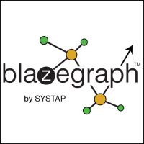



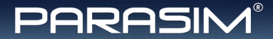







Industry Collaboration
Current Collaborations
Past Collaborations
ClinicNotes

Slide 16










Collaborations with National Labs

Slide 17
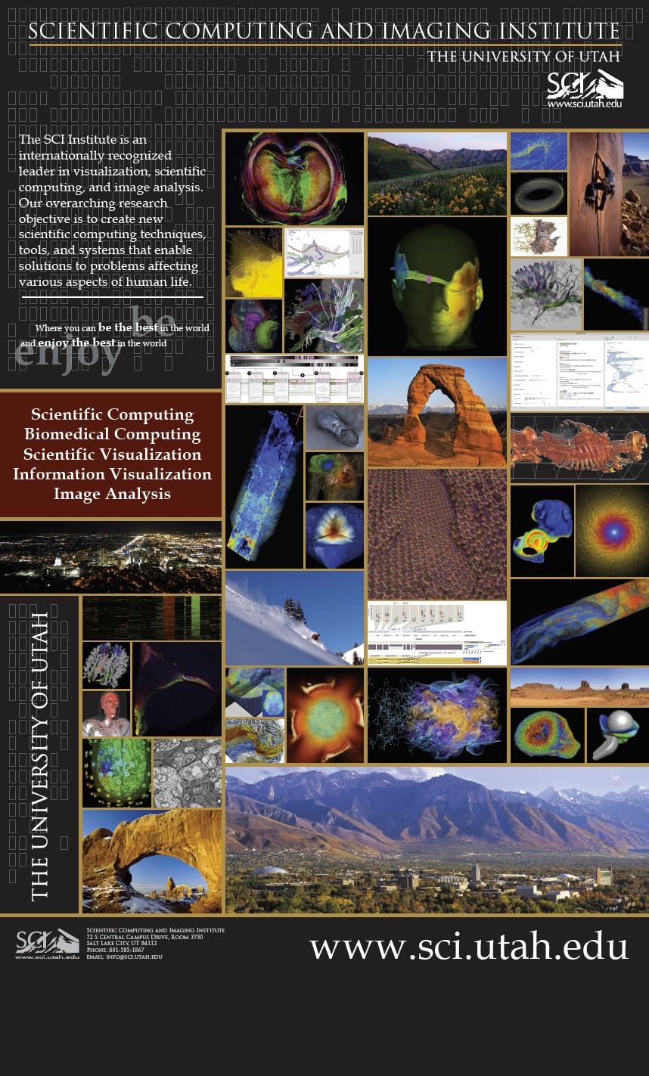
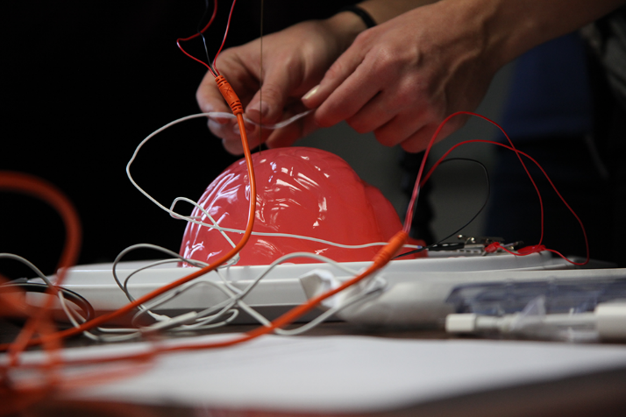
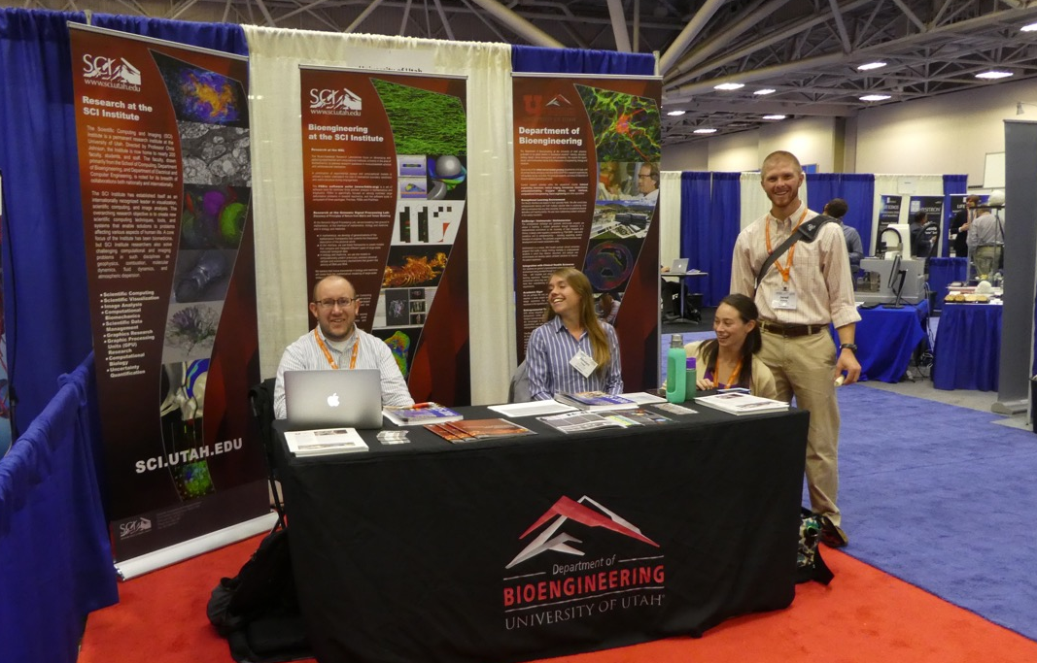
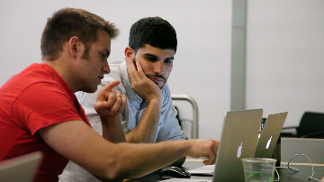
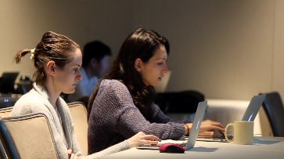
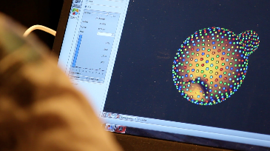
Outreach 2017
VIS 2017
Brainstem.science
BMES
IBBM 2017

Slide 18
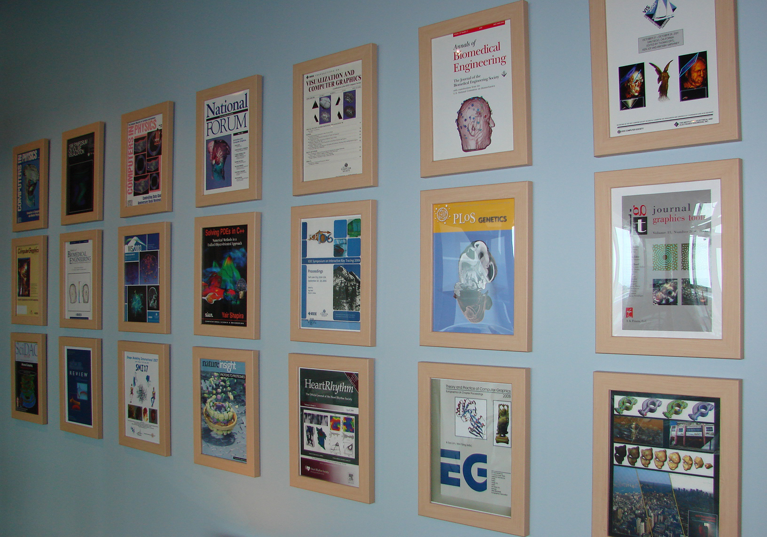
Journal Covers (30+)

Slide 19


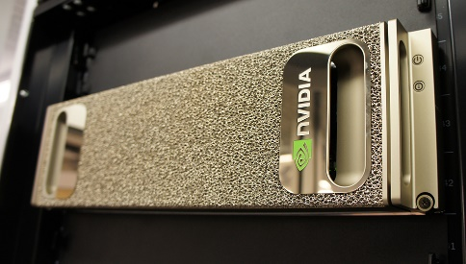





News from 2017
Yiliang Shi receives honorable mention for the CRA's Outstanding Undergraduate Research Award
Qi Wu receives Juror Choice Award in the 2017 Teapot Rendering Competition
Rob MacLeod elected President of the Board of Directors for the Computing in Cardiology Society
Technology from “Harry Potter” Movies Brings Magic of Brain into Focus
Best Paper: CANDAR 17
Best Paper: ESPM2 2017
Air Quality & U, Empowering Citizens through Science
Valerio and Kree Receive IEEE Visualization 15 Year Test of Time Award
Chuck Hansen Receives the 2017 IEEE Visualization Career Award
2017 NERSC Award for Innovative Use of HPC
Driving Visualization at the SH/EAHP Workshop 2017
SCI Acquires Nvidia DGX-1
Snapshots of Life: Muscling in on Development
Research Initiative Seeks to Understand Neural Pathways in Deep Brain Stimulation
Miriah Meyer Interviewed at Women in Data Science 2017
Mike Kirby Honored Among Top Researchers at the University of Utah
Combating Wear and Tear
Best Paper Award at SIGCSE 2017
Early Science Projects for Aurora Supercomputer Announced
SCI Alum Thiago Ize to Receive Technical Oscar
Rob MacLeod Elected as a Fellow of the American Institute for Medical and Biological Engineering (AIMBE)

