Slide 1


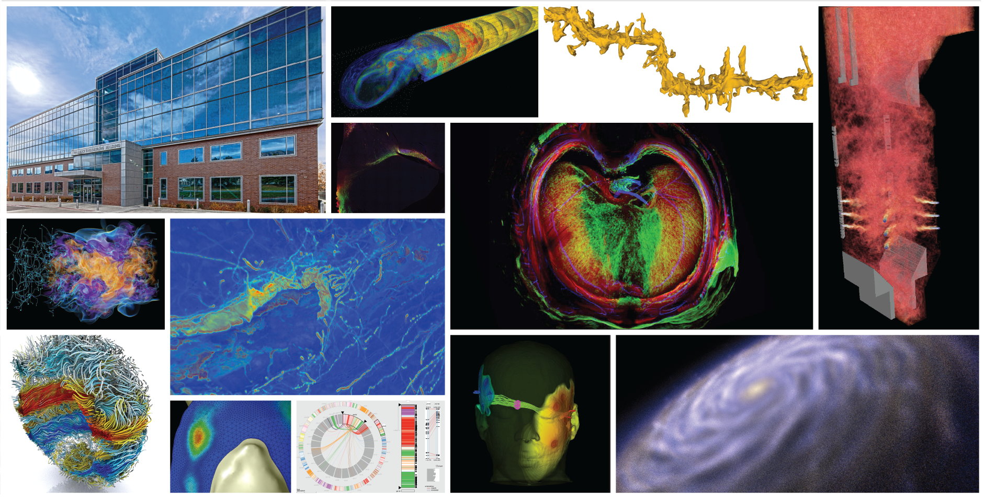
SCI Institute Faculty Retreat 2017-18

Slide 2

Best Books

Slide 4


Slide 7

Best Book
2017

Slide 9



Slide 11


Slide 12


Slide 13
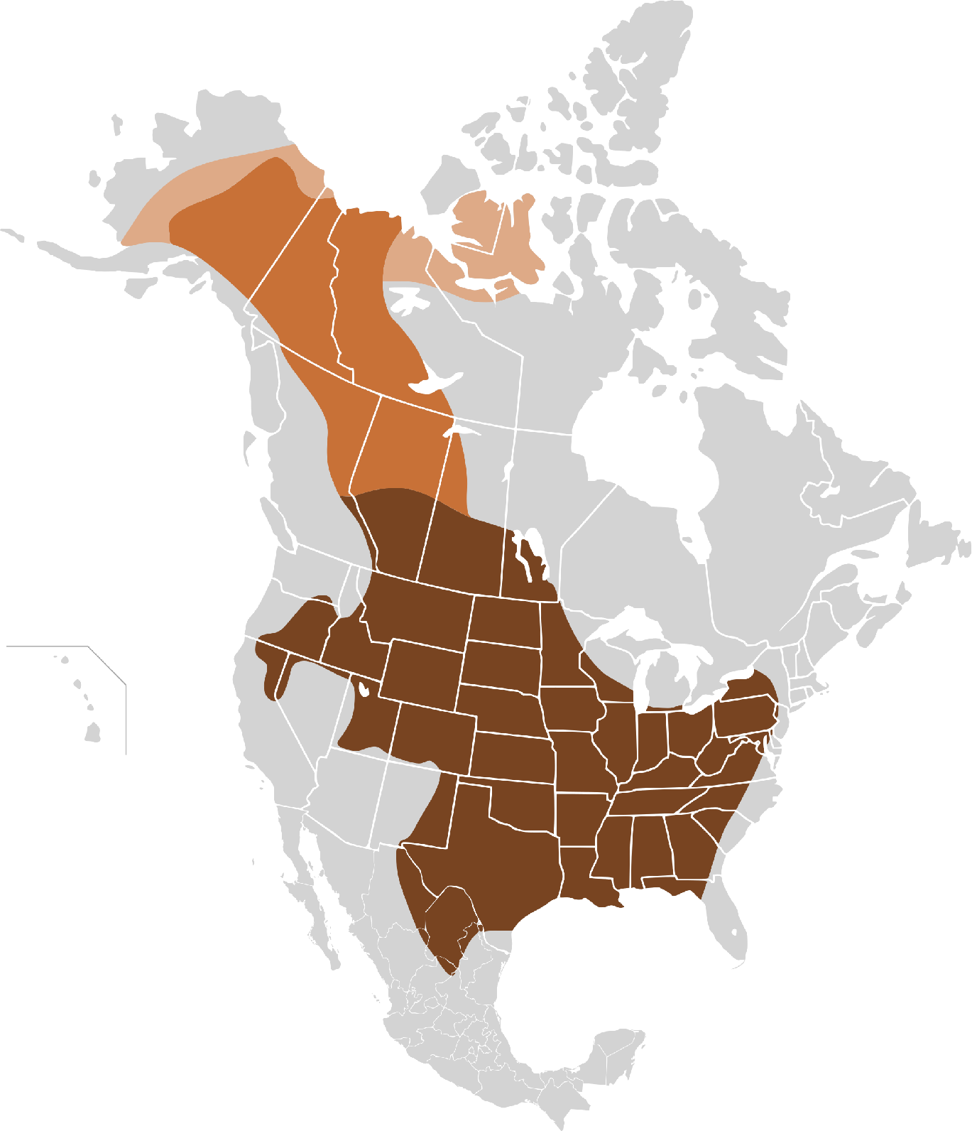
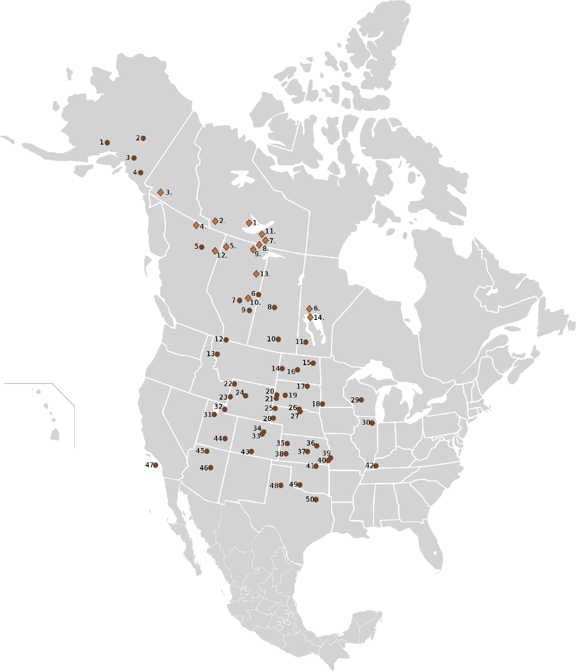
1800: 60,000,000
1900: 300
2017: 360,000

Slide 14


Slide 15

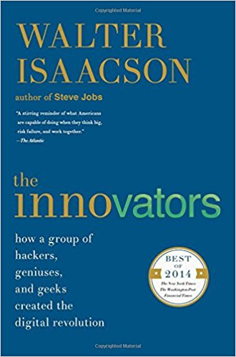

Slide 16

Next Year’s SCI Institute Faculty Retreat – Jan. 4

Slide 17




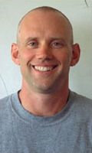
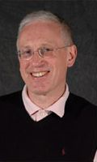

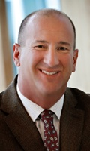
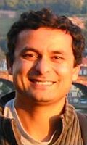
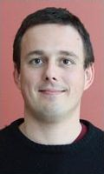
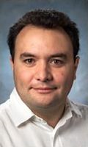
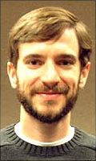
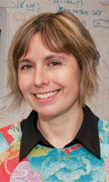

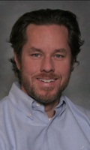
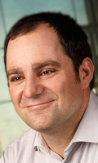
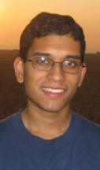
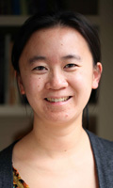
SCI Institute Faculty

Slide 18
SCI Institute Faculty
?

Slide 19
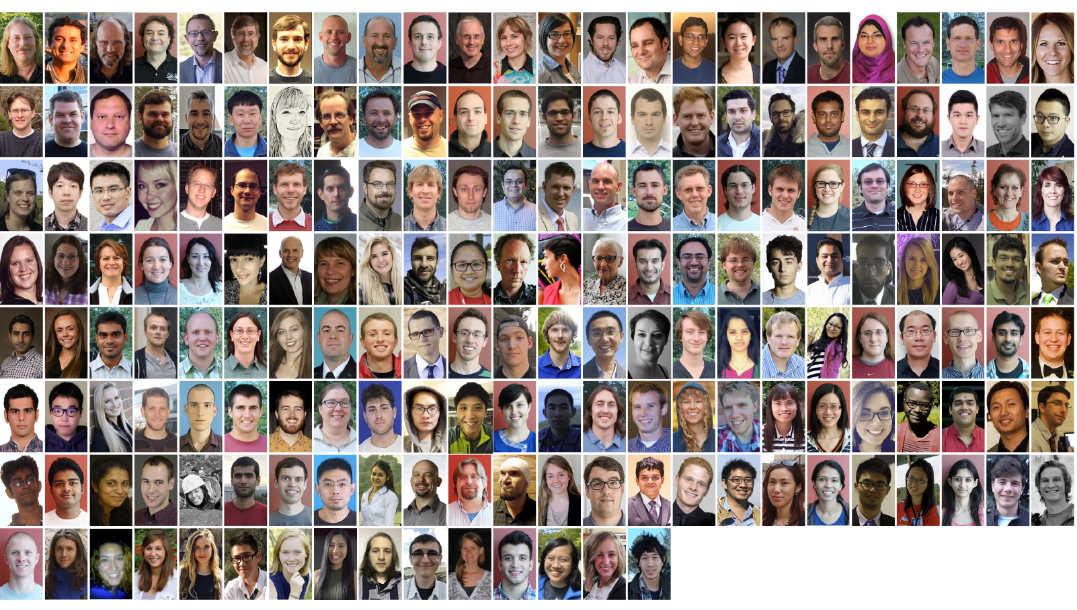
The Institute

Slide 20
SCI Institute Highlights 2017
Chuck receives IEEE Visualization Career Award
Valerio and Kree Receive IEEE Visualization 15 Year Test of Time Award
Alex receives NSF CAREER Award
Rob elected President of the Board of Directors for the Computing in Cardiology Society
Best Paper at the Fifth International Symposium on Computing and Networking 2017 (TAJO, Aaron, Mike and Martin)
Best Paper at IEEE ESPM2 2017 (Bradley, Alan, John, and Martin
Best Paper at SIGCSE 2017 (Nina and Erik Brunvand)
2017 NERSC Award for Innovative Use of HPC (Yarden et al.)
Technical Oscar (Thiago Ize)
CRA Outstanding Undergraduate Research Award Honorable Mention (Yiliang Shi)
SCI Institute history to appear in Cooley Collection (300+ pages)

Slide 21

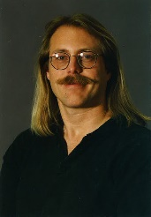
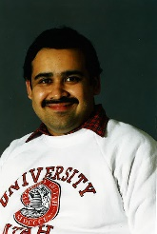
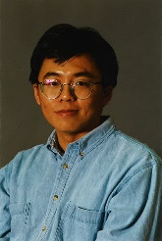
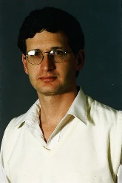
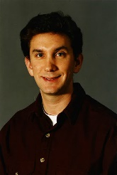
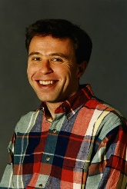
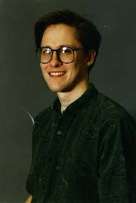
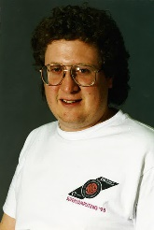
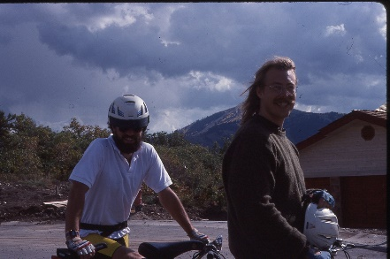
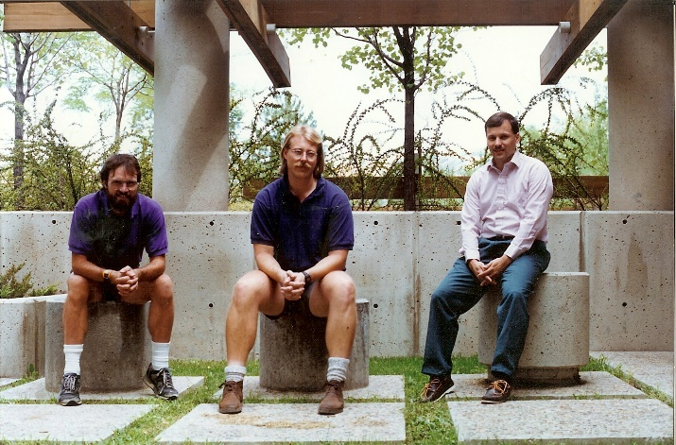
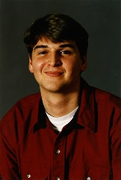
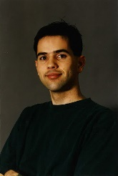
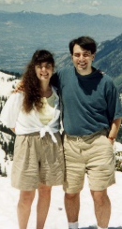
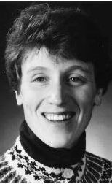
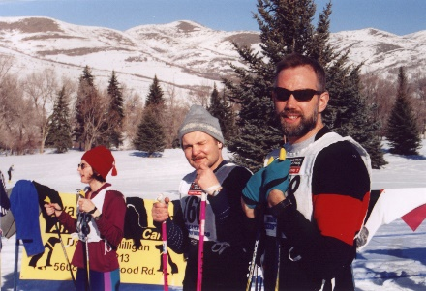
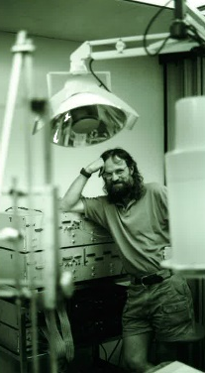
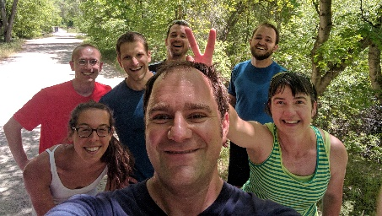
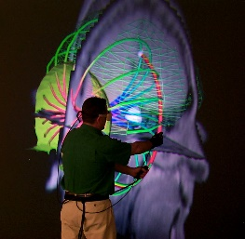
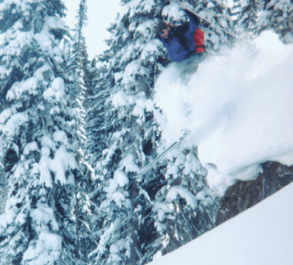
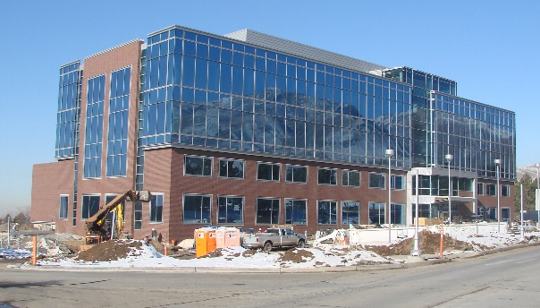
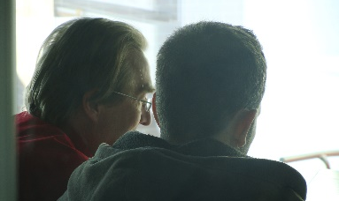
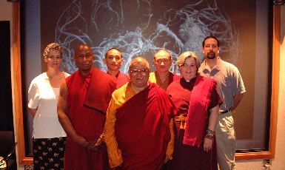
The Cooley Collection

Slide 22
Research Awards and Recognition
Over 49 Best Paper or Best Panel Awards
IEEE Technical Achievement Award for Visualization
2 IEEE Visualization Career Award
5 Fellows: American Institute for Medical and Biological Engineers
3 Fellows: Institute for Electrical and Electronic Engineers
Fellow: American Association for the Advancement of Science
Fellow: Society of Industrial and Applied Mathematics
Fellow: Department of Energy
6 NSF CAREER Awards + 1 NSF NYI and 1 NSF PFF
3 Distinguished Alumni Awards
TR 35 Award
Microsoft Faculty Fellow
Charles Babbage Award
Sidney Fernbach Award
Rosenblatt Prize
IBM Faculty Awards
PopTech Science Fellow
TED Fellow
2 HPC Wire People to Watch

Slide 23
University Leadership
Rob MacLeod – Associate Director CVRTI and SCI and CARMA* and Director of UG BE
Martin Berzins – Director, ARL CDE3M*, Director of the SoC*, Director CES Program*
Mike Kirby – Director, ARL CDE3M, Director, CES Program*, Chair, Scientific Computing Ph.D. Program, Director of SoC Graduate Studies*, Associate Director, SoC
Valerio Pascucci – Chair, Graphics and Visualization Computing Degree Program*, Director, CEDMAV
Ross Whitaker – Director, SoC, Associate Director, SoC*
Chuck Hansen – Chair, Graphics and Visualization Computing Degree Program*
Chris Johnson – Director, SCI Institute, Director, SoC*, Director, CES Program*
* = Previous Position

Slide 24
National and International Leadership
DOE Advanced Scientific Computing Advisory Committee (ASCAC).
Board of Directors for the Computing in Cardiology Society
Flatiron Institute Advisory Board
Several Other National and International Advisory Boards
CRA Computing Community Consortium
CRA Board of Directors
CRA Awards Committee (Chair)
NSF HPC Committee
NSF Task Force on Software for Science and Engineering
NSF Task Force on Cyber Science and Engineering
CRA Education Committee
KAUST Advisory Committee
IEEE VGTC
DOE Advanced Scientific Computing Advisory Committee (ASCAC) Subcommittees
IEEE Fernbach and Cray Award Committees
SIAM Computational Science Awards Committee

Slide 25

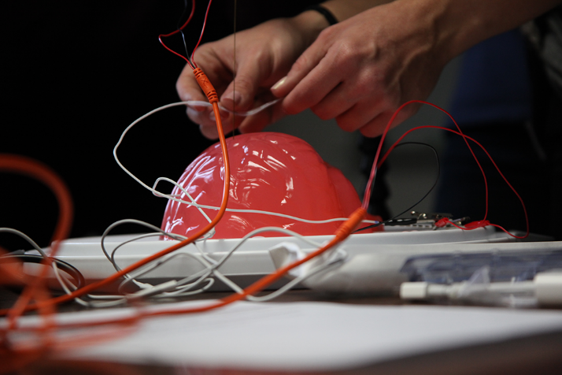
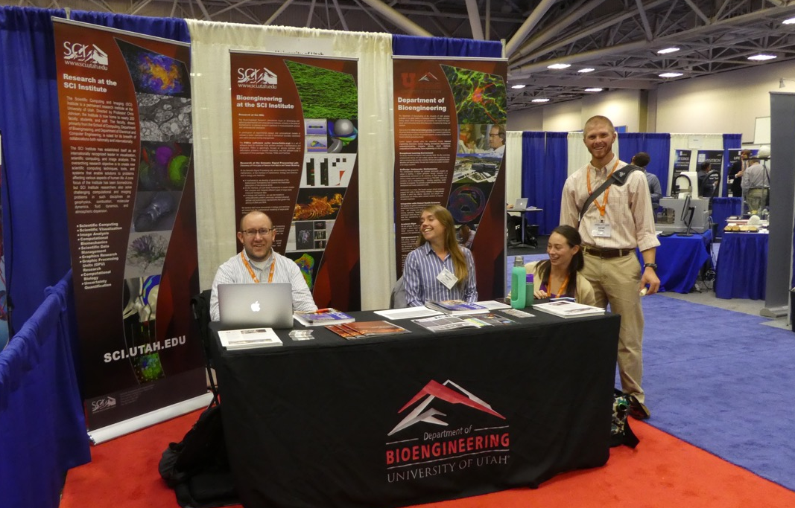
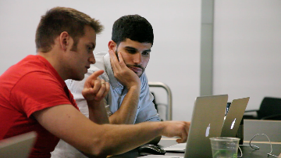
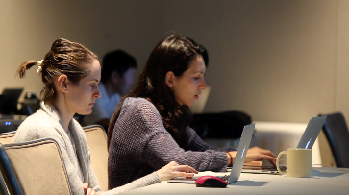
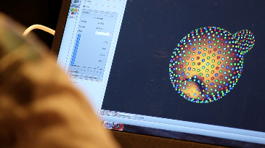
Outreach 2017
VIS 2017
Brainstem.science
BMES
IBBM 2017

Slide 26
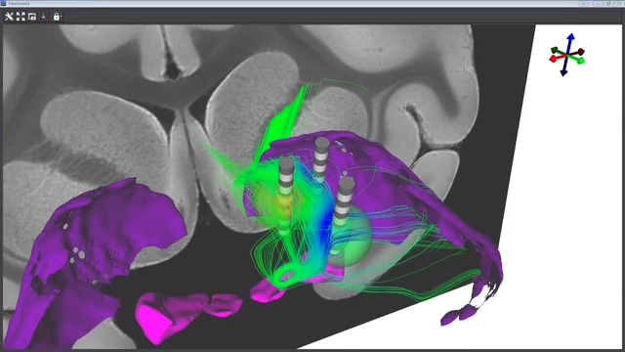
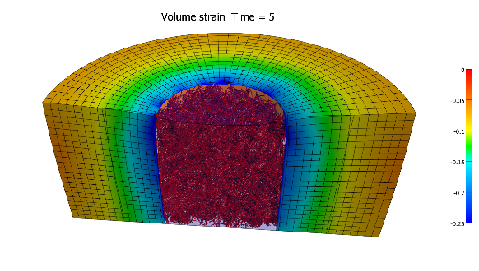
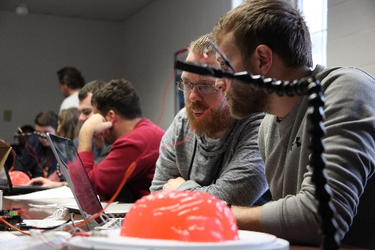
PR Video Production
Current Video Projects
JOVE Submission
Jeff’s P41 Submission Video
Virtual Neurophysiology Workbench
Paper Submissions
Seg3D Tutorial Set
Future Video Projects
Software Overviews (impact and collaborations)
More Software tutorials

Slide 27


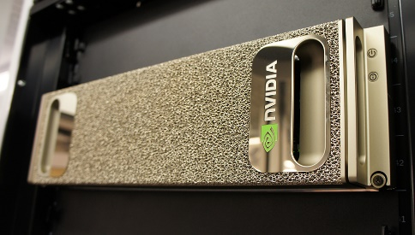

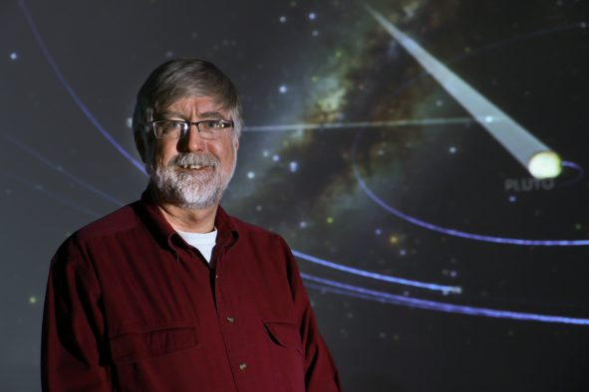



News from 2017
Yiliang Shi receives honorable mention for the CRA's Outstanding Undergraduate Research Award
Qi Wu receives Juror Choice Award in the 2017 Teapot Rendering Competition
Rob MacLeod elected President of the Board of Directors for the Computing in Cardiology Society
Technology from “Harry Potter” Movies Brings Magic of Brain into Focus
Best Paper: CANDAR 17
Best Paper: ESPM2 2017
Air Quality & U, Empowering Citizens through Science
Valerio and Kree Receive IEEE Visualization 15 Year Test of Time Award
Chuck Hansen Receives the 2017 IEEE Visualization Career Award
2017 NERSC Award for Innovative Use of HPC
Driving Visualization at the SH/EAHP Workshop 2017
SCI Acquires Nvidia DGX-1
Snapshots of Life: Muscling in on Development
Research Initiative Seeks to Understand Neural Pathways in Deep Brain Stimulation
Miriah Meyer Interviewed at Women in Data Science 2017
Mike Kirby Honored Among Top Researchers at the University of Utah
Combating Wear and Tear
Best Paper Award at SIGCSE 2017
Early Science Projects for Aurora Supercomputer Announced
SCI Alum Thiago Ize to Receive Technical Oscar
Rob MacLeod Elected as a Fellow of the American Institute for Medical and Biological Engineering (AIMBE)

Slide 28
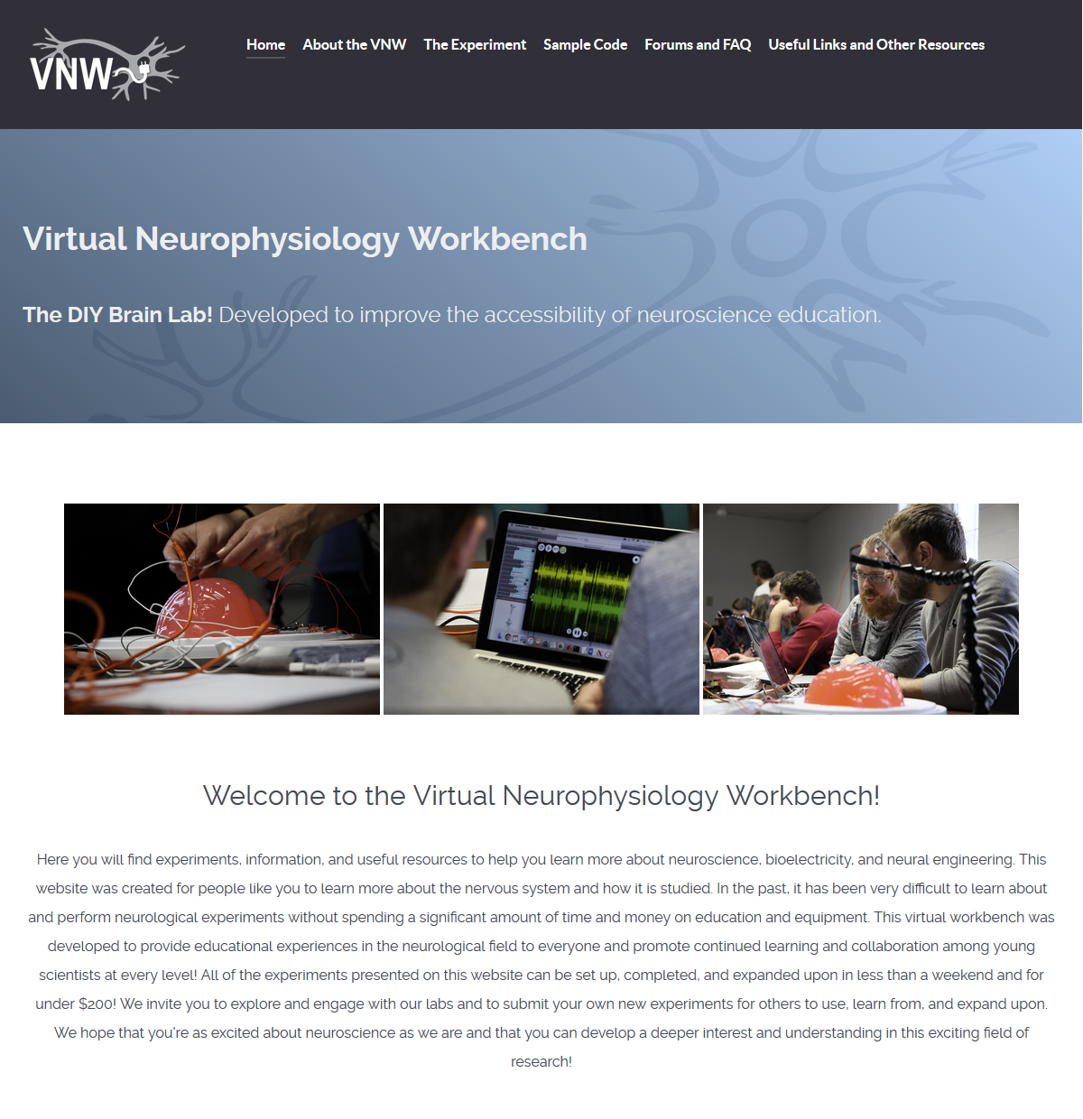
Virtual Neurophysiology Workbench
The Virtual Neurophysiology Workbench was developed at the University of Utah's Scientific Computing and Imaging Institute in an effort to improve the accessibility of neuroscience education. Typically, understanding of neurophysiology is developed through in vivo and in vitro experiments, as well as neurological procedures. These methods require extensive training and expensive, specialized equipment. We feel that students would benefit from educational experiences that facilitate this level of understanding prior to devoting years of training. This website was developed to address this need and promote general and critical knowledge development in this field of science at earlier education levels than have previously been feasible. Further, this website was also developed to promote interaction and collaboration between young scientists, who are encouraged to submit questions and new experiments that may help others.

Slide 29


Future of BIDAC as an HSC Core
Utah Biomedical Image and Data Analysis and Visualization Core
The Utah BIDAC is a University of Utah Health Sciences Core (UUHSC) facility providing image and data analysis and scientific visualization service to research laboratories at the University of Utah Health Sciences. These services leverage the R&D strengths of the University of Utah’s Scientific Computing and Imaging (SCI) Institute in scientific computing, image analysis and advanced visualization.

Slide 30

Journal Covers (30+)

Slide 31


Slide 32


Slide 33

17/Year

Slide 34


Slide 35
Prasanna Muralidharan (Tom)
Wathsala Widanagamaachchi (Valerio)
Alex Gerber (Rob)
Ayla Khan (Rob)
Fitsum Mesadi (Tolga)

Slide 36

4.0

Slide 37


Slide 38


Slide 39


Slide 40


Slide 41


Slide 42
Graduating student: “I just wanted to let you know that my experience working with Magali has been exceptional. She has taken care of all my problems promptly, professionally, and thoroughly. I have spoken to many other graduate students who's interface with the university wasn't any where near as pleasant as mine. SCI is lucky to have her.”
Graduating student: “Thanks Chris! It was my best five years being a graduate student at SCI and I am extremely honored to be a SCI Alumni. I will try all my best to make SCI proud of me in the future.”
Postdoc/student: “Thanks much, Chris. During my two stints at SCI, I got to learn a lot, technically and otherwise, from the many experts at SCI. I have many memories to cherish. I'll keep in touch.”
Graduating student: “Thank you. SCI provided a great environment and I've really enjoyed being a graduate student here. It also became more apparent when I started interviewing for postdocs that we truly have an outstanding group!”
SCI Staff: “Thank you so much Greg for your kind and encouraging e-mail. I feel privileged to be part of the SCI Institute and I look forward to many more years to come here at the SCI.”

Slide 43
SCI Staff: “Thanks Chris! This has been a great 10 years and I'm looking forward to many more :)”
Graduating student: “Dear Chris, Thank you so much! I really appreciate it! I was really lucky to have the chance to do my PhD in the SCI Institute at the University of Utah.”
Graduating student: “Thanks, Chris! I really appreciate the environment you, the faculty, staff, and students created at SCI during my years in grad school at Utah, and I am thankful for all of the opportunities the institute provided. Thanks again.”
Graduating student: “Thank you so much, Chris. It is really a wonderful experience for me to work at SCI. I am sure I will miss the time and people at SCI.”

Slide 44
Budget Slides

Slide 45

SCI Institute - Utah Collaborations
Pediatrics
Psychiatry
HCI
Obstetrics
Pathology
Architecture
School of Computing
Pharmaceutical Chemistry
Mechanical Engineering
Chemical Engineering
UCAIR
Mathematics
Moran Eye Center
Materials Science
UPDB
TCO
CHPC
CVRTI
Neurology
Pathology / ARUP
Neurosurgery
Geography
ICSE
Biomedical Informatics
Cardiology
Genetics
Physics
Psychology
Nephrology
Chemistry
Biology
Brain Institute
Nuclear Engineering
EGI
Bioengineering
PCMC Cardiology
Radiation Oncology
CTSA
English
Epidemiology
Radiology
Physiology
Geology
Orthopedics

Slide 46


Collaborators
Lawrence Livermore National Laboratories
Lawrence Berkeley National Laboratories
Sandia National Laboratories
Oak Ridge National Laboratory
University of California San Francisco
University of California Davis
University of California Los Angeles
Texas A&M University
University of Texas Health Science Center at San Antonio
North Eastern University
University of Arizona
University of Iowa
Ohio State University
University of North Carolina
Louisiana State University
Massachusetts Institute of Technology
University of Texas Austin
University of Washington
Northwestern University
University of Pittsburg
Stanford University
University of Oregon
Imperial College London
Harvard University
Duke University
Medical College of Wisconsin
John's Hopkins University
Children's Hospital Boston
Mayo Clinic
Cleveland Clinic
Brigham & Womens Hospital
Smithsonian Institute
Kettering Cancer Center
Kitware
VisTrails.org
crowdLabs
National Resource for Cell Analysis and Modeling
National Center for Microscopy and Imaging Research
University of California San Diego
National Biomedical Computation Resource
Neuroimaging Informatics Tools and Resources Clearinghouse
Center for Coastal Margin Observation & Prediction
DataOne
Electrical Geodesics Inc
University of Tennessee
University of Kentucky
Yale University
University of Chicago
Indiana University
Utah State University
Brown University
University of Southern California
Princeton Plasma Physics Laboratory
Science Applications International Corporation
General Electric Research Labs
SGI
Mountain View Data
Montana State University
North Carolina State University
Celera.
General Atomics
Caltech Computer Science
Rensselaer Polytechnic Institute
Argonne National Lab
Pacific Northwest National Laboratories
Electrical Geodesics, Inc.
University of Colorado
Los Alamos National Laboratories
Cornell University

Slide 47

Collaborators
Imperial College London
King Abdullah University of Science and Technology
University of Kaiserslautern
Charles University Hospital, Prague
University of Ljubljana
Technical University of Munich
University of Münster
University of Aukland
National Institute for Research in Computer Science and Control (Inria)
TurboLinux
University of Erlangen
University of Duisburg
Center of Advanced European Studies And Research (CAESAR), Bonn
Ben Gurion University, Israel
Hebrew University of Jerusalem
University of Stuttgart
Canadian Meteorological Center

Slide 48






























Industry Collaboration
Current Collaborations
Past Collaborations
ClinicNotes

Slide 49










Collaborations with National Labs

Slide 50
SCI Institute Mission
To solve important problems by performing cutting-edge collaborative image analysis, scientific computing, and visualization research.
Hallmarks of our approach have been:
- Building a team of the very best people who are both the best in their research areas and effective collaborators.
- A view of collaborative research where the whole is greater than the sum of the parts such that helping your colleagues will be a great return on investment.
- Working on "real world" problems and not "toy problems".
- Providing the best research resources in terms of administrative staff and equipment.
- Providing a very positive environment where the best researchers can use high end resources to do amazing research that impacts people's lives.

Slide 51
SCI Institute Role at the University
“There is no question that the SCI Institute is one of the crown jewels of the University of Utah. All three of the senior leaders feel that way (Ruth, Vivian and me). SCI is important to us because of the multiple national centers with their associated major external funding, because of the national and international recognition it brings to the U, and because of the caliber of the faculty, staff and students it attracts.”
President David W. Pershing

Slide 52
SCI Institute Role at the University (Cont.)
“I am happy to have been able to support it for so many years and certainly expect that to continue. I looked over your agenda for the afternoon and am pleased to see that you are collectively thinking about what you want the institute to be like 5 years from now. Successful interdisciplinary research is very hard work - I know that personally - and you are a shinning example of how strong that can be when it works well.”
President David W. Pershing

Slide 53


Research

Slide 54



Nektar ++ and LSIAC Filtering
Example 1
Naca 0012
~500K elements
4th degree
polynomials
Example 2
Co-rotating vortices
~220K elements
6th degree polynomials

Slide 55
Reduced order modeling for nonlocal problems
Nonlocal differential equations: “global” interactions
Materials modeling (e.g., peridynamics)
Image denoising energy functionals
Nonlocal waves
“Standard” nonlocal operators: fractional derivatives
Reduced order modeling: Fast simulations for
Parameter identification
Model calibration
Uncertainty quantification and prediction
ROM for nonlocal problems is hard.
We developed some nice solutions this year.
(In progress!)

Slide 56
Visualizing Multidimensional Data with Order Statistics

Slide 57
Motivation
Understand Complex Psychiatric Conditions
Discover Genetic Risk Factors
Dataset: 118k people, 19k suicide cases, 550 families
Notes:
The goal of our collaborators is to understand complex psychiatric conditions, such as autism and suicide. These diseases are caused by a combination of genetics and environmental factors. Our collaborators study these diseases using rich datasets, including thousands of diagnostic codes, detailed clinical profiles, genetic data, and genealogies, with the ultimate goal of discovering genetic risk factors that can be used for diagnosis and treatment. In this project we use a suicide dataset containing 118,000 individuals with and 19,000 suicide cases from 550 families.

Slide 58

Genealogy with ~400 members rendered with Progeny
Notes:
Unfortunately, current genealogy visualization tools cannot map more than a few attributes to the graph, and don’t scale well to the size of the data.
Here is an example of such family with 400 members. The primary phenotype is shown as filled in, and other attributes are shown as labels.
These graphs are not suitable for exploration. To remedy this we have developed Lineage.

Slide 59



1. De-cycle and
linearize graph
2. Plot attributes
in table
Notes:
Lineage is designed for the interactive exploration of large genealogical graphs and associated clinical data.
It has three main components.
A selection panel on the left allows analysts to choose one or more families to analyze and to select the attributes to display.
The genealogy view in the center displays the structure of the graph.
And the tightly integrated table displays the attributes associated with the nodes in the graph
Visualizing genealogies and rich attributes about the individuals is a multivariate graph visualization problem.
The fundamental idea behind lineage is to take a graph, make it into a tree, and then lay the tree out so that the nodes are associated with a table.

Slide 60





Slide 61

Exciting Research 2017
Discrete Stratified Morse Theory
An old idea back in 2012, revisited at Banff in 2017 with Kevin Knudson at UF
Inspired by the works of Forman on discrete Morse theory, we introduce a discrete analogue of the stratified Morse theory of Goresky and MacPherson for the analysis of complex data
Generating discrete stratified Morse functions from point cloud data.
Filtration-preserving reductions of complexes in persistent homology and parallel computation.
Applications in imaging and visualization.

Slide 62


Slide 63

Automated text report generation from radiological images with machine learning
Why? Radiologists spend most of their time generating reports (average 10 min/exam). Machine learning can help.
Applications of machine learning to medical image analysis has generally been limited to learning from labeled data, i.e. normal vs. disease, for research.
State-of-the-art deep learning models are data hungry. Radiology: Labeled data is rare. Text reports are plenty.
Research direction: Automatic image captioning and visual question answering combines vision and language models.
  NIH recently released 100K chest radiographs with text mined disease labels.
Utah project
  Radiology (Joyce Schroeder) + Computer Vision (Tolga Tasdizen) + Natural Language Processing (Vivek Srikumar)
  Seed support from SCI and the Department of Radiology
  First project: IRB approved for all chest radiographs taken at the U. of U. hospital and associated text reports over the last 5 years (~300K scans)
  In process of de-identification (Clement Vachet)
  Computational infrastructure: NVIDIA DGX (RIF + SCI + SoC funding)
Clinical information
69-year-old female with a history of smoking, asthma and bronchitis now with productive cough intermittently for several months.
Findings
The visualized thyroid gland is unremarkable. The lungs are hyperinflated….
Impression
Tracheomegaly and bilateral bronchiectasis.
No adenopathy or effusion. …

Slide 64

Butson Lab Most Exciting Research
Anderson D, Osting B, Vorwerk J, Dorval AD, Butson CR, Journal of Neural Engineering, Dec 2017

Slide 65

Exciting Research Directions
How to make Virtual Reality NOT fun (and do real work)

Slide 66

The Virtue of Assigning Blame!

Slide 67


Slide 68


Slide 69
Research I am excited about is diffusion processes on manifolds and in particular for Lei groups and submersions and the associated transitions probability density functions. I want to use this theory to do metric estimation given data using important sampling.

Slide 70
The Riemannian Geometry of Deep Generative Models
Hang Shao, Abhishek Kumar, Tom Fletcher
(CVPR 2018 submission)

Slide 71









We can compute geodesic curves between two randomly generated faces:
Using geodesic distance, we can compute average faces:
Deep generative models take random inputs in latent space and map them into “fake” generated images.
Averages of faces with dark / light hair, mouth closed / open.
We can parallel transport a change to a random face (mouth closed -> open):
This generative mapping is a coordinate chart of a low-dimensional submanifold of the original data space.

Slide 72



NNSA PSAAP2 Existing Simulations of GE Clean coal Boilers using ARCHES in Uintah
Large scale turbulent combustion needs mm scale grids
Structured, high order finite-volume discretization
Mass, momentum, energy conservation
LES closure, tabulated chemistry
PDF mixing models
DQMOM (many small linear solves)
Uncertainty quantification
Low Mach number approx. (pressure Poisson solve up to variables
Radiation via Discrete Ordinates – massive solves Mira or ray tracing Titan.
Weak and strong scaling on Mira and strong scaling on Titan.
60m
Good (superlinear!) scaling for the full problem on Titan and Mira

Slide 73




Molecular Level Detection and Localization of Mechanical Damage in Collagen Enabled by Collagen Hybridizing Peptides
Nature Communications, 8:14913, March 2017.
Jared L. Zitnay, Yang Li, Zhao Qin, Boi Hoa San, Baptiste Depalle,
Shawn P. Reese, Markus J. Buehler, S. Michael Yu, Jeffrey A. Weiss
We utilized collagen hybridizing peptide (CHP) to detect molecular level damage to collagen in mechanically stretched dense collagenous tissues.
Collagen triple helix unfolding occurs during tensile loading and thus is an important damage mechanism.
SMD simulations demonstrated that intermolecular shearing of collagen α-chains is the likely mechanism for triple helix unfolding.
Our results elucidate the molecular failure mechanism of collagen, and demonstrate the potential of CHP targeting for diagnosis, treatment, and monitoring of tissue injury.
https://www.nature.com/articles/ncomms14913
Notes:
73

Slide 74










Myocardial ischemia and its ECG signature: 100 years of forgery?
Brett Burton
Jess Tate
Wilson Good
Brian Zenger
Dr. Darrell Swenson
Dr. Shibaji Shome
Dr. Kedar Aras
Dr. Dana Brooks
Dr. Jaume Coll-Font
Dr. Burak Erem
Notes:
Make sure to a) encourage questions as I go along and b) to follow up later in the day with more details on any of the points I make.

Slide 75


The Dogma
Ischemia attaches to the inside of the heart chambers and grows outwards
This is the basis for all clinical detection of ischemia (think stress testing, ER)
Reimer, Jennings, et al., Circ. 56:786, 1977

Slide 76
Acute Ischemia is More Complex
Control
A
B
C
D
∆ST40%
Aras et al., PhD Thesis; manuscript in preparation.

Slide 77







The Bottom Lines
We are replacing the dogma
We need experiments, signal processing, and simulations to understand it
There may be better clinical markers
than ST segments

Slide 78

Quantifying and Visualizing Uncertainty for Source
Localization in Electrocardiographic Imaging

Slide 79
Strategic Vision

Slide 80
Greg’s Projects
DoD OEA – PI – Moved to Bart Raesmaeykers (ME) - $4M
Project Manager, Kevin Jessing
Software Manager, Anatasia Bertola
  Software Developers:
    Minh Pham, database
    Mark Dewey, database
    Riccardo Sonsini, Web and interfaces
    Eduardo Mendivil, Web and interfaces
Visualization Research
  Alex Lex
    Carolina Nobre
  Yarden Livnat
AFRL and University of Dayton Research Institute - $500K (In Process)
PI, Mike Kirby
Contract Negotiations: Erica A.
Coordination: DoD/OEA Military Liaison, Angie Tymofilchuk
Subcontract from UDRI for 3 months
Contract from AFRL (in process) for 21 months

Slide 81
DOE Congressionally Director Project - $1M/5M/10M (In Process)
PI: Chris Johnson
Co-PI’s:
Eric Eddings (Coal to Carbon Fiber Lead)
Andrew Metzger, UAA - atmetzger@alaska.edu
Matthew Weisenberger, UKy - matt.weisenberger@uky.edu
Tony Szwilksi, Marshall University - szwilski@marshall.edu
Ray Levy (O/G Lead)
Mike Kirby
Martin Berzins
Valerio Pascucci
Haliburton - $1M/Year (In Process)
Greg Powers – VP for Technology at Haliburton
Lead: Ray Levey
SCI folks involved:
Martin Berzins: MPM
Mike Kirby: Machine Learning
Valerio Pascucci: Visualization and Data Streaming

Slide 82






















SCI Institute Faculty Timeline
Martin Berzins
2003
Tom Fletcher
2008
Chris Johnson
1992
Claudio Silva
2003
Valerio Pascucci
2008
Miriah
Meyer
2012
Akil
Narayan
2015
Rob MacLeod
1992
Mike Kirby
2002
Jeff Weiss
2003
Tolga
Tasdizen
2008
Orly
Alter
2010
Dongbin
Xiu
2012
Alex Lex
2015
Chuck
Hansen
1997
Ross Whitaker
2000
Sarang
Joshi
2006
Guido
Gerig
2007
Juliana
Freire
2009
Chris
Butson
2014
Bei
Wang
2016
Steve Parker
2000

Slide 83













SCI Institute Faculty Rank
Full Professors
Open
Slot
Associate Professors
Assistant Professors
Open
Slot
Open
Slot
Open
Slot

Slide 84
SCI Institute Faculty Area
Biomedical and Scientific Computing
Open
Slot
Open
Slot
Image Analysis
Open
Slot
Visualization
Open
Slot

Slide 85
Strategic Faculty Recruiting
Open Image Analysis Position:
Open Scientific Computing Position:
Timo Heister (Jan. 29)
Open Biomedical Computing Position:
Open Visualization Position:
- Biodiversity Cluster with UMNH

Slide 86
Research Centers/Large Projects
Current:
  NIH CIBC – April 2020
  DOD ARL CDE3M – November 2019
  DOE CCMSC – February 2019
  NCI U01 – August 2020
  Exxon-Mobil – December 2017
  NIH UH3 – August 2020
  DoD OEA – August 2018
  DARPA (Akil/Dongbin) – September 2018
  DARPA (Mike/Ross) – December 2018

Slide 87
Research Centers/Large Projects
Planned:
  NIH P41 Biomechanics – Jeff
  DOE NETL CDP – Chris, Martin, Mike, Valerio
  NIH Image Analysis PP – Sarang, Tom, Tolga, Ross?
  Haliburton – EGI, Mike, Martin, Valerio, Chris
  DOE Energy – Brian McPherson, Pani, Valerio, Chris

Slide 88
Development Opportunities
Kimball Thomas joins the SCI Institute as head of Development (Report from Kimball)
Carnegie Institution for Science – Joint Development Opportunities (Matt Scott steps down as President of CIS)
Senior Vice President, Morgan Stanley Wealth Management – Visit from

Slide 89
The Institute

Slide 90
Next Year’s SCI Institute Faculty Retreat – Jan. 4

Slide 91
More Information
www.sci.utah.edu
crj@sci.utah.edu

