Slide 1


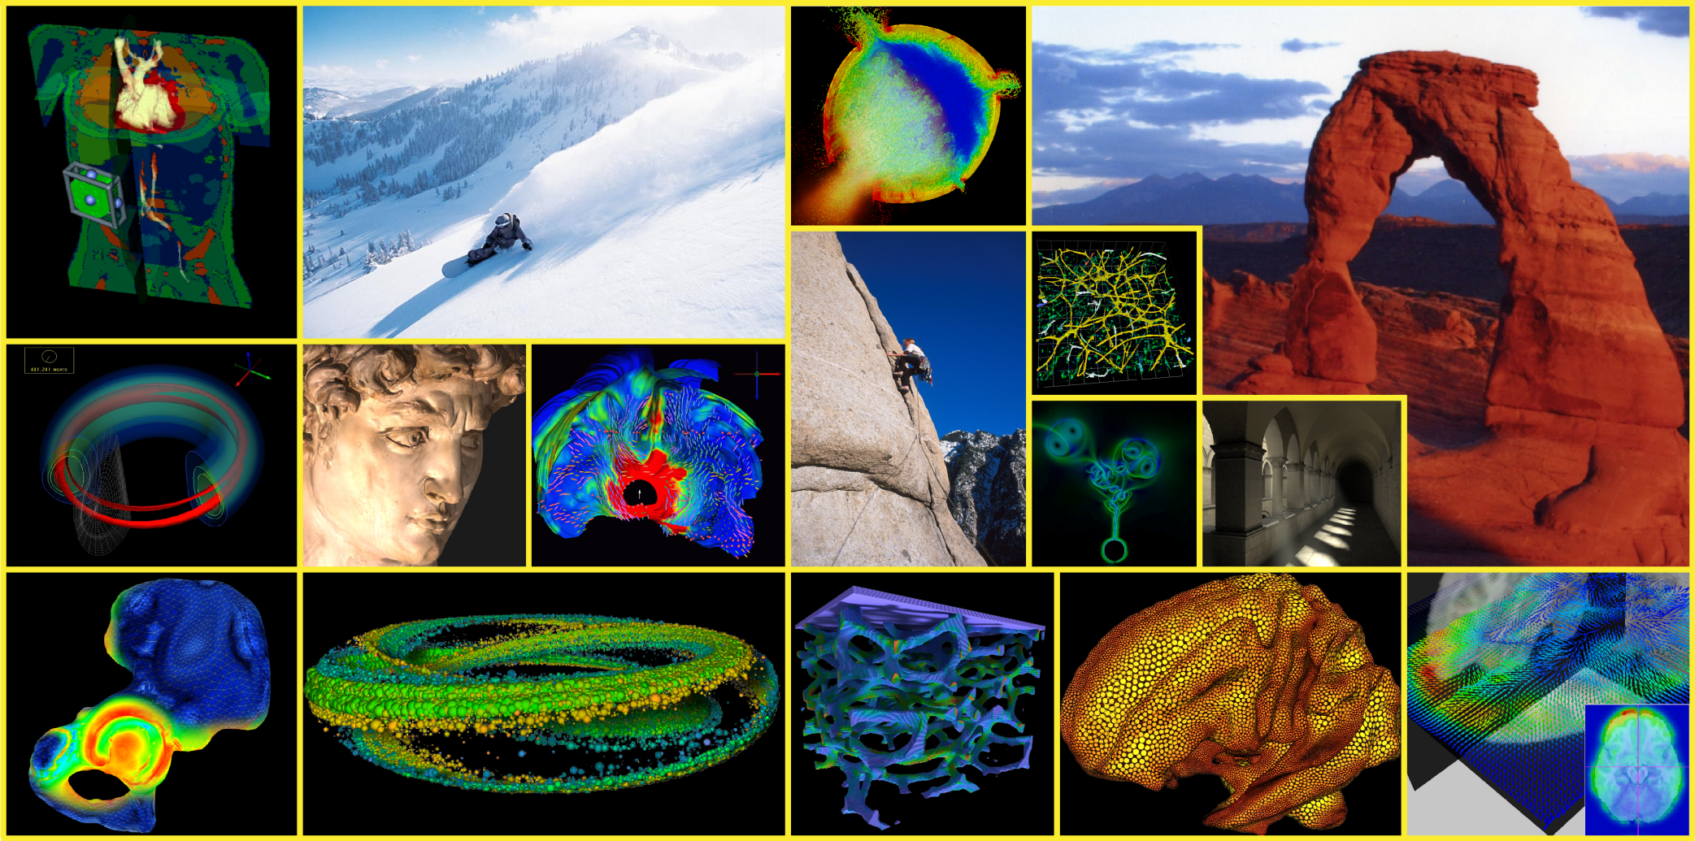
Scientific Computing and
Imaging Institute

Slide 2
How Did I Get Here?
1989-92 - Prof of Medicine, Mathematics
1992 - Present - Prof of Computer Science, Bioengineering, Physics
1990 - Me, Rob MacLeod, 1 Ph.D. Student
1994 - SCI Group - 7 total, 5 Ph.D. students
1996 - Center for SCI - 15 total - 7 Ph.D. students
2000 - SCI Institute - 32 total - 10 Ph.D. students
2006 - SCI Institute - 105 total - 42 Ph.D. students
2009 - SCI Institute - 145 total - 60 Ph.D. students
2010 - SCI Institute - 170 total - 80 Ph.D. students

Slide 3
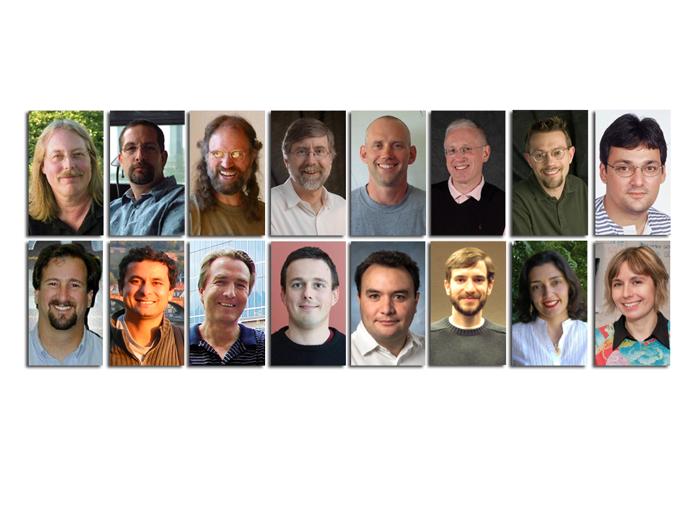
SCI Institute Faculty

Slide 4
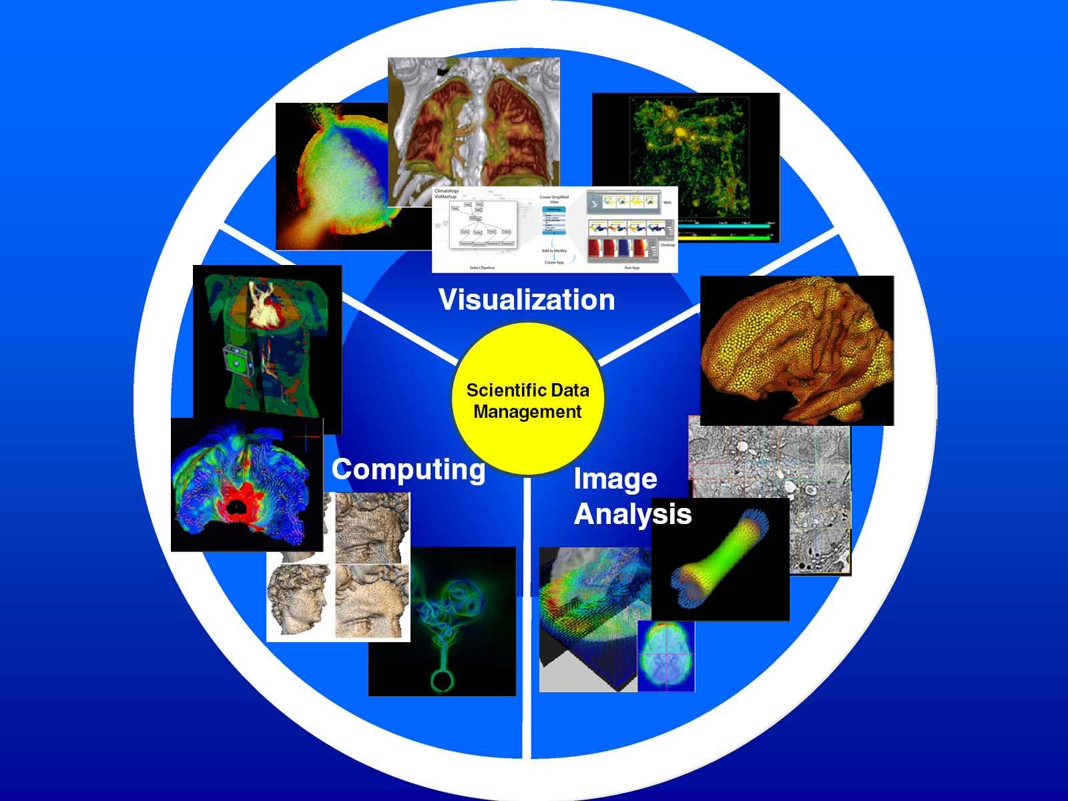
Research Cores

Slide 5
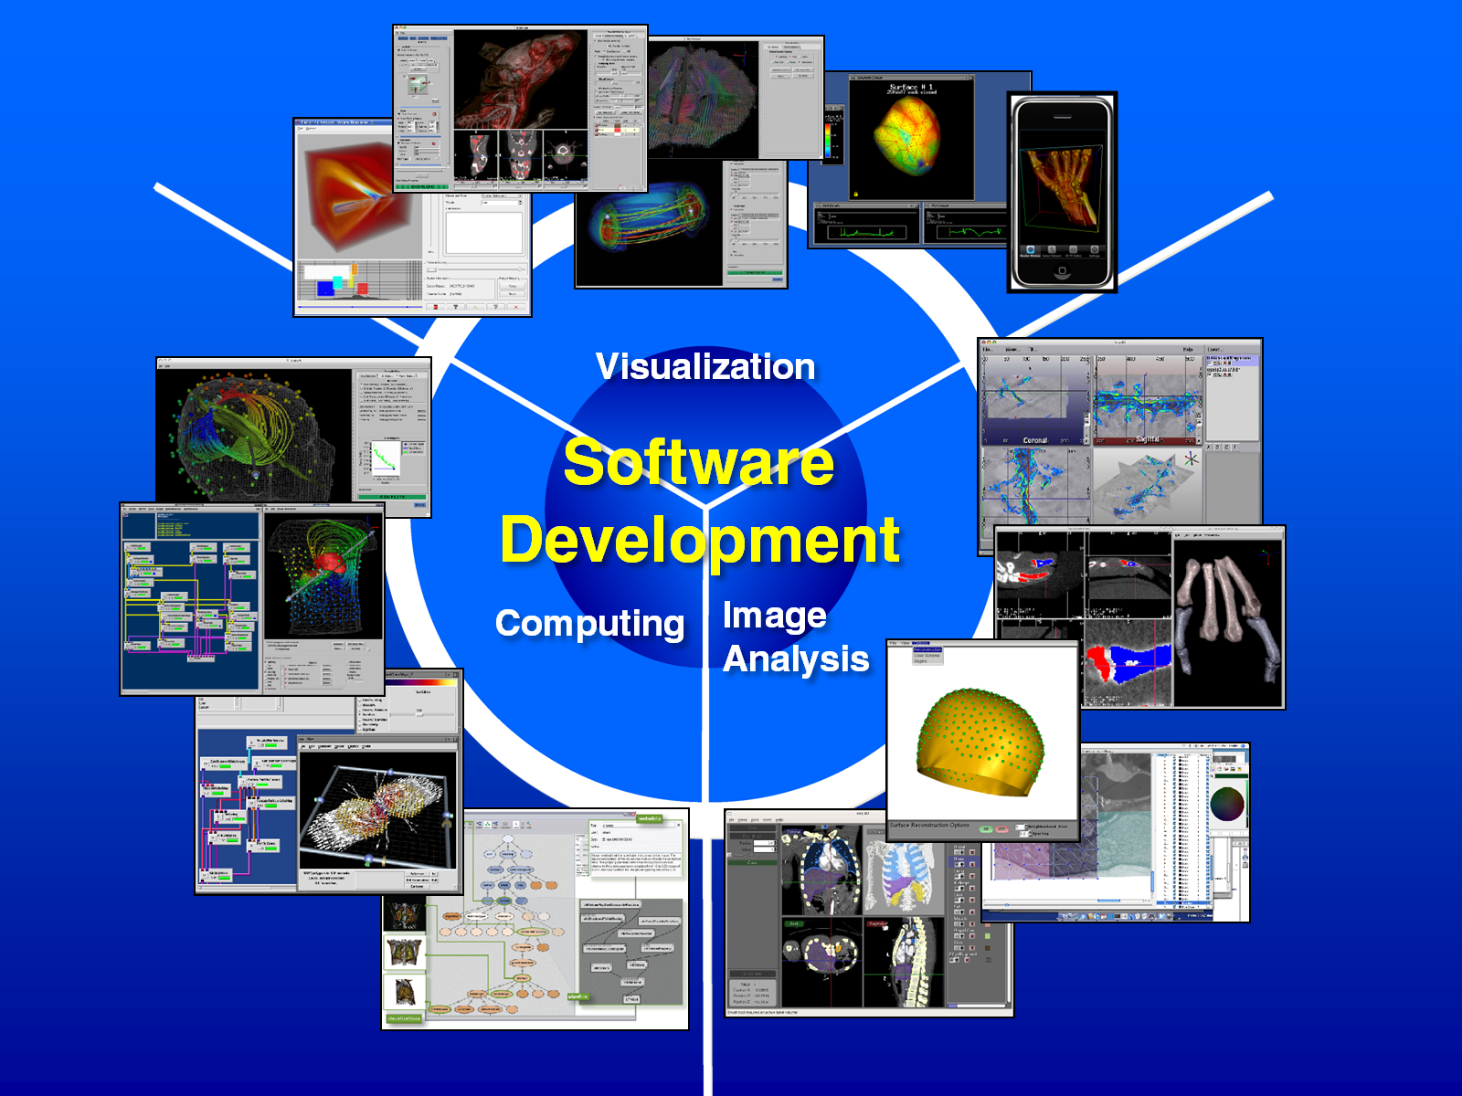

Slide 6
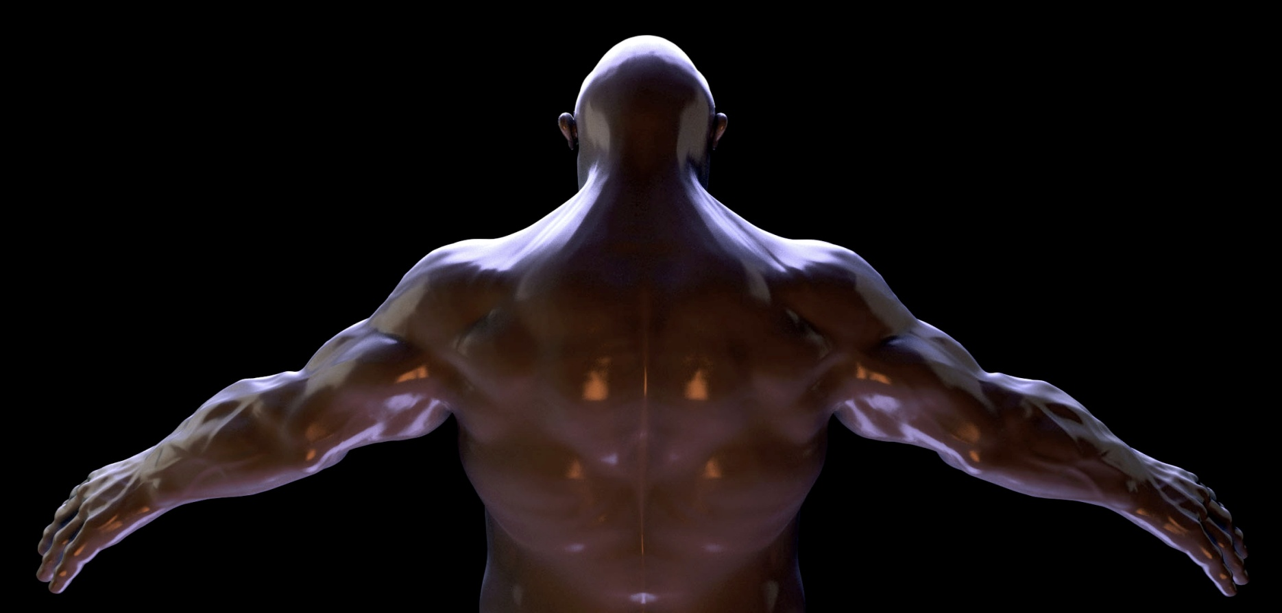
RayScale
Experts in Interactive Ray Tracing systems
Next generation of high quality graphics
Center of Excellence participant

Slide 7

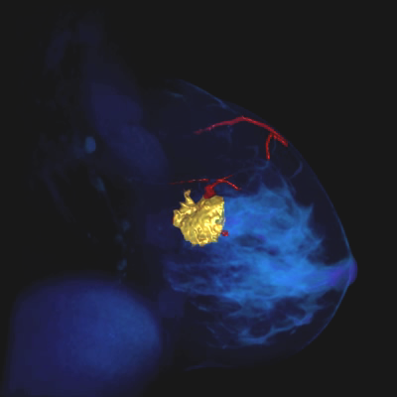
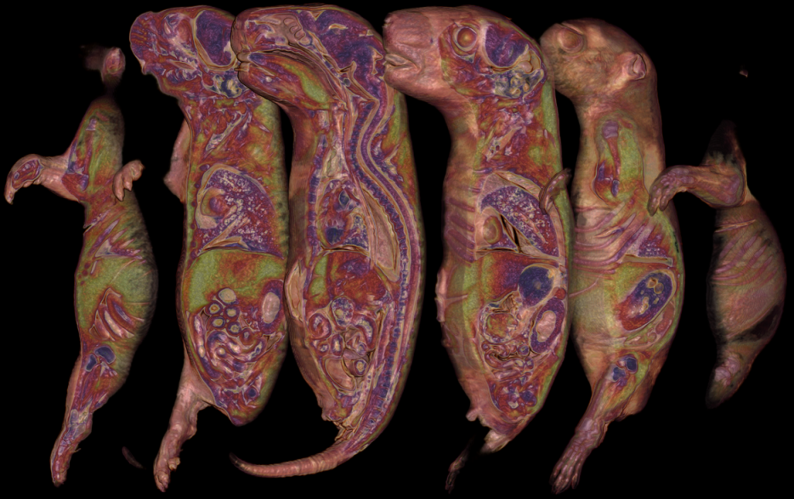
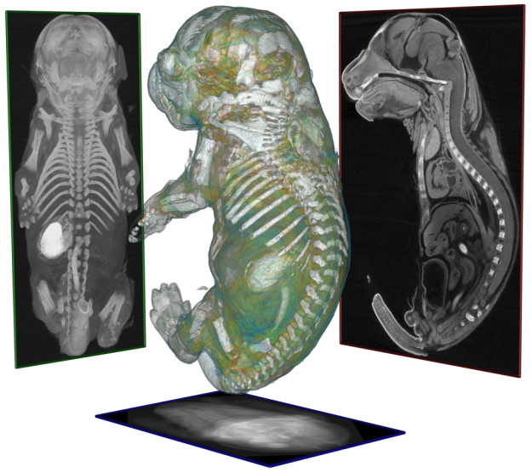
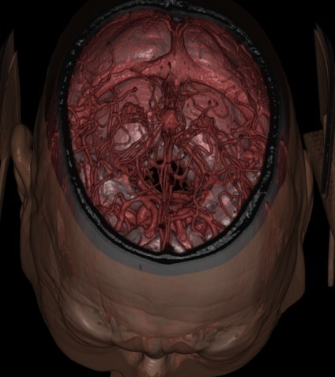
Imaging Solutions for Complex Problems
- Assessing gene function
- Understanding disease
- Measuring drug efficacy
- Ensuring drug safety

Slide 8
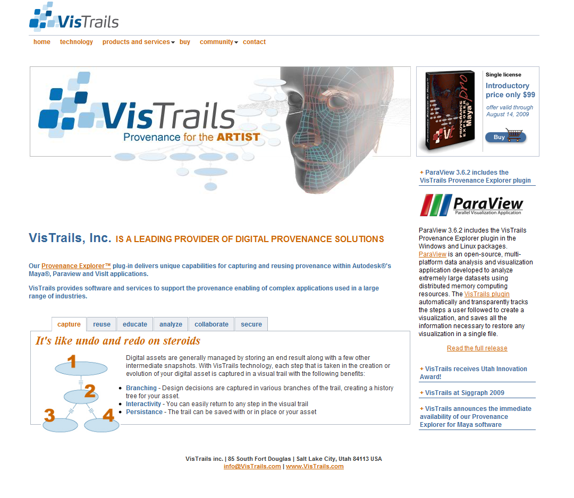
VisTrails Inc.
  Claudio Silva, CEO, Chairman, Tech. Adv. Board
Juliana Freire, CTO
Steve Callahan,
Manager, Software Engineering

Slide 9

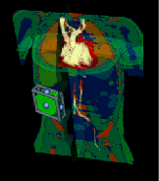
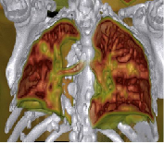
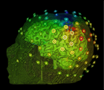





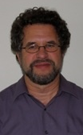






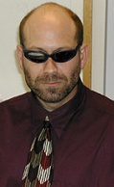



National Centers We Direct
NIH/NCRR Center for Integrative
Biomedical Computing
DOE/SciDAC Visualization and Analytics
Center for Enabling Technologies

Slide 10



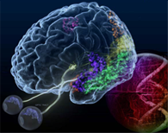



National Centers We are Affiliated With
DOE/SciDAC
Scientific Data Management
NIH NAMIC
STC for
Coastal Margins
DOE/SciDAC CCA
NIH CBC
IAMCS
Institute for Applied Mathematics
and Computational Science
CDC Decision-Support for Infectious Disease Epidemiology

Slide 11









External Collaboration
KAUST
Sandia
TAMU
UCSF
LLNL
UT Austin
UCLA
Sarang
Valerio
Kaiserslautern
TAMU
Chris
Chuck
MIT
NEU
Ross
Mike
Imperial College
London
Jeff
Martin
Cleveland
Clinic
Claudio
Tolga
U of A
Harvard
Rob
Guido
Pitt.
Iowa
Inria
Tom
Juliana
Northwestern
B & W
Hospital
UNC
U Wash.
CMOP
DataOne
ALPS
LSU
VACET
Kitware
LLNL
crowdLabs
NBCR
NITRC
OHSU
VisTrails.org

Slide 12

SCI Institute - Utah Collaborations
Architecture
School of Computing
Pharmaceutical Chemistry
Mechanical Engineering
Chemical Engineering
UCAIR
Mathematics
Moran Eye Center
TCO
CHPC
CVRTI
Neurology
Neurosurgery
ICSE
Bioinformatics
Cardiology
Genetics
Psychology
Nephology
Chemistry
Biology
Brain Institute
Nuclear Engineering
EGI
Bioengineering
PCMC Cardiology
Radiation Oncology
CTSA
Epidemiology
Radiology
Physiology

Slide 13
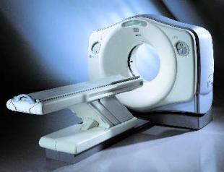
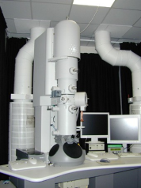
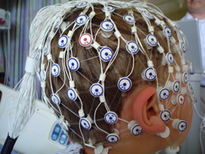
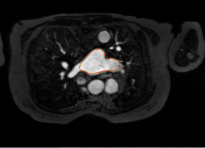
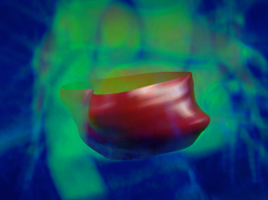

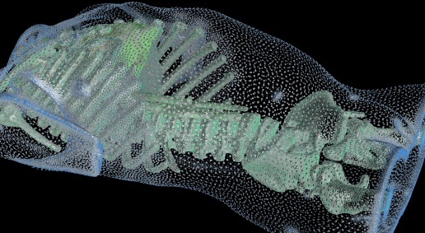
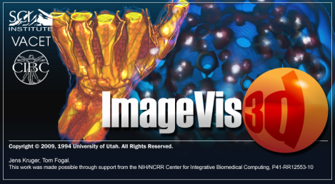
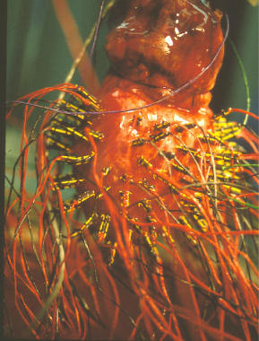
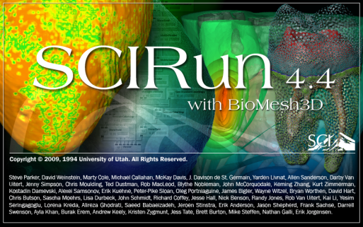
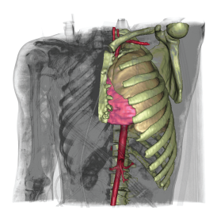
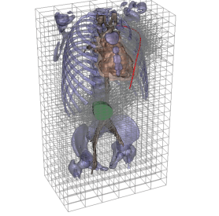

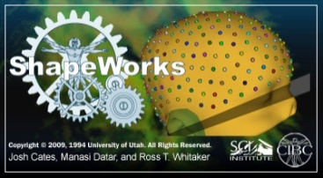
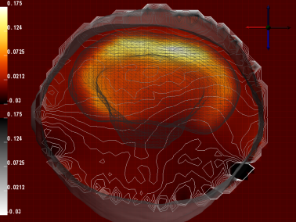
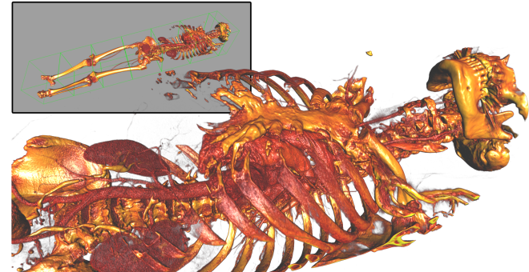
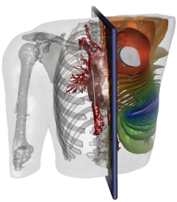
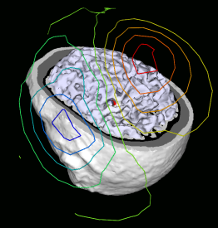
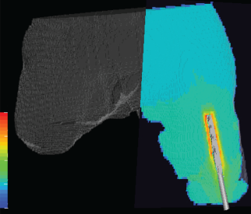
Biomedical Modeling, Simulation, and Visualization
Image Processing
Image & Data Acquisition
Integrated Software Tools
Lab/Clinic
Geometry Processing
Modeling, Simulation & Validation
Visualization
Notes:
The vision of the CIBC is to create new research, tools, and technologies that will enable new biomedical science breakthroughs and clinical applications.
We believe that one area where we can make a significant impact to biomedical research and clinical research is through the creation of new image-based modeling, simulation, and visualization research and software tools.
Shown here is our view of the image-based modeling, simulation and visualization pipeline where we taken data from biological and clinical image sources, perform image processing, create subject specific geometric models on which we perform functional simulation. We visualize the images, geometric models, and simulations results, and then use these research and software tools for important biomedical research and clinical applications.
We feel that such an image-based modeling, simulation, and visualization pipeline can help us to transition to one area of subject specific and personalized medicine applications.
Please be clear that we are not claiming to solve ALL such problems, but hopefully we can contribute to an important set of problems. I think a great example of the image-based pipeline with an important clinical application is with our DBP Partner John Treideman.

Slide 14
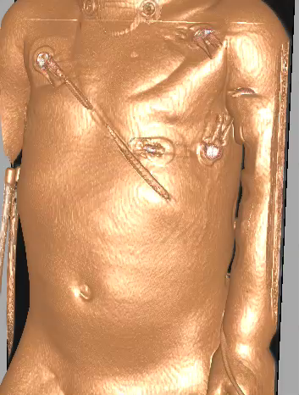
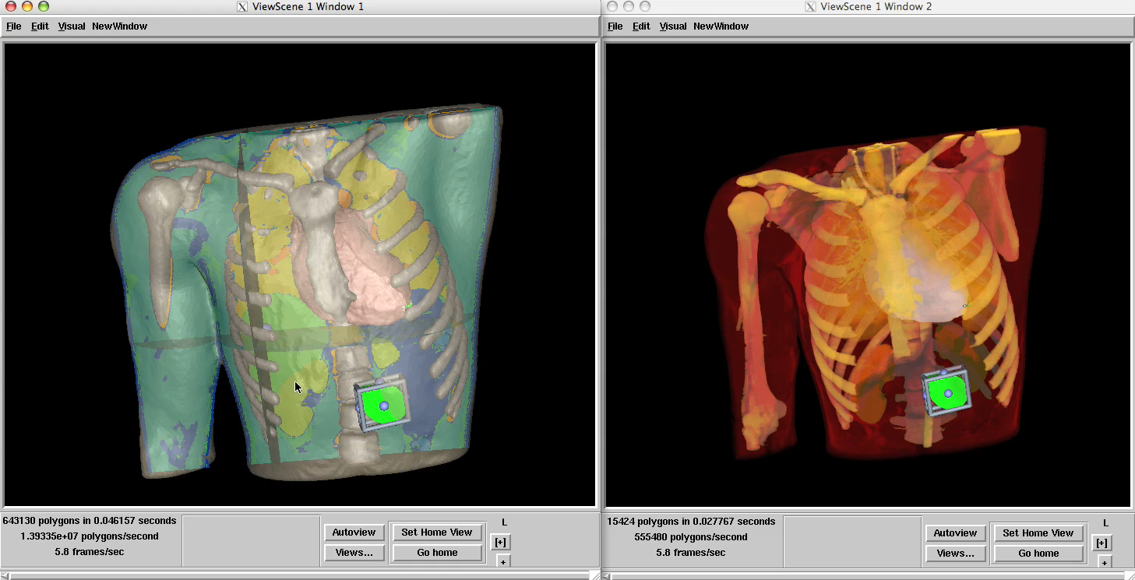
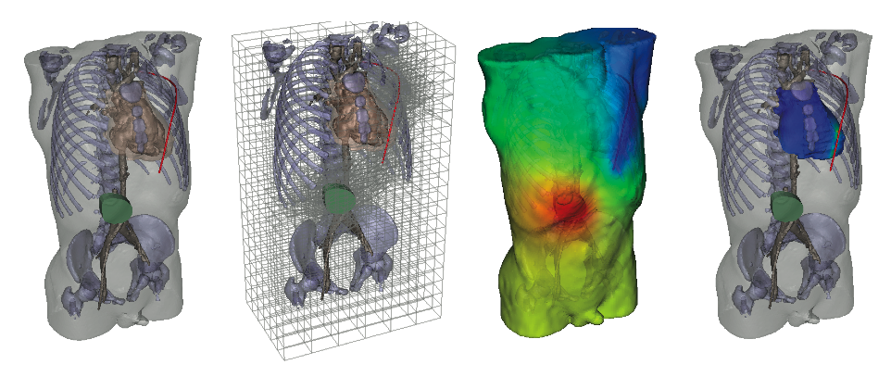
Personalized Medicine: Cardiac Defibrillation
Image-Based Modeling, Simulation, and Visualization with SCI software
Notes:
Dr. Treidman is a cardiologist who is working on an important clinical problem of implanting cardiac defibrillators into children with heart arrhythmias. It is a challenging problem because standard defibrillators are made for adults, not children and he has to place the leads and battery in novel places in children to be effective.
Shown in this slide is an example of the Center’s image-based pipeline of acquiring patient images and using the Center’s tools for segmentation, mesh generation, simulation, and visualization – and interactive design of the lead placement.
We think this is a great example of how the Center’s technologies can enable more subject specific biomedical research and clinical applications.

Slide 15
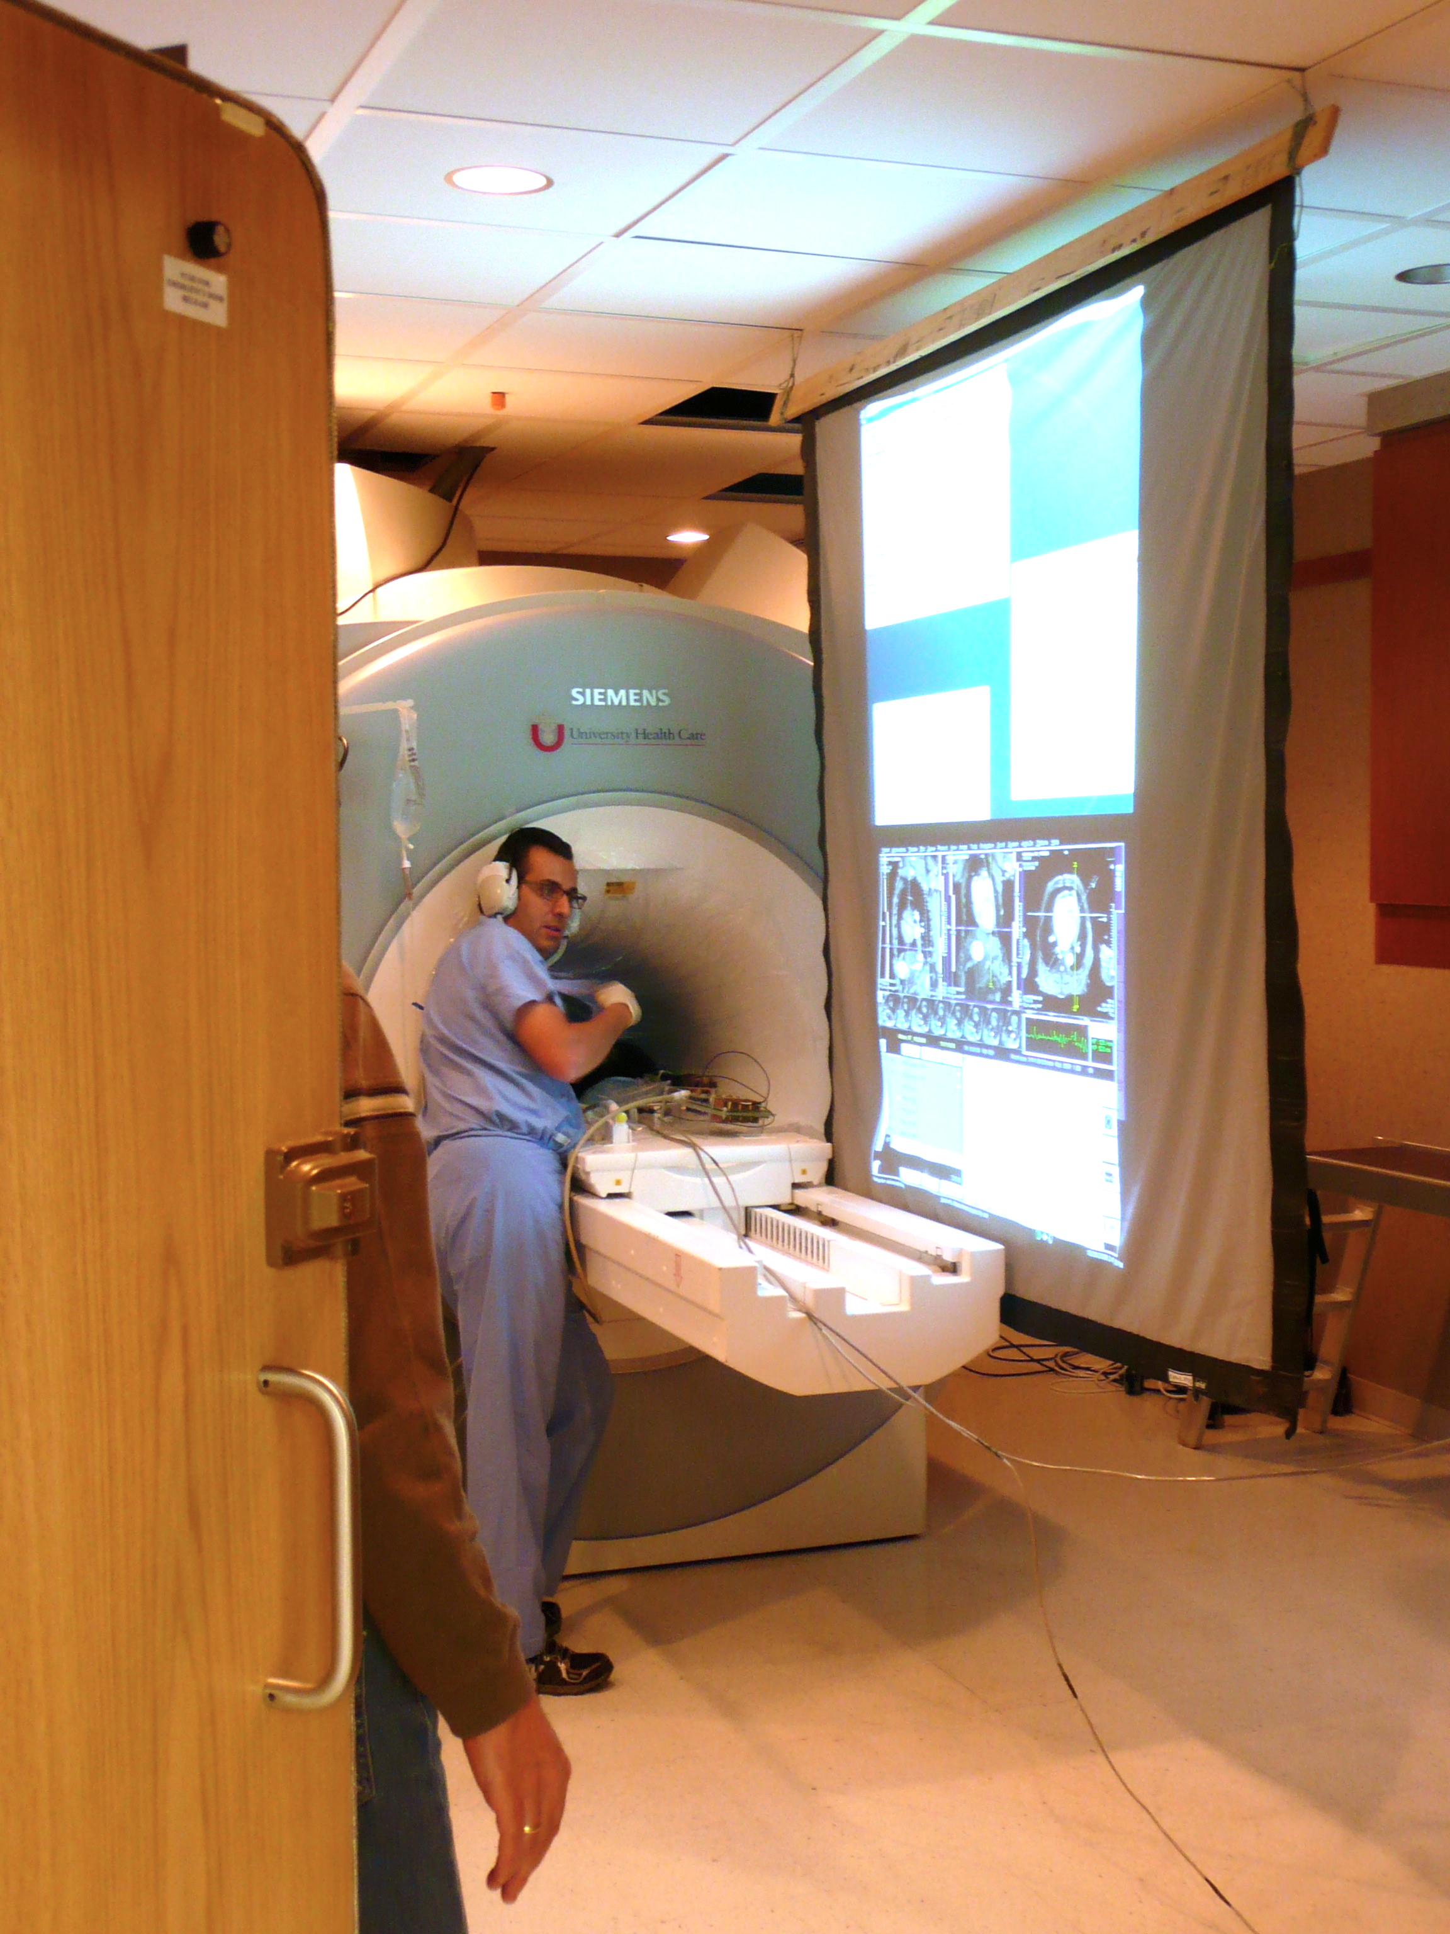
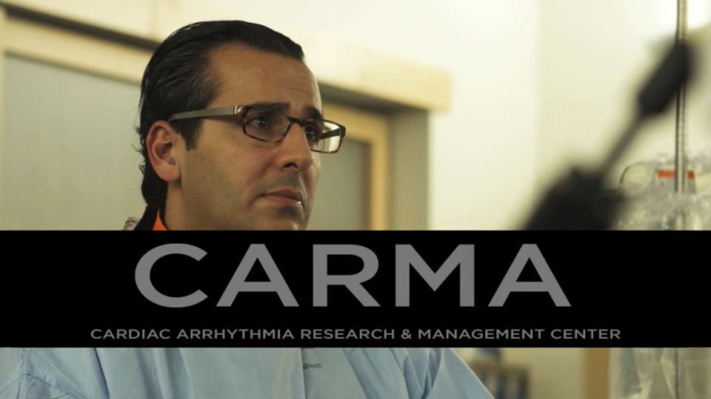
Atrial Fibrillation Oblation
Nassir Marrouche, M.D.
Director, Comprehensive
Arrhythmia Research and Management Center: CARMA
Notes:
Here is Dr. Nassir Mourrouche – title – performing an atrial fibrillation oblation using our Seg3D software within a new 3T MRI system.
You will hear from Dr. Mourrouche later during the DBP Partner presentations.

Slide 16
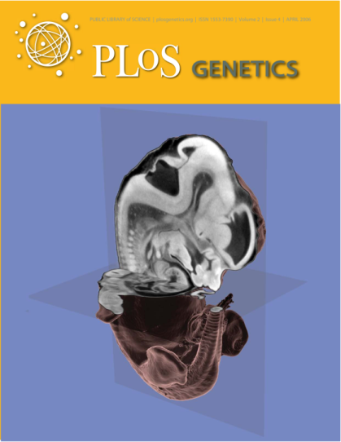
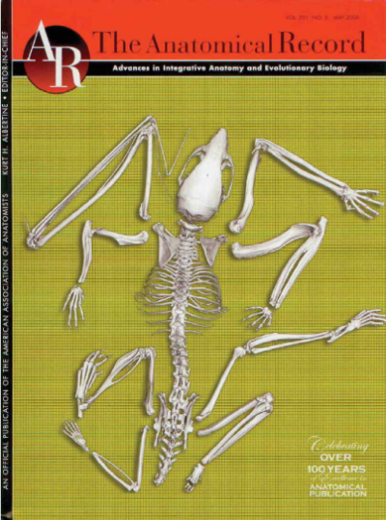
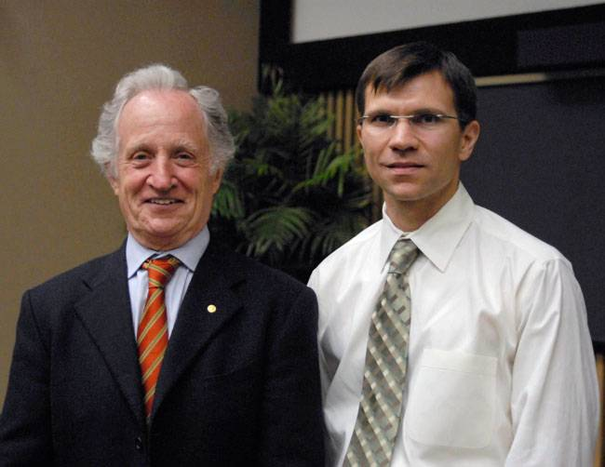
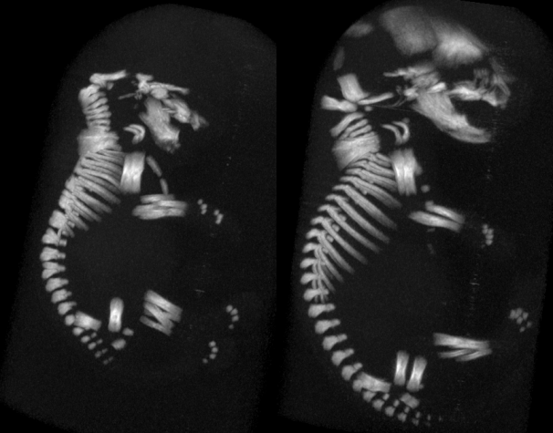
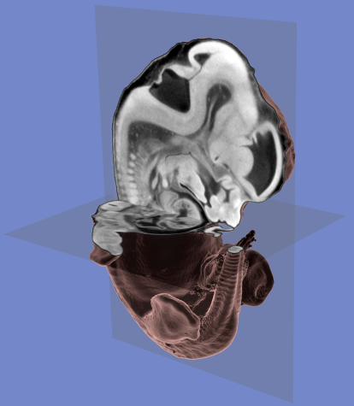
Image Based Phenotyping
Often, scientific breakthroughs stem from an enabling new technology
J.T. Johnson III, M.S. Hansen, I. Wu, L.J. Healy, C.R. Johnson, G.M. Jones, M.R. Capecchi, C. Keller.
“Virtual Histology of Transgenic Mouse Embryos for High-Throughput Phenotyping,”
In PLoS Genetics, Vol. 2, No. 1, pp. 471- 477. April, 2006.

Slide 17
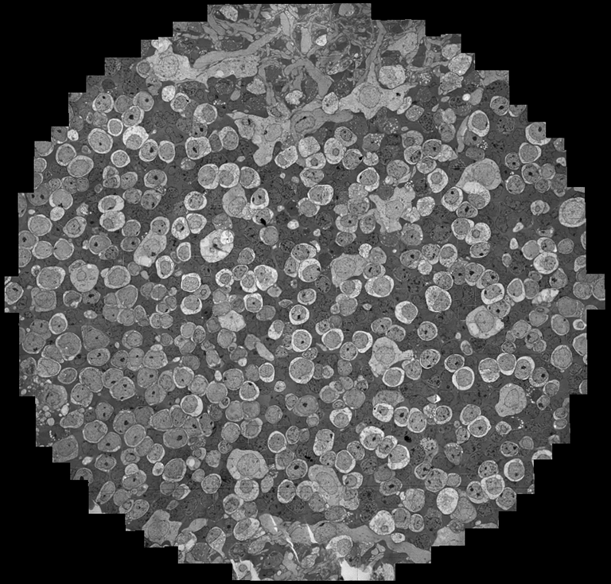
341 Sections
90nm thick sections
~32GB/Section
~1000 tiles/section
4096x4096 pixels/tile
2.18 nm/Pixel
16.5 TB after processing

Slide 18
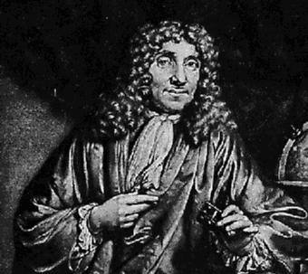
Antony van Leeuwenhoek (1632-1723)
. . . my work, which I've done for a long time, was not pursued in order to gain the praise I now enjoy, but chiefly from a craving after knowledge, which I notice resides in me more than in most other men. And therewithal, whenever I found out anything remarkable, I have thought it my duty to put down my discovery on paper, so that all ingenious people might be informed thereof.
Antony van Leeuwenhoek. Letter of June 12, 1716

Slide 19
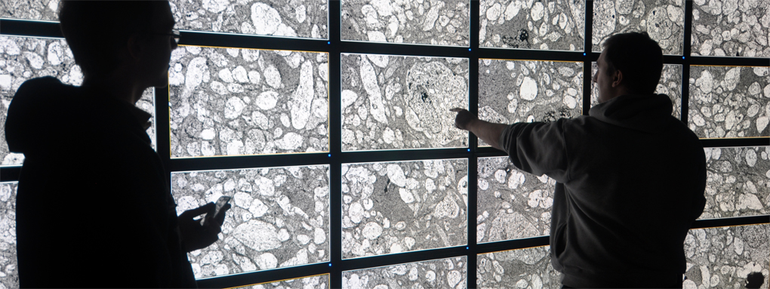

Slide 20

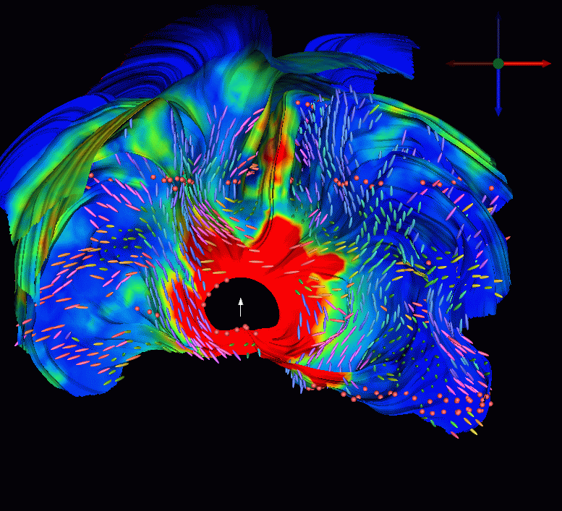
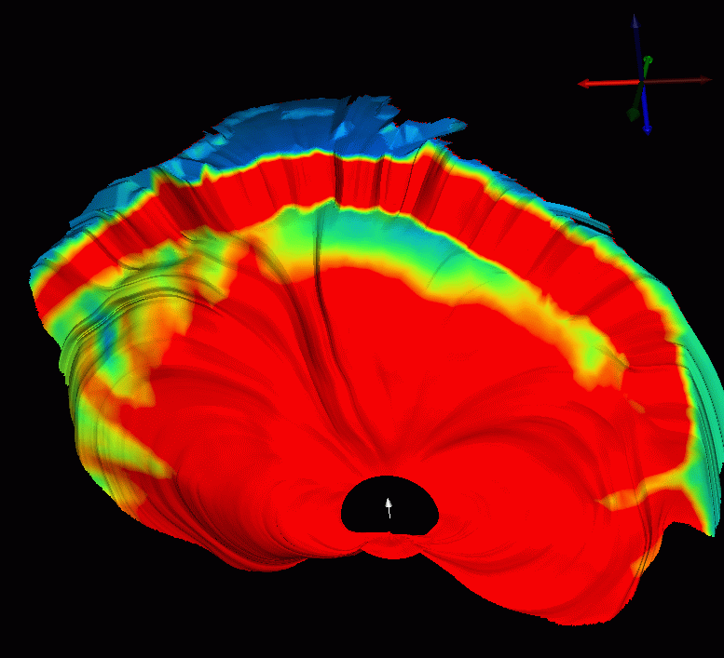
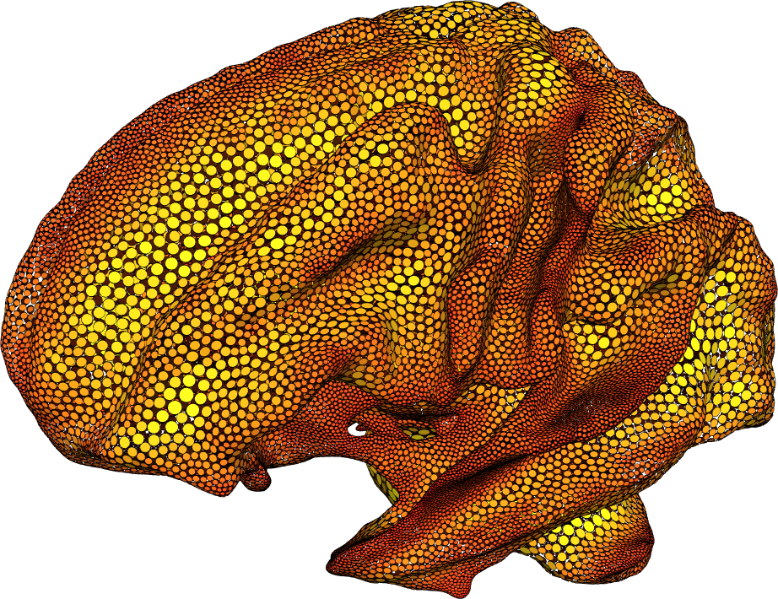
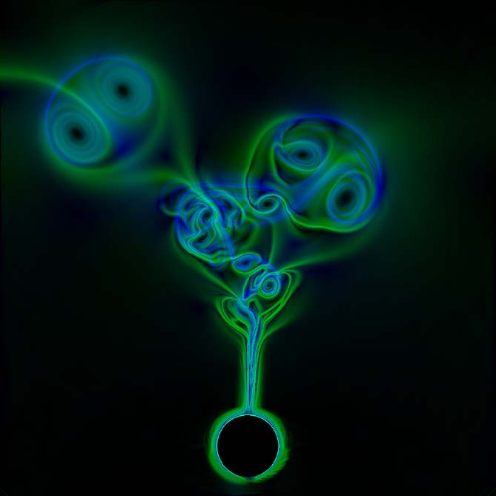









Visualization Everywhere
Scientific Computing and Imaging Institute, University of Utah

Slide 21













Visualization Everywhere
“VisTrail”
“Dataflow”
Scientific Computing and Imaging Institute, University of Utah

Slide 22




ImageVis3D - Mobile

Slide 23


ImageVis3D Mobile

Slide 24


Teaching

Slide 25

Scientific Computing and Visualization

Slide 26


Slide 27




Katharine Coles - Utah Poet Laureate

Slide 28

IEEE Visualization 2010 – Salt Lake City

Slide 29
More Information
www.sci.utah.edu
crj@sci.utah.edu

