Slide 1
Intel Visualization Center
Chris R. Johnson, Ph.D.
Scientific Computing and Imaging Institute
University of Utah July 2017

Slide 2
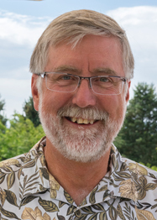
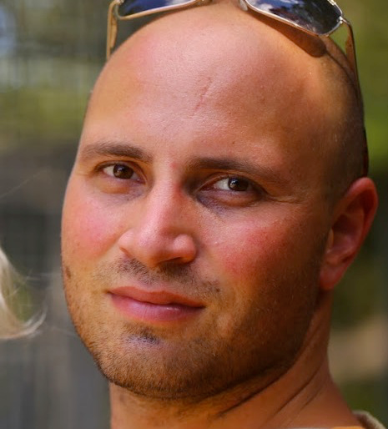
Utah Intel Visualization Center/Utah IPCC
University of Utah, Salt Lake City The “birthplace of computer graphics” — Evans and Sutherland, Catmull, Kajiya, Blinn, Phong, circa 1978
Scientific Computing and Imaging Institute: Ranked #1 in the World for Visualization according to csrankings.org
Intel centers at SCI: involving 5 faculty, 1 staff, ~3 postdocs, ~8 students
IPCC for “Applied Visualization, Computing and Analysis”: PIs: Aaron Knoll, Valerio Pascucci, Martin Berzins - Applying OSPRay to visualization and HPC production in practice (i.e., Uintah, VisIt) - Visualization analysis research: IO, topology, multifield/multidimensional (ViSUS) - Staging Intel resources for both the Vis Center and IPCC. - Students: Qi Wu, Will Usher
Intel Visualization Center PIs: Chris Johnson, Chuck Hansen, Ingo Wald (Intel) - Large-scale visualization and HPC technology on CPU/Phi hardware — especially OSPRay. - Students: Mengjiao Han, Laura Lediaev - New postdoc: Feng Wang (starting July 10, 2017)
Strong collaboration between two Intel efforts.

Slide 3
IPCC / IVC Students
Will Usher (Valerio Pascucci)
Pavol Klacansky (Valerio Pascucci)
Qi Wu (Chuck Hansen)
Jon Holmen (Martin Berzins)
Damodar Saharasbude (Martin Berzins)
Kui Wu (Cem Yuksel)
Laura Lediaev (Chris Johnson — Intel Vis Center) - Fall 2016
Mengjiao Han (Chris Johnson — Intel Vis Center) - Summer 2017

Slide 4
IPCC/IVC Students (interning at Intel)
Will Usher (Valerio Pascucci)
Pavol Klacansky (Valerio Pascucci)
Qi Wu (Chuck Hansen)
Jon Holmen (Martin Berzins)
Damodar Saharasbude (Martin Berzins)
Kui Wu (Cem Yuksel)
Laura Lediaev (Chris Johnson — Intel Vis Center)
Mengjiao Han (Chris Johnson — Intel Vis Center)

Slide 5
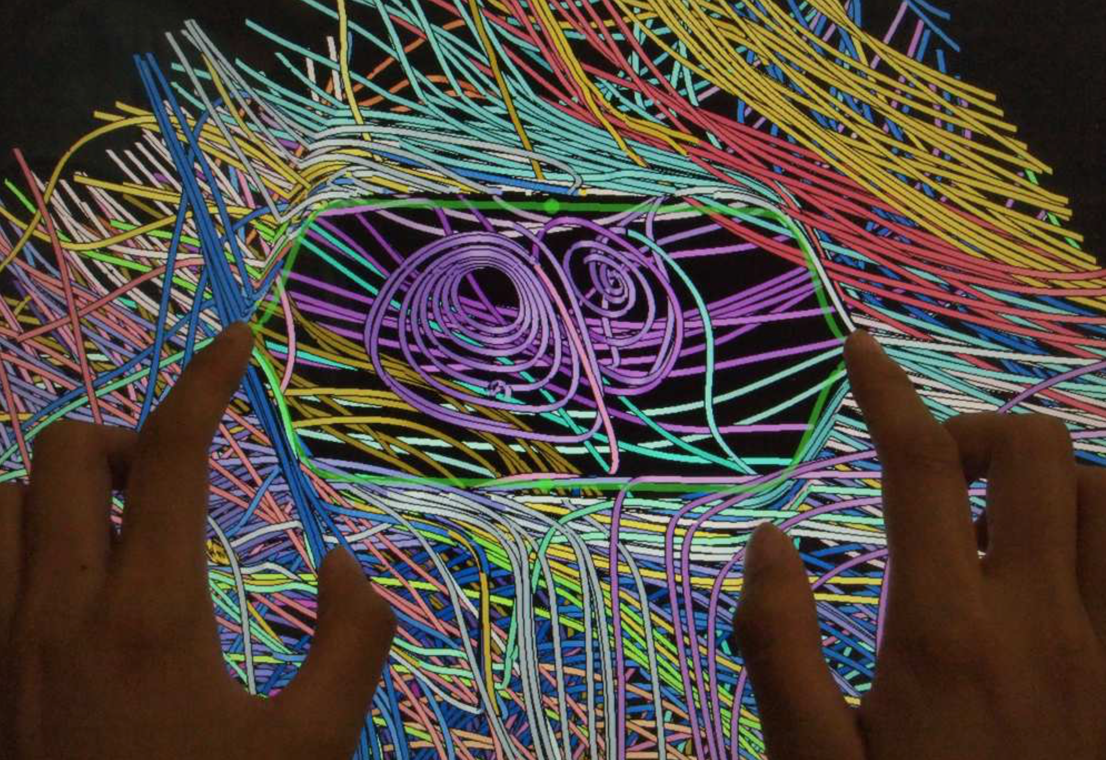
Visualization Center Highlights
Session on High Performance Visualization at the International Supercomputing Conference (ISC) 2017 in Frankfurt, Organized and Chaired by Chris Johnson
In Situ Processing: Instantiations, Opportunities & Challenges, Hank Childs, University of Oregon
Big Data Visual Analysis, Chris Johnson, University of Utah
Software Defined Visualization: Bringing the Vis to Where the Data Is, Ingo Wald (Intel)

Slide 6
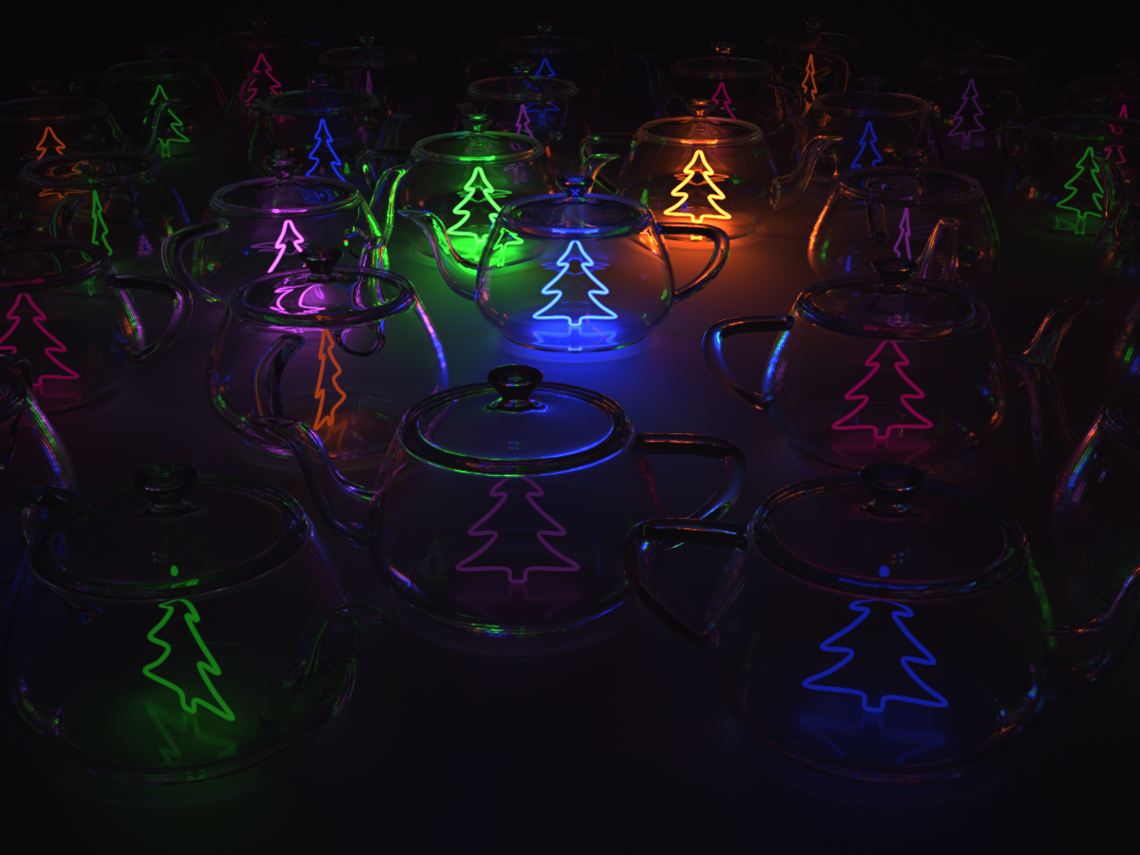
Visualization Center Highlights
Laura Lediaev wins the Utah Rendering Competition for the 3rd straight year.
Laura's entry, titled Christmas Teapots, was the overall winner and receiver of the audience choice award. The rendering is based on creating time-varying composites of light layers in order to simulate the effect of twinkling Christmas lights and flickering candles. The scene has 30 lights, one inside each teapot. Light layers are created during rendering by saving the contribution of each light into its own image. This produced 30 images/layers. Each light produced 4,000 samples per pixel. That adds up to 120,000 samples per pixel after compositing. Laura allowed up to 10 diffuse light bounces and 200 specular bounces.
See the video here: http://www.omnigraphica.com/classes/cs6620/contest2016.html

Slide 7
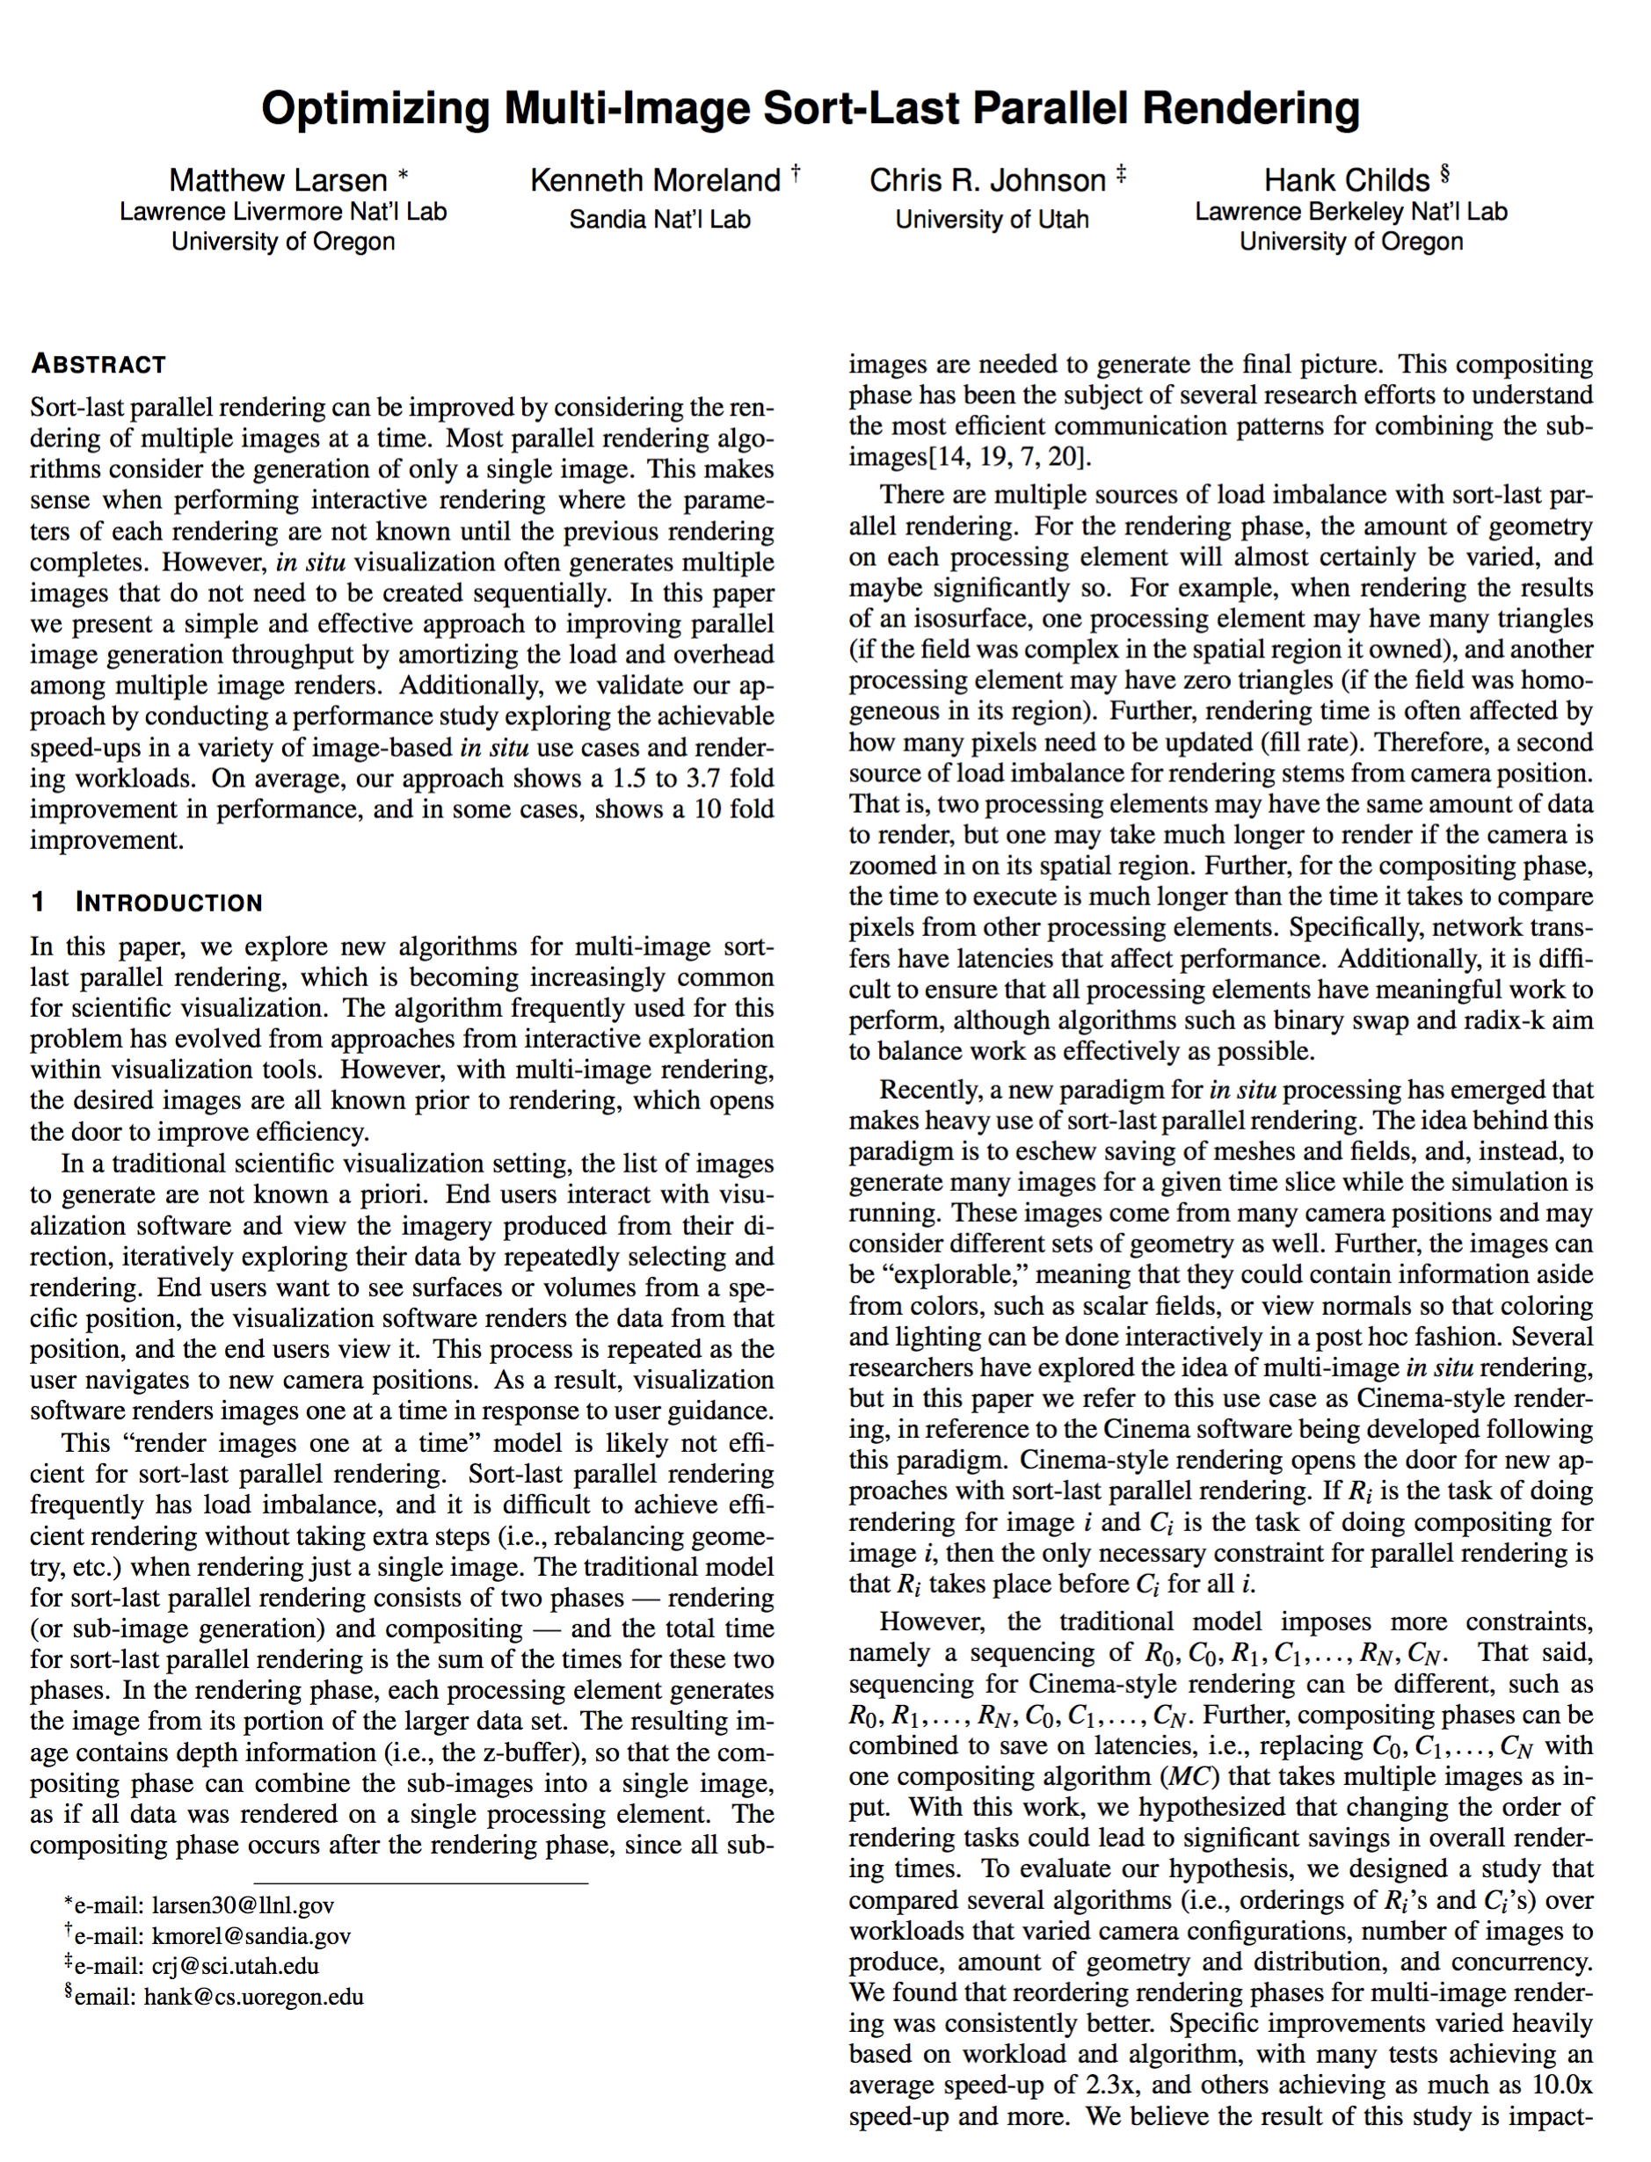
Optimizing Multi-Image Sort-Last Parallel Rendering
Sort-last parallel rendering can be improved by considering the rendering of multiple images at a time.
Most parallel rendering algorithm consider the generation of only a single image.
Present a simple and effective approach to improving parallel image generation throughput by amortizing the load and overhead among multiple image renderers.
On average, our approach shows a 1.5 to 3.7 fold improvement in performance and in some cases, shows a 10 fold improvement.
M. Larsen, K. Moreland, C.R. Johnson, H. Childs. “Optimizing Multi-Image Sort-Last Parallel Rendering,” In Symposium on Large Data Analysis and Visualization, IEEE, 2016.

