Slide 1
Intel PCC: Modernizing Scientific Visualization and Computation on Many-core Architectures
Valerio Pascucci,
Endowed Chair Professor of Computer Science
Director, Center for Extreme Data Management Analysis and Visualization
Faculty, Scientific Computing and Imaging Institute

Slide 2
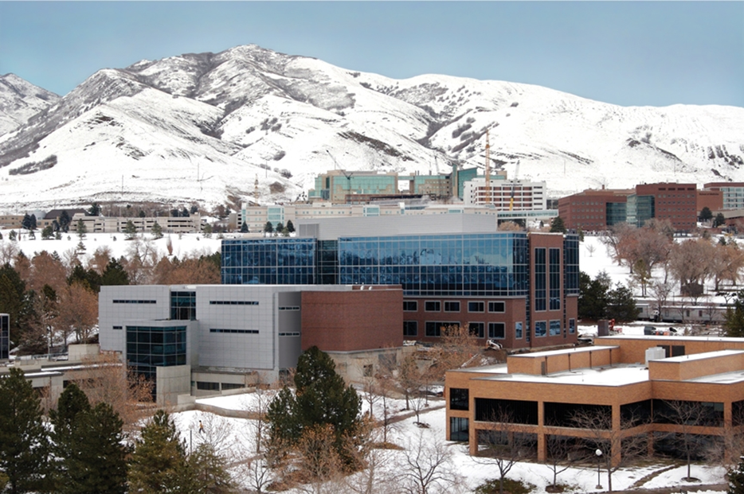
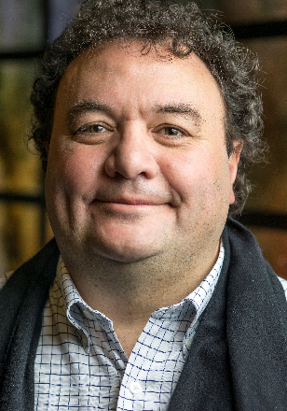
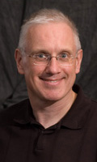

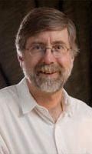
Intel PCC: Modernizing Scientific Visualization with In Place and In Situ Ray Tracing on Many-core Architectures
Scientific Computing and Imaging Institute: World leader in scientific visualization
Intel centers at SCI: involving 4 faculty, 4 postdocs, 7 students, 2 scientists
IPCC for “Modernizing Scientific Visualization with In Place and In Situ Ray Tracing on Many-core Architectures”
  PIs: Valerio Pascucci, Martin Berzins
  Applying OSPRay to visualization and HPC production in practice (i.e., Uintah, VisIt)
  Visualization analysis research: IO, topology, multifield/multidimensional (ViSUS)
  Staging Intel resources for both the Vis Center and IPCC.
  Preparing for exascale on DOE A21 via early science program
  Optimizing next-gen Navy weather codes for Intel KNL and beyond
Intel Vis Center at Utah
  PIs: Chris Johnson, Ingo Wald (INTEL)
  Large-scale vis and HPC technology on CPU/Phi hardware (OSPRay)
  Students: Mengjiao Han, Laura Lediaev
  New postdoc: Feng Wang
Strong collaboration between the two Intel efforts, weekly group meeting together

Slide 3
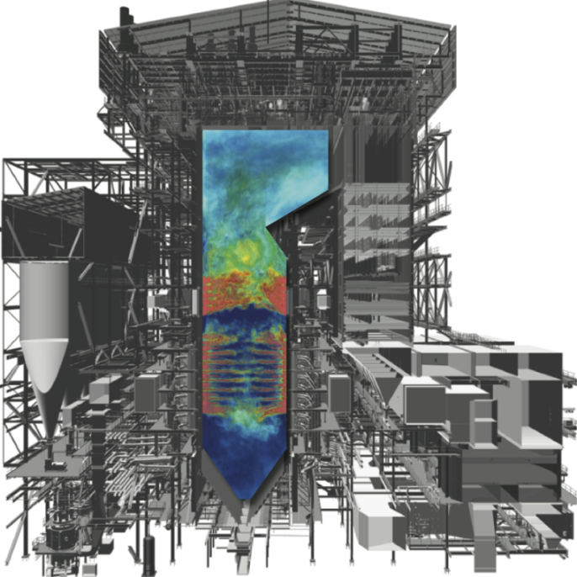
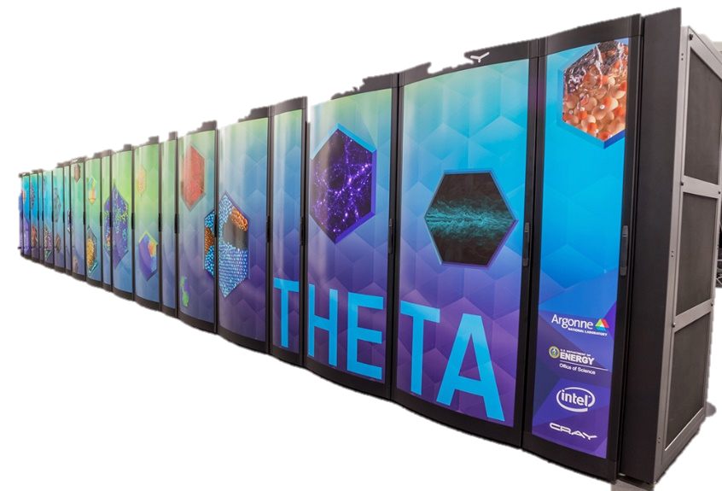
Synergistic Projects
CEDMAV: UofU Center for Extreme Data Management Analysis and Visualization (director Valerio Pascucci): vis, IO, HPC, and analysis
ViSUS: disk-out-of-core streaming visualization
Topological analysis (i.e., massively thread-parallel Morse-Smale complexes on KNL)
PIDX IO infrastructure (Sidharth Kumar, Steve Petruzza)
Uintah: DOE PSAAP II efficient coal boiler simulation (Phil Smith, Utah ICSE) and DOE INCITE computational awards (Martin Berzins)
350M hours for 2016 — the largest single open-science computational
effort in the nation -extended to 430M hours focus now on DOE A21 exascale via early science program award.
Students: John Holmen
NEPTUNE: OpenMP Optimization of Navy NWP codes (Martin Berzins)
Readiness for exascale via OpenMP and algorithmic improvements for KNL and beyond
Students: T.A.J. Ouermi (“TAJO”)
ALCF-Intel-Vis Collaboration with Argonne National Laboratory:
Mike Papka (director of ALCF), Joe Insley (ALCF vis lead), Silvio Rizzi (ALCF vis staff)

Slide 4
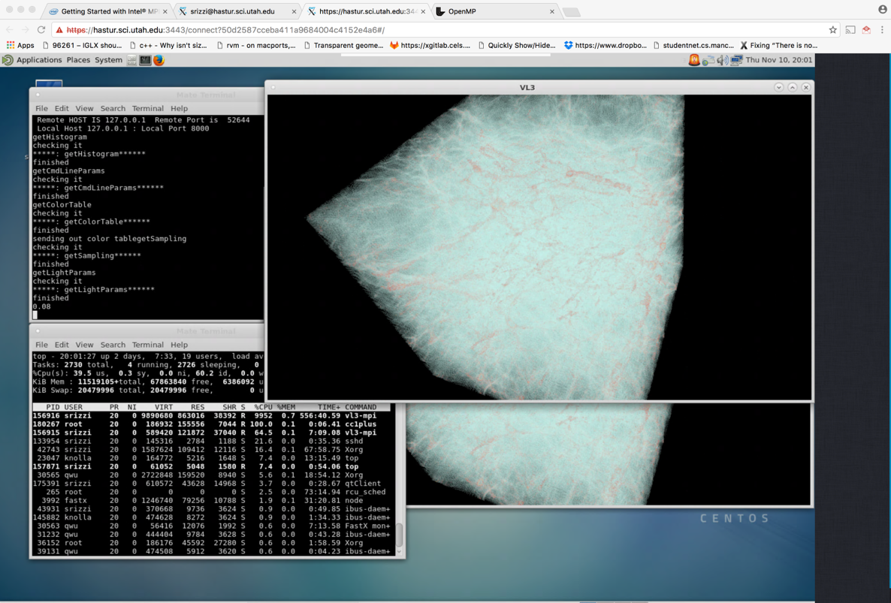
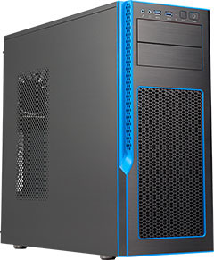
IPCC Hardware Resources
2 Dual Socket Xeon E5: saturn5, titan4
Quad-socket Brickland-EX platform: fsm
4x Xeon E7 CPUs – 72 cores
3TB RAM (thanks Micron!)
2 KNL DAP workstations: cthulhu, hastur
All resources with FastX for remote visualization
Four 4K 60” displays for high resolution vis, demos
Open to SCI, ANL, other collaborators
Thanks to Mark West, Darrell Black, Intel IDD
Holiday wish list for 2018: Quad-node KNL DAP,
Skylake Xeon workstation

Slide 5
Broader Impact and Collaborations
HPC centers :
ANL, LLNL, KAUST, TACC, RIKEN, …
Industry/Labs
Total and another big oil and gas company, General Electric (via PSAAP)
Naval Research Laboratory climate codes
Funding agencies
NSF, DoE, NIH, NNSA (Brain initiative, Exascale computing,
Data Sharing and Collaboration, Cyberinfrastructure, Large Scale Imaging, Nuclear Fuel Cycle, ...)
Target machines:
Theta (Knights Landing), Stapede 2 (Knights Landing), Shaheen 2 (Haswell), Quartz/Surface (Xeon E5), …
in addition to K, Mira, Surface, Vulcan, …

Slide 6
IPCC Collaborating Personnel
Will Usher (Valerio Pascucci)
Jon Holmen (Martin Berzins)
T.A.J. Ouermi (Martin Berzins)
Pavol Klacansky (Valerio Pascucci)
Qi Wu (Chuck Hansen)
Attila Gyulassy (Valerio Pascucci)
Peer-Timo Bremer (Valerio Pascucci)
Steve Petruzza (Valerio Pascucci)
Sidharth Kumar (Valerio Pascucci)
Duong Hoang (Valerio Pascucci)

Slide 7
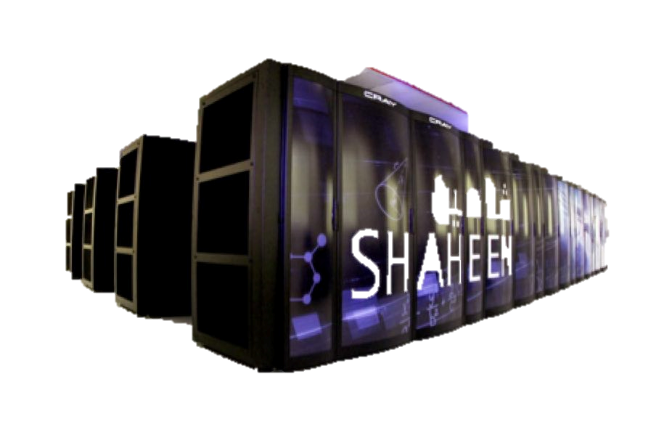
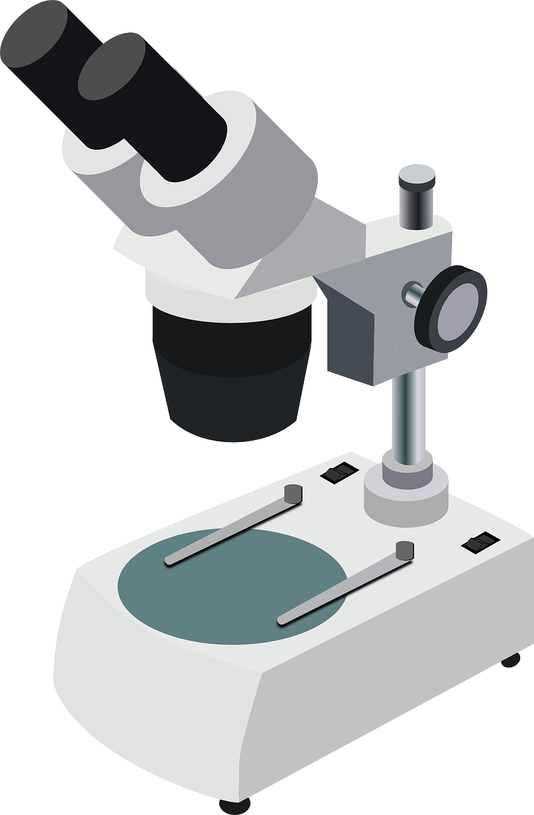
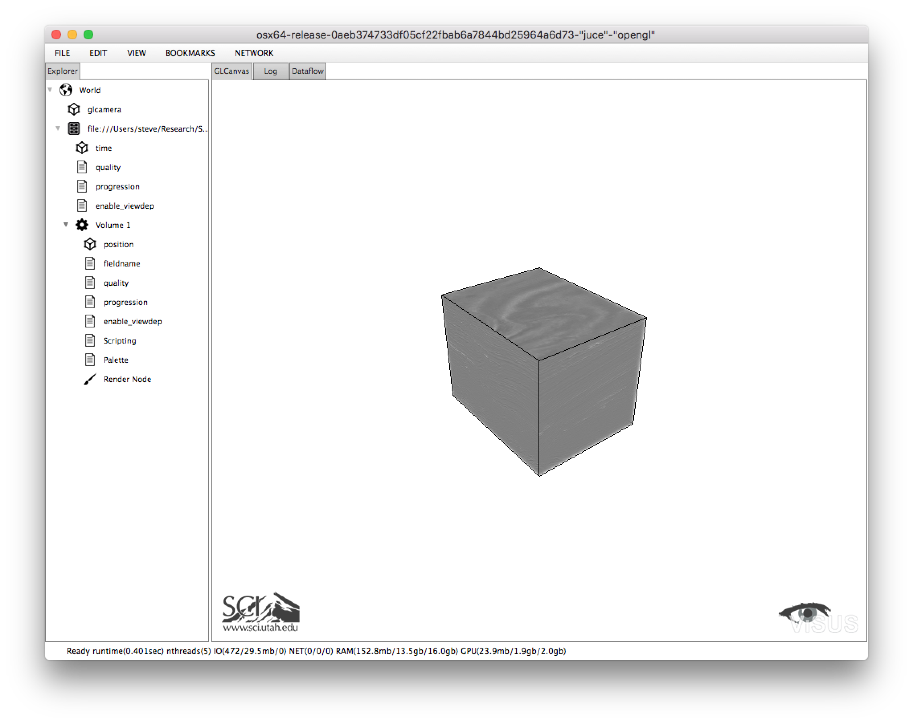
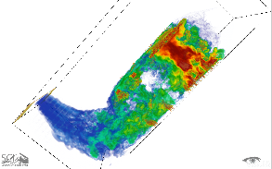

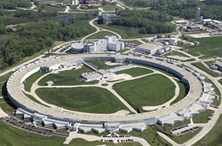
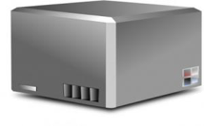
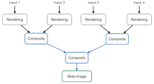
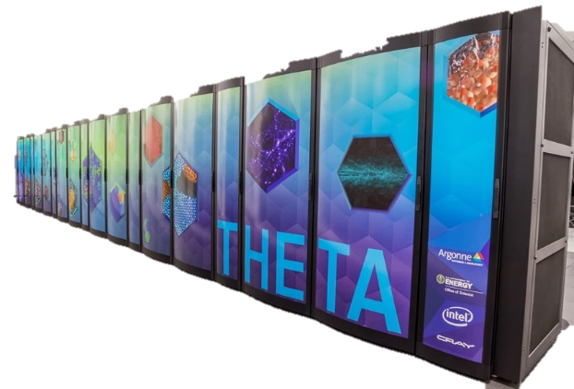

Overall IPCC Target Demostration
Use
Data Streaming
Query
User/Analysis
developer
ViSUS / VisIt / Power wall
Visualization
Scientific data production:
simulation (Uintah, ...), imaging (light srouces, microscopes, ...)
ViSUS Server
Implement
Interactive
Analysis
Task Graph
Update
Generate data
Large scale
Analysis
Access
Transfer /Conversion to IDX
Access
Save data
Data repository
local / shared file system
HPC System

Slide 8
Projects
OSPRay – ViSUS Integration (Will Usher)
OSPRay – VisIT Integration for interactive visualization(Qi Wu)
In Situ Vis. of Molecular Simulations (Will Usher, Silvio Rizzi & Joe Insley @ ANL)
Many-core Computing (T.A.J. Ouermi)
Prepare for Exascle (Jon Holmen)
MPI-Distributed Device and API for OSPRay (Will Usher, Jeff Amstutz @ Intel)
Babelflow (Steve Petruzza)
Parallel computation of Morse-Smale complexes (Attila Gyulassy, Timo Bremer)
High-performance Parallel IO (Sidharth Kumar)
Ray Tracing for VR (Will Usher, Pavol Klacansky)

Slide 9
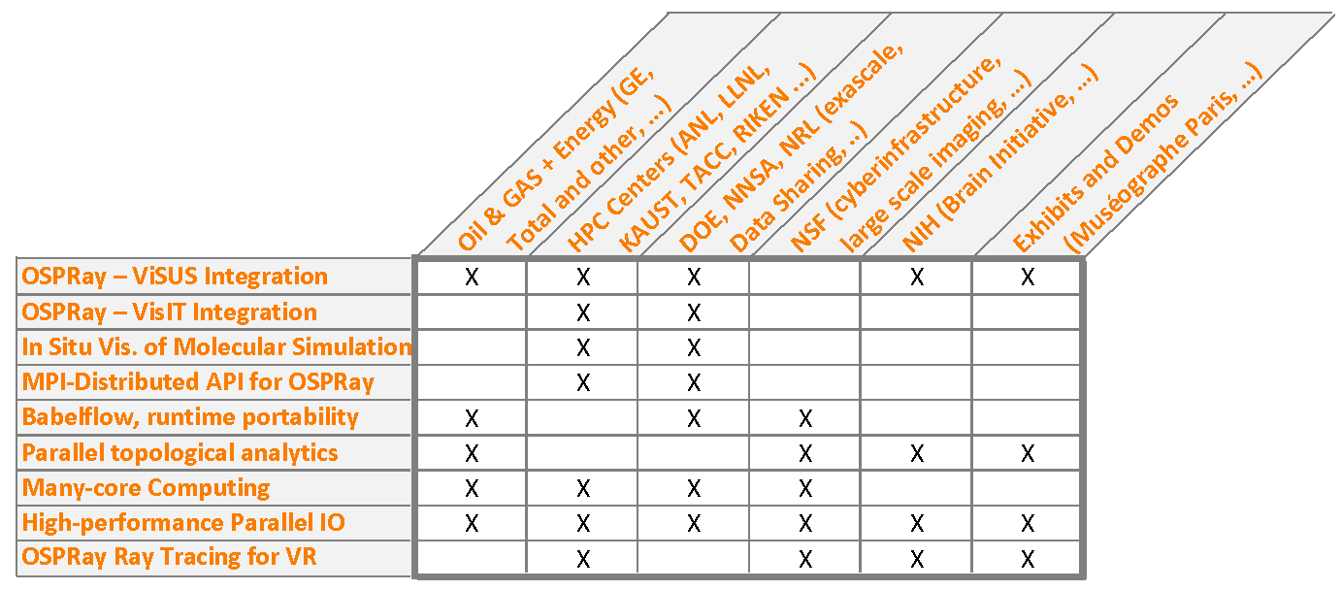
Projects Impact

Slide 10
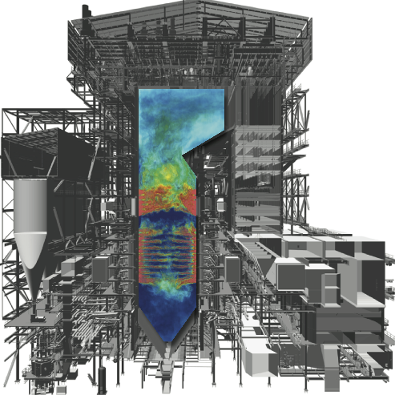
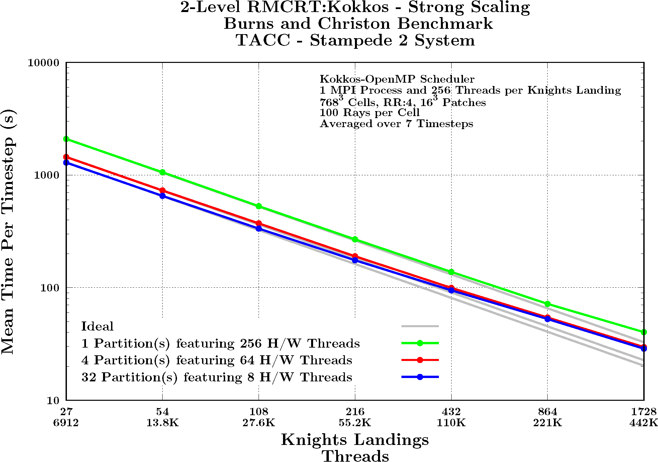
Preparing for Exascale Projects (i)
A21 Exascale Early Science Program – large scale combustion problem –development of runtime systems and raytracing combustion kernel on Stampede 2 and Theta. Collaboration with GE through DOE PSAAP Center at Utah and ANL + TACC. Scalability to 1728 KNLs on key raytracing radiation kernel
Performance optimization of Uintah code using
Kokkos library to access OpenMP in a portable
way for large scale runtime codes to move
beyond present architectures in a performance
portable manner to A21 and other exascale
architectures.
b

Slide 11
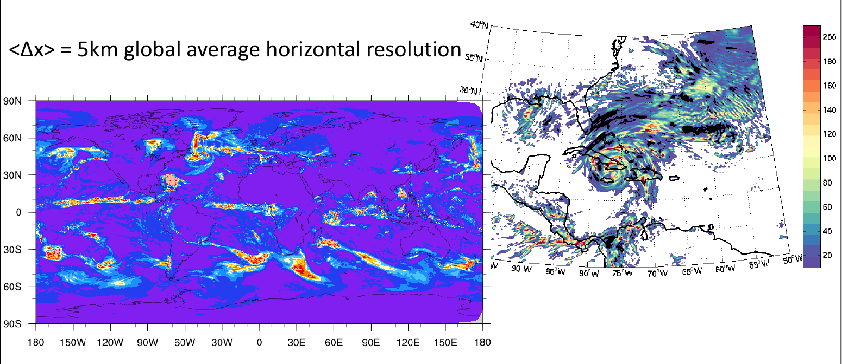
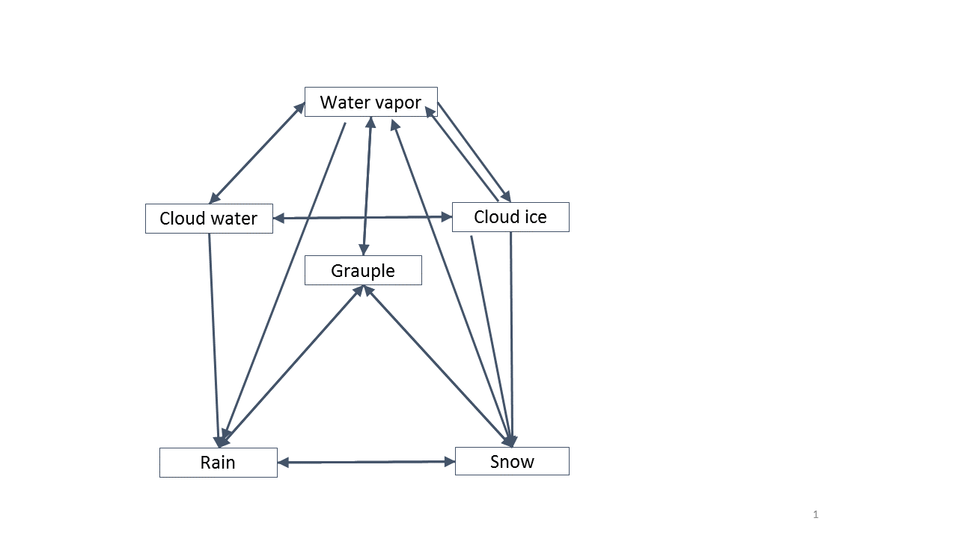
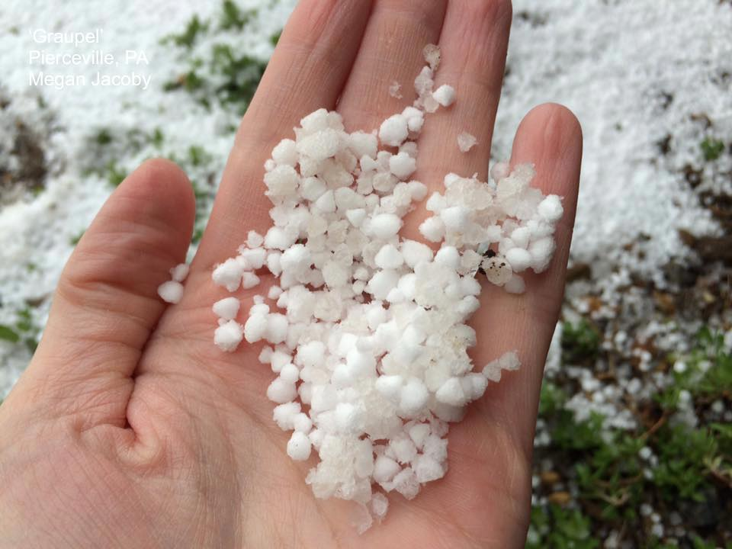
Preparing for Exascale Projects (ii)
Optimized Neptune code and weather physics. Collaboration with Naval Research Lab to get Neptune running quickly on KNL . Use Structure of Arrays approach
Low-level” OpenMP with OMP DO SIMD achieves ~50x speedup over the 25 parallelized loops of WSM6. Restructure non-trivial logic with nested conditionals, subroutine calls, and unaligned memory access to enable performance.
“High-level” and “low-level” -Restructure of non-trivial loops SOA at top level call in WSM6 and SIMD at the lower level This approach led to 70x on WSM6 physics
Best paper at CANDAR 2017 conference in Japan
Weather physics modules giving complex code
structure – difficult for performance
Grauple

Slide 12
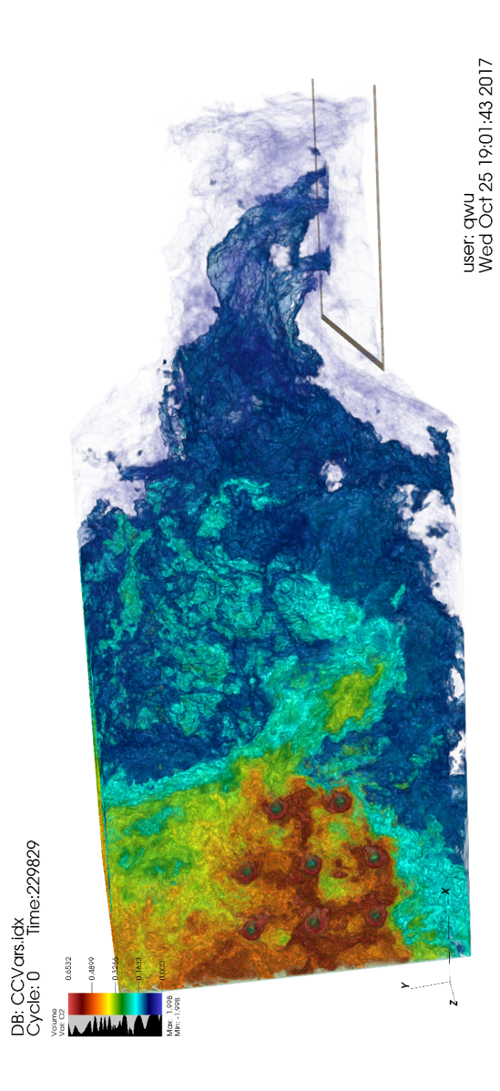
OSPRay – VisIT Integration
DOE user base, National Laboratories
VisIT and PIDX: used in production for Uintah coal boiler efficiency computations, 350M hour 2016 DOE INCITE Award
(PI: Martin Berzins)
Interactive vis. & offline movie rendering not possible with VisIT on Cooley or Theta
OSPRay integration yields 10-550x performance improvement enabling interactive production vis!
(Q. Wu, A. Knoll, W. Usher, S. Petruzza, V. Pascucci, C. Hansen)

Slide 13
OSPRay – VisIT Integration: Scaling on Theta
Good strong scaling on Theta
Compared to VisIT built-in raycaster:
50x speed-up at 8 nodes
550x speed-up at 64 nodes!
VisIT built-in raycaster crashes at 128+ nodes, OSPRay integration continues scaling

Slide 14
OSPRay – VisIT Integration: Scaling on Stampede 2
Good strong scaling on Stampede 2
Compared to VisIT built-in raycaster:
30x speed-up at 2 nodes
427x speed-up at 128 nodes!
VisIT built-in raycaster crashes at 256+ nodes, OSPRay integration continues scaling

Slide 15
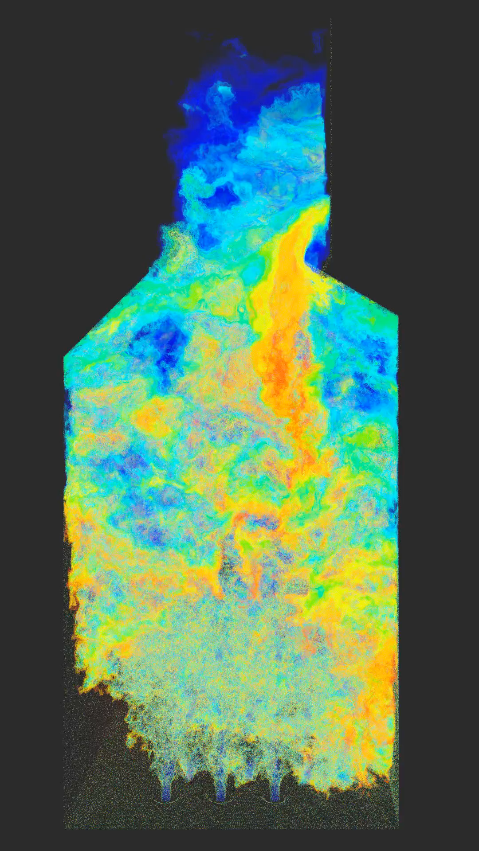
Lightweight Movie Renderer with ViSUS PIDX
High quality rendering for simulation users (uintah) and presentations (Paris Fire Museum)
Leverage PIDX and OSPRay to provide a lightweight movie rendering utility for Uintah
Also provides interactive
rendering when using
progressive refinement
(30-45FPS on 8 KNL nodes
@ Theta)
(W. Usher, S. Kumar)

Slide 16
OSPRay MPI-Distributed Device
Argonne National Laboratory simulations
Enable MPI-parallel applications to use OSPRay for rendering
Allow for easier integration into parallel applications like VisIT or in situ use cases in simulations
Hands-on tutorial presented at HPC DevCon17 by Will Usher, Jeff Amstutz, Silvio Rizzi, Jim Jeffers and Valerio Pascucci
(Will Usher, Jeff Amstutz @ Intel)
Application _
Rank _
OSPRay
Application _
Rank _
OSPRay
Will Usher, Jefferson Amstutz, Silvio Rizzi, Jim Jeffers and Valerio Pascucci. Using OSPRay with Data-Distributed Applications. Intel HPC DevCon, 2017.

Slide 17
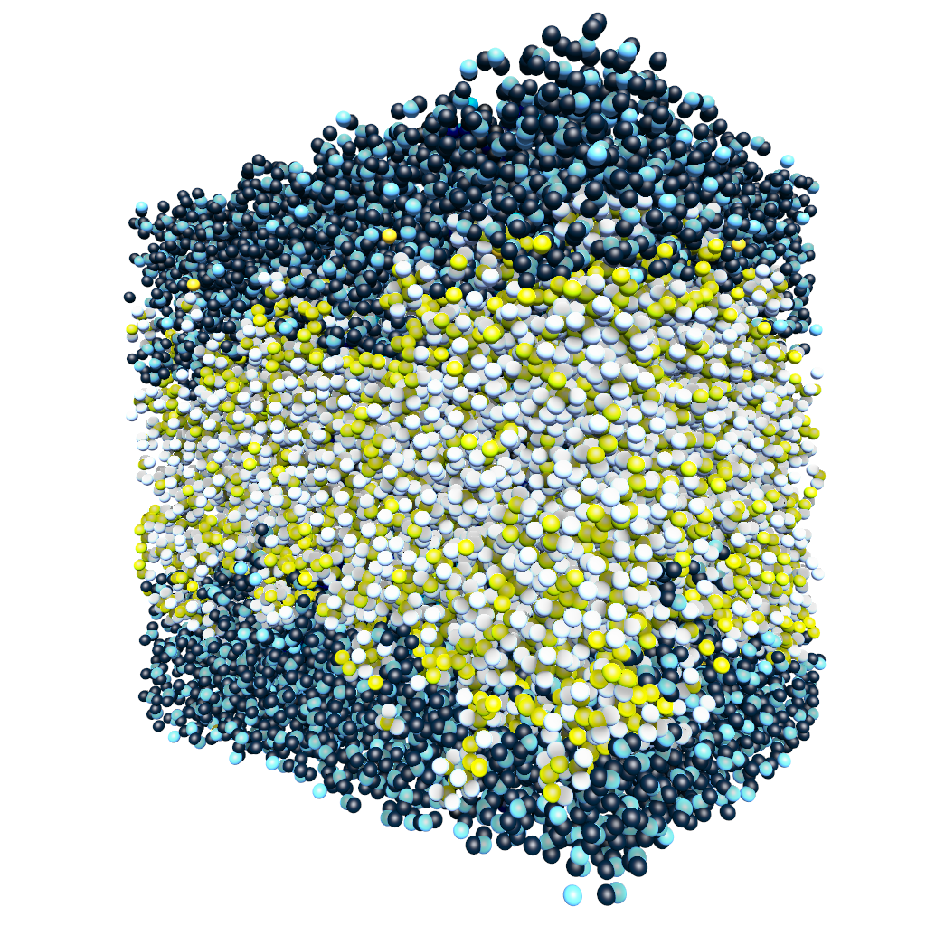

In Situ Visualization of Molecular Dynamics Simulations
SENSEI: LBL, ANL, Georgia Tech, VisIt, Kitware collaboration to enable portable in situ analysis
Use SENSEI in situ adaptor framework to expose LAMMPS as a “data server”
Interactive remote client connects over MPI using libIS communication library
(Will Usher, Silvio Rizzi & Joe Insley @ ANL)
Simulation
Analysis
Data Adaptor
Analysis Adaptor
Will Usher, Jefferson Amstutz, Joseph Insley, Aaron Knoll, Michael Papka, Valerio Pascucci, Silvio Rizzi and Venkatram Vishwanath. Flexible In Situ Visualization of LAMMPS Simulations. ISAV Lightning Talks, 2017.

Slide 18
libIS Enables Flexible In Situ Coupling
Indirect access: interactive remote client connects and requests data
Direct access: simulation and rendering client run in same process
Simulation
Client
Simulation
Simulation
Client
Client
Simulation
Simulation
Client
Client
Will Usher, Jefferson Amstutz, Joseph Insley, Aaron Knoll, Michael Papka, Valerio Pascucci, Silvio Rizzi and Venkatram Vishwanath. Flexible In Situ Visualization of LAMMPS Simulations. ISAV Lightning Talks, 2017.

Slide 19
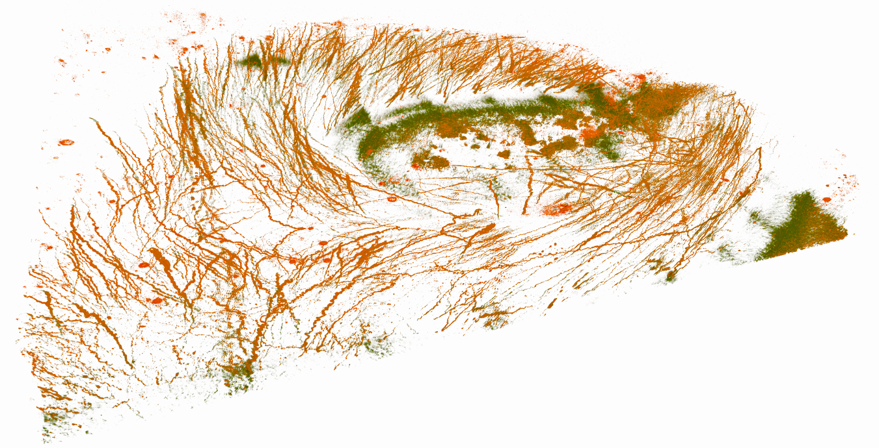
Integration of OSPRay into ViSUS
Tools for Oil and Gas industry and Brain Initiative
ViSUS + IDX format: state-of-the-art streaming and visualization for massive datasets
Potential for new streaming and optimized volume type in OSPRay to leverage IDX, provide high quality rendering for ViSUS users
(Will Usher)
600GB microscopy scan of Macaque monkey visual cortex from Brain Initiative project with the Moran Eye Center, rendered interactively with OSPRay on FSM
Image Courtesy: Aniketh Venkat, Frederick Federer, Cameron Christensen, Attila Gyulassy, Will Usher, Alessandra Angelucci and Valerio Pascucci, "An Online System for Continuous Image Acquisition of Long-range Circuits in Cleared Primate Cortex", 5155.531, Washington, D. C. Society for Neuroscience 2017 Online.

Slide 20
BabelFlow: An Embedded Domain Specific Language for Parallel Analysis and Visualization
DoE Exascale initiative: easy adoption of diverse runtime systems
Decouple algorithm definition from implementation
Simple Dataflow graph represents the communication patterns
Implicitly asynchronous
Runtime agnostic
(Steve Petruzza, Peer-Timo Bremer)

Slide 21
Experimenting different algorithms on multiple runtimes
More use cases:
Visualization
  Rendering with reduction compositing
  Rendering with binary swap compositing
Topological analysis for features extraction
3D image registration
Runtime backends:
MPI
Charm++
Legion (S3D Sandia NL)
HPX

Slide 22
Volume rendering with different composite algorithms on multiple runtimes
Volume rendering (VTK)
Reduce composite
Binary swap composite

Slide 23
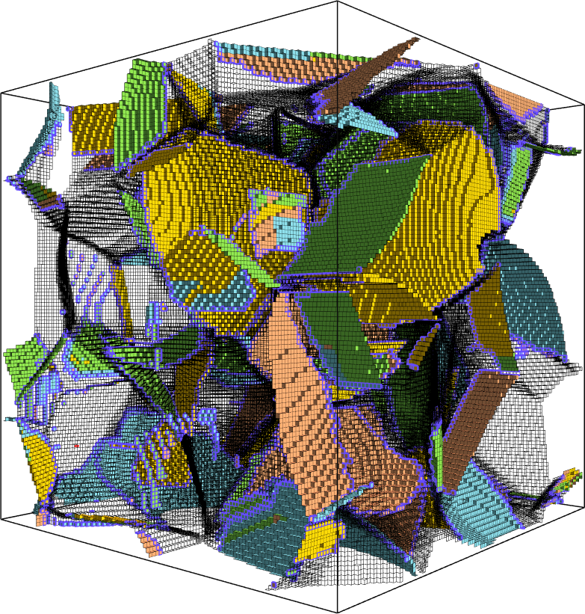
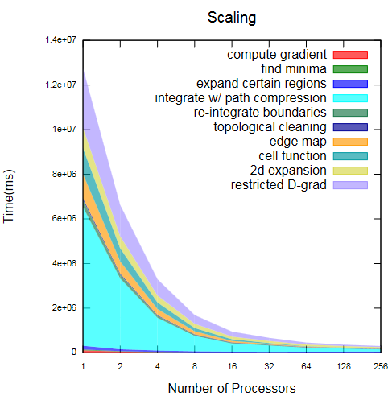
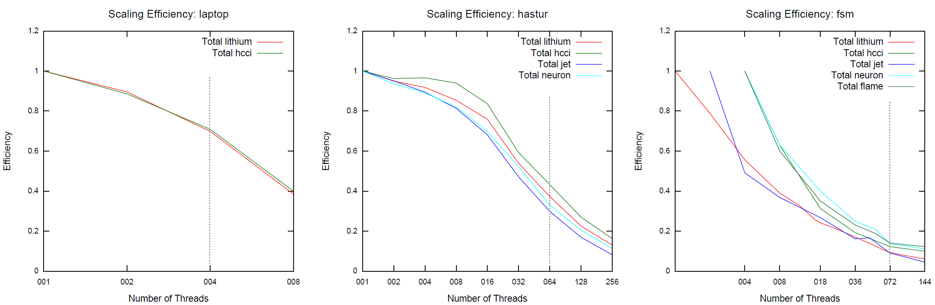
SMP computation of Morse-Smale complexes
DOE science analytics, Seismic Data, High Resolution Imaging
Topological structure is basis for many analytics
First large-scale computation with accurate geometric embedding
Numeric streamline computation
Majority of workload is combinatorics and memory access
Asynchronous threads
On KNL: 10x larger data than previously possible, 32x faster
Better scaling than laptop or Haswell: memory-heavy, low flops
64-core Xeon Phi 7210 (KNL)
4-core i7-3630QM
64-core Xeon Phi 7210 (KNL)
72-core Xeon E7-8890 v3

Slide 24
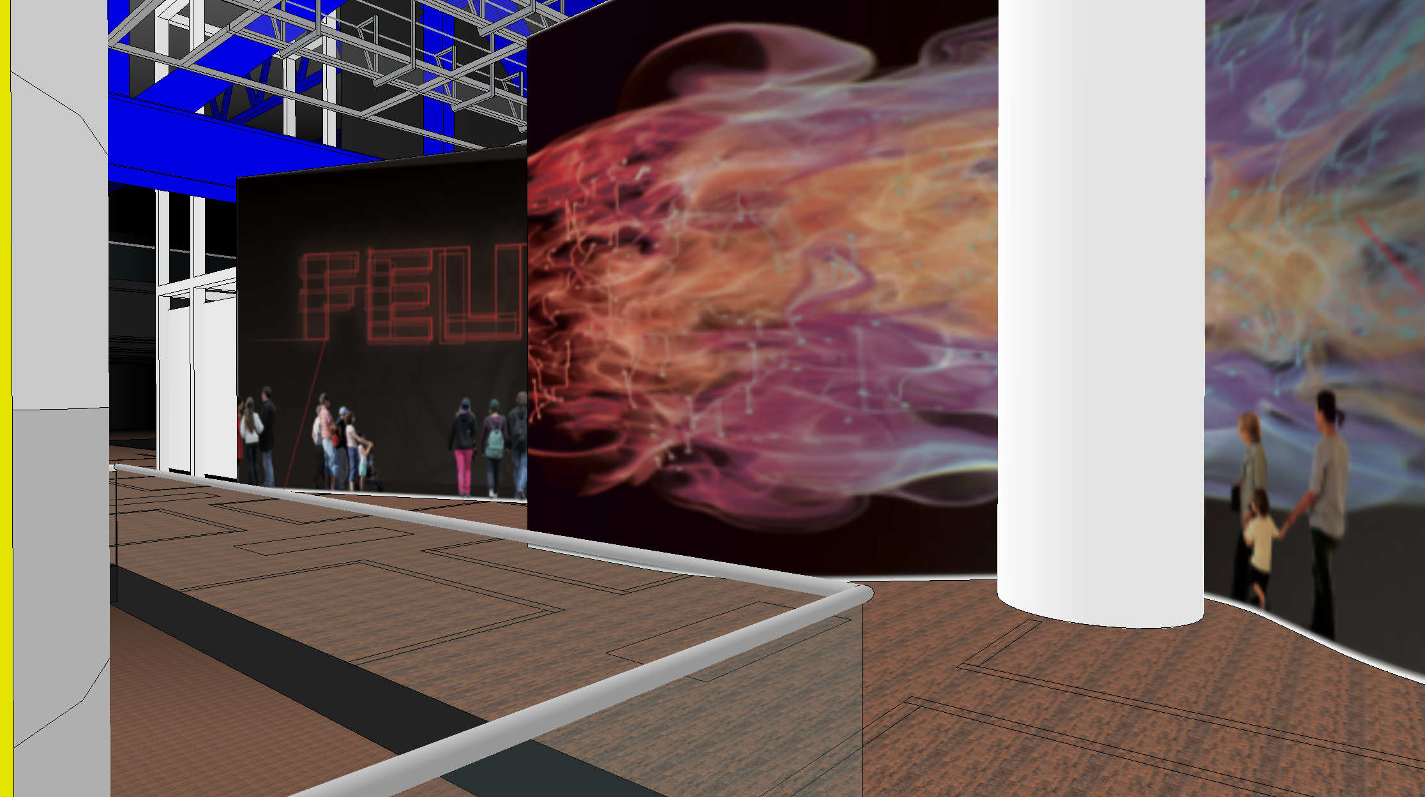
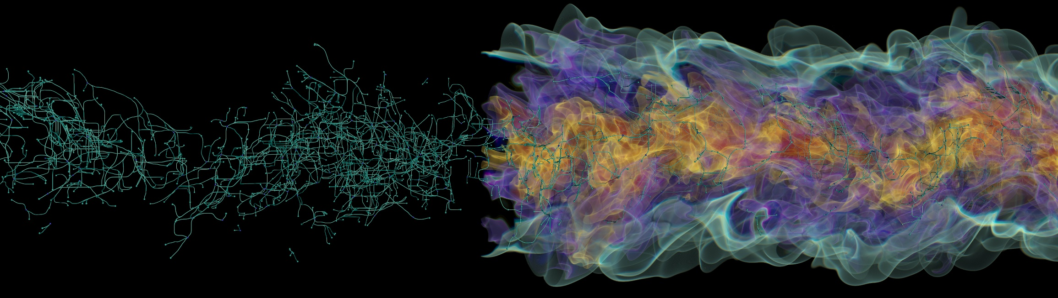
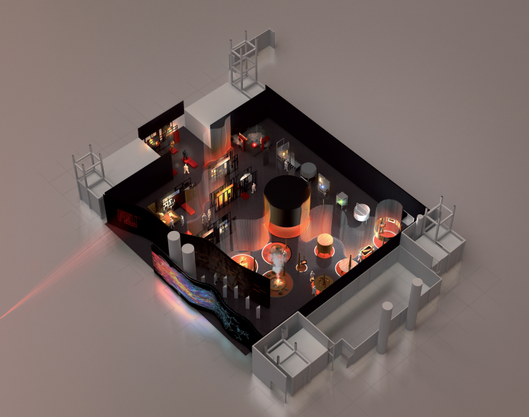
Large-scale rendering for gallery with OSPRay
Massive picture (1.5 gigapixel) for Muséographe Co Commissaire Expo FEU (Paris exhibit)
Mixed solid objects (spheres, streamlines) with volume rendering
Found and fixed edge case bugs in OSPRay: precision & integer overflow issues, framebuffer size limits
View full resolution with ViSUS web viewer: goo.gl/6WYLdF

Slide 25
Large-scale rendering for gallery with OSPRay
Massive picture (1.5 gigapixel) for Muséographe Co Commissaire Expo FEU (Paris exhibit)
Mixed solid objects (spheres, streamlines) with volume rendering
Found and fixed edge case bugs in OSPRay: precision & integer overflow issues, framebuffer size limits
View full resolution with ViSUS web viewer: goo.gl/6WYLdF

Slide 26
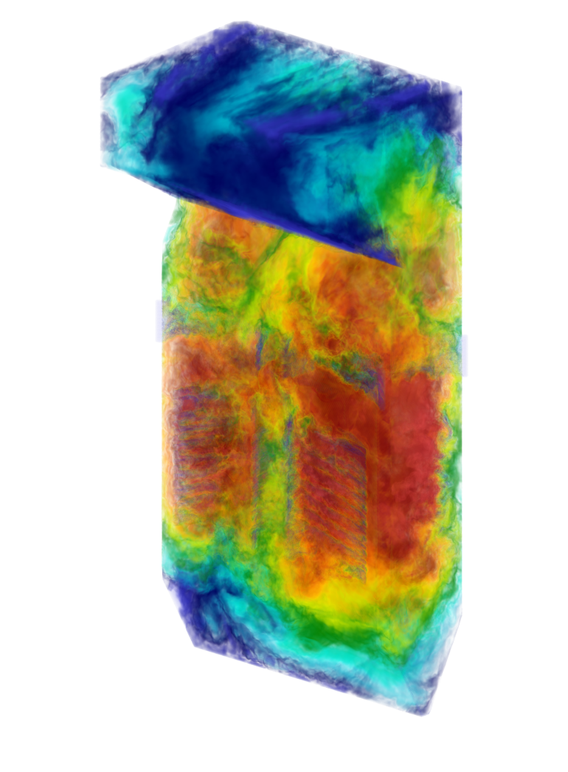
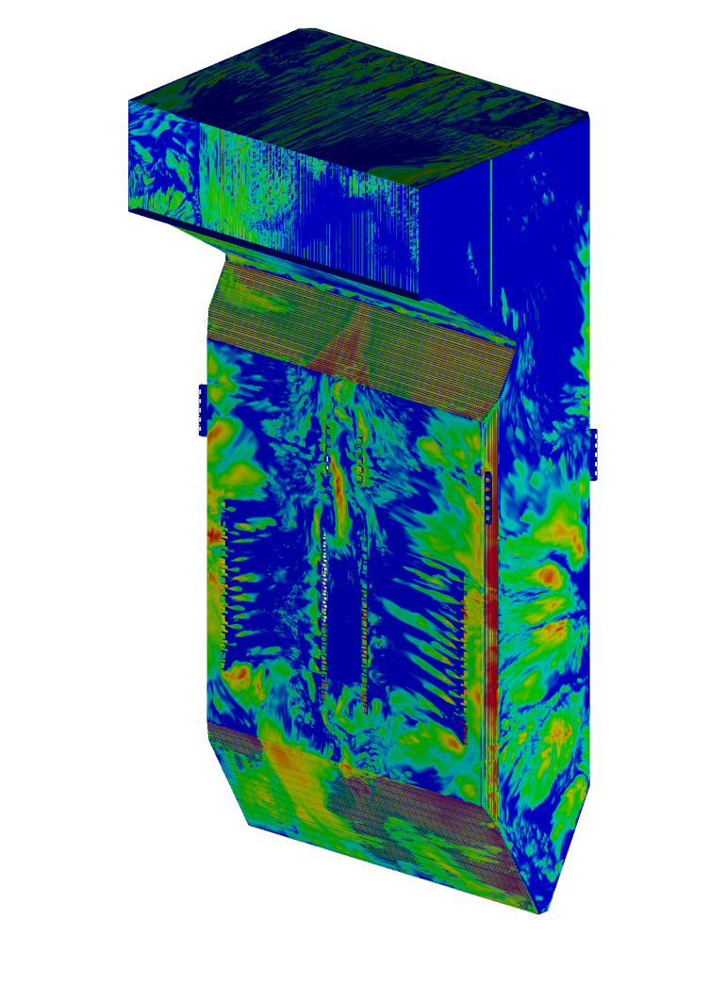
Production Simulations run using PIDX helped save 40% of total simulation time
NNSA application for exascale computing
“ With PIDX I/O time came down from 50% of total simulation time to 7%, thus allowing us to dump more data more frequently and have a much better understanding of the actual science.”
– Ben Isaac (PhD, PIDX user and Research Associate at Institute for Clean & Secure Energy)
69.3
Million Compute Hours
260,712
Cores
~200 Terabytes

Slide 27
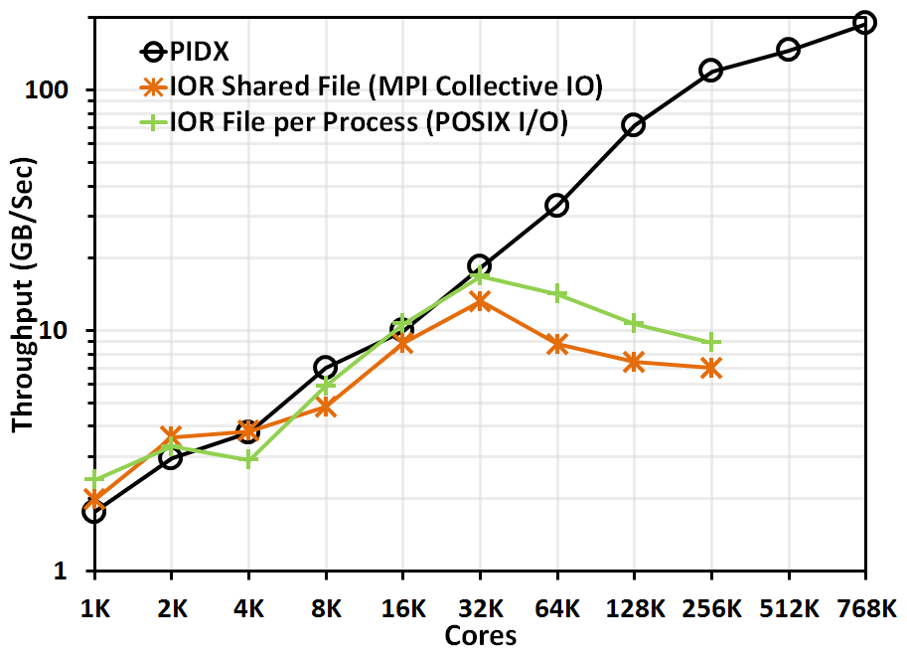
Parallel IDX I/O Library
PIDX salient features
Has shown scalability to 768K cores.
Generates analysis and visualization appropriate data format.
Allows real-time monitoring of simulation.
Allows ROI based dumps.
Uses ZFP compression scheme.
Exposes lots of parameters and is tunable for specific machine needs
(Sidharth Kumar)

Slide 28
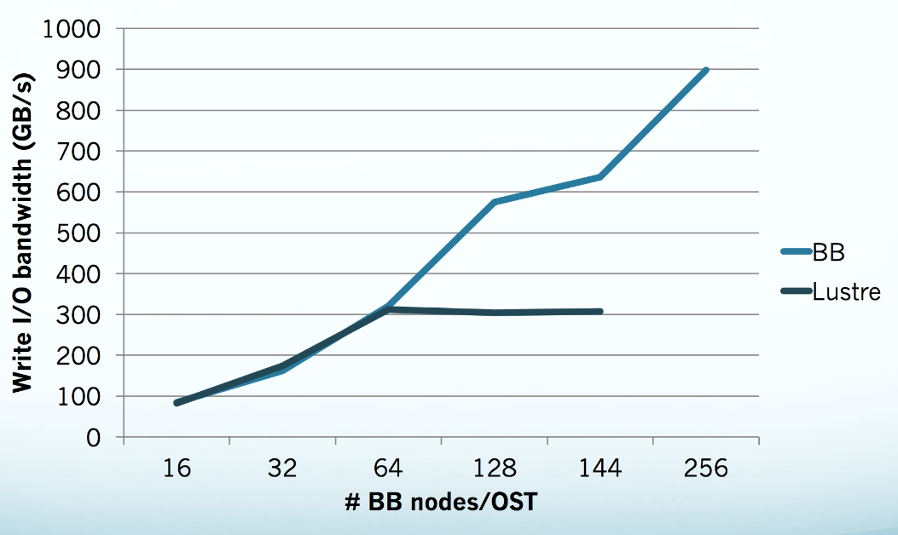
High Performance Parallel IO: PIDX on Cray/Intel DataWarp (burst buffers)
Early access to Cray/Intel DataWarp on Shaheen II (KAUST)
Good scalability performance
on both Burst Buffers and Luster filesystem
Presented in KAUST’s talks and tutorials:
Burst Buffer: From Alpha to Omega, tutorial for the early users on KAUST Burst Buffer, KAUST, 24 January 2017
BOF - Burst Buffers: Early Experiences and Outlook, 15 November 2016, SC16,
Salt Lake City, USA
(Steve Petruzza, Sidharth Kumar)

Slide 29
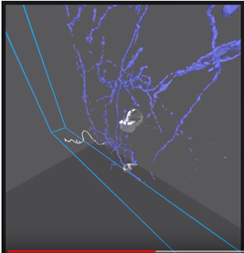
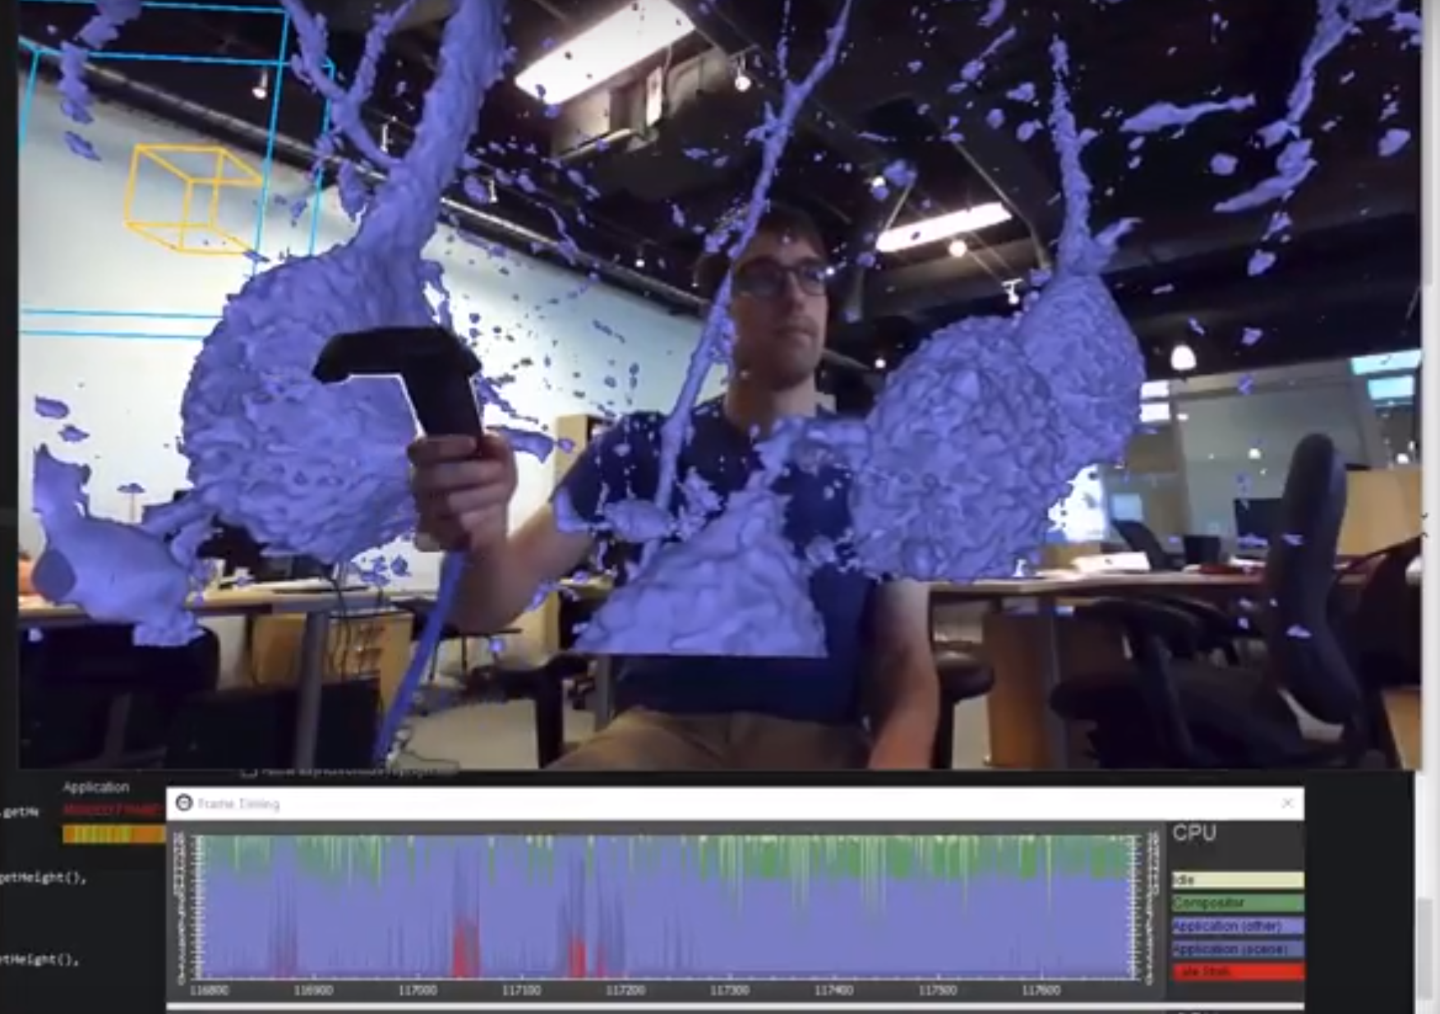
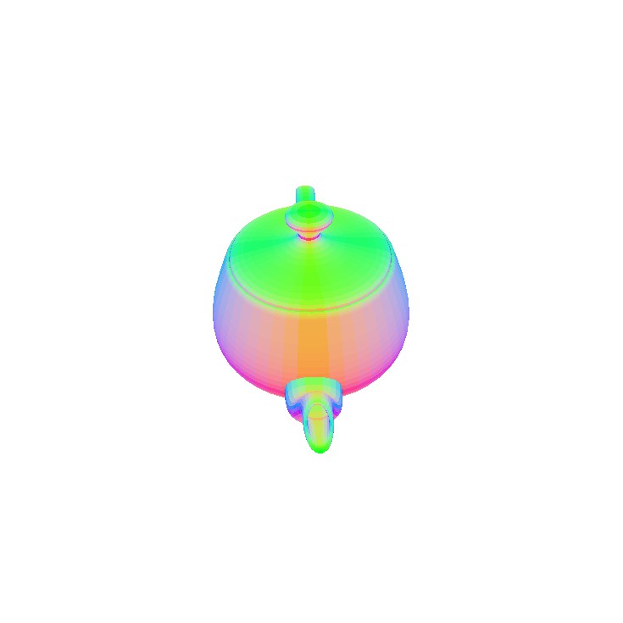
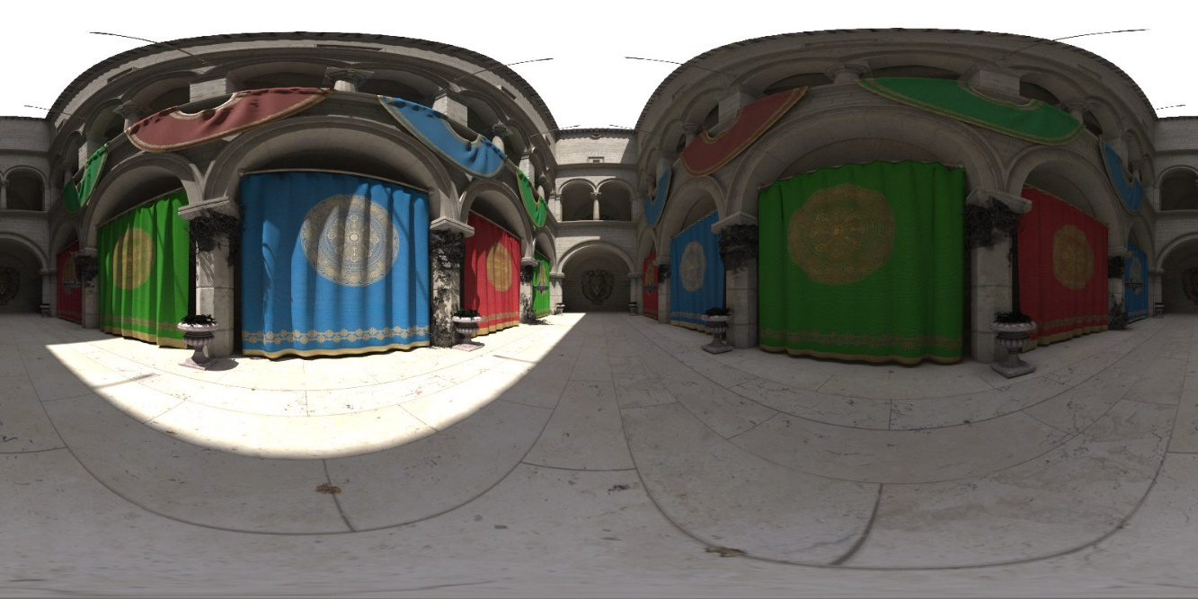
Ray Tracing for
Virtual Reality
Brain Initiative
Early prototypes using OSPRay:
  Room-scale model viewer
  – load small models and walk around them
  Seated 360 viewer – render 360 panorama of the scene and display in VR
Potential for ray tracing to be effective rendering method for VR
  Foveated rendering
  Render samples asynchronously & reproject
(Will Usher, Pavol Klacansky)

Slide 30
Papers

Slide 31
Published Papers
W. Usher, J. Amstutz, C. Brownlee, A. Knoll, I. Wald. Progressive CPU Volume Rendering with Sample Accumulation. Eurographics Symp. on Parallel Graphics and Visualization (EGPGV 2017).
W. Usher, P. Klacansky, F. Federer, P.-T. Bremer, A. Knoll, J. Yarch, A. Angelucci, Valerio Pascucci. A Virtual Reality Visualization Tool for Neuron Tracing. IEEE TVCG 2018
T.A.J. Ouermi, A. Knoll, R. M. Kirby, M. Berzins. OpenMP 4 Fortran Modernization of WSM6 for KNL. In Proceedings of PEARC17, New Orleans, LA, USA, 2017.
J. K. Holmen, A. Humphrey, D. Sunderland, and M. Berzins. Improving Uintah’s Scalability Through the Use of Portable Kokkos-Based Data Parallel Tasks. In Proc. of PEARC17, New Orleans, 2017.
T. A.J. Ouermi, Aaron Knoll, Robert M. Kirby, Martin Berzins. Optimization Strategies for WSM6 on Intel Micro-architectures. CANDAR workshop, Japan November 2017. Best Paper Award.
Steve Petruzza, Aniketh Venkat, Attila Gyulassy, Giorgio Scorzelli, Frederick Federer, Allessandra Angelucci, Valerio Pascucci, Peer-Timo Bremer. ISAVS: Interactive Scalable Analysis and Visualization System. ACM SIGGRAPH Asia 2017 Symposium on Visualization.
Ingo Wald, Carson Brownlee, Will Usher, Aaron Knoll. CPU Volume Rendering of Adaptive Mesh Refinement Data. ACM SIGGRAPH Asia 2017 Symposium on Visualization.
S. Kumar, D. Hoang, S. Petruzza, J. Edwards, V. Pascucci. Reducing network congestion and synchronization overhead during aggregation of hierarchical data. Proc. of the IEEE International Conference on High Performance Computing, Data, and Analytics (HiPC 2017), Jaipur (India).

Slide 32
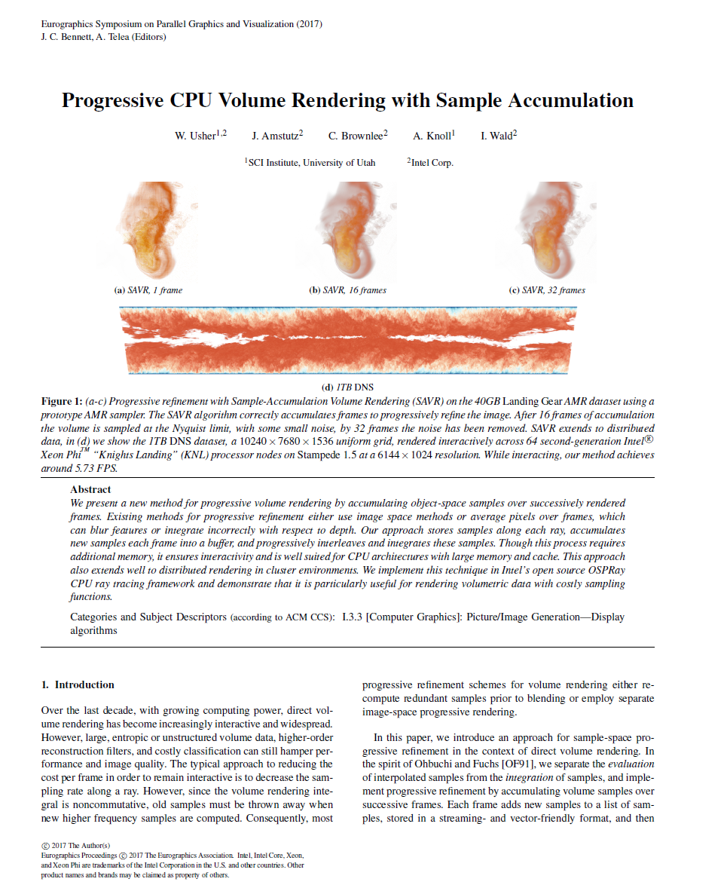
Progressive CPU Volume Rendering with Sample Accumulation
Object-space progressive volume rendering
Defer computation of samples until you need them
CPU/KNL with large memory
CPU/KNL clusters
Great for interactive viewing of massive volume data expensive computational kernels (RBFs, etc.)
Will Usher, Jefferson Amstutz, Carson Brownlee, Aaron Knoll, Ingo Wald. Progressive CPU Volume Rendering with Sample Accumulation. Eurographics Symposium on Parallel Graphics and Visualization (EGPGV) 2017.

Slide 33
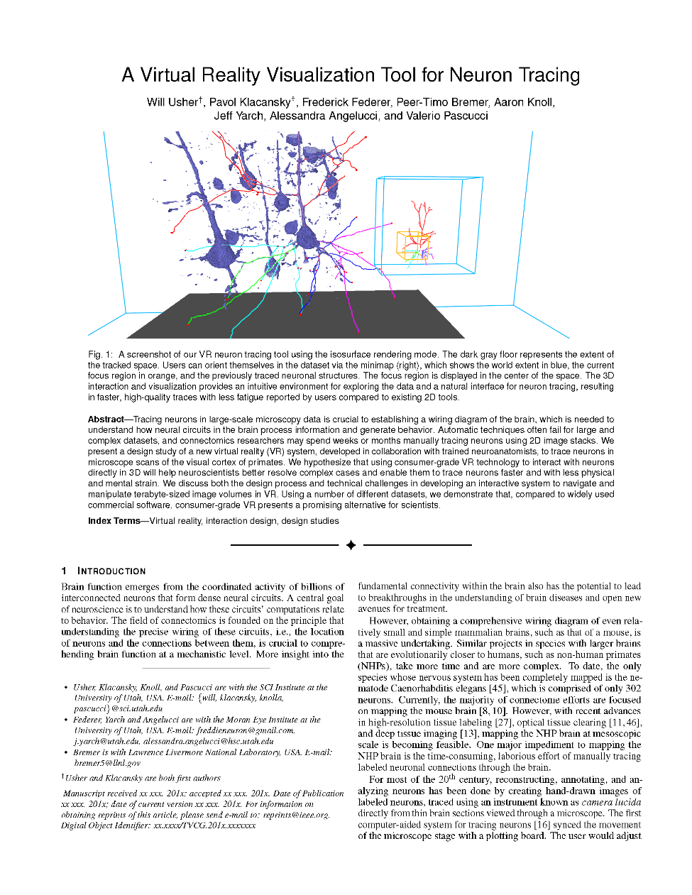
A Virtual Reality Visualization Tool for Neuron Tracing
Application & design study exploring how VR can be used to for manual neuron tracing in connectomics
Uses GPU raycasting of small subregion of data combined with out of core streaming of IDX data format to meet VR performance requirements
Can we use OSPRay or Embree for ray traced VR?
Benefits: Easier to sample adaptively for foveated rendering, correct distorted rendering
Challenges: Performance?
Will Usher, Pavol Klacansky, Frederick Federer, Peer-Timo Bremer, Aaron Knoll, Jeff Yarch, Alessandra Angelucci, Valerio Pascucci. A Virtual Reality Visualization Tool for Neuron Tracing. IEEE TVCG 2018

Slide 34
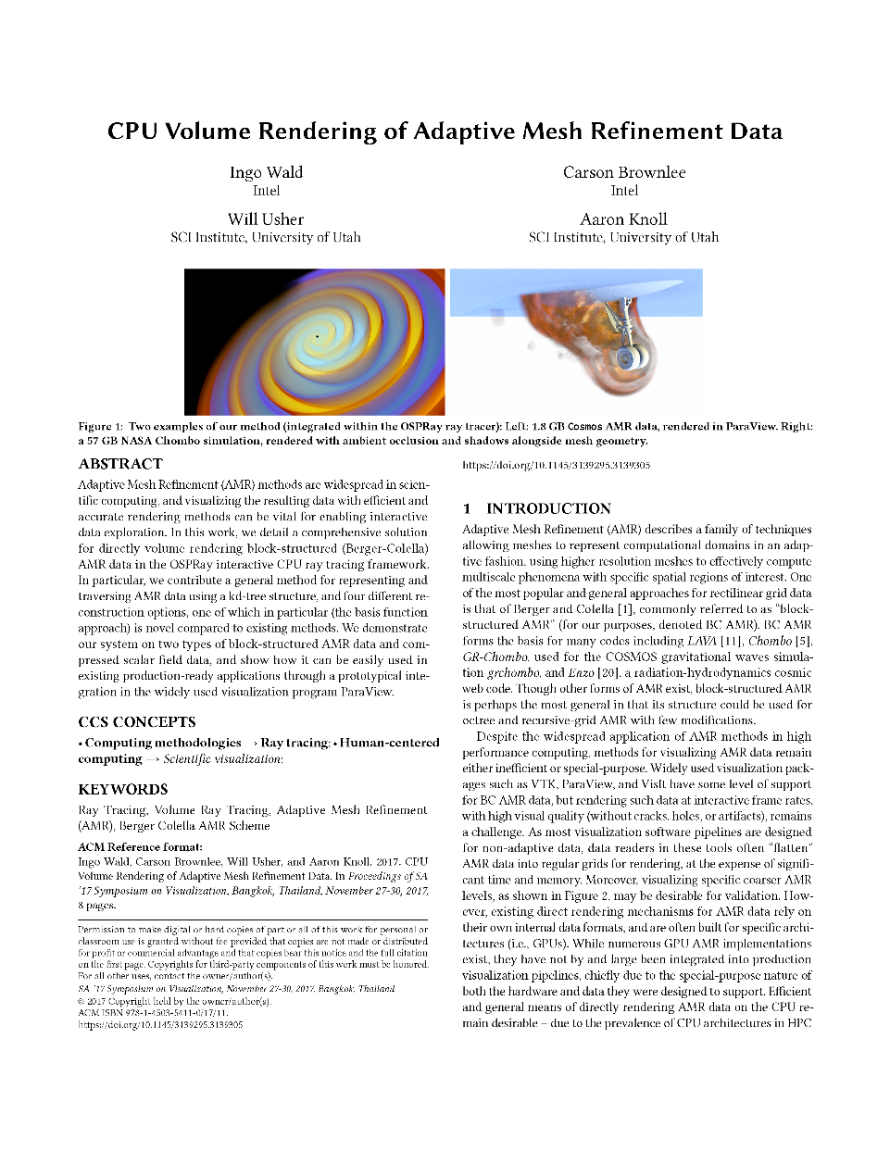
CPU Volume Rendering of Adaptive Mesh Refinement Data
Presents comprehensive solution for raycasting AMR data efficiently
Compelling performance for large datasets, compared to previous GPU approaches
Implemented in OSPRay and released publicly in 1.4
Ingo Wald, Carson Brownlee, Will Usher, Aaron Knoll. CPU Volume Rendering of Adaptive Mesh Refinement Data. ACM SIGGRAPH Asia 2017 Symposium on Visualization.

Slide 35
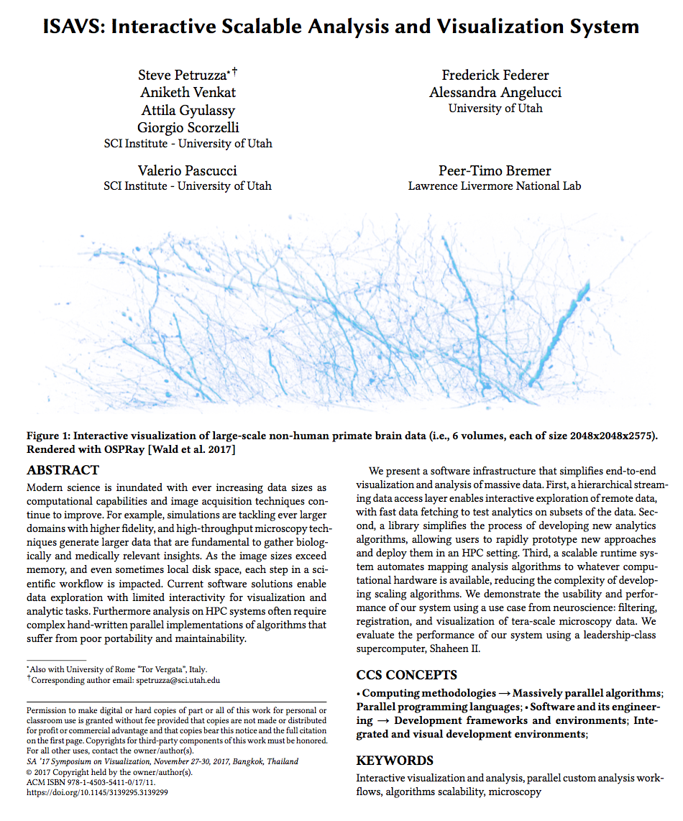
ISAVS: Interactive Scalable Analysis and Visualization System
End-to-end system for data movement analysis and visualization
New task based abstraction using a new EDSL
  Scale your application from
  a commodity PC
  (for interactive analysis)
  to HPC systems
  Brain data analysis and
  visualization use cases
Steve Petruzza, Aniketh Venkat, Attila Gyulassy, Giorgio Scorzelli, Frederick Federer, Allessandra Angelucci, Valerio Pascucci, Peer-Timo Bremer. ISAVS: Interactive Scalable Analysis and Visualization System. ACM SIGGRAPH Asia 2017 Symposium on Visualization.

Slide 36
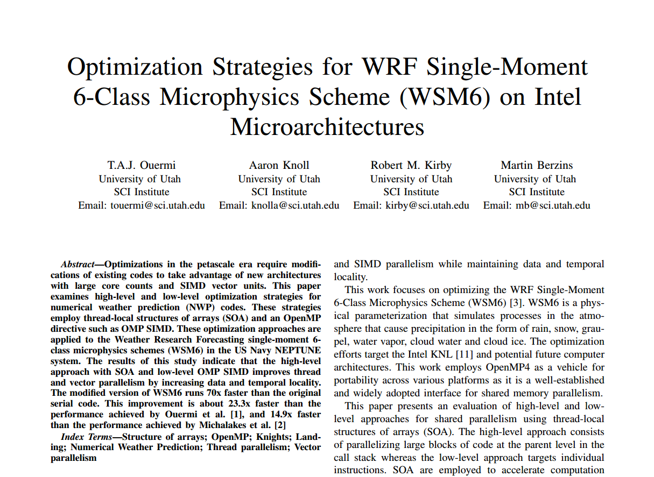
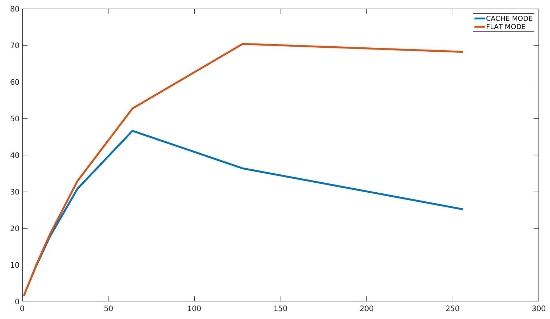
Optimization Strategies for WSM6 on KNL
WSM6 – physics component of next generation Navy weather simulation code
Combination of multiple optimizations:
Code restructuring to enable thread and vector parallelism
Data reorganization with structures of arrays (SOA) to increase locality
Directive based vectorization with !$OMP SIMD
70x speed up over serial on KNL!
Speed-up
T. A.J. Ouermi, Aaron Knoll, Robert M. Kirby, Martin Berzins. Optimization Strategies for WSM6 on Intel Micro-architectures. CANDAR workshop, Japan November 2017. Best Paper Award.
Number of threads

Slide 37
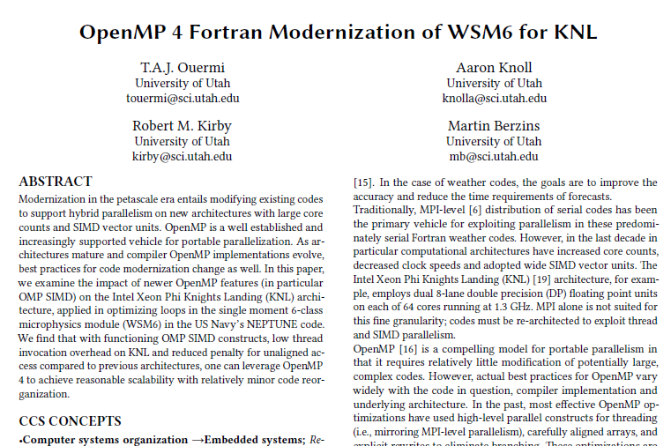
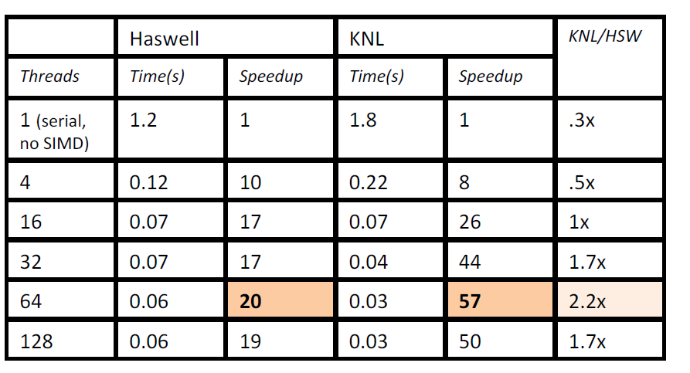
OpenMP 4 Fortran Modernization of WSM6 for KNL
Shows that even naive, “low-level” OpenMP approaches can dramatically speed up complex NWP codes (in Fortran)
!$OMP SIMD directives work (with conditionals, function calls)
Parallel sections have 57x speedup over serial on KNL, for a heavily memory-bound code!
Can similar approaches work in C++ (OSPRay tsimd?)
T.A.J. Ouermi, Aaron Knoll, Robert M. Kirby, and Martin Berzins. OpenMP 4 Fortran Modernization of WSM6 for KNL. In Proceedings of PEARC17, New Orleans, LA, USA, 2017.

Slide 38
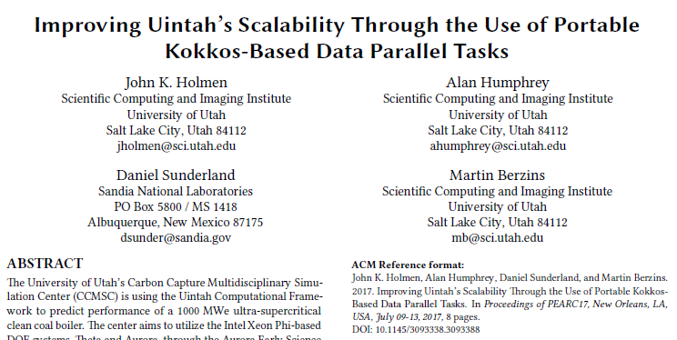
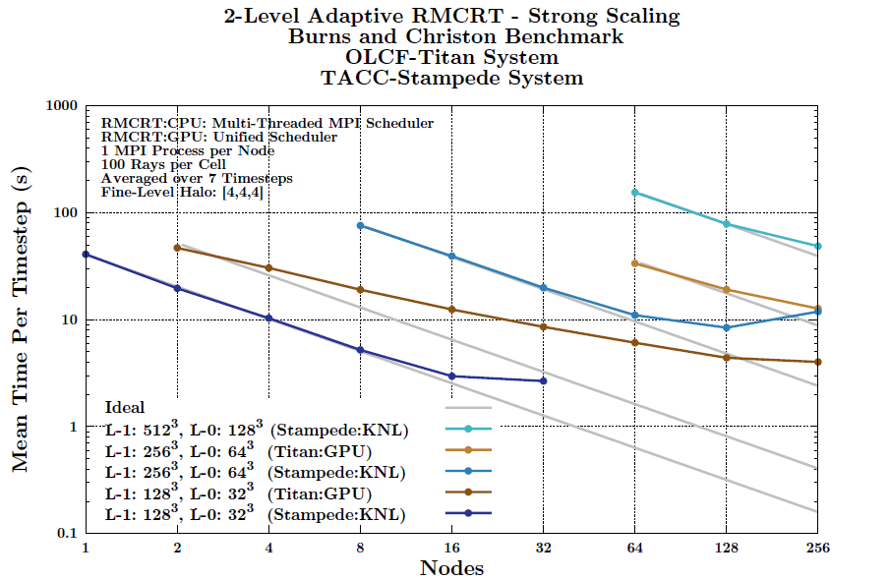
Improving Uintah’s Scalability Through the Use of Portable Kokkos-Based Data Parallel Tasks
Work from John Holmen on Uintah thread scalability
RMCRT: radiation transport, a ray tracing code for future CFD computations in Uintah
Uses Kokkos for platform portability, mapping data to KNL architecture through built-in operators.
Stampede KNLs show encouraging performance at scale vs Titan GPUs.
J. K. Holmen, A. Humphrey, D. Sunderland, and M. Berzins. Improving Uintah’s Scalability Through the Use of Portable Kokkos-Based Data Parallel Tasks. In Proceedings of PEARC17, New Orleans, LA, USA 2017.

Slide 39


Reducing network congestion and synchronization overhead during aggregation of hierarchical data
Topology-aware aggregation using indexing templates
Avoiding overheads of all-to-one aggregation with domain partitioning
Sidharth Kumar, Duong Hoang, Steve Petruzza, John Edwards, Valerio Pascucci. Reducing network congestion and synchronization overhead during aggregation of hierarchical data. In proceeding of HiPC, Jaipur, India 2017

Slide 40
Talks and Outreach

Slide 41
Talks
  Will Usher presented the CPU particle rendering portion of the IEEE VIS17 tutorial “Interactive Visualization of Large Dynamic Particle Data”
  T.A.J. Ouermi presented on optimizing NEPTUNE code at the Fall 2017 IXPUG
  Steve Petruzza presented on “High Performance I/O and streaming visualization of large scale data from scientific simulations” at the ISC Workshop on In Situ Visualization.
  Steve Petruzza presented on “ISAVS: Interactive Scalable Analysis and Visualization System” at the SIGGASIA Symposium on Visualization
  T.A.J. Ouermi presented on “Optimization Strategies for WSM6 on KNL” at CANDAR17
  Valerio Pascucci, invited presentation at Salishan conference on “Extreme Data Management Analysis and
  Visualization for Exascale Supercomputers”
  Valerio Pascucci, Keynote talk at TopHPC 2017, Tehran “Extreme Data Management Analysis and Visualization for Exascale Supercomputers”
  Valerio Pascucci, Keynote talk at Geometry Understanding in Higher Dimensions, Paris 2017, “Interactive Visualization of High Dimensional Data Between Curse of Dimensionality and Failure of Intuition”
  Valerio Pascucci, invited talk at Dagstuhl workshop 2017, “Observations on Scalable Topological Methods for Analysis and Visualization”
  Valerio Pascucci, invited talk at LANL summer school, “Interactive Visualization of High Dimensional Data Between Curse of Dimensionality and Failure of Intuition”
Will Usher, ISAV17 lightning talk on LAMMPS in situ integration with OSPRay
Will Usher, hands on OSPRay’s MPI distributed device features, as part of the in situ workshop at HPC DevCon17

Slide 42
Outreach
Demos
Demos of molecular rendering at SC16, HPC DevCon16
Demos of in situ LAMMPS rendering with ANL at SC17 and HPC DevCon17
Code Releases
Code for Sample Accumulation Volume Rendering paper release on Github
Code for OSPRay virtual reality prototypes on Github
OSPRay AMR volume released in 1.4 and available on OSPRay Github

Slide 43
Future Work

Slide 44
Projects in the Pipeline
Unified Particle File Formats (with Guido Reina, Michael Krone, Megamol group)
Patrick Gralka (student @ Stuttgart) will visit in Spring 2018
Fast Parallel IO for particle data (Will Usher, Sidharth Kumar)
ANL HACC Cosmology rendering at scale (Will Usher, Silvio Rizzi and Joe Insley @ ANL)
Will Usher visiting ANL in Spring 2018
In Situ analytics with Babelflow, KNL optimizations, OSPRay for rendering (Steve Petruzza, Will Usher)

Slide 45
Papers in the Pipeline
Evaluating IO and Rendering Scalability of VisIt, PIDX and OSPRay in Production Visualization (Qi Wu, Aaron Knoll, Will Usher, Chuck Hansen)
An Integrated Approach to Scaling Task-Based Runtime Systems for Next Generation Engineering Problems (Sidharth Kumar, Steve Petruzza, Will Usher, Uintah Team)
Ray Tracing Generalized Stream Line Primitives (Ingo Wald @ Intel, Mengjiao Han, Will Usher, Chris Johnson)
Particle Rendering State-of-the-Art Report (Michael Michalski & Jens Krüger @ Duisberg-Essen, Jens Schneider @ KAUST, Guido Reina @ Stuttgart, Will Usher, Rüdiger Westermann @ TU-Munich)
OSPRay Distributed Rendering Overview (Will Usher and Ingo Wald, Jefferson Amstutz, Carson Brownlee @ Intel)

Slide 46
Acknowledgements and Thanks
Intel Parallel Computing Centers Program
Argonne Leadership Computing Facility
DOE DE-AC02-06CH11357
NSF CISE ACI-0904631
DOE NNSA DE-NA0002375
OSPRay team: Ingo Wald, Jim Jeffers, Carson Brownlee, Jeff Amstutz, Johannes Guenther
Intel: Mark West, Darrell Black, Brian Napier, Lisa Smith, Joe Curley, Kent Li, Nathan Schulz
Argonne LCF: Mike Papka, Joe Insley, Silvio Rizzi
Argonne Materials Science Division: Kah Chun Lau, Larry Curtiss, Hakim Iddir, Lei Cheng
Argonne Center for Nanoscale Materials: Bin Liu, Maria Chan
Argonne Chemical Sciences and Engineering: Julius Jellinek, Aslihan Sumer
KAUST supercomputing laboratory: Georgios Markomanolis
RIKEN supercomputing center: Jorji Nonaka
Navy Research Lab: Alex Reinecke, Kevin Viner
DOD PETTT / Engility: Rajiv Bendale
TACC: Paul Navratil, Greg Abrams
Micron: Ed Caward, Janene Ellefson
VisIt-OSPRay effort: Hank Childs, Jian Huang, Alok Hota

